Slide 1
Beam Instrumentation for FCC injector
T. Lefevre

Slide 2
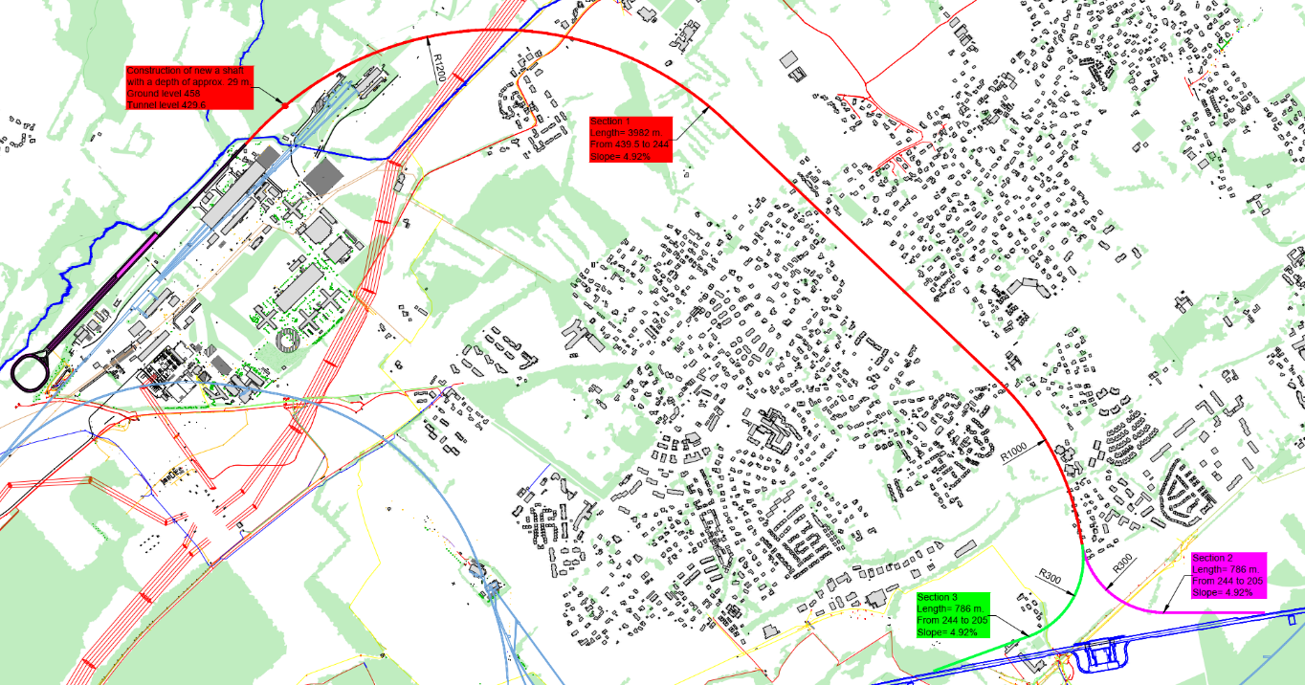
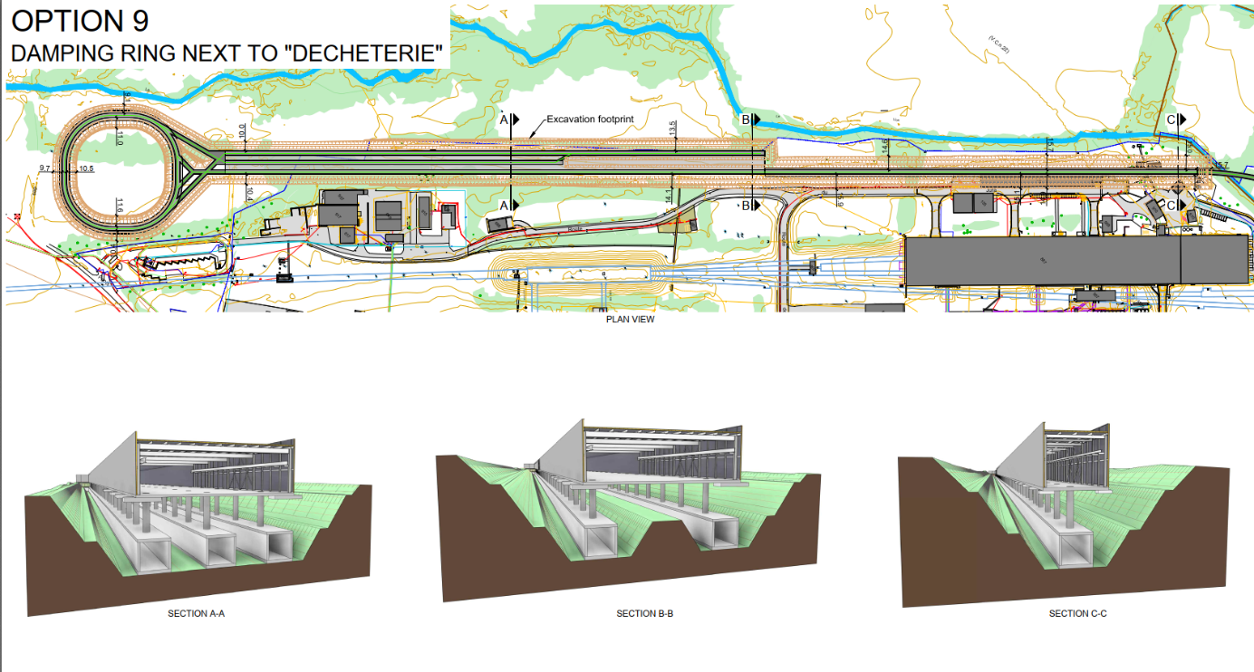
FCC-ee Injector TDR by 2028

Slide 3
FCC-ee Injector sub-systems
Electron source
Electron linac
Electron TL to DR
Positron souce
Positron linac
Positron TL to DR
Damping Ring
TLs to HE Linac
Merging and bunch compressor
HE linac

Slide 4
FCC-ee Injector sub-systems
One BPM per quad / triplet in linac
Diagnostic station at entrance / exit of each sub-systems
Charge
Energy&Energy spread
Emittance and bunch length

Slide 5
FCC-ee Injector sub-systems
Positron complex by IJCLab
E = 2.86 GeV
Q = 13 nC (considering 60% losses for transport, collimation and injection into DR)
2.86 GeV electron beam
from e- linac
Capture linac 2 GHz, 13.3 MV/m
100 Hz, 6 RF structures
Positron linac 2 GHz, 13.3 (12.8) MV/m
100 Hz, 20+52 RF structures
Positron/Electron
Separation at 170 MeV
Target & cryostat
DC solenoid
Injection section
E = 2.86 GeV
Q = ~3.8 nC
Energy collimator
and compressor
DC solenoid
Electron/Photon dumps
Damping Ring
E = 2.86 GeV
Q_{b} = 5 nC

Slide 6
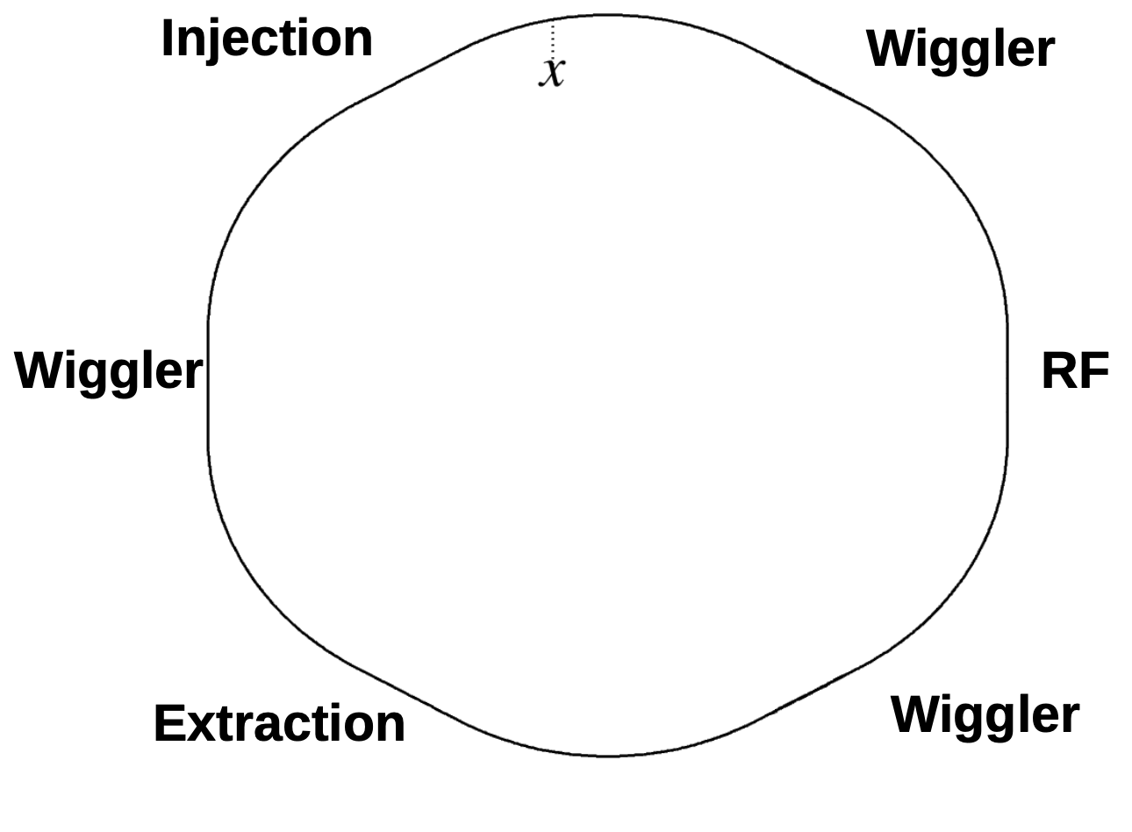
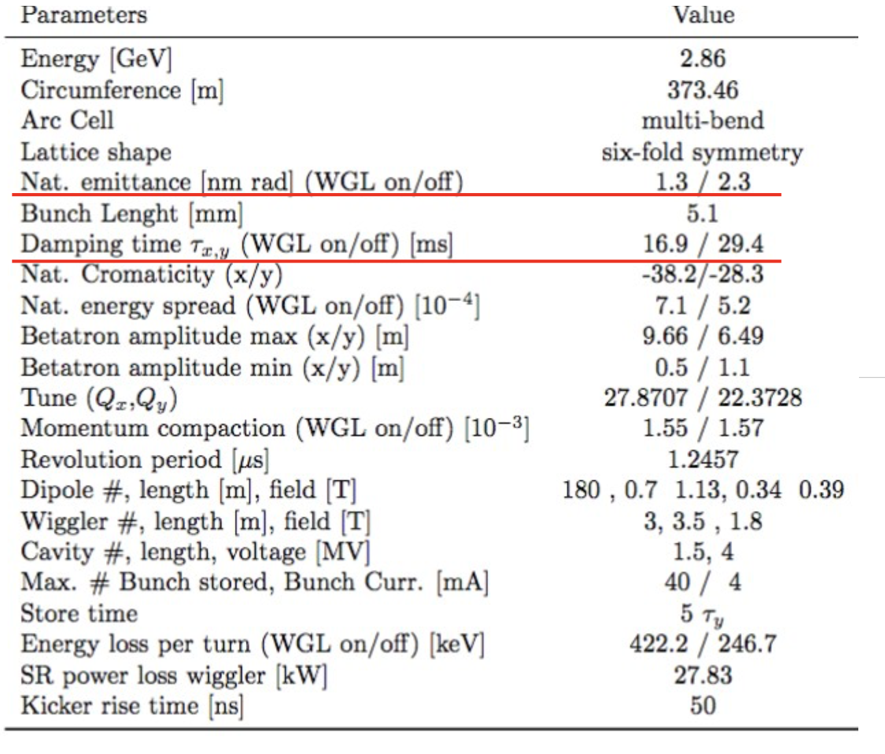
FCC-ee Injector sub-systems
Damping ring by INFN

Slide 7
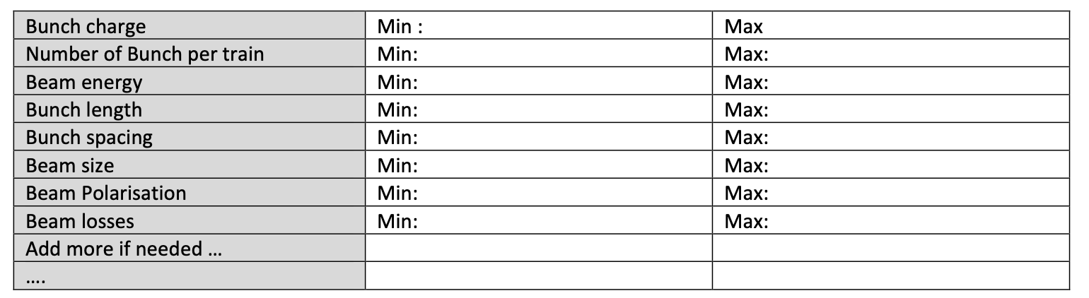
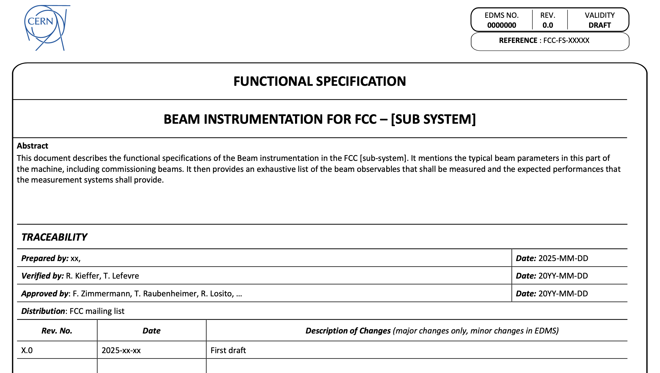
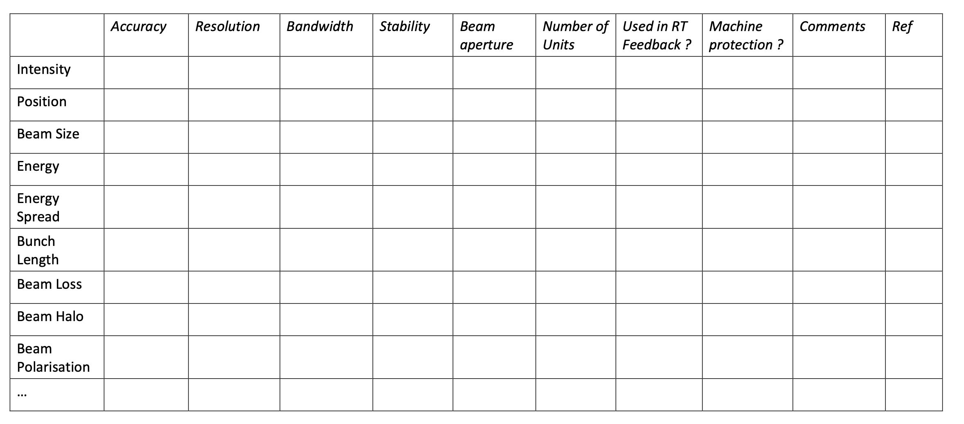
FCC-ee Injector sub-systems – towards first functional specifications

Slide 8
Next steps
List all BI needs in FCC injector complex
Establish preliminary functional specifications for all sub-parts of the complex
    Contact person for each part of the machine
Identify possible synergies with the rest of the instrumentation in FCCee complex
Identify the resource needs for the Technical Design phase

Slide 9
Thank you for your attention.
9

