Slide 1

Innovative bulge test setup for beam vacuum windows characterisation
Valentina Giovinco
M. Morrone, J.A. Ferreira, C. Garion
07/04/2024

Slide 2
Summary
Introduction
Bulge test setup
Si₃N₄ membranes characterization
Bulge test setup enhancement for larger membranes
Ti-6Al-4V window dimensioning
Conclusions

Slide 3
Summary
Introduction
Bulge test setup
Si₃N₄ membranes characterization
Bulge test setup enhancement for larger membranes
Ti-6Al-4V window dimensioning
Conclusions

Slide 4
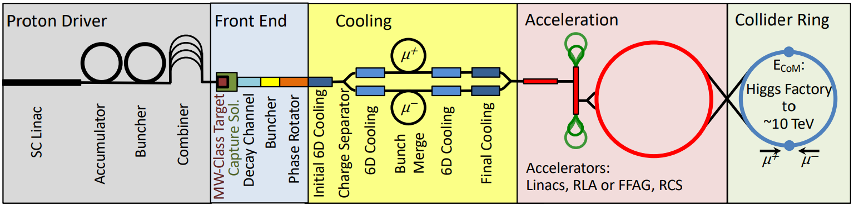
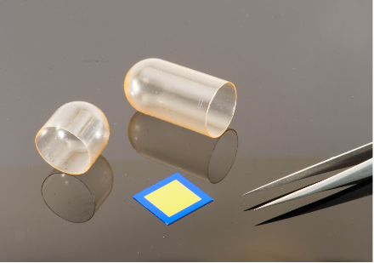
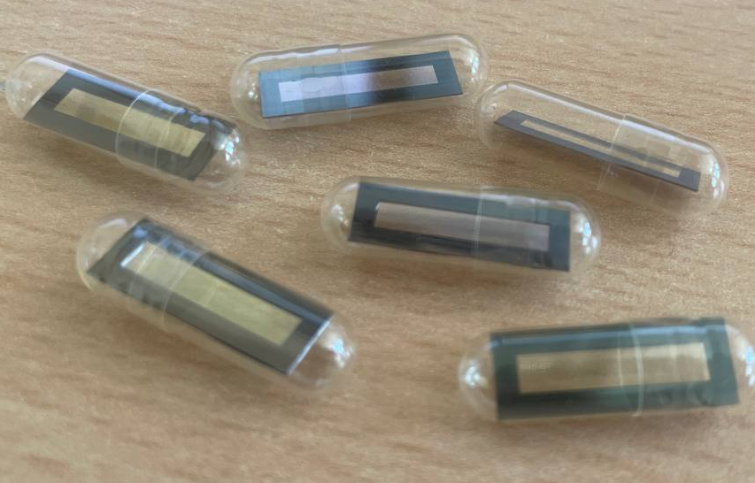

Introduction
Thin vacuum windows for the Muon Collider
Absorbers and vacuum are alternated in the final cooling → Windows
Low energy beam: 20 to 5 MeV
    Thin windows (<15 µm to lose <1% of the energy)
    Small windows (10×σ_{RMS}, σ_{RMS}=0.6 mm at 5Hz)
Si₃N₄ windows
        Commercially available with a thickness < 1µm
        Bulk material has excellent mechanical properties
Design of a beam window
Determination of the mechanical properties under operating conditions
Bulge test
@ T=77÷425 K, p=0÷8 bar

Slide 5
Summary
Introduction
Bulge test setup
Si₃N₄ membranes characterization
Bulge test setup enhancement for larger membranes
Ti-6Al-4V window dimensioning
Conclusions

Slide 6
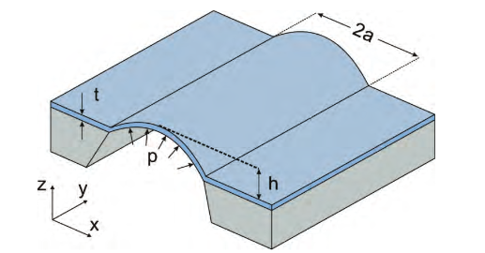
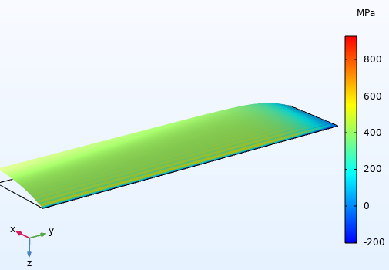




Bulge test setup
Experimental technique
Membrane
Setup: sample fixed along the edges and uniformly pressurized from one side.
Measurement: maximum deflection of the membrane as a function of the applied pressure.
Objective: determine the mechanical properties of freestanding membranes.
d
Frame
Method: analytical models are available to post-process experimental data. The Vlassak method has been applied to study rectangular membranes (aspect ratio > 4:1).
Stress /Strain state central section
Stress and strain
Bulge equation
$σ_{xx}=\frac{E_{Y}}{1−ν^{2}} (ε_{xx}$- $ε_{0}$)+ $σ_{0}$
$$σ_{xx}=\frac{pa^{2}}{2dt}$$
Initial residual stress
Young’s modulus
Plane-strain modulus
$$p=2 σ_{0} t \frac{d}{a^{2}}+\frac{4}{3 (1+ν)}\frac{E}{1−ν}t \frac{d^{3}}{a^{4}}$$
$$ε_{xx}=\frac{2d^{2}}{3a^{2}}+ε_{0}$$
Poisson’s coefficient
[6, 7, 8]

Slide 7
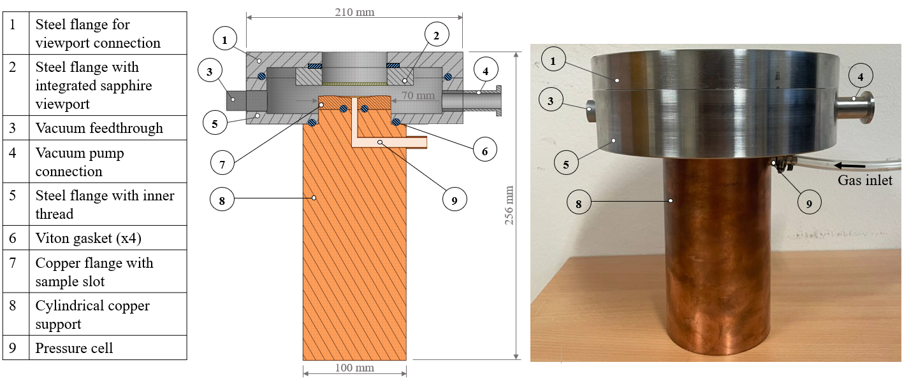
Bulge test setup
Mechanical assembly
1 | Steel flange for viewport connection
2 | Steel flange with integrated sapphire viewport
3 | Vacuum feedthrough
4 | Vacuum pump connection
5 | Steel flange with inner thread
6 | Viton gasket (x4)
7 | Copper flange with sample slot
8 | Cylindrical copper support
9 | Pressure cell
Temperature control: the copper cylinder can be cooled or heated to change the temperature of the sample by conduction.
Helium injection: maintains pressure stability at T=77K by avoiding phase transition.
Leak tightness: ensured by Viton O-ring or flat gaskets.

Slide 8
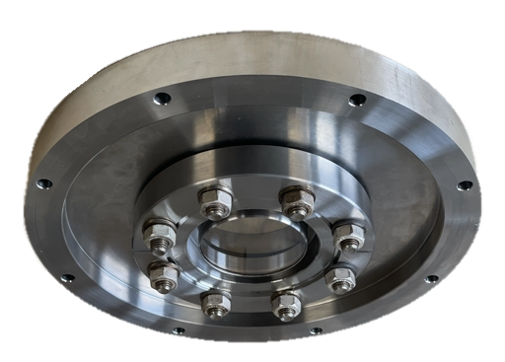
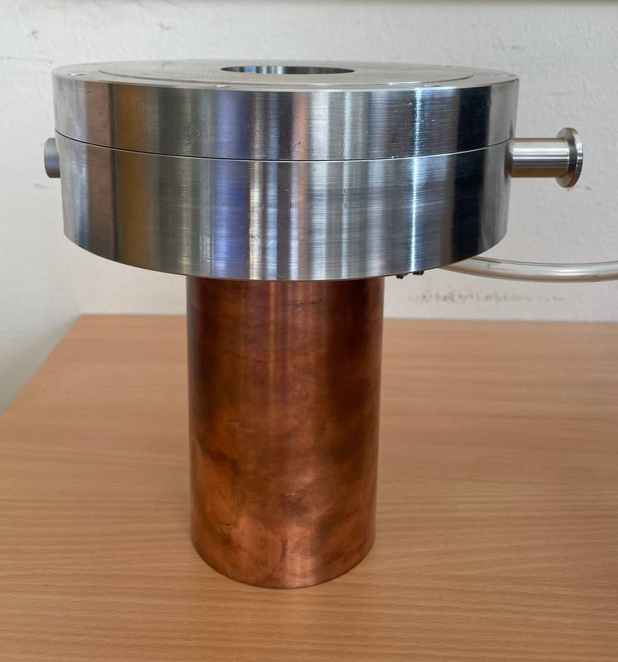
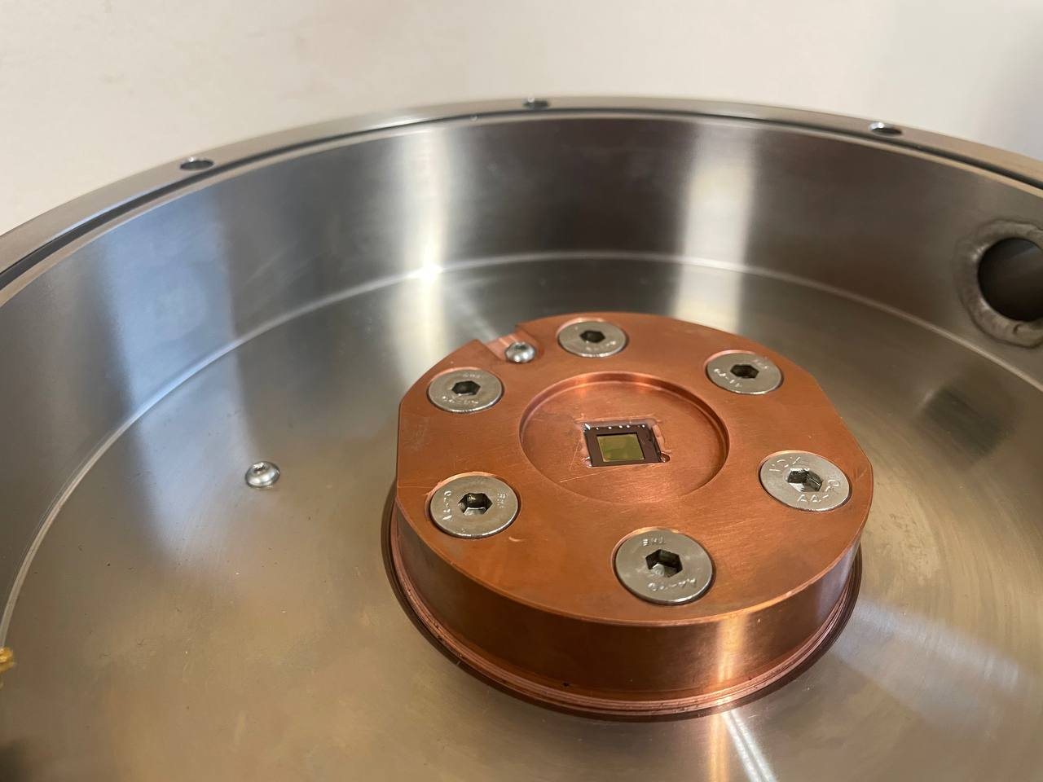
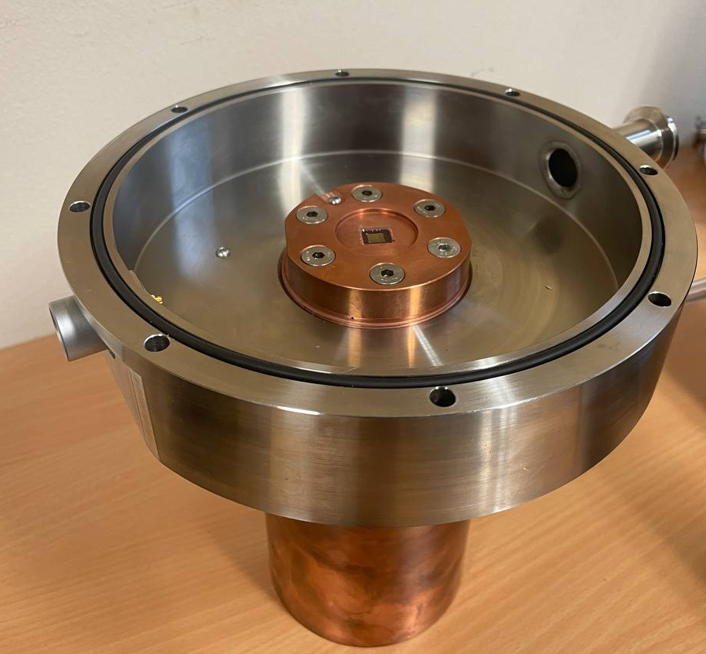
Bulge test setup
Mechanical assembly
Viewport
STEEL FLANGE
PT100 slots
Sample
COPPER FLANGE
STEEL FLANGE

Slide 9
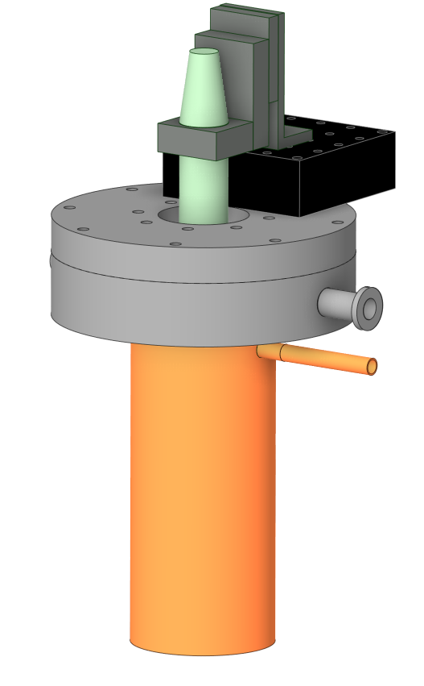
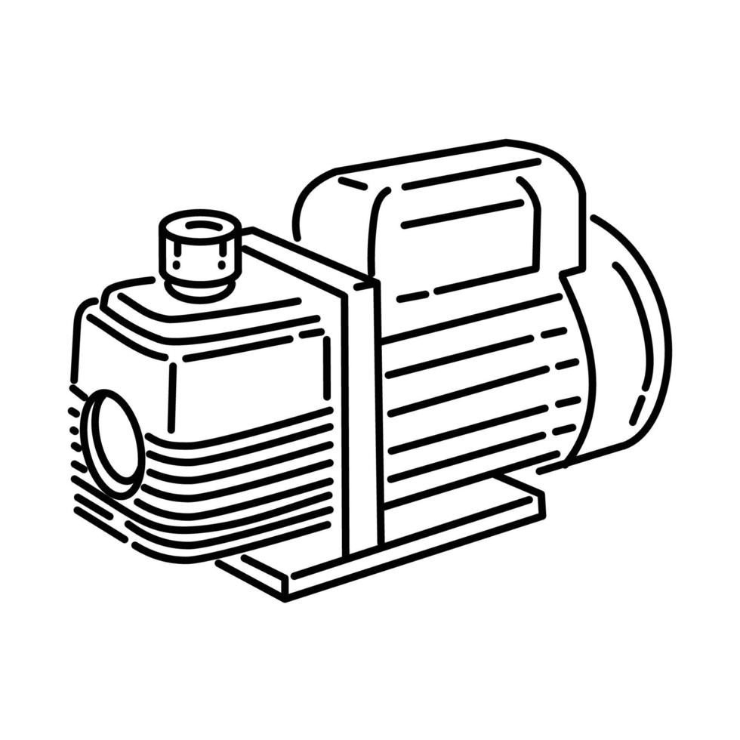
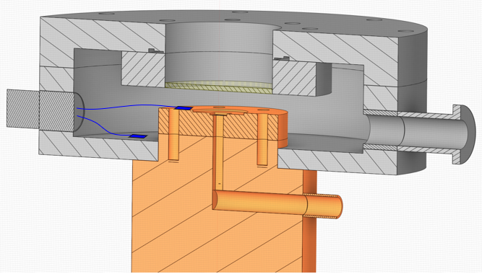

Bulge test setup
Instrumentation
DAQ developed and installed by Rodrigo Ferreira (TE-VSC)
1. Optical sensor
2. Servomotor stage
Vacuum pump
5. PT100s
4. Piezo gauge
Optical sensor (confocal chromatic): measures membrane deflection.
He
Servomotor stage: enable horizontal movement of the optical sensor to probe the membrane surface.
INLET
VALVE
Pressure control system: regulates pressure during testing.
Piezo gauge sensor: measures applied pressure to the membrane.
OUTLET
VALVE
PT100s: measure membrane and system components temperature.
3. Pressure control system

Slide 10
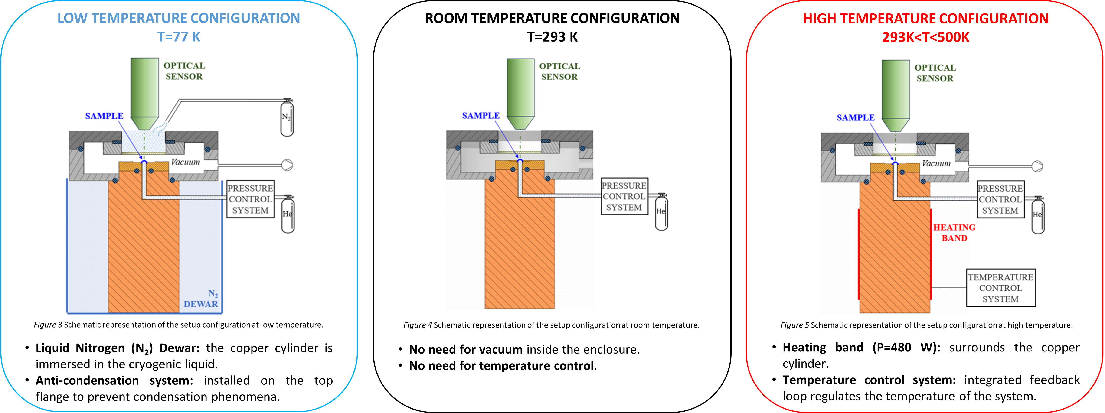
Bulge test setup
Three temperature configurations

Slide 11
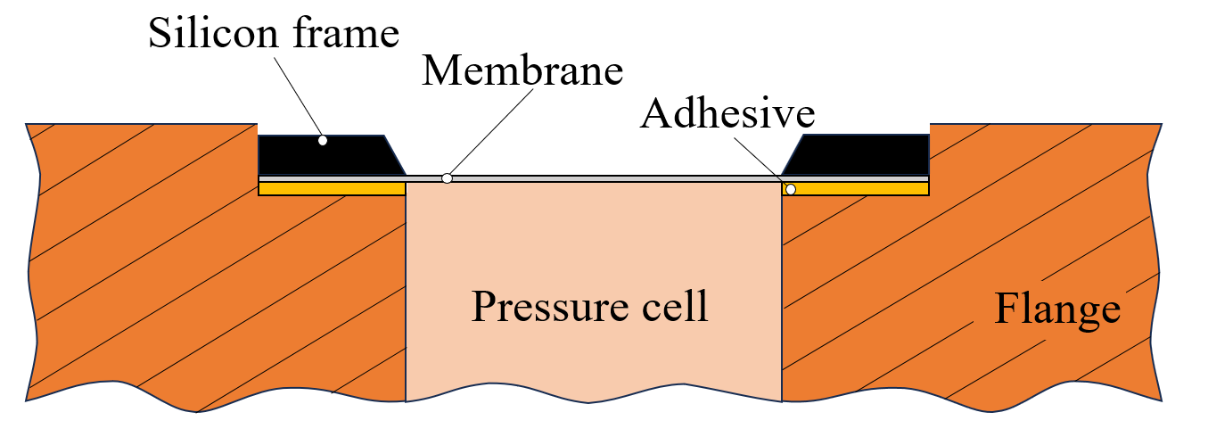
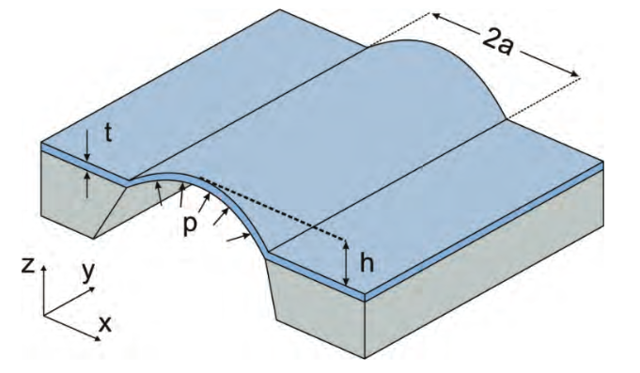
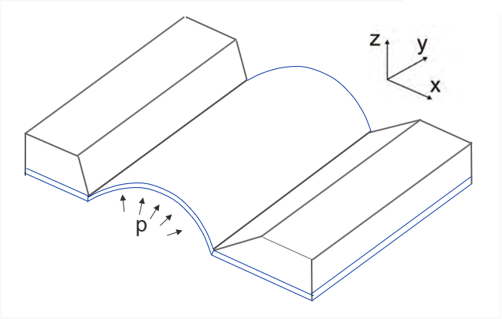
Bulge test setup
Sample mounting
Sample structure: a freestanding membrane supported by a silicon frame.
Sample mounting: bonding to a special slot created on the dedicated flange; it allows good repeatability of sample placement.
Sample orientation: two different ways to mount the membrane were investigated:
NEGATIVE ORIENTATION
POSITIVE ORIENTATION
Orientation | Adhesive | Temperature | Pressure @ failure
NEGATIVE | Acrylic glue (instantaneous) | RT | < 1 bar
POSITIVE | Acrylic glue (instantaneous) | RT | ~2 bars
Positive orientation prevents delamination phenomena.

Slide 12
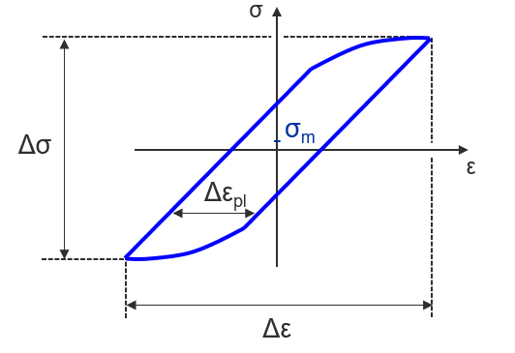
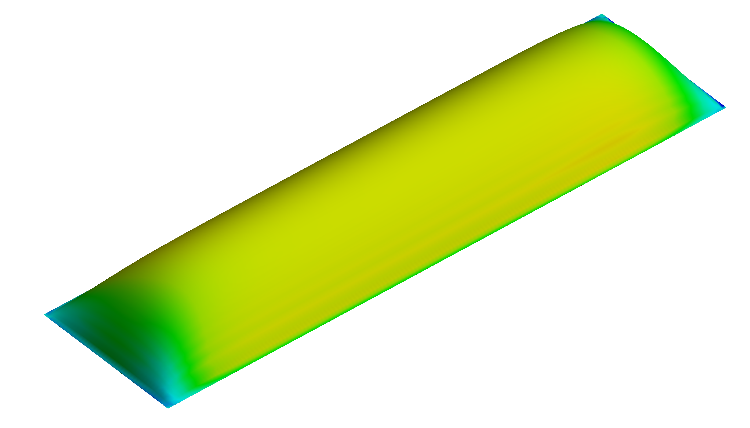
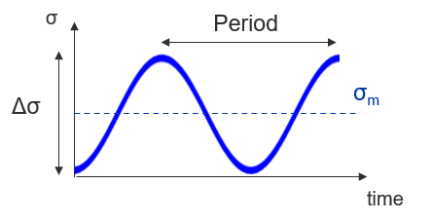
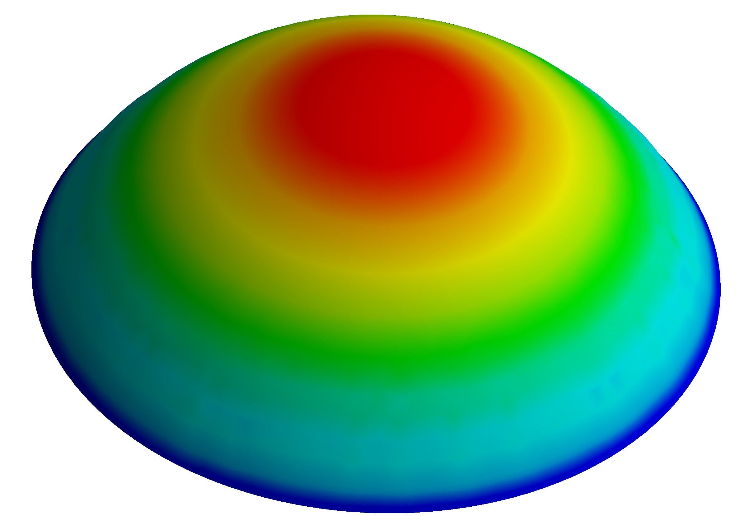
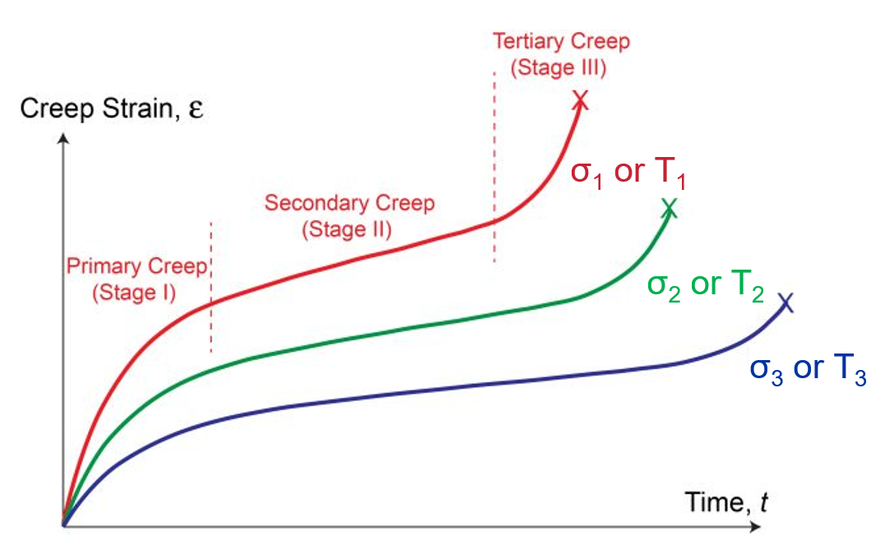
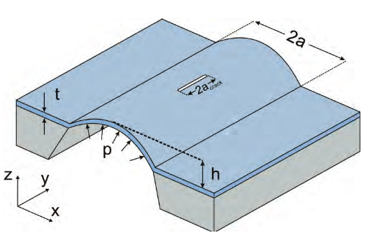


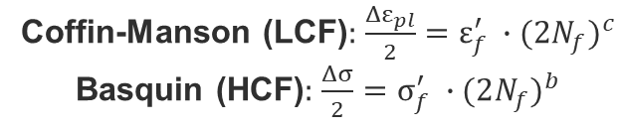
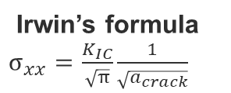
Bulge test setup
Capabilities
STATIC
FATIGUE
VM Stress
Rectangular shape
$$p=2 σ_{0} t \frac{d}{a^{2}}+\frac{4}{3 (1+ν)}\frac{E}{1−ν}t \frac{d^{3}}{a^{4}}$$
Circular shape
$$p=4 σ_{0} t \frac{d}{a^{2}}+\frac{8}{3}\frac{E}{1−ν}t \frac{d^{3}}{a^{4}}$$
Coffin-Manson (LCF): $\frac{{Δε}_{pl}}{2}=ε_{f}^{′} ∙{(2N_{f})}^{c}$
Basquin (HCF): $\frac{Δσ}{2}=σ_{f}^{′} ∙{(2N_{f})}^{b}$
BULGE TEST SETUP: TESTS
CREEP
FRACTURE TOUGHNESS
σ₁ > σ₂ > σ₃
Irwin’s formula
$σ_{xx}=\frac{K_{IC}}{\sqrt{π}}\frac{1}{\sqrt{a_{crack}}}$
T₁ > T₂ > T₃

Slide 13
Summary
Introduction
Bulge test setup: small membranes
Si₃N₄ membranes characterization
Bulge test setup: big membranes
Ti-6Al-4V window dimensioning
Conclusions

Slide 14
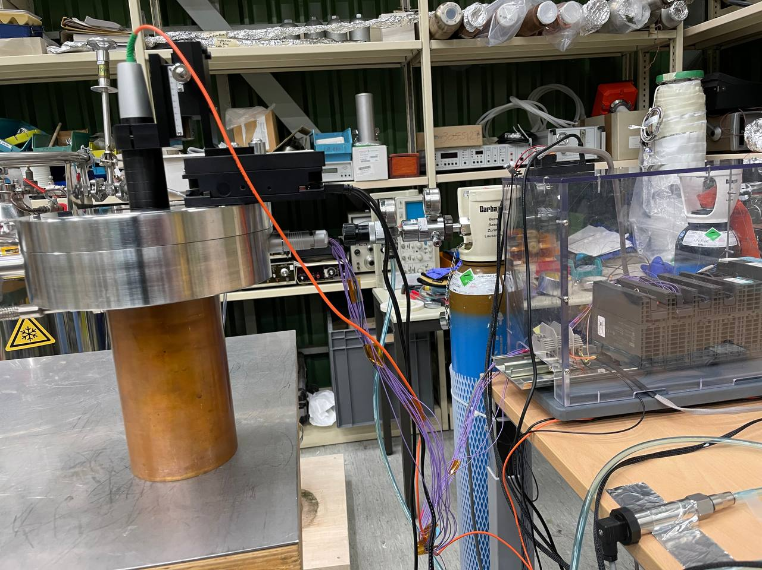
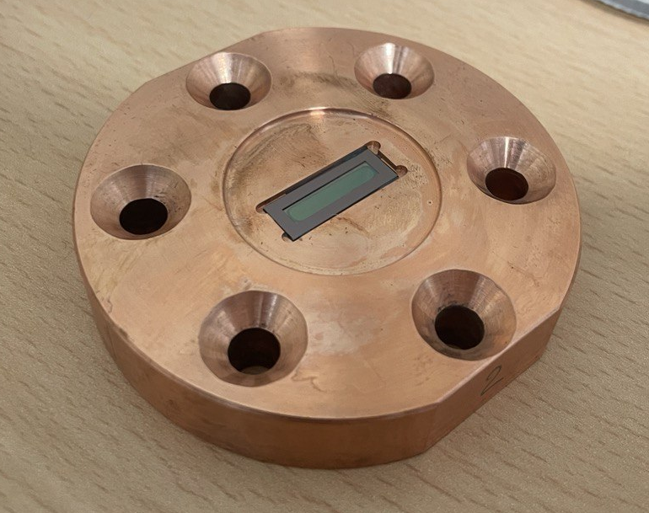
Si₃N₄ membranes: bulge tests @RT
Setup
Freestanding silicon nitride (Si₃N₄) membranes
Frame dimension: 19 mm x 7 mm
Frame thickness: 200 µm
Membrane dimension: 15 mm x 3 mm
Membrane thickness: 1000 nm
Membrane shape: rectangular
Testing temperature: Room Temperature (≈293K)
Number of sample tested: 5
Pressure load rate: 100 mbar/min
Adhesives: LOCTITE EA9492, 3M DP190, MG 832HT
Data post-processing: analytical procedure+FEM
DAQ system
Helium bottle
Room temperature measurements setup

Slide 15
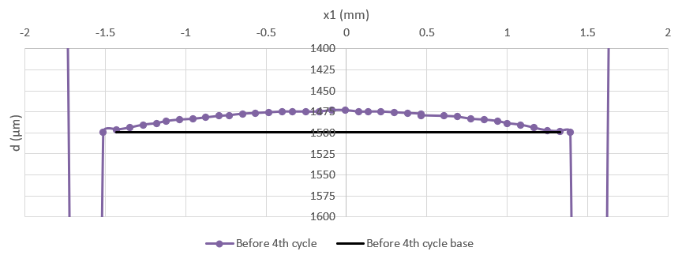
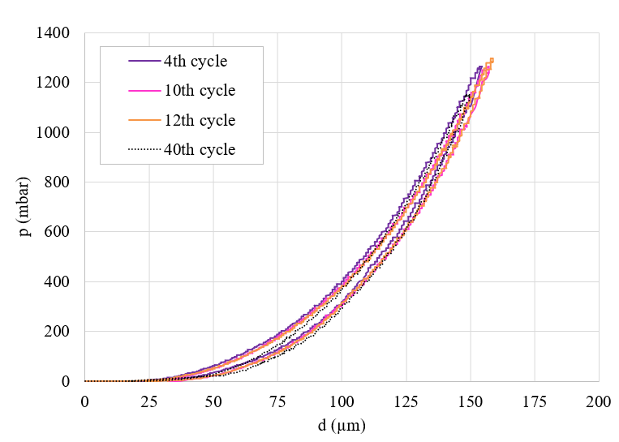
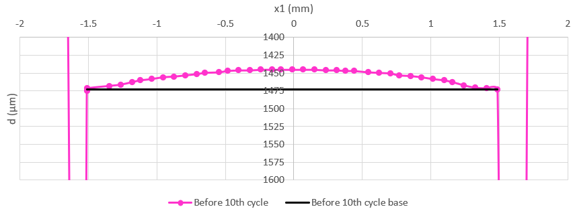
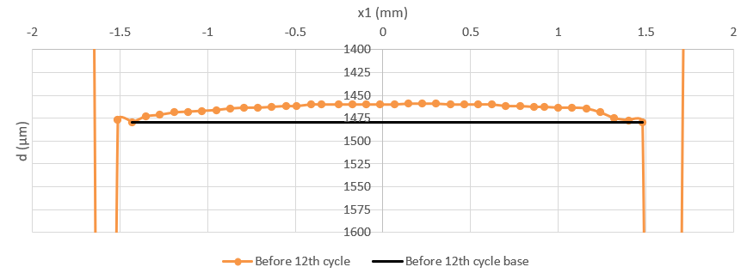
Si₃N₄ membranes: bulge tests @RT
Initial condition
The initial deformation of the membrane must be evaluated (and compensated) before each cycle
A repeatable behavior of the membrane is measured after many cycles (N_{max}=40)
The mechanical hysteresis measured by bulge tests is attributed to the glue, as demonstrated by FEM.
x1
x
Adhesive=3M DP190

Slide 16
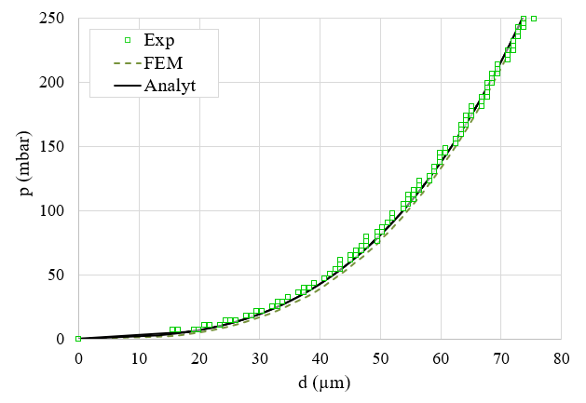
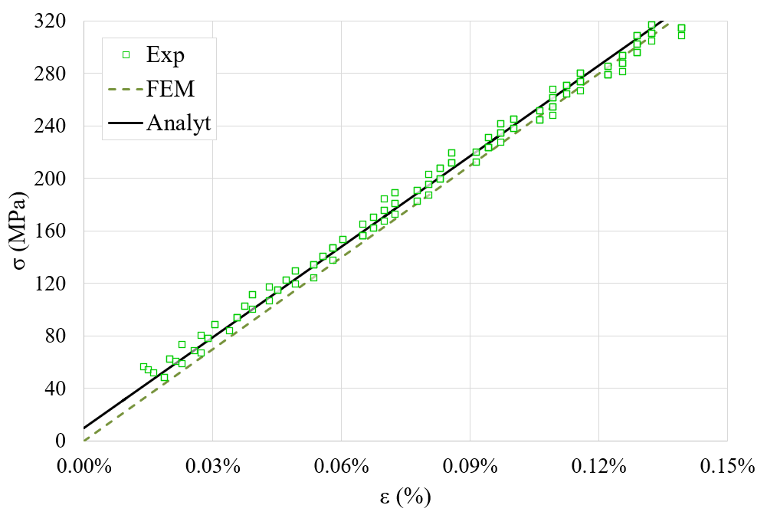
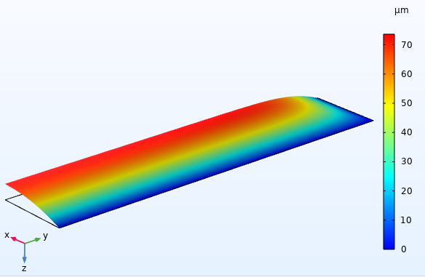

Si₃N₄ membranes: bulge tests @RT
Material properties
Membrane properties: calculated from the pressure-deflection curve obtained using the LOCTITE EA9492 adhesive.
displacement @ p=250mbar
Adhesive=LOCTITE 9492
$σ_{xx}$ @ p=250mbar
Young’s modulus | E | 230±10 | GPa
Initial Residual Stress | σ₀ | 10±5 | MPa
Poisson’s coefficient | ν | 0.1 | /
Ultimate pressure | p_{u} | 3±1* | bar
Ultimate tensile stress | σ_{xx,u} | 2 ±0.4** | GPa
*Remember this is for rectangular membranes!
**Indirect measure from p_{u}, under the hp of complete elastic material behaviour!

Slide 17
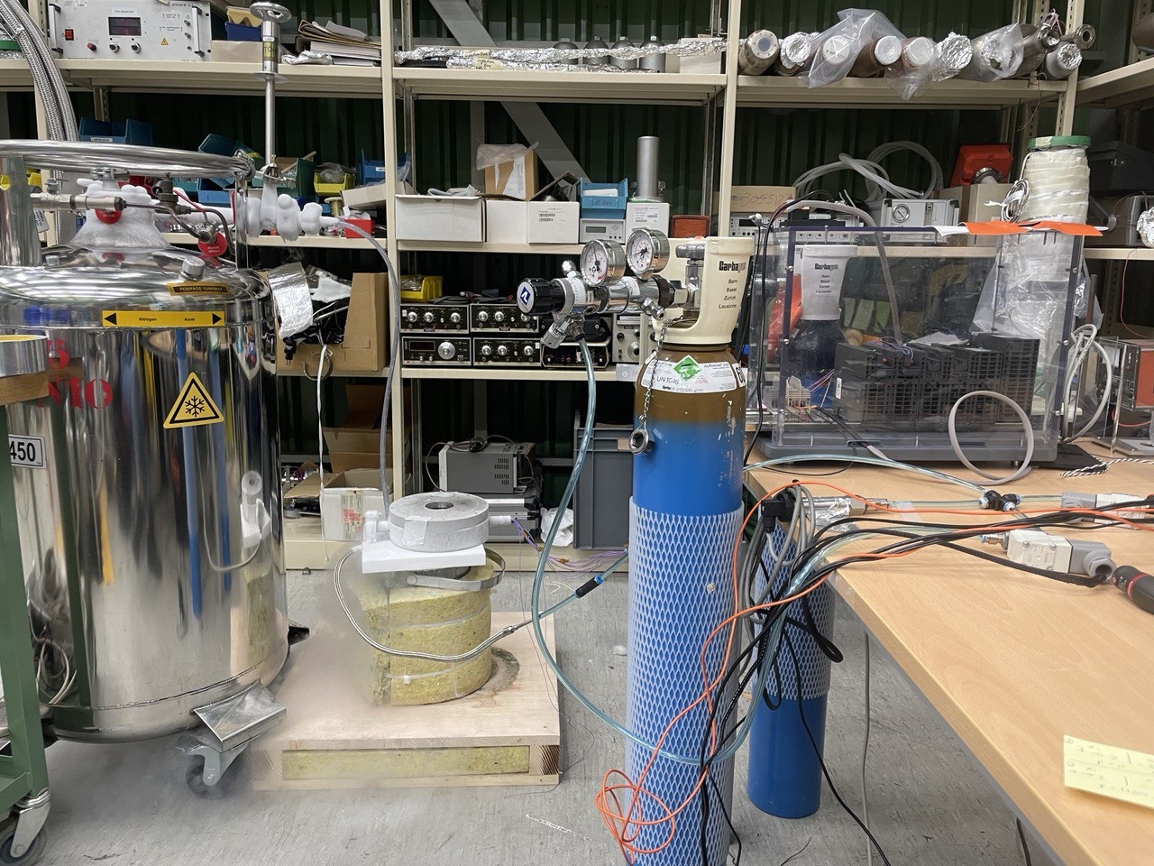
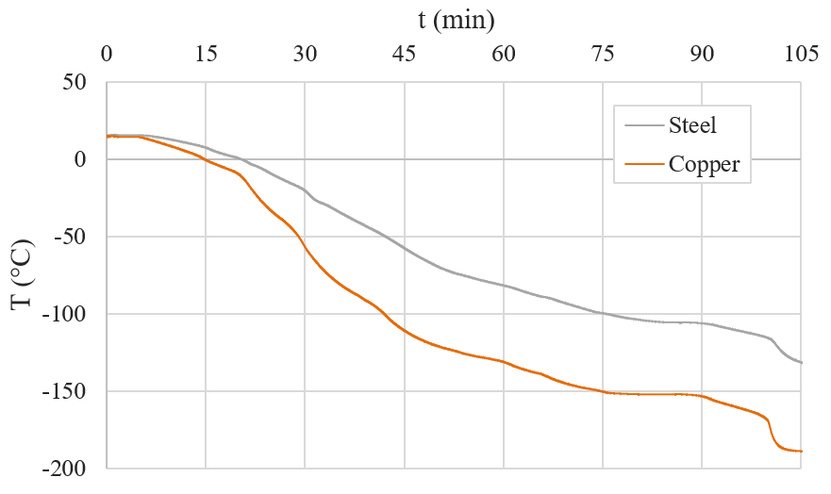
Si₃N₄ membranes: bulge tests @CT
Setup
Freestanding silicon nitride (Si₃N₄) membranes
Frame dimension: 19 mm x 7 mm
Frame thickness: 200 µm
Membrane dimension: 15 mm x 3 mm
Membrane thickness: 1000 nm
Membrane shape: rectangular
Testing temperature: Cold Temperature (≈77K)
Number of sample tested: 4
Pressure load rate: 100 mbar/min
Adhesives: LOCTITE EA9492, 3M DP190
Data post-processing: analytical procedure+FEM
DAQ system
Helium bottle
N₂ Dewar
Cold temperature measurements setup

Slide 18
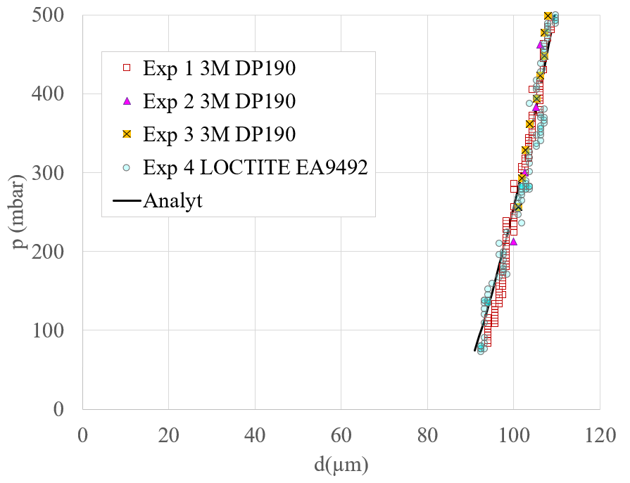
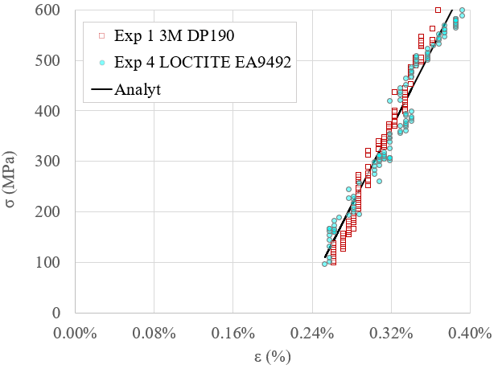
Si₃N₄ membranes: bulge tests @CT
Young’s modulus | E | 380±15 | GPa
Initial Residual Stress | σ₀ | -850±30 | MPa
Poisson’s coefficient | ν | 0.1 | /
Ultimate pressure | p_{u} | 5±1 | bar
Ultimate tensile stress | σ_{xx,u} | 3 ±0.4 | GPa

Slide 19
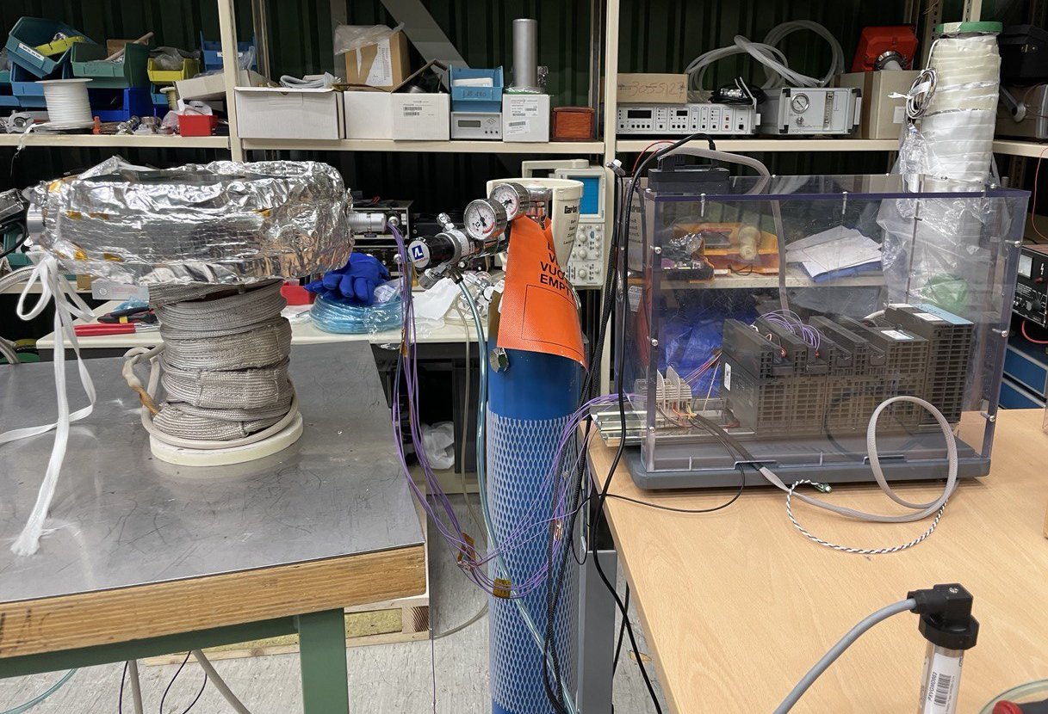
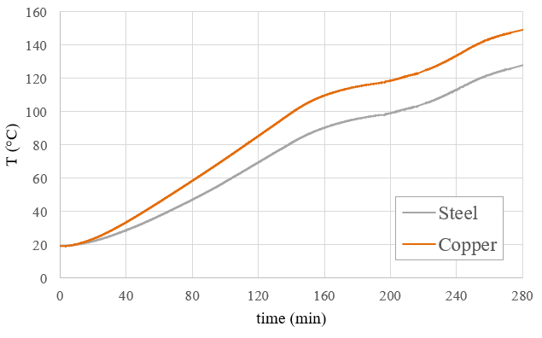
Si₃N₄ membranes: bulge tests @HT
Freestanding silicon nitride (Si₃N₄) membranes
Frame dimension: 19 mm x 7 mm
Frame thickness: 200 µm
Membrane dimension: 15 mm x 3 mm
Membrane thickness: 1000 nm
Membrane shape: rectangular
Testing temperature: Hot Temperature (=425K)
Number of sample tested: 3
Pressure load rate: 100 mbar/min
Adhesives: MG 832HT
Data post-processing: analytical procedure+FEM
DAQ system
Helium bottle
High temperature measurements setup

Slide 20
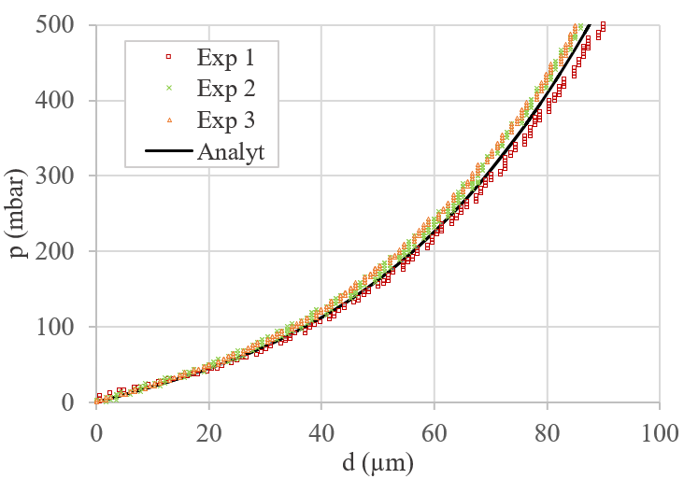
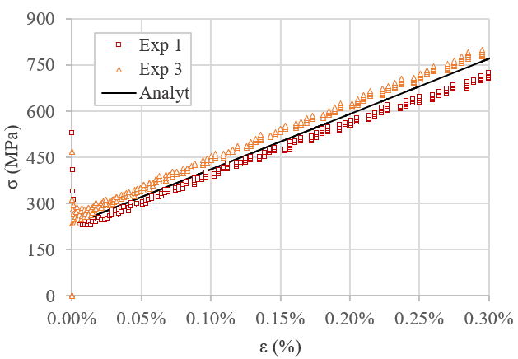
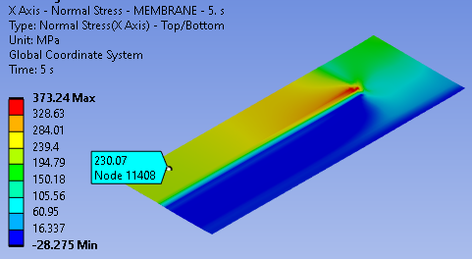
Si₃N₄ membranes: bulge tests @HT
Material properties
FEM simulation: the flange+adhesive+sample system response during heating + bulge test is simulated to:
  1. Estimate the residual stress in the membrane after heating: simulation results match the experimental measurements.
y
x
σ_{xx} @T=150°C
Young’s modulus | E | 230±10 | GPa
Initial Residual Stress | σ₀ | 230±20 | MPa
Poisson’s coefficient | ν | 0.1 | /
Ultimate pressure | p_{u} | 2±0.5 | bar
Ultimate tensile stress | σ_{xx,u} | 1.5 ±0.2 | GPa

Slide 21
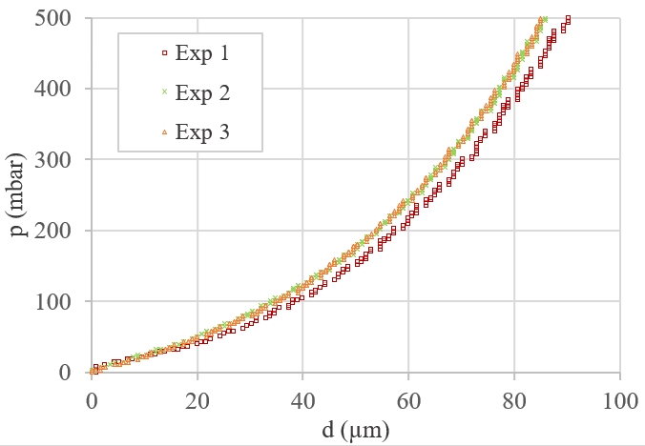
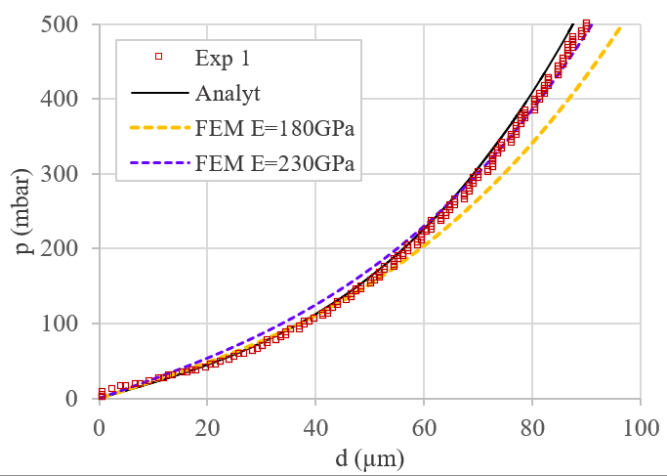
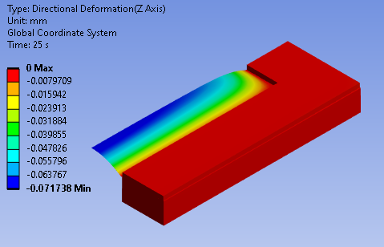
Si₃N₄ membranes: bulge tests @HT
Material properties
FEM simulation: the flange+adhesive+sample system response during heating + bulge test is simulated to:
  2. Estimate the Young’s modulus of the membrane determined by bulge test: simulation reveals that the experimentally measured lower membrane stiffness (E=180GPa) is an artifact due to the compliance of the rest of the system.
y
x
displacement @p=250mbar
Young’s modulus | E | 230±10 | GPa
Initial Residual Stress | σ₀ | 230±20 | MPa
Poisson’s coefficient | ν | 0.1 | /
Ultimate pressure | p_{u} | 2±0.5 | bar
Ultimate tensile stress | σ_{xx,u} | 1.5 ±0.2 | GPa

Slide 22
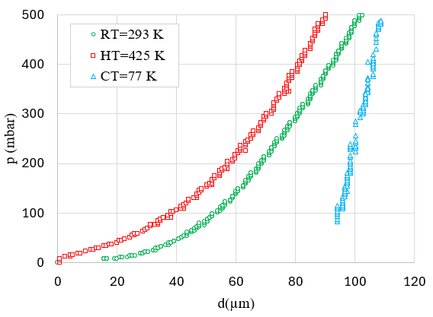
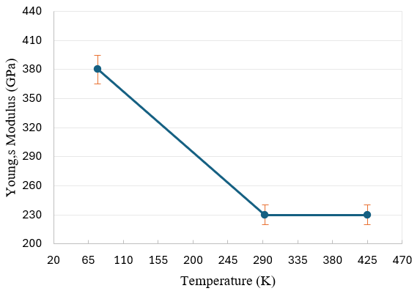
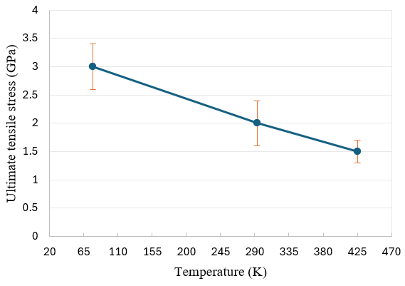
Si₃N₄ membranes: three temperature summary
Material properties
PARAMETER |  | THIN MEMBRANE |  |  | BULK | UNIT
 |  | 77 K | 293 K | 425 K | 293 K
Young’s modulus | E | 380±15 | 230±10 | 230±10 | 120÷241 | GPa
Initial Residual Stress | σ₀ | -850±30 | 10±5 | 230±20 | / | MPa
Poisson’s coefficient | ν | 0.1 | 0.1 | 0.1 | 0.23÷0.28 | /
Ultimate pressure | p_{u} | 5±1 | 3±1 | 2±0.5 | / | bar
Ultimate tensile stress | σ_{xx,u} | 3±0.4 | 2 ±0.4 | 1.5 ±0.2 | 0.06÷0.525 | GPa

Slide 23
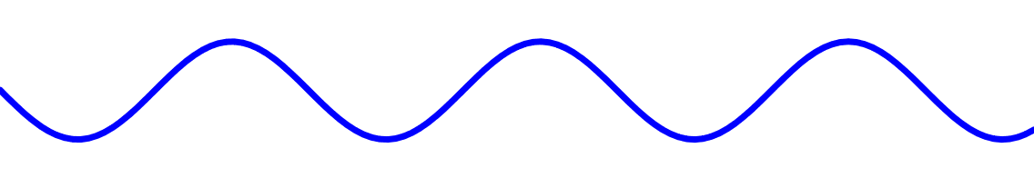


Si₃N₄ membranes: fatigue tests
Freestanding silicon nitride (Si₃N₄) membranes
p
t =10 s
→ f =0.1 Hz
Frame dimension: 19 mm x 7 mm
Frame thickness: 200 µm
Membrane dimension: 15 mm x 3 mm
Membrane thickness: 1000 nm
Membrane shape: rectangular
Testing temperature: Room and Cold Temperatures
Adhesives: LOCTITE EA9492
Δp =1 bar
p_{m} =500 mbar
PARAMETER | STATIC | DYNAMIC
Pressure rate, Δp/Δt | 1.6 mbar/s | 200 mbar/s
t
Pressure control system
Software (miCon-L)
INLET VALVE
PIEZO GAUGE
OUTLET VALVE

Slide 24


Si₃N₄ membranes: fatigue tests @RT (f=0.1 Hz)
N_{max}=1.75E+04 cycles
Si₃N₄ deforms purely elastically
Δp=1 bar, E_{max}(%) ≈15%
Δd=84 µm, E_{max}(%) ≈15%

Slide 25
Si₃N₄ membranes: fatigue tests @RT (f=0.1 Hz)
N_{max}=1.75E+04 cycles
Si₃N₄ deforms purely elastically
Δp=1 bar, E_{max}(%) ≈15%
Δd=84 µm, E_{max}(%) ≈15%
The diagram of all cycles overlap extremely well

Slide 26

Si₃N₄ membranes: fatigue tests @RT (f=0.1 Hz)
N_{max}=1.75E+04 cycles
Si₃N₄ deforms purely elastically
Δp=1 bar, E_{max}(%) ≈15%
Δd=84 µm, E_{max}(%) ≈15%
The diagram of all cycles overlap extremely well

Slide 27

Si₃N₄ membranes: fatigue tests @RT (f=0.1 Hz)
N_{max}=1.75E+04 cycles
Si₃N₄ deforms purely elastically
Δp=1 bar, E_{max}(%) ≈15%
Δd=84 µm, E_{max}(%) ≈15%
The diagram of all cycles overlap extremely well

Slide 28

Si₃N₄ membranes: fatigue tests @RT (f=0.1 Hz)
N_{max}=1.75E+04 cycles
Si₃N₄ deforms purely elastically
Δp=1 bar, E_{max}(%) ≈15%
Δd=84 µm, E_{max}(%) ≈15%
The diagram of all cycles overlap extremely well

Slide 29

Si₃N₄ membranes: fatigue tests @RT (f=0.1 Hz)
N_{max}=1.75E+04 cycles
Si₃N₄ deforms purely elastically
Δp=1 bar, E_{max}(%) ≈15%
Δd=84 µm, E_{max}(%) ≈15%
The diagram of all cycles overlap extremely well

Slide 30
Si₃N₄ membranes: fatigue tests @RT (f=0.1 Hz)
N_{max}=1.75E+04 cycles
Si₃N₄ deforms purely elastically
Δp=1 bar, E_{max}(%) ≈15%
Δd=84 µm, E_{max}(%) ≈15%
The diagram of all cycles overlap extremely well
Very good stability of the setup over long periods of time

Slide 31




Si₃N₄ membranes: fatigue tests @CT (f=0.1 Hz)
N_{max}=9.6E+02 cycles
Si₃N₄ deforms purely elastically
Δp=1 bar, E_{max}(%) ≈16%
Δd=65 µm, E_{max}(%) ≈30%

Slide 32
Si₃N₄ membranes: fatigue tests @CT (f=0.1 Hz)
N_{max}=9.6E+02 cycles
Si₃N₄ deforms purely elastically
Δp=1 bar, E_{max}(%) ≈16%
Δd=65 µm, E_{max}(%) ≈30%
The diagram of the displacement cycles oscillates due to system:
Thermal deformation (T=67÷77K)
Vibration (liquid N₂ injection)

Slide 33
Si₃N₄ membranes: fatigue tests @CT (f=0.1 Hz)
N_{max}=9.6E+02 cycles
Si₃N₄ deforms purely elastically
Δp=1 bar, E_{max}(%) ≈16%
Δd=65 µm, E_{max}(%) ≈30%
The diagram of the displacement cycles oscillates due to system:
Thermal deformation (T=67÷77K)
Vibration (liquid N₂ injection)
Limited number of cycles at cold to preserve instrumentations

Slide 34
Summary
Introduction
Bulge test setup
Si₃N₄ membranes characterization
Bulge test setup enhancement for larger membranes
Ti-6Al-4V window dimensioning
Conclusions

Slide 35




Bulge test setup enhancement for larger membranes
Design of a new holder flange
Socket head screw Ø6mm
DISK1
DISK 2
FLANGE
CIRCULAR MEMBRANE
Different material and size of membranes can be tested:
A circular shape of membrane can be easily obtained.
The use of three pieces (flange + disks) allows to test different membrane apertures by only changing the disks (cheap and easy manufacture).

Slide 36
Summary
Introduction
Bulge test setup
Si₃N₄ membranes characterization
Bulge test setup enhancement for larger membranes
Ti-6Al-4V window dimensioning
Conclusions

Slide 37



Ti-6Al-4V window dimensioning
A new window for the TT2-FTA line
Membrane aperture: from 44 mm to 65 mm
Membrane thickness: from 50 µm to max 100 µm
            Technical reference drawing
FE model: axisymmetric
            Experimental setup

Slide 38





Ti-6Al-4V window dimensioning
Exprimental tests
Bulge test: thickness=75 µm
Fatigue test: thickness=75 µm
σ₀=15MPa
Bulge test: thickness=100 µm
The FE model assumes ideal initial conditions (d₀, σ₀=0).
The analytical model considers real initial conditions.
The simulated curves closely match the experimental curves.
d₀=0.2mm
The FE model is accurate!

Slide 39


Ti-6Al-4V window dimensioning
FE simulation results
Effect of the thickness
Equivalent Von Mises Stress (MPa)
Thickness=75 µm
σ_{VM,centre}=281 MPa
σ_{VM,max}=876 MPa
σ_{VM}>800 MPa for less than 7% of the thickness
A thickness of 50 µm does not ensure membrane integrity during operation.
A thickness of 100 µm keeps the membrane well below the yield stress limit.
A thickness of 75 µm is slightly below the yield stress limit.
A trade-off between mechanical properties and beam transparency of the material is represented by the 75 µm thick Ti-6Al-4V membrane.

Slide 40
Summary
Introduction
Bulge test setup
Si₃N₄ membranes characterization
Bulge test setup enhancement for larger membranes
Ti-6Al-4V window dimensioning
Conclusions

Slide 41




Conclusions
Design, development and validation of a bulge test setup to test thin membranes at 77 K, 293 K and up to around 500 K.
Definition of the bulge test procedure for the characterisation of thin membranes at different temperatures by static and dynamic tests, including fatigue, creep and fracture toughness tests.
Characterisation of Si₃N₄ membranes at 77 K, 293 K and 425 in terms of determination of the mechanical properties and fatigue resistance of the membranes.
Characterization and testing of different types/size of membrane, including Ti-6Al-4V at 293 K.

Slide 42
Thank you for your attention!

Slide 43


Confocal chromatic sensor
A polychromatic light source illuminates the surface of the object.
The light is focused at different distances depending on the wavelength and only the light of a very narrow wavelength range is focused on the surface to be measured, with the remaining light concentrically distributed around this focus point onto a larger area.
By determining the wavelength of the focused light, which is reflected back into the optical system, very precise distance measurements are possible (nm resolution).

Slide 44






Potential other applications of the bulge test setup
Gasket profile
Contact persons: Gregory Cattenoz and Marios Kyprianidis (TE-VSC)
r (mm)
A
A
Δd_{max}≈310 µm
NOMINAL CASE
y
r
D
B
Δd_{max}≈334 µm
x
B
d (µm)
C
Δd_{max}≈296 µm
C
Flange
DN600mm
PROBLEM
Leakage in a vacuum system.
SOLUTION
The confocal chromatic sensor was used to trace the profile of a copper gasket and assess that the knife depth is within the tolerance range
D
Δd_{max}≈300 µm
Notes:
.

Slide 45




FEM simulations @HT
Load and boundary conditions
Symmetry (along x)
Frictionless support
p
Symmetry (along y)
HEATING
BULGE TEST

Slide 46





FEM simulations
Material properties
COPPER
SILICON NITRIDE
SILICON
E=169 GPa
(constant with temperature)

Slide 47



FEM simulations
Material properties
GLUE: MG 832HT
GLUE: 3M DP190
E=4 GPa
(constant with temperature)

Slide 48



Beam windows for final cooling
Absorbers (i.e., LH₂, LiH) and vacuum are alternated in the final cooling → Windows
Low energy beam: 20 to 5 MeV
→Thin windows (<15 µm to lose <1% of the energy)
→Small windows (10×σ, σ=0.6 mm at 5Hz)
Bethe-Bloch equation to calculate the stopping power at low energy (100keV to 100 MeV) [3]:
Possible material candidates → Be, C, Si₃N_{4,} SiC, …
 |  | 5 MeV | 20 MeV
Be | Stopping power [MeV×cm²/g] | 11.2 | 4.0
 | Linear stopping power [MeV/cm] | 21 | 7.3
C | Stopping power [MeV×cm²/g] | 12.2 | 4.3
 | Linear stopping power [MeV/cm] | 25 | 8.7
Si₃N₄ | Stopping power [MeV×cm²/g] | 11.8 | 4
 | Linear stopping power [MeV/cm] | 37 | 13
SiC | Stopping power [MeV×cm²/g] | 11.2 | 4.0
 | Linear stopping power [MeV/cm] | 36 | 13

Slide 49


Simulations vs experiments
According to simulations, the max displacement of the membrane @RT should be lower than @CT.
The diagram shows that due to the effect of the adhesive at high pressure (p>300mbar) simulated data deviates from the experimental curve @RT.
Experiments show that at Δp=1bar the max displacement of the membrane @RT is higher than @CT: this is confirmed by both static and dynamic tests.

Slide 50


Bulge test setup
Sample mounting
OPTICAL MICROSCOPE IMAGES
Membrane failure during cooldown.
Possible causes and solutions:
  Substrate/sample thermal deformation mismatch:
    Increase the slot size of the copper flange
    Change the substrate material
  Glue degradation at cold:
    Test different glues
Before cooling
After cooling
Adhesive=Araldite Rapid
Inspection performed by Ignacio Santillana (EN-MME)

Slide 51

Bulge test setup
Sample mounting
OPTICAL MICROSCOPE IMAGES
Membrane failure during cooldown.
Possible causes and solutions:
  Substrate/sample thermal deformation mismatch:
    Increase the slot size of the copper flange
    Change the substrate material
  Glue degradation at cold:
    Test different glues
Before cooling
After cooling
INVAR disc (t=2 mm)
COPPER flange
Adhesive=Araldite Rapid
Brazing performed by Alexandre Gerardin (EN-MME)

Slide 52



Bulge test setup
Sample mounting
Invar-copper flange designed to house the sample for low and high temperature measurements:
  CTE_{INVAR} ≈ CTE_{Si} → Low thermal stress on the sample during heating/cooling
  High k_{Cu}→ Effective heating/cooling of the sample
FE simulation results: stationary flange temperature reached after the copper cylinder is fully in contact with liquid N₂ (=77K)
Copper flange
Invar flange
Invar-copper flange
Thermal efficiency X
Sample-flange contraction ✓
Thermal efficiency ✓
Sample-flange contraction X
Thermal efficiency ✓
Sample-flange contraction ✓
E_{Cu} =130 GPa
k_{Cu} =400 W m⁻¹ K⁻¹
CTE_{Cu}=16 ppm °C⁻¹
E_{INVAR}=140 GPa
k_{INVAR}=15 W m⁻¹ K⁻¹
CTE_{INVAR}=2.5 ppm °C⁻¹

Slide 53



Bulge test
Adhesives for different temperature tests
Tests performed by Vincent Schenk and Sebastien Clement (TE-MSC)
Sample/substrate adhesion depends on:
  1. Substrate properties → SURFACE ENERGY TEST
    The higher the surface energy, the better the adhesion properties of the substrate
    Different materials/preparation surfaces have been tested
    Disperse and polar components have been determined for each surface →similar components means better adhesion
SP: sand paper P: plasma cleaning O: oxidized
1
2
2
1

Slide 54
Bulge test
Adhesives for different temperature tests
Sample/substrate adhesion depends on:
  2. Adhesive properties → BULGE TESTS
    Adhesives affect the mechanical response of the membrane
    The adhesion quality has been defined by determining the maximum pressure at membrane failure
    Adhesives have been tested at different temperatures to evaluate high and low temperature resistance
ADHESIVE PERFORMANCE
Epoxy bi-component adhesives | Cure | Pressure @ failure
 |  | CT=77K | RT=293K | HT=420K
Araldite RAPID | 2h @RT | < 1bar | 5±1 bar | 1.5 bar *
Araldite STANDARD | 24h @RT | 1.5 bar | 5±1 bar | 1.5 bar *
STYCAST 2850FT CAT27 | 4h @120°C | Not tested | Not tested | 3.5 bar *
LOCTITE ABLESTIK 286 | 24h @RT | Not tested | Not tested | broken
3M DP190 | 24h @RT | 5±1 bar | 5±1 bar | broken
LOCTITE EA 9492 | 3dd @RT | 3±1 bar | 4±1 bar | broken
MG 832HT | 24h @RT | broken | 3±1 bar | 2 bar
15 mm
3 mm
1 bar≈0.5 kg/membrane
5 bar≈2.5 kg/membrane
*not repeatable because of the high deformation of the membrane during heating

Slide 55


Si₃N₄ membranes: bulge tests @RT
FEM vs ESPERIMENTS
Adhesive type: bi-component epoxy resin → LOCTITE EA9492, MG 832HT, 3M DP190
Adhesive effect: compensated by FEM → the adhesive+sample system response during bulge test is simulated to demonstrate and evaluate the influence of the adhesive on the measurement
→ no influence of LOCTITE EA9492.
LOCTITE+M E=230GPa
3M DP190, M E=230GPa
3M DP190, M E=180GPa
E_{LOCTITE EA9492}=6.7 GPa, t_{3M DP190} =0.2mm
E_{3M DP190u} =0.5 GPa, t_{3M DP190} =0.2mm
Young’s modulus | LOCTITE 9492 | 230 | GPa
Young’s modulus | 3M DP190 | 180 | GPa

