Slide 1
Overview of TE-MPE activities during YETS 24/25
Mirko Pojer on behalf of TE-MPE
217th TE-TM meeting - April 7, 2025

Slide 2
Outline
The frame
Maintenance and hardware upgrade
Software updates and new deployments
Electrical Quality Assurance
Support to HWC
Conclusions

Slide 3
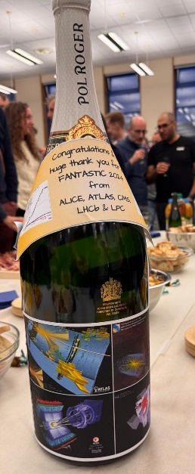
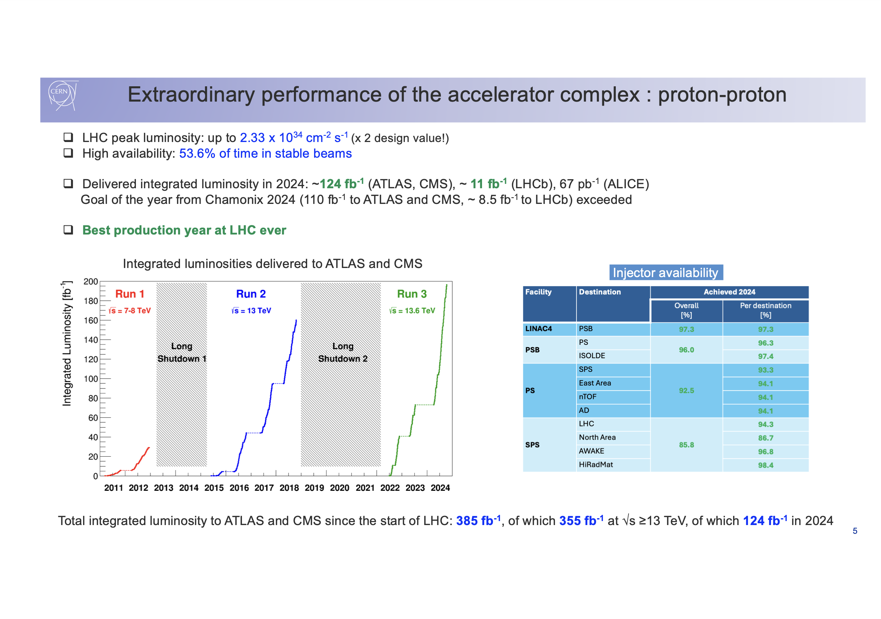

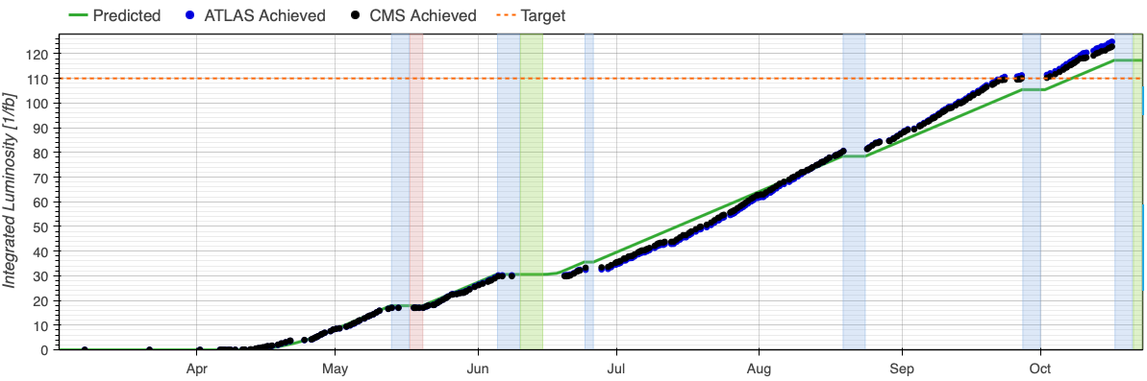
Intro
F. Gianotti
The yearly maintenance is vital in maintaining a perfectly working and smoothly performing machine!

Slide 4
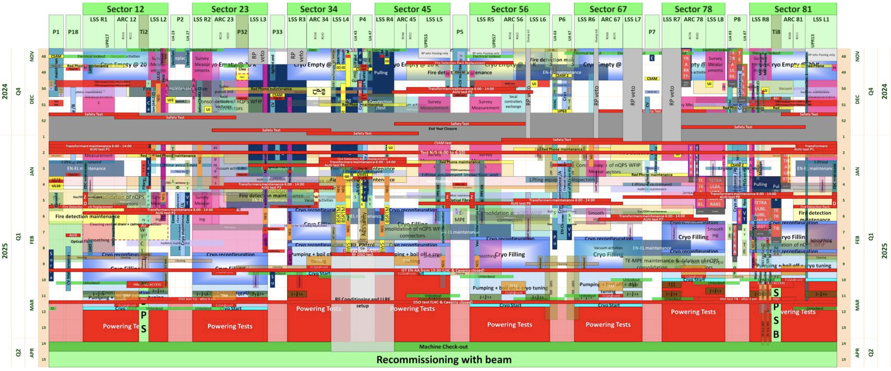
The frame: a lot of constraints for a multiplicity of activities.
MPE start here
…and finish here
… with many thanks to the coordination team!

Slide 5
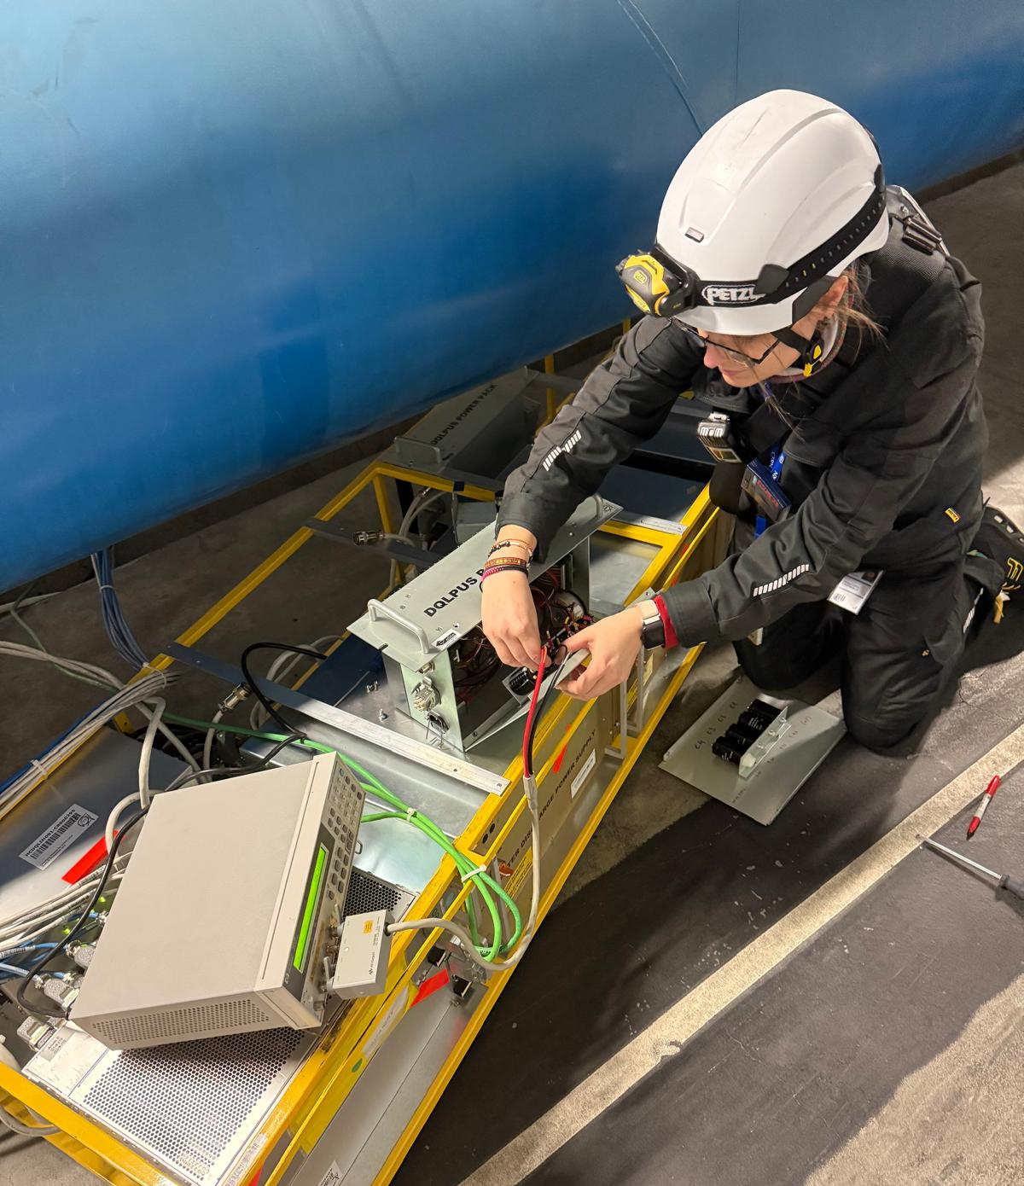
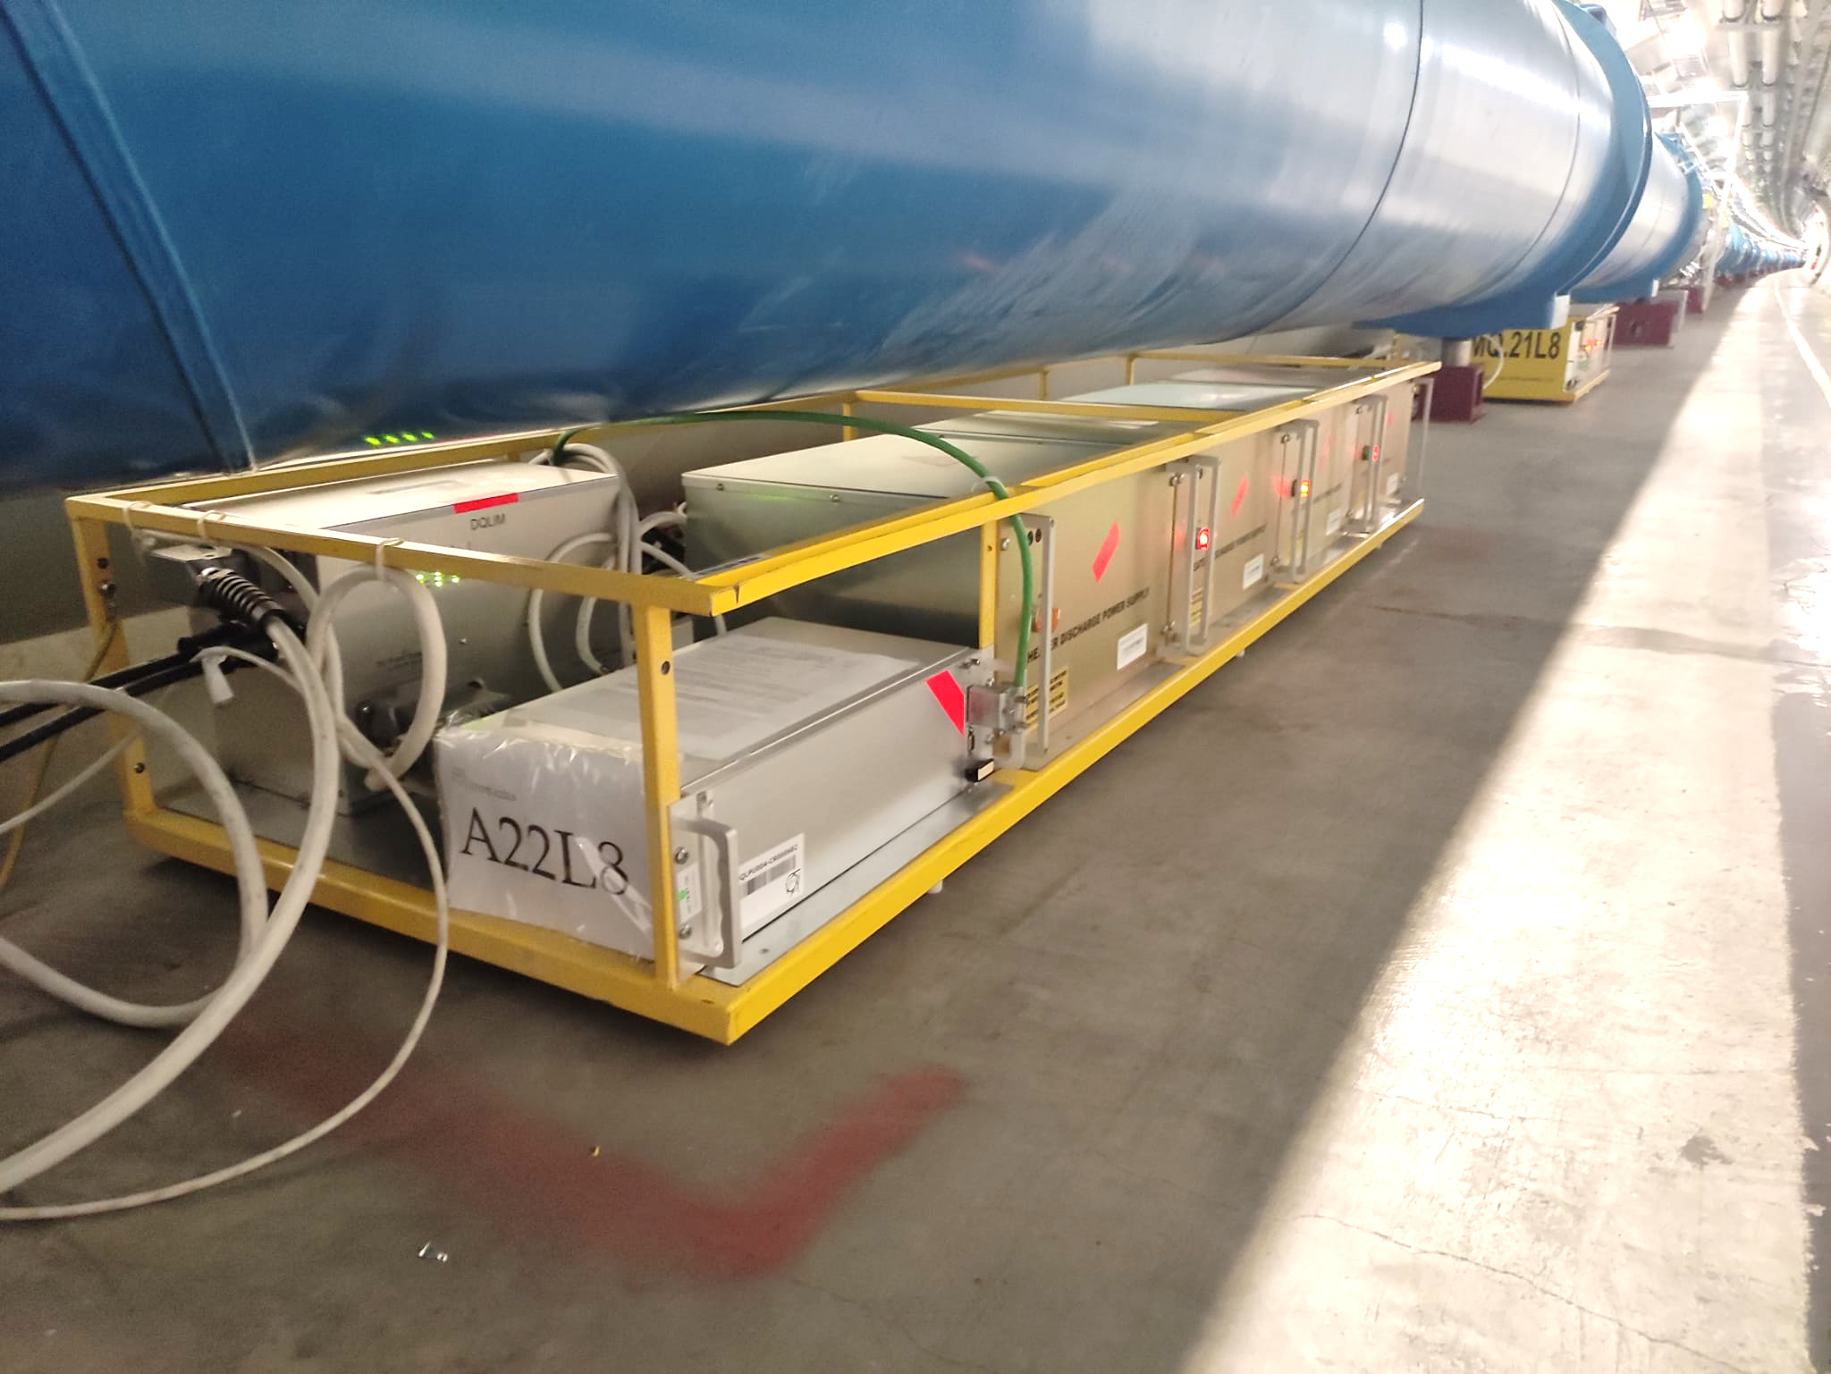
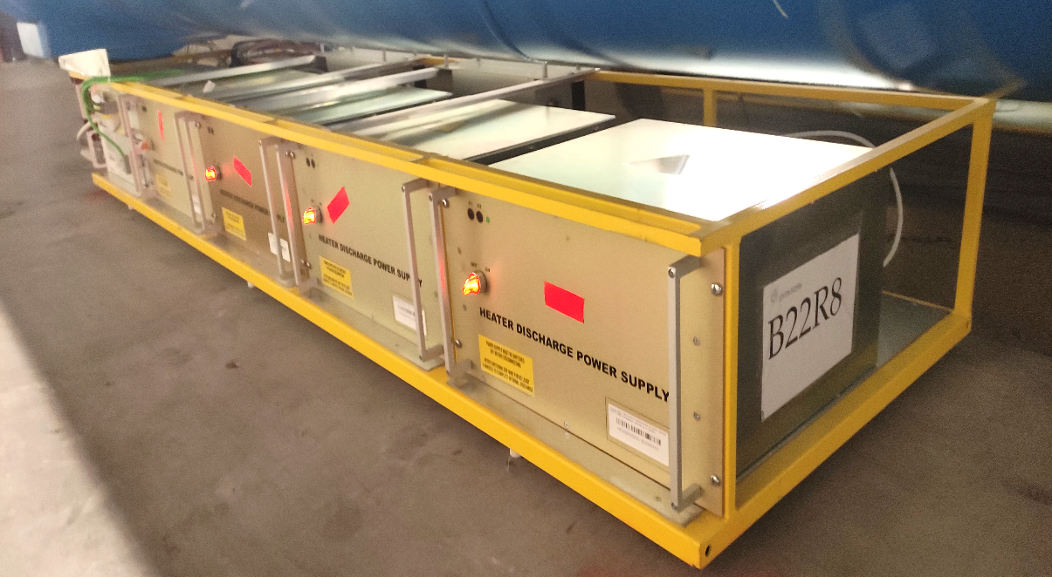
DQHDS switch off and lifetime studies activities
Switching off the DQHDS is necessary to guarantee the safety of circuits and personnel.
Equipment | Data of installation on the tunnel | Units in operation
DQHDS (Heater Discharge Power Supply) | LHC start | 6076
DQLIM (Interface module) for DYPB (dipole protection racks) | LS1 | 1232
DQLIM for DYPQ (quadrupole protection Racks) | LS2 | 392
DQLPR (Power Supplies) for Quench Detectors DQLPU-A | LS1 | 2464
DQLPR (Power Supplies) for Quench Detectors DQLPU-B | LS2 | 784
Power Packs (Power Supplies) for Quench Detectors DQLPU-S | 2009 | 872
Studies concluded that operation until LS4 is achievable, as long as periodic inspections, and rotation of selected components are planned.
Power packs capacitance measurement during YETS 24/25
During YETS 24/25:
- Capacitance measurements of selected capacitors within the Power Packs for DQLPU-S in sector 12.
- DQHDS main switches are showing recurrent failures: during the turning OFF/ON campaigns such failures are being recorded and being analysed.
DQLIM + DQLPR
Power Pack
DQHDS

Slide 6
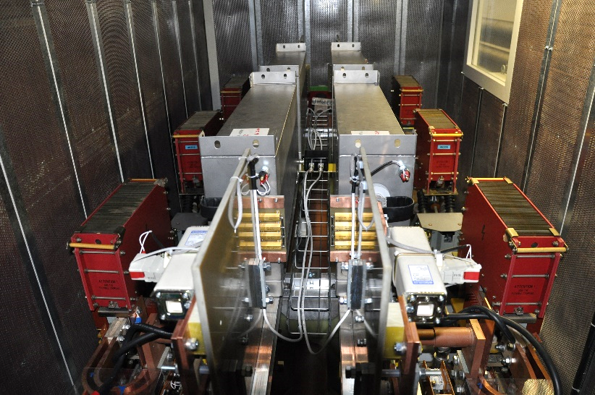
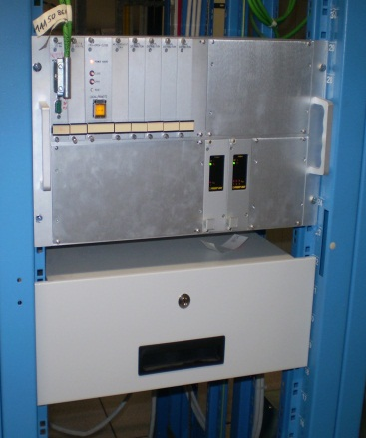
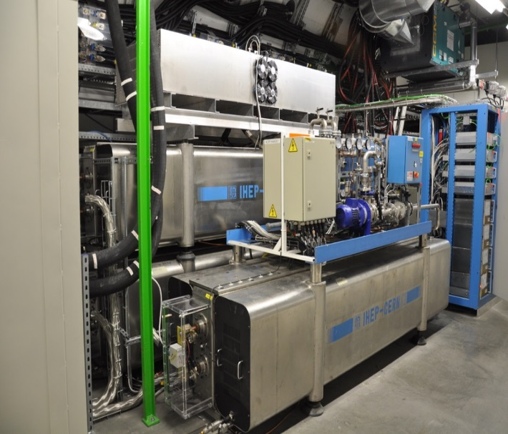
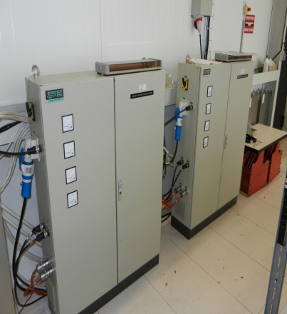
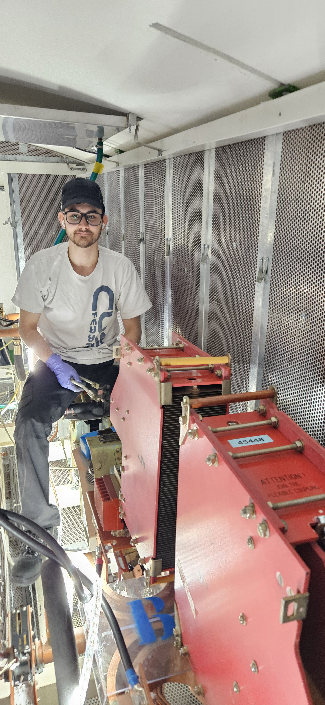
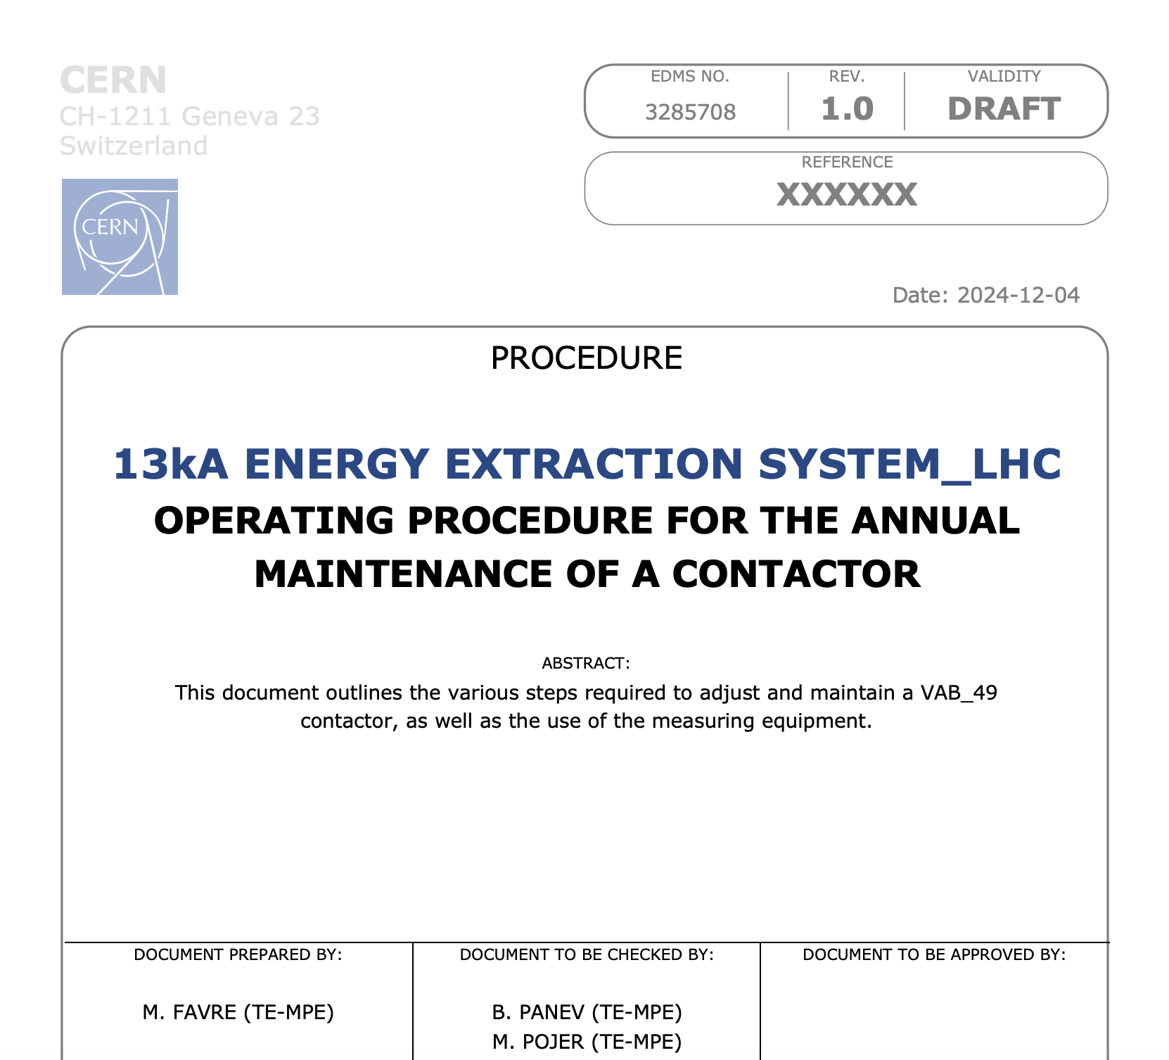
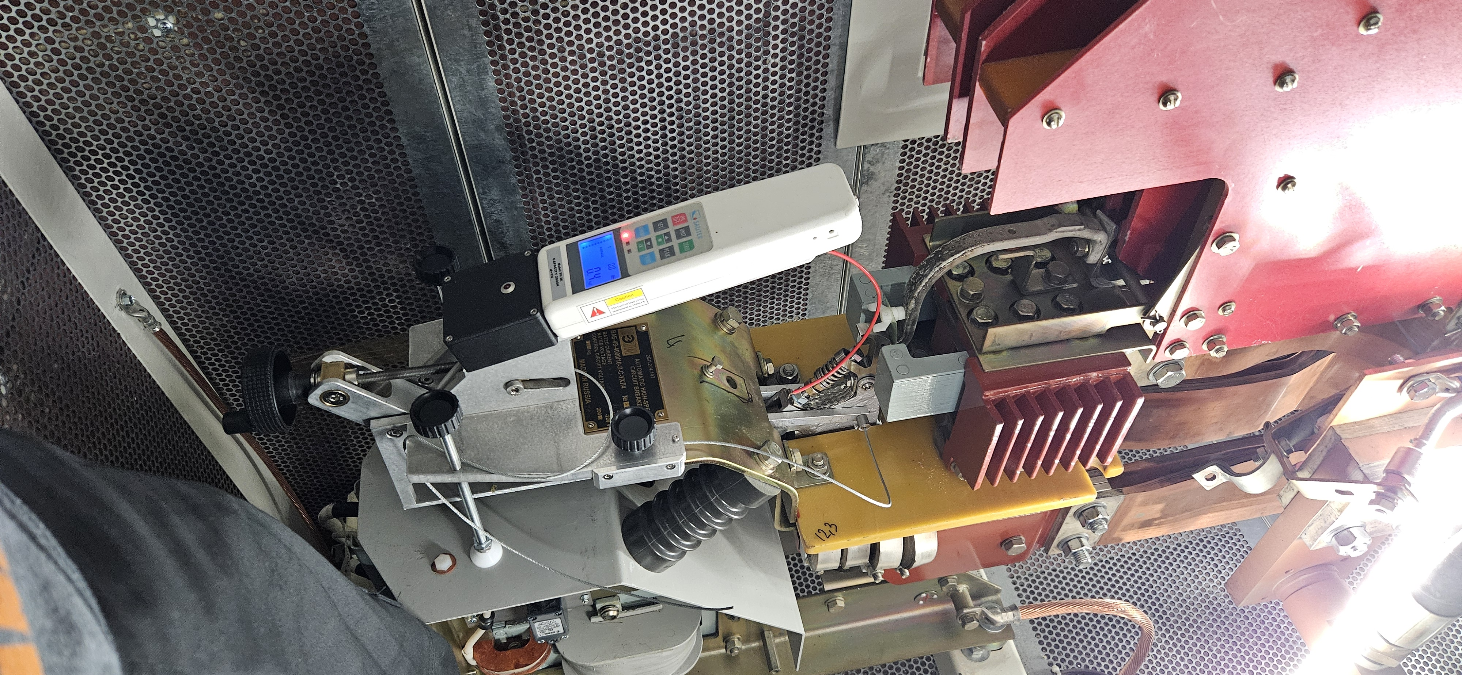
Maintenance of the 13 kA energy extraction systems
LHC has 32 EE systems for 13kA
  16 for main dipole circuits
  16 for main quadrupole circuits
Extraction Switch model: VAB49 (Energomash)
The switch manufacturer specifies maintenance once per year.
An expert team from IHEP/Kurchatov Institute was doing the maintenance till 2022.
The activity is now managed in-house: 256 switched inspected and maintained (electrical integrity, cleaning, force adj., lubrication and much more) in 2 months.
Circuit breakers
Electronics
Extraction Resistor
RB – 70 mΩ
The control electronics replacement is one of the major consolidations to be done during LS3!

Slide 7
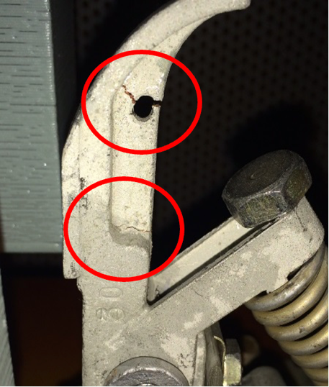
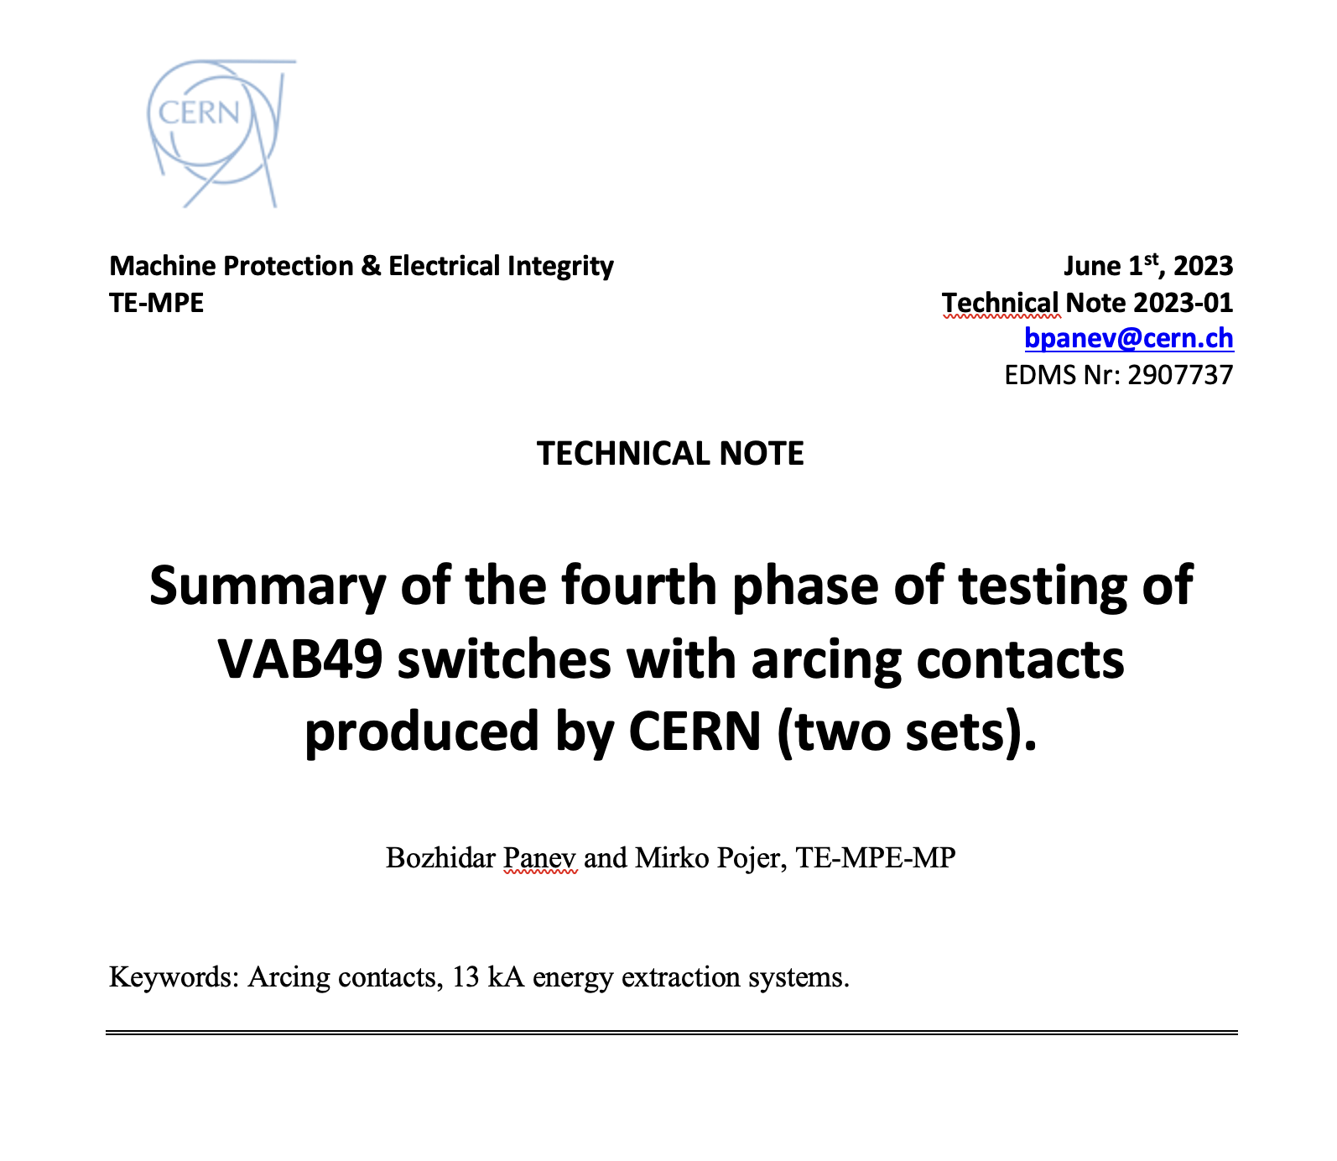
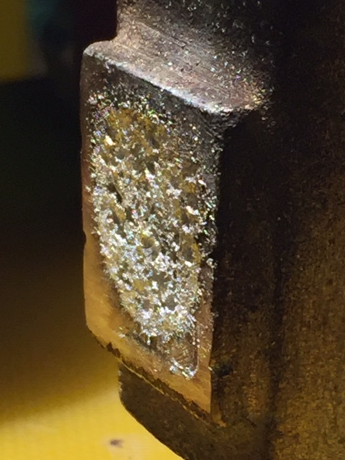
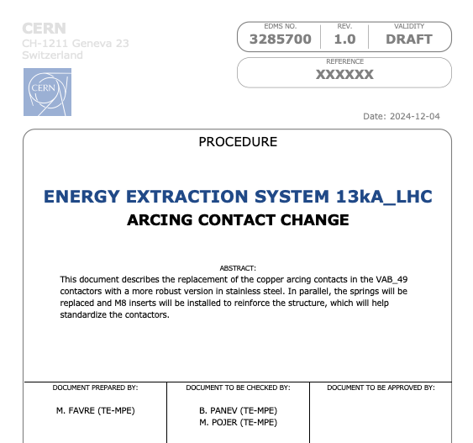
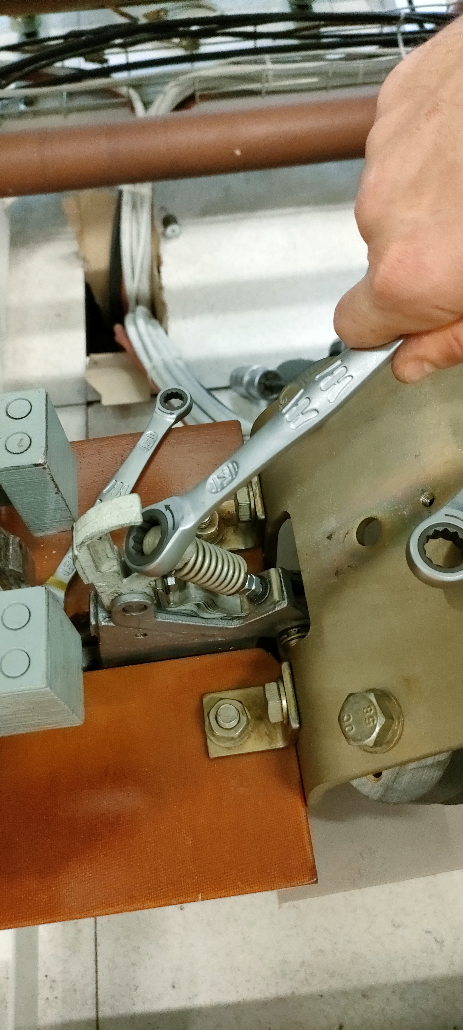
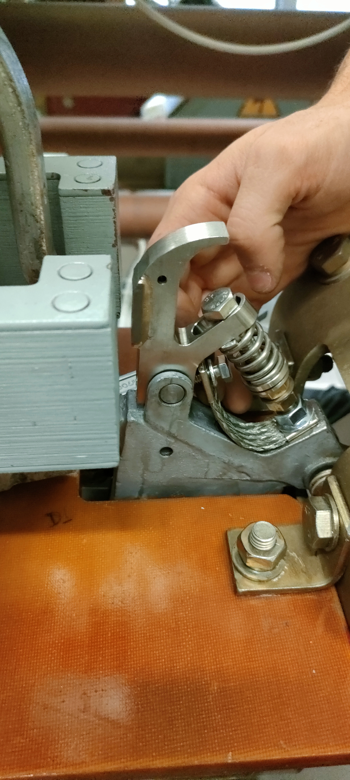
13 kA EES maintenance: arcing contacts replacement
In 2015, a non-conformity was detected on the secondary contact (a.k.a. arcing contact): fissures in few positions, provoked by the severe conditions during the operation of the breakers (high temperature gradient due to the arc created during the current commutation and high mechanical stress when moving). Several new series of A.C. were produced and the last one by EN/MME validated for operation.
The replacement of all arcing contacts was foreseen for LS3.
To gain some resources in the LS, all A.C. were replaced during YETS 24/25.
The length of YETS 25/26 does not allow for the typical maintenance of the breakers. A “light” maintenance is already planned, which include the inspection of random samples of arcing contacts.

Slide 8
Improved radiation tolerance of Quench Detection Systems
R. Denz
The R2E upgrades focus on equipment installed in the radiation exposed areas (i.e. half cells 8 through 12) around IP1, 2 (for ion operation), 5 and 8.
Deployment of refurbished radiation tolerant bus-bar splice protection systems type DQQBSv2. The functionality of the refurbished circuit boards has been fully validated during the 2025 LHC hardware commissioning.
Deployment of radiation tolerant communication board types DQAMG_ENH and DQAMC_ENH.
  These two communication board types are protected against single event latch-ups (SEL) and equipped with an additional supervisory FPGA ("babysitter") allowing automatic recovery in case the field-bus communication with the board is stalled (thus avoiding an access to the LHC).
Installation of R2E reinforced quench detection boards for MQ magnets.
  Hot spots around IP2 only (half cells 11 and 12) – especially for the LHC ion run.

Slide 9
Other activities around QDS
R. Denz
Firmware upgrade for inner triplet quench detection and DAQ systems.
  Additional latch functionality for current lead quench detection systems, which will prevent repeated quench heater firing in case of a persistent trigger condition, e.g. in case of a lost instrumentation voltage tap.
  Some minor changes in the DAQ systems to improve system operation and testing.
Consolidation of nQPS field-bus connectors in sector 3-4.
  Replacement of the existing connector with a new, much more robust type that is better suited to the LHC tunnel environment, e.g. with respect to mechanical impacts. First sector (S34) successfully upgraded; installation in the remaining sectors will be completed during LS3.
QDS individual system test & support to LHC hardware commissioning.
  In close collaboration with LHC-OP; automation level further increased.

Slide 10
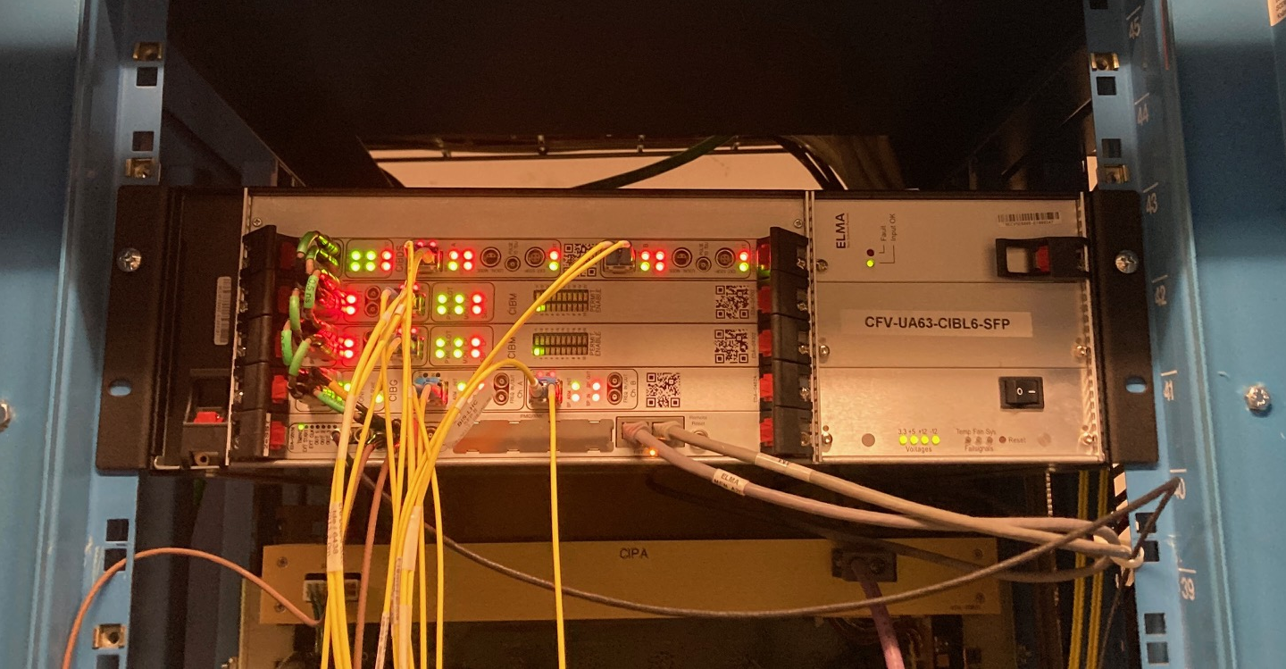
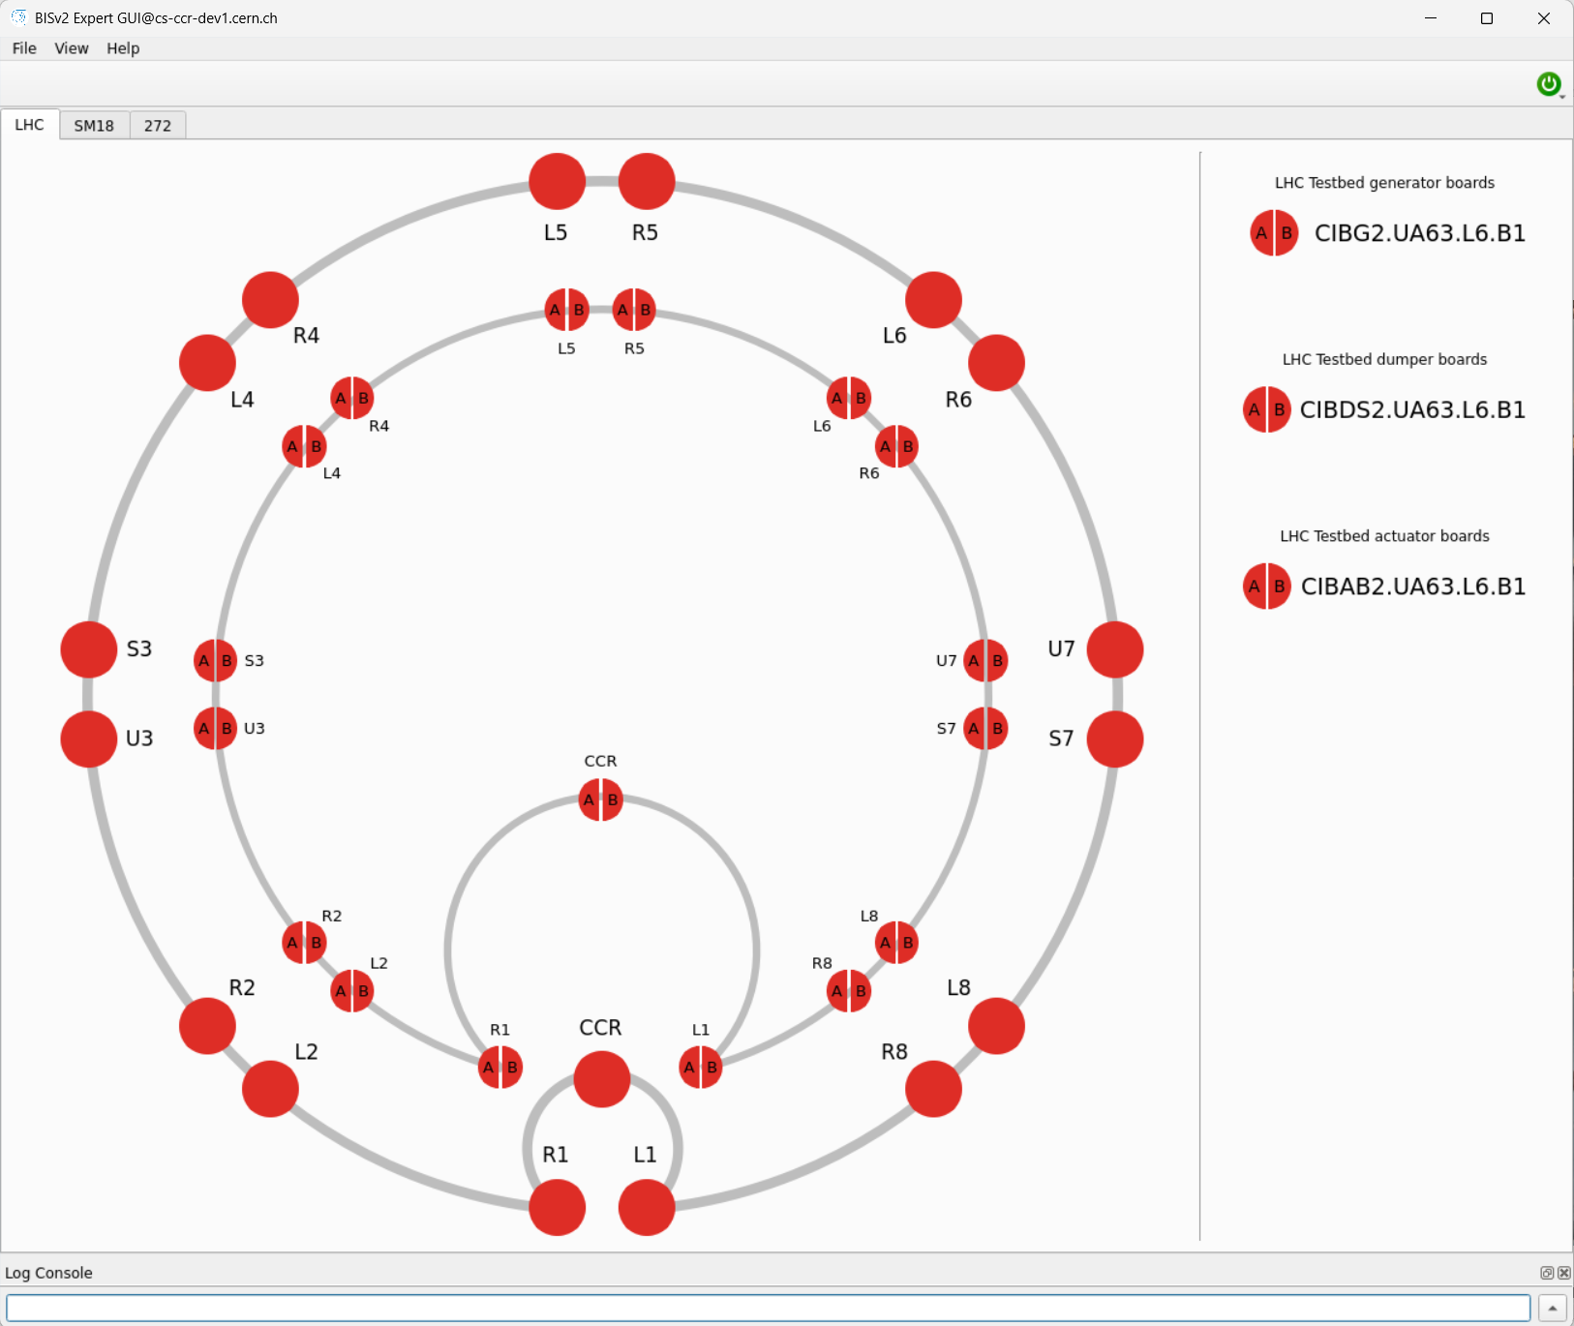
Deployment of BISv2 test crates
I. Romera
Deployment of 17 Beam Interlock Controllers (BIS v2) in the LHC.
The new BIS v2 test crates will operate in parallel to the existing LHC Beam Interlock System (BIS) until the end of Run 3.
The primary objective is to validate the performance of the BIS v2 under operational conditions before its final deployment in the SPS, SPS North Area and LHC during LS3.
Automated software will be used to ensure the proper functioning of the BIS v2 system, covering key aspects such as hardware triggers, optical communications, latency and more.
BISv2 test crate in UA63
BIS GUI displaying both v1 and v2 test crates

Slide 11
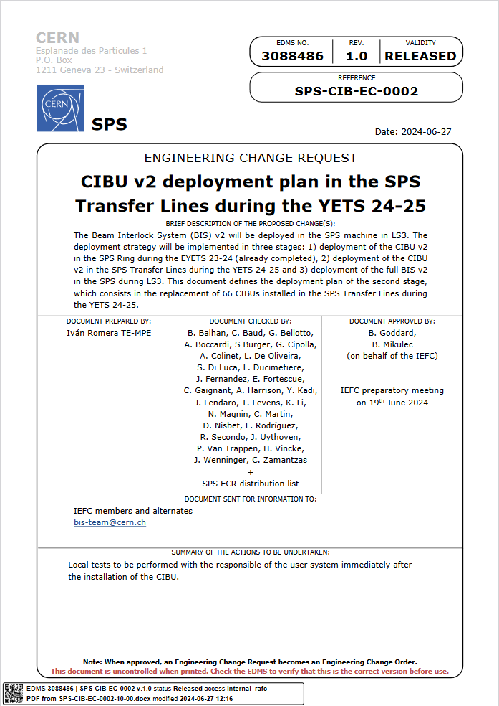
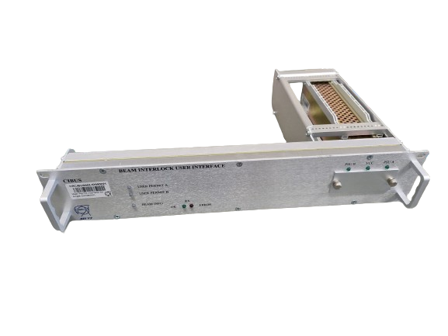
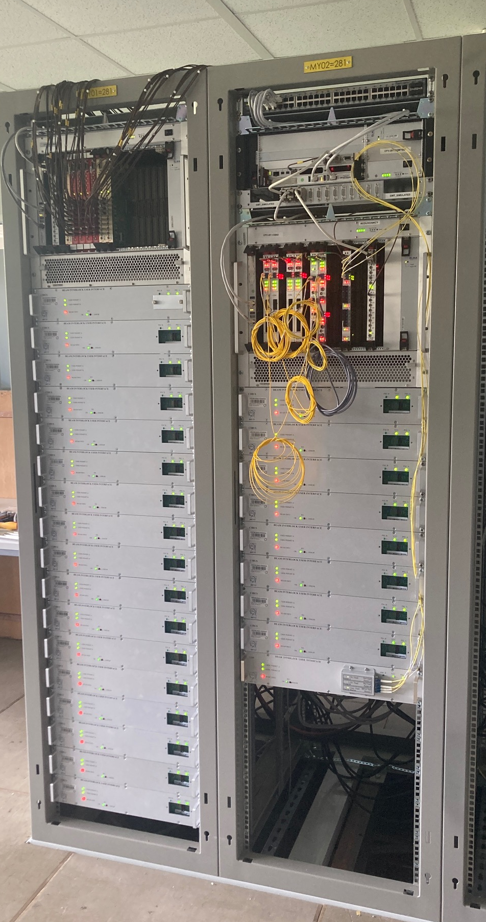
Deployment of CIBU v2 in the SPS to LHC Transfer Lines
I. Romera
Replacement of 60 CIBUs in the SPS to LHC Transfer Lines with CIBUs v2 to reduce workload during LS3.
Large collaboration effort across several groups (BE-CEM, EP, HSE-RP, SY-ABT, SY-BI, SY-EPC, SY-RF and TE-VSC).
All CIBU v2 interfaces were successfully tested during the HWC phase.
BIS v2 User Interface – CIBU v2
BIS v2 Functional Testbed
EDMS 3088486

Slide 12
Software updates and new deployments
D. Wollman
Third party library update and redeployment of all MPE controls and software systems.
AccTesting:
  Switch of database from DevDBU to ACCON.
  Removal of eDSL → superseded by SIGMON analysis.
  Update of internal registers for the sending of analysis requests to SIGMON.
  Signature merges as requested by MP3.
  Test of power converter implementation for East Area and PS complex (Efficient Particle Accelerator project WP7).
Post Mortem:
  Full re-deployment: bugfixes and updates of analysis tools.
  Deployment of improved beam loss analysis tool.
  Deployment of Beam Current Change Monitor module.
WIC automatic commissioning:
  Deployment for PSB injection line and injection.

Slide 13
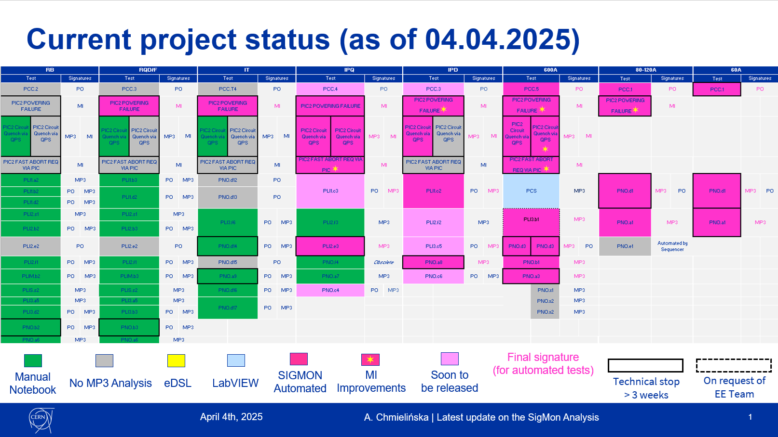
Analysis automation for the HWC
A. Chmielińska
Continuous effort of the group towards the automation of test execution, but also automation of test result analysis.

Slide 14
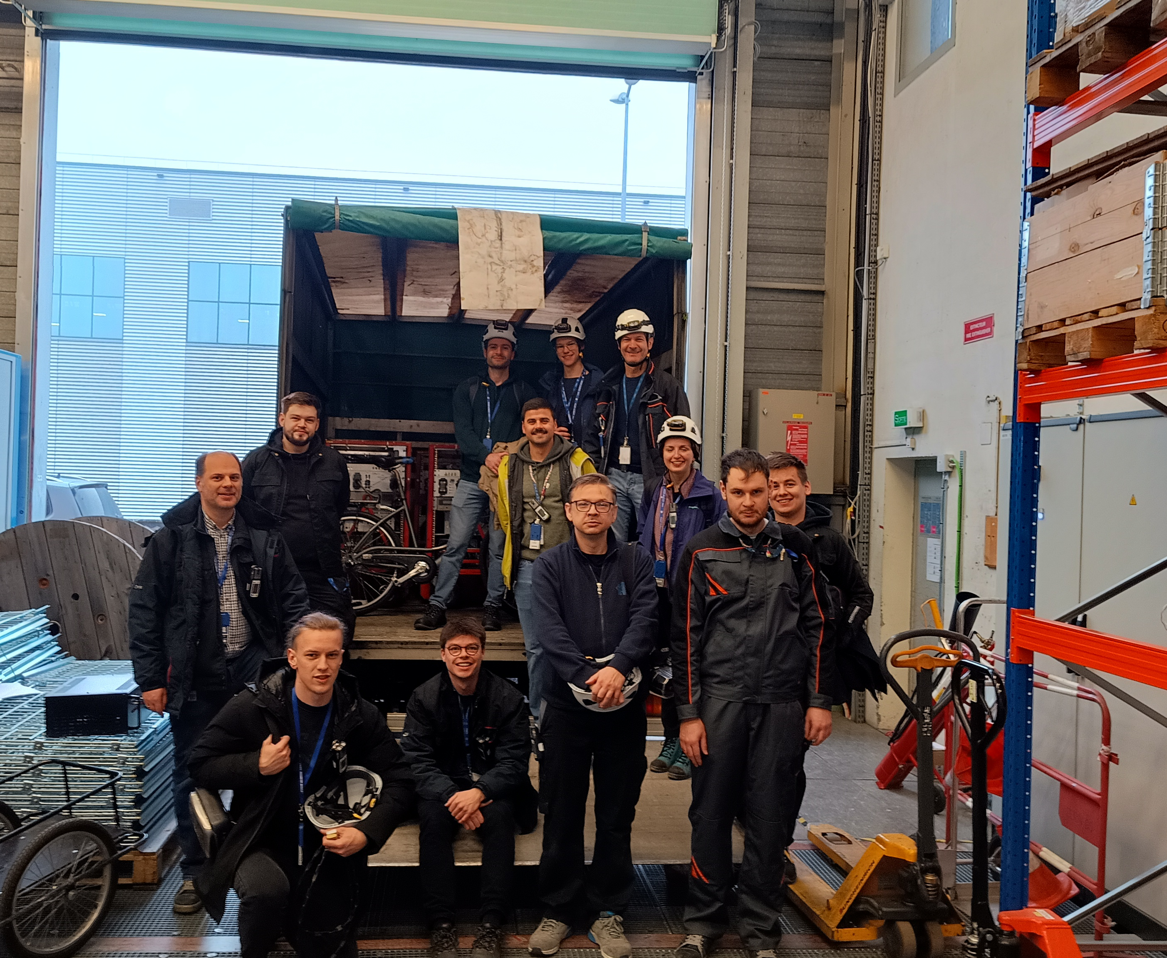
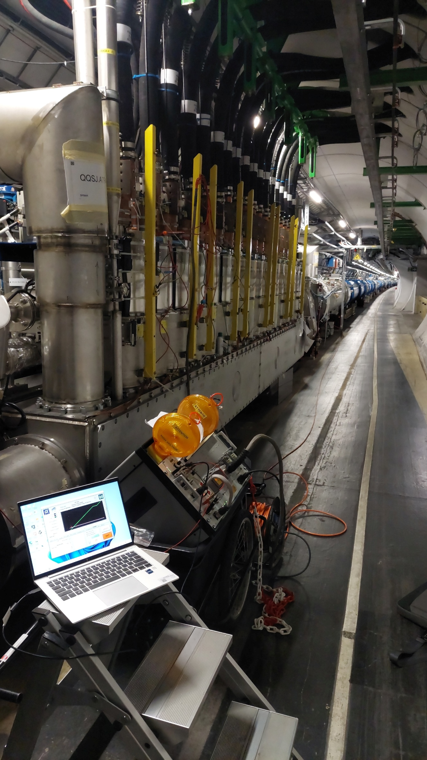
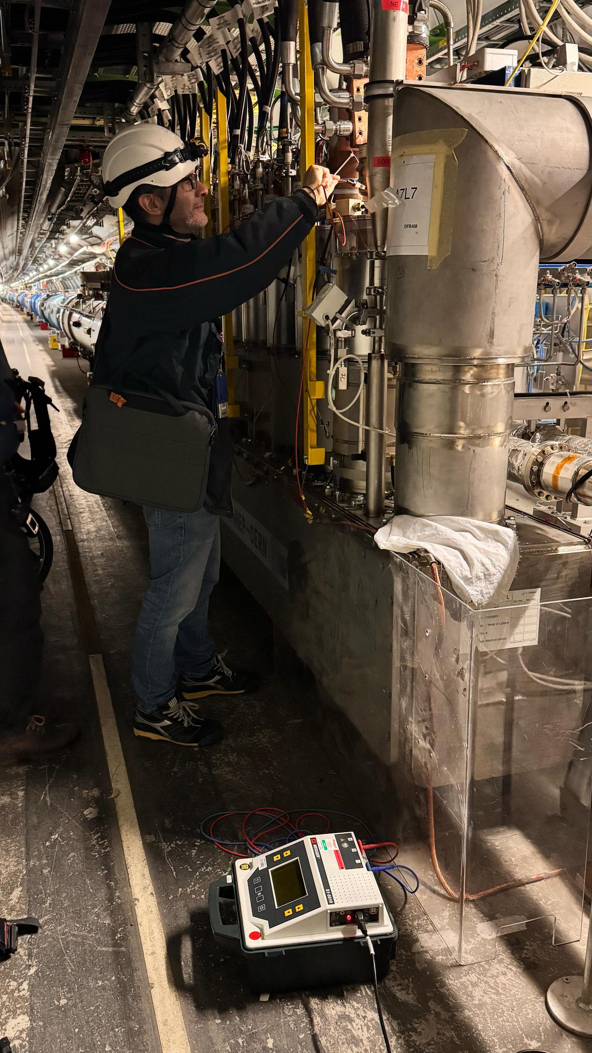
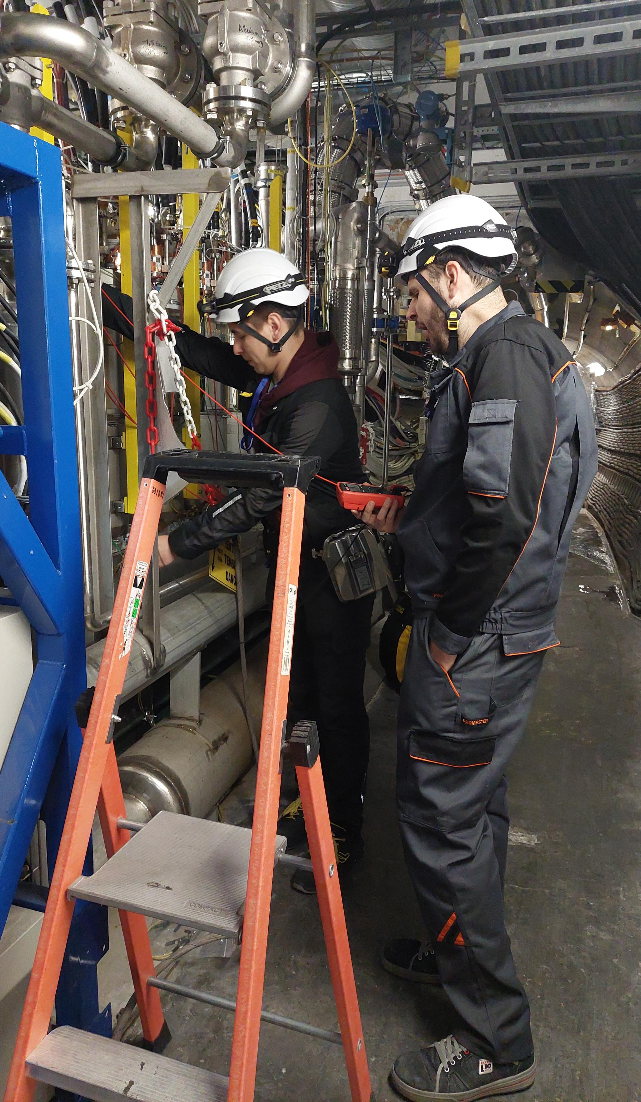
ElQA during YETS 24/25
G. D’Angelo
Consolidated collaboration CERN-HNINP
Local Transfer Function measurements on all MB magnets.
High Voltage tests of 13 kA circuits (RQDs, RQFs and RBs) + 600 A circuits powered from DFBLC in IP3.
DC cables reconnection to the current leads.
Mirko Pojer 217th TE-TM meeting
April 7, 2025

Slide 15
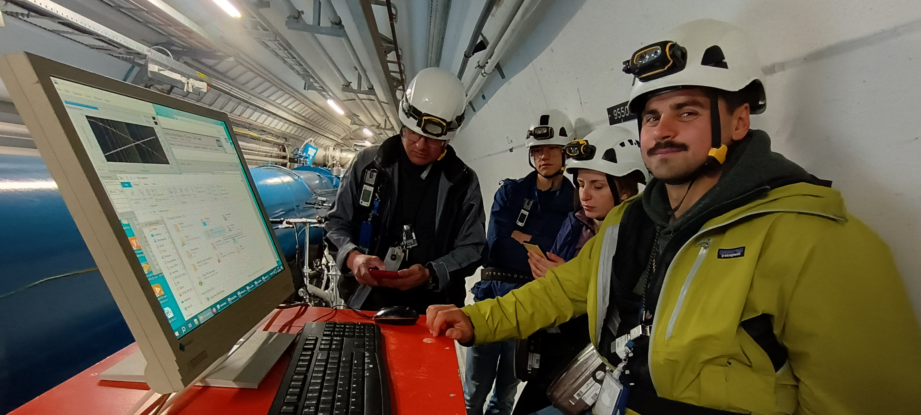
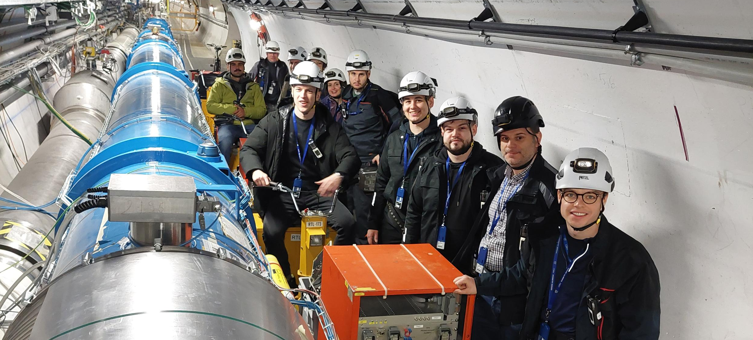
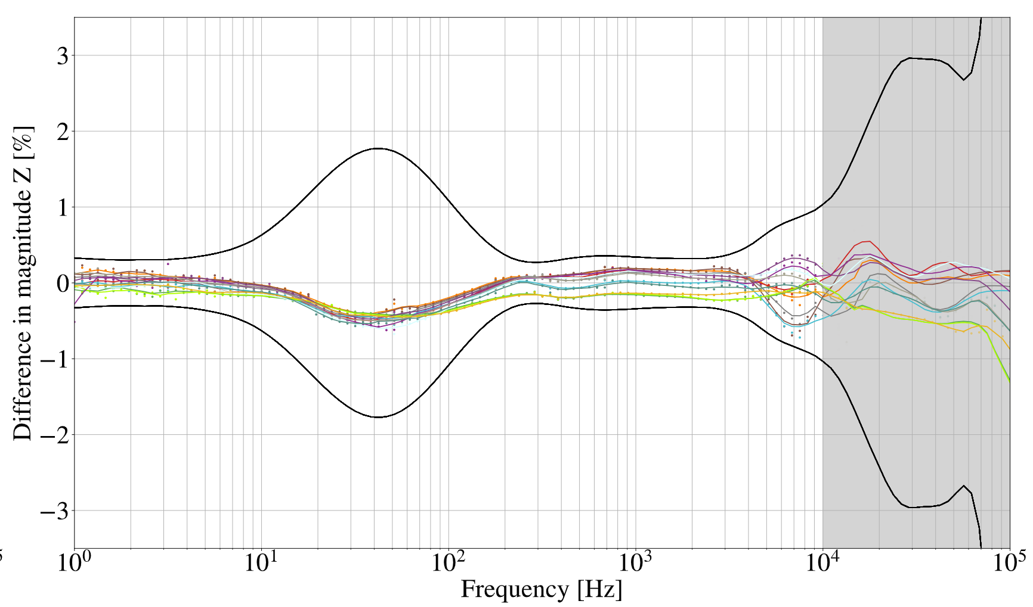
ElQA - Local Transfer Function measurements
All MB magnets (1232) + MQ magnets of sector 7-8
M. Janitschke
How it works:
A known input signal is sent into the circuit, and the response is recorded. Then, the spectrum of the response is divided by the spectrum of the input signal to determine the transfer function.
What it reveals:
The transfer function provides insights into the magnet's impedance and can help identify potential electrical non-conformities or problems with the circuits.
Mirko Pojer 217th TE-TM meeting
April 7, 2025

Slide 16
Hardware commissioning
QPS-IST (EE + QDS)
DQHDS power on
  Heaters firing at 300 V + analysis
  Heaters firing at 900 V + analysis
  (non-conformities fixing)
PIC tests
Support during powering tests: with ~11000 tests executed, even if mostly automatically analysed, there are the high current circuits to manually analyse, plus the failed tests on the small current circuits, the quenches, the FPAs and all offline analyses (some still ongoing, e.g. FTM data).
+ The validation of the systems during the Machine Check-out (BIS, FMCM)

Slide 17
Conclusions
A lot going on behind the scene, to allow the machine working smoothly for the coming 12-18 months.
The MPE team remains deeply committed at every stage of this process, actively engaging in a wide array of critical tasks.
Throughout YETS 24/25, numerous activities have been carried out, many of which are essential for maintaining optimal performance.
Additionally, some preparations originally scheduled for LS3 have been implemented ahead of time to streamline future operations and enhance long-term reliability.

Slide 18
Thanks for the attention!
Questions?

