Slide 1
Summary of TE-MSC Activities in Accelerators During YETS 24-25
J. Bauche, on behalf of TE-MSC

Slide 2
L4 – PSB – AD – ISOLDE
TE-MSC referent: A. Newborough

Slide 3
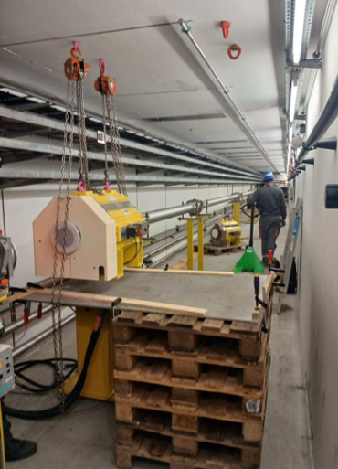
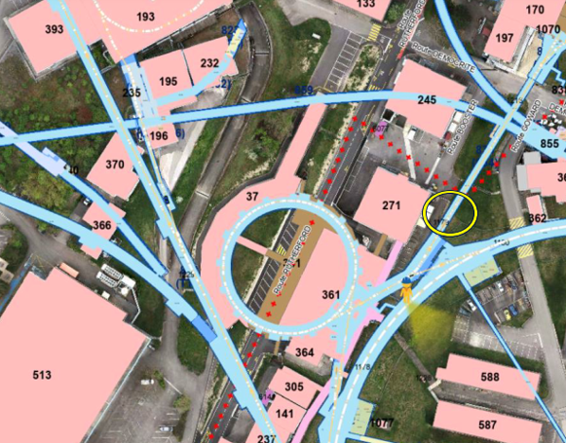
L4 – PSB – AD – ISOLDE
Magnet tests and inspections
  Audio-visual inspection
    → loose shim found on BR.BHZ122
    → water leak found in ISOLDE target area
  HV-test on PSB main magnets
  Polarity inspection of exchanged magnets
Preventive maintenance
  Planned exchange of BTY transfer line quadrupole (Q130) with spare unit and subsequent renovation and certification as spare
Exchange of the BTY.QFO148 quadrupole

Slide 4
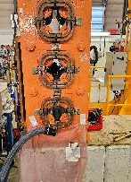
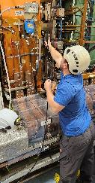
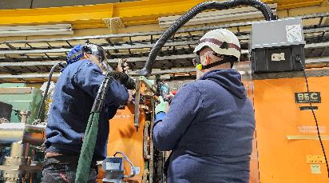
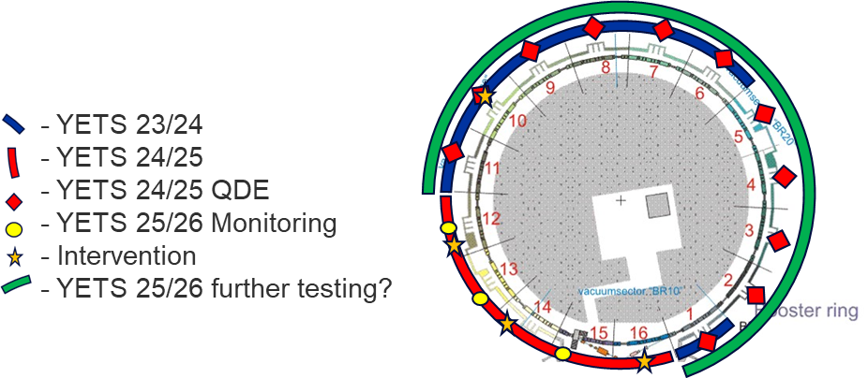
PSB Main Quadrupoles
Planned replacement of one main quadrupole with leaking brazed joint
  QDE11 water leak since June 24, EDMS 3120155
Planned in-situ repair of one main quadrupole with leaking brazed joint
  QFO72 water leak since Nov. 24, EDMS 3202130
Helium leak test (see report at 364th IEFC) on 26/48 main quadrupoles in the ring leading to identification of 7 leaks :
  Two magnets exchanged with spares
  One magnet repaired in workshop and reinstalled
  One magnet repaired in-situ
  Three magnets with minor leaks to be monitored
In-situ repair of main quadrupole BR.QFO72
PSB helium leak detection and workshop repair

Slide 5
List of NCRs on PSB quadrupoles
LEAK # | MAGNET | LOCATION | DATE | NC REPORT | DESCRIPTION | REPAIR | COMMENT
1 | PXMQNEC4WP-B2000030 *1 (QFO Left) | BR.QFO161 | Jun-21 | 2603476 | Water leak on upper brazed busbar | Brazed in workshop | Temporary patch with soft solder
2 | PXMQNEC4WP-B2000017 (QFO Left) | BR.QFO91 | Nov-21 | 2664838 | Water leak 'brazed end' Ring 2 | Brazed in workshop
3 | PXMQNFJ4WP-B2000005 (QDE Right) | BR.QDE5 | Sep-22 | 2779972 | Water leak 'brazed end' Ring 3 | Brazed in workshop | Water diverted to tunnel floor from Sept to YETS 22/23
4 | PXMQNED4WP-B2000027 (QFO Right) | BR.QFO142 | Dec-22 | 2812055 | Water leak 'brazed end' Ring 3 | Brazed in workshop
5 | PXMQNFA4WP-B2000011 *1 (QDE Left) | BR.QDE11 | Dec-22 | 2812056 | Water leak at aperture link R2 - R3 | Epoxy resin patch
6 | PXMQNEC4WP-B2000001 (QFO Left) | BR.QFO11 | Apr-23 | 2884501 | Water leak 'brazed end' Ring 2 | Brazed in workshop
7 | PXMQNFA4WP-B2000018 (QDE Left) | BR.QDE11 | Jun-24 | 3120155 | Water leak 'brazed end' Ring 4 | Brazed in workshop | Water diverted to tunnel floor from Sept to YETS 24/25
8 | PXMQNEC4WP-B2000030 *2 (QFO Left) | Workshop | Aug-24 | 3157397 | Helium leak (3E-4 mbar.l/s) 'brazed end' Ring 1 | Brazed in workshop | Helium leak after repairing initial water leak
9 | PXMQNFA4WP-B2000011 *2 (QDE Left) | Workshop | Jul-24 | 3139861 | Helium leak (3E-4 mbar.l/s) 'brazed end' Ring 3 | Brazed in workshop | Helium leak after repairing initial water leak
10 | PXMQNED4WP-B2000017 (QFO Right) | BR.QFO72 | Nov-24 | 3202130 | Water leak on upper brazed busbar | Brazed in-situ
11 | PXMQNFA4WP-B2000012 (QDE Left) | BR.QDE12 | Dec-24 | 3224923 | Helium leak (3E-5 mbar.l/s) 'brazed end' | Use as-is | To be monitored during YETS 25/26
12 | PXMQNFA4WP-B2000016 (QDE Left) | BR.QDE16 | Dec-24 | 3222461 | Helium leak (1E-4 mbar.l/s) 'brazed end' | Brazed in workshop
13 | PXMQNFJ4WP-B2000010 (QDE Right) | BR.QDE10 | Dec-24 | 3224953 | Helium leak (1E-4 mbar.l/s) 'water connection' | Brazed in-situ
14 | PXMQNED4WP-B2000026 (QFO Right) | BR.QFO132 | Dec-24 | 3224963 | Helium leak (5E-6 mbar.l/s) 'brazed end' | Use as-is | To be monitored during YETS 25/26
15 | PXMQNEC4WP-B2000028 (QFO Left) | BR.QFO151 | Jan-25 | 3224974 | Helium leak (5E-5 mbar.l/s) 'brazed end' | Use as-is | To be monitored during YETS 25/26
16 | PXMQNEC4WP-B2000034 *1 (QFO Left) | BR.QFO141 | Dec-24 | 3224839 | Helium leak (3E-2 mbar.l/s) 'brazed end' Ring 3 | Brazed in workshop | Helium leak devloped into water leak after removing insulation
17 | PXMQNEC4WP-B2000034 *2 (QFO Left) | Workshop | Jan-25 | “ " | Helium leak (5E-3 mbar.l/s) 'brazed end' Ring 2 | Brazed in workshop | Discovered after repair of initial leak
18 | PXMQNEC4WP-B2000034 *3 (QFO Left) | Workshop | Jan-25 | " " | Helium leak (5E-4 mbar.l/s) 'brazed end' Ring 1 | Brazed in workshop | Discovered after repair of initial leak
19 | PXMQNED4WP-B2000024 *1 (QFO Right) | BR.QFO122 | Dec-24 | 3224900 | Helium leak (3E-2 mbar.l/s) 'brazed end' Ring 3 | Brazed in workshop
20 | PXMQNED4WP-B2000024 *2 (QFO Right) | Workshop | Feb-25 | “ " | Helium leak (5E-5 mbar.l/s) 'brazed end' Ring 3 | Brazed in workshop | Discovered during certification, low insulation to ground water present (required vacuum drying),
21 | PXMQNFA4WP-B2000018 *2 (QDE Left) | Workshop | Mar-25 | 3284262 | Helium leak (5E-2 mbar.l/s) 'brazed end' Ring 3 | Ongoing | Discovered after certification (required vacuum drying), on-going
NC discovered during YETS24/25

Slide 6
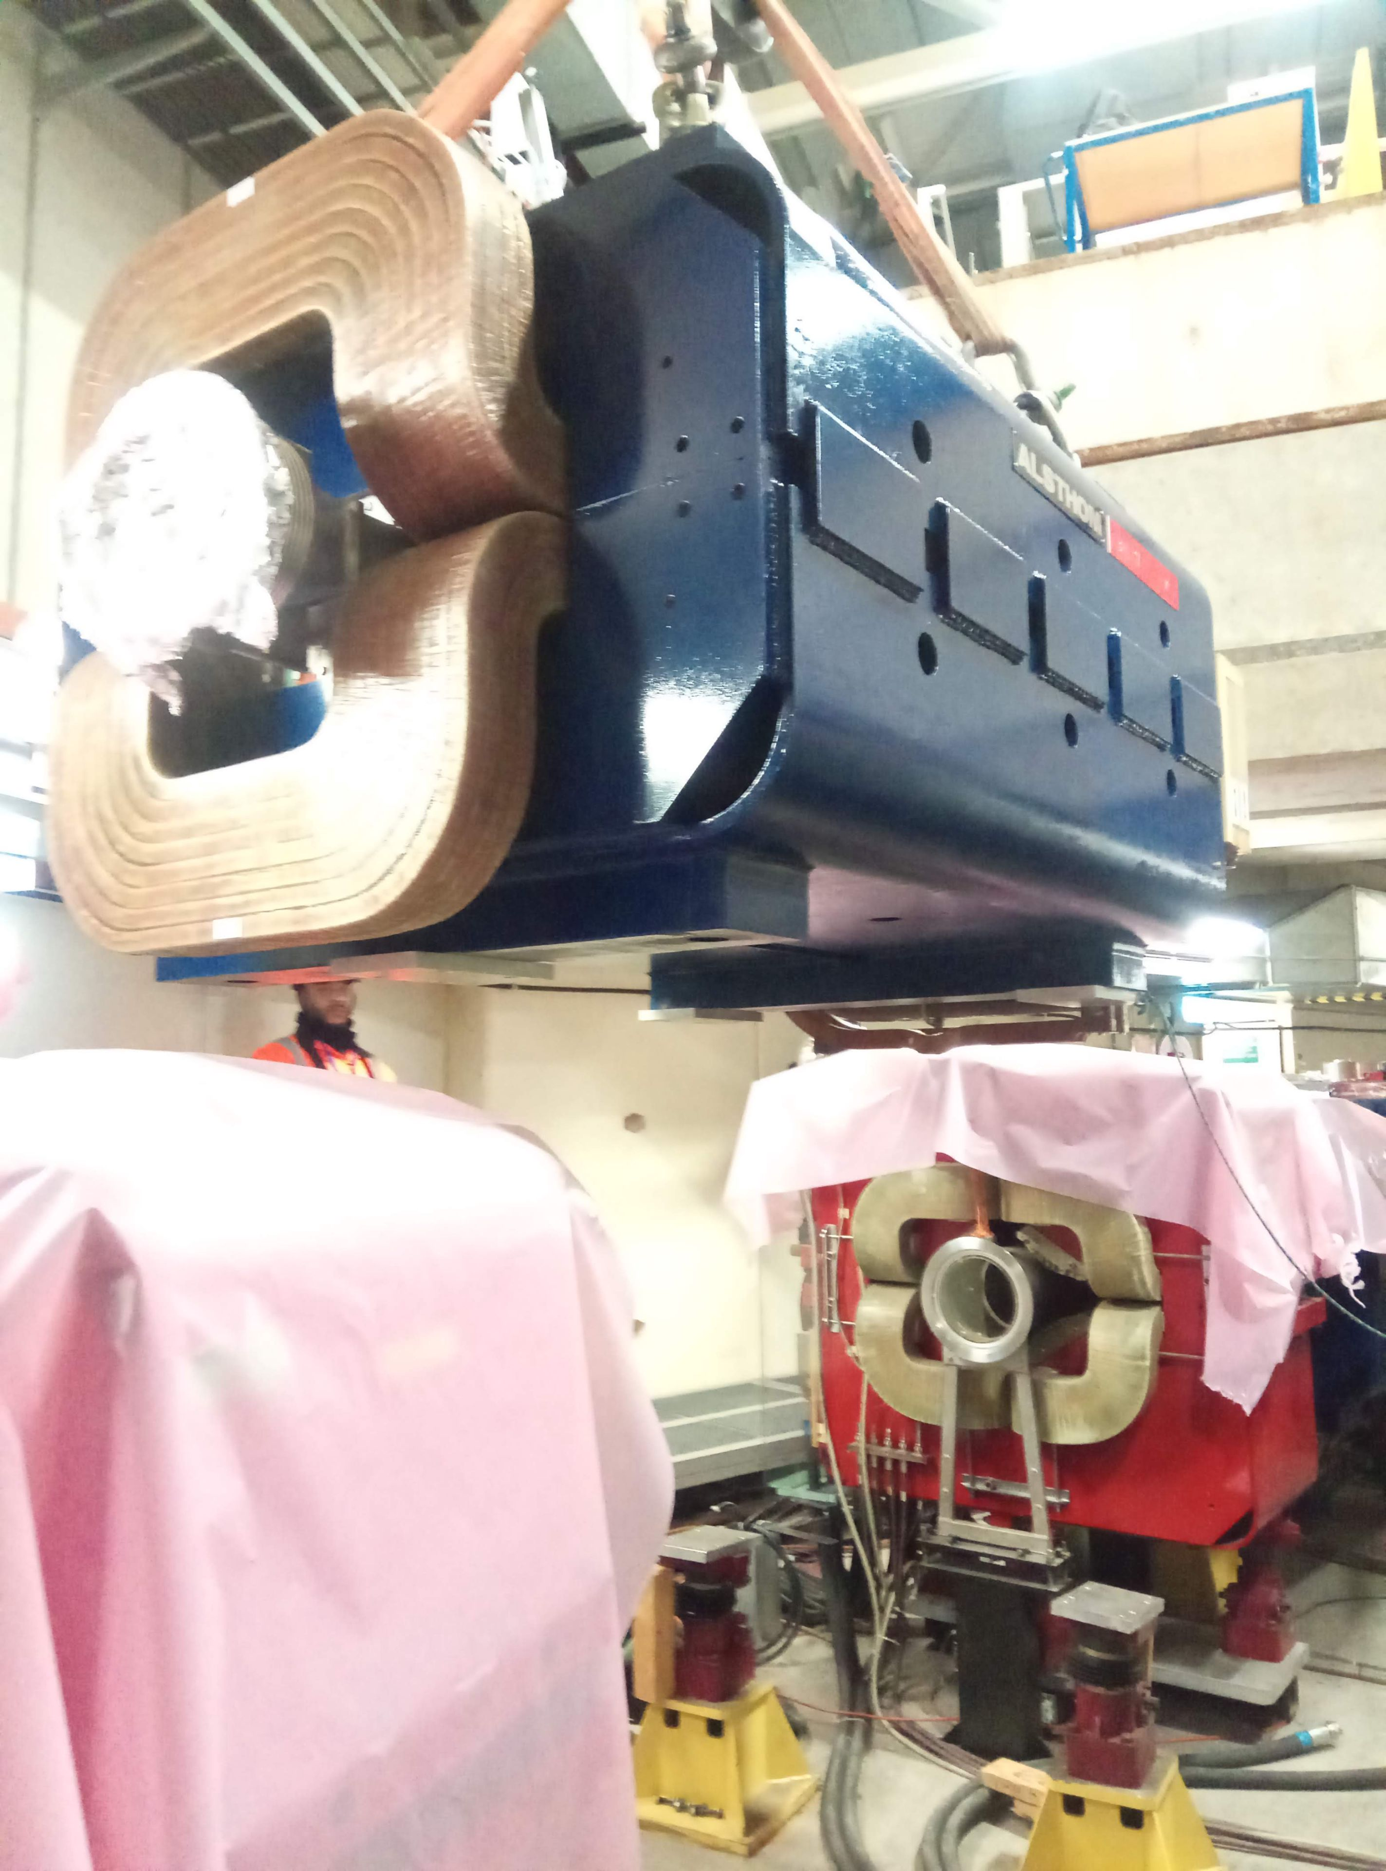
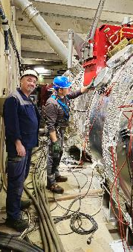
AD Ring and Target Area
Removal / renovation / certification of one main bending magnet (DR.BHN17)
Removal / renovation / certification of one main quadrupole magnet (DR.QFN26)
Installation of new flow switches in AD target area
Polarity measurement of exchanged magnets / new converters
Reinstallation of the renovated main quadrupole and bending magnet in the AD ring

Slide 7
PS – EA – LEIR – Ion Chain – CLEAR
TE-MSC referent: D. Bodart

Slide 8
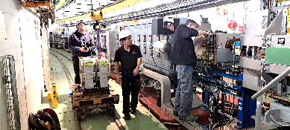
PS ring
Audio-visual inspection
  → Water leak detected and on octupole PR.ODN52.B, replaced by a spare
H/V test on the PS main magnets: main circuits, pole face windings, and figure-of-eight windings
Replacement of 3 bumper magnets type PXMCHBAWWP for preventive maintenance (upgrade of cooling connections)
Bumper magnet replacement in PS ring

Slide 9
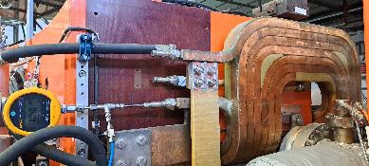
LEIR – Ion Chain – CLEAR – EA
Audio-visual inspection
Removal / installation of MDXL magnet in EA T10.MCXCF040 slot for new vacuum chamber installation
LEIR main bending magnets: coils leak testing with Helium (see report at 364th IEFC)
  → Results ≤ 2E-6 mbar.l/s within defined limits of 5E-5 mbar.l/s
Installation of 9 quadrupoles, 2 sextupoles and 2 dipoles on 2nd beam line of CLEAR
Upper coil testing setup of the LEIR main bending magnet (BHN20)

Slide 10
SPS – NA – HiRadMat – AWAKE
TE-MSC referent: P. Schwarz

Slide 11
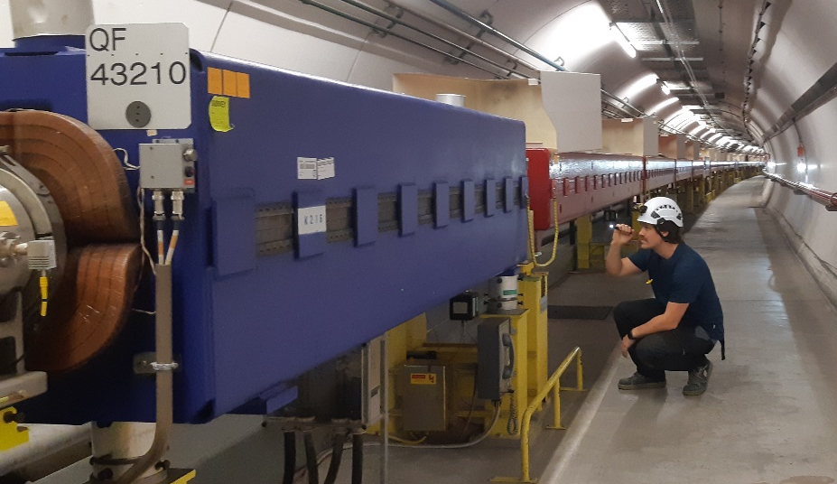
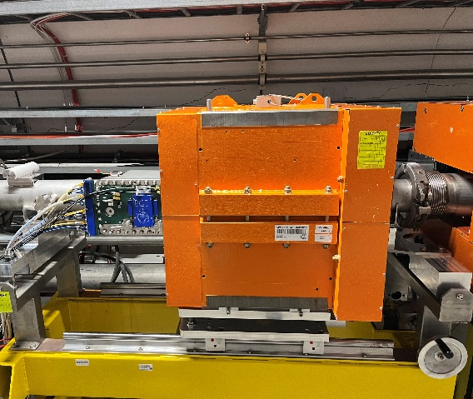
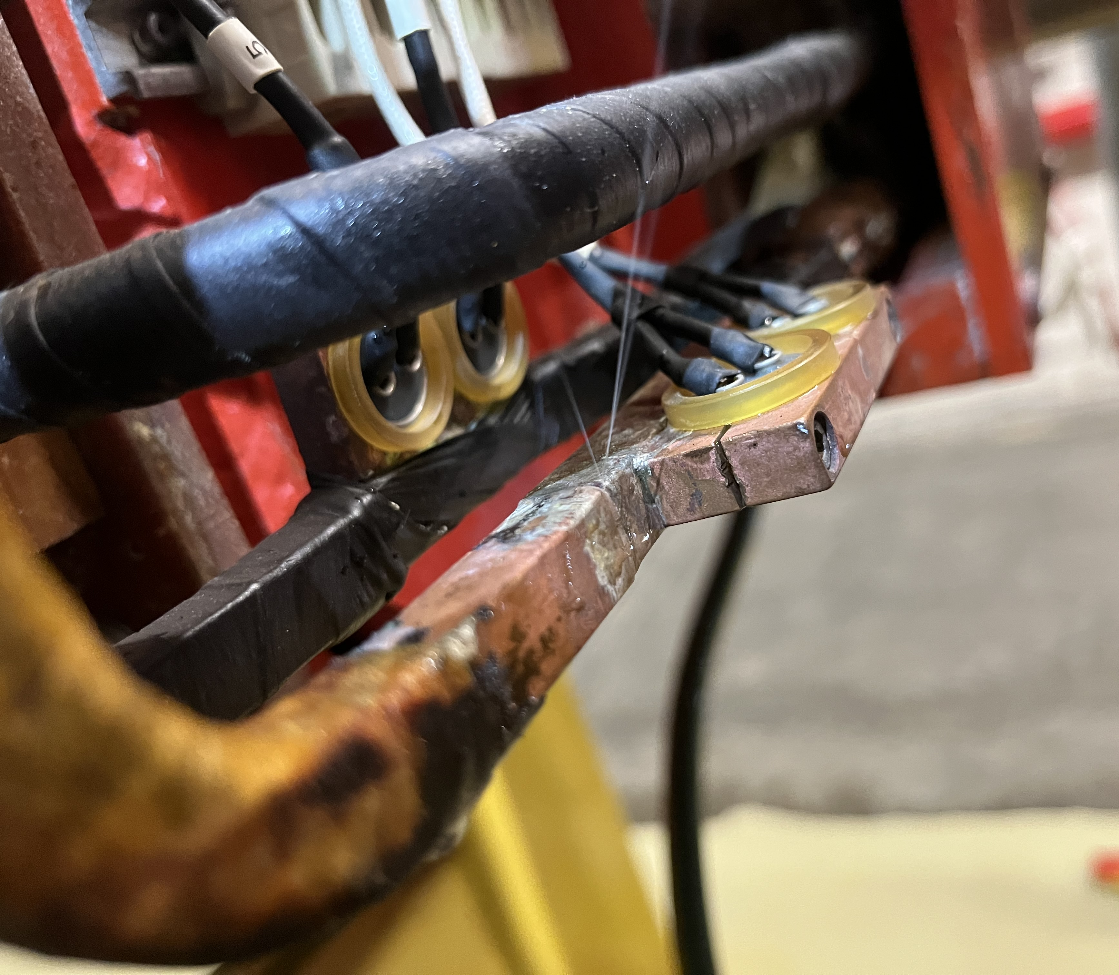
SPS and Transfer Lines
Magnet tests and inspections
  Audio-visual patrol
  HV-test
Corrective maintenance
  9 main magnets exchanged (4 MBB, 2 MBA, 3 quadrupoles
  In-situ repair of 6 leaks
Consolidation / upgrades
  Installation of additional BGI compensator magnet
  PU-support replacement test for TI2/TI8 and TT41 performed (preparation for LS3 campaign)
Magnet audio-visual patrol
BGI magnet
Leak on MSI.11855

Slide 12
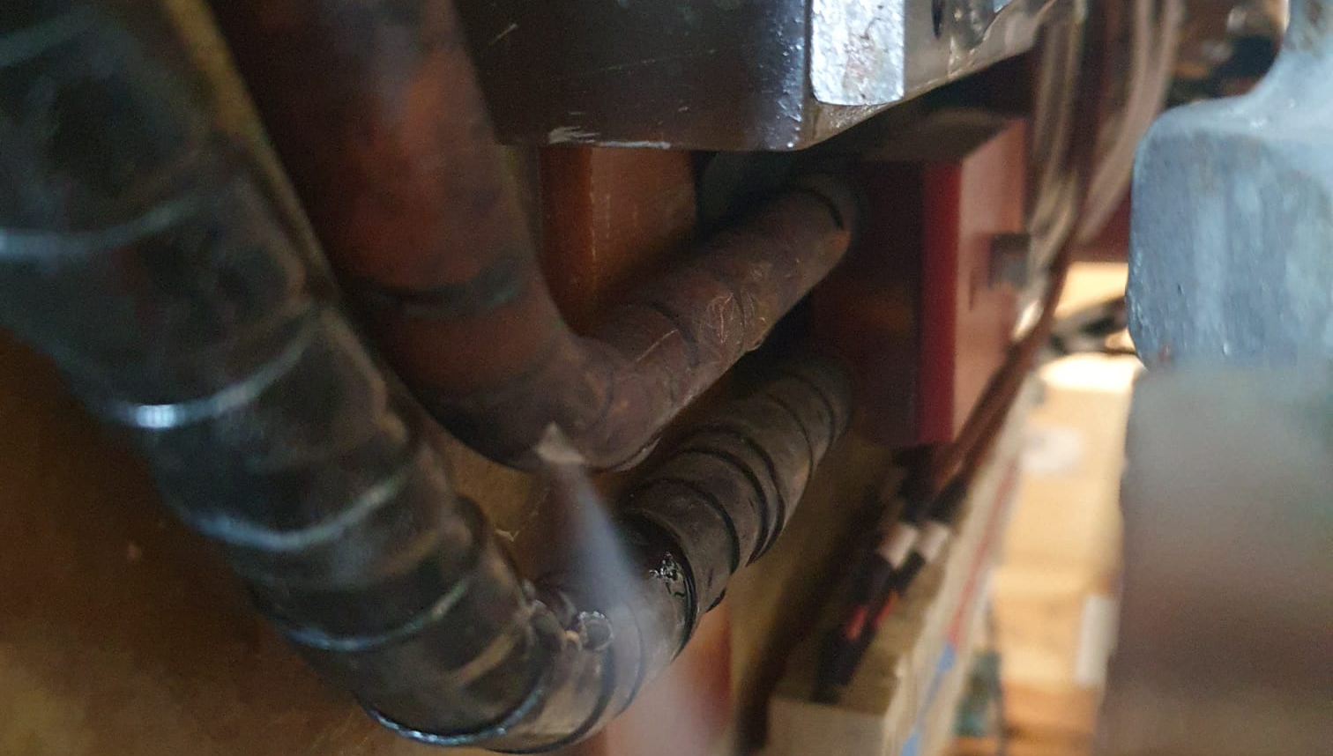
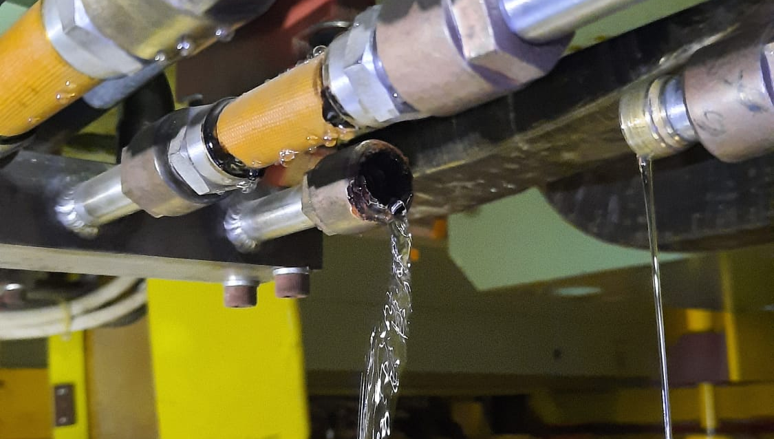
North Area
Magnet tests and inspections
  Audio-visual patrol
  HV-test
  Polarity inspection
Corrective maintenance
  15 moving coils shimmed on-site
  14 leaks repaired on-site (incl. MTN magnet in TCC2)
  2 magnets exchanged
Consolidation / upgrades
  Replacement of all manifolds in TT85
Consignation activities
  ~130 circuits consigned (!) + MALT-CC for various activities
QTS.X0410397 leak
MTN.241128 leak (TCC2)

Slide 13
LHC – TI2 – TI8
TE-MSC-NCM referent: P. A. Thonet
TE-MSC-HSD referent: A. Ballarino

Slide 14
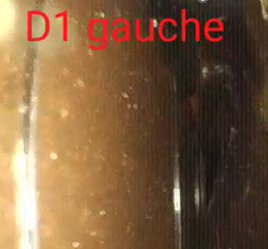
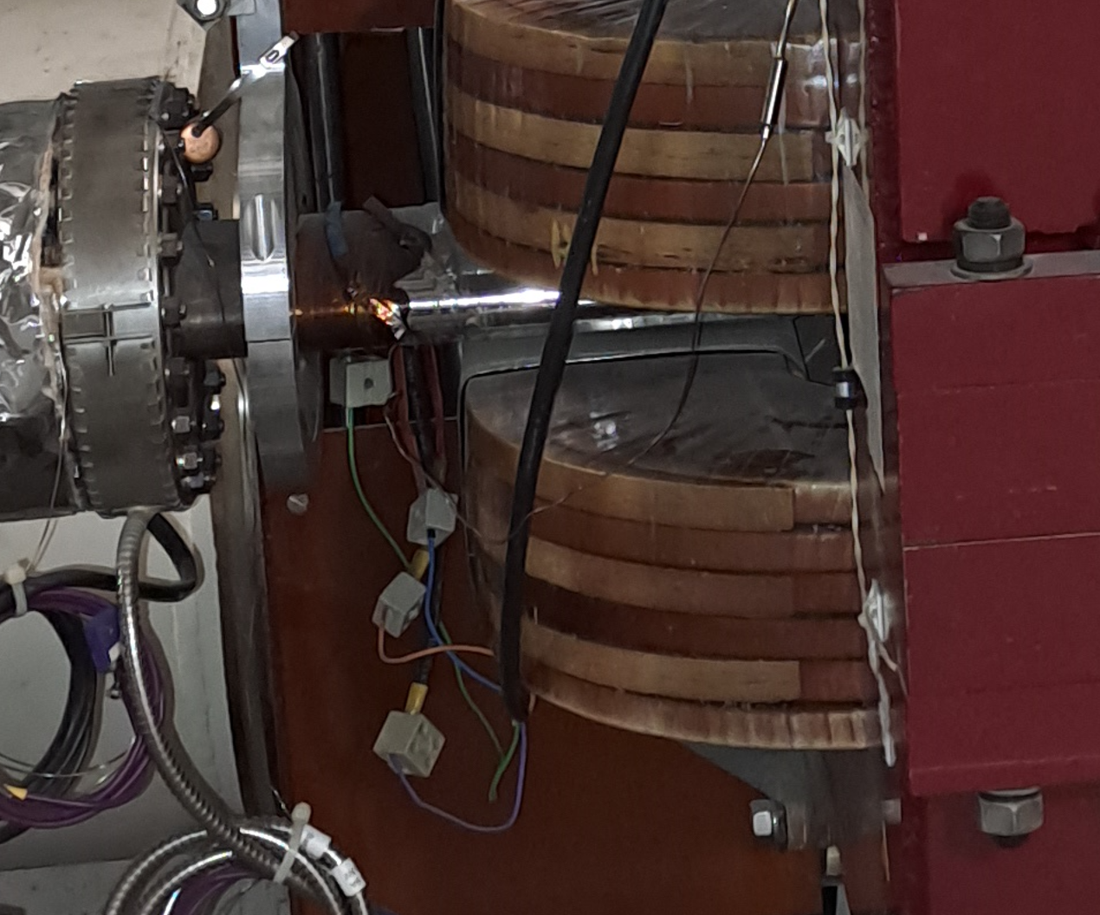
LHC – Normal Conducting Magnets
Audio-visual inspections
Specific inspection: D1 resin degradation from radiation dose in MBXW point 1 (see report at LBOC)
→ no further action until dismantling in LS3
Water leaks repairs in TI2
Annual exchange of dosimeters (dose monitoring on most critical magnets in points 1, 3, 5 and 7) and update of FLUKA models
Re-commissioning of 4 circuits in TI2 after cable extensions
Heat runs and cycling tests of all warm magnets in LHC and TI2/TI8
Electrical consignations for other teams
MBXW insulation endoscopic inspection

Slide 15
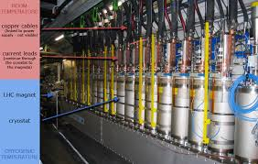
LHC – Current Leads
Maintenance interventions
High Temperature Superconducting leads
  Inside DFBs, > 1000 units
Resistive current leads
  Gas cooled inside DFBs / Conduction-cooled in SSSs, > 3000 units
Inspection checks of all leads and identification of non-conformities
Re-pumping vacuum insulation of few HTS current leads
Replacement of some ventilators of the conduction-cooled current leads
About 3 weeks of activity, which included the training of a technical staff
LHC current leads

Slide 16
Conclusions

Slide 17
Summary
The regular maintenance has been performed in the whole accelerator complex
  Standard inspections and corresponding corrective and preventive maintenance (NCM maintenance program reported at 360th IEFC)
  No significant issues (not more than usual), though some magnets with critical spare situation (report at RAWG) stay a concern (e.g. MTN in TCC2)
More specific inspections have been carried out
  Inspections and corresponding corrective actions on LHC current leads
  He leak tests on cooling circuits’ brazed joints
    LEIR main dipole coils: no leaks > 5E-5 mbar.l/s have been detected
    PSB main quadrupoles: 6 leaks > 1E-5 mbar.l/s were found in the inspected section and corrective actions performed where possible
    → More PSB quadrupole leaks get detected as we progress with inspections (improved sensitivity in workshops with purging). Inspections should continue during YETS 25-26
Electrical lock-out
  We receive more and more demands to perform 2 step lock-outs (“consignation”) for other teams, which involves a non-negligible amount of resources
Inspections at YETS 25-26 start are highly recommended

