Slide 1


The WarTPC: Hydrogen-rich gas mixture and hybrid optical/charge readout
Matthew Snape, Xianguo Lu,
Gary Barker, Alan Burton
University of Warwick
Matt.snape@warwick.ac.uk

Slide 2
Introduction
Motivation/Aims
Detector setup:
  Vessel, drift components, readout
Argon pressure & methane fraction measurements
Methane fraction results
Argon pressure Results
Conclusion
Outlook
  Charge readout, CF4

Slide 3
WarTPC Motivations
Optical Readout
  Provides scalable and cost-effective readout
  Highly granular data for analysis.
Hydrogen rich gas
  Enables Transverse Kinematic Imbalance analysis.
  Allows nuclear-effect-free neutrino flux detection.

Slide 4
WarTPC Aims
Develop optical/charge readout TPC
  Aim for high-pressure operating conditions.
Gas Studies
  Investigate hydrogen-rich gas mixtures.
  Achieve high scintillation yield for detection.

Slide 5
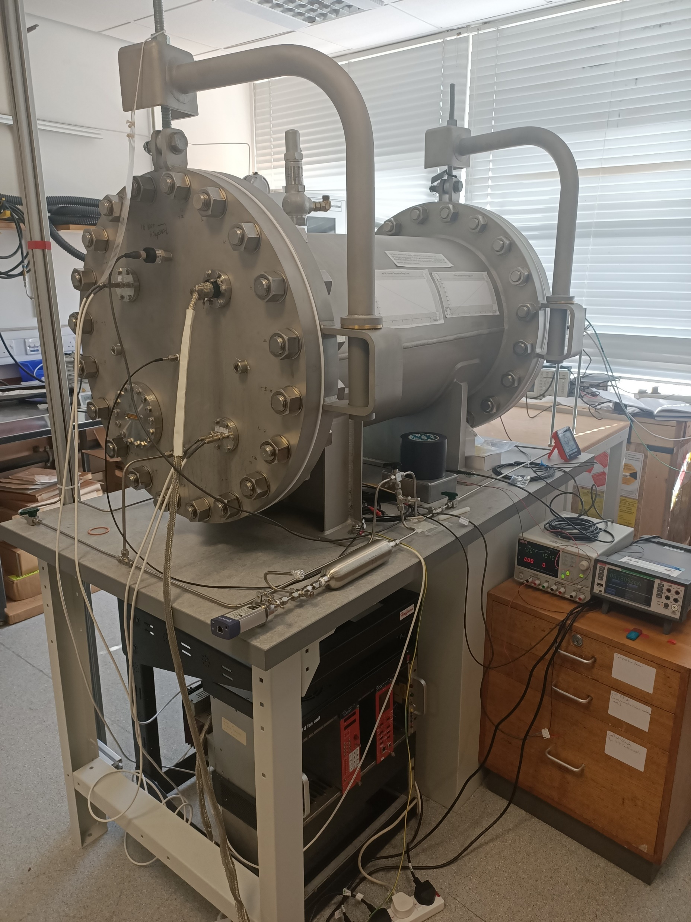
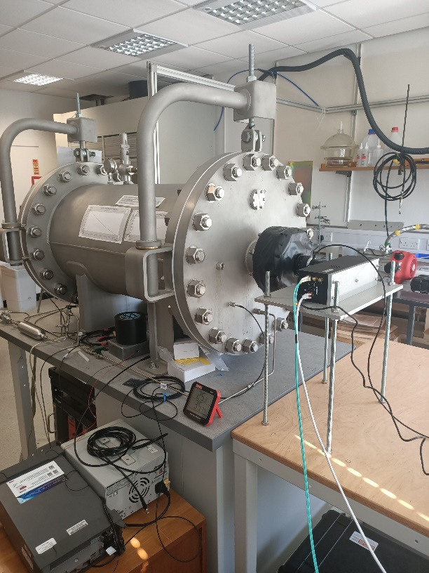
WarTPC Introduction
Hybrid optical/charge readout TPC
195L 10bar maximum pressure vessel
Gas purity monitored by RGA
Am-241 for ionisation source
Fig. 1. The closed pressure vessel seen from the cathode side (left) and the camera side (right).

Slide 6
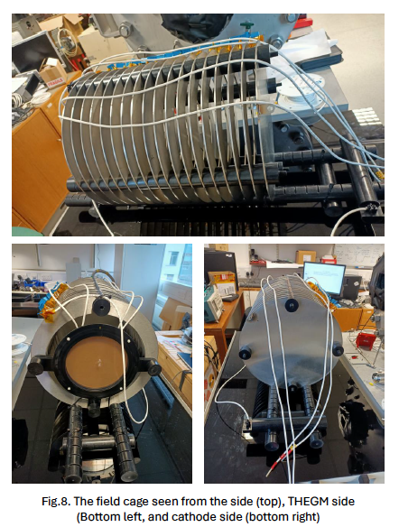
Drift components
~42cm drift length
Double THGEM configuration for amplification
PEN foil wavelength shifter:
  Shift scintillation light to visible
Further amplification by Photonis Cricket intensifier
Fig.2. The field cage seen from the side (top), from the THGEM side (bottom left), and from the cathode side (bottom right).

Slide 7
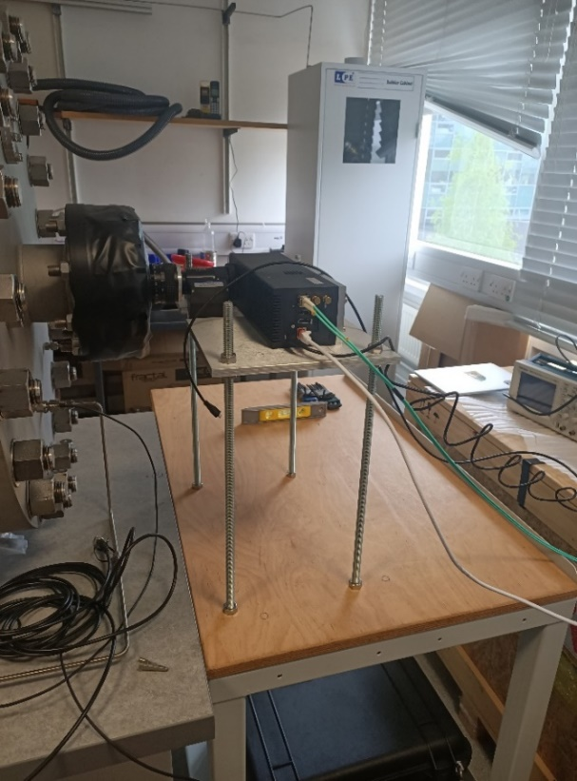
Optical Readout
TimePIX3 camera readout:
  Measures ToT, ToA, pixel coordinates
  ToA resolution of ~1.6ns
  Natively 3D data
  Zero-supressed readout
Fig. 3. TPX3 in mounted onto the camera mount.

Slide 8
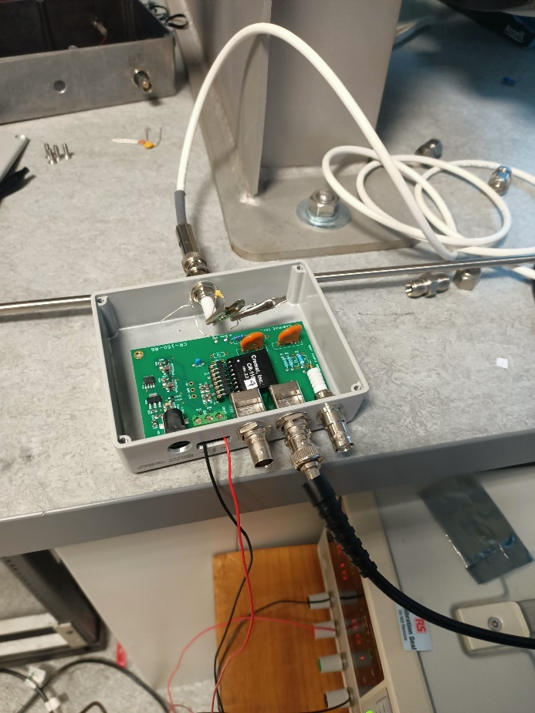
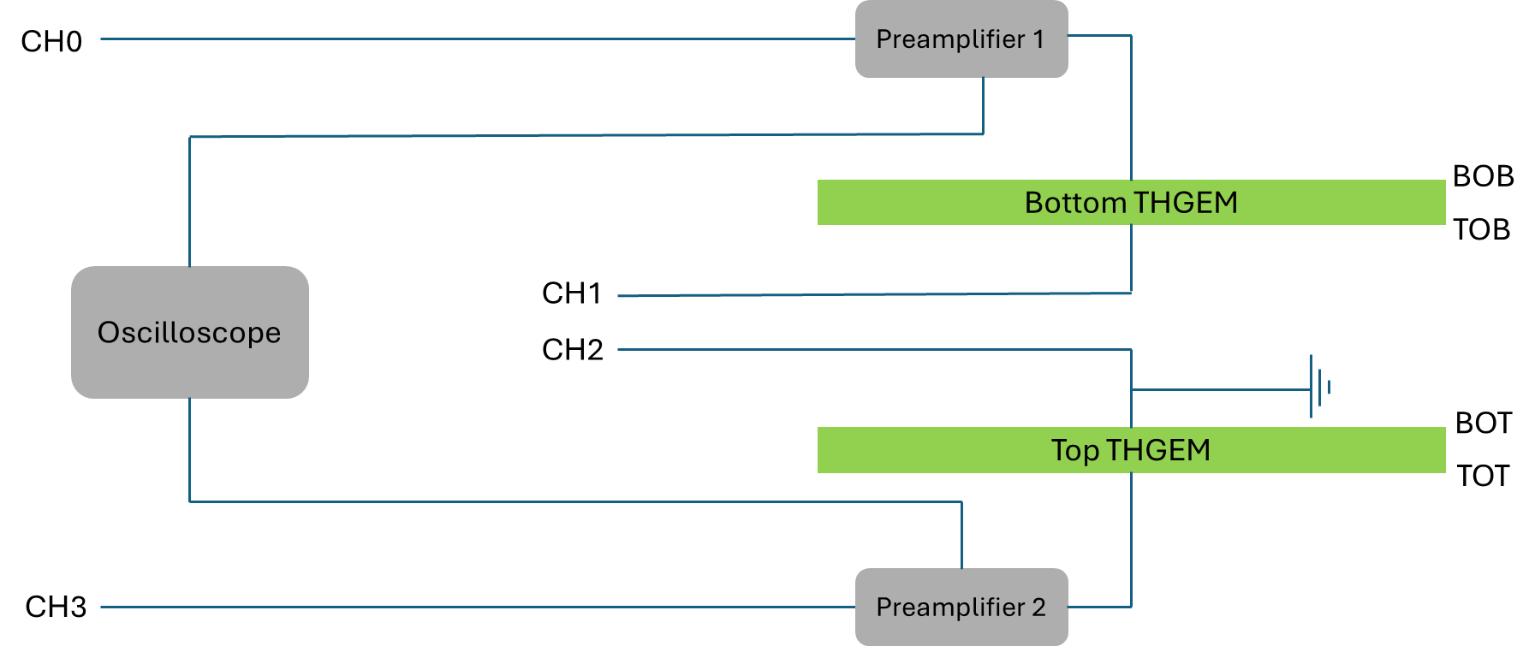
Charge Readout
Two channel readout:
  Preamps connected to electrodes
  Convert charge into measurable voltage
Connected to oscilloscope for readout
Can measure output pulse height
Fig. 5. The two high voltage power supplies (left), and the preamplifier and evaluation board (right).
Fig. 4. Circuit diagram for the THGEMs and charge readout.

Slide 9
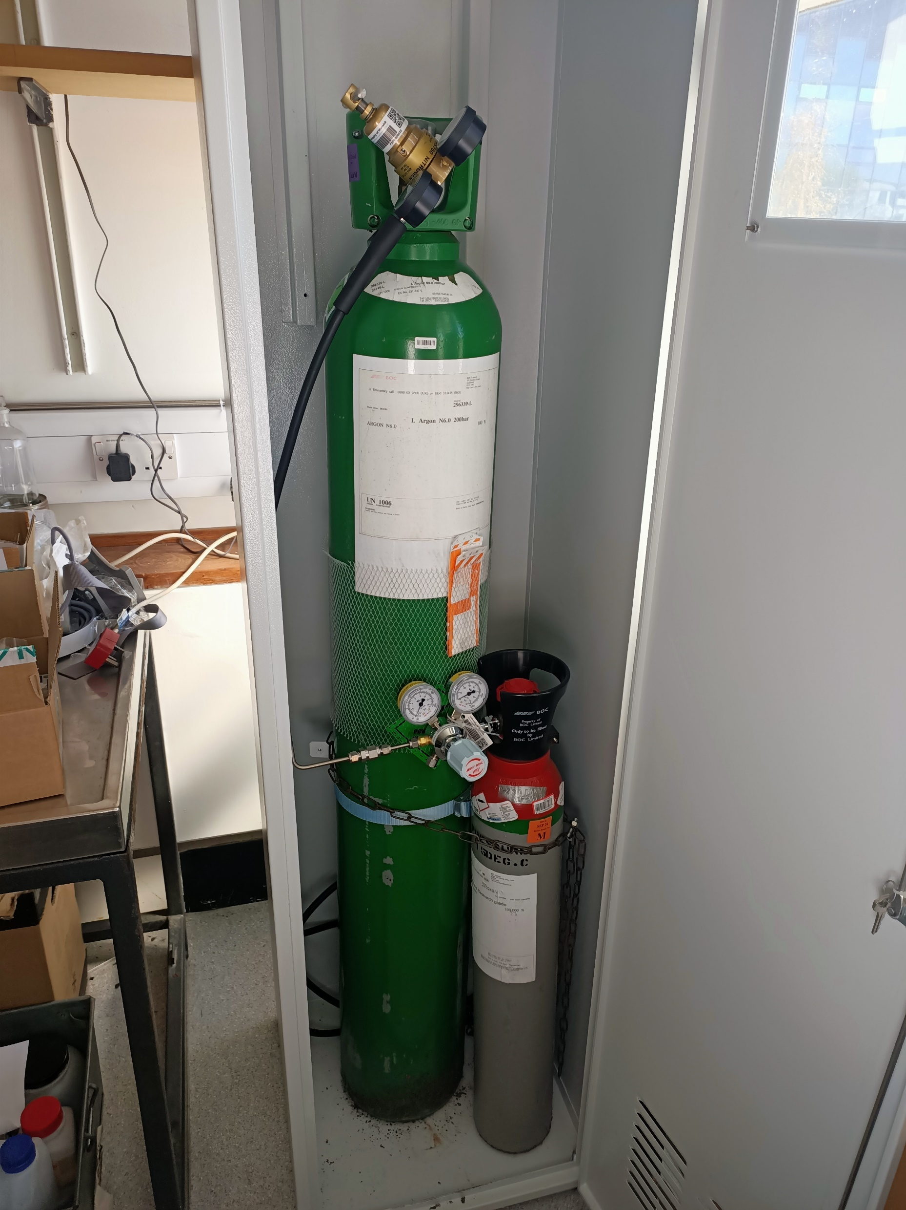
Argon Pressure & Methane Measurements
Methane fraction:
  Increased between 0% and 10%
  Incremented in 0.5% steps
Argon pressure:
  Increased from 1019mbar to 6000mbar
Looking at affect on light output
Integration test of charge readout
Fig.6. The argon and methane cylinders connected to the gas system

Slide 10
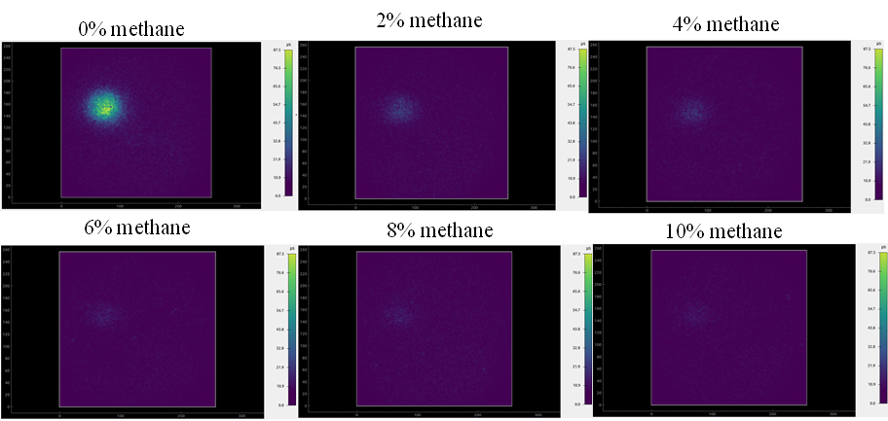
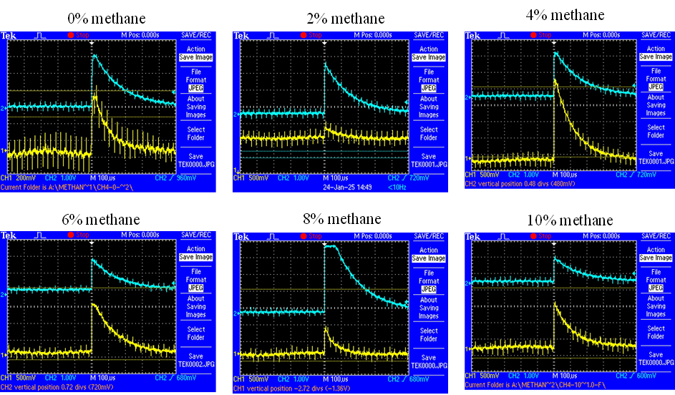
Methane Measurements
Integrated light images:
  Recorded at each methane fraction
  Clearer when calculating ToT integral
Charge readout:
  Observed events at each fraction
  Significant amount of noise in channels
  Difficult to build pulse-height spectrum
Fig. 7. Integrated ToT images at various methane fractions.
Fig. 8. Coincident events recorded at various methane fractions.

Slide 11
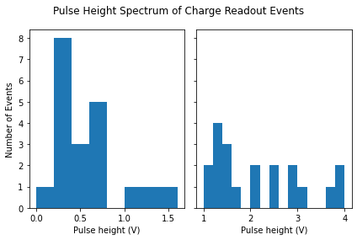
Pulse-Height Spectrum
Aimed to build pulse-height spectrum
Significant noise in readout channels
No digitiser, so done manually
Only build spectrum for 0% methane
Fig. 9. Example Pulse heigh spectrum of channel 1 (left), and channel 2 (right) taken in an Ar-100, CH₄-0 gas mixture.

Slide 12
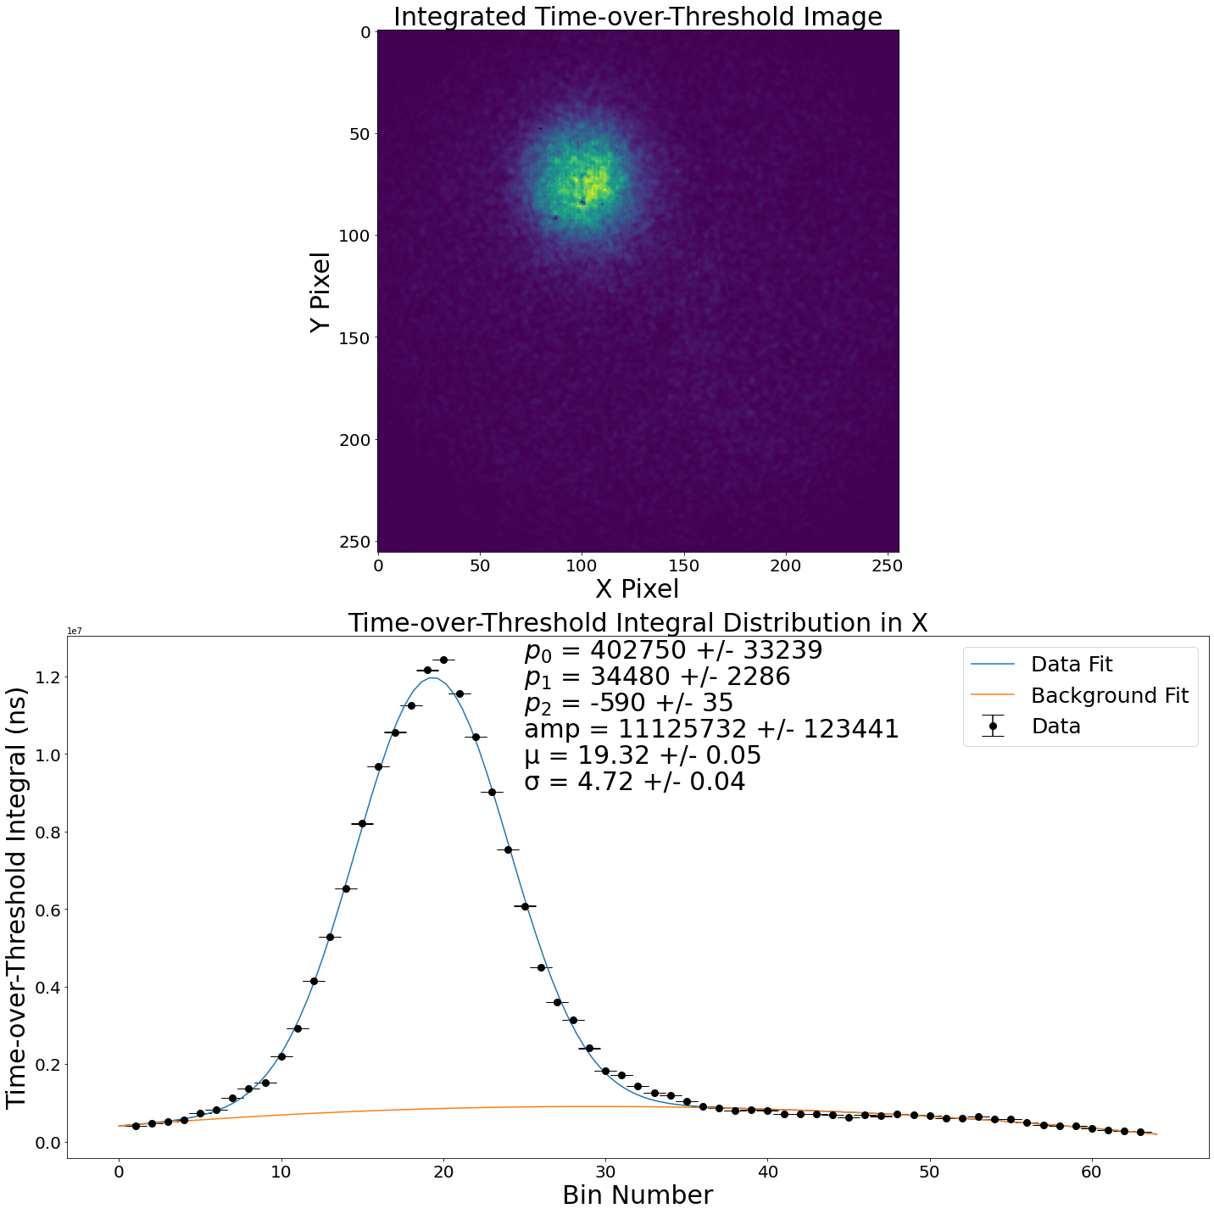
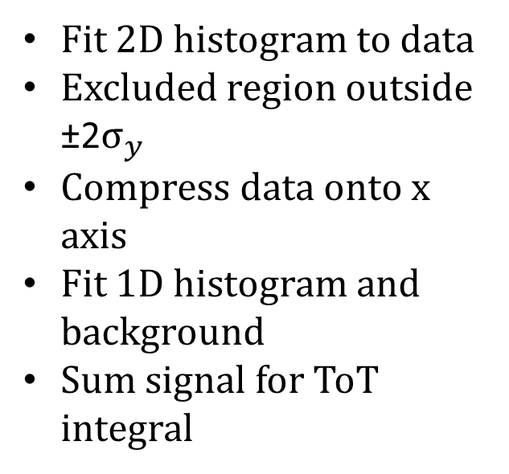
ToT Integral
Fit 2D histogram to data
Excluded region outside ±2$σ_{y}$
Compress data onto x axis
Fit 1D histogram and background
Sum signal for ToT integral
Fig.10. The Integrated Time-over-Threshold image (top), and the cut 1D compressed data with a histogram plus background fit (bottom)

Slide 13
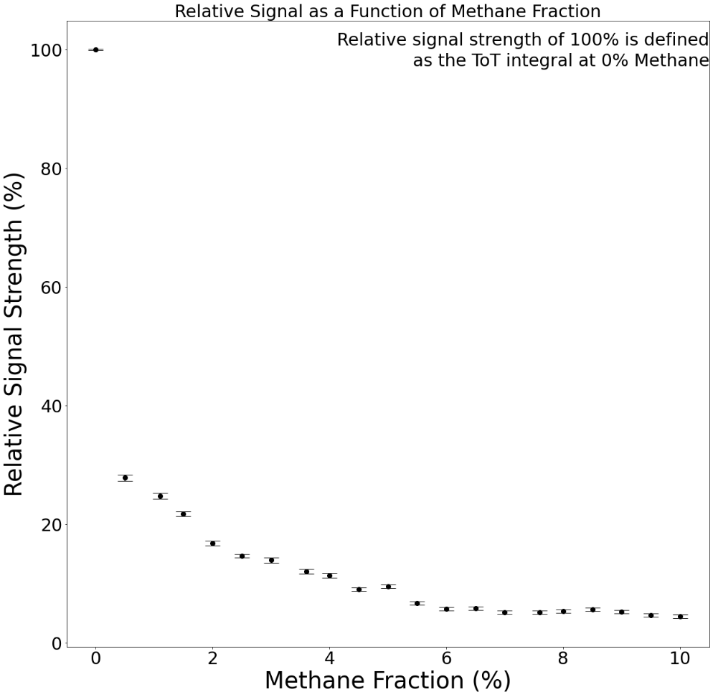
Methane Results
ToT integral:
  Calculated for every methane fraction
  0% methane fraction set baseline
Sharp drop between 0% and 0.5%
Decrease slows after 0.5%
Decrease slows significantly after 5.5%
Fig. 11. Calculated relative optical signal strength as a function of the CH₄ fraction.

Slide 14
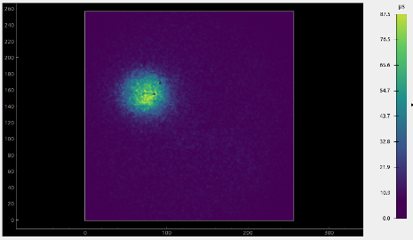
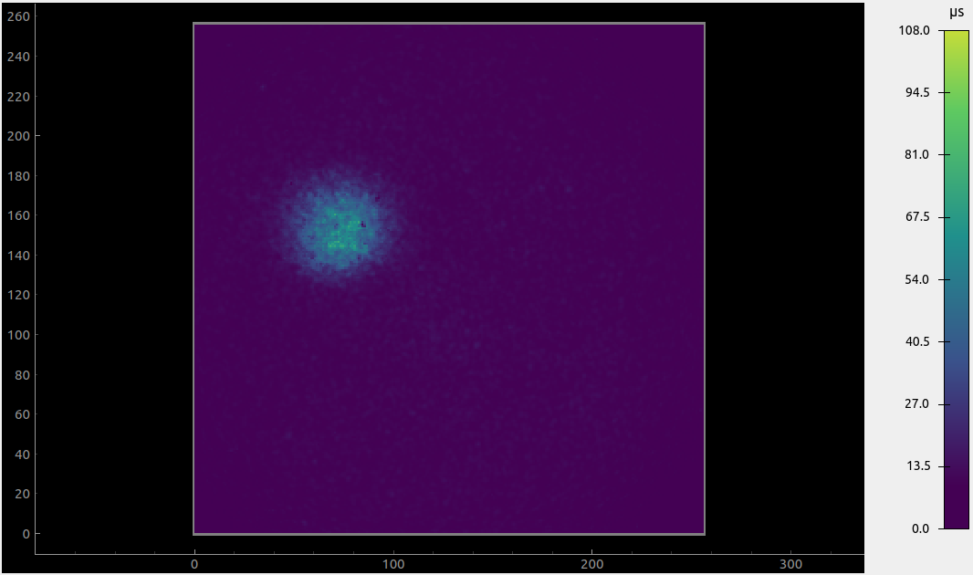
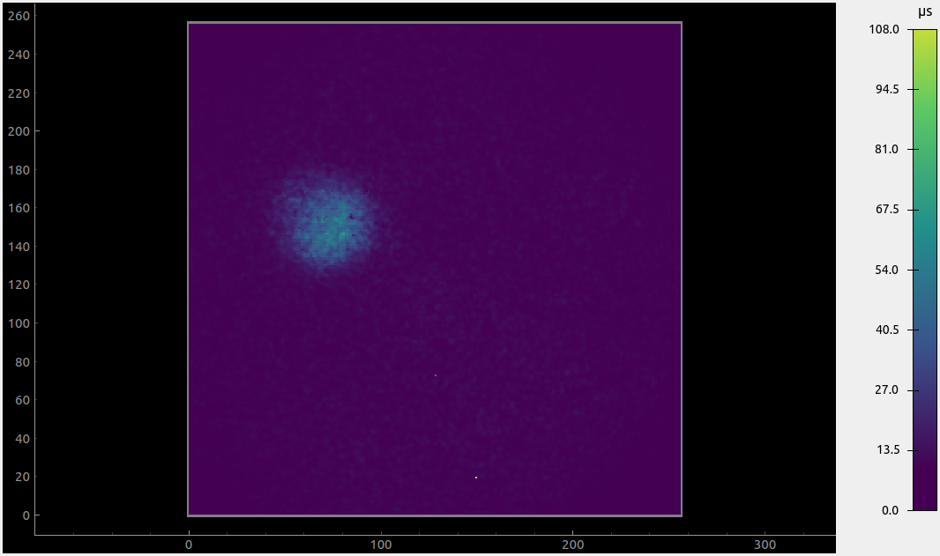
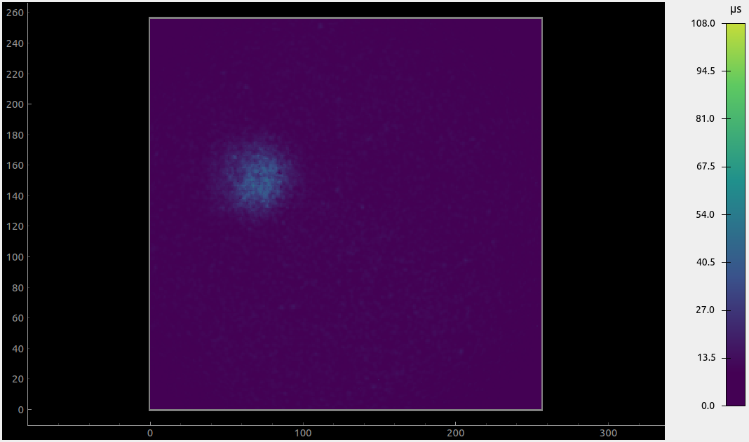
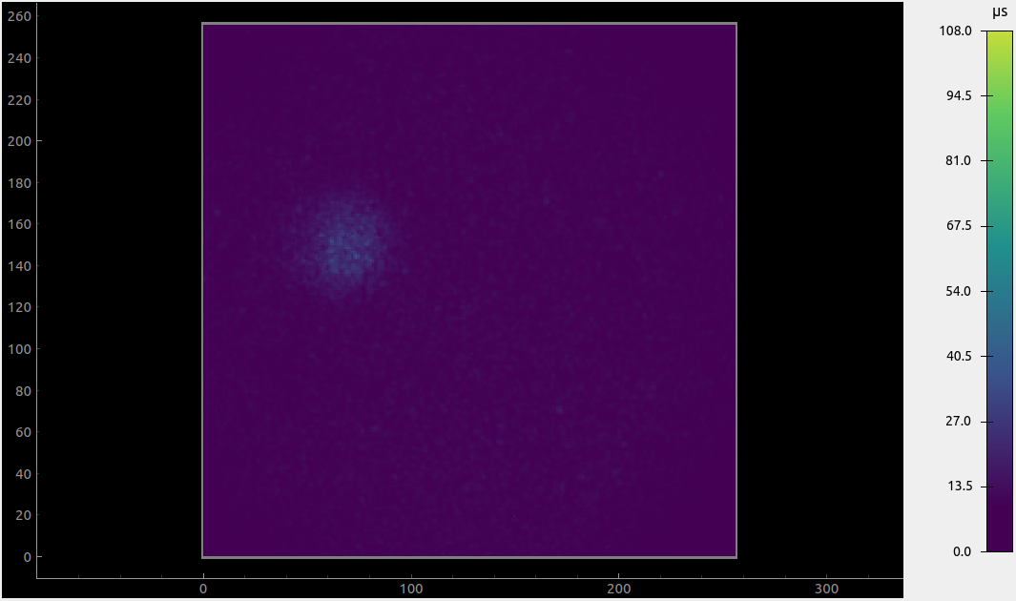
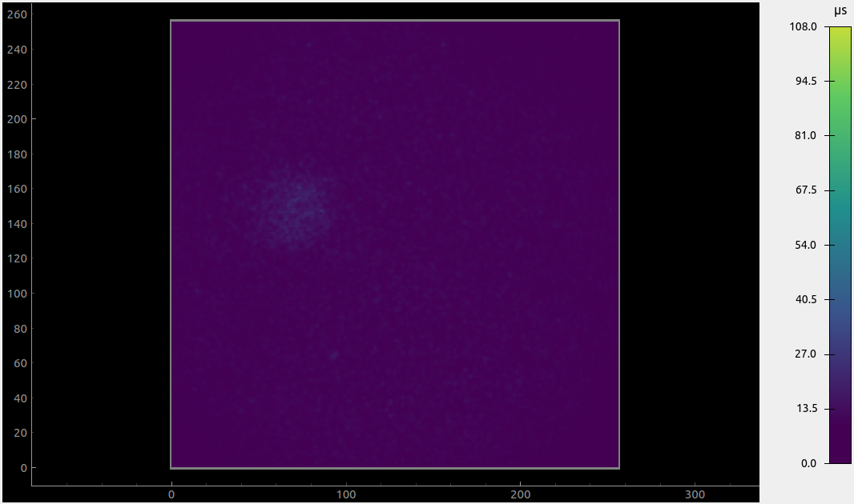
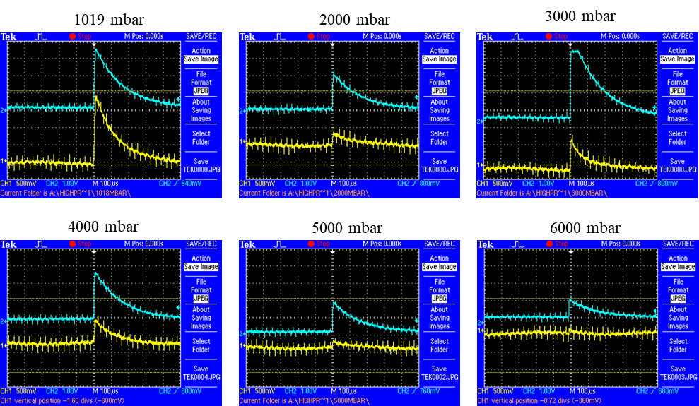
Argon Pressure Measurements
1019mbar
2000mbar
3000mbar
4000mbar
5000mbar
6000mbar
Similar measurements repeated
Decreasing light with increasing pressure
Charge readout:
  Observed events at each fraction
  No pulse-height spectrum
Fig. 12. The integrated ToT images at different pressures of argon.
Fig. 13. Coincident events observed at different argon pressures.
Fig. 18. Coincident events observed at different argon pressures.

Slide 15
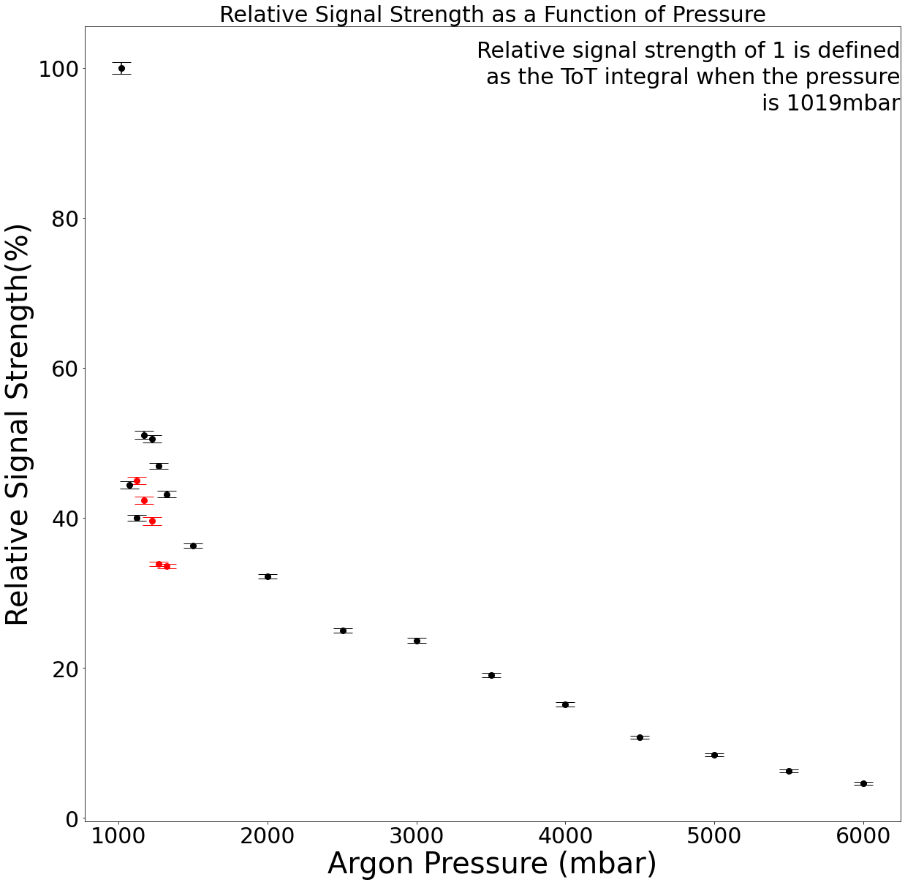
Argon Pressure Results
Steep drop off in light
Followed by slower decrease
Recovery potentially from inconsistent timing
Retook data between 1120mbar to 1320mbar
No observed recovery
Fig. 14. Calculated relative optical signal strength as a function of the argon pressure.

Slide 16
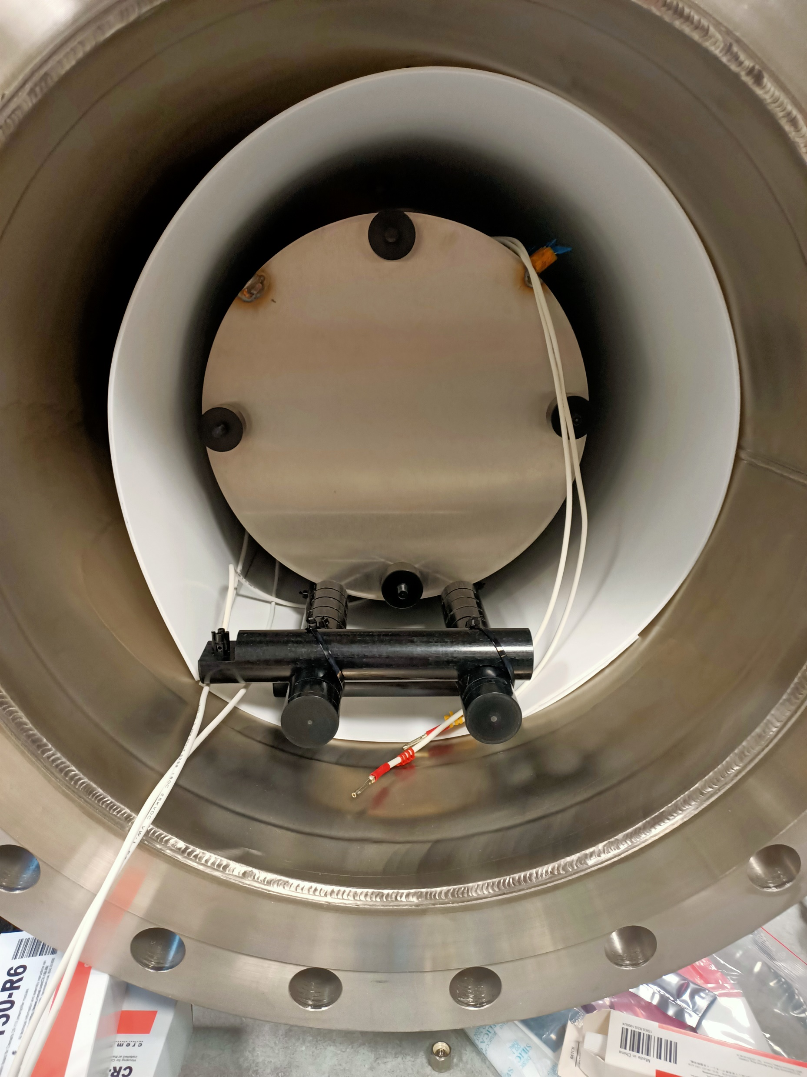
Conclusion
Optical readout:
  Expected ToT integral response
Charge Readout:
  Showed promising signs
  Suffers from noise
  Need to build pulse-height spectra
  Would allow qualitative analysis
Fig.15. The TPC mounted inside of the pressure vessel

Slide 17
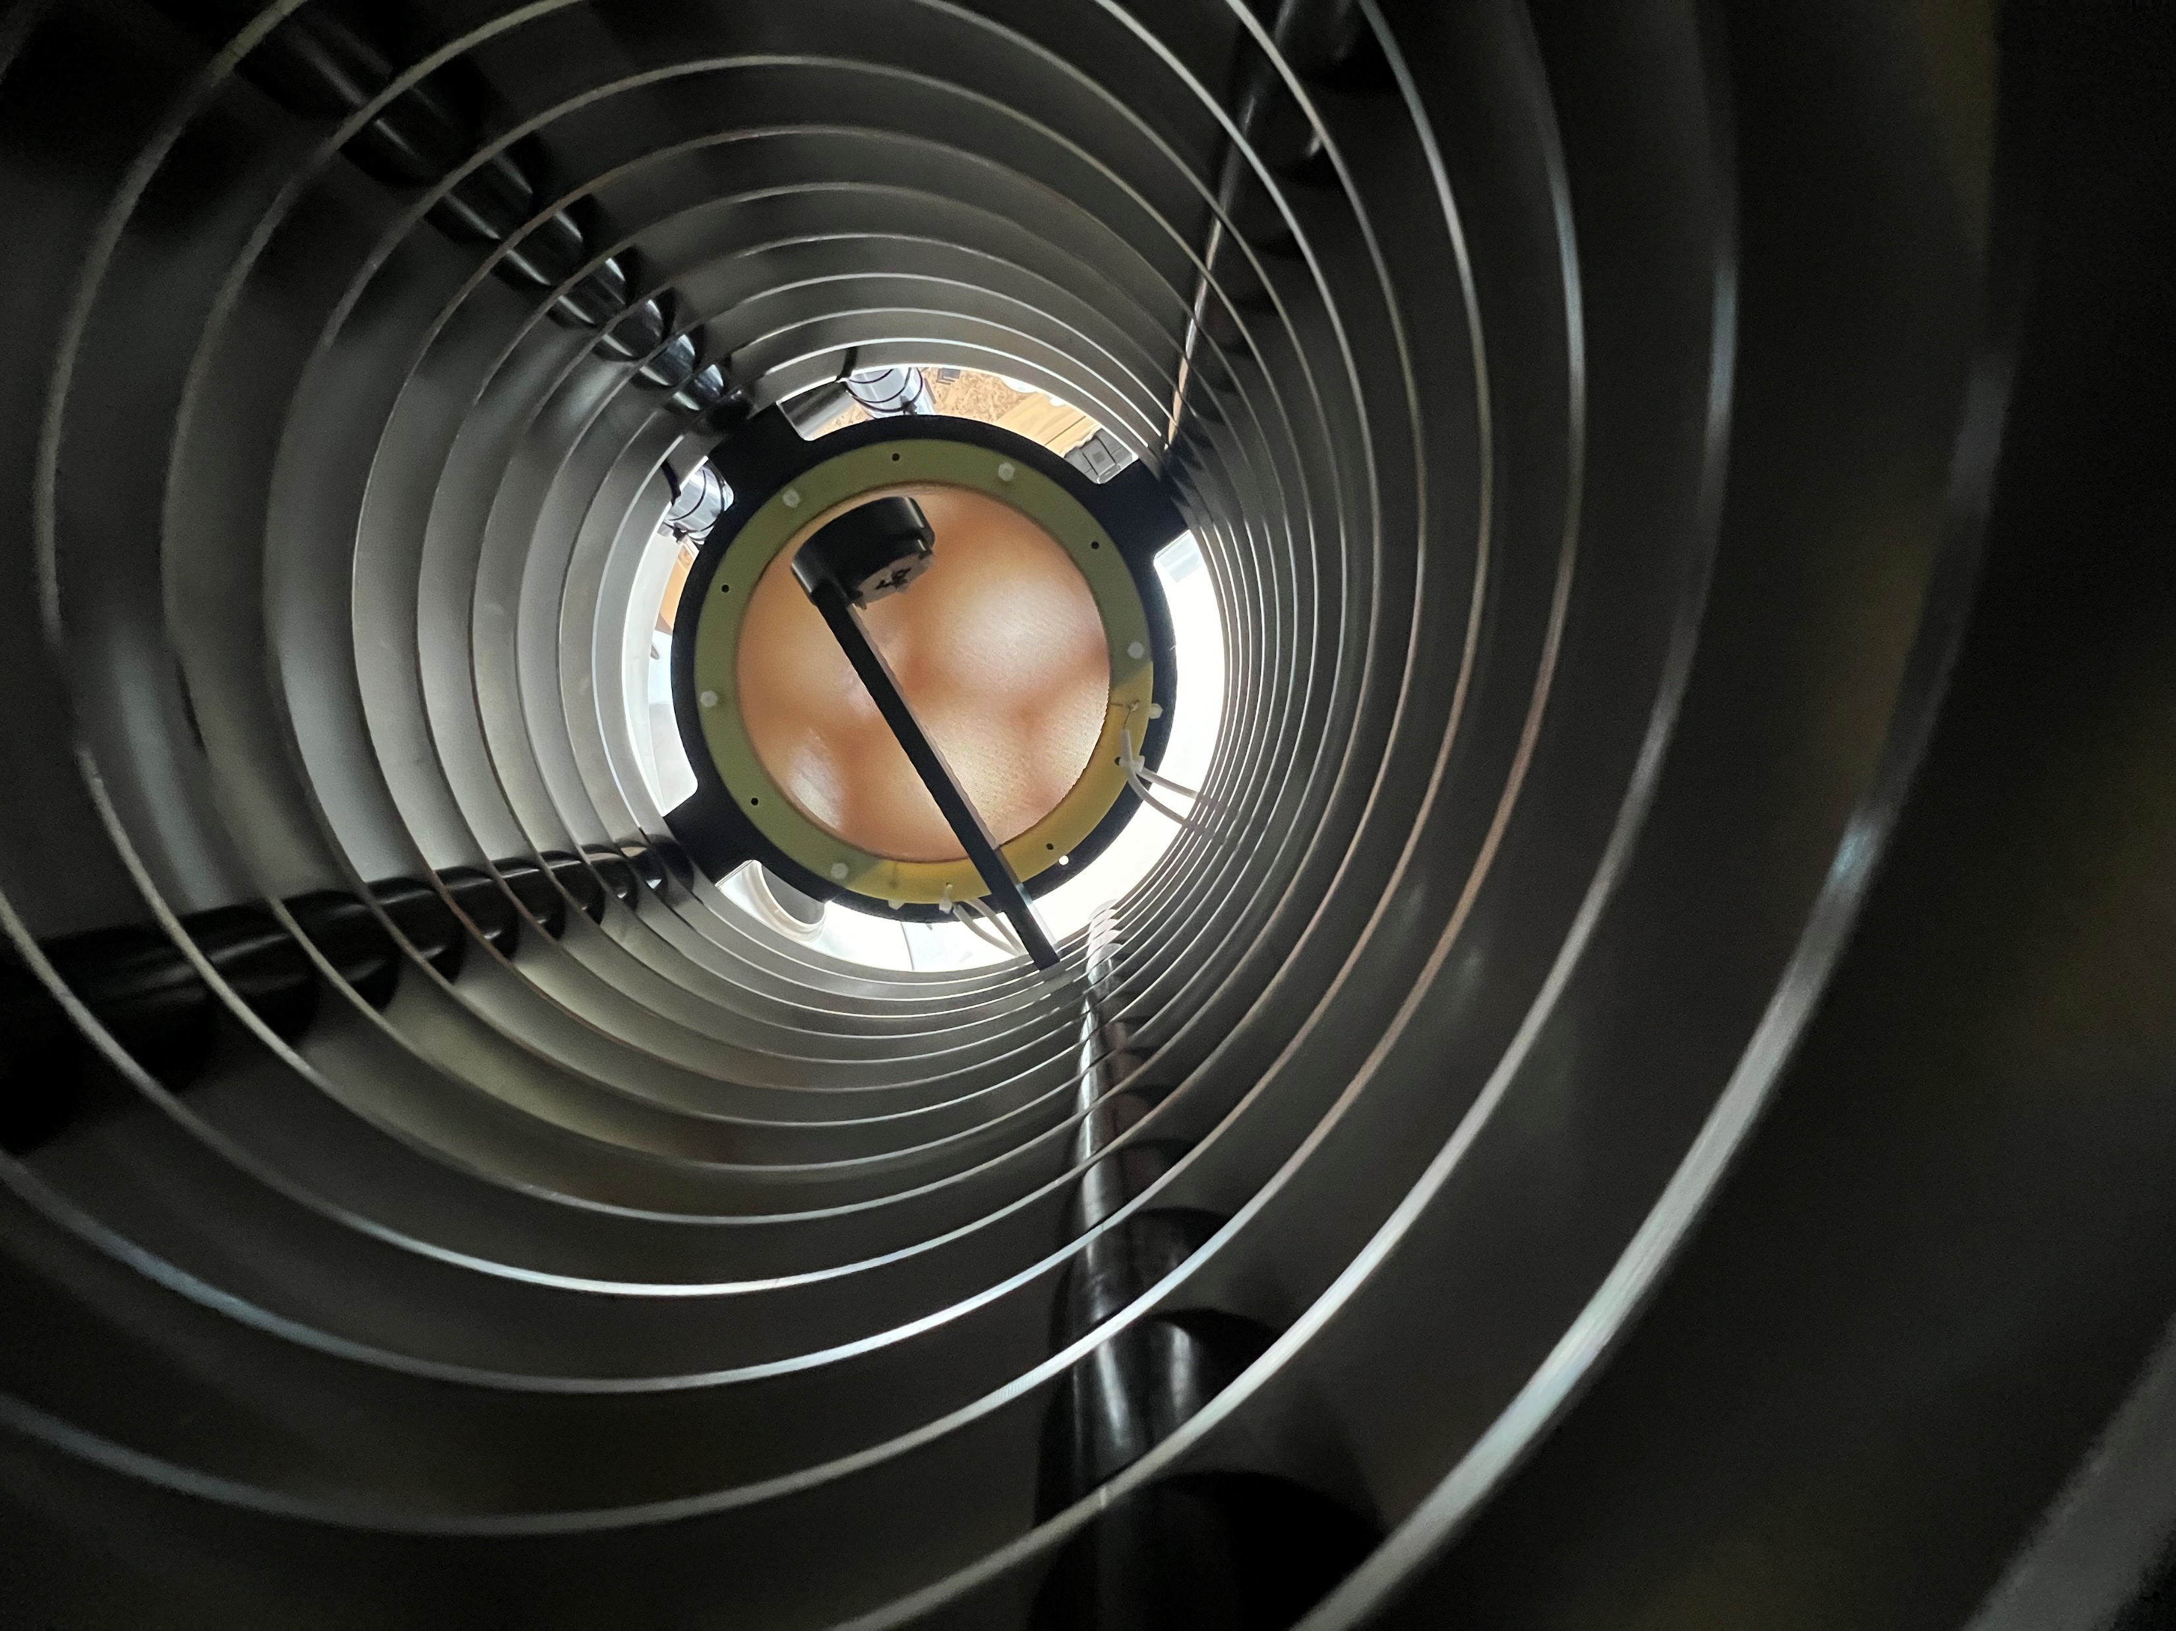
Outlook
Charge readout:
  Use filters to reduce noise
  Digitise readout for pulse-height spectra
  Test without alpha source present
CF4 gas runs:
  Aim to measure cosmic rays
  Perform more alpha source runs
Fig.16. Source holder mounted on field cage before alpha source run

