Slide 1
Considerations of Q6 quench level
Arjan Verweij

Slide 2
RQ6
8 circuits in the LHC: L3B1, L3B2, R3B1, R3B2, L7B1, L7B2, R7B1, R7B2
Each circuit contains 6 MQTLH magnets operated at 4.5 K with length=1.3 m and I_{ult}=490 A
L_{mag}=0.12 H, L_{circ}=0.72 H
Q_{stored, circuit}=0.6 kJ (at 40 A), 86 kJ (at 490 A)
Circuit has EE (R=0.7 Ohm) and R_{par}=0.2 Ohm over each magnet
Impregnated coil wound from ‘wire 3’ (bare: 1.13 mx0.6 mm, 60 μm PVA enamel coating, Cu/SC=1.75)
PS: Note that all multi-kA magnets are wound from a Rutherford cable (22 to 46 strands)

Slide 3
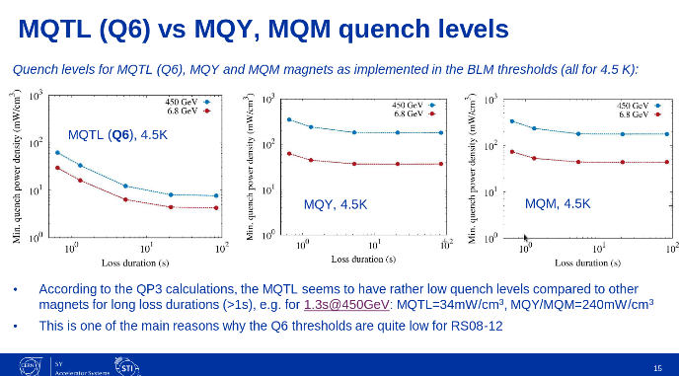
Question from Anton:
Do you remember why the MQTL quench levels are so much lower than the MQY and MQM ones?
Unfortunately I cannot run the QP3 code anymore, but could be foreseen if needed.

Slide 4
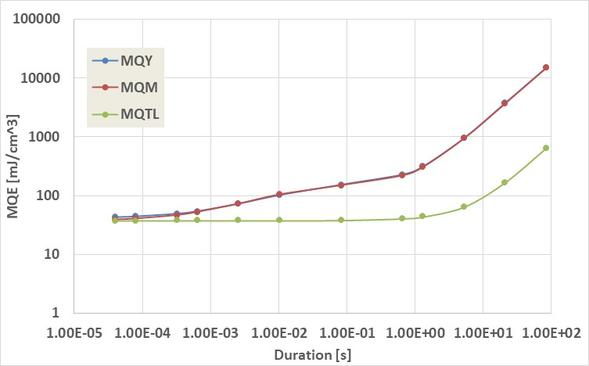
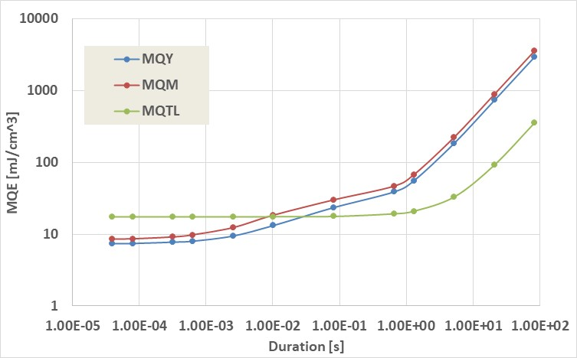
Short heat deposition
(up to ∼1 ms)
Injection
Minimum Quench Energy (MQE) is governed by the enthalpy margin between 4.5 K and the current sharing temperature (T_{CS}).
At injection, T_{CS} is the same for all magnets (about 9 K) as well as Cu/SC ratio, so the MQE is very similar.
Nominal
At nominal, the MQTL operates with higher margin (so higher T_{CS}) so the MQE is higher.

Slide 5
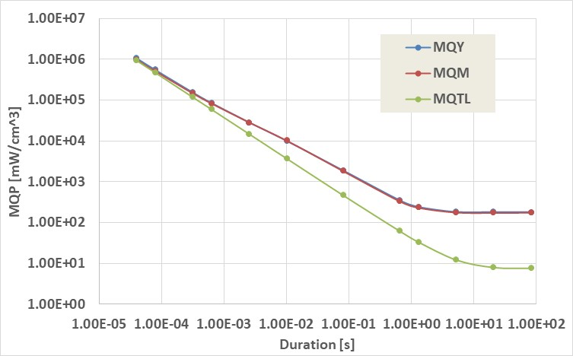
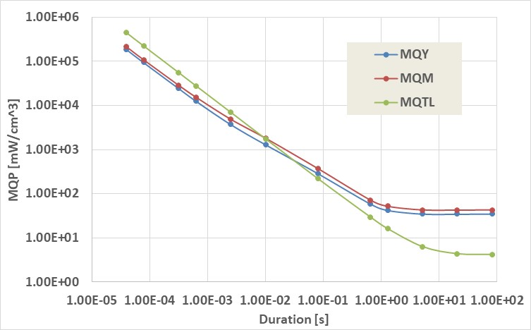
Long heat deposition
(above ∼2 s)
Injection
Minimum Quench Power (MQP) is governed by the cooling from the coil to the helium bath.
The QP3 model predicts that the cooling is better for the MQY and MQM due to the helium channels in the insulation and the wider conductor (causing and averaging effect for heating and T_{CS}, due to very good heat diffusion inside the conductor).
Nominal

Slide 6
Intermediate heat deposition (∼1 ms to ∼2 s)
Injection
Minimum Quench Energy (MQE) is given by the combined effect of enthalpy of the conductor, enthalpy of the helium inside the cable (for MQM and MQY), averaging advantages (for MQM and MQY) and cooling.
Nominal

Slide 7
Some remarks
We have no experimental data of the MQE for the MQTL. The theoretically calculated MQE is correct for short durations (<1 ms) but might be quite wrong for intermediate and long durations.
It is very likely that the MQE of the 8x6 magnets in the LHC are rather similar (within 25%).
Quench tests can be safely done for the MQTL when operated at low current (<50 A).
I suggest starting with an energy power deposition equal to the calculated theoretical value and, if no quench is observed, increase the power in steps of maximum a factor 2.
Once a quench is observed you might of course, if needed, add intermediate powers to improve the accuracy.

