Slide 1







HL-LHC
Project Steering Meeting
WP3 IR Magnets
S. Izquierdo Bermudez, D. Duarte Ramos, E. Todesco,
G. Ambrosio, S. Feher, T. Nakamoto, Q. Xu, F. Toral, S. Farinon, M. Statera
A. Foussat, E. Gautheron, J.-C. Perez,
A. Milanese, G. Willering, G. Vandoni, I. Crespo Garrido, S. Fleury
April 1st, 2025

Slide 2
Table of contents
Actions
  Action follow-up
  New action requests
Risks
  Main risks by Risk management
  Main risks by WPL
EVM
Change approval
Upcoming changes
  DMRs/ ECRs
  Changes in scope/ cost
Schedule
  Schedule management
  Schedule changes
  Milestones reporting
  Milestones trend analysis
Collaborations
Issues & concerns for TCC
  On cost, scope, interfaces, manpower
Milestones
  Since last 6 months/ last PSM
  Upcoming
  Upcoming tenders
NCRs
Safety

Slide 3
What is new from last PSM (October 2024)
STATUS
All cryo-assemblies (including the DCM) except LMQXFA02 were delivered to the string. N-line pulling and interconnections will start in the coming days
Test bench upgrade in SM18 completed: D2 will be tested in the coming weeks in C2 bench
Main milestones:
  Q2: 2 more magnets built, and the test of the 4th unit for installation is ongoing (MQXFB06): good results in the first thermal cycle
  Q1/Q3: LMQXFA02 arrived at CERN, LMQXFA03 is being tested and the final pressure/leak test of LMQXFA04 is ongoing
    2 more magnets qualified during vertical test (A18 and A12b), 1 failure (A16)
  D2: MBRD2 is ready for test, MBRD1 was delivered (the cold mass will be completed this week)
  MCBRD: 2 magnets qualified (05/06) and one more delivered but not yet tested (07)
  D1: MBXF3 qualified at KEK; and the first cold mass was tested; and it is being cryostated
  CP: the first corrector package was tested; the second cold mass is completed
  MCBXF: 2 more correctors qualified (B06/B07); one is being tested (A2)

Slide 4
What is new from last PSM (October 2024)
STATUS
In the last 6 months: 8 magnets qualified during vertical or horizontal cold powering testing, the test of 4 units is ongoing.
  17 more to complete units needed for installation, and 15 more spares to test.
EDMS 3199587

Slide 5
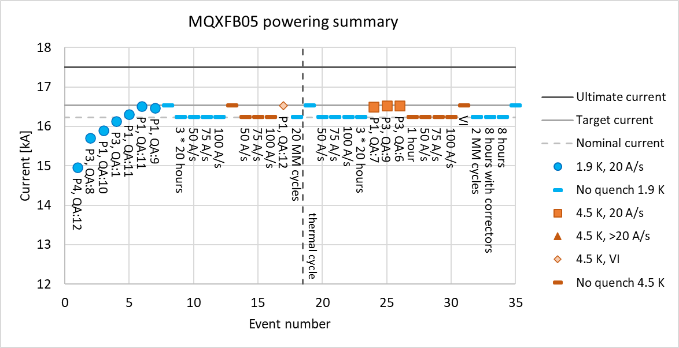
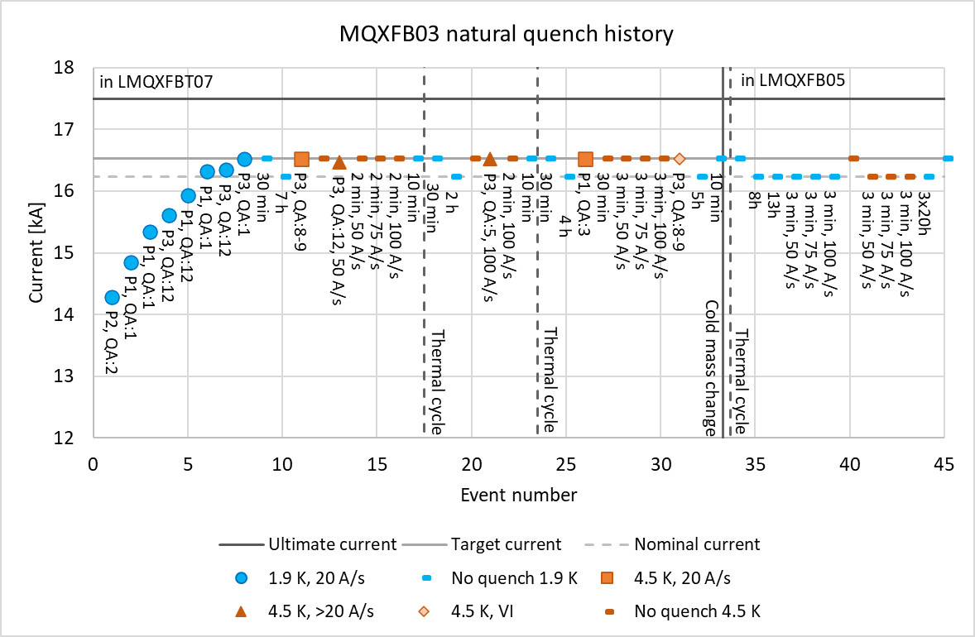
Q2 – highlights from October 2024
STATUS
Two MQXFB magnets fully qualified in Q2 cold masses (MQXFB03 and MQXFB05), including 3x20 h plateaus
  Fault to ground in the main circuit in MQXFB03 (EDMS 3198687) at cold in the 1st thermal cycle due to a weakness on the CLIQ leads. Cryo-assembly was tested after repair and fully qualified for HL-LHC

Slide 6
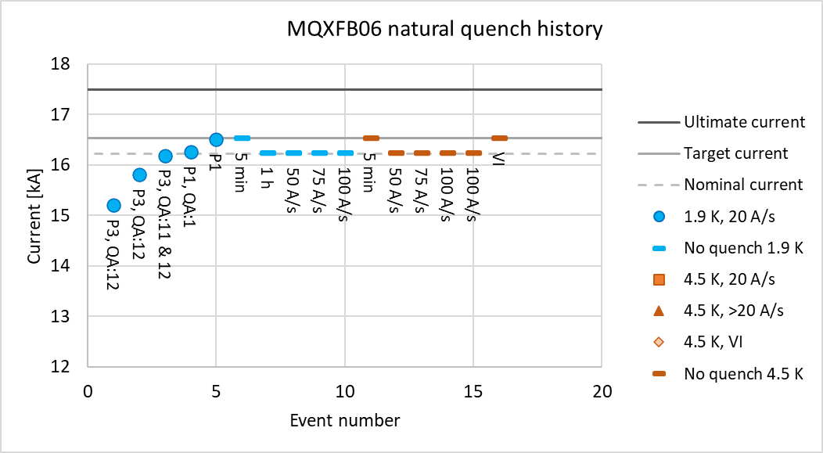
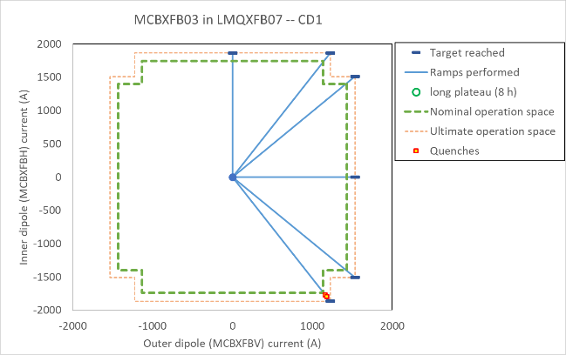
Q2 – highlights from October 2024
STATUS
First thermal cycle of the 4th Q2 for installation completed: both the quadrupole (MQXFB06) and the corrector (MCBXFB03) fulfill requirements, including 3 x 20 h flattop
Production continues smoothly:
  The winding of the coils for the spare magnets started.
    Delivery of the coated spacers from the US was in the critical path, but the issue was resolved in time, thanks!
  1 new magnet every 3.5 months

Slide 7
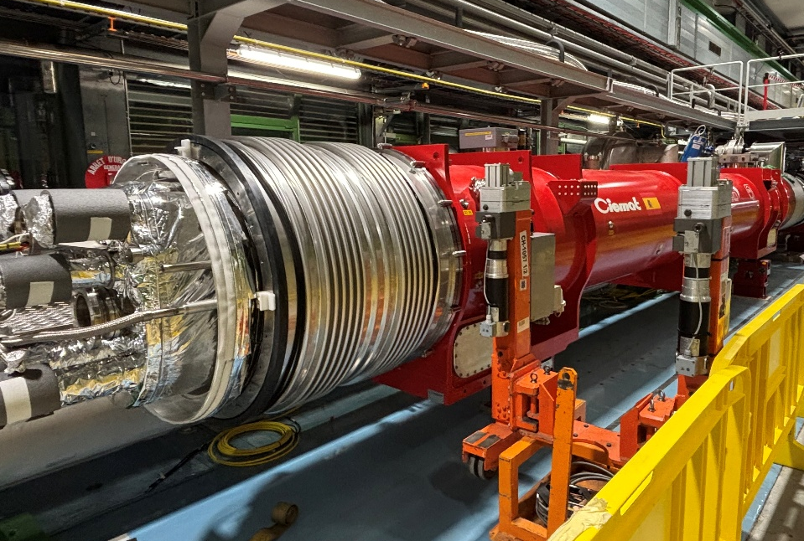
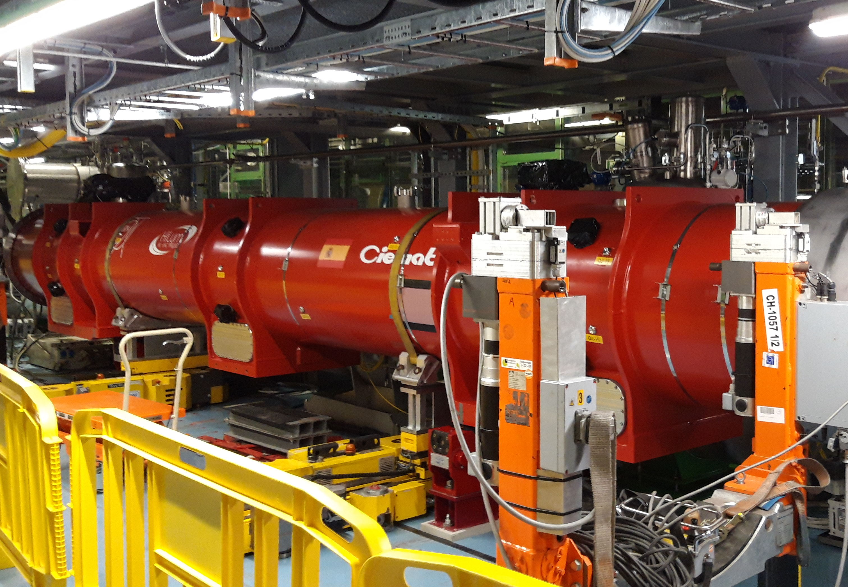
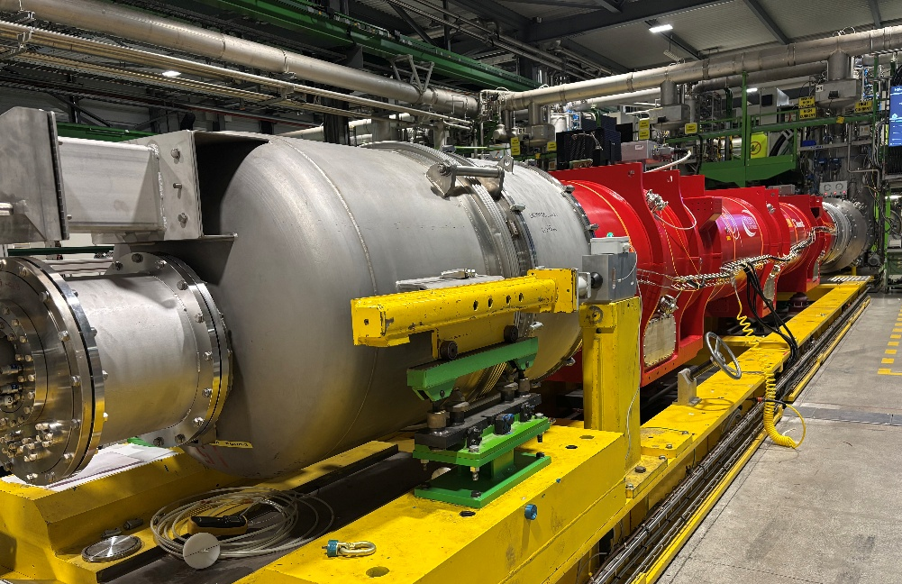
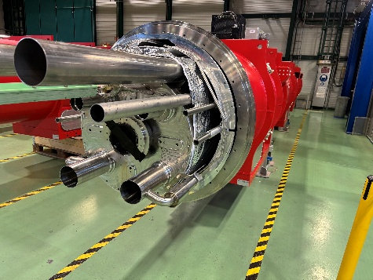
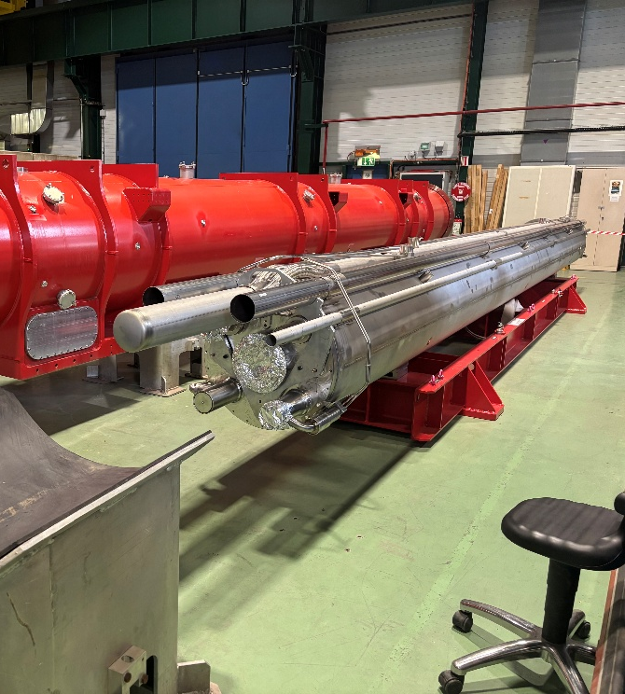
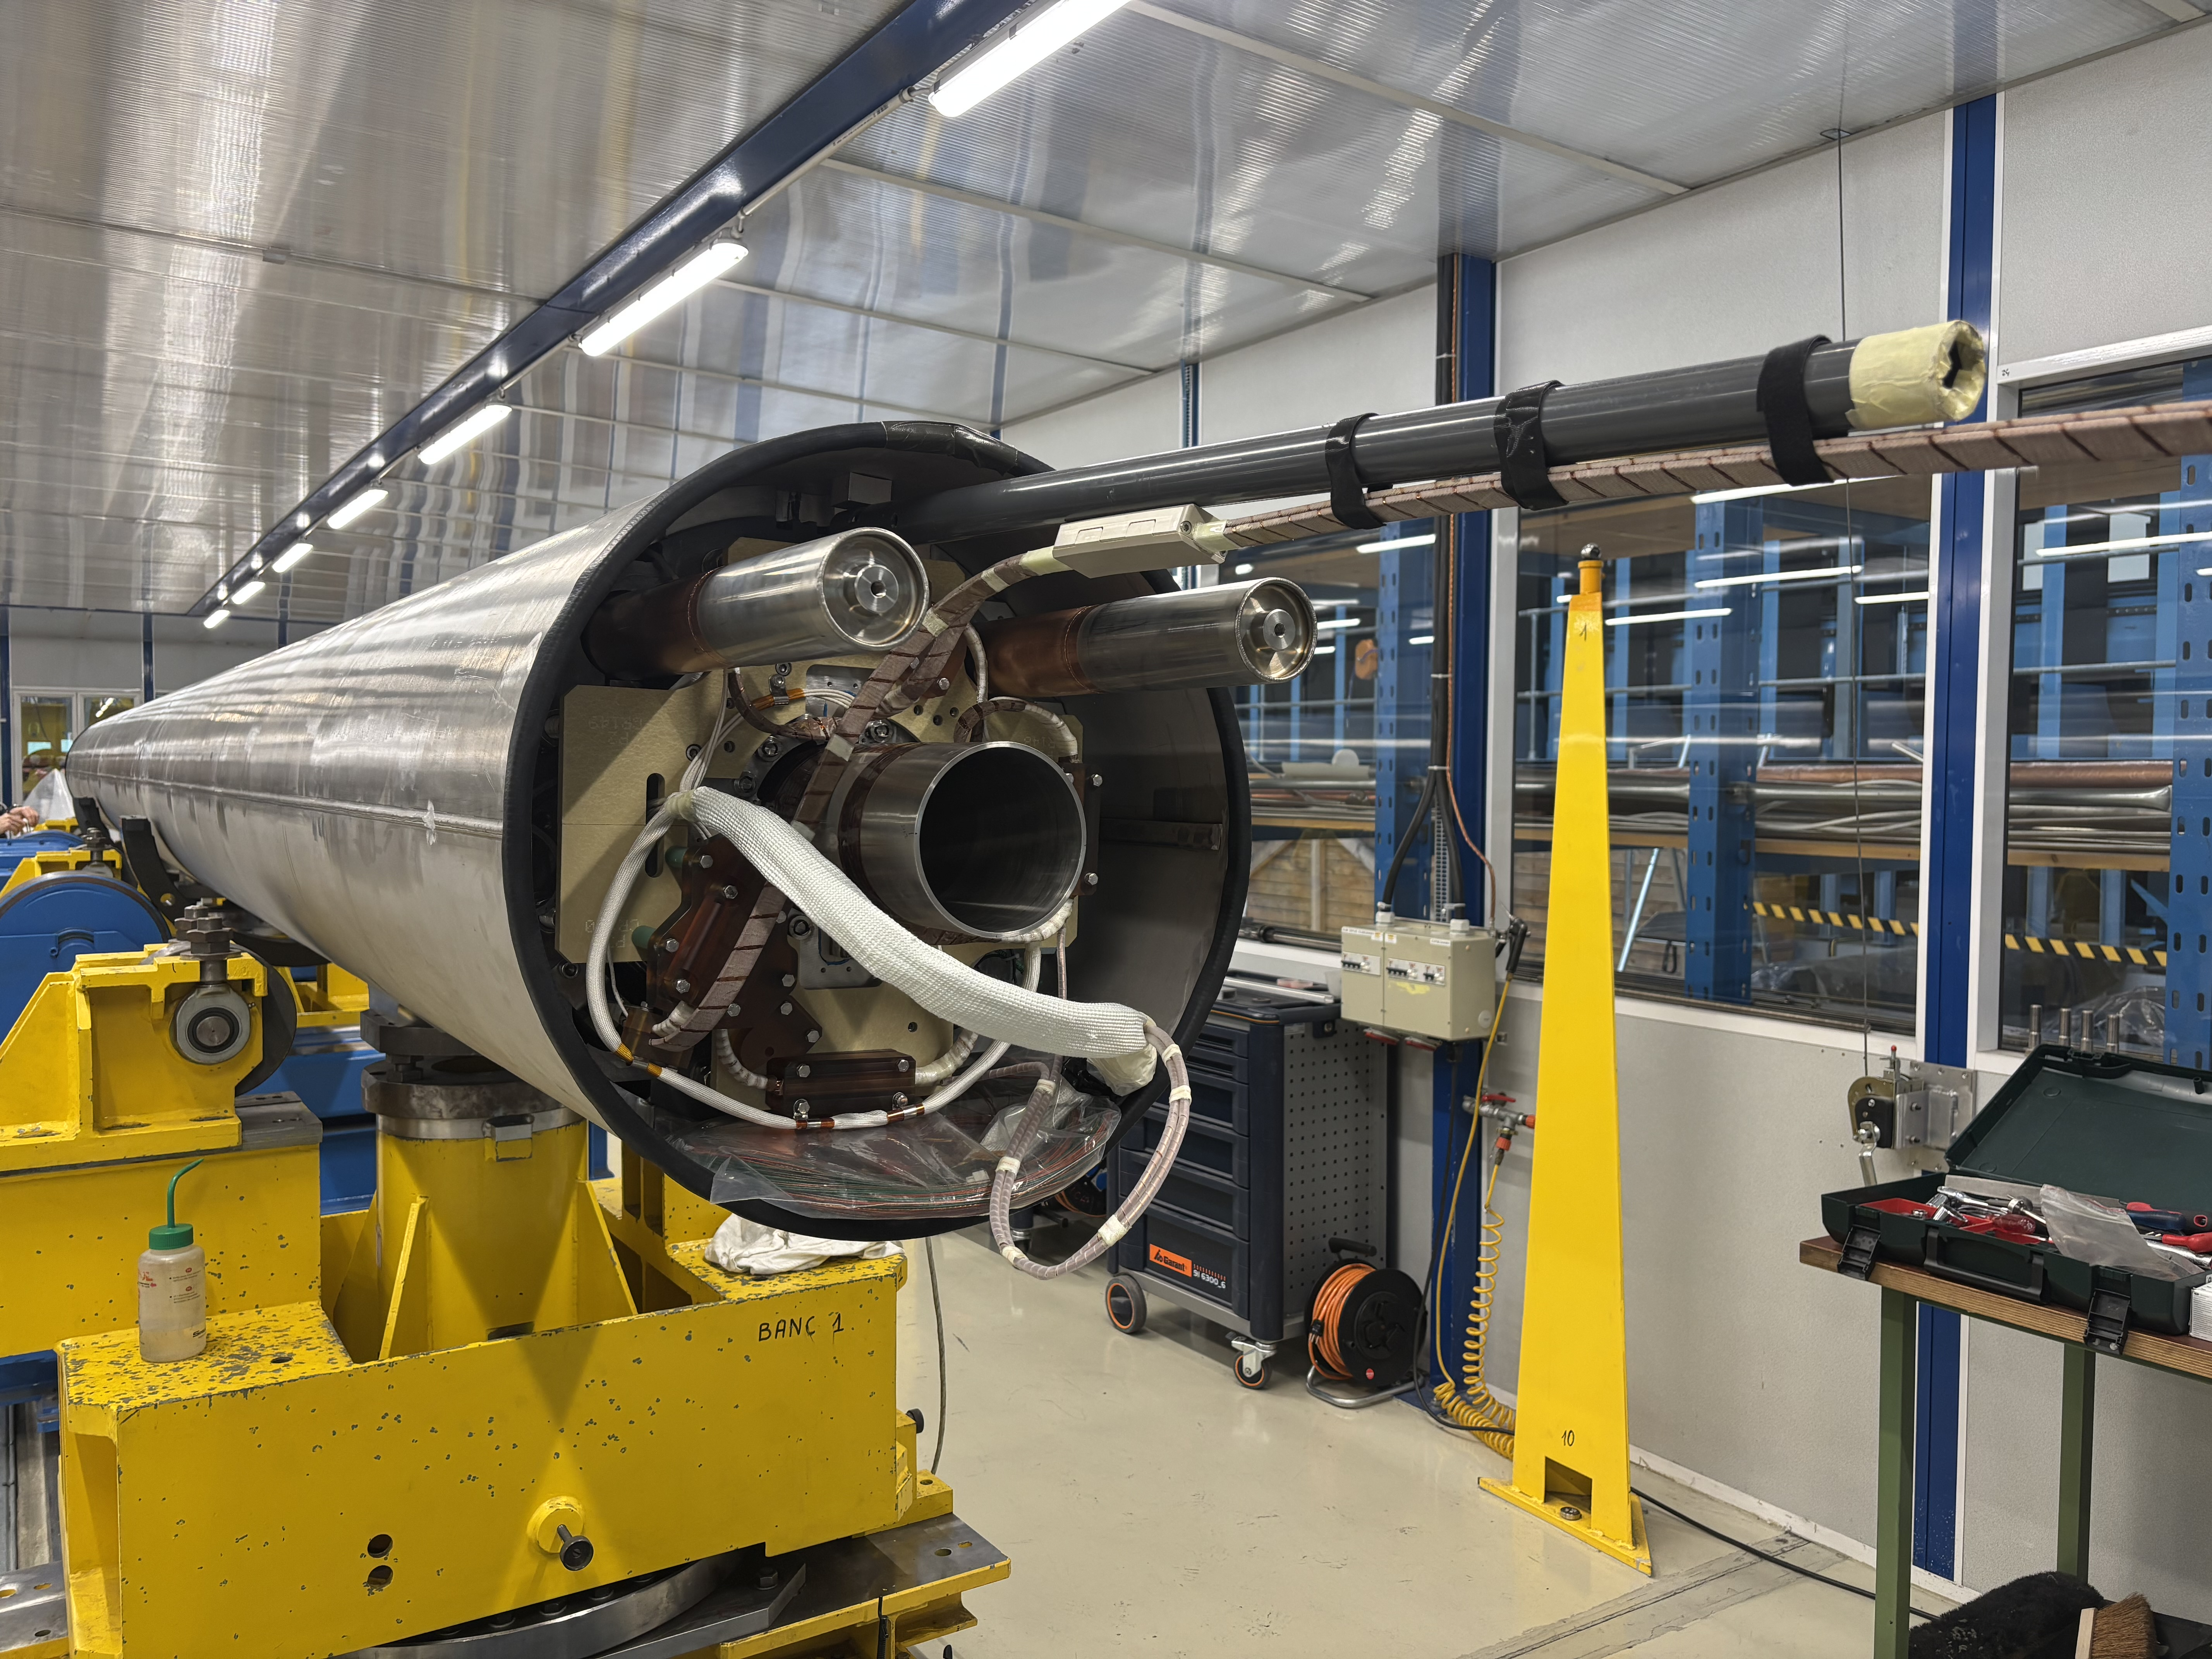
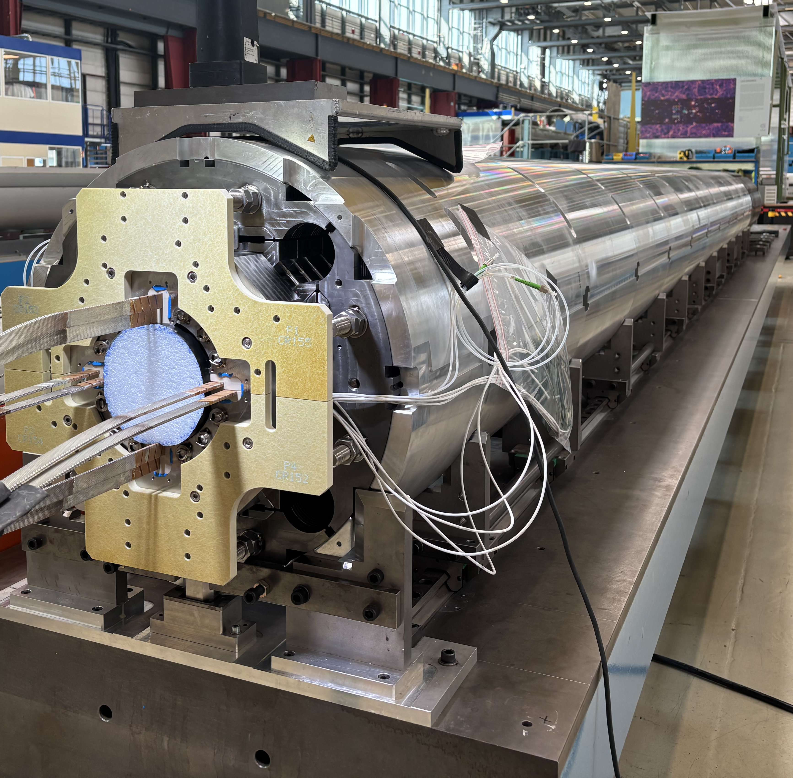
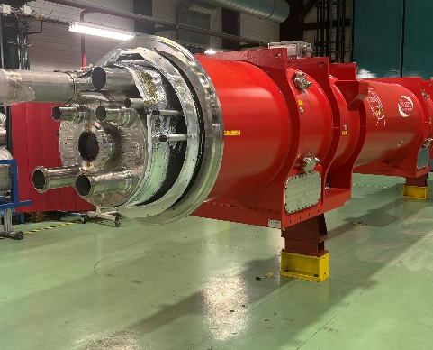
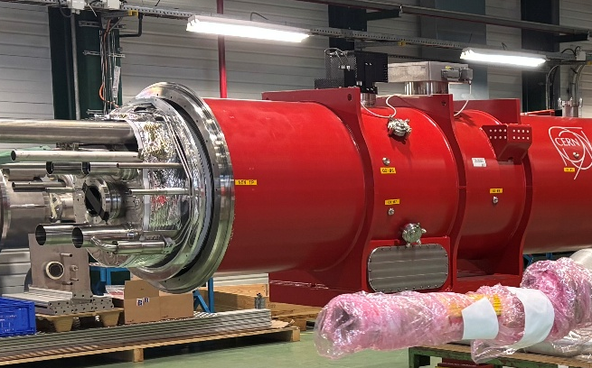
Q2 – Overall status
We are at full production speed!
STATUS
MQXFBP2: in the HL-LHC string
MQXFBP3: in the HL-LHC string
MQXFB06: test ongoing
MQXFB08: welded
MQXFB03: fully qualified for HL-LHC ✓
MQXFB04: fully qualified for HL-LHC ✓
MQXFB05: fully qualified for HL-LHC ✓
MQXFB07: cryostating ongoing
MQXFB09: connections ongoing
3 more magnets to build (B10-B12)

Slide 8
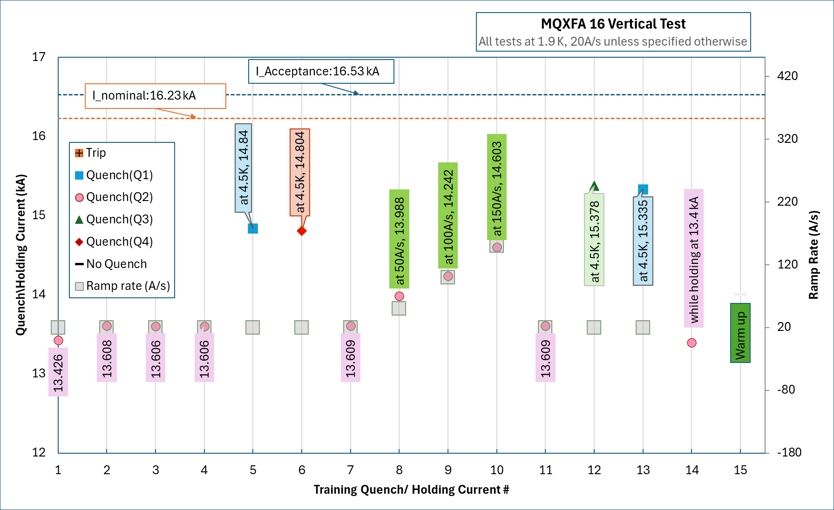
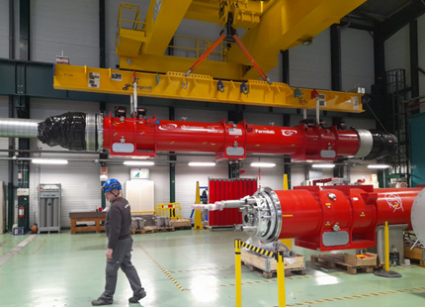
Q1/Q3- Highlights from October 2024
STATUS
Two more magnets qualified (A18/A12b), one magnet failed vertical testing (MQXFA16, see test results)
  MQXFA17b is cold, but electrical weakness (test station side) will require a 2nd thermal cycle
LMQXFA01 delivered to the string, after the repair of a leak detected in the final pressure leak tests (NCR 3280567)
LMQXFA02 arrived at CERN, it is being prepared for the string
Test of LMQXFA03 started, but HV weakness at cold before powering, being resolved.
LMQXFA01 on his way to the IT-string and LMQXFA02, being prepared for the string
(G. Ambrosio, S. Feher, F. Kurian, et al)

Slide 9
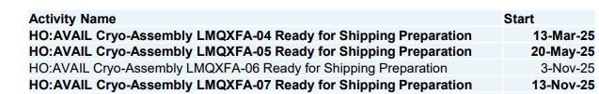
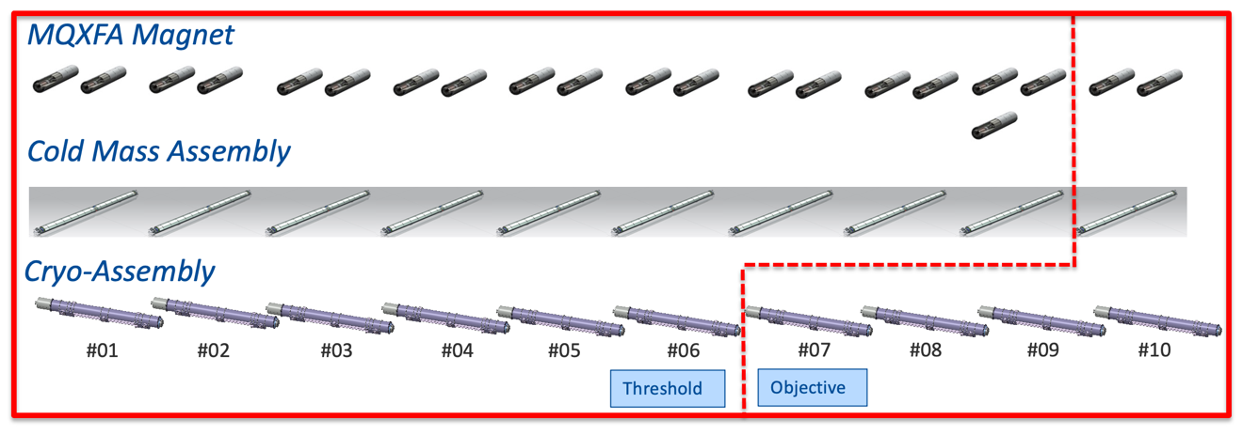
Q1/Q3: AUP – Remaining production
STATUS
In November 2024 (8th Steering Committee), we agreed:
  Three cryo-assemblies (#04/#05/#07) will be tested horizontally at CERN
  5 additional coils added to the baseline and financed by CERN
    The first two are under fabrication, the cable of the 3th is insulated and the strand for the 4th is inhouse
[8th SC, Nov 2024]
Goal was to test before summer cryo-shutdown, is getting unlikely (≈ 1 month delay, expected at CERN 2nd week of May)
✓
✓
✓
✓
✓
✓
✓
✓
✓
✓
✓
✓
✓
✓
✓
✓
✓
✓
✓
✓
✓
✓
✓
✓
✓
✓
✓

Slide 10
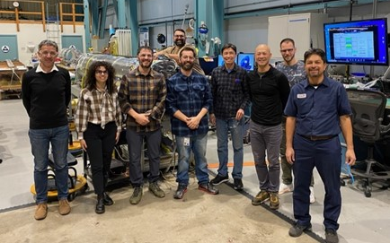
Q1/Q3 : AUP – Remaining production
STATUS
Targets by next steering committee (May 2025)
  Two more magnets qualified
  LMQXFA03 test completed
  LMQXFA04 at CERN
  LMQXFA05 cold mass completed
  LMQXFA06 and LMQXFA07 cold masses under fabrication
If CERN needs to take over part of the production:
  Magnet assembly: visit to LBNL in January 2025 (EDMS 3263707) to identify differences in required tooling and procedures
    Only considered for the repair of the magnets in LMQXFA01
  Cold mass: different longitudinal welding/fixed point than Q2, when doing a Q1/Q3 at CERN we are introducing a new feature that will be tested very late (see Q1/Q3 cold mass at CERN)
    Lower risk if we take over cold mass work after longitudinal welding
  Cryostating very similar to Q2 but resources to be adequately planned.
    The last 3 cryostat kits are ready for shipment, but the shipment is on hold
MQXFB team at LBNL for the loading of MQXFA19

Slide 11
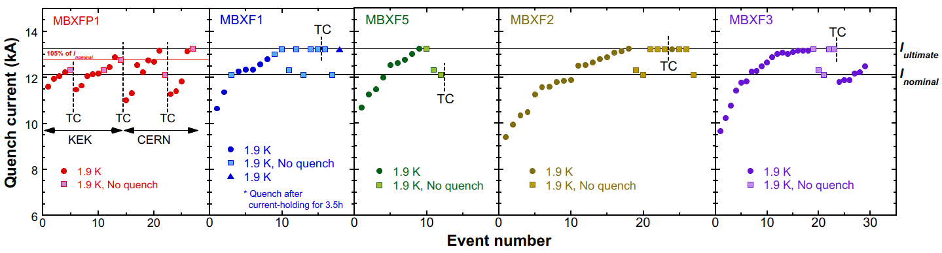
D1 – Progress from October 2024
STATUS
MBXF1 was delivered to CERN, it is ready to be cryo-stated
MBXF3 test completed, magnet is conform. 2nd thermal cycle of MBXF5 ongoing.
  All magnets needed for installation have been qualified during vertical test! (pending 2nd TC of #5)
MBXF2 cold mass expected to be completed in July 2025, @ CERN before the end of the year
(T. Nakamoto, J. C. Perez, et al)

Slide 12
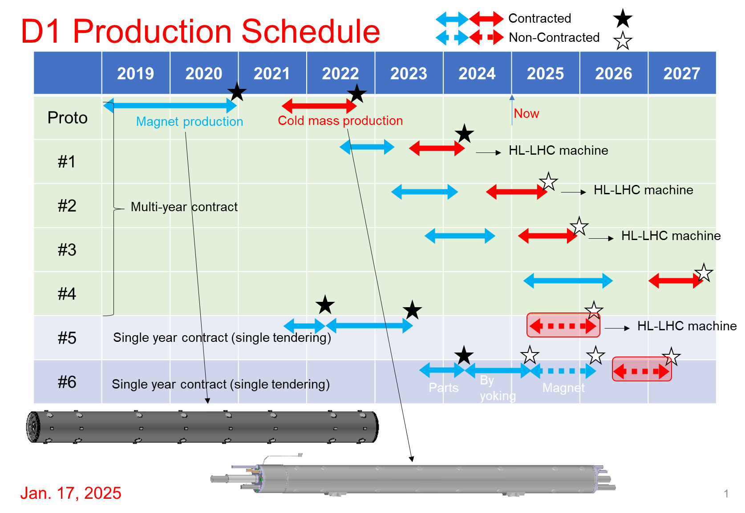
D1
STATUS
Very sequential production, with a large delay between magnet vertical test and delivery. Today the last magnet for installation is MBXF5, ready for installation in mid 2027.
  The signature with Hitachi for the completing magnet #6 and the cold mass of #5 & #6 is still pending.
    Additional funding is available to complete magnet 6 and cold mass 5, but it does not cover cold mass 6. To maintain the schedule, the contract may need to be split into two
  To be closely monitored, since it is the magnet with less floating for installation (11 months assuming #5 is at CERN in July 2026).
T. Nakamoto

Slide 13
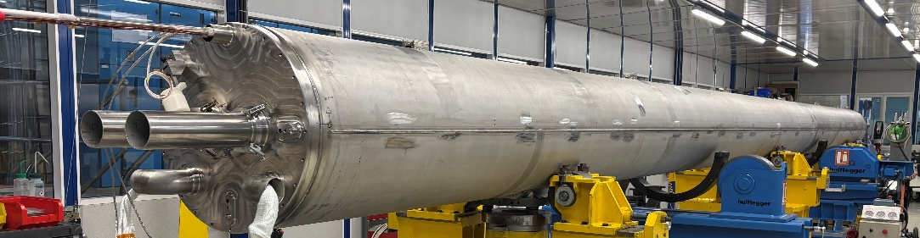
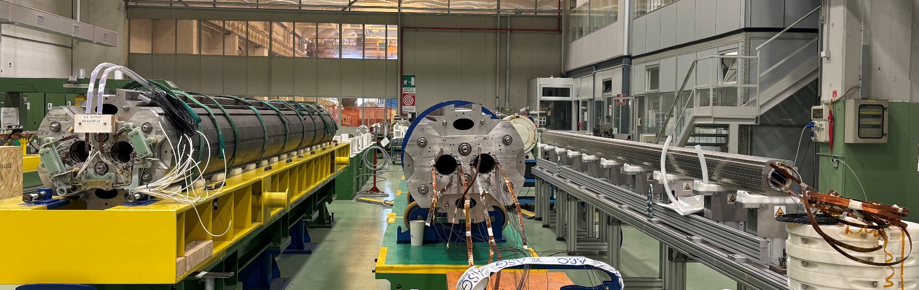
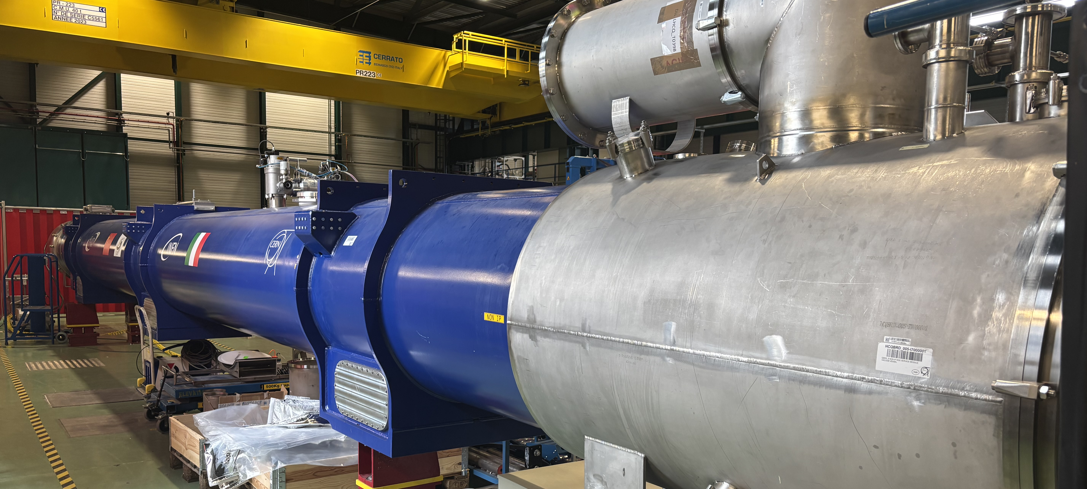
D2 – Progress from October 2024
STATUS
MBRD2 cryostating activities completed, ready for shipment to SM18
MBRD3 magnet was completed, but must be disassembled (cable protruding into the aperture, see
NCR 3235964) → Magnet delivery expected in September 2025
MBRD4 assembly ongoing, magnet to be completed in April 2025. First aperture of MBRD5 collared.
6 months delay for magnet 5 and 6, due to the re-work of magnet 3.
MBRD1, assembled in LMBRD2 cold mass
MBRD3, to be disassembled
MBRD4, to be completed in April
1st aperture of MBRD5
MBRD2, ready for test
Status ASG production during the CERN visit 18/03/2025 (EDMS 3284104)
(S. Farinon, A. Foussat, H, Prin, D. Duarte, et al)

Slide 14
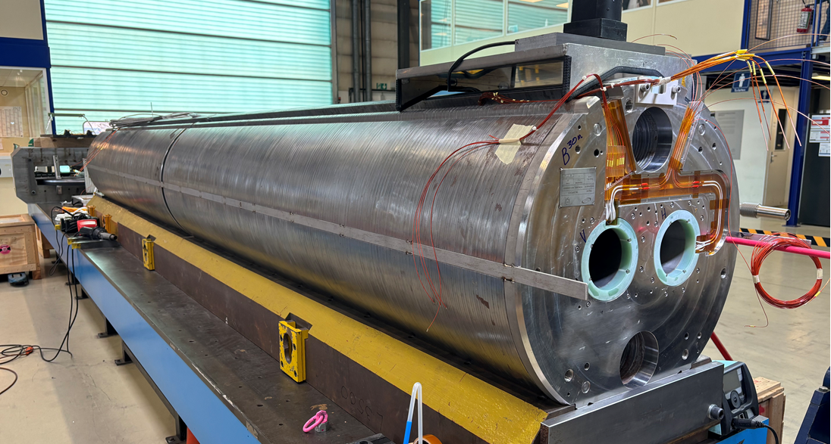
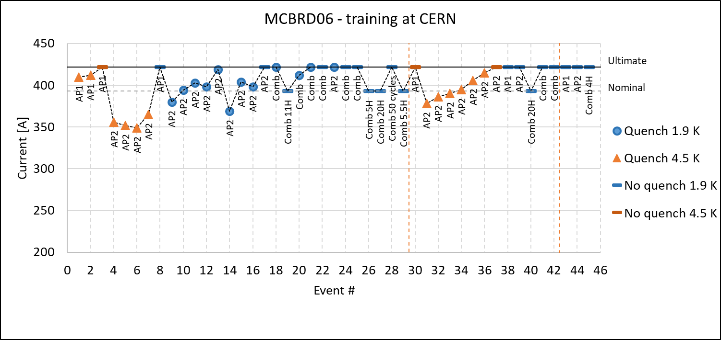
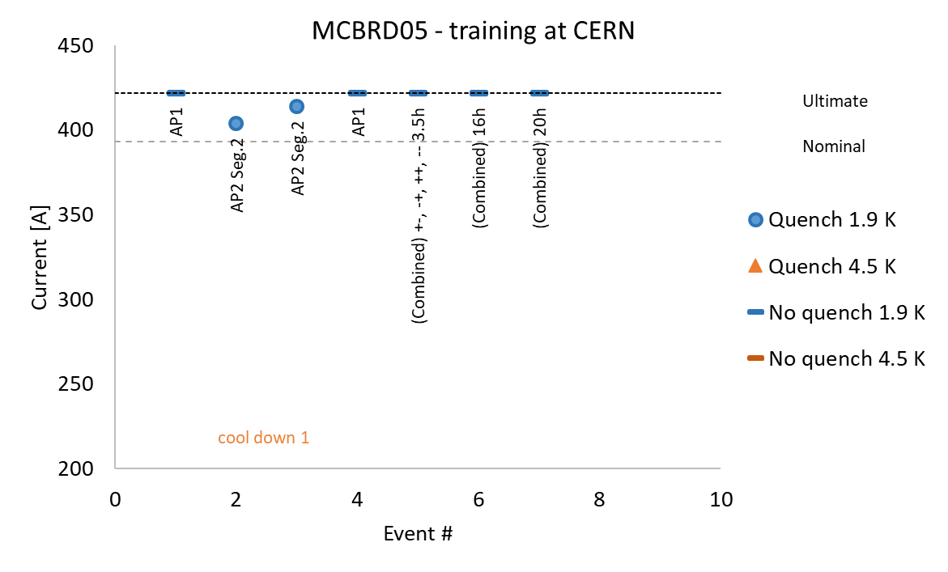
D2 Correctors – Progress from October 2024
STATUS
Three magnets delivered: MCBRD05 (tested in China), MCBRD06 (virgin) and MCBRD07 (virgin)
  Long training in MCBRD06 at 4.5 K, but OK at 1.9 K
  Good performance of MCBRD05 confirmed at CERN
All magnets expected to be at CERN before the end of 2025
Problems on the machining of the former are delaying the assembly of MCBRD11
CD1
CD2
CD3
Test report: EDMS 3263622
Test report: EDMS 3282742
(Q. Xu, A. Foussat, et al; Test engineer: G. Willering)

Slide 15
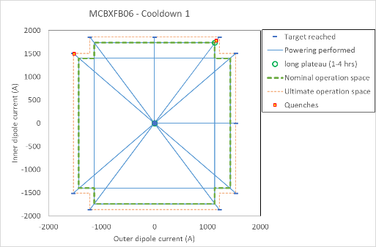
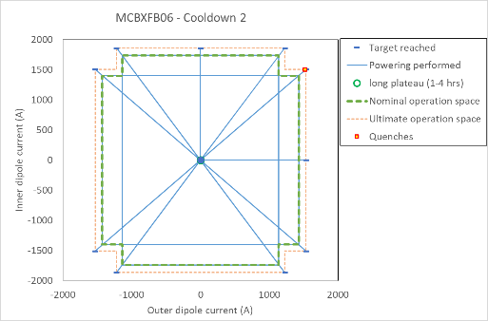
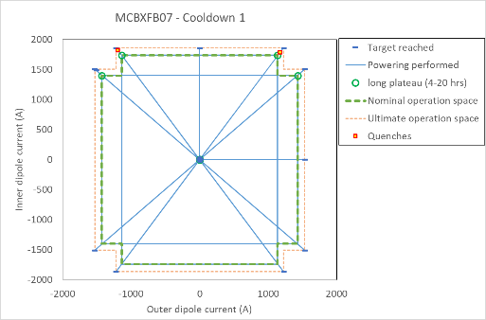
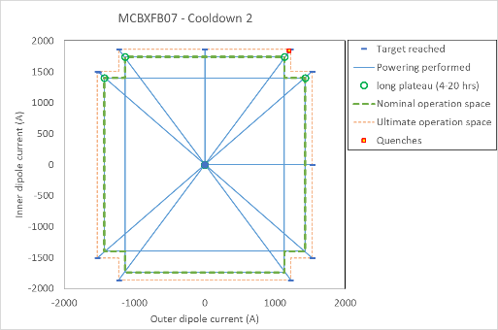
MCBXF
STATUS
Two more magnets qualified: MCBXFB06 and B07. The test of MCBXFA2 is ongoing.
  MCBXFB06 and MCBXFB07 operated > 40 h above nominal current without spontaneous quenches when testing in vertical configuration
MCBXFA6, MCBXFB11, MCBXFB12 removed from CIEMAT deliverables
  These magnets were spares of the spares.
The coil readiness for assembly is in the critical path for the spare magnets, it will impact the assembly schedule of the last two Q2 cold masses
MCBXFB06, EDMS 3221448; MCBXFB07, EDMS 3230565
(F. Toral, J. C. Perez, et al; Test engineer: G. Willering)

Slide 16
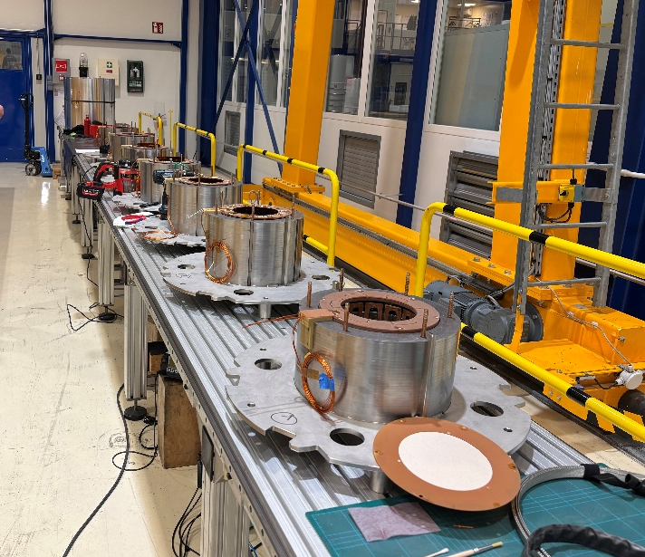
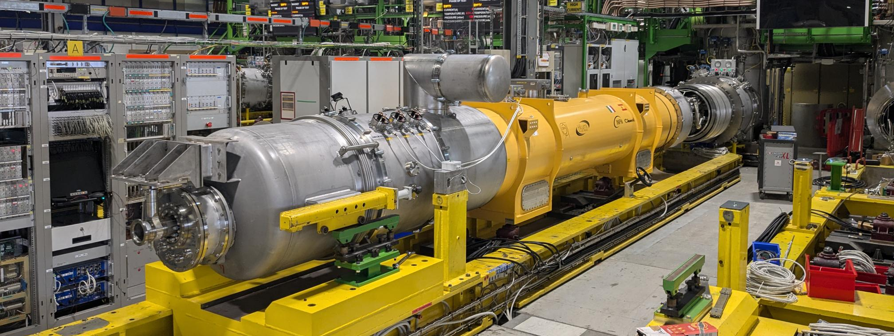
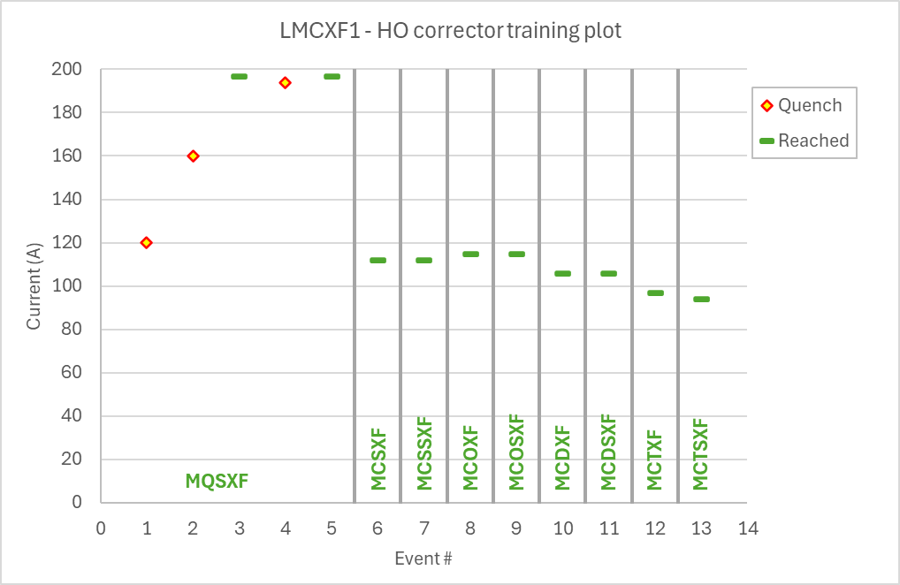
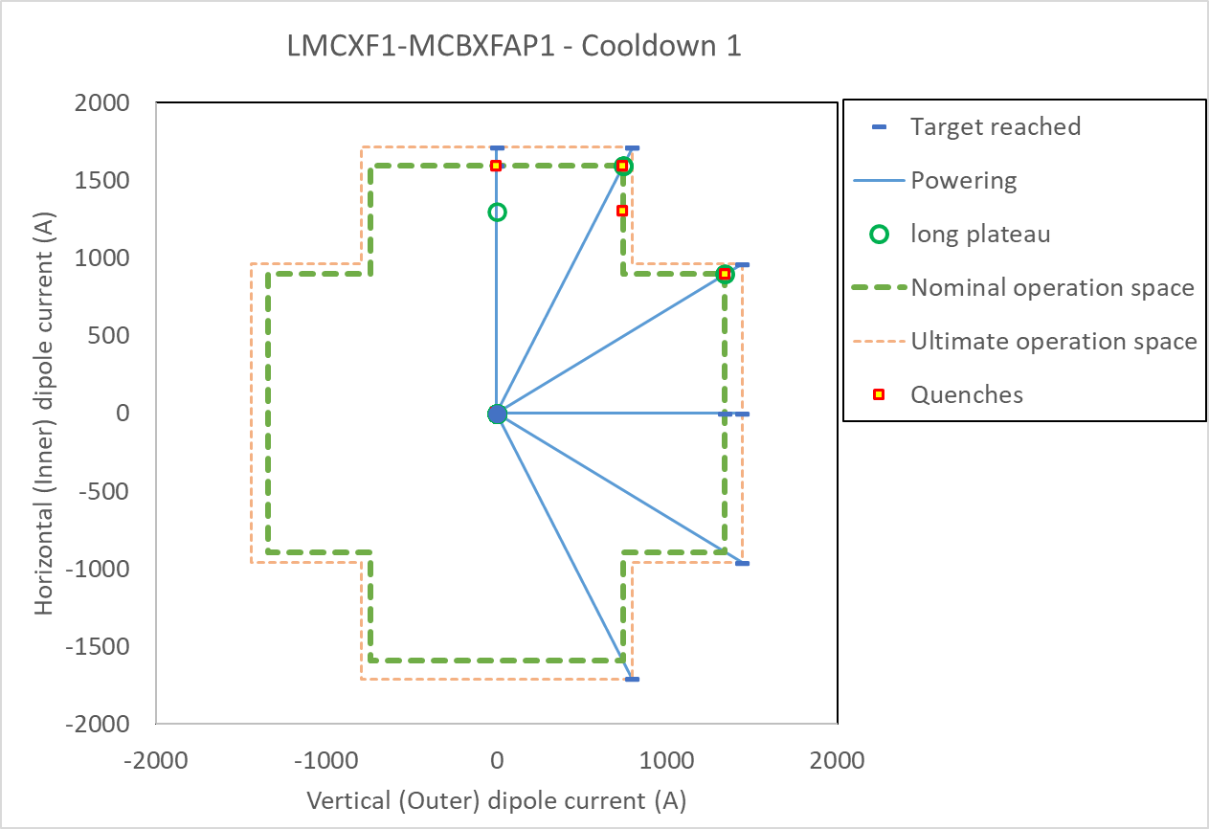
CP
STATUS
Test 1st cold mass, see test report EDMS 3213574)
  Spontaneous quenches (NCR 3219461) during extended powering in MCBXFAP1 magnet. The quench is always in the same coil, and it does not have a mechanical origin (quench also in stand alone powering of the inner dipole with lower electromagnetic forces).
The first HO corrector with damaged leads was repaired at SAES RIAL (see EDMS 3200053), the repair of the rest (17) is ongoing (CERN, LMF)
  Few magnets will be re-tested to qualify the repair procedure.
Repair of damaged leads in HO correctors @ LMF
(M. Statera, F. Toral, J. C. Perez, H, Prin, D. Duarte, et al; Test engineer: G. Willering)

Slide 17
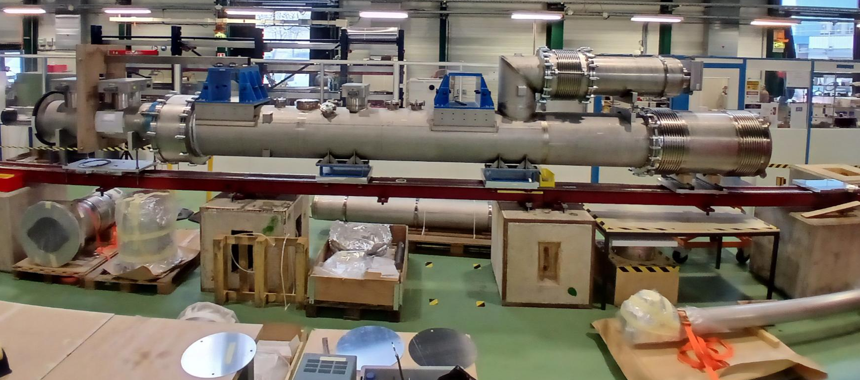
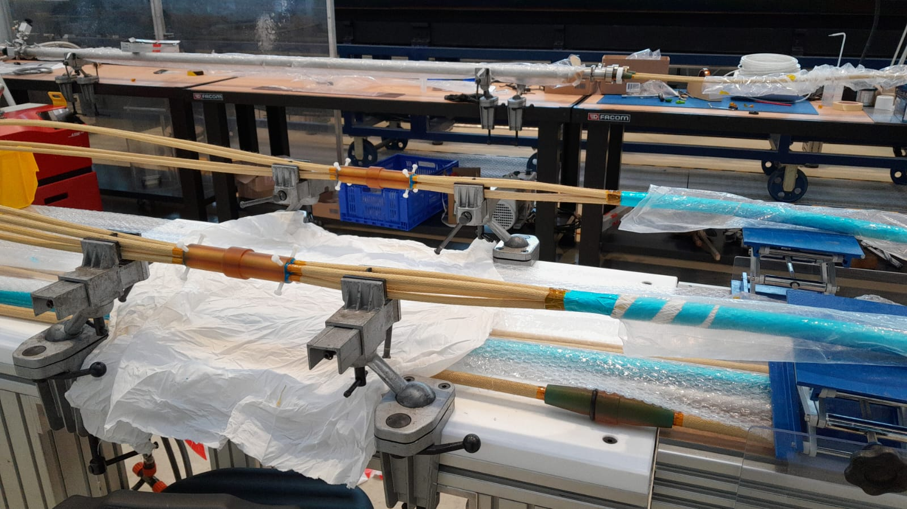
DCM
The prototype DCM was completed and fully qualified for installation in the string
The production of the busbars for the first unit for the series is ongoing
  Assembly in the DCM He Vessel will start after completion of connection activities in the IT-String (May).
Prototype DCM ready to be installed in the string
Busbars preparation for the 1st series unit
(R. Diaz, L. Baudin, et al)

Slide 18
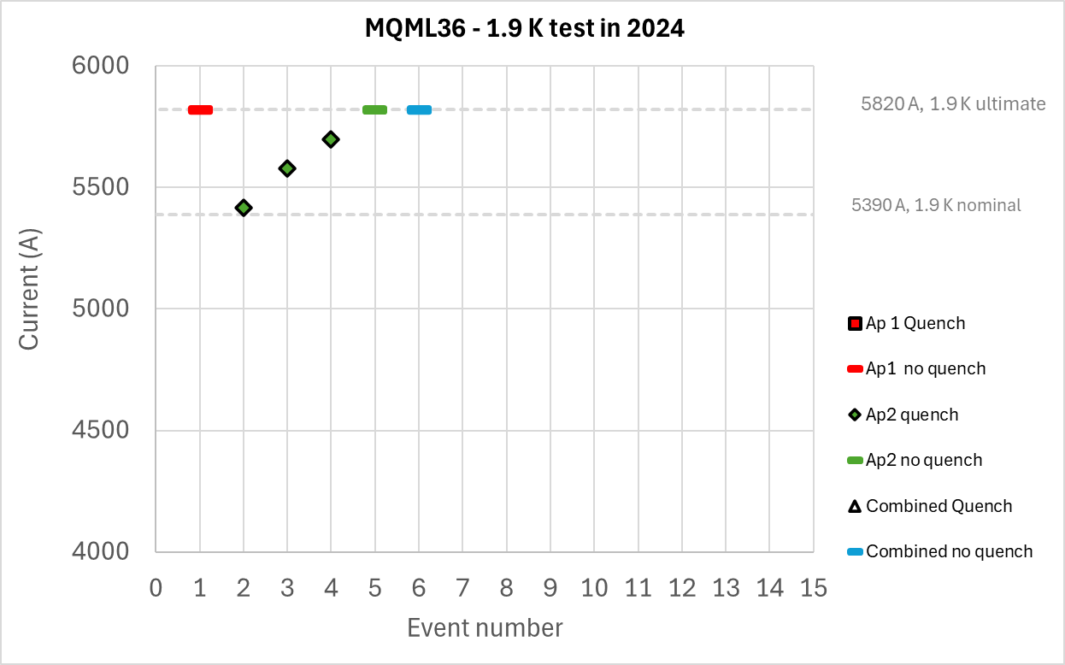
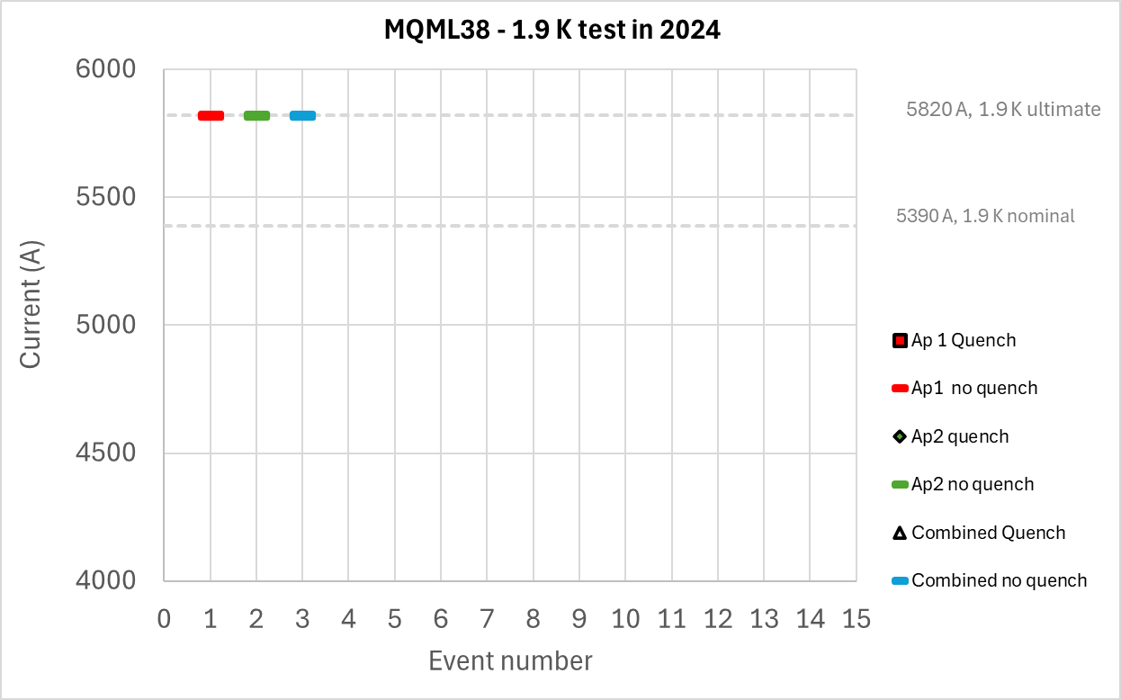
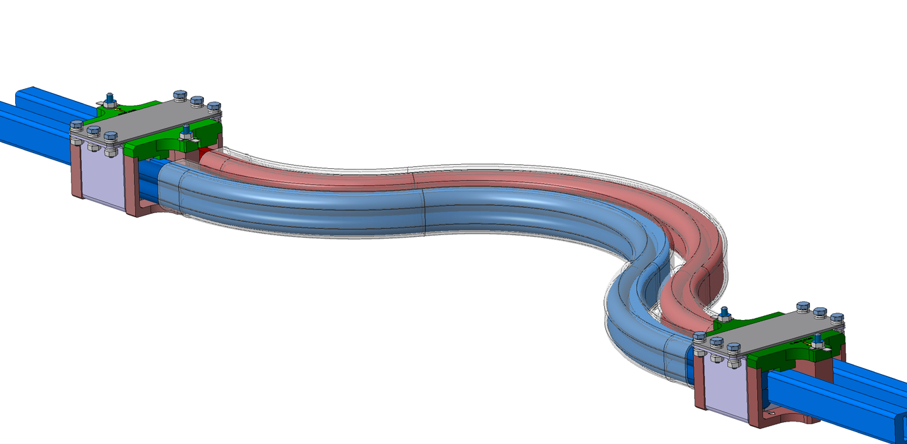

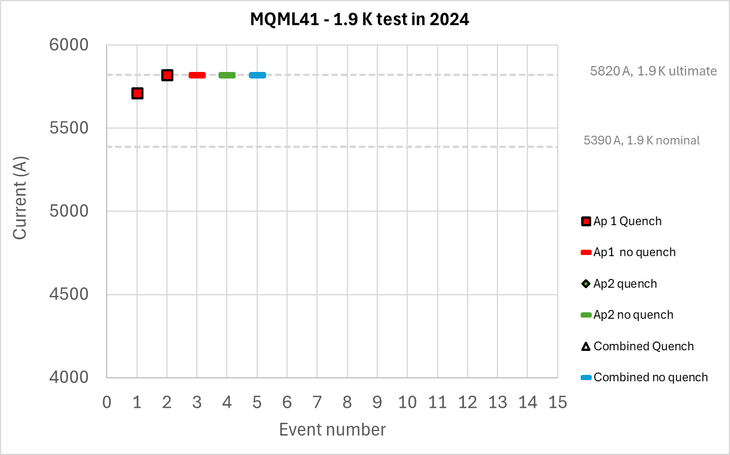
Q10
STATUS
All the magnets needed for HL-LHC Q10 cold masses have been qualified in SM18 (4 MQML and 4 MSCB)
Components are ready to start assembly
New busbar design for Q10 cold masses
Test engineer: G. Willering

Slide 19
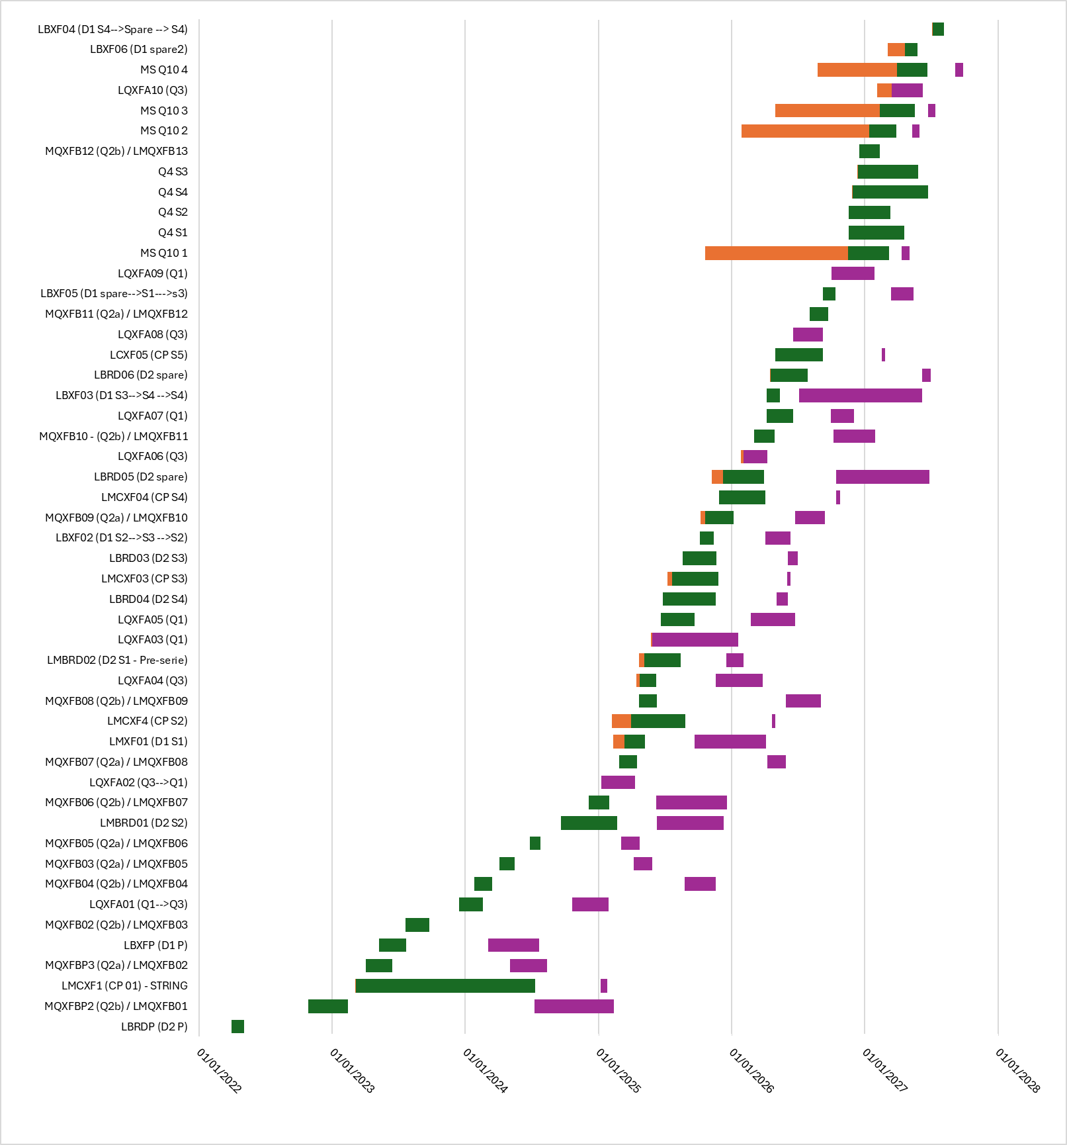
Cryostating
STATUS
Production ramp up coming!
Addendum for bellows delivery agreed and signed with Kompaflex: today it fulfils the SMI2 production needs for cryostating, but the delivery is done in small batches until first half of 2026
  It remains a topic to be closely followed up on our side.
To finish all cryomagnets by mid-2027 (including Q4 and Q10), SMI2 is getting close to its production capacity.
  To be carefully monitored since it can become critical in case of NCs, further delays on magnet deliveries or additional cryostating work not in the planning today (for example AUP cryo-assemblies)
  We expect an over-cost on material budget, to be further assessed this year
Phase1
Phase2
Waiting time
Today
D. Duarte Ramos, EDMS 3220596

Slide 20
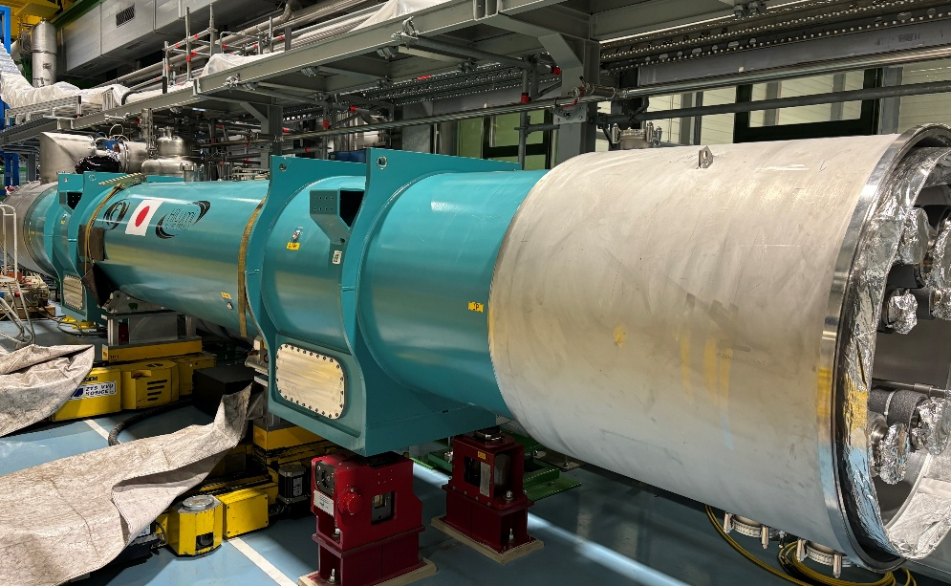
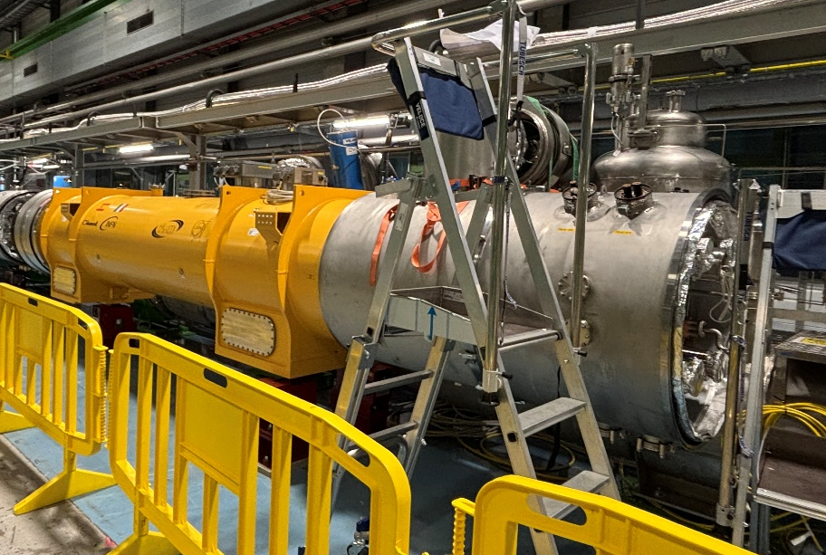

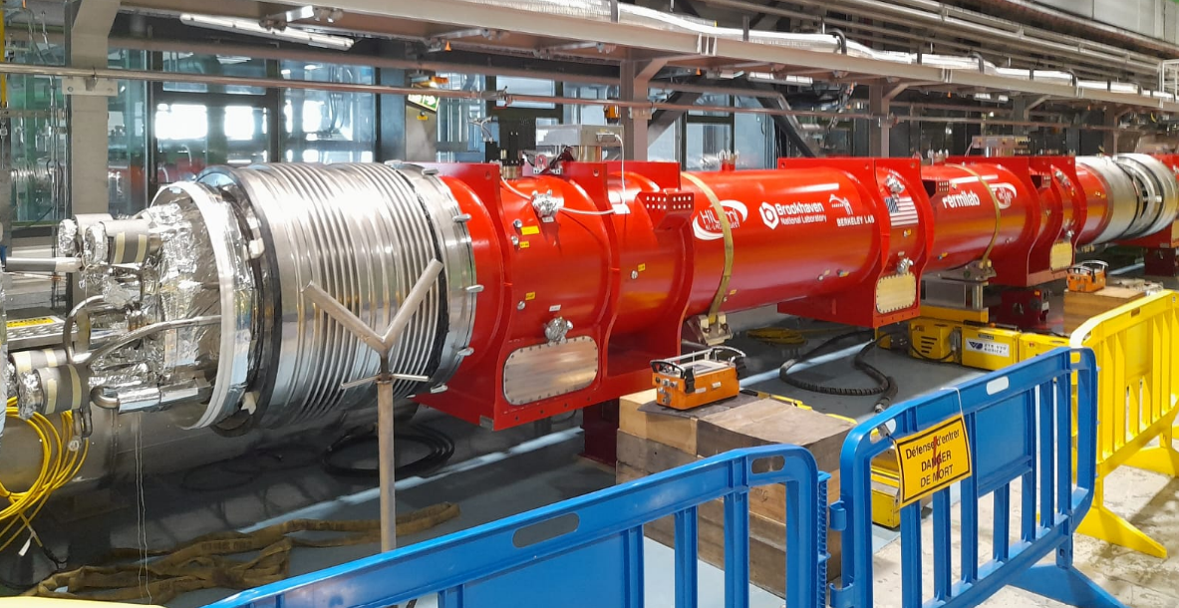
All cryo-assemblies but Q1 installed in the string!
STATUS
Q2a: Installed
D1: Installed
CP: Installed
Q2b: Installed
Q3: Installed. Q1 will be ready mid April.

Slide 21
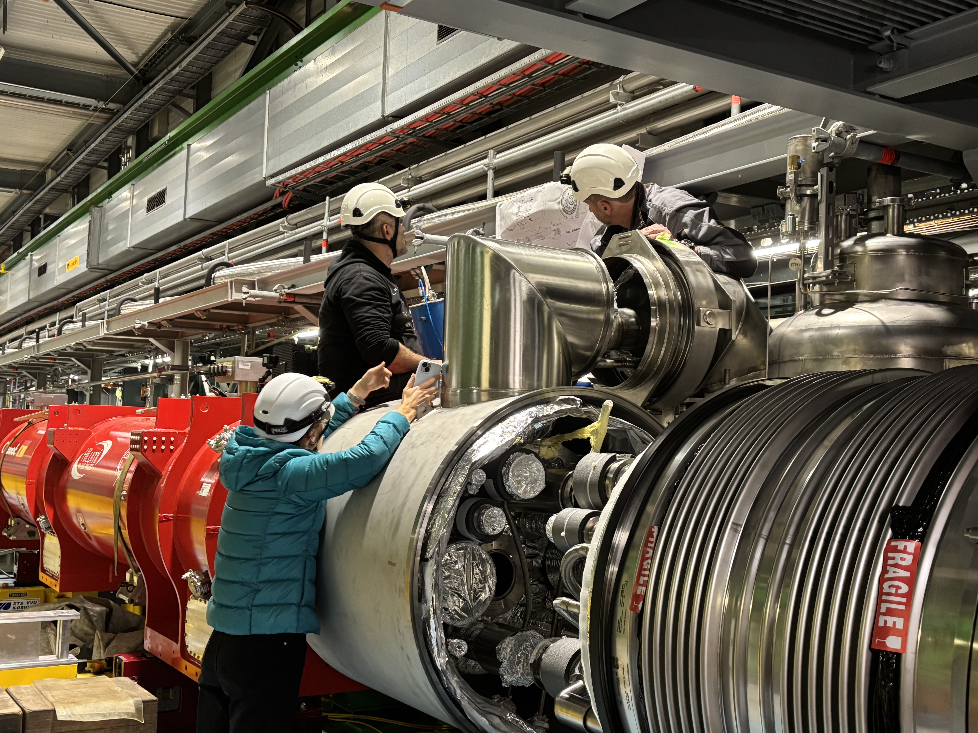
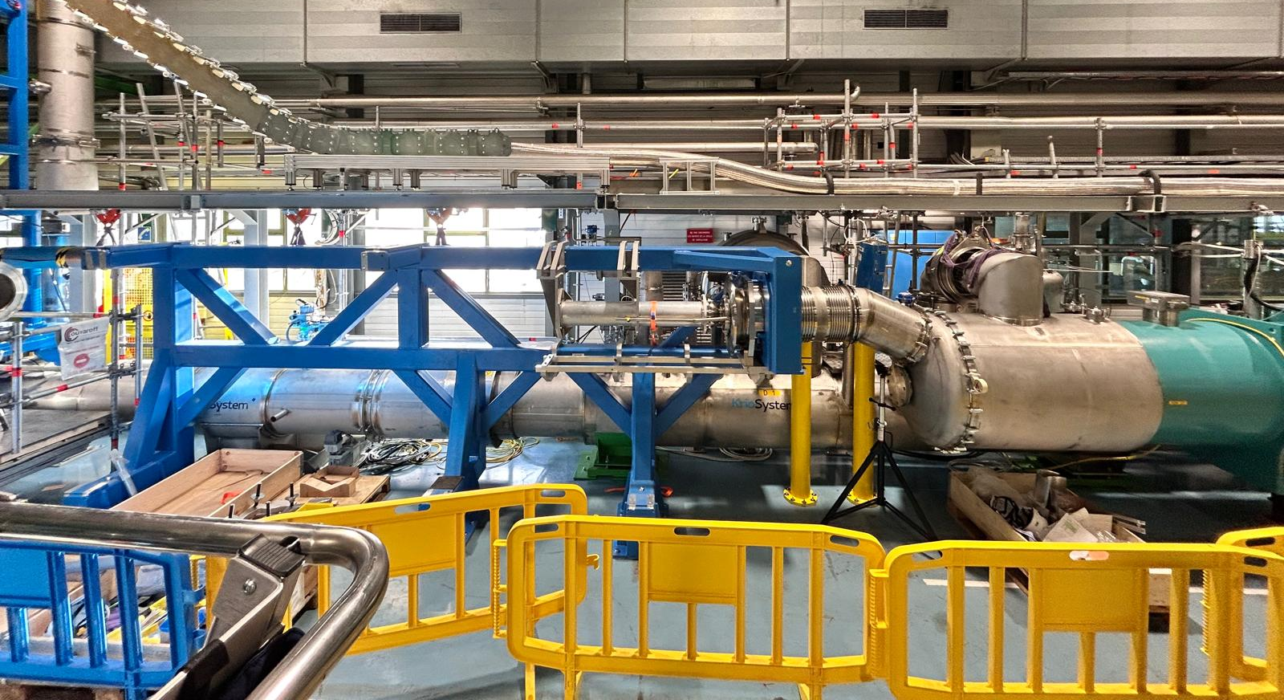
IT-String
Interface Jumper/SQXL in the IT-String required several iterations and adaptations.
  WP16 will write an NCR to trace the issues resolved and iterations needed
  First return of experience was shared with WP15 link (24/01/2025) , to better prepare the work during LS3:
    WP9 is finishing the interface drawings listed in HL-LHC jumpers' interface specification and requirements for flexibility of QXL jumpers.
    WP3 will be involved in the review of the 3D CAD of the jumpers on the QXL side
Successful trial assembly of the DCM and connection to D1
Jumper/SQXL interface
Connection DCM to D1 test
N. Bourcey, H, Prin, et al
R. Diaz, et al

Slide 23
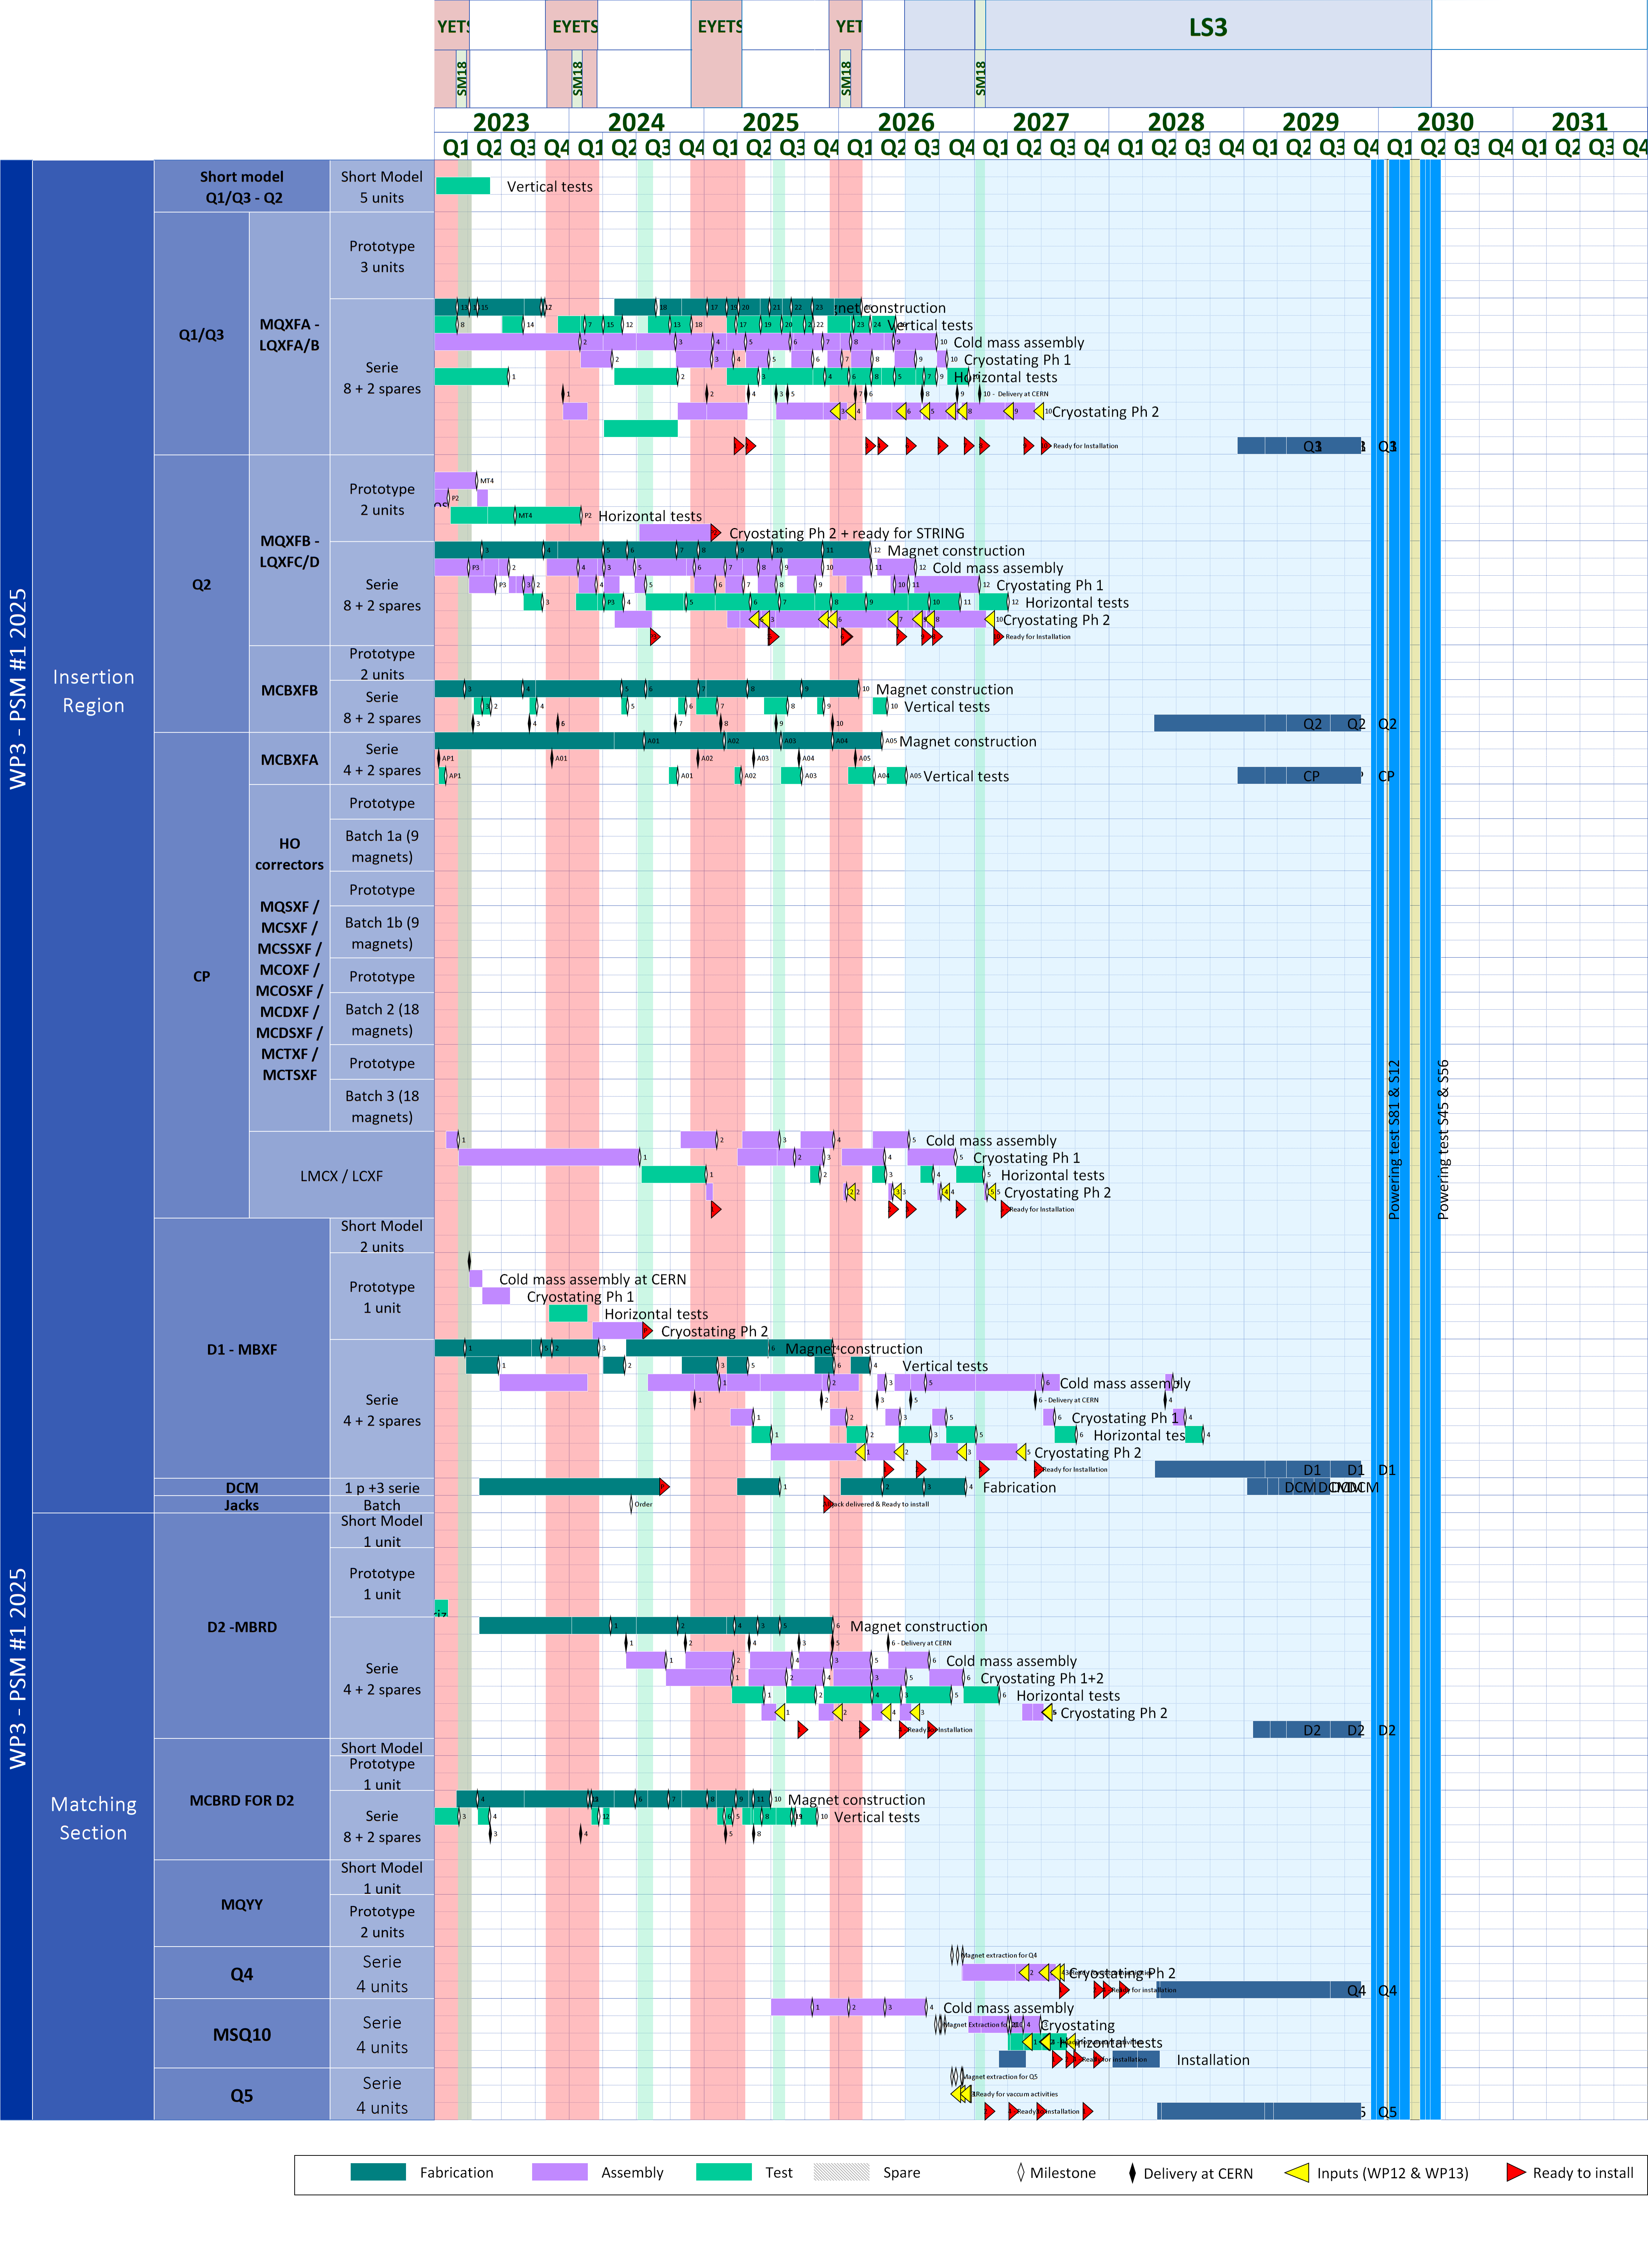
Reference schedule
PSM1-2025

Slide 24
Installation Float Long Straight Section 5 Right. IP side with smallest float for magnets
Paolo Fessia
 | C&S ‘24 Float Working version of schedule to be optimized with CERN need by dates and hp. inst. shift +3 m. |  | Chamonix ‘25 Float vs. version of updated schedule in work (average. inst. shift vs. LS3RR ≈ +6 m) |  | Target Projected Float with farther optimization of 2 months
 | Vs. Transp. | Vs. Install. | Vs. Transp. | Vs. Install. | Vs. Transp. | Vs. Install.
Q4 | 2 | 12 | 2 | 12 | 2 | 12
D1 | 9 | 21 | 13 | 25 | 11 | 23
Q2b | 11 | 23 | 15 | 27 | 13 | 25
Q3 | 13 | 15 | 17 | 19 | 15 | 17
Q1 | 17 | 19 | 20 | 23 | 18 | 21
Q5 | 18 | 18 | 17 | 18 | 17 | 18
CP | 21 | 23 | 24 | 27 | 22 | 25
Q2a | 26 | 28 | 30 | 32 | 28 | 30

