Slide 1
SHORT STRAW DETECTOR AS-BUILT UPDATE
SMARTEAM : ST1A23380

Slide 2
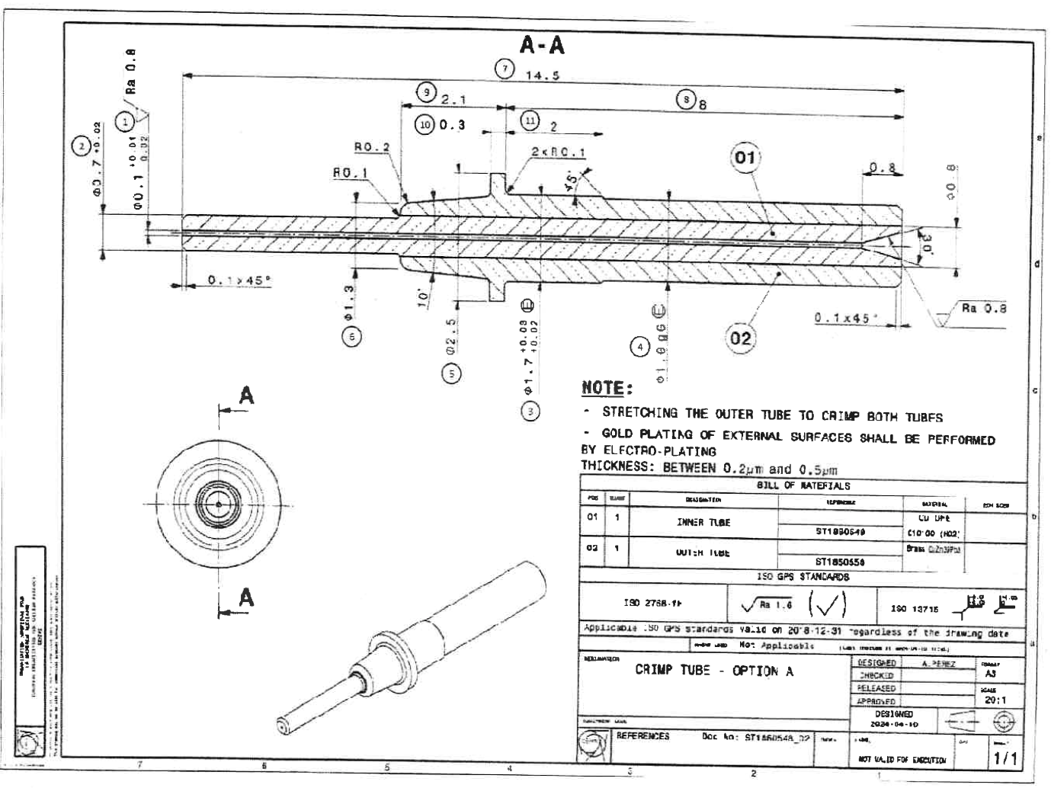
SHORT STRAW PROTOTYPE _ MASS PLUG
ST1A23467
COPIE ST1A00636 (DRAWING A.PEREZ ,FOR
LONG STRAW PROTOTYPE)
GAS CHANNEL TO BE VALIDATED (SLIDE 3)
DRAWING TO BE DONE
N° _____
READ OUT SIDE
SHORT PROTOTYPE_ CRIMP TUBE
ST1A23754
DRAWING
PDF ATTACHED IN SMARTEAM
STRAW PROTOTYPE
METALLIC SPRING PIN
ST1A23665
COPY ST1571594 (DRAWING A.PEREZ)
WITH MODIFIED LENGTH
LENGTH TO BE VALIDATED
DRAWING TO BE DONE
N° _____
HV PLUG
ST1571592
DRAWING A.PEREZ
N° _____
STRAW PLUG
ST1571587
DRAWING A.PEREZ
N° _____

Slide 3
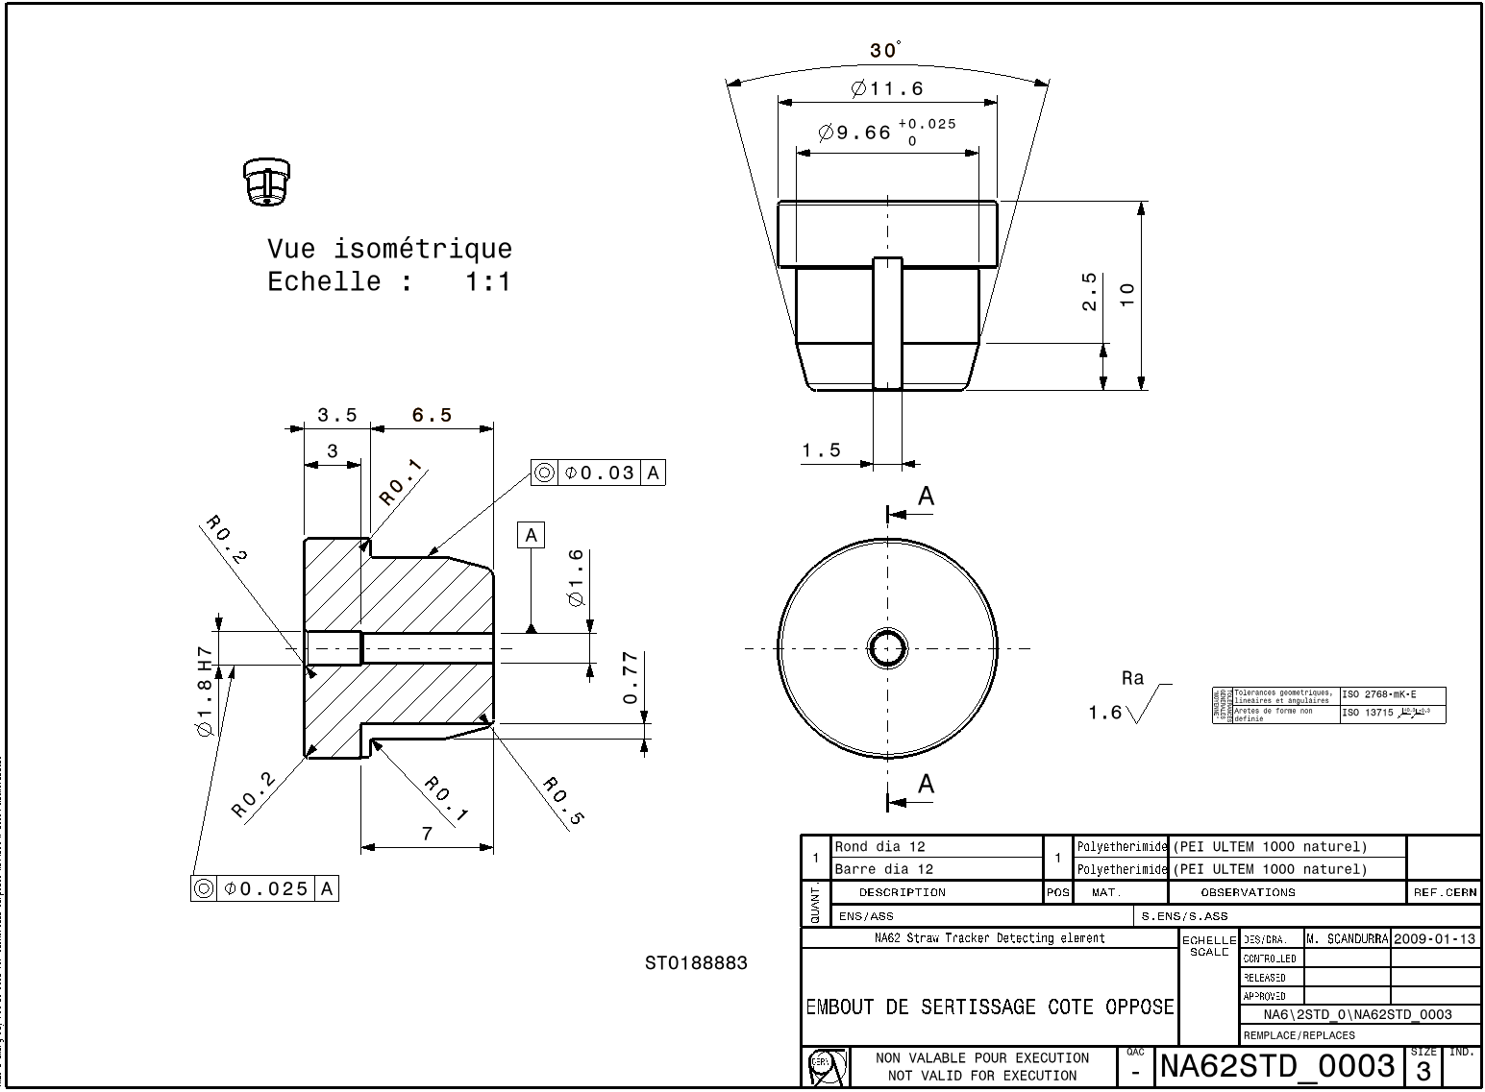
READ OUT SIDE
SHORT STRAW PROTOTYPE _ MASS PLUG
ST1A23467
DEPTH 0.77mm
GAS CHANNEL
DEPTH
THICKNESS 0.13mm
GAS CHANNEL

Slide 4
OPPOSITE SIDE
LENGTH TO BE VALIDATED
SHORT STRAW PROTOTYPE _ OPPOSIT SIDE PLUG
ST1A23593
NEW PART
DRAWING TO BE DONE
N° _____
ensemble élément de détection
ST0190031
DRAWING A.PEREZ
NASTD_0005/ATLI TD___0015
STRAW PLUG
ST1571587
DRAWING A.PEREZ
N° _____

Slide 5
Next step:
- MAKE THE MISSING DRAWINGS + MASTER DRAWING
METALLIC SPRING PIN and OPPOSIT SIDE PLUG , CHECK THE LENGTH
MASS PLUG, CHECK THE GAZ CHANNEL

