Slide 1

TR from complex radiators
Ivan Zhutikov

Slide 2
The development of a model of charge diffusion in semiconductors was continued. Using the FEM (Finite Element Method), a solution for the Poisson equation was obtained and a complete simulation of the evolution of charge in a constant electric field was obtained.

Slide 3
Drift-diffusion model
The model includes the following basic equations:
  1. Continuity equation:
  2. Drift-diffusion equation:
  3. The Poisson equation:

Slide 4
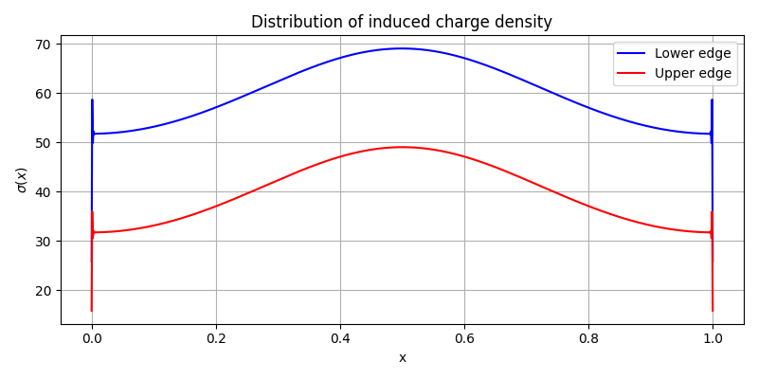
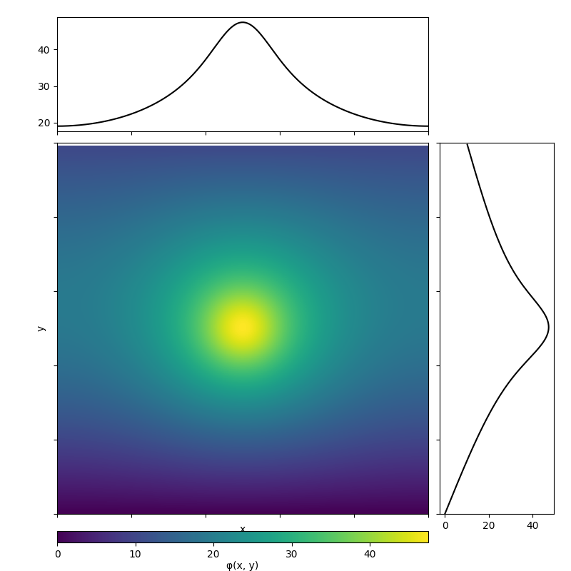
Results for point charge
Point charge cloud
Inside, the charge is distributed according to Gauss
A voltage of 10 V is applied to the boundaries.
ε = 1, Q = 100 C, all values are taken arbitrary for better visualization.

Slide 5
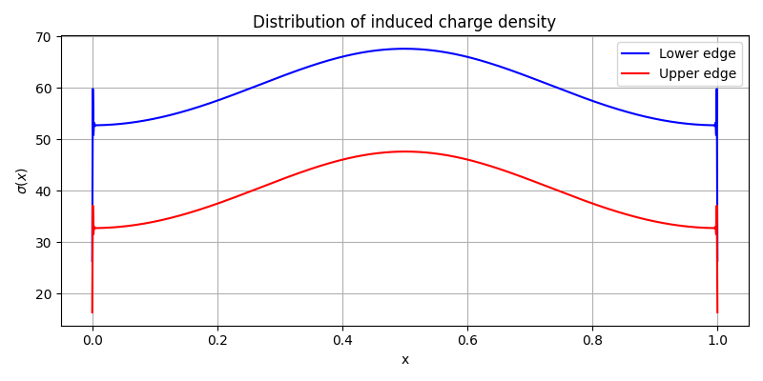
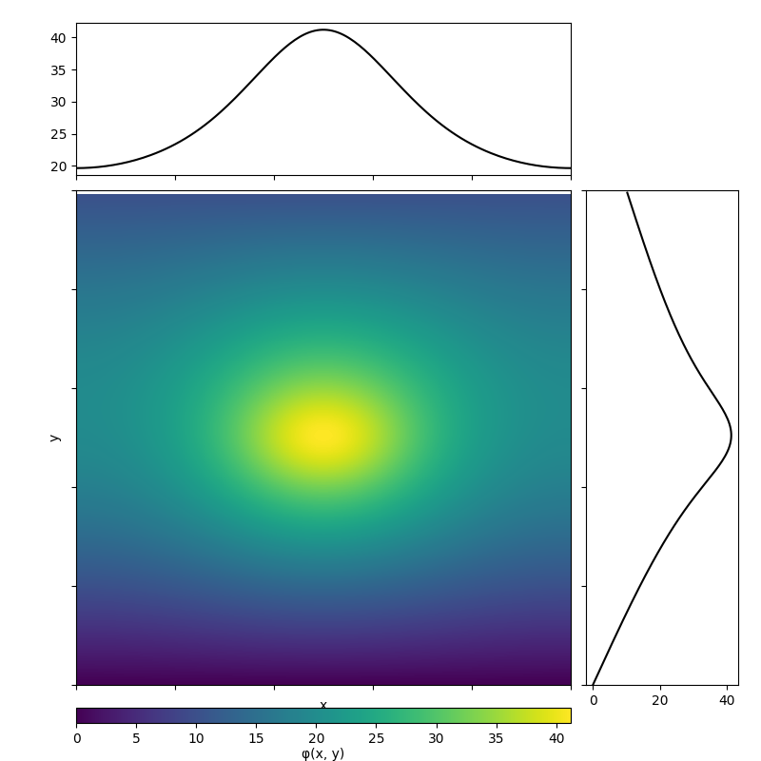
Results for elliptical charge
Elliptical charge cloud
Inside, the charge is distributed according to Gauss
A voltage of 10 V is applied to the boundaries.
ε = 1, Q = 100 C, all values are taken arbitrary for better visualization.

Slide 6
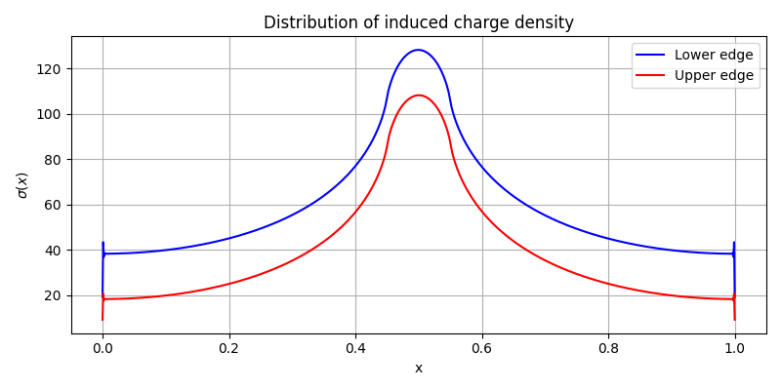
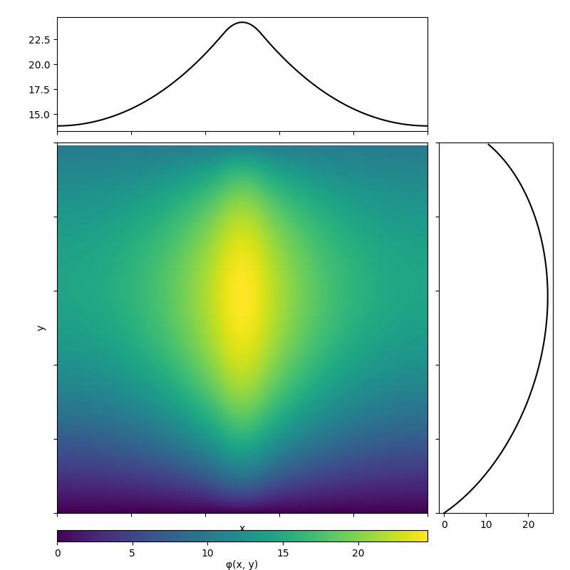
Results for charge from particle
Rectangular trace of a particle in which the charge is evenly distributed
A voltage of 10 V is applied to the boundaries.
ε = 1, Q = 100 C, all values are taken arbitrary for better visualization.

Slide 7
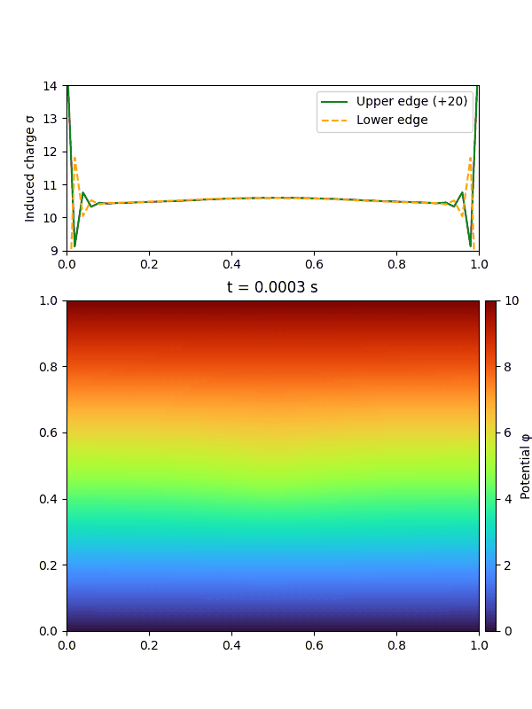
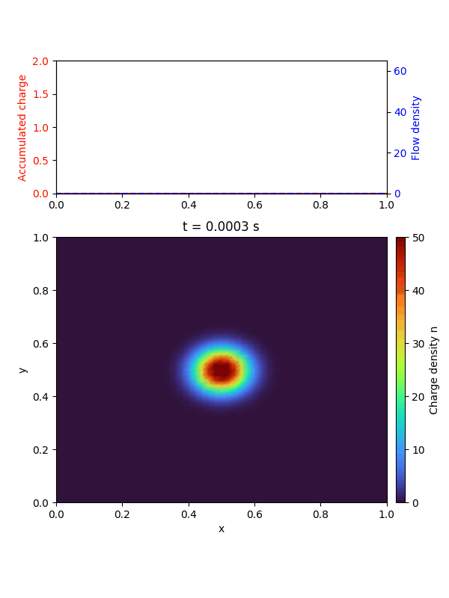
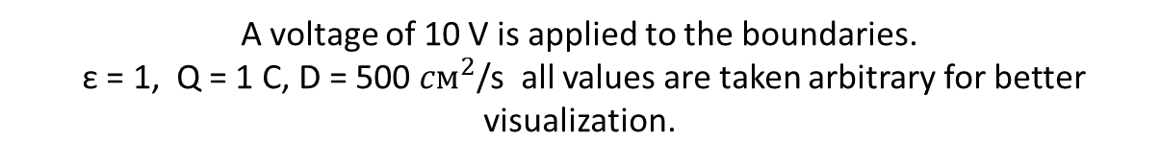
Results for point charge
A voltage of 10 V is applied to the boundaries.
ε = 1, Q = 1 C, D = 500 ${cм}^{2}$/s all values are taken arbitrary for better visualization.

Slide 8
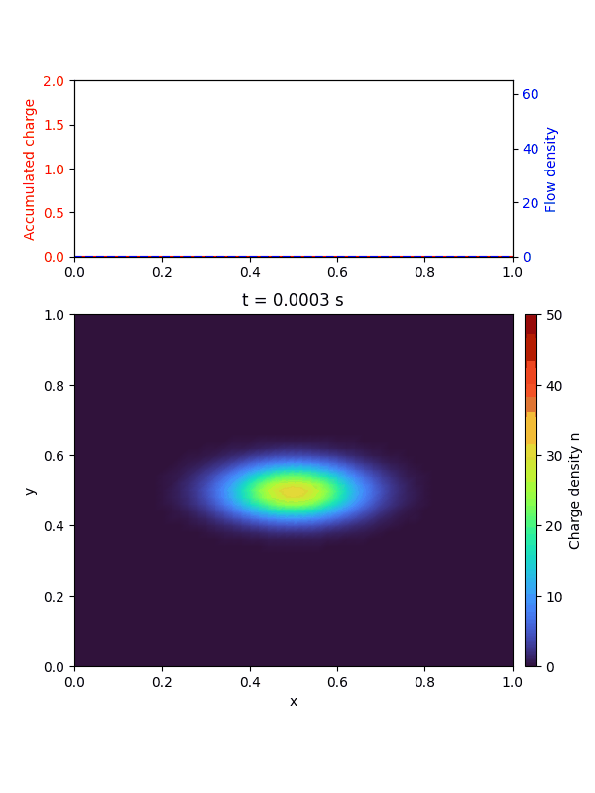

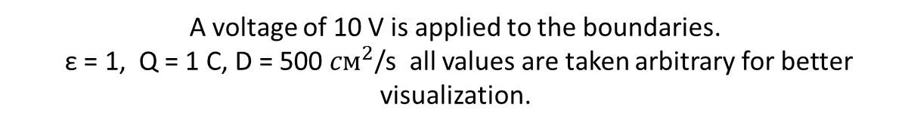
Results for elliptical charge
A voltage of 10 V is applied to the boundaries.
ε = 1, Q = 1 C, D = 500 ${cм}^{2}$/s all values are taken arbitrary for better visualization.

Slide 9
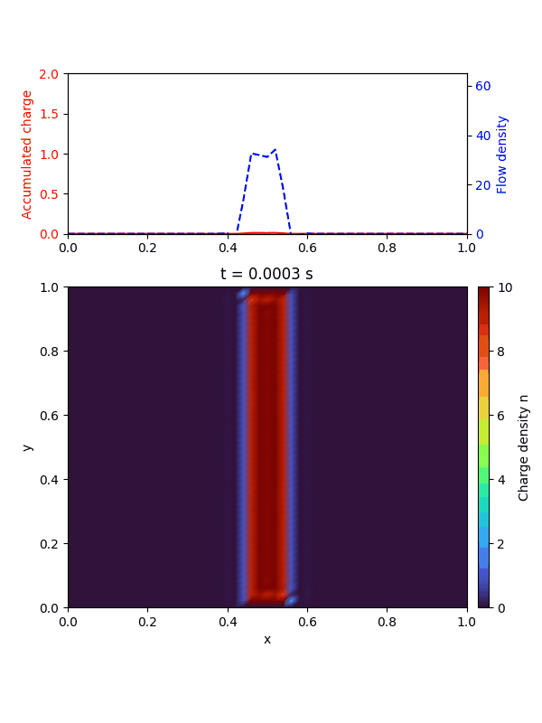

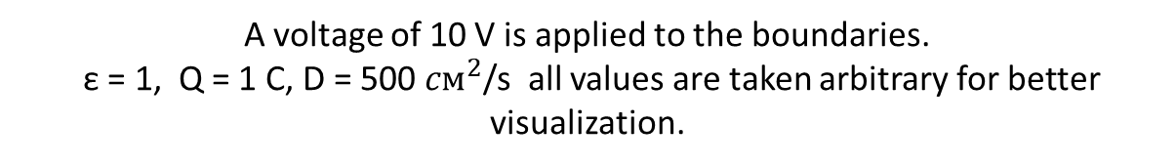
Results for charge from particle
A voltage of 10 V is applied to the boundaries.
ε = 1, Q = 1 C, D = 500 ${cм}^{2}$/s all values are taken arbitrary for better visualization.

Slide 10
Thanks

