Slide 1



Hannover Messe visit 2025
Hans Christian Tøfte
Andrés Viéitez Suárez

Slide 2
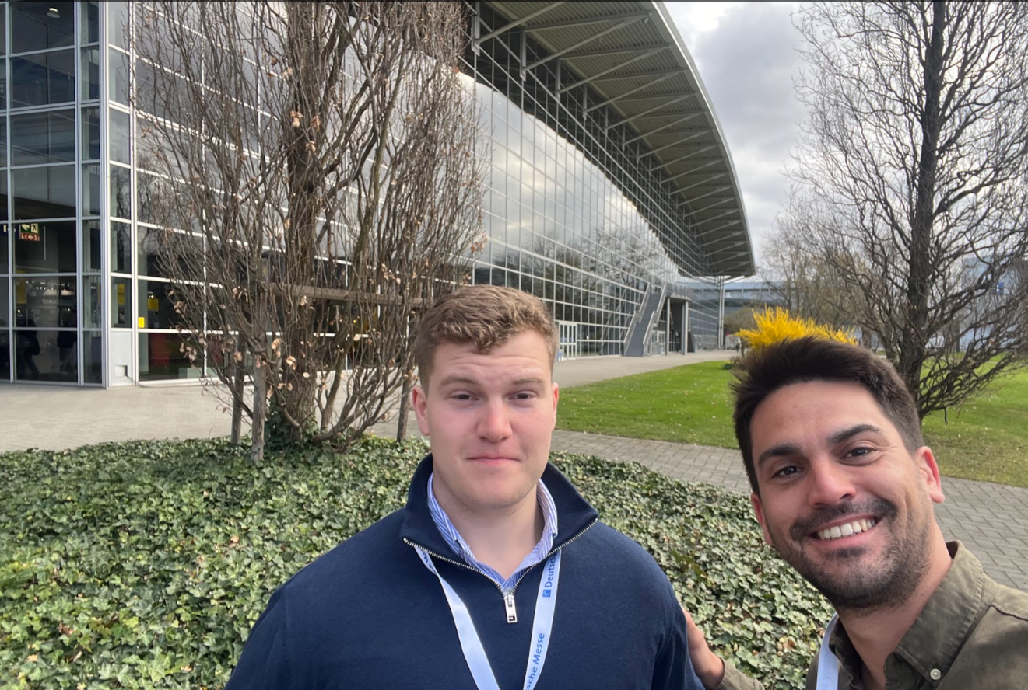
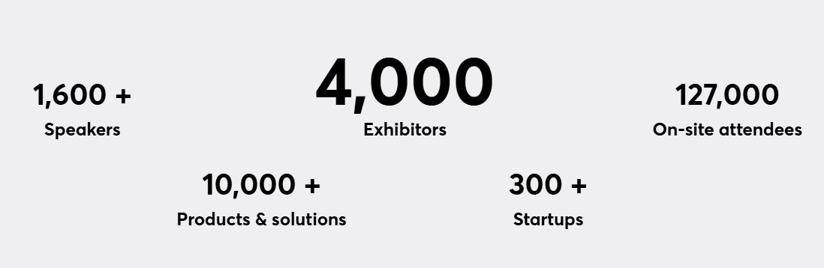
Hanover Messe 2025
Expositors from all over the world
Visited Monday 31.03 and 01.04.
Notes:
Struggle country members (mostly China)
Big installation, we started exploring the buildings
Hidrogen, electricity, manufacturing, robotics, hidraulic and pneumatic, Research institutions

Slide 3
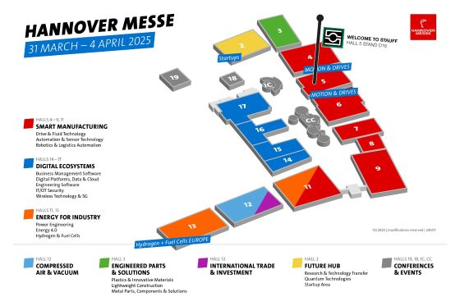
Purpose
Coatings on metallic components
Electrical insulator High temperature
Ceramic matrix composites, sinter ceramics, ceramic prepregs
Advanced Polymers
Long bronze plates

Slide 4

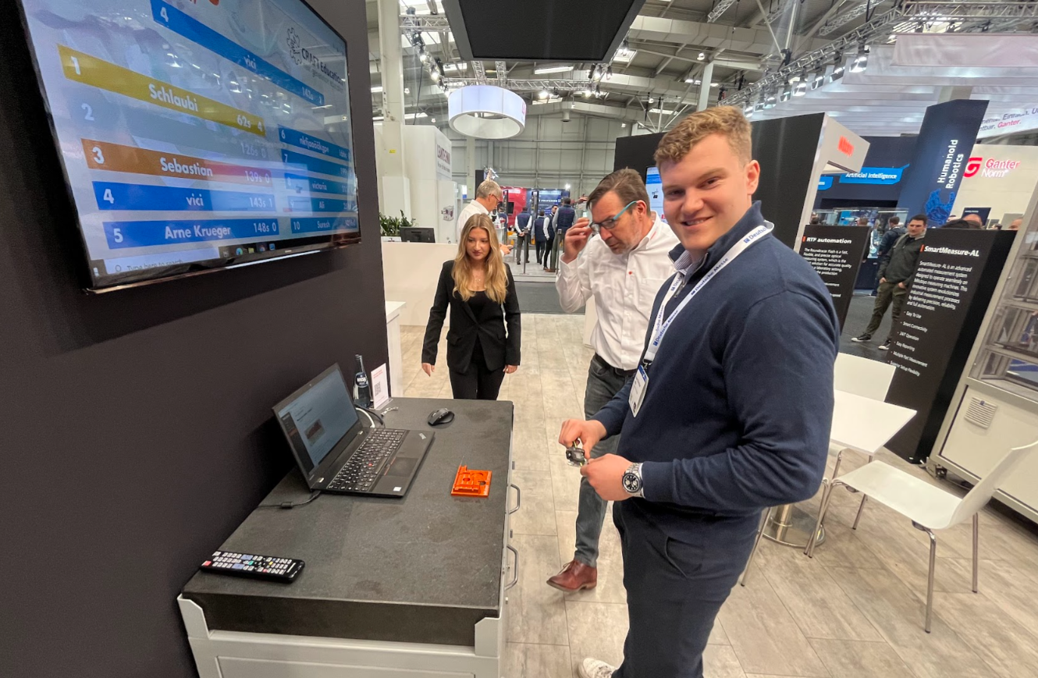
Metrology

Slide 5

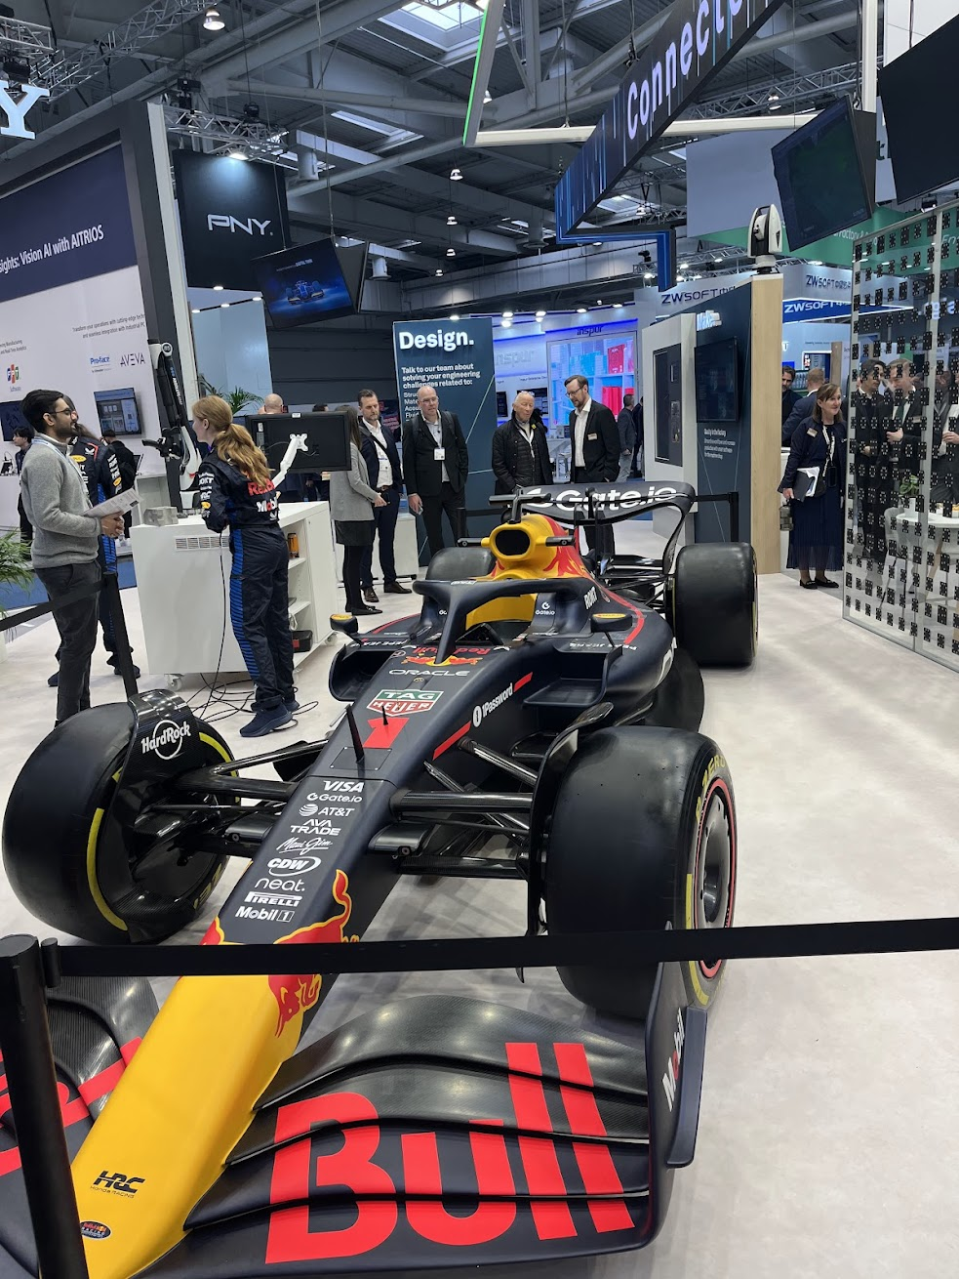
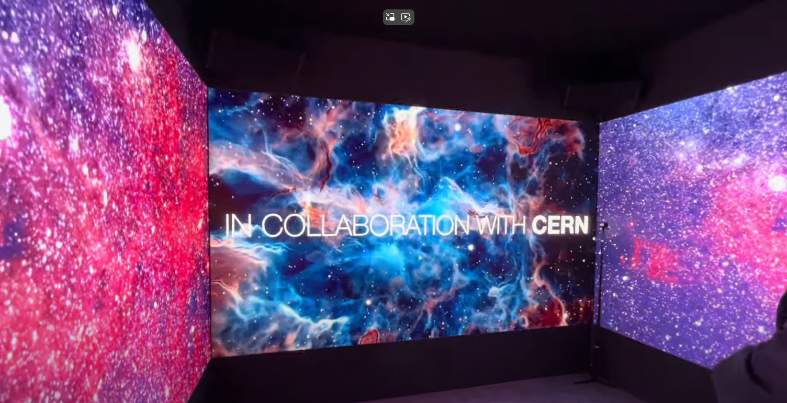
Metrology

Slide 6



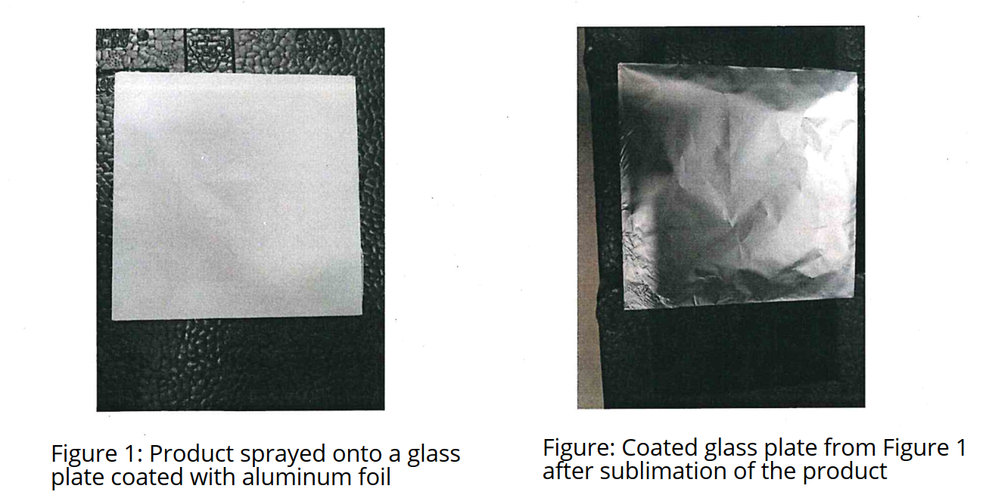
Metrology
Steffen Kappes
Steffen Kappes
Steffen Kappes
R&D in metrology
Residual particles – 9.7mg/kg

Slide 7
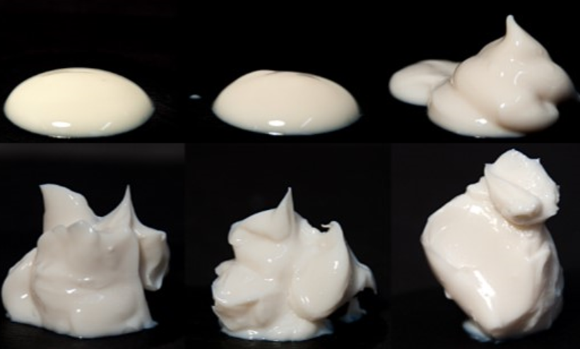


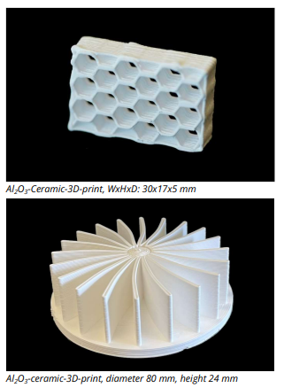
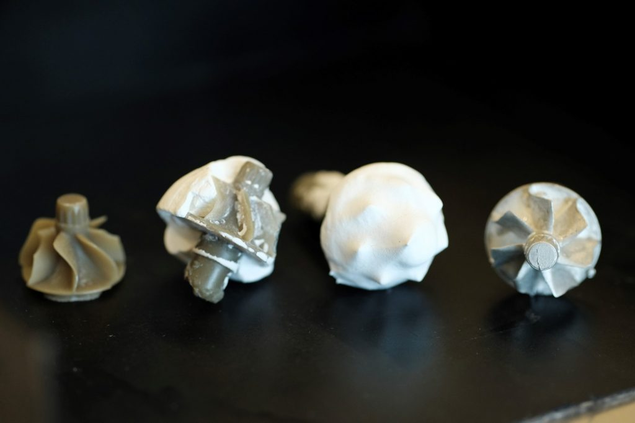
Ceramic
Dr.David Menne
Water-based capillary suspension
R&D Ceramic Slurry
3D printing, Glues, casting, coatings

Slide 8

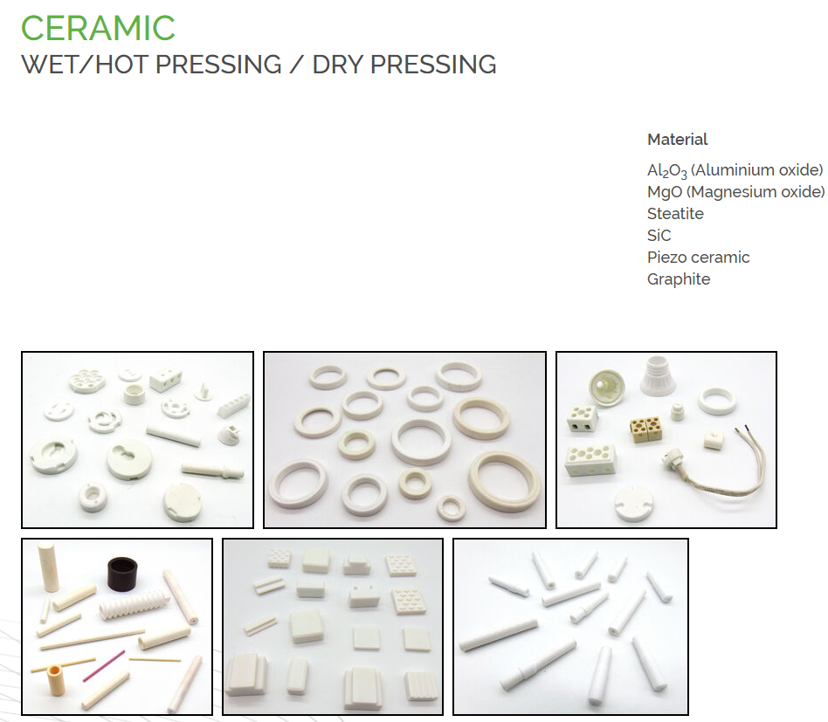
Ceramic
Jannic Lange

Slide 9

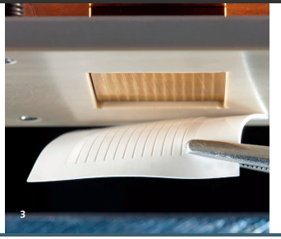
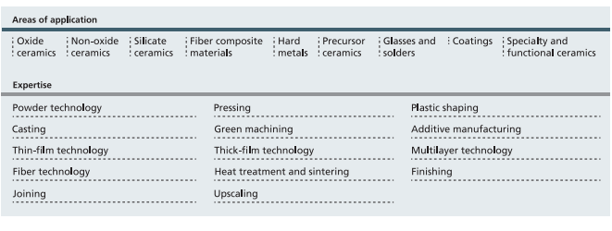
Ceramic
Dr. Carl Heinze
Fraunhofer match
Open to develop short series of ceramic matrix composite plates

Slide 10

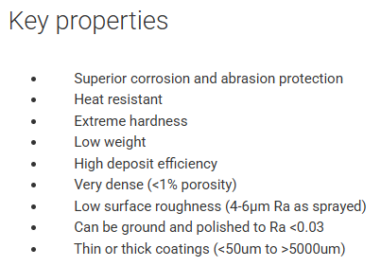
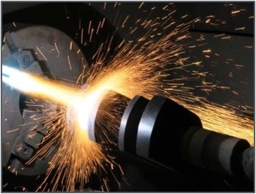
Ceramic coating
David Scamardella
Thermal spray of Silicon carbide

Slide 11

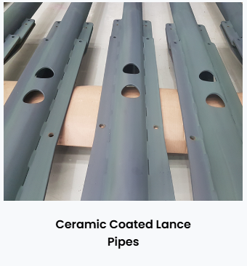
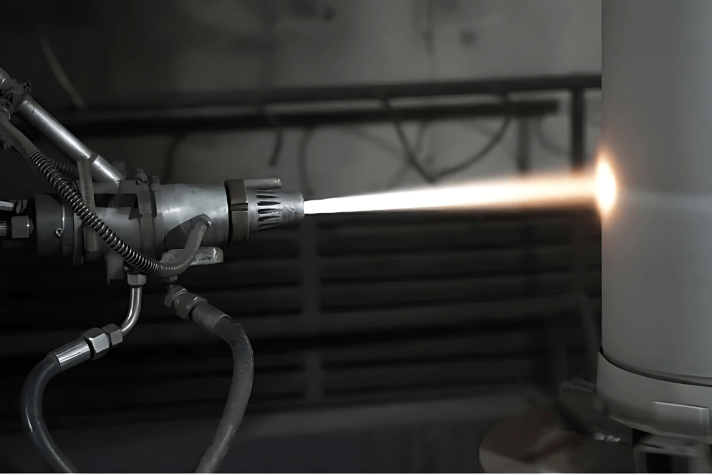
Ceramic coating
Indian company of Thermal Spay coatings
Ceramic coating for insulation with ceramics B01, B03C

Slide 12

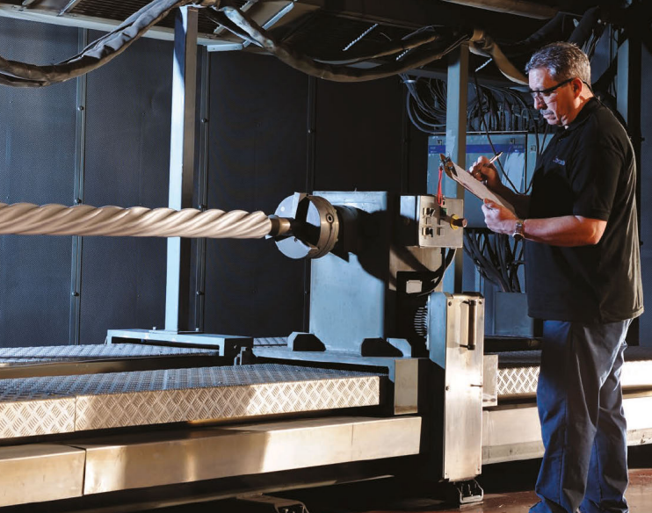
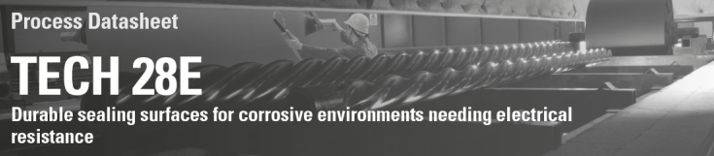
Ceramic coating
British company of heat treatments and surface technology

Slide 13

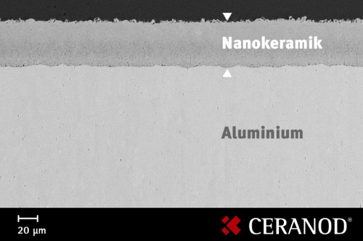
Ceramic + polymer coating
Dr. Anna Buling
Normally ceramic coating for hardening of soft metals
Water based PTFE or PEEK coatings in metals

Slide 14


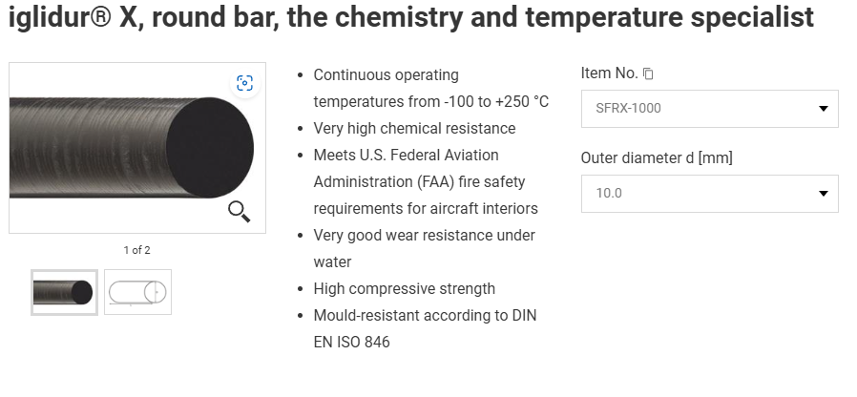
Advanced polymers
Nelson Kunz
Iglidur coatings
Profiles of Iglidur up to 1m
Low friction plastics for bearings

Slide 15
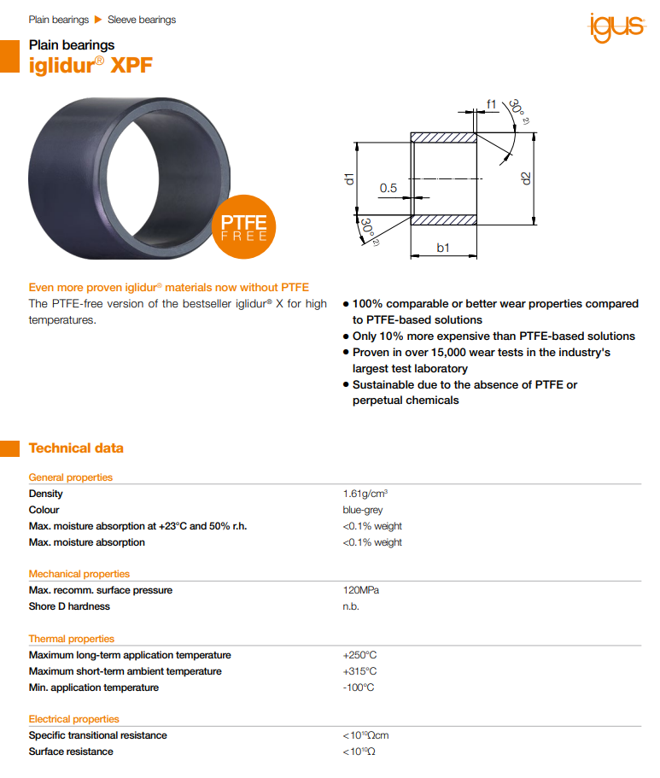
Advanced Polymers
Iglidur parts PTFE free

Slide 16

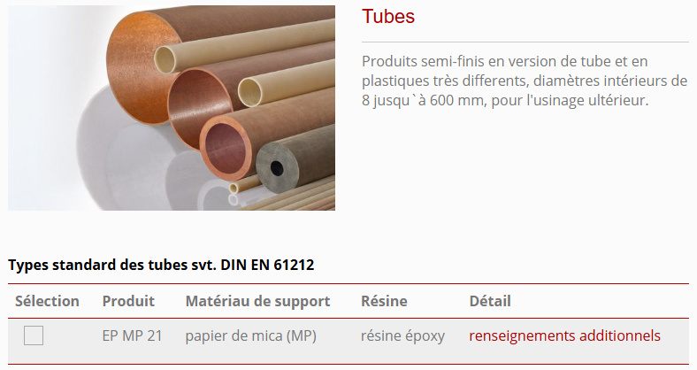
Advanced polymers
Rubén Chávez
Plastic composites profiles
Machined parts

Slide 17

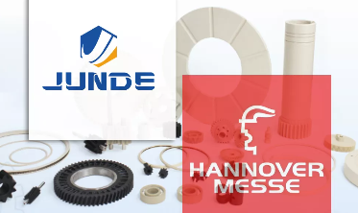
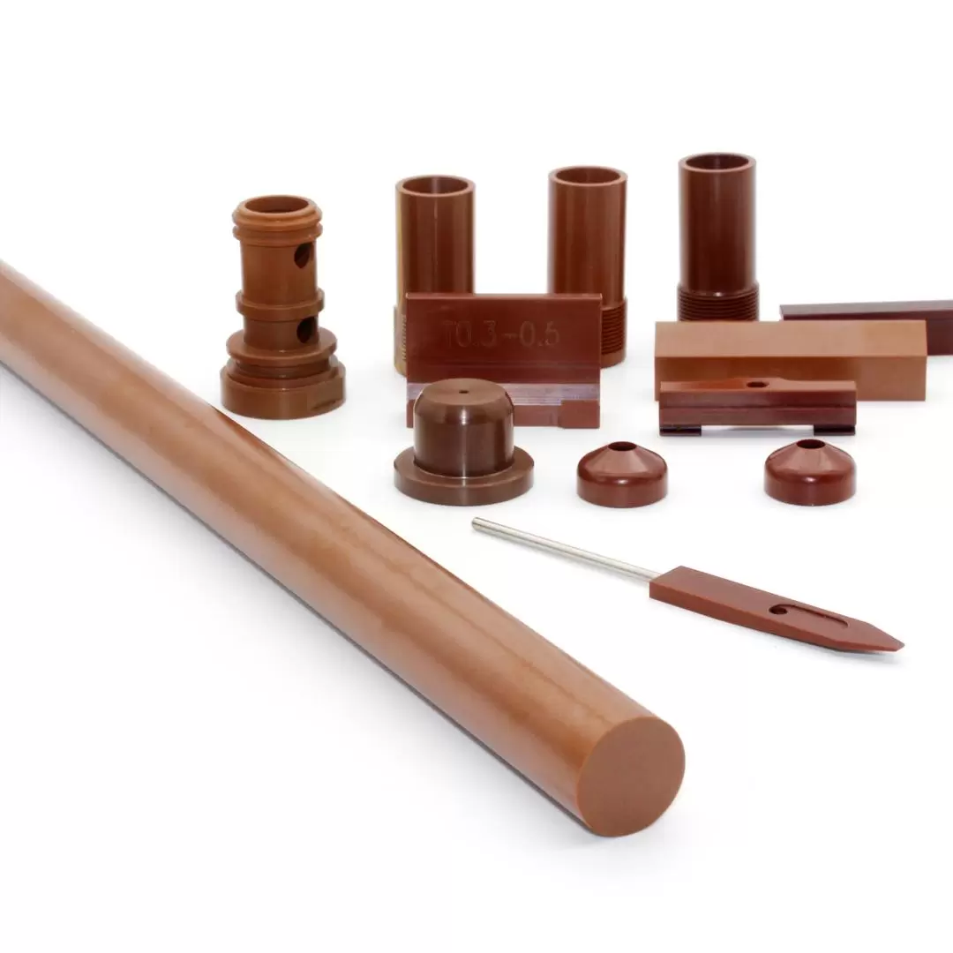
Advanced polymers
Johannes Dai JUNDE HPP (German company)
Rods, plates, films, cables and machined parts on High performance plastics
CF/PEEK prepreg
Ultra High Temperature Polyimide (PI)

Slide 18

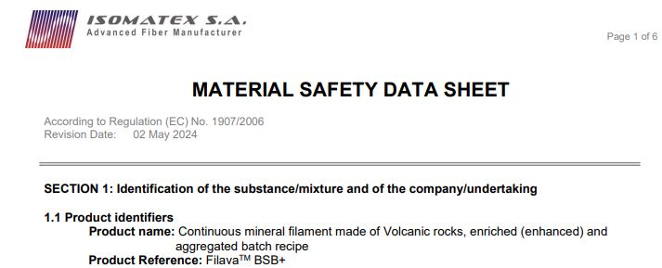
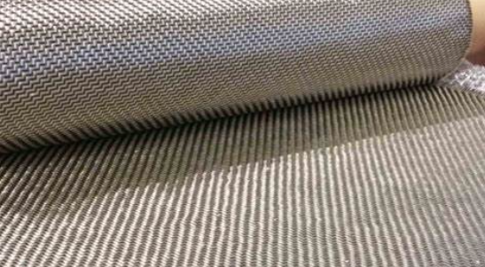
High temperature fibers
Johannes Kauschinger
R&D in fibers

Slide 19

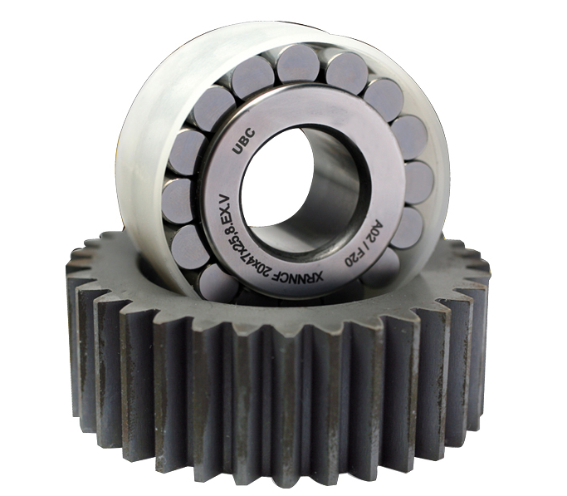
Bearings for high temprature
José Manuel Songel
Chinese company with partners in all Europe
All catalogue in ceramic under request

Slide 20


Bronze supliers
Romanian brass, copper and bronze specialist
Profiles manufactured under demand

Slide 21

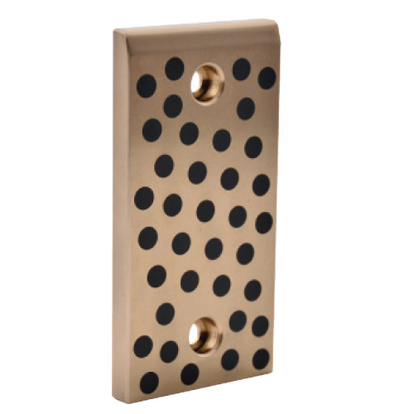
Bronze supliers
Guldiken Koç
Profiles up to 4m under demand

Slide 22

Thank you very much

