Slide 1
Low-mass physics in a high-energy world
Andre Frankenthal (UC Irvine)
April 10th, 2025
Topic Of The Week Seminar, Fermilab

Slide 2
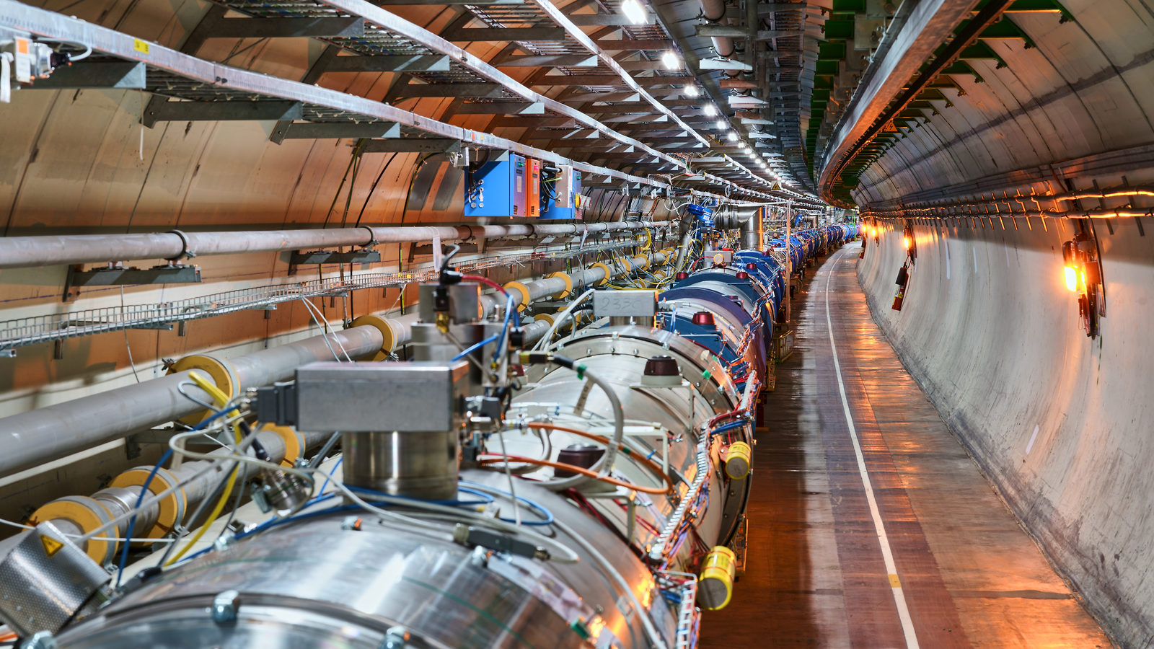
The highest-energy accelerator in the world
7,000 times the proton mass!
7 TeV protons
7 TeV protons

Slide 3
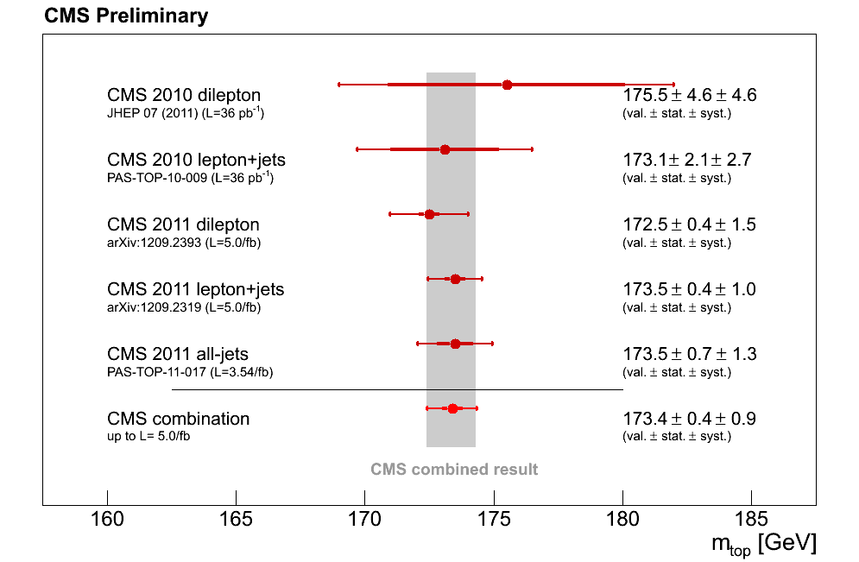
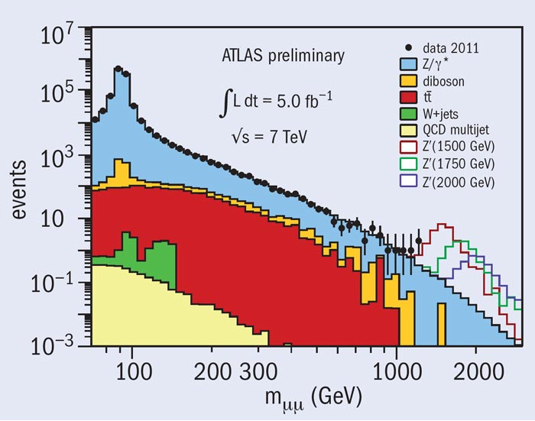
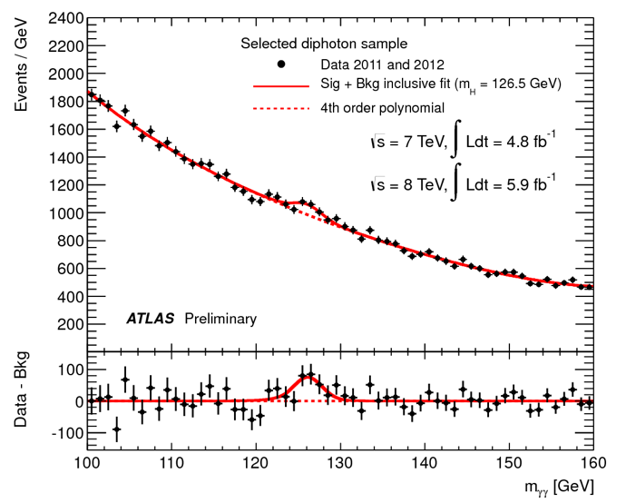
Why energy matters
Study the top quark!
Search for new, heavy particles!
Discover the Higgs Boson!

Slide 4
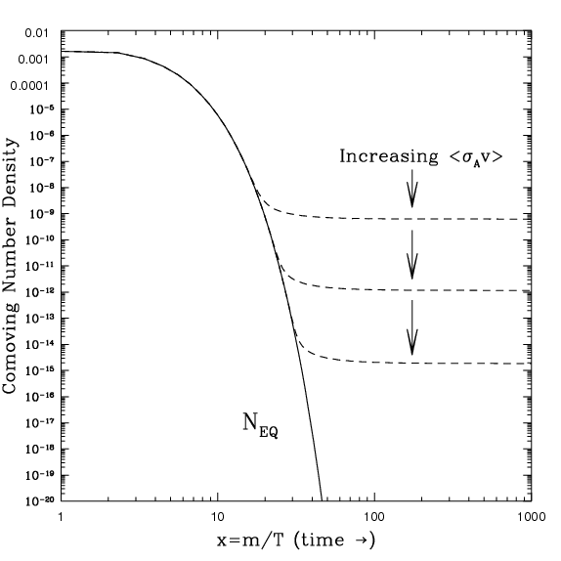
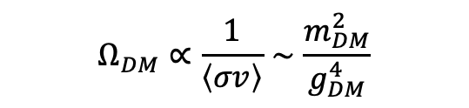

Heavy dark matter (DM) is very compelling
Thermal equilibrium
Decay
Freeze-out
Increasing DM scattering cross section implies a lower freeze-out abundance:
$$Ω_{DM}∝\frac{1}{\left\langle σv\right\rangle }∼\frac{m_{DM}^{2}}{g_{DM}^{4}}$$
“WIMP miracle”:
$$g_{DM},{ m}_{DM}∼g_{weak}, { m}_{weak} (100 GeV)$$
If DM mass and coupling are on the order of the weak scale, recover the observed DM abundance!
WIMP: Weakly Interacting Massive Particle

Slide 5
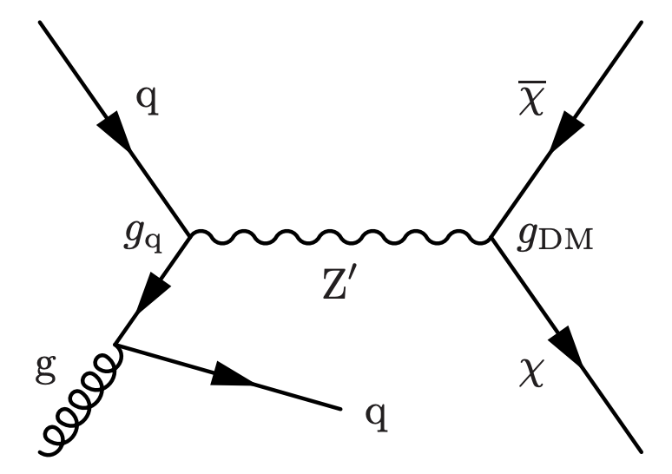
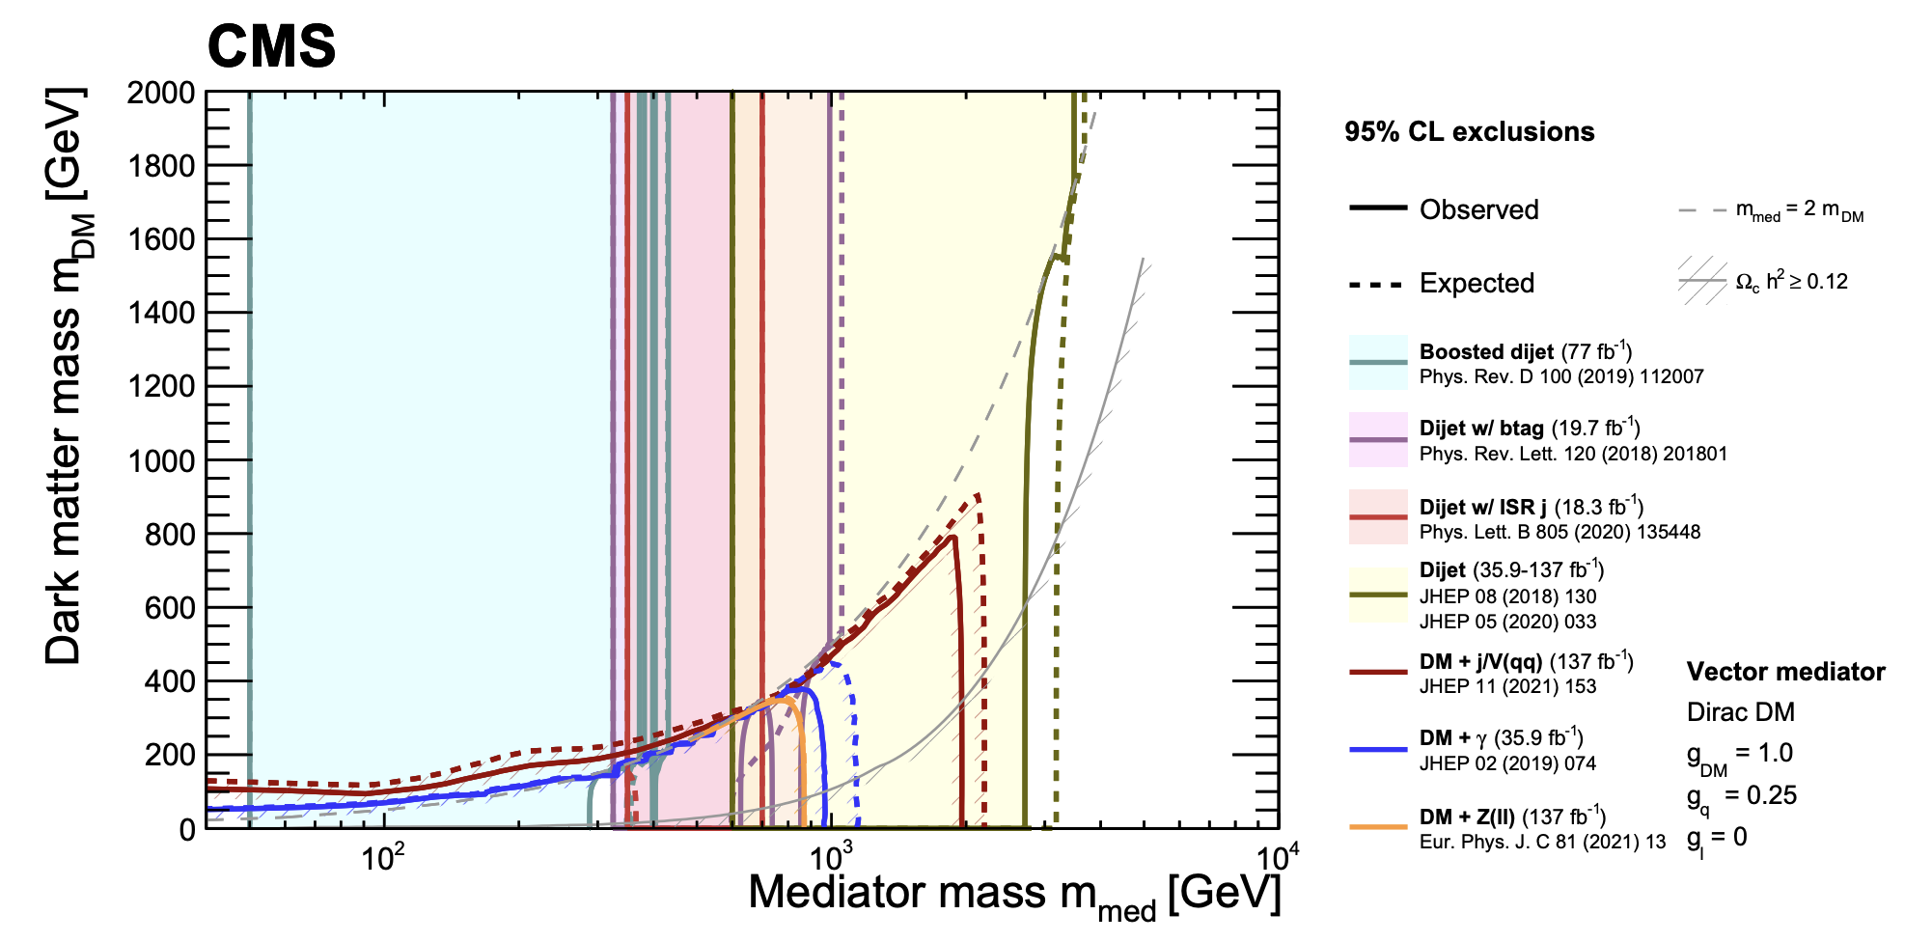
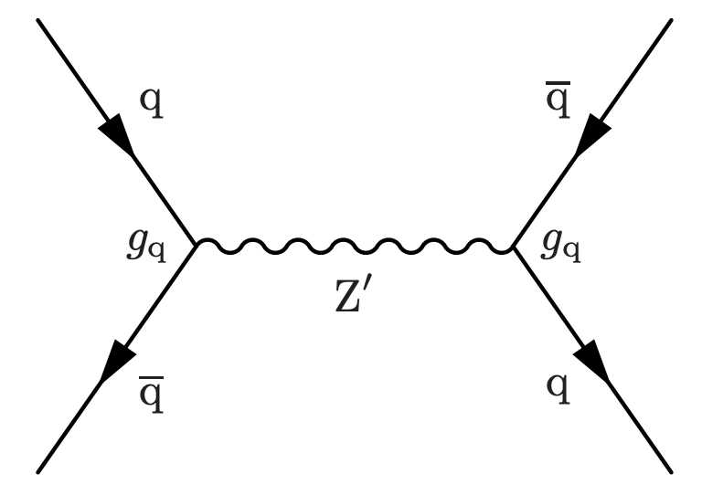
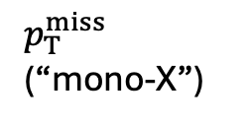
Lots of heavy DM searches at the LHC
“Canonical” searches:
$p_{T}^{miss}$ (“mono-X”)
Dijets

Slide 6
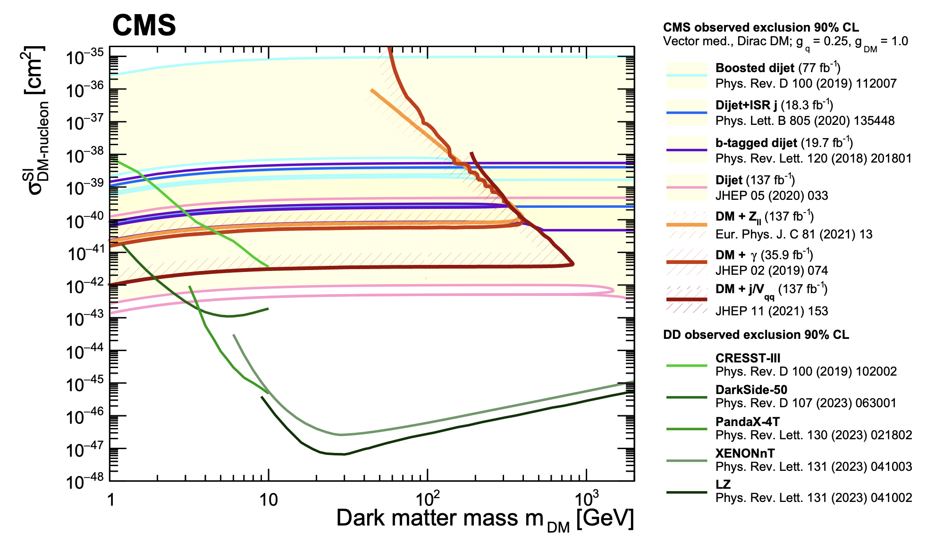
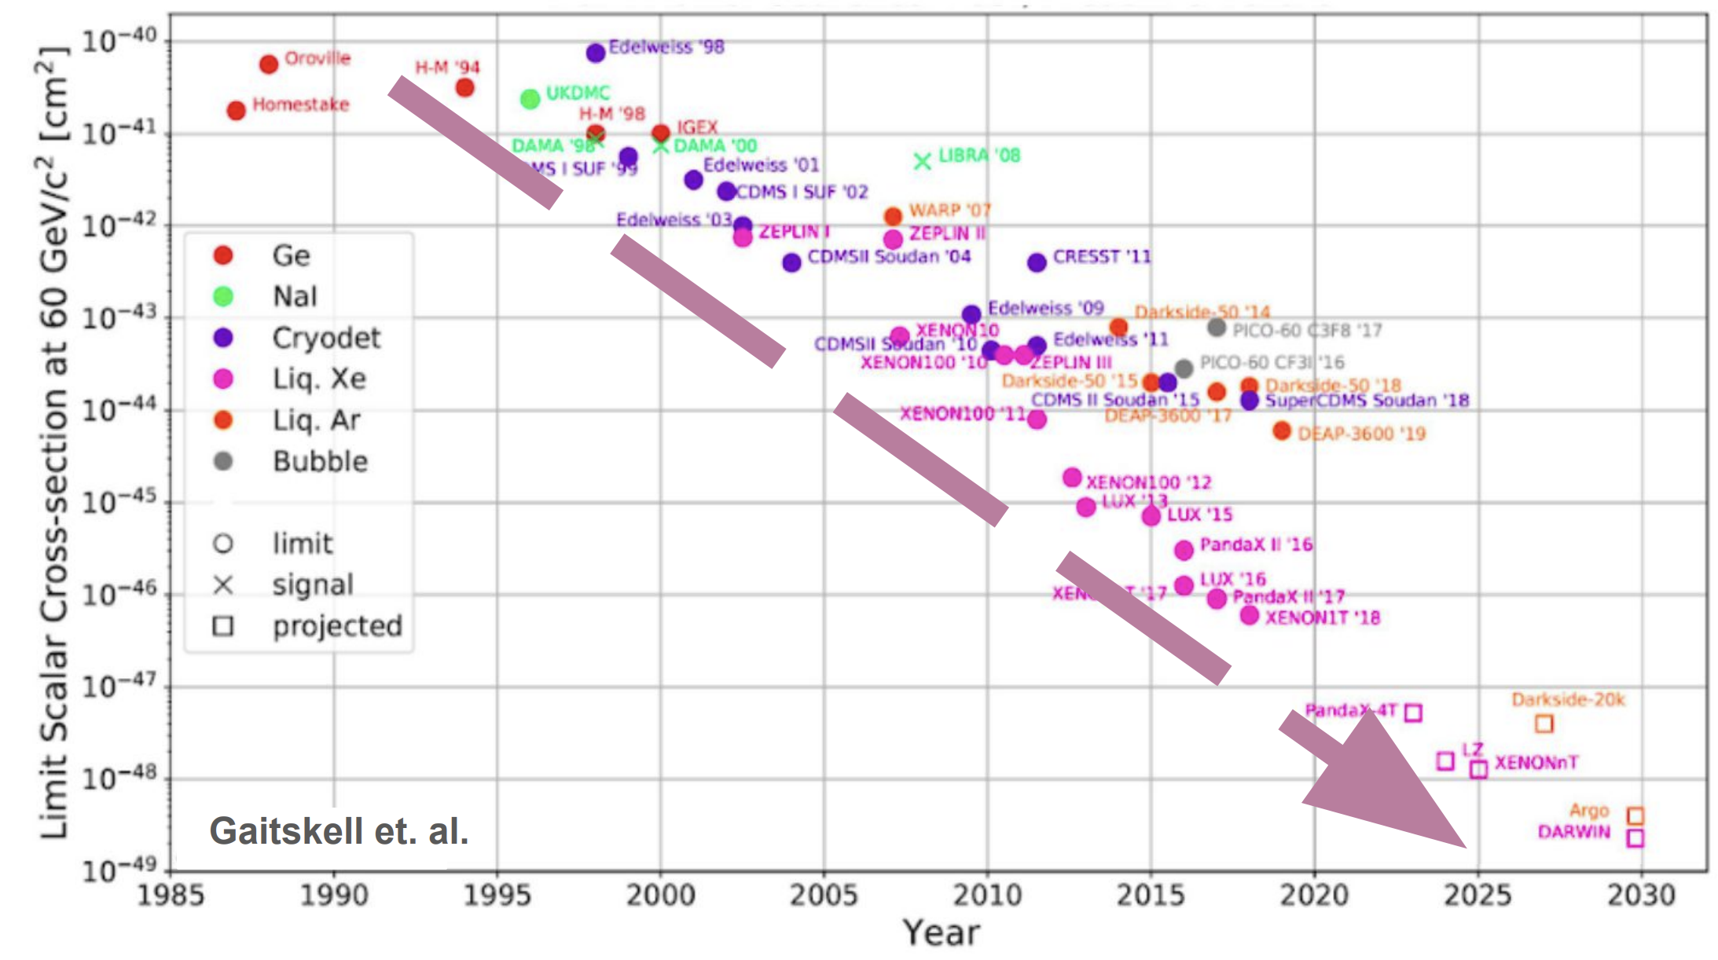
Lots of heavy DM searches beyond the LHC
Huge effort over the last 40 years!

Slide 7
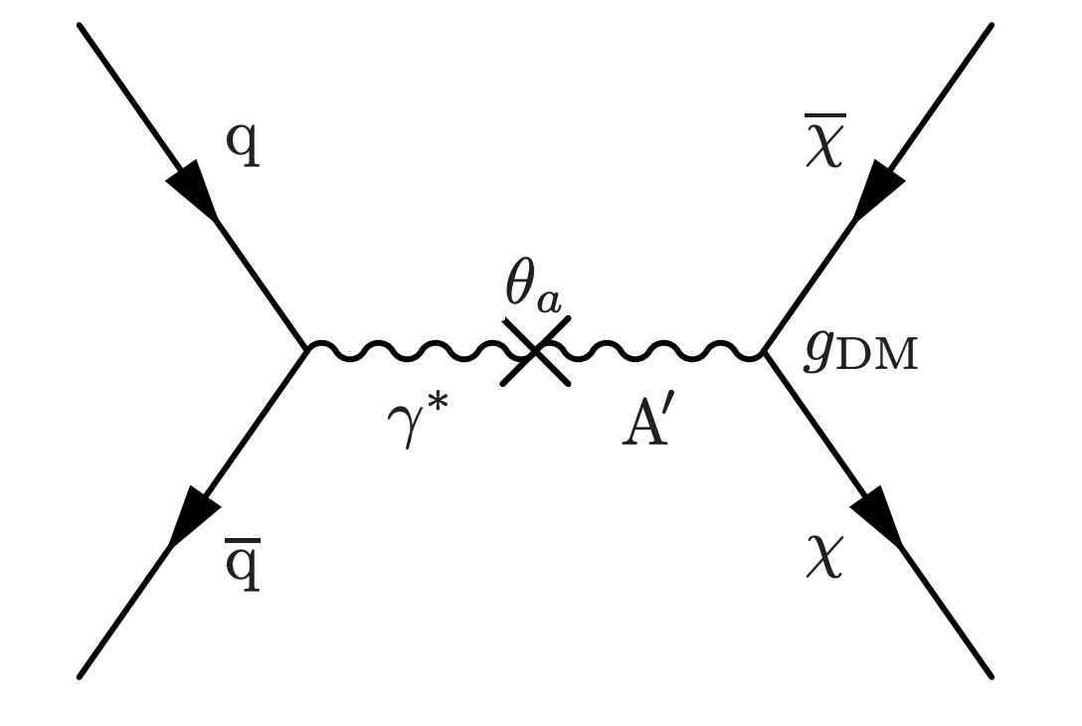
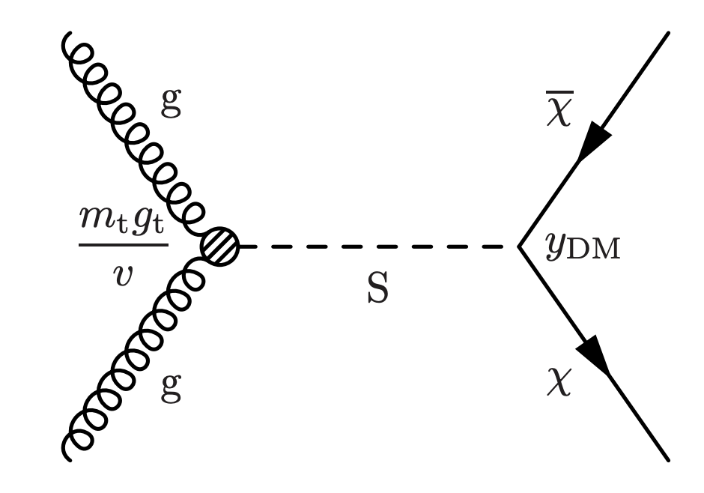
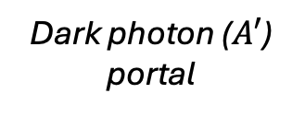
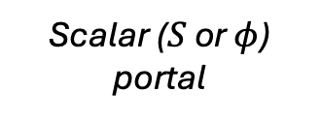
But… light DM is also very compelling!
Rich dark sectors (DS) can also explain observed thermal-relic DM assuming lighter DM particles
Common features of DS models:
Additional DS-only interactions
Additional particle species
Lighter, stable DM particles
SM-DS portal interactions
Dark photon ($A′$) portal
Scalar ($S$ or $φ$) portal

Slide 8
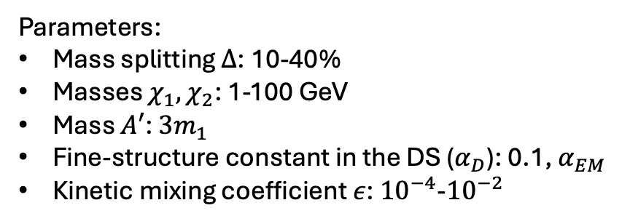

Inelastic DM as a benchmark
Assumptions:
  Two DM species ($χ_{1}$ and $χ_{2}$) instead of one ($χ$)
  Near mass degeneracy: $Δ≡(m_{2}−m_{1})<0.5 m_{1}$
  Dark photon as mediator (portal) and $m_{A^{′}}>m_{1}+m_{2}$
  Inelastic (off-diagonal) coupling between $χ_{1}$ and $χ_{2}$
Parameters:
Mass splitting $Δ$: 10-40%
Masses $χ_{1},χ_{2}$: 1-100 GeV
Mass $A′$: $3m_{1}$
Fine-structure constant in the DS ($α_{D}$): 0.1, $α_{EM}$
Kinetic mixing coefficient $ε$: ${10}^{−4}$-${10}^{−2}$

Slide 9
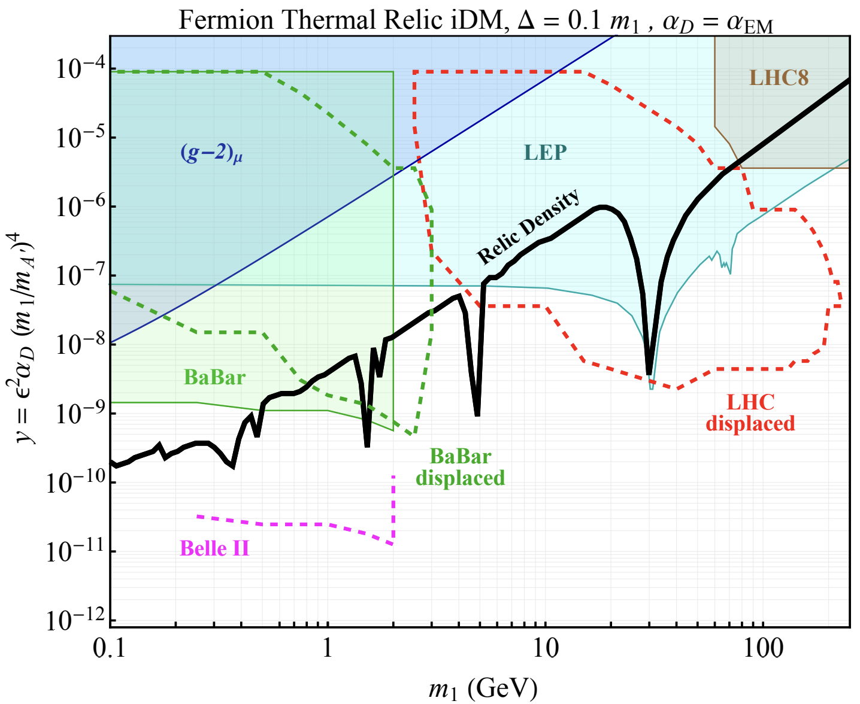
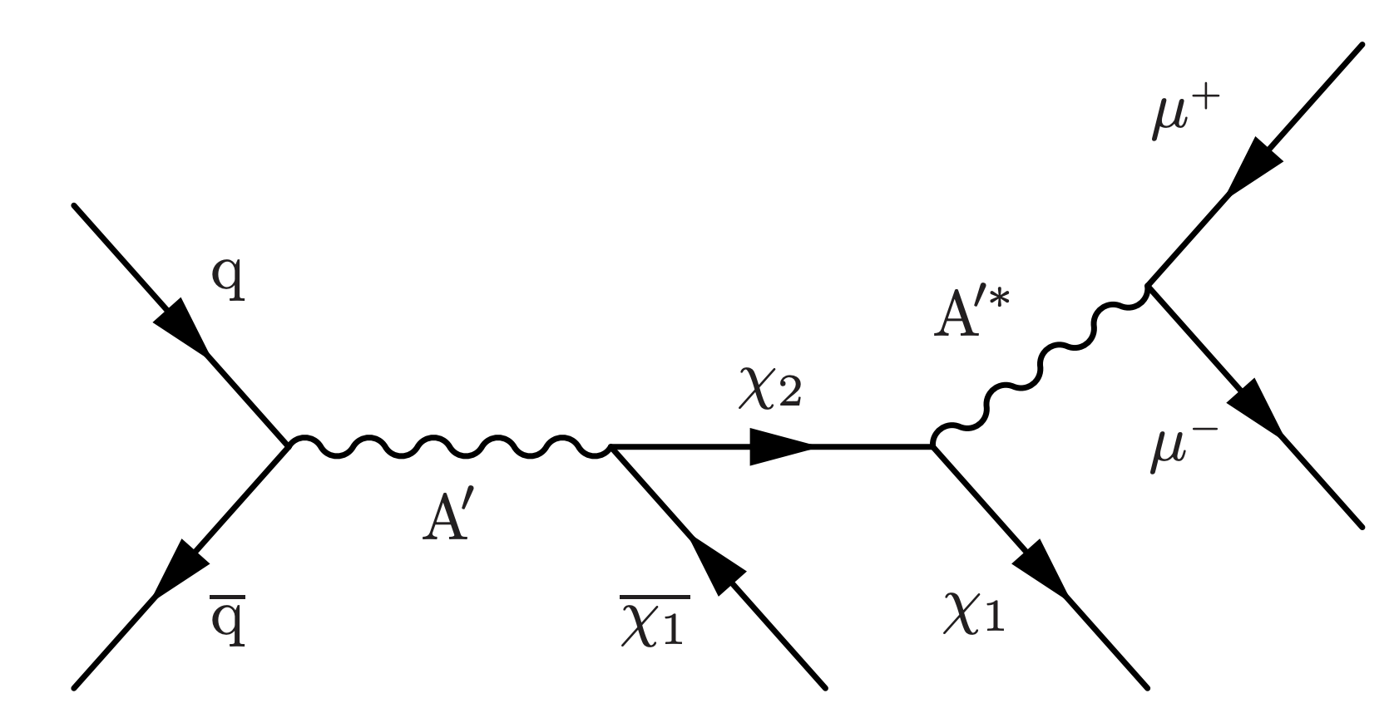

Inelastic DM as a benchmark
Implications:
  $A′$ decays predominantly to $χ_{2}+χ_{1}$ pair
  $χ_{2}$ decay width (to $χ_{1}$) small → $χ_{2}$ long-lived
  $χ_{1}$ could be the thermal-relic DM
  Current DM bounds evaded, and sensitivity at the LHC

Slide 10




iDM experimental signature
Challenging but unique experimental signature:
  Displaced, low-$p_{T}$, and nonresonant lepton pair
  ISR jet for recoil and triggering
  Considerable $p_{T}^{miss}$ from recoil boost, aligned with lepton pair
Displaced, soft, nonresonant muons
$χ_{1}$’s
$$p_{T}^{miss}$$
$$χ_{2}$$
CMS transverse cross section

Slide 11





First collider search for iDM – LPC-DM
Phys. Rev. Lett. 132 (2024) 041802
Main features:
  Trigger on $p_{T}^{miss}$ from DM
  Leverage displaced muon reconstruction
  Go as low in muon $p_{T}$ as feasible (5 GeV)
  Enforce alignment between muons and $p_{T}^{miss}$
  Enforce separation between ISR jet and DM
$χ_{1}$’s
$$l^{+}l^{−}$$
$$p_{T}^{miss}$$
$$χ_{2}$$

Slide 12
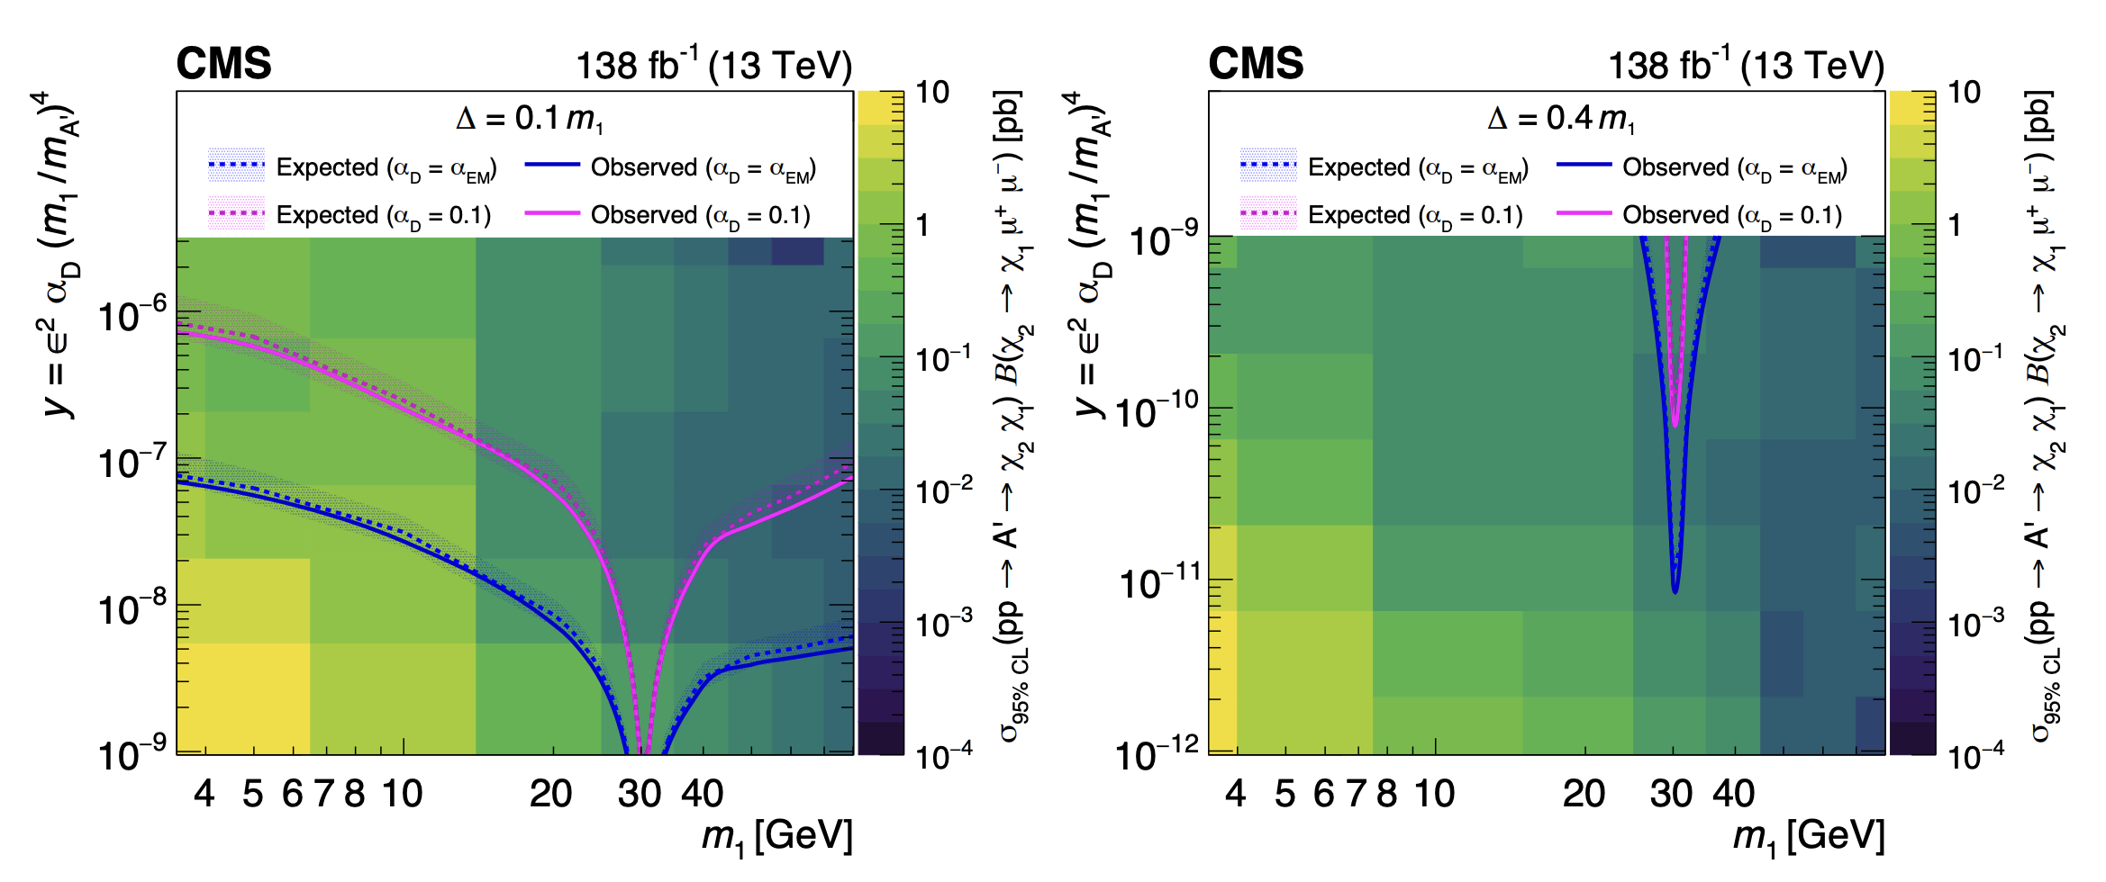

First collider search for iDM – LPC-DM
Phys. Rev. Lett. 132 (2024) 041802
Relevant thermal-relic parameter space excluded
More sensitivity to smaller mass splits (10% vs. 40% of $χ_{1}$)
Sensitivity to low DM masses (few GeV)

Slide 13
ISR helps in sensitivity to low-mass physics
ISR is a key tool in searches for low-mass (invisible) DM
  Something extra to trigger on in the event
  Extra boost from recoil brings kinematic observables above thresholds (trigger, reconstruction, ID...)
But it comes at the cost of reduced model acceptance

Slide 14
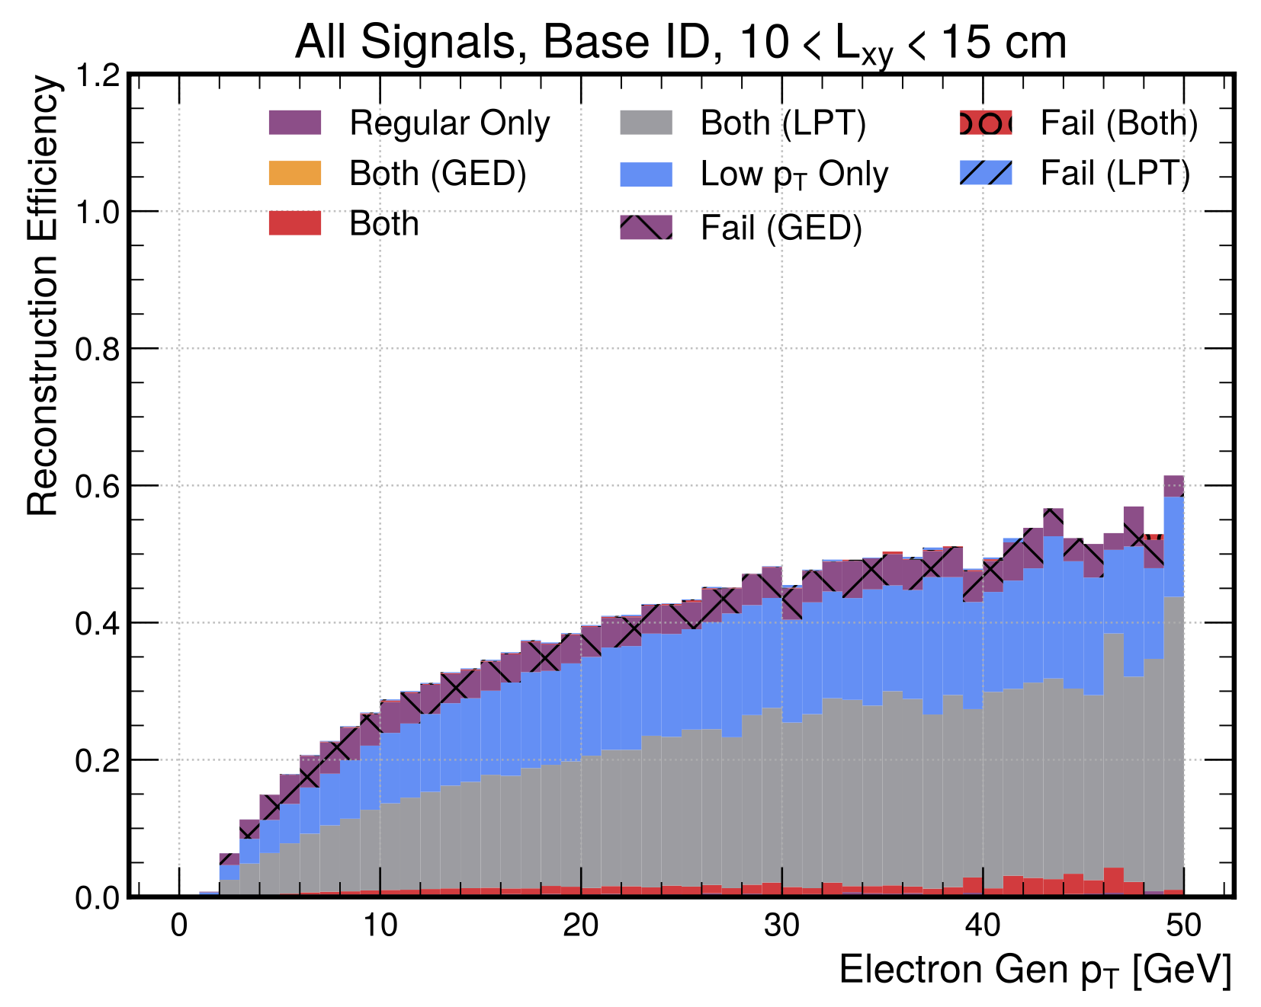
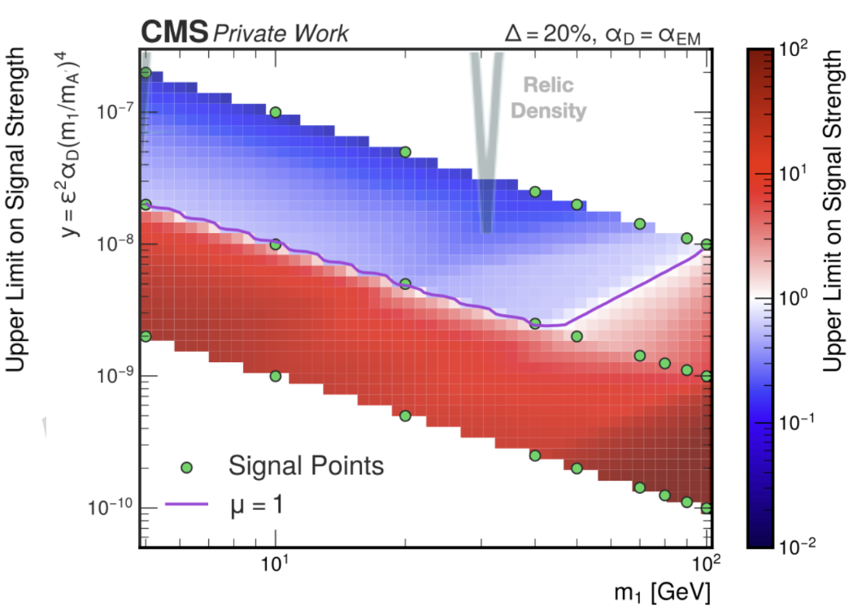


Inelastic DM with displaced, low-$p_{T}$ electrons
Accept down to 1 GeV electrons, less displaced but lower masses
Specialized low-$p_{T}$ electron reconstruction from BPH analyses

Slide 15
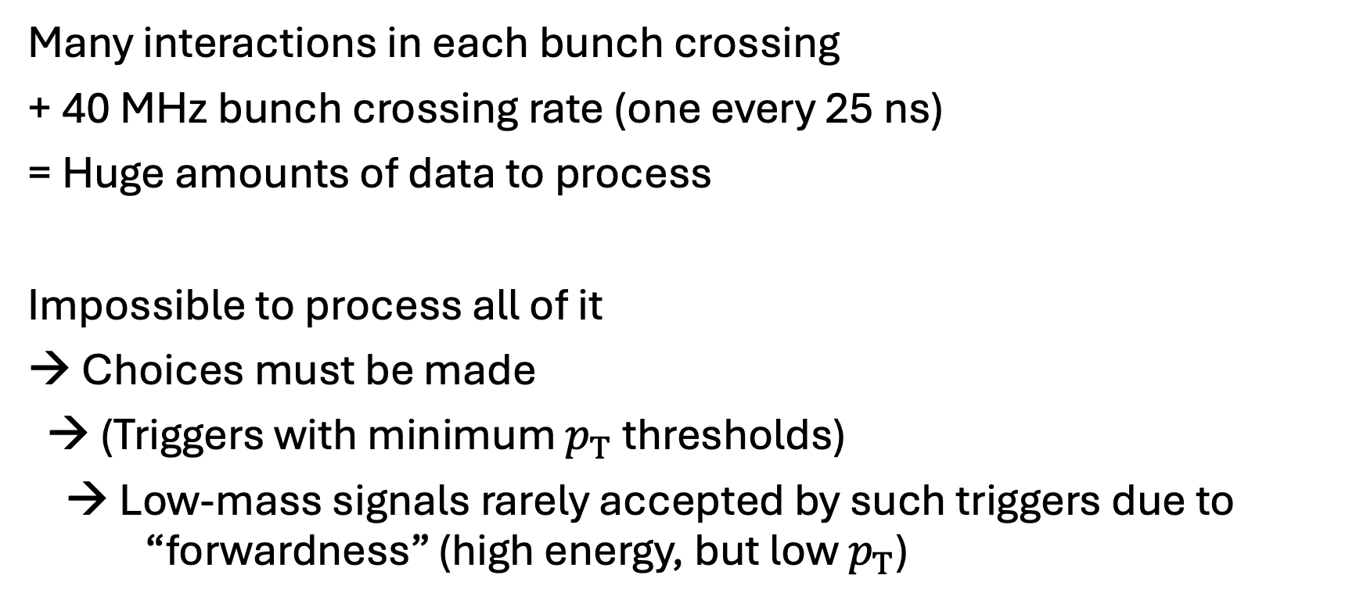
Why is low-mass physics so hard at the LHC?
Many interactions in each bunch crossing
+ 40 MHz bunch crossing rate (one every 25 ns)
= Huge amounts of data to process
Impossible to process all of it
→ Choices must be made
→ (Triggers with minimum $p_{T}$ thresholds)
→ Low-mass signals rarely accepted by such triggers due to “forwardness” (high energy, but low $p_{T}$)

Slide 16
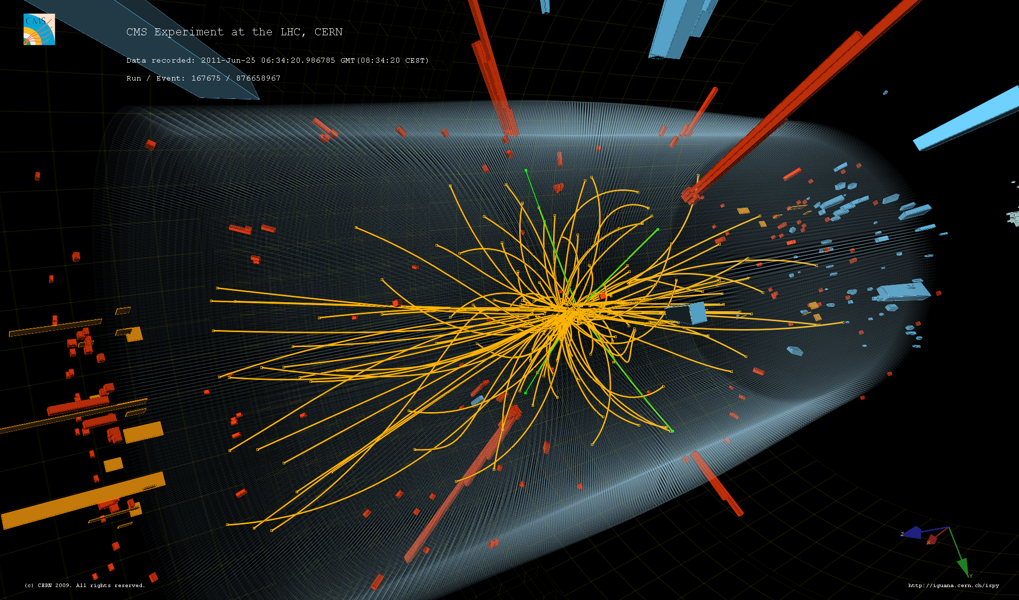
Why is low-mass physics so hard at the LHC?
1 MB / event
* 40 MHz
= 40 TB / second

Slide 17
Improving sensitivity to low-mass physics with nonstandard trigger strategies
Novel strategies developed to address these challenges:
Trigger-level analysis (ATLAS) / data scouting (CMS) / Turbo Streams (LHCb)
Delayed streams (ATLAS) / data parking (CMS)
Triggerless readout (LHCb)
Partial event building (ATLAS)

Slide 18
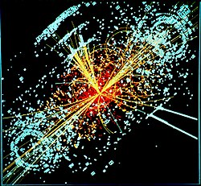
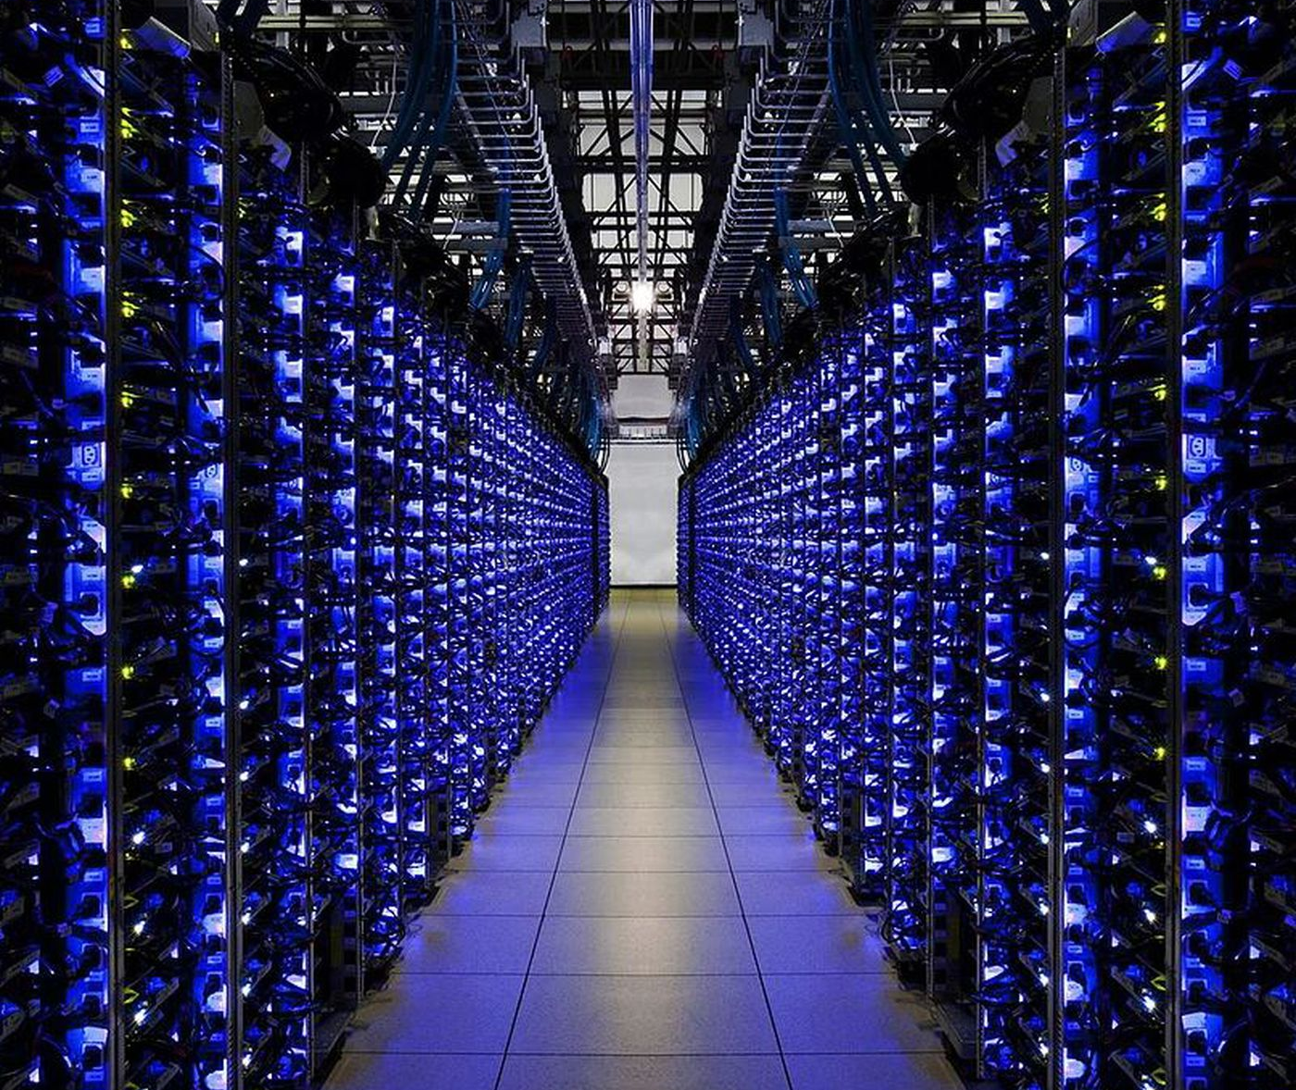
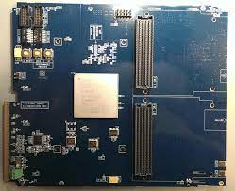

The CMS trigger system as a reference
40 MHz
Two-stage system:
  Level 1 (L1): hardware (FPGA) based
  High-Level Trigger (HLT): software (CPU) based
Storage
Slower, but almost full detector information
1 GB/s
HLT
1 kHz
Offline software reconstruction
100 kHz
Yes
Hardware reconstruction
L1
Online software reconstruction
No
Yes
No
Lost forever
Very fast: $<4 μs$
But coarse information

Slide 19
TLA / data scouting / Turbo Streams
Main idea: exchange event size for event rate
Define streams with only a subset of the data:
  Muons
  Jets
  Electrons/photons
Physics objects as reconstructed at the trigger
Enables lower trigger thresholds with reduced bandwidth

Slide 20
Standard vs. scouting pipelines
40 MHz
Scouting data
(No offline reconstruction)
<< 1 MB / evt → < 1 GB/s
Scouting triggers
Yes
Storage
>> 1 kHz
No
1 GB/s
HLT
1 kHz
Offline software reconstruction
100 kHz
Yes
Hardware reconstruction
L1
Online software reconstruction
No
Yes
Lost forever
No

Slide 21
Delayed data streams (data parking)
Main idea: park raw data until processing power available
Similarly define streams with new (lower threshold) triggers:
  Muons
  Jets
  Electrons/photons
Advantage: full data available after processing
Used to be reconstructed at EOY, but today close to “prompt”

Slide 22
Standard vs. parking pipelines
Parking data
(Delayed offline reconstruction)
40 MHz
Parking triggers
Storage
Parked (raw) data
Yes
> 1 kHz
1 GB/s
No
HLT
1 kHz
Prompt offline reconstruction
100 kHz
Yes
Hardware reconstruction
L1
Online reconstruction
No
Yes
No
Lost forever

Slide 23
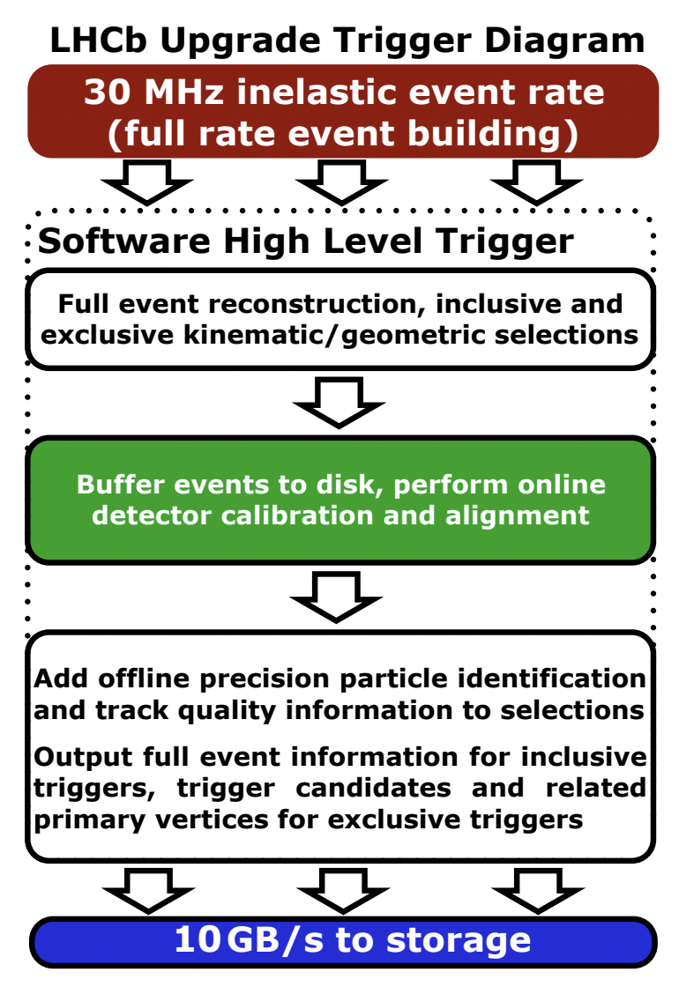
Triggerless readout
LHCb moved to a triggerless readout in Run 3
Completely eliminated hardware-level trigger
Alignment and calibration done online
HLT sees events at 30 MHz
But most raw data is not stored – risky!

Slide 24
Standard vs. triggerless readout pipelines
Add offline quantities
Storage
Event buffer on disk (days)
10 GB/s
HLT
> 1 kHz
Yes
Full online reconstruction
No
30 MHz
Lost forever

Slide 25
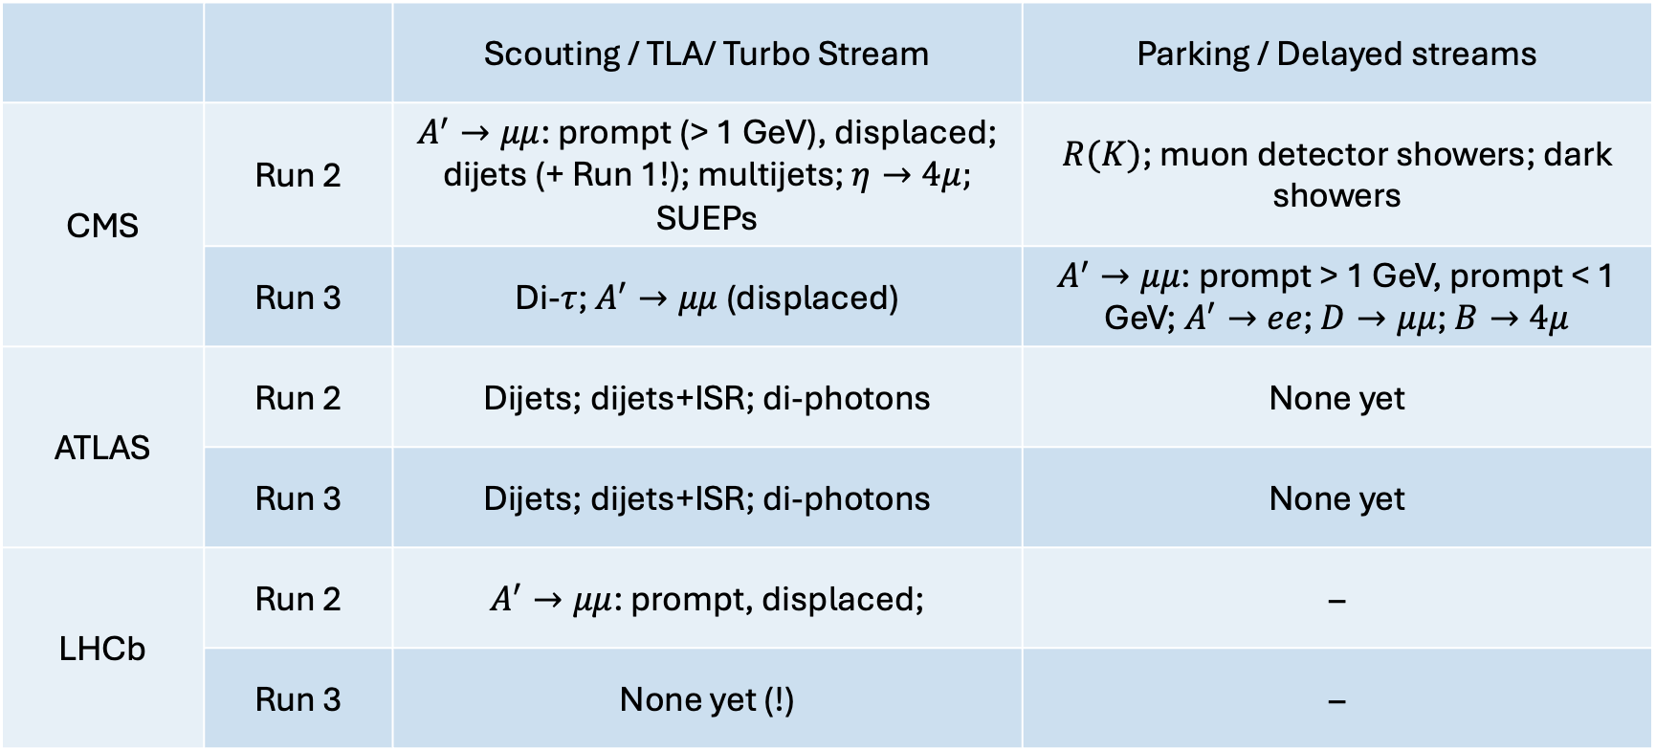
Exciting results with these strategies
 |  | Scouting / TLA/ Turbo Stream | Parking / Delayed streams
CMS | Run 2 | $A^{′}→μμ$: prompt (> 1 GeV), displaced; dijets (+ Run 1!); multijets; $η→4μ;$ SUEPs | $R(K)$; muon detector showers; dark showers
 | Run 3 | Di-$τ$; $A^{′}→μμ$ (displaced) | $A^{′}→μμ$: prompt > 1 GeV, prompt < 1 GeV; $A^{′}→ee$; $D→μμ$; $B→4μ$
ATLAS | Run 2 | Dijets; dijets+ISR; di-photons | None yet
 | Run 3 | Dijets; dijets+ISR; di-photons | None yet
LHCb | Run 2 | $A^{′}→μμ$: prompt, displaced; | –
 | Run 3 | None yet (!) | –

Slide 26
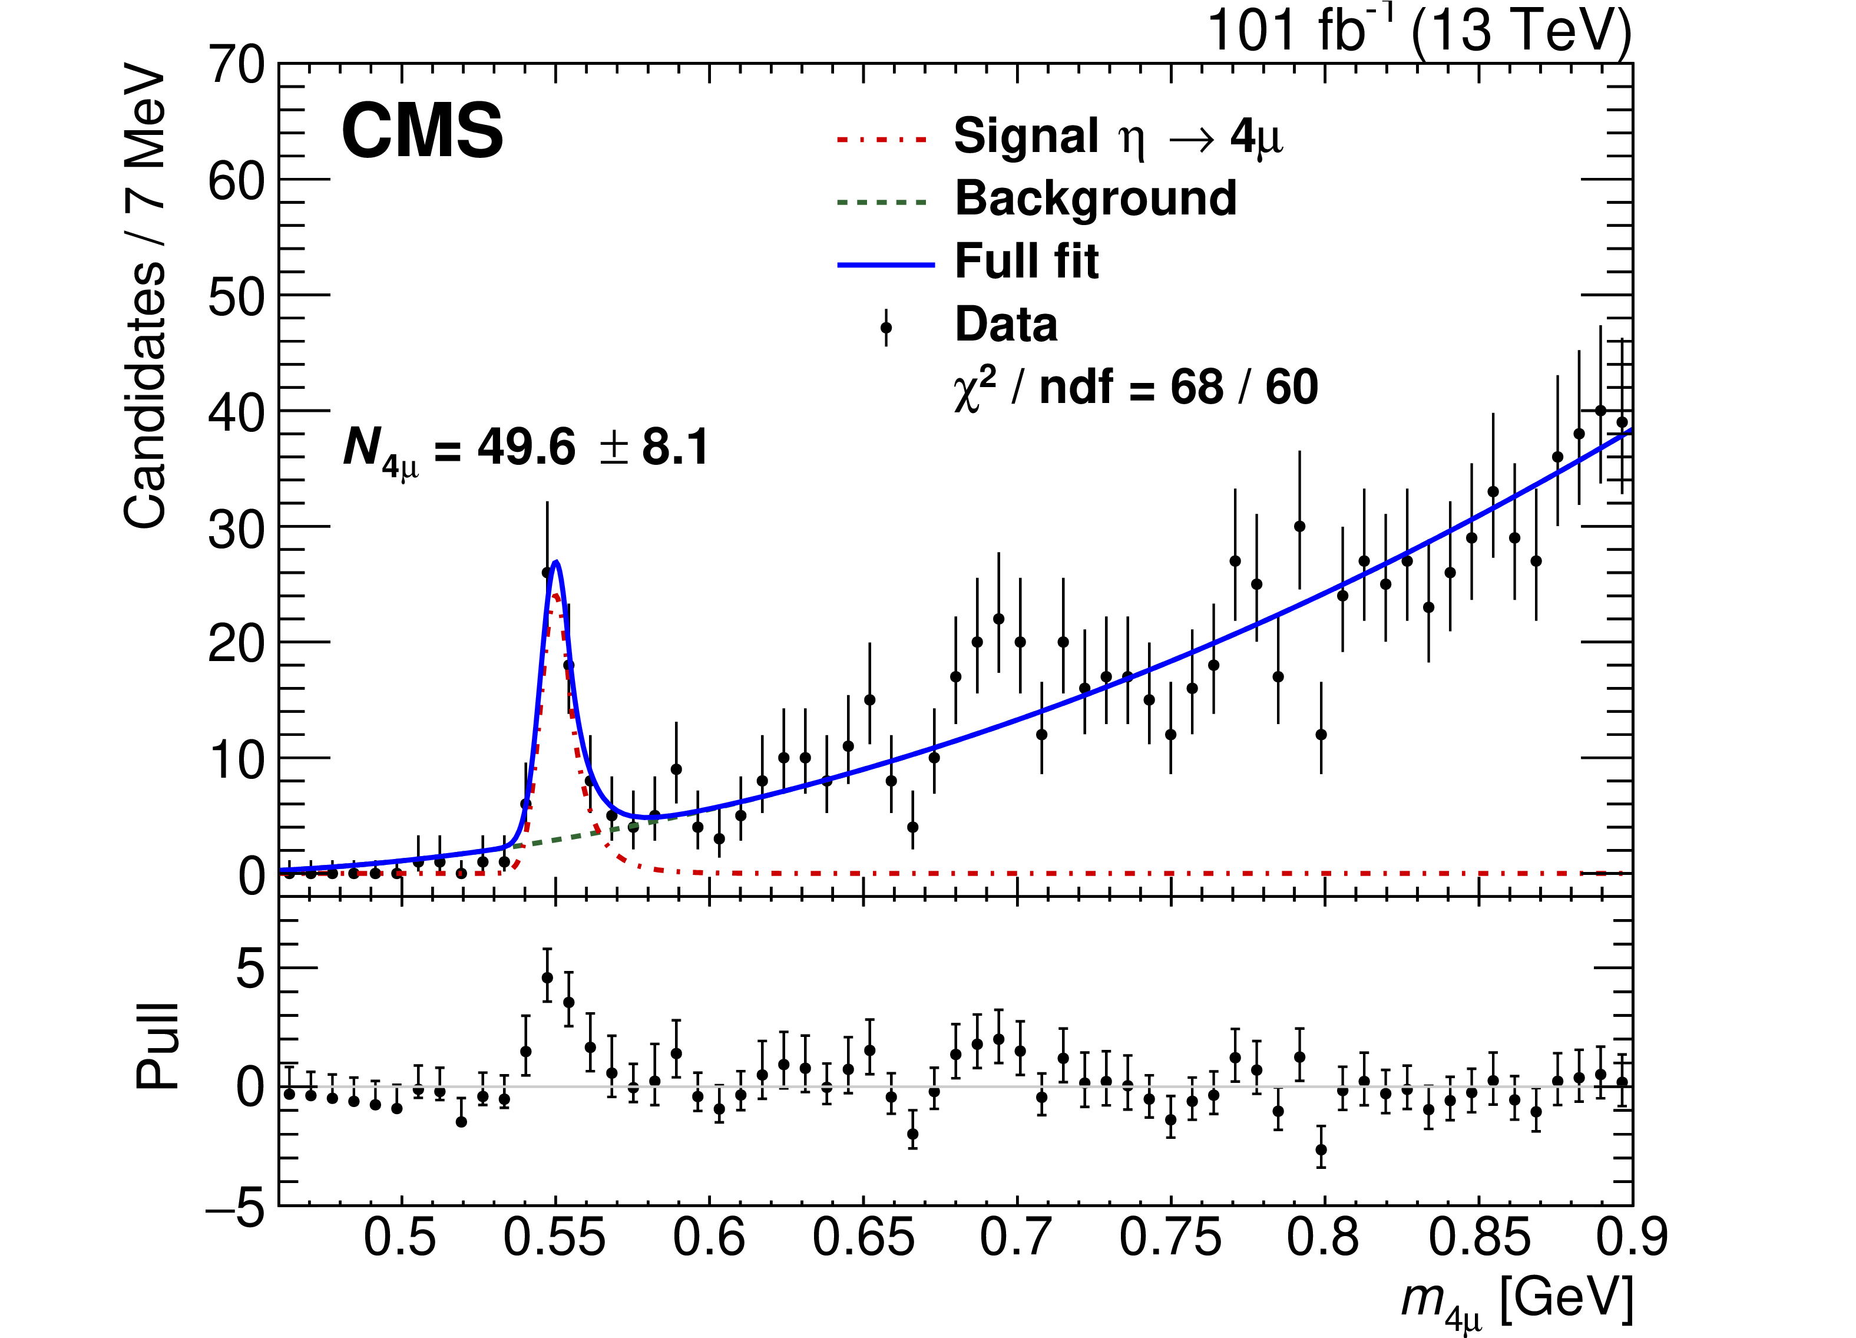
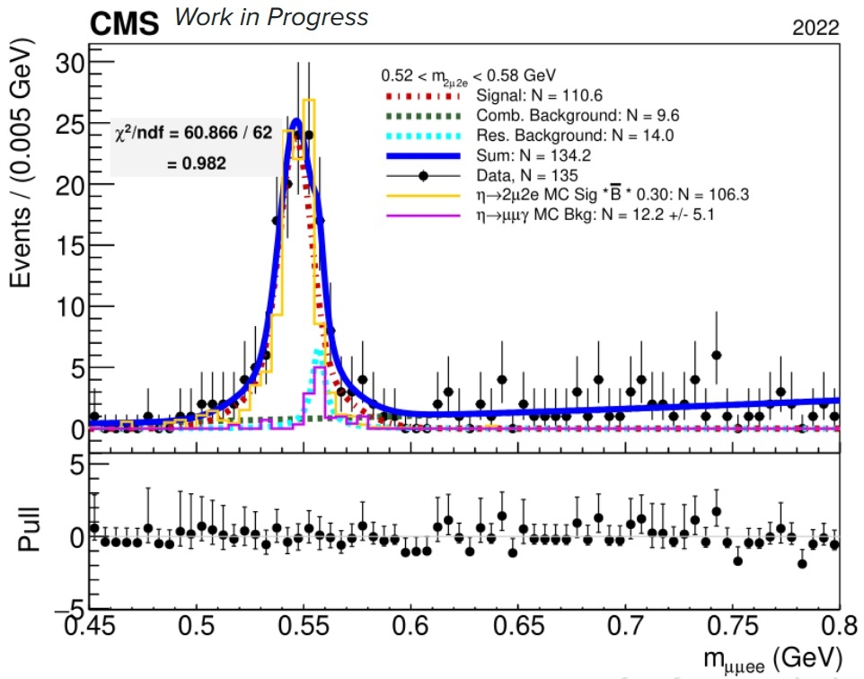
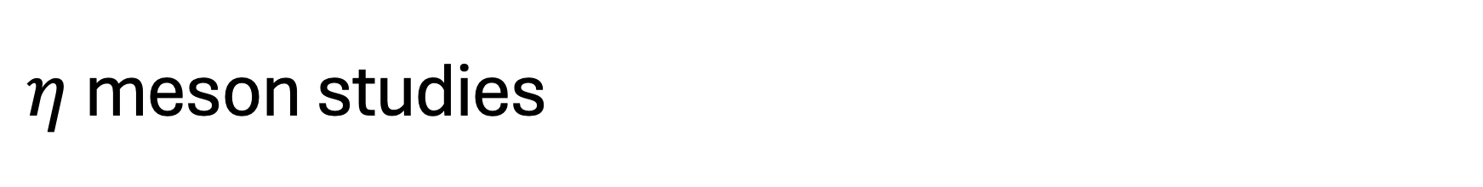
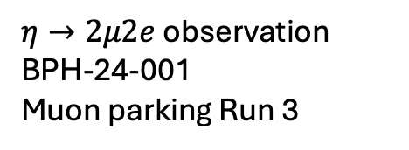
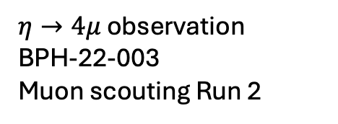
$η$ meson studies
$η→4μ$ observation
BPH-22-003
Muon scouting Run 2
$η→2μ2e$ observation
BPH-24-001
Muon parking Run 3

Slide 27
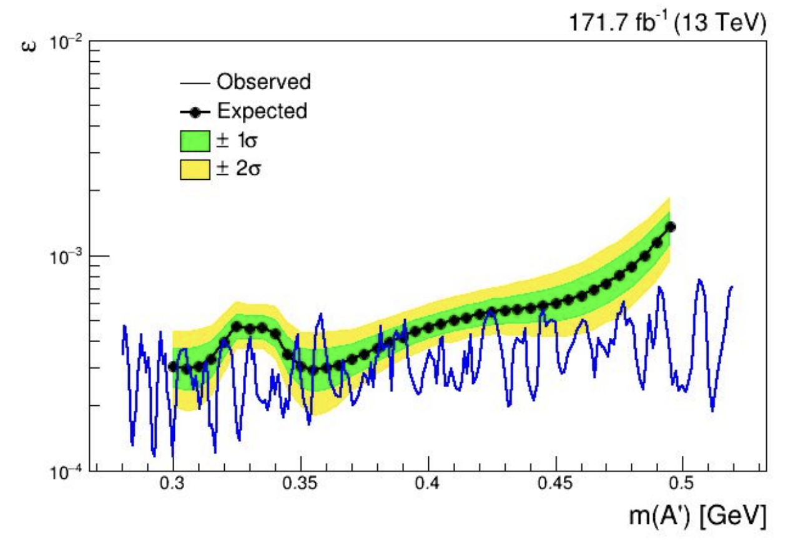
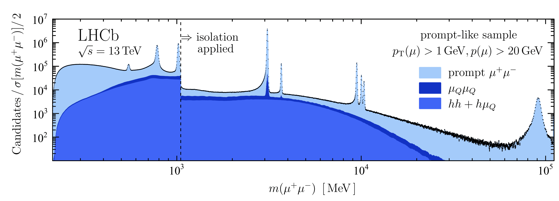
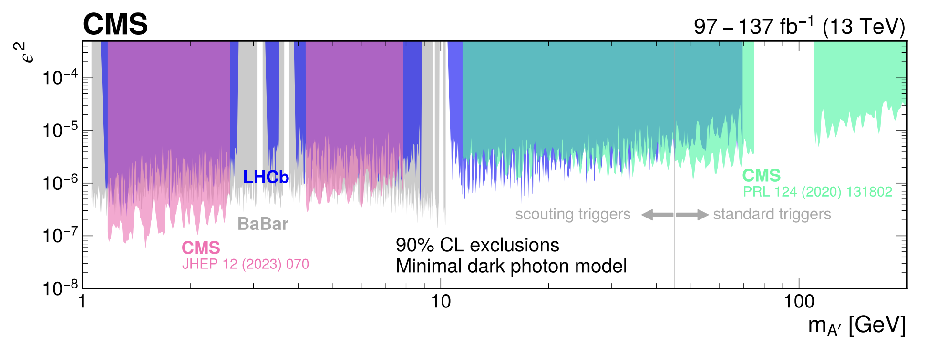
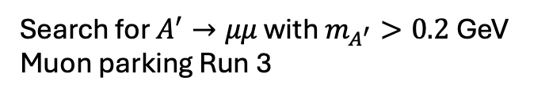
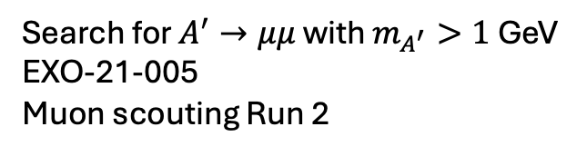
Low-mass dark photon searches
Search for $A^{′}→μμ$; Muon Turbo Stream Run 2
Search for $A^{′}→μμ$ with $m_{A^{′}}>0.2$ GeV
Muon parking Run 3
Search for $A^{′}→μμ$ with $m_{A^{′}}>1$ GeV
EXO-21-005
Muon scouting Run 2

Slide 28
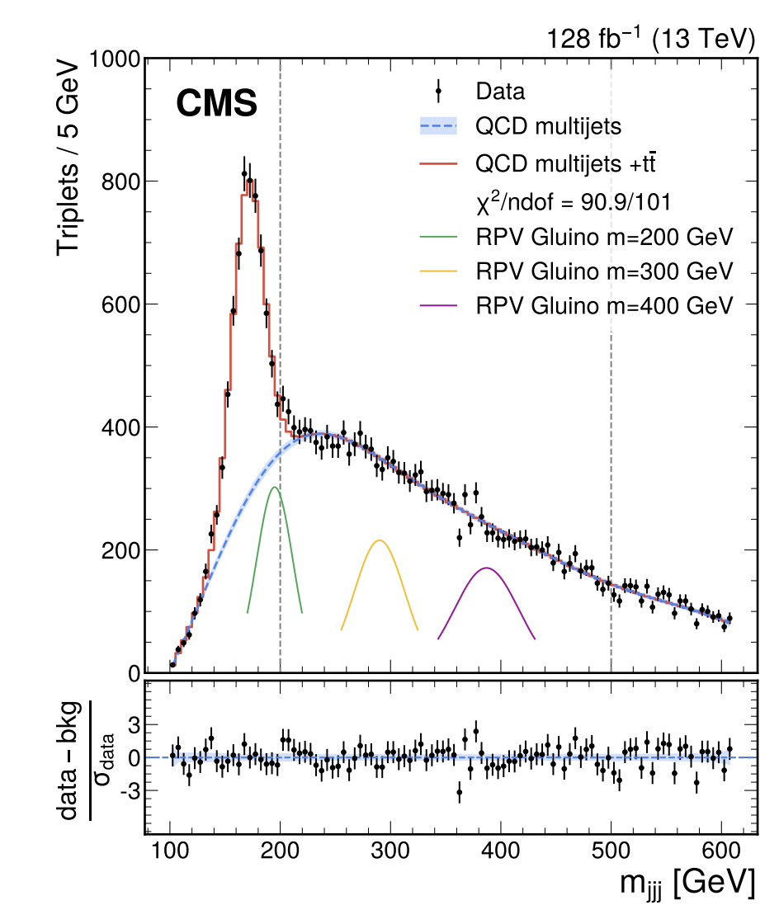
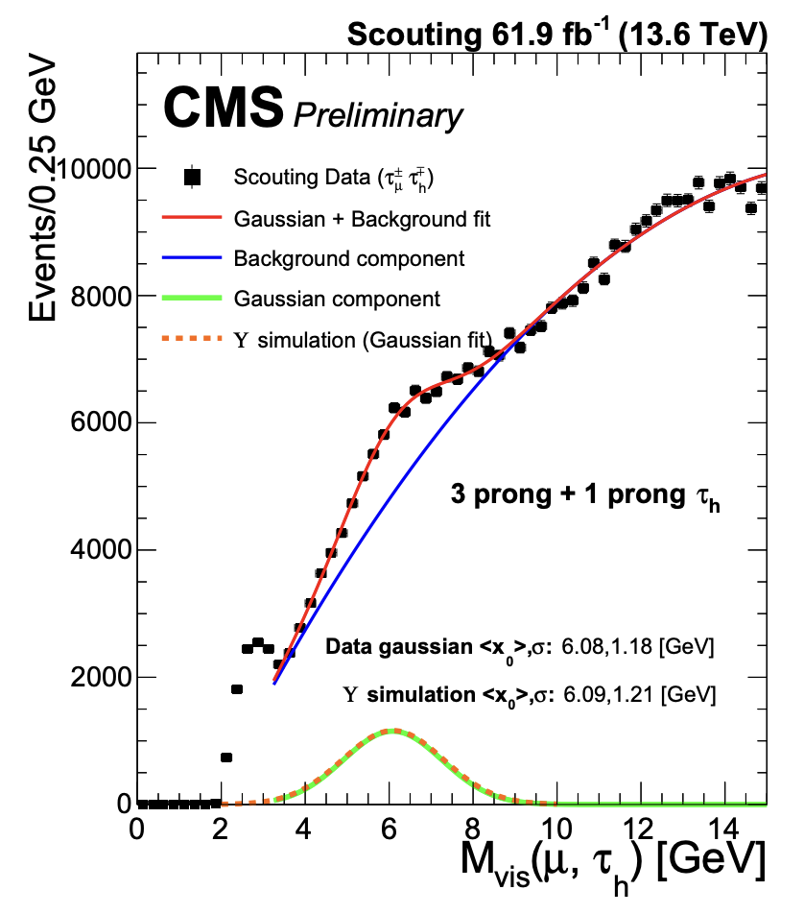
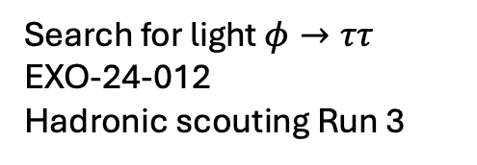
Multijet and tau-lepton scouting in Run 3
Search for multijets
EXO-21-004
Hadronic scouting Run 2
Search for light $φ→ττ$
EXO-24-012
Hadronic scouting Run 3

Slide 29
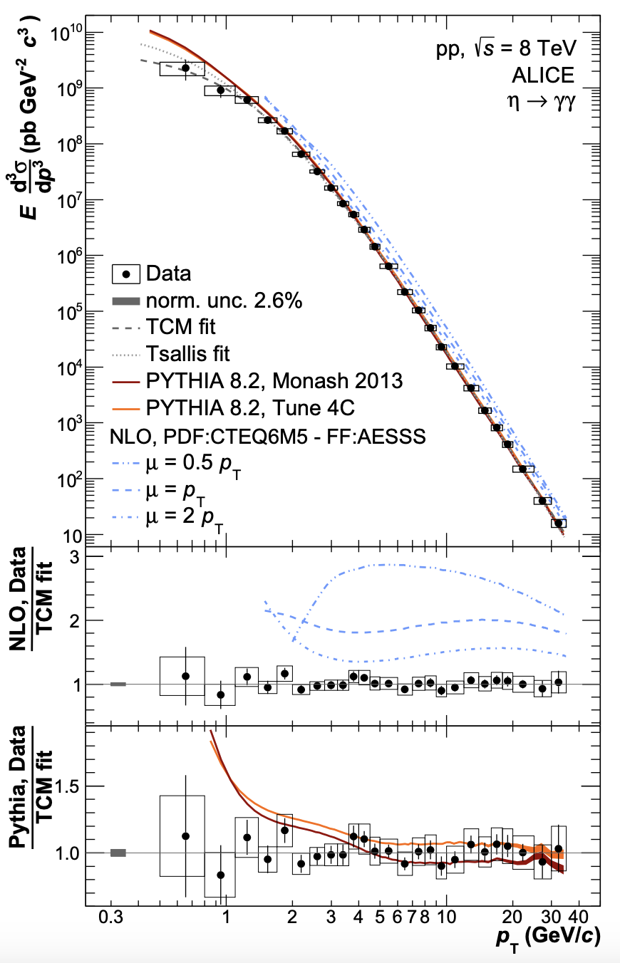
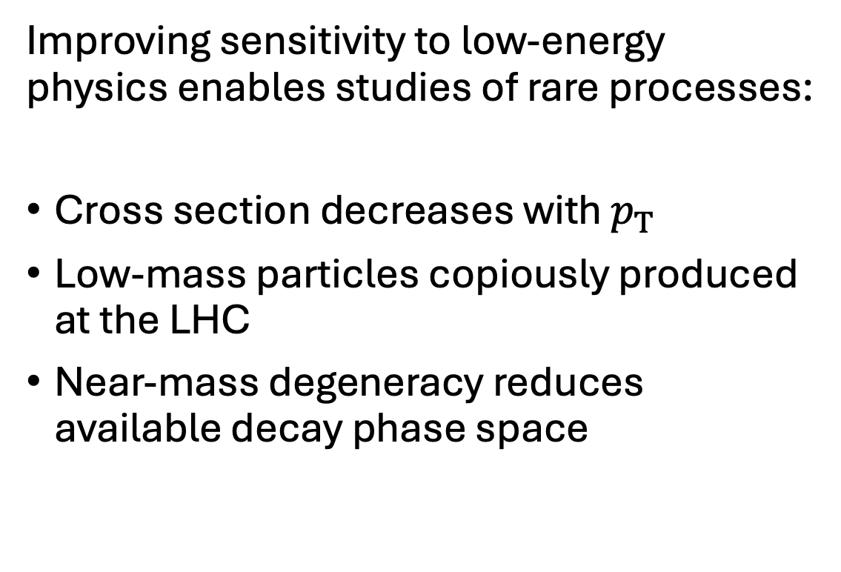
Low-energy sensitivity → rare processes
Improving sensitivity to low-energy physics enables studies of rare processes:
Cross section decreases with $p_{T}$
Low-mass particles copiously produced at the LHC
Near-mass degeneracy reduces available decay phase space

Slide 30
Future prospects
Several detector improvements for the Phase-II upgrade of the LHC experiments, in preparation for the High-Luminosity LHC era
Many interesting opportunities for studies of low-mass physics from these (and other) upgrades!

Slide 31




Detector upgrades
CMS/ATLAS
LHCb
Extension of tracker to $\left|η\right|≈4.0$ (CMS & ATLAS) ➔
increased acceptance to boosted particles!

Slide 32


Detector upgrades
Timing detectors (CMS & ATLAS) ➔
additional temporal dimension in reconstruction

Slide 33


Detector upgrades
ATLAS Muon Drift Tube upgrade ➔ increase purity of L0 muons by x3-4
CMS L1 track trigger ➔
tracking in the low-level trigger!

Slide 34

Data scouting at L1 / TLA at L0
Possibility to do real-time analysis at the hardware trigger
(close to LHCb’s triggerless readout)
CMS Phase-2 L1 system
Proposed L1 scouting

Slide 35

A few interesting scenarios
Several interesting studies featuring low-mass physics and rare processes might be possible in Run 4 of the LHC:
  Search for dark photons decaying to electrons with $m_{A^{′}}<0.2$ GeV
  Search for True Muonium
  Test of lepton flavor violation (LFV) in eta meson decays ($R(η)$)
  Search for light pseudoscalars (ALPs)
  Search for X17?

Slide 36

Searches for low-mass dark photons
Sub-GeV dark photons mainly produced in light meson decays

Slide 37

Searches for low-mass dark photons
CMS sub-GeV inclusive dimuon search (X → $μμ$) ongoing, but opportunity for exclusive search by tagging the photon:
Benefits:
  Significant background suppression
  Reconstruct the entire eta meson system
Challenges:
  Photon $p_{T}$ thresholds
  Collinearity between photon and lepton pair
Initial effort in looking for inclusive di-electron resonances too

Slide 38









Studies with $η$ mesons: True Muonium
Muonium: ${e^{+}μ}^{−}$ bound state
Similar search strategy:
$${ μ}^{+}$$
TM dissociates into $μμ$ or decays to $ee$
Predicted $ℬ(η→γTM) \sim {10}^{−10}$
Sensitive probe of QED and BSM physics
True Muonium: $μ^{+}μ^{−}$ bound state
$${ μ}^{+}$$
Theory projections:
$${ μ}^{−}$$
Mass: ~ 211 MeV
Phys. Rev. D 100 (2019) 053003
Never observed!

Slide 39





Studies with $η$ mesons: LFUV → $R(η)$
Electroweak interactions expected to respect lepton flavor universality in the SM
  ➔ same couplings to fermions of different flavors
Any deviations from LFU could indicate new physics
Rich program to search for LFUV processes across experiments, in particular R(K), R(D), R($J/ψ$)
New handle might be R($η$)!
$$R\left(J/ψ\right)=\frac{ℬ\left(B_{c}^{+}→J/ψ{ τ}^{+}{ ν}_{τ}\right)}{ℬ\left(B_{c}^{+}→J/ψ{ μ}^{+}{ ν}_{μ}\right)}$$
$$R\left(K\right)=\frac{ℬ\left(B^{+}→K^{+}{ μ}^{+}μ^{−}\right)}{ℬ\left(B^{+}→K^{+}{ e}^{+}e^{−}\right)}$$
$$R\left(η\right)=\frac{ℬ\left(η→{ μ}^{+}μ^{−}μ^{+}μ^{−}\right)}{ℬ\left(η→{ e}^{+}e^{−}μ^{+}μ^{−}\right)}$$
Purely electromagnetic processes

Slide 40


Searches for light (pseudo)scalars
Run-2 searches for pseudoscalars decaying to DM
Run-3 search for pseudoscalars decaying to SM

Slide 41





The Be/He/C (ATOMKI) anomalies
Phys. Rev. Lett. 116 (2016) 042501
Phys. Rev. C 104 (2021) 44003
¹²C*
Phys. Rev. C 106 (2022) L061601
¹¹B
¹²C

Slide 42

Looking for the explanation
Three main possibilities:
Systematic effects
Nuclear physics is hard!
New 17 MeV protophobic boson?
  → “X17”
Quanta Magazine

Slide 43


Digression: hot-off-the-press PADME results
PADME is a fixed-target experiment designed to search for MeV-scale dark photons
Since the ATOMKI anomalies, experiment changed to look for X17
(happy to talk more if interest!)
Mild excess in region around 16.85 MeV observed:2.5$σ$ local, 1.8$σ$ global (but existing prior!)

Slide 44
Searching for X17 at the LHC
Could we obtain sensitivity to X17 and other such light particles?
Same experimental approach in principle valid
Challenge: with 17 MeV, decay products will be extremely collinear
But new ML approaches have pushed down mass sensitivity
➔ Combine with scouting/parking?
To be continued…

Slide 45
Conclusions
Despite being the highest energy accelerator in the world, the LHC also enables world-leading sensitivity in studies of low-mass and rare processes
Several techniques overcome technical challenges faced by experiments, like data processing power and bandwidth limitations
The future is bright for the study of dark matter and other interesting low-mass physics at the LHC, especially with the ongoing Phase-II upgrade for the HL-LHC era

