Slide 1
iCAB WG - Kick off meeting
Planned replacements
Julien EMONDS-ALT (EN/EL-CS)
Thanks to C. BERNARD and G. GROS for the provided information
I-CAB meeting, 11 April 2025
Indico 153964

Slide 2
  Content
  Replacement conducted during YETS 24/25
  Replacement foreseen during YETS 25/26
  Replacement foreseen during LS3
    SPS 2
    TDC2/TCC2 (NA-CONS)
  Supply of Radiation Resistant Cables and Connectors
  Conclusion

Slide 3
  Replacement conducted during YETS 24/25
  12 replacement, conducted exclusively at SPS 2
    SVH2 cable type (General Purpose Cable, SVH2 is obsolete and replaced by SVA3)
    Cables used by Ion Pumps, TE-VSC
  4 replaced on the LEFT side SPS 2
    Replacement following failure identified by Abel Gutierrez, TE-VSC
    Old cables installed in 2009
    “Logical” (?) because very hot area and GPC cable type
  8 replaced on the RIGHT side SPS 2
    Replacement following failure identified by Abel Gutierrez, TE-VSC
    Old cables installed before 1984 (20100, 20104, 20118 → 1984; 24001 → 1976; 24219 → 1991)
    “Relatively hot” spot found on cable route during onsite investigation conducted with RP
  6 spare cables installed by waiting massive replacement foreseen during LS3

Slide 4
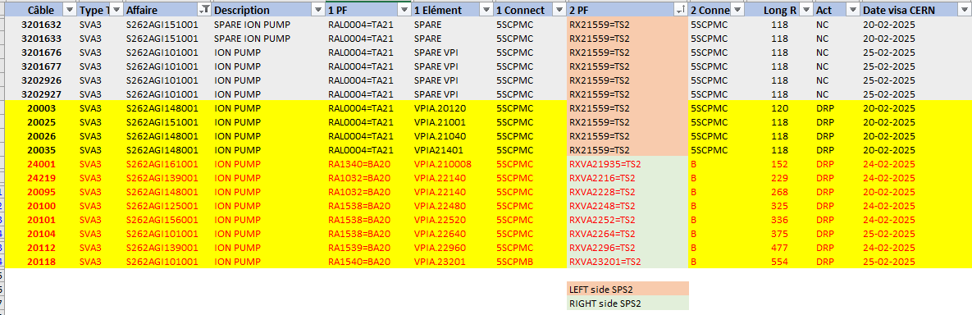
  Replacement conducted during YETS 24/25

Slide 5
  Replacement foreseen during YETS 25/26
  3 replacements requested by TE-VSC
    Ion pump application, SVH2 cable type (SVA3)
    Old cable installed in 1981 (1) and 1984 (2)
    2 cables at SPS 2 → Right side
    1 cable at SPS 5 → Not hot area…Not logical… Root cause analysis should be conducted (by who?)
  Deadline for YETS 25-26 preliminary cabling requests is 30.04.2025 (MEMO EDMS 3284663).
  Will maybe include irradiated cables replacement requests from users…and I-CAB.

Slide 6
  Replacement foreseen during LS3 – SPS 2
  Extended replacement : TS2- (70 km), TS2+ (~~~70 km) and TT20 (~20 km)
  Obsolete cables removed at the same time (299 km)
  Volume and Effort may vary significantly…
    Is a consolidation/optimization of the Cabling System Architecture necessary ?
      Review the use of Radiation Resistant Cables required ? Where ? What level ? 3.5 MGy or 10 MGy ?
      New cable routes required ?
      Additional patch panels required ? Accepted by users ?
      What are the priorities for optimization: Dose taken, Execution duration, Cost, Lifetime,…. ?
      → Current strategy is 1 to 1 replacement
      → Architecture review requires additional EN-EL resources (MTP2025) and I-CAB major support
    Should “all” signal cables be replaced indiscriminately, without assessing their condition, expected lifespan, criticality, etc.?
      Do we have to replace the cables interconnecting equipment’s in TS24 (left arc), not passing in TS25 (LSS2-) ?
      → Current plan do not include them if the users does not ask their replacement as quested by TE-VSC
      Do we have to replace cables going to TS24 via TS25/Transport side (LSS2-)….if they are found in good conditions (meaning ?)…and/or have been recently replaced… and/or….(?) ?
      → We envisage to keep some of the existing cables present in the transport side at LSS2-.

Slide 7
((Simplified and not accurate !!!))
  Replacement foreseen during LS3 – SPS 2
LSS2- (TS25-)
Patch PanelSSSSSS
Patch PanelSS
Patch PanelS
Patch PanelS
Is TID different ?
~~~~1500 cables
… GPC or RRC?
TA

Slide 8
  Replacement foreseen during LS3 – SPS 2
  ~9 new RPL sensors have been requested to SY-STI installed during YETS 25-26 to assess further dose rates
    QDA.21910, right side, “first” magnet on the right of the TA
      Potential hot spot who could explain observed SVA3 failures
    Magnet NPNH.21732, left side sps 2, transport side, (LSS)
      We have a cable tray and a safety cable tray with many cables there
      New RPL will allow to better define if 10 MGy cables are necessary
    Magnet NPNH.21732, left side sps 2, machine side, (LSS)
      Same logic than for the RPL located at the same point here on machine side instead of transport side.
  Last CARE Assessment Report(s)
    NGF2 from Polycab irradiated in LSS2- (EDMS 3224240)

Slide 9
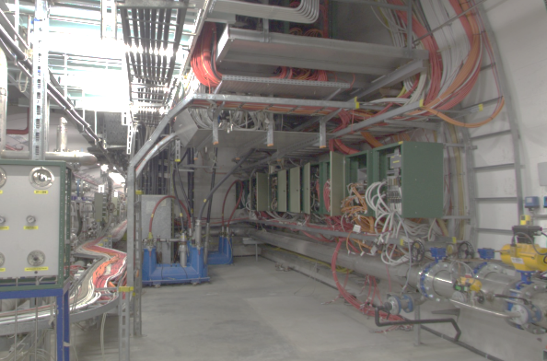
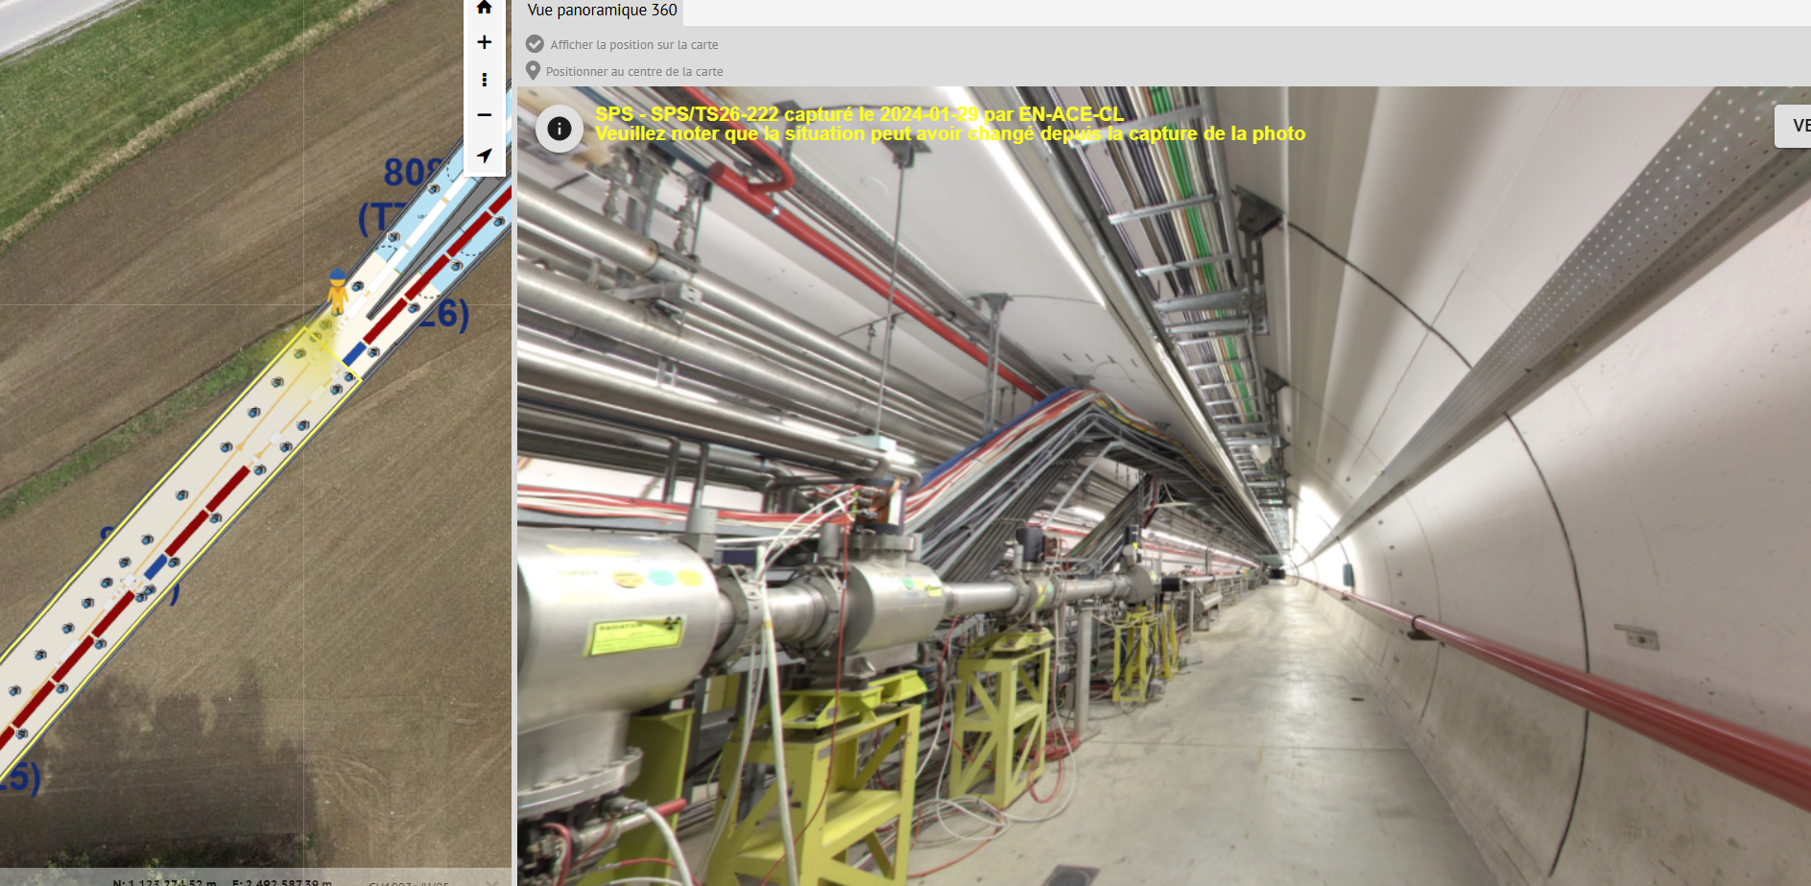
  Replacement foreseen during LS3 – SPS 2
  At the split point TT20/SPS
  Patch panels in front of TA exist to SPS at SPS2

Slide 10
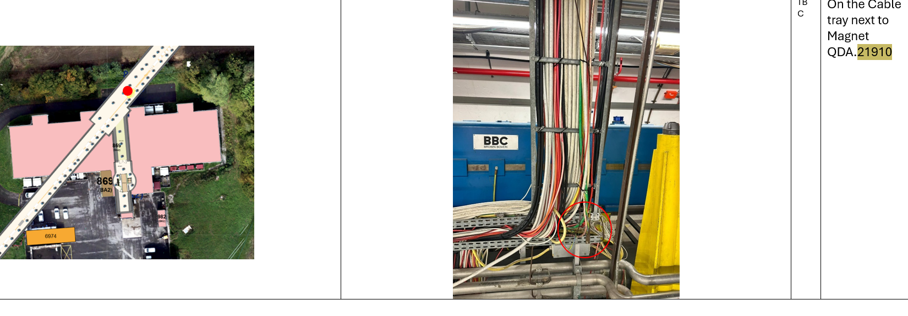
  Location new RPL YETS24-25

Slide 11
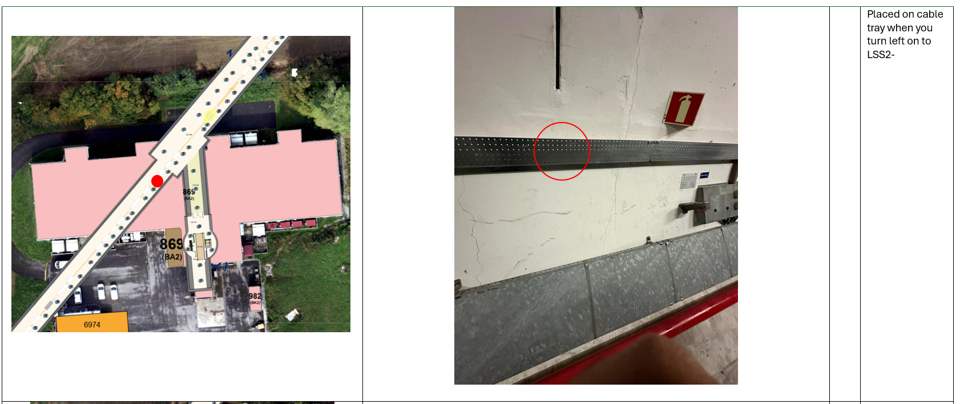
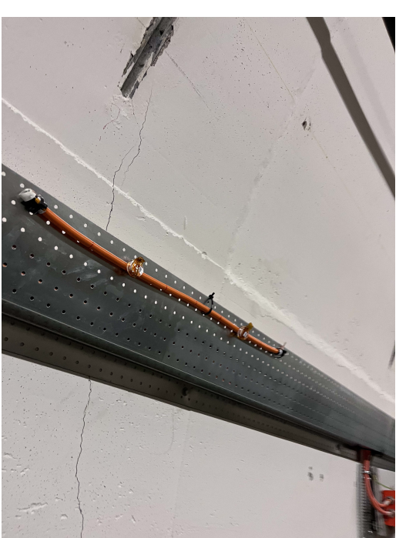
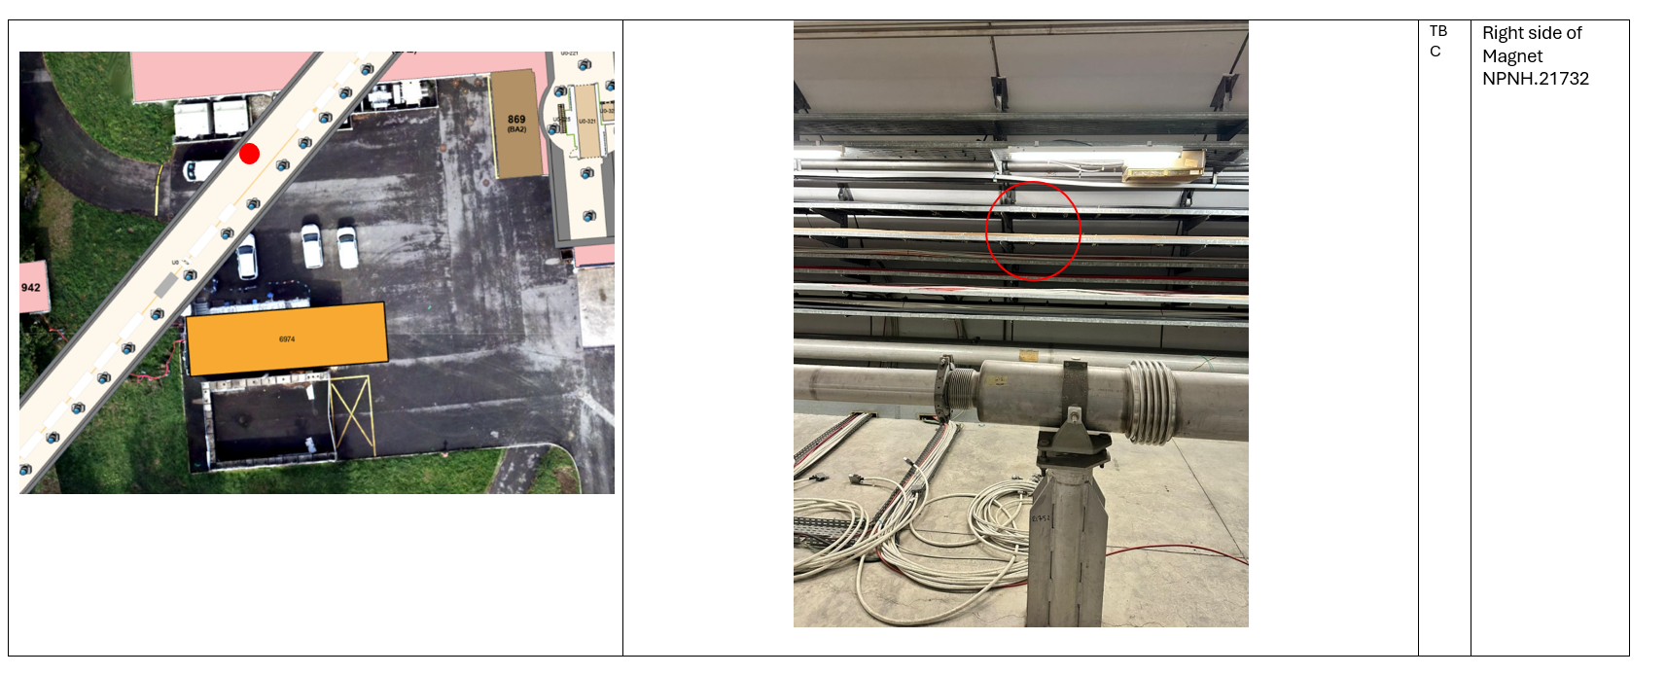
  Replacement foreseen during LS3 – SPS 2
  Location new RPL YETS24-25
  Location cable sample on the transport side of LSS2-
  Location new RPL YETS24-25

Slide 12
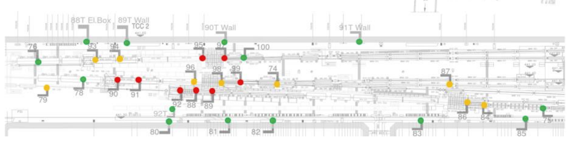
  Replacement foreseen during LS3 – TDC2/TCC2
  1 to 1 replacement, including removal of the obsolete, was the baseline…
  ACC-CONS Baseline is not anymore applicable due to NA-CONS project which required many new cables (new types, new routes, new dose rate)
  Cable System Architecture review is required… Increased complexity….
  Implication of NA-CONS, I-CAB, EN-EL, Users required
  EDMS3071544. Graphical representation of the predicted accumulative dose in each TCC2 RPL using 2018
  data after 22 years of operation

Slide 13
  Supply of Radiation Resistant Cables and Connectors
  Supply of Radiation Resistant Cables
    10 MGy and 3.5 MGy
    Opening IT-5062 done on the 9 April 2025
    Analysis ongoing
    No firms offer the connectors defined in option
  Supply of Radiation Resistant Connectors
    Do they really exist ?
    (Type of connector present on connected equipment should be checked with users)
    Who manage their procurement ?

Slide 14
  Conclusion
  12 cables replaced during YETS 24-25.
  All SHV2 type used for TE-VSC pumps a SPS 2 left and right sides.
  3 SHV2 cables TE-VSC ion Pump planned for replacement at SPS 2 and 5 during YETS 25-26.
  Additional requests can be transmitted to EN-EL, by users and I-CAB, up to end April 2025.
  Replacement foreseen during LS3
    SPS 2 (TS2-, TS2+ and TT20)
    TDC2/TCC2 NA-CONS
  Volume and Effort can vary sharply depending on replacement strategy
  Baseline is 1 to 1 replacement often not applicable and/or not efficient
  Cable System Architecture review requires additional EN-EL resources (MTP2025) and I-CAB major support
  IT-5062 Radiation Resistant Cables – Opening done 09.04.2025. Analyse ongoing.
  Supply of Radiation Resistant Connectors to be addressed

