Slide 1
Hot spots mapping of CERN’s accelerator facilities
Helmut Vincke on behalf of RP
Many thanks for providing information and material to: C. Ahdida, D. Bozzato, A. Devienne , R. Froeschl, J-F. Gruber, A. Infantino, F. Philippon , Y. Pira, F. Pozzi and to all (to me unknown) colleagues who provided them with information

Slide 2
Contents
Dose rate mapping will provide info in the following order:
PS complex (including experimental areas)
SPS complex (including experimental areas)
LHC (excluding experimental areas)
Important note:
The collective dose received during a cable intervention depends on dose rate values and intervention duration: ➔ even small dose rates can lead to high collective doses
For long term interventions, optimizations pay off already in low dose rate areas

Slide 3
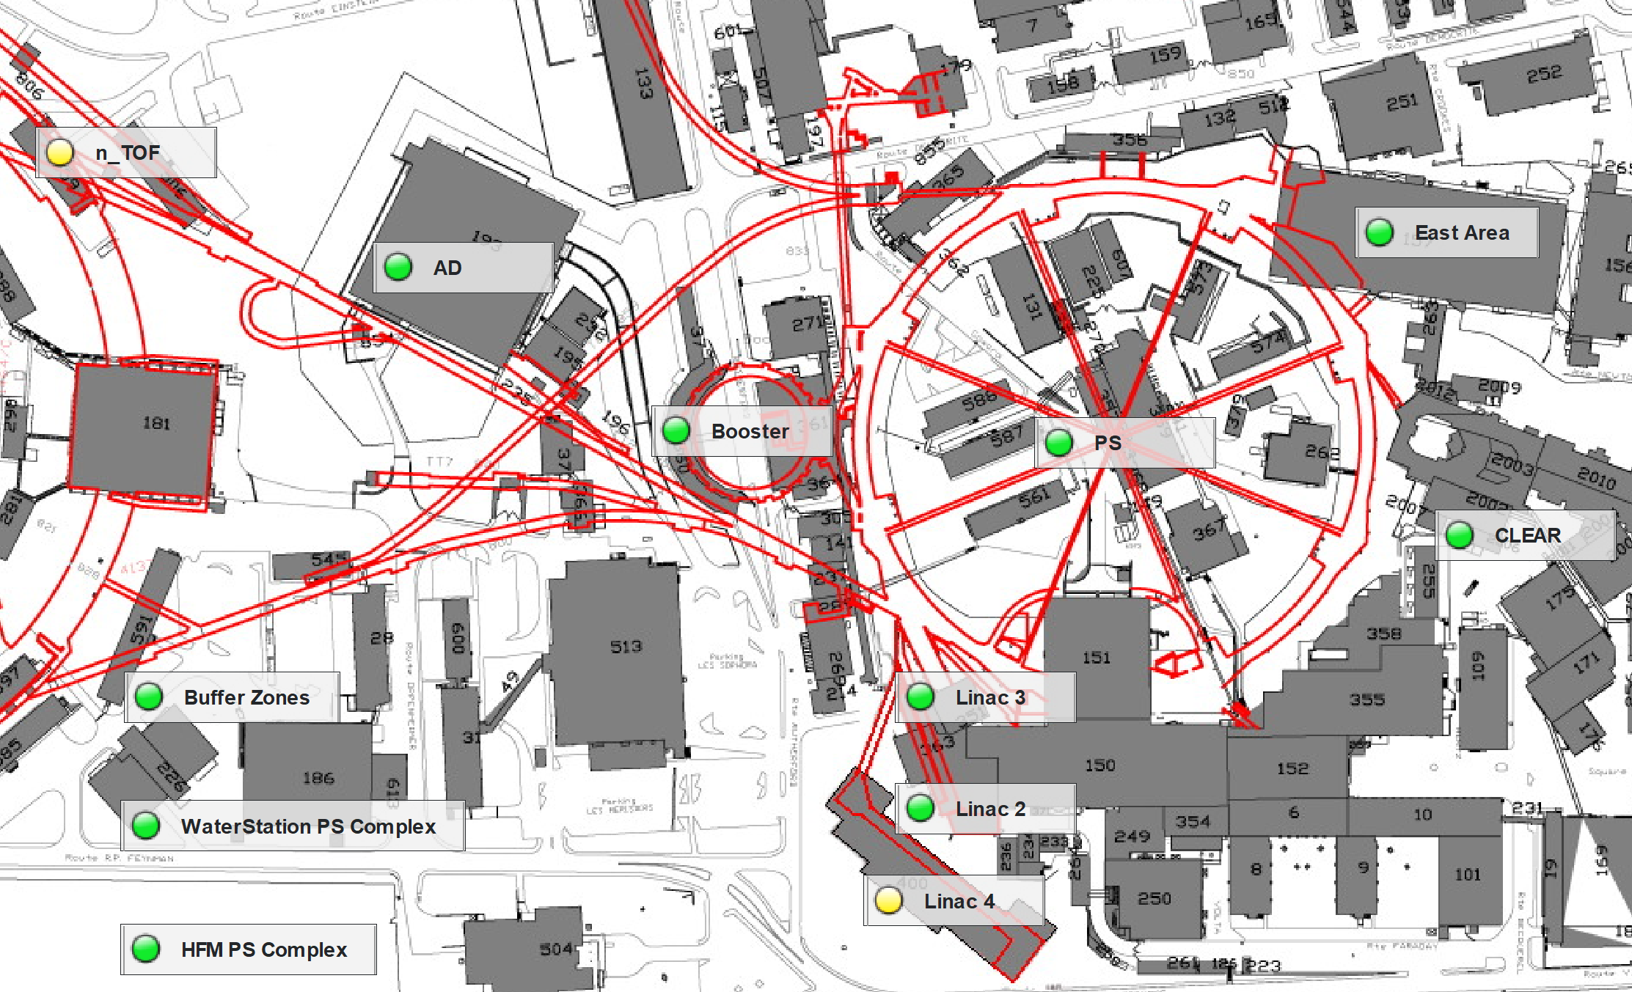
PS complex overview

Slide 4
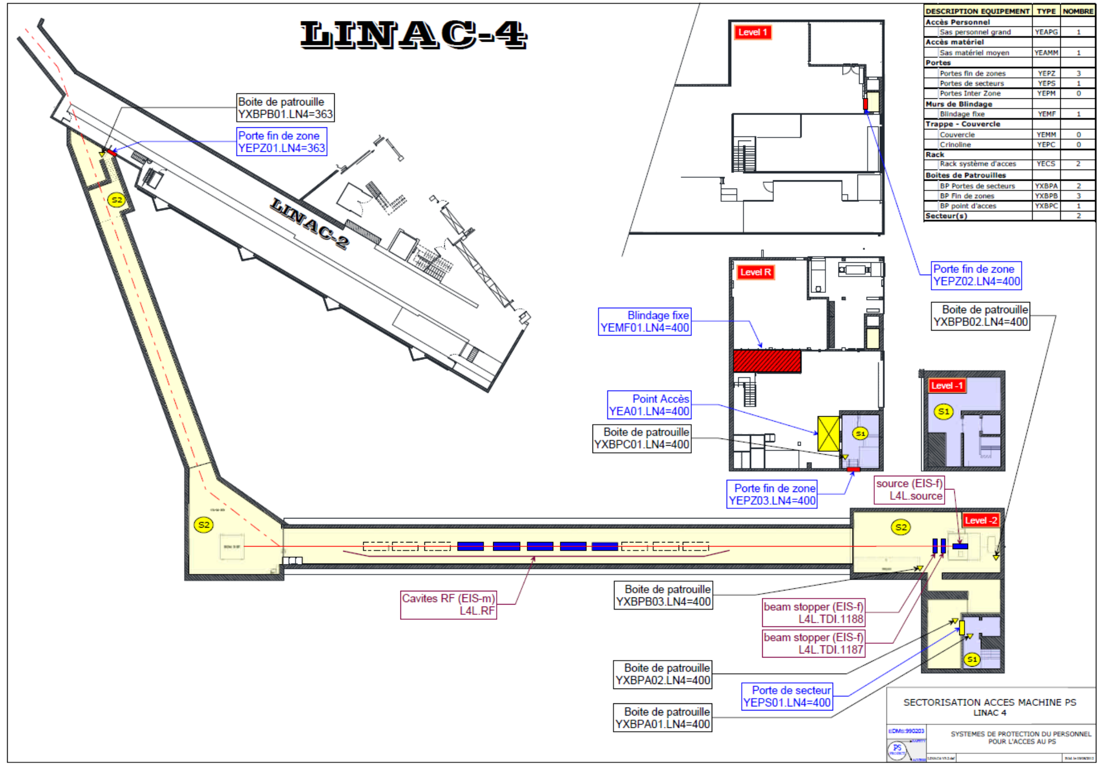
LINAC4
Hottest areas
  Main beam dump (in orange)
  End of transfer line (in red)
  Hottest areas after 4 – 6 months ~10 uSv/h
  RP study EDMS 1363543
  RP survey 2024-12-05_LIN4.pdf
Note: LINAC4 is a rather recent facility (2015). No cabling replacement issue expected from a RP perspective. Low dose interventions in general.

Slide 5
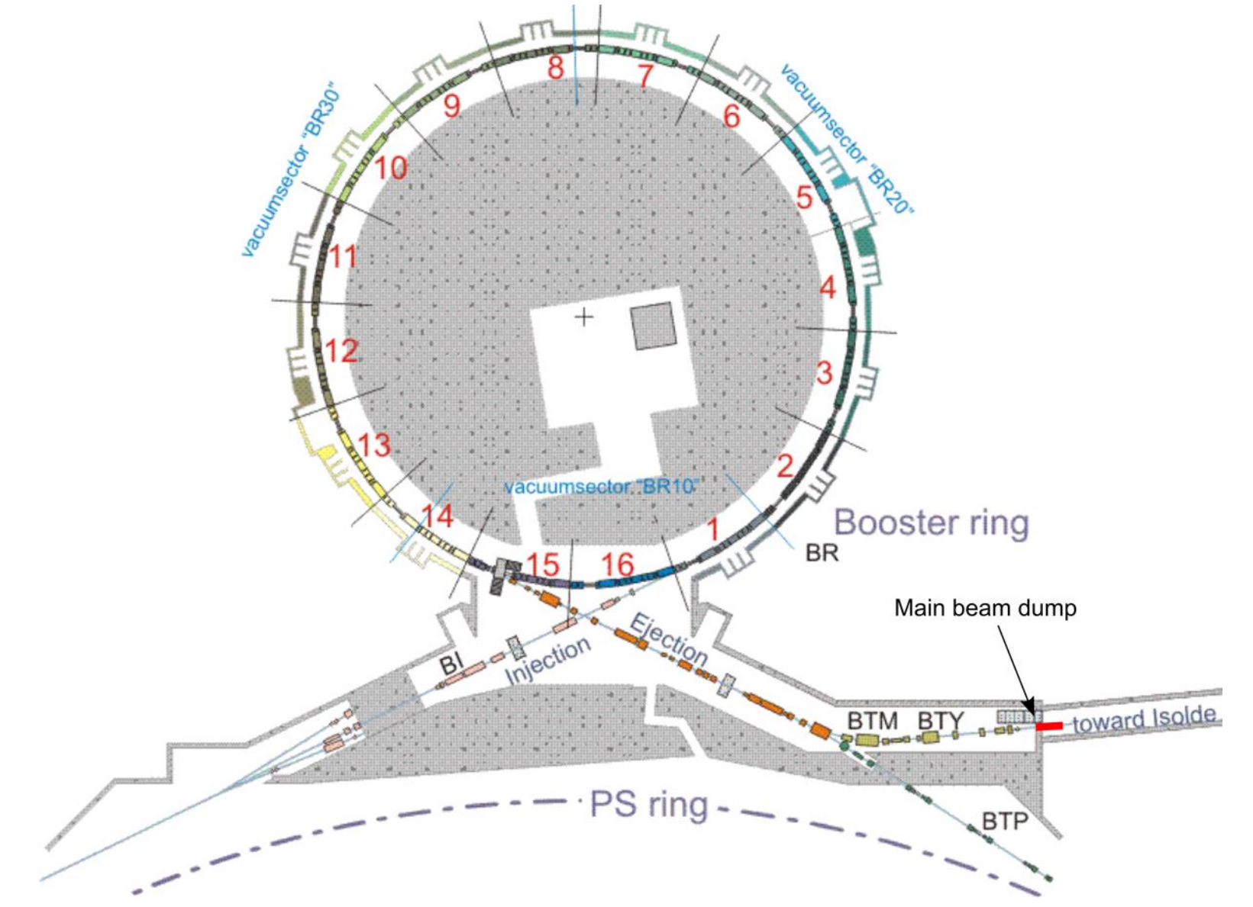
PSBooster
Hottest areas
  Period 15/16/1/BT (in red)
  Period 9/10 (in orange)
  Hottest areas after 4 - 6 months: ~10 - 100 uSv/h
  → RP study : EDMS 3123836
  RP survey 2024-12-03_PSB.pdf
Note: De-cabling campaign performed during LS2. Limited cabling replacement issues are expected from a RP perspective (longer works being usually farer from hot areas.

Slide 6
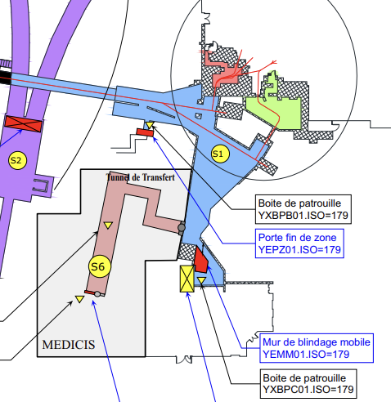
ISOLDE
EDMS 2650785 v.1.0 (Slides 11-12-13)
ISOLDE target area
  HRS and GPS Faraday Cages (in orange) have residual dose rate in the order of several mSv/h after a few months of cool-down
  The rest of the target area shows residual dose rate in the order of hundreds of uSv/h after a few months of cool-down time
  The target area presents a risk of contamination -> access requires adequate PPE

Slide 7
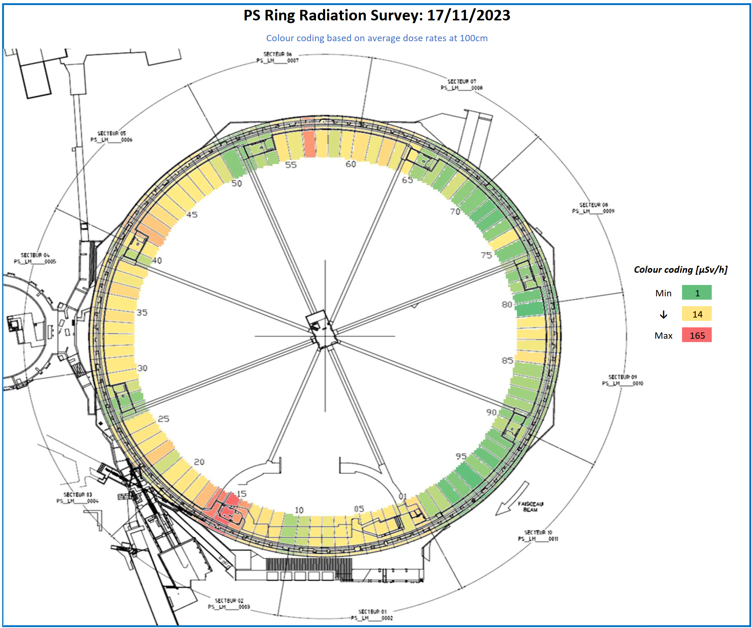
PS
the main points of concern are the extraction region towards TT2, i.e. SS15 with the dump septum and SS16 with the septum

Slide 8
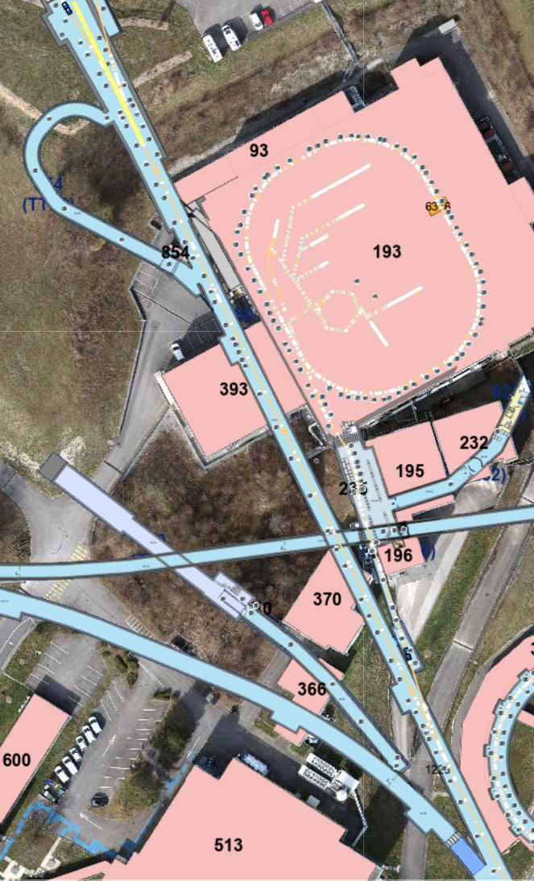
Transfer line TT2
Transfer lines to experiments and SPS do not show very high dose rate levels.
Elevated dose rate values in the range of 100 uSv (short cool down) can be found at the end of TT2

Slide 9
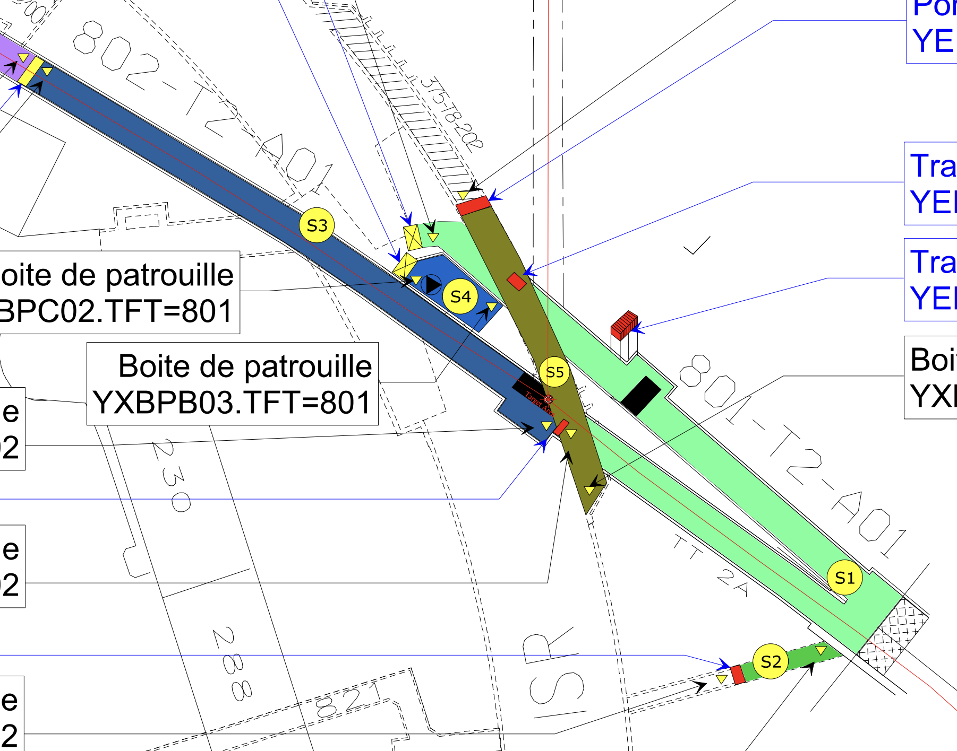
n_TOF
n_TOF target area
  Area in front of n_TOF target shows residual dose rate in the order of tens to hundreds of uSv/h after a few months of cool-down time
  Not many cable present in the area
FTN beam line
  Several hot-spots due to beam losses (up to 0.7 mSv/h, cool down of 30 hours)

Slide 10
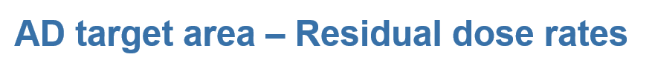
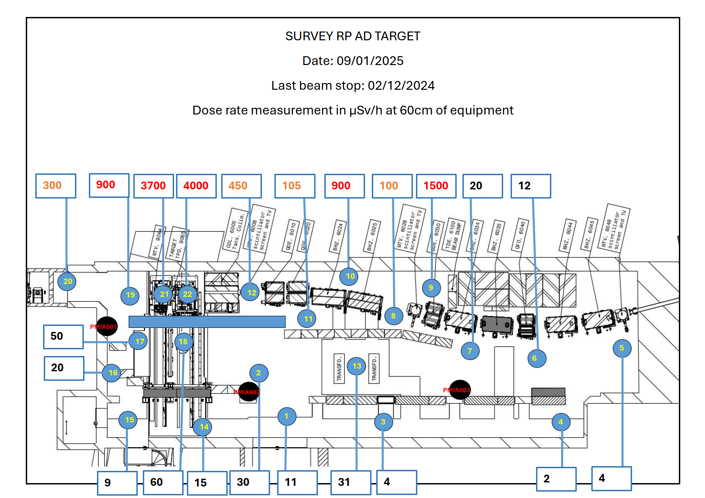

Slide 11
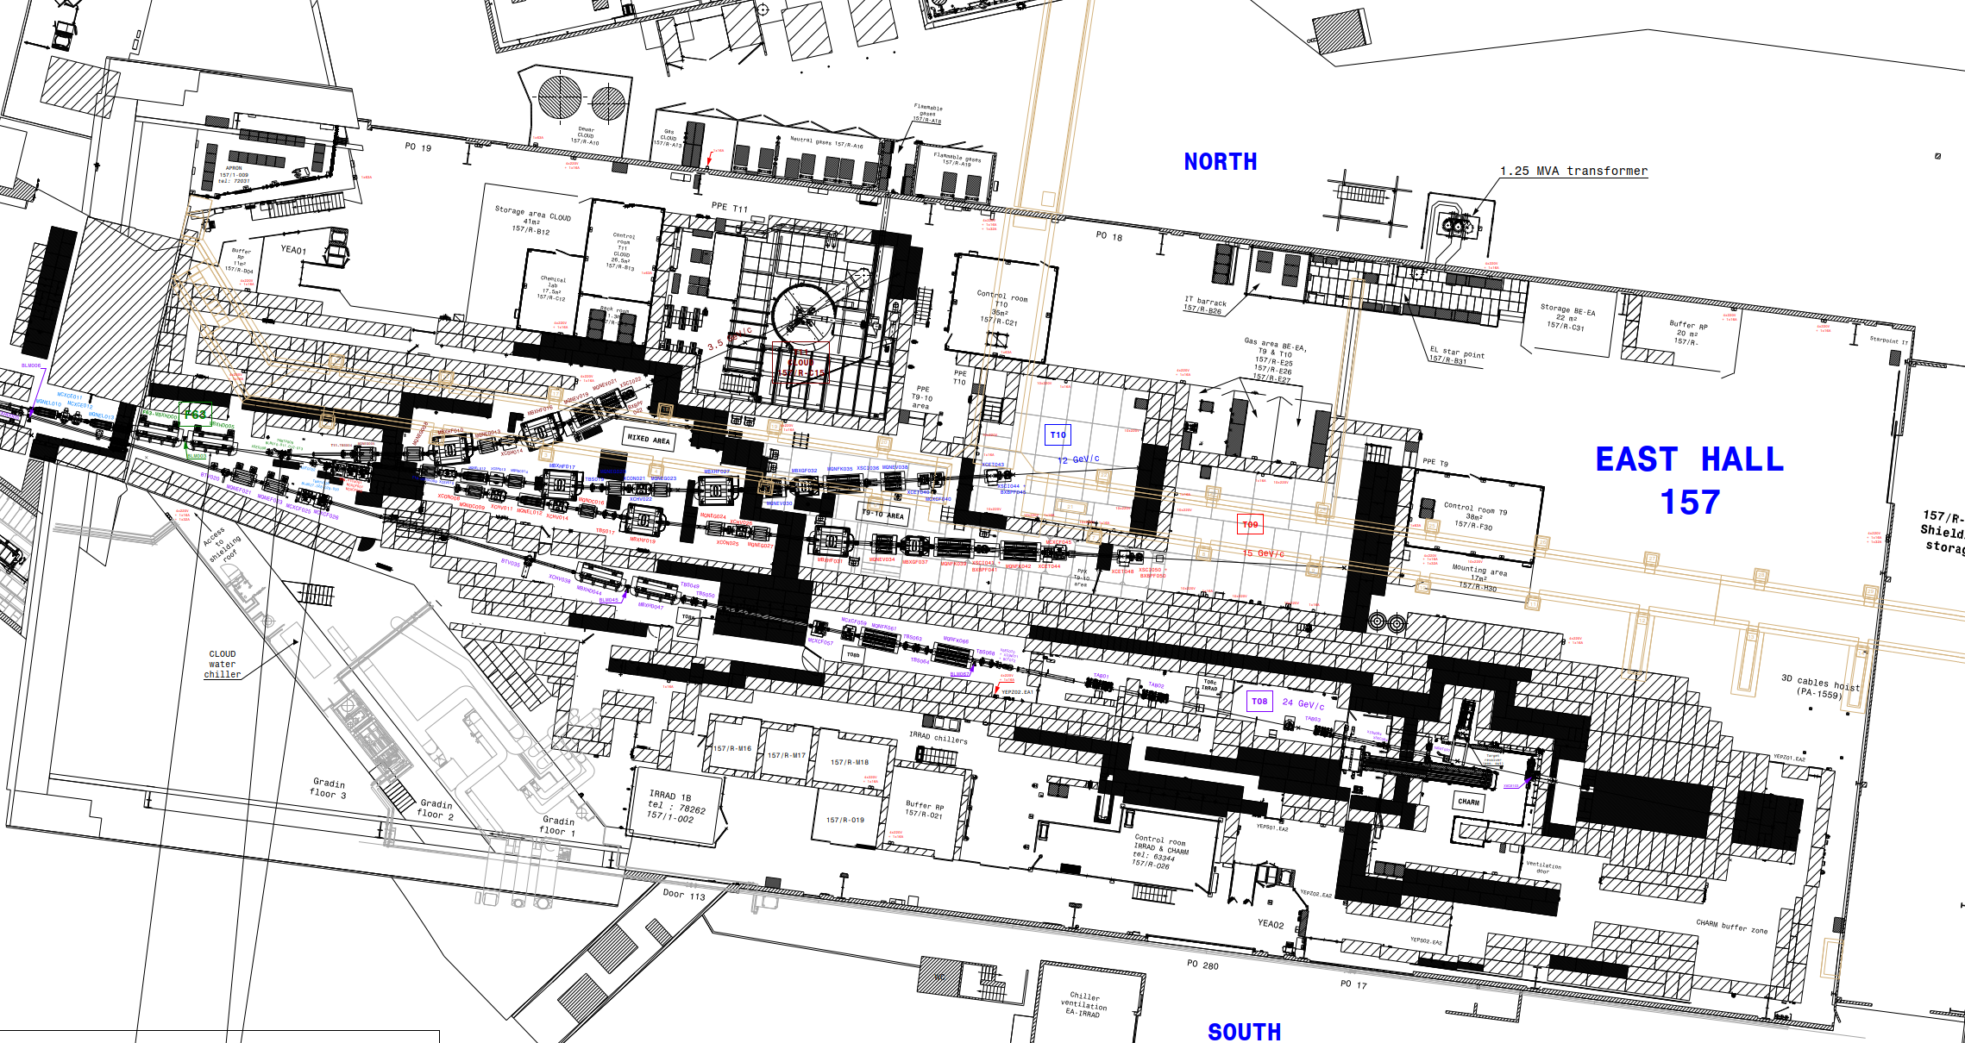
East Area
Hottest areas
Primary Area EA1
  Particularly the Target Area (in red)
  RP study EDMS 2058239
  RP survey note EDMS 2756842
  100-300 uSv/h at 1 m of the
  elements of Target Area
Primary Area EA2
  Particularly IRRAD-3 & CHARM (in orange)
  RP study EDMS 1355933
  RP survey: 100-800 uSv/h in the most activated referenced positions of IRRAD & CHARM
Note: rather recent installations (2015 for CHARM and 2021 for Target Area + T9/T10/T11) with limited number of cables in hottest areas and little cabling replacement issue expected from a RP perspective after reasonable cool-down times.

Slide 12
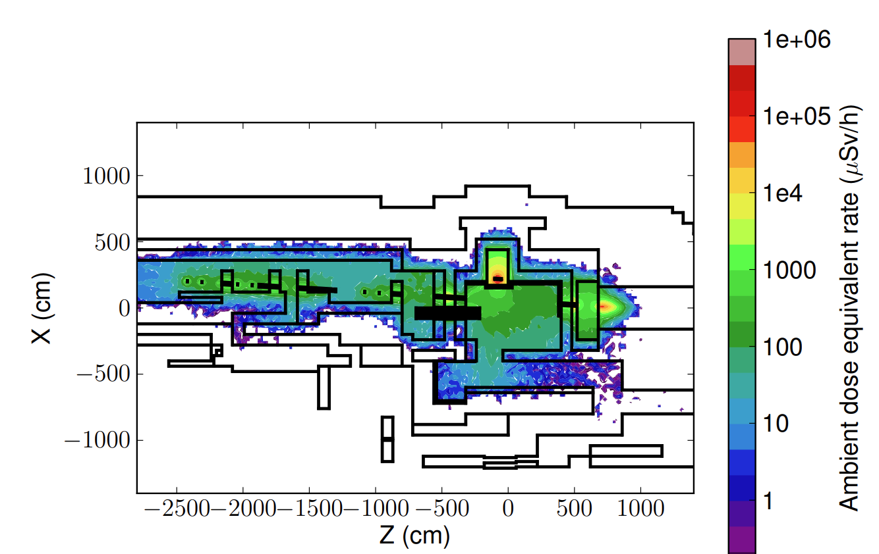
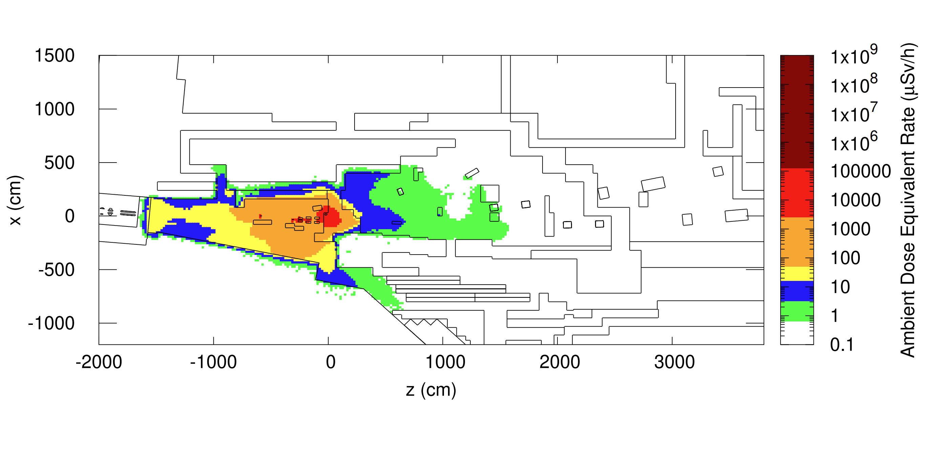
East Area
Dose rate levels next to target and CHARM-IRRAD area, conservative study
Cool down of 6 months
Cool down of 1 week

Slide 13
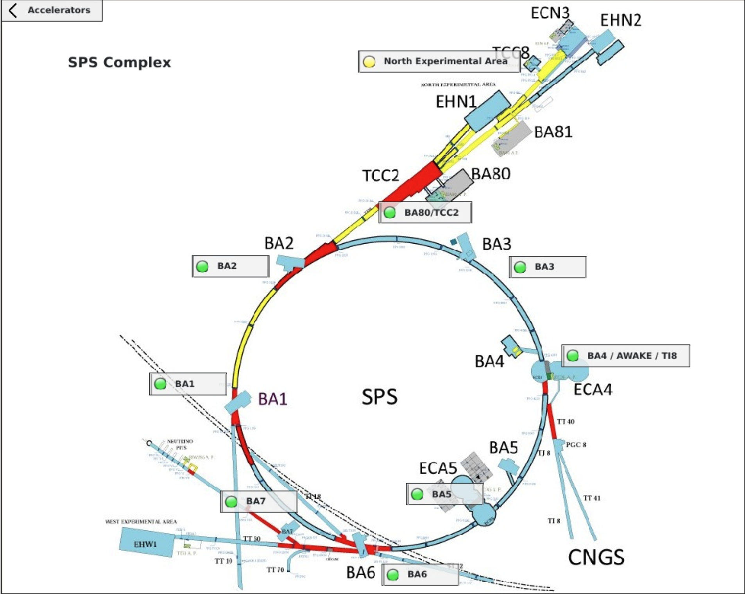
SPS complex
overview

Slide 14
Transfer line TT10:
No critical radiation hot spot in this line

Slide 15
SPS-complex
Areas of main concerns are: BA2, TT20, TDC2, TCC2, TCC8
BA1: strongly reduced issues since dumps were removed
BA3, BA4, BA5 and BA6 are not critical in terms of dose rates
Dose details : next slides
Reminder: even small dose rates can lead to a high collective dose in case of long-term interventions

Slide 16
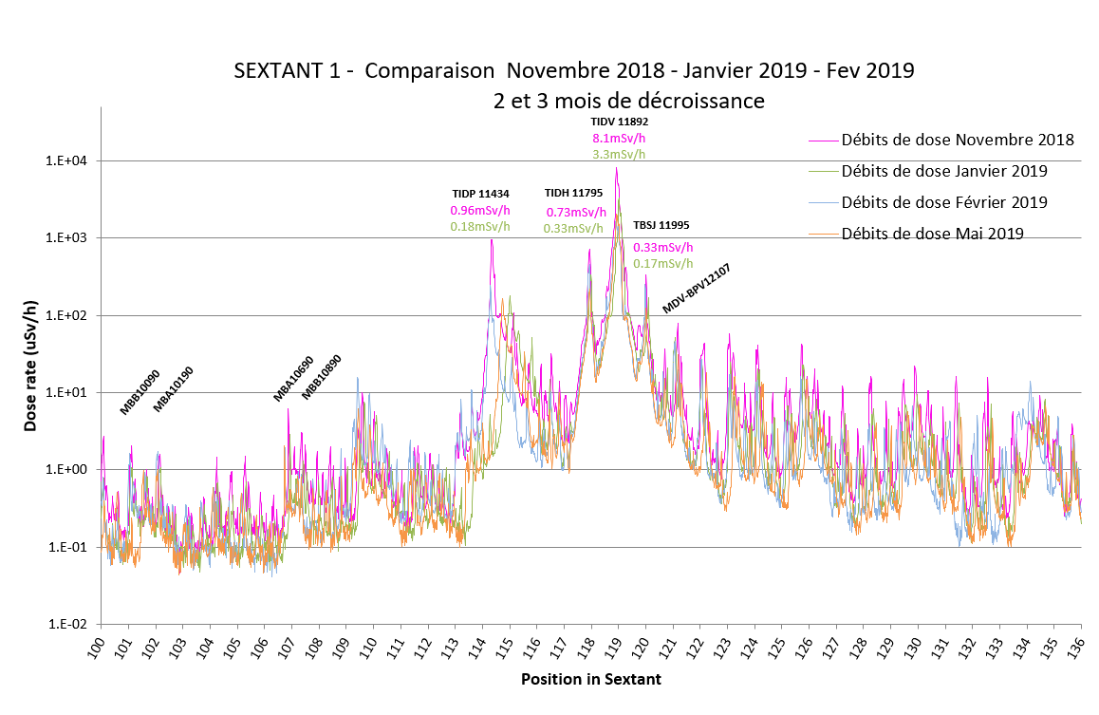
SPS BA1 (former situation)
Former radiation situation:
Hot spots around former beam dump locations (TIDV and TIDH) vanished

Slide 17
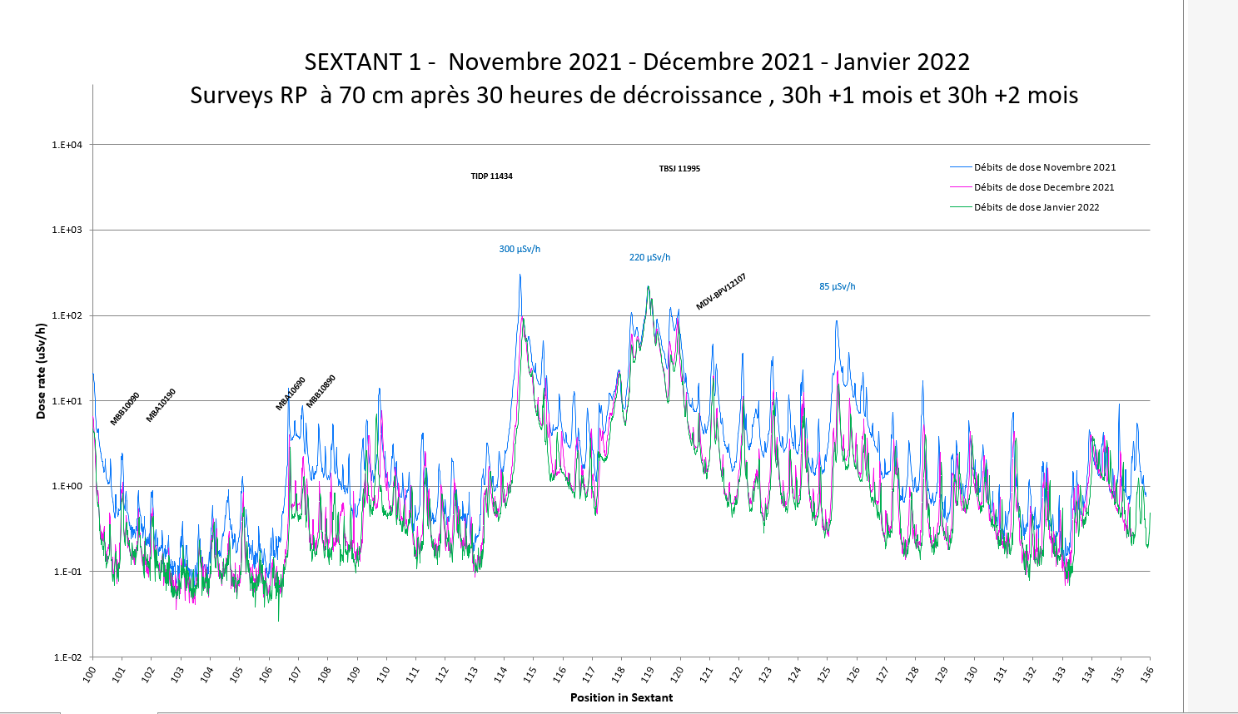
Today’s situation:
Dose rate situation nowadays more relaxed due to the removal of the TIDVG and TIDVH (compared to pre 2019 situation):
Dose rates at critical areas (TIDVG) factor 30 below

Slide 18
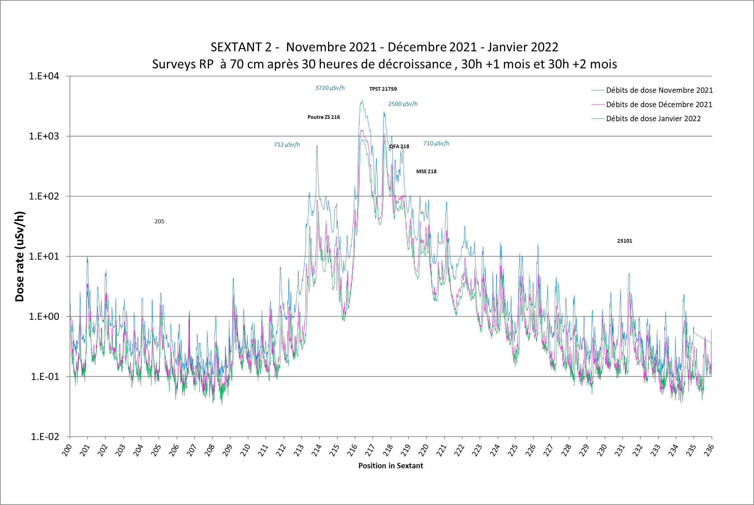
SPS BA2
Highly radioactive areas around the beam extraction to North Area

Slide 19
Transfer lines to the LHC (TT40, TI8, TJ8, TT41, TT60, TI2, +transfer to HIRADMAT)
There are no hot spots, even TCC6 cooled down
HIRADMAT
Up to experimental places: no critical hot-spots
Further downstream: dose rates up to the mSv/h range
TI2

Slide 20
TT20 + TDC2 + TCC2

Slide 21
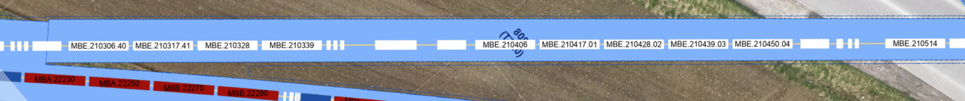
TT20 (cool down of 1 month, 40 cm distance, survey of 2024)
50 – 300 uSv/h
TED
> 300 uSv/h
TBSE

Slide 22
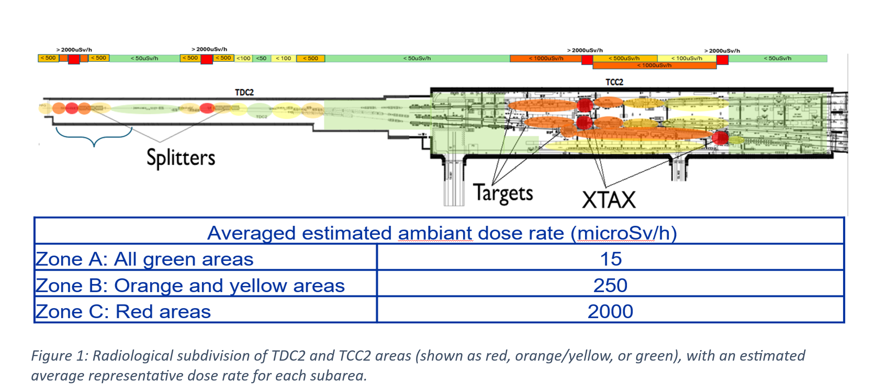
Dose rate levels in TDC2 and TCC2 after a cool down of ~6 month

Slide 23
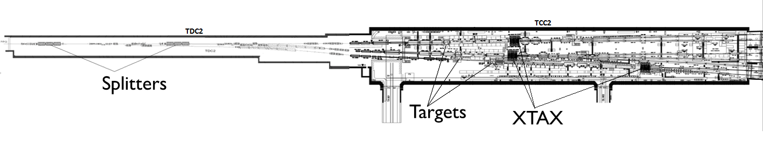
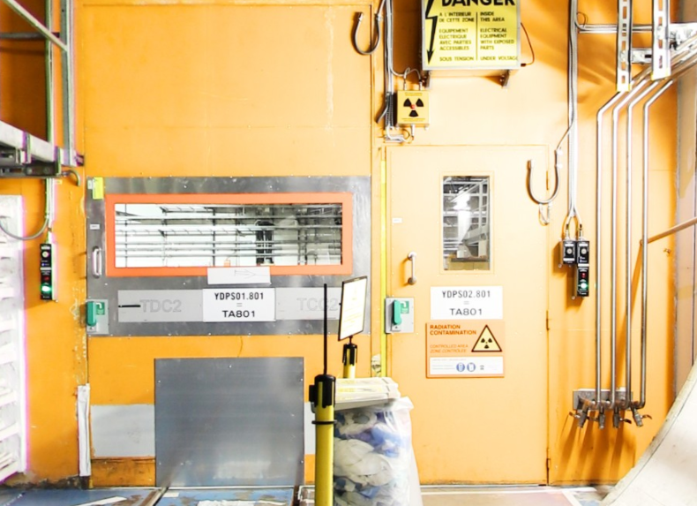
TDC2/TCC2 : Contamination risk
TDC2/TCC2 : presence of radioactive contamination (β/γ only) :
Variable levels from 0.1 to 50 Bq/cm².
Can be much more inside the most radioactive equipment (like XTAX).
Adapted PPE required to acess TDC2-TCC2 :
  At least gloves + overshoes,
  Depending on the situation : overall + mask or ventilated hood.
PPE available in the RP room 889/R-007.
TA801 door
TA801/GL802 : no contamination.

Slide 24
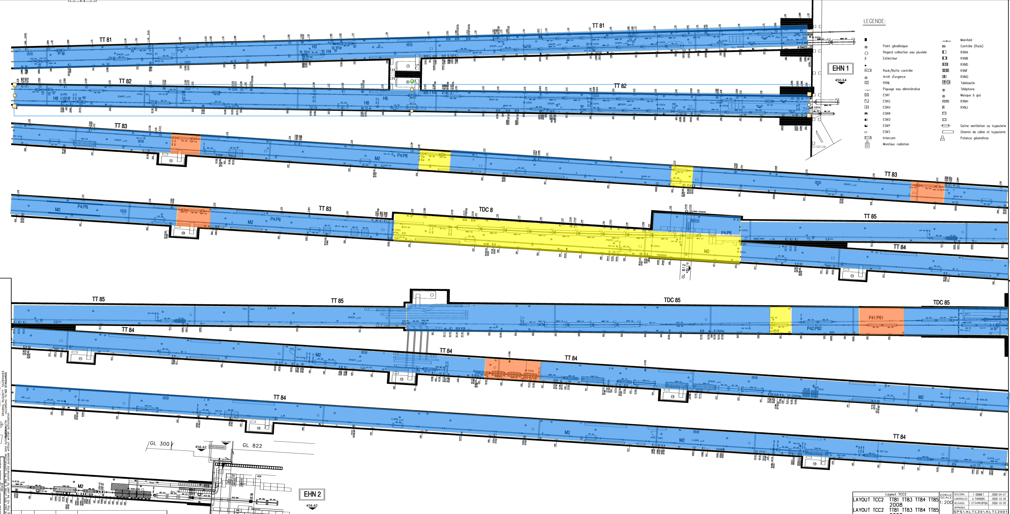
Transfer lines to North Experimental Areas
DR< 15 uSv/h
15 uSv/h < DR < 50 uSv/h
15 uSv/h < DR < 50 uSv/h

Slide 25
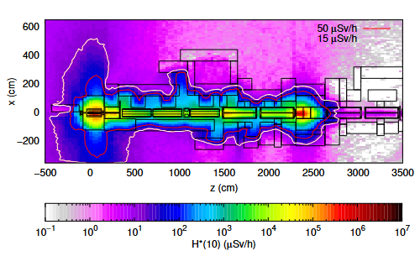
TCC8/ECN3 during LS3
Residual dose rates in Sep. 2027
(1 year + 2 months cool-down)
Decabling and dismantling of TCC8/ECN3 in LS3 in view of HI-ECN3
Residual dose rates critical only in T10-TAX area in TCC8, where cables are removed during dismantling process
Detailed plan for the de-cabling in the vicinity of the highly activated equipment (T10- XTAX; very little fraction of cables (~10 cables)) is still to be defined and will be optimized (i.e. sequence after removal of ''hot'' equipment, location of cutting, etc.)

Slide 26
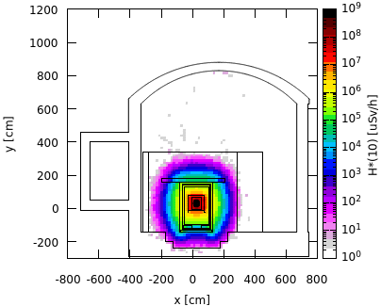
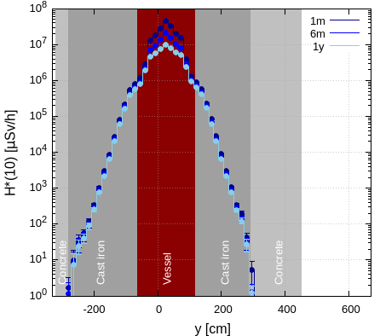
TCC8/ECN3 during HI-ECN3
Total PoT 6×10²⁰ (15 years)
In TTC8, high residual dose rates are limited to central BDF target/dump region
In the central region several 10 Sv/h after 1 month of cool-down requiring remote handling. In this region only radiation hard cables are foreseen
The residual dose rates outside the shielding are < 1 µSv/h
The upstream TCC8 area includes dilution magnets and drift space with minimal losses guaranteeing low background for SHiP
In the downstream ECN3 Supervised Radiation Area conditions are expected
Cross-sectional view, target level
Along x-axis, working height
1 month cool-down

Slide 27
LHC
Superconducting areas are no issue since the dose rates there are very low
Areas of the experiments are covered by the experiments themselves. General comment: all areas containing electronics are no issue for radiation triggered cable damage
All other (critical) areas are discussed in the following slides
Please note: after LS3 (start of Hi Lumi LHC) levels of radiation will increase to those shown here

Slide 28
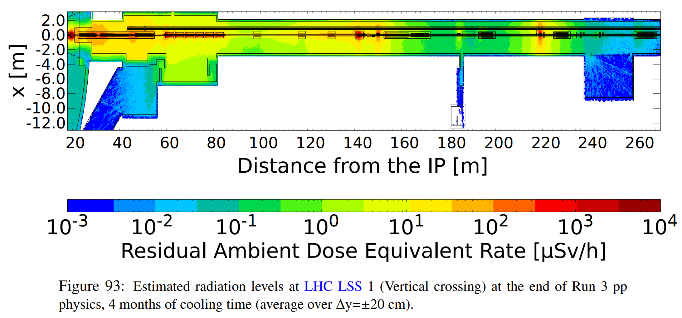
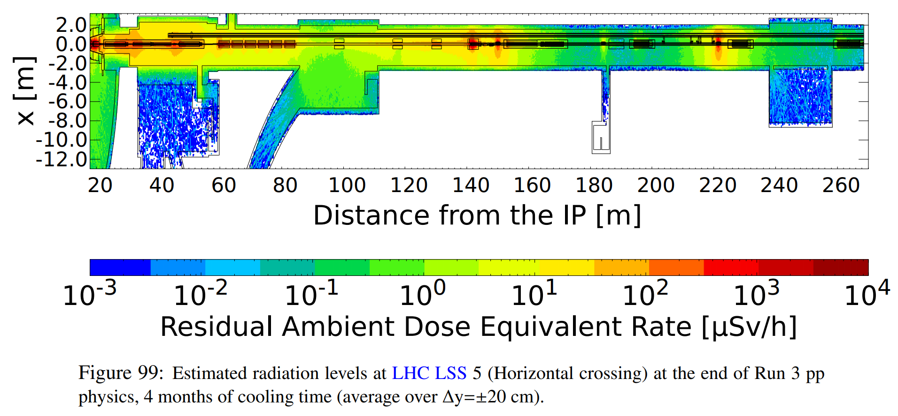
LSS1 & LSS5
Main hotspots at the level of the Inner Triplet (IT); TAN and TCLs collimators.
Similar situation will be present in the HL-LHC era, with residual dose rate expected to scale with integrated luminosity (long-term activation)

Slide 29
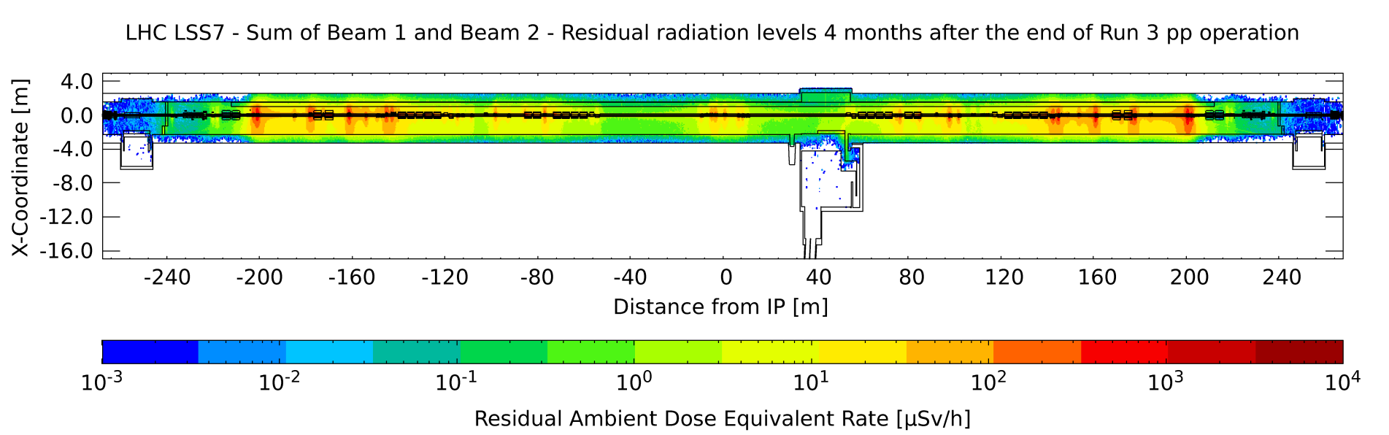
LSS3 and LSS7
LSS: hotspots at the level of primary and secondary collimators.
Simulation for LSS3 to be done; hotspots expected close to primary collimators;

Slide 30
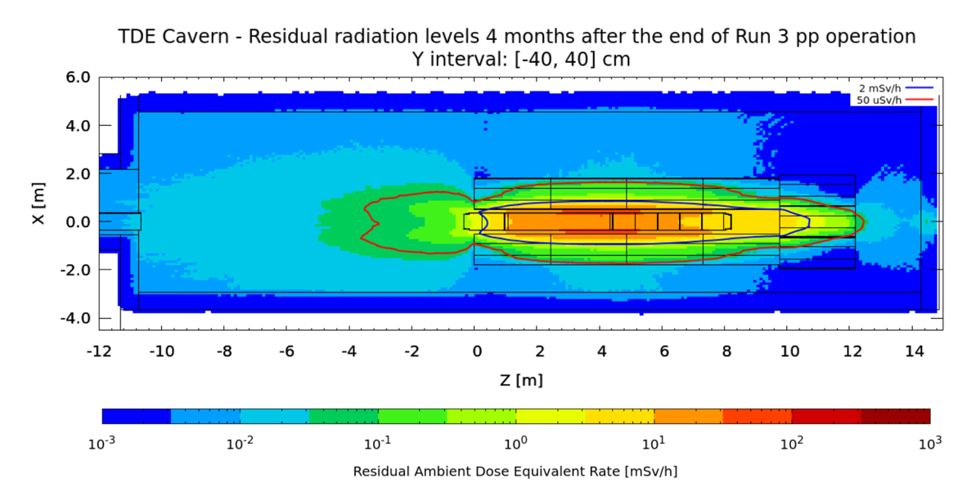
UD62 & UD68 (dump areas)

Slide 31
Questions?

Slide 32
Backup slides

Slide 33
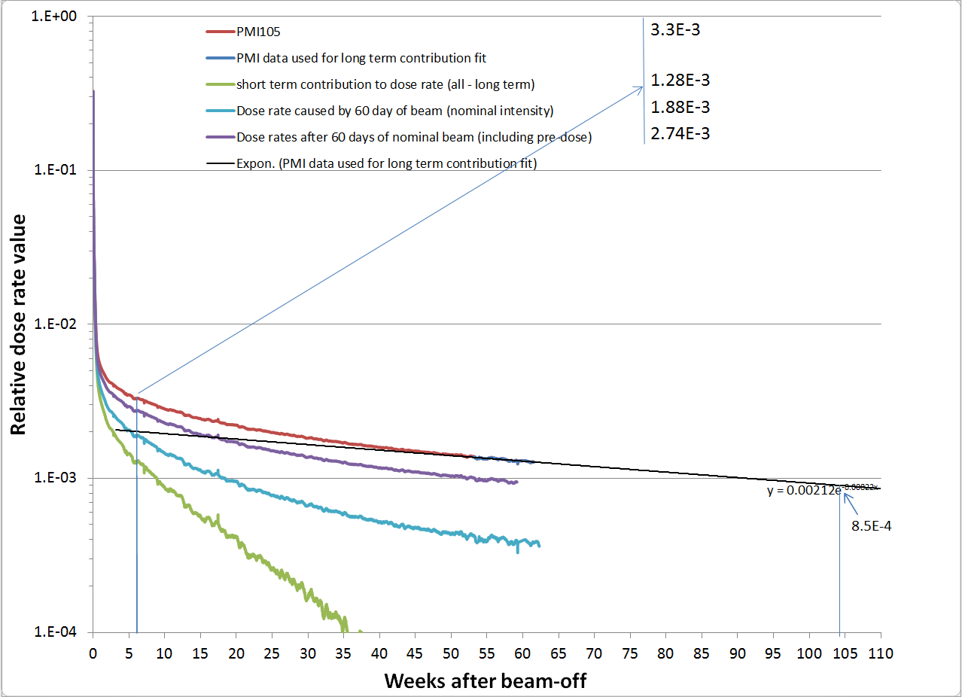
Might be useful
Dose rate behavior close to the TIDV (BA1) in the long shutdown 2004-2006
These data allow for estimating the decay effect as a function of cooling time

Slide 34
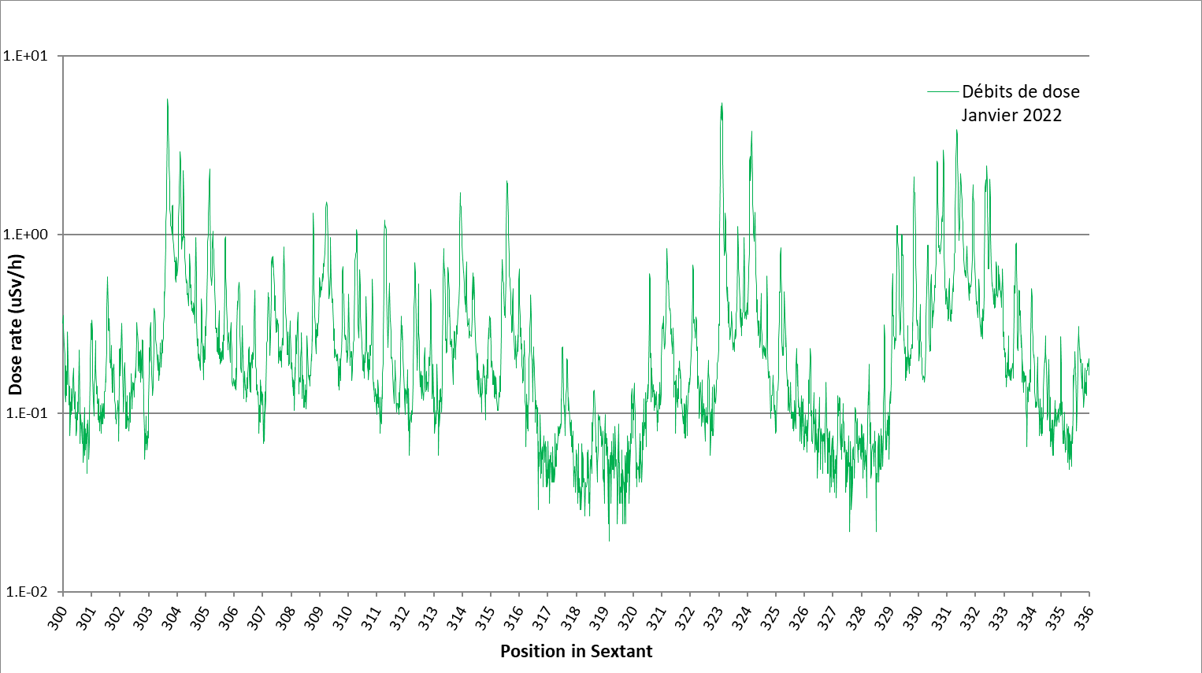
SPS BA3, 3 month of cool down
No particular problem in terms of dose rate

Slide 35
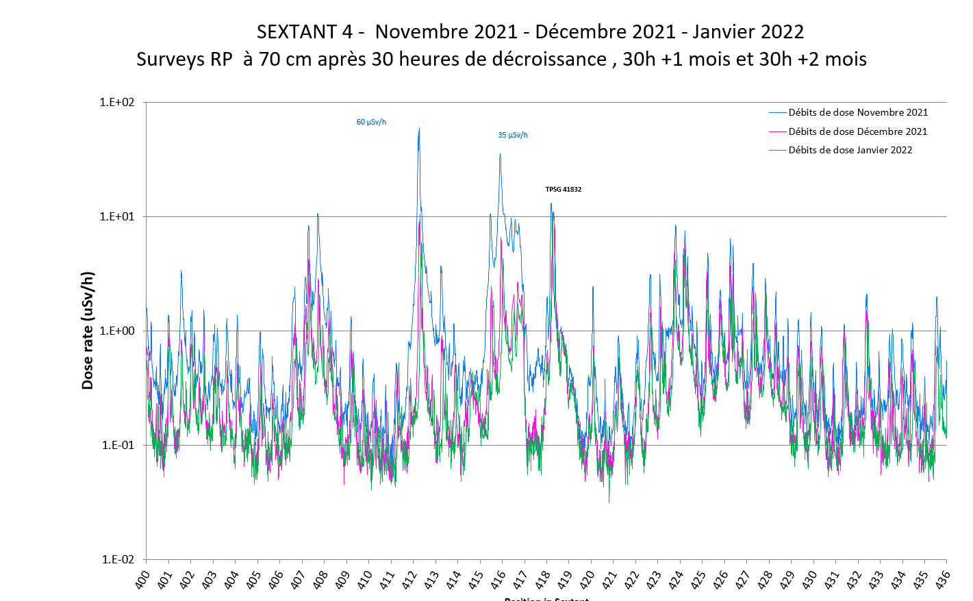
SPS-BA4
No critical area:
After 2012, no high intensity extraction to CNGS ➔ decay at TPSG
New (mild) hot spot at 412 (maybe due to crystal operation in LSS2)

Slide 36
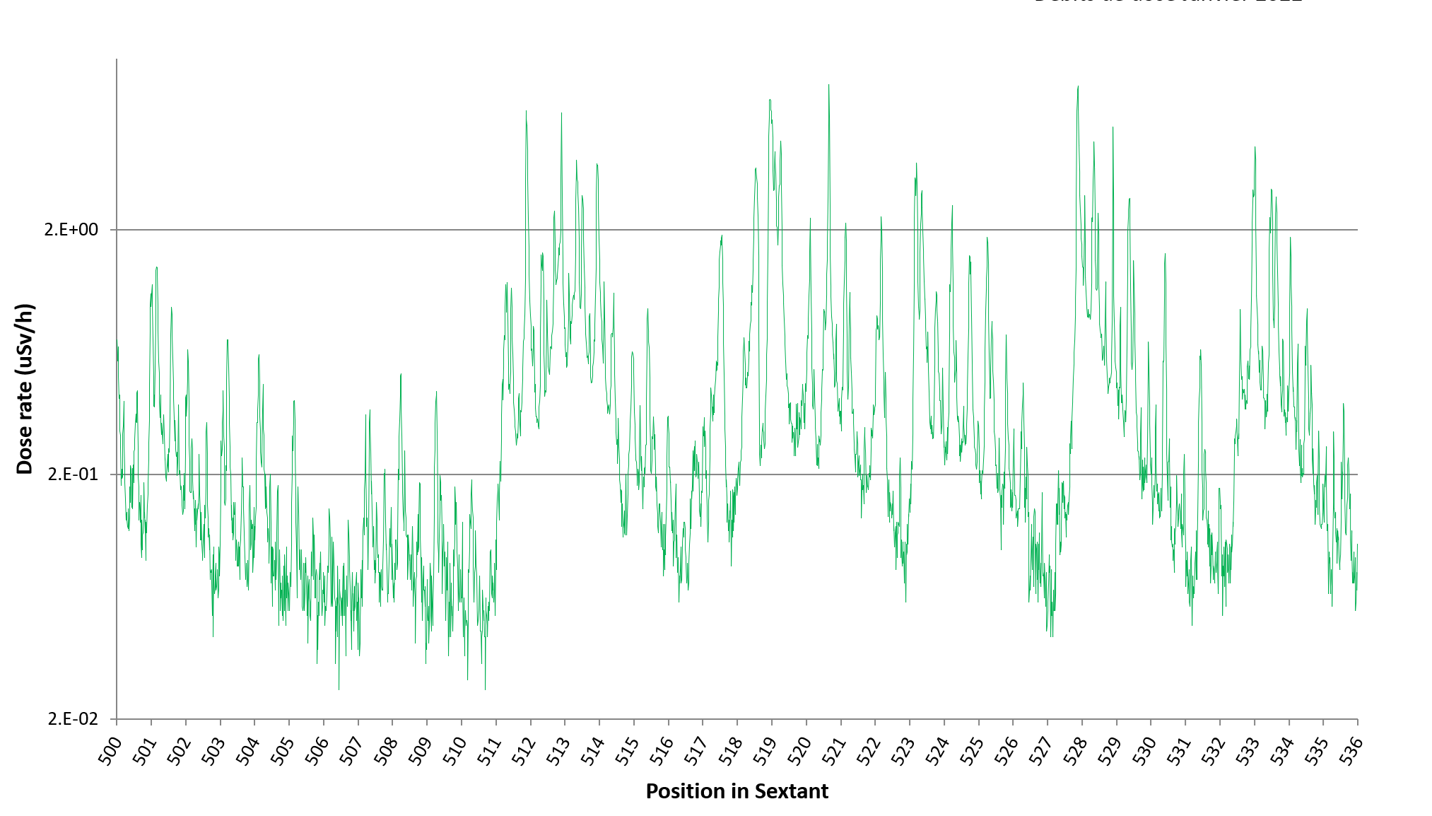
SPS BA5, 3 month of cool down
Although presence of dump, no particular problem in terms of dose rate.
Only cables leading directly into the dump shielding might be problematic

Slide 37
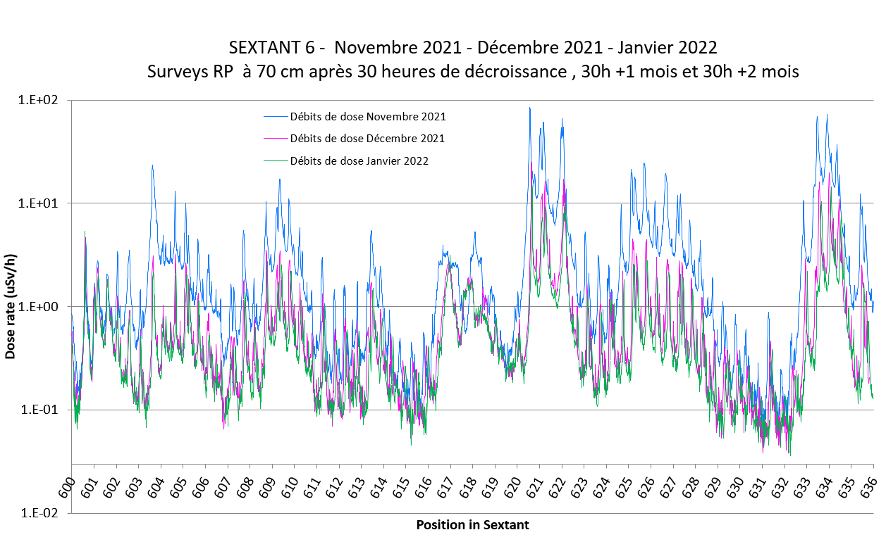
SPS-BA6
No particularly critical dose rate environment

Slide 38
