Slide 1

Summer student workshop 2024
Characterization of a simple particle detector using cosmic particles
Sune Jakobsen (some material from Christian Joram)
Additional material: AIDAinnova 2nd Annual meeting, 2 lectures on introduction to photo detectors
Program
Discussion of the detector parts
Scintillators
Wavelength shifters
Photodetectors
Experimental Part
Determine the 1 photo-electron charge and calculate the gain of a photomultiplier.
2a. Measure the light yield of a MIP in a scintillator coupled to a photomultiplier using a light guide.
2b. Measure the light yield of a MIP in a scintillator coupled to a photomultiplier using a wavelength shifter.
3. Measure the Quantum Efficiency of a PMT in the wavelength interval 200 to 800 nm (optional)

Slide 2

Scintillators
Energy deposition by an ionizing particle or photon (γ)
→ generation
transmission of scintillation light
detection
scintillator
photodetector
Two categories
Inorganic
(crystalline structure)
Up to 70000 photons per MeV
High Z (good for photoeffect Z⁵)
Large variety of Z and ρ
Undoped and doped
ns to μs decay times
Expensive
Fairly Rad. Hard (100 kGy/year)
E.m. calorimetry (e, γ)
Medical imaging
Organic
(crystals, plastics or liquid solutions)
Up to 10000 photons per MeV
Low Z (not good for photoeffect)
Low density ρ~1g/cm³
Doped, large choice of emission wavelength
ns decay times
Relatively inexpensive
Medium Rad. Hard (10 kGy/year)
2

Slide 3
Plastic scintillators
Often they consist of a solvent + scintillator and a secondary fluor as wavelength shifter.
UV
(~300 nm)
Visible
( 400 nm)
>
~
Solvent
Scintillator
wavelength
shifter (‘fluor’)
ionizing particle
ΔE = dE/dx·Δx
fluorescence light
Fast and local energy transfer via non-radiative dipole-dipole interactions (Förster transfer).
radiative transfer
A fluor has its absorption and emission spectra shifted. The difference of the two peaks is called Stokes shift
3

Slide 4
Wavelengh shifters - Two / One Dopant scheme
Abs. and emission spectra
A
solvent + scintillator + wave shifter
Förster Radiative
solvent + large stokes shift scintillator Förster
A
B
0.0025 molar sol.
0.025 molar sol.
B
B
Dopants in toluene: large Stokes shift dopants feature a much smaller self-absorption
4

Slide 5
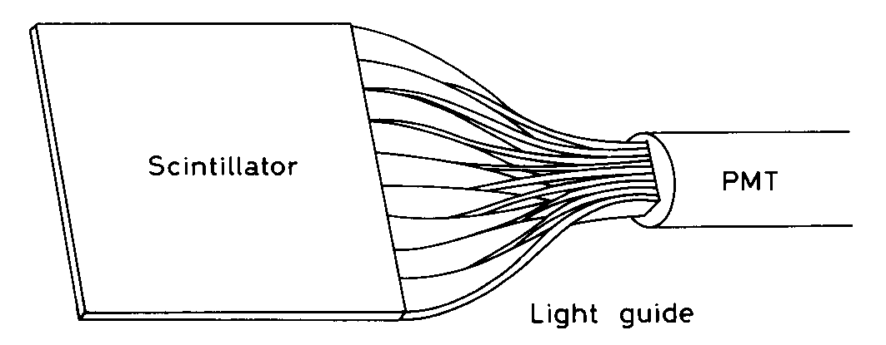
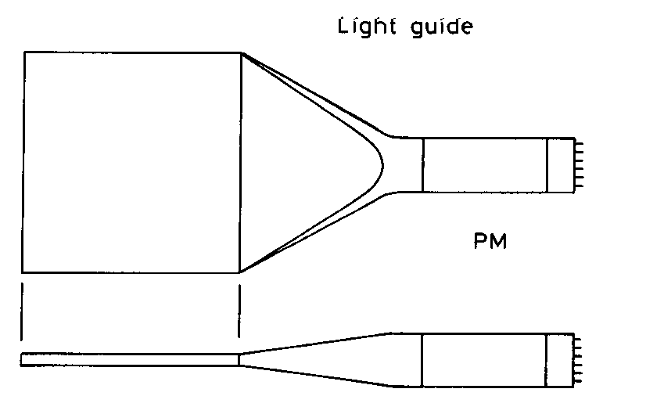
Scintillator readout
Readout has to be adapted to geometry, granularity and emission spectrum of scintillator.
Geometrical adaptation:
Light guides: transfer by total internal reflection (+outer reflector)
Wavelength shifter (WLS) bars
“fish tail”
adiabatic
5

Slide 6
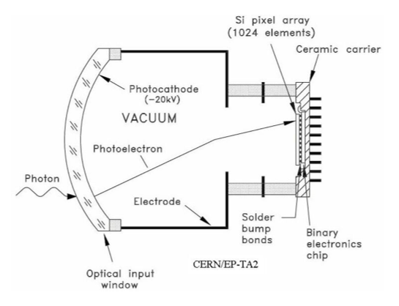
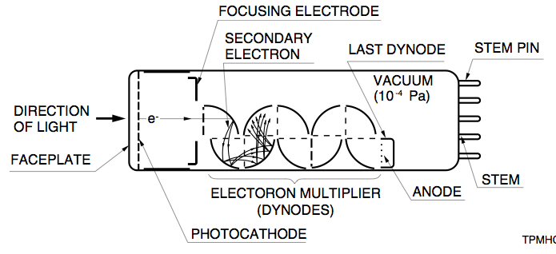
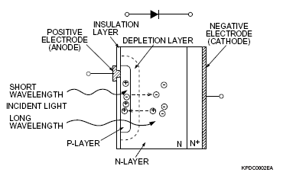
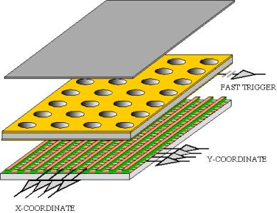
Photodetectors
Hybrid Photon Detectors
Photomultipliers
Photodiodes
Gaseous Devices
6

Slide 7
Photodetectors
Photodiode (PD)
  No internal gain, direct conversion of optical photons to electron-hole pairs that are simply collected. External amplification is required.
Avalanche PD (APD)
  They incorporate internal gain through higher electric fields that increases the number of charge carriers that are collected.
Geiger Mode APD (GM-APD = SiPM)
  They are operated with a voltage above the voltage breakdown. Breakdown is triggered by a photoelectron or a thermal electron. It has to be quenched.
Multipixel GM-APD
  They are made of many small area GM-APD on the same substrate and electrically connected in parallel.
7

Slide 8
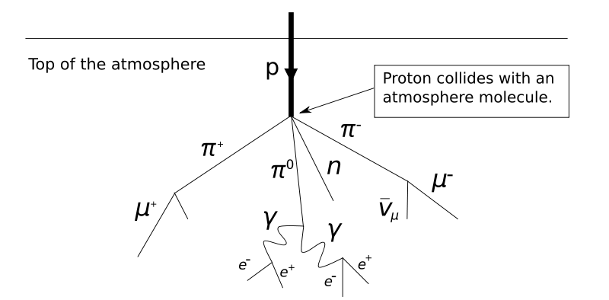
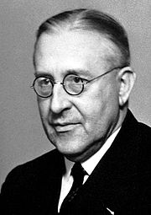
Cosmic Rays / Cosmic Radiation
Cosmic rays are energetic charged subatomic particles, originating in outer space. Most primary cosmic rays are protons, atomic nuclei, or electrons.
When cosmic rays enter the Earth's atmosphere they collide with mainly oxygen and nitrogen molecules → cascades of lighter particles, called air showers. Photons and electrons form electromagnetic showers. Muons don’t! In addition they have a long enough lifetime to reach the ground level. So, what we detect are mainly muons (and parts of e.m. showers).
The number of particles that hit the ground is dependent on several factors including location with respect to the earth's magnetic field, solar cycle, elevation, and the energy of the particles.
As a rule of thumb, the flux of muons above 1 GeV/c at sea level is :
Φ = 70 m⁻² s⁻¹ sr⁻¹ → 1 cm⁻² min⁻¹
→ “Cosmic muons” are very useful and cheap for testing particle detectors.
In 2012, it’s just 100 years, that Victor Hess discovered the cosmic rays by means of electrometer (=ionization) measurements during balloon flights up to 5300m. He concluded "The results of my observation are best explained by the assumption that a radiation of very great penetrating power enters our atmosphere from above." → Nobel prize 1936.
8

Slide 9
1 photo-electron
Task 1: Determine the 1 photo-electron charge and calculate the gain of a photomultiplier.
Materials:
Classic photomultiplier
Oscilloscope
Pulse generator
LED
High voltage power supply unit
Cables
9

Slide 10
Light yield using light guide
Task 2a: Measure the light yield of a MIP in a scintillator coupled to a photomultiplier using a light guide.
Materials:
Classic photomultiplier
Oscilloscope
Scintillator
Light guide
High voltage power supply unit
Cables
10

Slide 11
Light yield using wavelength shifter
Task 2b: Measure the light yield of a MIP in a scintillator coupled to a photomultiplier using a wavelength shifter.
Materials:
Classic photomultiplier
Oscilloscope
Scintillator
Wavelength shifter
High voltage power supply unit
Cables
11

Slide 12
Absolute Measurement of the Quantum Efficiency of a Classical PMT
Task 3: Measure the Quantum Efficiency of a PMT in the wavelength interval 200 to 800 nm. Discuss the result, its precision and possible error sources.
Set-up:
- PMT
- Xe-lamp
- monochromator
- reference photodiode
- Keithley picoampere meter
- PC (Labview)
12

Slide 13
Principle of the QE determination
Photon flux, unknown !
Use a reference detector with known (calibrated) ε_{Q} to determine the photon flux
(DUT = Detector Under Test
REF = Reference Detector)
13

Slide 14
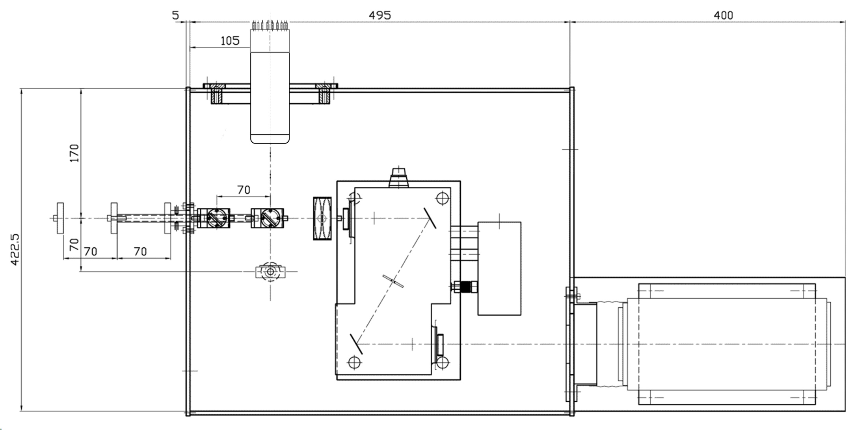
PMT under test
mirror
Calib. PD
Xe lamp
monochromator
14

Slide 15
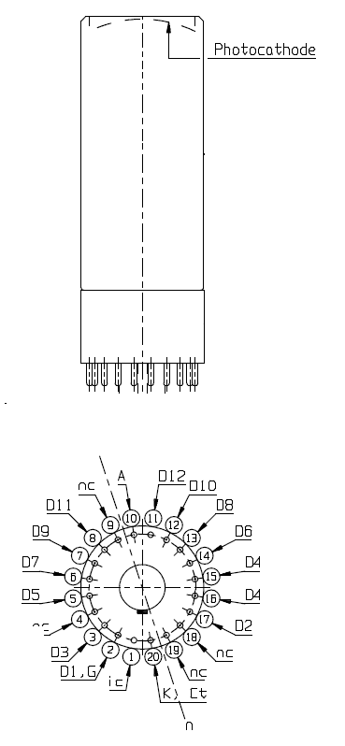
K
D1
K
Schematic representation of dynode structure
I_{photo}
D1
+V
15

Slide 16
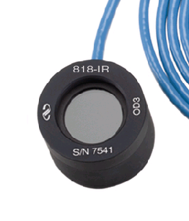
The 818-UV Low-Power UV Enhanced Silicon (Si) Photodetector is supplied with a NIST traced calibration report that details individual detector responsivity measured with and without attenuator over the 200 to 1100 nm wavelength range.
Model | 818-UV
Detector Type | Semiconductor
Spectral Range | 200 to 1100 nm
Active Diameter | 1.13 cm
Detector Active Area | 1 cm²
Material | Silicon-UV Enhanced
Power Density, Average Max w/ Attenuator | 0,2 W/cm²
Power Density, Average Maximum w/o Attenuator | 0,2 W/cm²
Pulse Energy, Maximum - w/ Attenuator | 0,1 µJ/cm²
Pulse Energy, Maximum - w/o Attenuator | 0.1 nJ/cm²
Uniformity | ±2 %
Shunt Resistance | ≥10 MΩ
Calibration Uncertainty | 4% @ 200-219nm 2% @ 220-349nm 1% @ 350-949nm 4% @ 950-1100 nm
Calibration Uncertainty, w/ Attenuator | 8% @ 200-219nm 2% @ 220-349nm 1% @ 350-949nm 4% @ 950-1100nm
NEP | 0.45 pW/√Hz
Reverse Bias, Maximum | 5 V
Linearity | ±0.5 %
Connector Type | BNC
16

Slide 17
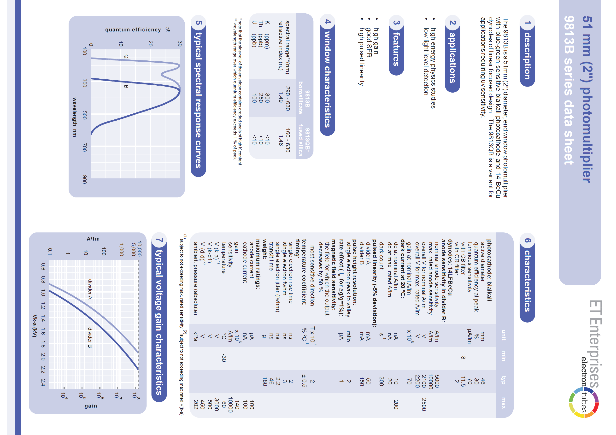
17

Slide 18
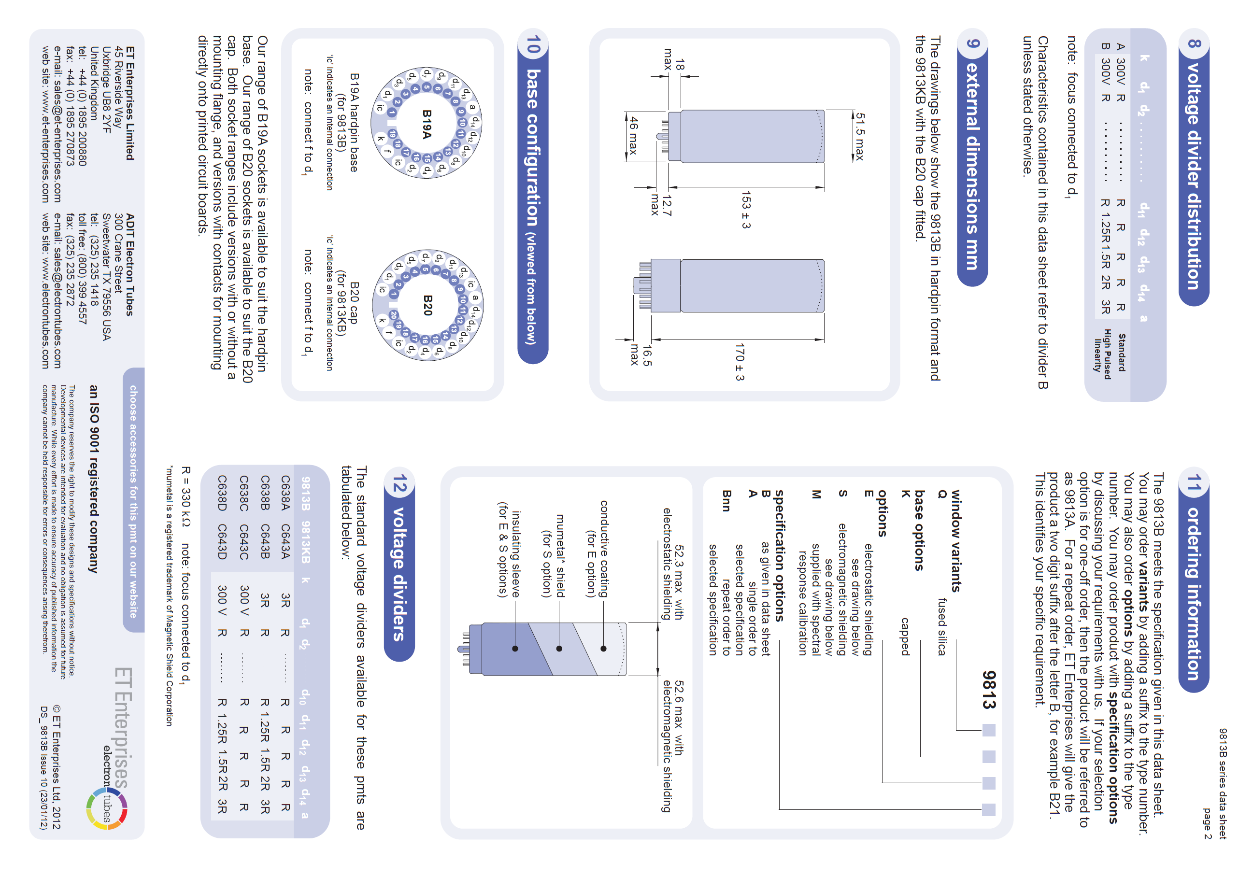
18

