Slide 1

Progress Update #4
Payton Harvill
08.04.2025

Slide 2
Coding

Slide 3
Get Accurate Period Value
Still working on this code
Made improvements from last time:
  Changed indexing: I improved the code by incorporating a new frequency indexing scheme. Now, after detecting the frequency peaks from the FFT, each detected frequency is multiplied by the expected period and then rounded to obtain a discrete cycle index. This approach effectively maps the continuous frequency data to expected indices (for missing peaks), facilitating a more direct comparison and helps to combat the PMT detection issue.

Slide 4
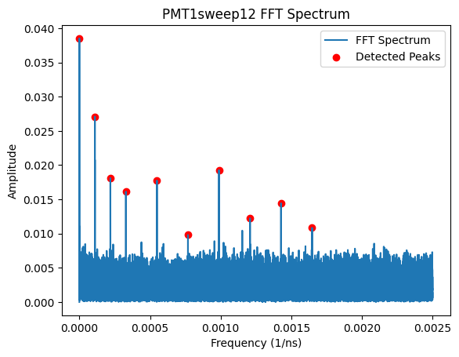
Old indexing:
Each peak corresponded 1:1 to each index
It’d look something like this: [0,1,2,3,4,5,6,7,8,9]
New indexing:
Each peak found is multiplied by the estimated period (observed in experiment) and rounded to the nearest possible index
Now, the detected peaks show:
[0,1,2,3,5,7,9,11,13,15]
Peaks that *should* be detected by pmt

Slide 5
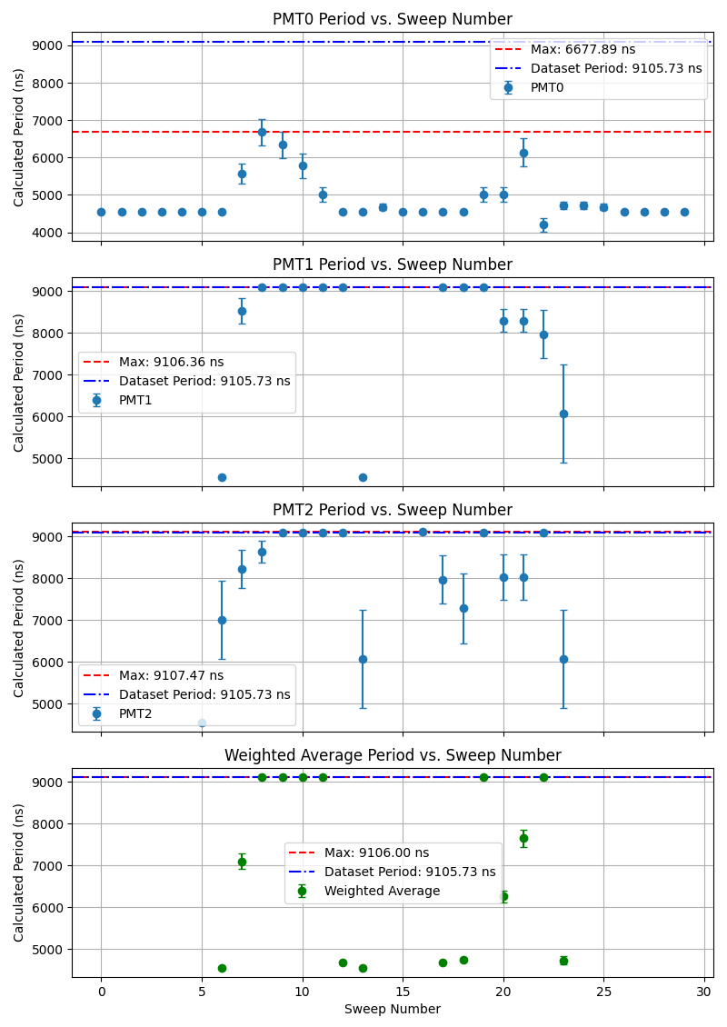
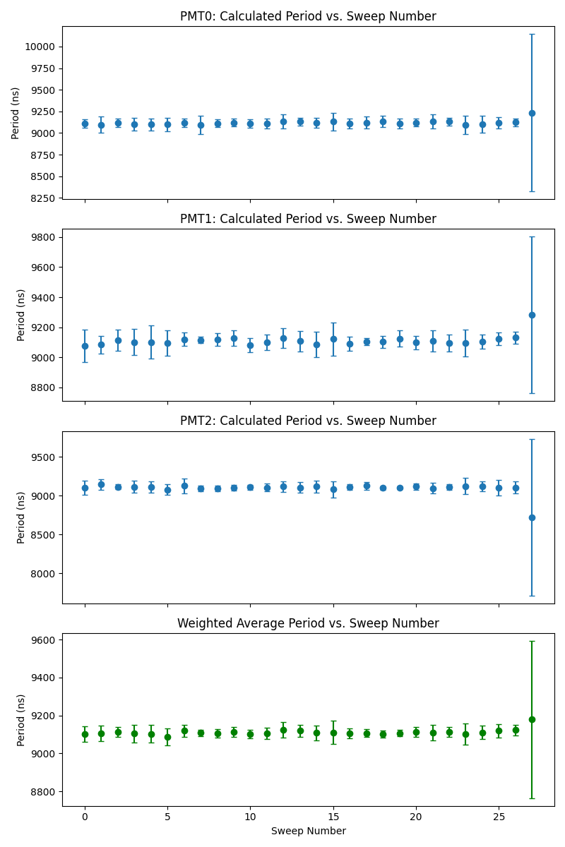
PMT Calculated Period Comparison:
Old Figure: After Improved Code:

Slide 6
Thoughts based on previous figures:
While the new method produces a calculated period that is more consistent, the uncertainty is still massive. Ranges from 30ns-100ns. Not good enough.
I can continue to try to refine peak detection parameters, however it isn’t clear what I need to do to optimize it better.
This poses the question: is this FFT method accurate enough?
  When there's cases with low SNR, this method proves difficult to be reliable
I might have to find a new way to analyze this data.
Any suggestions?
While I try to figure out whether my work is for nothing, I have another script I need to work on in the meantime…….

Slide 7


Slide 8
Magnesium Systematics

Slide 9
Found Possible Source of Error
As aforementioned, there is a 30 MHz discrepancy between our Mg resonance compared to literature value
We ruled out significant zeeman splitting as a result of magnetic field dependency and laser polarization
NEW THEORY: Photon Recoil
Results from ions absorbing or emitting photons, which transfers momentum and alters their velocity. In MR-TOF devices, this leads to a shift in resonance frequency.
There is also a laser power dependency: the higher the laser power, the larger the centroid (of resonance frequency) shift
Next step this week: Perform measurements on our Mg ions using different laser powers and see how the centroid changes. HOPEFULLY, this will provide us with some solid ground to quantify the error.

Slide 10
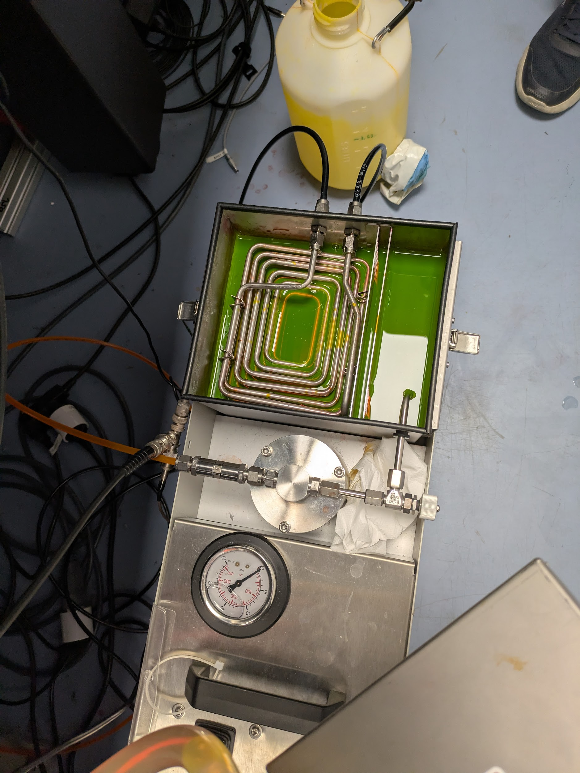
Replaced Dye in Laser
(first one I’ve taken part in doing)
FORBIDDEN JUNGLE JUICE
Our current setup for magnesium measurements relies on a dye laser system.
The dye absorbs light from the primary laser source and subsequently emits a different wavelength as electrons return to their ground state
The dye loses its chemical stability after approximately 48 hours of laser operation, which requires us to replace it every couple of weeks.
We anticipate that this dye replacement will mark the final one for the current system :( as we are completing our magnesium systematics
Next, we will transition to a new cadmium setup using a titanium sapphire crystal laser

Slide 11
The end.

