Slide 1


Performance Evaluation of TOF-PET Readout Electronics: Progress & Contributions #4
Cesar Cardona*
Boston University | Group: EP-CMX-DD
Mentors: Carsten Lowis✲ , Giulia Terragni※
* sciences@bu.edu | ✲ carsten.lowis@cern.ch | ※ giulia.terragni@cern.ch
Cesar Cardona
April 8, 2025

Slide 2
FastIC+ ASIC Team
Cesar Cardona
April 8, 2025

Slide 3
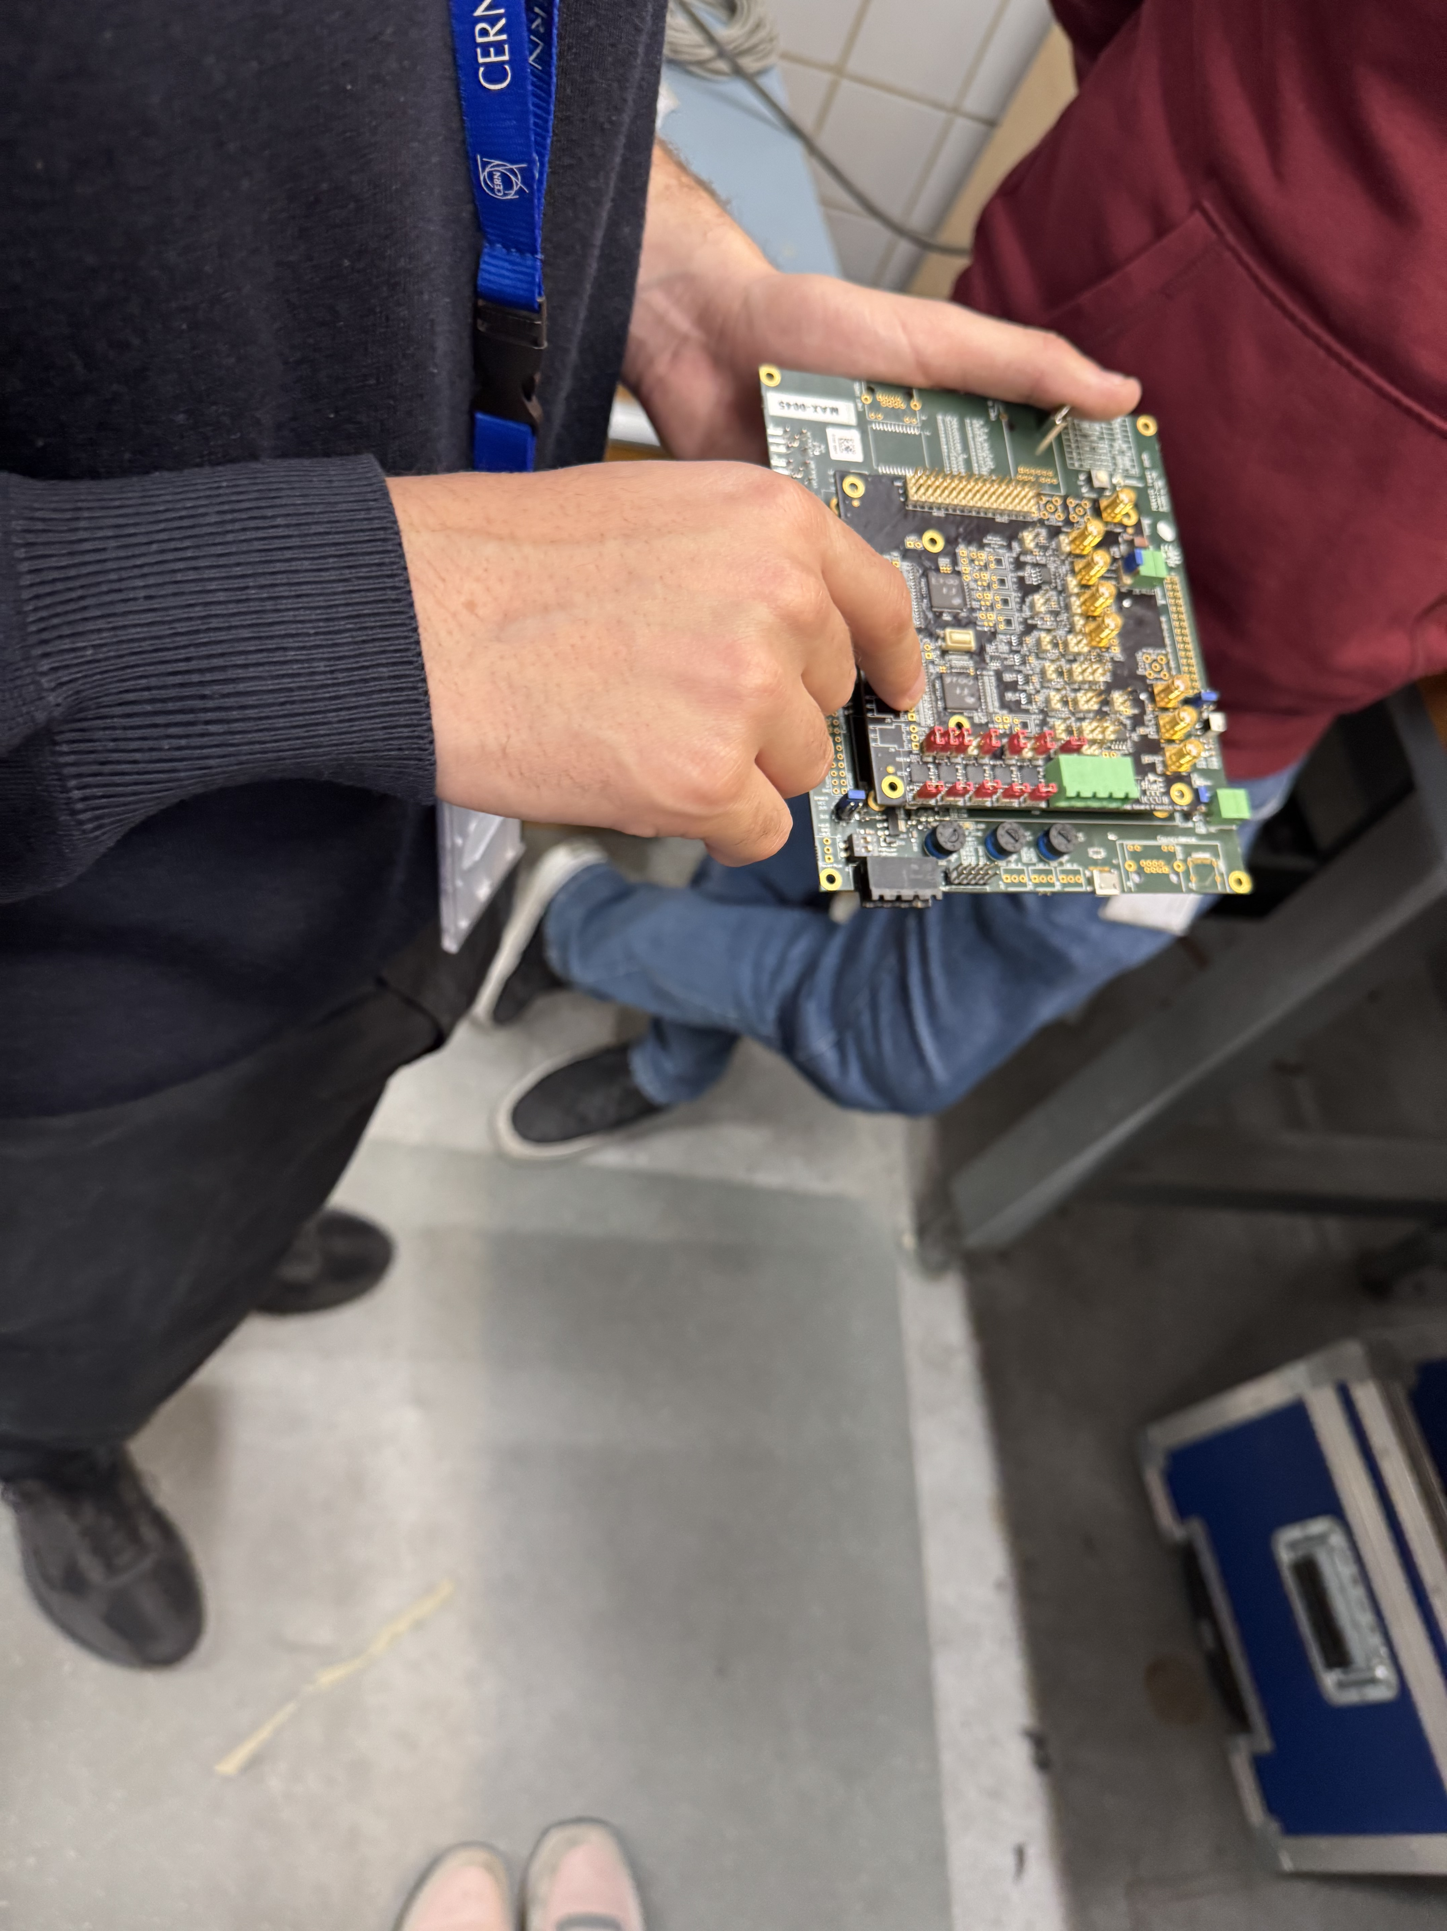
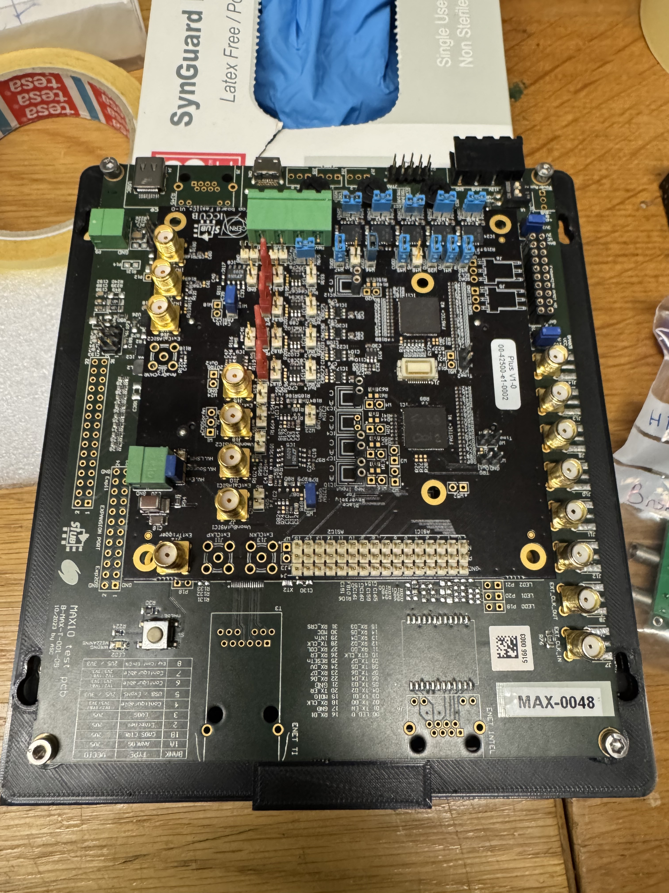
FastIC+ ASIC Team
FastIC+ ASIC Team
• Barcelona team (David Mazzanti) visited last week
• Gave hands-on tutorial on how the FastIC+ board works
• Explained signal chain and board features
• Boards had already been tested by them
• Now it’s our turn to use and evaluate them
Cesar Cardona
April 8, 2025

Slide 4
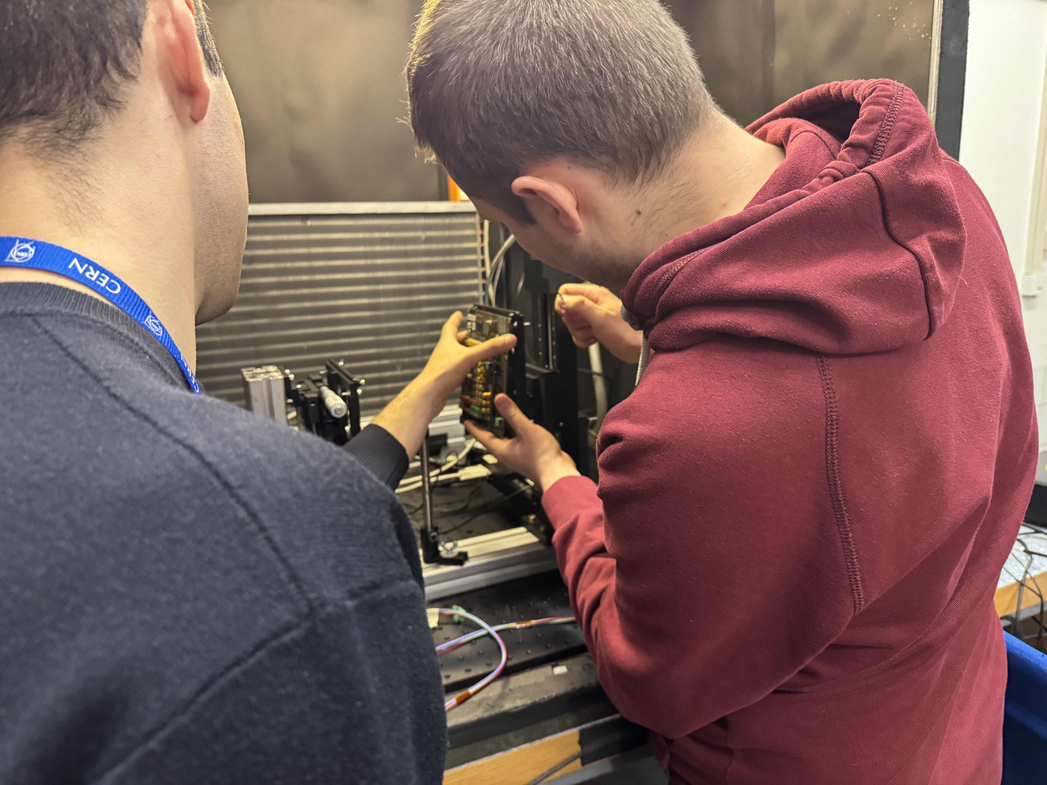
FastIC+ ASIC Team
FastIC+ ASIC Team
• Start of hands-on collaboration
• Our mechanical setup worked perfectly
Cesar Cardona
April 8, 2025

Slide 5
Measurements
Cesar Cardona
April 8, 2025

Slide 6
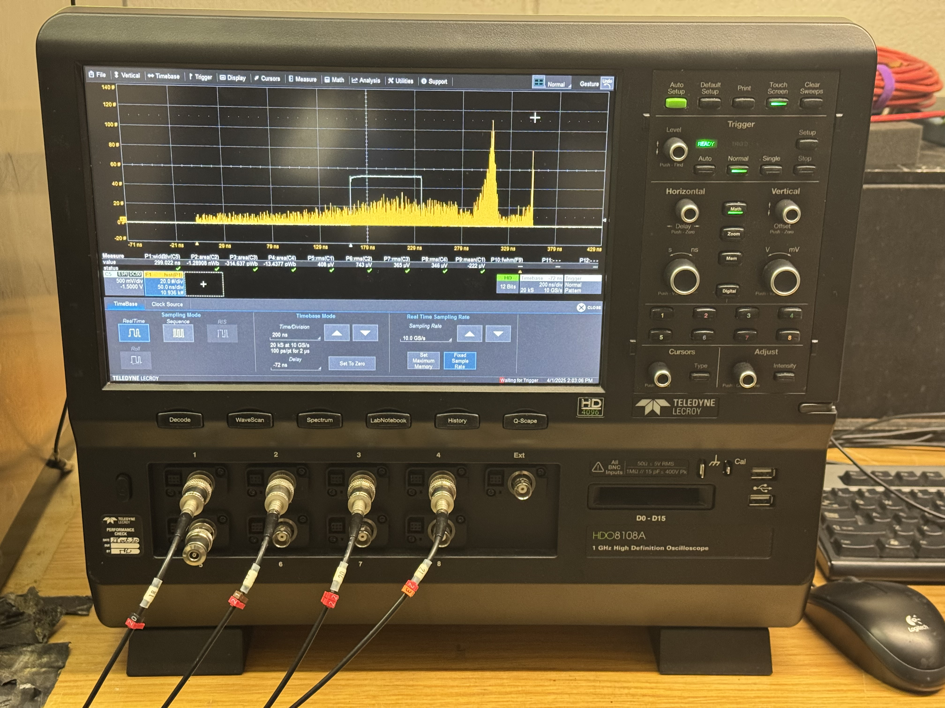
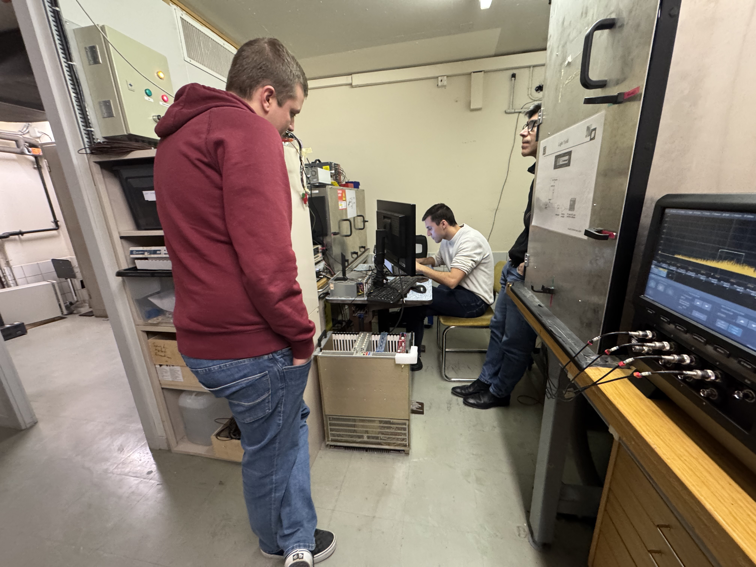
Measurements: SPTR
• Started by calibrating boards using SPTR
• SPTR = Single Photon Time Resolution — board’s response to single-photon events
• Used new laser test bench — built in one week
• Bench lets us simulate single photons with precise timing
• Calibration helps us understand ASIC timing performance before full CTR tests
Cesar Cardona
April 8, 2025

Slide 7
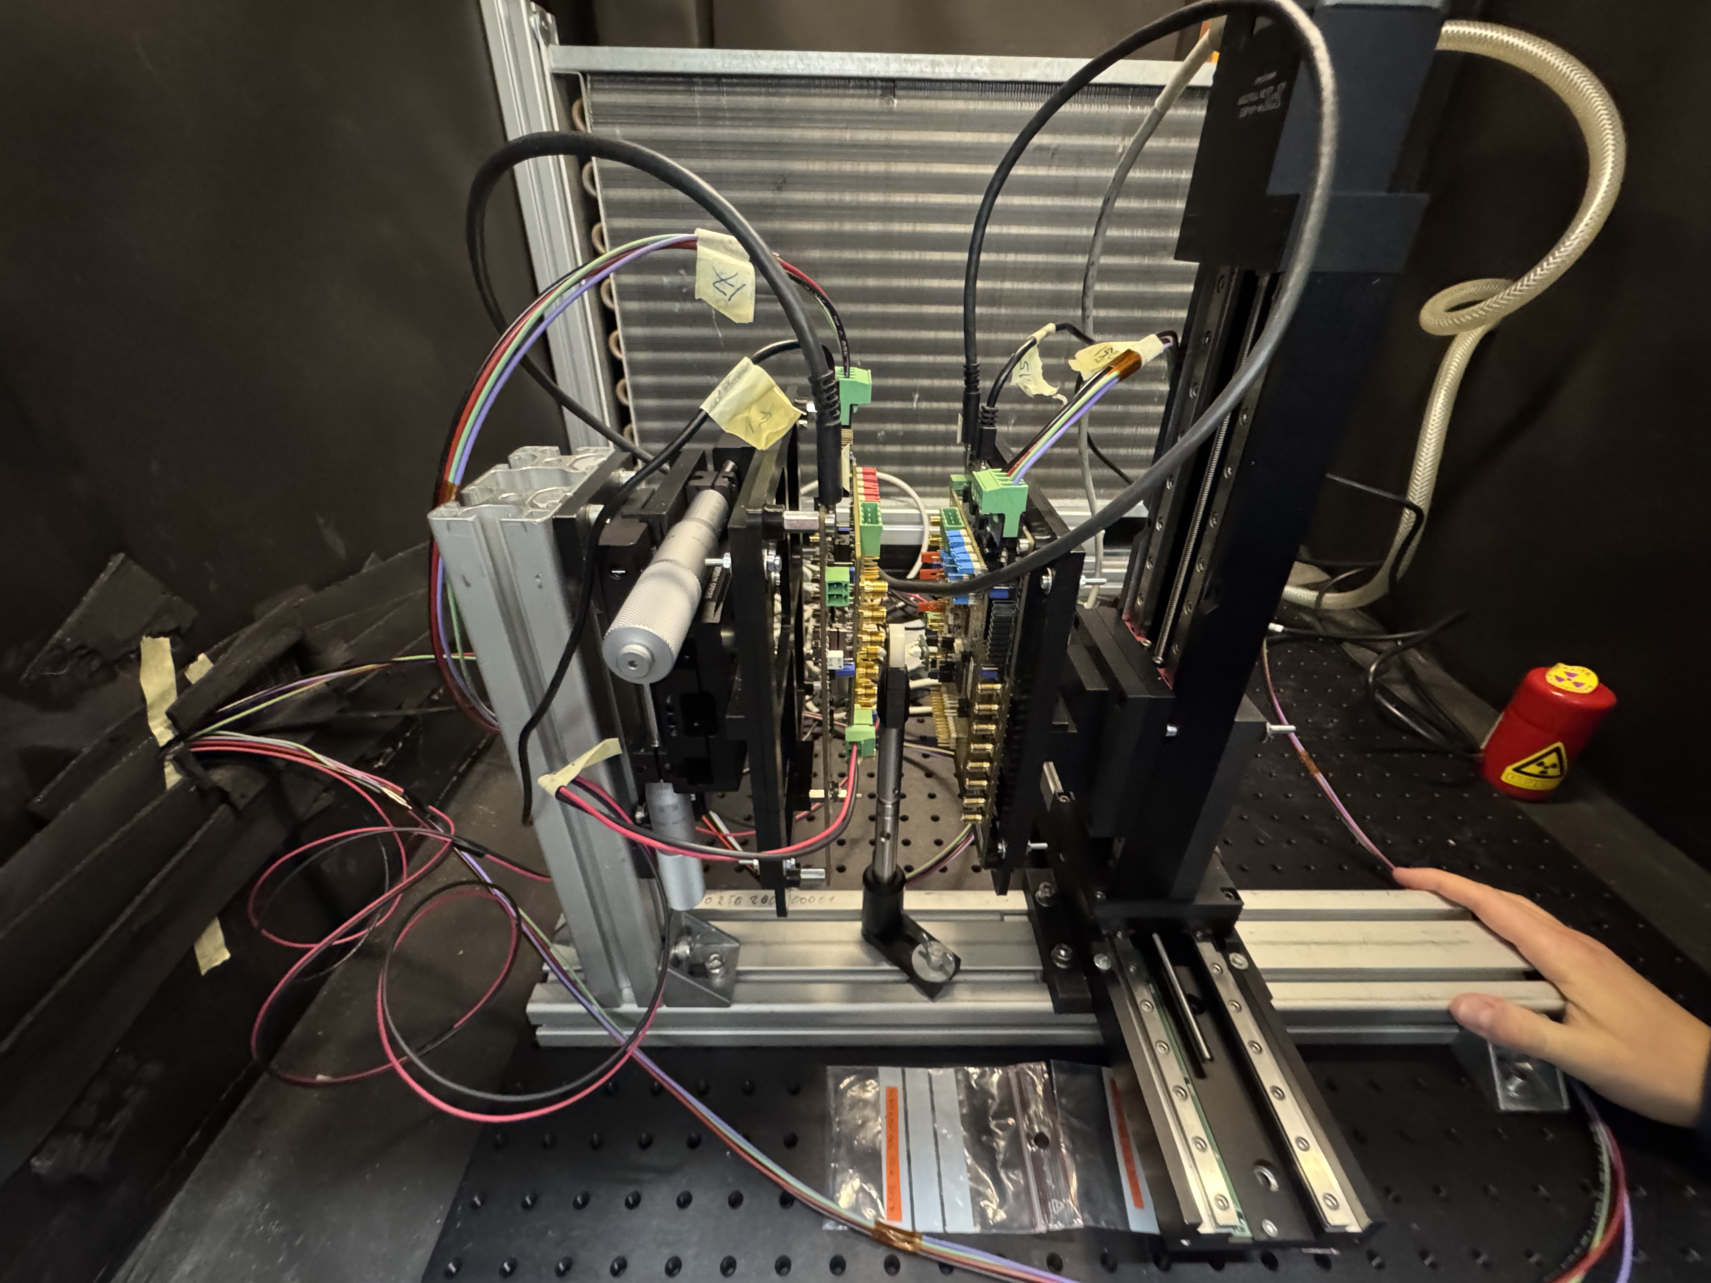
Measurements: CTR Bench Setup
• Setup for Coincidence Time Resolution (CTR) measurements
• Using two 2×2×3 mm LYSO:Ce codoped crystals (top-grade)
• Crystals face each other — single bar configuration
• Goal: measure time difference between photon detections
• Setup inside dark box, mechanically stable
Cesar Cardona
April 8, 2025

Slide 8
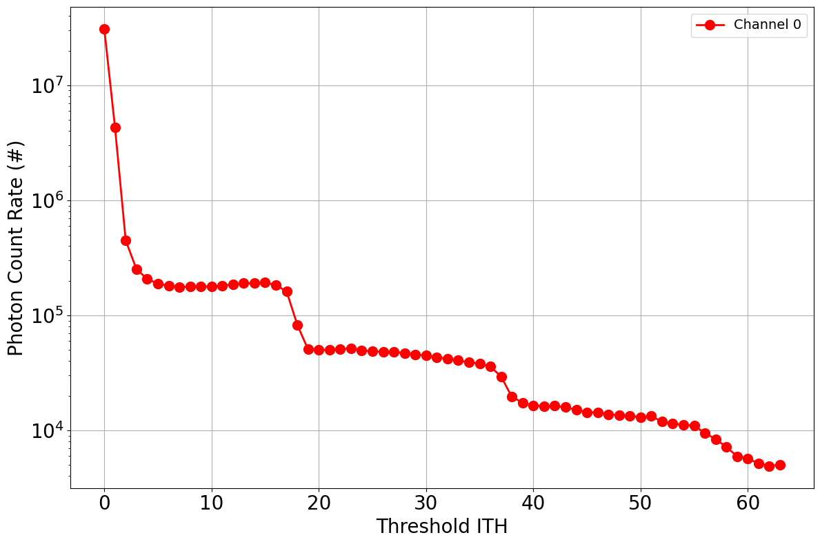
Measurements: Threshold Scan
• To set threshold, perform ITH* scan → get staircase-like plot
• Y-axis: photon count rate | X-axis: internal threshold (ITH)
• Each step = additional photons triggering detection
• First step (8–10 mV here) = single-photon detection threshold
• Set threshold here for best time resolution
• Especially critical for BGO due to lower light yield
*(ITH stands for Internal Threshold. An ITH scan is a procedure where you vary the internal discriminator threshold of the ASIC to determine at what signal level (in mV or LSB) the system starts registering photon events.)
Cesar Cardona
April 8, 2025

Slide 9
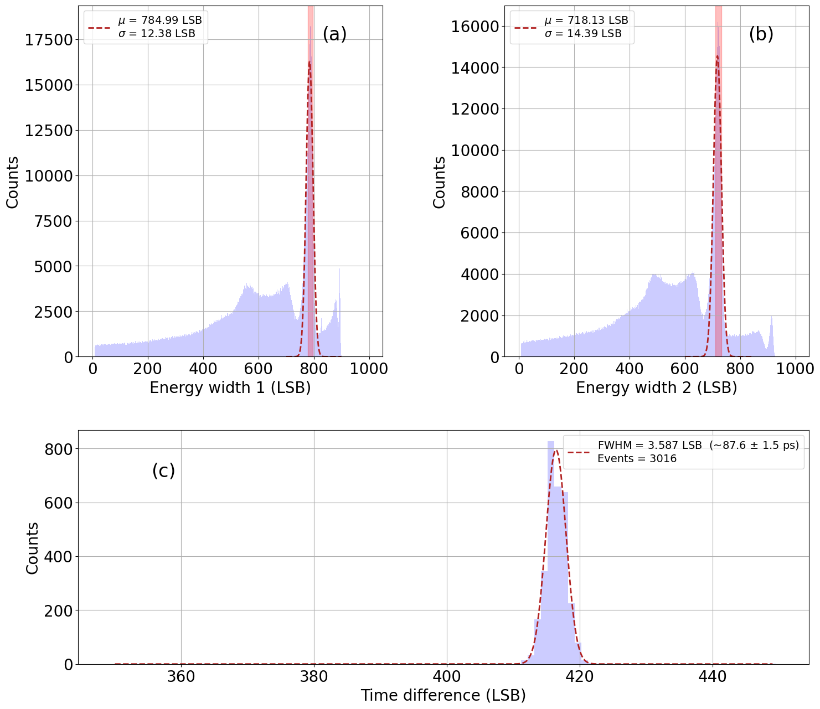
Measurements: Preliminary Results
LYSO Ce:Ca Preliminary Results
• Used David’s code for initial CTR extraction — may adapt later
• FWHM Coincidence Time Resolution (CTR): 87.6 ps
• Both crystals show good energy resolution
• Double peaks in spectra likely LYSO Lu-176 natural radioactivity
• Promising start for FastIC+ with codoped LYSO
Cesar Cardona
April 8, 2025

Slide 10
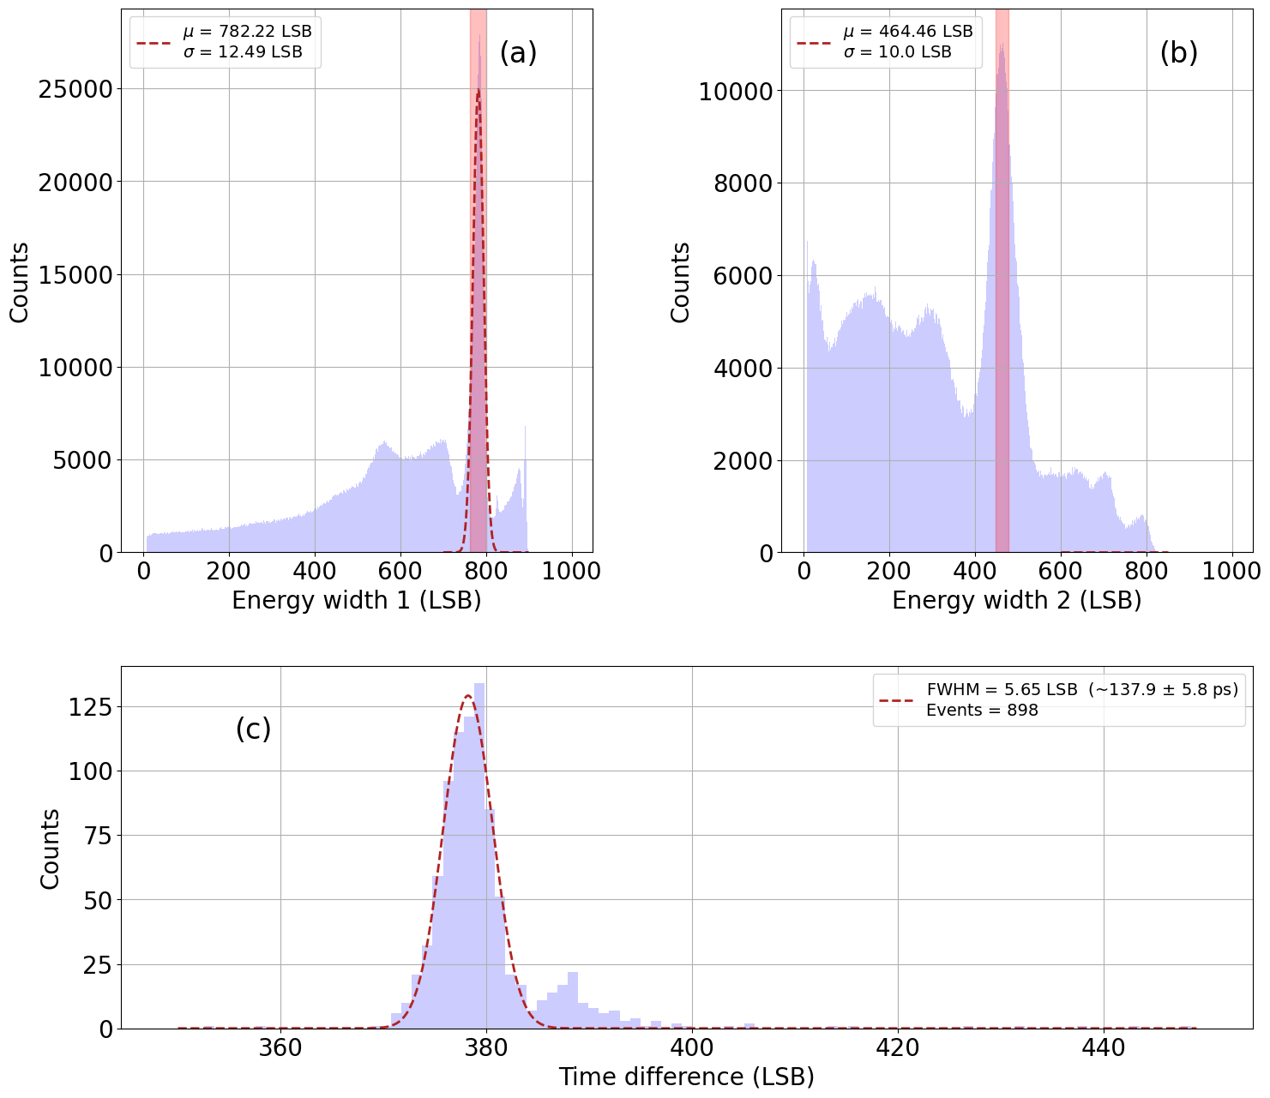
Measurements: Preliminary Results
BGO Preliminary Results
• One LYSO codoped crystal (reference) + one BGO crystal
• BGO signal looks distorted — poor energy resolution
• DT distribution not symmetric → fit is unreliable
• Code still David’s — may improve with our own analysis
• Reported CTR: –252.3 ps, clearly incorrect
• Highlights challenge of working with low-light-yield crystals like BGO
Cesar Cardona
April 8, 2025

Slide 11
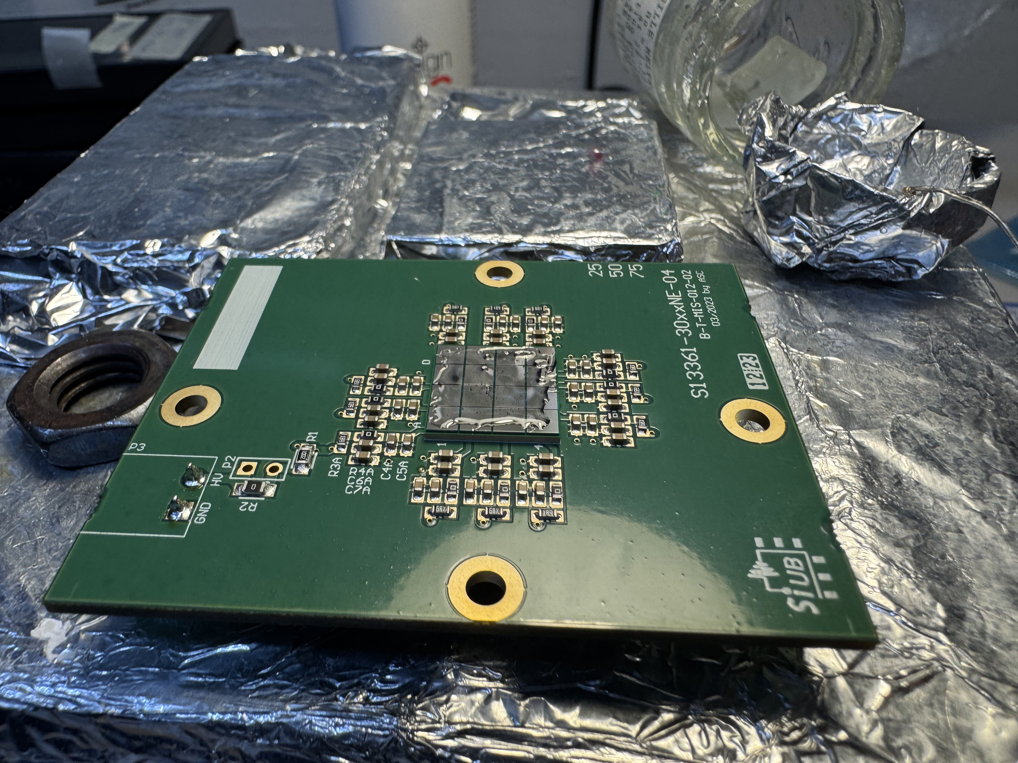
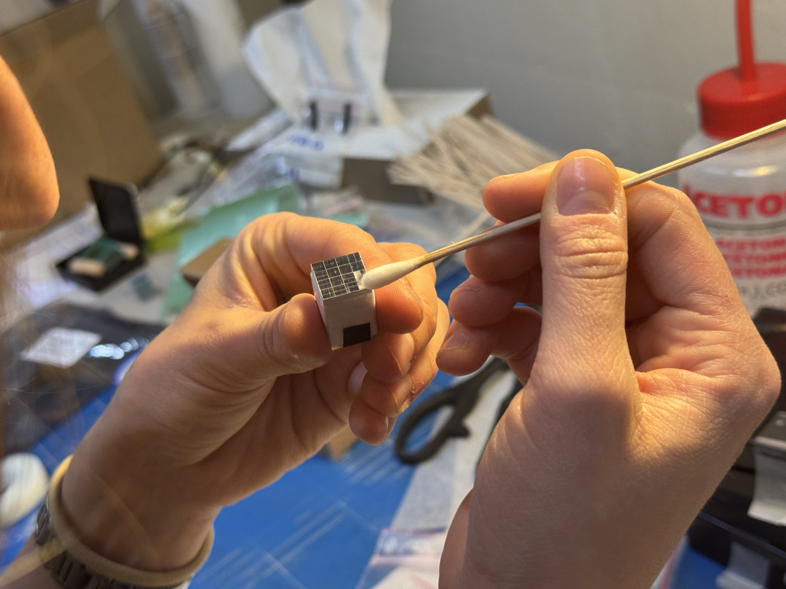
Measurements: Matrix Setup
Matrix Setup
• Transitioned to LYSO 4x4 crystal matrix measurements
• Carefully coupling matrix to SiPM array
• Alignment is challenging — must ensure full optical contact
• Precision here is critical for uniform light collection
Cesar Cardona
April 8, 2025

Slide 12
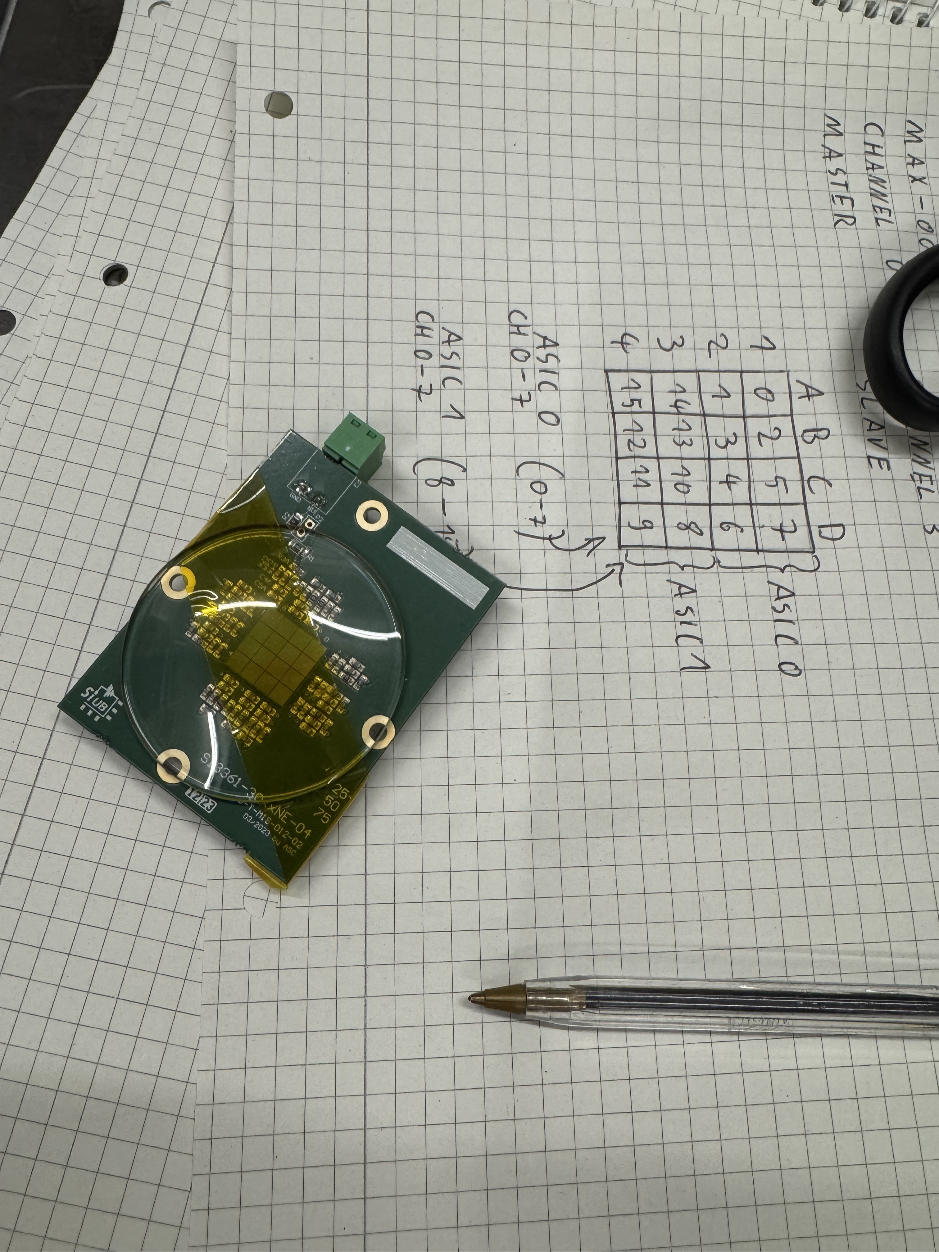
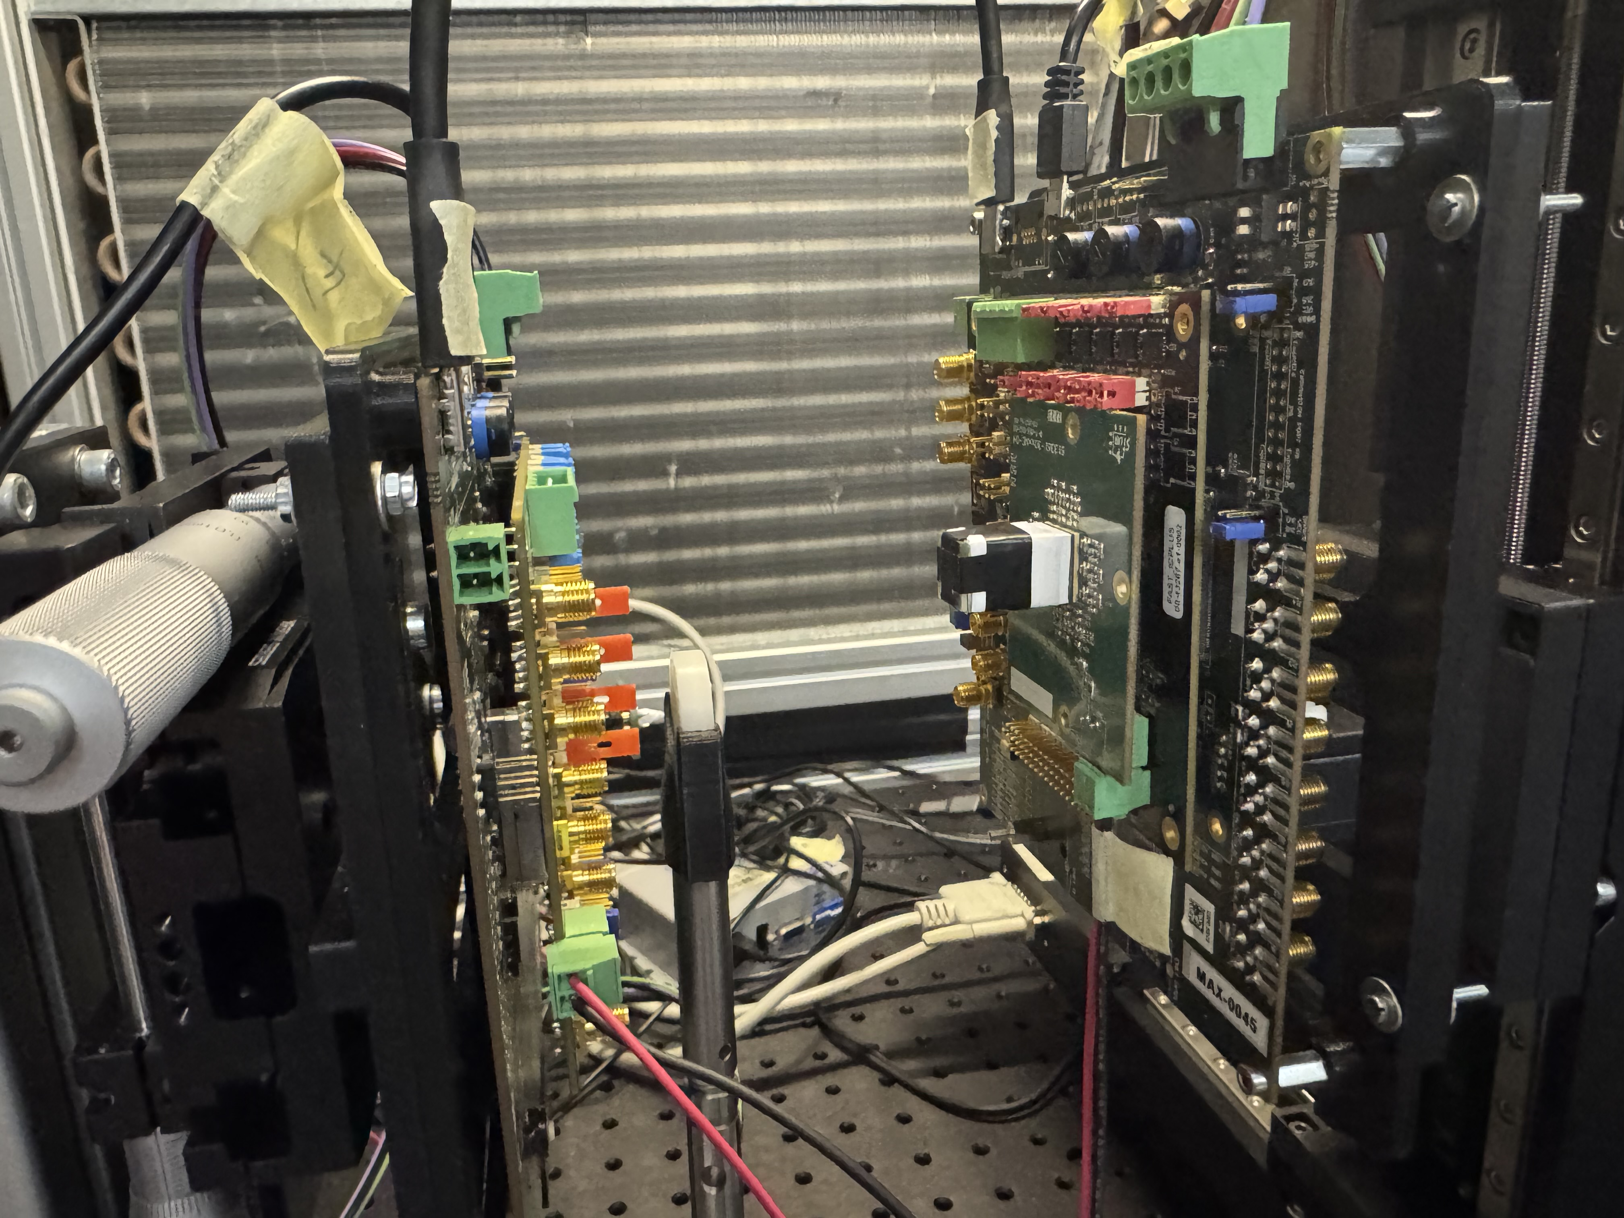
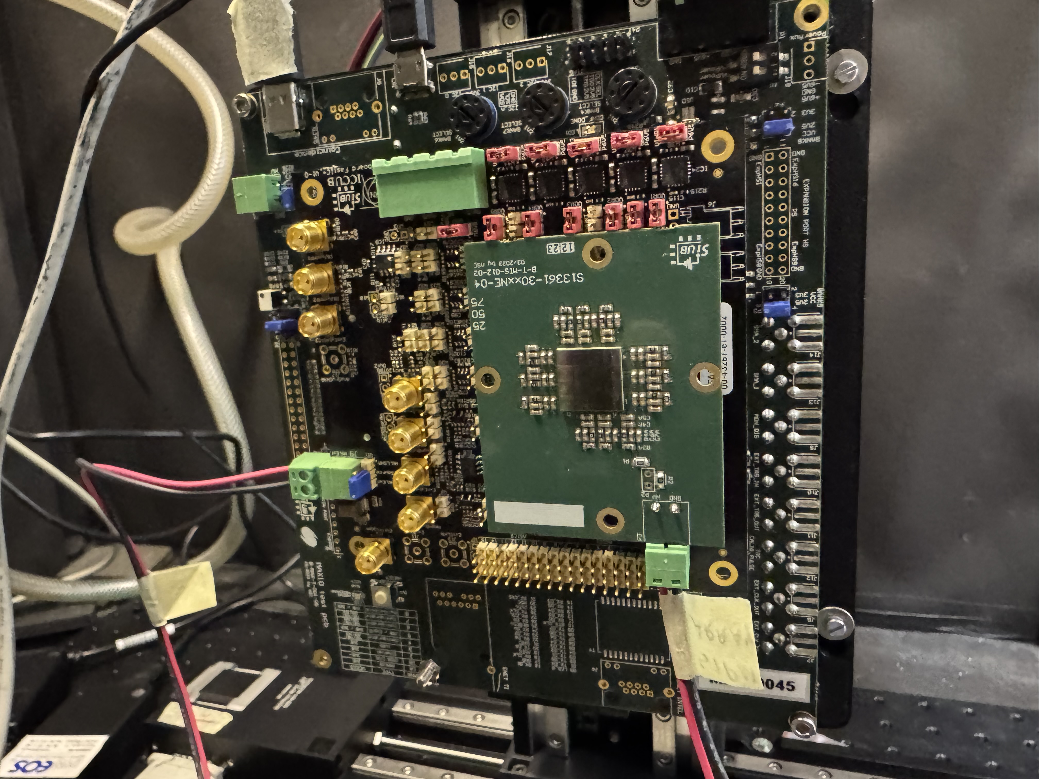
Measurements: Matrix Setup
• Setup: 4×4 LYSO crystal matrix on one side, single LYSO crystal (reference) on the other
• Matrix coupled to SiPM board, carefully aligned
• Matrix board connected to FastIC+ and mounted in dark box
• Used handwritten channel map to identify matrix channels
Cesar Cardona
April 8, 2025

Slide 13
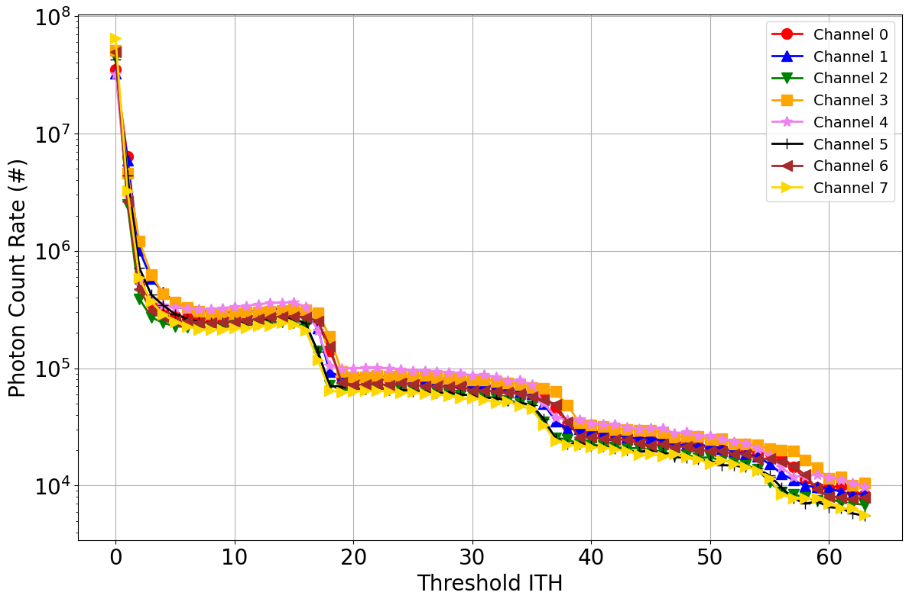
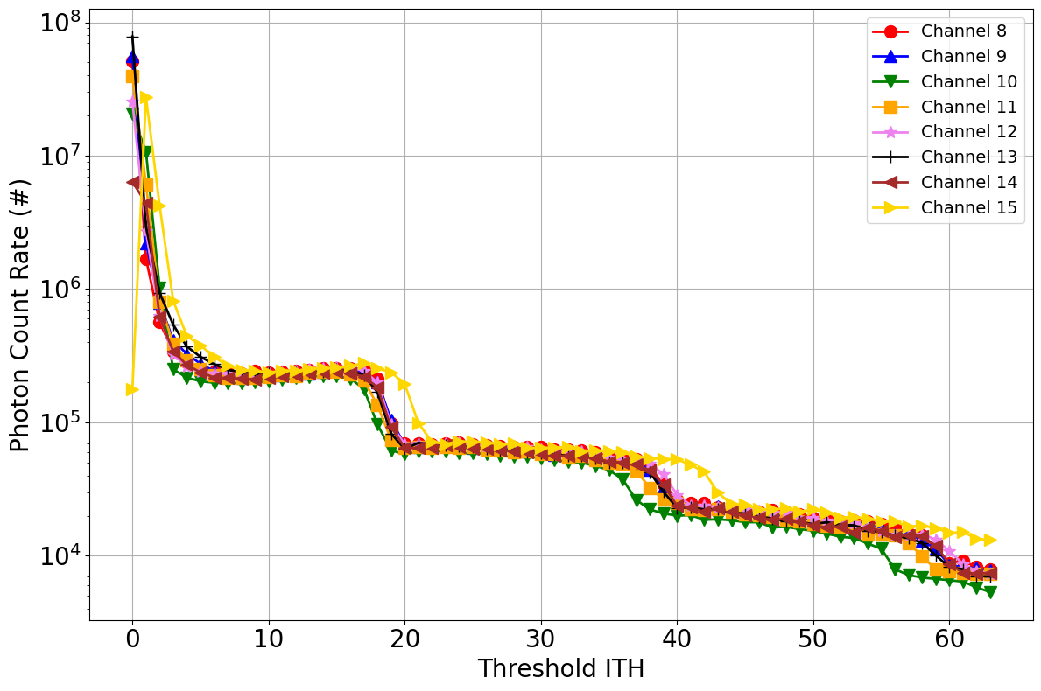
Measurements: Matrix ITH
Cesar Cardona
April 8, 2025

Slide 14
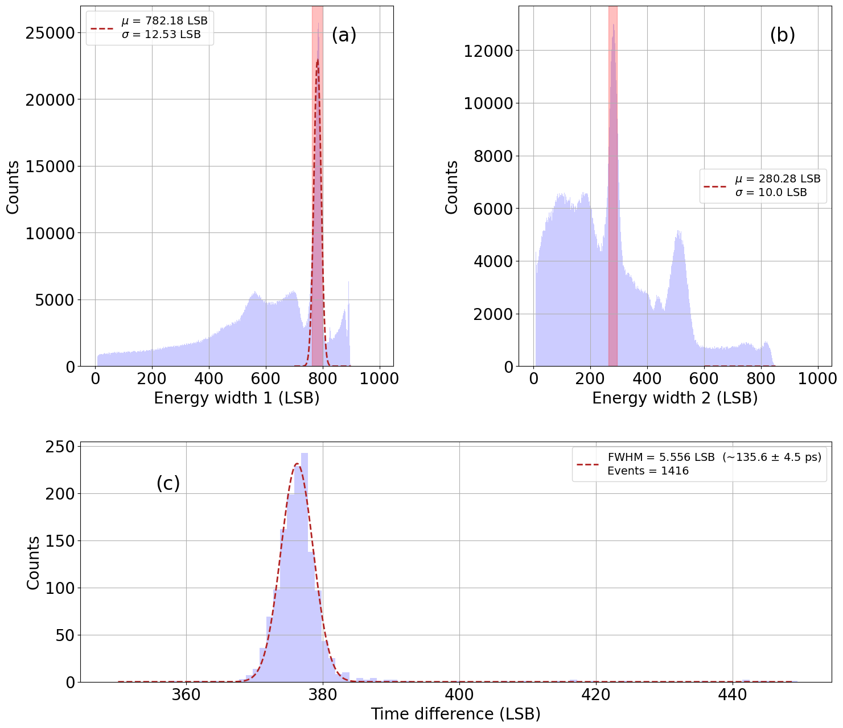
Measurements: Matrix
Preliminary Results
• Currently no proper way to analyze matrix data
• FastIC+ has 16 channels — split across 2 ASICs (8 channels each)
• Problem: channels are mirrored — e.g., channel 5 = ASIC1 CH5 + ASIC2 CH5
• This creates overlap/confusion in the data
• In the plot, one side appears clear while the other is jumbled
• Working on custom analysis to isolate individual ASIC channels
Cesar Cardona
April 8, 2025

Slide 15
Lower Voltage Reference
Cesar Cardona
April 8, 2025

Slide 16
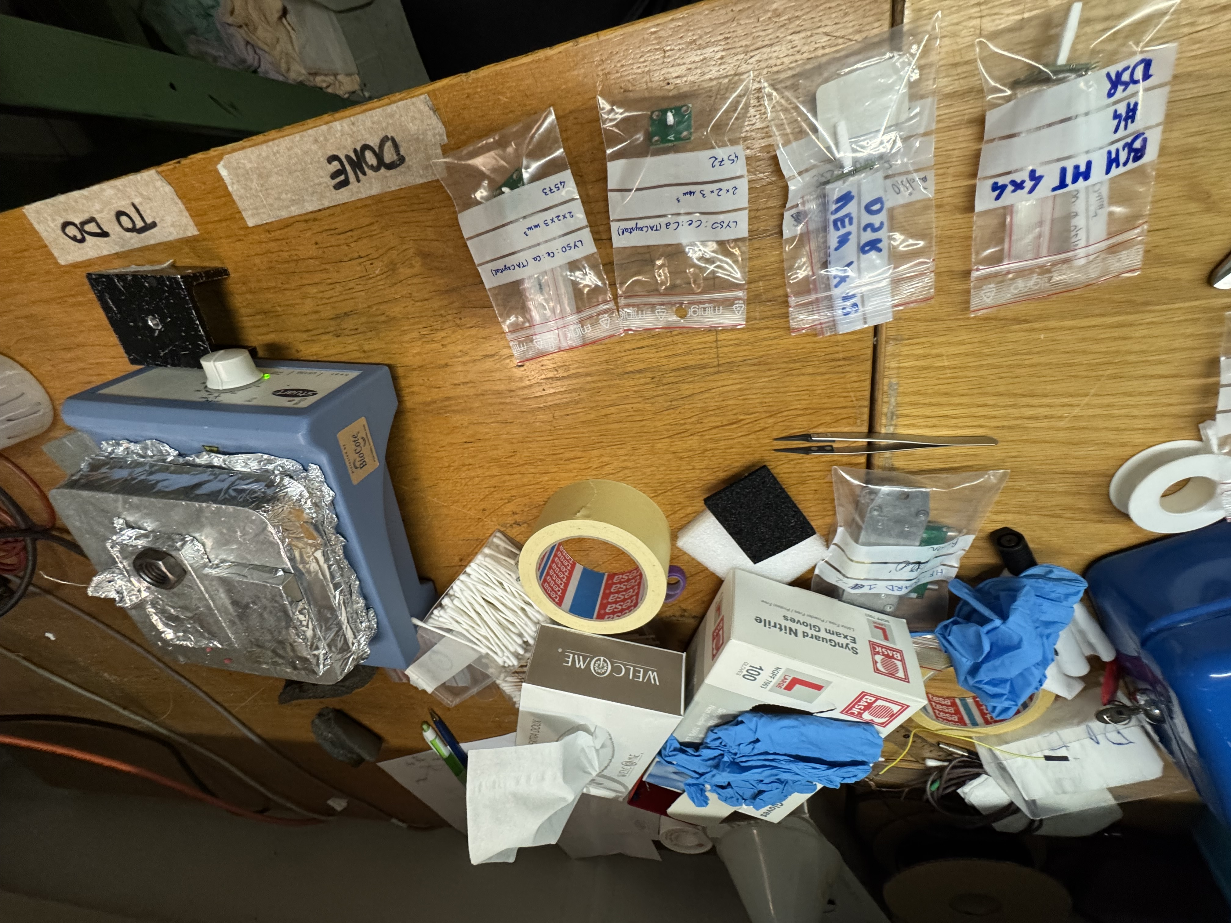
Lower Voltage Reference
More Reference Measurements
• FastIC-compatible SiPM saturates above 42V bias
• Initial reference scans done at 45–48V — not usable
• Need to repeat reference measurements at 40–42V
• Preparing new runs to match FastIC’s voltage limitations
• I'm a pro at coupling single crystals now.
Cesar Cardona
April 8, 2025

Slide 17
Analysis
Cesar Cardona
April 8, 2025

Slide 18
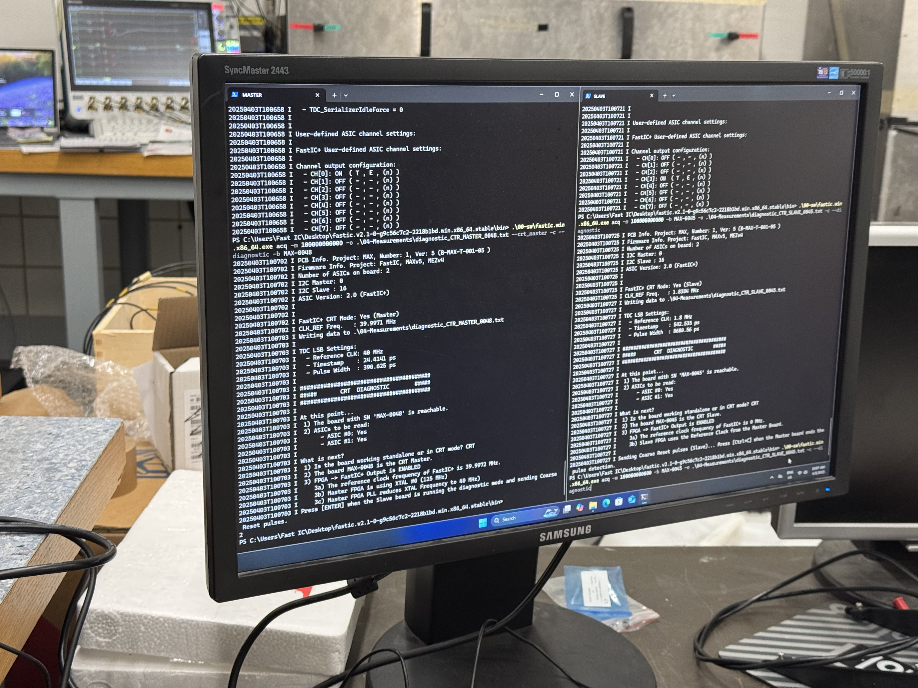
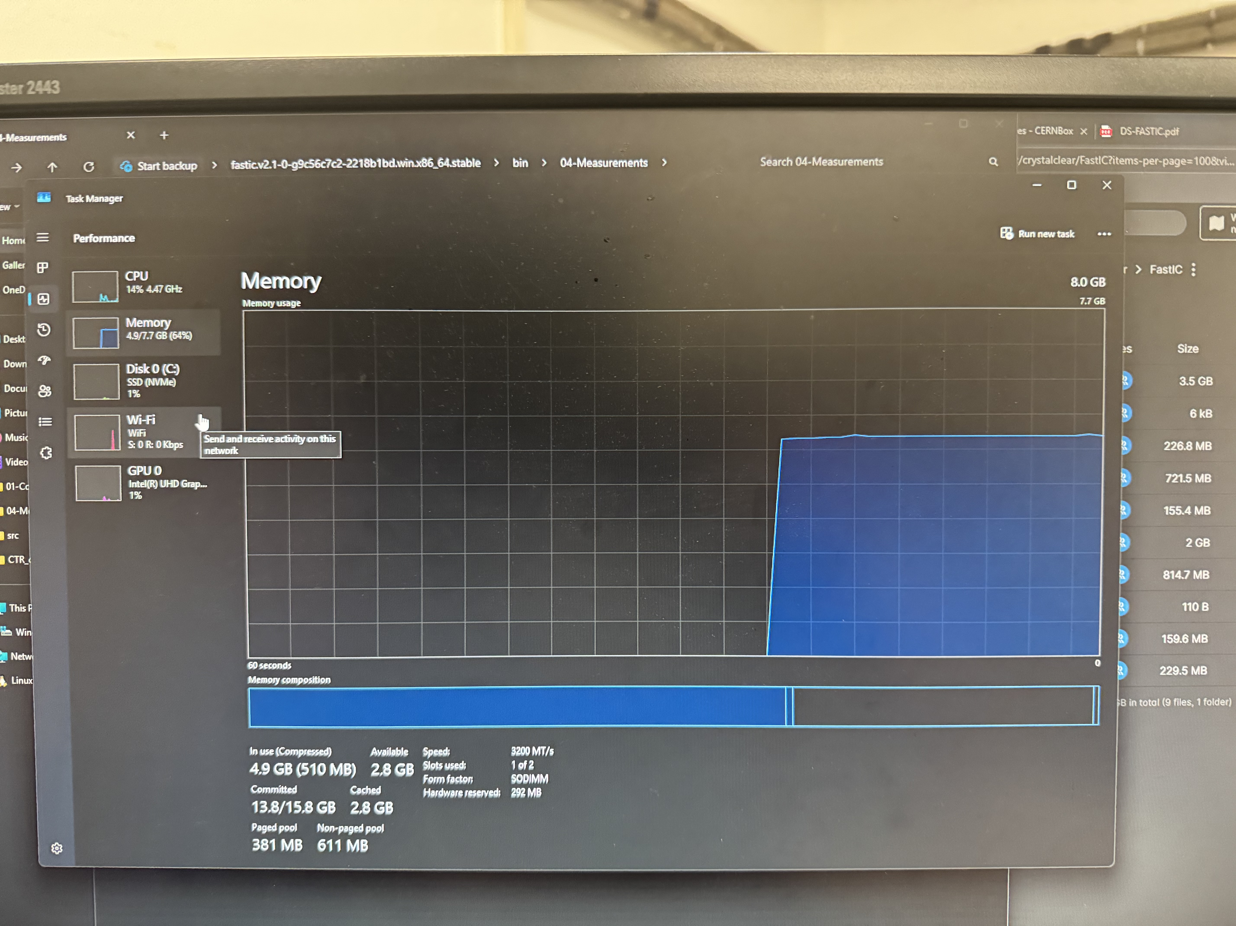
Analysis
ROOT Comeback
• Boards must be controlled from two separate terminals
• Our computer struggles with very large data volumes
• Reference board records every event → ~10⁸ events in 2 hours
• Storage and processing becoming a bottleneck
• Moving forward with ROOT-based analysis for efficiency and scalability
Cesar Cardona
April 8, 2025

Slide 19
Miscellaneous
Cesar Cardona
April 8, 2025

Slide 20
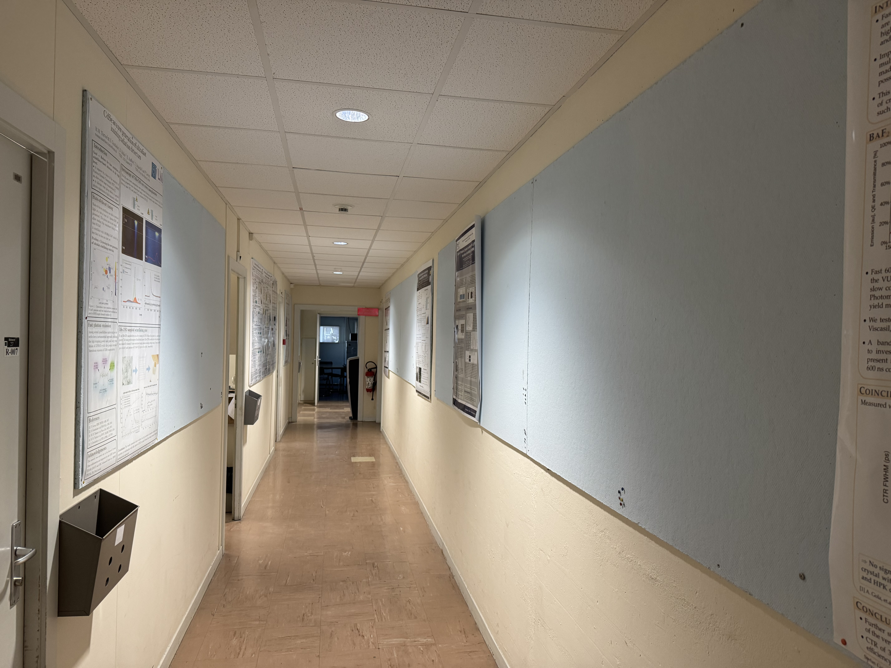
Miscellaneous
Poster Reeboot
• Tasked with removing old posters from lab hallway walls
• Carefully scanned and uploaded them to the CERN Box
• Now digitally immortalized… until a high-energy EM pulse erases history
• RIP wall posters — your contributions will not be forgotten
• (At least not until the next intern clears the Box folder)
Cesar Cardona
April 8, 2025

Slide 21
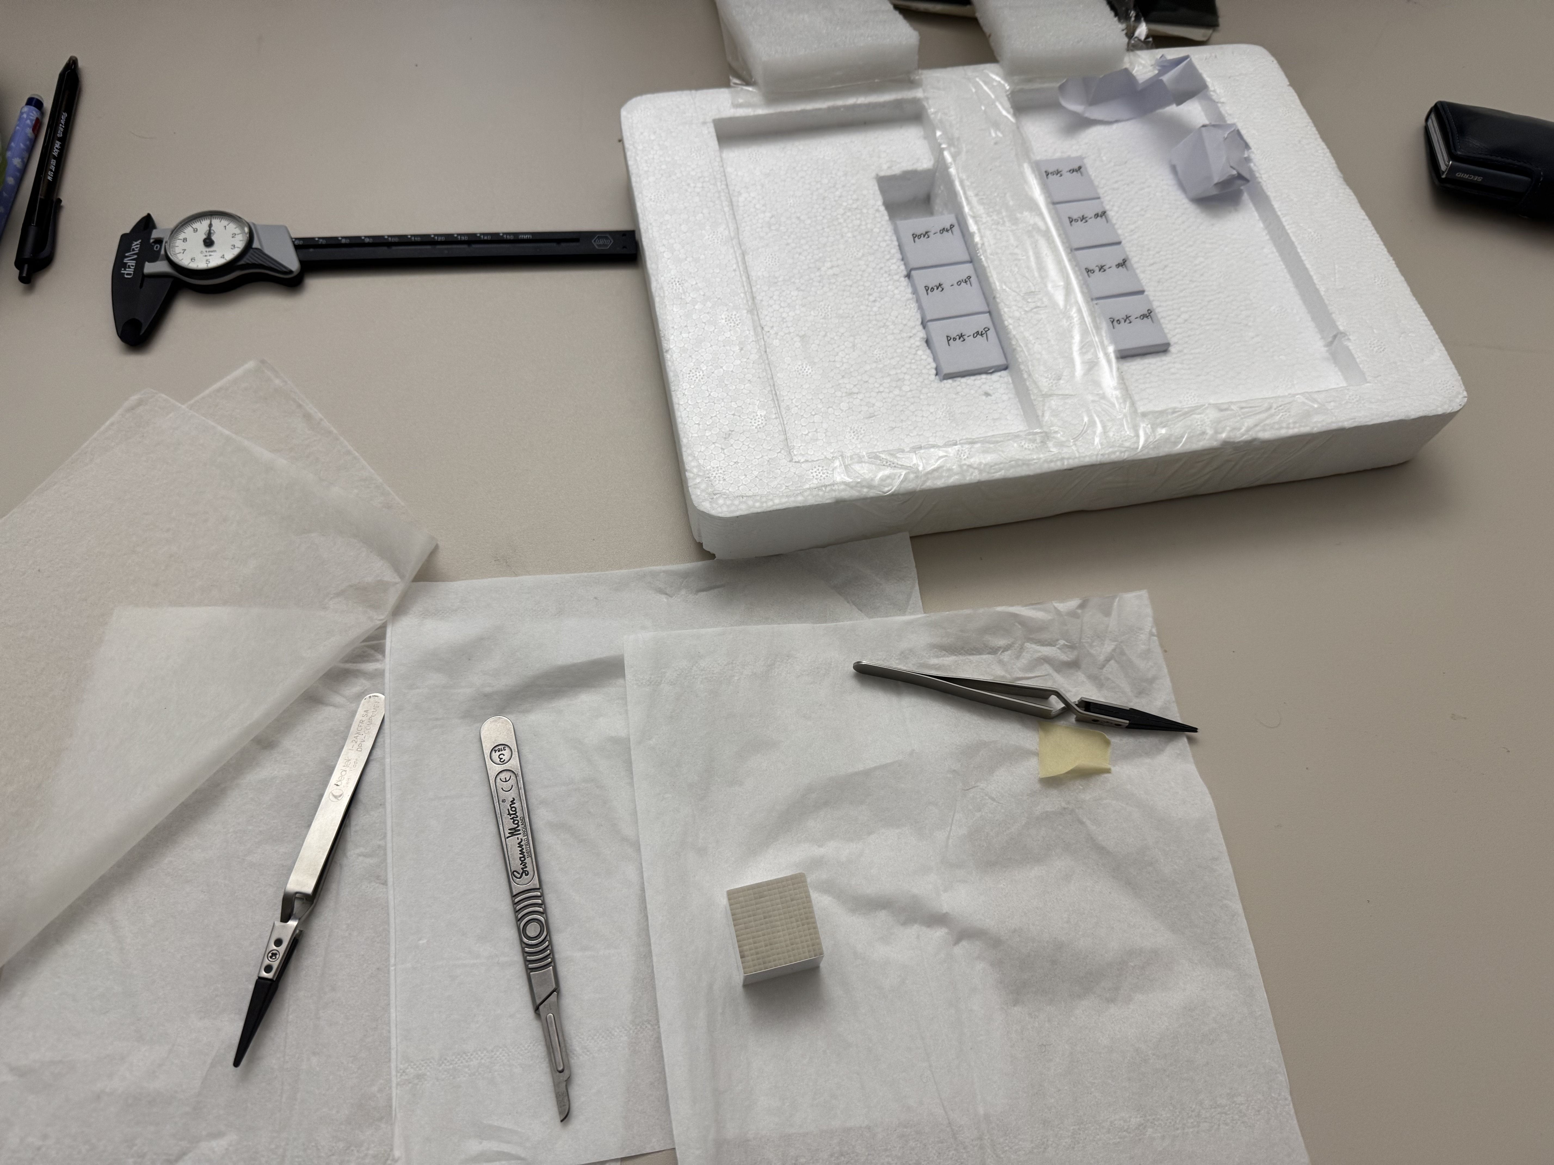
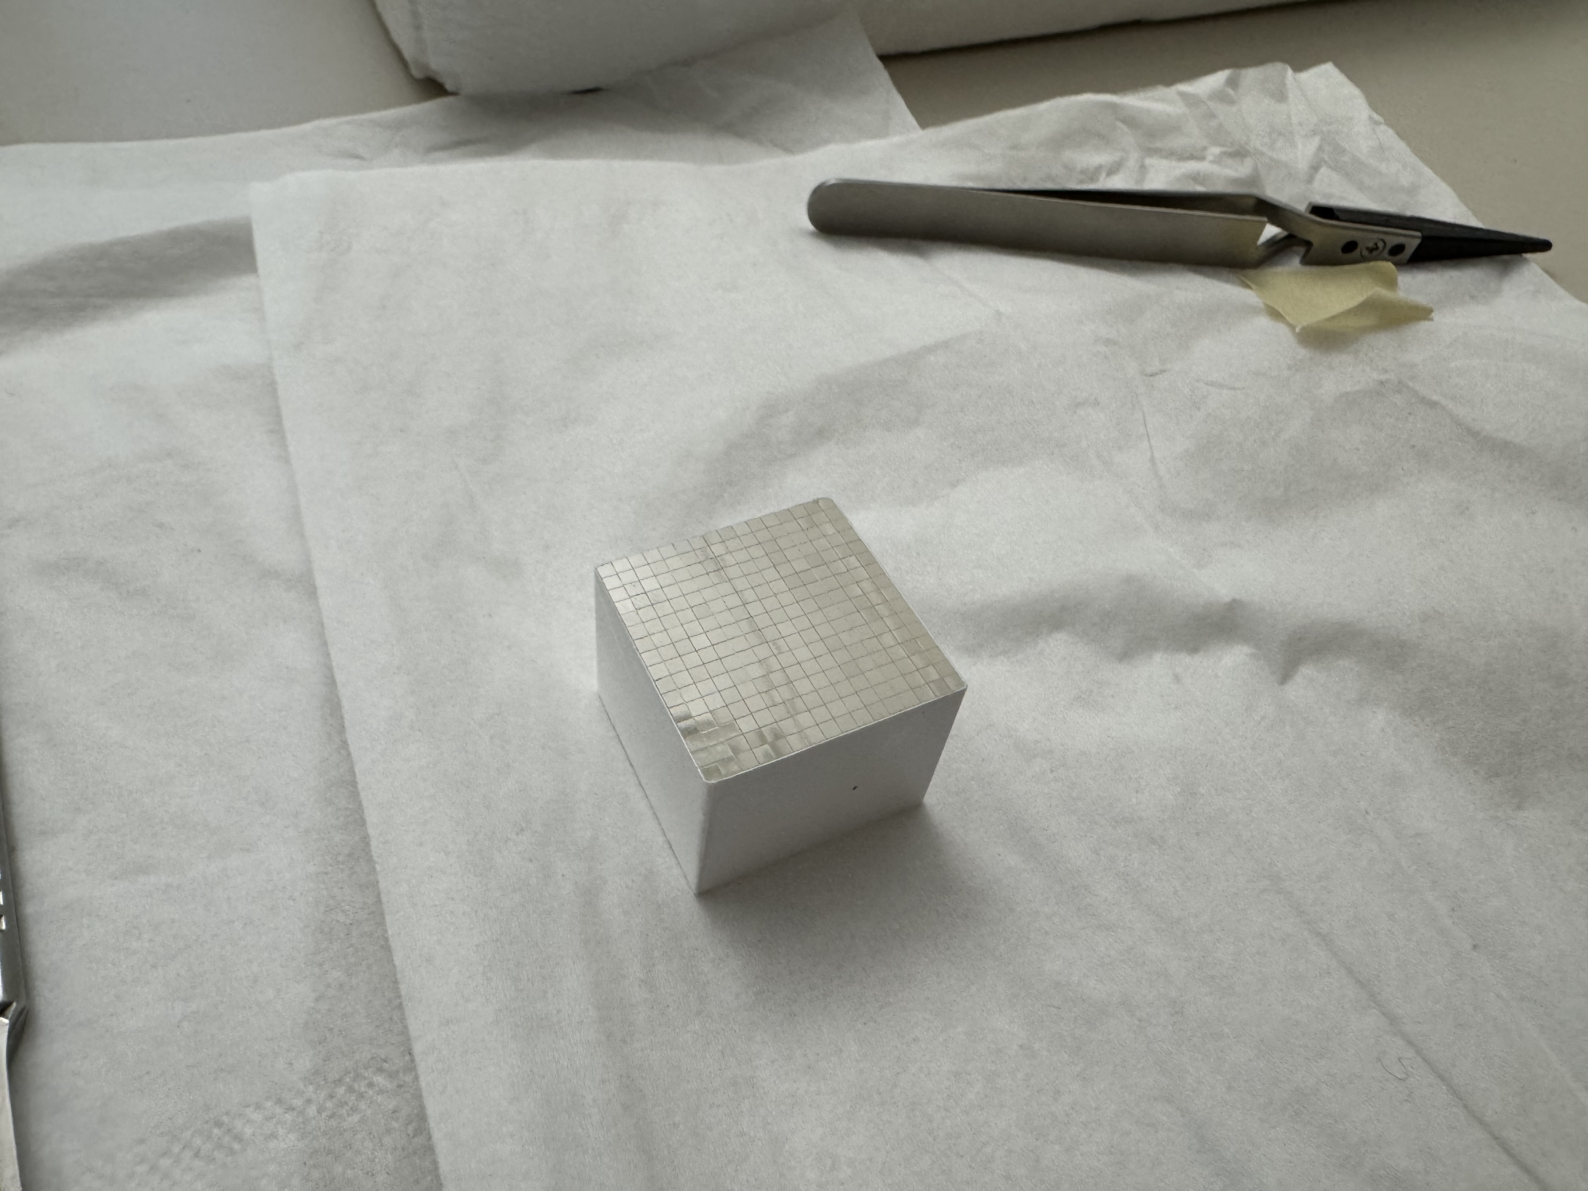
Miscellaneous
Cesar Cardona
April 8, 2025

Slide 22
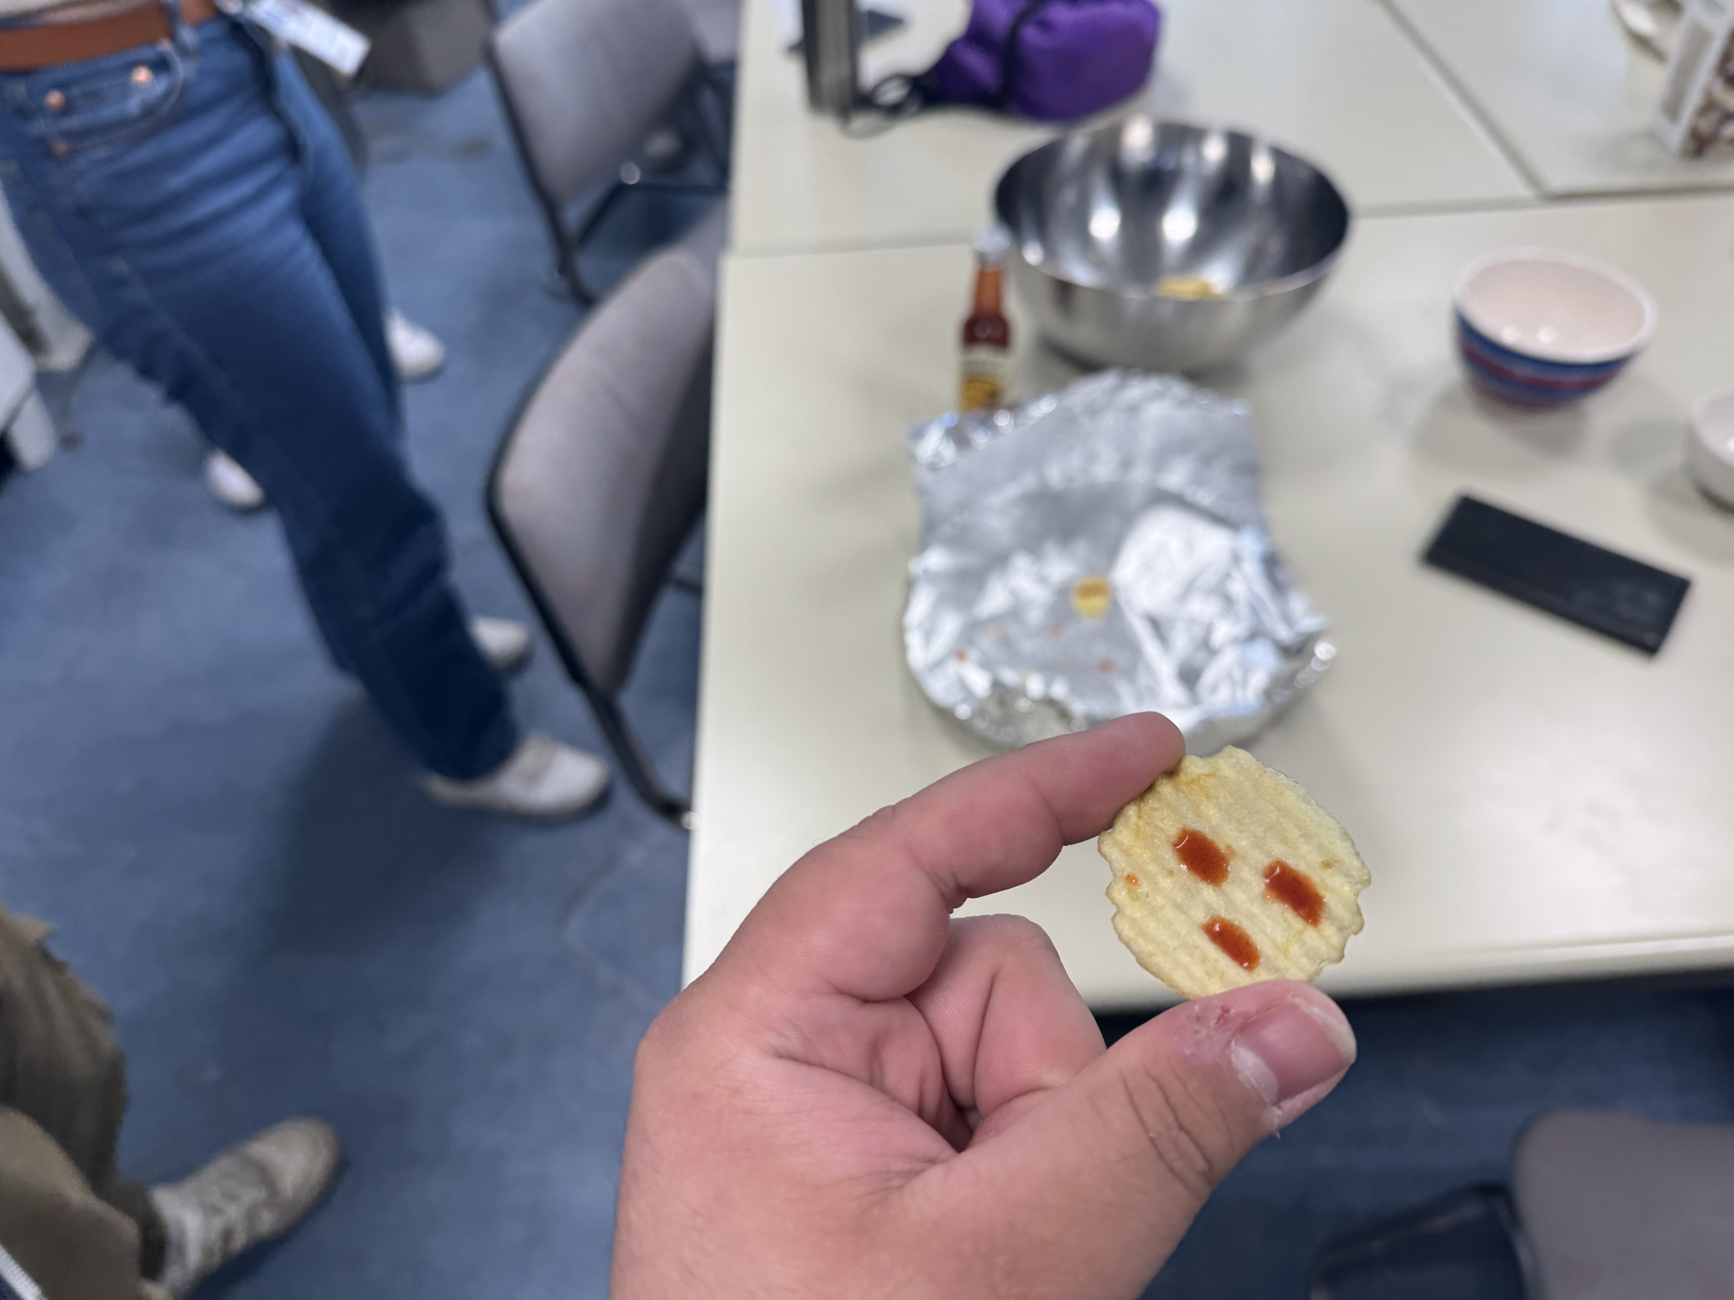
Miscellaneous
Edible Radioactivity
• Word got out I was Mexican…
• Naturally, this turned into a lab challenge
• Tried one drop of a 1,000,000 Scoville hot sauce — child’s play
• Confidence was high → added three drops
• Regret was… also high
Cesar Cardona
April 8, 2025

Slide 23
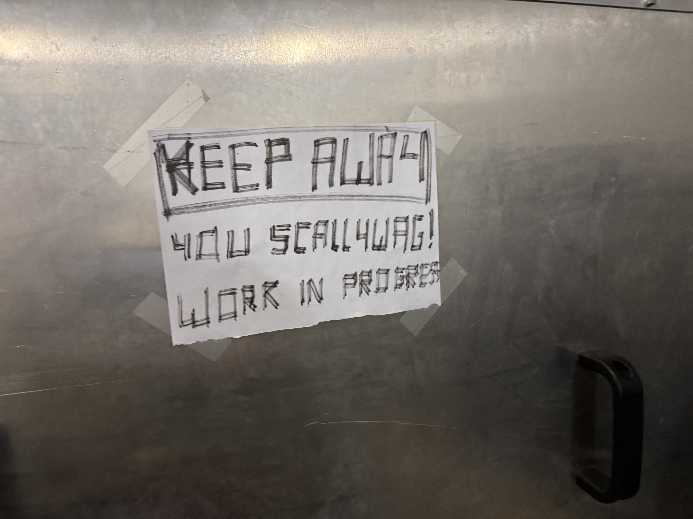
Questions?
Cesar Cardona
April 8, 2025

