Slide 1



Characterizing Lead Perovskite Crystals as Radiation Detection Materials
Michael Durant
08/04/2025

Slide 2
Experimental Set-Up Update

Slide 3
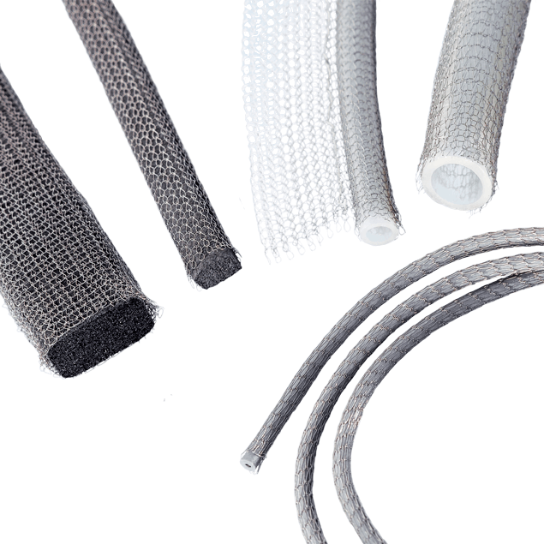
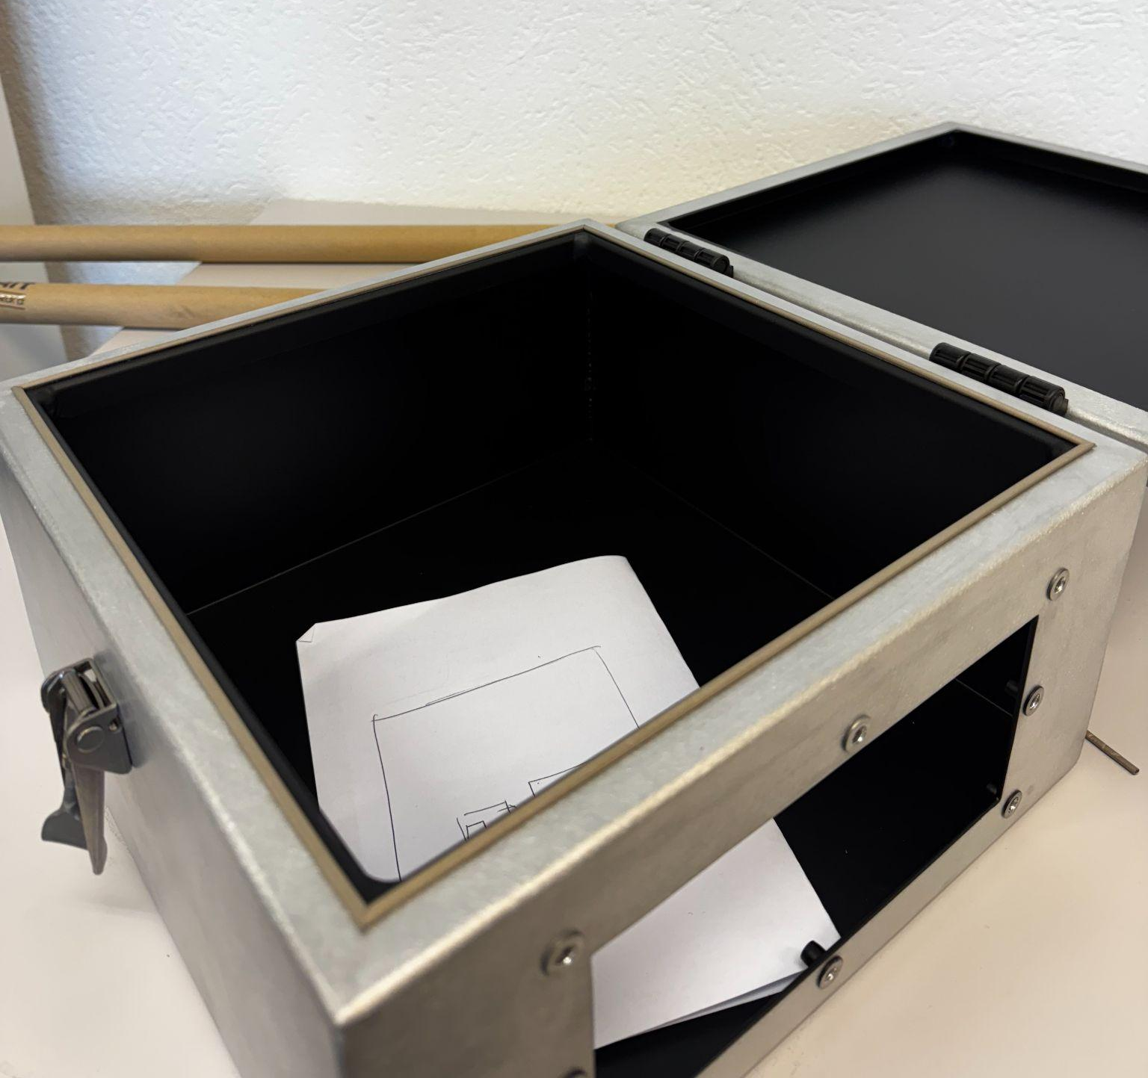
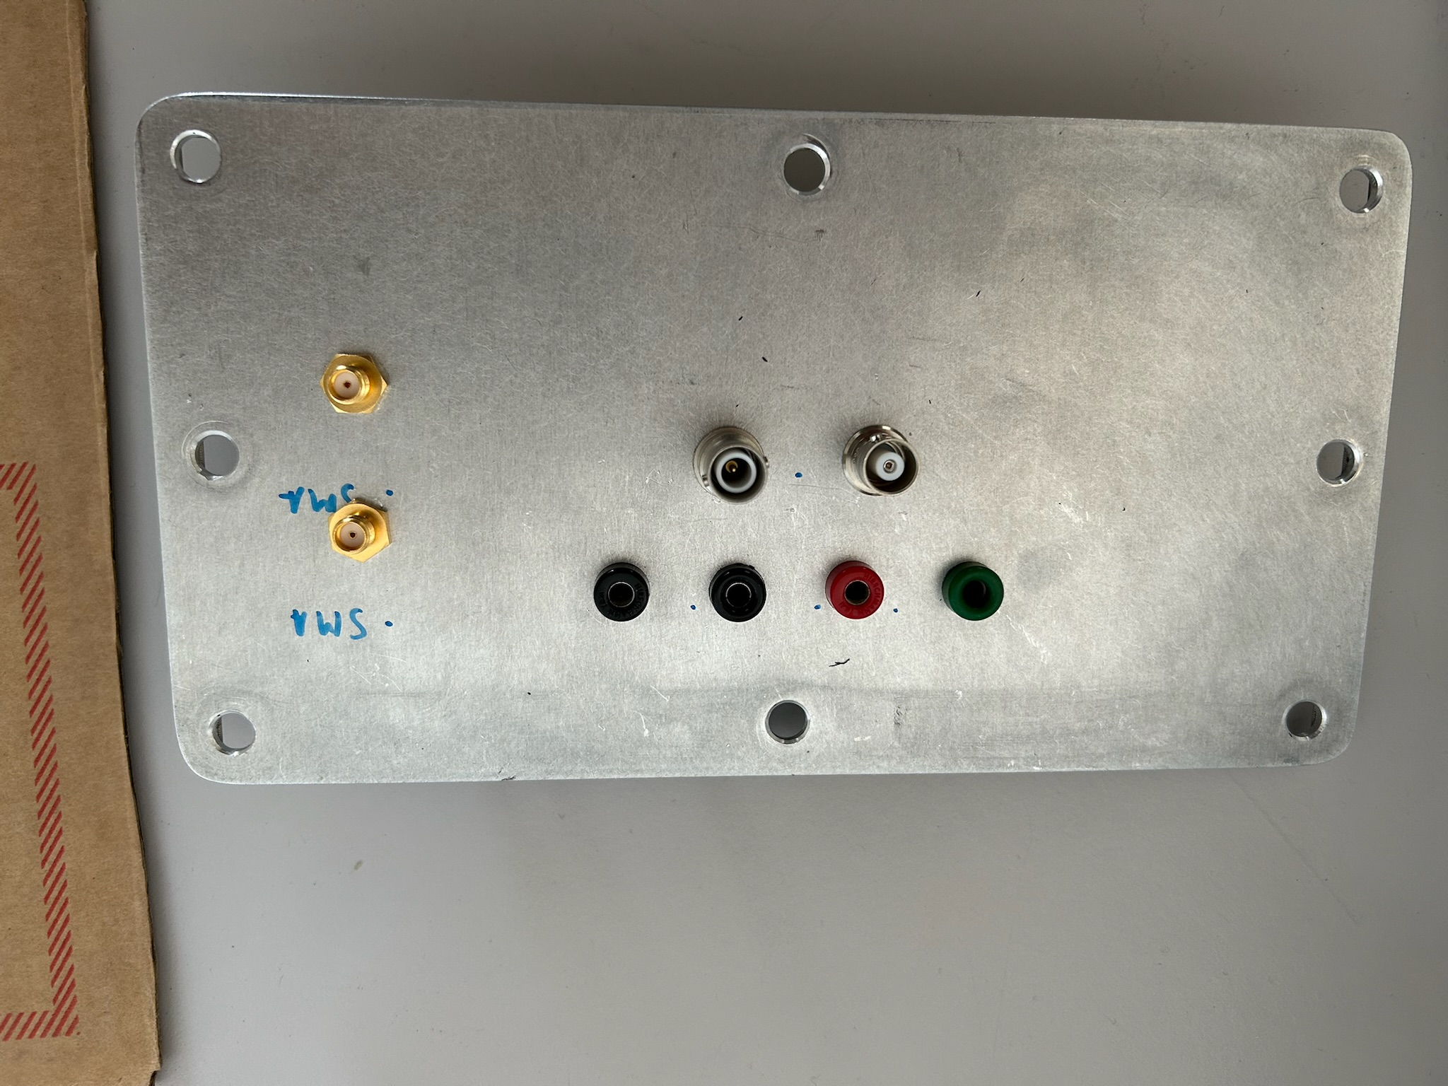
Recap From Last Talk
Sealed new box lid with metal gasket
Conducted successful tests to ensure electrical continuity
Patch panel holes were drilled and metal gasket was applied

Slide 4
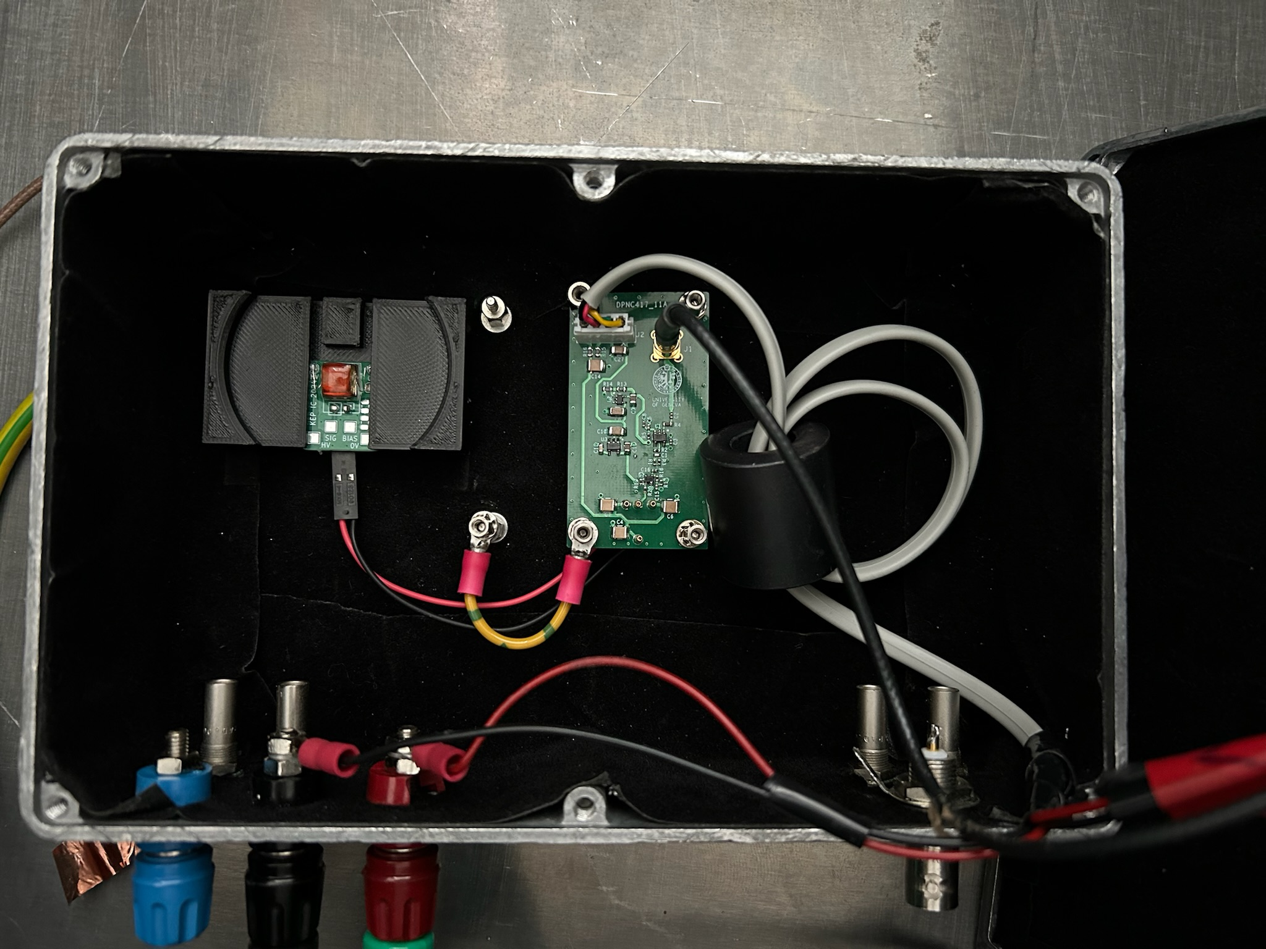
Taking Data
While waiting for the new setup, started taking data with the old setup
Goal is to familiarize myself with the data taking methods so that we will be ready to use the new setup when construction is complete
Did threshold voltage sweeps for two different experimental configurations:
  Cs104A crystal with no source
  No crystal (just SiPM) with no source
Several problems arose
  Late peaks at the end of the data taking window
  Large amounts of noise
  Recording time

Slide 5
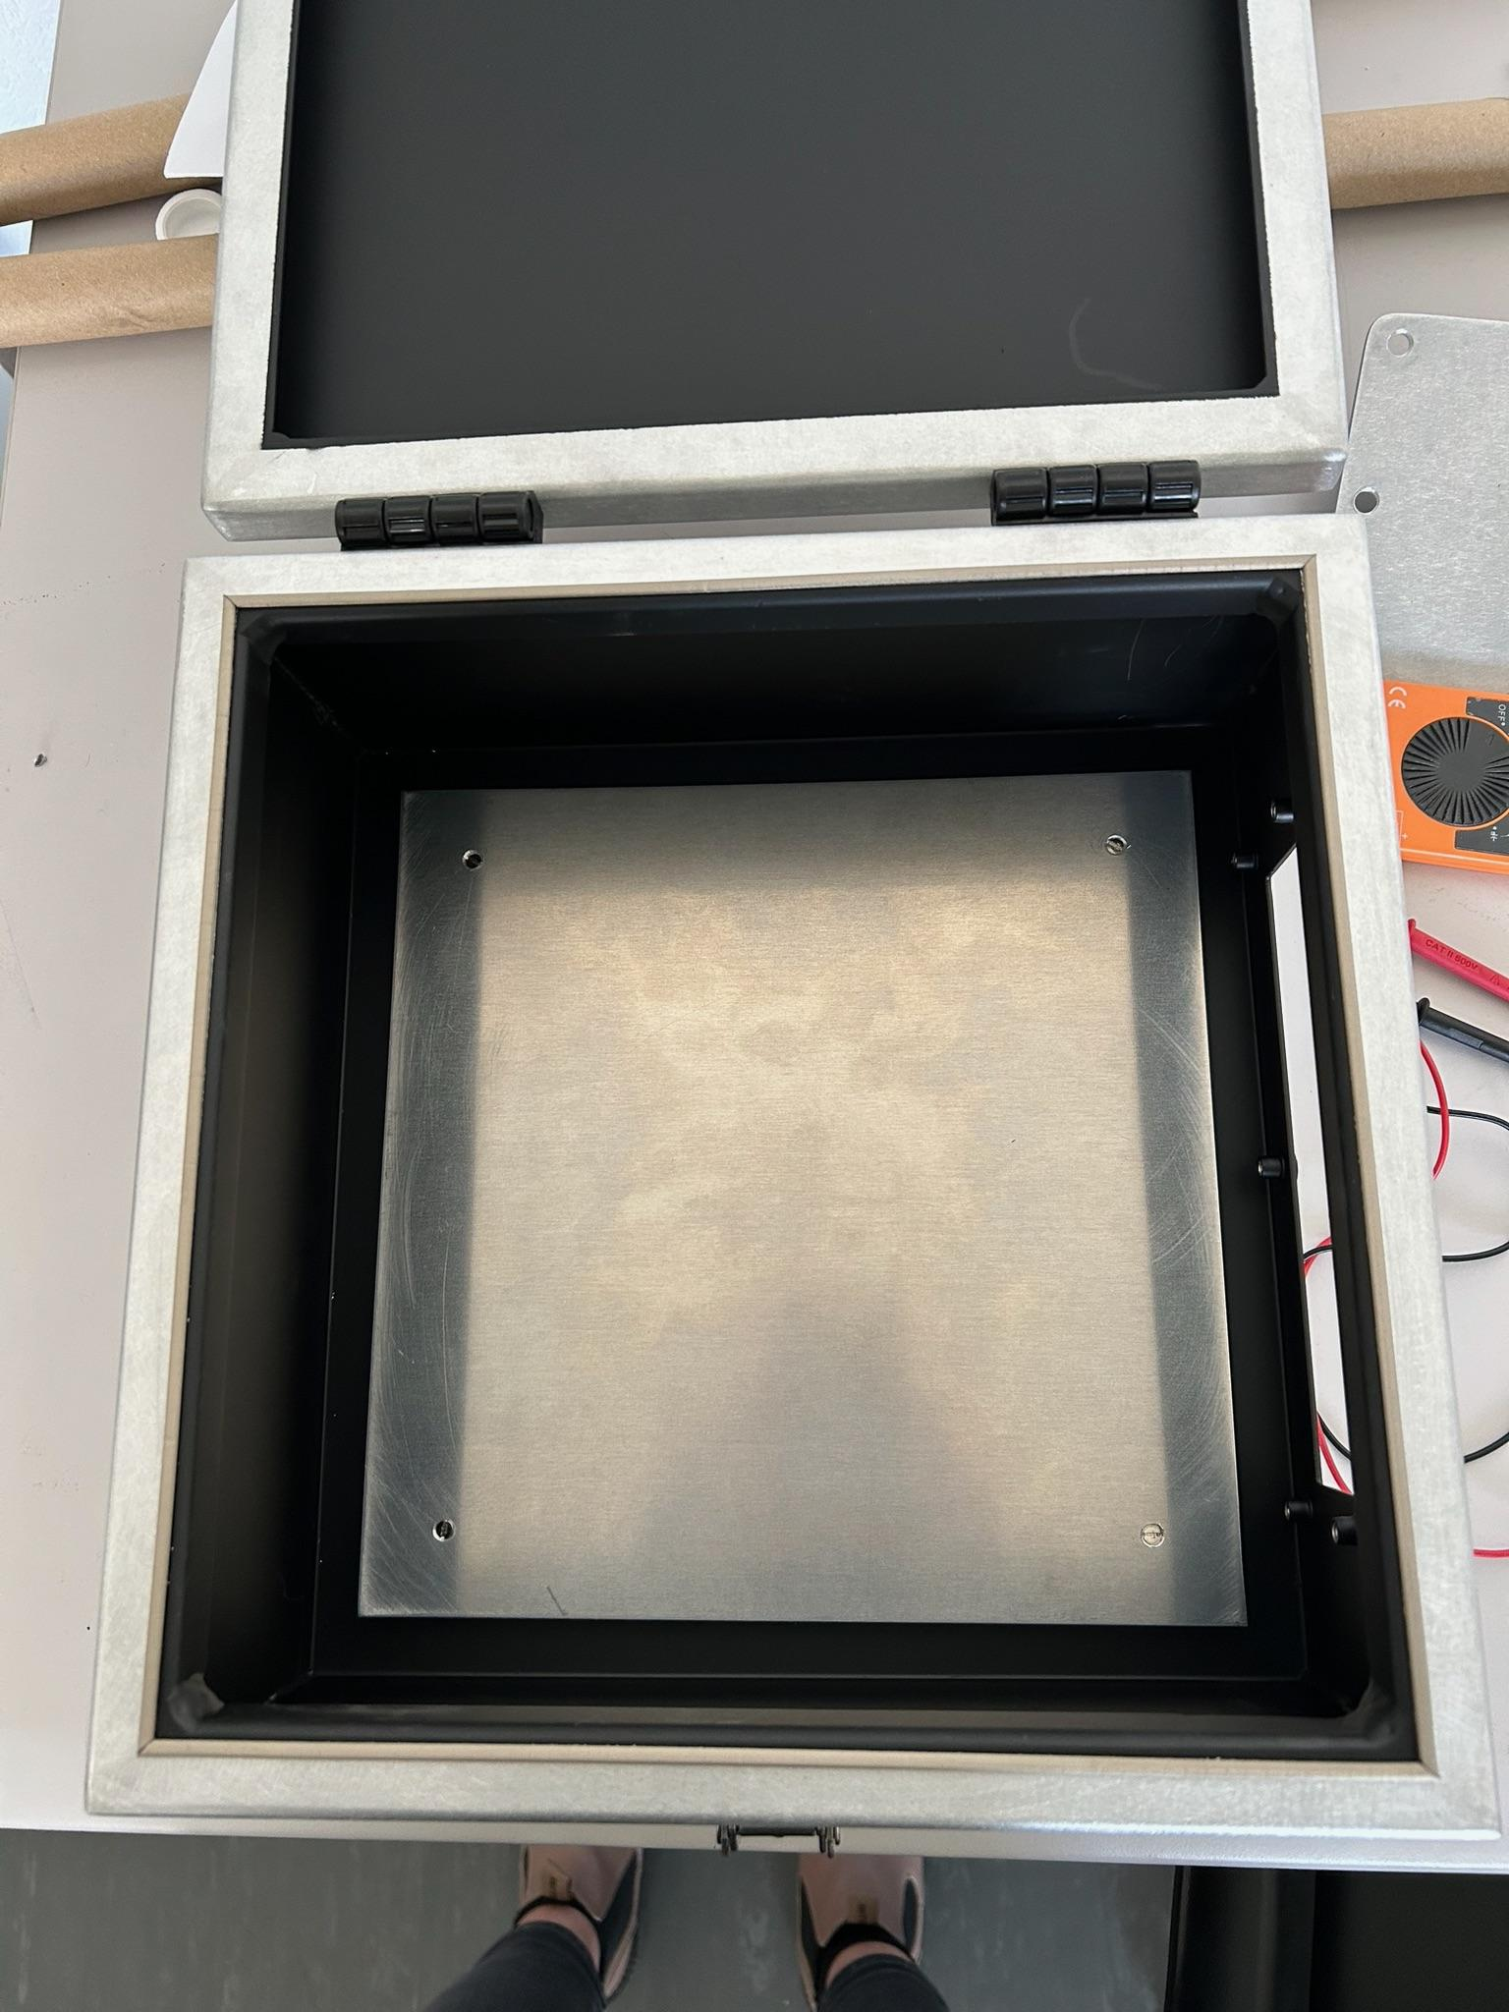
Status of New Box
Base has been installed
Without it we would have to drill holes in the box every time we want to adjust the configuration
Now we can just drill holes in the base/swap to a new base without impinging on the faraday cage
Still waiting on
New PCBs
  Includes new boards from KEP with fresh crystals
3D Printed source holder

Slide 6
New Ideas - Noise Reduction
Running on old setup made clear the importance of noise reduction
Jumbled and crossed wires cause lots of unwanted noise in data
Should try to eliminate unnecessary adapters, connections, and long wires from new setup
Board from KEP
Was previously connected to other board with wires running across the box
Instead we can just connect them directly

Slide 7
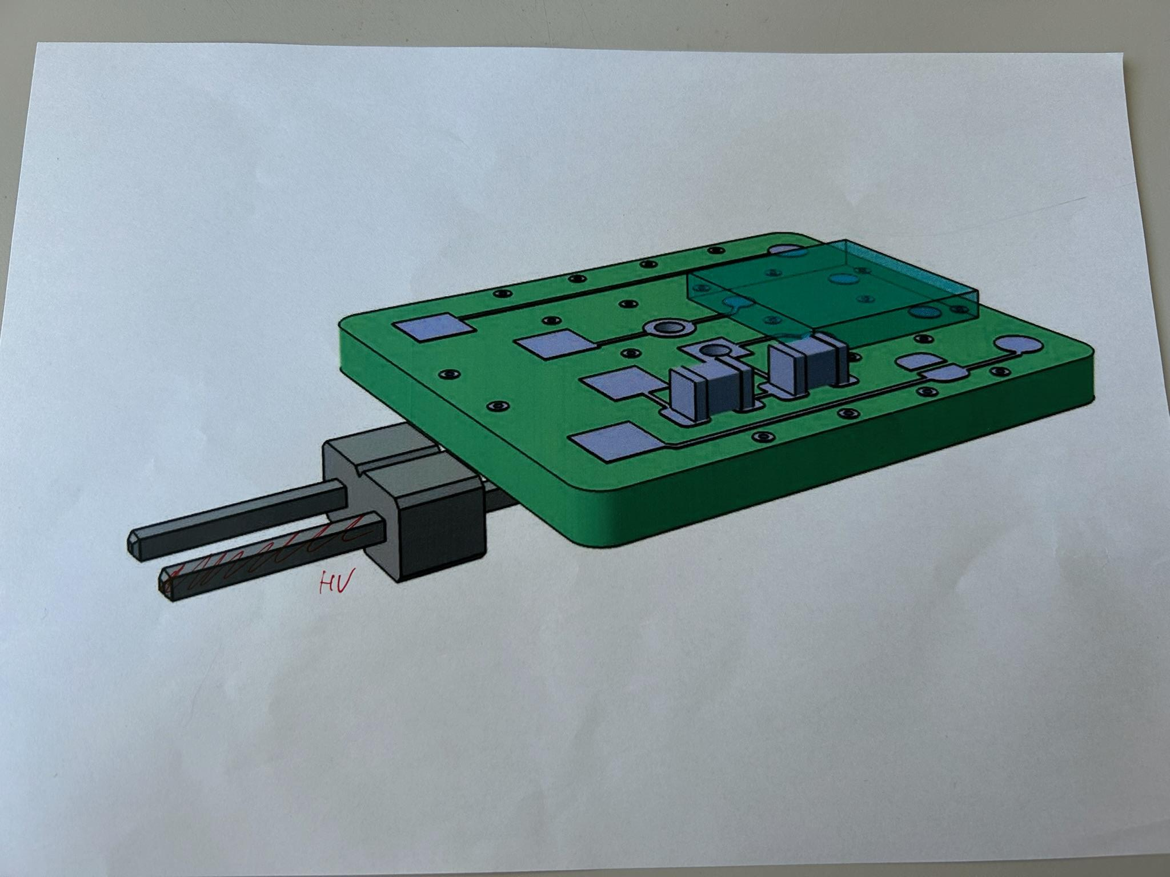
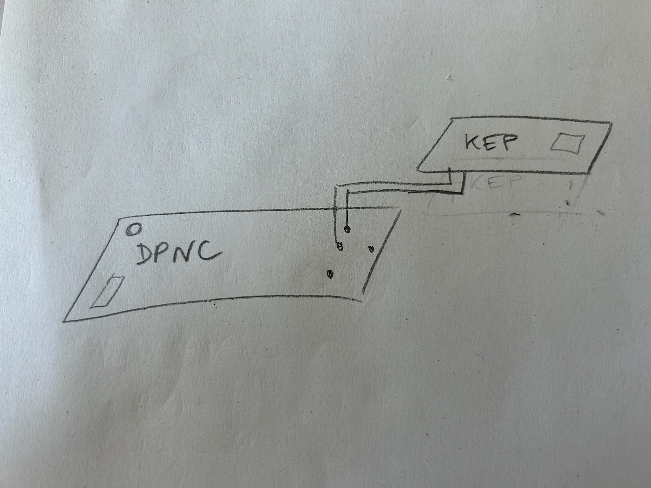
New Ideas - Noise Reduction
Running on old setup made clear the importance of noise reduction
Jumbled and crossed wires cause lots of unwanted noise in data
Should try to eliminate unnecessary adapters, connections, and long wires from new setup
Board from KEP
Was previously connected to other board with wires running across the box
Instead we can just connect them directly
Old Board:
Proposed
Solution:

Slide 8
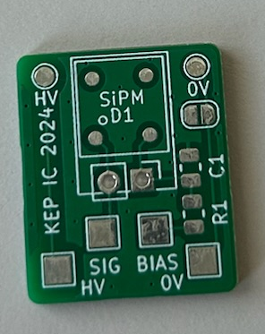
New Ideas - Crystal Bias Voltage
Struggled to collect data on crystal bias voltage
Every attempt to connect the board to the power source introduced tremendous amounts of noise
This was the case in spite of trouble shooting
  Different power sources, adjustments to internal configuration, and changing input voltage (even to 0)
Believed to be a grounding problem
Solutions - want to avoid redesign of board
  Add capacitor, shunt if that doesn’t work
Complications
  Modifications will have to be made to a board with SiPM and crystal already mounted

Slide 9
New Ideas - New Box Testing
Trying to make use of dead time due to waiting for PCBs, bread board, and source holder
Considering taking old setup and transferring internals to new box in order to run some preliminary experiments and evaluate the fidelity of the new faraday cage

Slide 10
Data Analysis Update

Slide 11
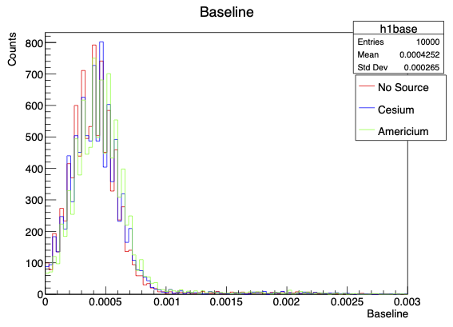
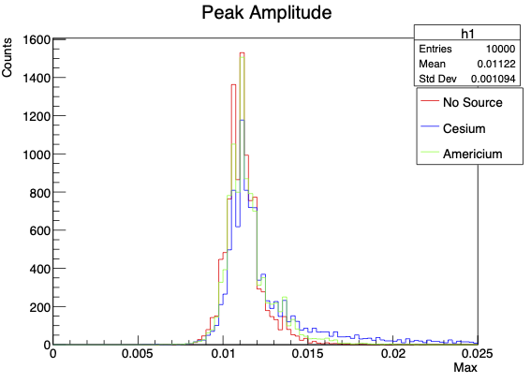
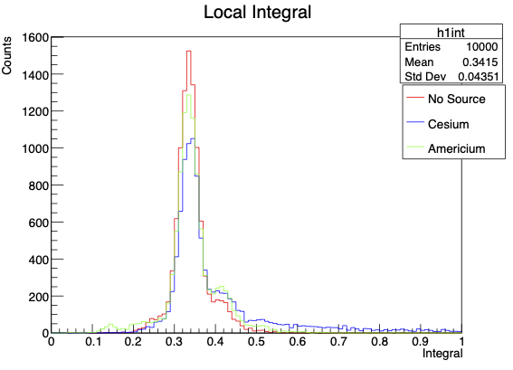
Recap From Last Talk
Made plots using sample data taken with the old experimental setup before my arrival
  CsPbBr3 Crystal with no source, Cs 137 Source, and Am 241 Source
Looked at several metrics
  Baseline estimation, peak amplitudes, local integrals around the peak amplitude
  Compared across the three data sets
Point of this exercise was to practice developing my own analysis code and handling the data files

Slide 12
Plotting New Data
No radioactive source for either data set
Comparison (old) data sets are from December and January of this past winter
Configuration | Threshold Voltages (mV) | SiPM Bias Voltage (V) | Crystal Bias Voltage (V) | # of Events | Date Data was Taken
CsPbBr3 Crystal | 1, 3, 5, 7, 10, 15 | 55.5 | 0 | 10,000 | 3/28/2025
Just SiPM | 1, 3, 5, 7, 10, 15 | 55.5 | 0 | 10,000 | 3/28/2025

Slide 13
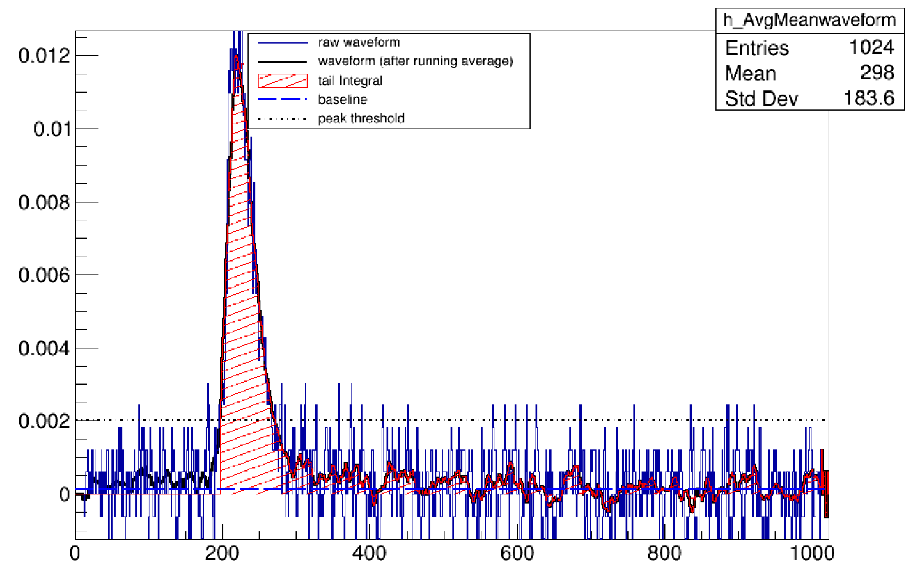
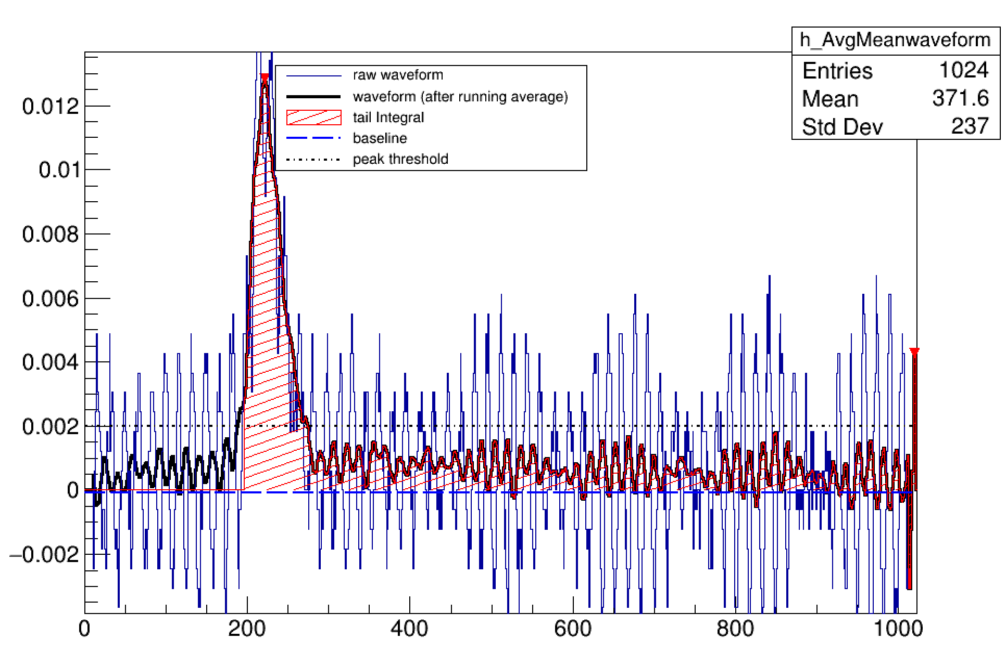
Plotting New Data
Sample waveforms from old (top) and new (bottom) 10 mV threshold runs w/ crystal present
Still able to see defined signal peak but other metrics are more difficult to determine due to noise
Using new analysis code with more advanced capabilities

Slide 14
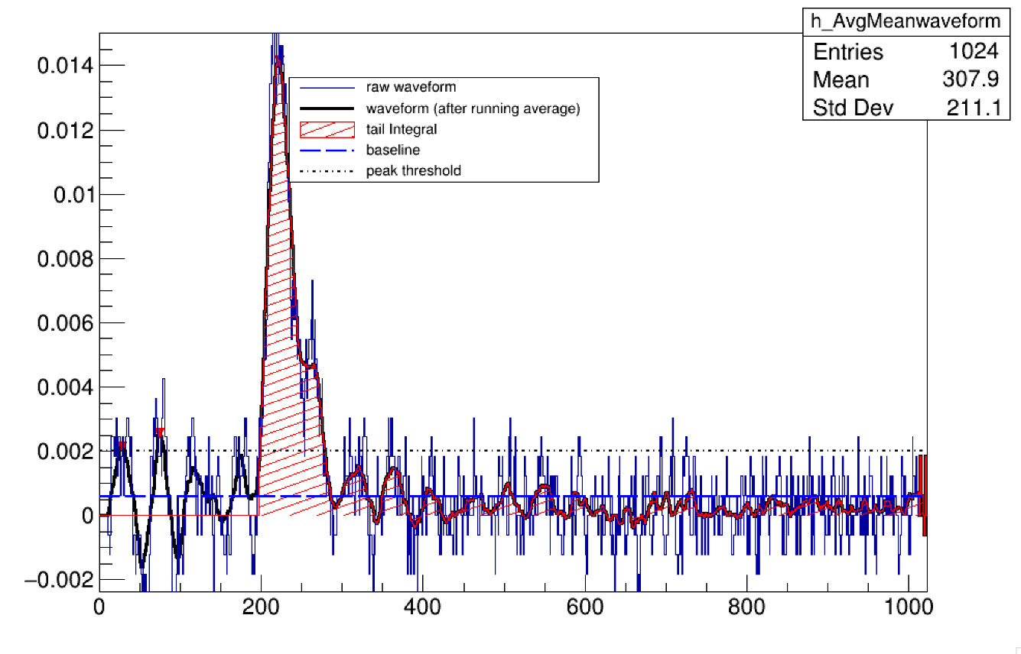
Problems in Data - Noise
Much more noise in the new data set
Baseline estimation is larger which we expect
Integral is in fact slightly smaller, due to larger negative fluctuations

Slide 15
Problems in Data - Peaks
We have our main peak which is followed by some smaller peaks if we have a radioactive source present

Slide 16
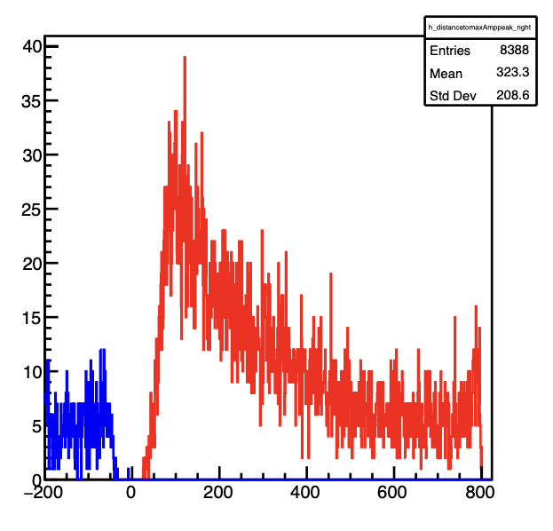
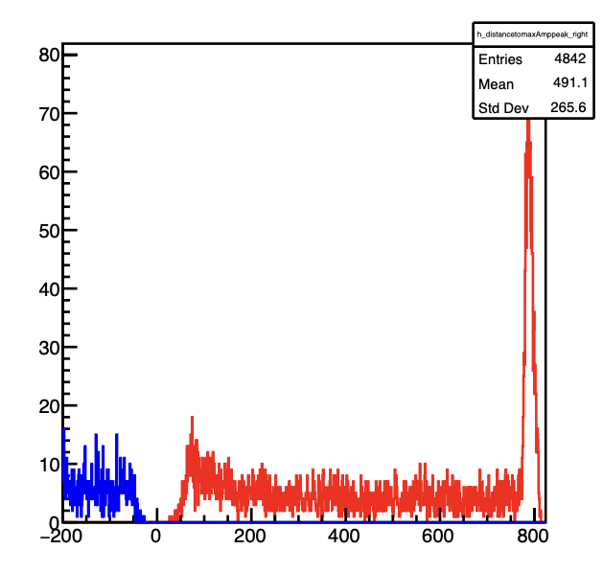
Problems in Data - Peaks
Looking at histogram of positions of peaks
Blue is left of the start of the peak, red is to the right
Huge spike at the end just before new sample ends

Slide 17
Problems in Data - Peaks
Looking at waveforms, we can see where we have spikes at the end of the new data
Peak finding algorithm is not well adapted to this much noise
Running average over sample to smooth out data is also causing problems
  Too large of a step is making the late peaks even more exaggerated
  Too small of a step flattens the late peak but causes program to identify more false peaks by exaggerating the noise

Slide 18
Fixes
How can we learn from this?
Shows some glaring errors in our peak finding algorithm
  Need to focus on wider peaks if we can’t get rid of the noise
Also underscores importance of eliminating noise as much as possible
  Light tightness and cabling in new box

Slide 19
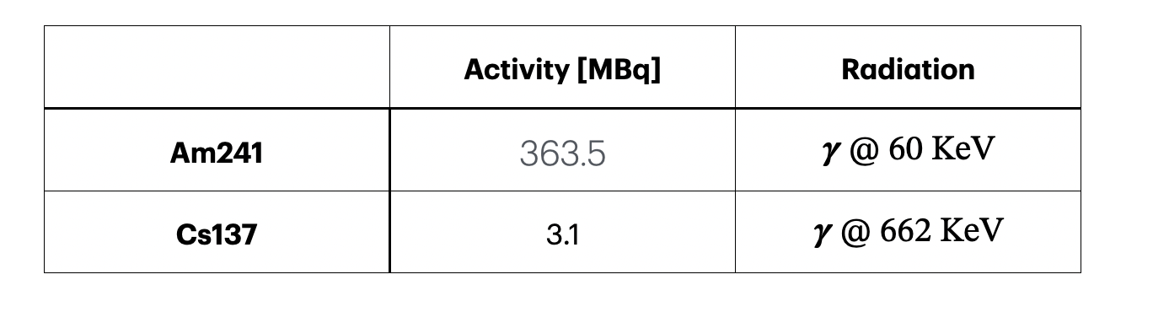
Radioactive Sources

Slide 20
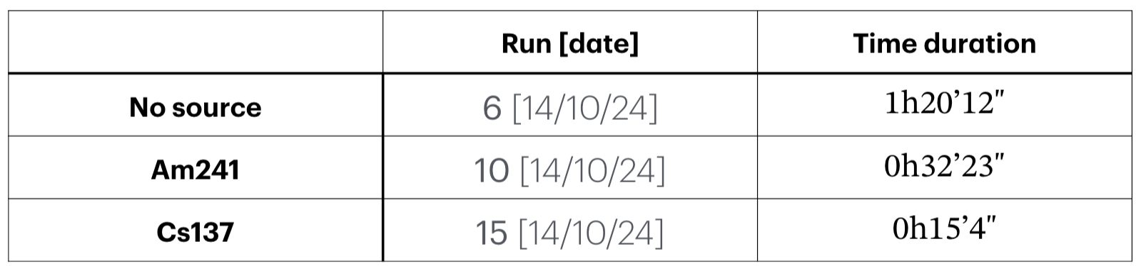
Potential Problem in Data - Rate
CsPbBr3 - CS104-A - threshold @ 10mV
10,000 events

Slide 21
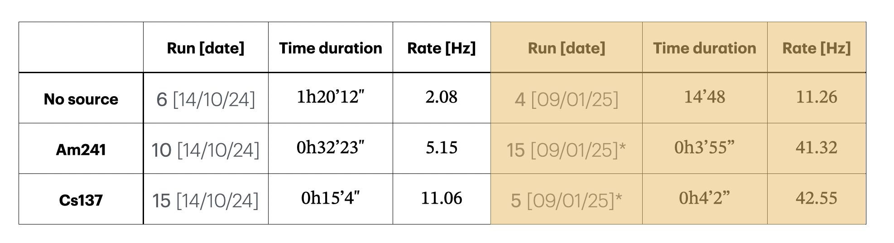
Problems in Data - Rate
CsPbBr3 - CS104-A - threshold @ 10mV
10,000 events
*source inside the box

Slide 22
Fixes
How can we learn from this?
Once again, need to limit noise as much as possible
  Eliminating noise will make rate of data taking cleaner, so slower rate
Need to look at how much noise we are actually getting
  Should try to calculate the rate of data intake that is coming from noise
  Then we can find the rate of data intake from the signal
  Ideally, this rate would be constant across the experiments, independent of the noise present, but there are other factors which affect this

Slide 23
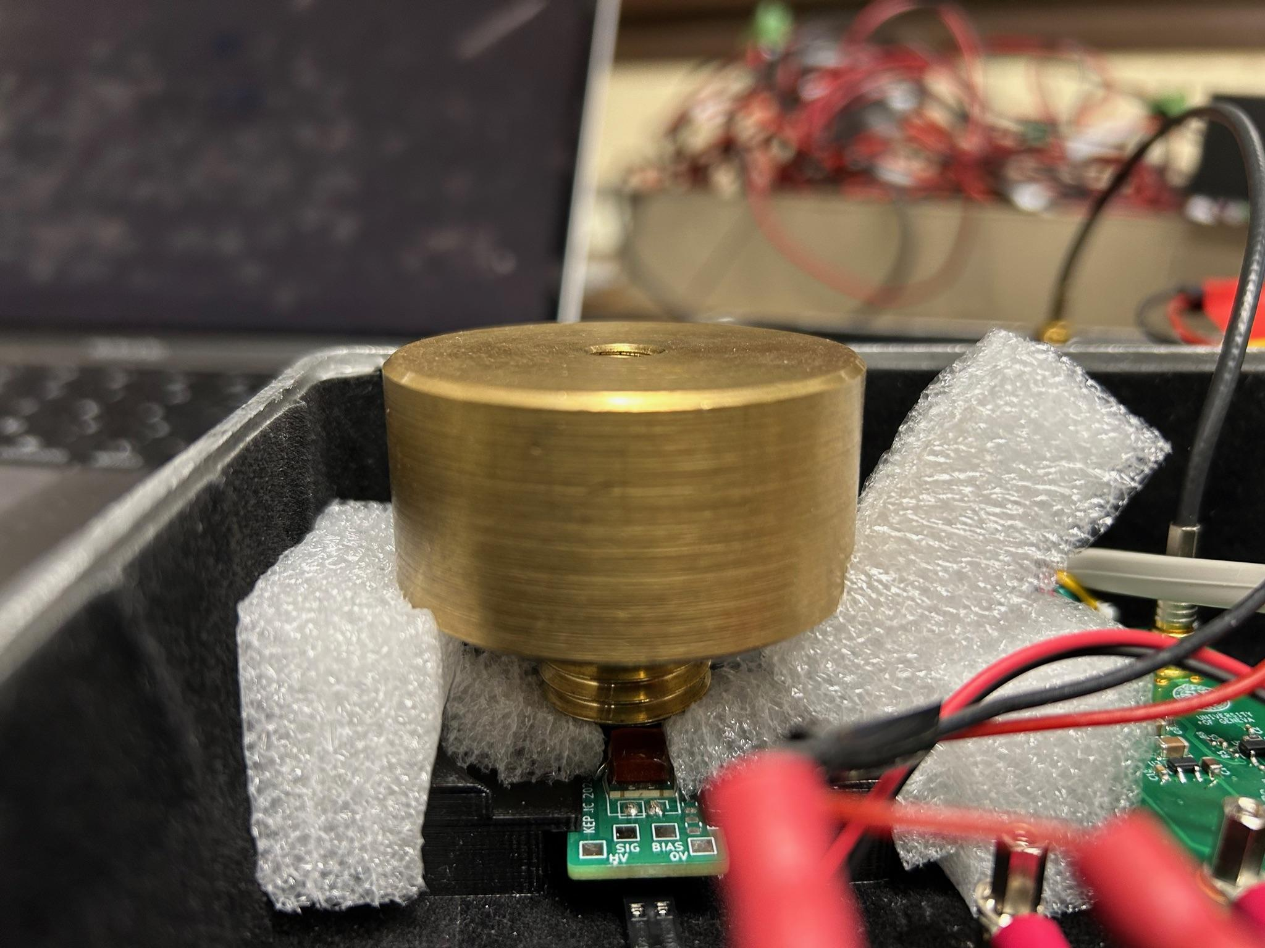
Causes
Several potential issues leading to observed problems in new data
Damage to crystals
  Deterioration over time
  Highly sensitive to moisture & temperature
  Damage during previous runs with the old experiment
Damage to SiPMs
  Similarly to crystals, could be damage from lack of space in box
Poor cable management and damage
  Failure to find optimal arrangement of cables
Problems with analysis code
  Peak finding and smoothing of waveform need to be adjusted for noise

Slide 24
Looking Forward

Slide 25
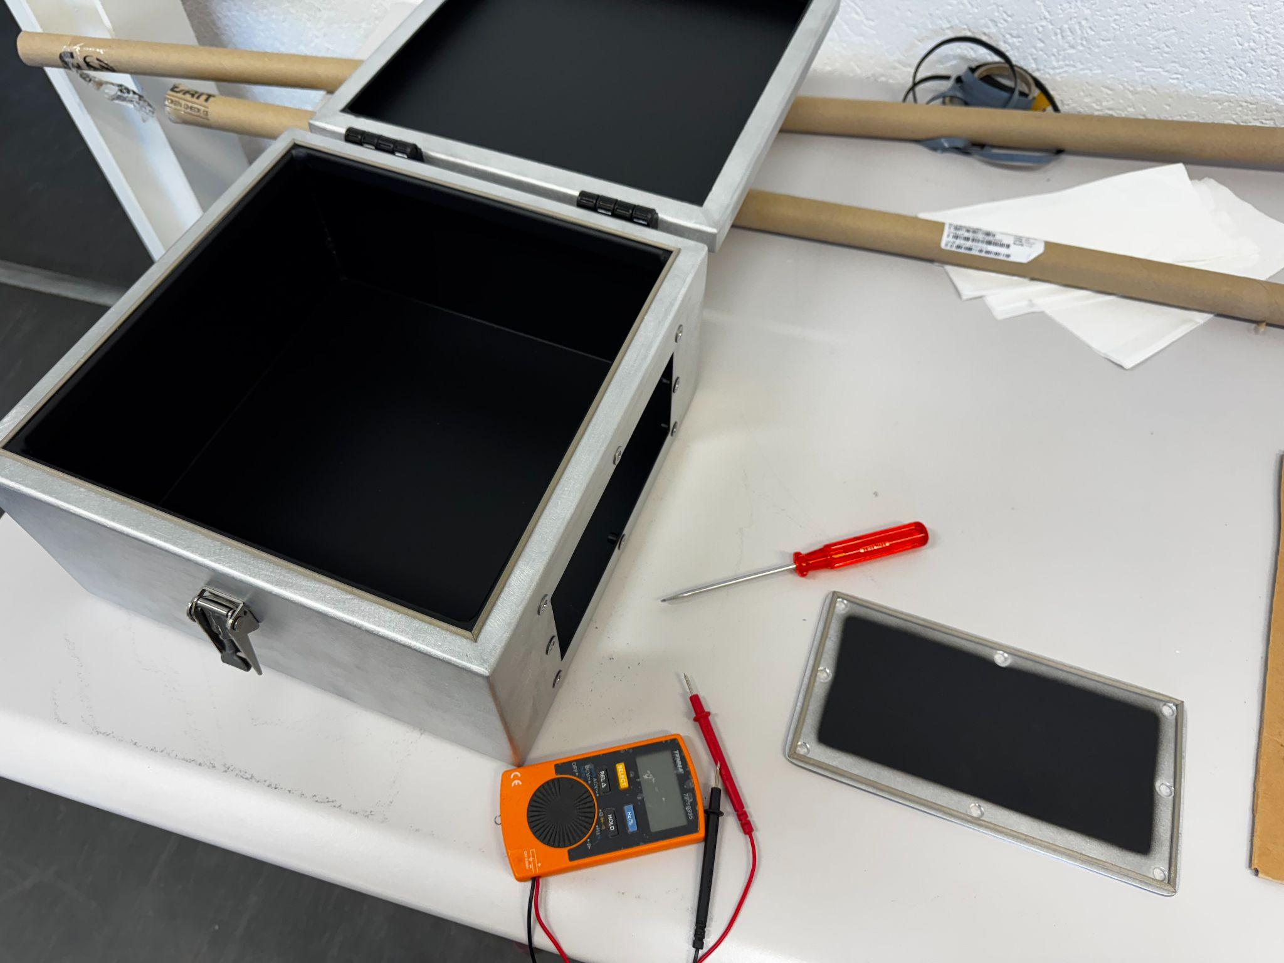
Next Steps
Finish new box
  Delays waiting for parts have pushed back the expected finish date to Easter
Test old and new boxes
  Transferring the CPMs from the old box to the new will enable preliminary testing on the new box
  Continued testing of the old box at UniGe site with new radioactive sources
Simulate crystal stopping power
  Want to gain a more complete understanding of how crystal thickness and type of radiation affect crystal performance
  How big of a factor is self-absorption
Look into rate problem
  Can we effectively separate the sources of our data into signal and noise to estimate the signal rate?

Slide 26
Questions?

