Slide 1



Weekly Updates
Pedro Baculima – 04/08/2025
1

Slide 2
Quick Updates
I didn’t have a lot of free time during the weekend and the beginning of last week since I was studying for my Quantum exam.
My supervisor and I used Monday of the previous week to polish and submit the summer extension application.
I worked on Thursday and Friday of last week, and yesterday. I will discuss my progress in the next slides.
Pedro Baculima – 04/08/2025
2

Slide 3
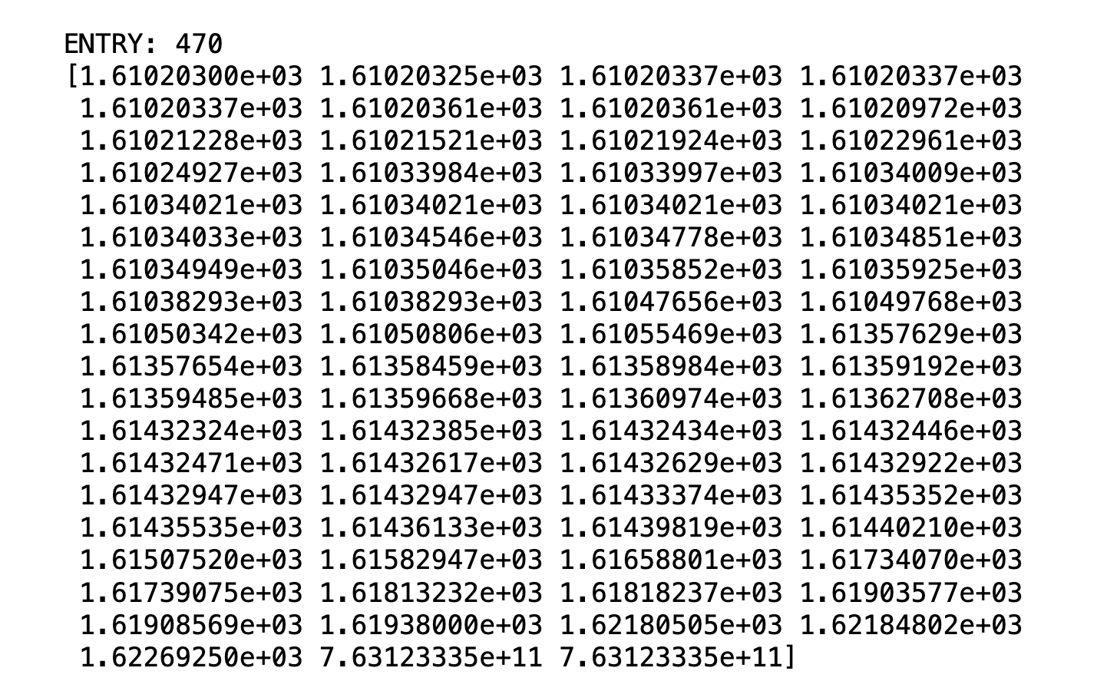
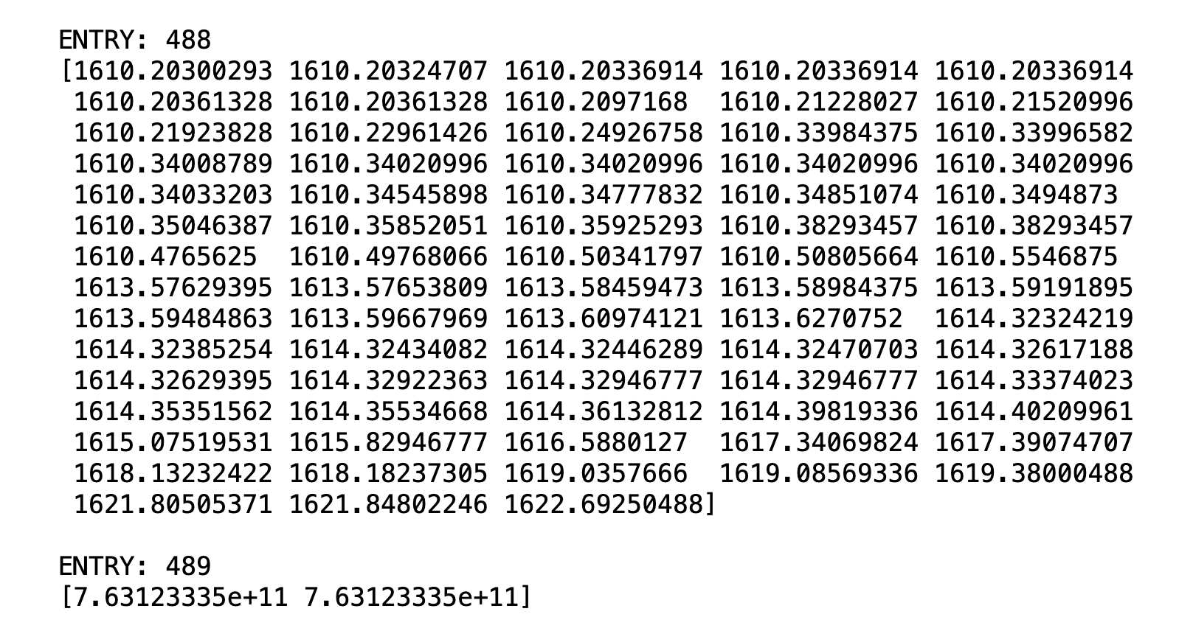
Progress
Mu Filter Point and SciFi Point data from the original file and their subbranches, as well as the content are properly stored in 25ns chunks.
0ne event original file for Mu Filter Point
Multiple events new file for Mu Filter Point
There are more entries in the final file!
Pedro Baculima – 04/08/2025
3

Slide 4
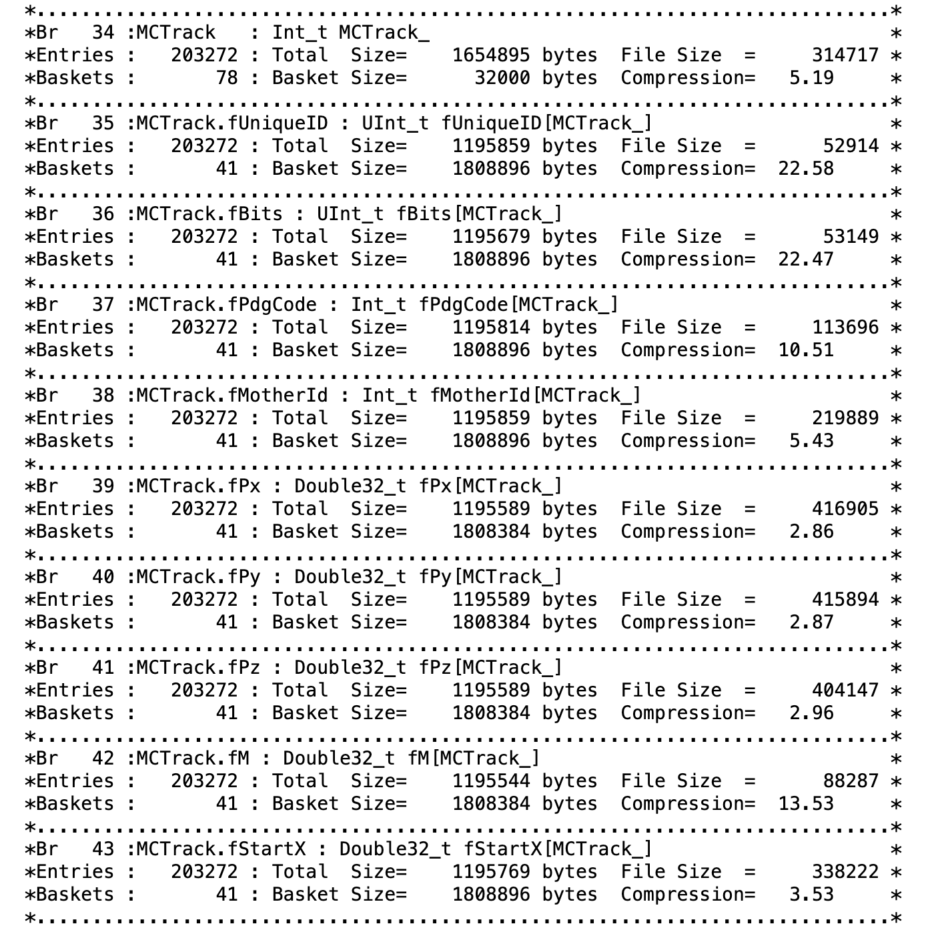
Progress
Started working with the MCTrack branch.
It contains all the information of the track that produced those points in the detector’s Mu and SciFi Planes (i.e. pdg code, starting coordinates, momentum).
For each entry, the Mu Filter and SciFi Points have a subbranch called TrackID, it corresponds to the index of the MCTrack class points.
Pedro Baculima – 04/08/2025
4

Slide 5
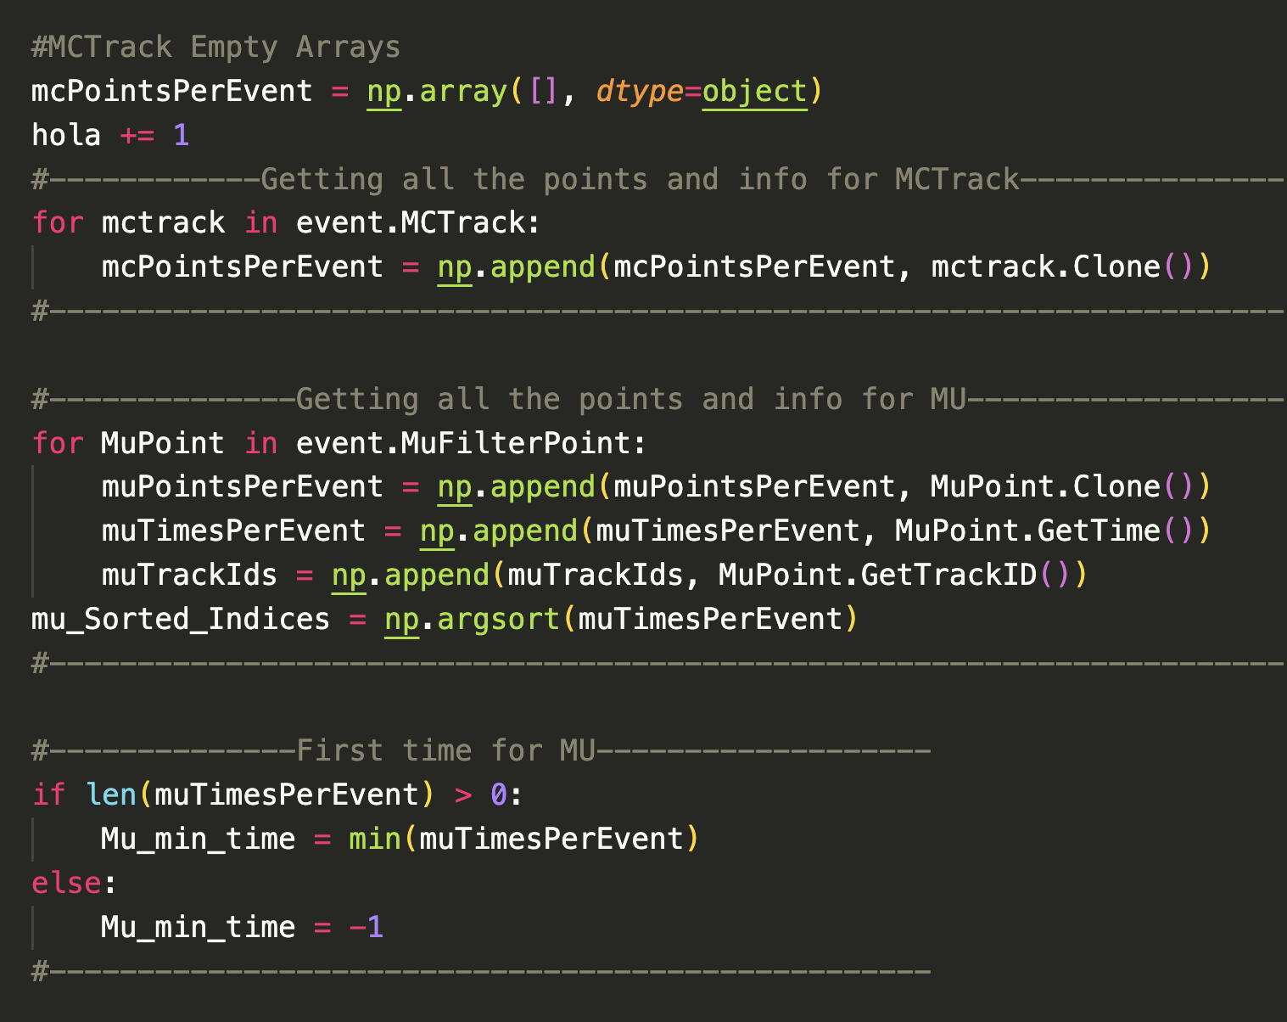
Main Issues
Not as complex as the previous ones.
Organizing my code and writing comments as it’s becoming too long (~400 lines).
Improving run-time efficiency by cutting/simplifying unnecessary code that I wrote initially to make sure I was doing the right thing (i.e. for loops)
🤠👍
Pedro Baculima – 04/08/2025
5

Slide 6
Next Steps
I will finish documenting my code soon.
I’m currently fixing some small errors in my code, but they do not affect the final output, it’s just a matter of time efficiency.
I will start soon working on building the Event Header, which has all the information regarding each event. Since what I do is split events in the original file into 25ns chunks in the new file, I need to duplicate and assign those Event Headers to the newly created events. The class format is a bit different, but I’m learning how to deal with it.
Pedro Baculima – 04/08/2025
6

Slide 7
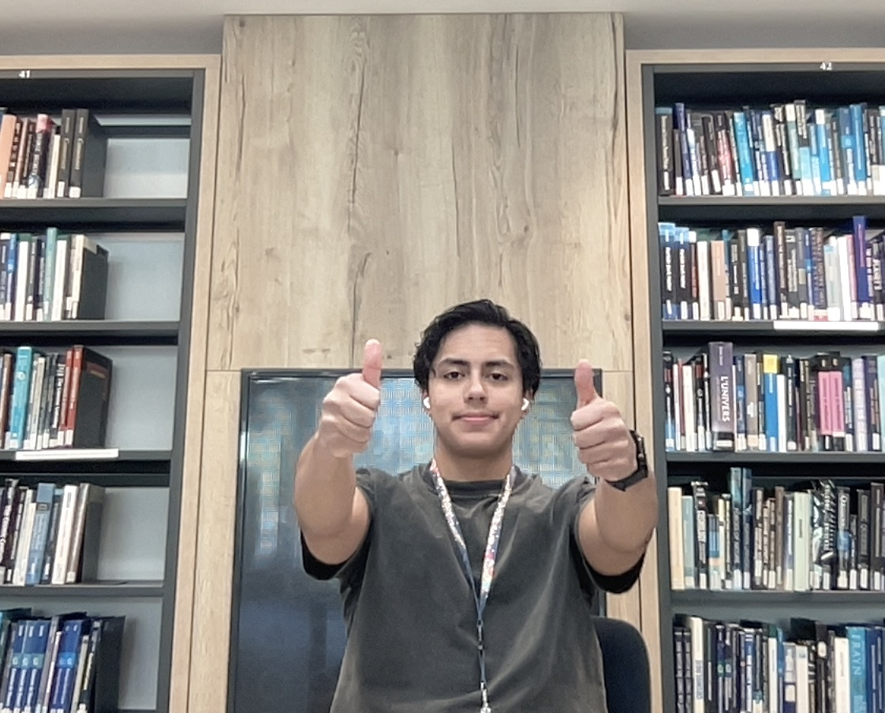
Other Updates
I’m feeling alive.
Looking forward testing my code in a real simulation file as the first draft of what it is my Event-Building code should be ready soon.
One of our group member’s contract ended so he’s not with us anymore at CERN.
Pedro Baculima – 04/08/2025
7

Slide 8
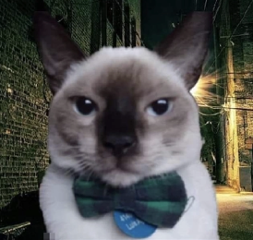
Thank you!
Pedro Baculima – 04/08/2025
8

