Slide 1


Slide 2
Motivation for ISAAC model magnet
J. García Matos, C. Martins, F. Toral (CIEMAT)
J.C. Pérez, E. Todesco (CERN)

Slide 3
Outline
HFM plans at CIEMAT
High field magnets based on common coil topology
Conclusions: why do we need ISAAC?

Slide 4
High Field Magnet Program at CIEMAT (as 2021)
CIEMAT is contributing to the High Field Magnet (HFM) program led by CERN. There is a Collaboration Agreement (KE3920) finishing at Feb’27. A Spanish funding agency (CDTI) is also contributing to this effort.
Initial constraints for the research on high field magnets at CIEMAT:
  Some delay to start the activity due to the workload driven by MCBXF magnets.
  The new laboratory will not be fully operational till the end of 2023.
  Previous work was focused on common coil layout (EuroCirCol).
Our proposal is based on the following steps:
  Model magnet using RMC coils in common coil configuration.
  Revisit the existing design of 16T common coil dipole magnet.
  Research on fabrication techniques: hybrid magnets, react-and-wind coils.
  Prototype of a high field magnet in common coil configuration.
4

Slide 5
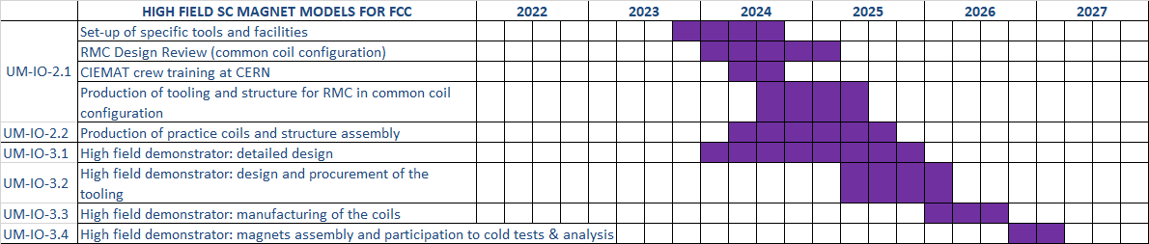
High Field Magnet Program at CIEMAT (as today)
In the amendment of the Collaboration Agreement, the field target for the demonstrator magnet is reduced from 16 to 14 T.
The status of the ongoing activities allow us to present this new schedule:

Slide 6
First High Field Magnets at CIEMAT
CIEMAT is contributing to the High Field Magnet (HFM) program led by CERN.
CIEMAT is working on high field magnets based on common coil topology, profiting from the lessons learned from EuroCirCol collaboration.
The target is to develop a prototype magnet able to provide 14 T at the aperture.
In a first step, CIEMAT is working on a model magnet (ISAAC) using existing coils produced by CERN. The aim is to learn about mechanics of high field magnets in common coil configuration. ISAAC means Investigating Superconducting Assembly to Address Common coil mechanics.
In a second step, we are developing DAISY: Demonstrator for Assembly Innovations in Superconducting common coil technologY. It honours Margarita Salas, an outstanding Spanish biologist (daisy is translated into Spanish as margarita).
DAISY coils will be the first ones made with Nb₃Sn cable in the new CIEMAT magnet laboratory (SMART-Lab: Superconducting MAgnet Research and Technology Laboratory).

Slide 7
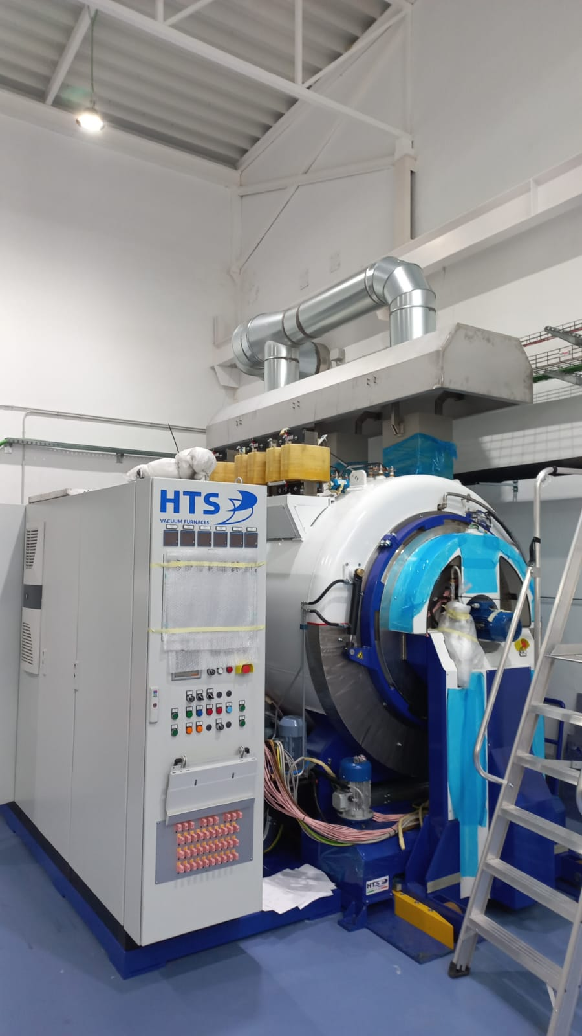
SMART-Lab commissioning
A large reaction furnace is being commissioned, suitable for moulds up to 2.5 m length.
A small reaction furnace is also available for small coils or cable samples. The commissioning is ongoing in parallel.
This equipment is procured in the framework of the Agreement KE-3920. Thank you very much to Juan Carlos for his dedication and support.

Slide 8
High field magnets (personal view)
The actual proposal for FCC-hh is based on 14 T main dipole magnets. Nowadays, the most convenient superconductor for a 14 T magnet is Nb₃Sn. It is strain-sensitive.
A 14 T dipole features 2.5 times the forces than a 9 T dipole.
The most difficult task for a magnet designer is to find the right solution for the given input parameters: a 14 T long dipole with 50 mm double aperture. Up to now, all the main dipoles of circular colliders are based on cos-theta layouts.
A 50 mm aperture is limiting the performance of curved coil geometries:
  Cos-theta or canted cos-theta coils are difficult to wind, due to the small bending radius at the coil ends.
  Block coils need flared ends.
Common coil topology is only valid for double aperture dipoles. It is based on simple coils, and the 50-mm-aperture diameter is not a limiting factor. But there are challenges to be solved…

Slide 9
Considerations about common coil high field magnets
For a given field and aperture, the stored energy and the electromagnetic forces are higher in a common coil magnet. Solving magnet protection and mechanics is the key to success in the development of a high field magnet.
Horizontal preload cannot be applied without a support structure around the aperture that decreases the magnet efficiency.
The aim of preloading superconducting coils is to limit the training and to achieve a good quality. Can we fulfil these objectives with a very rigid support structure? Is shell necessary?
The common coil configuration is intrinsically suited for grading with NbTi. A hybrid magnet would be potentially cheaper and feature lower AC losses and better stability at low fields.
The standard coils to achieve good field quality are curved… Asymmetric configuration proposed by PSI is very promising.

Slide 10
Why do we need ISAAC?
We dream to develop a high field magnet based on common coil topology. This layout is not deeply explored…. And even less in the last twenty years. Previous studies are needed before addressing a large prototype magnet.
We have accumulated delays, we are not ready yet to produce a large Nb₃Sn coil: ISAAC is based on existing coils.
We want to explore a new mechanical concept, based on a rigid support structure with low preload. Let’s learn on this feature using ISAAC!

