Slide 1


Slide 2
ISAAC Magnetic and Mechanical Design
J. García Matos, C. Martins, F. Toral (CIEMAT)
J.C. Pérez, E. Todesco (CERN)

Slide 3
Outline
ISAAC design baselines
ISAAC 2D design
  Magnetic design
  Mechanical design
ISAAC 3D design
  Magnetic design
  Quench protection
  Mechanical design
Conclusions

Slide 4
Outline
ISAAC design baselines
ISAAC 2D design
  Magnetic design
  Mechanical design
ISAAC 3D design
  Magnetic design
  Quench protection
  Mechanical design
Conclusions

Slide 5
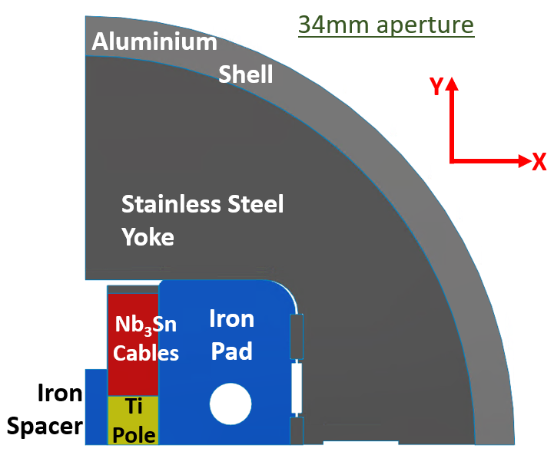
ISAAC design baselines
ISAAC: Investigating Superconducting Assembly to Address Common coil mechanics
Main goal: Learn for the 14 T demonstrator (DAISY) with existing coils, mostly on mechanics.
  Existing RMC coils made at CERN with MQXF strand.
  Provide ≈14 T in the 34-mm aperture (100% load). 50-mm aperture is possible to test insert HTS coils (also HFM aperture).
  No horizontal preload: no coil mechanical support in aperture side.
Free horizontal movement of the coil.
Horizontally-split yoke to hold large horizontal EM forces: rigid structure to limit coil horizontal displacement.
Assembly with bladder and keys, slight preload at room temperature just to keep contact between parts. In a second step, we could not use any shell.
Fixed Yoke and Shell for different apertures (34 mm & 50 mm): Pad & Spacer change.
Presentation focused on the 34 mm aperture configuration and 14T in the aperture (higher horizontal EMF).

Slide 6
Outline
ISAAC design baselines
ISAAC 2D design
  Magnetic design
  Mechanical design
ISAAC 3D design
  Magnetic design
  Quench protection
  Mechanical design
Conclusions

Slide 7
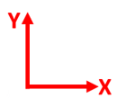
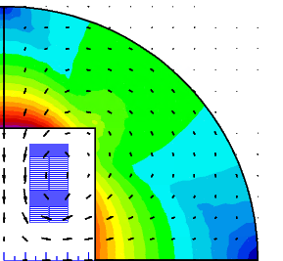
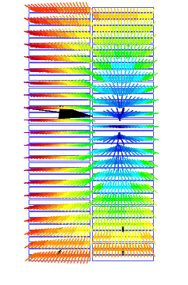
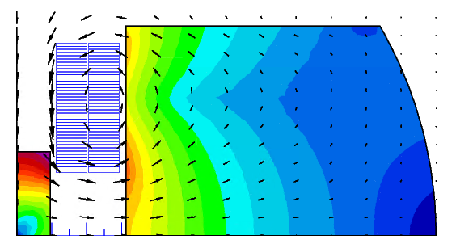
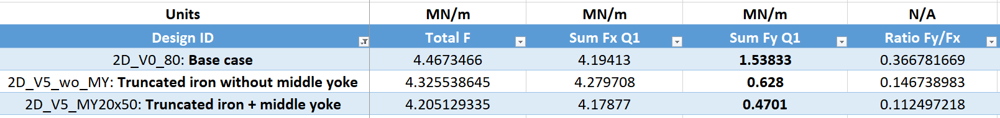
2D Magnetic design: vertical EMF
Goal: Vertical EMF towards the pole to allow free horizontal movement (without friction) of the coil.
Iron Pad near the midplane of the magnet pulls the field lines in the desired direction. To provide good horizontal support the Iron Pad must be truncated above the coil: Vertical EMF reduced, but still pulls the cables up from the pole.
Iron Spacer helps to decrease vertical EMF significantly and enhances the aperture field. Having an iron Pole in the coils will also be helpful (not possible with the existing RMC coils).
Truncated yoke

Slide 8
2D Magnetic design: field quality vs coil position
Aperture decreased from 50 mm to 34 mm to reach 14T in the aperture.
Intra-beam distance tuned to decrease a2: 149.6 mm.
mm | T | units | units | units | units | units | units | units | units | %
Displ. X | Aperture field | b3 | b5 | b7 | b9 | a2 | a4 | a6 | a8 | % B
0 | 13.999139 | 297.12975 | 0.74637 | 2.18884 | -0.52826 | 3.02079 | -25.65207 | -1.53509 | 1.44829 | 0
0.5 | 13.863671 | 297.03506 | 1.08324 | 2.19718 | -0.53572 | 1.49924 | -25.94459 | -1.55069 | 1.46195 | -0.96768808
1 | 13.729701 | 296.82646 | 1.42133 | 2.20147 | -0.5382 | -0.00928 | -26.23901 | -1.56249 | 1.47012 | -1.92467551
1.5 | 13.597258 | 296.50431 | 1.75736 | 2.20814 | -0.54216 | -1.50665 | -26.53531 | -1.57543 | 1.4797 | -2.87075512
With a coil horizontal displacement of 0.5 mm:
  Aperture Field decreases only by about 1%.
  Multipoles variation below 0.5 units except for a2 (1.5 units).
  Reduce the possibility of sudden coil movements: avoid quenches.
Goal: limit the coil horizontal displacement below 0.5 mm.
Outer Iron Pad diameter can be reduced without significant impact on the aperture field.

Slide 9
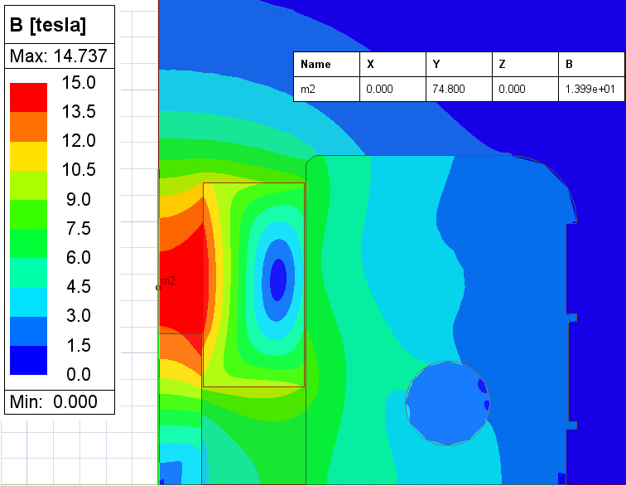
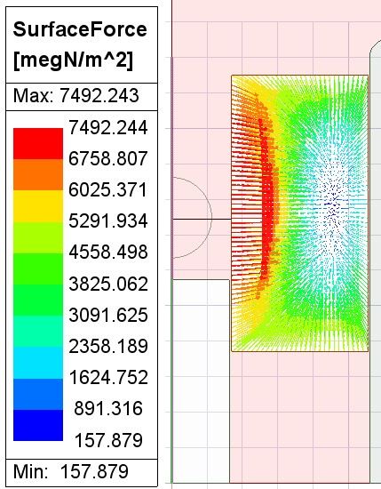
2D Magnetic design
Field (B)
34mm aperture
Parameter | Conf.#1 |  | Conf.#2 |  | Units
Aperture | 34 |  | 50 |  | mm
Nominal current | 19340 |  | 20728 |  | A
 | Roxie | Maxwell | Roxie | Maxwell
Magnetic length | 0.55 | - | 0.55 | - | m
WorkPoint on LoadLine | 100.6 | - | 100.4 | - | %
Stored energy | 1049 | - | 1357 | - | kJ/m
Aperture Field | 14.04 | 13.99 | 12.74 | 12.70 | T
Peak Field | 14.85 | 14.74 | 14.45 | 14.32 | T
Field ratio | 1.06 | 1.05 | 1.13 | 1.13 | -
F_{x} (Q1) | 6.56 | 6.40 | 5.98 | 5.83 | MN/m
F_{y} (Q1) | 0.45 | 0.44 | 0.85 | 0.83 | MN/m
Coil Cable EMF
34mm aperture
Parameter | Conf.#1 | Conf.#2 | Units
Aperture | 34 | 50 | mm
Nominal current | 16264 | 19410 | A
Aperture Field | 12 | 12 | T
WorkPoint on LoadLine | 85.5 | 94.3 | %

Slide 10
Outline
ISAAC design baselines
ISAAC 2D design
  Magnetic design
  Mechanical design
ISAAC 3D design
  Magnetic design
  Quench protection
  Mechanical design
Conclusions

Slide 11
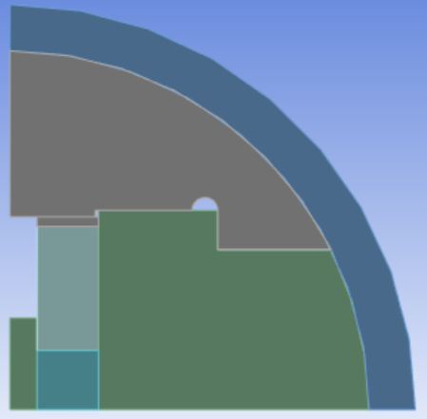
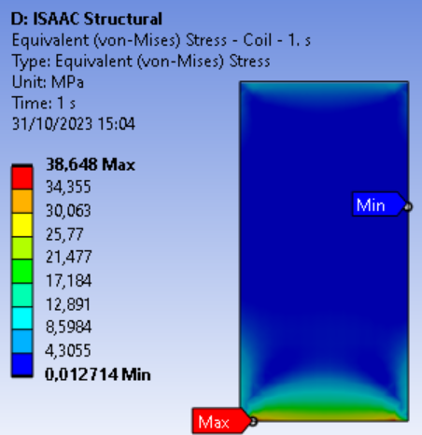
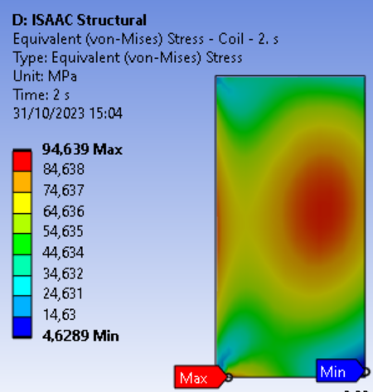
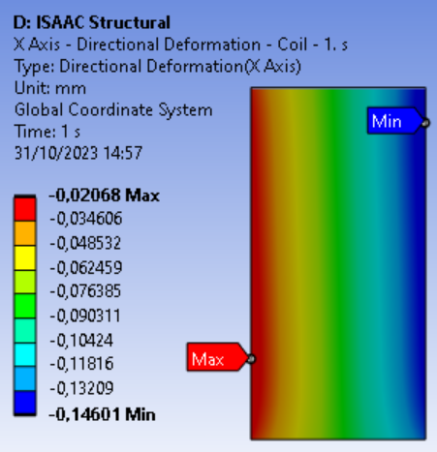
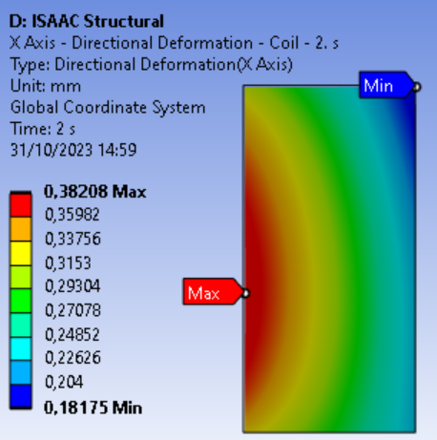
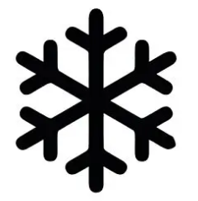
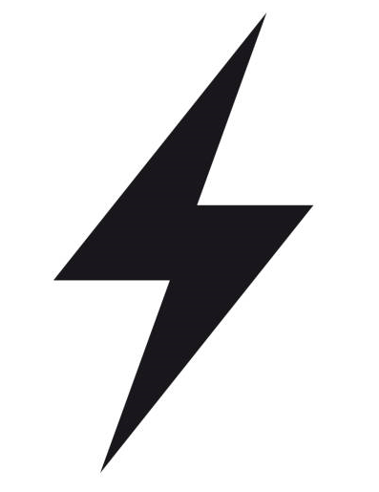
2D Mechanical design: first model
34 mm aperture
Use of the stainless steel yoke as a support structure.
Iron Pad and aluminium shell help to hold the large horizontal EMF.
Coil will lose contact with the iron spacer during cooling down: move horizontally without friction.
Assembly with bladder and keys not modeled.
Slight preload just to keep contact between parts at RT:
  Vertical contact btw. Yoke and Pad, also in contact at cold.
  Vertical contact btw. Yoke and Coil, gap at cold.
Contacts btw components:
Coil: bonded
Magnet: frictionless
Horizontal displacement due to EMF below 0.5 mm (inner face: 0.41 mm / outer face 0.33 mm)
Coil stress below 95 MPa!!

Slide 12
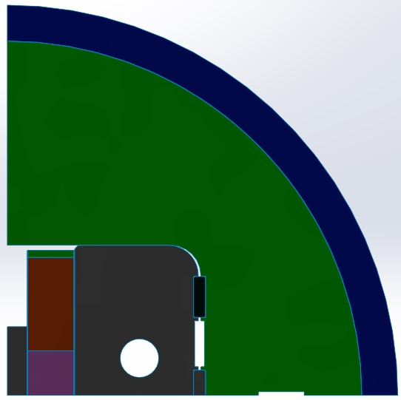
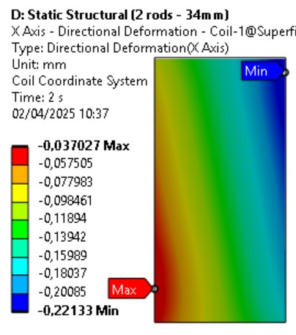
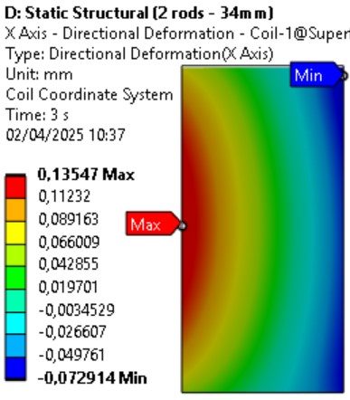
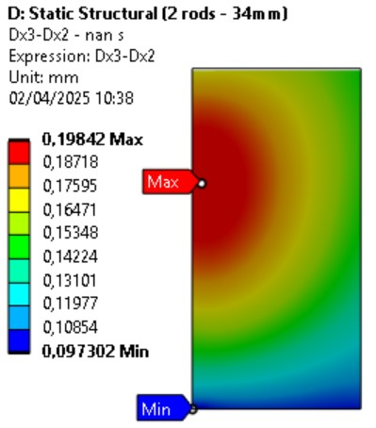
2D Mechanical Design: second model (I)
34 mm aperture
One Ø31 (M30) mm Rod per quadrant.
Shell dimensions: Ø Outer: 650 mm. Thickness: 30 mm (Ø Inner: 590 mm).
Bladders and keys considered.
No preload at room temperature (keys in contact).
Pad horizontal dimension reduced (no impact in aperture field).
Stiffer stainless steel Yoke (Horizontally-split).
Horizontal displacement due to EMF below 0.2 mm

Slide 13
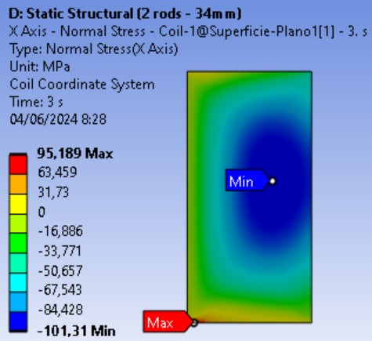
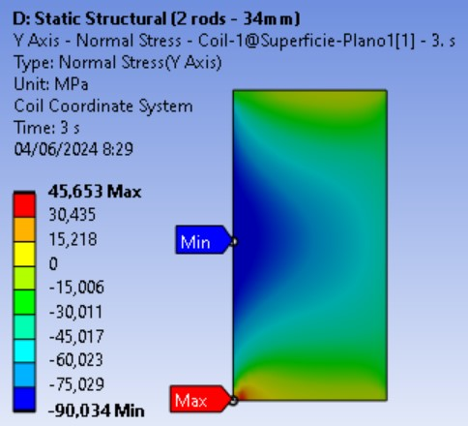
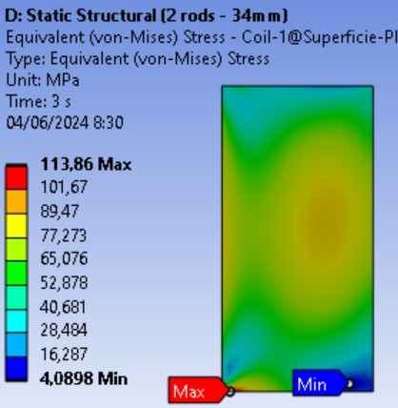
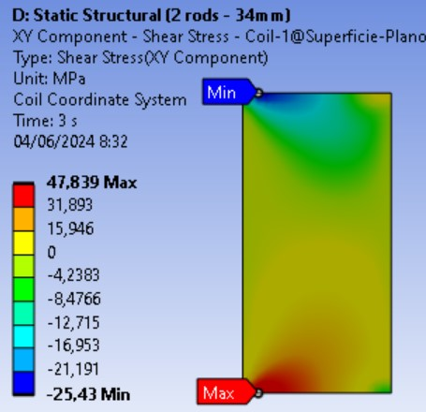
2D Mechanical Design: second model (II)
34 mm aperture
Compression/Tension:
@RT: -120 MPa <-> 20 MPa
@Cold: -150 MPa <-> 20 MPa
Shear @RT & Cold:
-45 MPa <-> 45 MPa
Main concern: Pole turn detaching due to Vertical (Y) and Shear Stress
EMF
Short intrabeam distance induces repulsive vertical forces, that is, vertical tensile stress at pole turn.
But… what is causing the shear stress?

Slide 14
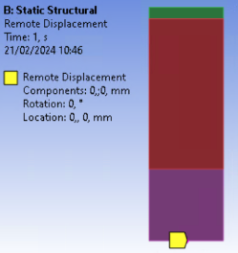
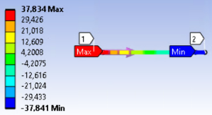
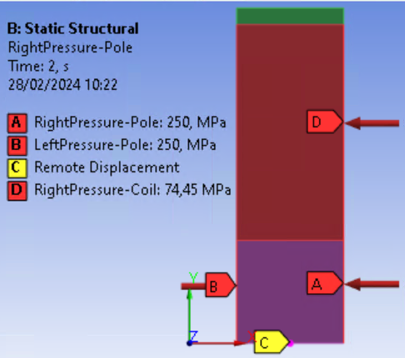
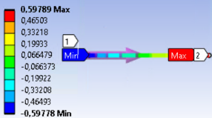
2D Mechanical design: Only-Coil model (shear stress)
Model with only the coil, boundary conditions replace the magnet components.
Fixed point at the center of the pole symmetry line is considered.
Model with no external loads
Model with external loads: minimum shear stress
  Shear Stress @ Pole-Cables transition
(MPa)
  Shear Stress @ Pole-Cables transition
(MPa)
  Thermal contraction:
  Pole (Titanium): 1.7 mm/m
  Coil (Nb₃Sn): 3~4 mm/m
Shear stress after cooldown is about 38 MPa -> Most of the shear stress appearing in ISAAC (47.8 MPa in powering) is due to the different thermal contraction between the cables and the pole.
250 MPa (A & B) during cooldown compensate for the different thermal contractions between cables - pole

Slide 15
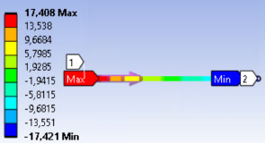
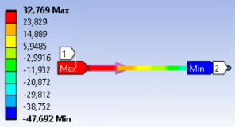
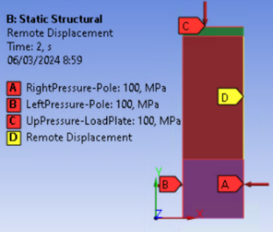
2D Mechanical design: Only-Coil model for ISAAC
Moderate preload, considering Nb3Sn stress limits (120 MPa at RT).
Support on the right side of the coil: Pad (no horizontal displacement, free in vertical).
100 MPa (A, B & C) during cooldown compensate for the different thermal contractions between cables - pole
Horizontal support (D) during powering to balance out the EMF arising over the coil
&
A significant shear stress is induced at the pole turn due to the glued titanium pole:
Can be reduced by applying horizontal preload only to the pole (both sides).
Vertical preload applied to the coil also helps to reduce shear stress (Poisson effect).

Slide 16
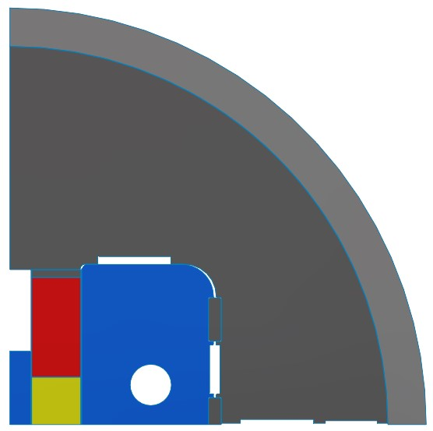
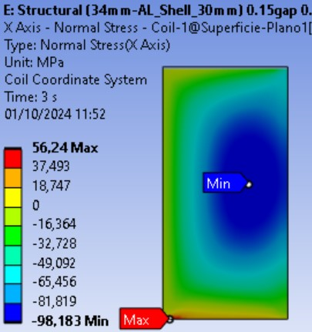
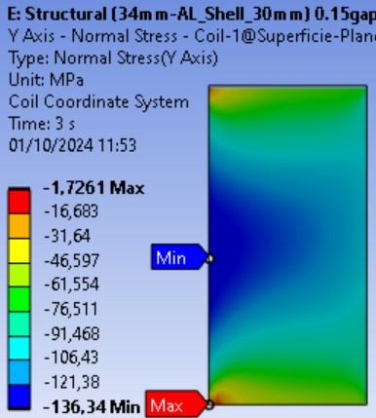
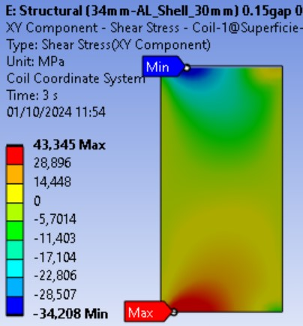
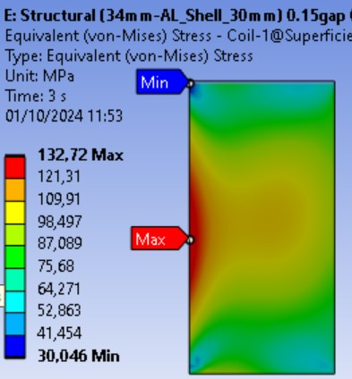
2D Mechanical Design: Vertical preload
To reduce the shear stress at the pole turn due to the glued titanium pole in ISAAC:
No easy way to apply horizontal preload only to the pole.
Some vertical preload can be applied to the coil (Poisson effect). It also helps to reduce vertical stress.
Vertical interference Coil - Yoke at RT of 0.2 mm.
This is NOT our original target: free horizontal movement of the coil.
Compression/Tension:
@RT: -120 MPa <-> 20 MPa
@Cold: -150 MPa <-> 20 MPa
Shear @RT & Cold:
-45 MPa <-> 45 MPa
Only compressive vertical stress (no tension).
Maximum shear stress is slightly reduced.
Horizontal tension stress is reduced.
VM equivalent stress is 133 MPa (below the limit of 150 MPa).

Slide 17
Outline
ISAAC design baselines
ISAAC 2D design
  Magnetic design
  Mechanical design
ISAAC 3D design
  Magnetic design
  Quench protection
  Mechanical design
Conclusions

Slide 18
3D Design: Iron length
The spacer and the pad can be made of iron. Which length?
Same integral Field in all cases.
Peak Field lower with no iron in pad and spacer in coil heads.
Field Ratio lower when the Peak Field is in the straight section.
The efficiency generating the field is better with more iron.
With more iron to reinforce the field the margin is higher.
The stored magnetic energy decreases with more iron volume (easier protection).
The mechanical structure is subjected to less horizontal load with more iron.
A full iron pad provides better support to the large outwards horizontal EMF.
The best-balanced is Case #6: Pad entirely made of iron (820 mm) and iron Spacer in SS+S1 (central part: 420 mm)

Slide 19
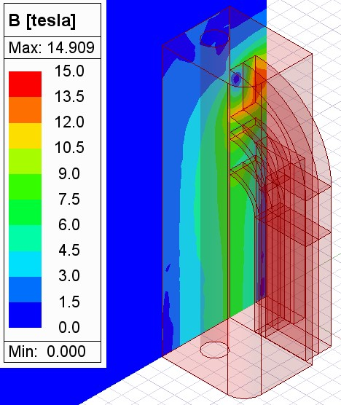
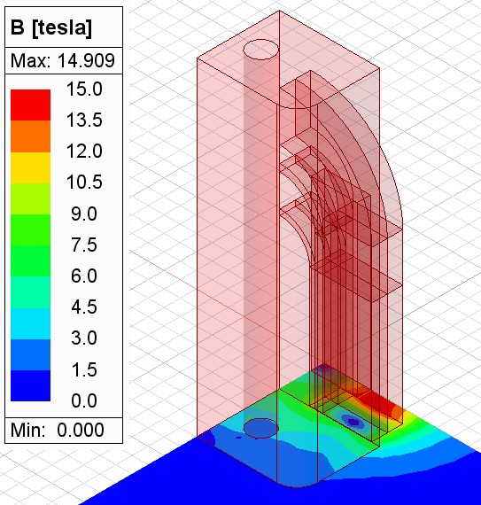
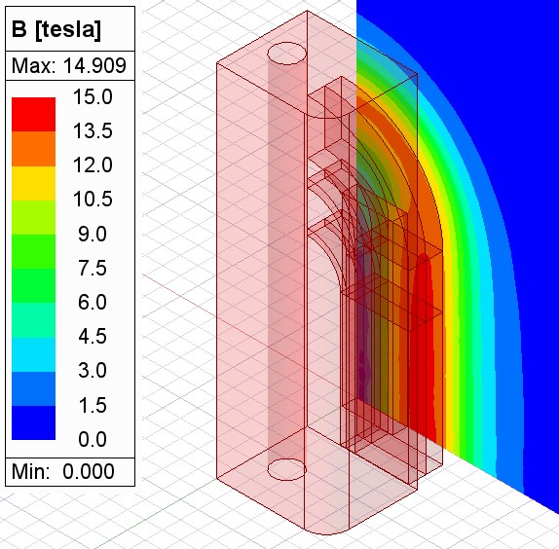
3D Magnetic Design
EMF per quadrant
Nominal current: 19340 A
Aperture Field: 14.069 T
Axial EMF: 296 kN per quadrant
XZ
XY
YZ

Slide 20
Outline
ISAAC design baselines
ISAAC 2D design
  Magnetic design
  Mechanical design
ISAAC 3D design
  Magnetic design
  Quench protection
  Mechanical design
Conclusions

Slide 21
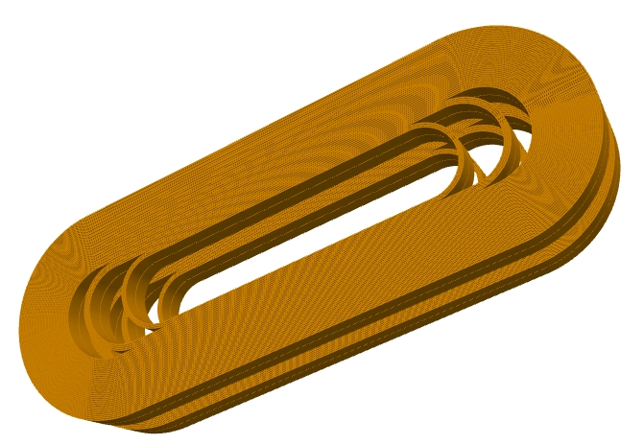
Quench protection
 | No iron | SS only | Complete
Integrated field [Tm] | 12.72 | 13.81 | 13.9
Magnetic length [m] | 0.554 | 0.536 | 0.55
The 3D Roxie model provided a magnetic length close to 0.55 m using different 3D iron configurations, so this is the value used on all quench computations.
Comparing 2D and 3D Roxie computations, the peak field value is slightly higher on 2D, so 2D data have been used for all quench computations.
Quench computation has been performed using QP-sheet [1] for fast feedback on the worst-case hot spot temperature (adiabatic assumption). Roxie23 is used for the calculation of the magnetic field distribution and the differential inductance.
Protection strategy consist in an external dump resistor for a 1kV maximum voltage.
Parameter | Conf.#1 | Conf.#2 | Conf.#1 (12 T) | Conf.#2 (12 T) | Units
Aperture | 34 | 50 | 34 | 50 | mm
Nominal current | 19340 | 20728 | 16264 | 19410 | A
Aperture Field | 14.04 | 12.74 | 12 | 12 | T
Stored energy | 1049 | 1357 | 754 | 1196 | kJ/m
Differential L | 5.34 | 6.04 | 5.38 | 6.05 | mh/m
Energy density | 90 | 116.4 | 64.7 | 102.6 | J/cm³
Detection delay | 40 | 30 | 40 | 40 | ms
R dump | 49.2 | 45.9 | 58.6 | 49.1 | mΩ
Hot Spot T | 295 | 291 | 110 | 242 | K
[1] T.Salmi et al., “Quench protection analysis integrated in the design of dipoles for the Future Circular Collider” Mar. 2017

Slide 22
Outline
ISAAC design baselines
ISAAC 2D design
  Magnetic design
  Mechanical design
ISAAC 3D design
  Magnetic design
  Quench protection
  Mechanical design
Conclusions

Slide 23
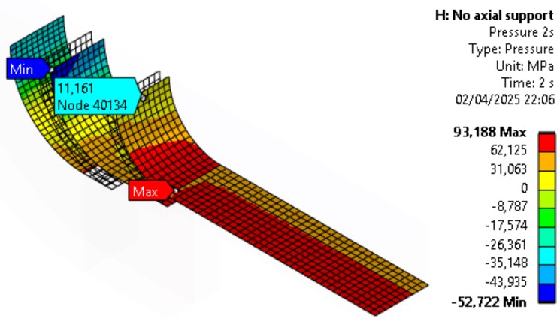
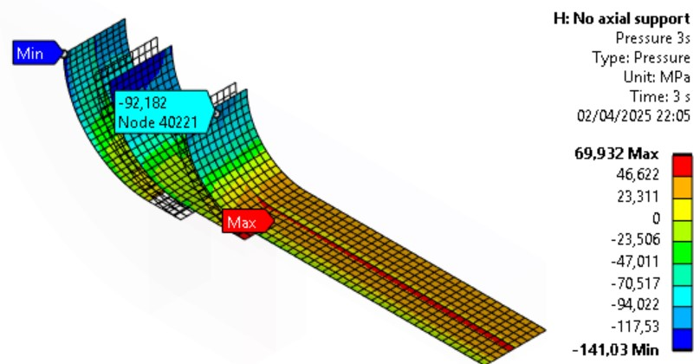
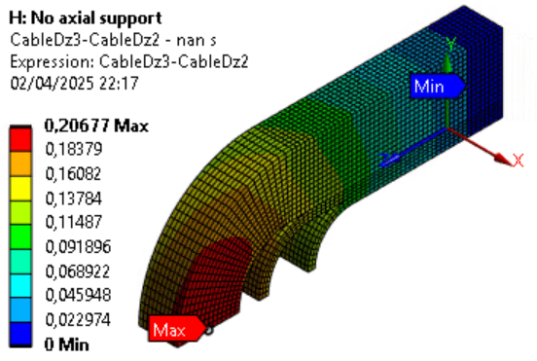
3D Mechanical Design: Axial behavior (no preload)
The pole turn is glued to the titanium pole. When the magnet is cooled down, as the cables contract more than the pole, the cables are under tensile stress and the pole under compression:
  Contact pressure of the cables with pole/spacers mostly positive: Closer.
When the magnet is powered, the axial EMF (296kN per quadrant) try to detach the cables from the pole:
Contact pressure of the cables with pole/spacers turns to negative on the coil heads: Separation.
Small axial displacement of the cables due to the EMF due to glued pole (0.21mm).
  Thermal contraction:
  Pole (Titanium): 1.7 mm/m
  Coil (Nb₃Sn): 3~4 mm/m

Slide 24
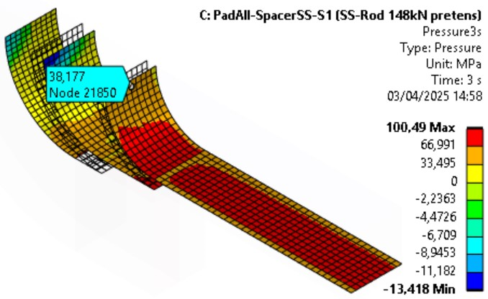
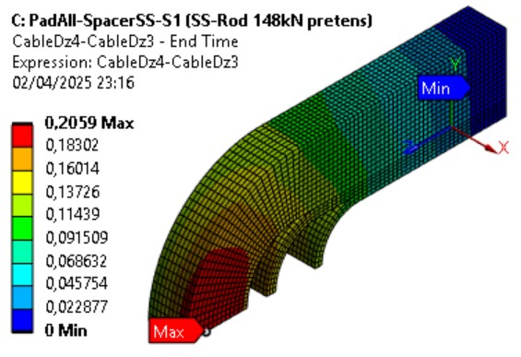
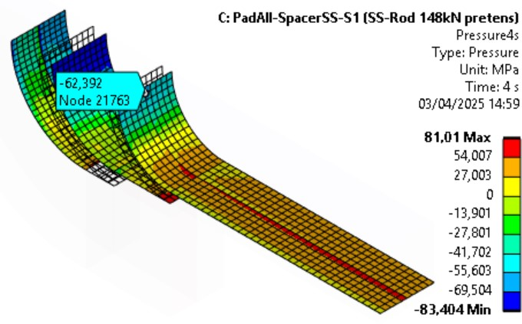
3D Mechanical Design: Axial behavior (preload)
Axial preload per Ø31 (M30) stainless steel rod (quadrant): 148 kN.
When the magnet is cooled down and when it is powered, the contact pressure of the cables with pole/spacers is more positive than without preload: More contact (closer).
Same axial displacement of the cables due to the EMF than without preload: 0.21 mm.
axial EMF: 296kN (per quadrant)
Axial preload changes stress distribution but not the axial displacements (coil components bonded).
The contact pressure is still negative (cable detach), but these results are for 100% loadline (14T in the aperture)….

Slide 25
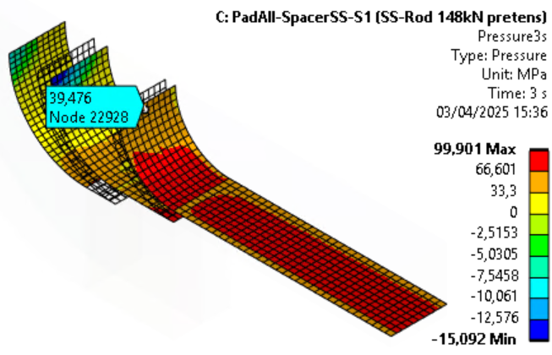
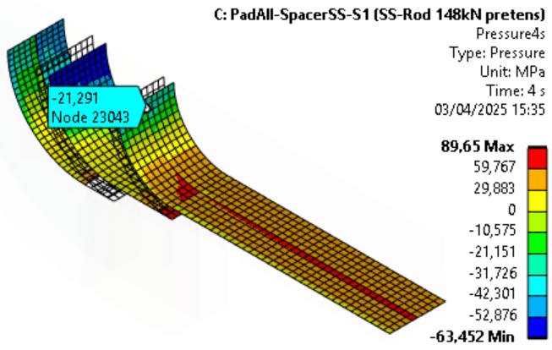
3D Mechanical Design: Axial behavior (12T)
axial EMF: 296kN (per quadrant)
These results are for 100% loadline (14T in the aperture).
For 12T (85,5%), the EMF are 27% lower and the tensional stress is lower.
14T
14T
12T
12T

Slide 26
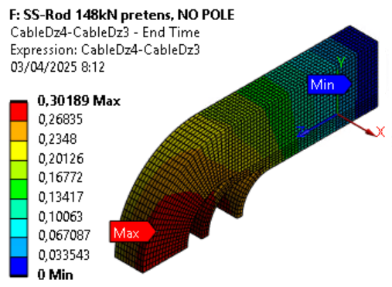
3D Mechanical Design: Axial support structure
With no pole in the coil (148 kN axial preload per Ø31 rod): Axial displacements due to the EMF are higher than with glued pole (from 0.2mm to 0.3mm).
With cables bonded to the titanium pole, the axial displacements are limited.
ISAAC has a low transversal preload, that is, low friction between magnet components. It is better to have an axial rigid structure to avoid “stick-slip” due to low friction:
  Material of the rods: stainless steel (instead of aluminium).
  Diameter of the rods increased from Ø31 (M30) to Ø34 (M33).
axial EMF: 296kN (per quadrant)
Simulations with coil components bonded (impregnated coil) -> the Axial EMF seen by the rods is low:
  With aluminium rods, Ø31 (M30), 148kN preload:
    Part of the EMF(z) seen by the rod: 28 kN (9%)
  With stainless steel rods, Ø31 (M30), 148kN preload:
    Part of the EMF(z) seen by the rod: 41 kN (14%)
Simulations with not bonded contacts btw. cables and pole/spacers to understand the behavior of detached cables on going.

Slide 27
Outline
ISAAC design baselines
ISAAC 2D design
  Magnetic design
  Mechanical design
ISAAC 3D design
  Magnetic design
  Quench protection
  Mechanical design
Conclusions

Slide 28
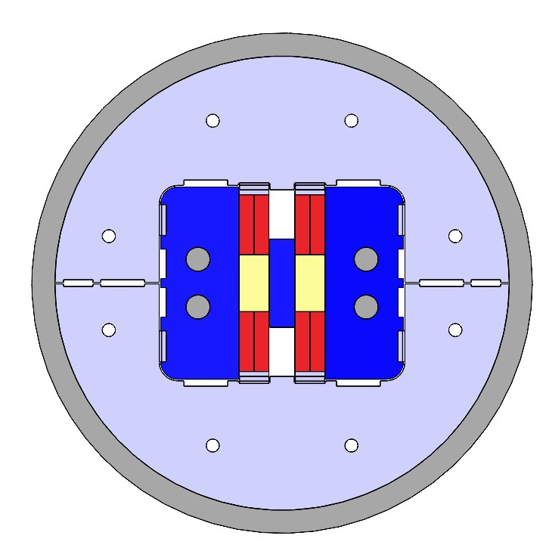
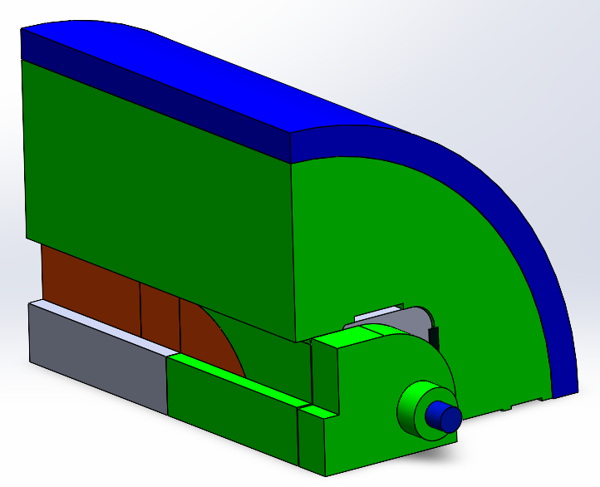
Conclusions & Learned lessons
ISAAC is a model magnet made using existing RMC coils (learn mostly about mechanics).
2D and 3D magnetic and mechanical analysis done show coherent results.
Glued titanium pole induces large shear and horizontal stresses at pole turn. No simple way to reduce them.
Short intrabeam distance contributes to the vertical tensile stress at the pole turn.
Mechanics based on a low preload concept:
  Horizontal preload over the coil is difficult to apply, but a rigid support structure allows small coil displacements.
  Coil vertical preload (0.2 mm interference with yoke) to reduce vertical and shear stress (avoid cable detaching from pole).
The axial displacement of the cables due to the EMF is limited due to the glued pole. Axial preload changes stress distribution but not the axial displacements.
Rigid axial support with Ø34 (M33) stainless steel rods, preload level under study.
Simulations with not bonded contacts btw. cables and pole/spacers to understand the behavior of detached cables on going.
Simulations for 12T (85.5% load-line) on going .

Slide 29
References
G. Vallone et al., "A Review of the Mechanical Properties of Materials Used in Nb3Sn Magnets for Particle Accelerators" in IEEE Transactions on Applied Superconductivity, vol. 33, no. 5, pp. 1-6, Aug. 2023, Art no. 4002806, doi: 10.1109/TASC.2023.3248544
F. Toral et al., “WP3.7 - Nb3Sn ultimate performance common coil dipole demonstrator – CIEMAT”, HFM Annual Meeting 2023, CERN, Geneva, Switzerland, Nov. 2023
F. Toral et al., “ISAAC, a first common coil with RMC coils: Features and plans”, HFM Forum Meeting -
CIEMAT and PSI Common Coils, CERN, Geneva, Switzerland, Mar. 2024
C. Martins et al., “Progress on the mechanics of ISAAC magnet” 7th Common-Coils Joint Meeting, CERN, Geneva,
Switzerland, Mar. 2024
J. A. García-Matos et al., "Design of a Common Coil Magnet Using Existing Racetrack Model Coils (RMC)“, in IEEE Transactions on Applied Superconductivity, vol. 34, no. 5, pp. 1-5, Aug. 2024, Art no. 4300105, doi: 10.1109/TASC.2023.3336624
C. Martins Jardim et al., "Mechanical Design of a Common Coil Magnet With RMC Coils (ISAAC)“, in IEEE Transactions on Applied Superconductivity, vol. 35, no. 5, pp. 1-5, Aug. 2025, Art no. 4002705, doi: 10.1109/TASC.2025.3537063

Slide 30
Thanks for your attention

Slide 31
Extra slides

Slide 32



Maxwell 2D - 34mm aperture
Intrabeam⁽¹⁾: 149.6 mm
Nominal Current: 19340 A
Peak Field: 14.74 T
Aperture Field: 13.99 T
Middle Yoke height (Q1): 57.3 mm (0.5mm to aperture)
⁽¹⁾: a2 optimization

Slide 33



Maxwell 2D - 50mm aperture
Intrabeam⁽¹⁾: 149.6 mm
Nominal Current: 20728 A
Peak Field: 14.32 T
Aperture Field: 12.70 T
Middle Yoke height (Q1): 49.3 mm (0.5mm to aperture)
⁽¹⁾: a2 optimization

Slide 34




2D Mechanical design: first model results
Horizontal coil displacement below 0.5 mm
COOLING
X displacement
Y displacement
Total displacement
COOLING + EM

Slide 35



2D Mechanical design: first model results
Coil stress below 95 MPa!!
No significant problems for the structural parts.
COOLING
COOLING + EM

Slide 36

2D Mechanical design: second model
Both keys in contact @ room temperature (20ºC). Cooling up to 1.9K. 34mm aperture
Max. Horizontal Coil Displacement (X) due to EMF: 0.2 mm
Max Stress @ Coil (Cooling + EMF):
  Max X Stress @ Coil: 95.2 MPa (-101.3 MPa)
  Max Y Stress @ Coil: 45.7 MPa (-90.0 MPa)
  Max VM Stress @ Coil: 113.9 MPa
  Max Shear Stress @ Coil: 47.8 MPa (located @ Pole – Coil transition)
Coil Displacement due to EMF

Slide 37





2D Mechanical design: second model
Both keys in contact @ room temperature (20ºC). Cooling up to 1.9K. 50mm aperture
Max. Horizontal Coil Displacement (X) due to EMF: 0.16 mm
Max Stress @ Coil (Cooling + EMF):
  Max X Stress @ Coil: 94.2 MPa (-101 MPa)
  Max Y Stress @ Coil: 52.7 MPa (-99.4 MPa)
  Max VM Stress @ Coil: 113.9 MPa
  Max Shear Stress @ Coil: 48.4 MPa (located @ Pole – Coil transition)
Coil Displacement due to EMF

Slide 38

2D Mechanical design: vertical preload
Max. Horizontal Coil Displacement (X) due to EMF: 0.23 mm
Max Stress @ Coil (Cooling + EMF):
  Max X Stress @ Coil: 56.2 MPa (-98.2 MPa)
  Max Y Stress @ Coil: -1.7 MPa (-136.3 MPa)
  Max Shear Stress @ Coil: 43.3 MPa (located @ Pole – Coil transition)
  Max VM Stress @ Coil: 132.7 MPa
Coil Displacement due to EMF

Slide 39




3D Mechanical Design: Axial behavior (no preload)
The pole turn is glued to the titanium pole. When the magnet cools down:
Pole under axial compression
Cables under axial tensile stress
  Thermal contraction:
  Pole (Titanium): 1.7 mm/m
  Coil (Nb₃Sn): 3~4 mm/m
Model without axial preload
Pole under axial tensile stress
Cables under more axial tensile stress

Slide 40




3D Mechanical Design: Axial behavior (preload)
Compared to no preload case
Higher axial compression
Lower less axial tensile stress
Model with 148 kN axial preload per stainless steel rod
Lower axial tensile stress
Lower axial tensile stress

