Slide 1
BLM simulations for the FCC-ee
Simulation Results and Future Work
Fabian Titz, Belen Salvachua (SY-BI-BL)
In collaboration with Anton Lechner and Barbara Humann (SY-STI-BMI)
April 10, 2025

Slide 2
Table of contents
Motivation and Objectives
Introduction to FLUKA and flair
Geometry: FCC-ee Arc Half-Cell Simulation Setup
Input parameters
Results
Future plans

Slide 3
Motivation and Objectives
Motivation:
Protect machine components from damage and monitor performance
Potential beam energy density in the FCC can be very high (Z-pole configuration is comparable in order of magnitude to HL-LHC)
Objectives:
Provide some basic parameters and ideas for the BLM setup used for the FCC-ee (e.g. which type of BLM and the spacing between BLMs)
focusing on the BLMs along the arc
Roughly quantify how many BLMs are needed for the FCC-ee

Slide 4
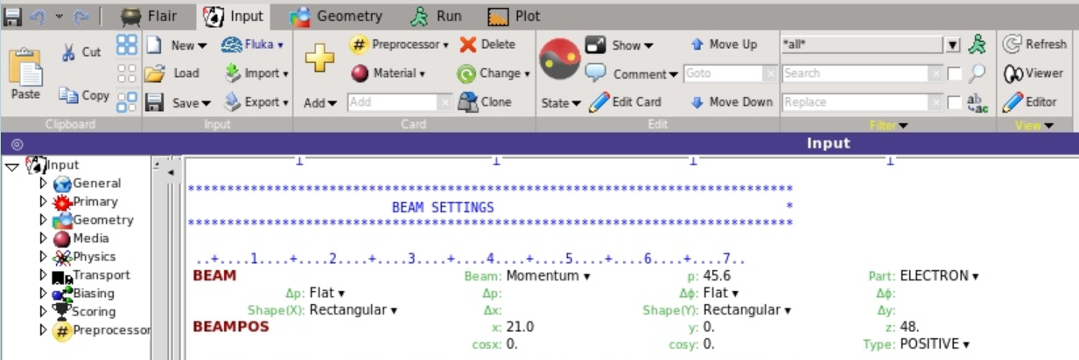
Introduction to FLUKA and flair
FLUKA (https://fluka.cern/): Monte Carlo code for the interaction and transport of particles in matter
Flair (https://flair.web.cern.ch/): advanced user-friendly interface for several Monte Carlo codes, such as FLUKA

Slide 5
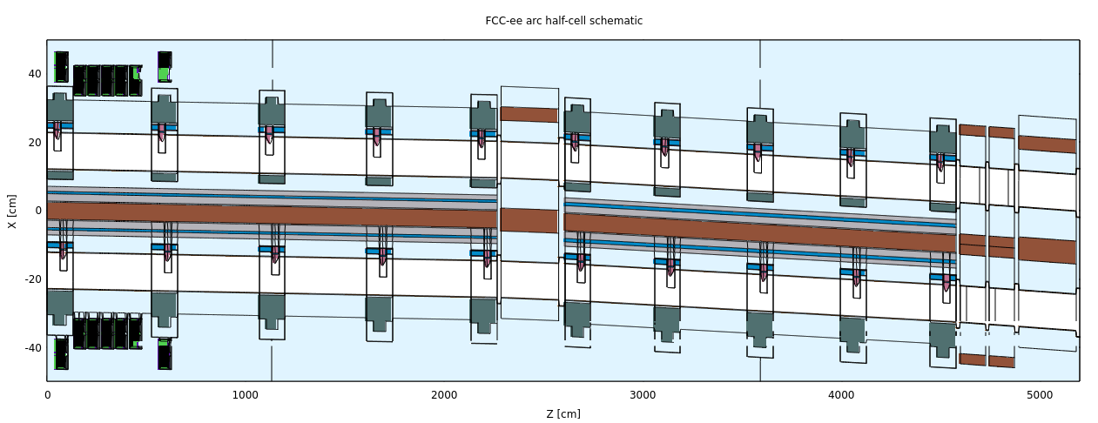
Geometry: FCC-ee Arc Half-Cell Simulation Setup
FCC-ee arc half-cell setup: special thanks to Anton Lechner and Barbara Humann

Slide 6
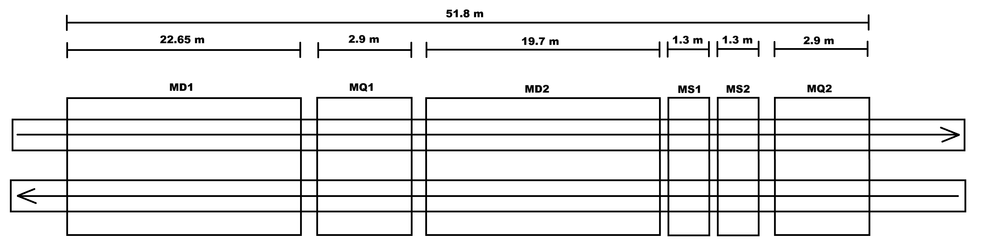
Geometry: FCC-ee Arc Half-Cell Simulation Setup
Schematic view of the FCC-ee arc half-cell (Z-pole configuration):

Slide 7
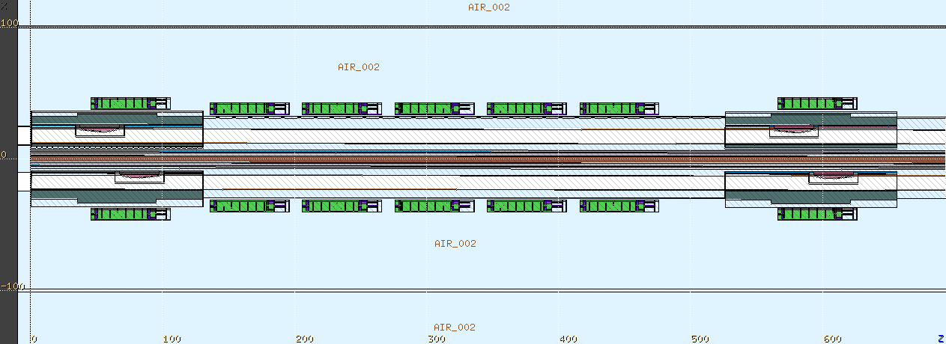
Geometry: FCC-ee Arc Half-Cell Simulation Setup
View of the IC BLM setup for the simulations (horizontal plane).
In the vertical plane, the IC BLMs are on the same Z values as those in the horizontal plane.

Slide 8
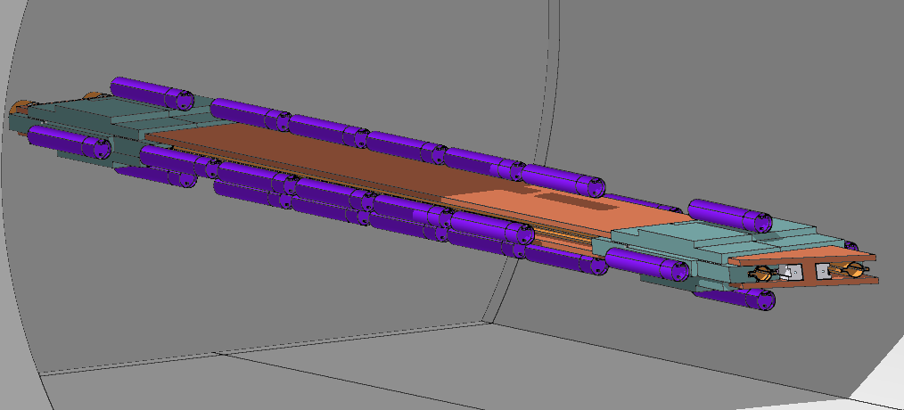
Geometry: FCC-ee Arc Half-Cell Simulation Setup
3D view of the first dipole section:

Slide 9
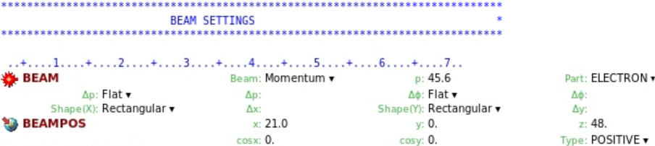
Input parameters
Beam parameters:
Pencil beam
Start parameters: x = 21.0 cm, z = 48.0 cm, p = 45.6 GeV, going straight in positive z-direction
Impacting the first absorber in the radiation shielding region

Slide 10
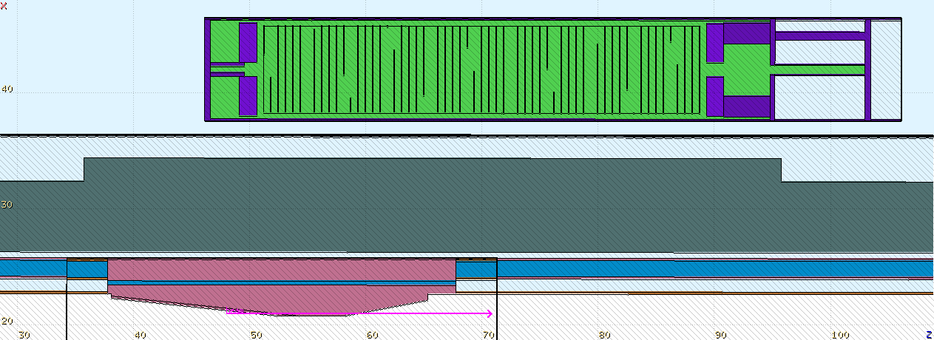
Input parameters
Impact point of the beam on the beam absorber in the geometric viewer

Slide 11
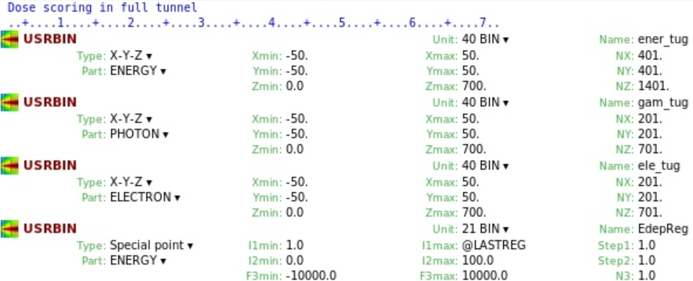
Input parameters
Scoring of the energy deposition:
X-Y-Z mesh: score energy deposition in small cubes (bins), the quantities will be normalized to GeV/cm^3 per primary instead of the bin size
Region (here: Special point): Scores the total Energy deposition in a region, GeV per primary

Slide 12
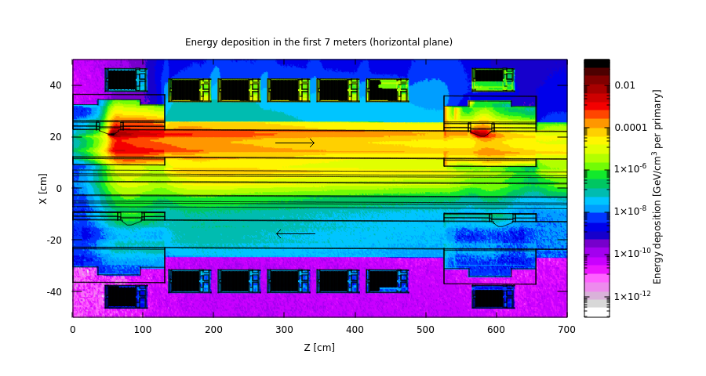
Results
X-Y-Z mesh: averaged over the Y-axis from -7 - 7 cm

Slide 13
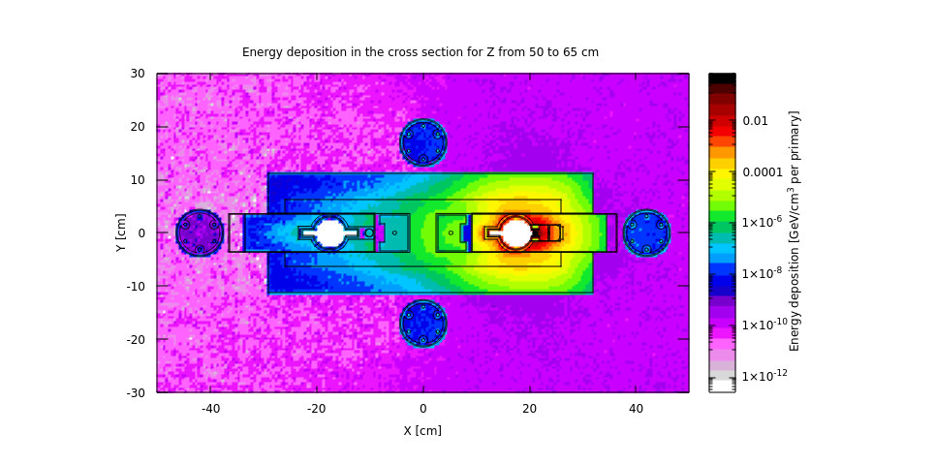
Results
X-Y-Z mesh: cross-section averaged over the Z-axis from 50 - 65 cm

Slide 14
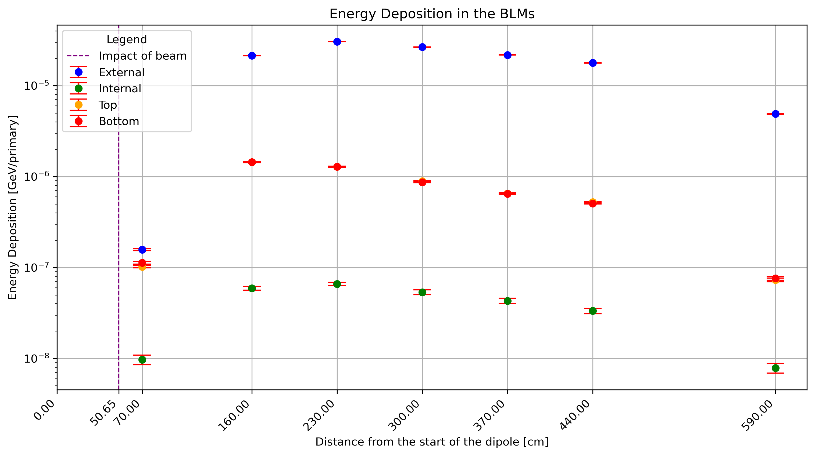
Results
Region based scoring: Total energy deposition in the ionization chambers

Slide 15
Future plans
Expand the simulations:
  More BLMs along the aperture and magnets
  Vary the beam impact points
  Different types of BLMs (optical fiber, semi-conductors, diamonds, pin diodes, etc.)
Consider synchrotron radiation and simulate the impact of it on the Signal of the BLMs
For the FCC week poster session:
  BLMs (ionization chambers) to cover a whole dipole + quadrupole (instead of the first 7 meters)
  Vary impact points

Slide 16
Thank you for your attention!

Slide 17
Extra Slides

Slide 18
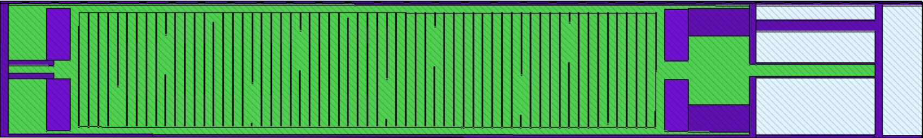
Geometry: FCC-ee Arc Half-Cell Simulation Setup
Ionization chamber:
Sensitive gas volume filled with nitrogen gas
Particle ionizes the gas and creates an electron-ion pair
Voltage between electrodes
If the voltage is sufficient, a current will be induced. Otherwise, the electron-ion pair recombines

Slide 19
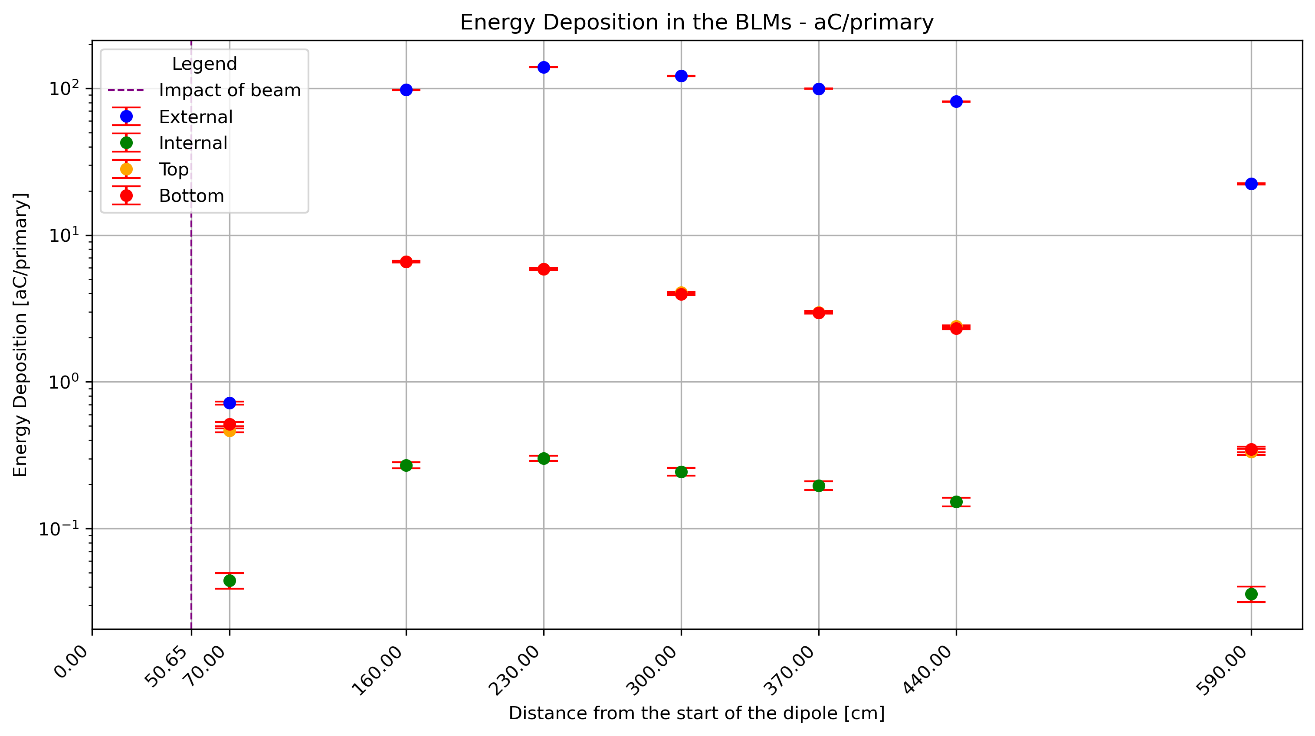
Results
Region based scoring: Total energy deposition (aC/primary) in the ionization chambers

Slide 20
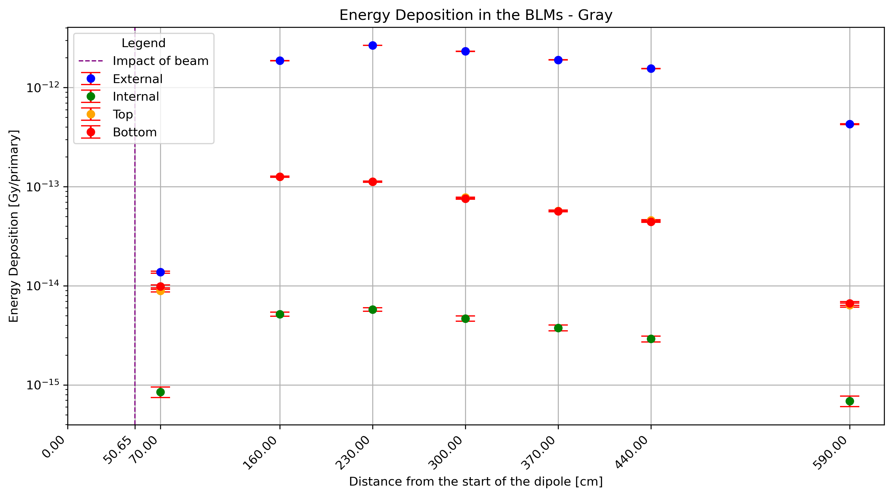
Results
Region based scoring: Total energy deposition (Gy/primary) in the ionization chambers

