Slide 1
Modelling and Trajectory Optimization for Magnetically Coupled Linear BWS
Marie Faure
4th April 2025
SY-BI-PM

Slide 2
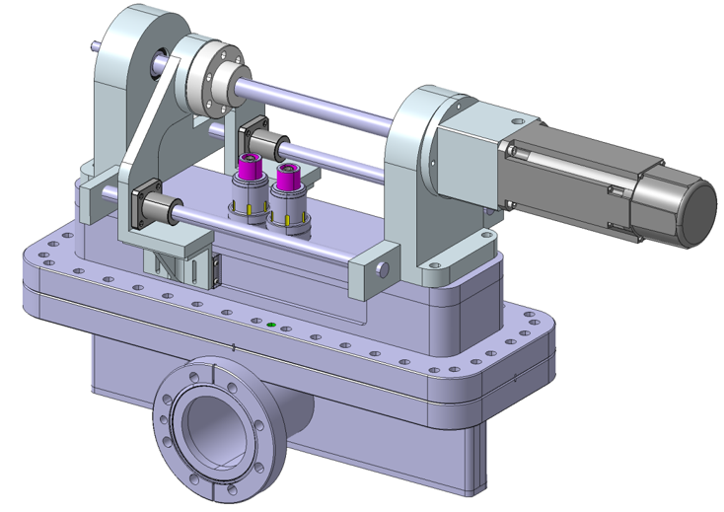
Beam Wire scanner – Trajectory Optimization
Introduction to BWS
Specificities Linear BWS
System Identification
Results (SI)
Trajectory Optimization

Slide 3
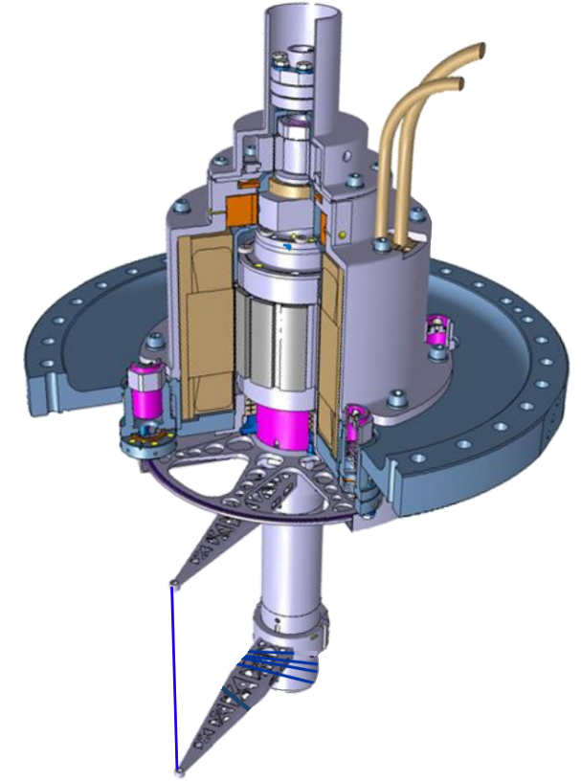
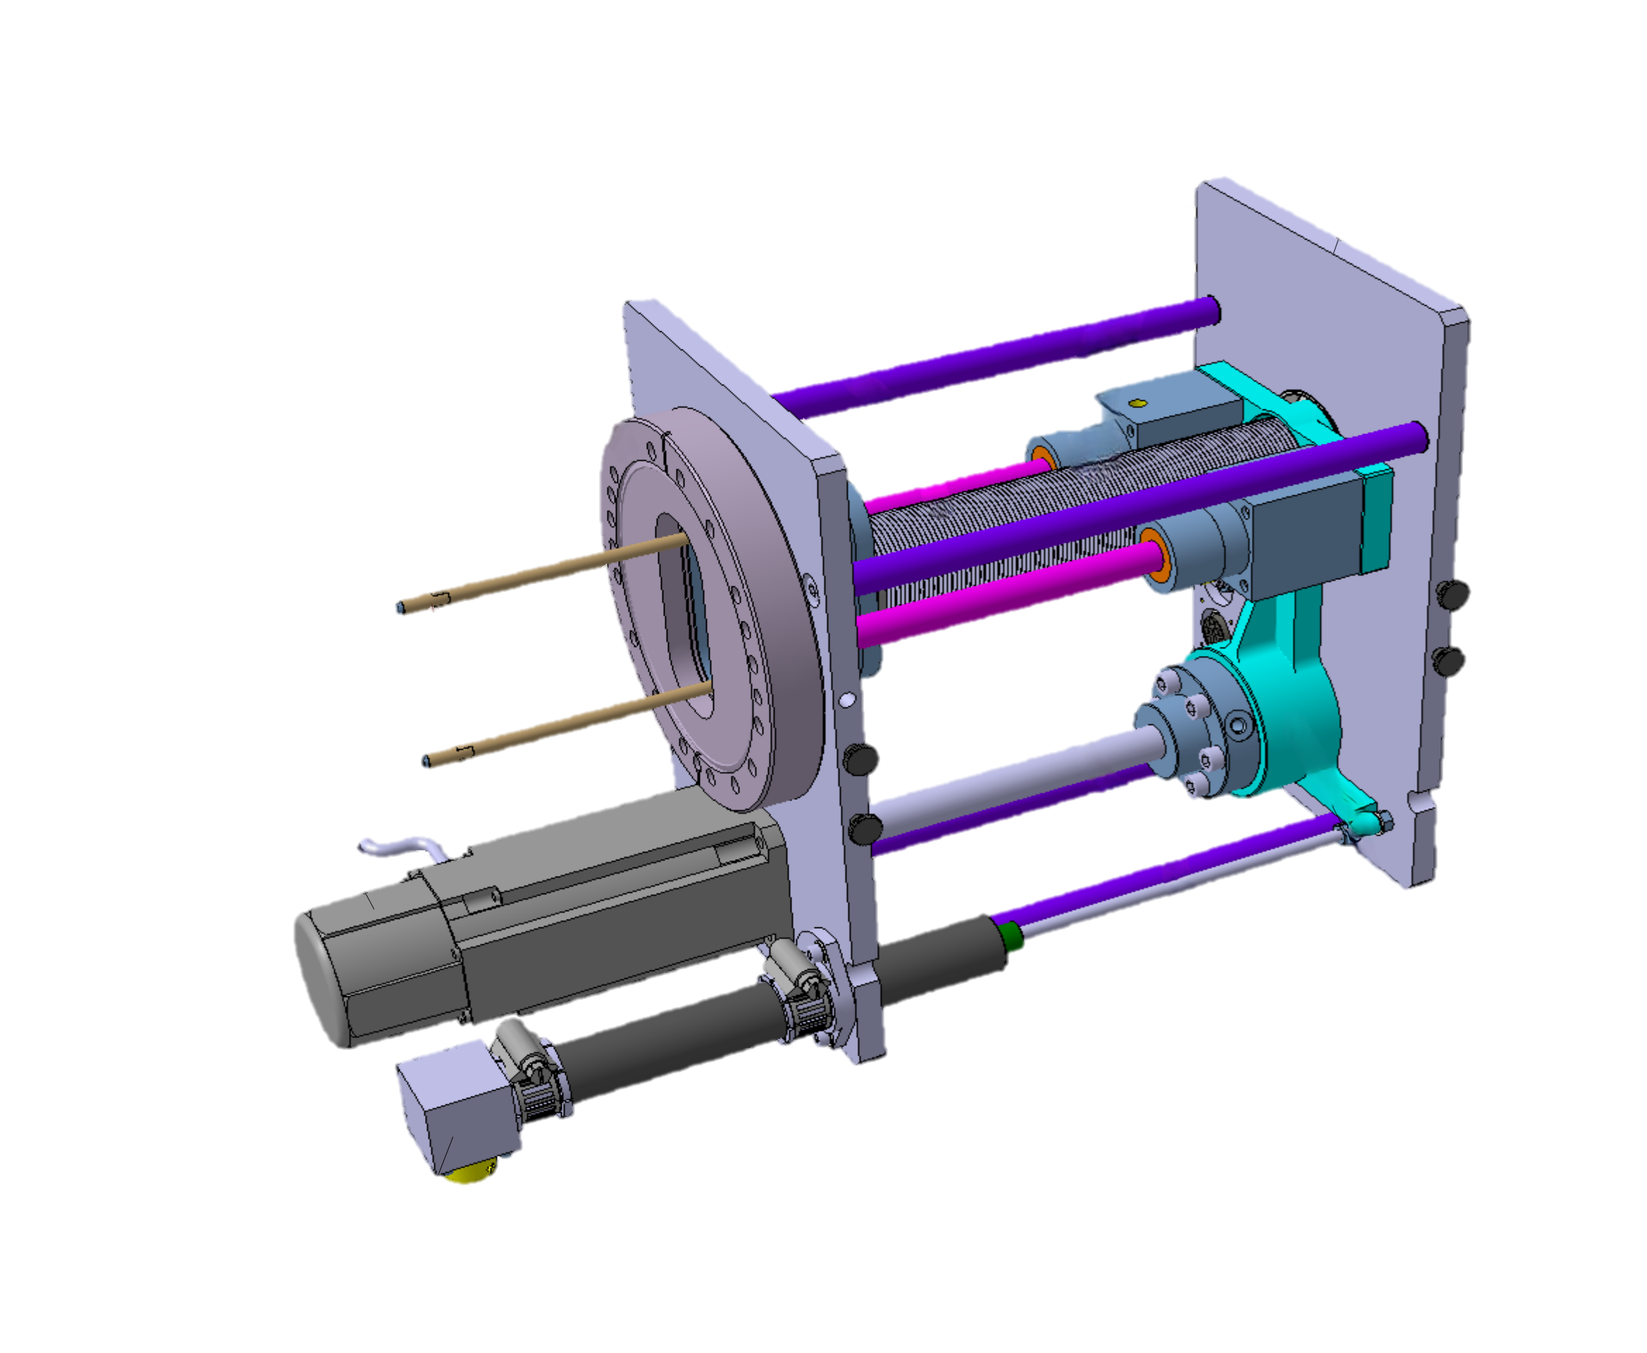
Introduction
What is a Beam Wire Scanner (BWS)?
A diagnostic tool in accelerators that measures the transverse beam size by mechanically crossing a thin wire through the beam and detecting the resulting particle losses.
Two Main Types: Rotary vs. Linear
  Rotary: Wire rotates through the beam.
  Linear: Wire moves in a straight line across the beam, giving higher position accuracy.
    Direct linear motion offers higher positional accuracy.
    Well-suited for smaller beam sizes and stricter precision needs.
Notes:
Transition: Let's break down how a linear Beam Wire Scanner works

Slide 4
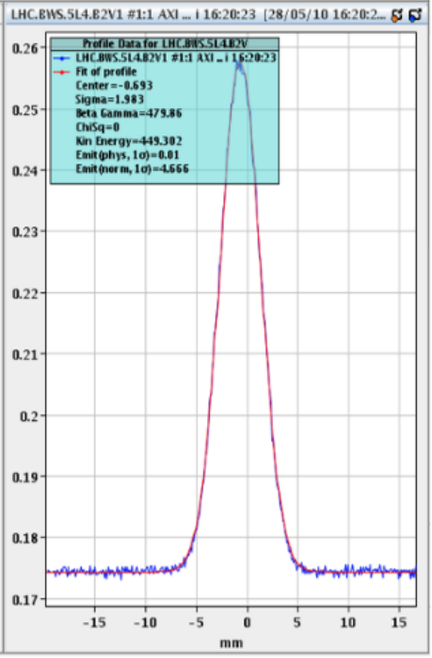
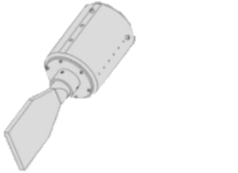
Introduction
  Crossing the Beam
      The wire moves across the beam path (in a linear design, it travels straight in and out)
      A thin carbon wire (typically ~30 µm) intercepts a fraction of the beam
  Secondary Shower Detection
      The wire’s interaction with the beam produces a shower of secondary particles
      A scintillator + photomultiplier system converts these secondary particles into a measurable signal (intensity)
  Reconstructing the Beam Profile
      By correlating the measured intensity with the wire’s known position, one can map the beam’s intensity profile vs position
      Fitting that distribution (often Gaussian-like) gives the beam size and shape
BEAM
Position
Intensity
Beam Transversal Profile
Notes:
Transition: The picture I used in this slide is the currently used linear beam wire scanner. This design is using bellows for turning the rotation of the motor into a linear motion. However there are other way of transmitting the motion that have been studied.

Slide 5
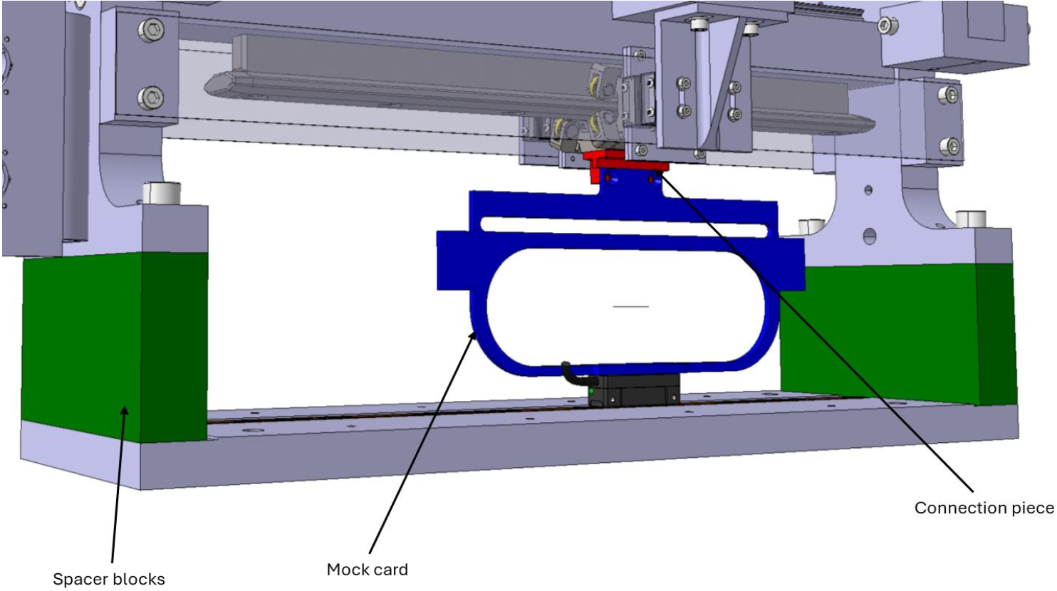
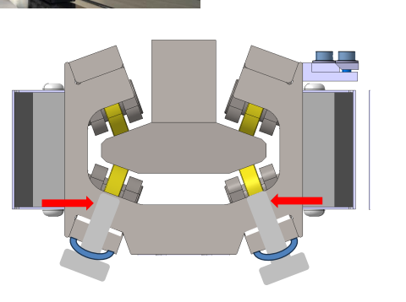

Specificities Linear BWS
  Consolidation – BWS – LHC
    Current system has reliability issues
    Main change: below → rail in vacuum and linear encoder on the shaft
    Specifications:
  Magnetically Coupled Motion
      The motion in vacuum is driven by magnets on the “air side”
      A membrane separates vacuum from atmosphere; one magnet in air couples to another magnet in vacuum without direct mechanical linkage
1 m/s
120 mm
Following
magnet (2)
Leading magnet (1)

Slide 6
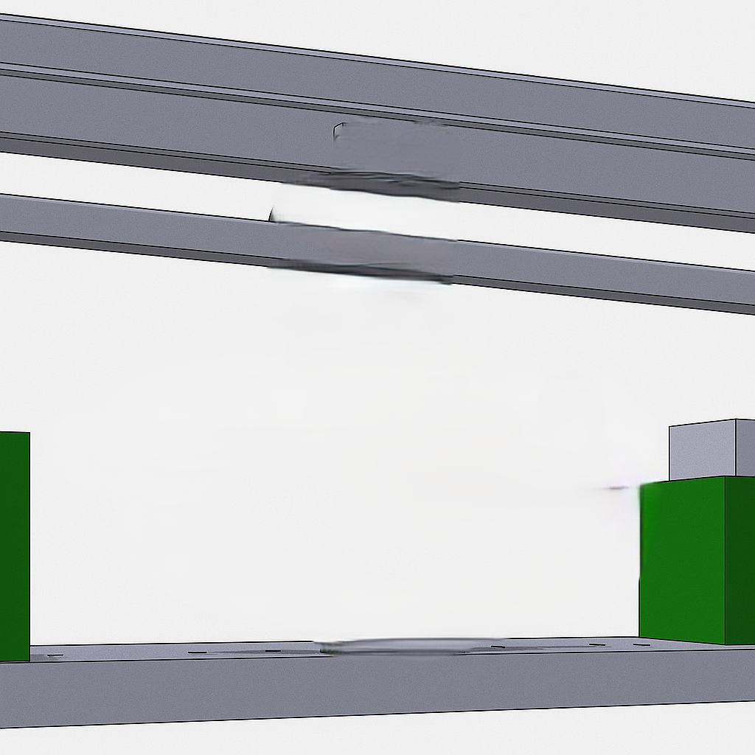
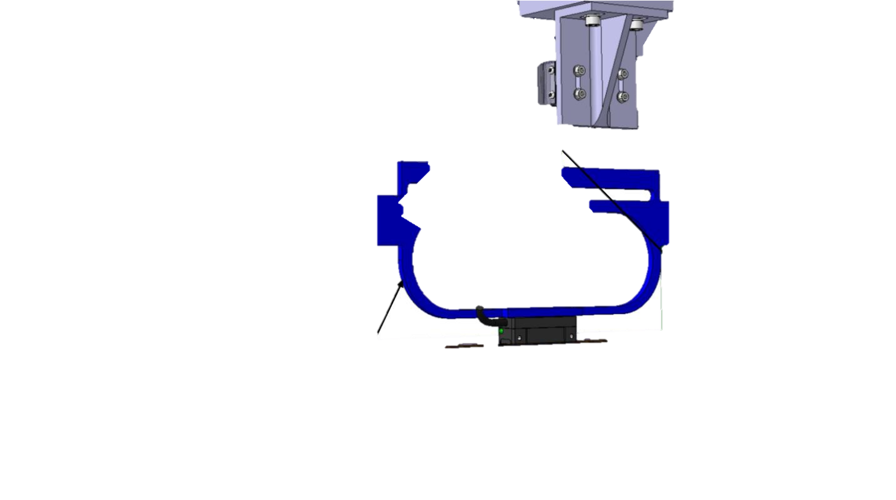
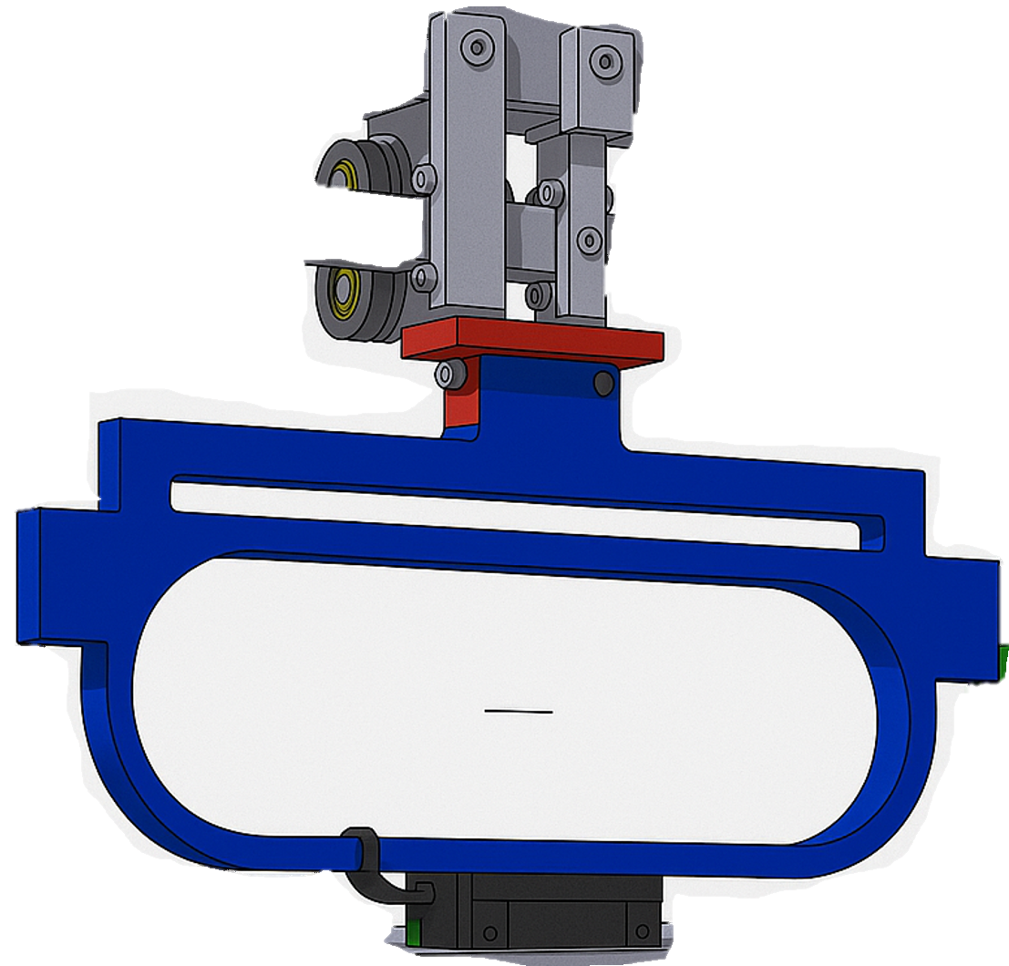

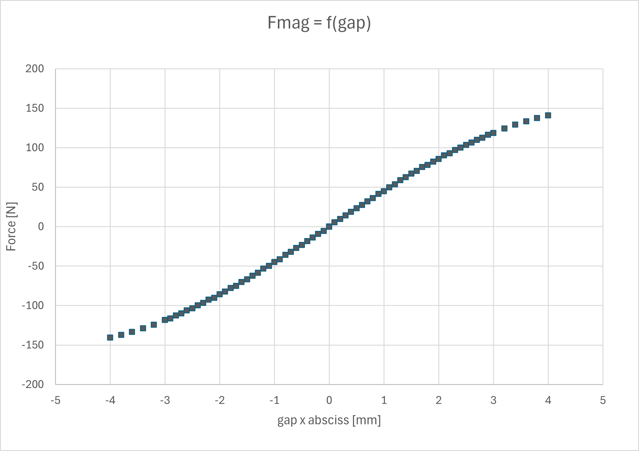
Specificities Linear BWS
  System
      Magnet 1: “leading” (actuated by PMSM through ball-screw).
      Magnet 2: “following” (actuated by magnetic field).
    oscillatory mechanism
      Near an equilibrium gap, this behaves like a “spring”
Actuation Force
d
Magnetic Force

Slide 7
Specificities Linear BWS
  Resonant Frequency Challenge
      At certain frequencies, mechanical or magnetic elements in this coupling can resonate.
      These resonant frequencies amplify vibrations and oscillations in the wire, distorting the measured beam profile and possibly risking damage.
  Goal: Identify and Avoid
      At certain frequencies, the overshoot of the following magnet is amplified => resonant frequency leading to the oscillation of the wire shaft
        Uncertain position of the wire
      How to know these frequencies? => system identification
      Design a trajectory that avoids these frequencies
Actuation Force
d
Magnetic Force

Slide 8
Specificities Linear BWS
  Modelling the system
      Understand how motion transfers from the air-side magnet to the vacuum magnet
      Predict vibrations, resonances, and how the wire moves at all speeds
    How?
      Exciting the leading magnet at all frequencies and collecting measures of the output magnet
      Find a function that links the displacement of the following magnet based on the leader magnet
        Transfer function: straightforward frequency response representation
        (describing how any input signal, in the Laplace or frequency domain, is mapped to the system’s output under linearity and time-invariance assumptions)
    First Approach
      Experiment & Data Collection: Measure displacement, while exciting a range of frequencies
      System Identification: Build a transfer function representation linking “input” motion to “output” Shaft position
      Analyze Resonances: Extract resonant frequencies
Actuation Force
d
Magnetic Force
      How/ which tests?

Slide 9
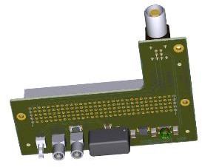
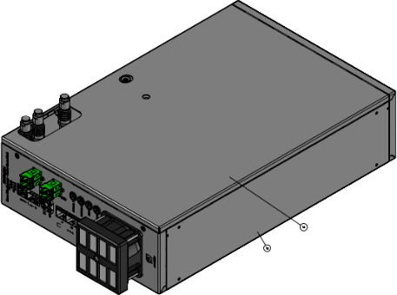
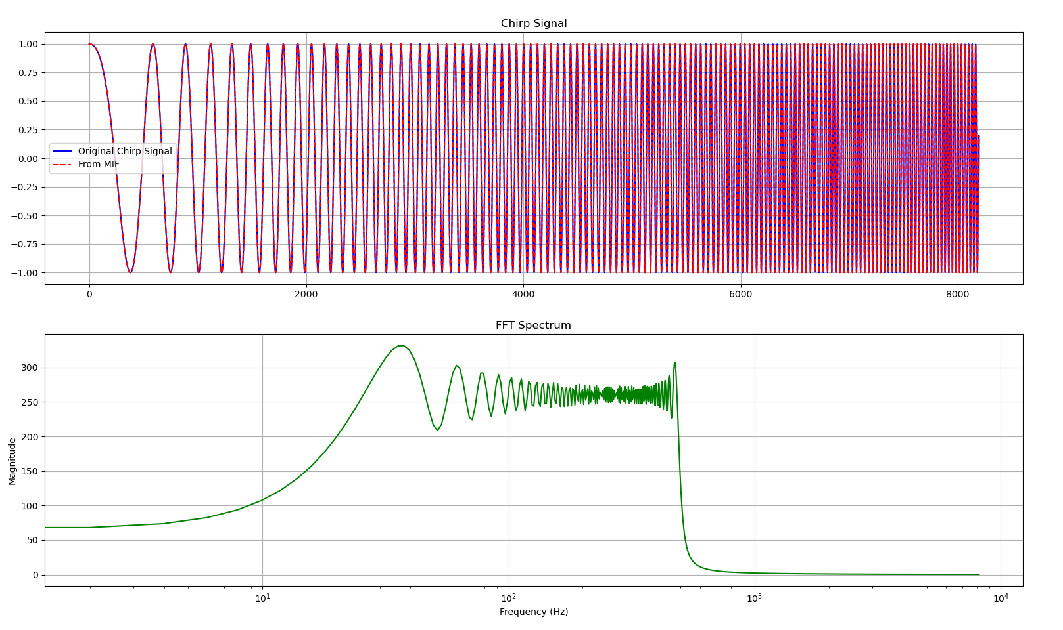
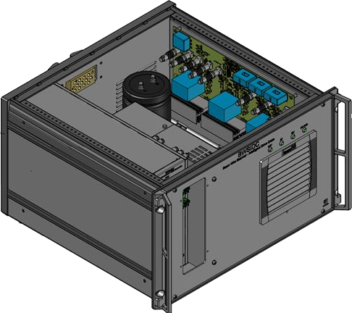
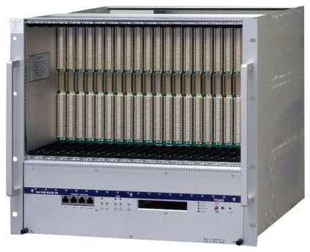
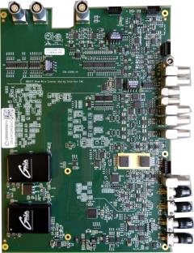





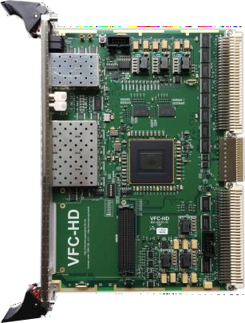

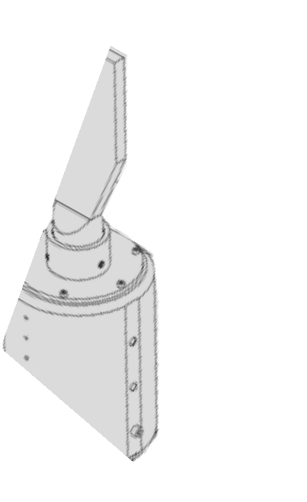

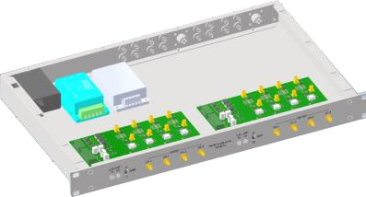
System Identification
  Data Collection:
      Generation of input sets (command of the currents in the PMSM) -> Multisine, Chirp signals (user commands)
      User commands sent to MCU: real‐time control logic computing how the motor should move desired torque/velocity), based on trajectory profiles or user commands
      IDC: provides and switches the higher‐power signals (voltage/current) that drive the motor.
      Encoder of the Magnet 1 Displacement (input)
      Encoder of the Magnet 2 Displacement (output)
MCU (Motion Control Unit)
Brake locking power
IDC (Intelligent Driver Crate)
Acquisition & Supervision crate
LIN POT
Wire, ESN, brake
Position (Resolver)
Power
Ethernet
Analog Interface FMC

Slide 10
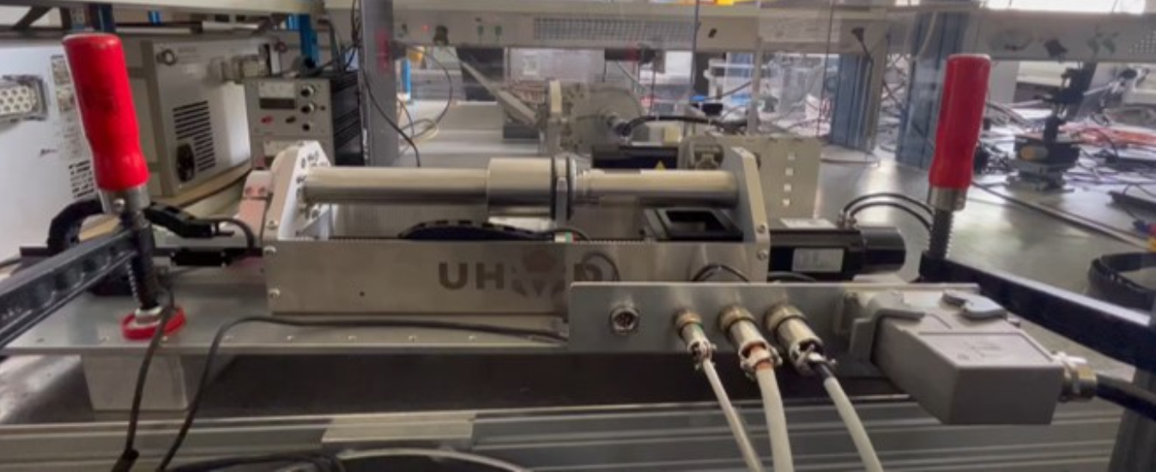
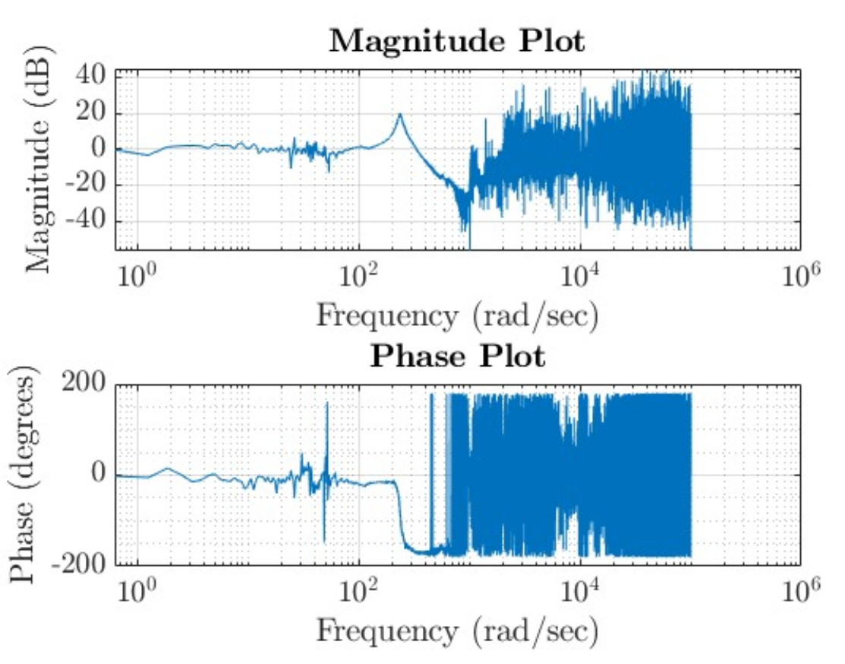
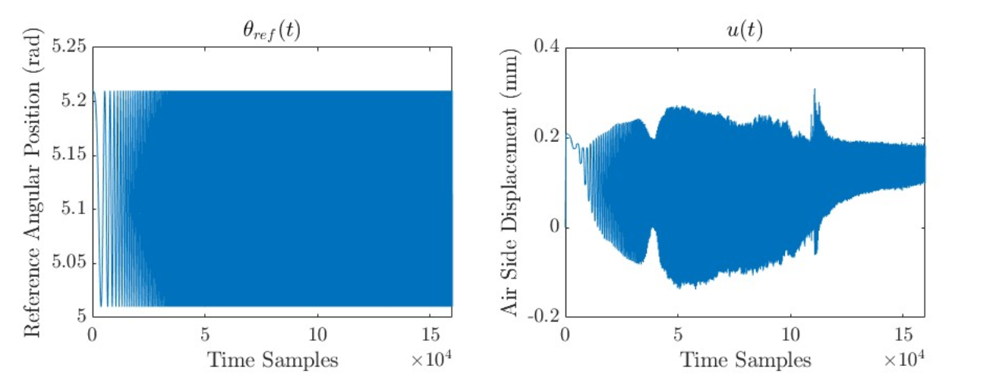
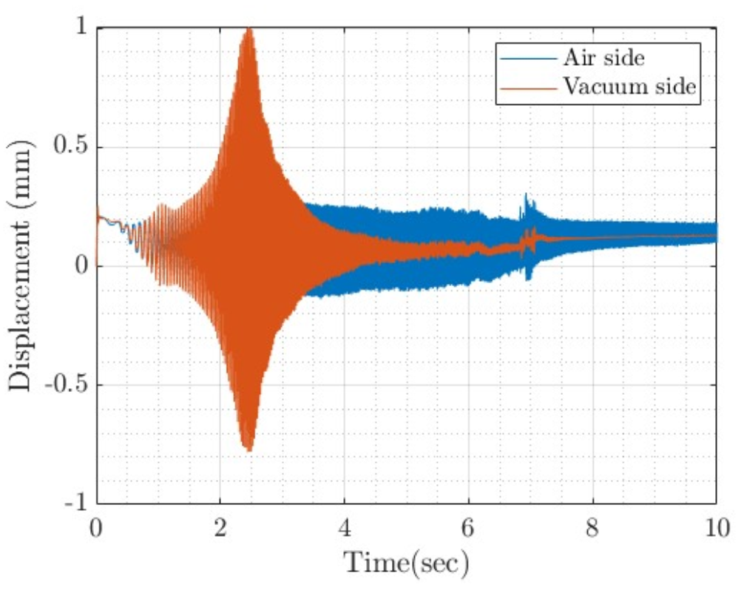
System Identification
  Previous work on system identification
    Commercial testbench tubular-type linear magnetic coupling
    Dspace MicrolabBox (test, or measurement applications for new control concepts) → 10 secs per dataset
    Chirp signal identification
Notes:
Transition: So I wanted to have the same approach but also finding a parametric model with precise estimation of the resonant frequency. First I had to choose which excitation signal to choose because Vishnu choose chirp but there are different type of signals.

Slide 11
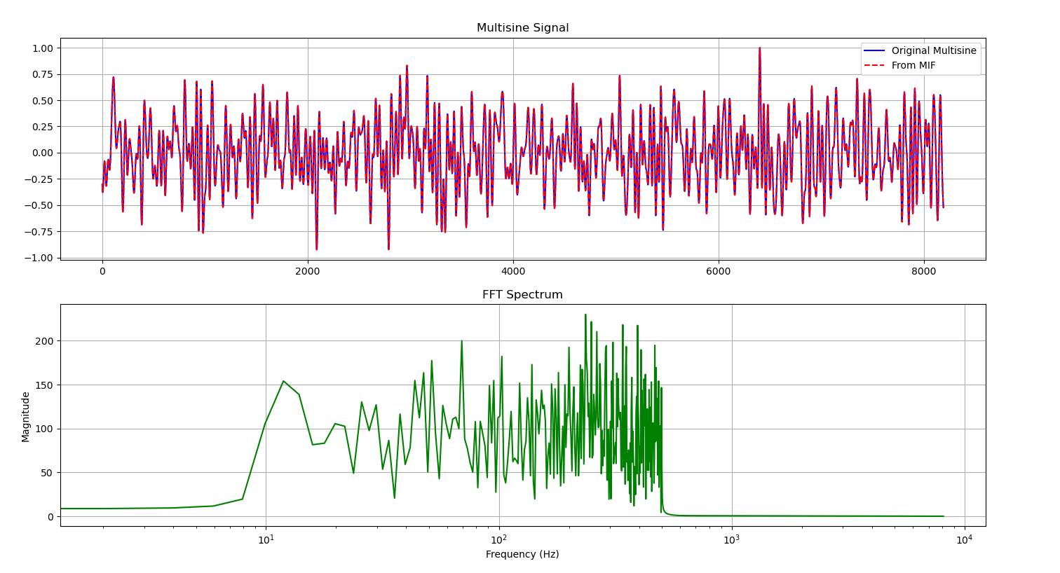
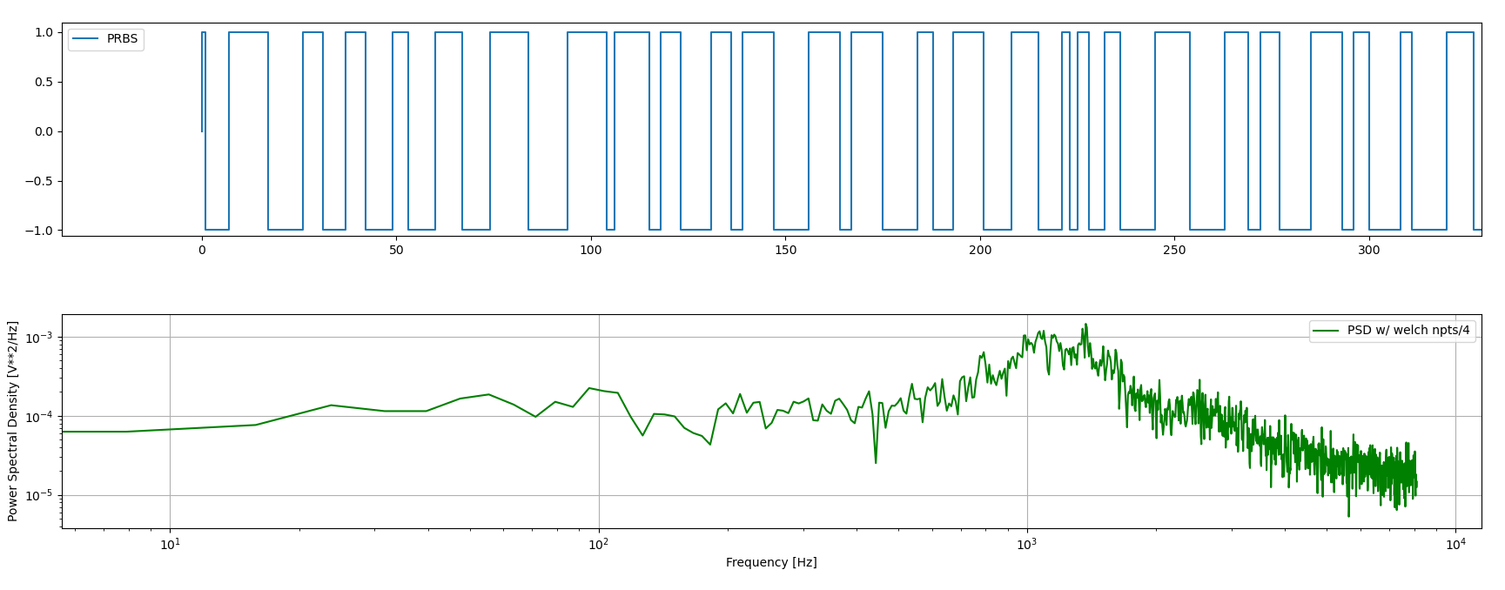
System Identification
  Types of excitation signals :
      Multisine: addition of a range of sinusoidal signal
      Multisine: need to be careful of the range of excitation to focus on the resonant, or the one we are interested in
      Chirp: increasing the frequency of a signal in a given range
      Chirp: system has big time constants (slow dynamics), it might not fully respond before the chirp moves on
      PRBS: random binary signals
      PRBS: need multiple cycles to get clean measurements, too sharp slope of input
      How/ which tests?
Notes:
What made me choose this type of excitation signals is because compared to the commercial system studied in the past I have more constraints and limitations to do my tests.

Slide 12
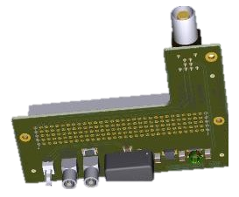
System Identification
  Limitations:
      Working on the operational system
      Set Points Tables length: containing set points (8192 points -> ~0.5 secs!) due to FPGA memory limitation
      Datasets variability: can’t have a lot of different datasets due to the long recompilation time of the FPGA
      Length of tests: The inverter has tendencies to saturate can not stay at max voltage for too long (operational system – can’t run continuously)
MCU (Motion Control Unit)
Brake locking power
IDC (Intelligent Driver Crate)
Acquisition & Supervision crate
LIN POT
Wire, ESN, brake
Position (Resolver)
Power
Ethernet
Analog Interface FMC

Slide 13
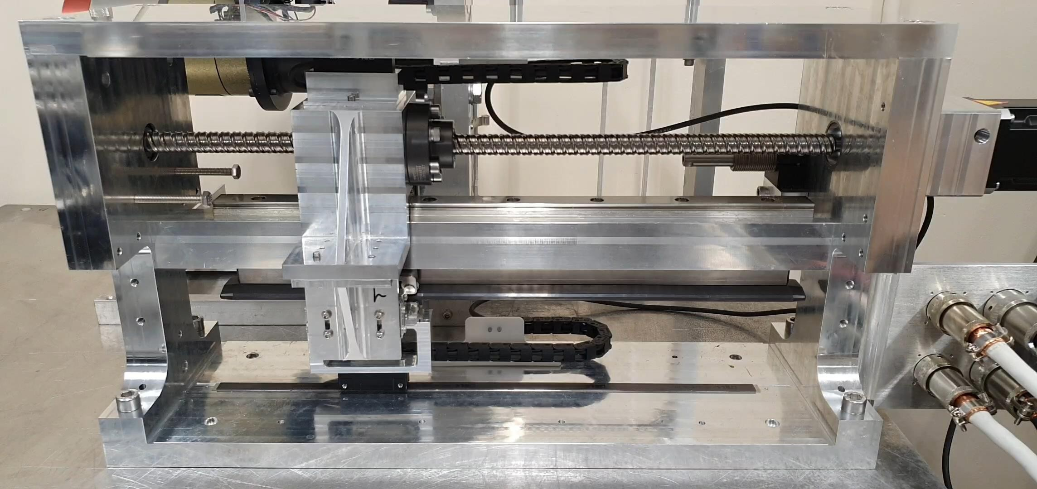
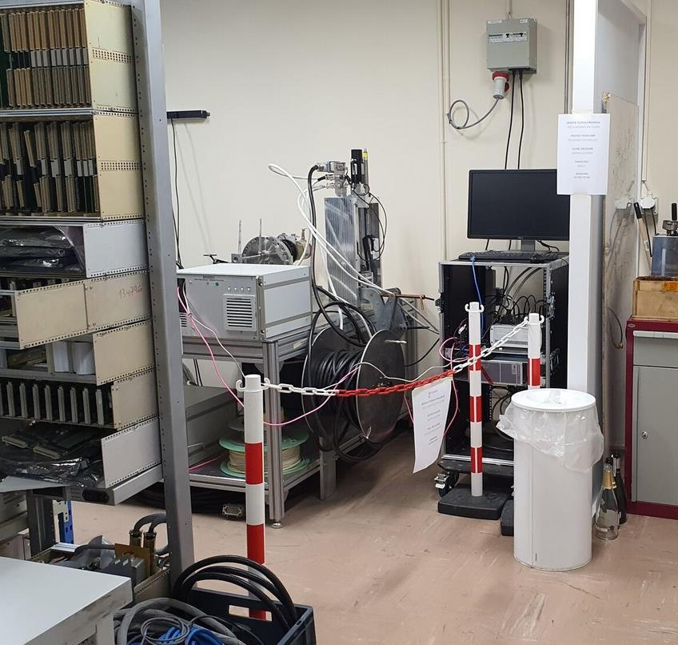
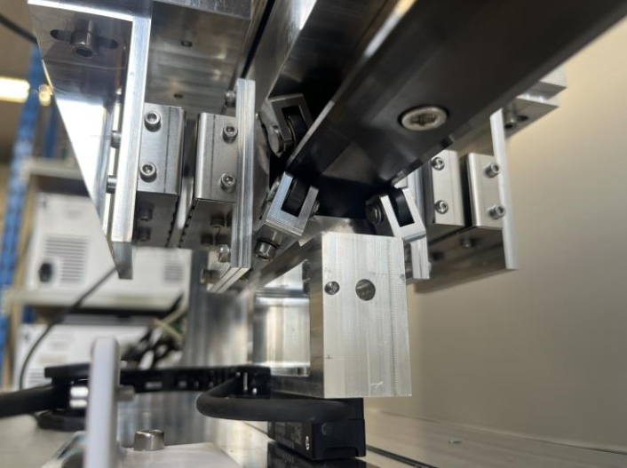
System Identification
Testbench
Encoder leading magnet (input displacement)
PMSM
Acquisition & Supervision
IDC+MCU
Vacuum side
Air side
Encoder shaft (output displacement)
Wire support

Slide 14
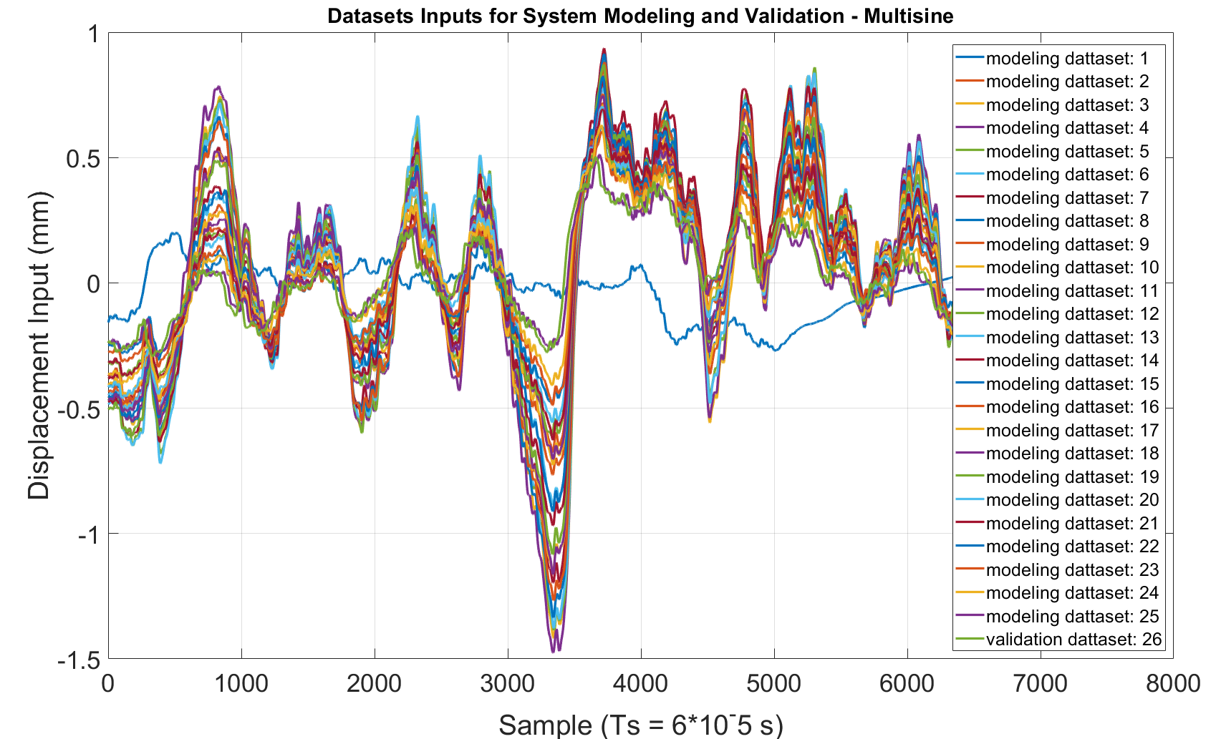
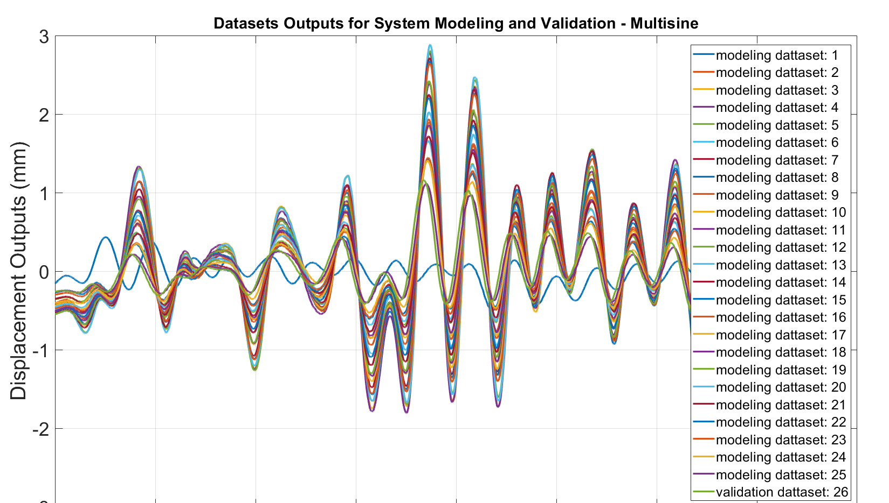
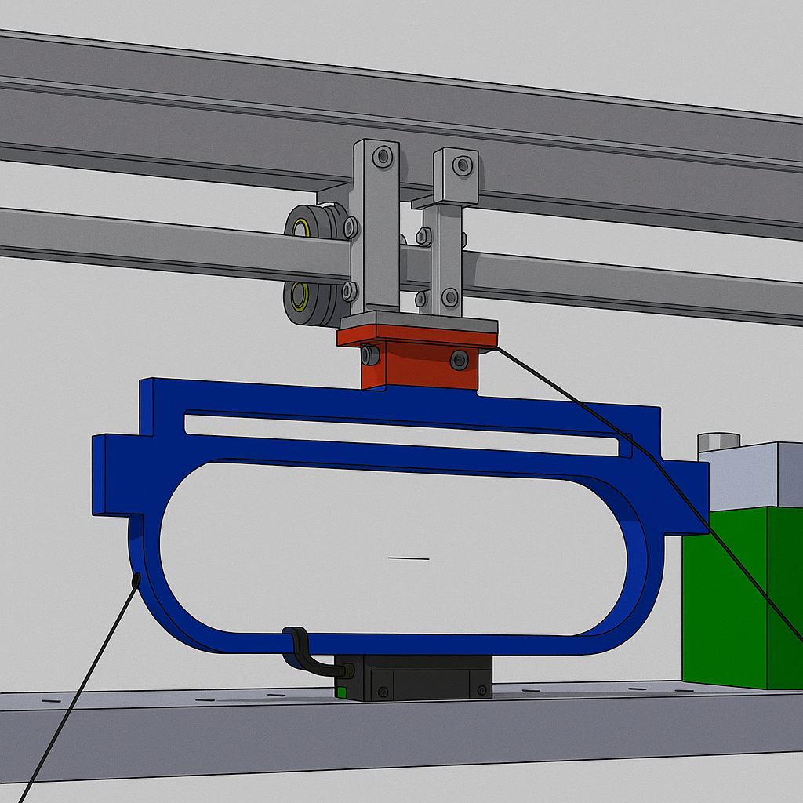
System Identification
Method – data collection
x25
Leading magnet encoder
Multisine datasets
INPUTS
Following magnet encoder
OUTPUTS

Slide 15
System Identification
Method – Validation
Residuals
Fit rate
Noise
Distribution
Spectrum
Multisine datasets
training
Model
Simulated Outputs
TFEST
simulation
analysis
X23
comparison
inputs
Multisine datasets
validation
X2
TFEST
Parametric modelization

Slide 16
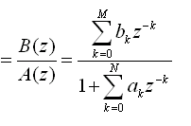
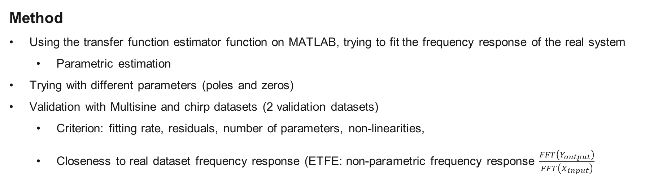

System Identification – Multisine
$$H(z)=\frac{Y_{output}\left(z\right)}{X_{input}\left(z\right)}$$
Method
Using the transfer function estimator function on MATLAB, trying to fit the frequency response of the real system
  Parametric estimation
Trying with different parameters (poles and zeros)
Validation with Multisine and chirp datasets (2 validation datasets)
  Criterion: fitting rate, residuals, number of parameters, non-linearities,
  Closeness to real dataset frequency response (ETFE: non-parametric frequency response $\frac{FFT\left(Y_{output}\right)}{FFT\left(X_{input}\right)}$
Parameters of the transfer function describing how the system behaves physically
In a first approach, system = black box => we don’t know the system’s equations (but spring link behavior=> 2nd order = 2 zeros)
In a second approach, we’ll make a linear behavior around the operational behavior and assume it is linear to define the magnetic equations

Slide 17
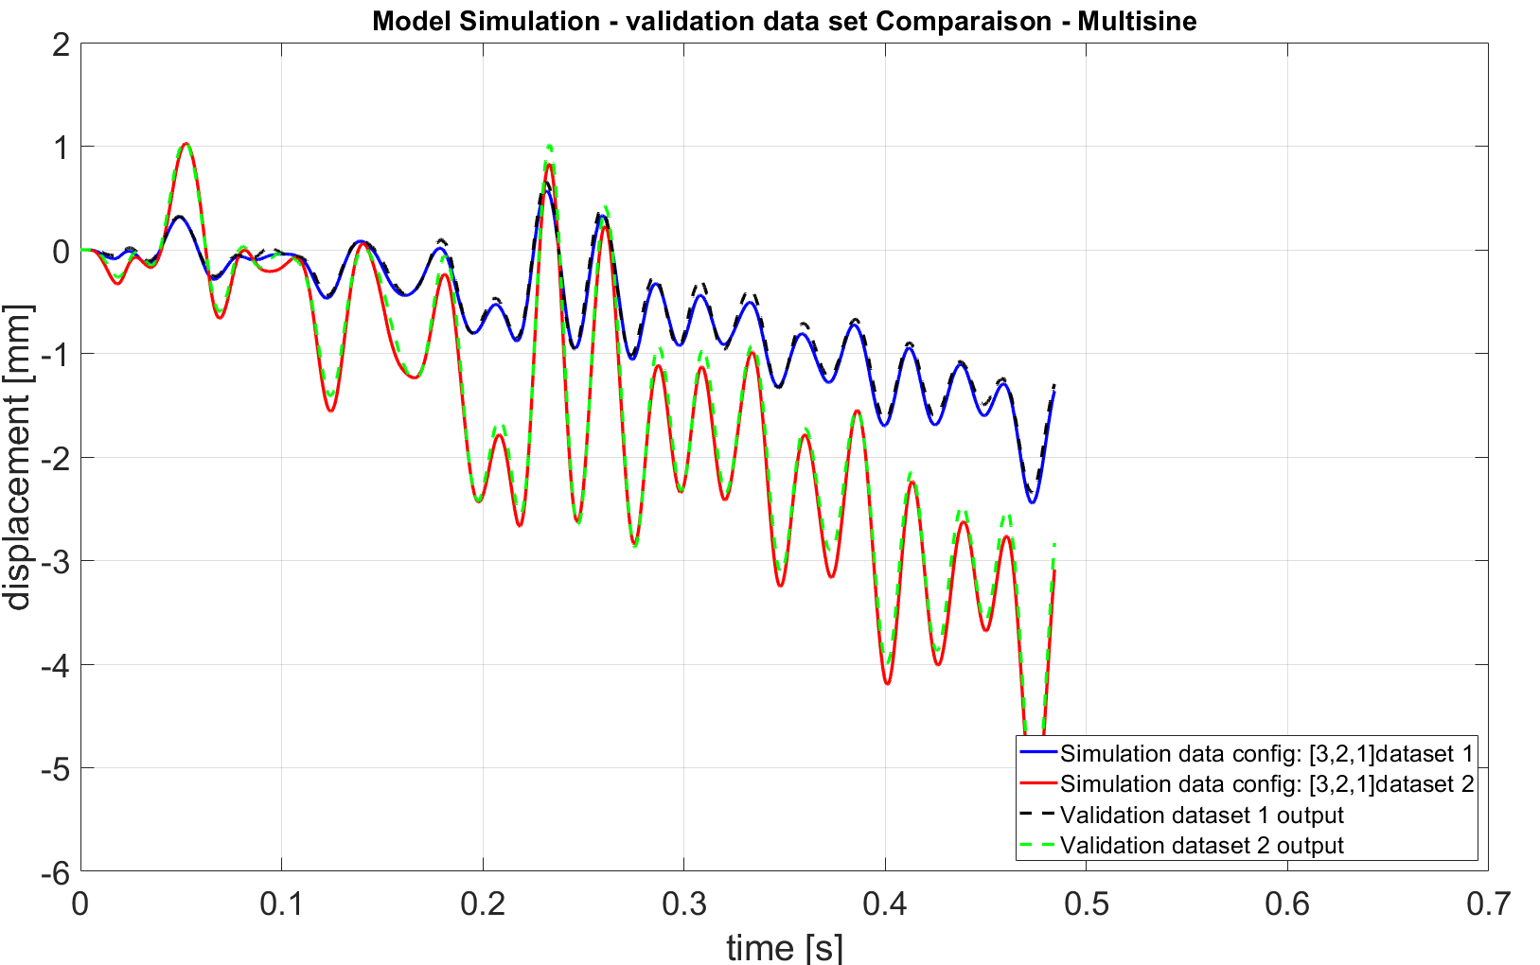
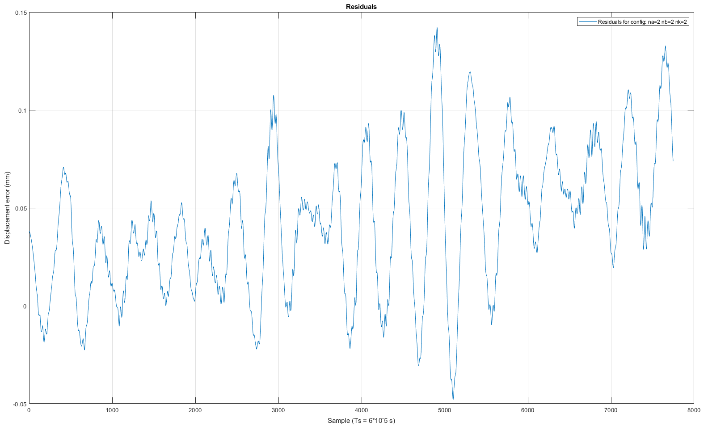
System Identification – Multisine
Time-domain results for number of poles = 2, number of zeros = 2
Simulation of the output predicted using input from the validation datasets and compared with real output

Slide 18
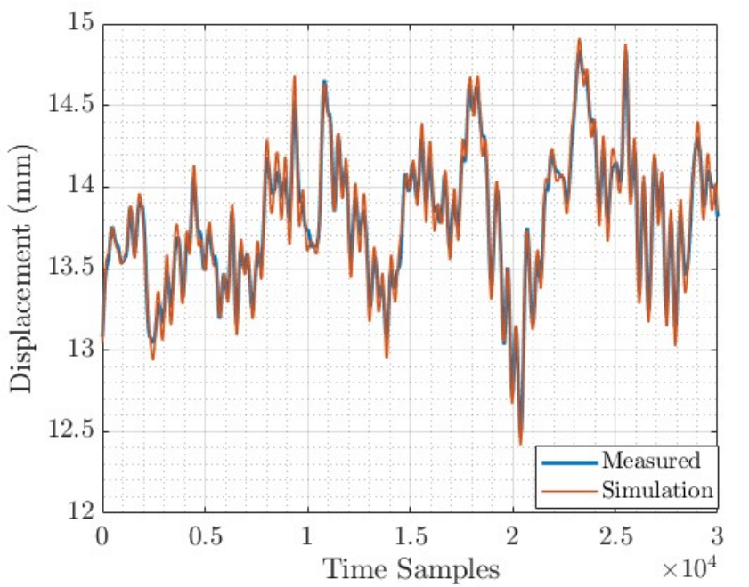
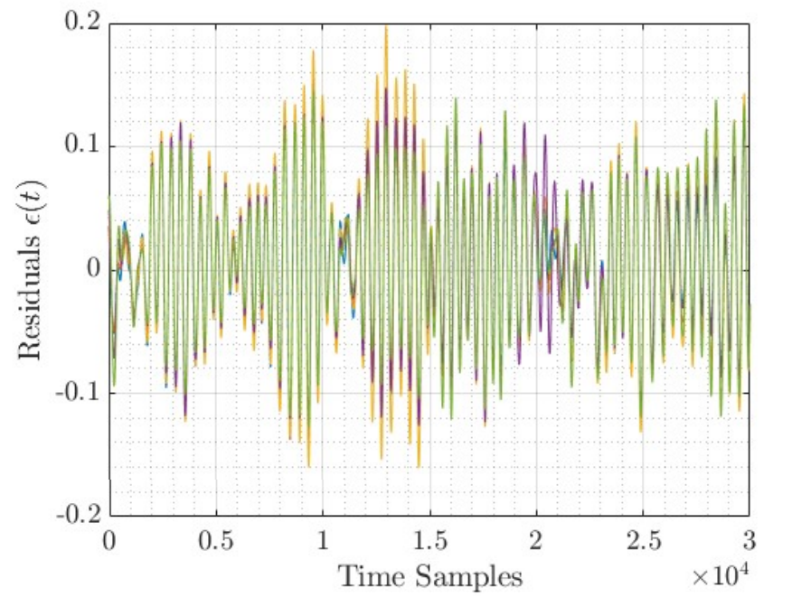
System Identification – Multisine
Result previous study on commercial testbench

Slide 19
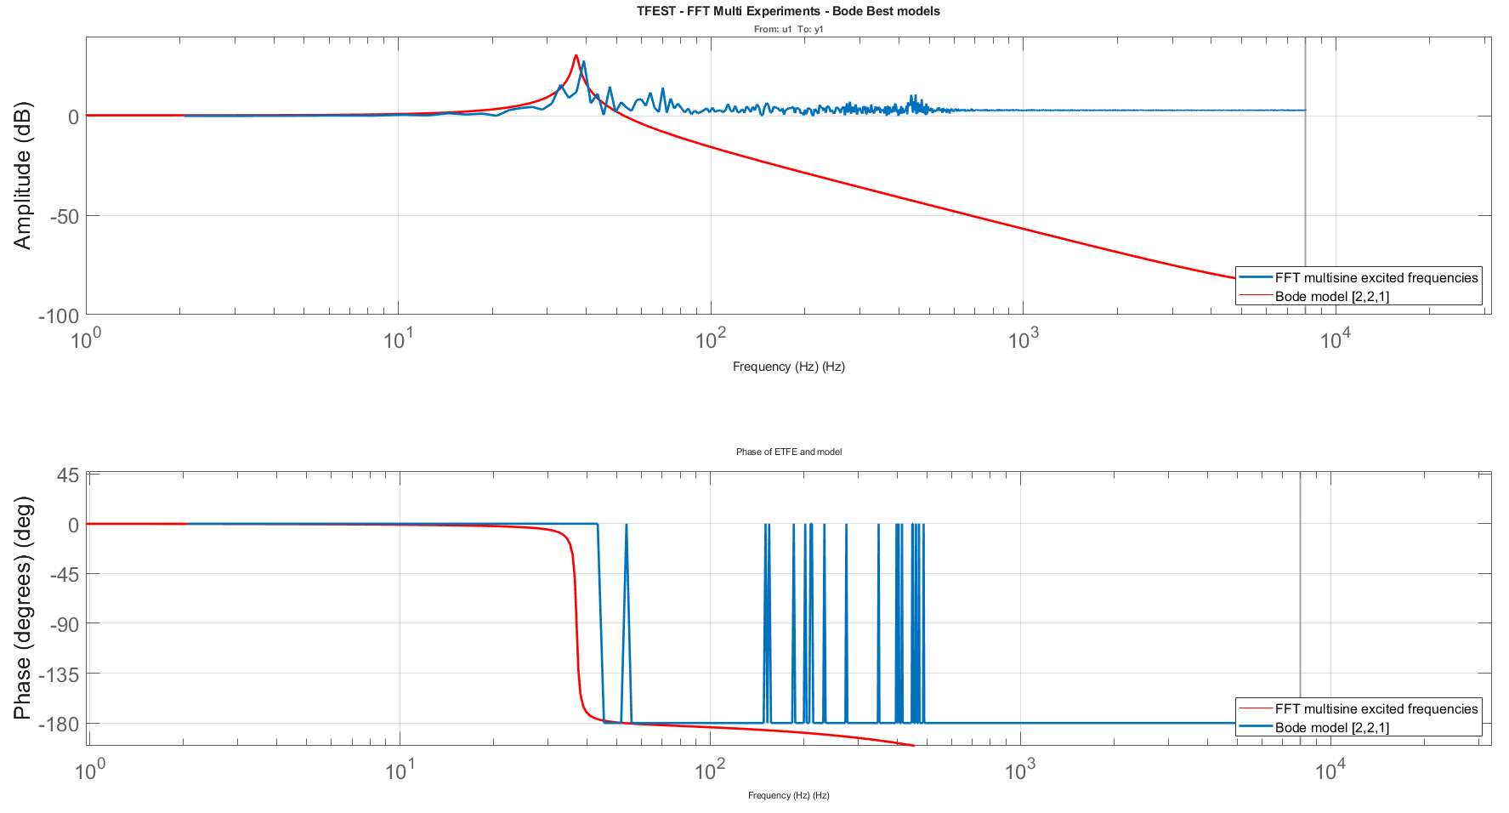
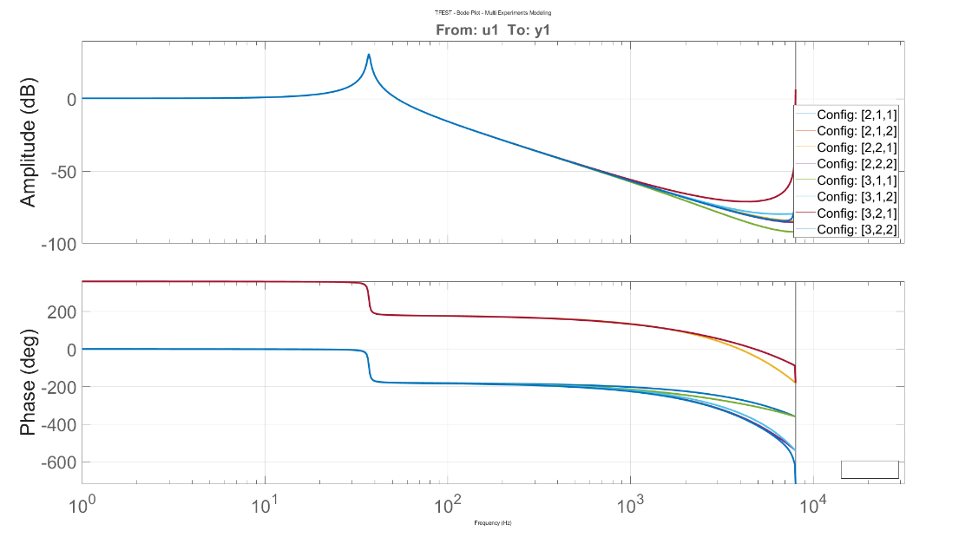

System Identification – Multisine
Frequency-domain results
Resonant frequency identification
High frequency noisy -> amplitude to 1 (out/in), Multisine didn’t excite these frequencies/ noise
$$f_{model}=37 Hz$$
$$f_{ETFE}=39 Hz$$

Slide 20
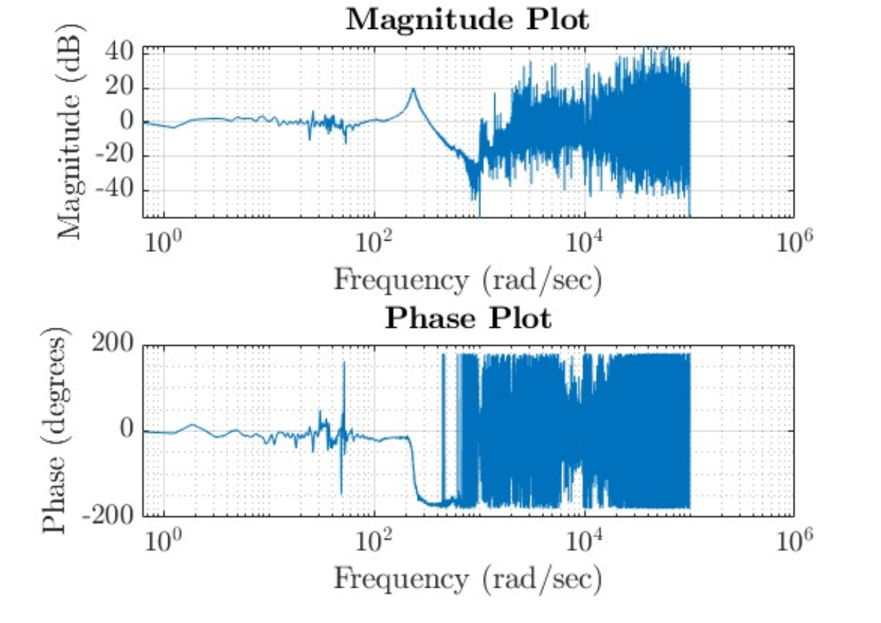
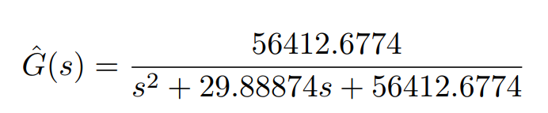
System Identification – Conclusion
Previous identification on a commercial magnetic coupled link
  Chirp, 2nd order, dSpace setup (10-second tests)
Hardware limits (length of identification dataset) are strict and don’t allow to excite multiple cycles on the same dataset which limits the modeling of all frequencies
For now, waiting for further tests and maybe hardware changes we’ll consider the resonant frequency ~35 Hz for trajectory optimization
Vishnu comparison (old system)
Designed model
Multisine: [2,2,1]
-1.037e-05 z + 0.0002307
------------------------
z^2 - 1.999 z + 0.9996
One zero more

Slide 21
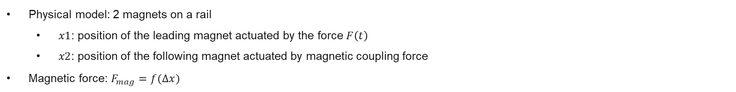
System Identification – ideas for improvement
Black-box approach → gray-box approach: starts from magnetic equation and identify the parameters
gray-box: Combination of known physics (magnet masses, geometry, approximate force law) plus unknown or uncertain parameters (exact 𝑘, damping, friction, …)
  Identification procedure:
  1) Measure input force (actuator) and displacements
  2) Initial model: physical equations
  3) Fit Parameters: Use time or frequency-domain methods to find parameters values that best match measures response
    Include non-linearities (frictions) and see it’s impact on vibrations
  4) Validate: Compare simulated to real data to confirm the “gray-box” model captures key dynamics
Physical model: 2 magnets on a rail
  $x1$: position of the leading magnet actuated by the force $F\left(t\right)$
  $x2$: position of the following magnet actuated by magnetic coupling force
Magnetic force: $F_{mag}=f(∆x)$

Slide 22
Trajectory Optimization
  Avoiding the exciting resonant frequency: identified frequency
  Method: S-curve smoothers
      Cascade filters to limit velocity, acceleration and jerk
      Kinematic constraints: stroke distance, max speed, max acceleration
      Frequency constraint: resonant frequency
Constraints
      Efficient speed given in the requirements: 1 m/s => 392.7 rad/s
      Stroke = 120 mm
      acceleration = ?

Slide 23
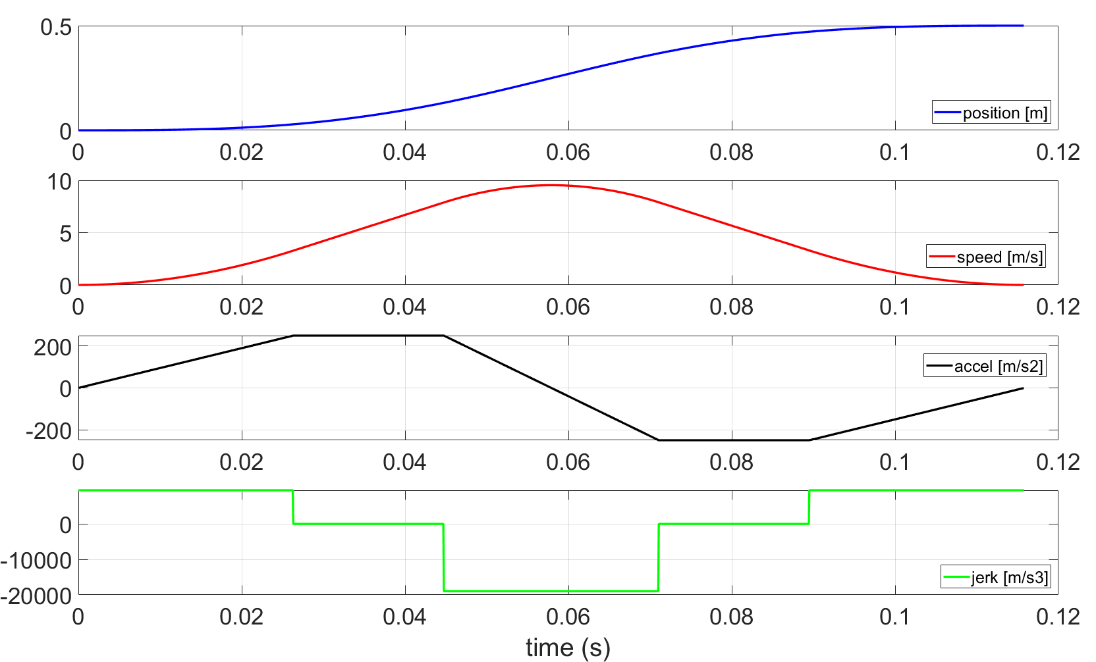
Trajectory Optimization – Kinematic Constraints
  Other constraint to take into account: plateau for the speed -> need to be constant when crossing the beam

Slide 24
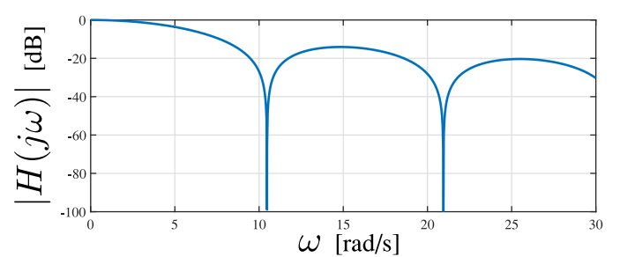
Trajectory Optimization – Kinematic Constraints
  Next step: do the spectrum analysis (dampen resonant frequencies)
  BIAGIOTTI AND MELCHIORRI: OPTIMIZATION OF GENERALIZED S-CURVE TRAJECTORIES

Slide 25
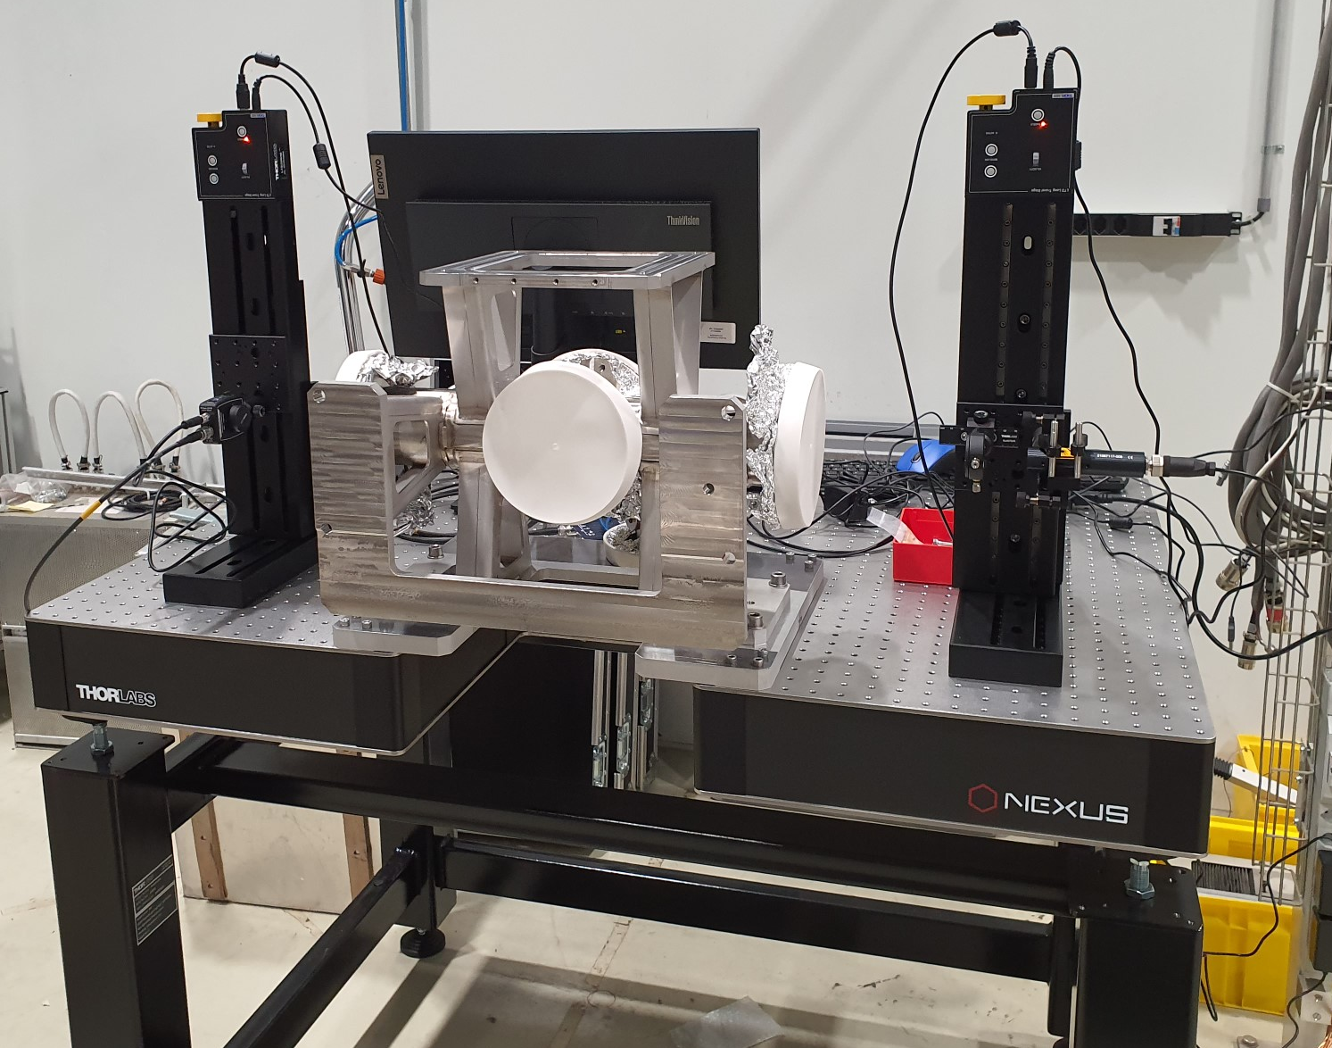
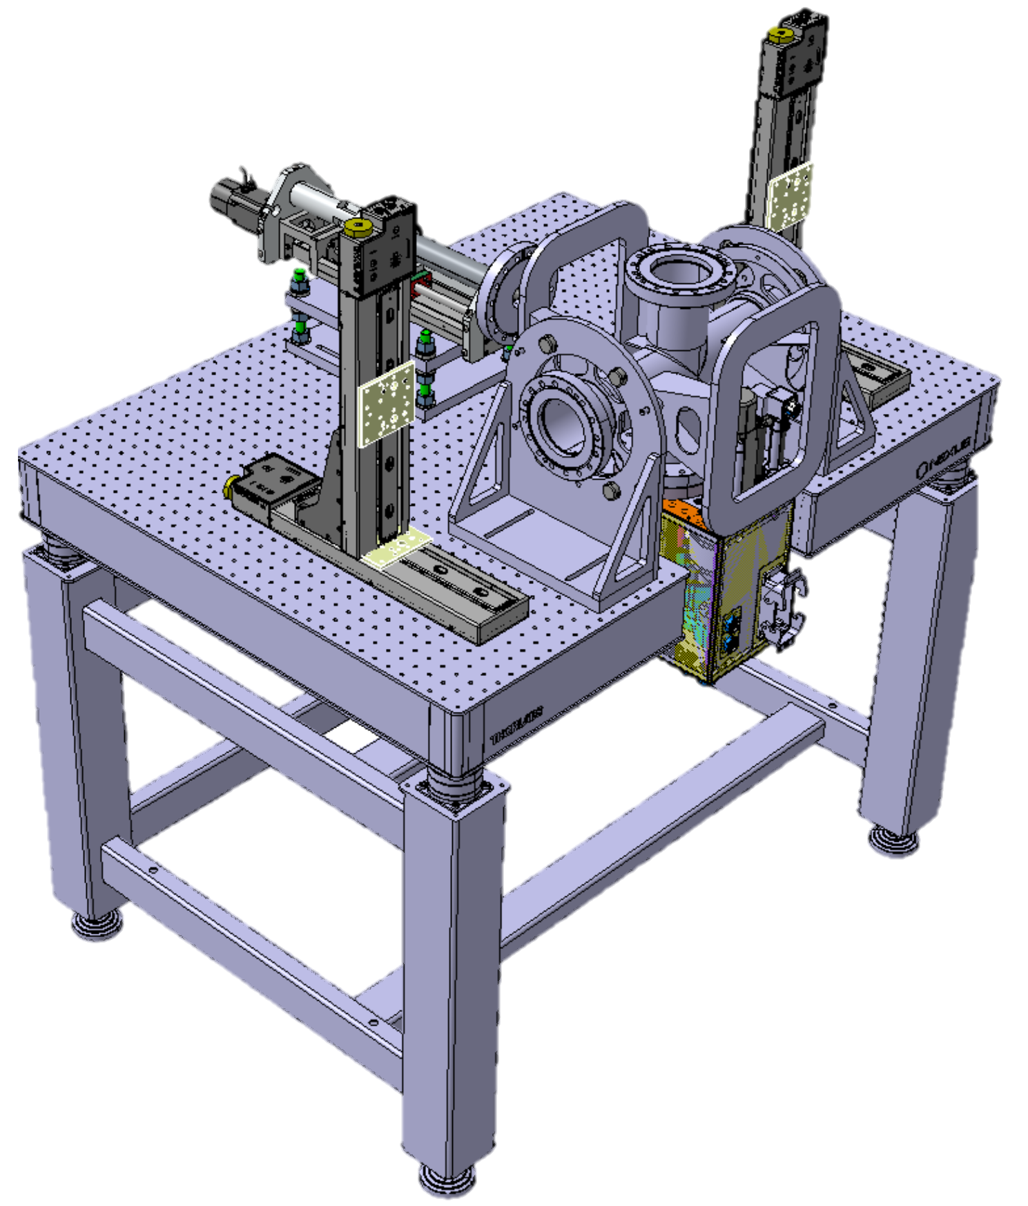
Conclusion and Future Work
  Results:
    Model of shaft position
    First draft trajectories with kinematic constraints
  Future work
    Trajectory generation within the criterion
    Application of trajectory on calibration testbench
    Check carbon wire position accuracy

Slide 26
Thank you for your attention!
Any questions?

