Slide 1
CERN April 2025
LiRR

Slide 2
Cells:
Repetition of experiments with beam parameters used with the FLAT beam

Slide 3
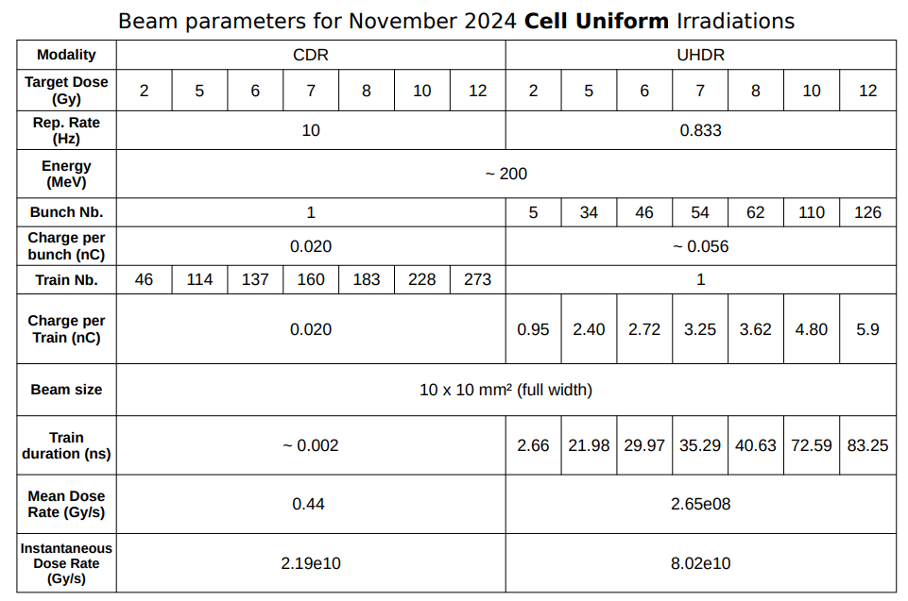
Beam parameters from November 2024
Charge per bunch at FLASH mode: 56 pC
ROS measurements will be repeated the same day
Outcome will be screened at 24h, 72h and 6 days post RT

Slide 4
Week1_Day 1_FLAT_Cells at 4%O2-37°C
09.04.25
Cells, 110µL
Outcome: Survival and proliferation of cells after irradiation
Run 1
F1 2Gy HaCat 56pC | F2 2Gy FaDu 56pC | F3 2Gy U87 56pC | F4 5Gy HaCat 56pC | F5 5Gy FaDu 56pC | F6 5Gy U87 56pC | F7 7Gy HaCat 56pC | F8 7Gy FaD 56pC | F9 7Gy U87 56pC | F10 10Gy HaCat 56pC | F11 10Gy FaDu 56pC | F12 10Gy U87 56pC
C13 2Gy HaCat 20pC | C14 2Gy FaDu 20pC
C15 2Gy U87 20pC | C16 5Gy HaCat 20pC
C17 5Gy FaDu 20pC | C18 5Gy U87 20pC
C19 7Gy HaCat 20pC | C20 7Gy FaDu 20pC | C21 7Gy U87 20pC | C22 10Gy HaCat 20pC | C23 10Gy FaDu 20pC | C24 10Gy U87 20pC
# Ctrl1 Beam | # Ctrl2 Beam
# Ctrl3 Beam | # Ctrl4 Incubator
# Ctrl5 Incubator | # Ctrl6 Incubator
Cells at 4%O2-37°C
Run 2
Outcome: ROS production after irradiation
F1 6Gy HaCat 56pC | F2 6Gy FaDu 56pC | F3 6Gy U87 56pC | F4 8Gy HaCat 56pC | F5 8Gy FaDu 56pC | F6 8Gy U87 56pC | F7 10Gy HaCat 56pC | F8 10Gy FaDu 56pC | F9 10Gy U87 56pC | F10 12Gy HaCat 56pC | F11 12Gy FaDu 56pC | F12 12Gy U87 56pC
C13 6Gy HaCat 20pC | C14 6Gy FaDu 20pC
C15 6Gy U87 20pC | C16 8Gy HaCat 20pC
C17 8Gy FaDu 20pC | C18 8Gy U87 20pC
C19 10Gy HaCat 20pC | C20 10Gy FaDu 20pC | C21 10Gy U87 20pC | C22 12Gy HaCat 20pC | C23 12Gy FaDu 20pC | C24 12Gy U87 20pC
# Ctrl1 Beam | # Ctrl2 Beam
# Ctrl3 Beam | # Ctrl4 Incubator
# Ctrl5 Incubator | # Ctrl6 Incubator

Slide 5
Zebrafish:
Repetition of experiments with beam parameters used with the FLAT beam (November 2024)
Charge per bunch escalation
Spacing time between the bunches

Slide 6
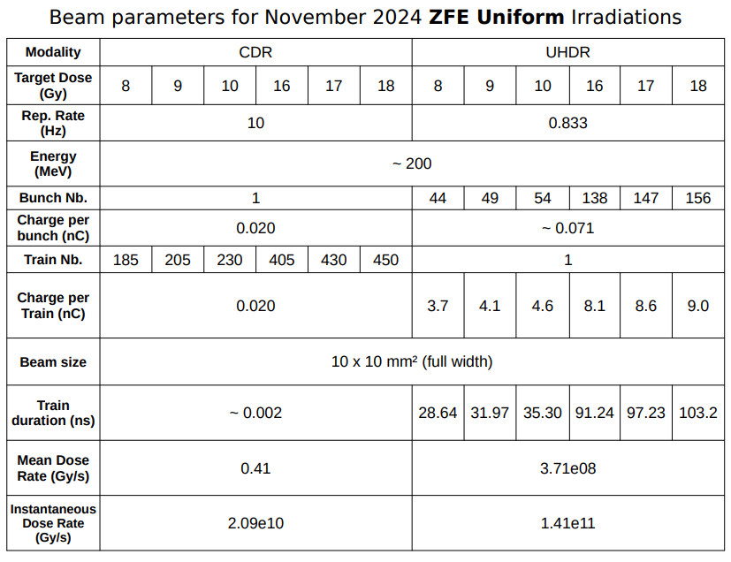
01/11/2024_Flat_Beam parameters_FLASH sparing
The charge per bunch at FLASH mode was 71 pC, almost half the charge per bunch of July experiments.

Slide 7
Week 1_Day 2_ZFE at 4hpf_Flat_21%O2-28°C
10.04.25
ZFE, V = 200 µL
With sparing parameters in FLAT
Run 1
C1 8Gy 20pC | C2 8Gy 20pC | C3 9Gy 20pC | C4 9Gy 20pC | C5 10Gy 20pC | C6 10Gy 20pC | F7 8Gy 71pC | F8 8Gy 71pC | F9 9Gy 71pC | F10 9Gy 71pC | F11 10Gy 71pC | F12 10Gy 71pC
# Ctrl1 Beam | # Ctrl2 Beam
# Ctrl3 Incub | # Ctrl4 Incub
Run 2
ZFE at 6hpf_Flat_21%O2-28°C
C21 16Gy 20pC | C22 16Gy 20pC | C23 17Gy 20pC | C24 17Gy 20pC | C25 18Gy 20pC | C26 18Gy 20pC | F27 16Gy 71pC | F28 16Gy 71pC | F29 17Gy 71pC | F30 17Gy 71pC | F31 18Gy 71pC | F32 18Gy 71pC
# Ctrl5 Beam | # Ctrl6 Beam
# Ctrl7 Incub | # Ctrl8 Incub

Slide 8
Week1_Day 3_ZFE at 4hpf_FLAT_21%O2-28°C
Dose per bunch escalation
11.04.25
ZFE, V = 200 µL
Dose: 10Gy
UHDR ?pC (1 train)
UHDR ?pC (1 train)
UHDR 71pC (1 train)
CONV 10pC (230 trains)
Depending on what can be done with CLEAR beamline
10 embryos/sample_12 tubes to be irradiated + 4 controls
Irradiation should be done in 30min
C1 10G 10pC | C2 10Gy 10pC | C3 10Gy 10pC
F4 10Gy 71pC | F5 10Gy 71pC | F6 10Gy 71pC | F7 10Gy ?pC | F8 10Gy ?pC | F9 10Gy ?pC | F10 10Gy ?pC | F11 10Gy ?pC | F12 10Gy ?pC
# Ctrl1 Beam | # Ctrl2 Beam
# Ctrl3 Incub | # Ctrl4 Incub
To be discussed

Slide 9
Week2_Day 1 _ZFE at 4hpf_Flat_21%O2-28°C
16.04.25
ZFE, V = 200 µL
With sparing parameters in FLAT
Run 1
C1 8Gy 20pC | C2 8Gy 20pC | C3 9Gy 20pC | C4 9Gy 20pC | C5 10Gy 20pC | C6 10Gy 20pC | F7 8Gy 71pC | F8 8Gy 71pC | F9 9Gy 71pC | F10 9Gy 71pC | F11 10Gy 71pC | F12 10Gy 71pC
# Ctrl1 Beam | # Ctrl2 Beam
# Ctrl3 Incub | # Ctrl4 Incub
Run 2
ZFE at 6hpf_Flat_21%O2-28°C
C21 16Gy 20pC | C22 16Gy 20pC | C23 17Gy 20pC | C24 17Gy 20pC | C25 18Gy 20pC | C26 18Gy 20pC | F27 16Gy 71pC | F28 16Gy 71pC | F29 17Gy 71pC | F30 17Gy 71pC | F31 18Gy 71pC | F32 18Gy 71pC
# Ctrl5 Beam | # Ctrl6 Beam
# Ctrl7 Incub | # Ctrl8 Incub

Slide 10
Week2_Day 2_FLAT_Spacing time between the bunches
17.04.25
Dose: 10Gy
UHDR – 71pC (1 train) in 54 bunches separated by
666ps
0.1s
0.33s
0.625s
1 sec ?
CONV – 20pC (230 trains) seperated by 0.1s
ZFE, V = 200 µL
ZFE at 4hpf_FLAT_21%O2-28°C
C1 10Gy 20pC 0.1s | C2 10Gy 20pC 0.1s | F3 10Gy 71pC 666ps | F4 10Gy 71pC 666ps | F5 10Gy 71pC 0.1s | F6 10Gy 71pC 0.1s | F7 10Gy 71pC 0.33s | F8 10Gy 71pC 0.33s | F9 10Gy 71pC 0.625s | F10 10Gy 71pC 0.625s
# Ctrl1 Beam | # Ctrl2 Beam
# Ctrl3 Incub | # Ctrl4 Incub
To be discussed
(Maximum spacing time between bunch?)

