Slide 1
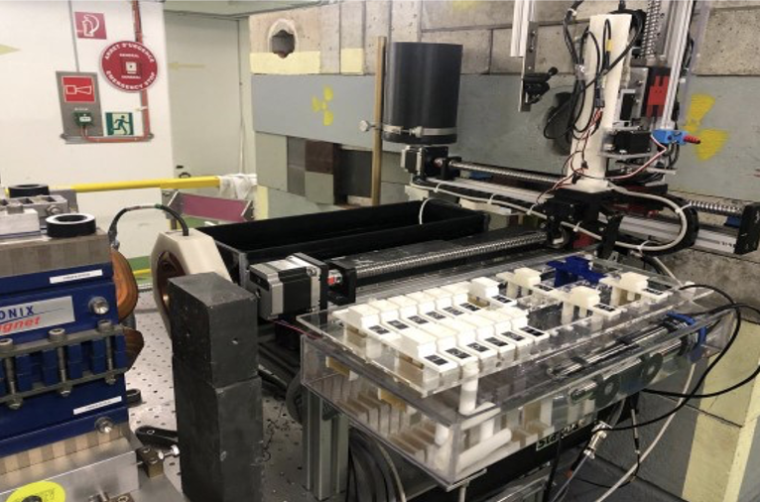
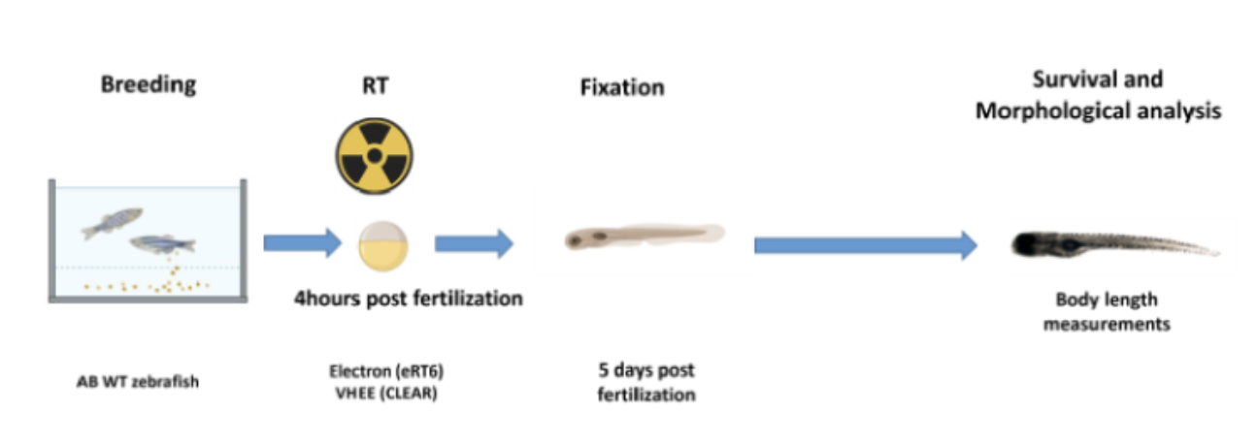
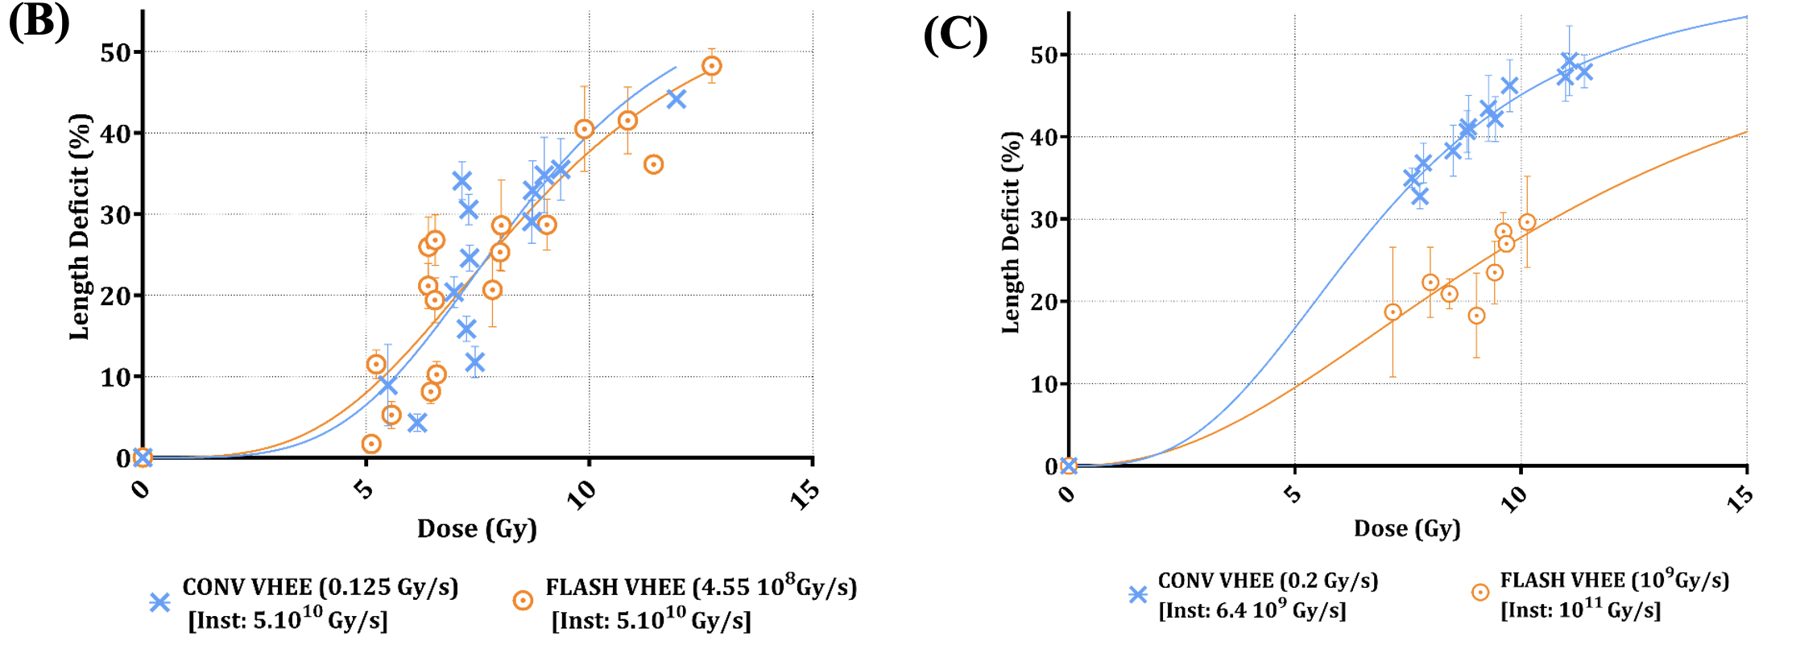
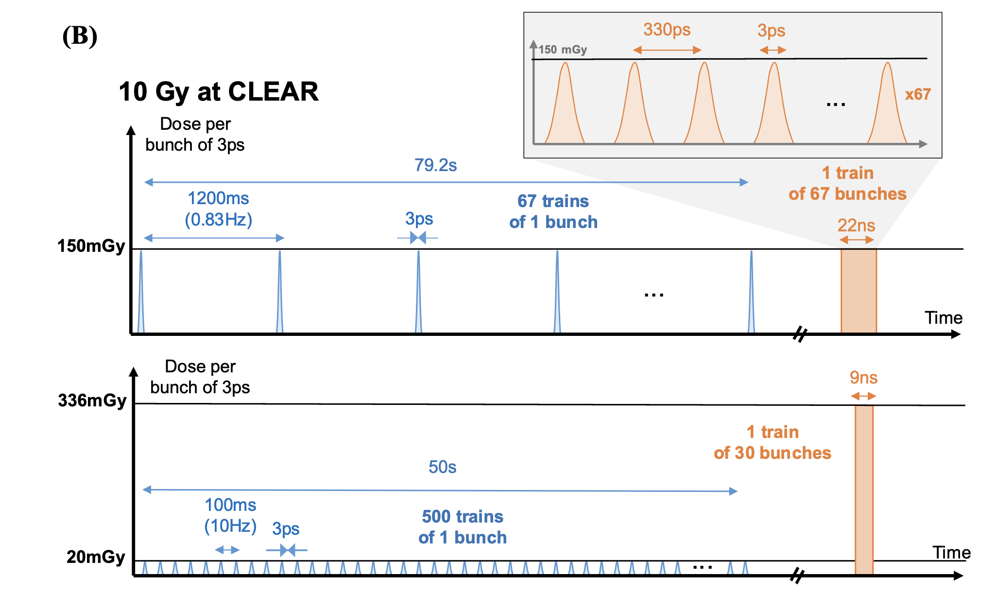
Zebra Fish Eggs irradiation in CLEAR
Kacem et al.,
submitted
First observation of FLASH sparing with a VHEE beam
Same “instantaneous” dose rate
Factor ~ 15 in “instantaneous” dose rate
What matters seems to be the dose rate over the bunch (ps time scale)

Slide 2
Bunch charge vs. dose per bunch
Quoting bunch charge might be confusing, expecially comparing gaussian vs. uniform, since dose depends on beam size.
Proposal: use dose per bunch in the discussion for easy comparison
Instantaneous dose rate might also work, but we don’t systematically measure bunch length, and strictly speaking it depends on bunch longitudinal shape (not gaussian in general…)
Reference conditions:
FLASH: 150 mGy/bunch, train
(i.e. 67 bunches for 10 Gy total, 22ns)
“Anomalous”: 150 mGy/bunch, single bunch - 1 Hz
(i.e., 67 bunches for 10 Gy total, 79 s)
FLASH: 336 mGy/bunch, train
(i.e., 30 bunches for 10 Gy total, 9ns)
Conventional: 20 mGy/bunch, single bunch - 10 Hz
(i.e., 500 bunches for 10Gy total, 50 s)

Slide 3
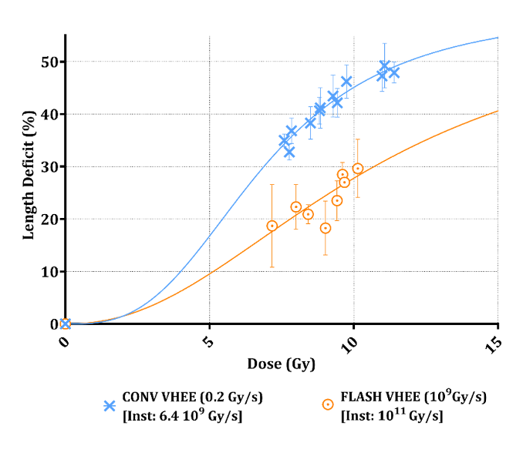
Proposal: 3-point experiment
Hypotesis: the instantaneous dose rate plays a role in FLASH
First observation – no difference between FLASH and ”anomalous” (high instantaneous dose rate)
Second observation: difference found between FLASH and CONV
Repeat simultaneously the 3 conditions (with the same eggs batch, etc…) to measure the differential effects in the same biological and ambient conditions
anomalous
What parameters? Not very important, as far as very different for the 3 points, and in the same ballpark as previous observations. However:
  Good to have same dose per bunch in FLASH and “anomalous” (fast beam set-up, direct comparison)
  Might want to favour higher doses per bunch for FLASH and “anomalous”

Slide 4
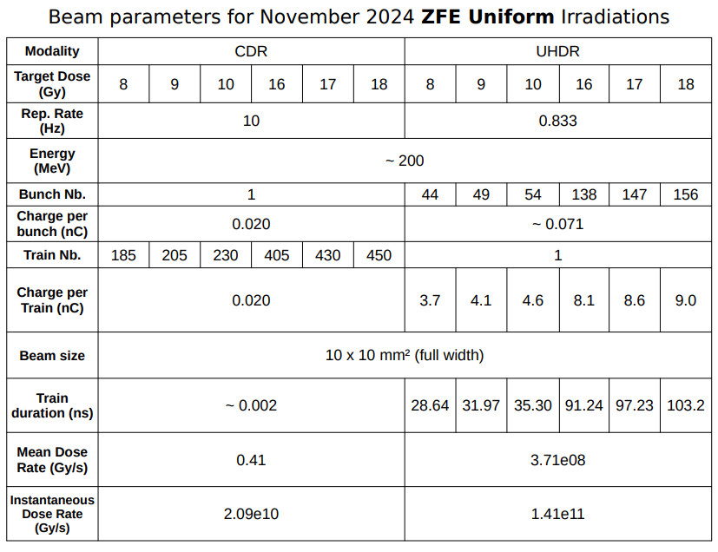
01/11/2024_Flat_Beam parameters_FLASH sparing
Dose per bunch
(mGy)
43 | 44 | 43 | 40 | 40 | 40 |  | 182 | 184 | 185 | 116 | 116 | 115
Dose per bunch in previous experiments: CONV 20 mGy, FLASH 336 mGy and 150 mGy, “anomalous 150 mGy…

Slide 5
Week 1_Day 2_ZFE at 4hpf_Flat_21%O2-28°C
10.04.25
ZFE, V = 200 µL
With sparing parameters in FLAT
Run 1
C1 8Gy 20pC | C2 8Gy 20pC | C3 9Gy 20pC | C4 9Gy 20pC | C5 10Gy 20pC | C6 10Gy 20pC | F7 8Gy 71pC | F8 8Gy 71pC | F9 9Gy 71pC | F10 9Gy 71pC | F11 10Gy 71pC | F12 10Gy 71pC
# Ctrl1 Beam | # Ctrl2 Beam
# Ctrl3 Incub | # Ctrl4 Incub
Run 2
ZFE at 6hpf_Flat_21%O2-28°C
C21 16Gy 20pC | C22 16Gy 20pC | C23 17Gy 20pC | C24 17Gy 20pC | C25 18Gy 20pC | C26 18Gy 20pC | F27 16Gy 71pC | F28 16Gy 71pC | F29 17Gy 71pC | F30 17Gy 71pC | F31 18Gy 71pC | F32 18Gy 71pC
# Ctrl5 Beam | # Ctrl6 Beam
# Ctrl7 Incub | # Ctrl8 Incub
How to adapt the experiment to 3 conditions (and 3 doses)?

Slide 7
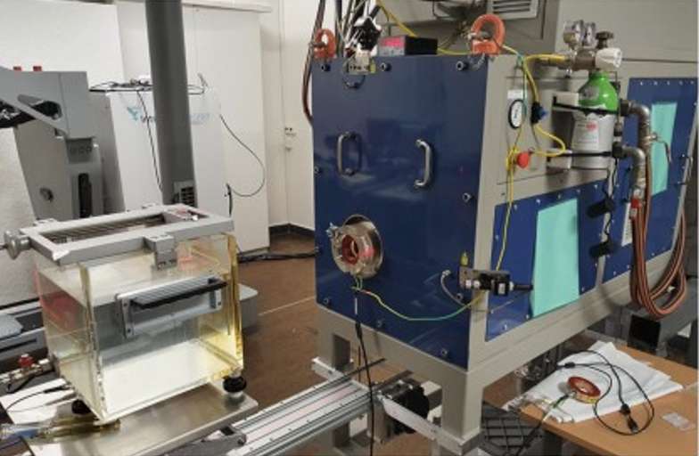
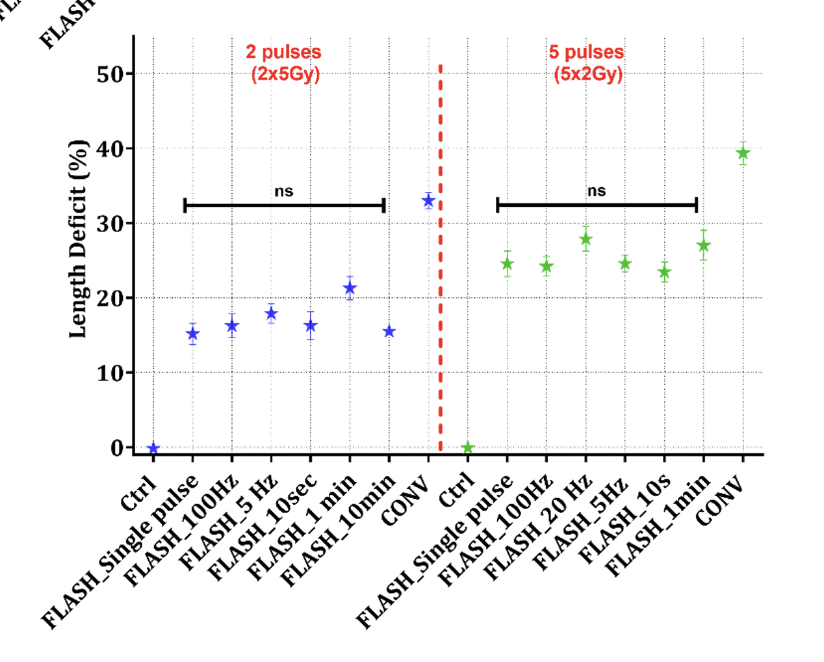
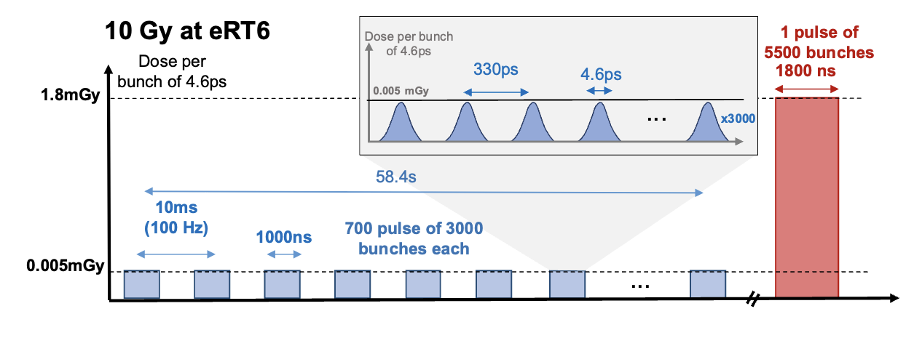
Zebra Fish Eggs irradiation in eRT6
Kacem et al.,
submitted
5.5 Mev
electrons
Seems to confirm the CLEAR results
See also Poster 297, J. Ollivier, this conference

Slide 8
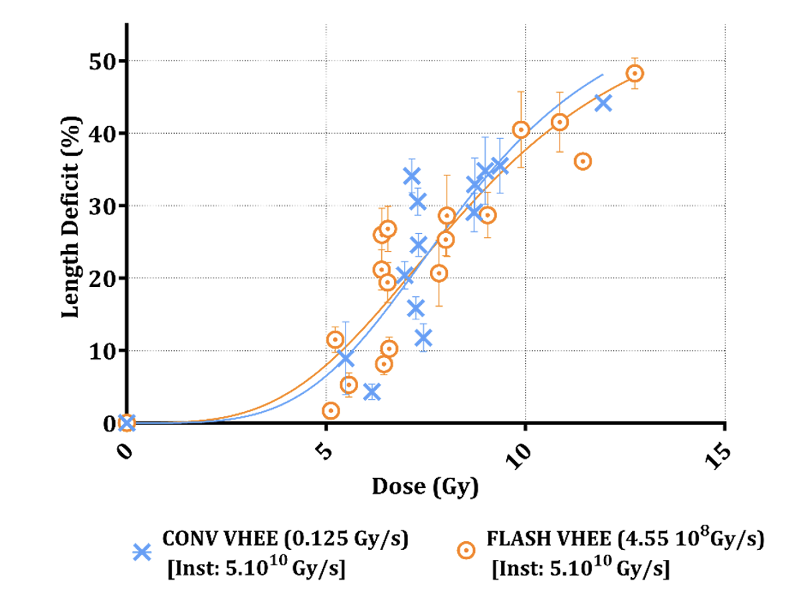
FLASH sparing effect at low average dose rates & long irradiation times?
CLEAR VHEE (200 MeV)
CHUV – eRT6 IEE (5.5 MeV)
Total irradiation time for 10 Gy > 1 minute
(average dose rate 0.13 Gy/s)
Total irradiation time up to 10 minutes
(average dose rate as low as 0.04 Gy/s)

