Slide 1
Gas systems for the LHC experiments:
M&O summary for 2024

Slide 2
Outlook
Gas Systems M&O contributions: present and future
Conclusions

Slide 3
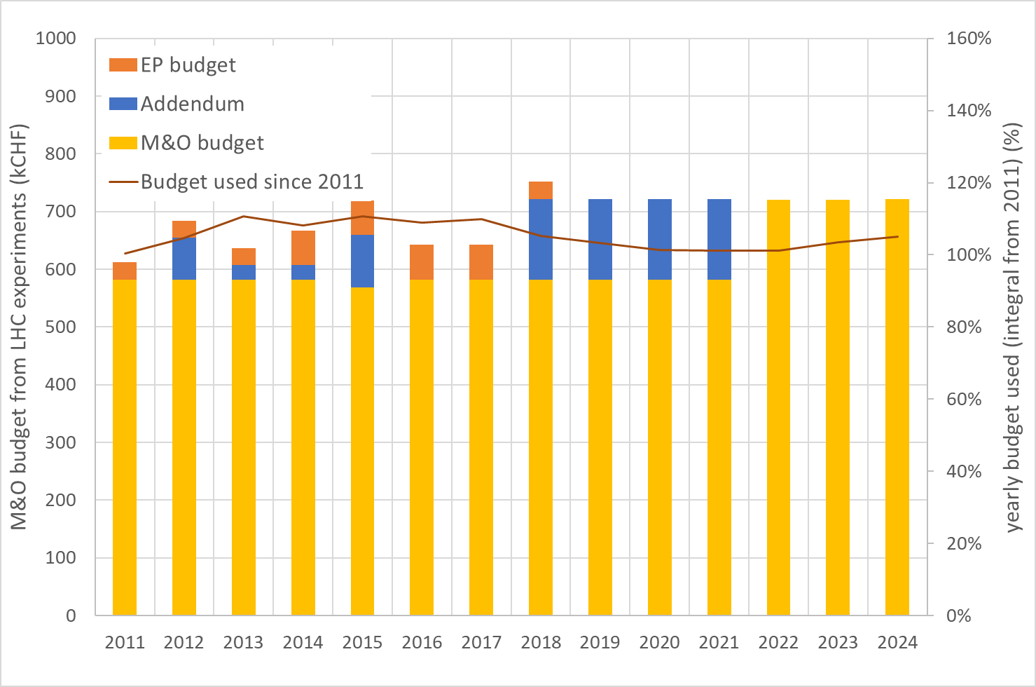
M&O budget: where we are

Slide 4
M&O budget
2024 M&O agreement (EDMS 2779718):
Material and personnel costs covered by the M&O agreement
MFCs maintenance
Consumables (lab, tools, connectors, …)
Gas analysis (calibration gases, materials, O2 cells, maintenance, …)
Pump maintenance 2000h & 30000 h
Purifier maintenance
Safety valve maintenance
Pneumatic controls
PLC & Power Supply
Pressure sensors
“ex-Addendum”: what has been added wrt original 2007 M&O agreement (EDMS 867594 v.2):
Maintenance organization (procedures, reports, …)
Operation of gas recuperation plants
Analysis modules and operation (in particular gas chromatography)
R&D for upgrade/consolidation (pressure sensors, gas analysers, PLC, …)

Slide 5
M&O budget
Last year discussion for an “update from 2025” (EDMS 3088231):
Size and complexity of the gas systems infrastructure is increasing (both from due to additional requirements and new recuperation plants)
Material costs is increased by about 30% in the last 10 years
Additional expertise needed
  +1/3 fellow (3D drawings) paid on M&O
  +1 fellow for gas systems operation and flowcells
  +1/2 fellow for gas systems operation and gas recuperation
  +1 tech. student/Doctoral for EAM/Infor, risk assessment and reliability analysis
Human resources evolution
  -1 staff (controls) paid on EP budget (from 2025 back to EP budget thanks to a new LD)
  +1 fellow (controls) paid on M&O (same position as above, from mid-2025 back to EP budget thanks to a new LD)
  -1.5 staff technical (new LD technical opened)

Slide 6
M&O budget
“update from 2025” (EDMS 3088231):
Extra cost (total):
150 k from the experiments + 50 k from DT group
To compare with the cost saving for the LHC experiments directly produced by Gas Team R&D activities, development and construction funded by CEPS and HostLab:
Experiment | Additional contribution (kCHF)
ALICE | 28
ATLAS | 44
CMS | 50
LHCb | 28
Experiment | Activity | Cost saving per year achieved
ATLAS | New 30% CO2 gas mixture for RPC [doi 10.1016/j.nima.2023.168088] | 100 kCHF (at present mixer flow) since mid 2023
CMS | CF₄ recuperation plant for CSC | 50-60 kCHF
 | R134a recuperation plant for RPC | 67 kCHF since 2024
 | R134a for RPC variable injection according to LHC status (MD, TS, Ion Run, …) | 9 kCHF since 2024
LHCb | CF₄ recuperation for RICH2 | ~1.5 kCHF
 | C₄F₁₀ recuperation for RICH1 | 26 kCHF
Total cost saving |  | ≥ 240 kCHF

Slide 7
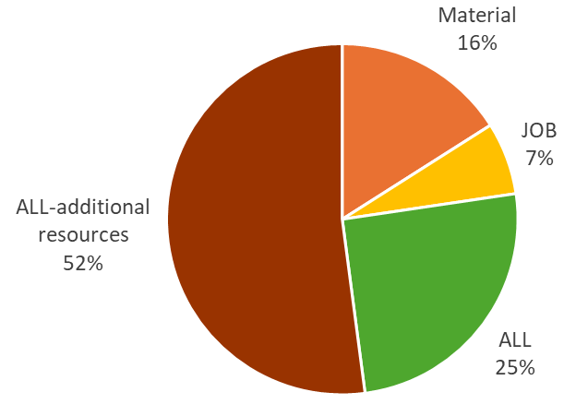
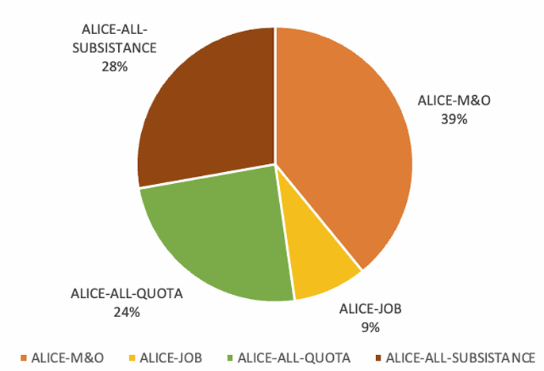
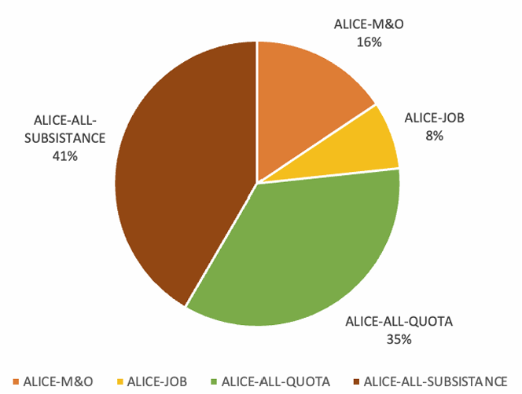
M&O budget 2022, 2023 and 2024
ALICE example:
2022
93% budget used
2023
118% budget used
2024
118% budget used

Slide 8
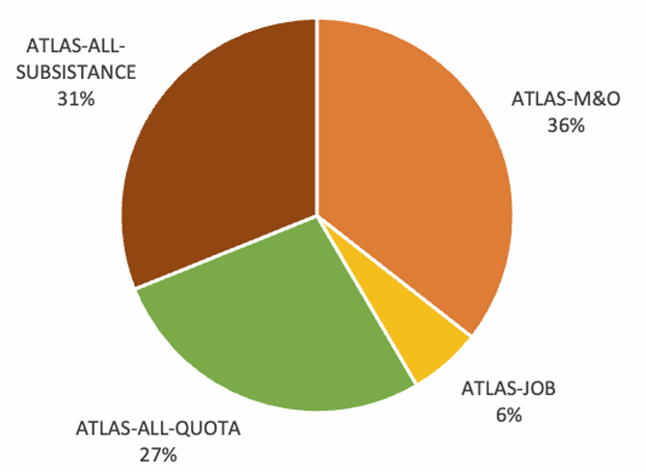
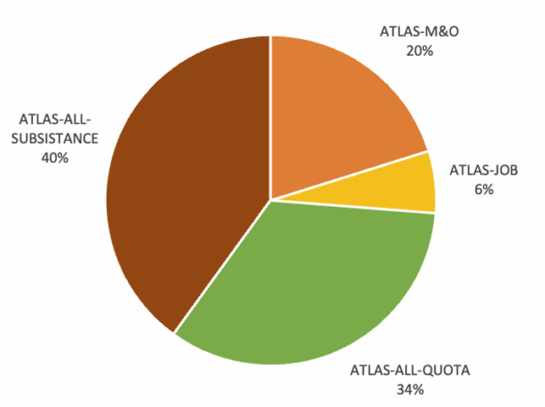
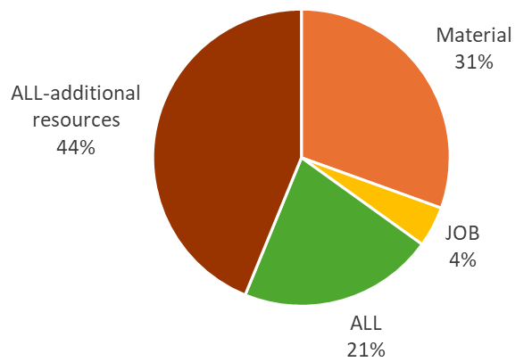
M&O budget 2022, 2023 and 2024
ATLAS :
2022
2023
2024
83% budget used
125% budget used
140% budget used

Slide 9
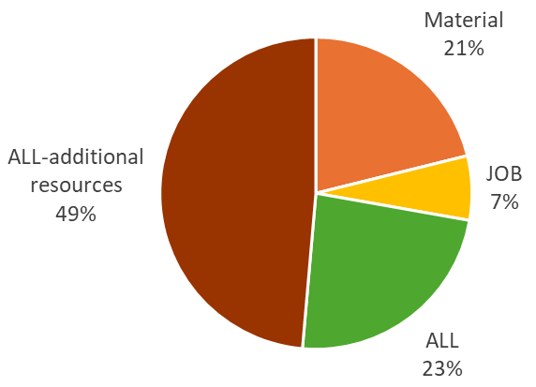
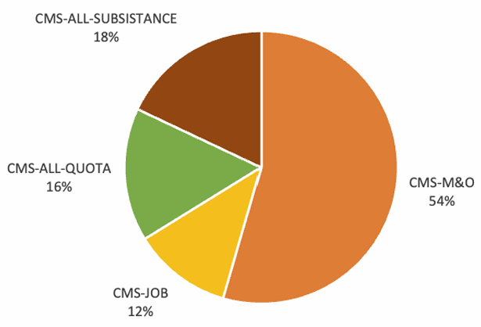
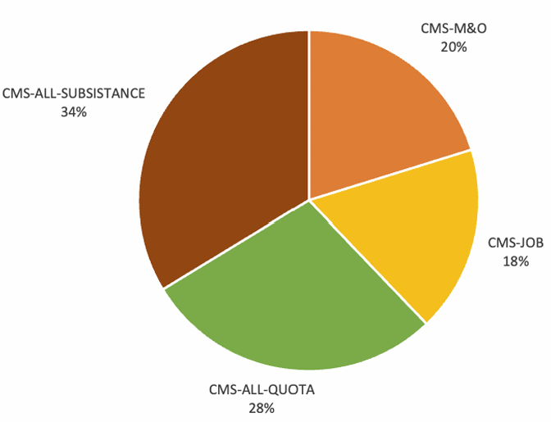
M&O budget 2022, 2023 and 2024
CMS :
2022
2023
2024
122% budget used
135% budget used
126% budget used

Slide 10
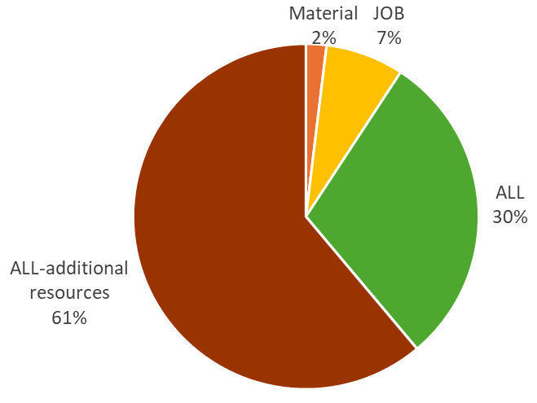
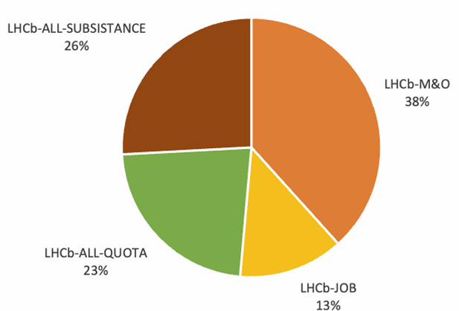
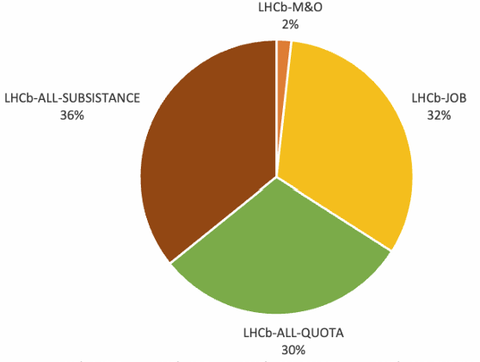
M&O budget 2022, 2023 and 2024
LHCb :
2023
2022
2022
140% budget used
210% ← including RICH1 recuperation →
100% budget used
145%
100% budget used

Slide 11
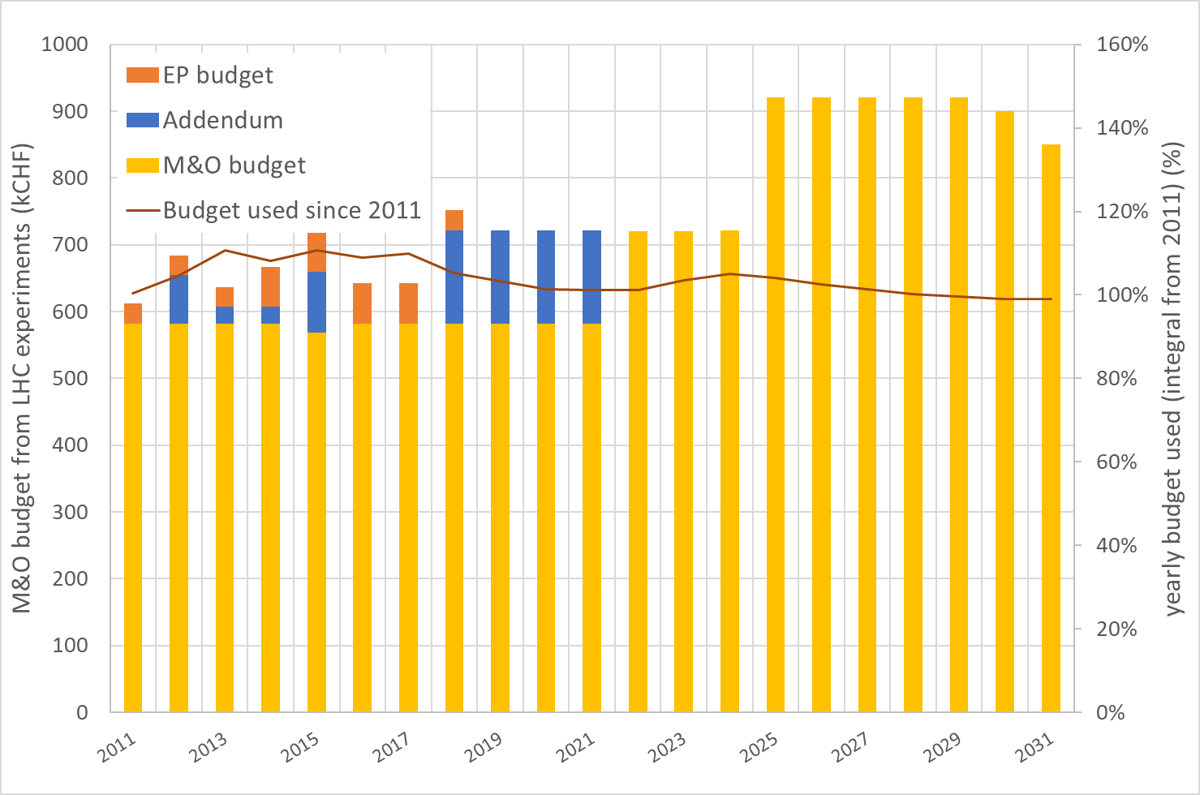
M&O budget: forecast for coming years

Slide 12
M&O budget: forecast for coming years
Expected cost changes
2025: -0.5 fellow back on EP budget (new LD replacing existing position in the past)
-0.5 TTE back on EP budget (new LD replacing existing position in the past)
2026-2028: -1 fellow and -1 TTE
From ~2029 (end LS3-> beginning Run4): restart of gas systems and gas recuperation plants
+0.5 fellow

Slide 13
Conclusions
From 2025 the situation should normalize:
Mainly thanks to the two new LD positions opened to recuperate positions already present in the past and recently lost
We can expect a decrease probably after LS3, but to keep an eye on the increasing complexity of new and old plants
In any case, the need of new competencies that we do not have in the existing technicians in the team, remains an issue that can be mitigated only with doctoral students and fellows (and the new LD technicians, which job description requires these competencies)
Additional remark:
We are often called for gas systems in facilities related to detectors construction/preparation/tests for the LHC experiments (i.e., GIF++, 904, T10, BB5, …).
It is an additional important load that with the present resource schema can be very easily critical.
It deserves the right level of attention and resources if we want to run these facilities efficiently.

Slide 15
Other incomes
CEPS – 33390 reduction of greenhouse gas emissions
 | 2023 | 2024 | 2025
Fellow | Gianluca (10%) | Gianluca (10%)
 |  | Pieter (j) (33%) | Pieter (j) (33%)
Doct.Std. | Arena (10%)
 | Mattia V (50%) | Mattia V (50%) | Mattia V (50%)
 | Stefania (100%) | Stefania (100%) | Stefania (100%)
Tech. Std |  | Amin (50%)
~ 200 kCHF
Main activities:
Consolidation of CF4 recuperation plants for CMS and LHCb
Development of R134a recuperation plant for ATLAS, CMS and ALICE
Development of C4F10 recuperation plant for LHCb
Development of SF6 recuperation plant for ATLAS, CMS and ALICE
Development of monitoring systems for LHC experiments
Development of medium size gas recirculation system
Development of small size gas recirculation system
Leading role in research for ecofriendly gas mixture
Notes:
CEPS 2024
Stef 50
MattiaV 25
Amin 20 circa
Gianluca 12 circa
Pieter 30
Totale 140 k

Slide 16
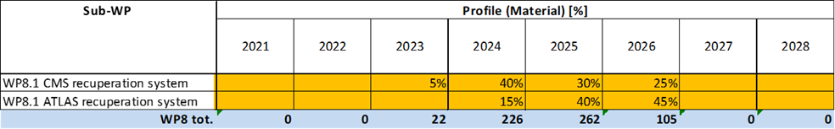
Other incomes
HostLab WP8 – 95528 & 95530 construction of R134a recuperation plants for ATLAS and CMS
 | 2023 | 2024 | 2025
Fellow |  | Damiano (j) (50%) | Damiano (j) (100%)
Doct.Std. |  | Arena (30%)
First R134a recuperation plant built in 2023 and installed at CMS
2024: operation and tuning of parameters

