Slide 1
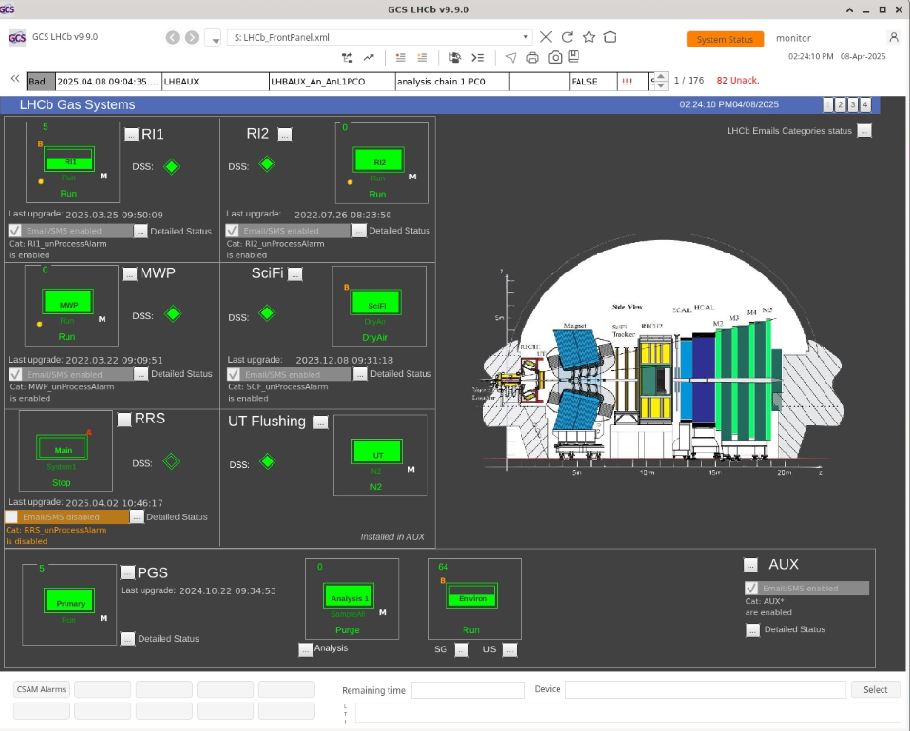
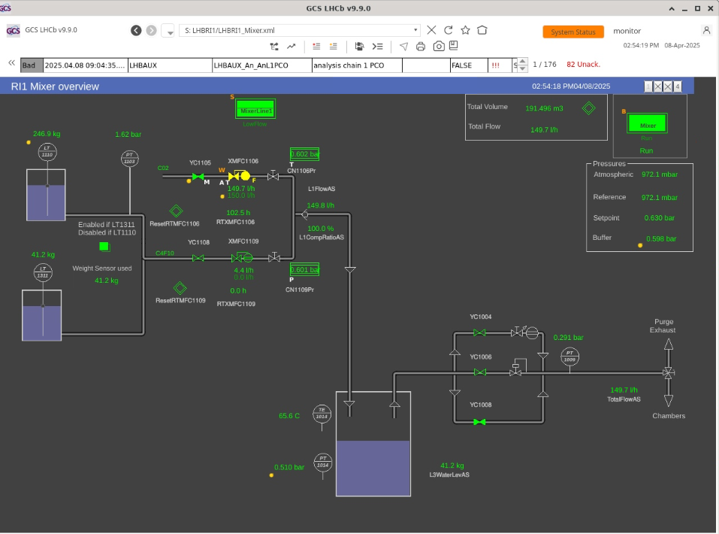
LHCb RICHI (CO₂ + C₄F₁₀ )
LS3:
  System to be operational
  Most of the time filled with CO₂/N₂
  In case of lack of pressure regulation
  system in backup mode with CO₂ supply
Run 4:
  Same conditions as Run 3
    C₄F₁₀ ~ 50 kg / year

Slide 2
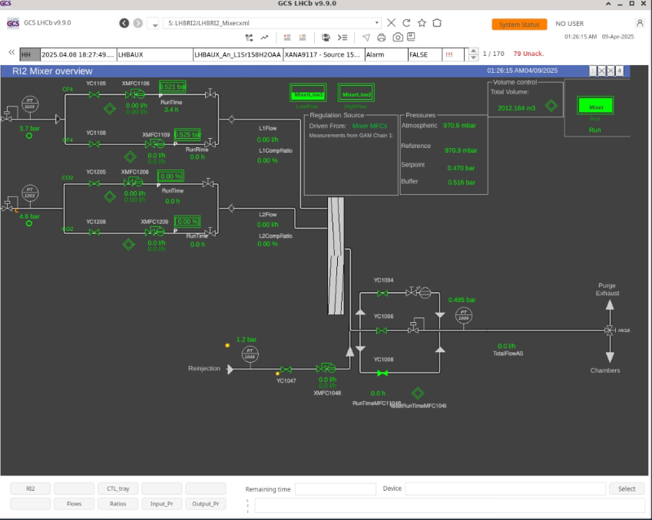
LHCb RICH II ( CO₂ + CF₄ )
LS3:
  System to be operational
  Gas not yet decided – potentially CO₂
  In case of lack of pressure regulation
  system in backup mode with CO₂ supply
Run 4:
  Same conditions as Run 3
    CF₄ ~ 20 … 50 kg / year

Slide 3
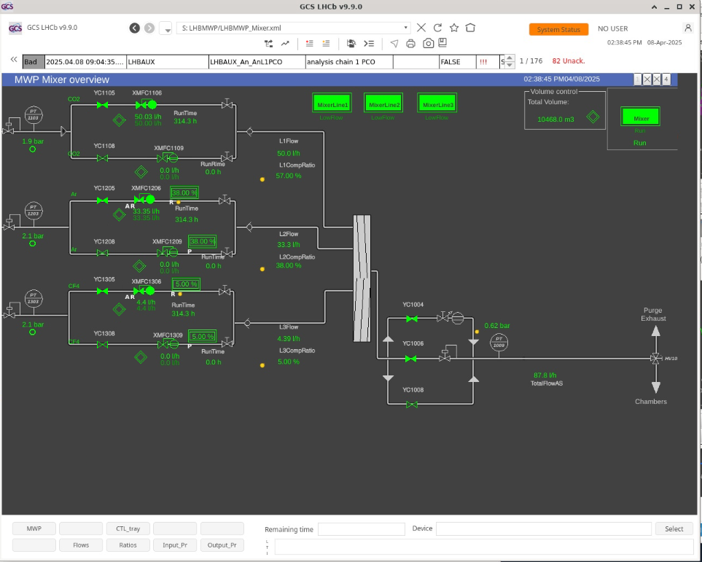
LHCb MUON ( CO₂ + Ar + CF₄ ), purifier (Ar+H₂)
LS3:
System to be operational:
  ~End of Run 3 – fix/study issues
  discovered during data taking period
  ~End of LS3 – recommissioning
Gas Mixture (to be agreed):
  During LS2 system flushed with N₂
  During YETS system flushed with Ar + CO₂
Run 4:
  Same conditions as Run 3

Slide 4
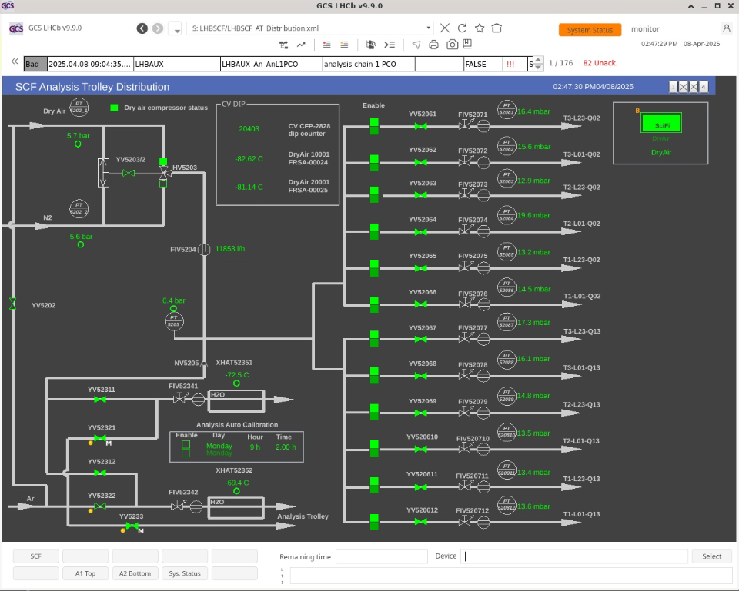
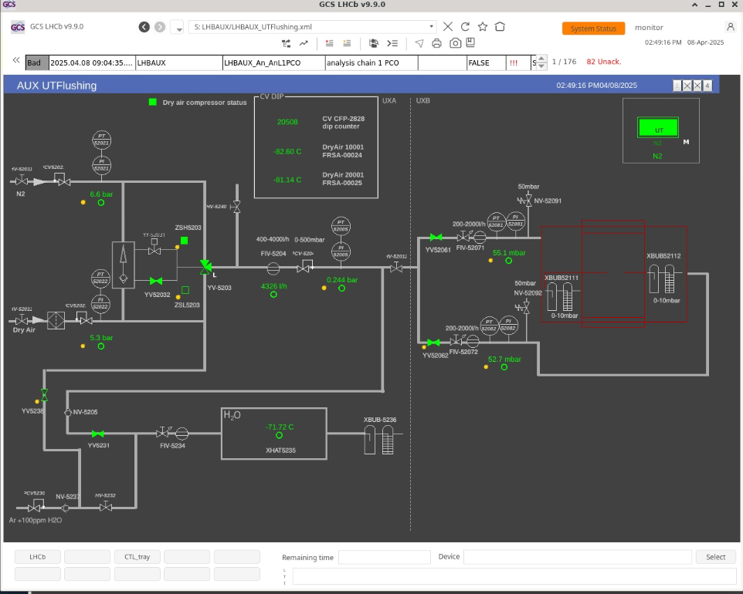
LHCb SciFi & UT (N₂ / Dry Air flushing)
LS3:
  UT main gas N₂ , backup Dry Air
    ~ 4400 l/h
  SciFi main gas Dry Air, backup N₂
    ~12000 l/h
Run 4:
  Same conditions as Run 3

Slide 5
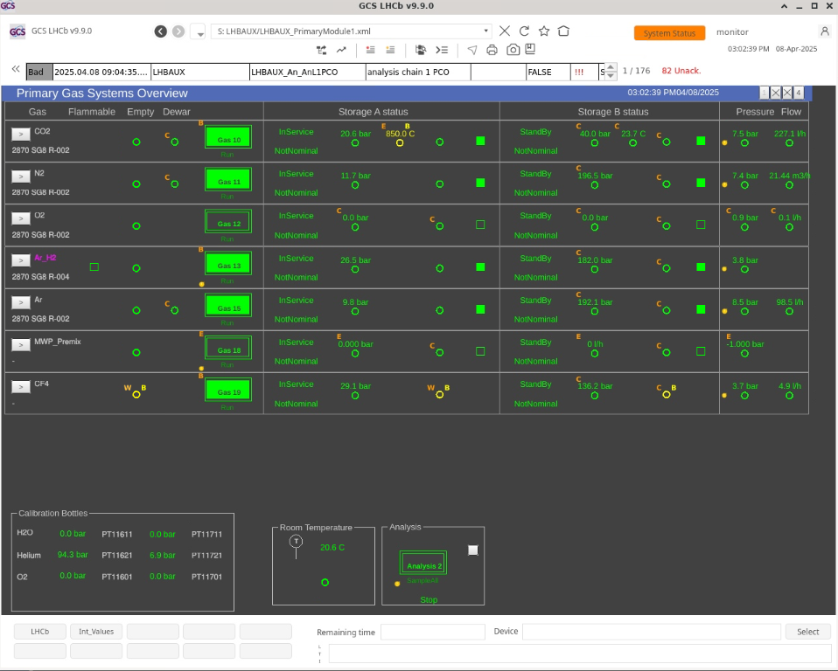
LHCb PGS ( CO₂, N2, O2, CF₄ , Ar)
LS3:
  Which gasses can be backed up
  during LS3 consolidation work?
Run 4:
  Same conditions as Run 3

