Slide 1


Slide 2



Magnetic and optics modeling of accelerator’s main magnets and validation via beam-based measurements: case study at the CERN Proton Synchrotron
14 April 2025
Vittorio Ferrentino
Advisor: Prof. Pasquale Arpaia
co-Advisor: Dr. Ewen Hamish Maclean (CERN)
Cycle: XXXVII

Slide 3




Candidate’s information
MSc degree: Electrical Engineering at DIETI, UNINA, Naples, Italy
DIETI Research group/laboratory: IMPALab
Scholarship type: Enrolled as supernumerary under the UNINA-CERN agreements and CERN Doctoral Student Programme
Partner company: European Organization for Nuclear Research (CERN)
PhD Defense - Vittorio Ferrentino 14 April 2025

Slide 4
Contents
Introduction to particle accelerators, context and research scope
The CERN Proton Synchrotron and its main magnetic units
PS-MU modeling
Beam-based measurements
Models’ validation: bare-machine
Models’ validation for auxiliary circuits control
Conclusions – Take away messages
4
PhD Defense - Vittorio Ferrentino 14 April 2025

Slide 5
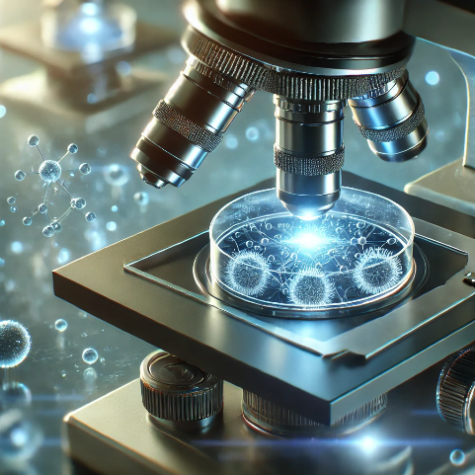
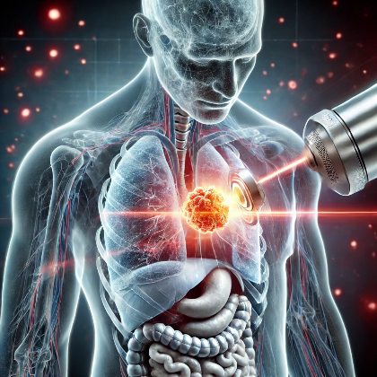
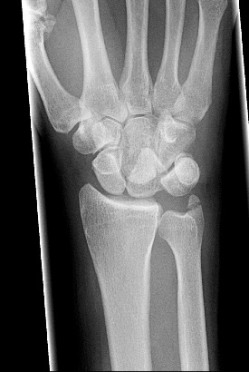
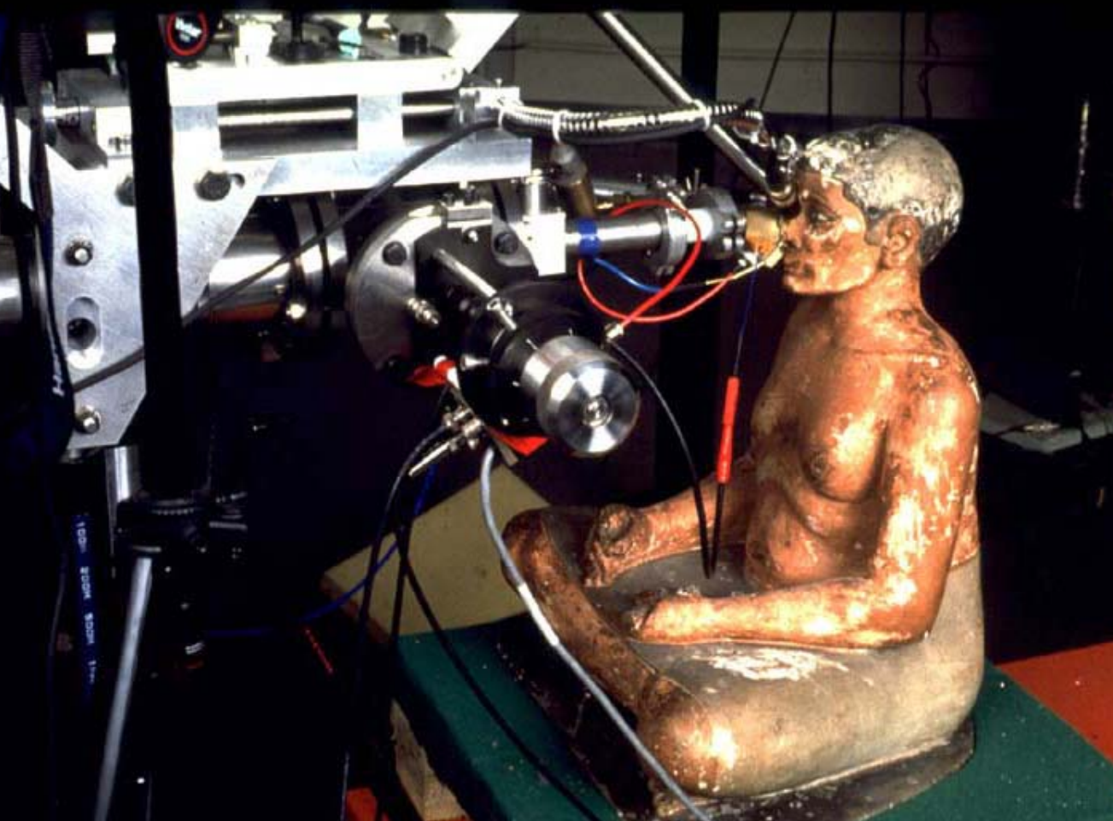
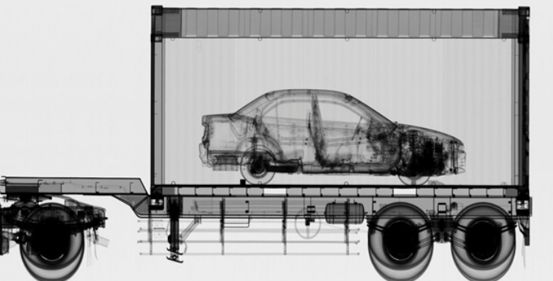
Particle accelerators: why?
To understand the fundamental elements of matter and the origin of the universe, we need very powerful “microscopes”: particle accelerators.
These unconventional microscopes are machines which accelerate particles close to the speed of light.
Besides their application in fundamental physics research, more than 30000 particle accelerators are in operation worldwide. They are used in medical application (diagnostics, medical imaging and cancer treatments), industry (e.g., semiconductors manufacturing, food industry), biology research, archeology, energy and security applications, and many others [2].
*
**
* https://accelconf.web.cern.ch/e02/TALKS/FRYGB001.pdf
** https://cas.web.cern.ch/sites/default/files/Sheehy-Applications.pdf
5
PhD Defense - Vittorio Ferrentino 14 April 2025

Slide 6
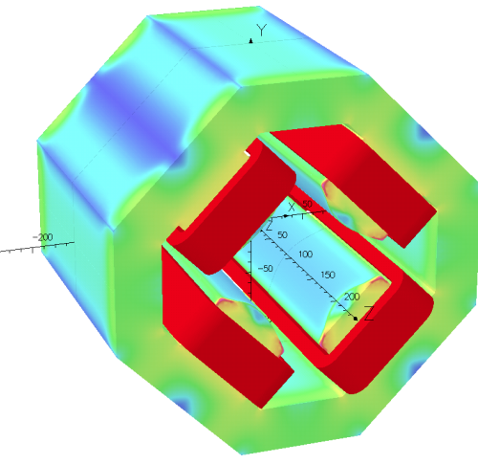
Modeling of particle accelerators
Particle accelerators employed for fundamental physics research allow for collisions of sub-atomic particles to study the essential components the matter is built of.
Integration of multiple disciplines, including accelerator magnet design, beam instrumentation, radio-frequency systems, particle dynamics studies, cryogenics, power converters, etc.
Motion of particle beams in circular accelerators, and the space they occupy within them, determined by electromagnetic forces generated by magnetic units distributed along the accelerator ring.
Accurate models of the magnetic units and resulting beam dynamics in accelerators are essential for their design, supporting operational decisions, addressing increasingly stringent experimental requirements.
*
* https://cds.cern.ch/record/1662563/files/CERN-ACC-2014-0029.pdf
6
PhD Defense - Vittorio Ferrentino 14 April 2025

Slide 7



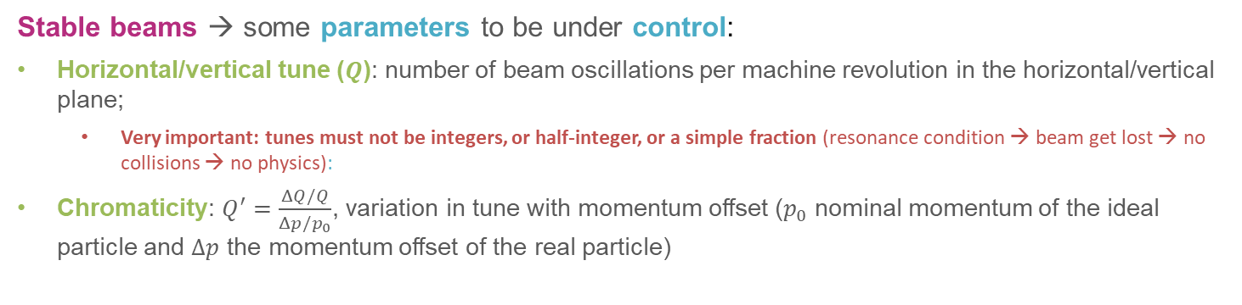

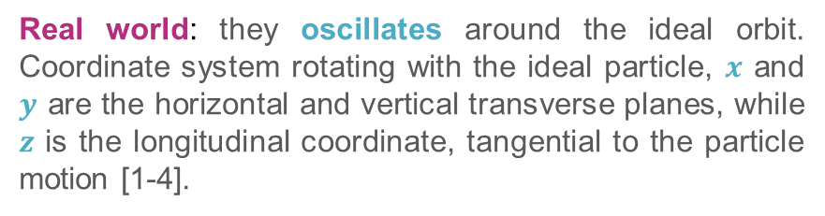

Beam dynamics concepts
Ideal particle in accelerators are designed to move on reference orbit.
$$O$$
Real world: they oscillates around the ideal orbit. Coordinate system rotating with the ideal particle, $x$ and $y$ are the horizontal and vertical transverse planes, while $z$ is the longitudinal coordinate, tangential to the particle motion [1-4].
$$y$$
$$ρ$$
$$x$$
$$z$$
Physics studies require high precision control of the particles motion to allow for collisions.
Stable beams → some parameters to be under control:
Horizontal/vertical tune ($Q$): number of beam oscillations per machine revolution in the horizontal/vertical plane;
  Very important: tunes must not be integers, or half-integer, or a simple fraction (resonance condition → beam get lost → no collisions → no physics):
Chromaticity: $Q^{′}=\frac{ΔQ/Q}{Δp/p_{0}}$, variation in tune with momentum offset ($p_{0}$ nominal momentum of the ideal particle and $Δp$ the momentum offset of the real particle)
7
PhD Defense - Vittorio Ferrentino 14 April 2025

Slide 8



Beam control
Particles motion is governed by the electromagnetic forces → Lorenz’s force:
Electric fields used to accelerate particles within radiofrequency (RF) cavities
magnetic fields used to guide particles throughout the accelerator.
Dipole magnet → magnetic field to bend the particle’s trajectory
$$\vec{B_{1}}$$
Quadrupole magnet → magnetic field to focus (defocus) particle’s trajectory
$$\vec{B_{2}}$$
$$\vec{E}$$
RF cavity → electric field to accelerate particles
8
PhD Defense - Vittorio Ferrentino 14 April 2025

Slide 9
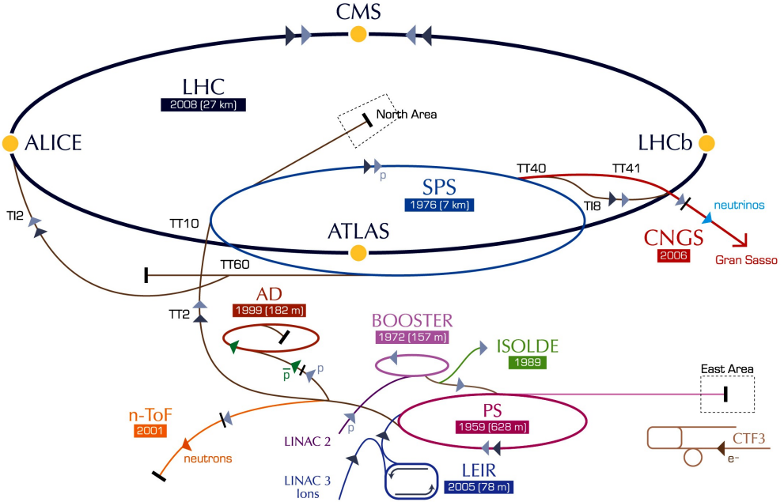
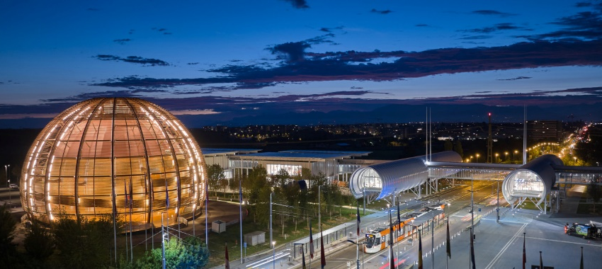
Research area and scope
The main research area of interest is the combined magnetic and optics modelling of main magnetic units in particle accelerators, and their validation via beam-based measurements.
The case study is centred on the CERN Proton Synchrotron (PS) accelerators Main Unit (MU) magnets, which is part of Large Hadron Collider’s (LHC) injector chain and plays a vital role in delivering high quality and stable beams to downstream accelerators.
[1]
[1] https://indico.cern.ch/event/1382428/
[2] https://cds.cern.ch/images/CERN-GRAPHICS-2022-001-1
9
PhD Defense - Vittorio Ferrentino 14 April 2025

Slide 10
Contents
Introduction to particle accelerators, context and research scope
The CERN Proton Synchrotron and its main magnetic units
PS-MU modeling
Beam-based measurements
Models’ validation: bare-machine
Models’ validation for auxiliary circuits control
Conclusions – Take away messages
10
PhD Defense - Vittorio Ferrentino 14 April 2025

Slide 11
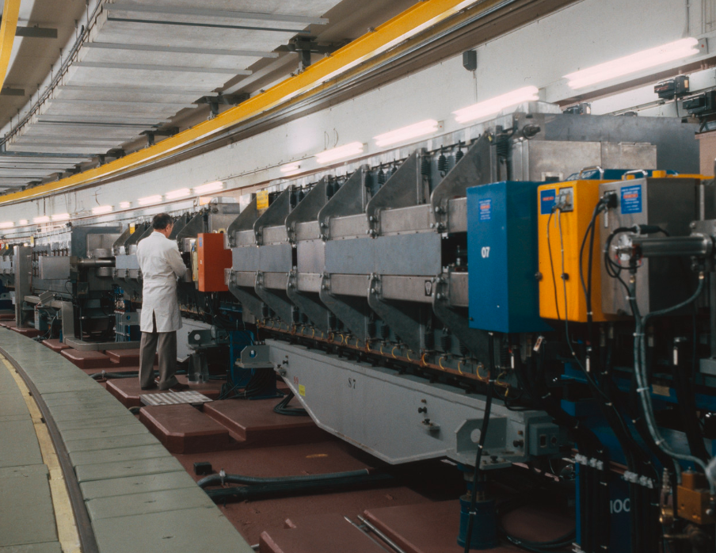
Proton Synchrotron (PS)
CERN Proton Synchrotron (PS) is the first accelerator built at CERN, accelerating the first protons in 1959.
Accelerates proton and heavy ion beams from 2 GeV/c to 26 GeV/c;
Circumference of 628 m;
277 room-temperature magnets (dipole main-units, injection magnets, extraction magnets, etc.)
  100 Main-Units (MU) magnets generating the main field in the accelerator to keep the beam circulating.
*
* https://cds.cern.ch/record/2423241;
11
PhD Defense - Vittorio Ferrentino 14 April 2025

Slide 12
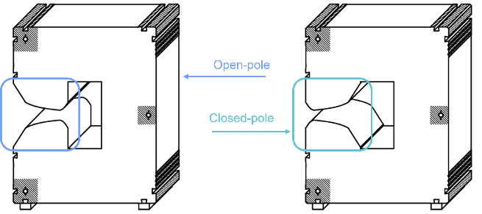
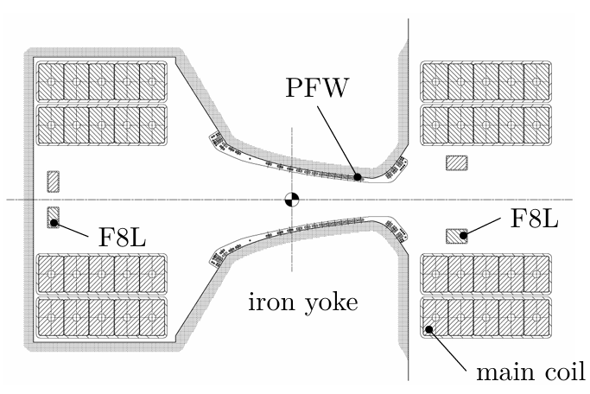
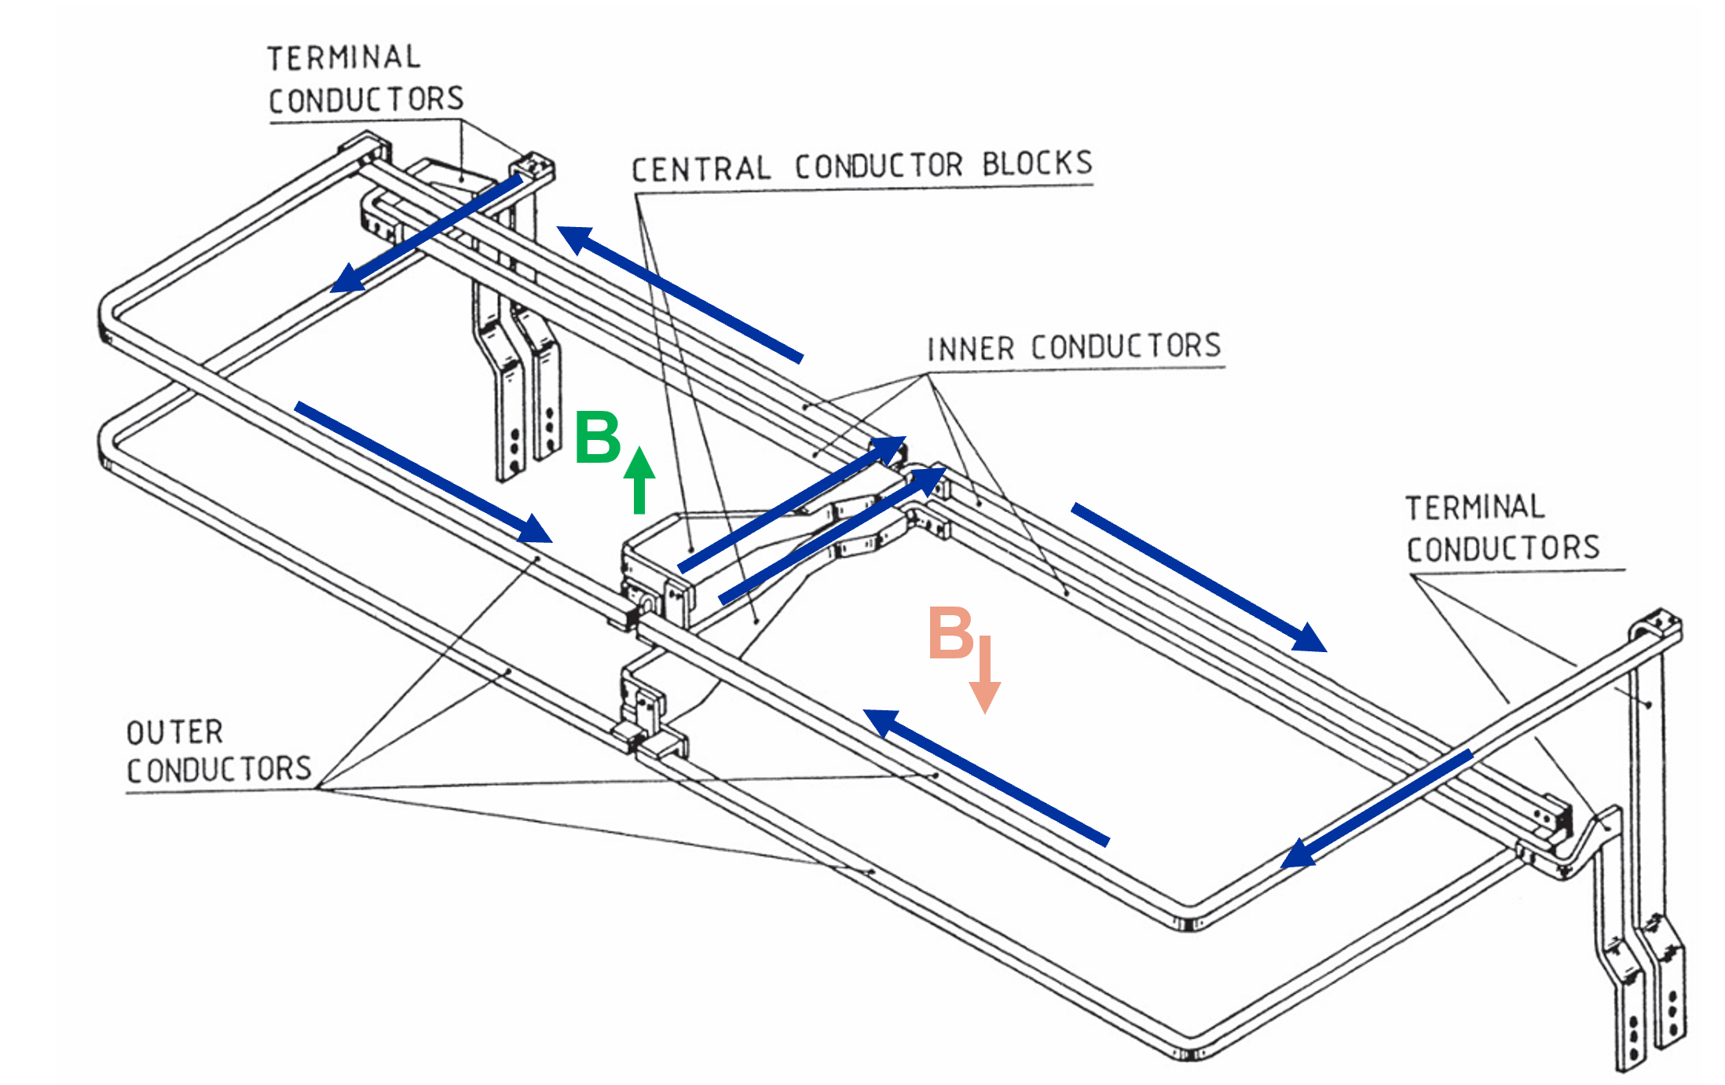
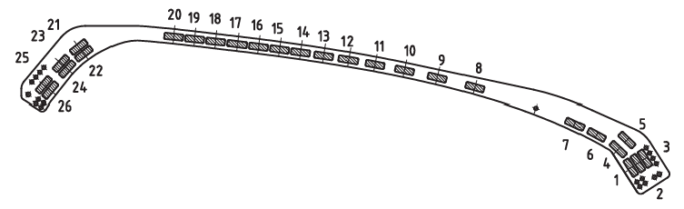
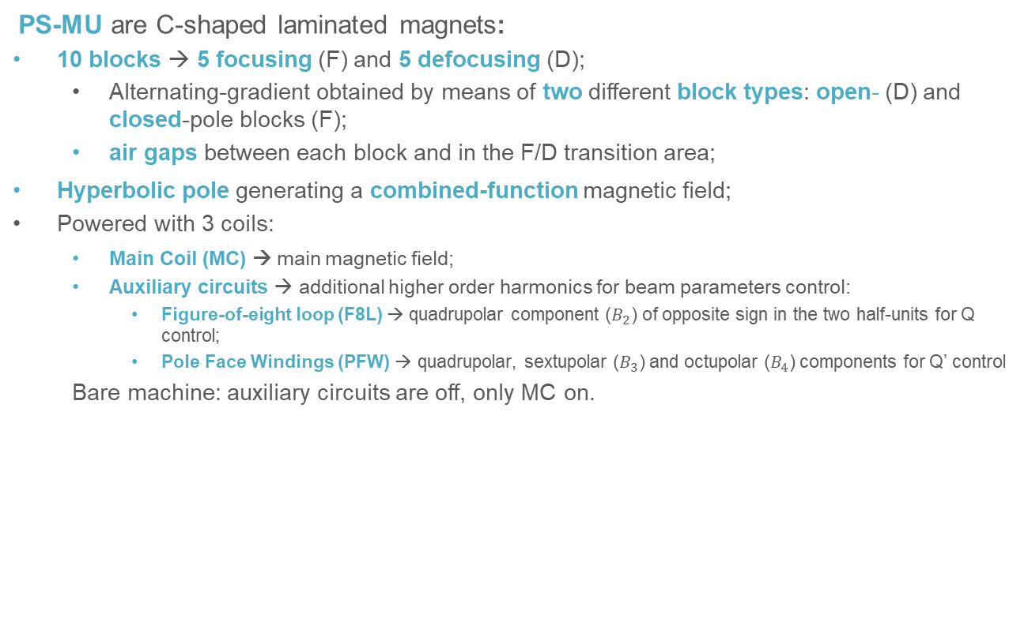
PS Main Unit (PS-MU)
PS-MU are C-shaped laminated magnets:
10 blocks → 5 focusing (F) and 5 defocusing (D);
  Alternating-gradient obtained by means of two different block types: open- (D) and closed-pole blocks (F);
  air gaps between each block and in the F/D transition area;
Hyperbolic pole generating a combined-function magnetic field;
Powered with 3 coils:
  Main Coil (MC) → main magnetic field;
  Auxiliary circuits → additional higher order harmonics for beam parameters control:
    Figure-of-eight loop (F8L) → quadrupolar component ($B_{2}$) of opposite sign in the two half-units for Q control;
    Pole Face Windings (PFW) → quadrupolar, sextupolar ($B_{3}$) and octupolar ($B_{4}$) components for Q’ control
  Bare machine: auxiliary circuits are off, only MC on.
*
*
**
*
*
*
* Mariusz Juchno. Magnetic Model of the CERN Proton Synchrotron. PhDthesis, IPEP, Lausanne, 2013
** https://cds.cern.ch/record/2194332/files/CERN-THESIS-2016-061.pdf
12
PhD Defense - Vittorio Ferrentino 14 April 2025

Slide 13


PhD thesis: modelling of PS-MU
Today – Where we are
Operation and modeling of the PS MU follows an empirical approach based on beam-based measurements:
effective models;
No predictive capabilities to support operational decisions.
Tomorrow – Where we want to go
Have predictive optics models of the PS MU to predict beam parameters and their energy dependence within the PS;
to support operational decisions (establishing new working points, defining power cycle settings, optimizing beam extraction setups)
PS-MU:
Magnetic modelling
PS-MU:
optics modelling
Optics
measurements
Simulated field harmonics → input for optics simulations
Models’ benchmarking
Prediction of beam parameters
13
PhD Defense - Vittorio Ferrentino 14 April 2025

Slide 14
Contents
Introduction to particle accelerators, context and research scope
The CERN Proton Synchrotron and its main magnetic units
PS-MU modeling
Beam-based measurements
Models’ validation: bare-machine
Models’ validation for auxiliary circuits control
Conclusions – Take away messages
14
PhD Defense - Vittorio Ferrentino 14 April 2025

Slide 15
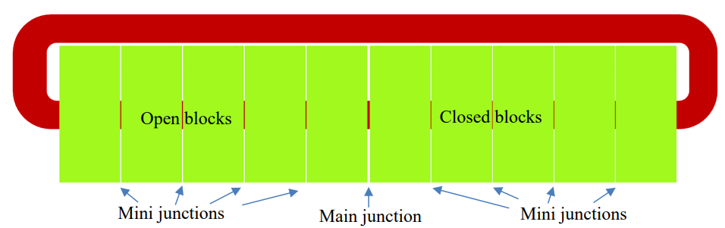
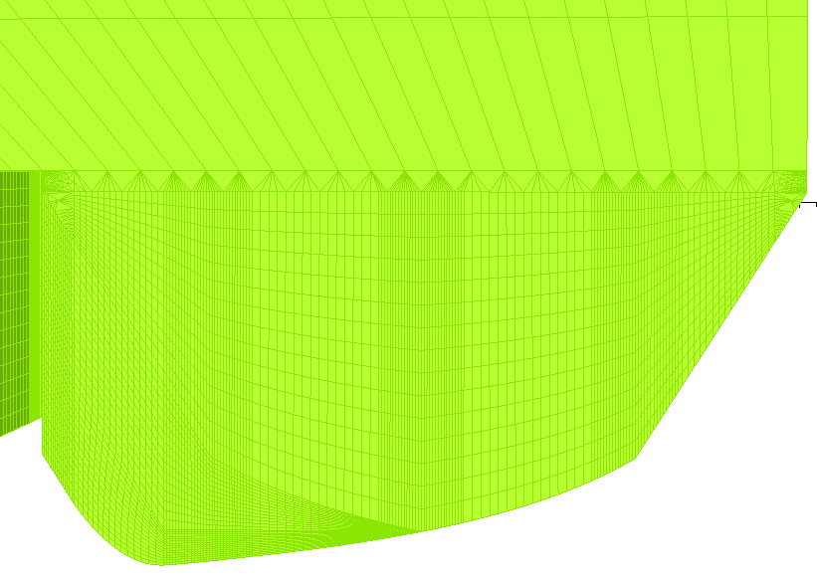


PS-MU: magnetic modelling
Modeling of the PS-MU, a significant engineering challenge:
  complicated pole shape;
  presence of the air gaps;
  multipole harmonics to be predicted (combined-function).
Pre-existing finite-element (FE) MU magnetic model [1] developed in Opera 3D [2-3] between 2010 and 2020, not largely used for operational studies. Why?
extremely resource-intensive → hindered efficiency;
Very slow (2-5 days to complete a simulation) → not practical for routine analysis (operation ideally requires simulations to be completed within ~10 hours for machine setup);
$$z$$
Identified causes:
  mesh type (hexahedral) featuring the model;
  inconsistent mesh element densities between neighboring regions across the magnet pole;
    very tiny angles domains in the boundary region → FE solver slows down;
To support operation efficiently, need a refined and faster model
15
PhD Defense - Vittorio Ferrentino 14 April 2025

Slide 16
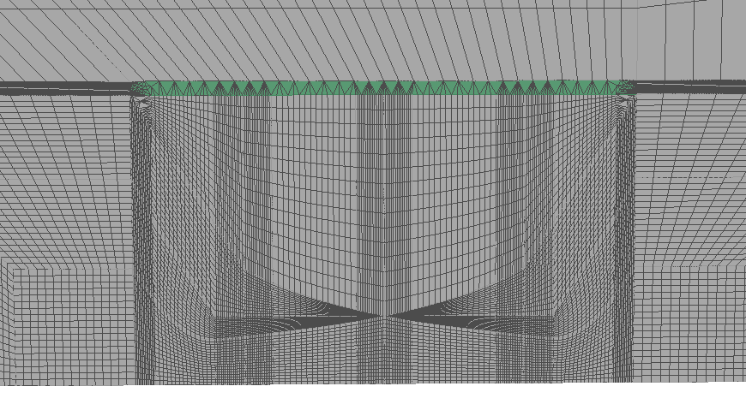
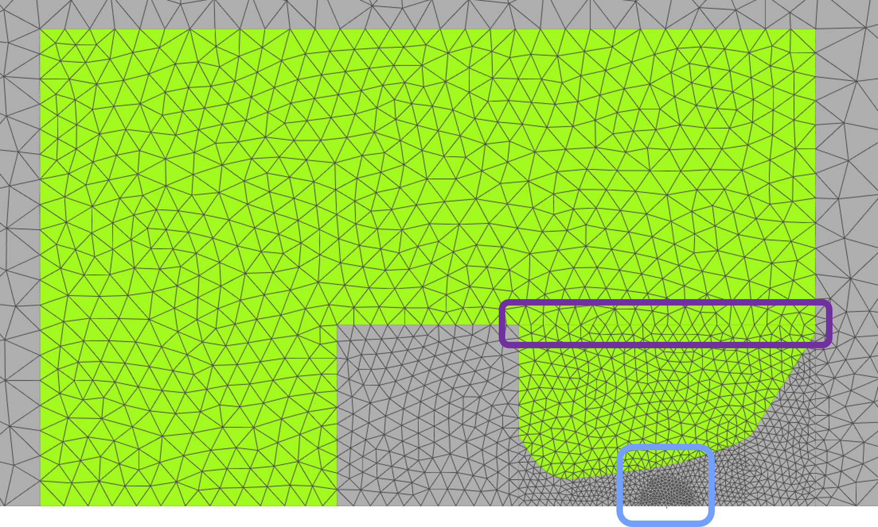
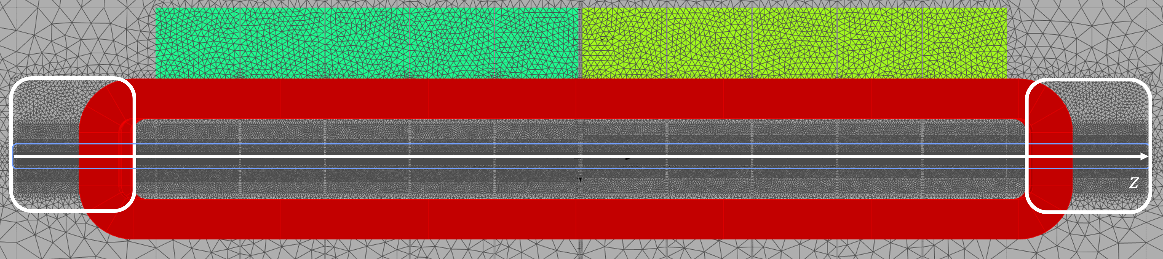
PS-MU: new refined magnetic model
New meshing structure proposed:
Hexahedral domains replaced by tetrahedral elements;
  better adapts to multi-sided facets and surfaces [3, 7], as is the case of the PS-MU poles;
only one pole profile defined, depending on the half-unit
  significantly decreased the number of mesh domains → reducing computational load
optimized for harmonics computation within a reference radius of 35 mm:
  highest mesh density concentrated in the magnet center (light blue);
    precise harmonic calculations in the region traversed by the beam;
  Coarser mesh where high quality field is not needed;
dense mesh at the magnet longitudinal extremities;
  precise harmonics computation at the fringe fields (highlighted in white)
OLD
NEW
16
PhD Defense - Vittorio Ferrentino 14 April 2025

Slide 17
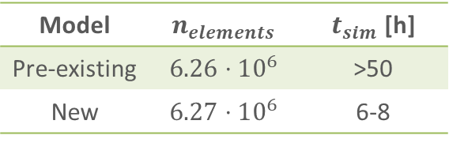
Refined magnetic model: performance
Refined MU magnetic model much lighter, manageable and resource- and time-efficient;
  Computation times reduced to 6-8 hours in contrast to the ~50 needed by the previous model;
How was this gain in computational efficiency achieved?
Not by drastically reducing number of mesh elements, rather, by strategic selection of tetrahedral mesh elements and careful placement of high-density domains only where necessary
High accuracy reduced computational load
Model | $$n_{elements}$$ | $t_{sim}$ [h]
Pre-existing | $$6.26⋅10^{6}$$ | >50
New | $$6.27⋅10^{6}$$ | 6-8
17
PhD Defense - Vittorio Ferrentino 14 April 2025

Slide 18
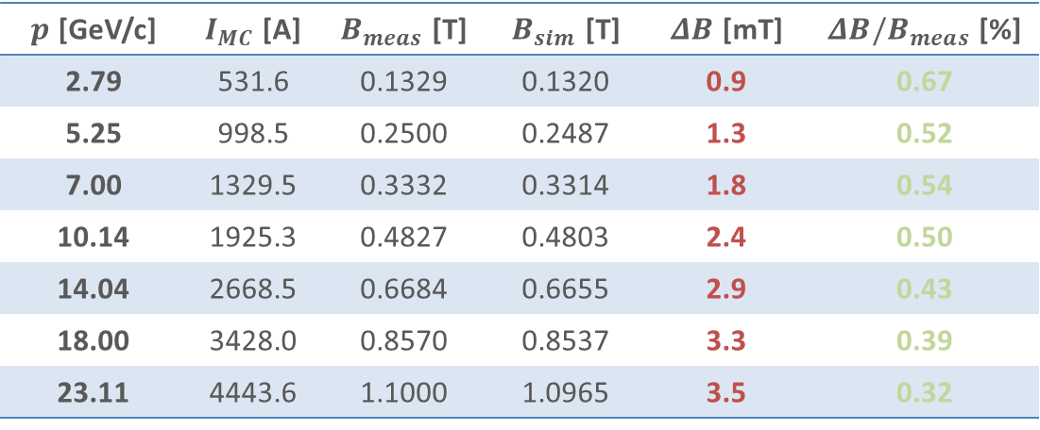

Refined magnetic model: performance
New MU magnetic model validated against magnetic measurements:
  $p$ → designed beam momentum;
  $I_{MC}$ → measured current in the main coil;
  $B_{meas}$ → measured field, computed as:
  $B_{meas, tot}=0.5∙1.09353∙B_{F}+0.5∙0.90533∙B_{DF}$
  $B_{sim}$ → simulated field;
$p$ [GeV/c] | $I_{MC}$ [A] | $B_{meas}$ [T] | $B_{sim}$ [T] | $ΔB$ [mT] | $ΔB/B_{meas}$ [%]
2.79 | 531.6 | 0.1329 | 0.1320 | 0.9 | 0.67
5.25 | 998.5 | 0.2500 | 0.2487 | 1.3 | 0.52
7.00 | 1329.5 | 0.3332 | 0.3314 | 1.8 | 0.54
10.14 | 1925.3 | 0.4827 | 0.4803 | 2.4 | 0.50
14.04 | 2668.5 | 0.6684 | 0.6655 | 2.9 | 0.43
18.00 | 3428.0 | 0.8570 | 0.8537 | 3.3 | 0.39
23.11 | 4443.6 | 1.1000 | 1.0965 | 3.5 | 0.32
Absolute error between simulation and measurements on the level of mT.
Relative error gets lower for higher energies as remanent field gets negligible.
18
PhD Defense - Vittorio Ferrentino 14 April 2025

Slide 19
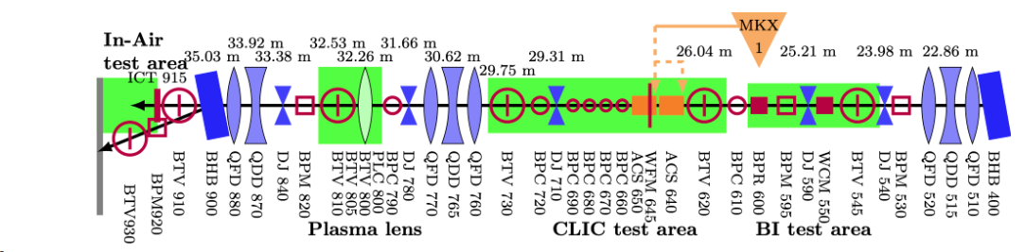
Optics simulation tool: MAD-X
MU optics model built with the Methodical Accelerator Design (MAD-X) [10-13], which is the reference tool in the field of accelerator physics for the design, optimization, and analysis of particle accelerators. Main features:
defining the sequence of elements throughout the accelerator (magnets, RF cavities, etc.);
  For the magnets, users can specify the locations, dimensions, and magnetic strengthsof these elements;
allows for the simulation of beam dynamics, including the calculation of beam optics parameters, its orbit, effect of perturbations, etc.;
How does MAD-X simulate the beam dynamics? In accelerator physics, each magnetic element is modelled with a transfer matrix describing the effect of that element on the beam.
Once the element building up the machine are defined, MAD-X computes the beam dynamics by multiplying the transfer matrix of each elements.
Example of MAD-X sequence for the CLEAR experiment at CERN.
* https://clear.cern/content/beam-line-description
19
PhD Defense - Vittorio Ferrentino 14 April 2025

Slide 20
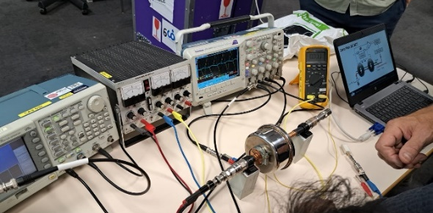

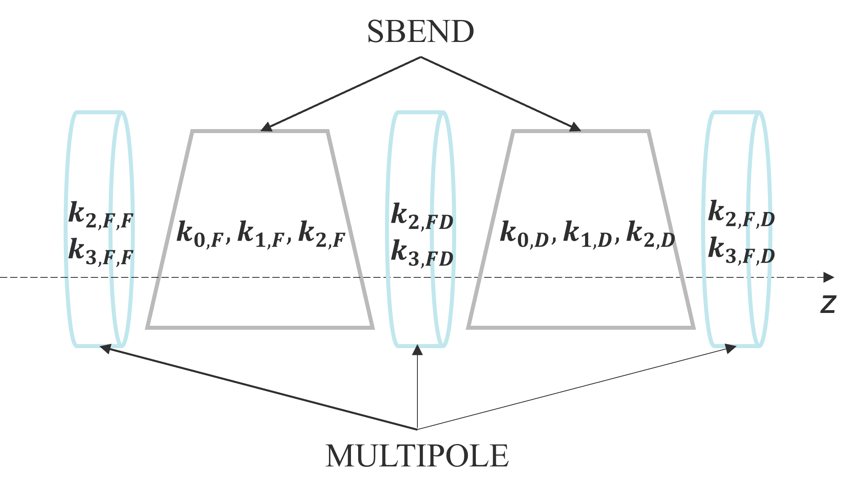
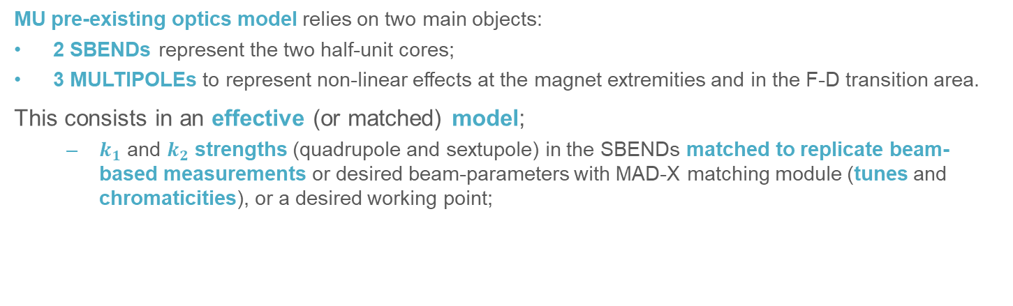
Refined magnetic model: performance
MU pre-existing optics model relies on two main objects:
2 SBENDs represent the two half-unit cores;
3 MULTIPOLEs to represent non-linear effects at the magnet extremities and in the F-D transition area.
This consists in an effective (or matched) model;
  $k_{1}$ and $k_{2}$ strengths (quadrupole and sextupole) in the SBENDs matched to replicate beam-based measurements or desired beam-parameters with MAD-X matching module (tunes and chromaticities), or a desired working point;
Scope of the thesis: to predict the dependence of beam optics on energy, or an operational scenarios, magnet strengths in the optics model are only based on predicted harmonics from the new MU magnetic model
20
PhD Defense - Vittorio Ferrentino 14 April 2025

Slide 21
Contents
Introduction to particle accelerators, context and research scope
The CERN Proton Synchrotron and its main magnetic units
PS-MU modeling
Beam-based measurements
Models’ validation: bare-machine
Models’ validation for auxiliary circuits control
Conclusions – Take away messages
21
PhD Defense - Vittorio Ferrentino 14 April 2025

Slide 22
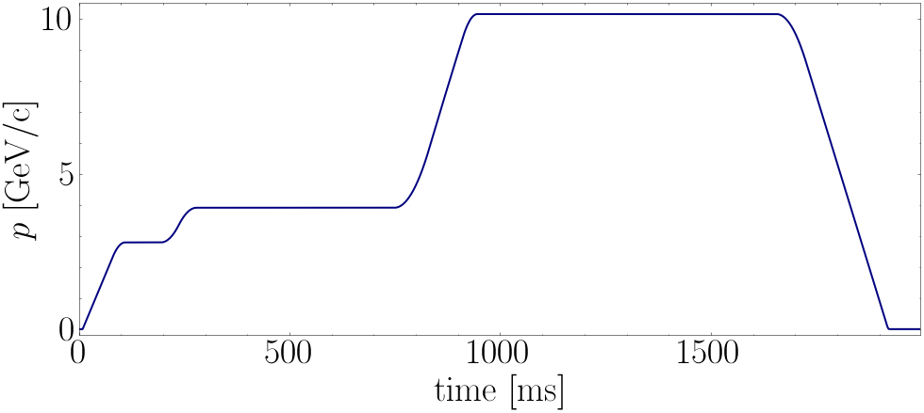
Beam-based measurements: setup
First step: benchmark the models for bare-machine → to isolate the effect of the MU on the machine optics, enabling an effective benchmarking of the MU models:
  F8L and PFW circuits deactivated;
  all additional corrector magnets in the machine deactivated → no interference from additional magnets, which could otherwise affect the measurements → circulating beam influenced exclusively by MUs
Machine powering: to study optics dependence on energy, dedicated bare-machine power cycles created;
  Example of bare-machine power cycle with momentum plateau at 10.14 GeV/c;
22
PhD Defense - Vittorio Ferrentino 14 April 2025

Slide 23
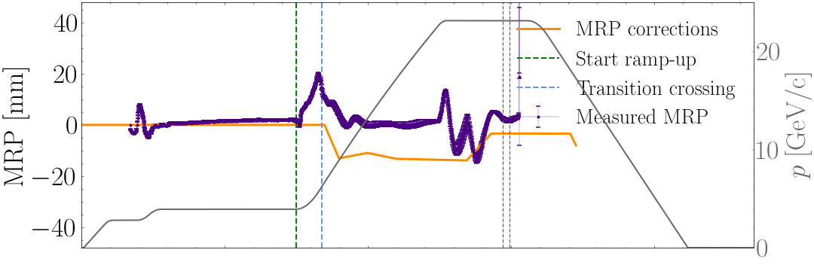
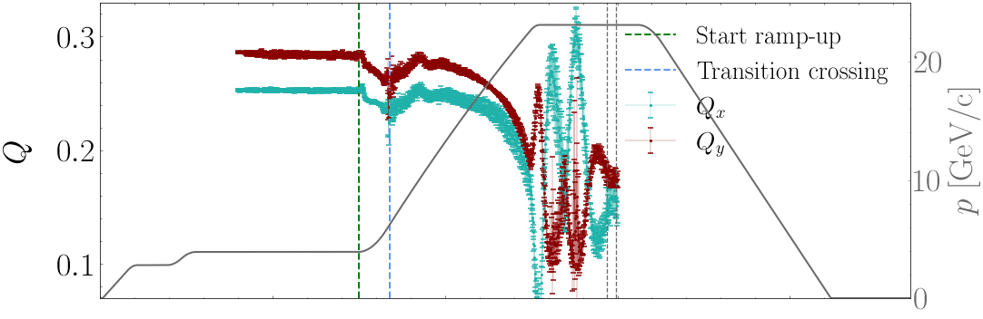
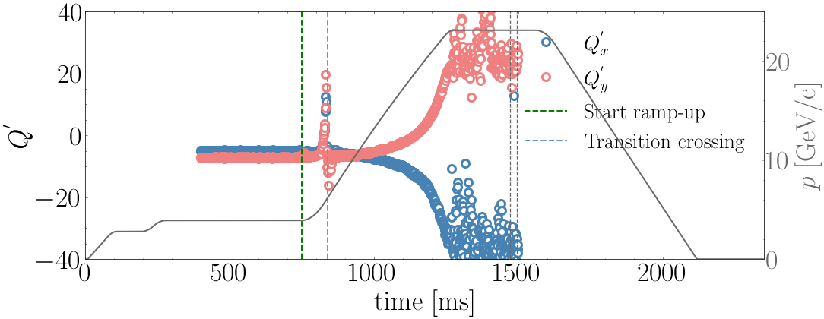
Beam-based measurements
Open question: is the harmonic distortion caused by eddy-currents critical for beam-based measurements? Initial measurements showed poor reproducibility of tune evolution over time scales longer than a day → concern for models’ benchmarking
Investigation: in the model, reference orbit assumed to be aligned with the center of the magnets
need to replicate in measurements these conditions.
Monitoring, measure and (eventually) correct the beam Mean Radial Position
23
PhD Defense - Vittorio Ferrentino 14 April 2025

Slide 24
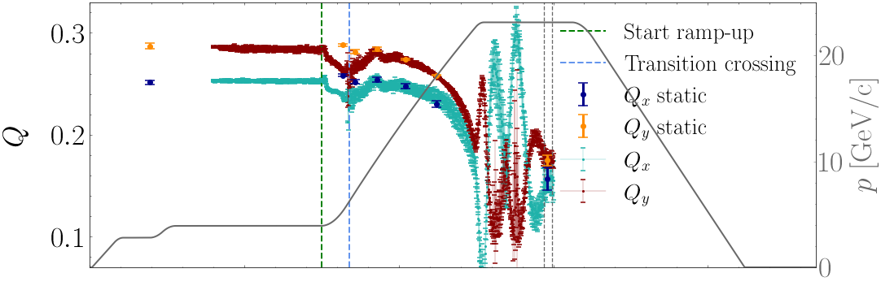
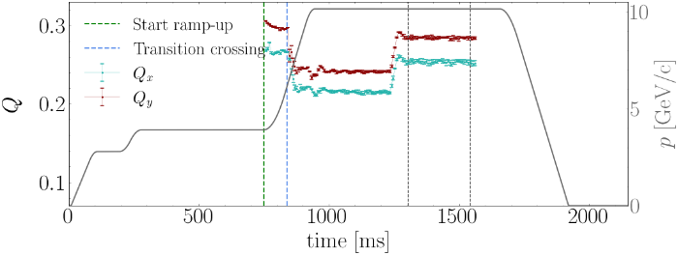
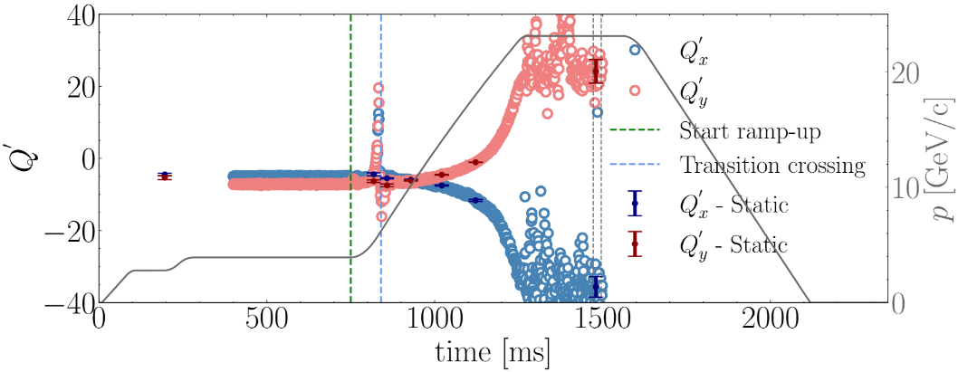
Beam-based measurements
Open question: is the harmonic distortion caused by eddy-currents critical for beam-based measurements? Initial measurements showed poor reproducibility of tune evolution over time scales longer than a day → concern for models’ benchmarking
Excellent alignment between static and dynamic Q-Q’ measurements → Conclusions:
two sets of measurements are equivalent for model validation → dynamic measurements (ramp) can be reliably used for benchmarking at various energies
Q-Q’ measurements are not significantly affected by eddy-current effects throughout the main portion of the ramp;
possible to use static Opera-MAD-X models to predict Q-Q’ during the main part of the ramp
24
PhD Defense - Vittorio Ferrentino 14 April 2025

Slide 25
Contents
Introduction to particle accelerators, context and research scope
The CERN Proton Synchrotron and its main magnetic units
PS-MU modeling
Beam-based measurements
Models’ validation: bare-machine
Models’ validation for auxiliary circuits control
Conclusions – Take away messages
25
PhD Defense - Vittorio Ferrentino 14 April 2025

Slide 26
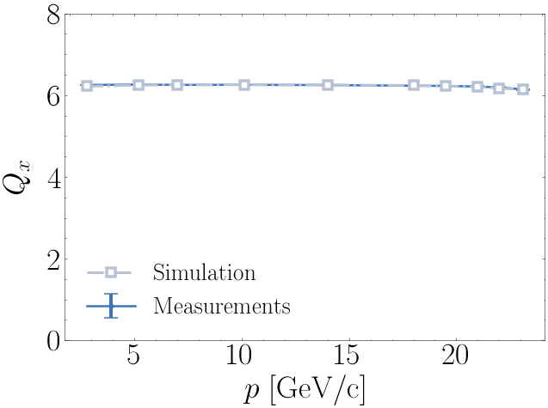
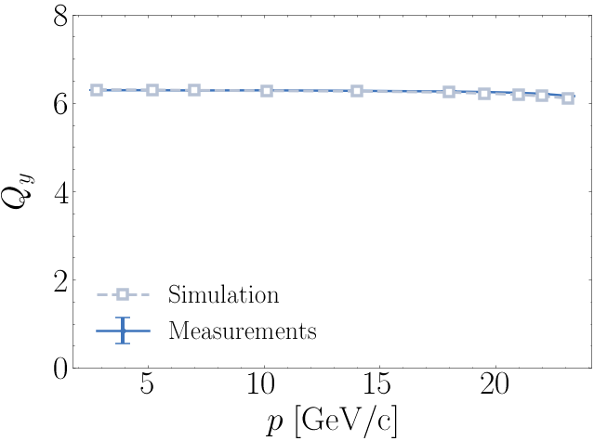
Models’ benchmarking: bare-machine
Comparison between simulated and measured tunes on both planes
Models successfully predict the integer part. Let’s zoom in…
26
PhD Defense - Vittorio Ferrentino 14 April 2025

Slide 27
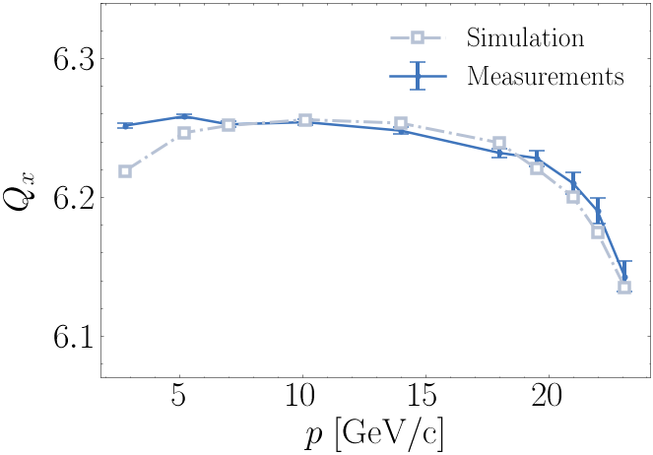
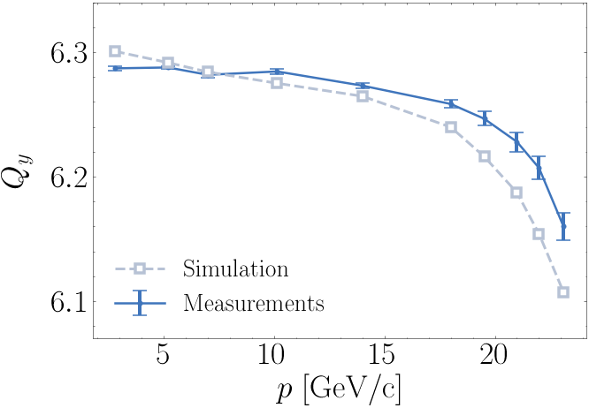
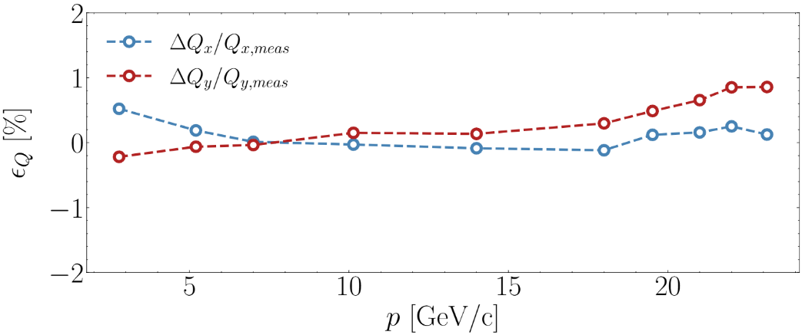
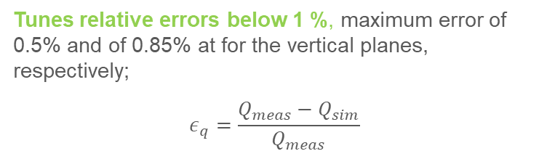
Models’ benchmarking: bare-machine
Comparison between simulated and measured tunes on both planes
rapid decrease of tunes at high energies captured by models;
  within the error bars for the horizontal tunes, slightly more pronounced saturation on the vertical plane;
At low energy, discrepancy observed due to remanent field, not included in the model;
  At higher energies, remanent field effect becomes negligible → quality of agreement progressively improves
Tunes relative errors below 1 %, maximum error of 0.5% and of 0.85% at for the vertical planes, respectively;
$$ε_{q}=\frac{Q_{meas}−Q_{sim}}{Q_{meas}}$$
Can we explain the rapid tune decrease approaching high energies?
27
PhD Defense - Vittorio Ferrentino 14 April 2025

Slide 28
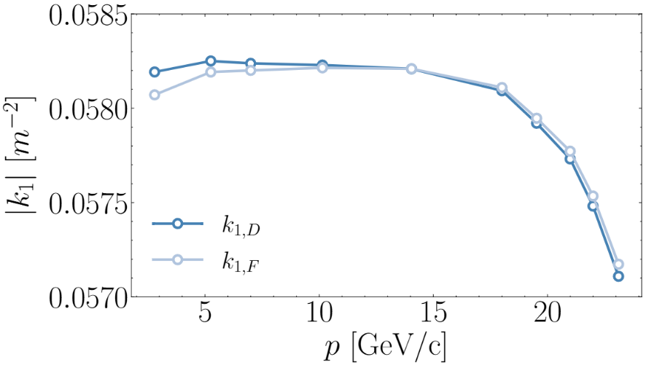
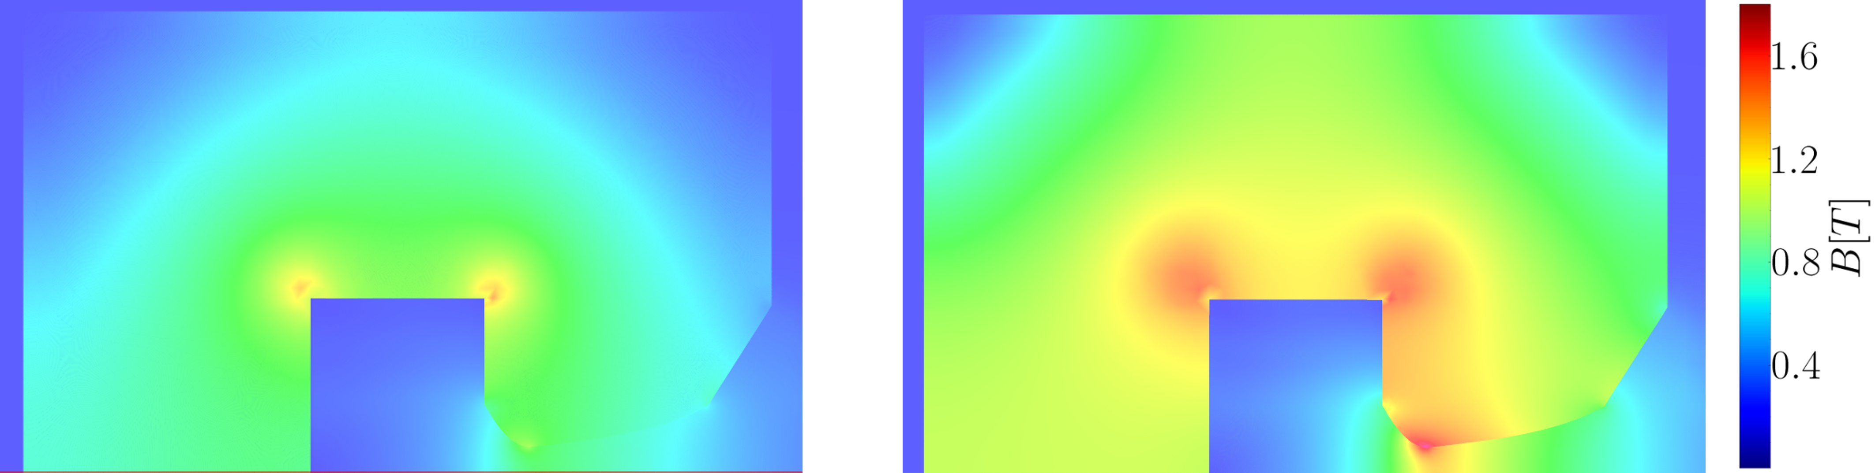
Models’ benchmarking: bare-machine
Simulated quadrupolar strengths of the SBENDs in the F and D half-units derived from Opera (input for the optics simulations).
Model revelation
quadrupole generated within the main body of the half-units exhibits pattern of rapid saturation as tunes at high energies → Why?
2D field maps at 10.14 GeV and 18.00 GeV
hyperbolic pole, characteristic of an ideal quadrupole, begins to saturate at its edges as energy increases → localized saturation reduces effectiveness of the quadrupole field generation (increase in quadrupole does not scale proportionally with increase in dipole strength);
  this imbalance leads to observed reductions in tune;
  10.14 GeV
18.00 GeV
28
PhD Defense - Vittorio Ferrentino 14 April 2025

Slide 29
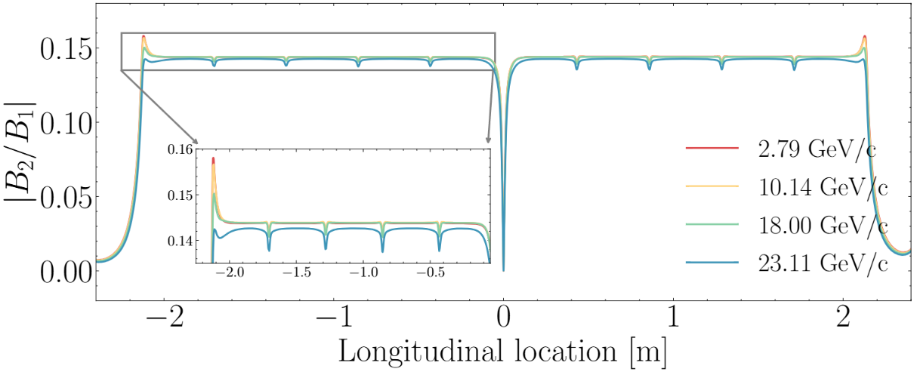
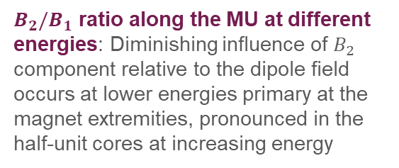
Models’ benchmarking: bare-machine
Simulated quadrupolar strengths of the SBENDs in the F and D half-units derived from Opera (input for the optics simulations).
Model revelation
quadrupole generated within the main body of the half-units exhibits pattern of rapid saturation as tunes at high energies → Why?
$B_{2}/B_{1}$ ratio along the MU at different energies: Diminishing influence of $B_{2}$ component relative to the dipole field occurs at lower energies primary at the magnet extremities, pronounced in the half-unit cores at increasing energy
29
PhD Defense - Vittorio Ferrentino 14 April 2025

Slide 30
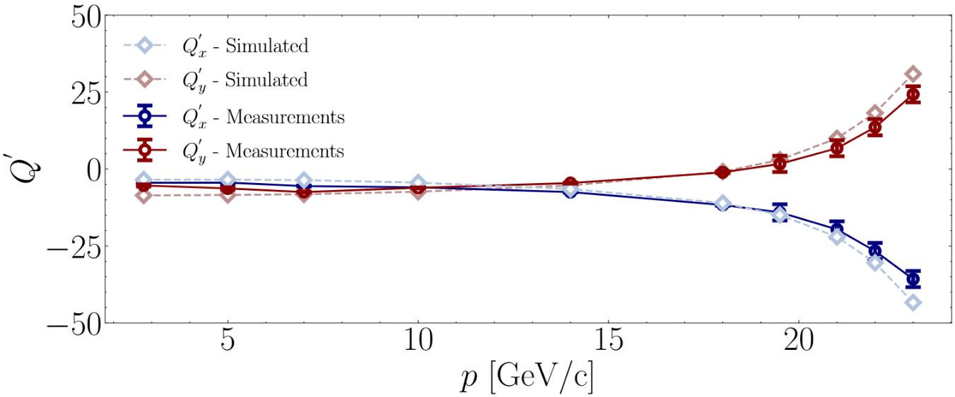

Bare-machine models’ benchmarking: $Q′$
Comparison between simulated and measured first order chromaticity: simulations closely align with the experimental data over the whole range of energy.
Very good agreement was observed over the entire energy range:
slight discrepancies at low energies attributed to the effects of remanent fields;
predicted chromaticity remained relatively constant up to 10 GeV, aligning with the experimental observations.
Beyond 10 GeV, the model accurately captured the saturation of the horizontal and vertical chromaticity, which shift in opposite directions, consistent with the measured data;
30
PhD Defense - Vittorio Ferrentino 14 April 2025

Slide 31
Contents
Introduction to particle accelerators, context and research scope
The CERN Proton Synchrotron and its main magnetic units
PS-MU modeling
Beam-based measurements
Models’ validation: bare-machine
Models’ validation for auxiliary circuits control
Conclusions – Take away messages
31
PhD Defense - Vittorio Ferrentino 14 April 2025

Slide 32
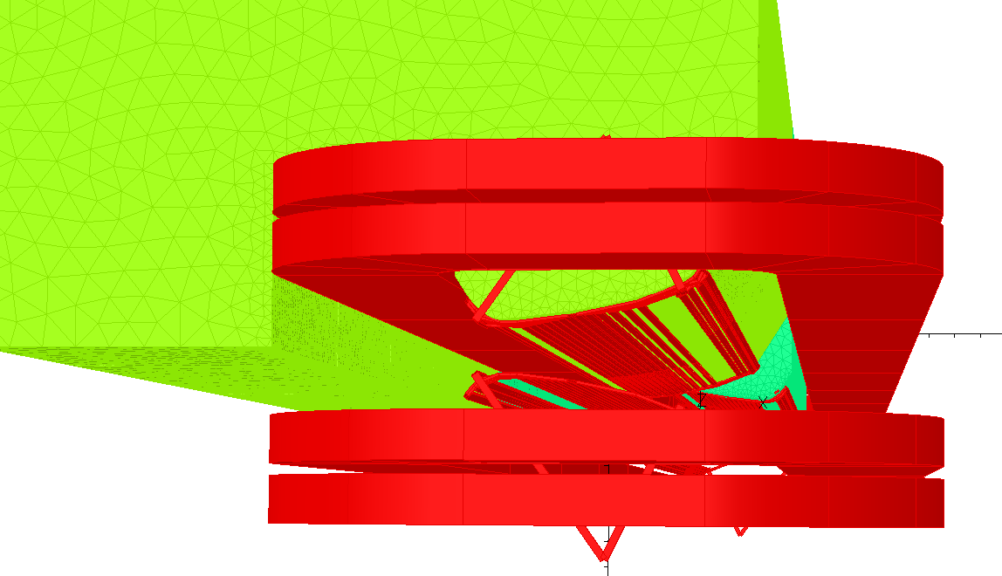
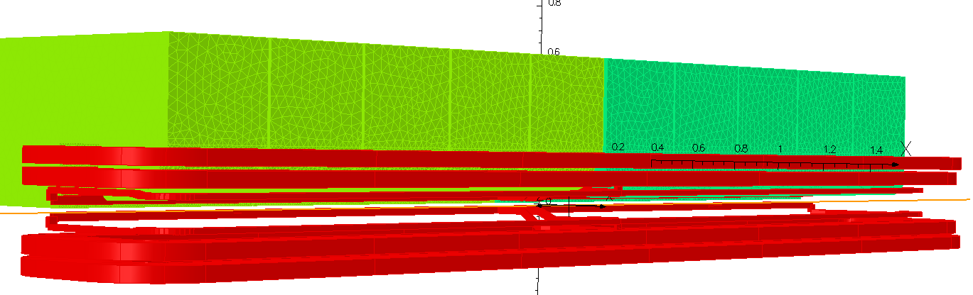
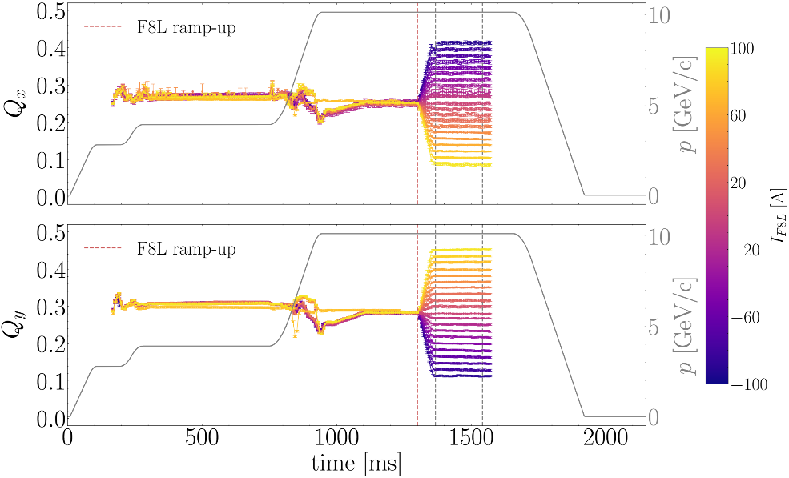
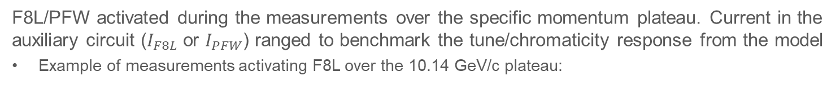
Beam-based measurements: auxiliary circuits
Models including F8L/PFW benchmarked at 3 different momentum levels:
  2.79 GeV/c (injection) → remanent field;
  10.14 GeV/c, intermediate momentum → remanent field and iron saturation both negligible;
  18.00 GeV/c, high momentum → iron saturation;
F8L/PFW activated during the measurements over the specific momentum plateau. Current in the auxiliary circuit ($I_{F8L}$ or $I_{PFW}$) ranged to benchmark the tune/chromaticity response from the model
Example of measurements activating F8L over the 10.14 GeV/c plateau:
32
PhD Defense - Vittorio Ferrentino 14 April 2025

Slide 33


Beam-based measurements: auxiliary circuits
Models including F8L/PFW benchmarked at 3 different momentum levels:
  2.79 GeV/c (injection) → remanent field;
  10.14 GeV/c, intermediate momentum → remanent field and iron saturation both negligible;
  18.00 GeV/c, high momentum → iron saturation;
F8L/PFW activated during the measurements over the specific momentum plateau. Current in the auxiliary circuit ($I_{F8L}$ or $I_{PFW}$) ranged to benchmark the tune/chromaticity response from the model
Comparison between predicted tunes and measurements at varying $I_{F8L}$ (at 10.14 GeV/c, from -100 A to 100 A):
Excellent agreement on both planes, relative error below 0.5%
33
PhD Defense - Vittorio Ferrentino 14 April 2025

Slide 34




Beam-based measurements: auxiliary circuits
Lesson from bare-machine: we have a discrepancy, better to focus on tune-shift at varying $I_{F8L}$ with respect to the bare-machine: $δQ=Q_{0}−Q\left(I_{F8L}\right)$:
Tune (left) and chromaticity (right) shifts at varying $I_{F8L}$ on the 10.14 GeV/c plateau
Excellent agreement → similar results also for comparison at 2.79 GeV/c and 18.00 GeV/c. As expected:
F8L circuit creates $B_{2}$ field → clear shifts in the tunes at varying $I_{F8L}$;
No relevant impact on the first order chromaticity;
Outcome: combined magnetic/optics models can predict the tune and first order chromaticity response, at a specific momentum, when additional circuits are activated.
34
PhD Defense - Vittorio Ferrentino 14 April 2025

Slide 35



Simultaneous powering of all MU circuits
Power cycles employed in operation typically make use of all the three circuits (MC, F8L and PFW) for beam control.
Operational scenario investigated considering the powering settings from the operational LHC cycle LHC25\#48b-BCMS-LowTail-24 at 10.14 GeV/c and 18.00 GeV/c, applied on the corresponding plateaus to measure Q-Q’
35
PhD Defense - Vittorio Ferrentino 14 April 2025

Slide 36


Simultaneous powering of all MU circuits
Power cycles employed in operation typically make use of all the three circuits (MC, F8L and PFW) for beam control.
Operational scenario investigated considering the powering settings from the operational LHC cycle LHC25\#48b-BCMS-LowTail-24 at 10.14 GeV/c and 18.00 GeV/c, applied on the corresponding plateaus to measure Q-Q’
Tune discrepancy on the level below $2⋅{10}^{−2}$, measured and simulated tune-shifts are consistent.
Good agreement for the first order chromaticity, mostly within the error bars.
Outcome: combined magnetic/optics models can predict the tune and first order chromaticity response also with operational powering settings.
36
PhD Defense - Vittorio Ferrentino 14 April 2025

Slide 37
Contents
Introduction to particle accelerators, context and research scope
The CERN Proton Synchrotron and its main magnetic units
PS-MU modeling
Beam-based measurements
Models’ validation: bare-machine
Models’ validation for auxiliary circuits control
Conclusions – Take away messages
37
PhD Defense - Vittorio Ferrentino 14 April 2025

Slide 38

Conclusion – Take away messages
The aim is to provide a predictive tool to PS operation to support decisions.
A new time-efficient MU magnetic model developed → allows to complete simulations in 6-8h. Predicted field harmonics to be used as input for optics simulations.
MRP corrections required for coherent model benchmarking. Measurements with corrected MRP showed that static and dynamic measurements are equivalent in bare-machine and there is no strong influence of the eddy-currents on the Q-Q’ measurements. Measurements show now excellent reproducibility over long timescales
Model benchmarking revealed good agreement for both Q-Q’ in bare-machine. Operational impact:
Magnetic length saturation curve already in operation to correct momentum computation.
Models used to re-design extraction settings for some experiments;
Predicted Q-Q’ response when F8L/PFW are powered very well aligned with the measurements.
Combined magnetic and optics model of the MU demonstrate a predictive power to support PS operation
38
PhD Defense - Vittorio Ferrentino 14 April 2025

Slide 39

Conclusion – Take away messages
The aim is to provide a predictive tool to PS operation to support decisions.
A new time-efficient MU magnetic model developed → allows to complete simulations in 6-8h. Predicted field harmonics to be used as input for optics simulations.
MRP corrections required for coherent model benchmarking. Measurements with corrected MRP showed that static and dynamic measurements are equivalent in bare-machine and there is no strong influence of the eddy-currents on the Q-Q’ measurements. Measurements show now excellent reproducibility over long timescales
Investment in this methodology ~150k https://www.smartrecruiters.com/CERN/744000047732285-applied-physicist-magnetic-and-beam-based-modeling-be-abp-lno-2024-183-grap-
Model benchmarking revealed good agreement for both Q-Q’ in bare-machine. Operational impact:
Magnetic length saturation curve already in operation to correct momentum computation.
Models used to re-design extraction settings for some experiments;
Predicted Q-Q’ response when F8L/PFW are powered very well aligned with the measurements.
Combined magnetic and optics model of the MU demonstrate a predictive power to support PS operation
39
PhD Defense - Vittorio Ferrentino 14 April 2025

Slide 40
Research products 1/5
Published International Journal papers
[P1] | V. Ferrentino, P. Arpaia, A. Gilardi, M. Karppinen, C. Kokkinos, E. Ravaioli, Analysis of Powering and Quench Protection of the SIGRUM Superconducting Combined-Function Dipole Magnet, IEEE Transactions on Applied Superconductivity, Vol. 33, number 7, pp. 1-8, 2023, DOI: 10.1109/TASC.2023.3296281.
[P2] | J. Dilly, V. Ferrentino, M. Le Garrec, E. H. Maclean, L. Malina, T. Persson, T. Pugnat, L. van Riesen-Haupt, F. Soubelet, and R. Tomás, First operational dodecapole correction in the LHC, Physical Review Accelerators and Beams (PRAB), Vol. 26, pp. 121001, Dec. 2023, DOI: 10.1103/PhysRevAccelBeams.26.121001.
[P3] | R. Tomás, F. Carlier, F. Chudoba, L. Deniau, J. Dilly, V. Ferrentino, S. Horney, M. Hostettler, J. Keintzel, S. Kostoglou, M. Le Garrec, E.H. Maclean, T. Nissinen, K. Paraschou, T. Persson, M. Solfaroli, F. Soubelet, A. Wegscheider and J. Wenninger, Optics for Landau damping with minimized octupolar resonances in the LHC, Journal of Instrumentation (JINST), Vol. 19, pp. T05010, May 2024, DOI: 10.1088/1748-0221/19/05/T05010.
40
PhD Defense - Vittorio Ferrentino 14 April 2025

Slide 41
Research products 2/5
International Journal papers under review
[P4] | V. Ferrentino, P. Arpaia, D.G. Cotte, V. Di Capua, A. Gilardi, A. Huschauer, M. Karppinen, E.H. Maclean, M. Pentella, T. Persson, R. Tomas Garcia, and L. Von Freeden, Optics energy dependence within the CERN Proton Synchrotron Main Units, Physical Review Accelerators and Beams (PRAB).
[P5] | E.H. Maclean, V.Ferrentino, M. Le Garrec, W. Van Goethem, S. Horney, K.Paraschou, R. Tomas Measurement and correction of forced RDTs to improve machine models and performance Physical Review Accelerators and Beams (PRAB).
41
PhD Defense - Vittorio Ferrentino 14 April 2025

Slide 42
Research products 3/5
International Conference papers:
[P6] | T. Persson, J.Cardona, F. Carlier, A. Costa Ojeda, J. Dilly, H. García Morales, V. Ferrentino, E. Fol, M. Hofer, E.J Høydalsvik, J. Keintzel, M. Le Garrec, E.H. Maclean, L. Malina, F. Soubelet, R. Tomás, L. Van RiesenHaupt, and A. Wegscheider, Optics Correction Strategy for Run 3 of the LHC, 13th International Particle Accelerator Conference (IPAC), Bangkok, Thailand, 12 - 17 Jun 2022, pp.1687-1690, Publisher JACoW IPAC 2022, DOI: http://dx.doi.org/10.18429/JACoW-IPAC2022-WEPOST008.
[P7] | F. Carlier, A. Costa Ojeda, J. Dilly, V. Ferrentino, E. Fol, M. Hofer, J. Keintzel, M. Le Garrec, T. Levens, E. H. Maclean, T. H. B. Persson, F. Soubelet, R. Tomás Garcia, L. Van RiesenHaupt, A. Wegscheider, Challenges of K-modulation measurements in the LHC Run 3, 14th International Particle Accelerator Conference (IPAC), Venice, Italy, 7 - 12 May 2023, pp. 531-534, JACoW Publishing, Geneva, Switzerland, DOI: 10.18429/JACoW-IPAC2023-MOPL014
[P8] | F. Carlier, J. Cardona, A. Costa Ojeda, R. De Maria, J. Dilly, V. Ferrentino, E. Fol, M. Hofer, J. Keintzel, M. Le Garrec, E. H. Maclean, T. H. B. Persson, F. Soubelet, G. Trad, R. Tomás Garcia, L. Van Riesen-Haupt, A. Wegscheider, LHC Run 3 optics corrections, 14th International Particle Accelerator Conference (IPAC), Venice, Italy, 7 - 12 May 2023, pp. 535-538, JACoW Publishing, Geneva, DOI: 10.18429/JACoW-IPAC2023- MOPL015.
42
PhD Defense - Vittorio Ferrentino 14 April 2025

Slide 43
Research products 4/5
International Conference papers:
[P9] | M. Le Garrec, K. Paraschou, F.S. Carlier, V. Ferrentino, E.H. Maclean, J. Dilly, R. Tomas, Measurement and modelling of decapole errors in the LHC from beam-based studies, 14th International Particle Accelerator Conference (IPAC), Venice, Italy, 7 - 12 May 2023, pp. 567-570, JACoW Publishing, Geneva, Switzerland, DOI: 10.18429/JACoWIPAC2023-MOPL024.
[P10] | V. Ferrentino, P. Arpaia, D.G. Cotte, A. Gilardi, A. Huschauer, M. Karppinen, E.H. Maclean, T. Persson, R.Tomás Garcia, L. Von Freeden, Energy dependence of PS Main Unit Harmonics, 15th International Particle Accelerator Conference (IPAC); Nashville, TN, US, 19 - 24 May 2024, pp. 1036-1039, JACoW Publishing, Geneva, Switzerland, DOI: 10.18429/JACoW-IPAC2024-TUPC15.
[P11] | V. Ferrentino, P. Arpaia, A. B. Carazo, J. Cardona, F. S. Carlier, J. Dilly, E. Fol, A. Gilardi, M. Hofer, S. J. Horney, J. Keintzel, M. Le Garrec, E. H. Maclean, T. Nissinen, T. Persson, F. Soubelet, R. Tomás Garcia, W. Van Goethem, A. Wegscheider, LHC 2023 Ion Optics Commissioning, 15th International Particle Accelerator Conference (IPAC), Nashville, TN, US, 19 - 24 May 2024, pp. 99-102, JACoW Publishing, Geneva, Switzerland, DOI: 10.18429/JACoW-IPAC2024-MOPC20.
43
PhD Defense - Vittorio Ferrentino 14 April 2025

Slide 44
Research products 5/5
International Conference papers:
[P12] | T. Persson, A. B. Carazo, F. Carlier, J. Cardona, F. Chudoba, J. Dilly, R. De Maria, S. Fartoukh, V. Ferrentino, E. Fol, S. J. Horney, U. Kar, J. Keintzel, M. Le Garrec, E. H. Maclean, T. Nissinen, F. Soubelet, K. Skoufaris, G. Trad, R. Tomás, L. Van Riesen-Haupt, W. Van Goethem, A. Wegscheider, LHC Optics Commissioning in 2023 and 2024, 15th International Particle Accelerator Conference (IPAC), Nashville, TN, US, 19 - 24 May 2024, pp. 67-70, JACoW Publishing, Geneva, Switzerland, DOI: 10.18429/JACoW-IPAC2024-MOPC12.
[P13] | S. J. Horney, E. Maclean1, P. Burrows, F. Carlier, J. Dilly, L. Deniau, V. Ferrentino, E. Fol, M. Hofer, J. Keintzel, M. Le Garrec, T. Persson, L. van Riesen-Haupt, F. Soubelet, R. Tomás, A. Wegscheider, Sextupole RDTs in the LHC at Injection and in the Ramp, 15th International Particle Accelerator Conference (IPAC), Nashville, TN, US, 19 - 24 May 2024, pp. 71-74, JACoW Publishing, Geneva, Switzerland, DOI: 10.18429/JACoW-IPAC2024-MOPC13.
[P14] | R. Bruce, A. Carazo, F. Carlier, M. D’Andrea, J. Dilly, I. Efthymiopoulos, S. Fartoukh, V. Ferrentino, S. Horney, M. le Garrec, E. Maclean, D. Mirarchi, T. Nissien, T. Persson, S. Redaelli, M. Solfaroli Camillocci, R. Tomás García, F. F. Van der Veken, A. Wegscheider, Evolution of Special, LHC Optics Configurations Run 3 Update, 15th International Particle Accelerator Conference (IPAC), Nashville, TN, US, 19 - 24 May 2024, pp. 83-86, JACoW Publishing, Geneva, Switzerland, DOI: 10.18429/JACoW-IPAC2024-MOPC16
44
PhD Defense - Vittorio Ferrentino 14 April 2025

Slide 45
References
Edmund Wilson. An introduction to particle accelerators. Oxford University Press, 2001.
Helmut Wiedemann. Particle accelerator physics. Springer, 2015.
Andrzej Wolski. Beam dynamics in High Energy Particle Accelerators. Imperial College Press, 2014.
Shyh-Yuan Lee. Accelerator physics. World Scientific Publishing Company,2018.
Daniel Brandt, editor. CAS - CERN Accelerator School: Magnets: Hotel Novotel Brugge Centrum, Bruges, Belgium 16 - 25 Jun 2009. Proceedings, 2009 CAS-CERN Accelerator School: Specialised course on Magnets. Bruges, Belgium, June 16 - 25, 2009. CAS - CERN Accelerator School: Specialised course on Magnets, Geneva, 2010. CERN, CERN. 14 lectures,494 pages, published as CERN Yellow Report, https://cds.cern.ch/record/1158462, doi: 10.5170/CERN-2010-004.
Stephan Russenschuck. Field computation for accelerator magnets: Analytical and numerical methods for electromagnetic design and optimization. Wiley-VCH, Weinheim, 2010.
J. Renedo. A reference magnetic model of the proton synchrotron main units, 2019. Technical Note 2019-08, report number:2140704, https://edms.cern.ch/ui/#!master/navigator/document?D:100416838:100416838:subDocs.
Dessault Systems. Opera. https://www.3ds.com/products/simulia/opera.
Opera - 3D Reference Manual. https://www.rcnp.osaka-u.ac.jp/~sakemi/OPERA/ref-3d.pdf.
CERN. MAD-X: website. https://mad.web.cern.ch/mad/.
H. Grote and F. Schmidt. MAD-X - An Upgrade from MAD8. In Proceedings of the 2003 Particle Accelerator Conference, volume 5, pages 3497–3499, 2003. doi: 10.1109/PAC.2003.1289960.
Werner Herr and F Schmidt. A MAD-X Primer. Technical report, CERN,2006.
F. Schmidt. Mad-x a worthy successor for mad8? Nuclear Instrumentsand Methods in Physics Research Section A: Accelerators, Spectrometers,Detectors and Associated Equipment, 558(1):47–49, 2006. Proceedings ofthe 8th International Computational Accelerator Physics Conference.
P. A. Thonet. Design and manufacturing of two high gradient quadrupoles based on permanent magnets for the CERN antiproton decelerator. IEEE Transactions on Applied Superconductivity, 32(6):1–5, 2022.
Eliott Johnson, Ewa Oponowicz, Matthew Fraser, Miroslav Atanasov, and Yann Dutheil. Beam optics modelling through fringe fields during injection and extraction at the CERN proton synchrotron. JACoW IPAC, 2022:511–514, 2022.
Trygve Helseth, Thomas Kramer, Matthew A Fraser, Laurent Ducimetière, Bruno Balhan, Miroslav G Atanasov, and Jan Borburgh. Jacow: Feasibility study for the novel CERN PS fast extraction septum. JACoW IPAC,2021:2363–2366, 2021.
45
PhD Defense - Vittorio Ferrentino 14 April 2025

Slide 46
Thank you all for your attention
46
PhD Defense - Vittorio Ferrentino 14 April 2025

Slide 47
Backup slides
47
PhD Defense - Vittorio Ferrentino 14 April 2025

Slide 48


Beam control
Particles motion is governed by the electromagnetic forces → Lorenz’s force:
Electric fields used to accelerate particles within radiofrequency (RF) cavities
magnetic fields used to guide particles throughout the accelerator.
Dipole → bend the particle’s trajectory
*
Expression of the vertical magnetic field in a normal magnet acting on the horizontal plane ($y=0$) [3,5,6]:
$$B_{y}=B_{0}+\frac{∂B_{y}}{∂x}x+\frac{1}{2}\frac{∂^{2}B_{y}}{∂x^{2}}x^{2}+\frac{1}{6}\frac{∂^{3}B_{y}}{∂^{3}x}x^{3}+…$$
Quadrupole → focus (defocus) particle’s trajectory
Sextupole: quadratic dependence to particle’s displacement → chromaticity correction
Beam optics: commonly defined as the study of single particle dynamics as it passes through magnetic elements, ignoring interactions with other particles in the machine.
* https://cds.cern.ch/record/1158462, doi: 10.5170/CERN-2010-004
48
PhD Defense - Vittorio Ferrentino 14 April 2025

Slide 49



Thesis overview
General problem – Bridging the gap:
Historically, operation and modeling of the PS main magnets have followed an empirical approach based on beam-based measurements → effective models;
Downstream experiments’ requirements might change throughout the years and operation requires upgrades on the machine → impact on the optics of the circulating beam;
PS now operates in a highly saturated regime with respect to its original design parameters;
Effective models must be repeated whenever hardware changes occur.
Existing models lack predictive capabilities to support operational decisions.
Objective:
Development of predictive magnetic and optics models of the PS main magnets to assess the possibility of predicting the beam dynamics and the beam parameters energy dependence within the PS;
proposed models aim to support operational decisions, aiding in tasks such as establishing new working points, defining power cycle settings, optimizing beam extraction setups, and serving as inputs for adaptive learning approaches
Methodology:
Development of finite-element magnetic model of PS main magnetic units.
Computation of field harmonics;
Development of a MU optics model based on predicted harmonics from the magnetic model;
benchmarking of the combined magnetic and optics models’ predictions via beam-based measurements
49
PhD Defense - Vittorio Ferrentino 14 April 2025

Slide 50

Pre-existing MU model: limitations
Initial simulations with old MU model showed key limitations constraining their applicability:
model extremely resource-intensive during the pre- and post-processing phases;
  slowed down basic operations (mesh generation, selection of specific cells, or to assign boundary conditions) → hindered efficiency
  Impeding to perform simulations in a reasonable timeframe → simulations extended to several days to complete → impacting the practicality of using the model for routine analysis (operation ideally requires simulations to be completed within approximately 10 hours to allow operators to setup the machine)
After thorough investigations and discussion with experts at CERN, it was determined that the mesh type used in the model, along with the inconsistent mesh element densities between neighboring regions across the magnet pole, were the primary areas requiring improvement in the pre-existing model
50
PhD Defense - Vittorio Ferrentino 14 April 2025

Slide 51

Tune measurements
Tune measurements throughout the bare-machine power cycle to the 23.11 GeV/c momentum plateau.
Observations:
tune decrease throughout the ramp;
strong tune oscillations at the end of the ramp
Tunes quite stable on the momentum plateau after oscillations collapse.
Open question at the outset of this work: is the harmonic distortion caused by eddy currents critical for beam-based measurements? → Measurements on the individual plateaus (static powering) compared to those recorded continuously throughout the ramp to the 23.11 GeV/c plateau (dynamic powering).
51
PhD Defense - Vittorio Ferrentino 14 April 2025

Slide 52


Tune measurements
Tune measurements throughout the bare-machine power cycle to the 23.11 GeV/c momentum plateau.
Observations:
tune decrease throughout the ramp;
strong tune oscillations at the end of the ramp
Tunes quite stable on the momentum plateau after oscillations collapse.
Static measurements = constant momentum = static MU powering
Open question at the outset of this work: is the harmonic distortion caused by eddy currents critical for beam-based measurements? → Measurements on the individual plateaus (static powering) compared to those recorded continuously throughout the ramp to the 23.11 GeV/c plateau (dynamic powering).
Comparison of static and dynamic tune measurements at the same momentum revealed a generally poor agreement. Why? Do the eddy-currents perturb so much the tune measurements in dynamic regime? → Need to investigate
52
PhD Defense - Vittorio Ferrentino 14 April 2025

