Slide 1
BLonD on GPU Cluster HTCondor
BLonD Community Meeting 04/04/2024
Niki Gallou, Acknowledgements: Bartosz Bielawski

Slide 2
Content
Motivation
Set up your simulation folder
Compile BLonD for GPU
Compile BLonD for HTCondor
Run your simulation on HTCondor
Submit job

Slide 3
Motivation - Why HTCondor?
Available GPUs - significant speed-up (lhc-blow-up: ~12 times on average)
Run simulations in parallel
Expose simulation parameters as arguments – run with different parameters at the same time
Dedicated GPUs for ATS for accelerator physics simulations – NVIDIA H100
Run BLonD functions on GPU:
bm.use_gpu()
bm.use_precision() # change to single for more speed
self.total_Vind.to_gpu()
self.profile.to_gpu()
self.profile_2.to_gpu()
self.PL.to_gpu()
self.rf_station_tracker.to_gpu()

Slide 4
Set up your simulation folder
Detailed instructions on the wiki: https://confluence.cern.ch/pages/viewpage.action?spaceKey=BERF&title=Getting+started+on+HTCondor
HTCondor can only see files on eos/ and /afs/cern.ch/work/,so create a folder and put all your simulation files, python venv and BLonD repo there.
e.g. mkdir afs/cern.ch/work/a/auser/workdir
Create a python venv using:
python3.11 -m venv venv
source venv/bin/activate
python -m pip install --upgrade pip
python -m pip install numpy matplotlib scipy h5py mpmath pathlib # BLonD needs those modules
→ Note: It is strongly recommended that the output of your simulation points to eos/, since afs/ has very limited space.

Slide 5
Compile BLonD for GPU
To run your code on GPU you can connect to lxplus-gpu:
shh username@lxplus-gpu.cern.ch
Open your simulation folder and source your venv:
cd afs/cern.ch/work/a/auser/workdir
source venv/bin/activate
Clone BLonD and compile it according to the gpu computing capability:
git clone https://gitlab.cern.ch/blond/BLonD.git
cd BLonD
Find out which cuda version lxplus-gpu is using (in my case it is 12.4)
nvcc –version
pip install cupy-cuda12x # if your cuda version is 11, then cupy-cuda11x etc.
pip install cupy # it needs this one as well! (even if it gives a warning for having both)
You should checkout which linux architecture you're using first. For me it was x86_64.
You need to source this specific version of gcc, the latest one does not work!
source /cvmfs/sft.cern.ch/lcg/releases/gcc/13.1.0/x86_64-el9/setup.sh
Try to compile BLonD using your GPU’s compute_capability. (Note: lxplus has 75 in my case). This will create the necessary files.
python BLonD/blond/compile.py -gpu 75 –optimize
pip install -e .

Slide 6
Compile BLonD for HTCondor
Try to compile BLonD for HTCondor specifically using the compute_capability 70, 75, 80, 90.
This will create the necessary files for the different GPUs in HTCondor.
python BLonD/blond/compile.py -gpu 70 –optimize
python BLonD/blond/compile.py -gpu 75 –optimize
python BLonD/blond/compile.py -gpu 80 –optimize
python BLonD/blond/compile.py -gpu 90 -optimize
pip install -e .
You can find the available GPUs and their compute capability here: https://htcondor.readthedocs.io/en/latest/man-pages/condor_gpu_discovery.html

Slide 7
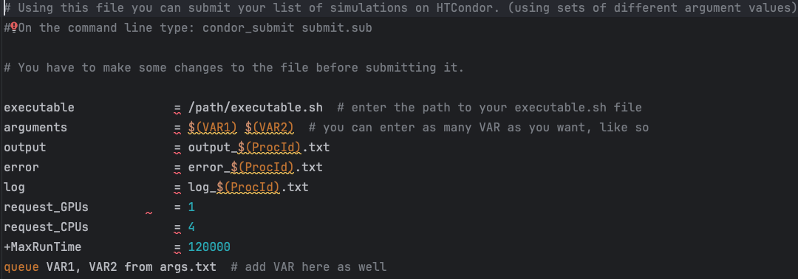
Run your simulation on HTCondor
HTCondor Manual: https://htcondor.readthedocs.io/en/latest/index.html
https://batchdocs.web.cern.ch/local/submit.html
You need three files: executable.sh, submit.sub and args.txt (to run jobs in parallel)
submit.sub: HTCondor configuration - docker
executable.sh: should source your venv and run your script
#!/bin/bash
Activate the virtual environment
source /path/venv/bin/activate
python your_script.py -arg_1 $1 –arg_2 $2 etc.
args.txt: argument values separated by space
5 4e9
6 4e9
6 5e9
…

Slide 8
Submit job
To submit a job you must be on lxplus. Use: condor_submit submit.sub
To check the status of your jobs use: condor_q
To remove a job use: condor_rm (job_id) - e.g. condor_rm 6.0
Other useful links:
Python API for HTCondor: https://batchdocs.web.cern.ch/local/pythonapi.html

Slide 9

Thank you!
Questions?

