Slide 1
Bond Project
Mock-up design of sliding reaction tooling
Displacement measurement feasibility
Michael, Oscar, Sylvain, Alexandre, Vincent

Slide 2
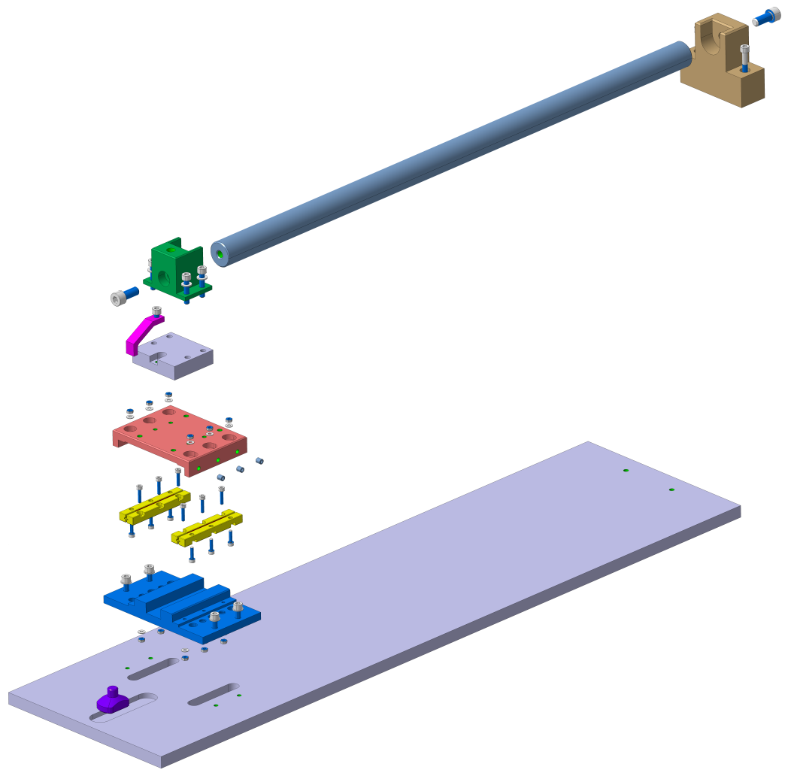
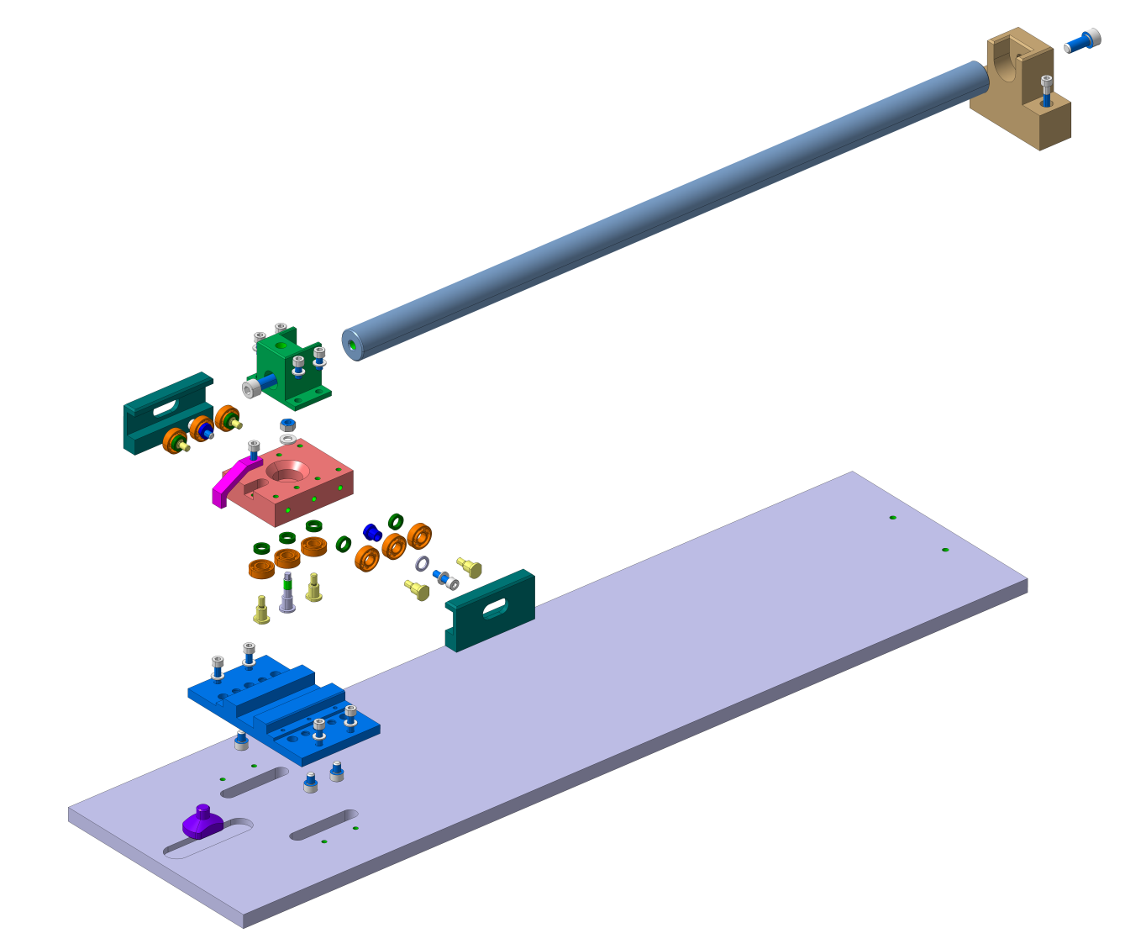
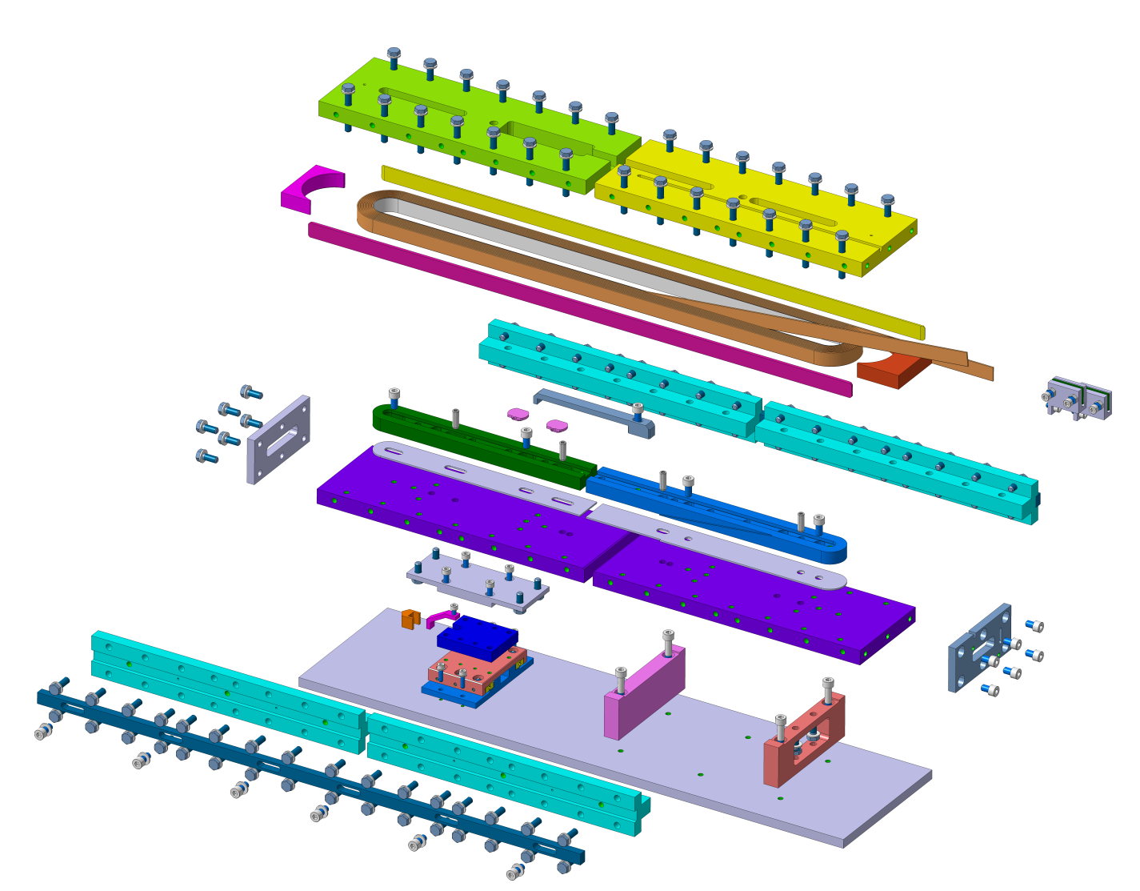
Set-up to be tested:
Linear ceramic bearing
Circular ceramic bearing
Racetrack coil mock-up
Expected differential displacement of about 5 mm
Expected differential displacement of about 2.8 mm
Expected differential displacement of about 2.8 mm
Goal of the displacement measurements :
- Check some stick-slip during temperature profile up to 650°C for the two first setups;
- Evaluate the gap on the Racetrack coil mock-up over the temperature profile in the three directions

Slide 3
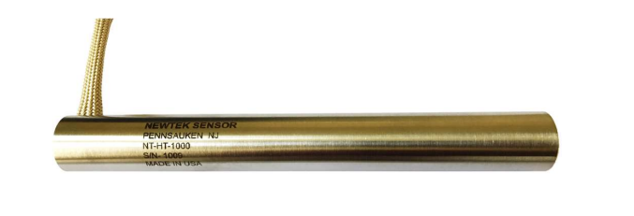
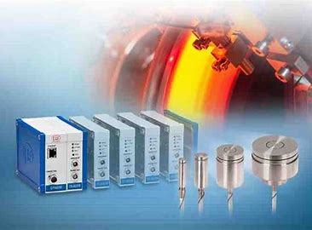
Displacement measurements @650°C - Proposal
Linear Variable Differential Transformer (LVDTs)
Contact principle, some existing solutions up to 850°C
Relative measurements requesting high temperature stability of the supporting systems and the sensors
Request sensors in three directions to access bending, torsion, buckling of the setup at high temperature
High temperature cabling and feedthrough
Capacitive sensors
Non contact principle, some existing solutions up to 850°C, large diameter for long measurements
Relative measurements requesting high temperature stability of the supporting systems
Measurements strongly dependant of the face parallelism
Request sensors in three directions to access bending, torsion, buckling of the setup at high temperature
High temperature cabling and feedthrough

Slide 4
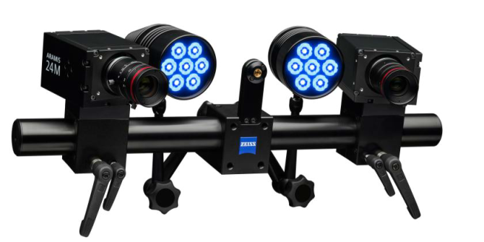
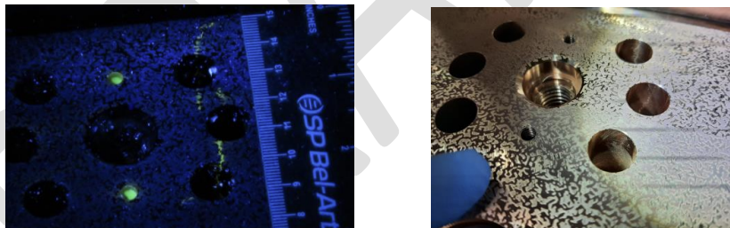
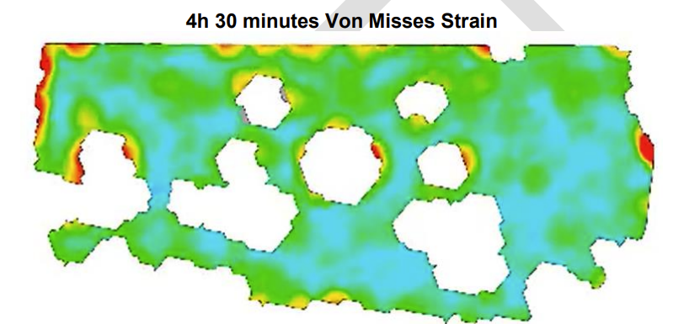
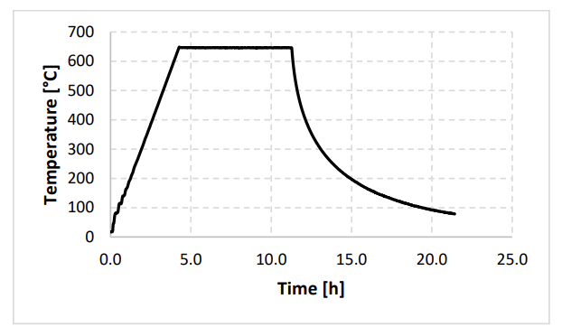
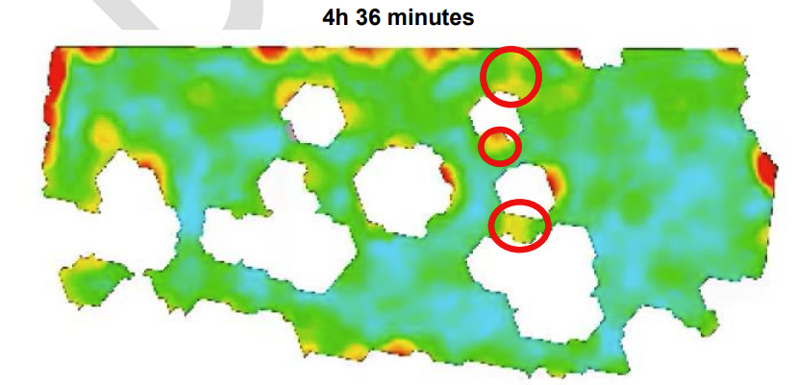
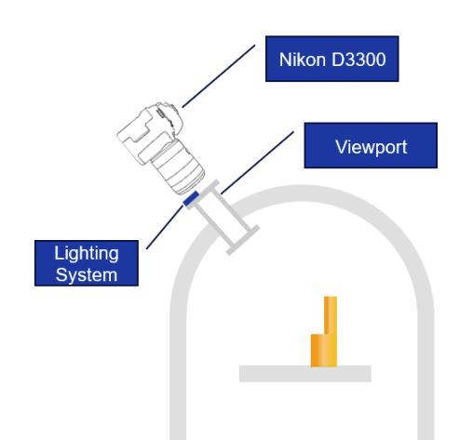
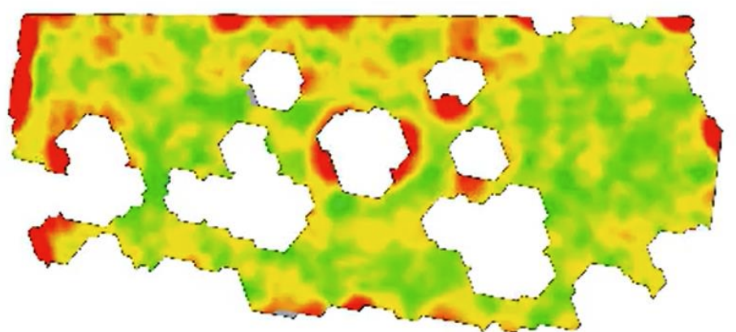
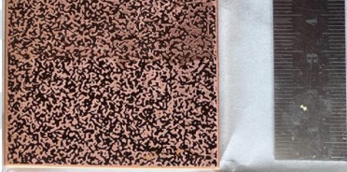
Displacement measurements @650°C - Proposal
Optical approach based on DIC
Non contact principle, measurement equipment at room temperature
One camera → 2D measurements → Probably enough for the first two setups
Two cameras → 3D measurements → Well adapted for the Racetrack coil mock-up
Experience : Investigation of Surface Cracking in OFE Copper Current Leads During High-Temperature Stress-Relief Heat Treatment Using 2D Digital Image Correlation (Report_3160899.pdf)
13h

Slide 5
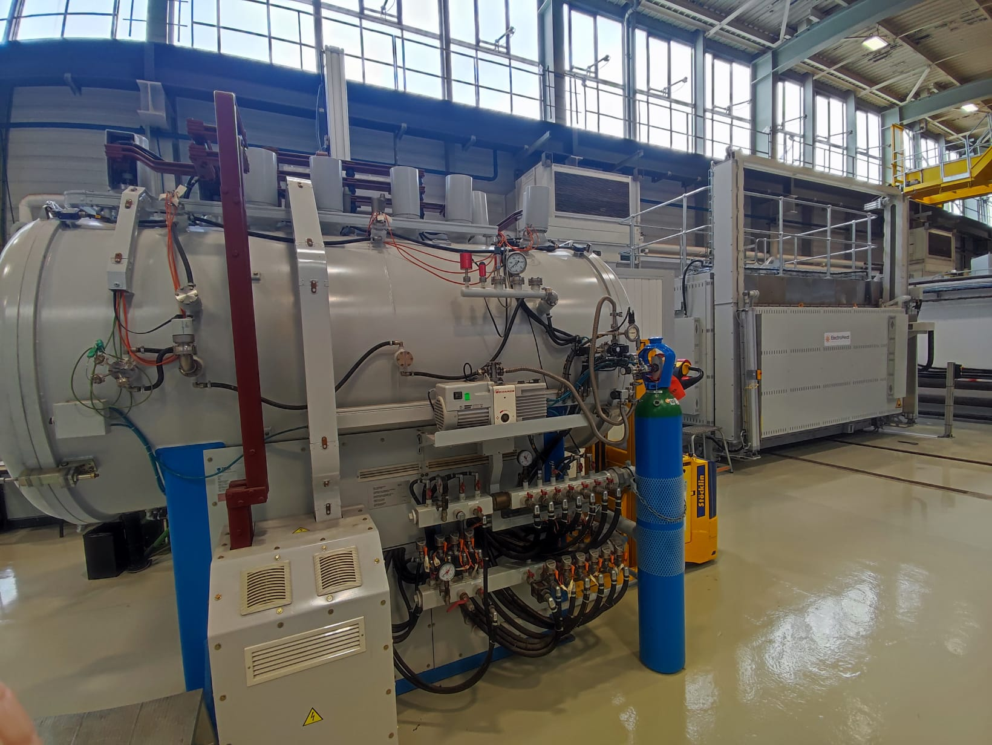
Where to perform the measurements ?
Our proposal : MME Brazing Section – Two solutions
TAV Furnace :
Vacuum or Argon atmosphere
Up to 1250°C
CF40 viewports available
Straightforward solution
Trial possible asap
Test setup must be placed in vertical position and centred on the viewports-Optical path design TBC
ELECTROHEAT Furnace :
Air atmosphere
Up to 850 degrees
Large viewports to be installed
Not straightforward, discussions ongoing with supplier
Expected delay : Q3
Test setup must be placed horizontally - Optical path is confirmed

Slide 6
Conclusion
Based on this document and past experiences, the best solution for us is to use an optical approach based on DIC ;
The proposal is to test the first two setups in the TAV furnace with Argon repeating the same temperature profile;
Expected delay : next 3 or 4 weeks for a first test.

