Slide 1
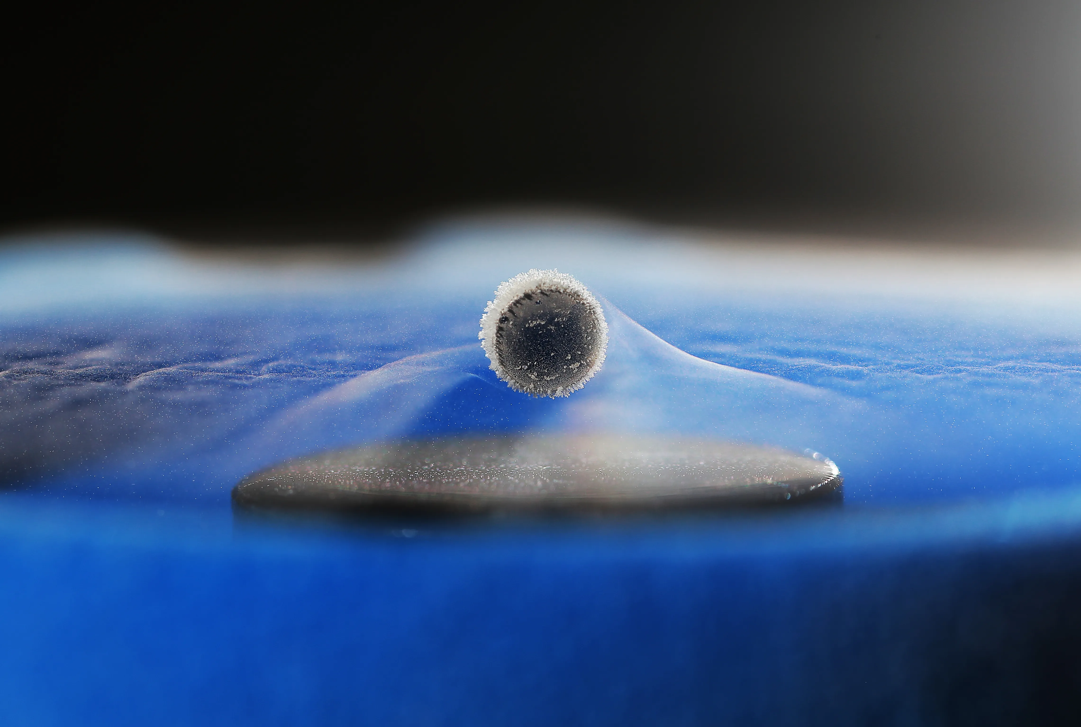

Superconductivity
Technology for Discovery Science
Technology for a Better World
Luca.Bottura@cern.ch
CERN, 4 April 2025

Slide 2
Outline
What is a superconductor ?
What can you do with it ?
  At CERN (High Energy Physics) …
  … and elsewhere
Final exam
Objective
Make you advocates of superconducting technology, for a future that is greener, healthier, more prosperous, and sustainable

Slide 3
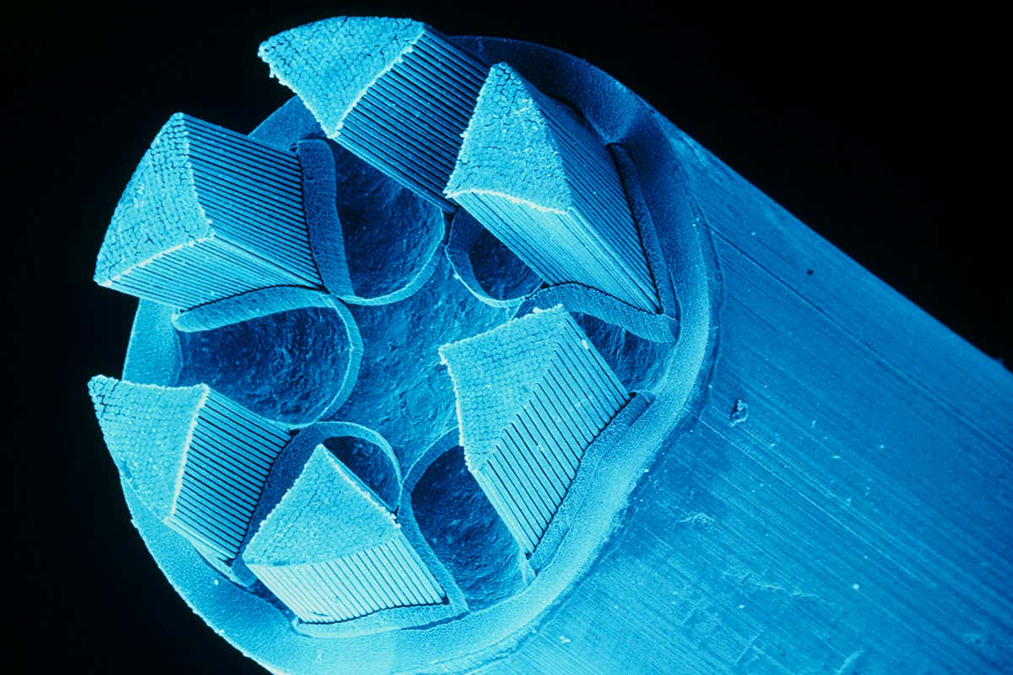
Outline
What is a superconductor ?
What can you do with it ?
  At CERN (High Energy Physics) …
  … and elsewhere
Final exam

Slide 4
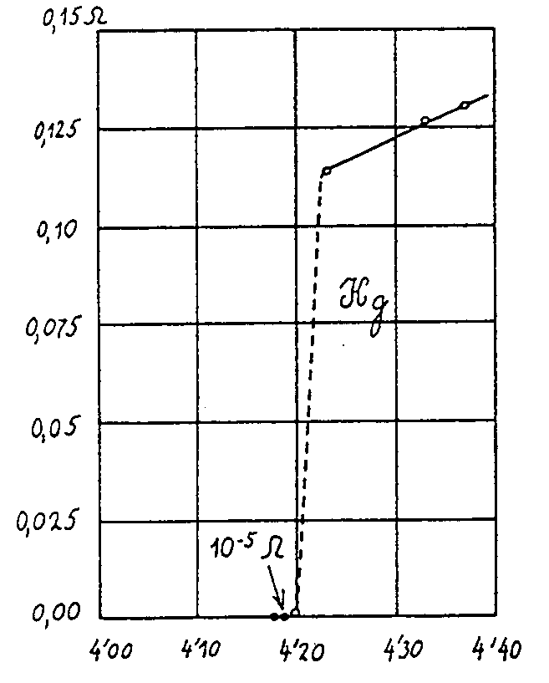
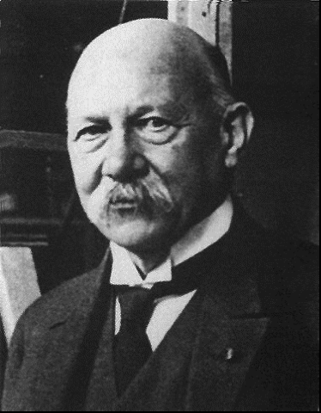
The discovery – 1911
… thus the mercury at 4.2 K has entered a new state, which, owing to its particular electrical properties, can be called the state of superconductivity…
H. Kamerlingh-Onnes (1911)

Slide 5
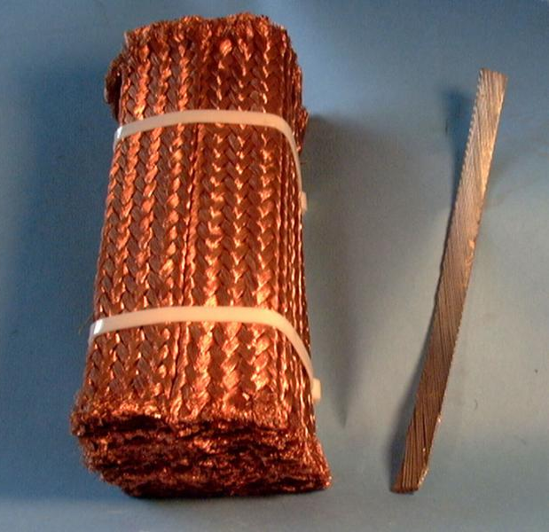
Superconductors vs. copper
13,000 A
13,000 A
Copper
resistive
Nb-Ti
superconductor
100x100 mm
15x2 mm
10 kA cables

Slide 6
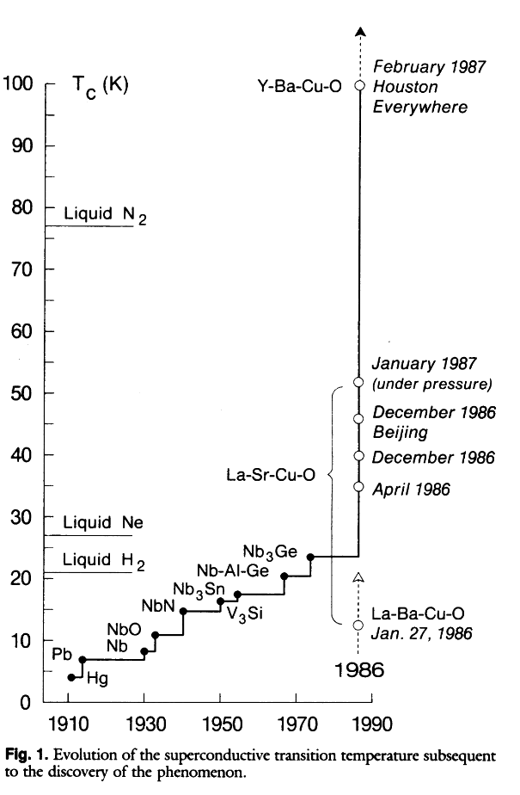
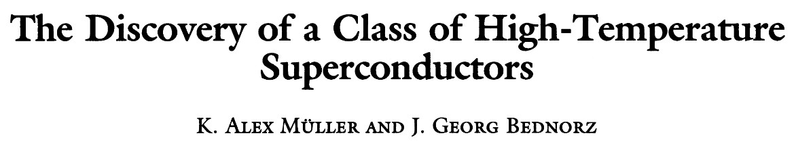
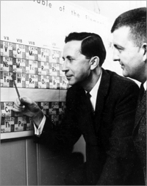
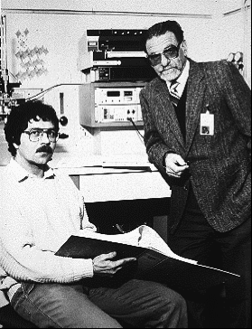
The big surprise – 1986
Theoretical limit around 30 K
One Thousand and One Superconductors
B. Matthias (1918-1980)
Bednorz and Mueller
IBM Zuerich, 1986

Slide 7
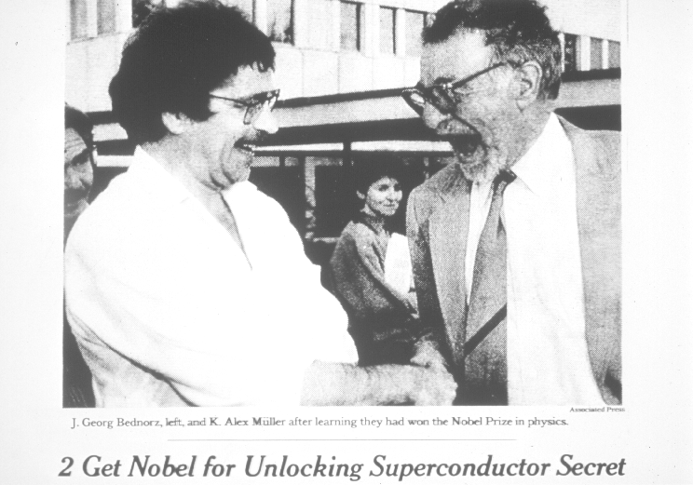
The prize ! 1987

Slide 8
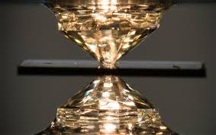
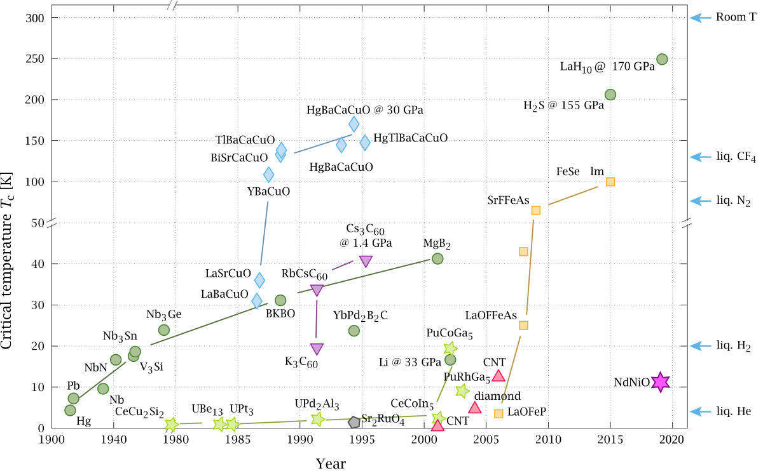
15 C
269 GPa
Room Temperature Superconductors (RTS)
(on Jupiter)
High Temperature Superconductors (LTS)
Low Temperature Superconductors (LTS)
Nb, Nb-Ti

Slide 9
Basic takeaway #1
A superconductor is a material that has zero resistance and can carry large currents with no loss
A material becomes superconducting only if it is cooled down below a critical temperature, typically between liquid helium (-269 ºC) and liquid nitrogen (-196 ºC)
Bonus knowledge: superconductivity is a quantum macroscopic phenomenon

Slide 10
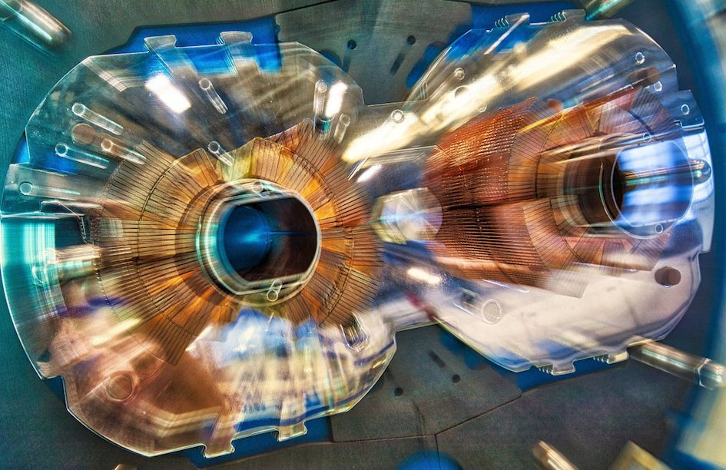
Outline
What is a superconductor ?
What can you do with it ?
  At CERN (High Energy Physics) …
  … and elsewhere
Final exam

Slide 11

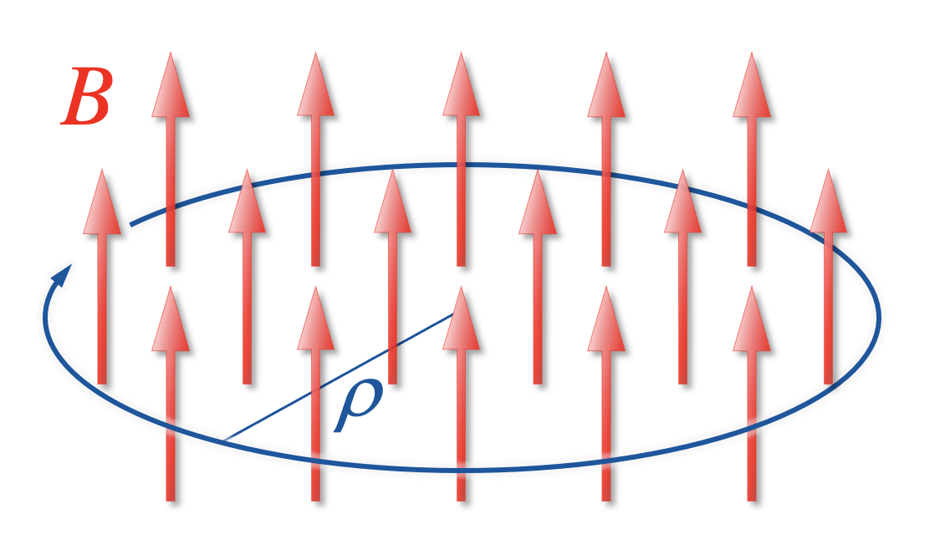
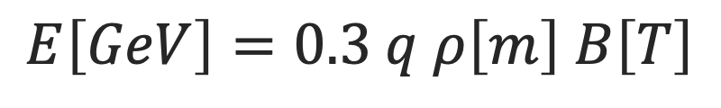
Particle accelerator basic
Particle accelerator = Merry-go-round
Magnetic field
RF
particles
E
acceleration
Particle beam
Image courtesy of Alamy
$$E\left[GeV\right]=0.3 q ρ\left[m\right] B\left[T\right]$$
Large magnetic field gives higher energy with a smaller (cheaper !) accelerator

Slide 12
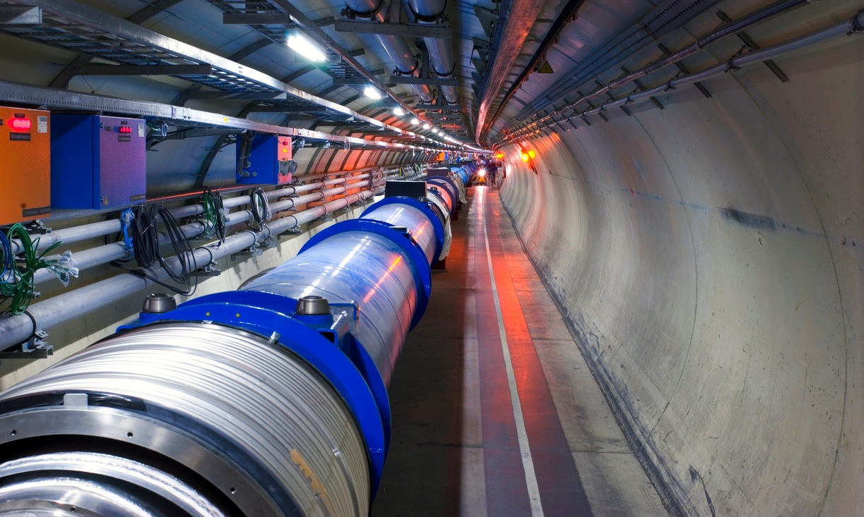
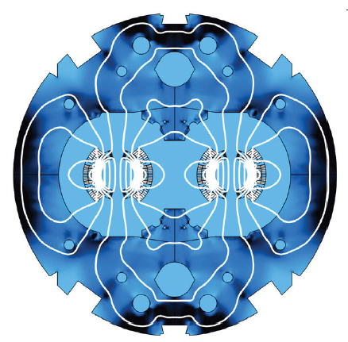
LHC – Superconducting magnets
Extreme magnetic fields
B = 8.3 T (200,000 times earth magnetic field)
B
B
LHC dipole cross section

Slide 13
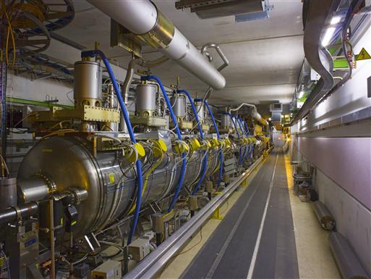
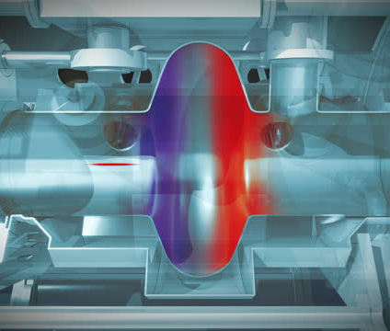
LHC – Superconducting RF
Extreme electric fields
V = 2 MV (10,000 times household appliance)
LHC RF cavity cross section

Slide 14
Basic takeaway #2
Superconducting magnets, radio-frequency (and power transmission cables) made it possible to realize the largest instrument built by humankind
LHC would not exist without superconductors
The superconductors used in the LHC (and future accelerators) would not be at the same level of technology readiness without the stewardship of High Energy Physics

Slide 15
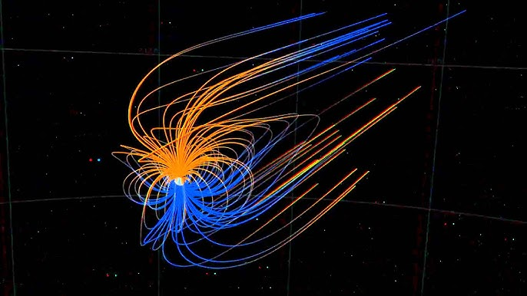
Outline
What is a superconductor ?
What can you do with it ?
  At CERN (High Energy Physics) …
  … and elsewhere
Final exam

Slide 16
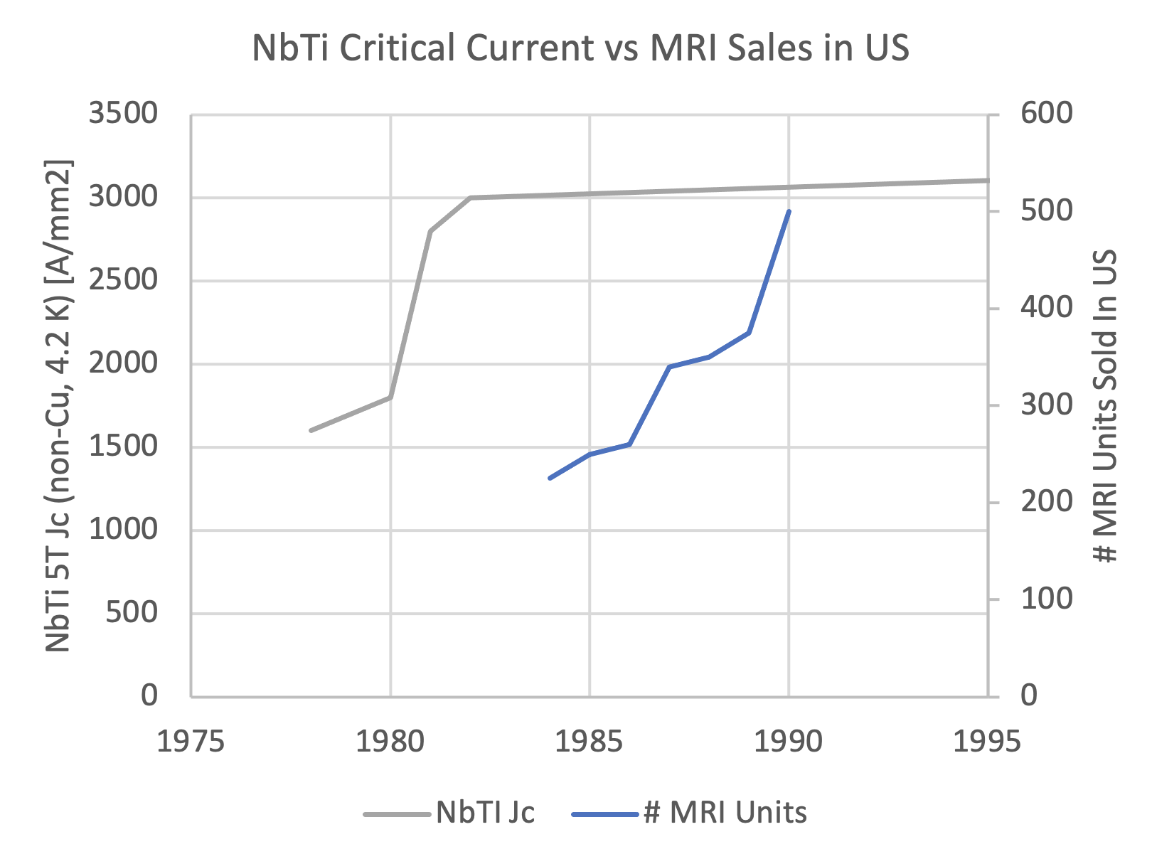
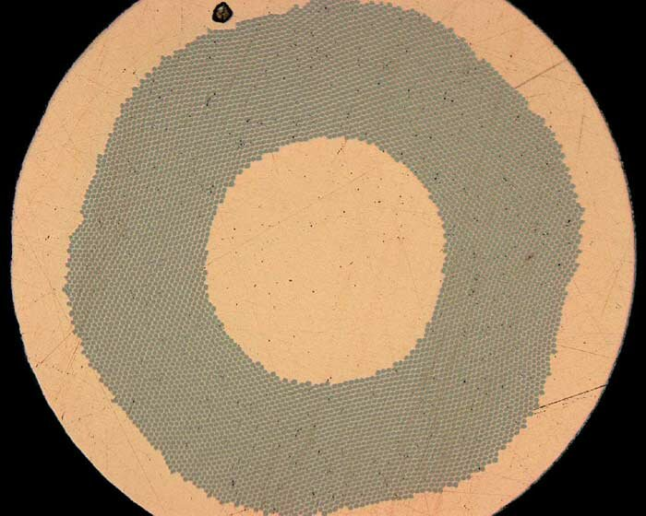
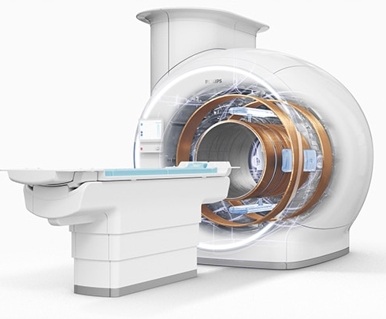
Magnetic Resonance Imaging
SSC R&D
LHC
Hi-Ho Nb-Ti
Tevatron
Prime choice for non-invasive imaging

Slide 17

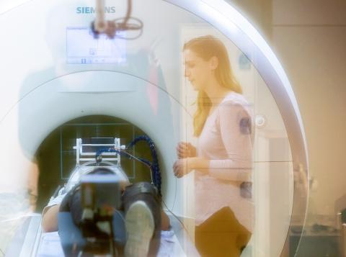
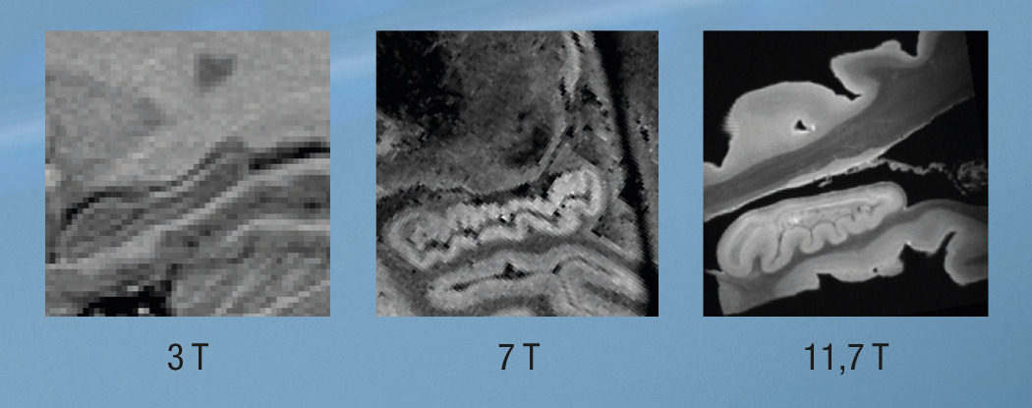



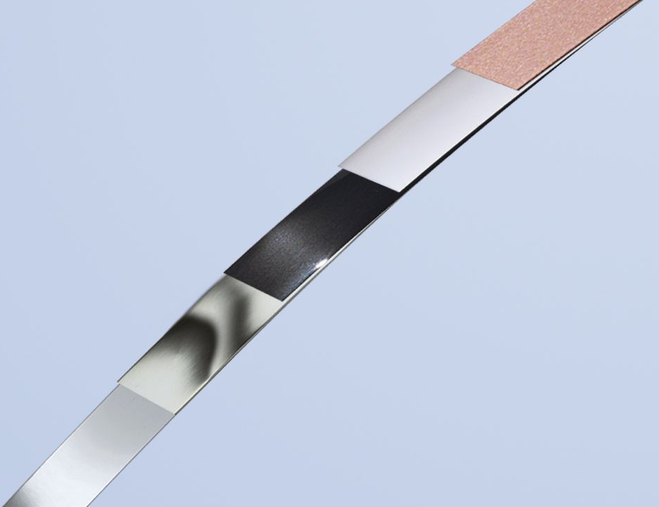
Next step in MRI
Hippocampus taken at different MRI field
HTS tape (REBCO) used in R&D magnets at CERN and associated laboratories
Radboud University (responsible institution), Amsterdam Medical Centre (AMC), Leiden University Medical Centre (LUMC), Maastricht University, Radboud University Medical Centre, Spinoza Centre for Neuroimaging – KNAW and University Medical Centre Utrecht (UMCU)

Slide 18
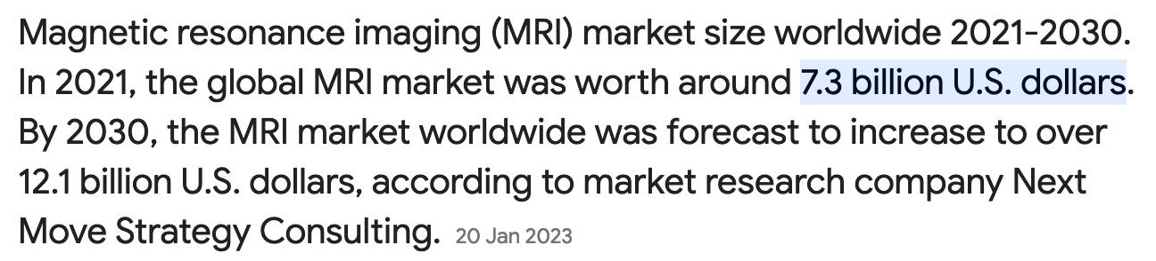
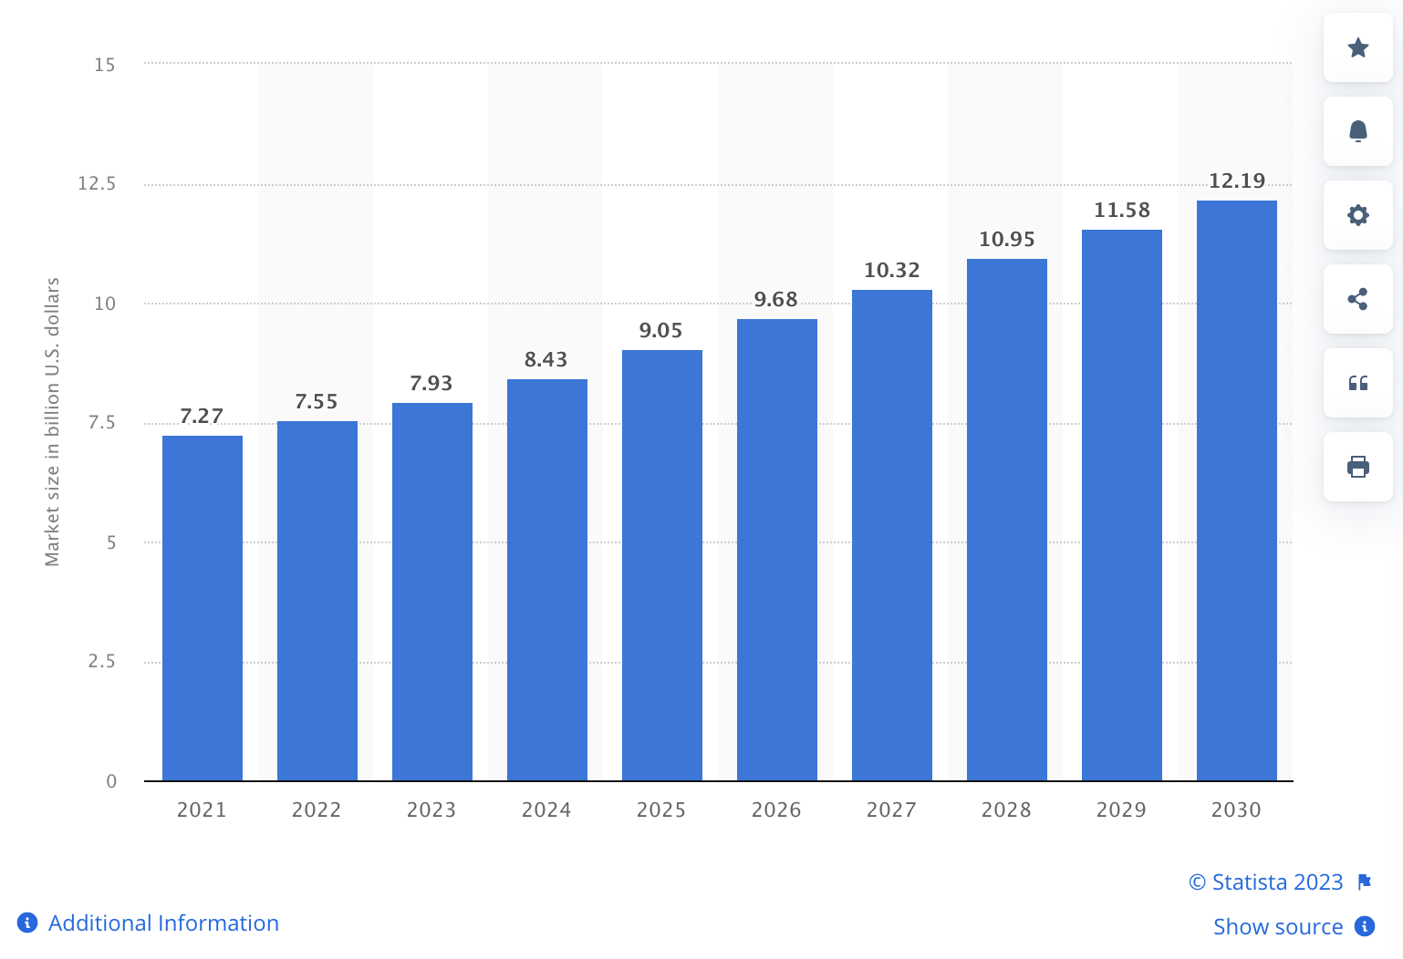
MRI market size and projection

Slide 19
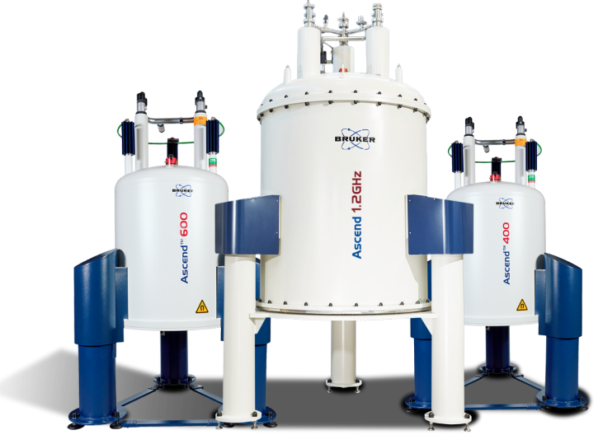
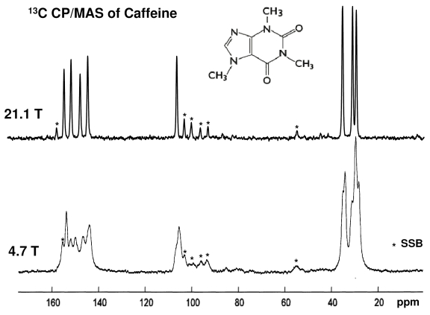
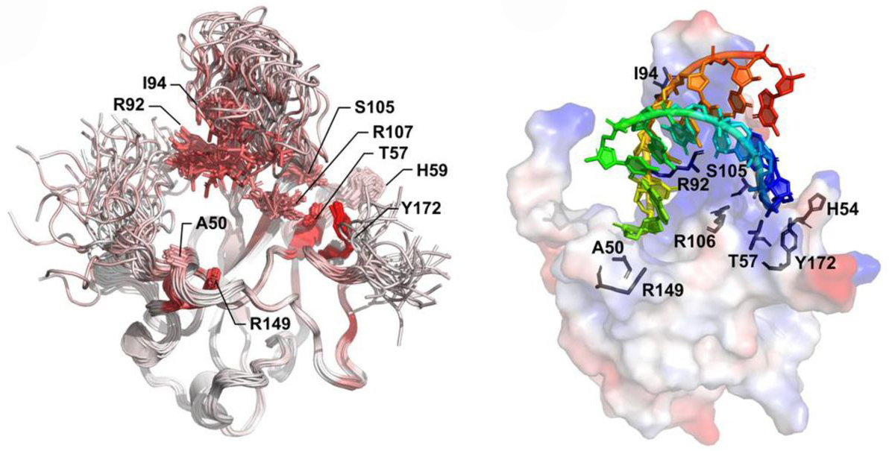
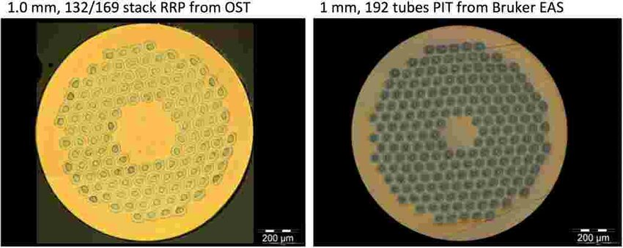
Nuclear Magnetic Resonance
Bruker ASCEND 1.2 GHz
28.2 T in 54 mm (LTS+HTS)
Nb₃Sn wires used in HL-LHC magnets
NMR structure model of the SARS-CoV-2 N-NTD:RNA complex
Unique insight in materials and molecules

Slide 20
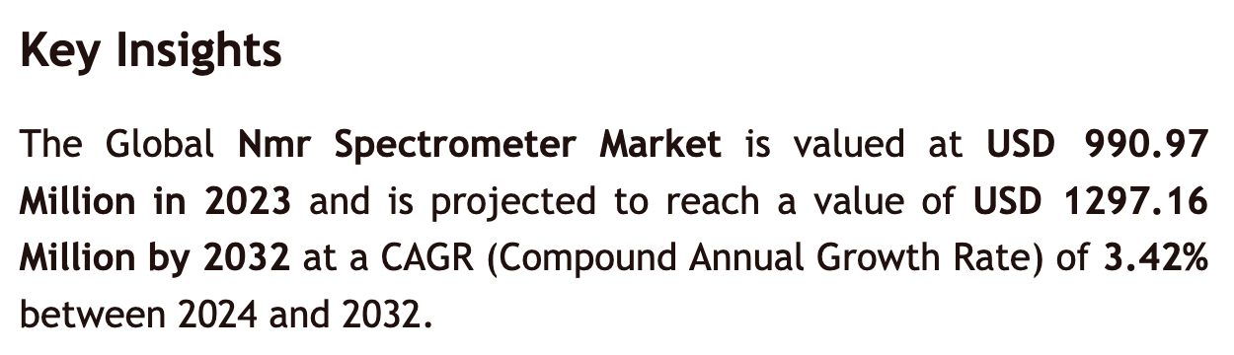
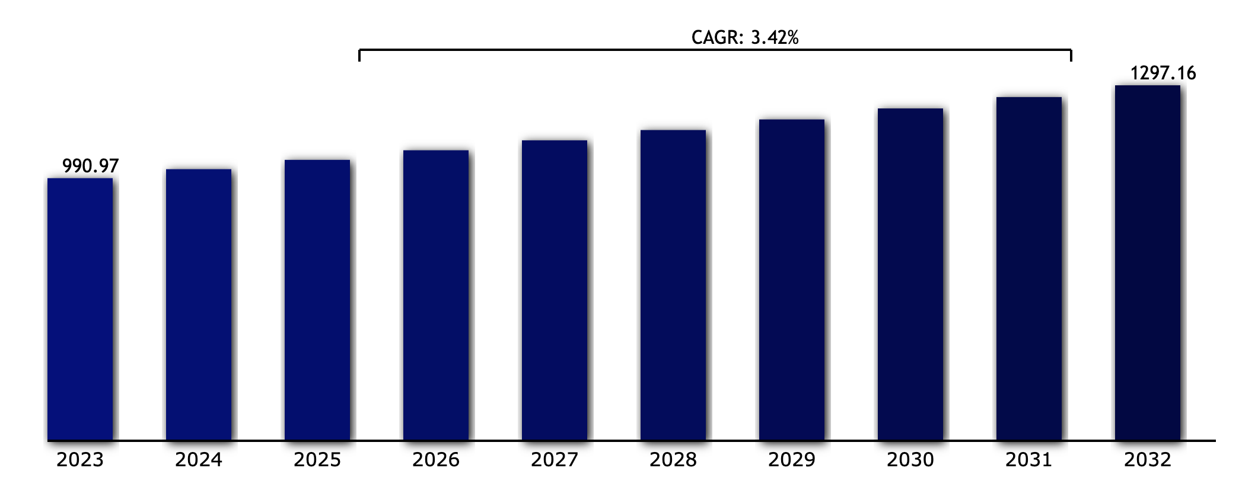

NMR market size and projection
Source: Vantage Market Research

Slide 21
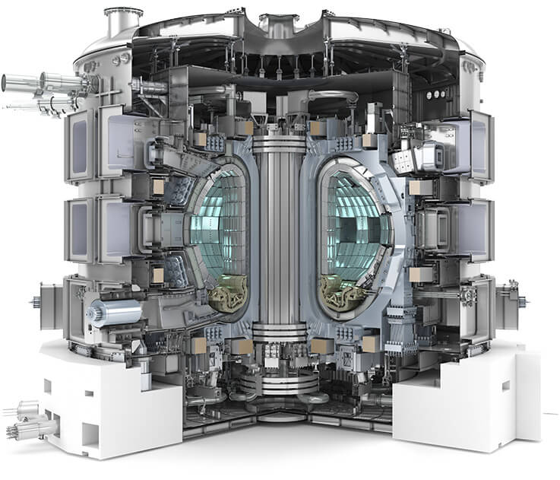
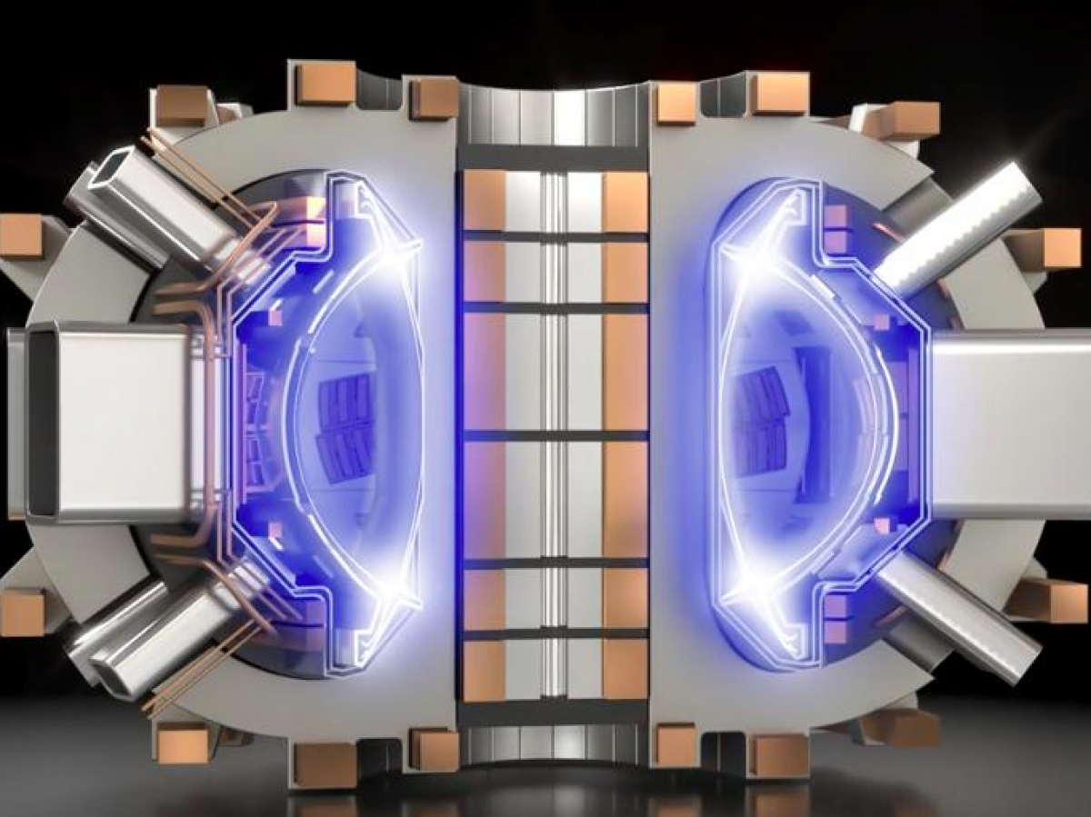
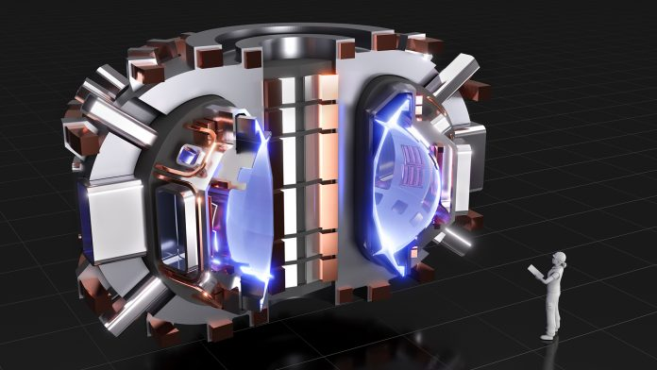
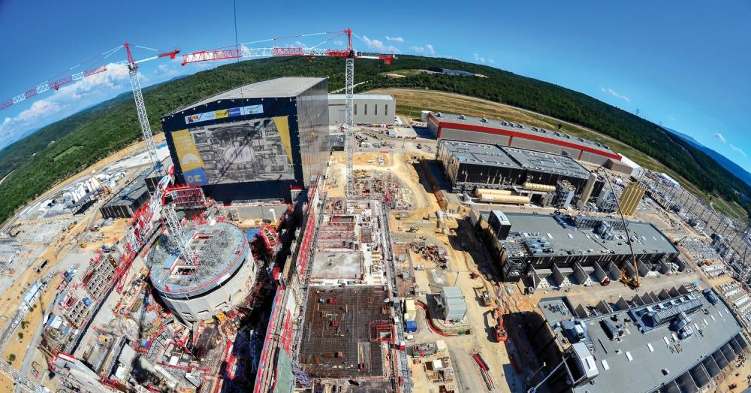
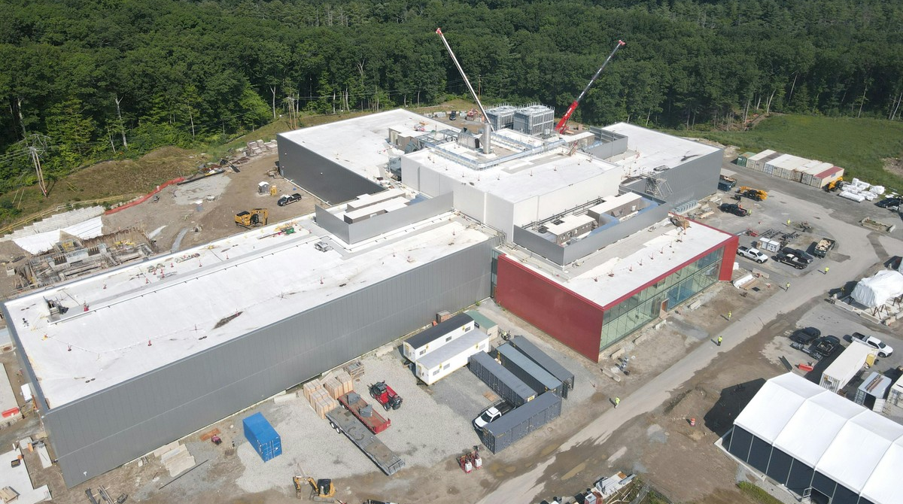
Thermonuclear fusion
ITER reactor, Cadarache (F)
CFS SPARC reactor, Devens (MA, USA)
Promise of unlimited, clean energy

Slide 22
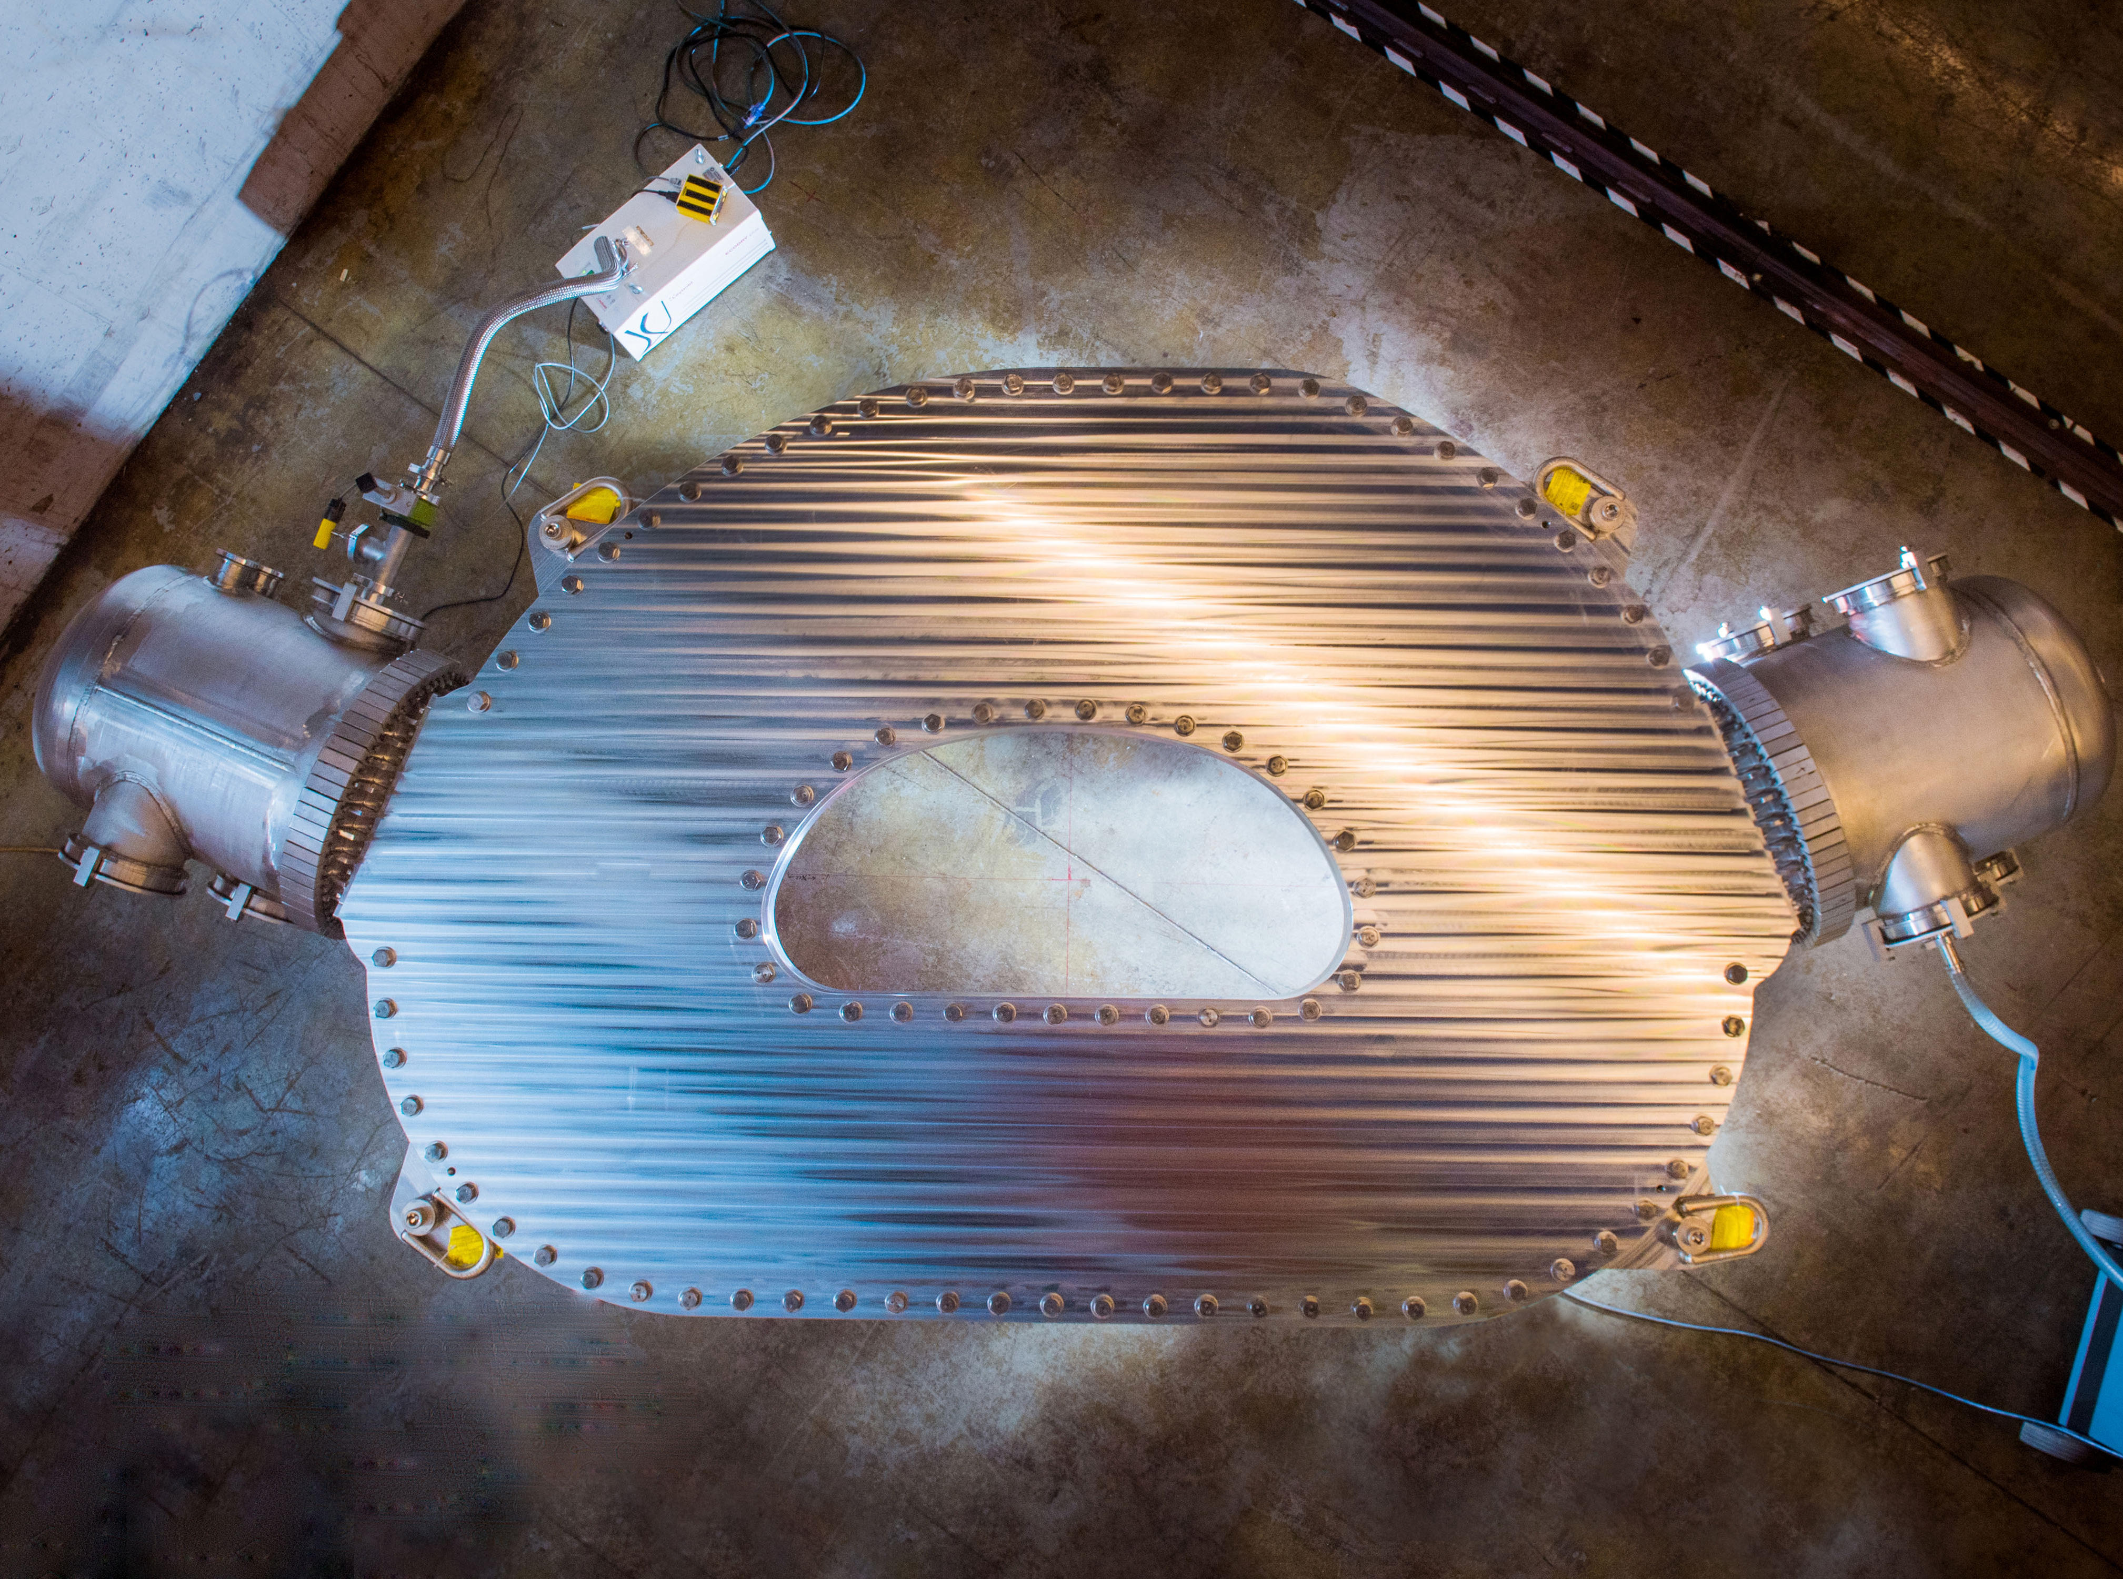

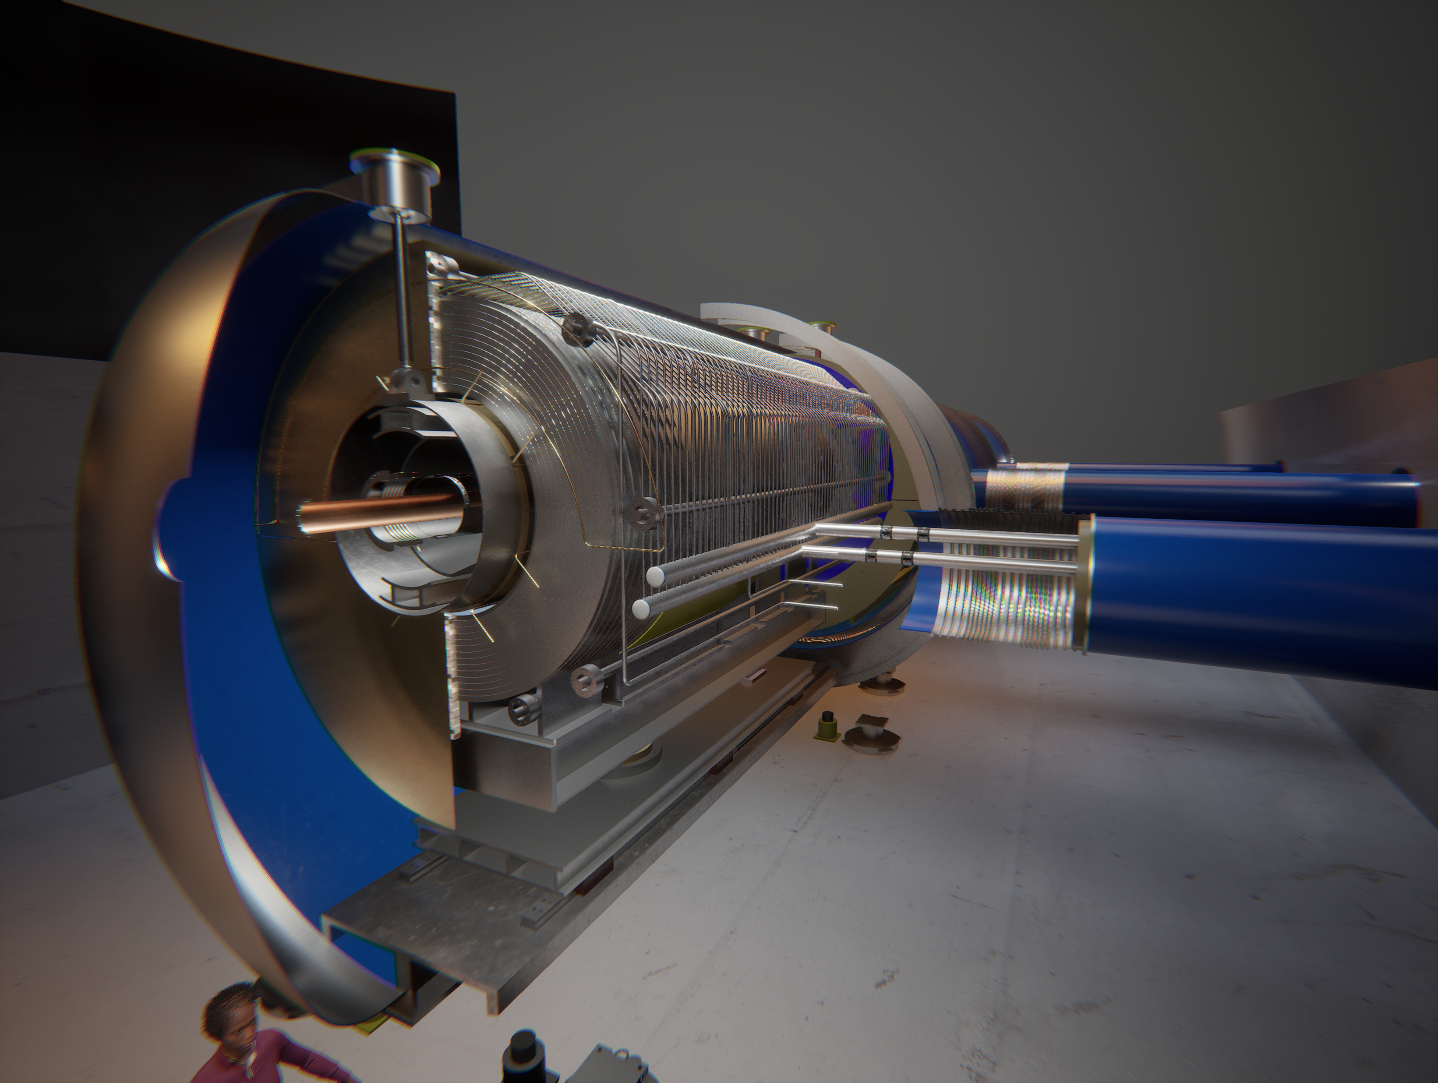

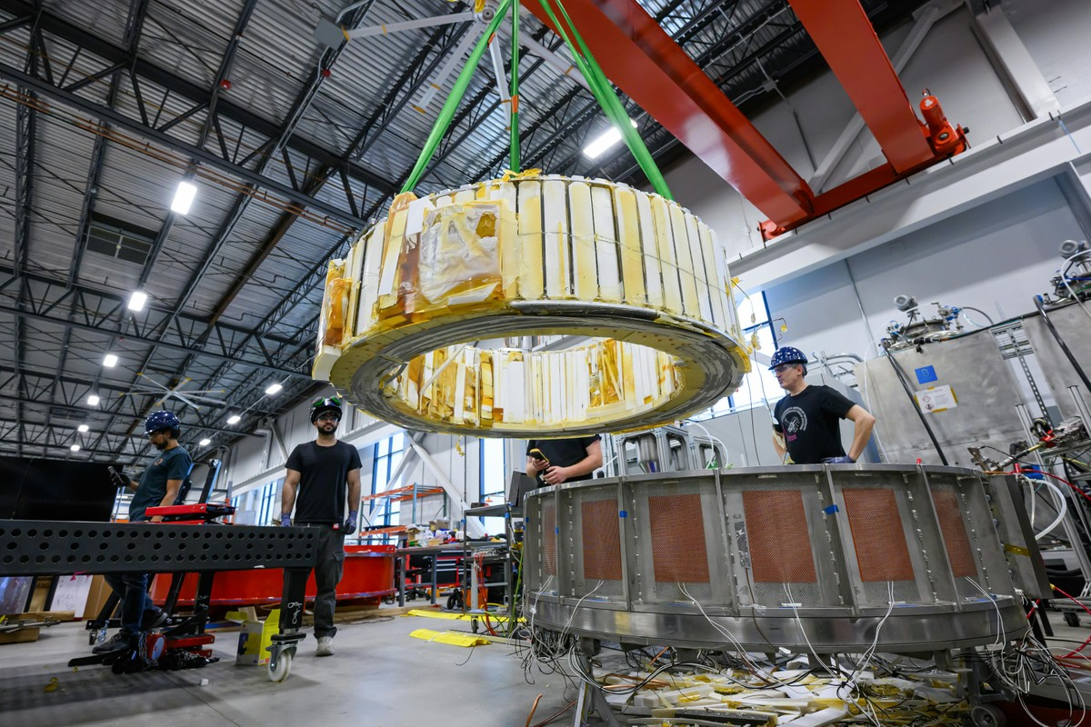
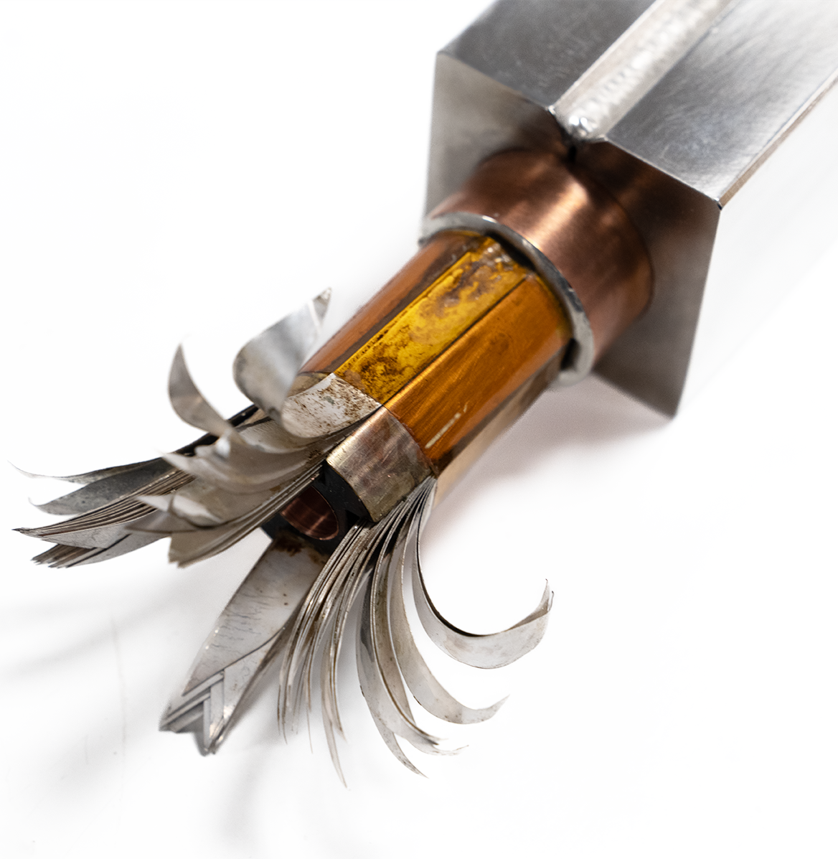
Powerful magnets for fusion
MIT/CFS SPARC TF Coil prototype
20 T at 20 K (HTS)
Fusion-like internally cooled HTS cable developed at CERN for the target and capture solenoid of the Muon Collider
MIT/CFS SPARC CS Coil prototype
5.7 T, 5 T/s at 20 K (HTS)

Slide 23
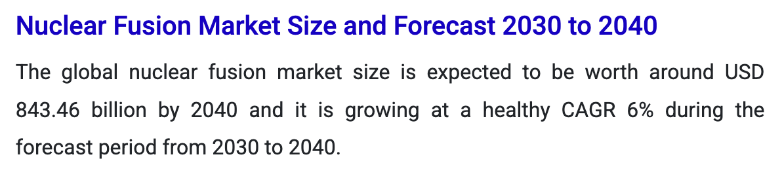
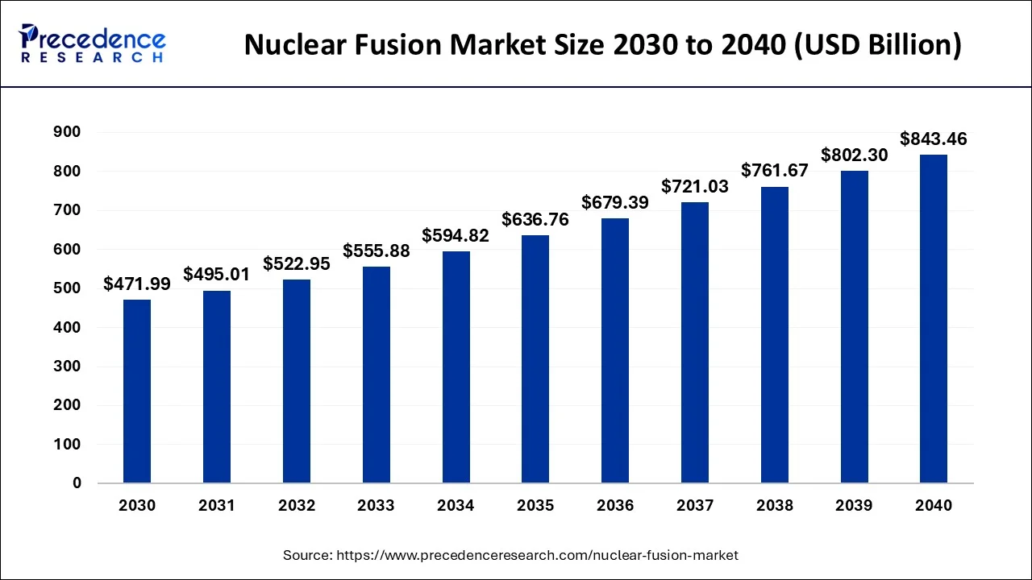
Fusion market size and projection

Slide 24
Basic takeaway #3
Superconductivity is the enabling technology for applications that have revolutionized our life
  Healthcare (MRI)
  Biology and pharmaceutical research (NMR)
Superconductivity can lead to paradigm shift in
  Energy production (fusion reactors, generators)
  Electric power distribution (transmission cables)
  Transportation (propulsion and levitation)
  Electronics and quantum (QUBITs)

Slide 25
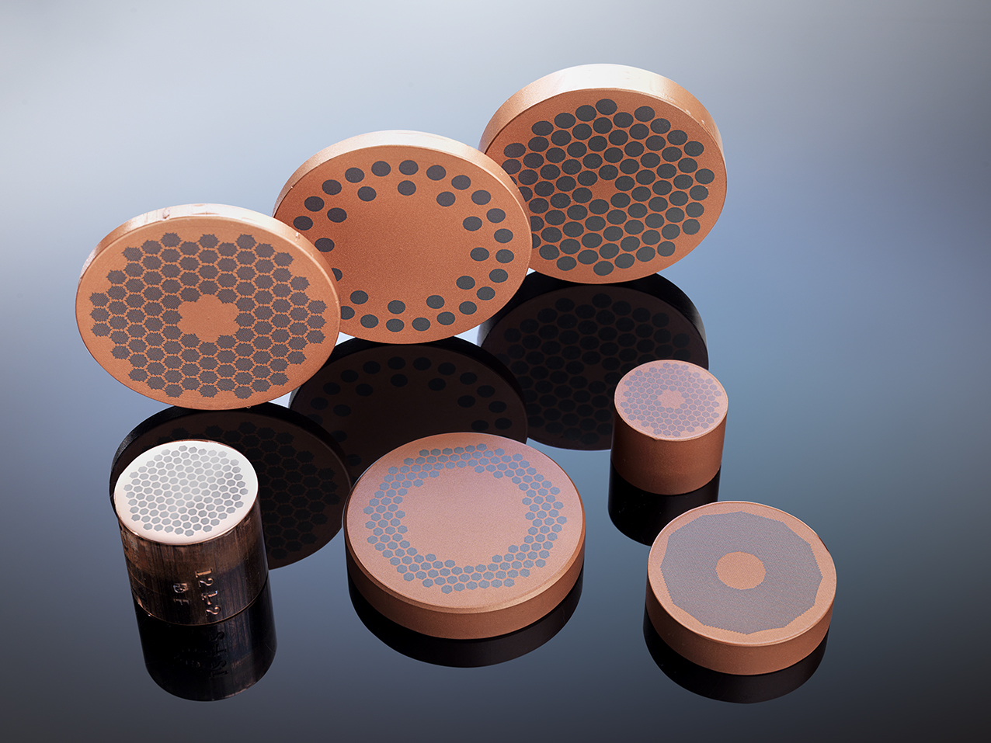
Outline
What is a superconductor ?
What can you do with it ?
  At CERN (High Energy Physics) …
  … and elsewhere
Final exam

Slide 26

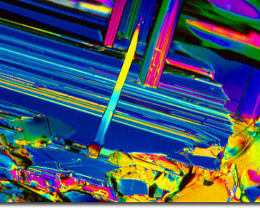


Quiz – 1/3
What is a superconductor ?
  An orchestra or choir conductor with extraordinary abilities
  A material that, when cooled down to cryogenic temperatures, can carry very large currents with no resistance
  A material that keeps the Pandora mountains afloat

Slide 27
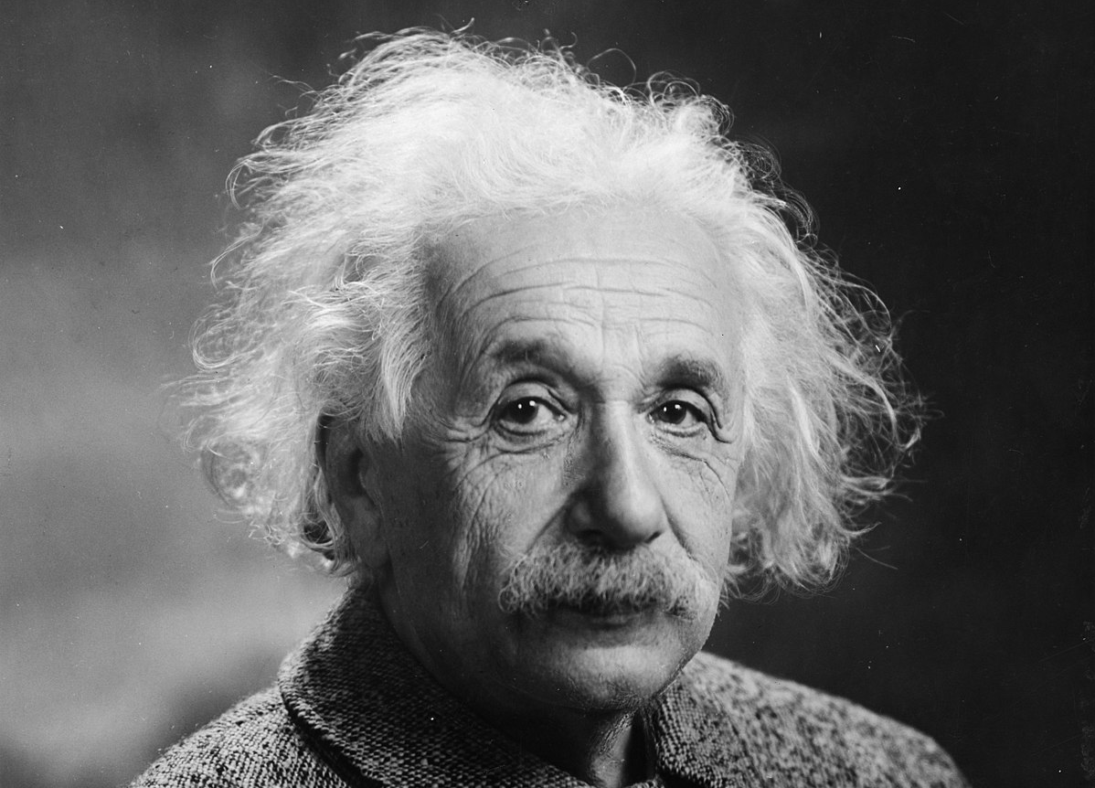

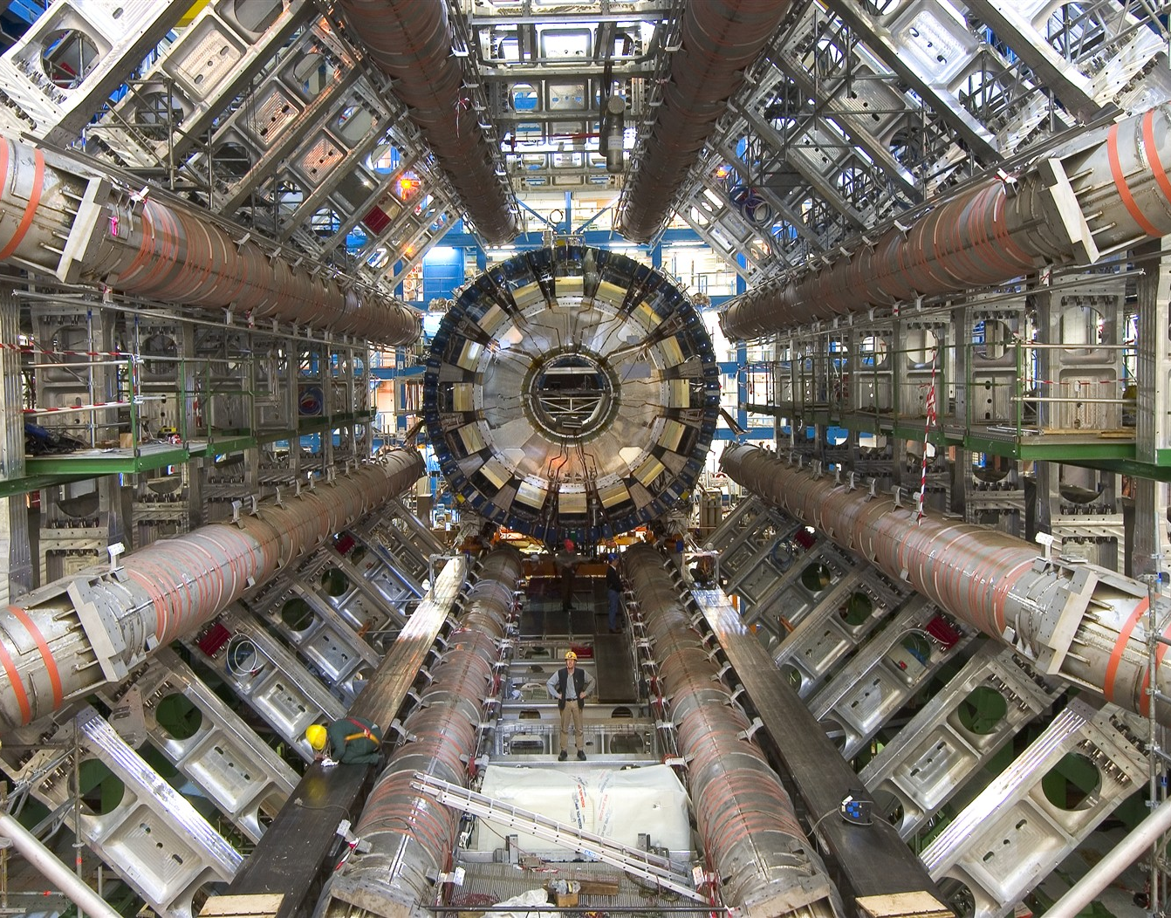
Quiz – 2/3
Why are superconductors important to discovery science ?
  Because physicists tend to get passionate about strange and useless materials
  Because they are cheap
  Because superconductivity is the enabling technology for instruments that have led to many of the fundamental discoveries of the last century

Slide 28
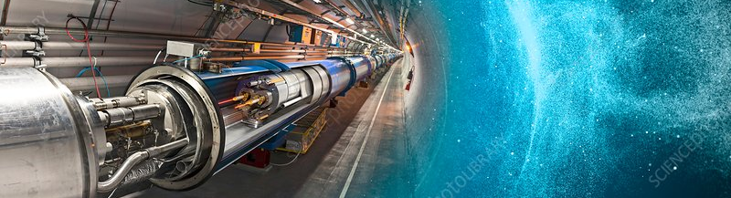
Quiz – 3/3
Why is discovery science important to society ?
  Among the many reasons (science, collaboration, education), because the superconducting technology needed for discovery science is conducive to revolutionary changes in the way we live

Slide 29

Cognizable in superconductors
Thank you for taking part to this class !
Now make good use of what you have learned…
… and we will be very happy to help you !

