Slide 1
TE LHC LS3 Activities
Beniamino Di Girolamo
TE Department – Meeting #1 15/04/2025

Slide 2
Small recap
Sandrine presented the organization we have in TE for the coordination of the activities during LS3 in LHC at the LS3 days
Since then, we have populated the tasks with names
We need now to start more regular and general meetings where to discuss status of preparation and interfaces: this is the first meeting
In this moment it is urgent to focus on the BST activities to organize the complete set of documentation, the flow diagram and the tools for the work follow-up
  We will dedicate next meetings to complete BST discussion, if today not finished, and for the analysis of the dismantling activities in IT1 and IT5 (now under schedule review)
Let’s review the global context and then focus

Slide 3
Difference with SMACC and DISMAC: no train, no single main operation
Workload
0
IT-STRING
BST Mock-up
DeInst Mock-up
Bellow Cons. Mock-up
TIME
1
2
3
De-INST
LHC IT1&5
Q10,Q4-D2,Q5
BST first sector (81)
~2.5 months-ish
1
ACC-CONS (2 DIP and 2 QUAD)
and
IT2&8-Bellows
and COATING
NC
(Diodes,CRG instr., Jacks, etc.)
2
BST
~18 months-ish
Installation
HL-LHC
AoB
Remaining NCs
3
BST++
~9
Months-ish

Slide 4
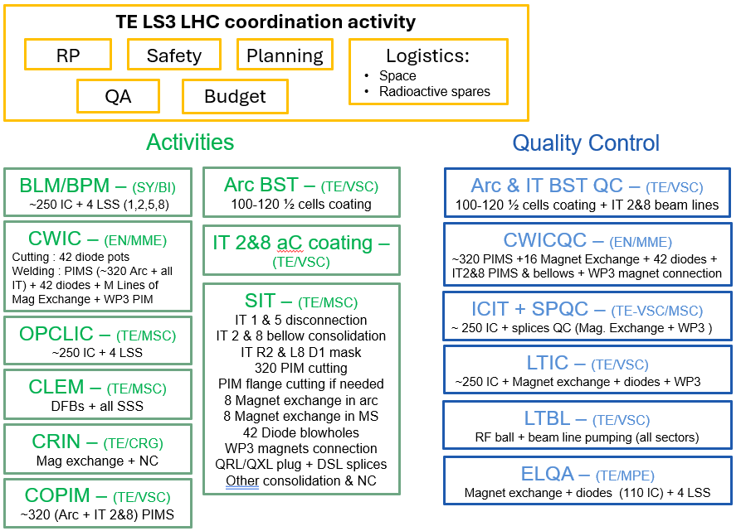
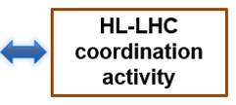
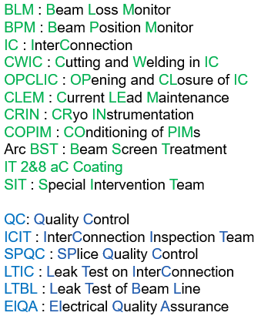
Detailed duties was given by B. Di Girolamo at LS3C
First meetings of TE LS3 coordination will start on Oct 24
No exhaustive list: other groups may intervene punctually

Slide 5
TE LS3 LHC coordination activity
HL-LHC coordination
B. Di Girolamo
S. Le Naour (deputy)
Safety: GRAD
RP: (A. Infantino)
P. Fessia
Planning: M. Bernardini
M. Barberan
E. Vergara F.
QA: ??
Logistics
Space: G. Riddone
Spares: L. Scibile
Budget: V. Perez-Reale/BDG
Quality Control
Activities
Arc BST coating QC (TE/VSC)
M. Charrondiere
BLM/BPM (SY/BI)
E. Calvo/C. Zamantzas/M. Krupa
(Arc) BST (TE/VSC)
G. Rosaz/V. Petit
IT coating QC (TE/VSC)
B. Henrist
BLM: Beam Loss Monitor
BPM: Beam Position Monitor
IC: InterConnection
CWIC: Cutting and Welding in IC (including diodes)
OPCLIC: OPening & CLosing of IC
CLEM: Current LEads Maintenance
CRIN: CRiogenics INstrumentation
COPIM: COnditioning of PIMs
(Arc) BST: Beam Screen Treatment
IT2&8 aC Coating
CLHS: Current Leads Heater System
DFBX-QRL: DFBX-QRL dismounting
SIT: Special Intervention Team
IT2&8 Bell. Cons.: IT2&8 Bellows Consolidation
QA: Quality Assurance
QC: Quality Control
ICIT: InterConnection Inspection Team
SPQC: SPlices QC
LTIC: Leak Test on ICs
LTBL: Leak Test on Beam Line
ElQA: Electrical Quality Assurance
CWIC (EN/MME)
Contact G. Favre
IT2&8 aC (TE/VSC)
P. Costa Pinto/ B. Henrist
CWIC QC (EN/MME)
G. Arnau/A. Porret
OPCLIC (BE/OP)
J. Dalla-Costa/O. Andujar/S. McIntyre (MSC tech support)
CLHS dism. (TE/MPE)
G. D’Angelo
ICIT+SPQC QC (TE/VSC-MSC)
L. Grand-Clement/M. Malabaila/C. Duclos
CLEM (TE/MSC)
C. Barth/ M. Rowland
DFBX-QRL (TE/CRG)
A. Perin
LTIC QC (TE/VSC)
J. Somoza/G. Merino Fernandez
CRIN (TE/CRG)
N. Vauthier
SIT (TE/MSC)
J. Ferradas Troitino/N. Bourcey
LTBL QC (TE/VSC)
C. Vasquez Pelaez/G. Bregliozzi
COPIM (TE/VSC)
C. Duclos/J. Chauré
IT2&8 Bell. Cons (TE/MSC)
H. Prin/T. Bampton
ElQA (TE/MPE)
G. D’Angelo

Slide 6
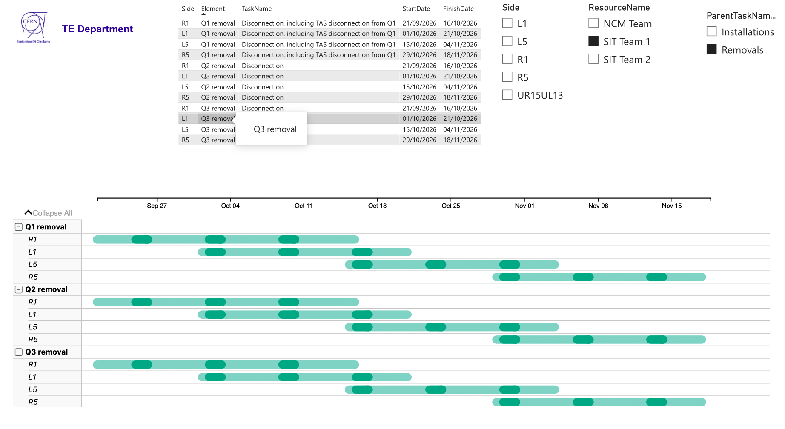
Scheduling aspects (planning, sequence, interfaces)
Several discussions on IT and LSS dismantling
  Optimisation requested by LS3C
  Technical visits organised by TE with TE, EN, SY groups to assess radiobiological risk and sequence
    Feedback passed to EN/ACE for planning and for the sequence
    Dedicated followup organised by EN/ACE for the sequence (this week)
BST
  First coordination meeting by TE TODAY for the interfaces between the various intervening groups within and outside the department

Slide 7
Radiobiological risk: DIMR for ITs dismantling
Magnets (warm + SC) deinstallation (all along LSS1 & LSS5) plus DFBX, including D2 | B. Di Girolamo | TE-MSC | VSC (insulation vacuum), BI, GM, ACE, MPE, CRG (DFBX), HE |  | 3 |  | 09/26 | 11/26
WDPs being collected
  MSC very advanced for warm and SC magnets
  CRG under preparation
  MPE under preparation
  VSC under preparation
Soon reminder with deadline April 15th

Slide 8
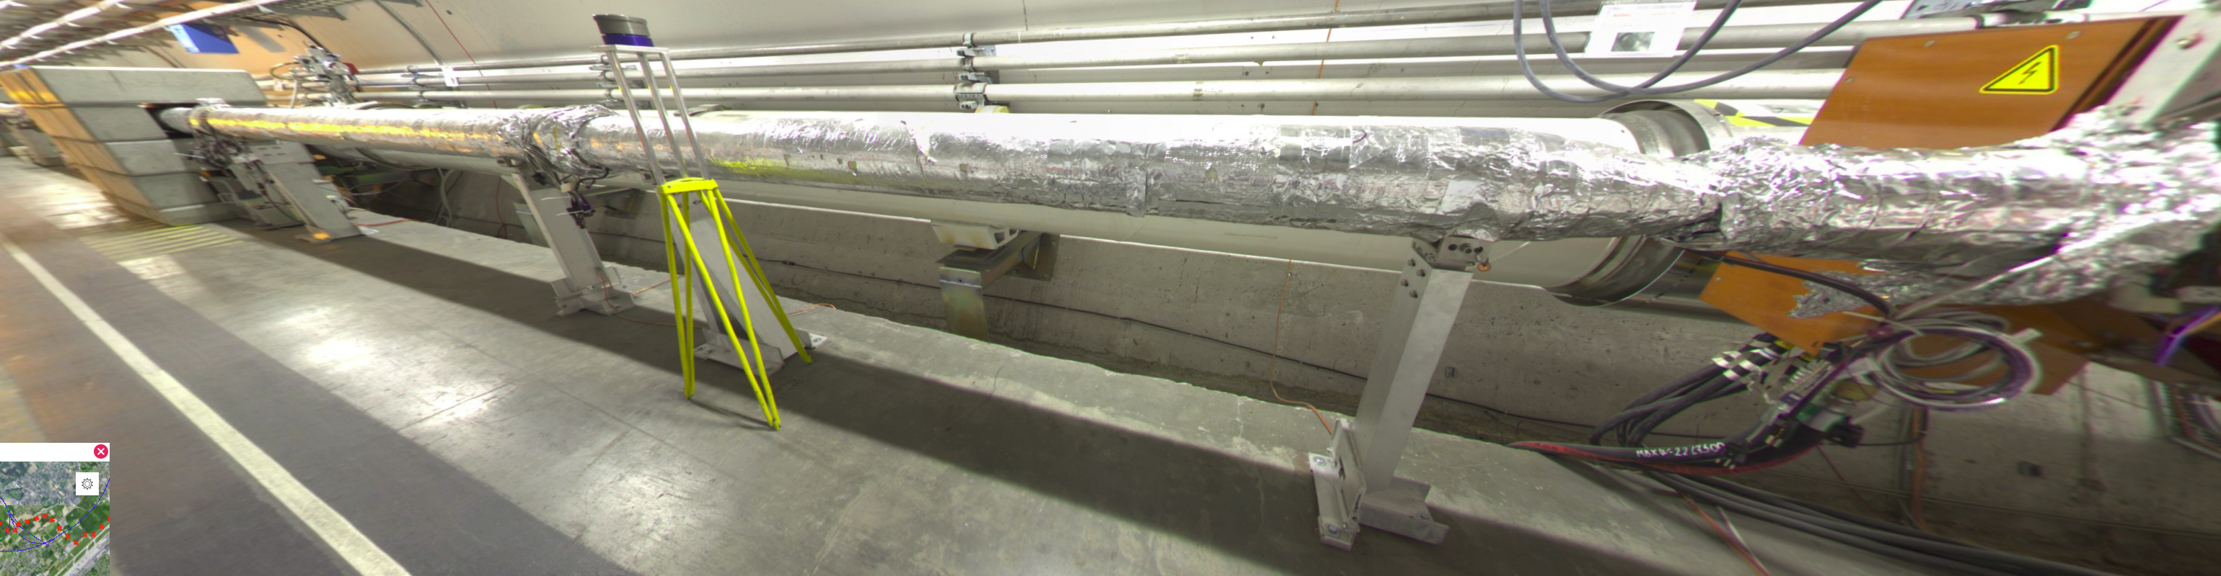
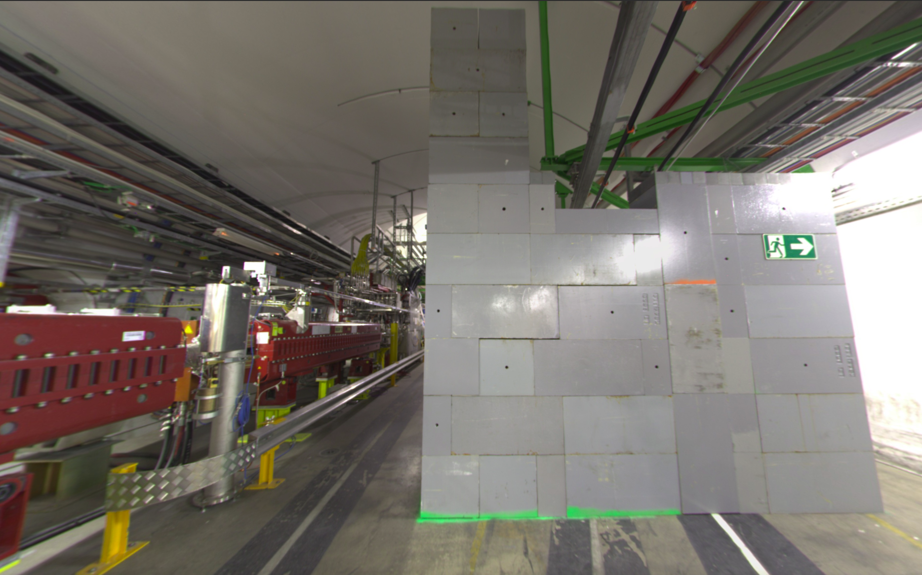
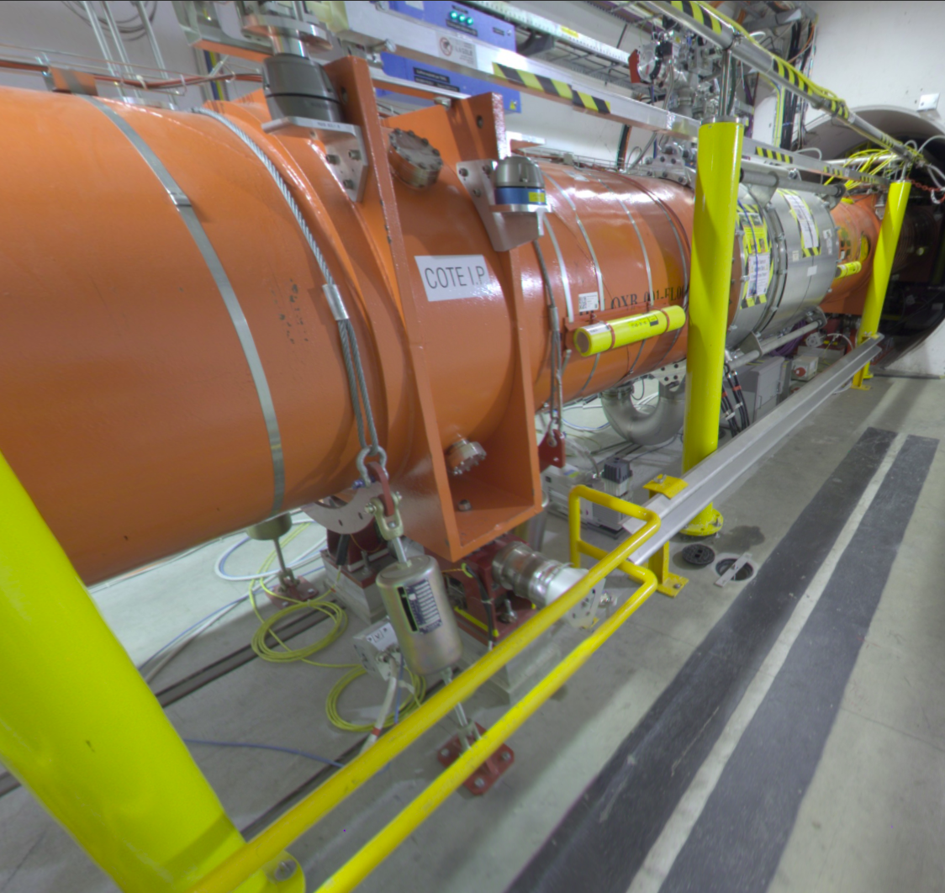
Points to be retained (please add) – part I
Sequence from beginning to end for IT dismounting
  Electrical lockout
  TE-VSC at early stage: dismounting of beam vacuum warm part
  EN/HE Remove shielding walls were needed to widen the passage
  EN/ACE dismounting rails and motors protections
  Vacuum venting, atm pressure in cryomagnet and beam vacuum
  BE-GM nuts on jacks and dismount radial motors
  SY-BI (in parallel?) dismount BLMs
  BE-GM remove alignment systems (HLS fluid, wire, rails, yellow pillars)
  TE-VSC insulation vacuum
  Cryo lockout (to be assessed with EROS)
  EN-ACE removing bumpers (postpone hotter ones)
  EN-ACE removing ties on the bumpers (only point 5)
From technical visits follow-up

Slide 9
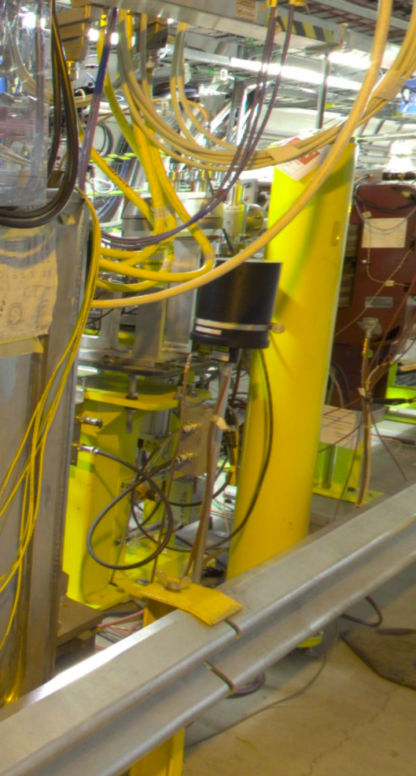
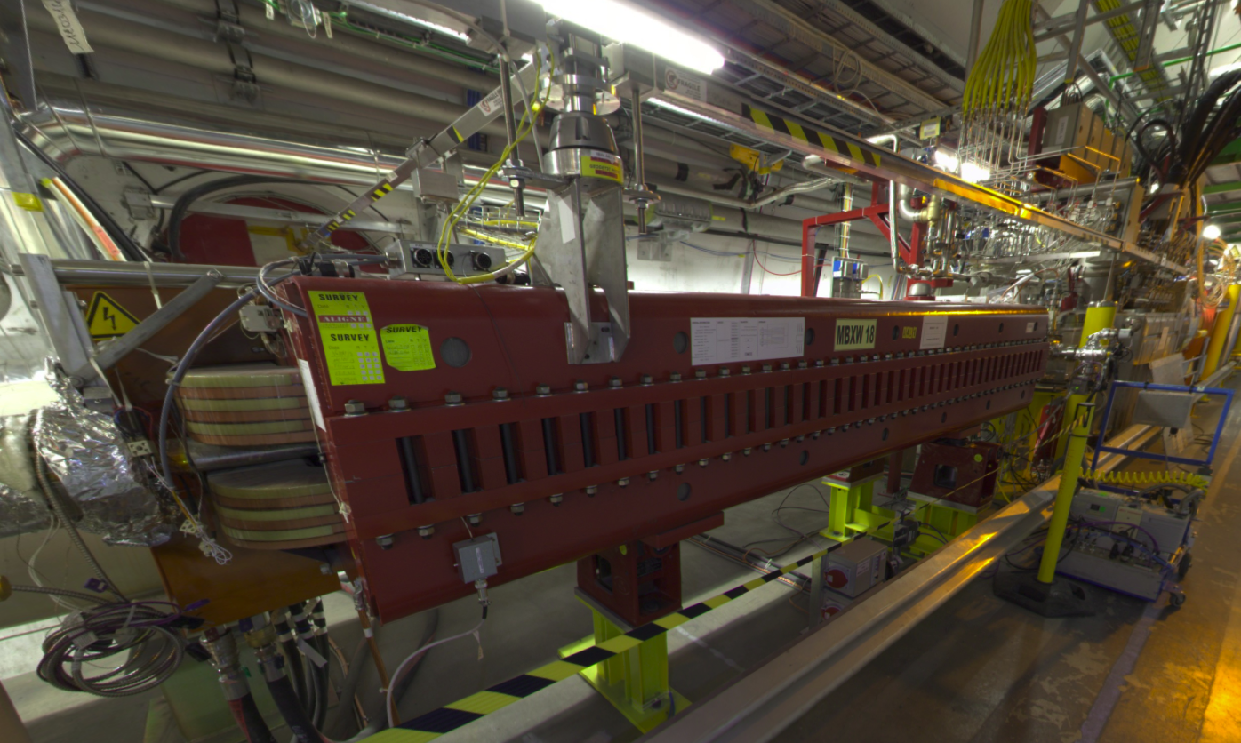
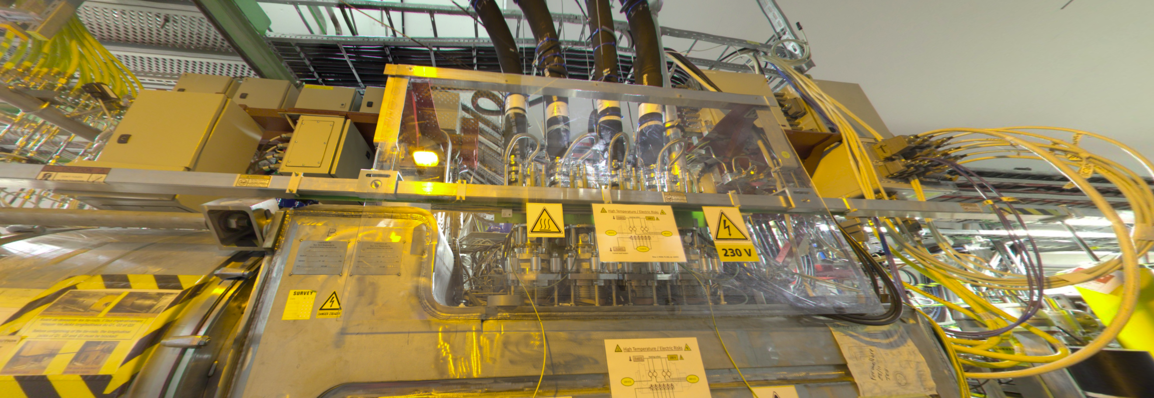
Points to be retained (please add) – part II
Sequence from beginning to end for IT dismounting (cont.)
  TE-VSC and SY-BI remove valves and BPM and supports
  TE-MSC to remove D1 magnets (priority to first on IP side to free up space for DFBX access): this can go in parallel
  TE-MPE disconnect (TE-CRG disconnect instrumentation) and remove complete upper part of red frame with electrical boxes (different access on the back of DFBX between P1 and P5)
  EN/CV emptying, EN/EL removing water-cooled cables
  TE-CRG work on DFBX
  TE-MSC Interconnect work (in parallel or shortly after): several operations (tie rods, W-bellows etc)
  TE-VSC, SY-BI and EN/AA remove Q1 connections and elemets IP side (VAX, TAS, BPM, BLM)
  All electrical boxes under magnet gone
  EN-ACE removing bumpers (if not done before)
  TE-MSC removing ties (if not done before)
  EN-HE remove D1 (at least first one), DFBX, Q3, Q2, Q1
From technical visits follow-up

Slide 10
Last important points before focusing to BST
Safety training for teams: see next slide
  It is possible to pre-book sessions for teams we know will arrive shortly before LS3 start
  No need of name, just reason and how many participants
We need to organise the Quality Plan: starting from DISMAC, addressing differences, without reinventing: see next to next slide and next presentation
We have a draft version of the Interconnections to be opened in the Arcs for BST and other tasks: see current dashboard = my next presentation
I created a mailing list: te-lhc-ls3-activities@cern.ch
  Feel free to use it for general questions. It is also archived
It would be nice to find a name easy to remember and for referencing to for this coordination project
  Ideas are welcome
  I had one, but I got criticism about the meaning (Jean-Philippe promised a champagne bottle if I would manage, though…)

Slide 12
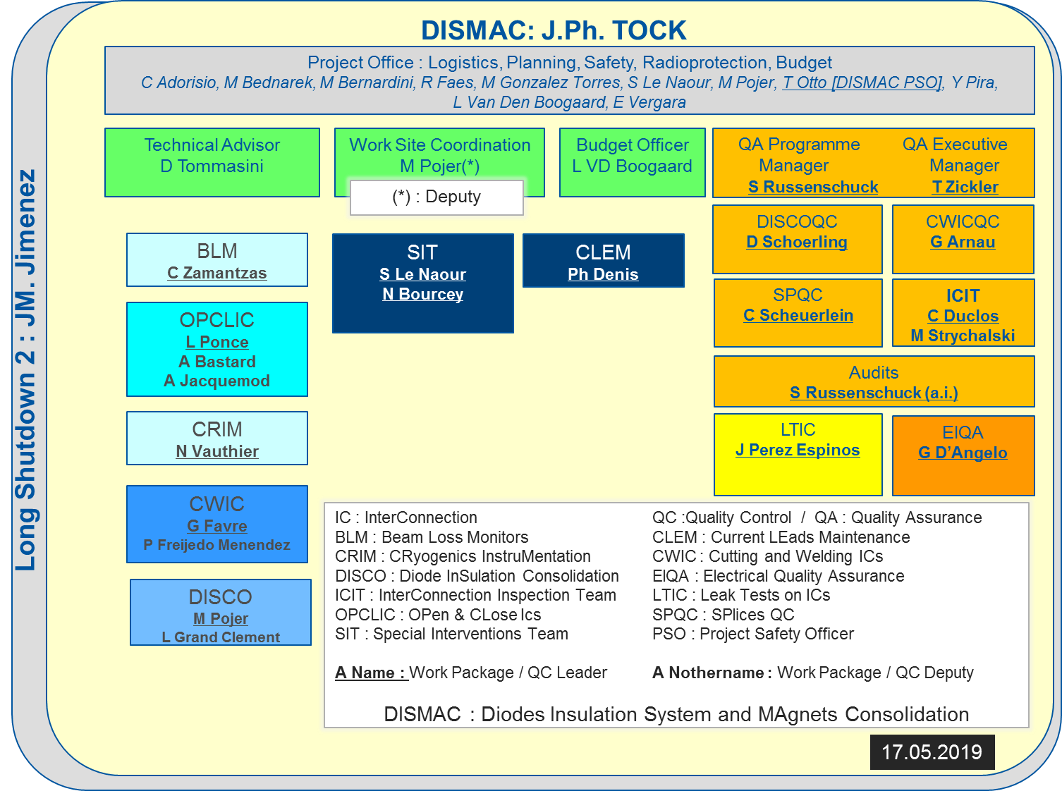
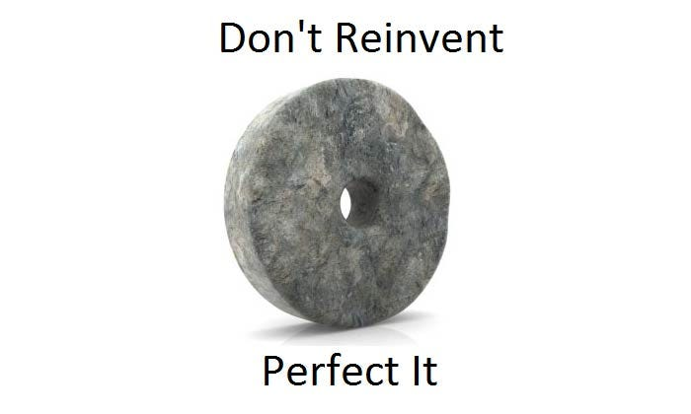
Review and update of DISMAC Quality Plan

Slide 13
Ideas for names
Please send ideas to me and Sandrine

