Slide 1

Beam Screen Treatment project
Current Baseline
TE LHC LS3 activities – Meeting #1
15.04.2025
On behalf of the BST project team

Slide 2
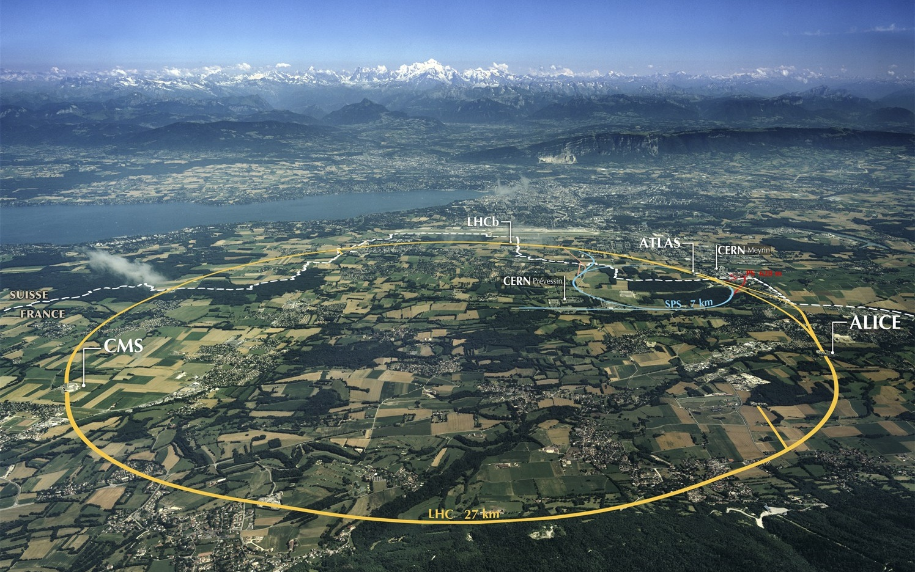
Beam Screen Treatment in the LHC arcs
Issue
Electron cloud-induced heat load on beam screens will overcome the limit of the cooling capacity in some LHC arcs for HL-LHC
Mitigation strategy
Deposit a thin amorphous carbon layer on selected arc beam screens
→ recover proper scrubbing efficiency of the beam screens
→ recover cooling margin
→ in-situ coating of about 12 km of LHC beam screens, by sections of 53 m (half-cell between 2 QQBIs ICs)
In. Triplets IP2/8
In-situ
190 m total
In. Triplets IP1/5
Ex-situ
320 m total
Matching sections
Ex-situ, in magnet
20 m total
Arcs
In-situ
≈ 12 km total
BST

Slide 3
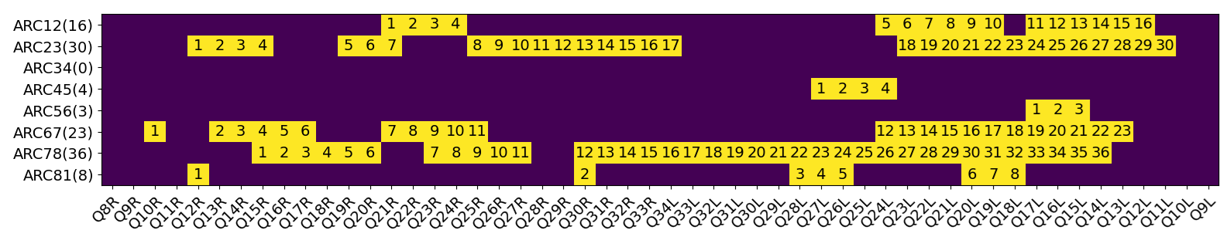
Selection of half-cells to be coated
BASELINE
B. Bradu, TE-CRG
Selection by Beam-Induced Heat Load Task Force of 120 half-cells to be treated (see B. Bradu's talk at Chamonix)
Equilibrate cryogenic margins along the machine
Consecutive half-cells (minimize number of interconnection openings)
→ intervention in 7 arcs, 140 QQBI interconnections to be opened (see EDMS 3106682)

Slide 4
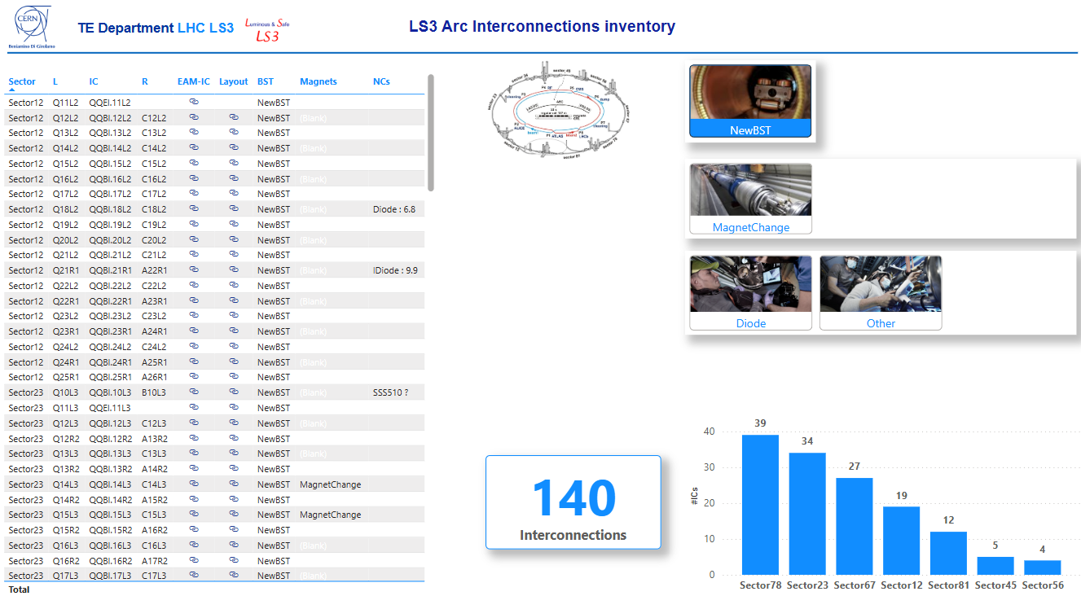
IC openings
Large Time-span for some sectors
- anticipated preparatory works
Arc 8-1 | Arc 1-2 | Arc 2-3 | Arc 3-4 | Arc 4-5 | Arc 5-6 | Arc 6-7 | Arc 7-8
16/09/206 - 01/02/2027 | 13/11/2026 - 06/04/2028 | 23/11/2026 - 01/03/2028 |  | 10/12/2026 - 24/03/2028 | 16/10/2026 - 28/04/2028 | 21/10/2026 - 22/10/2027 | 07/10/2026 - 03/09/2027
QQBI.12R | QQBI.21R | QQBI.12R |  | QQBI.27L | QQBI.17L | QQBI.10R | QQBI.15R
QQBI.13R | QQBI.22R | QQBI.13R |  | QQBI.26L | QQBI.16L | QQBI.11R | QQBI.16R
QQBI.30R | QQBI.23R | QQBI.14R |  | QQBI.25L | QQBI.15L | QQBI.13R | QQBI.17R
QQBI.31R | QQBI.24R | QQBI.15R |  | QQBI.24L | QQBI.14L | QQBI.14R | QQBI.18R
QQBI.28L | QQBI.25R | QQBI.16R |  | QQBI.23L |  | QQBI.15R | QQBI.19R
QQBI.27L | QQBI.24L | QQBI.19R |  |  |  | QQBI.16R | QQBI.20R
QQBI.26L | QQBI.23L | QQBI.20R |  |  |  | QQBI.17R | QQBI.21R
QQBI.25L | QQBI.22L | QQBI.21R |  |  |  | QQBI.18R | QQBI.23R
QQBI.20L | QQBI.21L | QQBI.22R |  |  |  | QQBI.21R | QQBI.24R
QQBI.19L | QQBI.20L | QQBI.25R |  |  |  | QQBI.22R | QQBI.25R
QQBI.18L | QQBI.19L | QQBI.26R |  |  |  | QQBI.23R | QQBI.26R
QQBI.17L | QQBI.18L | QQBI.27R |  |  |  | QQBI.24R | QQBI.27R
 | QQBI.17L | QQBI.28R |  |  |  | QQBI.25R | QQBI.28R
 | QQBI.16L | QQBI.29R |  |  |  | QQBI.26R | QQBI.30R
 | QQBI.15L | QQBI.30R |  |  |  | QQBI.24L | QQBI.31R
 | QQBI.14L | QQBI.31R |  |  |  | QQBI.23L | QQBI.32R
 | QQBI.13L | QQBI.32R |  |  |  | QQBI.22L | QQBI.33R
 | QQBI.12L | QQBI.33R |  |  |  | QQBI.21L | QQBI.34L
 | QQEI.11L | QQBI.34L |  |  |  | QQBI.20L | QQBI.33L
 |  | QQBI.33L |  |  |  | QQBI.19L | QQBI.32L
 |  | QQBI.23L |  |  |  | QQBI.18L | QQBI.31L
 |  | QQBI.22L |  |  |  | QQBI.17L | QQBI.30L
 |  | QQBI.21L |  |  |  | QQBI.16L | QQBI.29L
 |  | QQBI.20L |  |  |  | QQBI.15L | QQBI.28L
 |  | QQBI.19L |  |  |  | QQBI.14L | QQBI.27L
 |  | QQBI.18L |  |  |  | QQBI.13L | QQBI.26L
 |  | QQBI.17L |  |  |  | QQBI.12L | QQBI.25L
 |  | QQBI.16L |  |  |  |  | QQBI.24L
 |  | QQBI.15L |  |  |  |  | QQBI.23L
 |  | QQBI.14L |  |  |  |  | QQBI.22L
 |  | QQBI.13L |  |  |  |  | QQBI.21L
 |  | QQBI.12L |  |  |  |  | QQBI.20L
 |  | QQEI.11L |  |  |  |  | QQBI.19L
 |  | QQBI.10L |  |  |  |  | QQBI.18L
 |  |  |  |  |  |  | QQBI.17L
 |  |  |  |  |  |  | QQBI.16L
 |  |  |  |  |  |  | QQBI.15L
 |  |  |  |  |  |  | QQBI.14L
 |  |  |  |  |  |  | QQBI.13L | TOTAL
12 | 19 | 34 |  | 5 | 4 | 27 | 39 | 140
TE LS3 dashboard
https://app.powerbi.com/groups/me/reports/b13cd5b2-07bc-4637-bfb6-2e3d5c1f8d66/212e405fc02ccc58b7c2?ctid=c80d3499-4a40-4a8c-986e-abce017d6b19&openReportSource=ReportInvitation&experience=power-bi
https://edms.cern.ch/project/CERN-0000252698

Slide 5
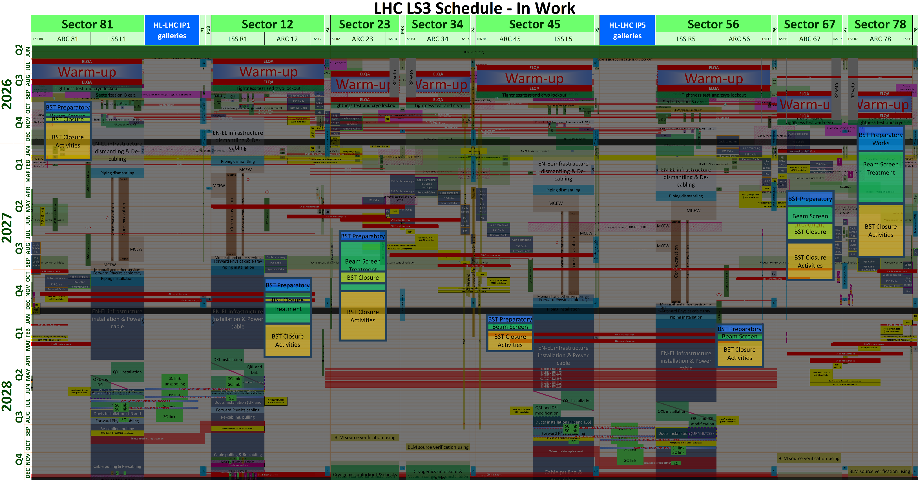
BST in LS3 master schedule
Sequential treatment of each single arc
3 coating fronts in parallel in a single arc
From Oct 2026 to Apr 2028
On-going optimization
Arc8-1
Arc7-8
Arc6-7
Arc2-3
Arc1-2
Arc4-5
Arc5-6
Progress direction within arcs to be implemented.
Actual beam screen treatment sequence being optimized and updated
EN-ACE

Slide 6
Intervention scheme
Radmon supports displacement (BE-CEM)
Racks insulation vacuum displacement (TE-VSC)
CV sensor displacement (EN-CV)
BLM Removal (SY-BI)
BPM Testing (SY-BI)
IC W bellow opening (TE-MSC)
PIMs cutting (TE-MSC)
BS treatment (TE-VSC)
BPM testing (SY-BI)
PIMs positioning / rewelding (TE-VSC / EN-MME)
PIMs radiography (EN-MME)
Beam vacuum leak testing (TE-VSC)
Interconnection Inspection
PIM shielding (TE-VSC)
IC W bellow closure (TE-MSC)
Insulation Vacuum leak test (TE-VSC)
BLM re-installation (SY-BI)
Radmon supports reinstallation (BE-CEM)
Racks insulation vacuum reinstallation (TE-VSC)
CV sensor reinstallation (EN-CV)
All identified intervening teams already contacted, on-going build-up of complete workflow and tracking tool
Coordination of activities others than BS treatment at the level of TE department (B. Di Girolamo)
Maryline will detail BST related activities

Slide 7
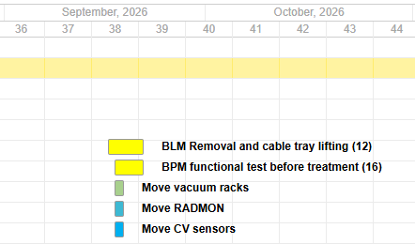
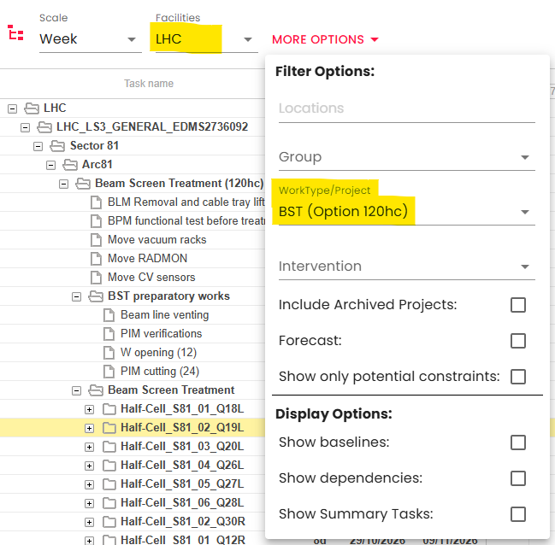
Activities planning
Space clearance
BLM removal
BPM testing
Vacuum racks, Radmon and CV sensors displacement
Arc 8-1: 16/09/2026 → 21/09/2026
Arc 5-6: 16/10/2026 → 14/12/2026
Arc 6-7: 21/10/2026 → 30/10/2026
Arc 1-2: 13/11/2026 → 23/11/2026
Arc 2-3: 23/11/2026 → 02/12/2026
Arc 4-5: 10/12/2026 → 14/12/2026
Arc 7-8: 30/10/2026 → 12/11/2026
https://oss-coordination.web.cern.ch/gantt/latest?baselines=false&dependencies=false&facilities=LHC&forecast=false&includeArchived=false&locations=&potentialConstraints=false&scale=week&summary=false&worktypeproject=BST%20%28option%20120hc%29

Slide 8
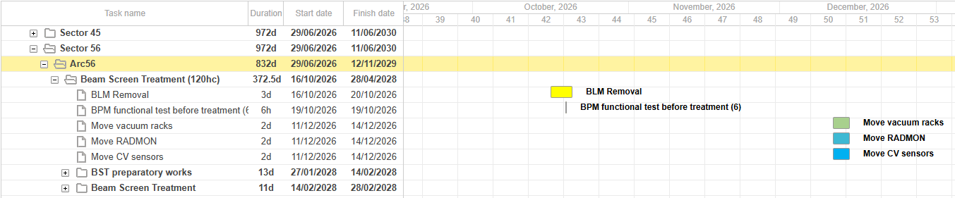
Activities planning
Space clearance
BLM removal
BPM testing
Vacuum racks, Radmon and CV sensors displacement
Arc 8-1: 16/09/2026 → 21/09/2026
Arc 5-6: 16/10/2026 → 14/12/2026
Arc 6-7: 21/10/2026 → 30/10/2026
Arc 1-2: 13/11/2026 → 23/11/2026
Arc 2-3: 23/11/2026 → 02/12/2026
Arc 4-5: 10/12/2026 → 14/12/2026
Arc 7-8: 30/10/2026 → 12/11/2026
https://oss-coordination.web.cern.ch/gantt/latest?baselines=false&dependencies=false&facilities=LHC&forecast=false&includeArchived=false&locations=&potentialConstraints=false&scale=week&summary=false&worktypeproject=BST%20%28option%20120hc%29
Arc 5-6

Slide 9
Activities planning
ICs openings
Beamline venting
W opening
PIM cutting
Arc 8-1: 16/09/2026 → 08/10/2026 (12 W, 24 PIMS)
Arc 7-8: 07/10/2026 → 17/11/2026 (39W, 78PIMS)
Arc 1-2: 19/10/2026 → 16/11/2026 (19 W, 34 PIMS)
Arc 6-7: 13/04/2027 → 18/05/2027 (27W, 54 PIMS)
Arc 2-3: 08/07/2027 → 28/07/2027 (34W, 78 PIMS)
Arc 4-5: 06/01/2028 → 24/01/2028 (5W, 10 PIMS)
Arc 5-6: 27/01/2028 → 14/02/2028 (4W, 8 PIMS)
Closing (PIMS welding)
Arc 8-1: End Oct 2026 (2d) and Mid Nov 2026 (4d)
Arc 2-3: Oct 2027 (10d) / mid-Nov 2027 (1w)
Arc 1-2: Dec 2027 (2d) and end Jan 2027 (1w)
Arc 7-8: Mid May 2027 (20 d)
Arc 6-7: End June 2027 (2w) / Aug 2027 (1w)
Arc 4-5: Feb 2028 (2d)
Arc 5-6: End Feb 2028 (2d)
Space for PIMS machining available in SMA18 (bunker)
Lathe available
More questions to come with Maryline…

Slide 10
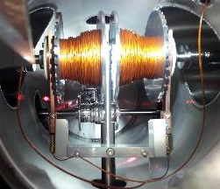
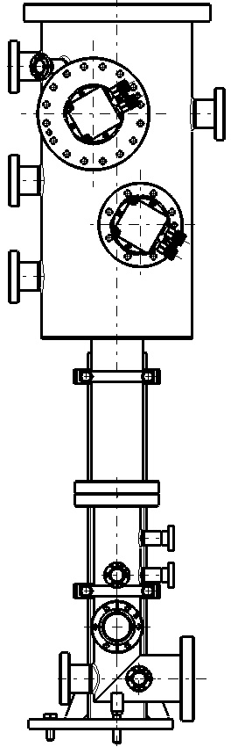
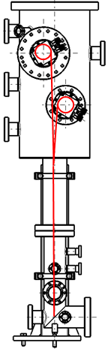
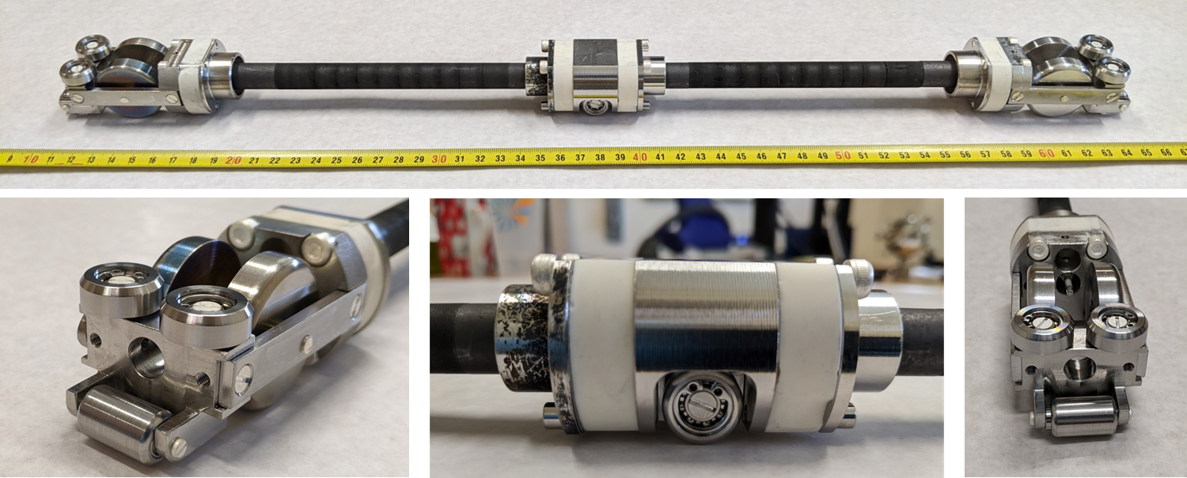
Coating system - principle
PIM
PIM
PIM + BPM
Dipole
Dipole
Dipole
Quadrupole
System developed for Q5L8 (LS2) and HL-LHC beam screen coating:
Coating train: graphite target on wheels
Plasma powering: electrical cables
Train displacement: mechanical pulling and braking cables
→ In-vacuum spool system with automated rolling/unrolling by external motors

Slide 11
Coating system - principle
PIM
PIM
PIM + BPM
Dipole
Dipole
Dipole
Quadrupole
System developed for Q5L8 (LS2) and HL-LHC beam screen coating:
Coating train: graphite target on wheels
Plasma powering: electrical cables
Train displacement: mechanical pulling and braking cables
→ In-vacuum spool system with automated rolling/unrolling by external motors

Slide 12
Coating system - principle
PIM
PIM
PIM + BPM
Dipole
Dipole
Dipole
Quadrupole
System developed for Q5L8 (LS2) and HL-LHC beam screen coating:
Coating train: graphite target on wheels
Plasma powering: electrical cables
Train displacement: mechanical pulling and braking cables
→ In-vacuum spool system with automated rolling/unrolling by external motors

Slide 13
Coating system - principle
PIM
PIM
PIM + BPM
Dipole
Dipole
Dipole
Quadrupole
System developed for Q5L8 (LS2) and HL-LHC beam screen coating:
Coating train: graphite target on wheels
Plasma powering: electrical cables
Train displacement: mechanical pulling and braking cables
→ In-vacuum spool system with automated rolling/unrolling by external motors

Slide 14
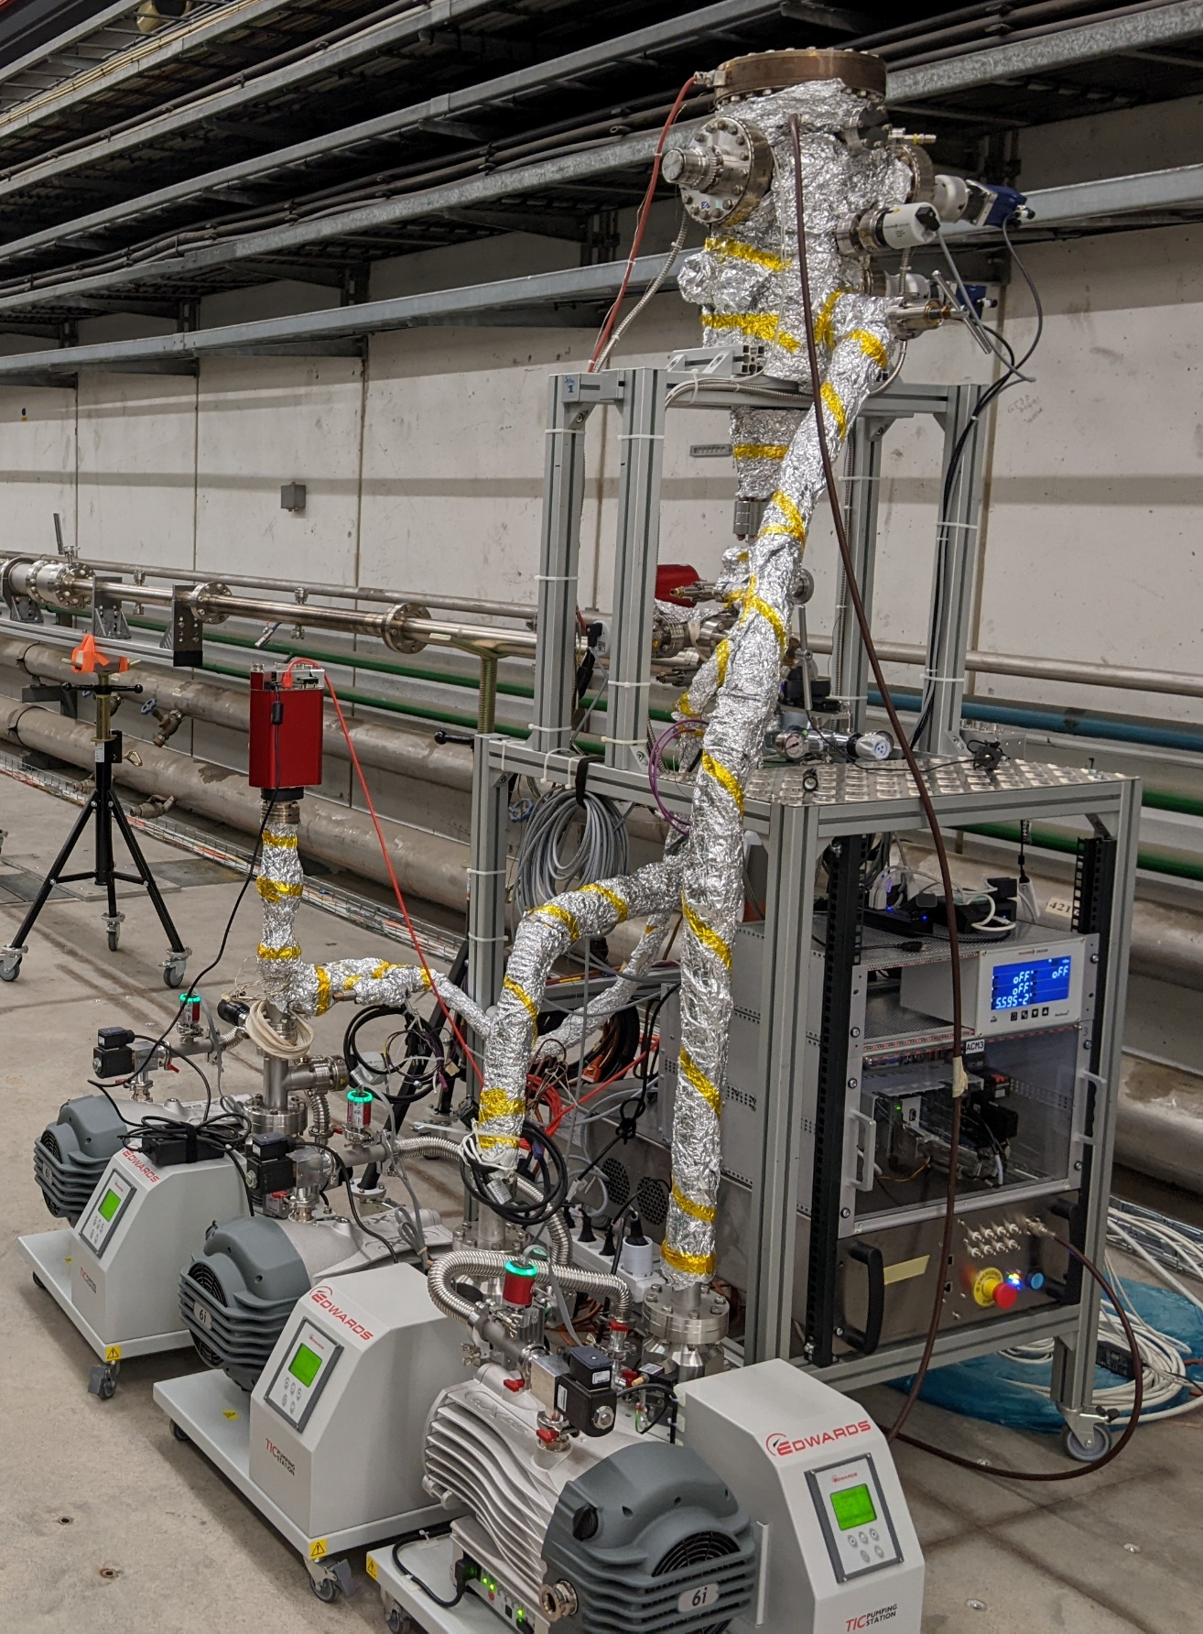
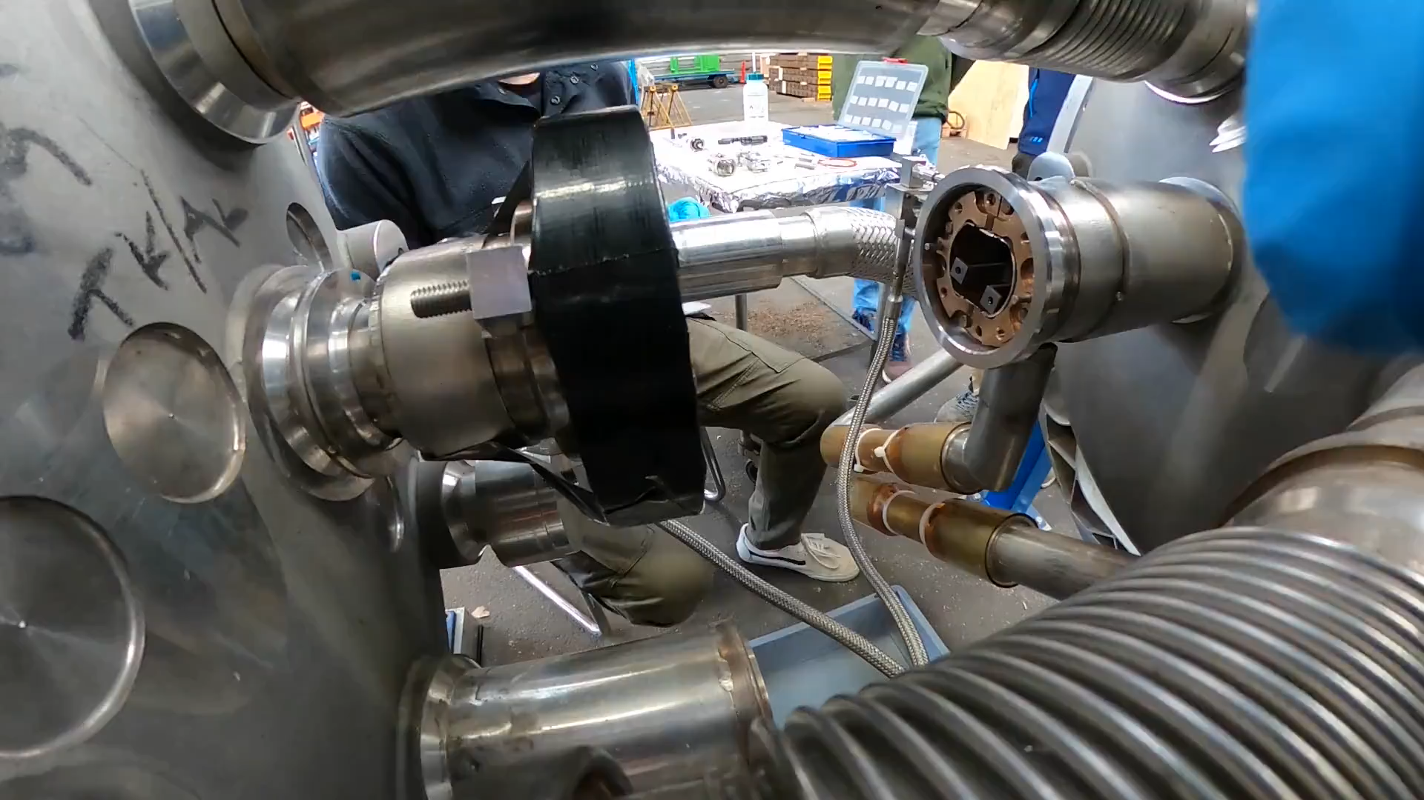
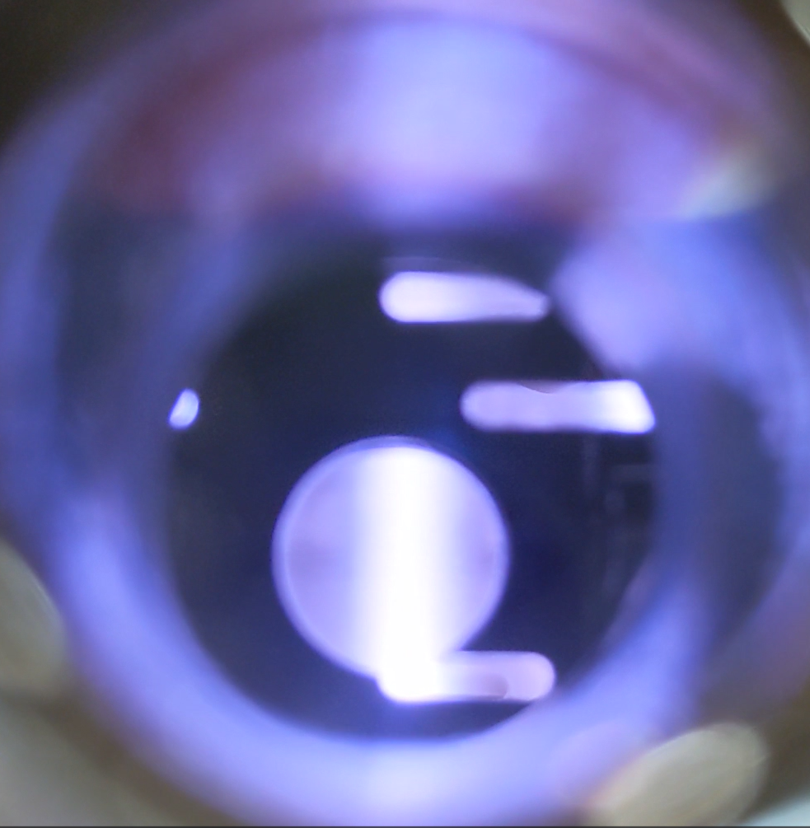
BST installation - sequence
2. Fit the coating system in the interconnection
1. Assemble the coating trains
1/interco
Coating chamber
Residual gas analyzer
Gas injection system
Gauge controller
Motor control for cable spools
3. Coat
Plasma power supplies
4. Disassemble
× 240
Pumping groups

Slide 15
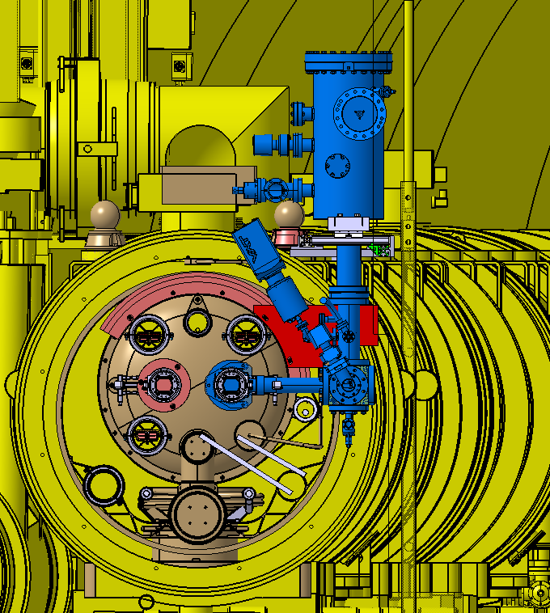
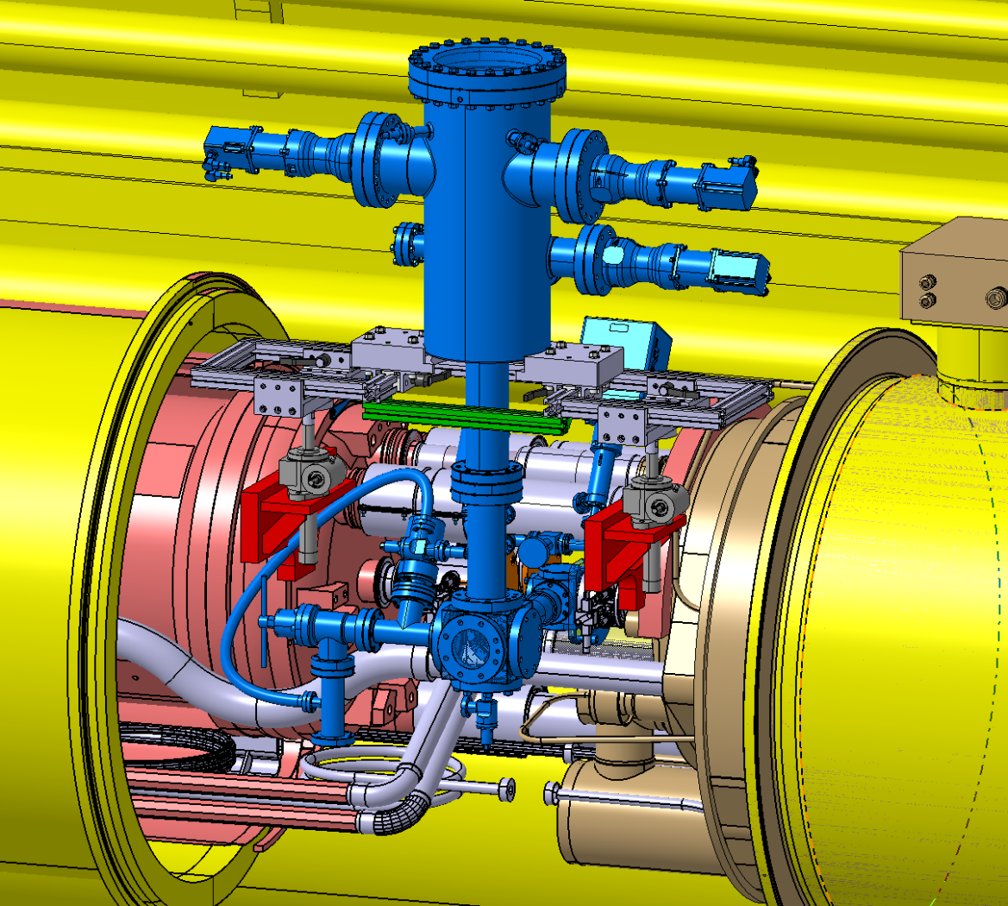
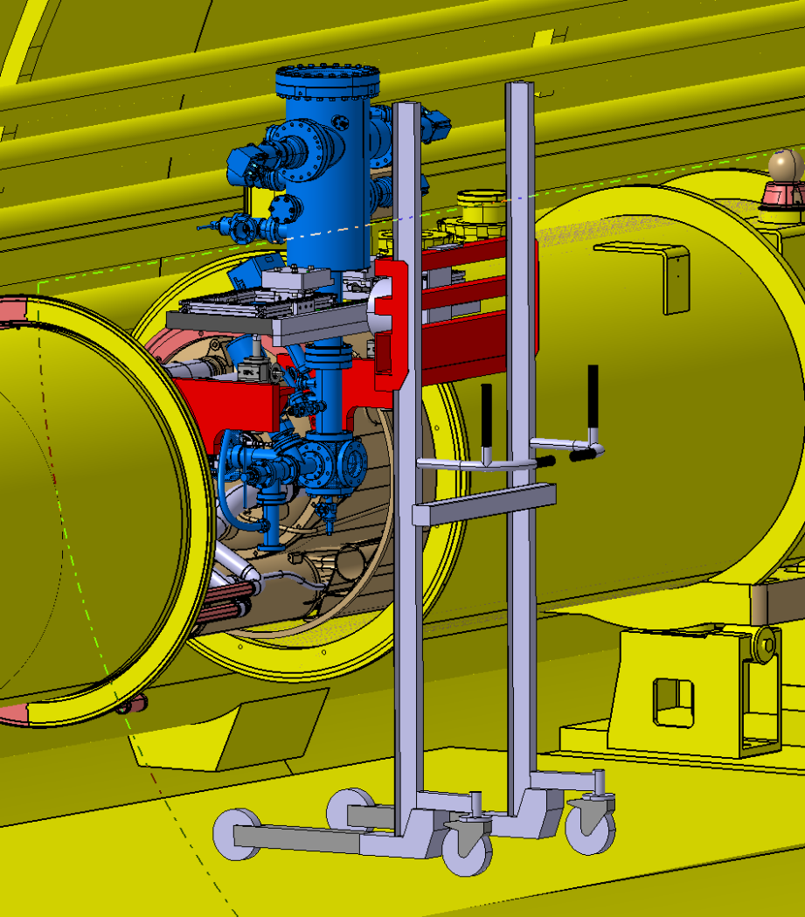
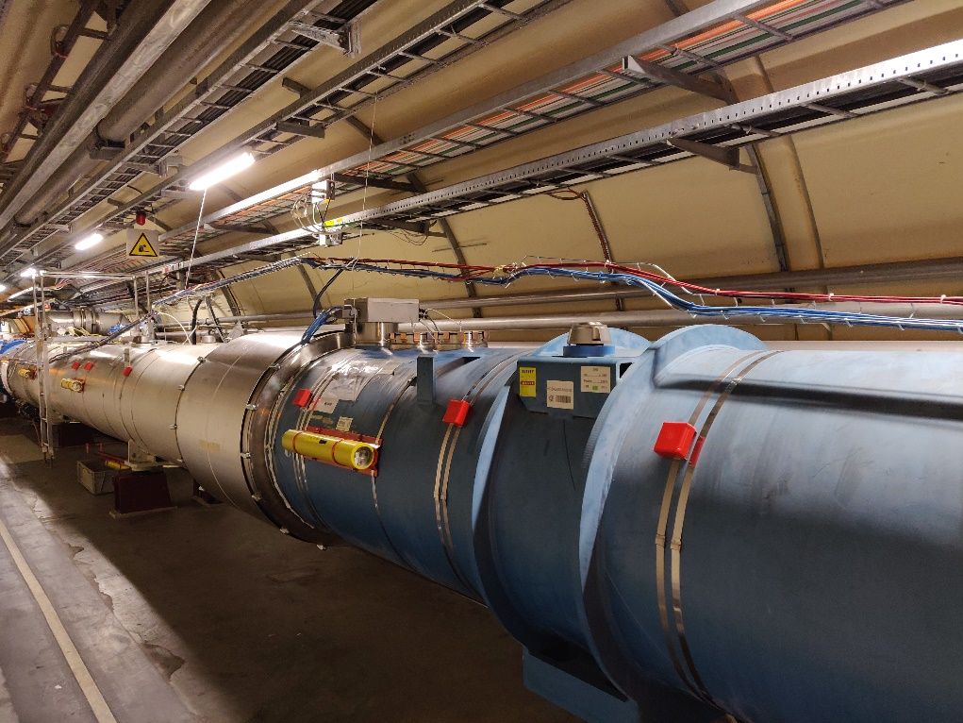
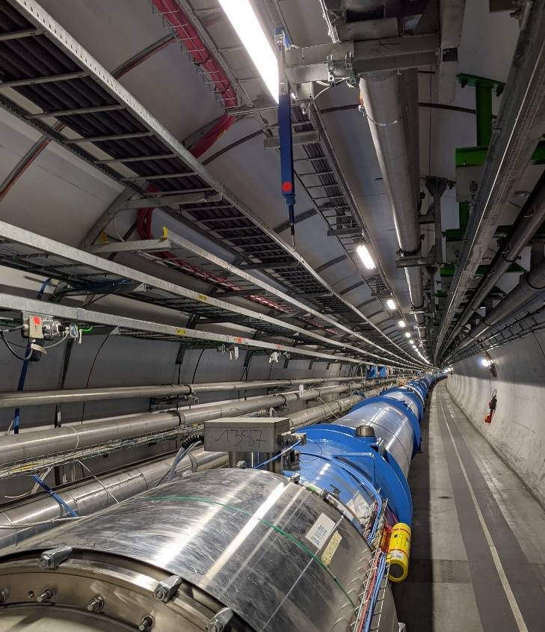
BST installation – coating chamber
Preliminary
Preliminary
Preliminary
G. Girod, EN-MME
On-going integration study
Coating chamber impinges in the transport zone in coating mode
Heavy impact on transport zone during handling of the chamber (lifter, use of monorail…)
Possible interference with cable tray for BLM (position to be defined) Need for 4×10 A sockets/interco and compressed air

Slide 16
BST installation – coating chamber
Preliminary
Preliminary
Preliminary
G. Girod, EN-MME
TRANSPORT ACTIVITIES
  Keep space for a standard EPAL transport when we intervene
  Magnet transport and coating NOT compatible
    EN-ACE support to optimize
    Short-term storage overnight will be needed
    Strategy: remove the coating apparatus when a transport is foreseen

Slide 17
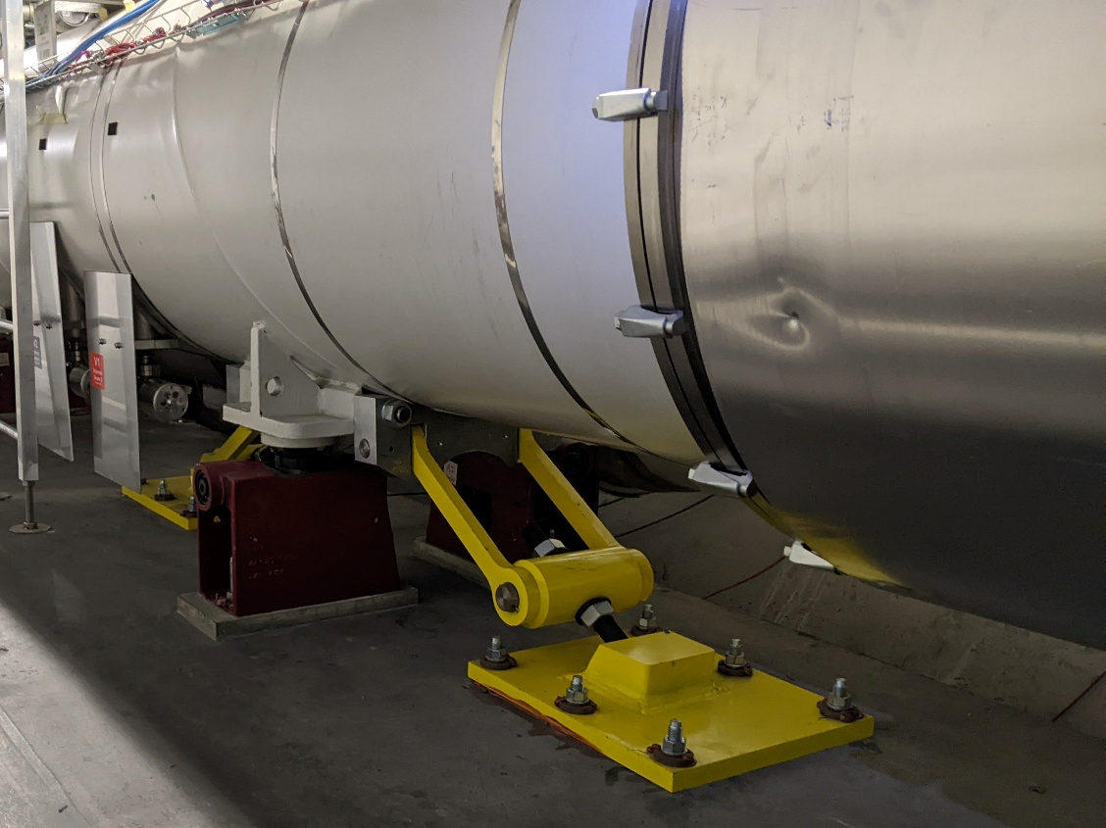
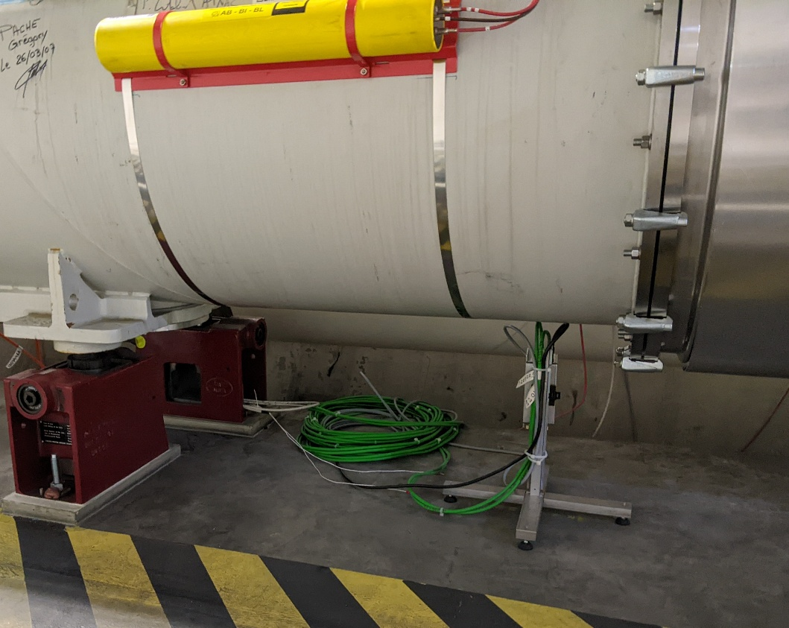
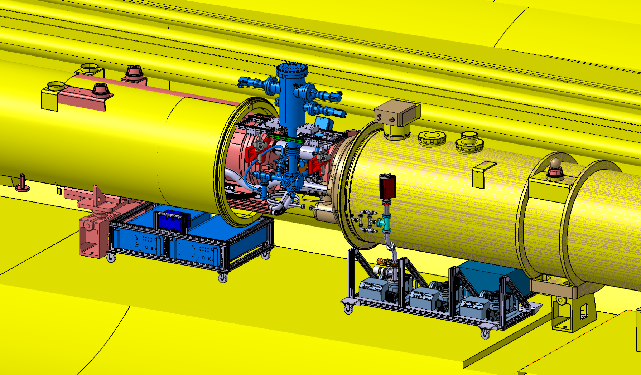
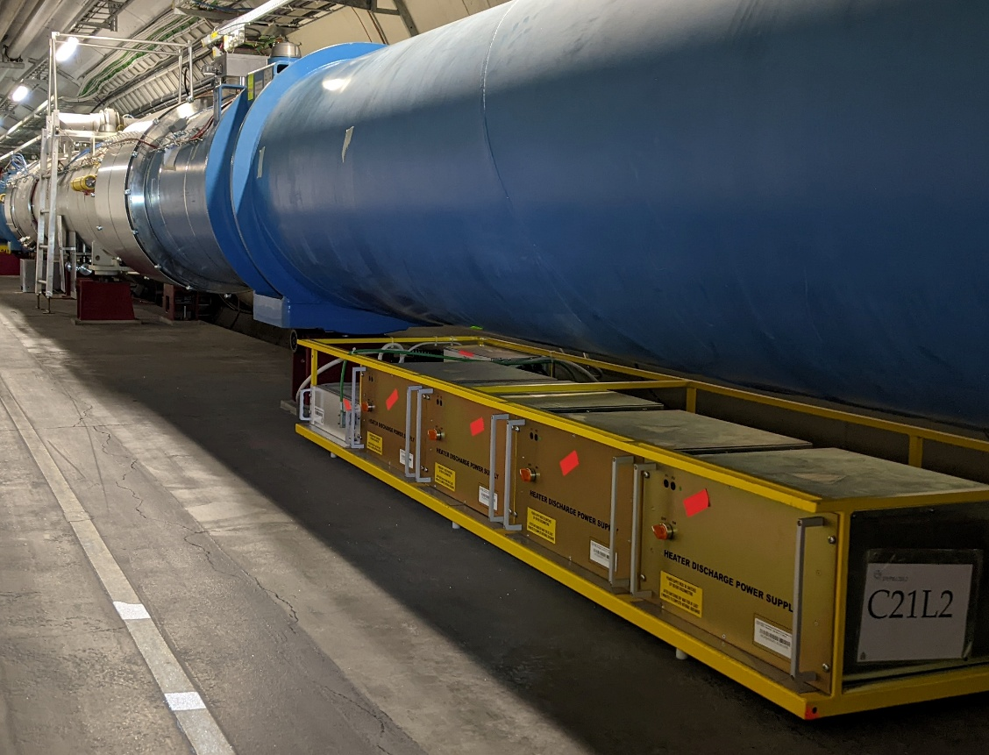
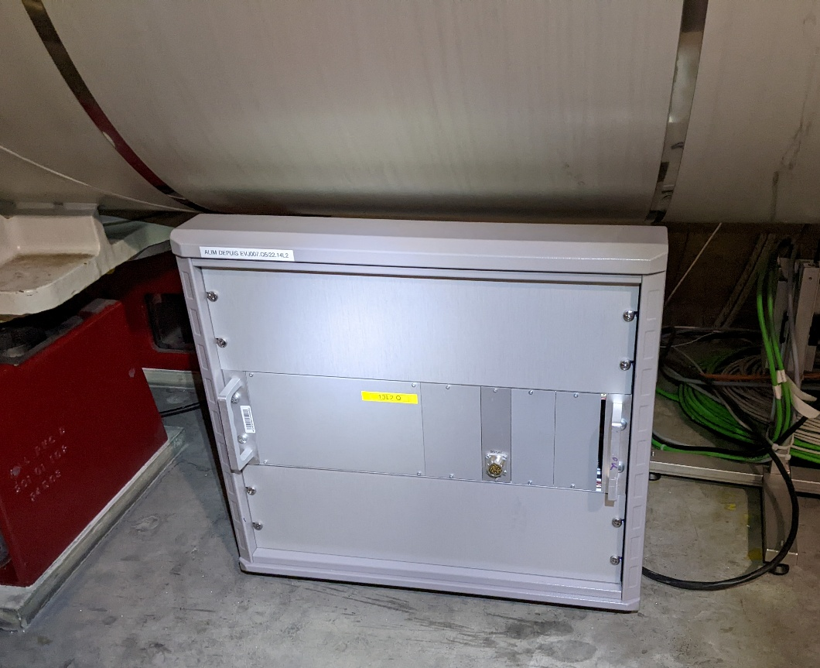
BST installation – auxiliaries
Cannot move
OK to move (4 m on the left)
OK to move
Preliminary
G. Girod, EN-MME
Use the space under the cryostat to install the pumping groups, power supplies…
Visit in LHC tunnel: identification of equipment located around QQBIs, contacted owners for checking the possibility to displace
Complete visit of interconnections to be opened during next TS

Slide 18
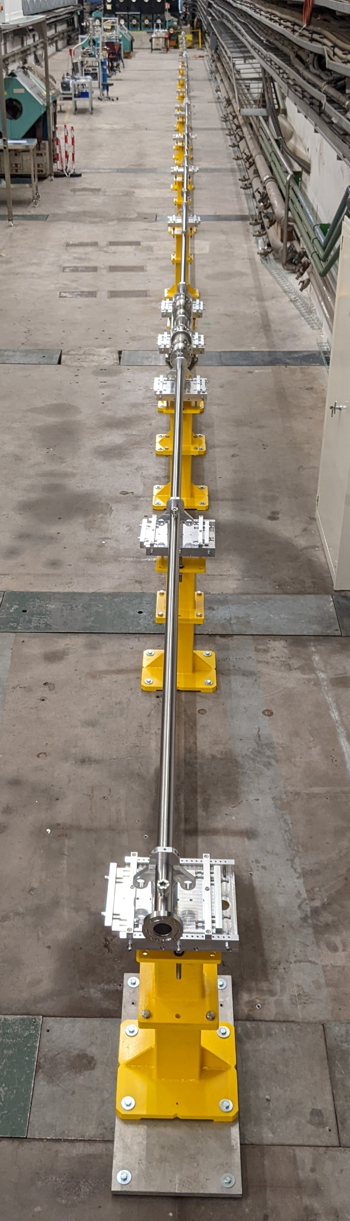
Conclusion and outcome
TT4
Baseline scenario
  120 half cells
On-going prototyping phase
  BS treatment duration refinement
  Planning update in pogress
Integration study
  External constraints (transport zone, space interco…) ↔ BST constraints (coating system, auxiliaries…)
  Requires several iterations between involved teams
  Visit of all interconnections by the end of this year
Visit possible of the coating system / mock-up in 1:1 scale in TT4
If any impact on other system/activities is missing:
  G. Rosaz (Project Leader)
  M. Charrondiere (Project Coordination)
  V. Petit (Technical Coordinator)
Resources optimization appears critical

Slide 19
Thank you

