Slide 1

SKA Regional Centre Networking Requirements update
Ian Collier
ian.collier@stfc.ac.uk
LHCOPN-LHCONE 55
Karlsruhe Institute of Technology
7th October 2025

Slide 2
SRCNet Global and Local Network Provisioning
Background
SRC Distribution & GREN
Estimating data volumes and bandwidths
More on data flows
Summary

Slide 3
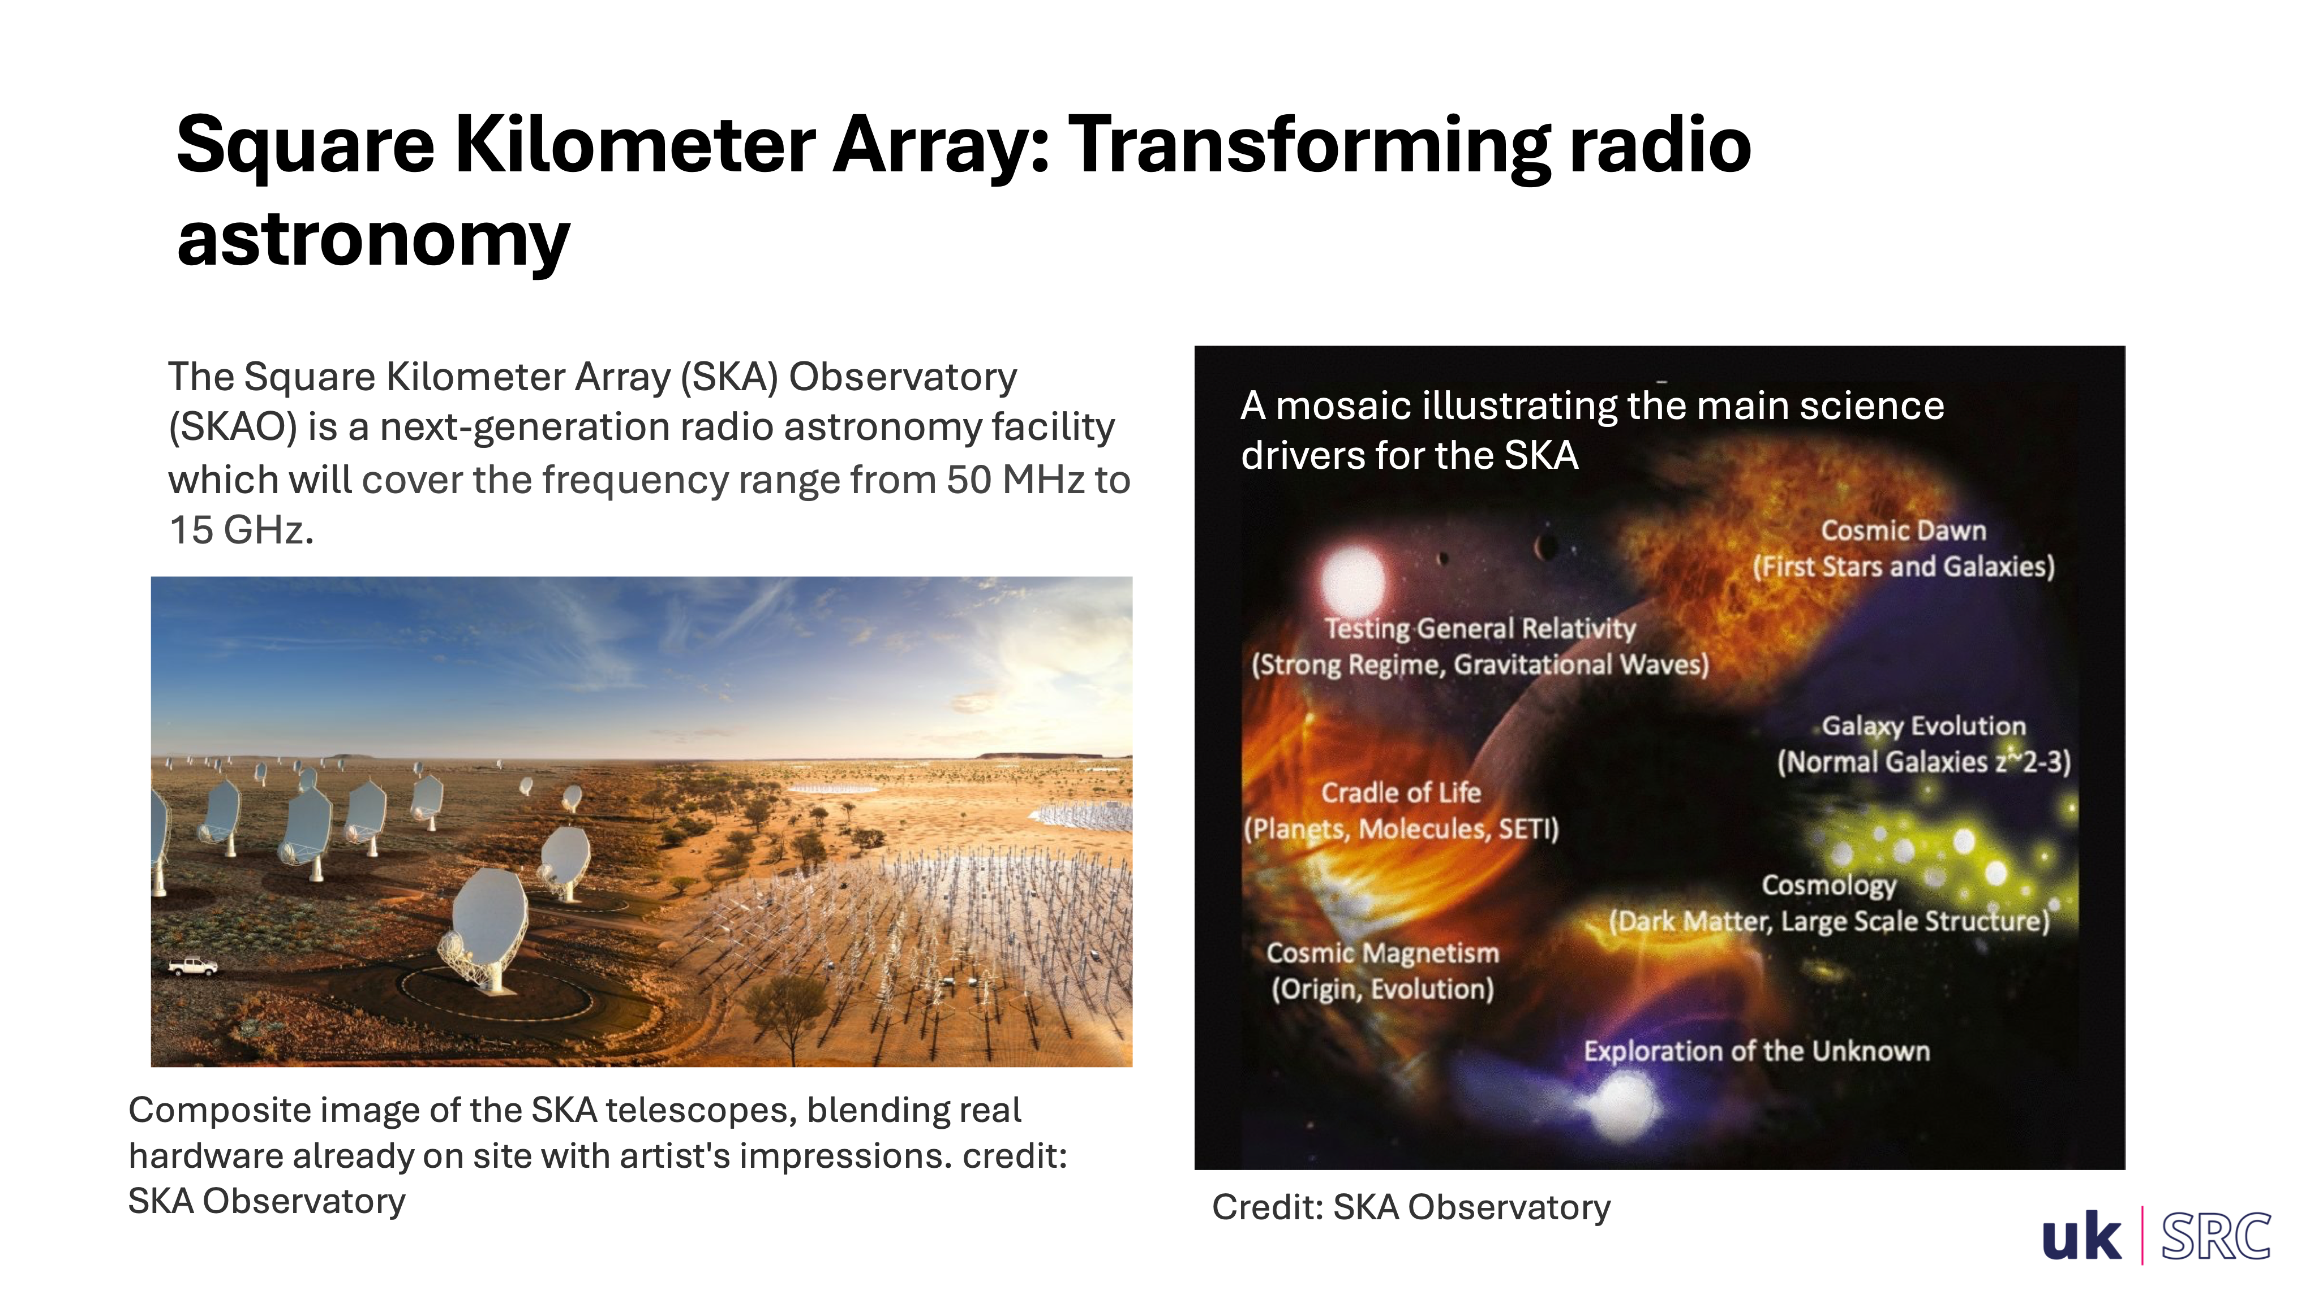

Slide 4
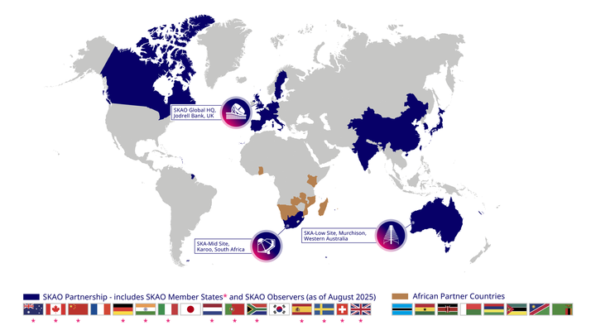

Slide 5
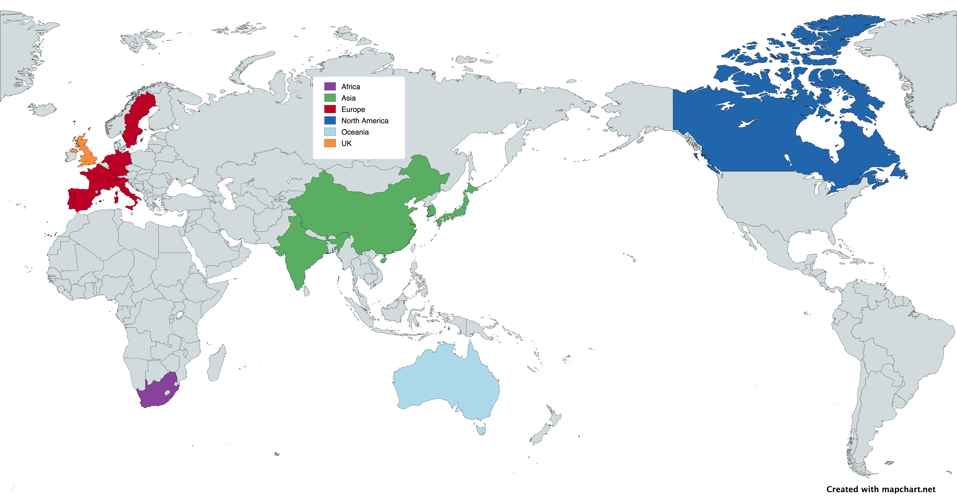
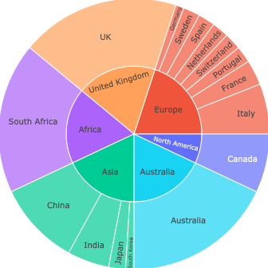
Regional Centre Nodes & distribution
Current modelling assumes a Regional Centre share of Resources proportionate to their construction share:
  ~ 6 similar Global Regions (Canada smaller)
Australia, South Africa, and the UK dominate as single country entities
Composition of Node’s resource contributions,
following SRCNet Top Level Roadmap shares

Slide 6
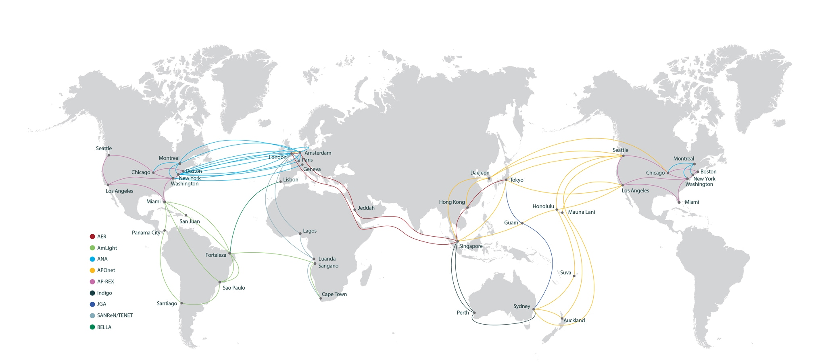
The Global Research & Education Network

Slide 7
The Global Research & Education Network
GREN already connects all the places we care about in SRCNet

Slide 8
Latest SKAO Expected data rates
Until very recently SKAO was predicting ~300PB/year by 2029
  With mean data rates ~50Gb/s from each of Australia & South Africa
New timeline suggests those rates will now arrive in 2035
In 2029 expecting 25PB of new data
  Much, much lower mean network utilization and in turn much lower load on global R&E network than earlier projections
  BUT this doesn’t necessarily mean lower bandwidth requirements at sites

Slide 9
Latest updates - Timeline to science

Slide 10
Latest updates - Timeline to science

Slide 11
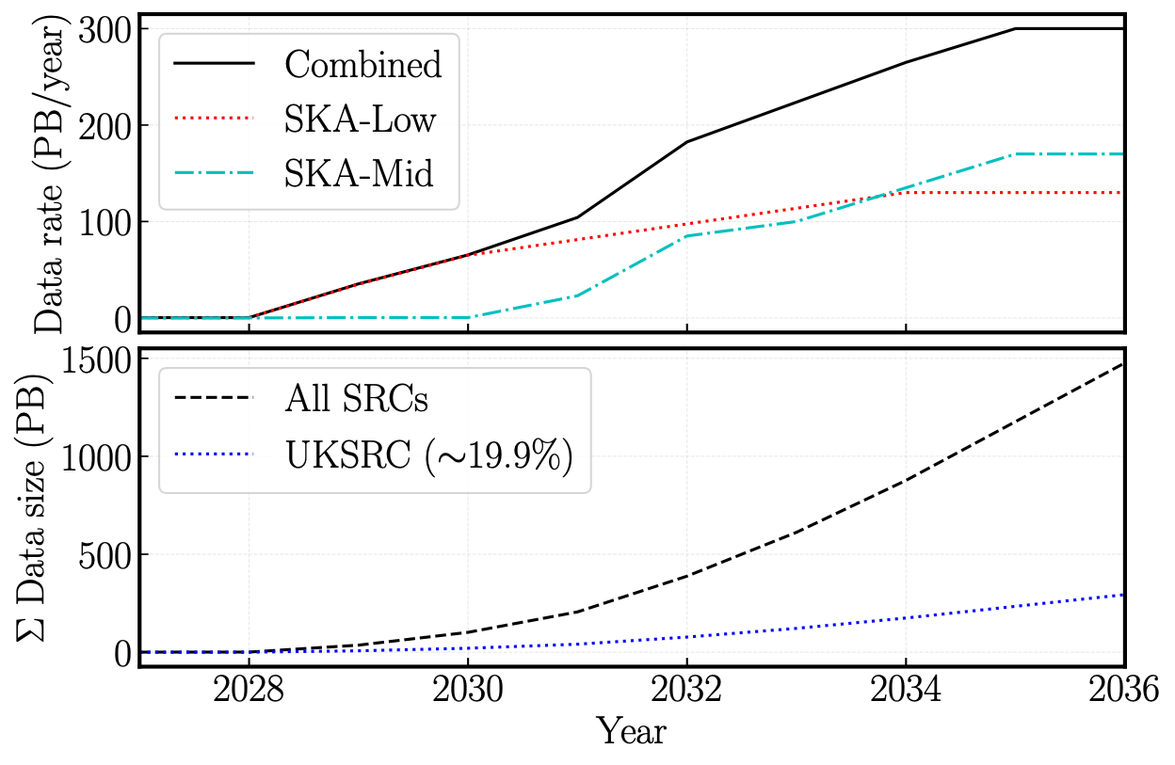
Implications for data rates
A factor of ~2.3x reduction in data rate for steady-state SKAO
Delays mean a slower build-up of resources needed.
Lower plot shows total disk storage for a large (20% of total) regional centre such as UKSRC

Slide 12
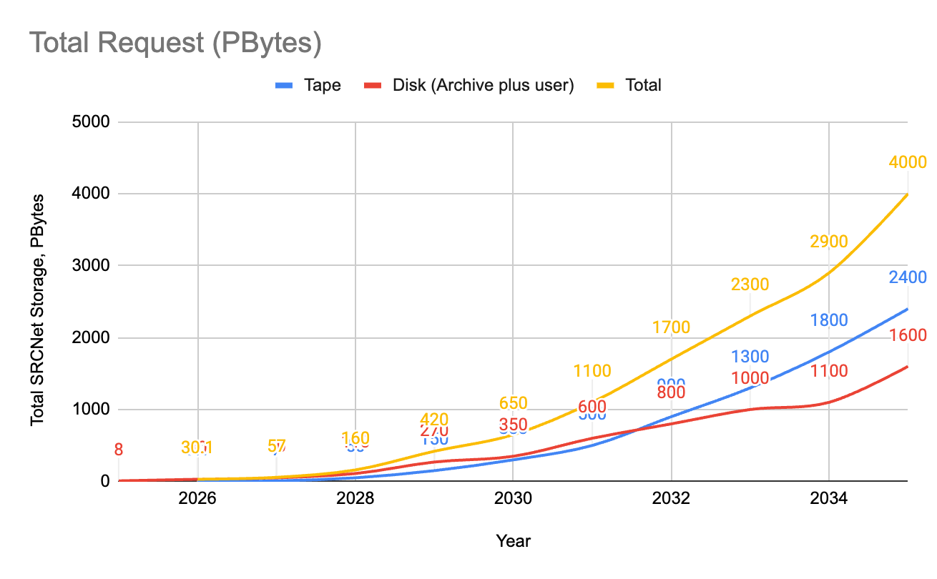
Latest SKAO Expected storage volumes
Updated expected storage growth:
2029
  110PB disk
  ~25PB from WA
  ~10Gb/s average
2035
  1600PB disk
  2400PB tape
  4000PB total
  Archive of data from the instruments + user generated data
  Mean ~50Gb/s from each of SA & WA

Slide 13
SRCNet Total Storage Requests by Year
(SRCNet as a whole)
Year | Disk - PBytes (Archive + user) | Tape - PBytes | Total - PBytes | 2023 Roadmap Figures (PBytes)
2025 | 0.0 | 0 | 8 (SRCNet 0.1 Pledge) | 21
2026 | ~8 | 0 | 8 | 159
2027 | 7.8 | 0.2 | 8 | 530
2028 | 18 | 2 | 20 | 1060
2029 | 103 | 15 | 118
2030 | 270 | 100 | 400
2035 | 1530 | 2100 | 3600

Slide 14
SRCNet Node Requirements - 2029
Category | 1% no tape | 2% no tape | 4% no tape | 8% no tape | 20% with tape | TOTAL
Online (Disk) Storage | 1.03PB | 2.06PB | 4.12PB | 8.24PB | 20.6PB | 103PB
Scratch/cache | 50TB (TBC) | 100TB (TBC) | 150TB (TBC) | 300-400TB (TBC) | 1.6TB | ~3-4PB
Tape |  |  |  |  | 5PB | 15PB
Network | 50 Gbps External ≥100 Gbps Internal | 50 Gbps External ≥100 Gbps Internal | 50 Gbps External ≥100 Gbps Internal | 50 Gbps External ≥100 Gbps Internal | 50 Gbps External ≥100 Gbps Internal | 50 Gbps External ≥100 Gbps Internal

Slide 15
SRCNet Node Requirements - 2035
Category | 1% no tape | 2% no tape | 4% no tape | 8% no tape | 20% with tape | TOTAL
Online (Disk) Storage | 15.3PB | 30.6PB | 61.2PB | 122.4PB | 306PB | 1530PB
Scratch/cache | 50TB (TBC) | 100TB (TBC) | 150TB (TBC) | 300-400TB (TBC) | 1.6TB | ~3-4PB
Tape |  |  |  |  | 700PB | 2100PB
Network | 100 Gbps External ≥100 Gbps Internal | 100 Gbps External ≥100 Gbps Internal | 100 Gbps External ≥100 Gbps Internal | 180 Gbps External ≥100 Gbps Internal | ~300 Gbps External ≥100 Gbps Internal
Network mean ingress/egress utilisation | ~11 Gbps | ~22 Gbps | ~44 Gbps | ~88 Gbps | ~145 Gbps
Still refining modelling of network utilisation

Slide 16
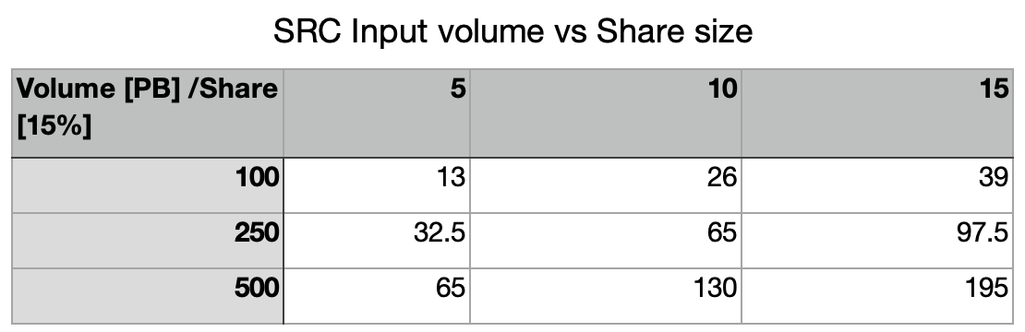
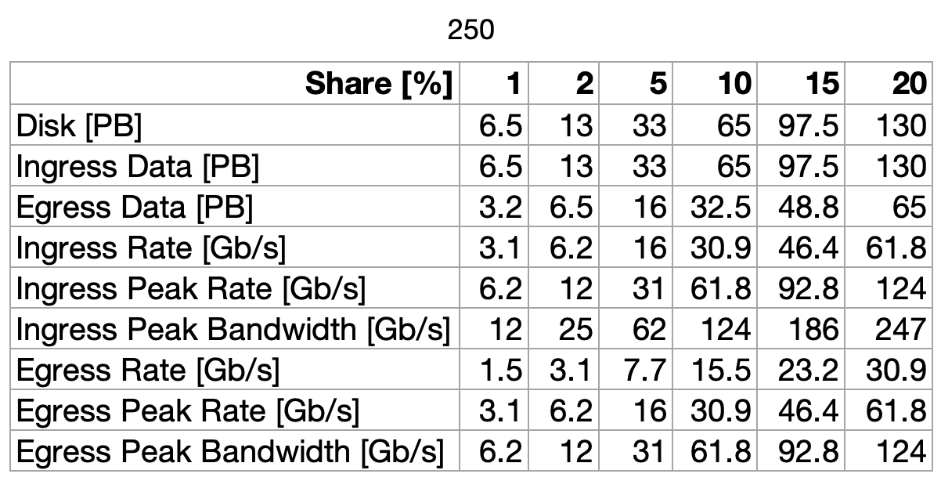
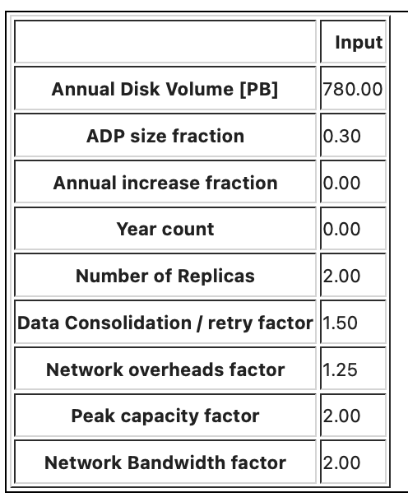
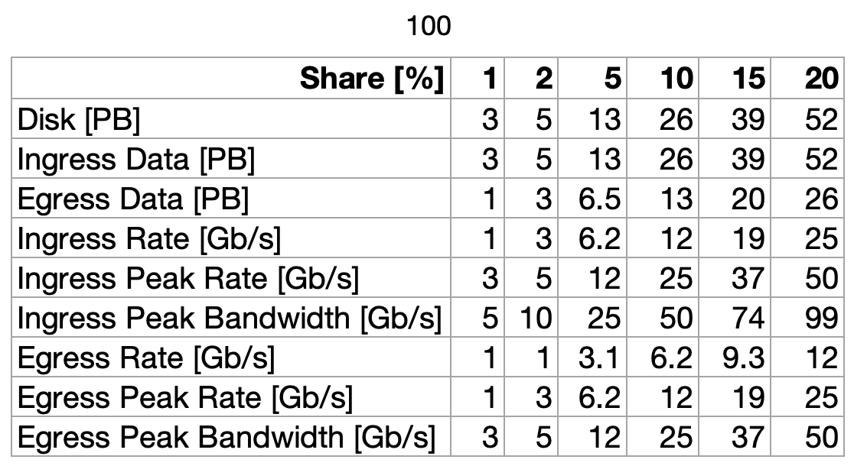
Estimating SRC data volumes and bandwidths
From these totals we can estimate data volumes at individual SRCs based on % share of total
In turn we can also estimate mean network utilisations
These mean network utilisations in turn much lower
  50Gb/s from each of SA & WA in 3035
  Much lower in 2029

Slide 17
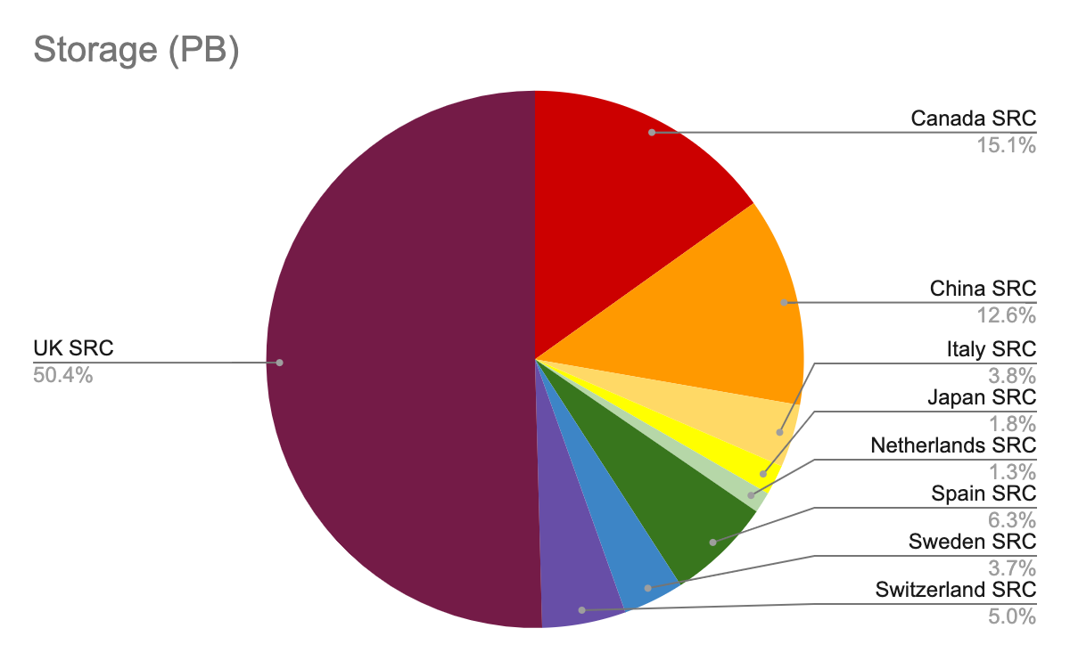
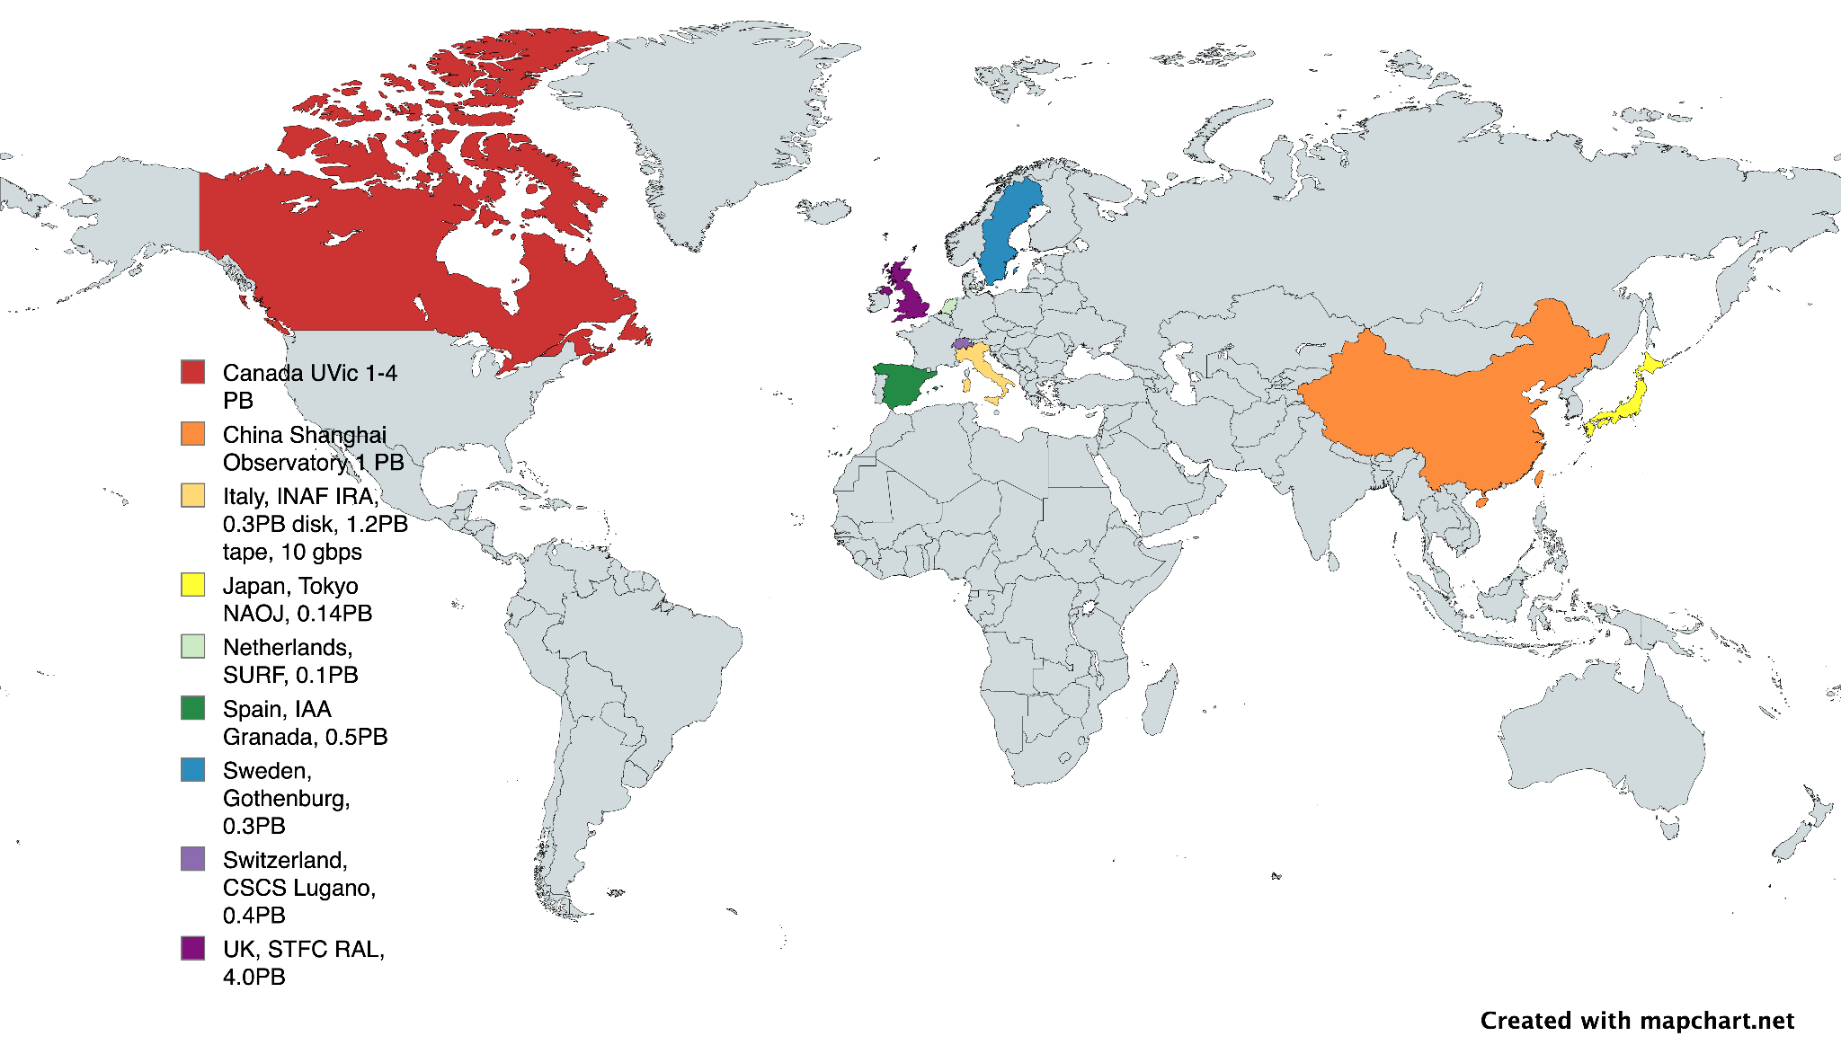
SRCNet 0.1 testing
8 PBytes total storage offered for SRCNet0.1 (c.f stated target of 20 PB)
Sites have demonstrated they meet all the resource & operational requirements
WLCG experience at some sites (Canada, Netherlands, Sweden, Switzerland, UK)
Some sites quite new and teams will learn by being involved

Slide 18
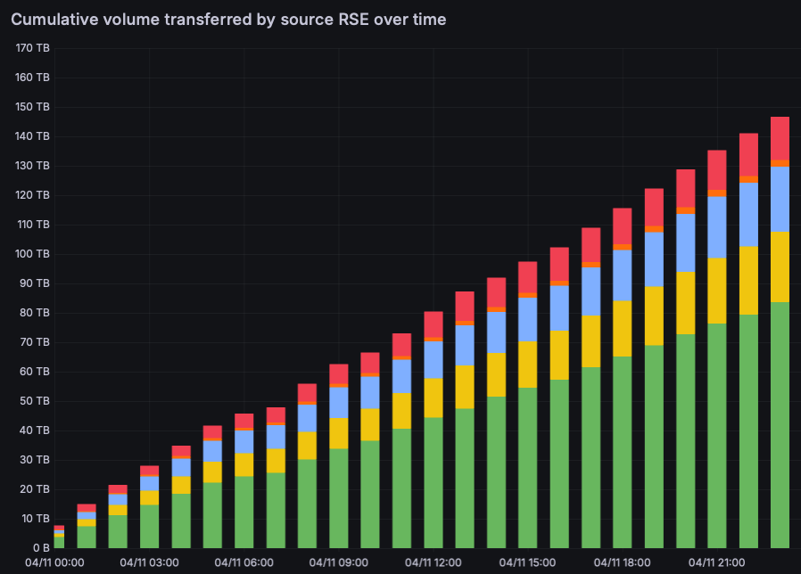
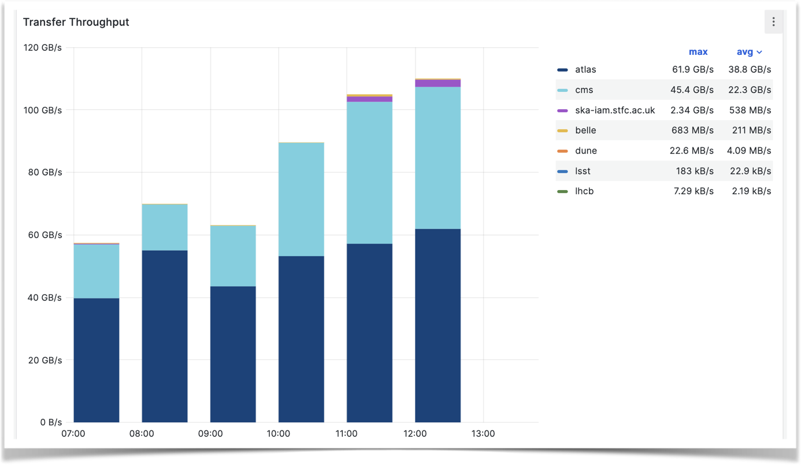
Milestones so far achieved (1)
Capability tests performed:
  Replication from Site_A -> Site_B and Site_B->Site_C
    (Excluding Site_A -> Site_C)
    Emulating data flow modelling
    5GiB files
Capacity testing:
  150TB target in 24hours
    Target rates for each RSE link-pair
      Simple modelling emulating movements between
      larger and smaller RSEs
  147TB transferred within the time window
Improvements in modelling in expected
share of resources and long-haul source
testing
SRCNet now visible within the Global FTS Monitoring plots
150TB

Slide 19
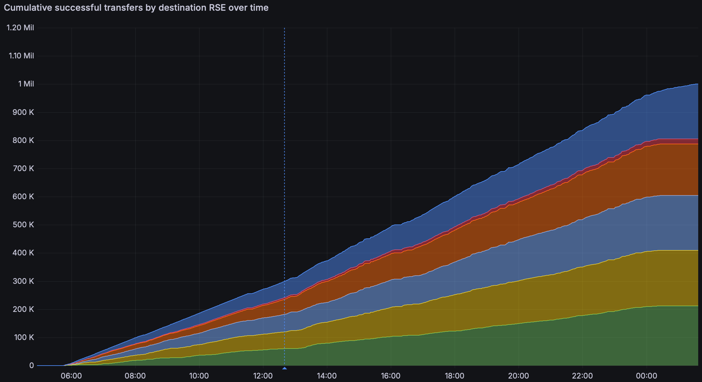

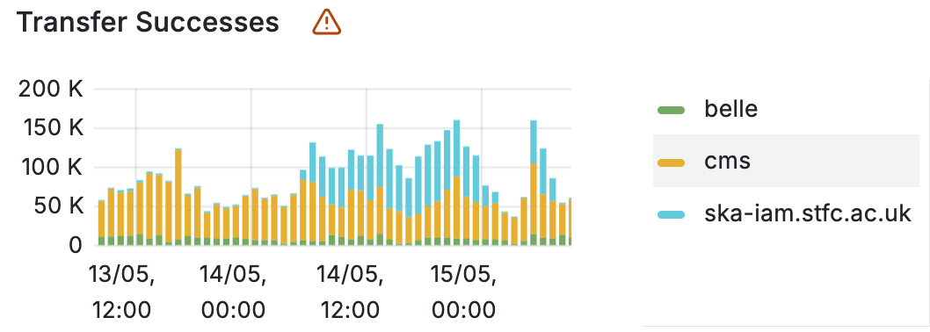
Milestones achieved (2)
Test of ability of Rucio / FTS to handle higher submission rates, and tests of enabling services (e.g. monitoring)
1M x 1MiB files; target to replicate from a single source RSE to other Sites within 24hours
  Stored as 1k x 1000 file datasets; submitted throughout the test period
  Storage at Rutherford Appleton Lab used as source for all transfers
Nominal submission rate (by rucio) ~ 50k/hour, with increase tested to 100k / hour.
Rate comparable to e.g. CMS during the period.
1M
0

Slide 20
Some things we have we learned
Mean network utilisation will be lower than originally foreseen for some time
BUT for efficient transfers we will want high bandwidth connections to SRC Nodes – want transfers to complete quickly and reliably
  And in internally federated SRCs like UK we will need to stage data between sites quickly and efficiently
Even a “small” SRC node with maybe only a few 10s of PB of storage will benefit from 100Gb links – aim to match output rates of SDPs in South Africa & Australia
  Can be shared with other use cases
  Mean utilisation may remain 5-10Gbps for smaller SRCs
  Will be significantly higher for the large SRCs
    UK, South Africa, Australia
  As happened in WLCG we will surely see growth in user/workflow driven transfers - not modelled yet

Slide 21
Science Verification - Next major milestone in 2027
First “real” science data will arrive from SKA-Low in Australia – planned in 1st half of 2027
  Will need to be distributed from Australia into and across the SRC network for analysis & verification
  Relatively modest 0.5PB expected
    Sizes and cadence of data set releases to be determined
  Modelling of ingestion plans based on what was achieved in 0.1 testing earlier this year
2026 will involve verifying that all SRC nodes can demonstrate required performance reliably

Slide 22
Science Verification – network requirement modelling
For planning assume 5 lots of 100TB
  Assume we want to move each 100TB “lot” from Australia to “not Australia withing 24 hours (this is within what we achieved earlier this year – albeit not to and from Australia)
  Assume we then distribute across the rest of the SRC nodes over one week
  Then available for analysis and verification
This suggests that large SRC nodes (UK, Australia) will need ~20Gb/s available for these ingestion periods
  Other SRCs will need ~10Gb/s
  China SRC in Shanghai will be large ~9% share
Obviously, mean utilisation over the year will remain low. Shared links with suitable planning should be just fine.

Slide 23
Summary
Data Volumes and Bandwidth estimation
SKAO is refining its roadmap for how much data will be produced and when
Can translate that to local bandwidth requirements at SRCNet sites
  Can map that to the developing requirement
  New estimates are much lower than previous ones
  Full rates now arriving alongside LHC Run 5
  Global R & E Networks should be able to cope comfortably
NRENs and SRCNet sites will need to work together where investment/development is required
  It continues to be the responsibility of sites to ensure they have the network provision required locally
Data movement tests
Successfully demonstrated ability to move both large files/datasets and large numbers of files/datasets
Shaking out network and storage configuration issues
Will need to optimise throughput significantly
Road to Science Verification - 2027
0.5 PB to be produced by SKA-Low in Australia through 2027
  Distributed across SRCNet network
  Aiming one week campaign for each data release.
Implies ~20Gb/s at the larger SRCs and SKA-Low, ~10Gb/s elsewhere
Reliable data movement to be demonstrated through 2026
Opportunity of participating/coordinating with DC27

Slide 24
Questions

