Slide 1





Longitudinal beam dynamics update
HEMAC 08/04/25
E. Lamb, S. Albright, L. Thiele, H. Demerau, A. Grudiev,
D. Amorin, U. Von Rienen, R. Calaga
Thanks to: A. Pastinante, B. Karlsen-Baeck
Funded by the European Union (EU). Views and opinions expressed are however those of the author(s) only and do not necessarily reflect those of the EU or European Research Executive Agency (REA). Neither the EU nor the REA can be held responsible for them.
1

Slide 2
Contents
Toy model of counter rotating beam
Assumptions
Comparison with BLonD
    Induced voltage with a detuned cavity and multiple passes
Injection of the RLA2 distribution into RCS1
Optimisation with a phase jump scheme
Bunch compressor requirements
Work in progress
2

Slide 3
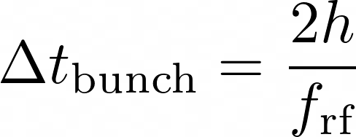
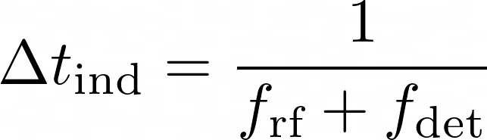
Toy model, CR
+
+
3

Slide 4
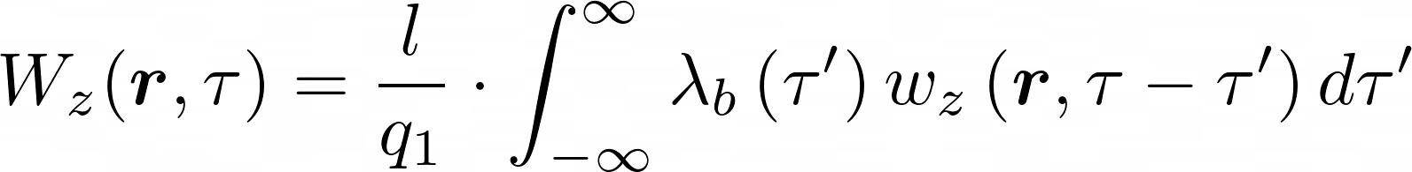
Toy model, CR
Wake function given by the resonator model
Assume a Gaussian bunch
[1]
Solution for a Gaussian bunch [2]
4

Slide 5

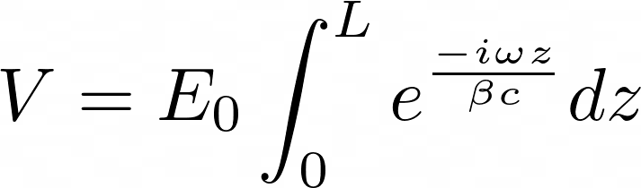
Toy model, CR
+
+
oppositely charged bunches
travelling in opposite directions
arrive at the same phase
Limits swapped for opposite direction [3]
5

Slide 6
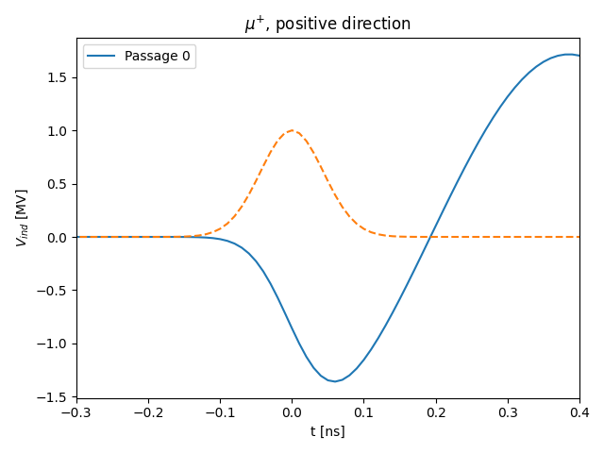
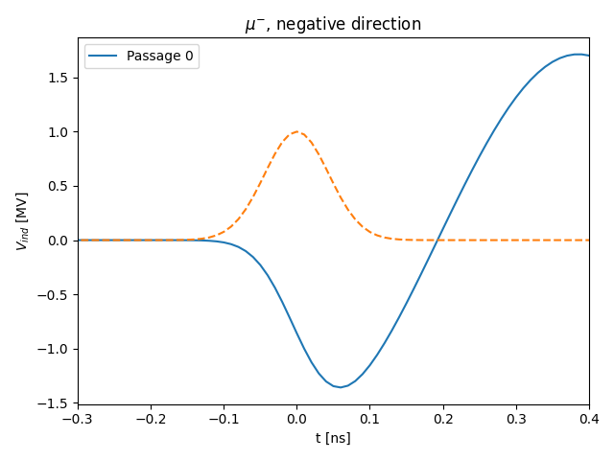
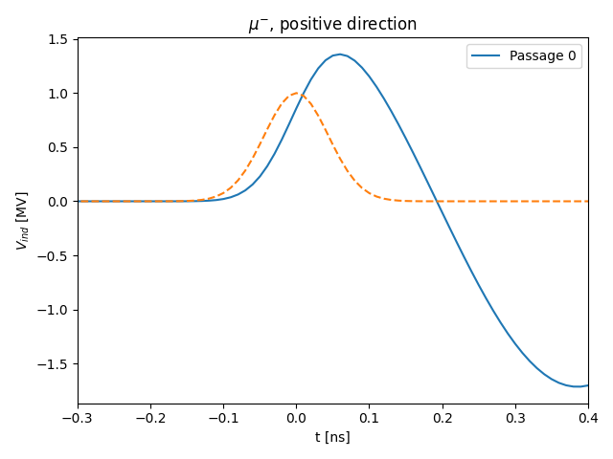

Toy model, CR
oppositely charged bunches
travelling in opposite directions
arrive at the same phase
and induce voltages that add constructively
6

Slide 7




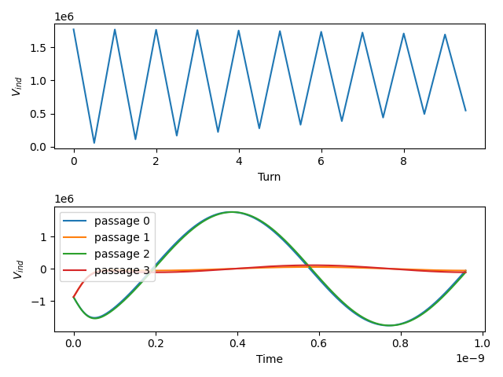
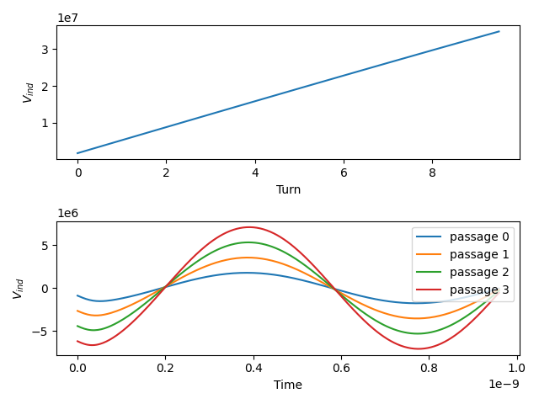
Toy model, CR
Toy Model
Toy Model
In reality, the would not be both accelerating, as they need to arrive with a phase offset
7

Slide 8


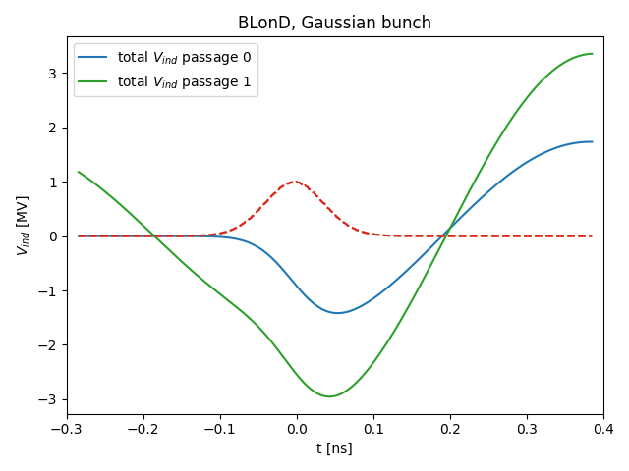
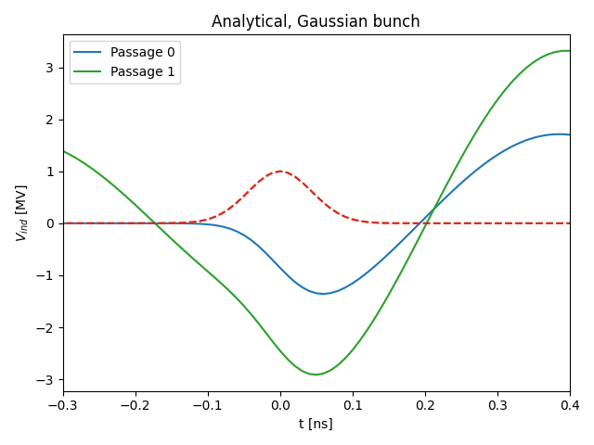
Toy model, CR
Minimises generator current for steady state, assuming dc current
BLonD
Toy Model
Passage 0: convolution with line density
Passage 1: shift array by time between bunch arrivals, sum to convolution with line density
Passage 0: analytical formula
Passage 1: shift array by time between bunch arrivals decay, sum to analytical formula
8

Slide 9

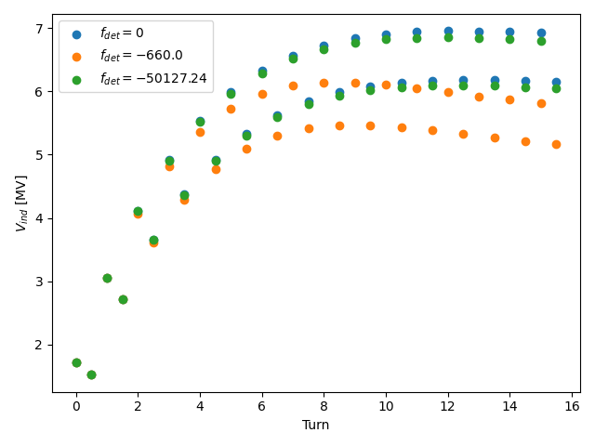
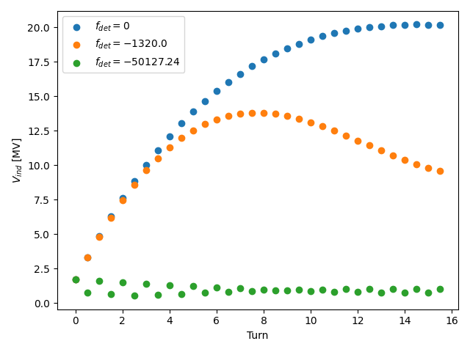
Toy model, CR
Minimises generator current for steady state
Toy Model
1 beam
2 beams
Toy Model
9

Slide 10

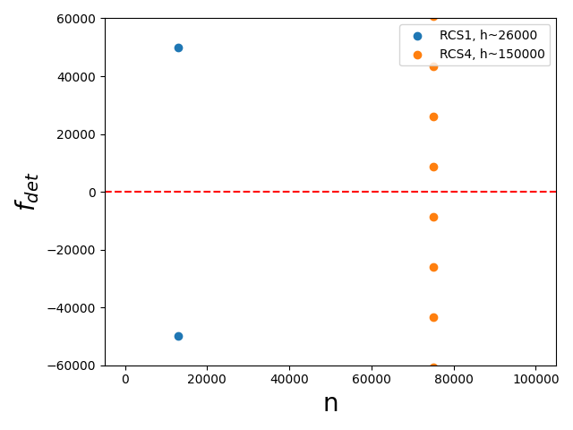

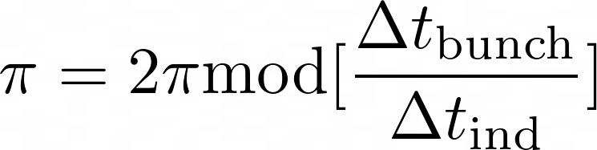
Toy model, CR
Solve for
Would it be useful to find solutions for HOMs to optimise cavity spacing?
What happens when we are detuned by one revolution frequency/harmonic?
10

Slide 11
RLA2 Injection

Slide 12
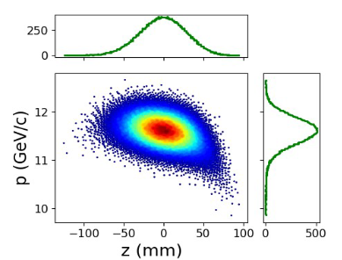
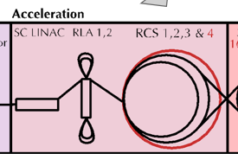
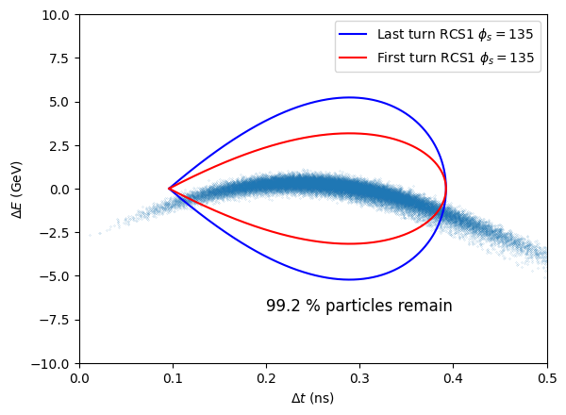
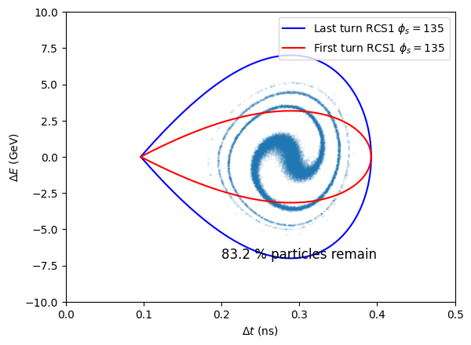

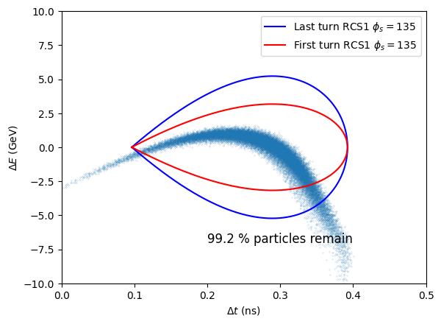
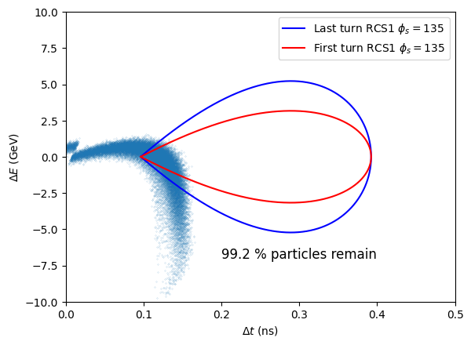



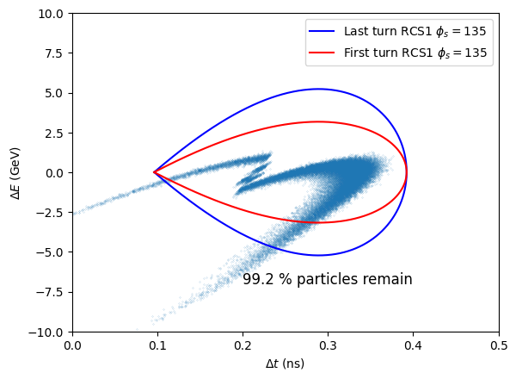
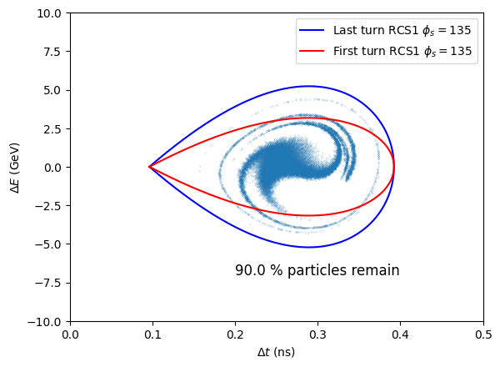

Phase jump
Distribution from RLA2 [5]
Move bunch to UFP
12
12
12
Notes:
Try and show the filling factor and separatrices here

Slide 13


Phase jump
(multiple RF stations per ring)
Tune ~ 1
Constraints:
are discrete and sections of a ring
Distribution from RLA2 [5]
BLonD simulation of RCS1
Remaining particles [%]
13
13
Notes:
Try and show the filling factor and separatrices here

Slide 14
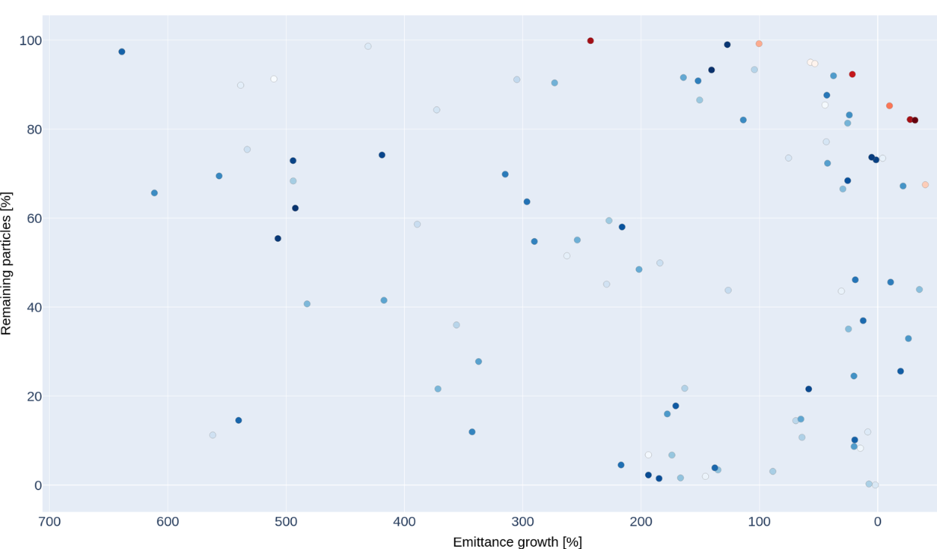
Phase jump
Optimised with Optuna [6]
14
Notes:
Improve legend sizes , add separatrices examples

Slide 15
Phase jump
15
Notes:
Improve legend sizes , add separatrices examples

Slide 16
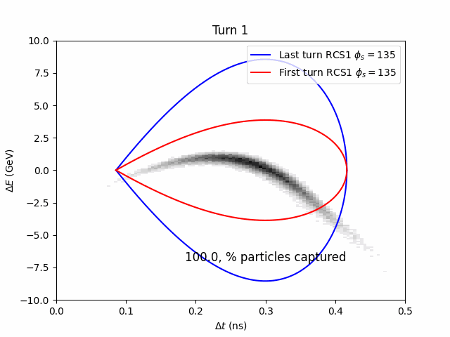
Phase jump
16
Notes:
Improve legend sizes , add separatrices examples

Slide 17
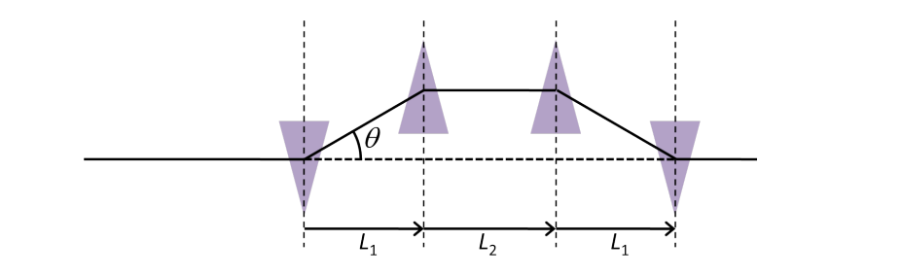
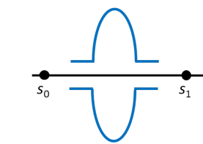
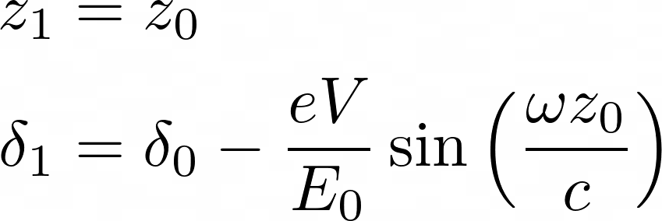
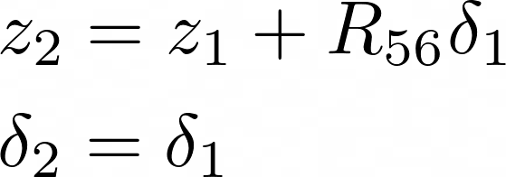
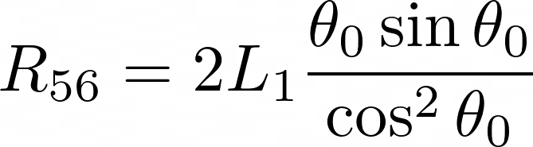
Bunch compression
Bunch compression [7] is a single pass device
Contains an RF cavity to ‘chirp’ the bunch to give a correlation of position with momentum offset
In a linear approximation, can be modelled with a matrix
[4]
Cavity
Chicane
17
Notes:
Improve legend sizes , add separatrices examples

Slide 18

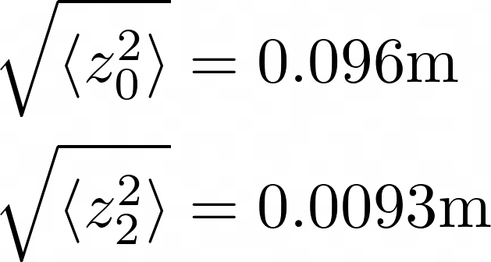
Bunch compression
Solving for the voltage, to create a 10 x bunch length reduction
Given the constraint there is no chirp at exit of chicane, , [7]
[4]
RLA2 bunch length
V = 130,000 MV
~ 4000 TESLA cavities
Desired RCS1 bunch length ≈
18
Notes:
Questions: Why no chirp? How does optuna work? What is the second order effect? What is a typical R56 value?

Slide 19
Conclusions
Toy model for counter-rotating beams [gitlab]
  Induced voltages with a resonator model which matches BLonD with multiple turns
  Can be applied to HOMs, to study affect of RF station position
  To be understood: transient beam loading? Never in the steady state case in RCS1
RLA2 bunch does not seem to be feasible for injection into RCS1
  A bunch compressor would require ~ 4000 tesla cavities
  A lower frequency would help with acceptance
19

Slide 20
References
CAS proceedings 1993
Analytical formula for Gaussian bunch and a resonator
http://blond-admin.github.io/BLonD/modules/impedances.html#module-blond.impedances.induced_voltage_analytical
Monopole, Dipole and Quadrupole Passbands of the TESLA 9-cell Cavity, R. Wanzenberg, DESY, Notkestr. 85, 22603 Hamburg, Germany, September 14, 2001
CERN, “Beam longitudinal dynamics code (blond).” http://blond.web.cern.ch.
A. Aaksoy, ‘Beam Dynamics for RLA2 for the Muon Collider’
https://indico.cern.ch/event/1456536/contributions/6131257/attachments/2955755/5197393/mucol_rla_28-10-24_aaksoy.pdf
Takuya Akiba, Shotaro Sano, Toshihiko Yanase, Takeru Ohta, and Masanori Koyama. 2019.
Optuna: A Next-generation Hyperparameter Optimization Framework. In KDD.
Wolski, A. (2016, October). Nonlinear dynamics: Part 1. CAS: Introduction to Accelerator Physics, Budapest, Hungary
20

Slide 21
