Slide 1
Status of East Area XSEC Calibration
Dani Metin, Aurélie Goldblatt, Michel Duraffourg, Federico Roncarolo
07 April 2025

Slide 2
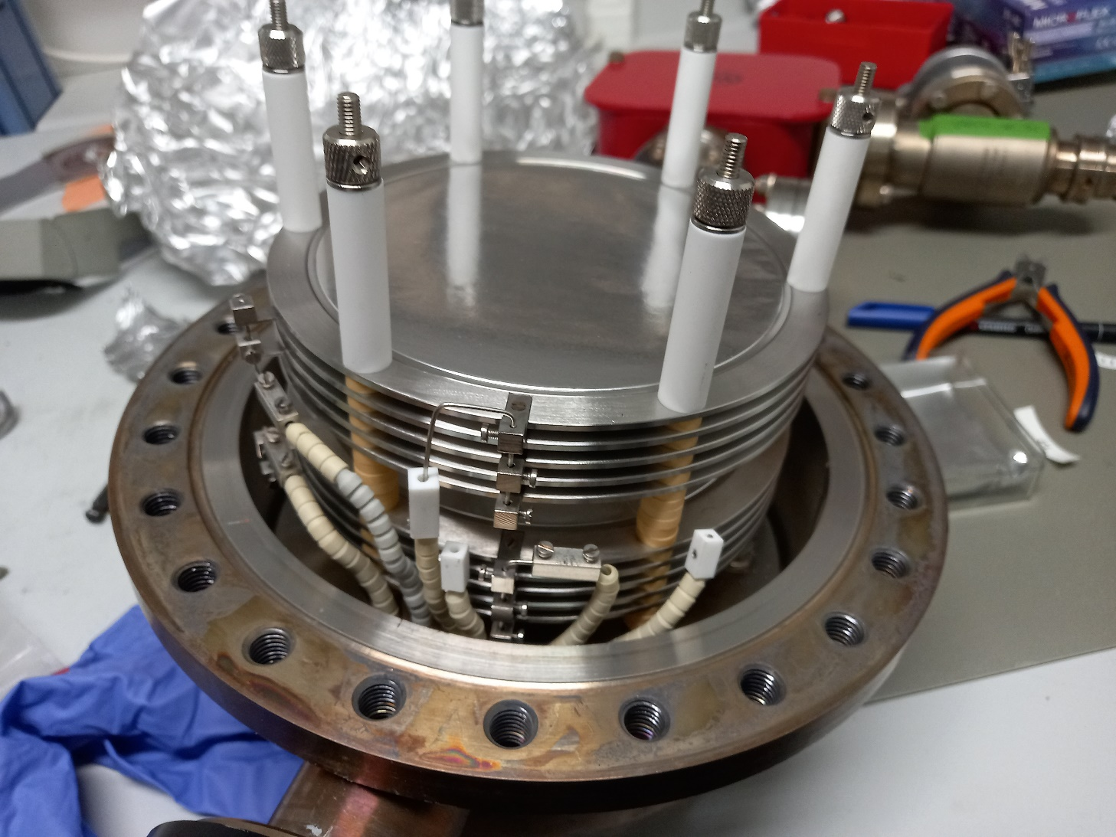
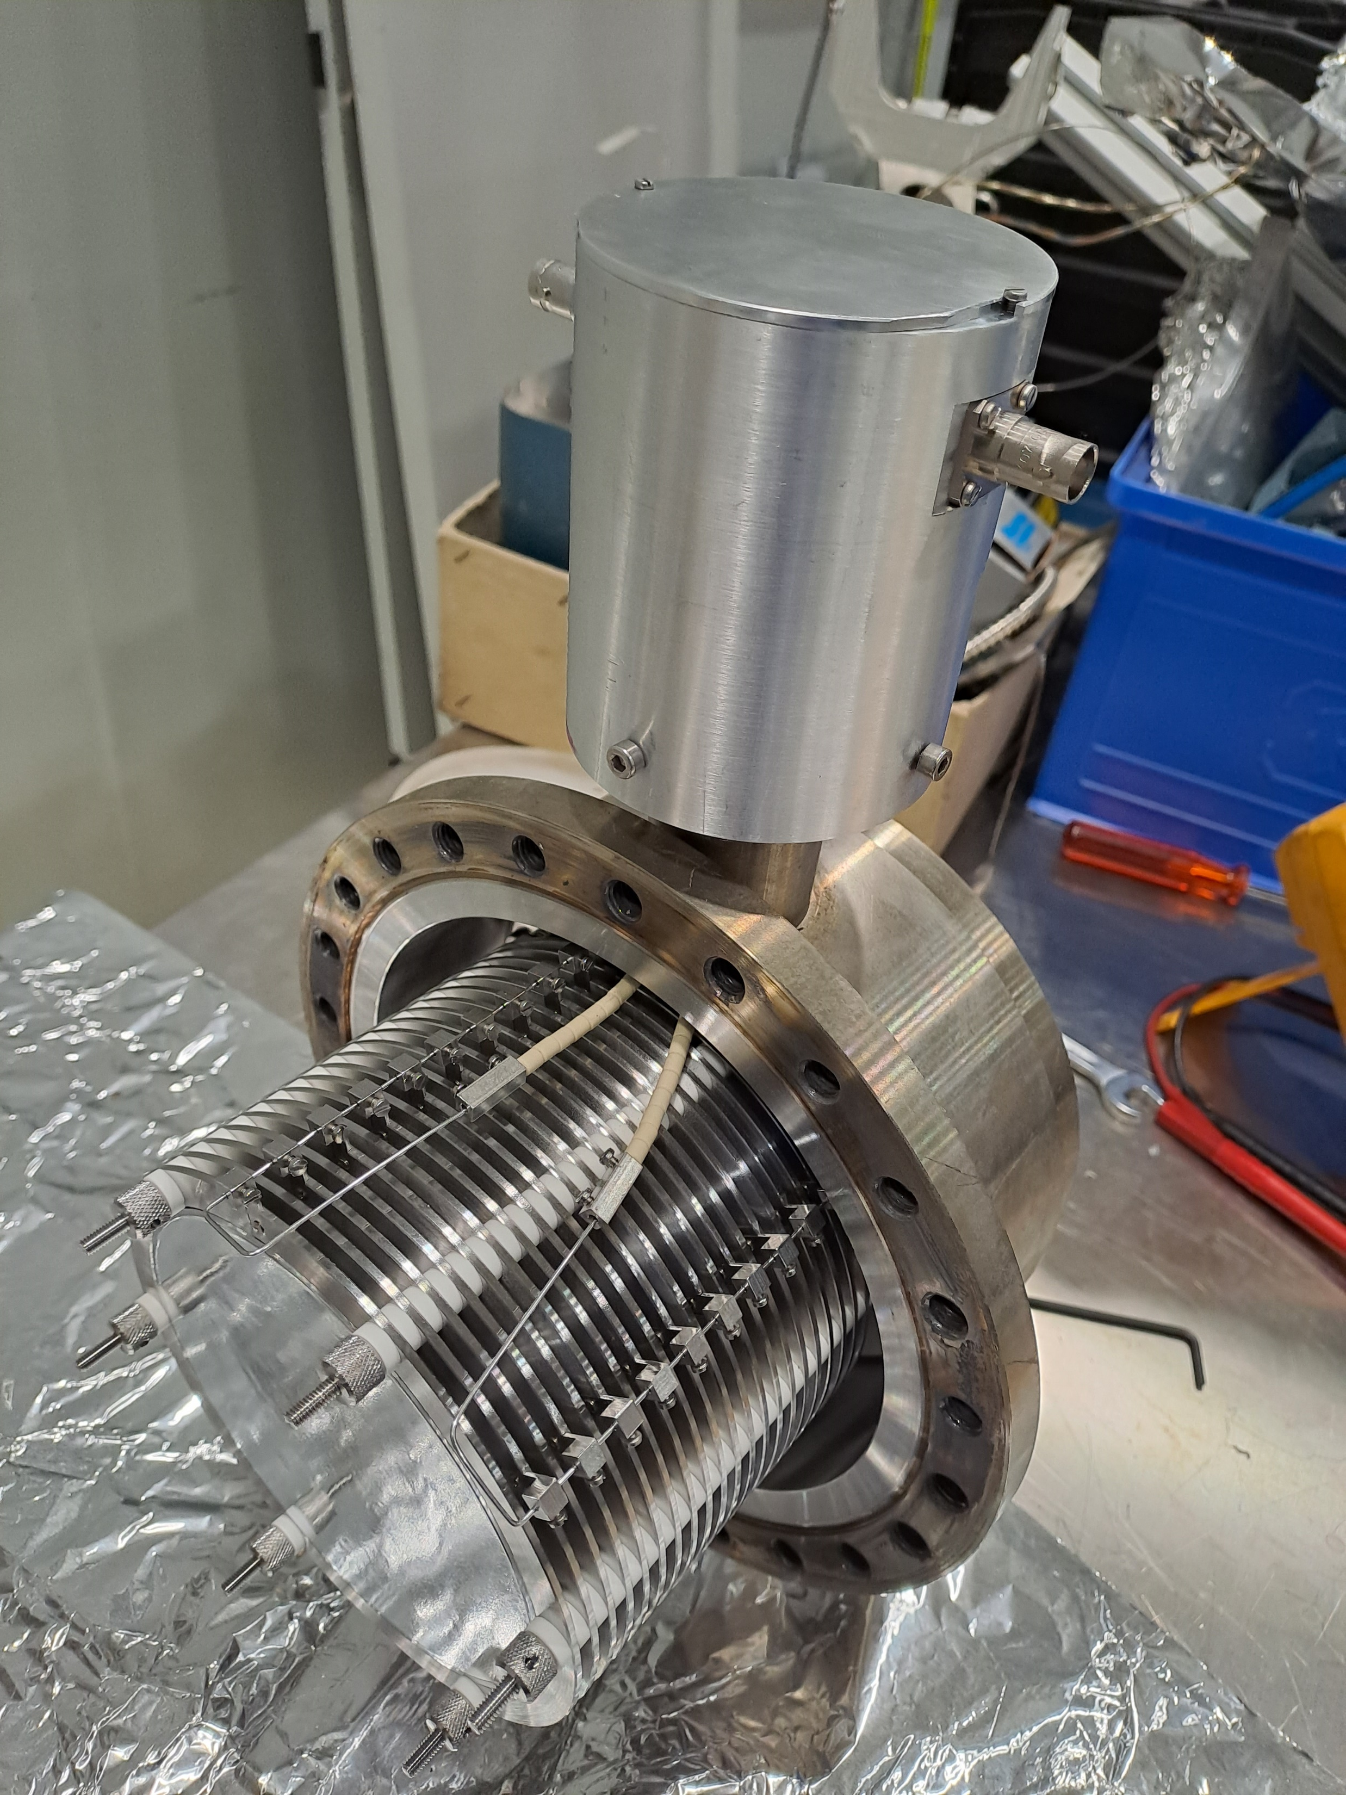
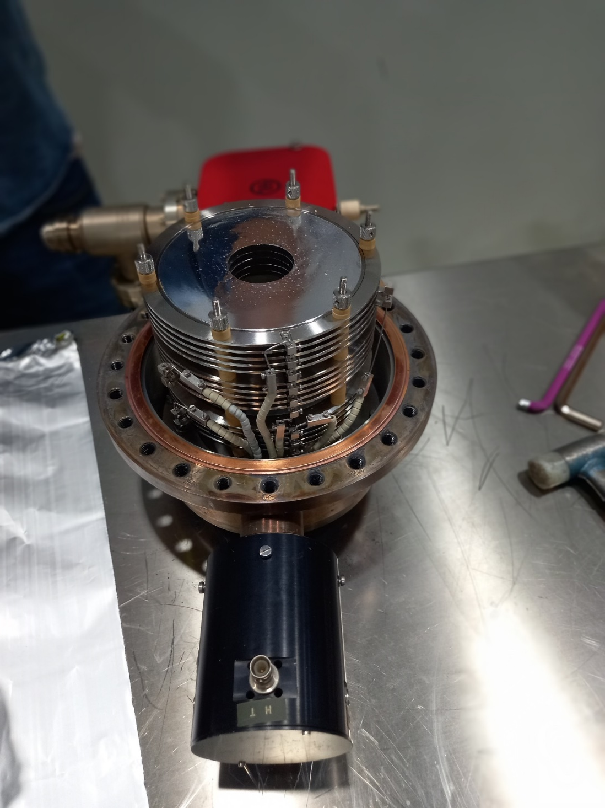
Secondary Electron Emission Chamber (XSEC)

Slide 3
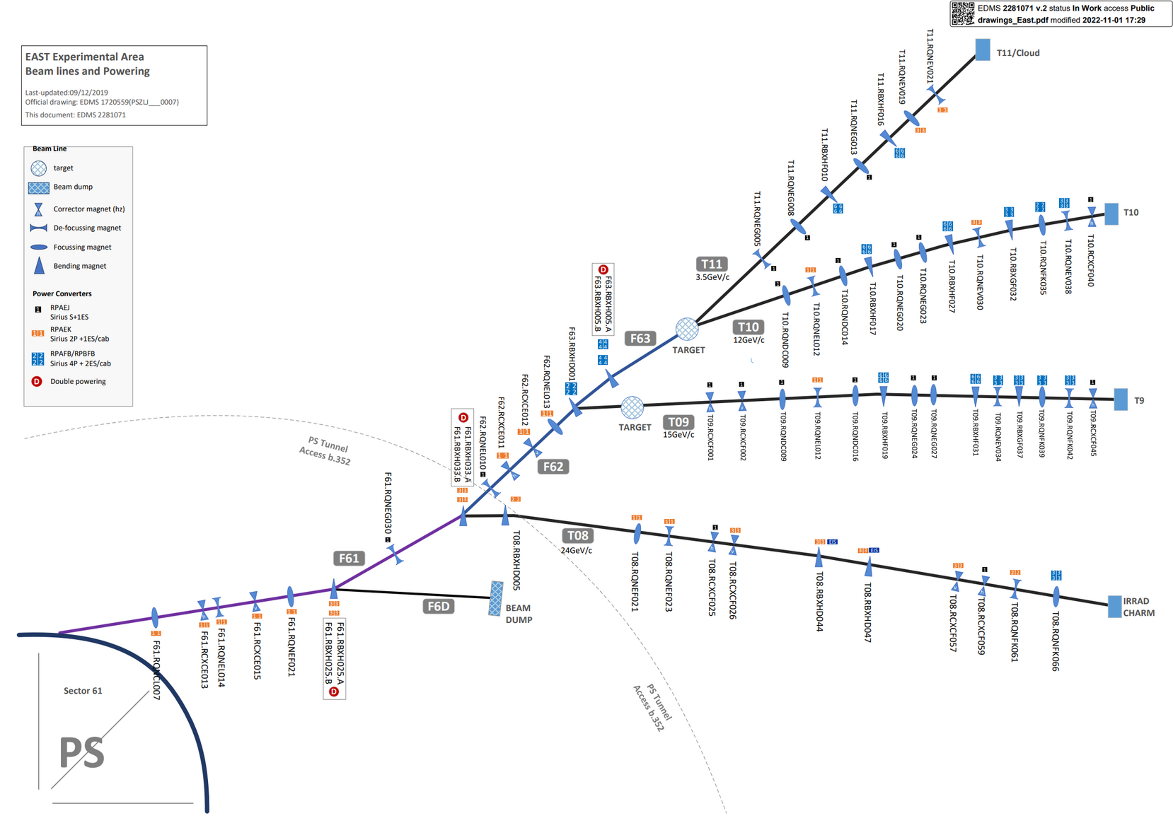
East Experimental Area Beam Lines and Powering

Slide 4
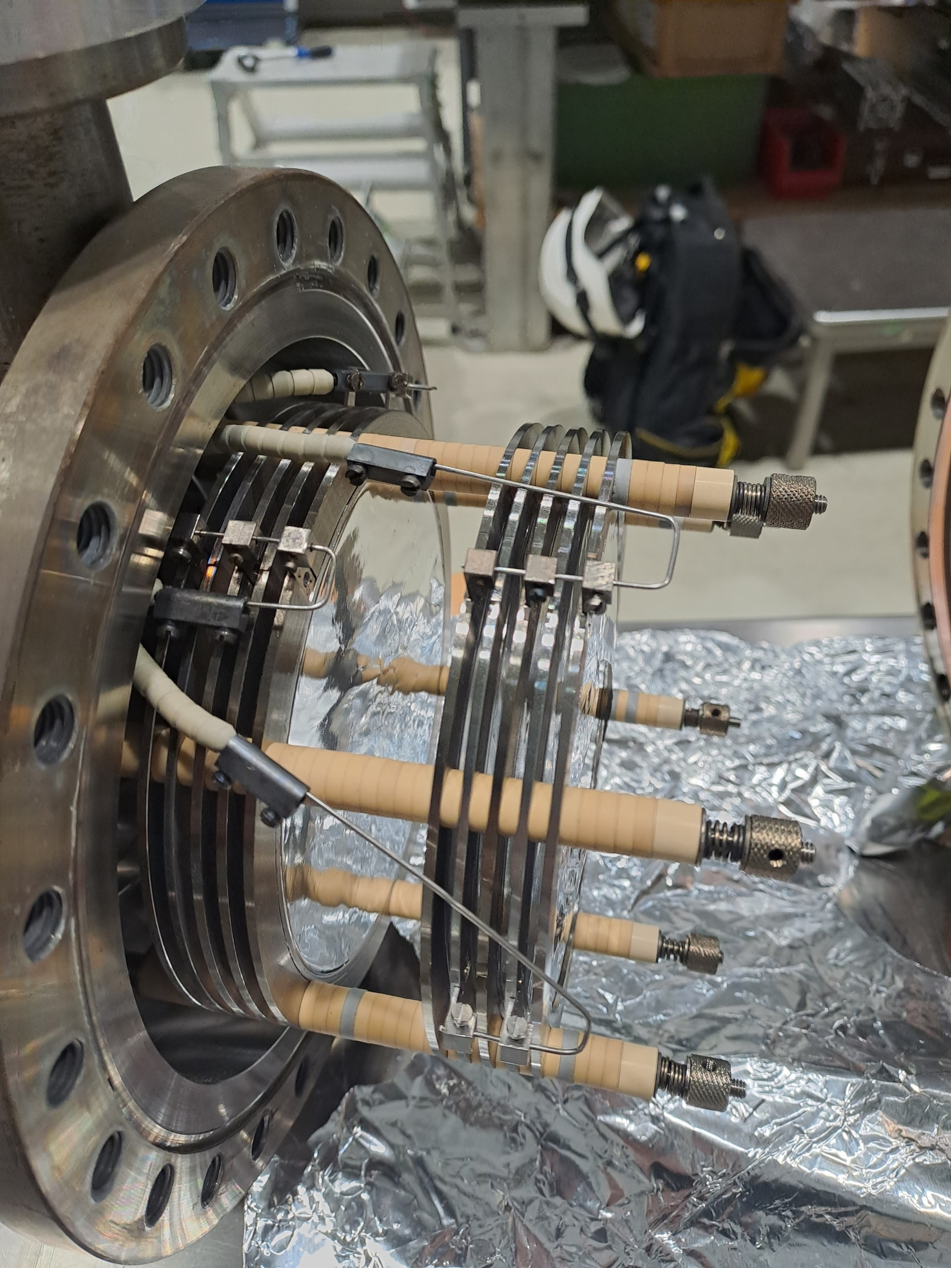
XSEC Calibration factor and details
Signal depends on number of foils and construction¹
Name​ | 2024 Calibration factor​ | ​Notes (last updated Dec 2024)
T08.XSEC070-I​ | 1.0923e+08​ | 900pF --> 10 x signal foil + 11 x bias foil​
F61.XSEC023-I1​ | 1.15e+08​ | 2 x signal foil + 3 x bias foil​
F61.XSEC023-I2​ | 1.15e+08​ | 2 x signal foil + 3 x bias foil​
F62.XSEC022-I​ | 5.08e+08​ | 10 x signal foil + 11 x bias foil​
F63.XSEC008-I​ | 5.08e+08​ | 2 x signal foil + 3 x bias foil​
T8.XSEC095-I​ | 4.3697e+08​ | 900pF --> 10 x signal foil + 11 x bias foil​ ​
¹ Ravotti, F., Ollacarizqueta, A.G. and Ruffieux, R.B., 2022. Calibration of the T08. XSEC devices by means of Al-foil activation and BCTF measurements (No. EP-Tech-Note-2022-001).

Slide 5
Calibration factors for F61, F62 & F63

Slide 6
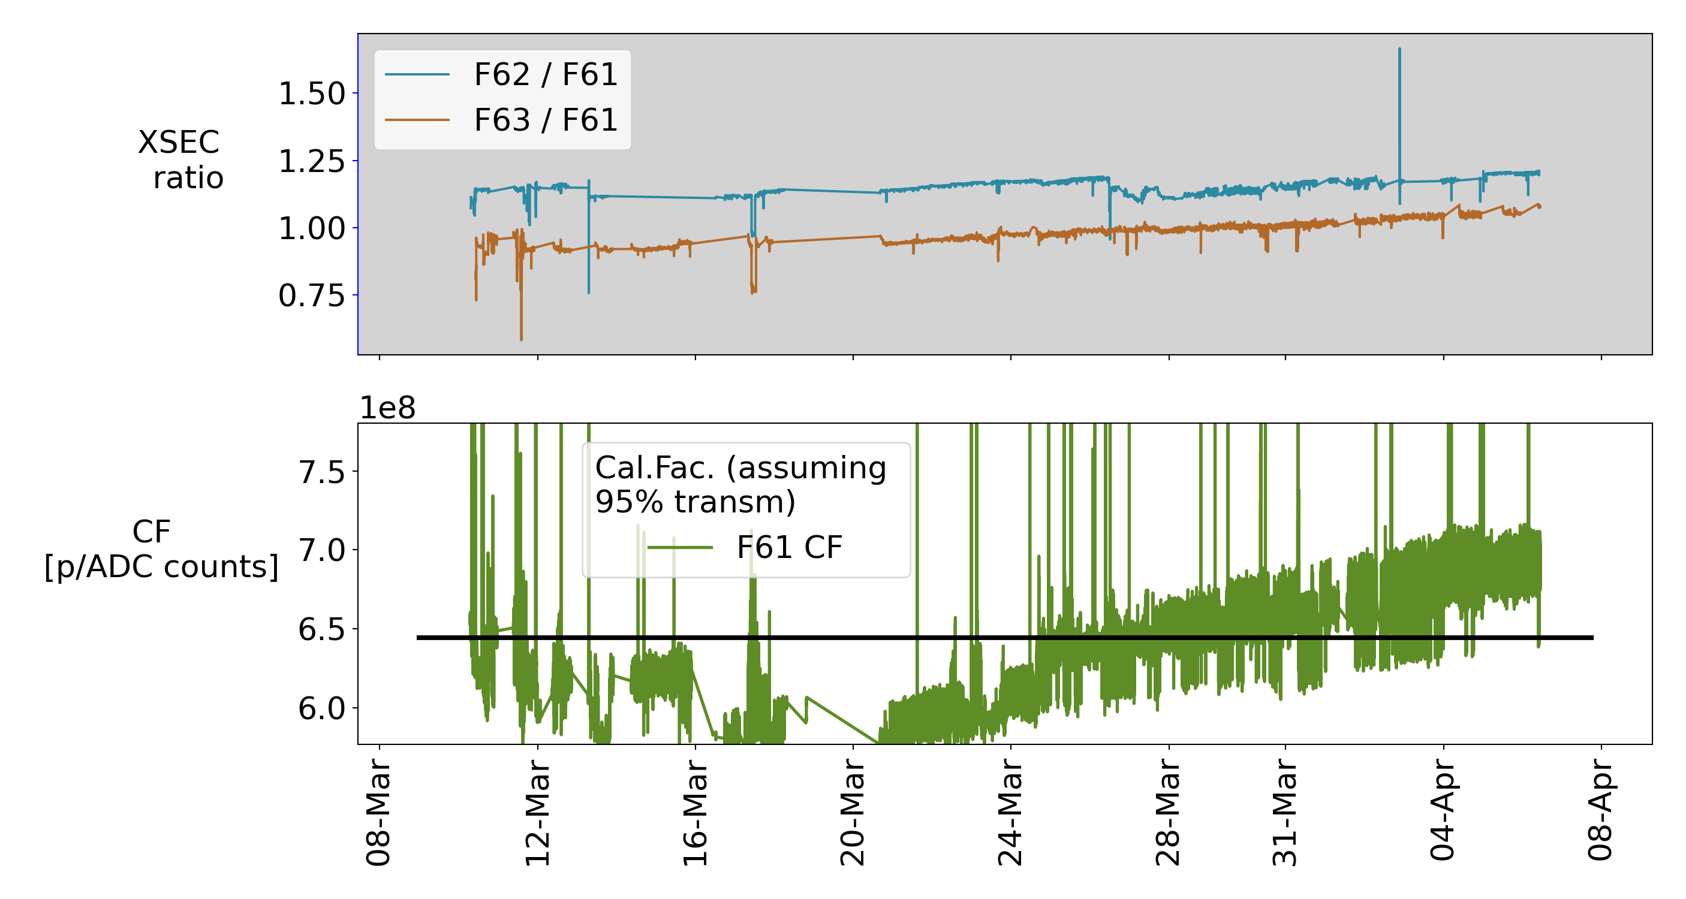
XSEC relative signal and Calibration Factor for F61 (2025)

Slide 7
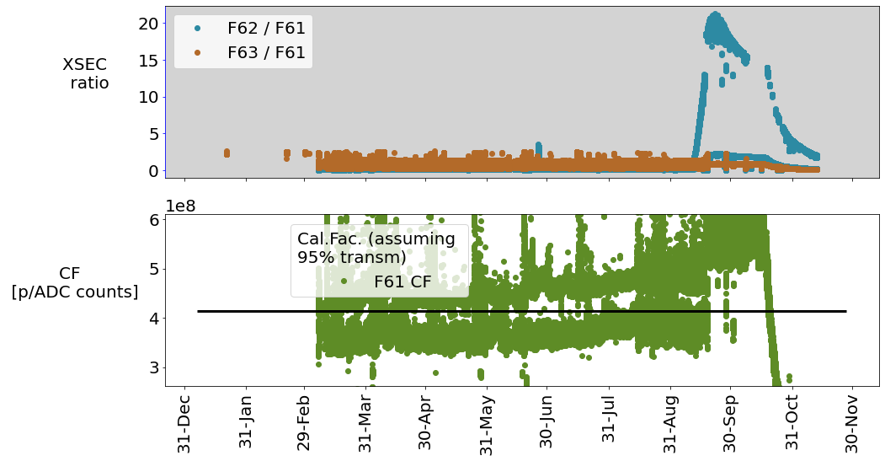
XSEC relative signal and Calibration Factor for F61 (2024)

Slide 8
Today’s Conclusion for Calibration Factors
Name​ | 2024 Calibration factor​ | 2025 calibration factor (TBC) (95% BCT transmission target for F61) | ​ Notes (last updated Dec 2024)
T08.XSEC070-I​ | 1.0923e+08​ |  | 900pF --> 10 x signal foil + 11 x bias foil​
F61.XSEC023-I1​ | 1.15e+08​ | 6.39e+08 | 2 x signal foil + 3 x bias foil​
F61.XSEC023-I2​ | 1.15e+08​ |  | 2 x signal foil + 3 x bias foil​
F62.XSEC022-I​ | 5.08e+08​ | 1.06+08 | 10 x signal foil + 11 x bias foil​
F63.XSEC008-I​ | 5.08e+08​ | 6.39e+08 | 2 x signal foil + 3 x bias foil​
T8.XSEC095-I​ | 4.3697e+08​ |  | 900pF --> 10 x signal foil + 11 x bias foil​ ​
Must observe vacuum environment

Slide 9
New Foil - T08.XSEC095

Slide 10
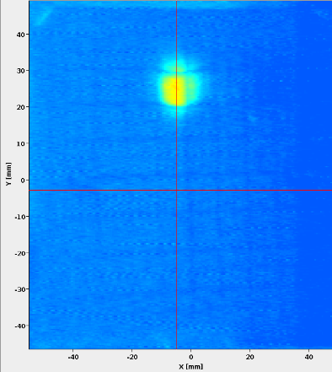
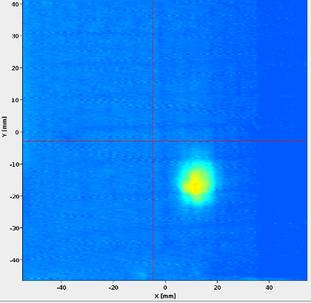
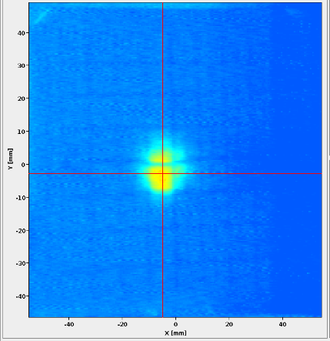
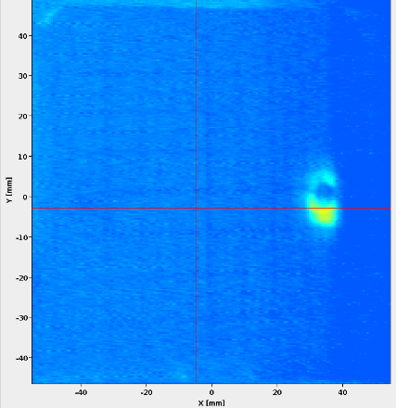
Scan of new foil
Measurements taken morning of 13th March 2025
Position on foil moved from 0 to over 30mm away from center
Examples from logbook are shown below

Slide 11
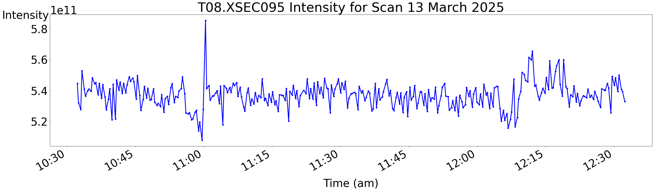
Scan of new foil - response

Slide 12
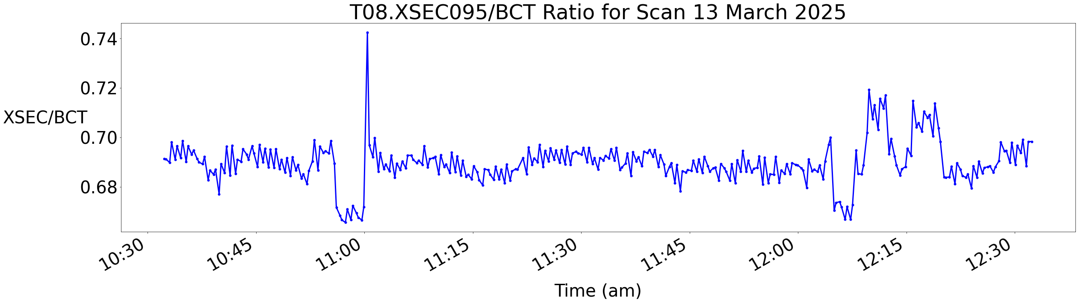
Scan of new foil - response
Norm. XSEC signal only shifted by more than 2% when beam was on very edge of foil

Slide 13
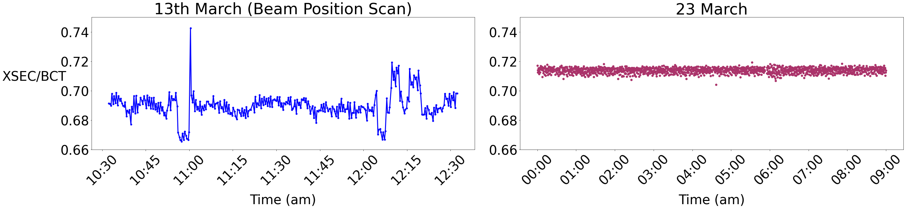
Comparison to more stable beam position
Changes are more dramatic than when the beam position is stable, but remain small

Slide 14
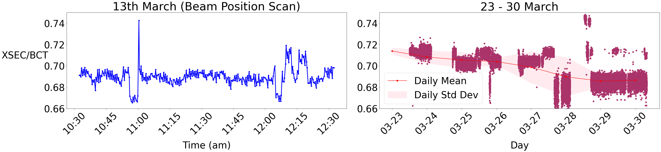
Comparison to more stable beam position
Changes during beam position scans are similar in magnitude to those observed over weeks without beam position variation
Will compare with another beam position test once the foil has aged

Slide 15
Supplementary Slides

Slide 16
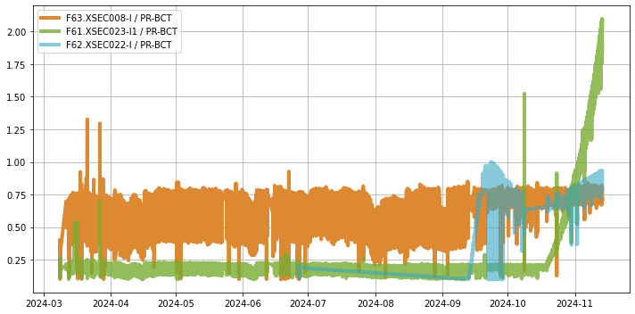
2024 XSEC

Slide 17
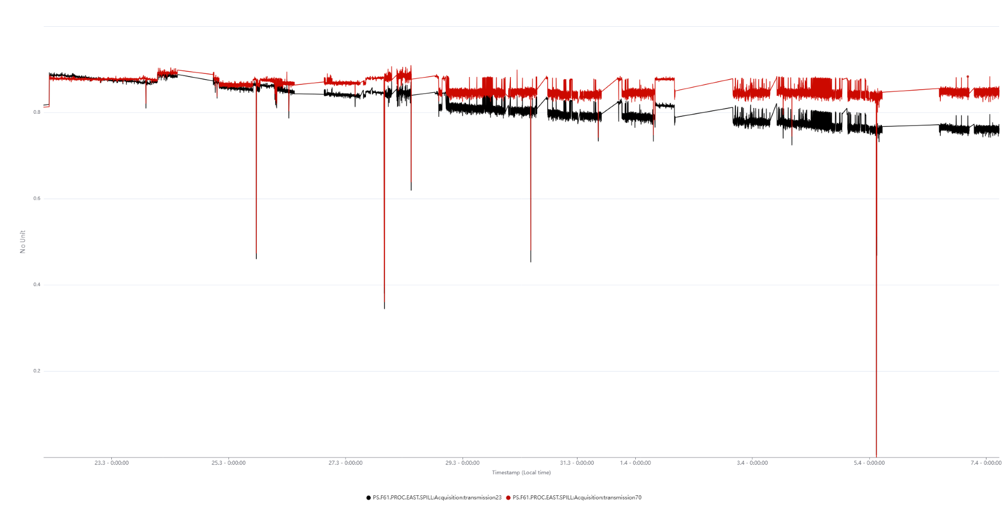
Transmission for F61

Slide 18
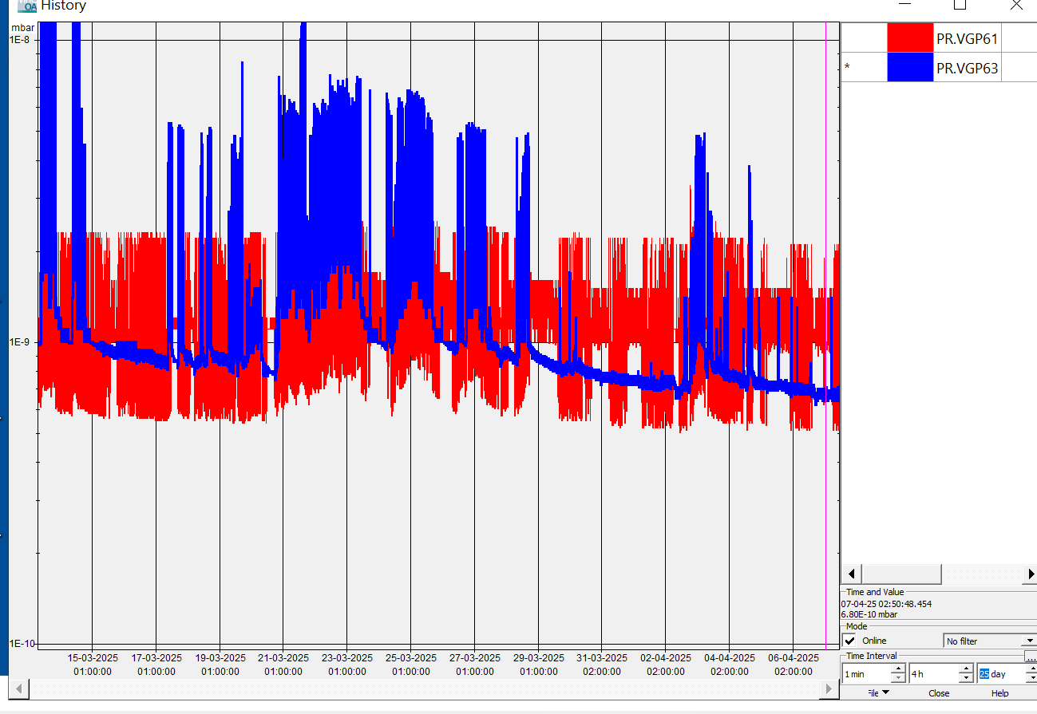
2025 Vacuum for F61

Slide 19
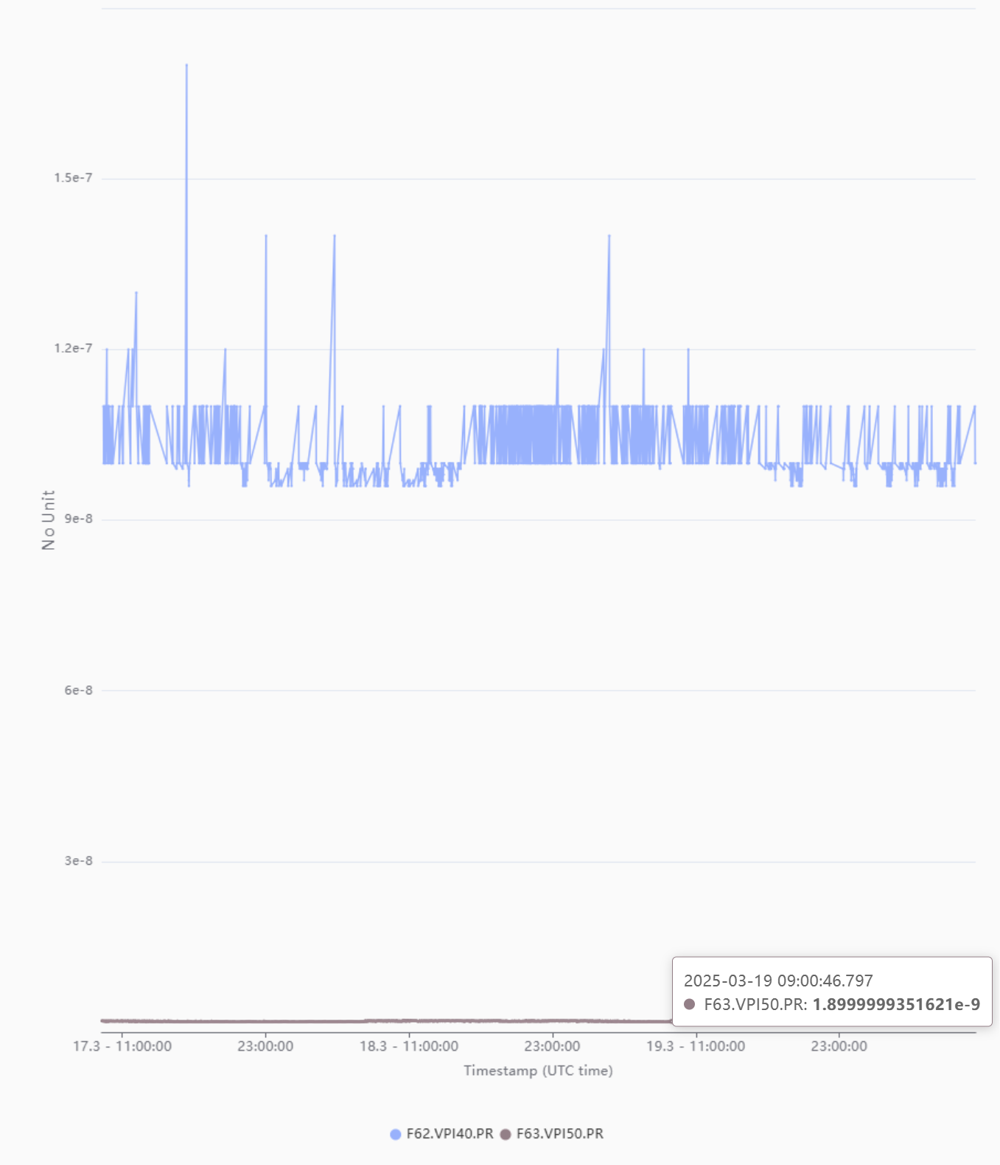
2025 Vacuum for F62 and F63

