Slide 1
New target complex service building (754)
SCE Milestones for IRP Design Study
27th March 2025 - CERN
Jean-Louis GRENARD - Gemma HUMPHREYS – CERN – SY-STI-TCD

Slide 2
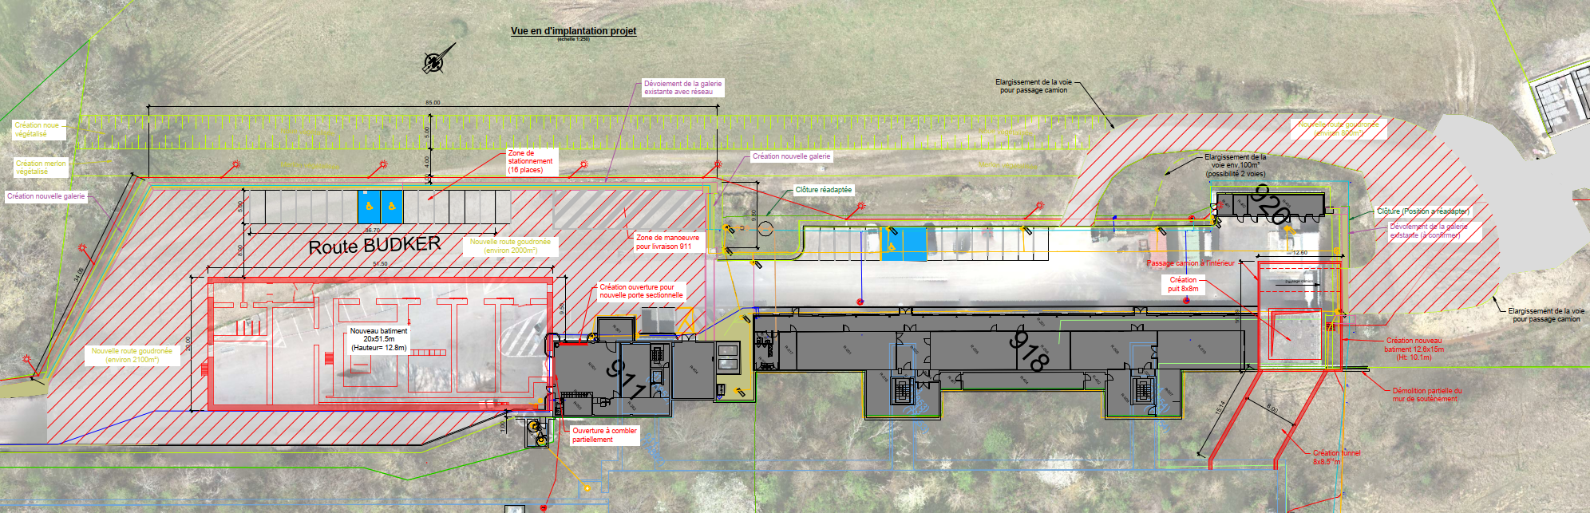
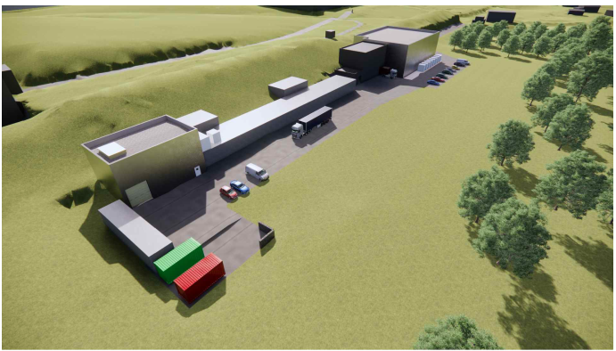
Service building within the BDF/SHiP complex

Slide 3
The target complex service building
Nuclear ventilation system of the target complex
  Air handling units, filters, dehumidifiers (outside)
Target and proximity shielding cooling systems
  Pumps, Filters, Heat exchanger, Cooling instrumentation, He circulation system
  Target controls systems
  Target monitoring (sensors), Target control valves, vacuum vessel confinement
  Service cell
  Buffer area
Safety systems
Electrical distribution system
Control and safety systems
(evaporator?)
~1000 m²
~18m
~46m* → 48m

Slide 4
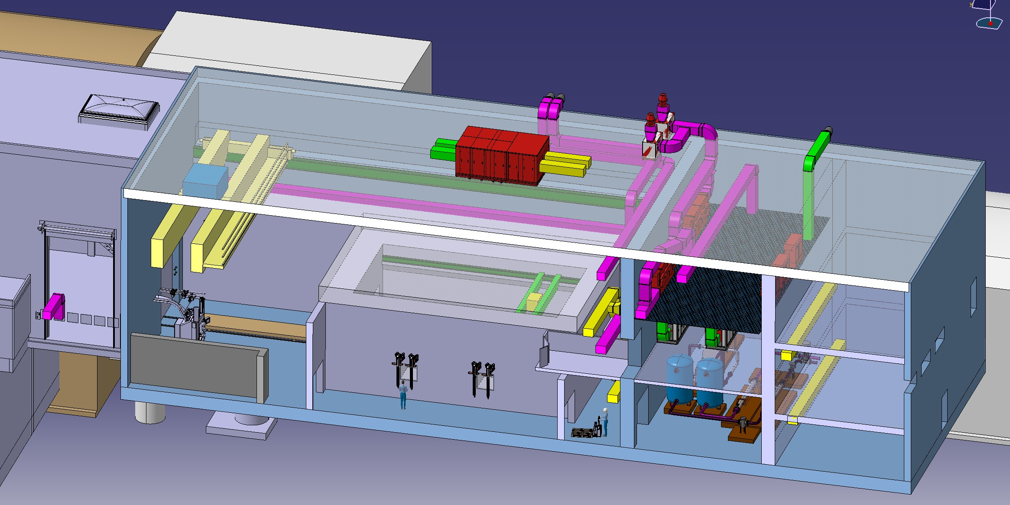
Service building - Overview

Slide 5
Service building – ground floor
Cooling equipment
He + water
5t/m²
Material access
Service corridor
Service cell (~78m²)
Internal load 10t/m²
Changing room
Personnel access
Access shaft
Lorry access
Mobile Shielded Door
Modular shielded buffer zone
Punctual loads 15t over 1m²

Slide 6
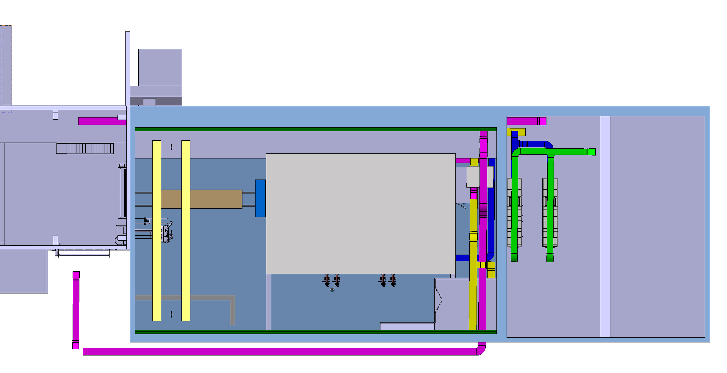
Service building – 1st floor
Equipment not yet defined
Expected UPSs and power distribution cubicles
30t Overhead Traveling Crane
Mezzanine
~1000kg/m²
Filter Room
~1000kg/m²
Power Distribution Room
False floor min 250kg/m²
Rack support structure min 750kg/m²
800mm false floor height

Slide 7
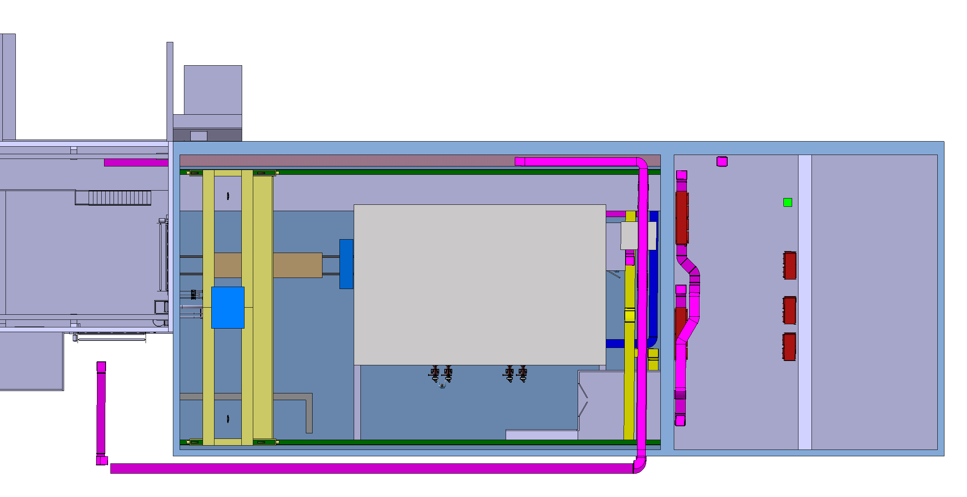
Service building – 2nd floor
~8 SPS type control racks
3 Racks in a safe room for safety systems
30t Overhead Traveling Crane
Filter Room
~1000kg/m²
Control Racks
False floor 250kg/m²
Rack support structure 750kg/m²
800mm false floor height
A mezzanine need to be added

Slide 8
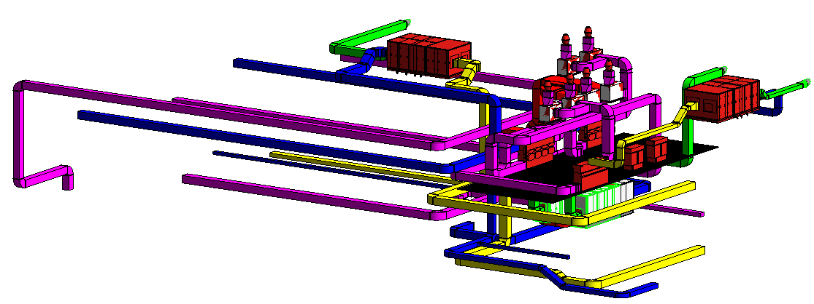
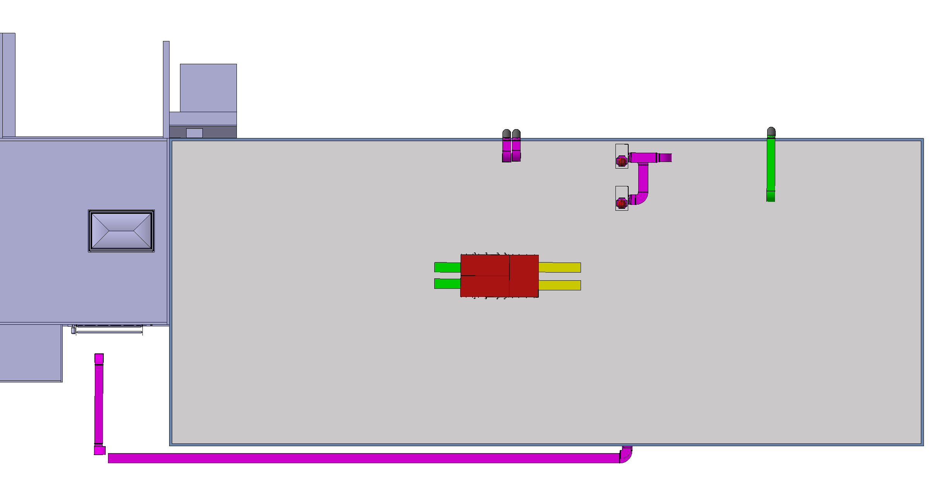
Service building – roof
2 Air handling units
~6 Exhaust stacks
CV equipment location to be defined

Slide 9
Service Building – External stair cases
Power Room and Control Room
Available equipment for installation
An extension of the access platform will be required to access with a crane
Forklifts
Control room
Power room

Slide 10
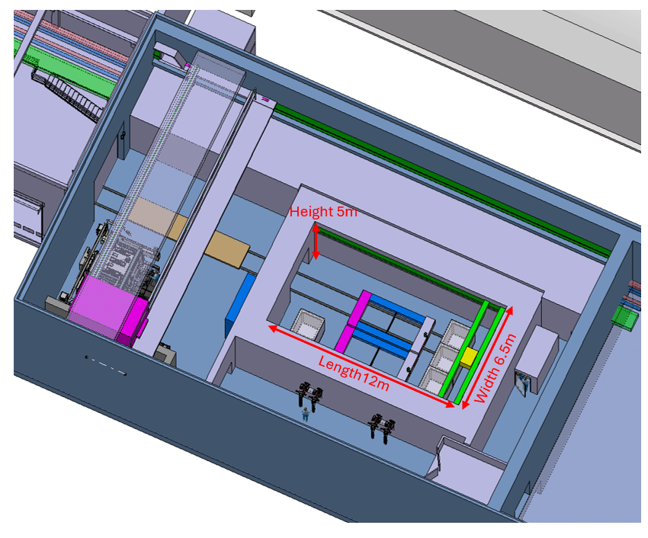
Service building – Service cell
Completly independant for the building
Weight of the cell 900t concrete - 2000t cast iron
Internal size 12 x 6,5 x 5m
External size 14,4 x 8,9m x 6,2m concrete
External size 13,6 x 8,1m x 5,8m steel
Floor loading 20-60t/m² from the cell
Assumptions:
1,2m concrete wall and ceilling
0,8m steel wall and ceilling

Slide 11
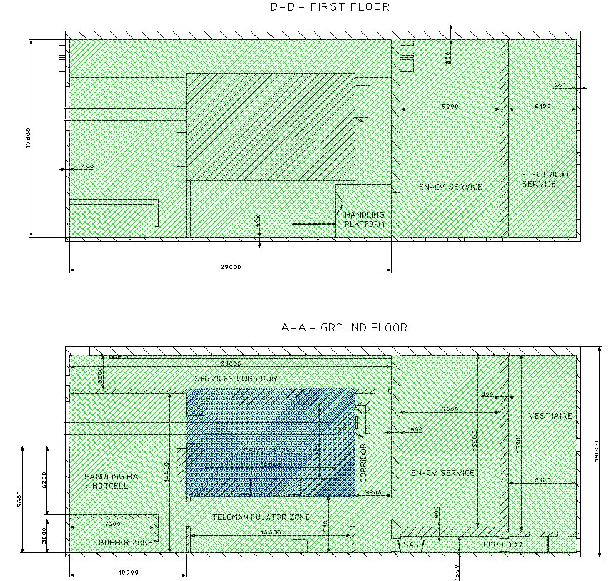
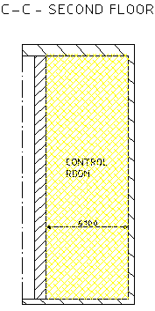
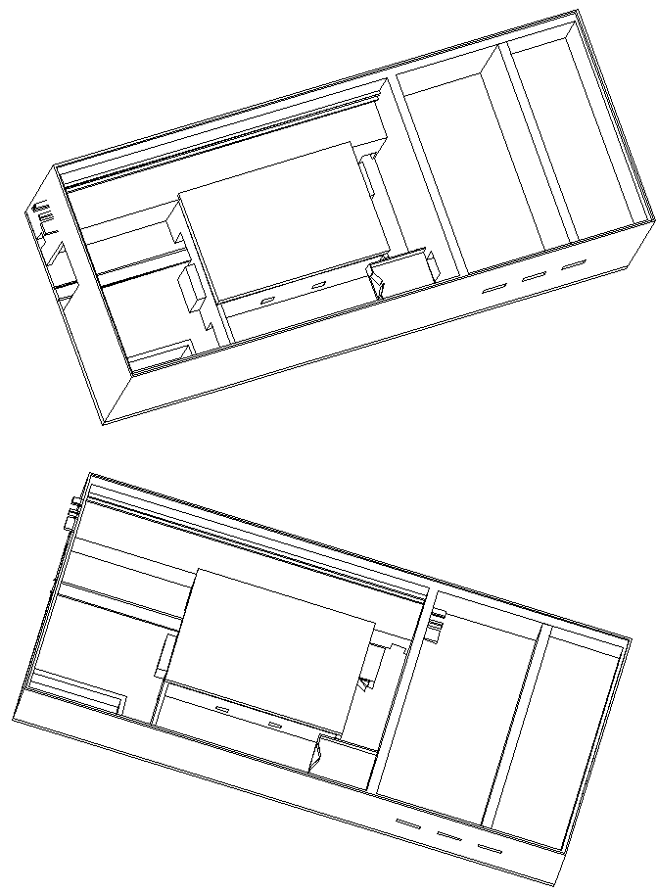
Service building – differencial pressures
S-1 Zone
Full fresh air ~ 2,300 m3/h
N+1 redundancy
Filters nearby Service Cell and in filter room
0Pa
-20Pa
0Pa
S-2 Zone
Full fresh air ~ 12,660 m3/h
No redundancy
Filters in filter room
-10Pa
-30Pa
-30Pa
-10Pa
-50Pa
S-3 Zone
~ 1,000 m3/h
No redundancy
0Pa
-10Pa
-10Pa
-10Pa
+30Pa
0Pa

Slide 12
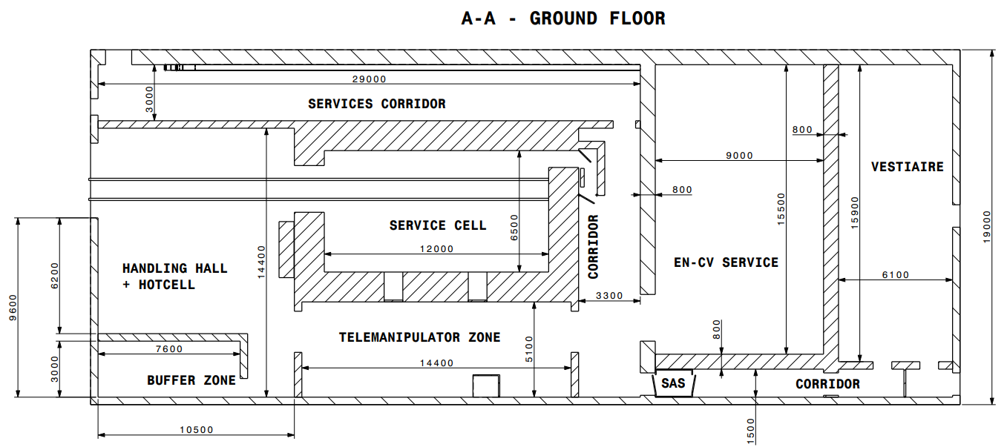
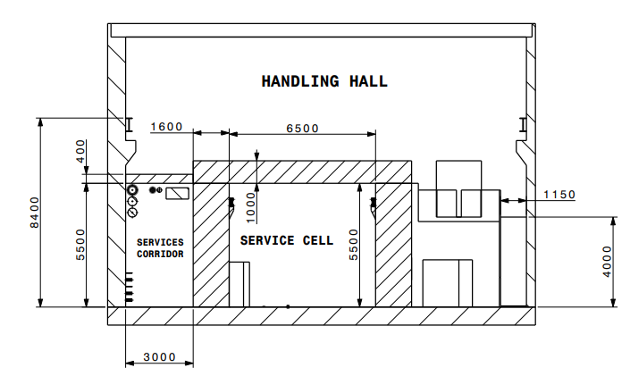
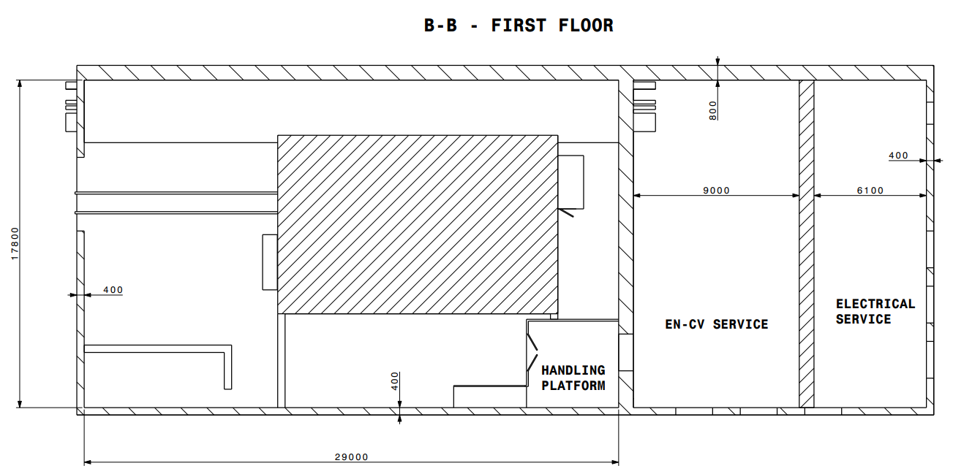
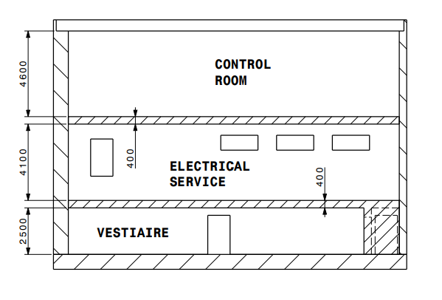
Service building - dimensions
Overlall length to be extended by 2m (installation requirement for CV équipements)

Slide 13
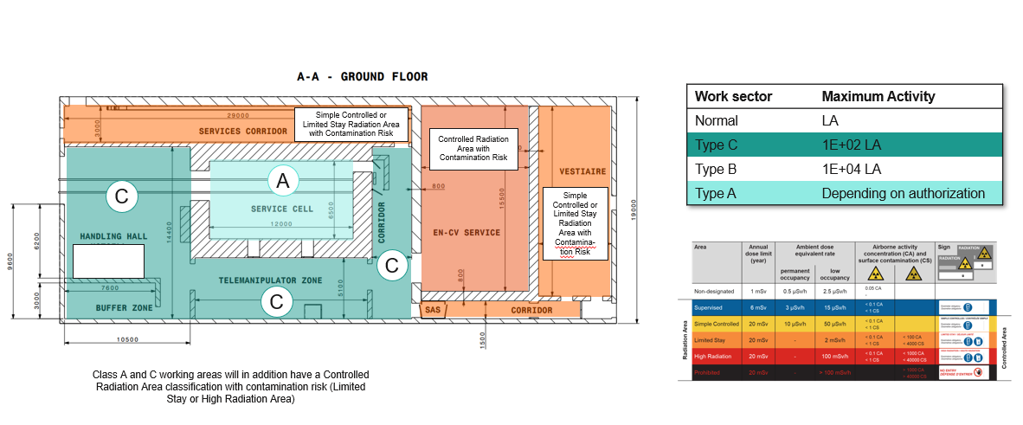
Service building – RP classification

Slide 14
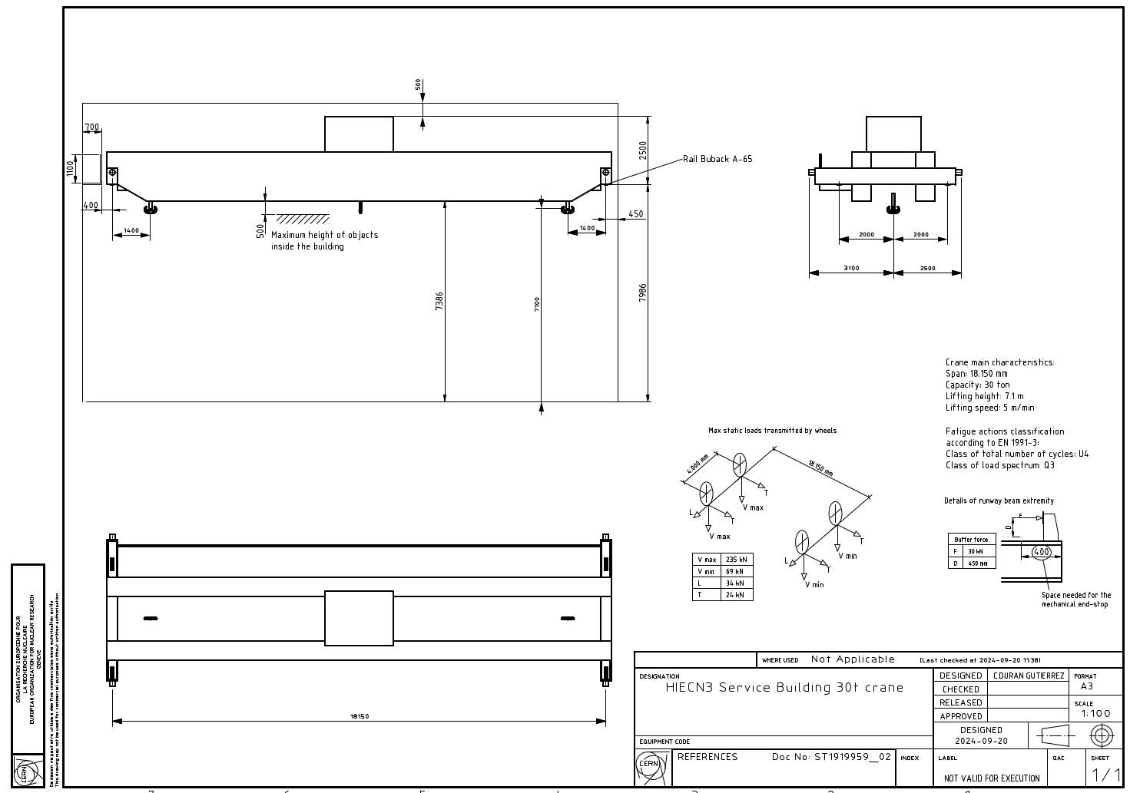
Handling loads
30t Crane loads →
HE as provided the infos (minor changes to be expected)
Draft

Slide 15
Handling loads
Transfer platform between 911 → 754 → service cell
  Rails excluded -> use of polyurethane wheels (or similar)
  Punctual load per wheel expected ~10t (4 wheels expected)
Fixed handling equipement to forsee in Cooling and Ventilation rooms (rails and/or small cranes) To be defined (~1-5t capacity)

Slide 16
Service building - Sump system
To be defined
Probably 2-3 to not mixed:
Service cell
Cooling room
General collection of water from the building

Slide 17
Interfaces with other CE structures
911 material door
Shall wistand differencial pressure -10Pa with respect to 911
Final cross section not yet defined (do we keep current size or shall we reduce)
Connection with 911 for services
Existing 911 Sump room connection to not mix this area with the buidling

Slide 18
Design parameters
Service building design parameters.xlsx

