Slide 1
Layerjump configuration correction

Slide 2
Connection side

Slide 3
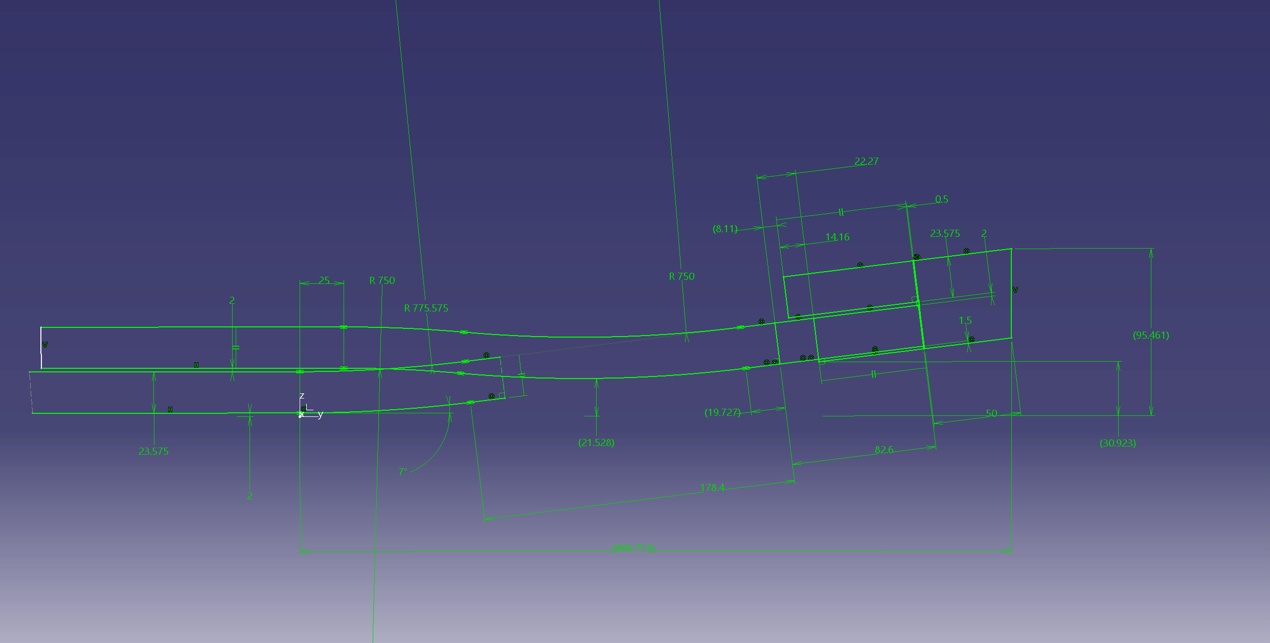
Original

Slide 4
Option 1
Head straight section : 178,4 mm-> 200mm
Additional cable length = 2246.4mm (per coil head)

Slide 5
Option 2 :
Head angle : 7°->9°
Head straight section : 178.4mm->158.6mm
Additional cable length = 748.8mm (per coil head)

Slide 6
Option 3 :
Head angle : 7°->8°
Head straight section : 178.4mm->176.3mm
Additional cable length = 1622.4mm (per coil head)

Slide 7
Non connection side

Slide 9
Option :
Head straight section : 178.4mm->120mm
Additional cable length = 12147.2mm

