Slide 1
HQ and TQ magnets
Quench Protection Study
HFM Protection Studies
WP4.5-T5-D1
M. Wozniak & E. Ravaioli
24.04.2025

Slide 2
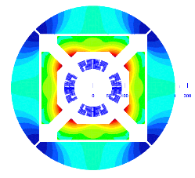
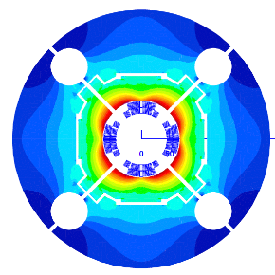
Outline
Scope
Magnets & Conductors
Circuit & Quench Detection
Details for protection with:
  QH and/or CLIQ
  E-CLIQ
  ESC
Summary of cases studied
Results

Slide 3
Scope
Study HQ (High gradient, high field Quad) and TQ (Technology Quad) magnets (both develop within the framework of the US LARP)
Consider individually powered, long (7.15 m), single-aperture magnet
In terms of quench protection study:
    Outer layer QH (quench heaters) and CLIQ quench protection
    QH only or CLIQ only or both together
    Include three ways (glued, miniswap, impregnated) of placing QH
    Novel E-CLIQ quench protection (at conceptual level)
    Novel ESC quench protection with 4 capacitive units
    Study Time to Quench by quenching all turns at specific time
Quantify regarding quench protection:
    maximum adiabatic hot spot temperature
Keep is simple, do not consider failure cases, low current quenches etc.

Slide 4

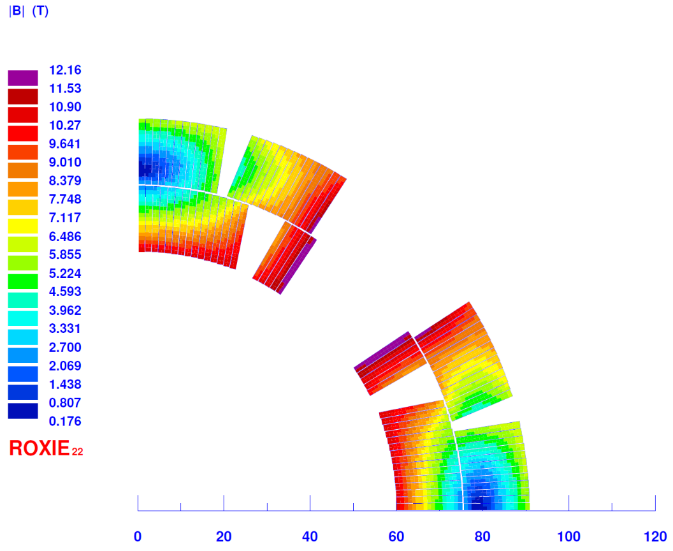
HQ magnet
Current: 15366 A*
Gradient: 175 T/m**
Copper current density: 1621 A/mm²
Overall current density: 612 A/mm²
Acknowledgement of design: GianLuca Sabbi
* Current adjusted to obtain the gradient
** Gradient assumed for this study, not clear what the original nominal value was

Slide 5

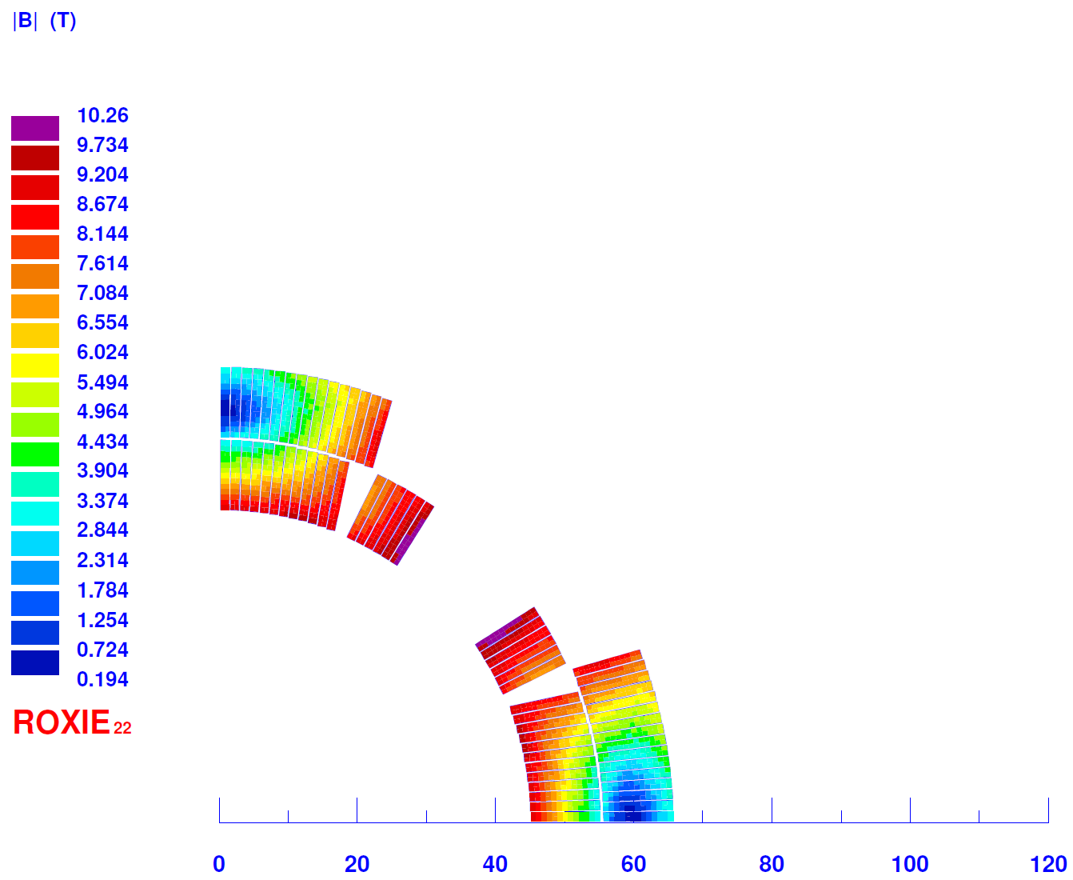
TQ magnet
Current: 11019 A*
Gradient: 200 T/m
Copper current density: 1738 A/mm²
Overall current density: 708 A/mm²
Acknowledgement of design: GianLuca Sabbi
* Current adjusted to obtain the gradient

Slide 6
Conductors
HQ (IR2TQ_V1)
Common
RRP Nb₃Sn
RRR: 150
Filaments twist pitch: 18.5 mm
Cable transposition length: 109 mm
Glass fibre insulation
TQ (IR2TQ_V1)
Strand
Diameter: 0.8 mm
Cu/non-Cu ratio: 1.17
Strand
Diameter: 0.7 mm
Cu/non-Cu ratio: 0.89
Cable
Number of strands: 35
Bare:
  width: 15.15 mm
  height low: 1.338 mm
  height high: 1.538 mm
Insulation thickness : 100 μm
Cable
Number of strands: 27
Bare:
  width: 10.05 mm
  height low: 1.172 mm
  height high: 1.348 mm
Insulation thickness : 125 μm
Using the MQXF cable average measured J_{c} of 937 A/mm² @ 4.2 K, 16 T
I_{c} (1.9 K, 12.16 T) = 28991 A for I_{op} = 15366 A
I_{c} (1.9 K, 10.26 T) = 36166 A for I_{op} = 11019 A
Jc(B, T) following Summer’s fit: Tc0: 16.33 K, Bc20: 26.45 T, Jc0: 4.663 10¹⁰ A/m²

Slide 7
Circuit and quench detection
t_{off}
0.0 Ω
This is the most pessimistic case with crowbar and diode parameters.
0V
PC
Time when quench protection is activated called trigger time (and power supply t_{off})
This is a parameter that is changed in the simulations from 10 ms to 40 ms

Slide 8
Quench heaters and insulation design
Polyimide film: 50 μm *
SS (304L) foil: 25 μm
Cu layer: 10 μm
Length of SS patch: 50 mm
Ground insulation: 0.5 mm Polyimide
Heater current peak: 150 A
Heater power supply: ±450 V, 7 mF
Additional insulation – variable
Epoxy adhesive: 15 μm
Identical to MBH QH
Identical to MBH QH powering
Details on the next slide
Not included, as in all the models I know of
GND insulation
Cu layer
SS layer
Adhesive
Kapton
Additional insul.
Cable insulation
Cable bare
Cross-section:
(not to scale)
* Some of the original TQ and HQ magnets used 25 μm Kapton insulation QH. Here, a more common today 50 μm is used instead.

Slide 9
Additional insulation – QH application method
Approach name | Additional insulation |  | Description
 | Thickness (μm) | Material
Impregnated | 0 | N/A | QH placed directly on the coil was impregnated with the coil
Miniswap | 50 | G10 | 50 μm E-Glass cloth layer placed between QH and the coil QH impregnated with the coil []
Glued | 100 | G10 | QH glued to the coil after it had been impregnated. The thickness corresponds to additional coil insulation and glue layer (G10 used for both).
GND insulation
Cu layer
SS layer
Adhesive
Kapton
Additional insulation
Cable insulation
Cable bare
Cross-section:
(not to scale)

Slide 10
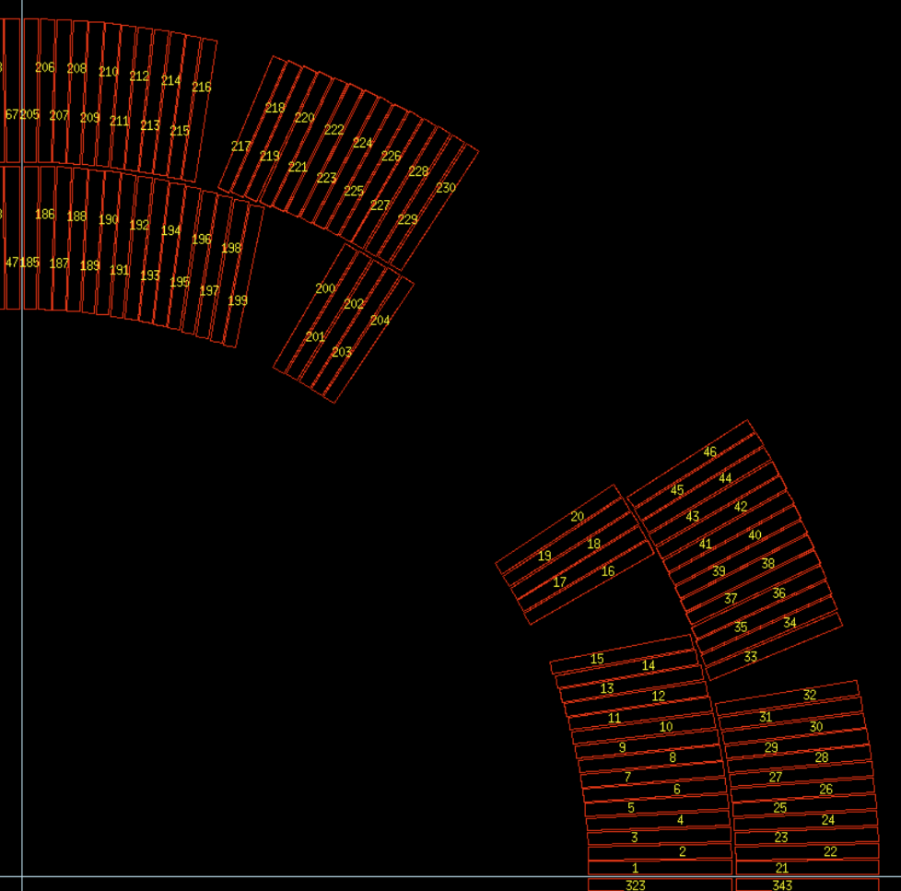
Quench heaters placement - HQ
OL
OH
Not covering this turn with the heating element
OH (outer high field trace – 13 turns covered)
OL (outer low field trace – 11 turns covered)
Not covering this turn with the heating element
Two traces form a U-shaped heater pad. 8 pads per aperture.

Slide 11
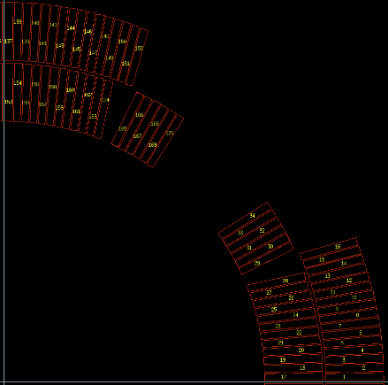
Quench heaters placement - TQ
OL
Not covering this turn with the heating element
OL (outer low field trace – 14 turns covered)
Not covering this turn with the heating element
Two traces connected at non-powered end. 8 traces per aperture.

Slide 12
Quench heaters adjustment (not optimization)
The quench heater design differs from the 11 T (MBH) (LF and HF) heaters in the details described below.
The width of the quench heater has been adjusted to match the arch length of the coil blocks.
The length of the Cu patch (see picture) has been adjusted to result in a total heater trace resistance of 3 Ohm per trace. The two traces are in series, giving 6 Ohm, and this is powered with 900 V ( ±450 V to the ground) with a peak current of 150 A.
Room temperature resistance (heater power supply and connection to heaters) is 9 mOhm.
Magnet name | Trace name | Length (mm) |  | # turns covered | Width (mm) | Wedge width covered (mm)
 |  | Copper | Stainless steel
HQ | OL | 86.3 | 50 | 11 | 19.1 | 0
 | OH | 65.3 |  | 13 | 22.6 | 0
TQ | OL | 66.4 | 50 | 14 | 22.4 | 0
Longitudinal view:
(not to scale)
Width
Length Cu
Length SS

Slide 13
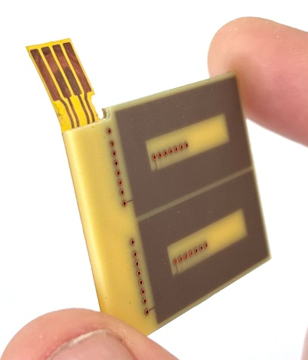
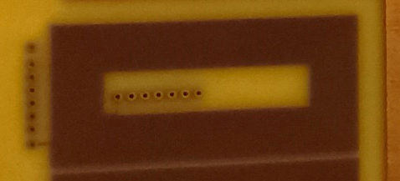
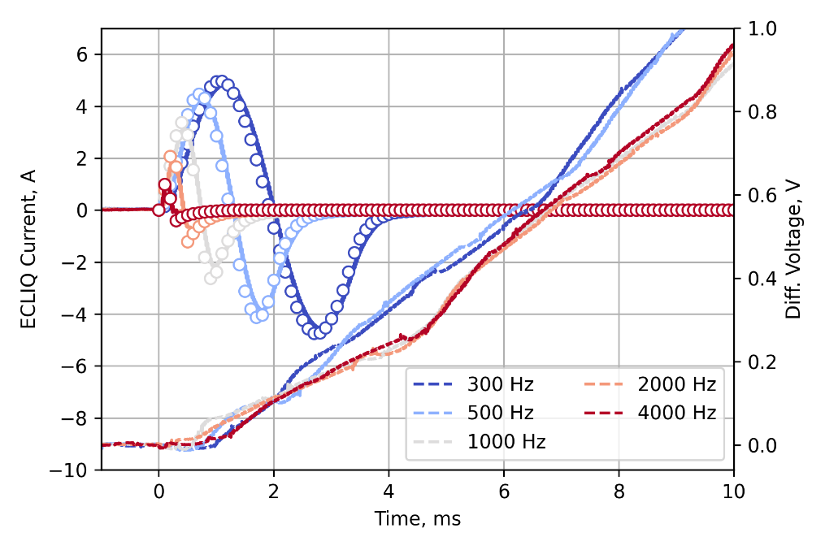
E-CLIQ – very preliminary estimate – QH like
Magnet name | E-CLIQ name | Length (mm) |  | # turns covered | Width (mm) | Wedge width covered (mm)
 |  | Gap | Coil
HQ | OL | 86.3 | 50 | 11 | 19.1 | 0
 | OH | 65.3 |  | 13 | 22.6 | 0
TQ | OL | 66.4 | 50 | 14 | 22.4 | 0
“The same” numbers as for QH
Longitudinal view:
(not to scale)
Width
Length Gap
Length Coil
Measured E-CLIQ
Results on SMC
Today E-CLIQ is at about TRL3, so predicting quench performance of a full-size magnet has large uncertainty
Without going into details, two quench delay times are studied for E-CLIQ: 2 ms and 10 ms
This time is not dependent on a local magnetic field (enthalpy to quench), so it is wrong, but nonetheless useful as a very preliminary estimate
Normal zone initiated with a ms!
E-CLIQ pictures and results courtesy of Tim Mulder et al.
More details: https://indico.cern.ch/event/1517509/

Slide 14
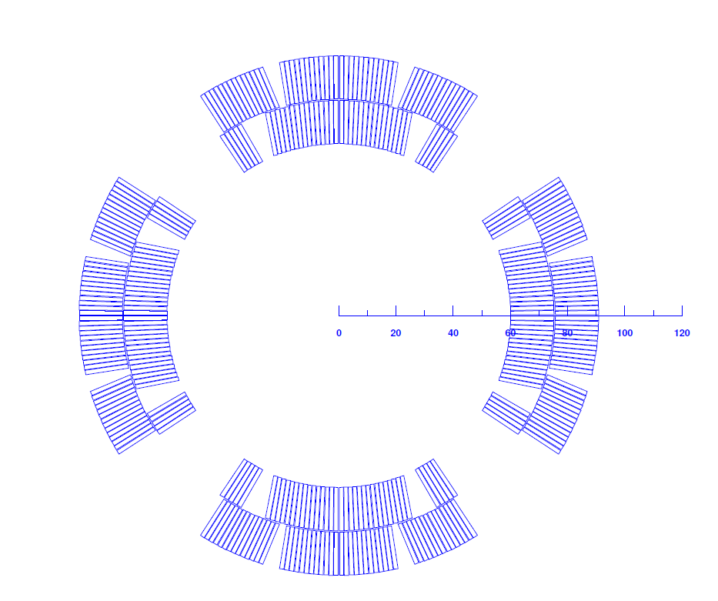
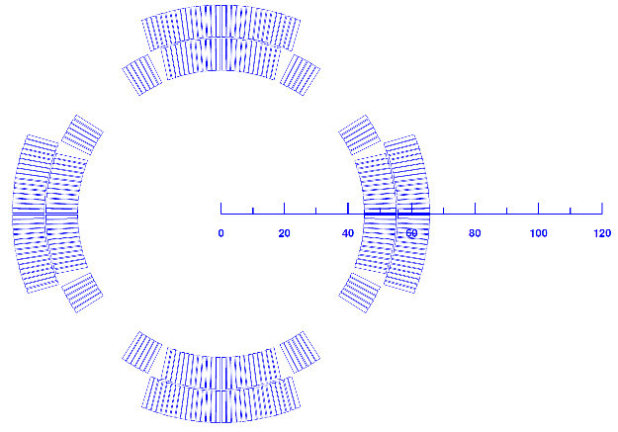
CLIQ unit and connections
Parameter | Value | Unit
Capacitance | 40 | mF
Initial voltage | 1000 | V
Internal resistance | 50 | mΩ
HQ magnet
TQ magnet
P2
P1
P2
P1
E.O.#1
P3
R_{crowbar}
P3
0 Ω
P3
P4
P4
+
P2
CLIQ
Unit
P4
V_{F}
1 CLIQ unit connected in pole configuration
0V
P1
PC

Slide 15
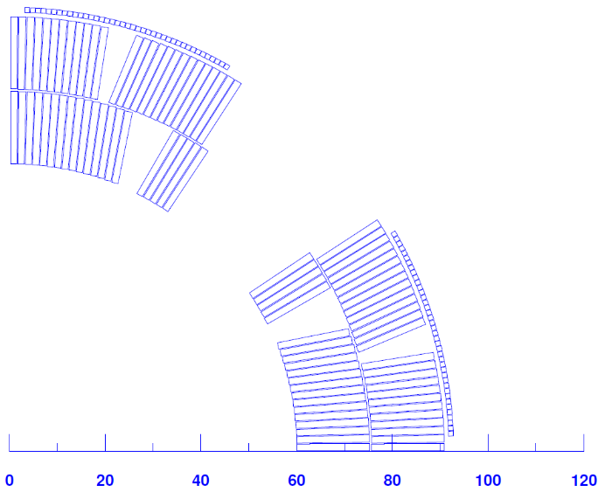
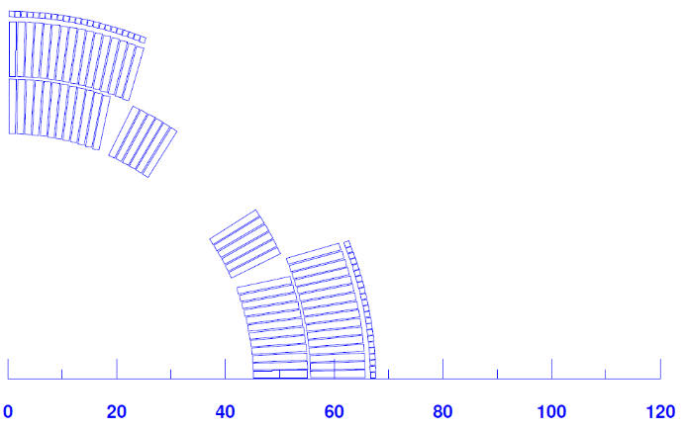
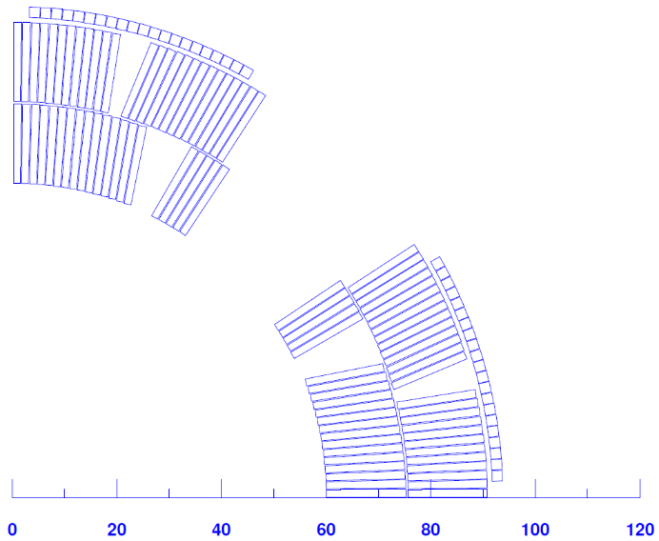
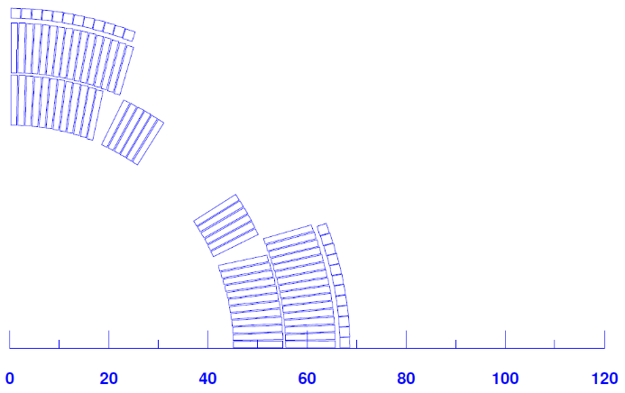
ESC coils design
1 mm thick insulation
HQ magnet
TQ magnet
These are the only configuration tired.
No optimization whatsoever.
Sime interesting features can be already discussed.
23 x 1 mm²
1 kV -> 3 kA
Conductor:
Two sizes of bare copper square :
  1 mm² = 1 mm x 1 mm
  4 mm² = 2 mm x 2 mm
For HQ:
Not full arc is filled as high resistance for 1mm² wire for 40 turns resulting in relatively low ESC current
For TQ*:
For 4mm² wire, 12 turns the ESC unit initial voltage is lowered to 0.6 kV to stay below 6 kA (limit of CLIQ unit switch)
40 x 1 mm²
1 kV -> 2 kA
12 x 4 mm²
0.6 kV -> 6 kA
21 x 4 mm²
1 kV -> 6 kA
More details on ESC: https://indico.cern.ch/event/1517509/
*Iron yoke slightly adjusted for TQ magnet to make space for ESC coils

Slide 16
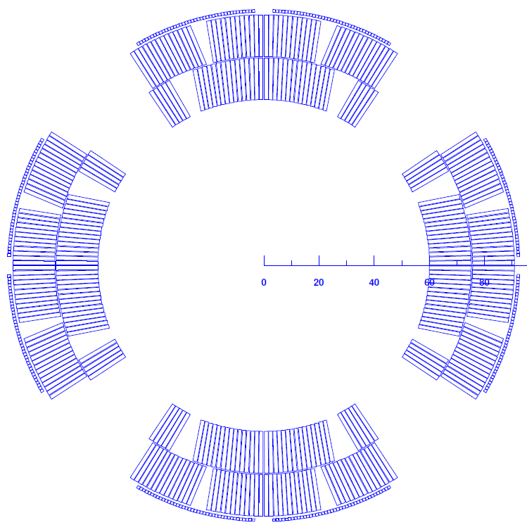
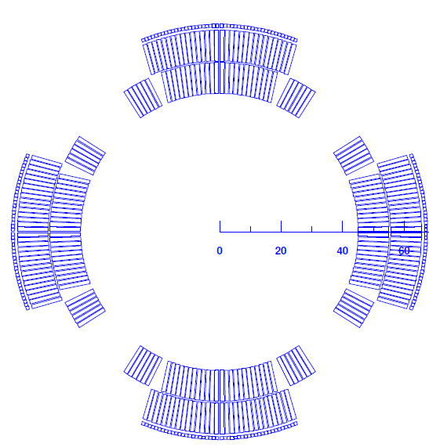
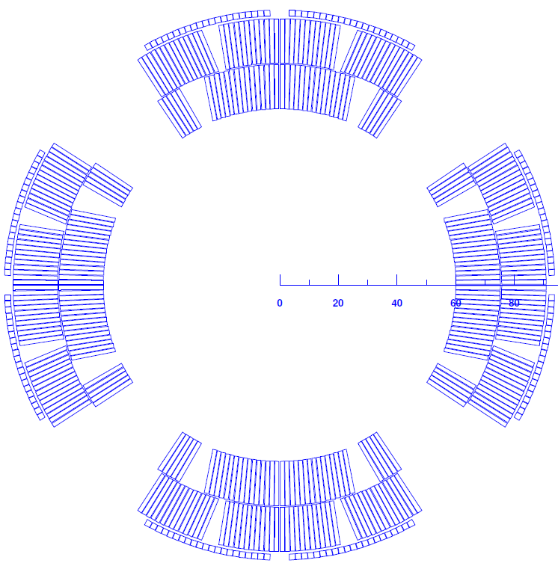
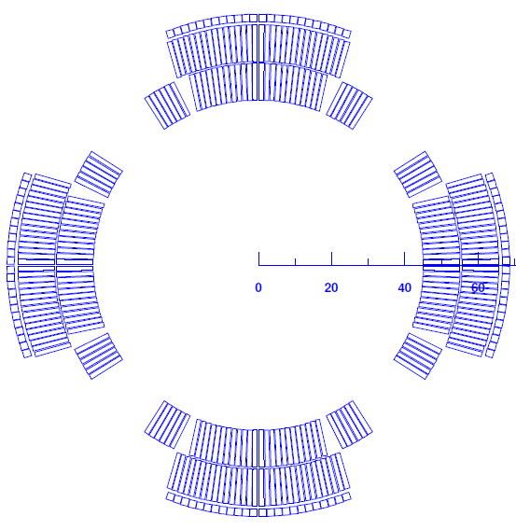
ESC units and connections
P2
P1
P2
P1
Parameter | Value | Unit
Capacitance | 50 | mF
Initial voltage | 1000 (600) | V
Internal resistance | 50 | mΩ
P3
P4
P3
P4
E.O.#1
+
P2
P1
P3
ESC Unit
P2
P1
R_{crowbar}
+
0 Ω
P2
ESC Unit
+
P4
ESC Unit
V_{F}
0V
+
P1
ESC Unit
P3
P4
PC
P3
P4

Slide 17


Protection cases studied
LEDET
Protection case
Outer QH only (3 appl. met.)
CLIQ only
Outer QH (3 appl. met.) & CLIQ
E-CLIQ (2 delay times)
ESC (2 coil designs)
Time to Quench
  2 magnet design
  1 electrical order
  1 magnet length
  16 trigger times (10, 12, … , 40 ms)
12 protection cases studied, with :
Total: 384 simulations
STEAM tools have been used for simulations:
STEAM: https://cern.ch/steam
STEAM SDK: https://gitlab.cern.ch/steam/steam_sdk
LEDET: http://cern.ch/ledet
Magnet length: 7.15 m
Initial temperature: 1.9 K
Repeatability information:
https://gitlab.cern.ch/steam/analyses/tq-hq-quench-protection Tag: 2025.03.0

Slide 18
HQ –current vs time for trigger time of 2 ms
QH - glued
CLIQ
CLIQ + QH - glued
ESC (21x4mm² 1kV)
E-CLIQ (2ms)
100 % quenched

Slide 19
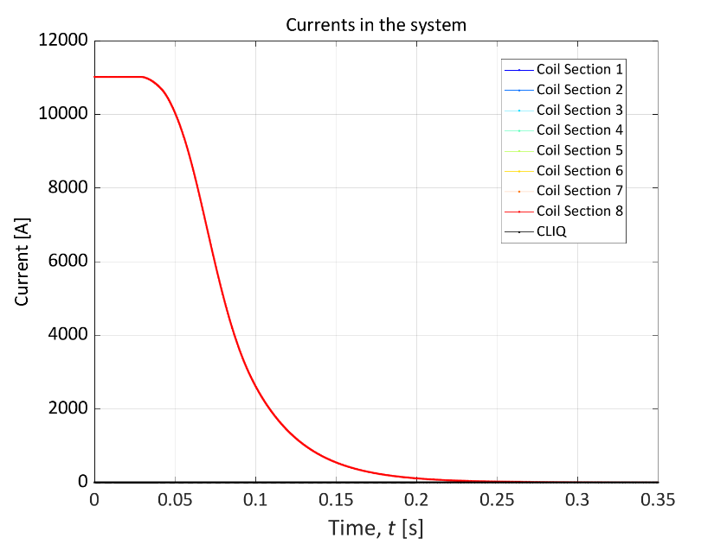
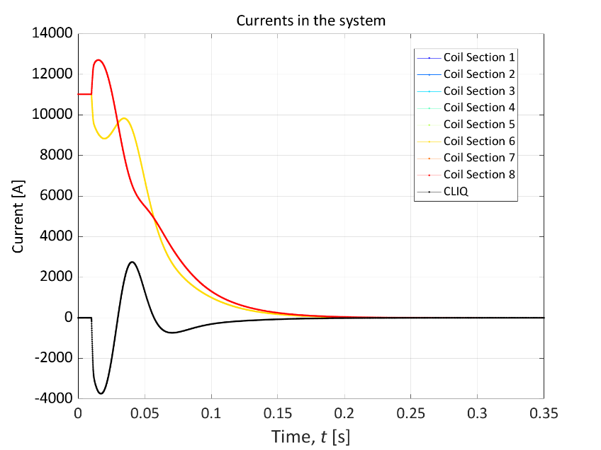
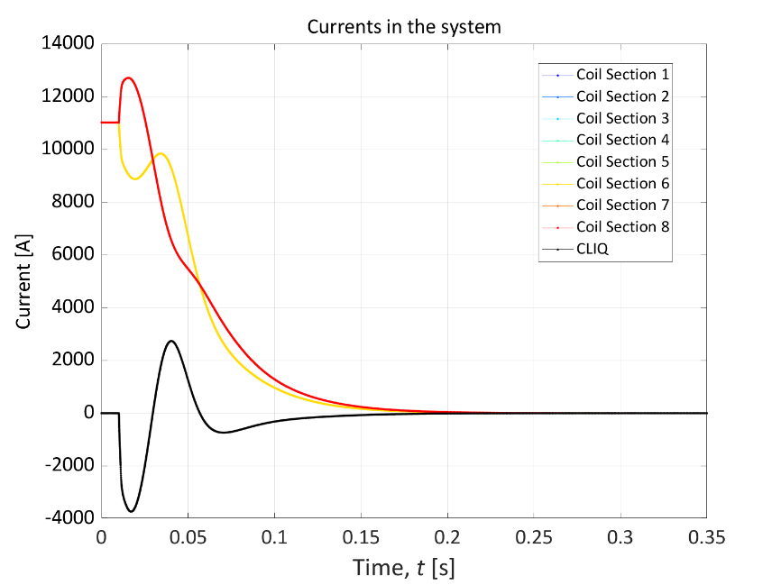
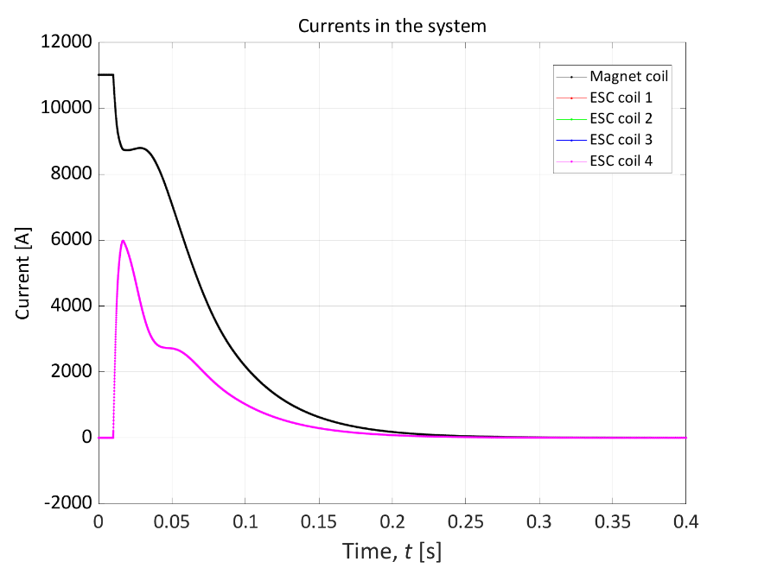
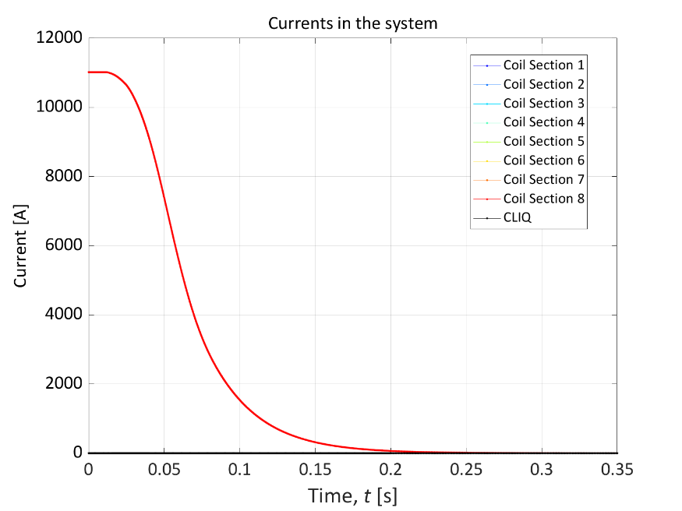
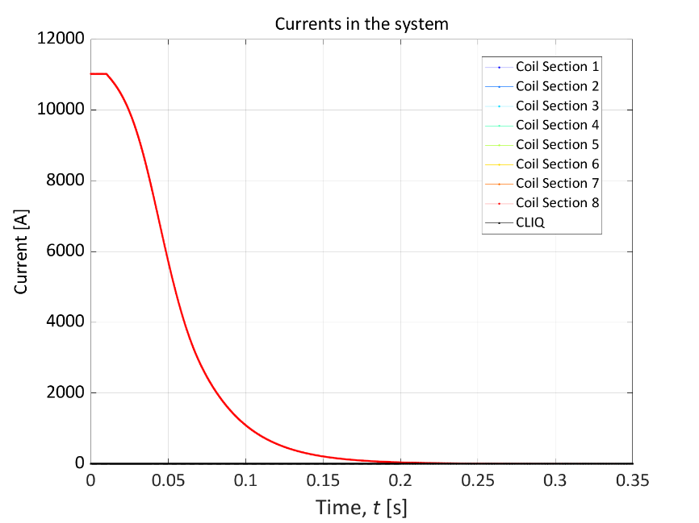
TQ –current vs time for trigger time of 2 ms
QH - glued
CLIQ
CLIQ + QH - glued
ESC (12x4mm² 0.6kV)
E-CLIQ (2ms)
100 % quenched

Slide 20
Results – top level summary as a conclusion
Magnet name | HQ | TQ
Time margin to 300 K (ms) | 28.5 | 20.8

