Slide 1
355-359-365 Tuning Power converters study
PS Surface Integration Study
D. del Álamo – EN-ACE-INT
ICL 09-04-2025
EDMS#3267928

Slide 2

Track-it Data
Tracks for the Integration Studies:
TUNING POWER CONVERTERS FOR PS 10 MHz RF CAVITIES – 107646
#3267928

Slide 3
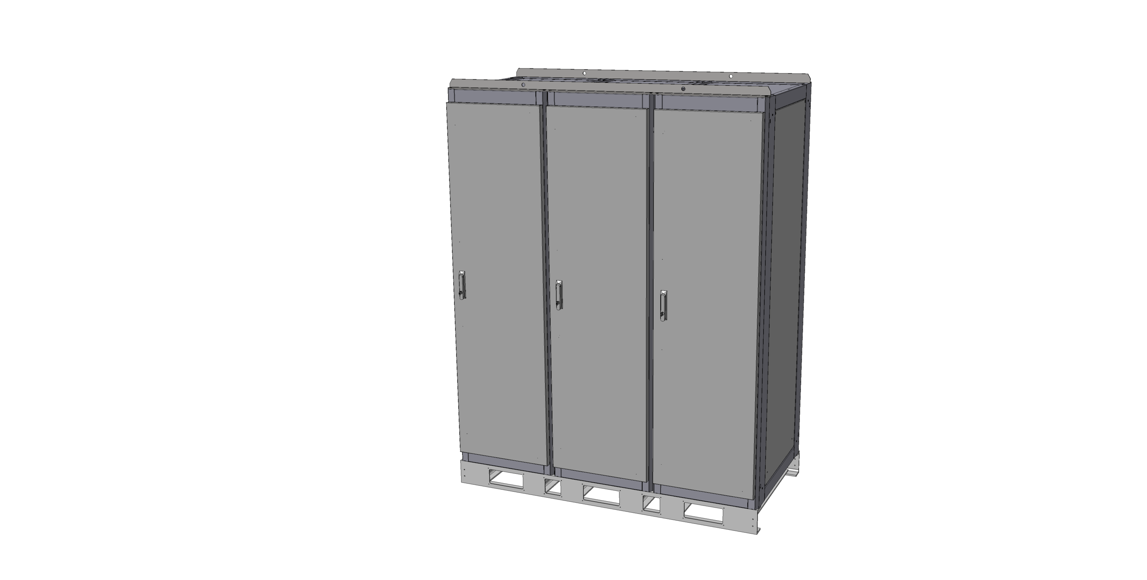
ELEMENTS TO BE INSTALLED
RF3kA Converters:
L=1800mm
W=900mm
H=2360mm
Empty weigh:
Operating Weigh:
Need for water connections
Need for electricity connections
4 RF3kA Converters for building
#3267928

Slide 4
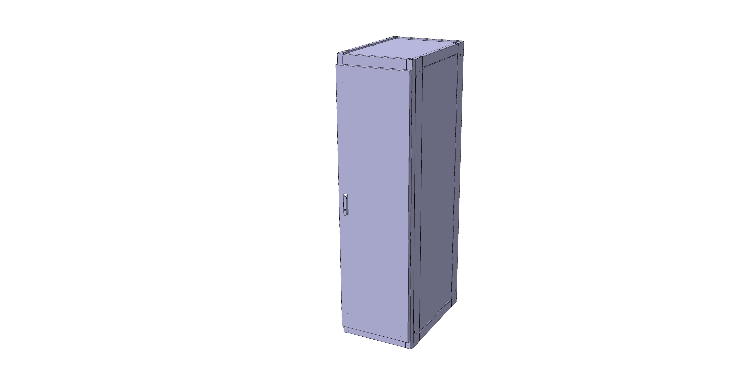
ELEMENTS TO BE INSTALLED
Rack:
L=600mm
W=900mm
H=2170mm
Empty weigh: 100kg
Weigh with modules: 400kg
No need for water
No need for electricity connections inside
Installed by SY-EPC
1 RF3kA rack for building
#3267928

Slide 5
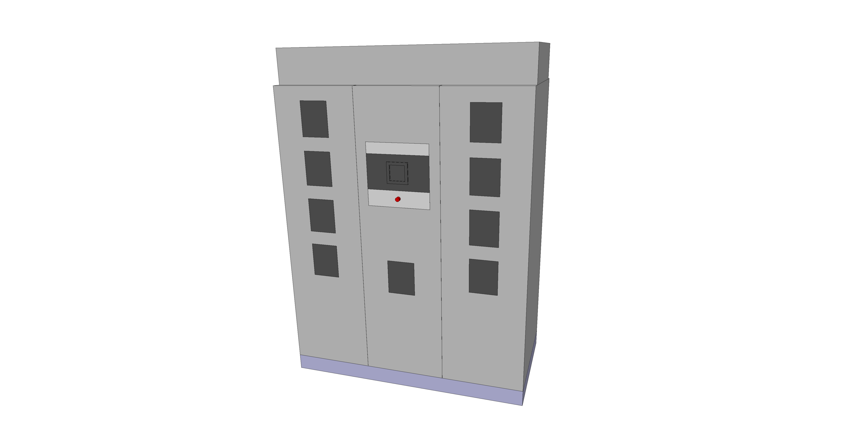
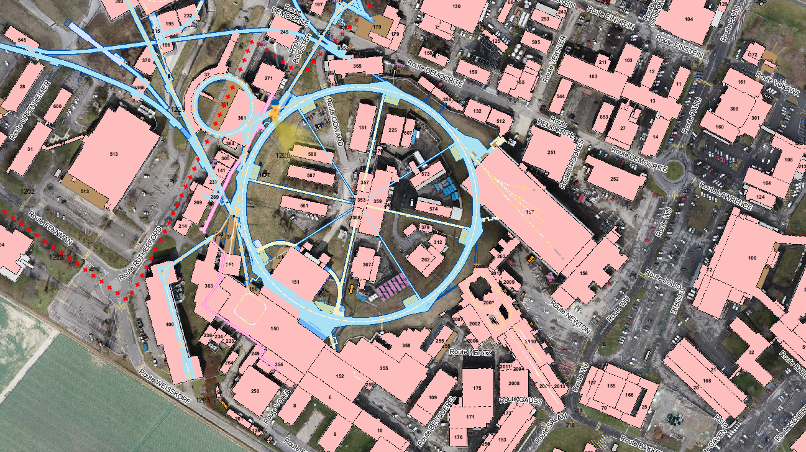
355
#3267928

Slide 6
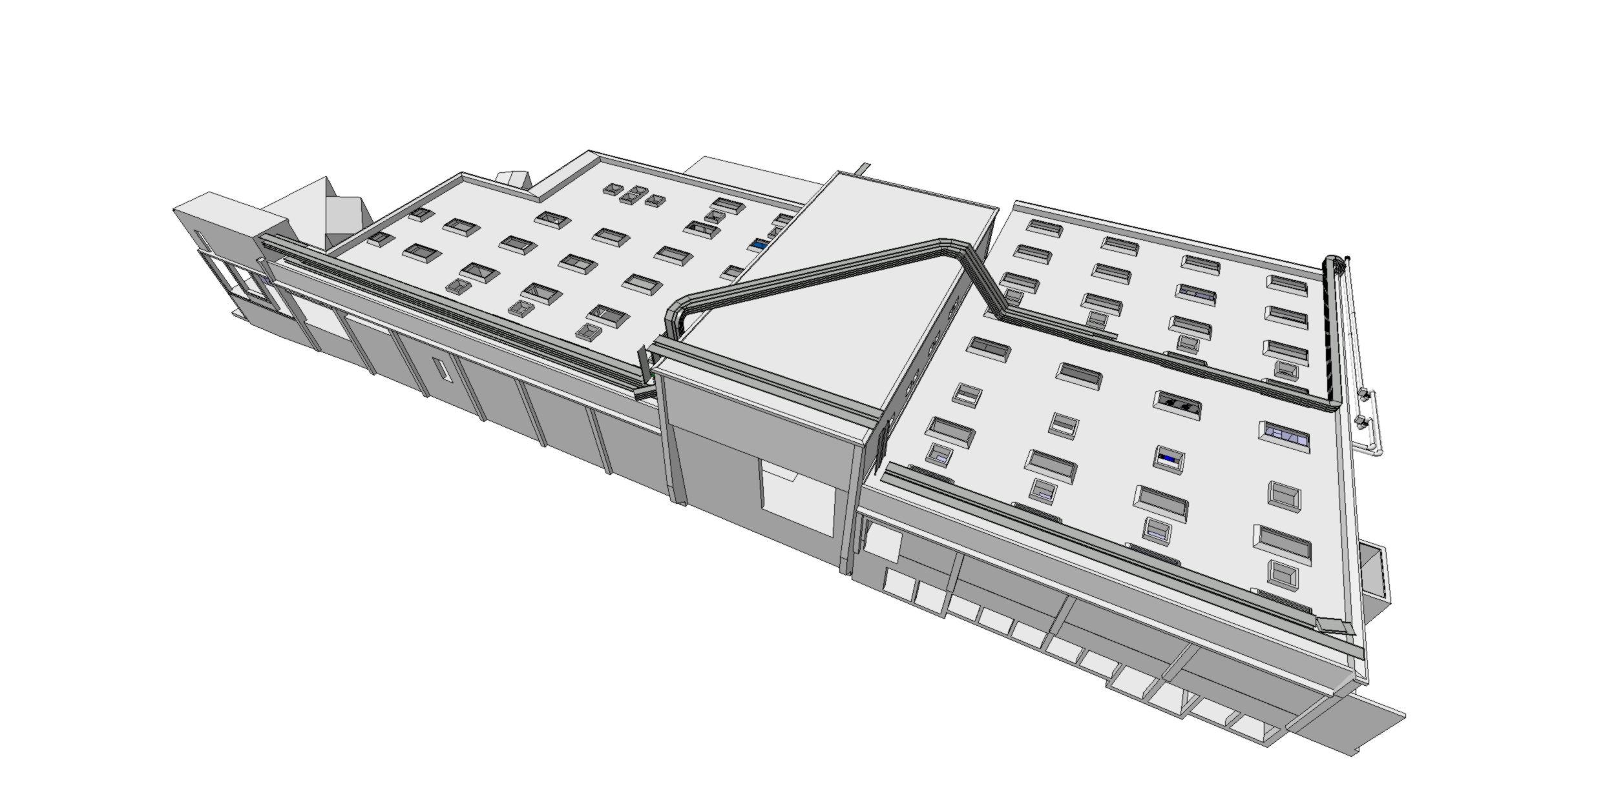
355
ST0793486_04
#3267928

Slide 7
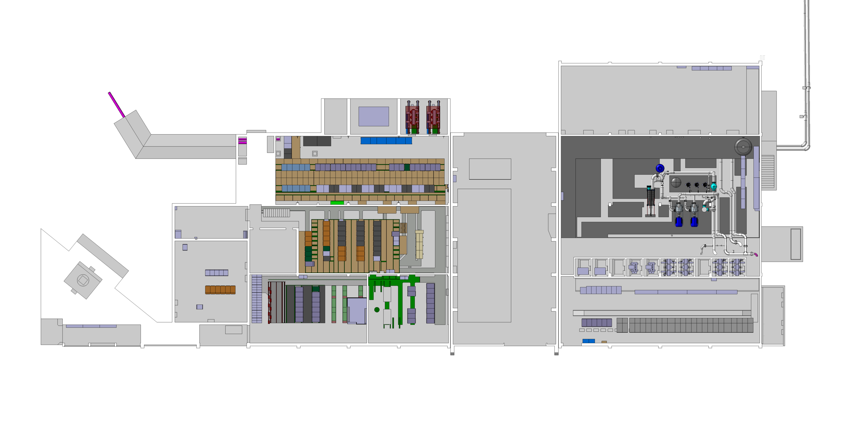
355 – Current situation
Area for the future installation
#3267928

Slide 8
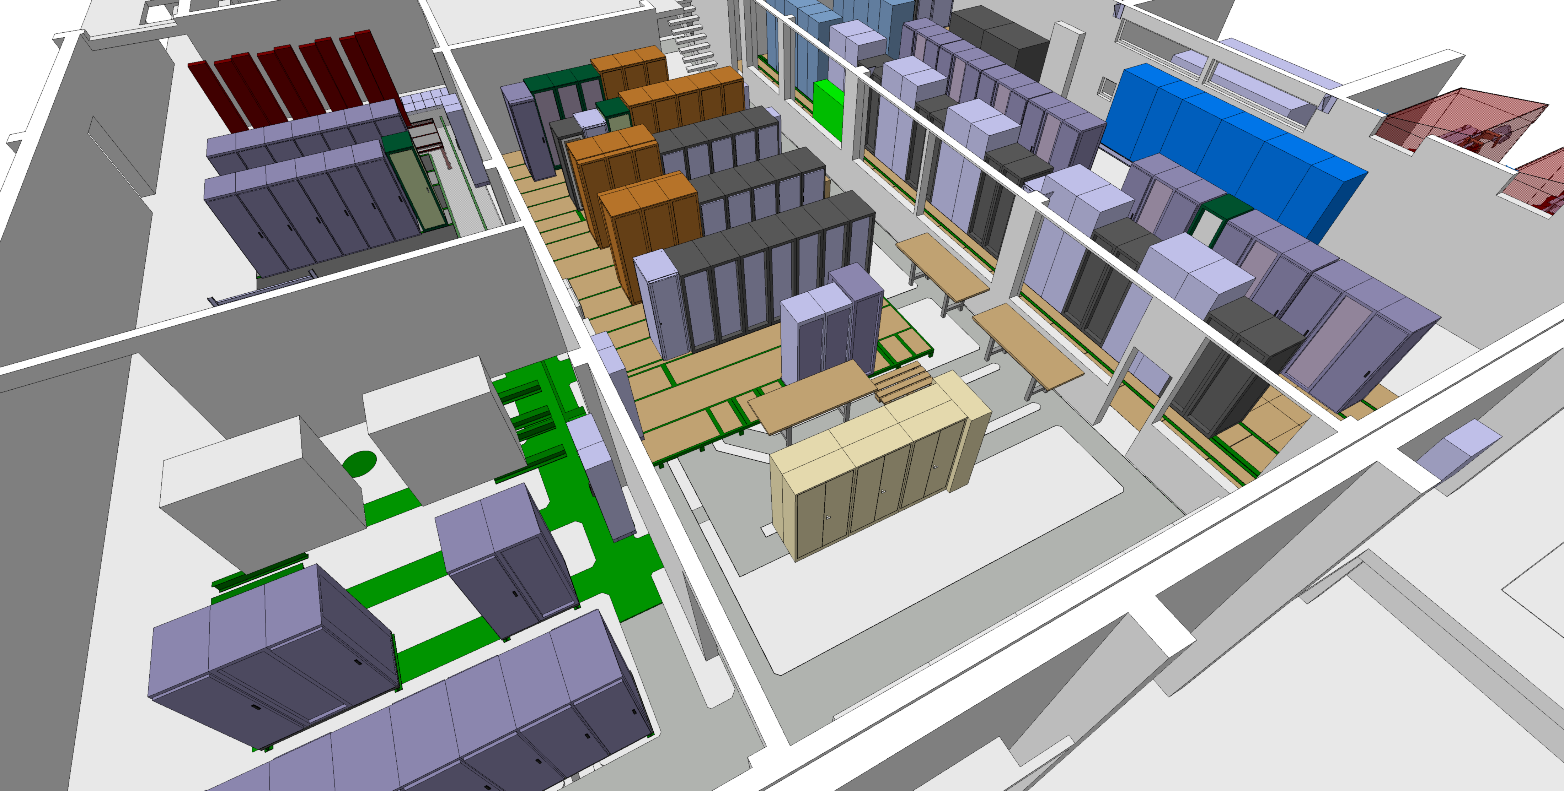
355 – Current situation
Area for the future installation
#3267928

Slide 9
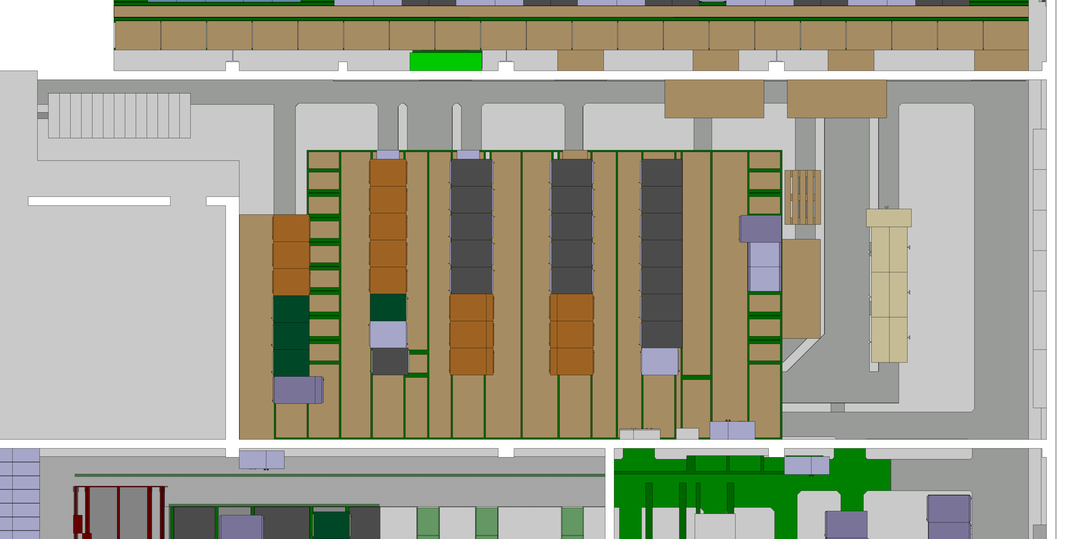
355 – Actions
Remove or move existing furniture
#3267928

Slide 10
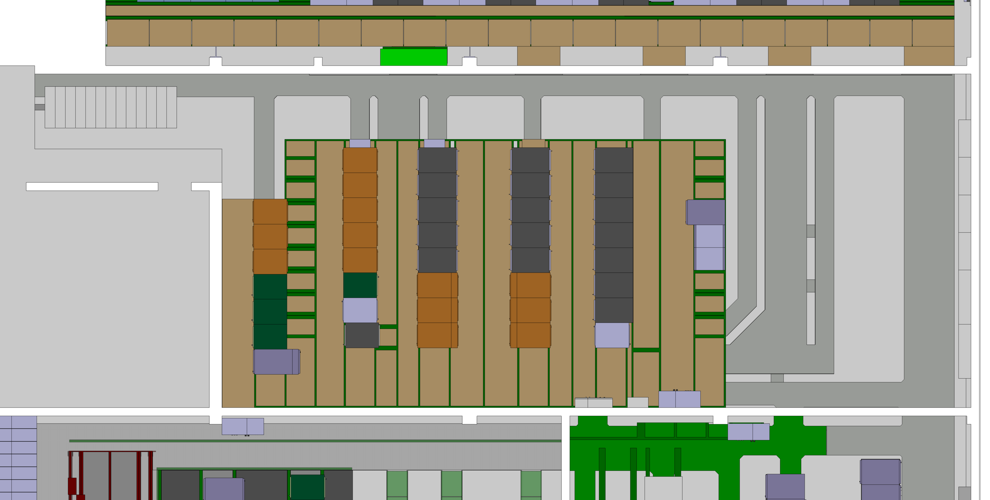
355 – Actions
One converter on top of the existing structure
#3267928

Slide 11

355 – Actions
On site visit with CE to check the feasibility of the installation.
#3267928

Slide 12

355 – Actions
The water connections have not yet been validated.
#3267928

Slide 13
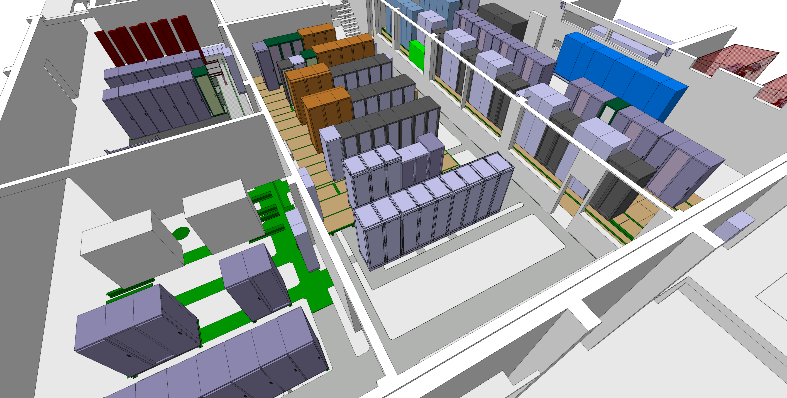
355 – LS3
These two racks are empty, and the location is ideal for the RF 3kA module rack
#3267928

Slide 14
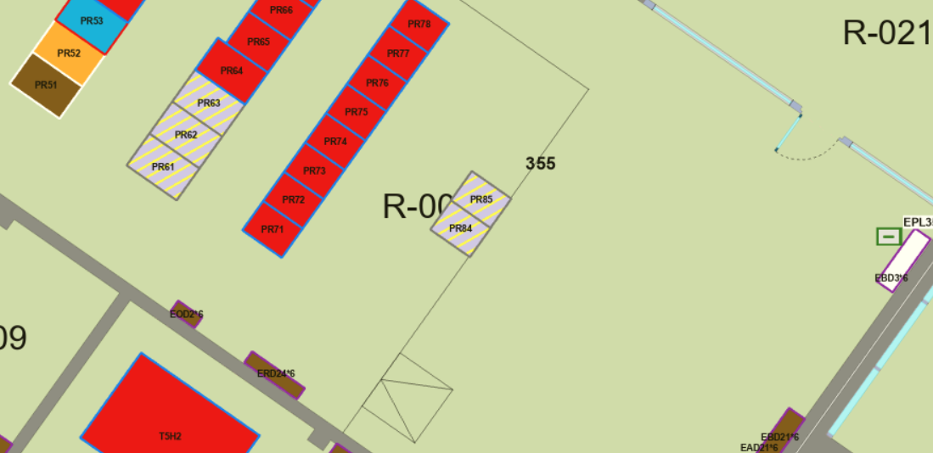
355 – LS3
According to GIS portal (may not be up to date), the racks belong to BE-CEM
#3267928

Slide 15
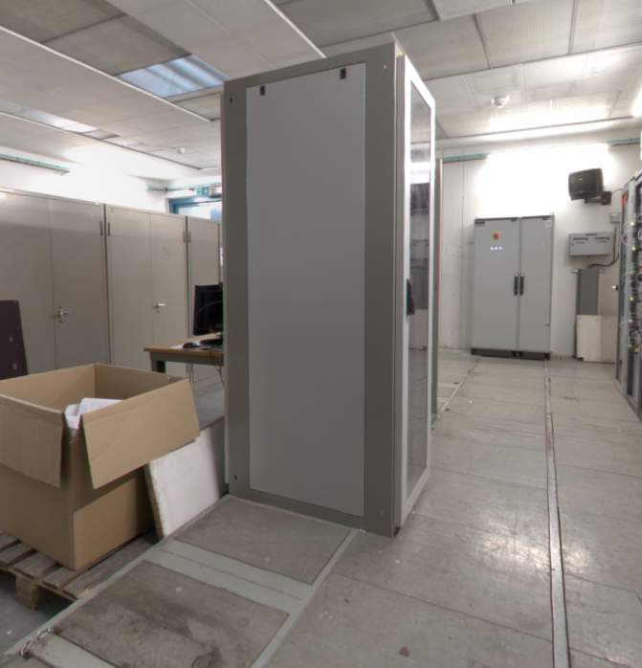

355 – LS3
#3267928

Slide 16
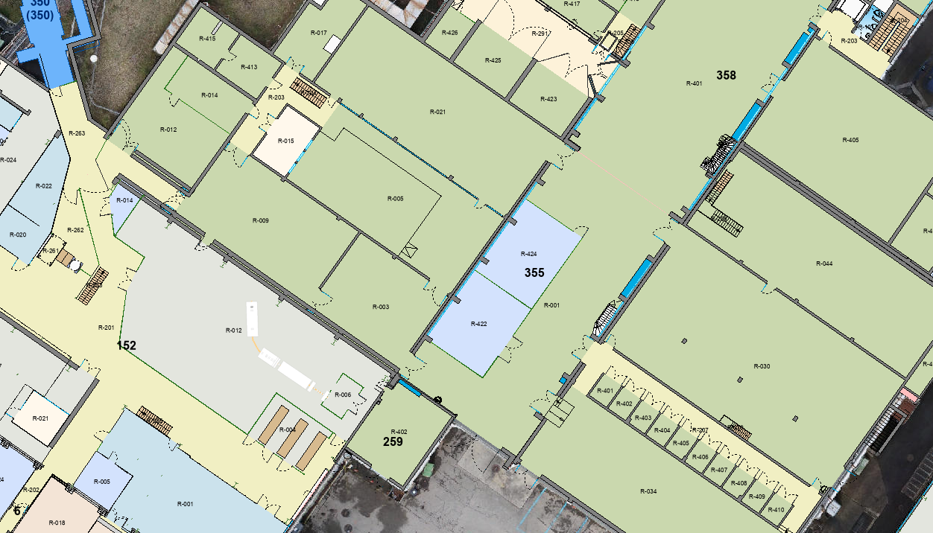
355 – ACCESS/HE
HE has validated the feasibility of transporting and installing the converters on-site.
Contact Y. Seraphin
#3267928

Slide 17
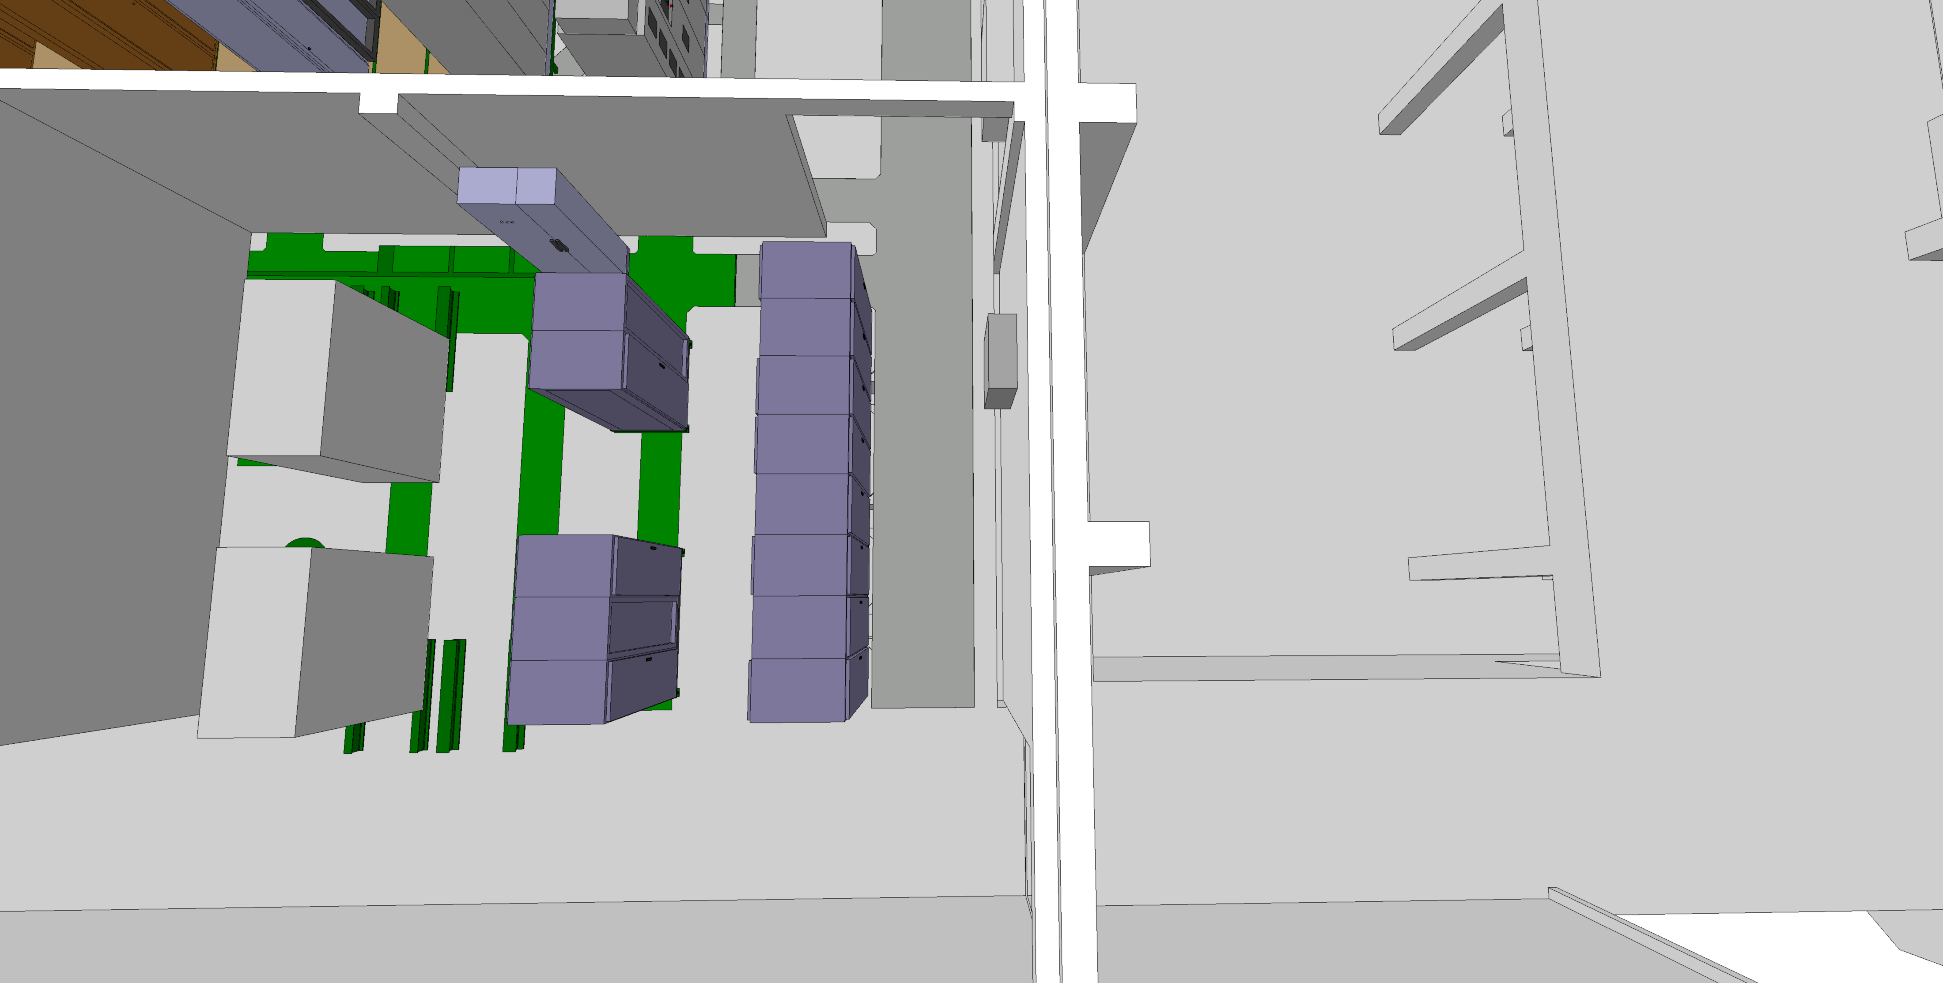
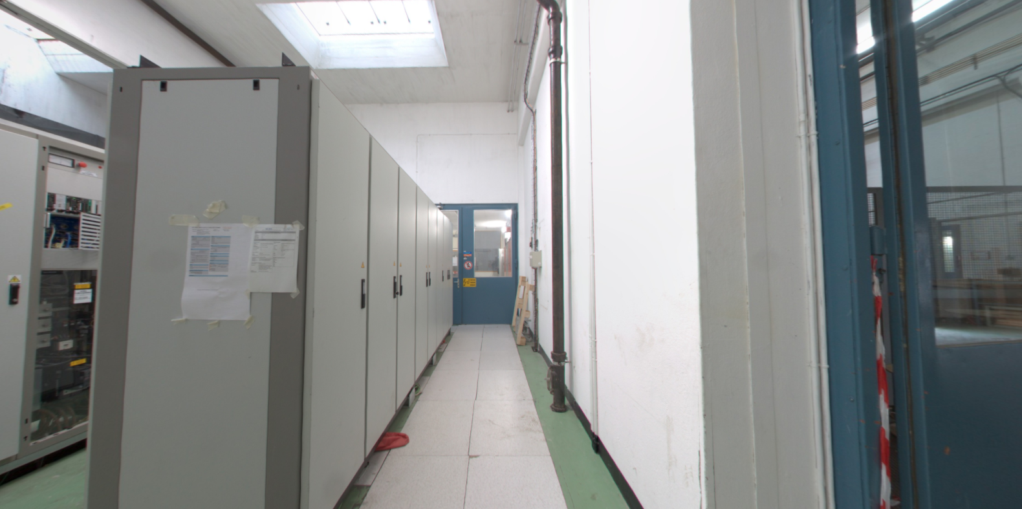
355 – ACCESS/HE
The false floor requires load verification for transport during the next visit.
#3267928

Slide 18
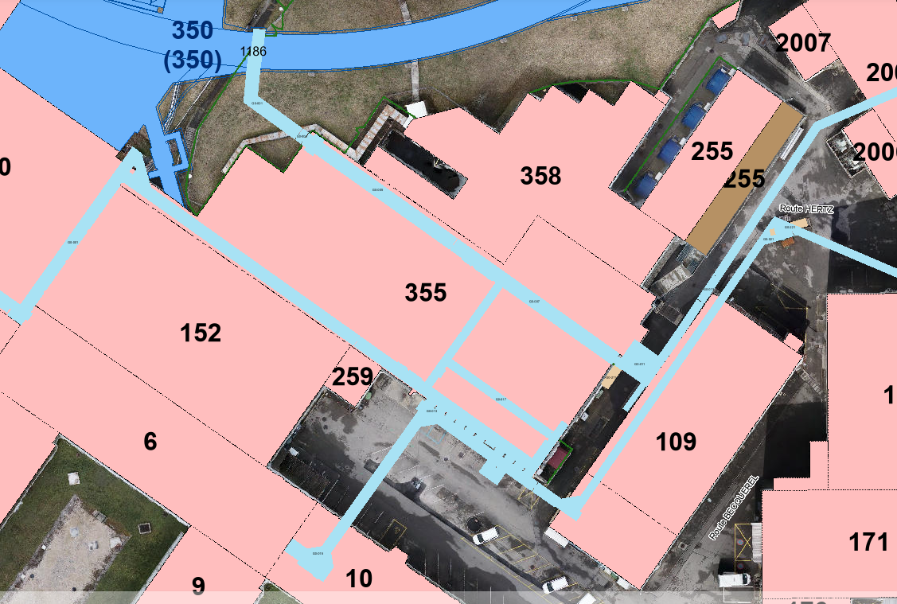
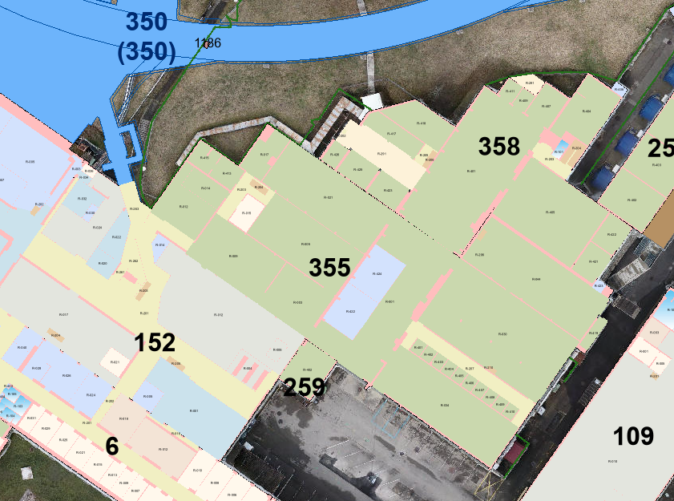
355 – EL/CV
The water connections have not yet been validated.
#3267928

Slide 19
359
#3267928

Slide 20
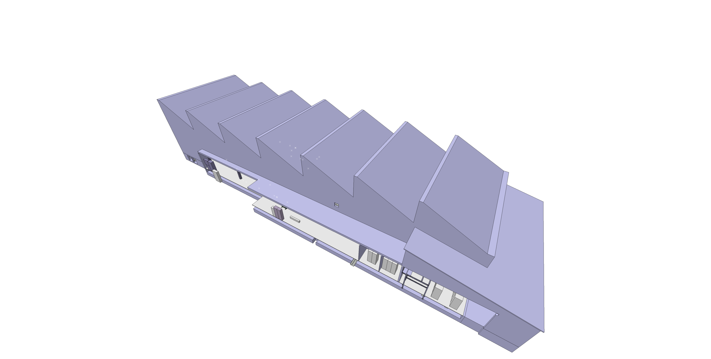
359
ST1791746_01
#3267928

Slide 21
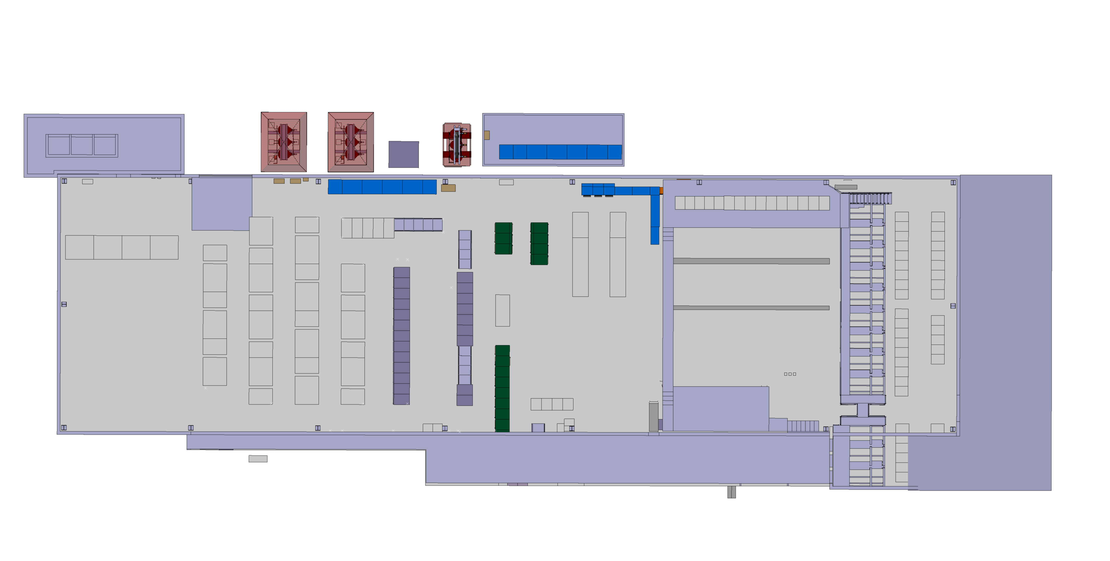
359 – Current situation
Area for the future installation
#3267928

Slide 22
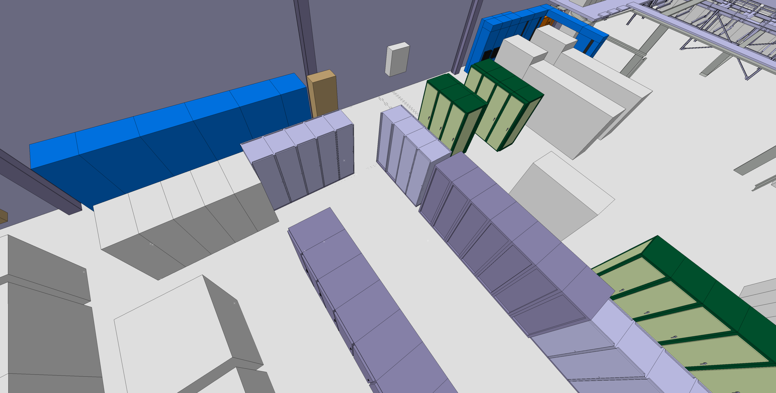
359 – Current situation
#3267928

Slide 23
359 – CONSOLIDATION FOR LS3
#3267928

Slide 24
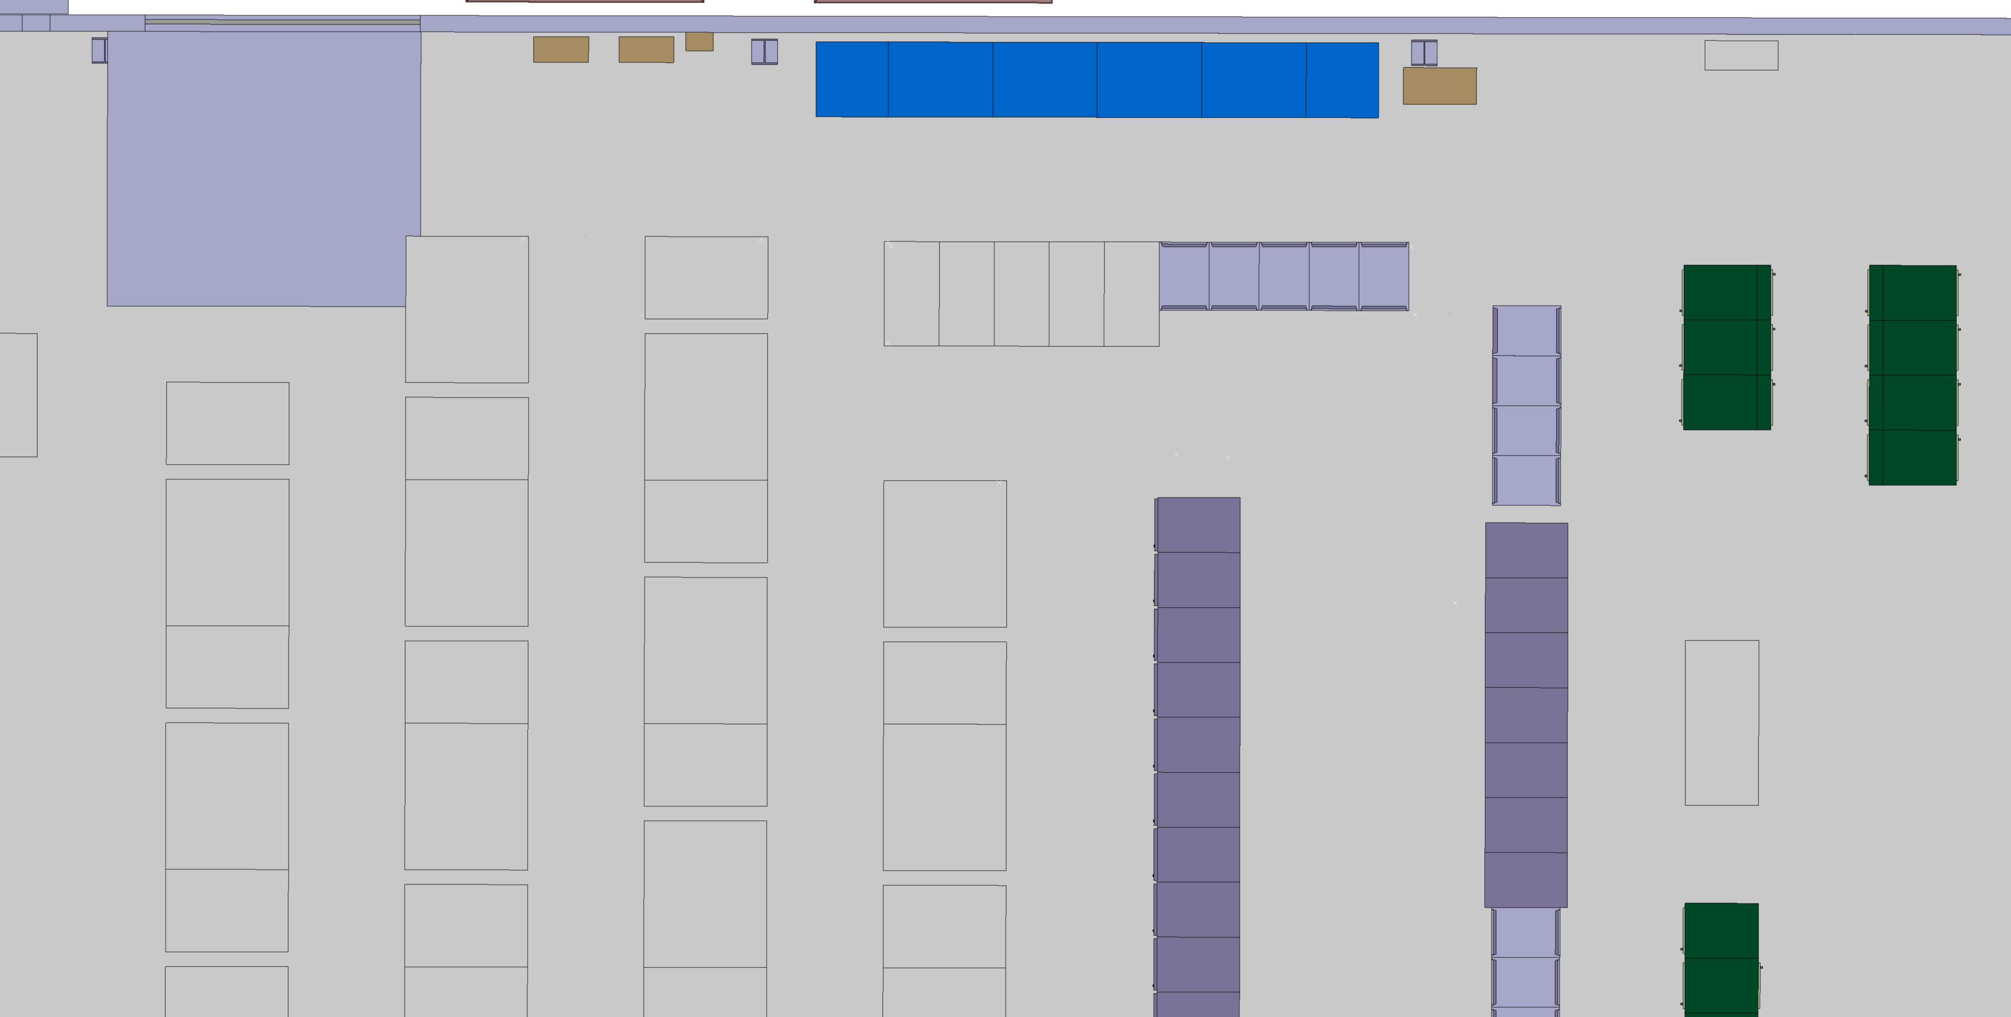
359 – Actions
Remove the racks
#3267928

Slide 25
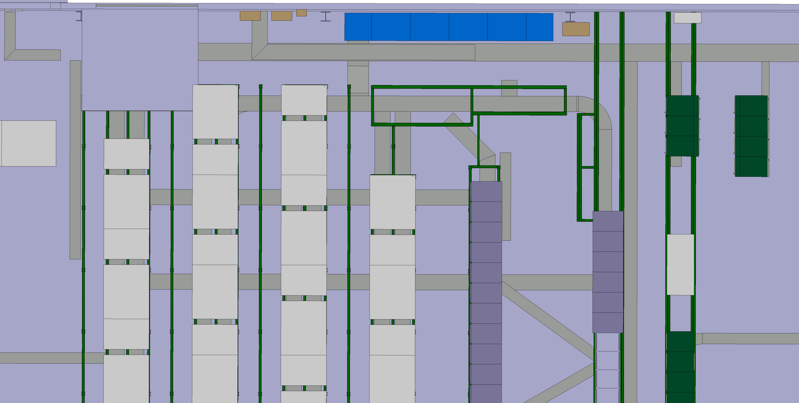
359 – Actions
Reinforce this structure to install the converters
#3267928

Slide 26
359 – Actions
Reinforce this structure to install the converters
#3267928

Slide 27
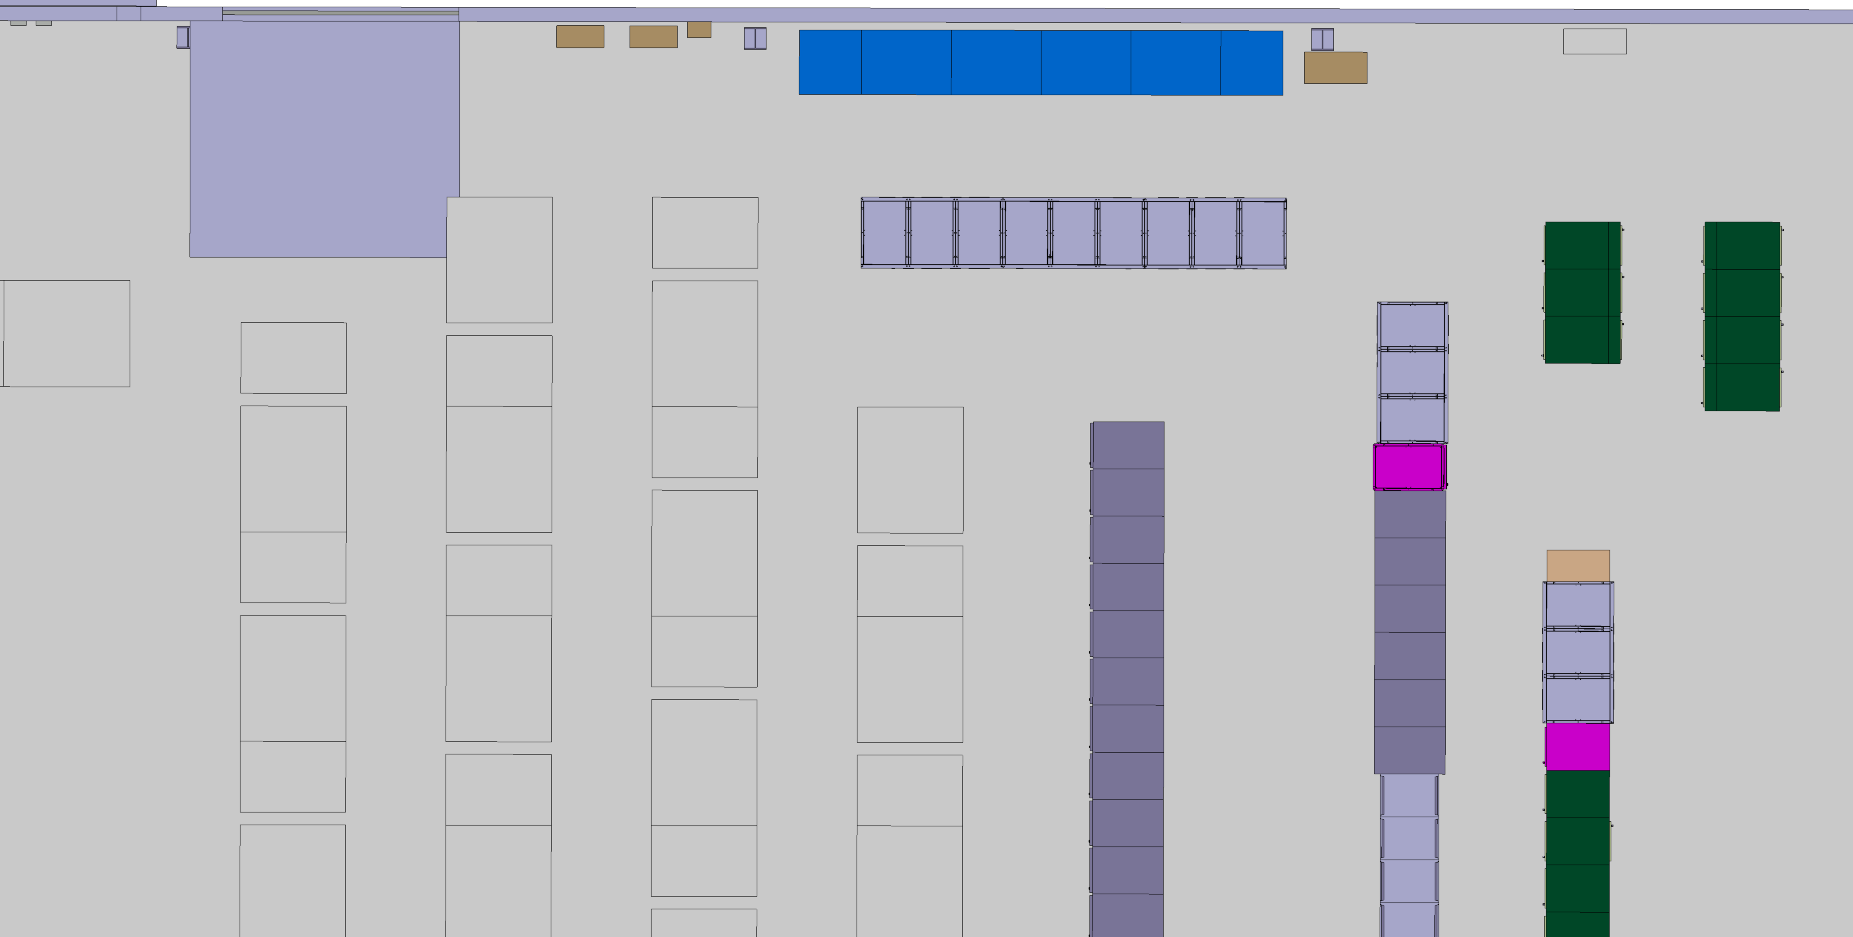
359 – Actions
Install the converters and the module rack
#3267928

Slide 28
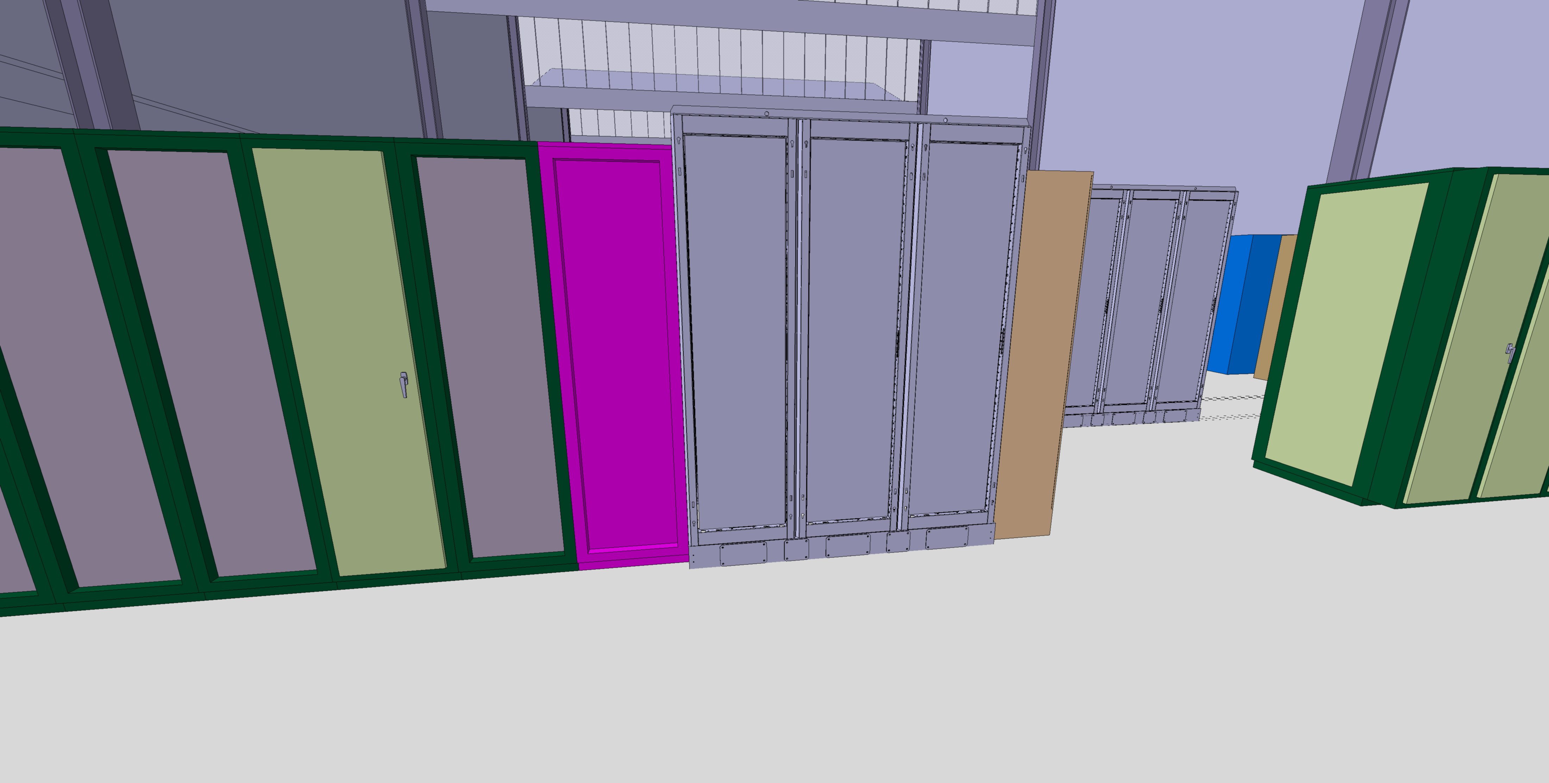
359 – YETS 24/25
During YETS 24/25, a control rack and a converter prototype were planned to be installed. However, according to the latest information received by INT, the prototype was not installed, which renders this integration study obsolete. Should the situation be reverted to the state prior to the study?
#3267928

Slide 29
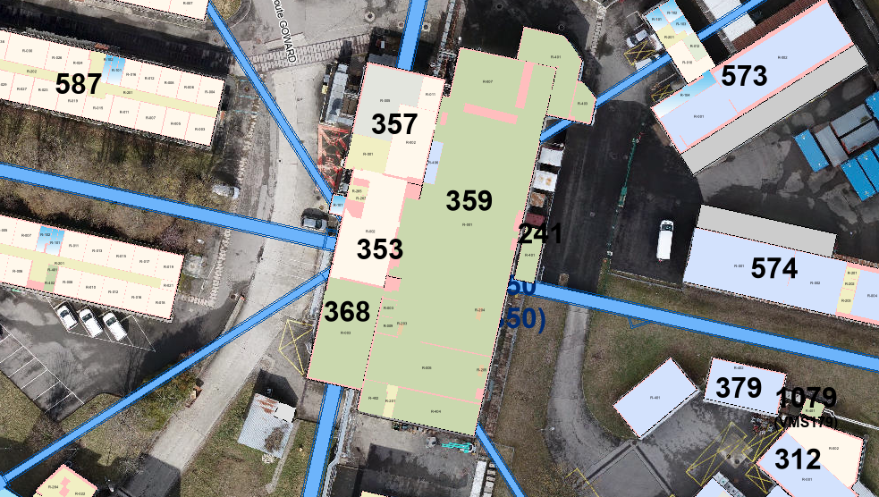
359 – ACCESS/HE
No issues for HE to transport and install the converters and rack inside the building.
#3267928

Slide 30
359 – CV
The water connections have not yet been validated.
#3267928

Slide 31
365
#3267928

Slide 32
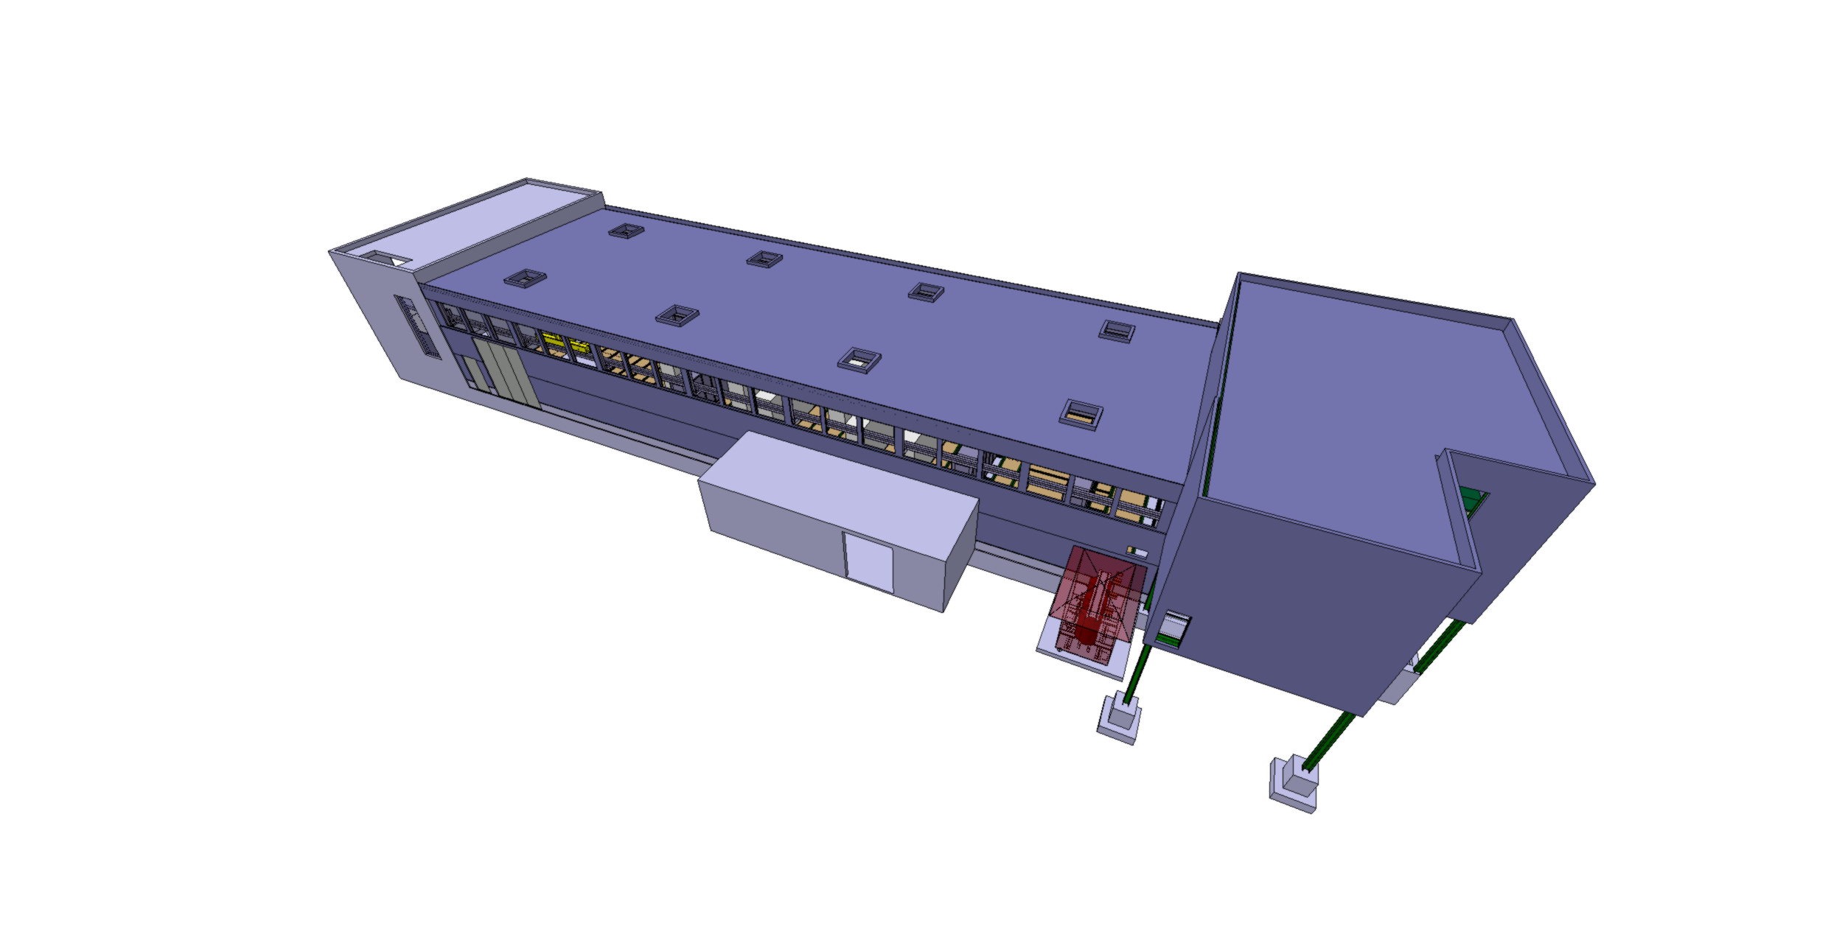
365
ST0943290_02
#3267928

Slide 33
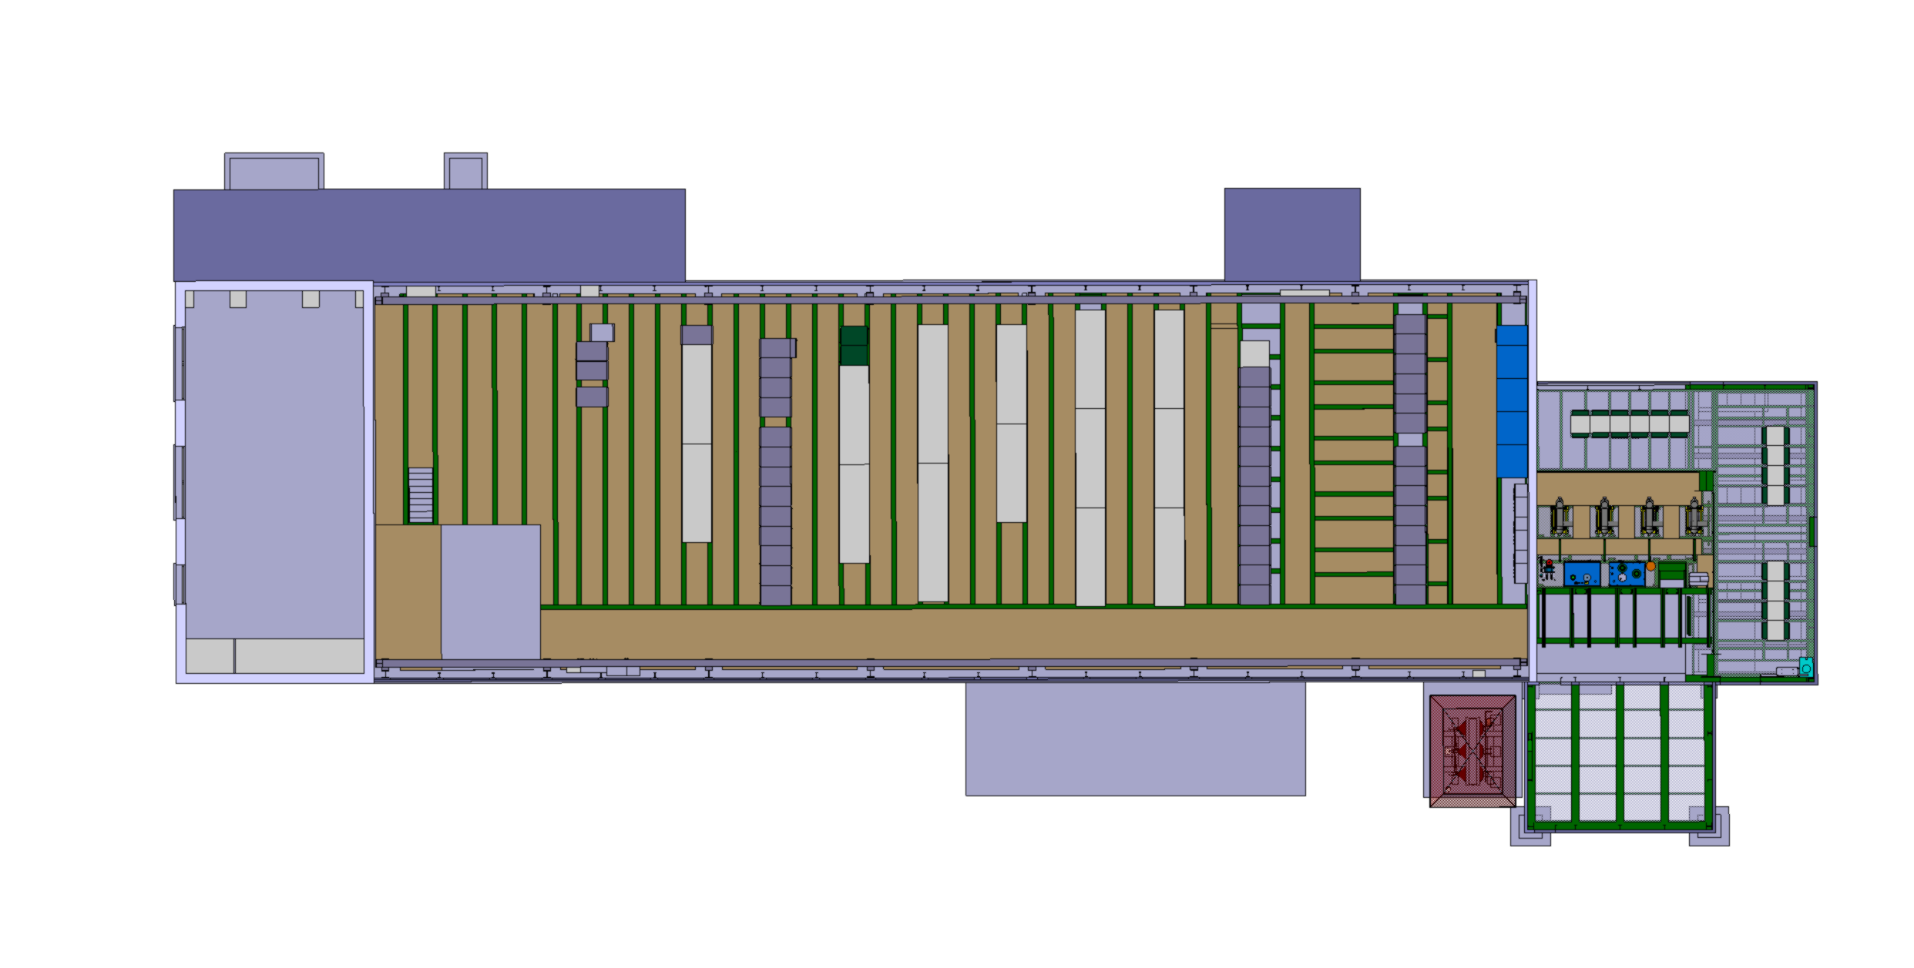
365 – Current situation
Area for the future installation
#3267928

Slide 34
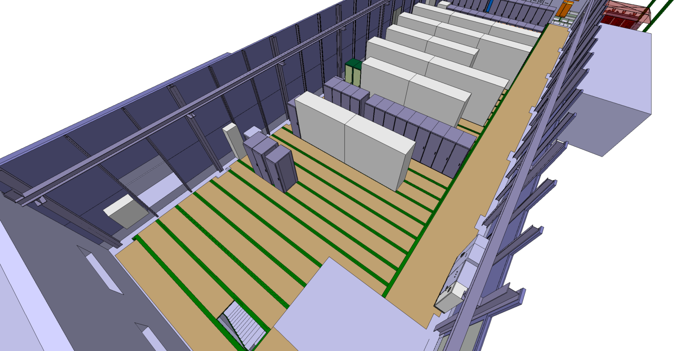
365 – Current situation
#3267928

Slide 35
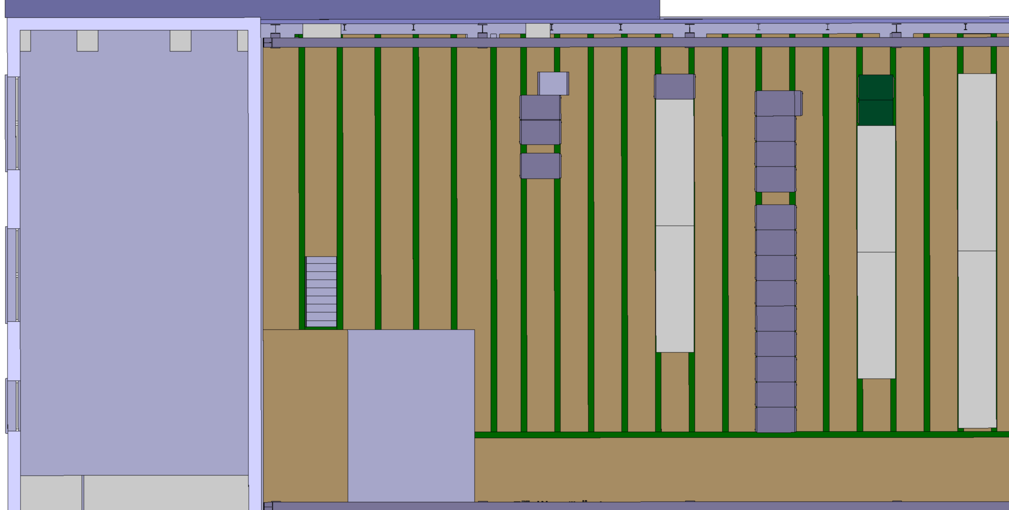
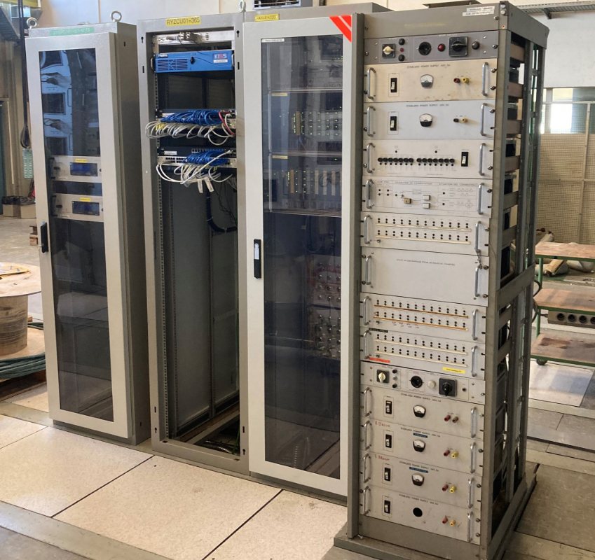
365 – Actions
Remove the obsolete rack
#3267928

Slide 36

365 – Actions
Put the racks together
#3267928

Slide 37
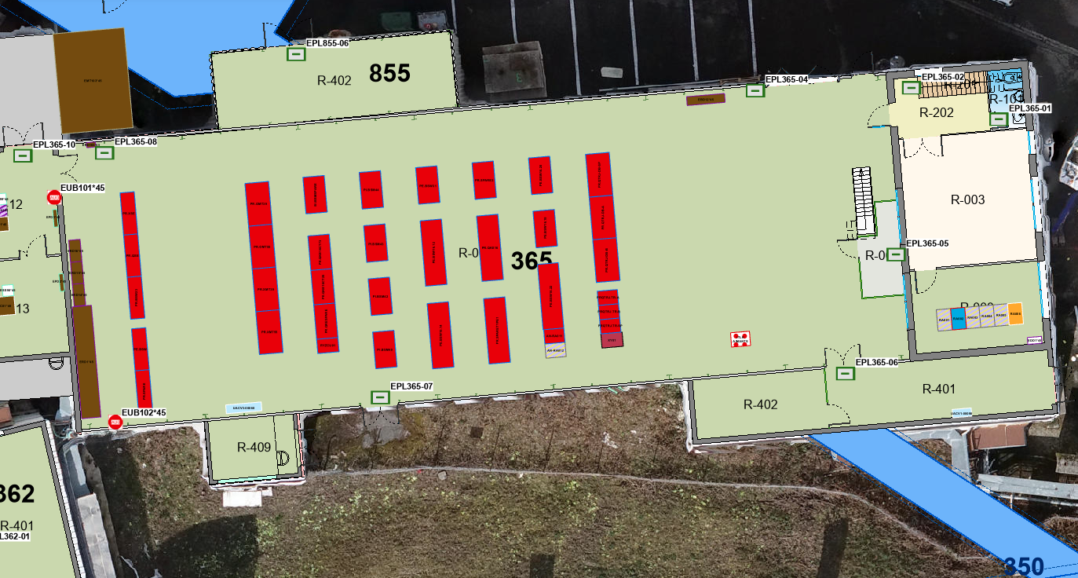
365 – Actions
Information on GIS Portal not up to date
#3267928

Slide 38

365 – Actions
Area ready for installation
#3267928

Slide 39
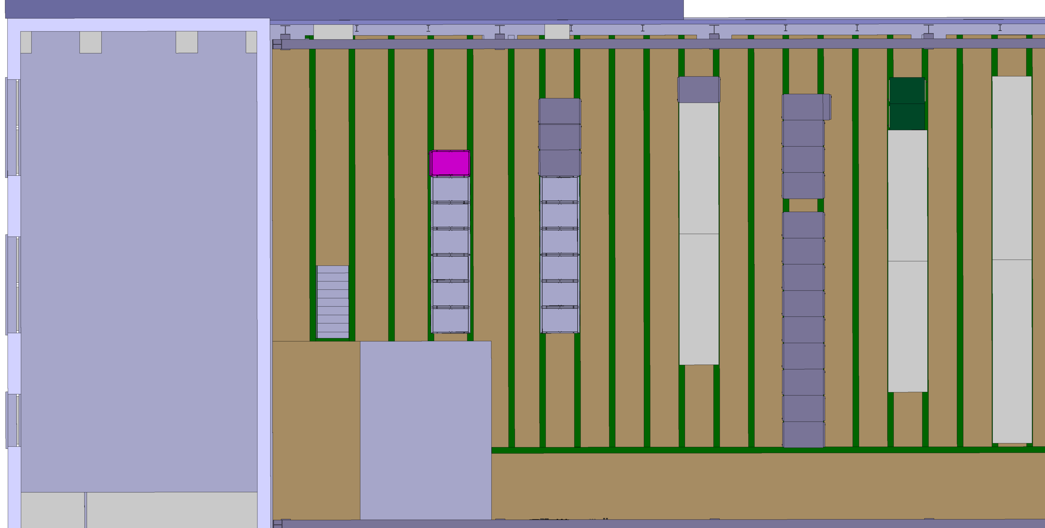
365 – Actions
Installation of the power converters and module rack
#3267928

Slide 40
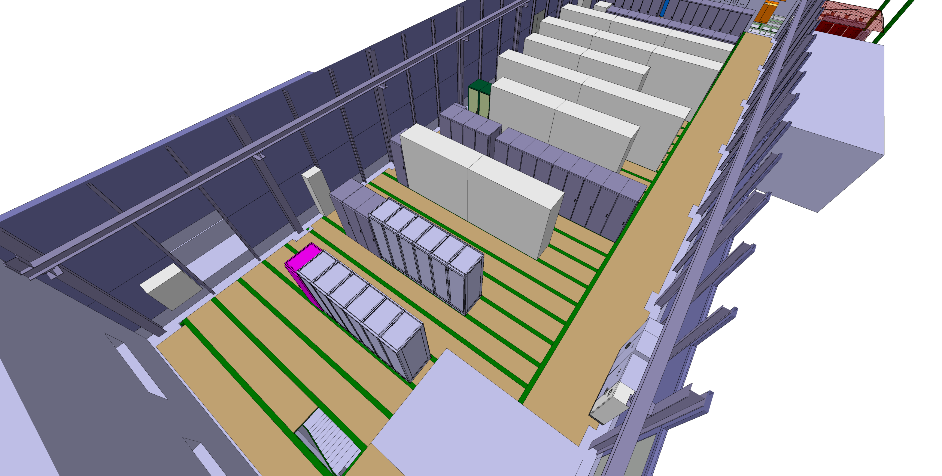
365 – LS3
#3267928

Slide 41
365 – ACCESS/HE
No issues for HE to transport and install the converters and rack inside the building.
#3267928

Slide 42
365 – CV
The water connections have not yet been validated.
#3267928

