Slide 1

BDF Target Complex systems engineering
“The biggest advantage of not doing systems engineering is that failure takes us by surprise.”
Quote from NASA
Mike Parkin, Alvaro Romero Francia, Gemma Humphreys, Rui Franqueira Ximenes, Jean-Louis Grenard , Gabriel Banks 16/4/25

Slide 2




BDF target & target complex Systems Engineering
WHAT: Use range of methods available in the Systems Engineering toolbox to:
Gather and understand requirements (including gaps)
Structure design process
Systematically define system functionality and failure modes
WHY: Gain a structured understanding of the system and its requirements
Prioritise the most critical functions
Identify failure modes of the system in operation
Articulate concerns, (likelihood, severity, probability of detection) and identify needs for development/mitigation
Tool to systematically compare design options eg water vs helium
WHY NOW:
Was successfully used for LHC beam dumps TDE’s
Was a recommendation from TSAC#1
What makes a system a system?
Inputs
Outputs (performance and “emergent behaviour”)
Environment
Functions
Sensitivities
Failure modes
Gather
Analyze
Design
Confirm
Cost to fix
Requirements
Production
Operation
Design

Slide 3
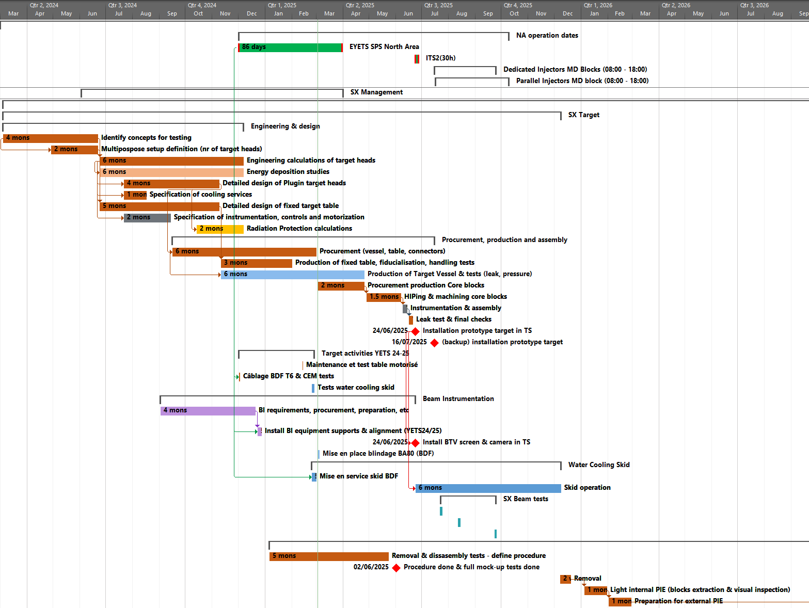
FMEA for BDF expected steps
Systems description
  Interfaces (next slide)
  Interviews
  lists
Gather and Analise Requirements
Functional modeling (causes and effects)
  Systems tree functions
  Systems context diagrams
Failure modes and effects
  Workshop
  FMEA results
System breakdown (optional)
Quality Function Deployment analysis (optional)
We are here
We need your help here!
Timeline
Systems description
Production Phase…
Review & FMEA
Review, Systems breakdown & QFD analysis
Functional requirements & modelling

Slide 4
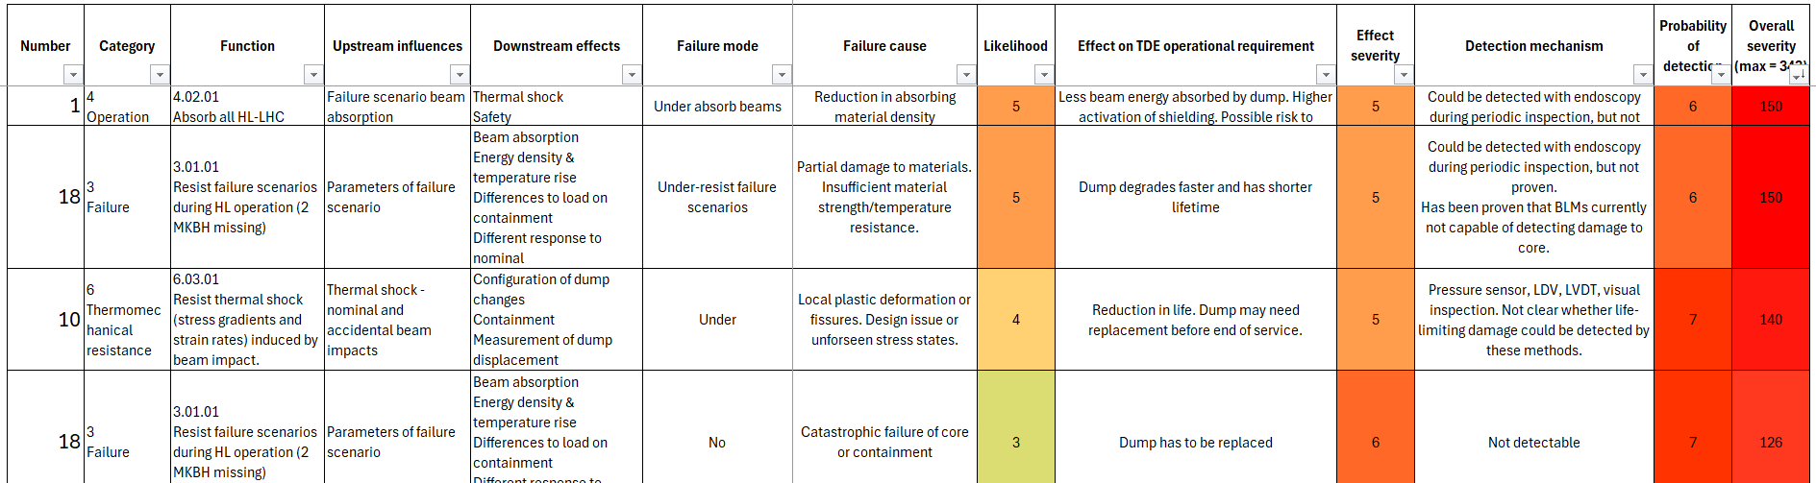
FMEA example - TDE
FMEA was performed for HL-LHC beam dump – this model and experience will be used as a guide for performing FMEA of BDF target
FMEA example: HL-LHC-beam dump

Slide 5
BDF systems description
Interfaces
Scope
this sets the context for defining our systems requirements
Scope of project is limited to what we can control.
Excludes adjacent systems, like:
Beam dilution system
SHiP
Space & access (what can’t be changed)

Slide 6
In conclusion…
1. We will need the help of many stakeholders within the project
2. We may invite you for a brainstorming session to identify functional requirements.
3. Your collaboration will be crucial!

