Slide 1
EUCAIF WG2-CODESIGN
Meeting 2025/1
T. Dorigo, P. Vischia
26/3/2025

Slide 2
Today’s Agenda
- News from EUCAIF
- Proposed activities:
1) innovative calorimetry
2) co-design of muon tomography applications
3) other bottom-up suggestions
- Define timeline and objectives for 2025
- AOB

Slide 3
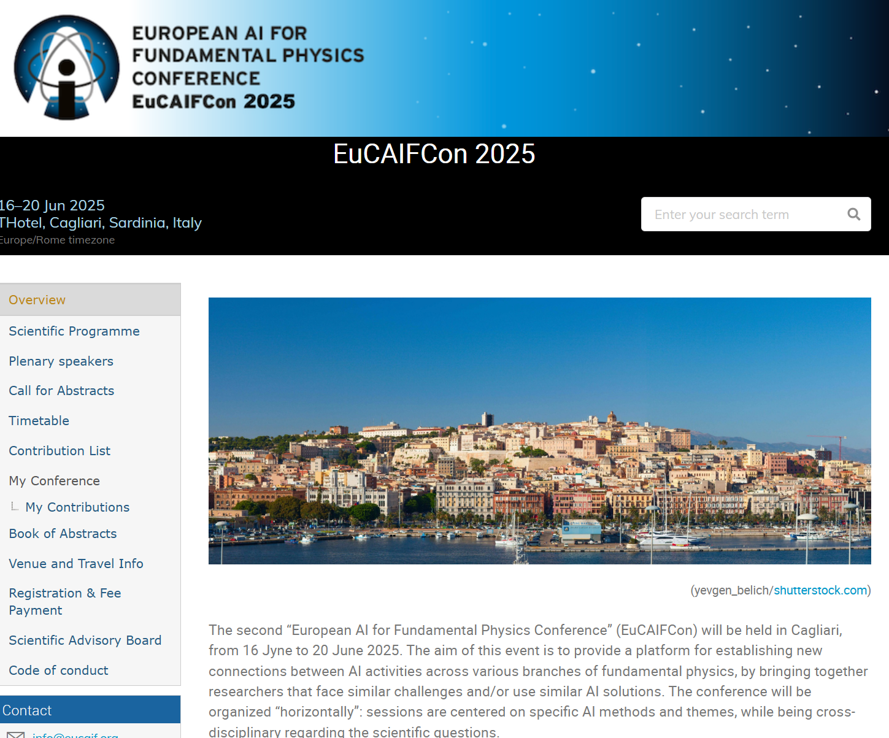
News: 1/Conference
The abstract submission to the II EUCAIF Conference (Cagliari, June 16-20 2025) has ended, and talk slots and posters have been assigned
  Almost 200 abstracts submitted, 60 talks selected (best scoring after at least three grades per abstract submitted by fellows who participated in reviewing them), the rest will be posters with 3’ flash intro talk
  Huge work by Christoph to prepare material, spreadsheet, etc.
  In general, large amount of novel and intriguing material
Register to the conference ASAP!
Early bird registration ends March 31

Slide 4
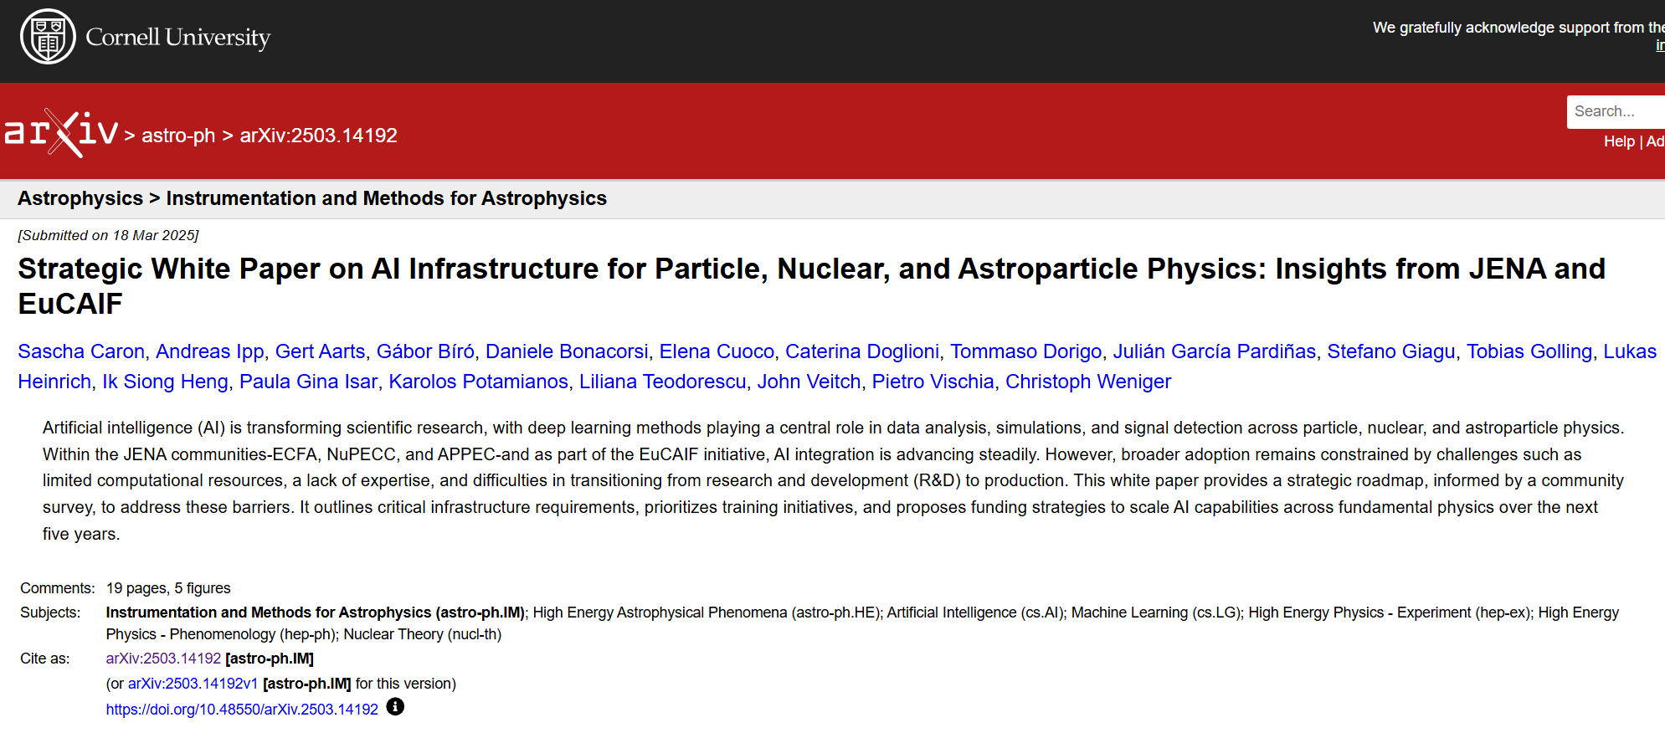
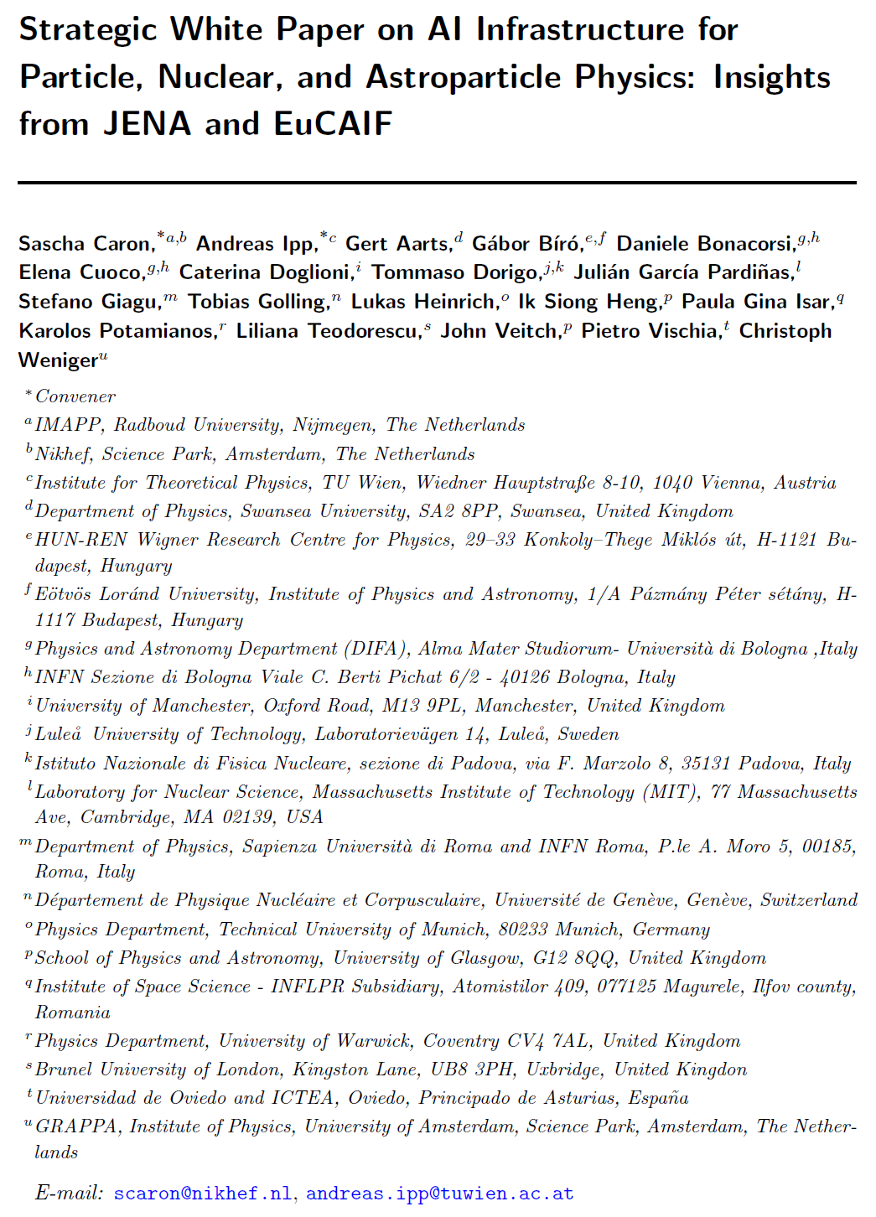
News: 2/Papers
A paper on the AI infrastructure was produced by WG4, on the arxiv (2503.14192)
It will be published also on JENAA web site (nupecc.org/jenaa) and will be part of the JENA computing white paper, https://nupecc.org/jenaa/docs/JENA_comp_white_paper.pdf
A second paper, managed by a small group of editors, is meant as a contribution to the ESUPP. You can add your signature if you wish so (not sure if there is still time, though!), link to overleaf: https://www.overleaf.com/1174783687sxfjkrqvprvv#e92a13

Slide 5
News: 3/EUCAIF Fellows Meeting
An all-fellows meeting will be held on Thursday, April 3 (14.00-15.30), to discuss recent developments and activities in our WGs, and plans for 2025.
WG leaders will report on the status – that is also part of the reason for us meeting today.
Pietro and I will report to the mailing list on the main topics touched on, after the meeting.

Slide 6
News: 4/WG2 Composition and Survey
As of today, the WG2 mailing list includes a total of 44 members
Not all of them subscribed to be active in the WG – several “observers”
Last November we launched a short survey to try and take a snapshot of the group, their interests, and the personpower they would be willing to devote to this group’s activities
We failed to do so, because too many of you did not respond (less than 20 answers). We are going to iterate on the challenging task of making you spend five minutes of your life on answering an email.

Slide 7
Proposed activities for 2025
We need to aggregate researchers interested in developing co-design solutions to future experiments in some focused projects that can be pilots and later grow into flagship activities and prototype demonstrations of the power of simultaneous optimization of hardware and software
What can be your motivation to participate?
Become authors of papers resulting from the work activities → we need to be inclusive, but recognize merit and leading efforts
By taking part, you become an actor and a potential PI of future grant applications to, e.g., the EIC or the MSCA of the EC
If you are a young post-doc, seniors in the group will vow to support you for reference letters, and may be able to open positions for overperformers
If you are a senior, the group will be an excellent place to invest personpower (your students, to which you can offer topics that they will then develop with easy supervision)

Slide 8
What can we deliver?
An area where there is a whole lot of gain possible from co-design activities is hadron calorimetry
High granularity/precise timing: particle ID limits? PF gains?
Neuromorphic readout with photonics: fast preprocessing
Hybridization of tracker and calorimeter
Special geometries for special situations
Another area of co-design studies where there is high potential is optimization of detectors for muon tomography

Slide 9
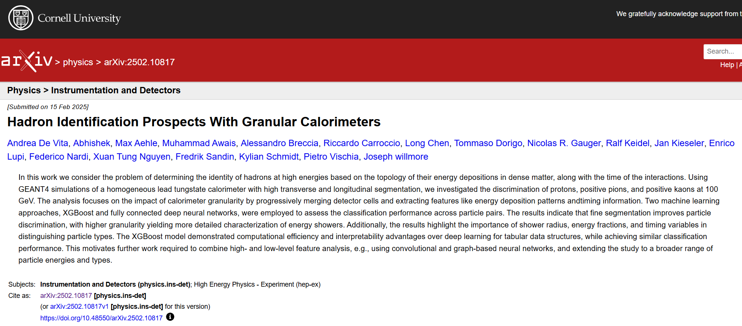
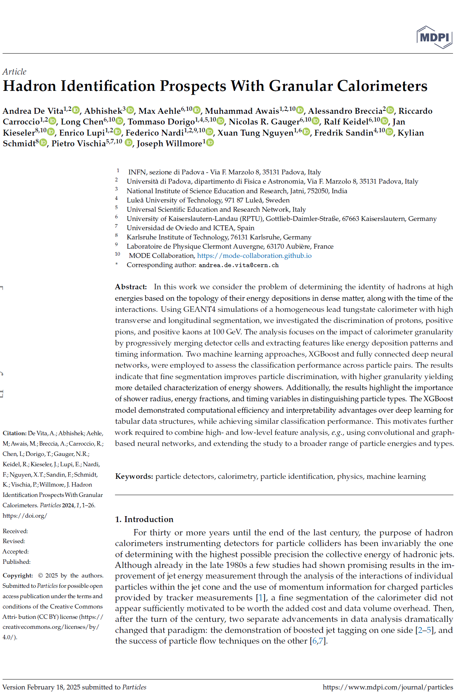
High granularity / precise timing pursued ubiquitously. However, unclear what are the gains. Can you do particle ID? With what accuracy? How much can you improve particle flow performance?
We started to explore p/k/pi discrimination as a function of cell size in very-high-granularity, homogeneous PbWO4 calorimeter
Preprint produced, now under review, with preliminary results (only one energy point), another more conclusive publication foreseen by end of the year.
Currently involved: 3 seniors, 2 pre-PhD students
Profile sought: anybody interested, but in particular young contributors who can help with analysis.
Possible involvement: producing large simulations; developing discriminating features; run trainings on large computing clusters; produce results for different PID discrimination tasks; editing manuscript

Slide 10
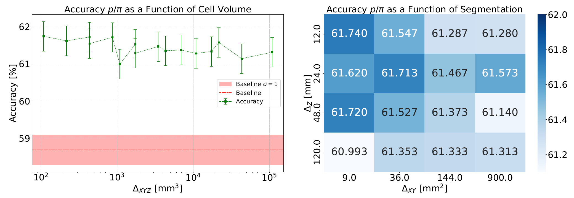
Sample results: p/pi discrimination
(https://arxiv.org/abs/2502.10817 )

Slide 11
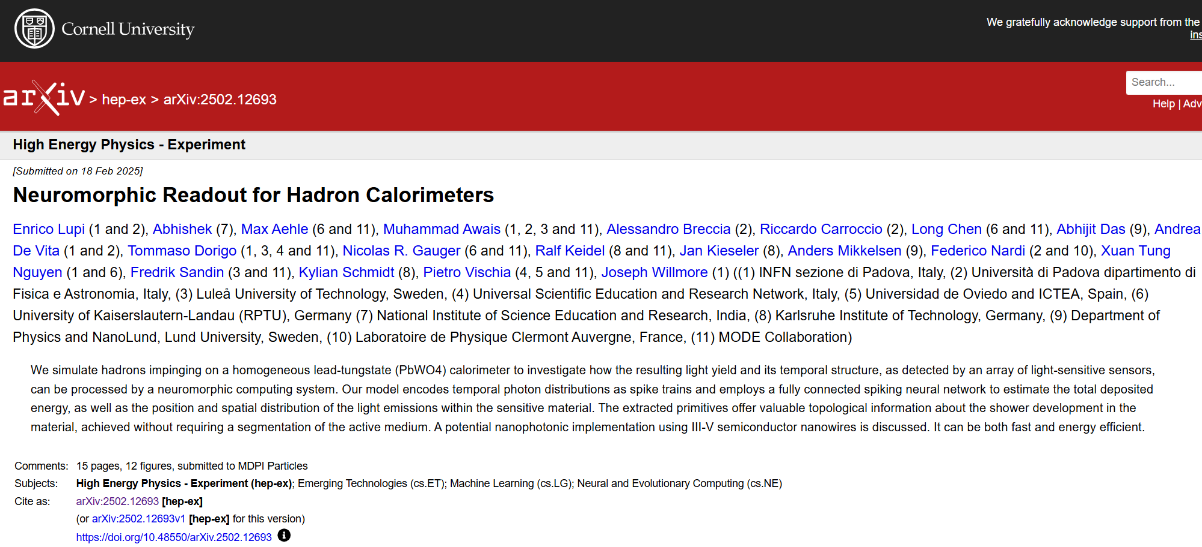
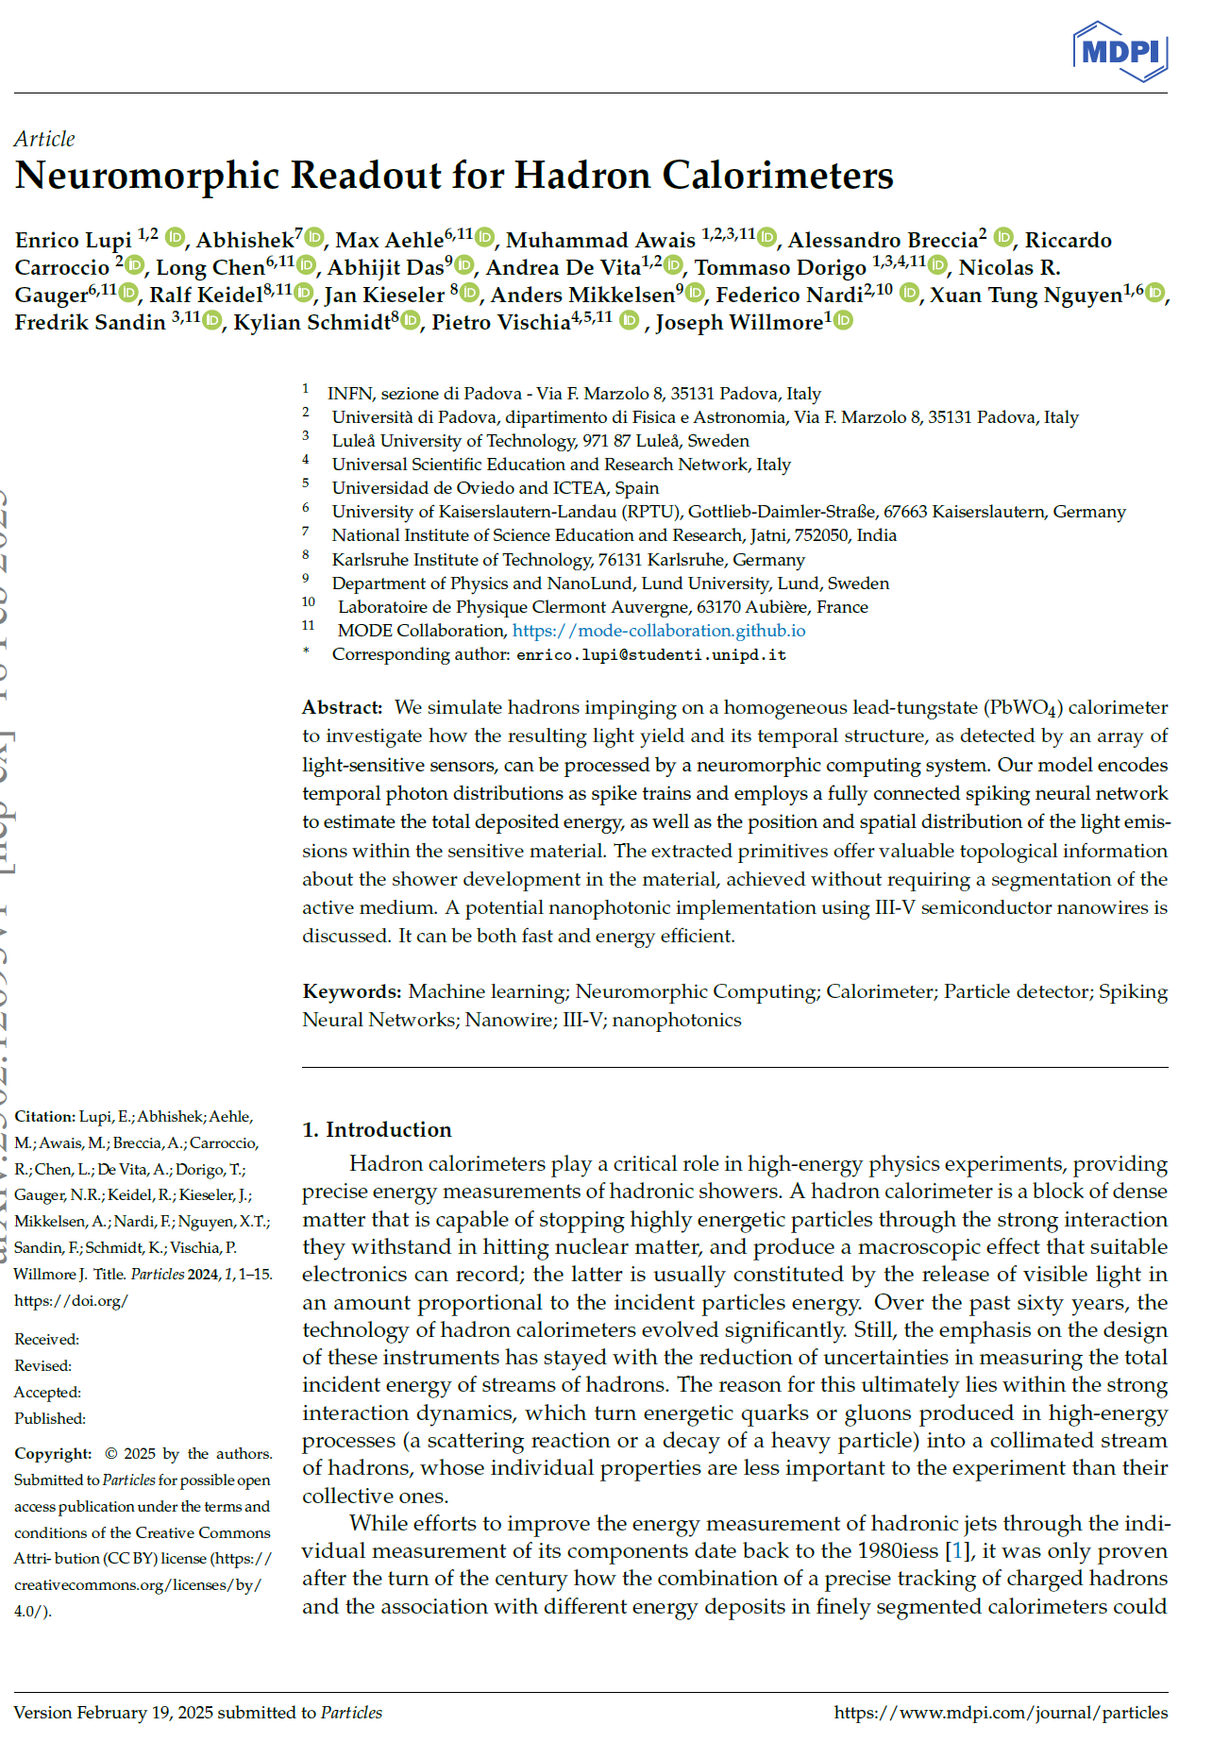
2) Faster readout of hadron showers and on-site dimensionality reduction becomes very important.
Neuromorphic computing and photonics-based localized preprocessing may be key to dramatically reduce data throughput (→ improve triggering on detailed properties), plus offering potential benefit of partly removing need of high granularity
→Studied SNN-based regression of energy, energy xyz centroid, and dispersion in PbWO4 cube where main interaction took place
Preprint produced, now in review. Much to explore in near future! At least a couple of publications foreseen
  One on hardware implementation with nanowires
  One on optimization of design of neuromorphic system
Currently involved: 3 seniors, 1 PhD student, 2 pre-Phd, one bachelor student + advisory at nanoLund
Profile sought: anybody interested. Also hardware experts to explore implementation/prototyping with AI
Possible involvement: explore SNN architecture; optimize layout of neurons for automated dimensionality reduction with generative models; conceive hardware parameter space and proceed to study co-design
Also in the process of using this for an EIC Pathfinder application

Slide 12
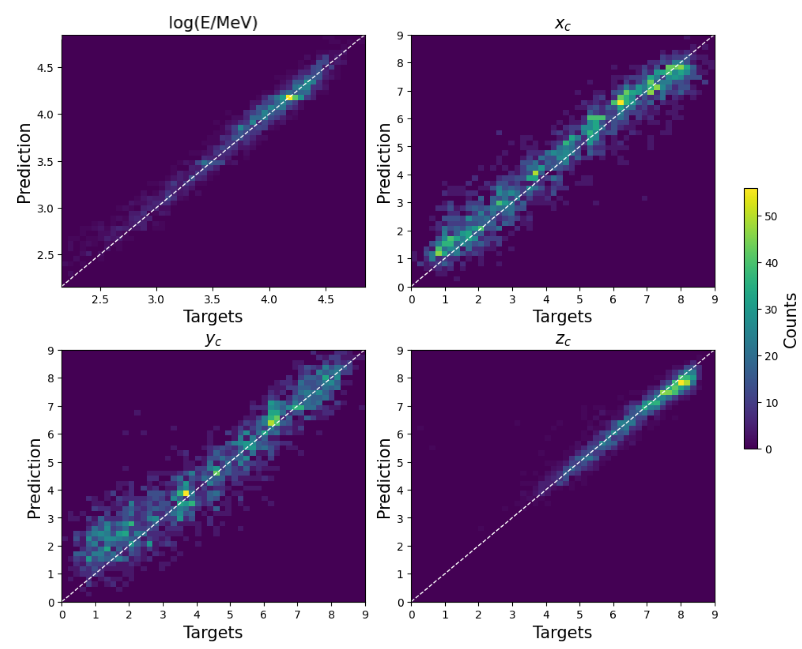
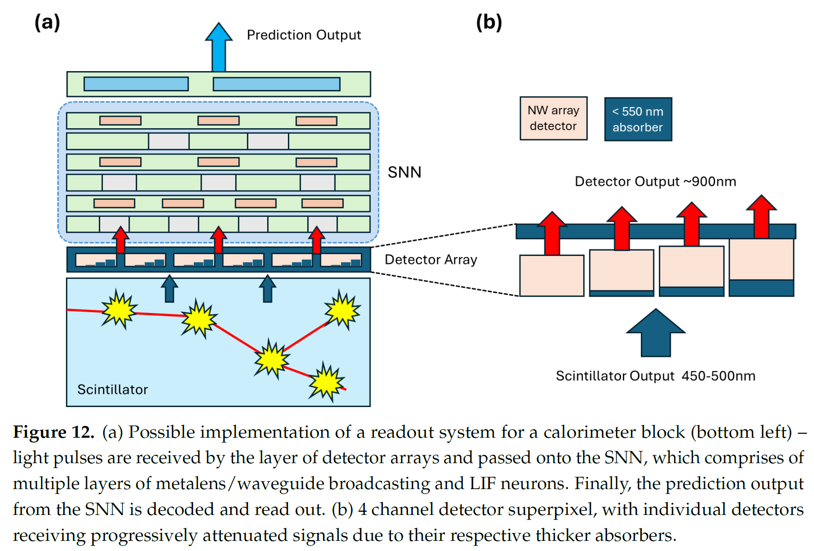
Example from paper (https://arxiv.org/abs/2502.12693 ):
Regression E+ E centroid x,y,z

Slide 13
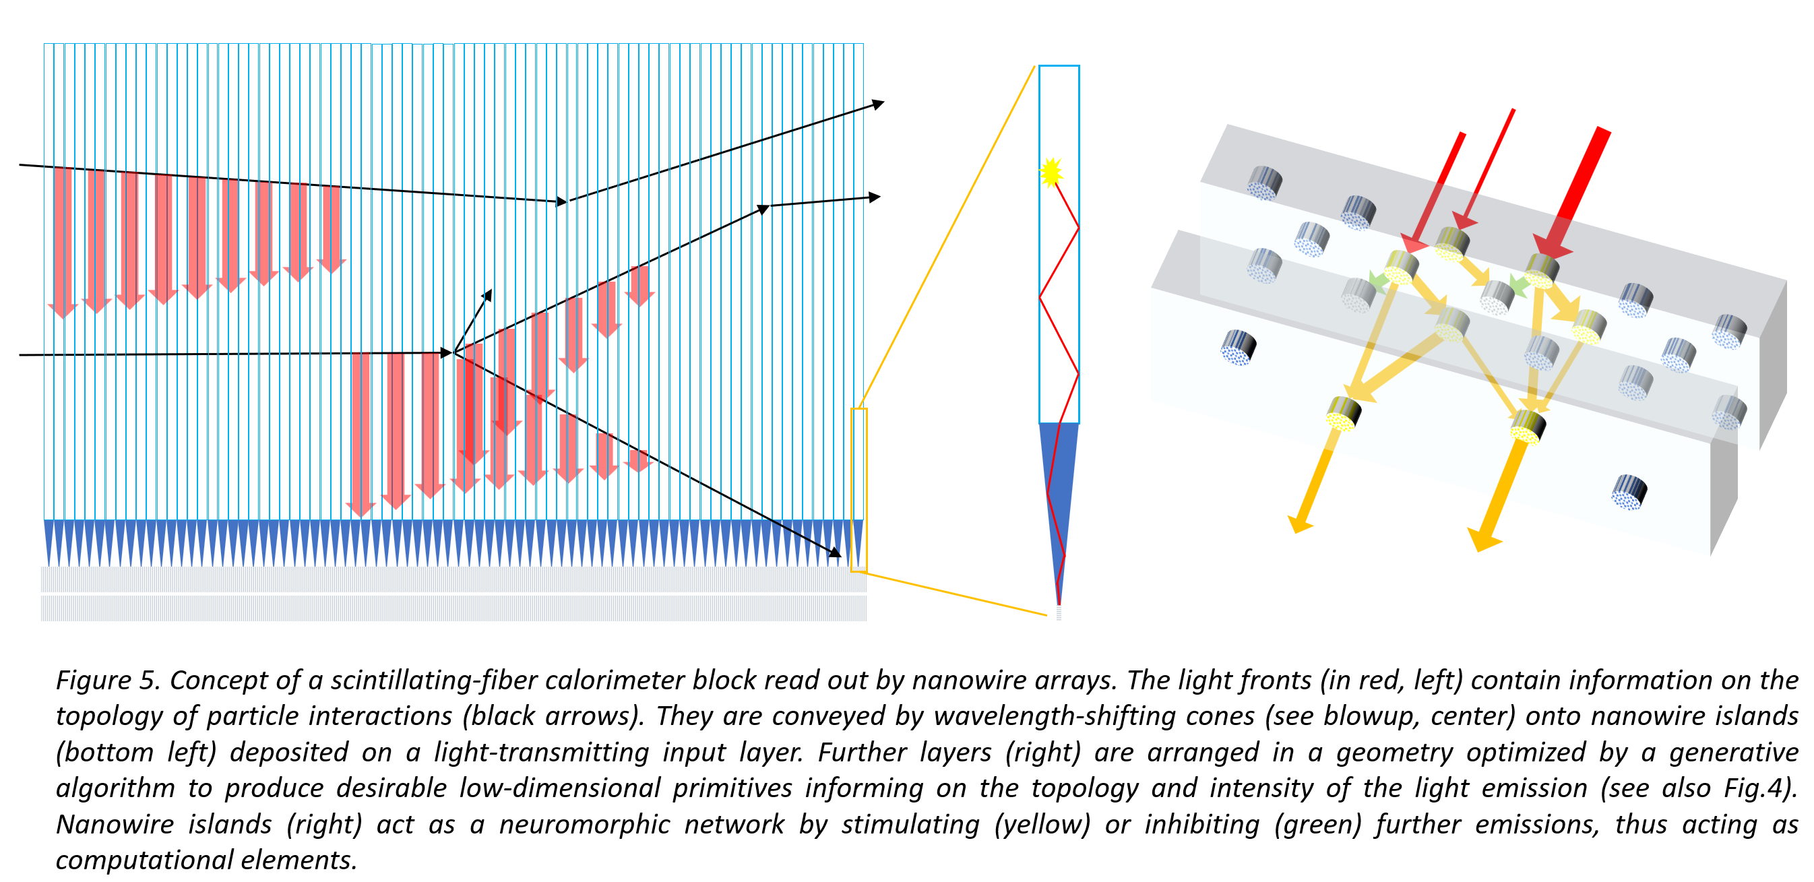
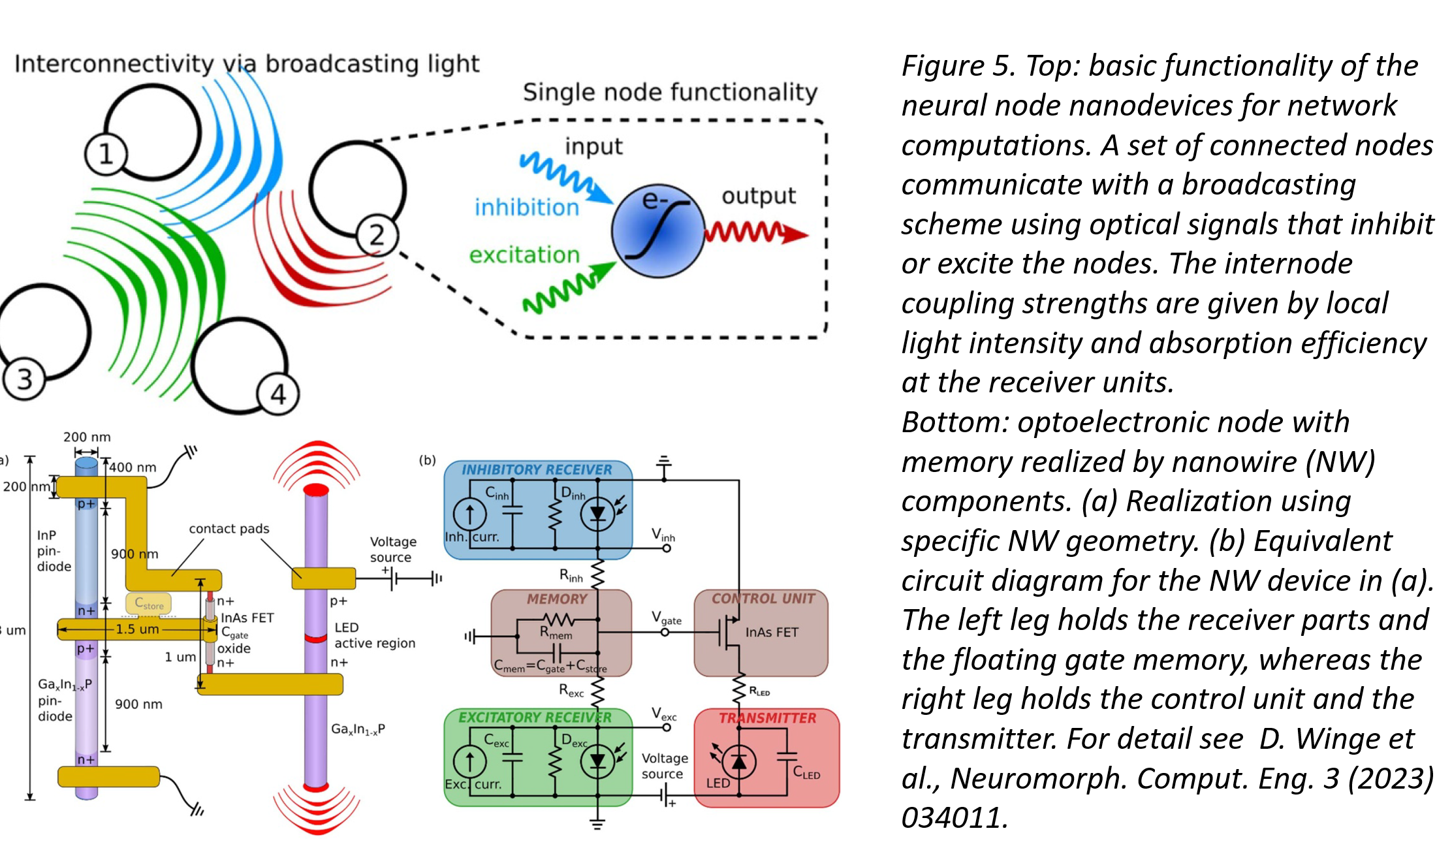
(digressing a bit): Future idea for neuromorphic computing readout with nanophotonics
Using scintillating fibers coupled to nanowires, and a generative model to learn 3D geometry of “neurons” in photonic network, we can produce ultrafast, low-throughput dimensionality reduction of calorimeter signals

Slide 14
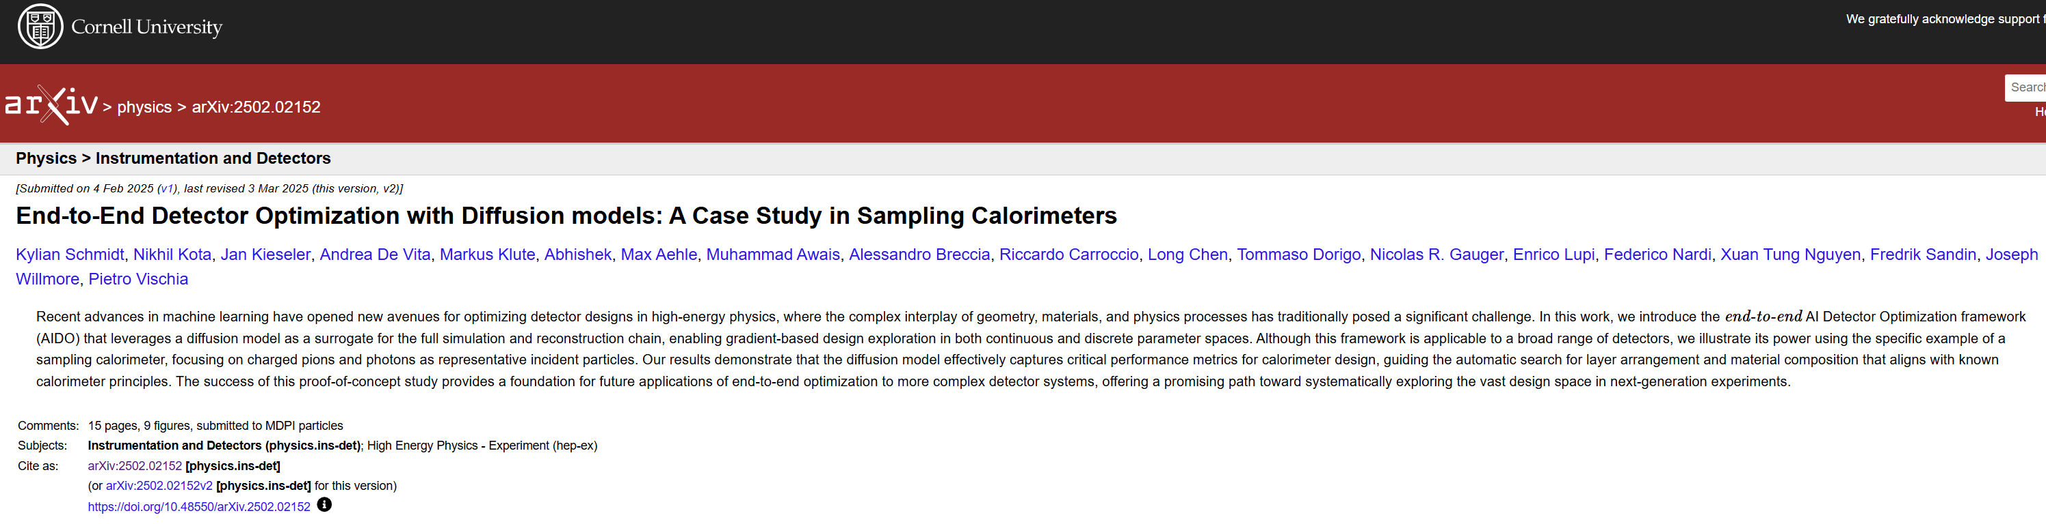
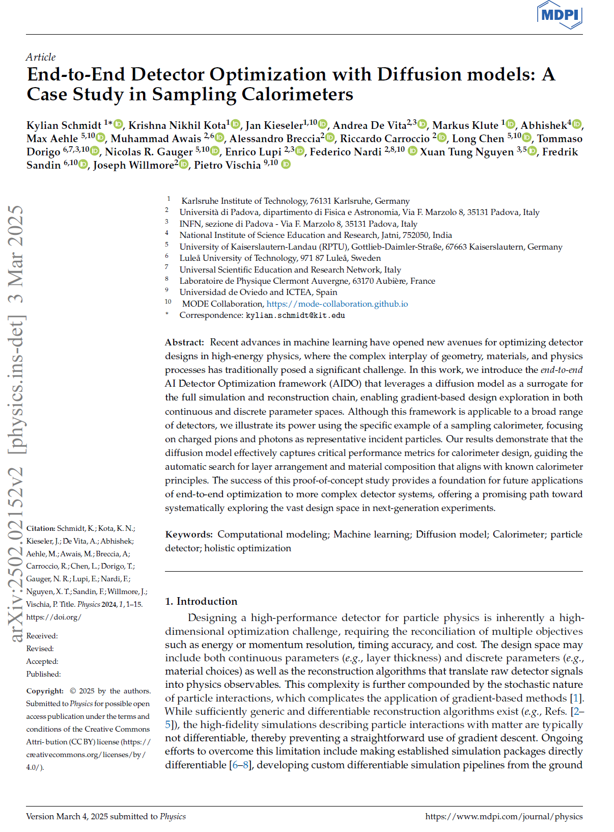
3) A lot can be explored in hybridization of tracking and calorimetry. Why density 0 → density 1? There must be a better solution.
We have started to prepare software that will explore these possibilities (AIDO) – an end-to-end pipeline that generates new G4 data at every epoch, and approximates with a diffusion model the full data chain. Best example of co-design in place so far.
Preprint produced (proof of principle), now in review by MDPI. Lots of possible questions to ask to the software & papers to produce
Currently involved: seniors + 3MS + 1BA
Profile sought: TBD – happy to enlarge group
Possible involvement: hyperparameter optimization, extension to handle tracking layers, study of different loss functions, inclusion of fragmentation function priors, use of nuclear interactions for particle ID

Slide 15
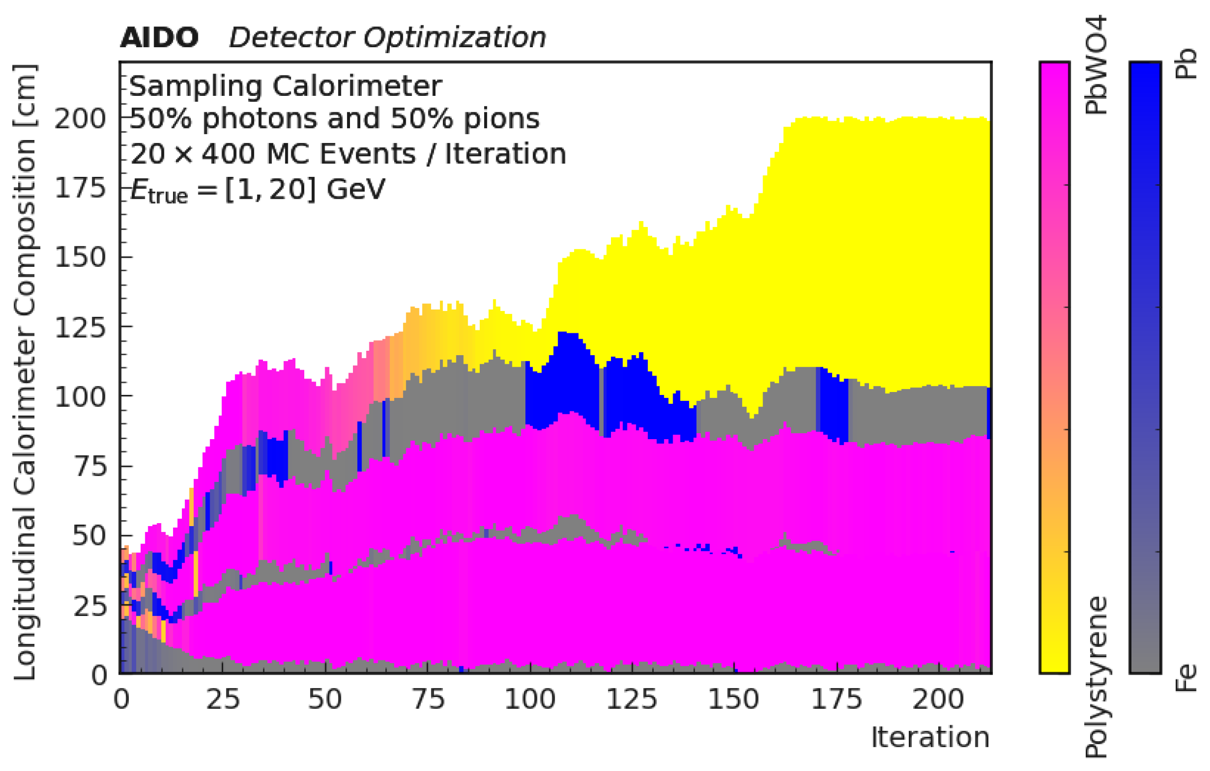
Money plot from paper (https://arxiv.org/abs/2502.02152 ):
Evolution of sampling calorimeter during learning

Slide 16
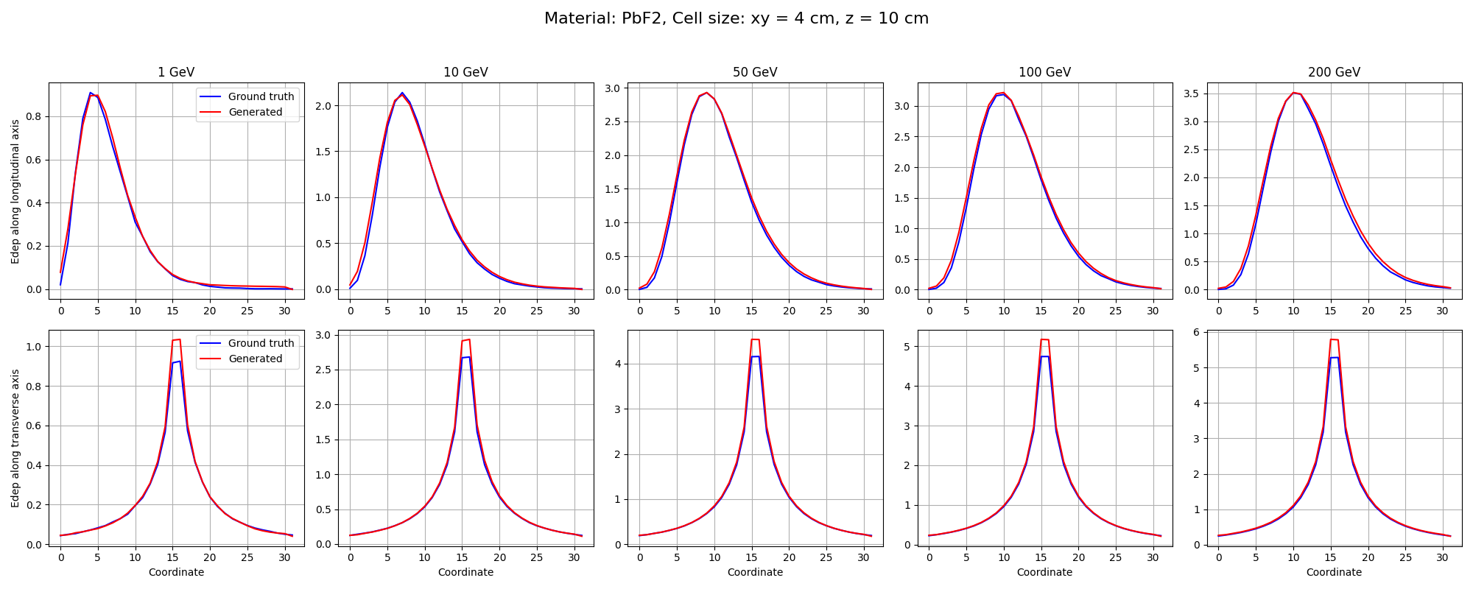
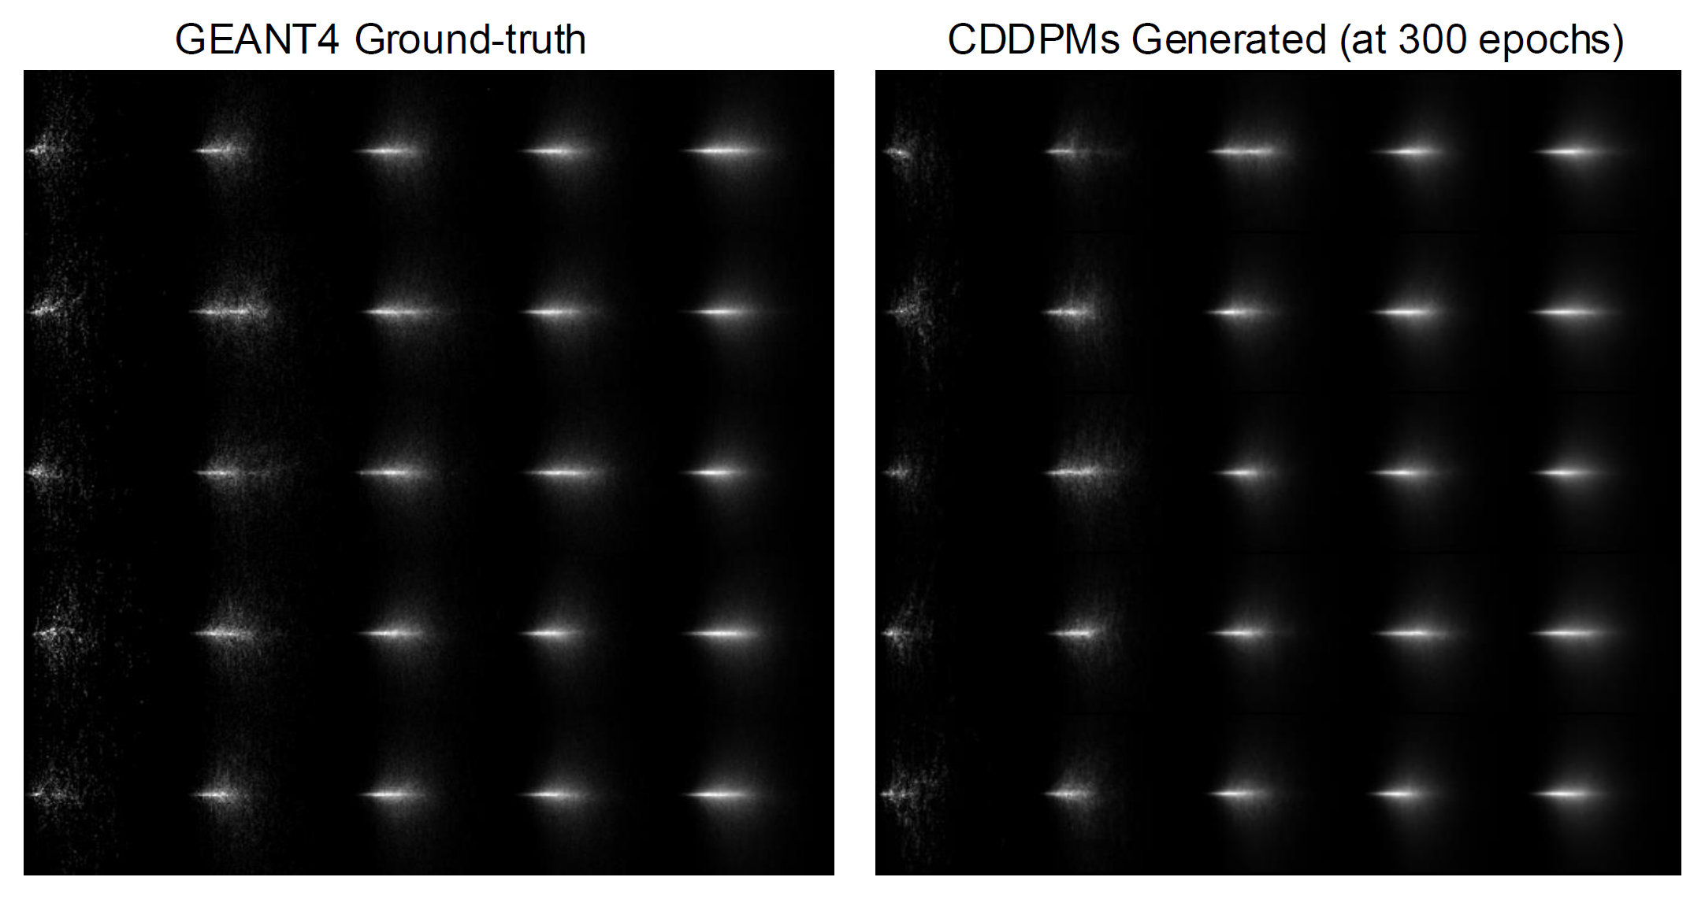
4) Some special situations (EM calorimeter for muon collider, where background from BIB is different from any previous collider detector) demand special studies → F. Nardi’s PhD thesis; work to be expanded into complete optimization using co-design ideas; presently also developing precise diffusion model for photon shower surrogate
Work in progress (currently involved: 2 seniors, 1 postdoc, 1 PhD, 1 post-master)
Profile sought: anybody willing to contribute
Possible developments: proof of end-to-end optimization with state-of-the-art reconstruction (object condensation), papers / involvement with Muon Collider collaboration

Slide 17
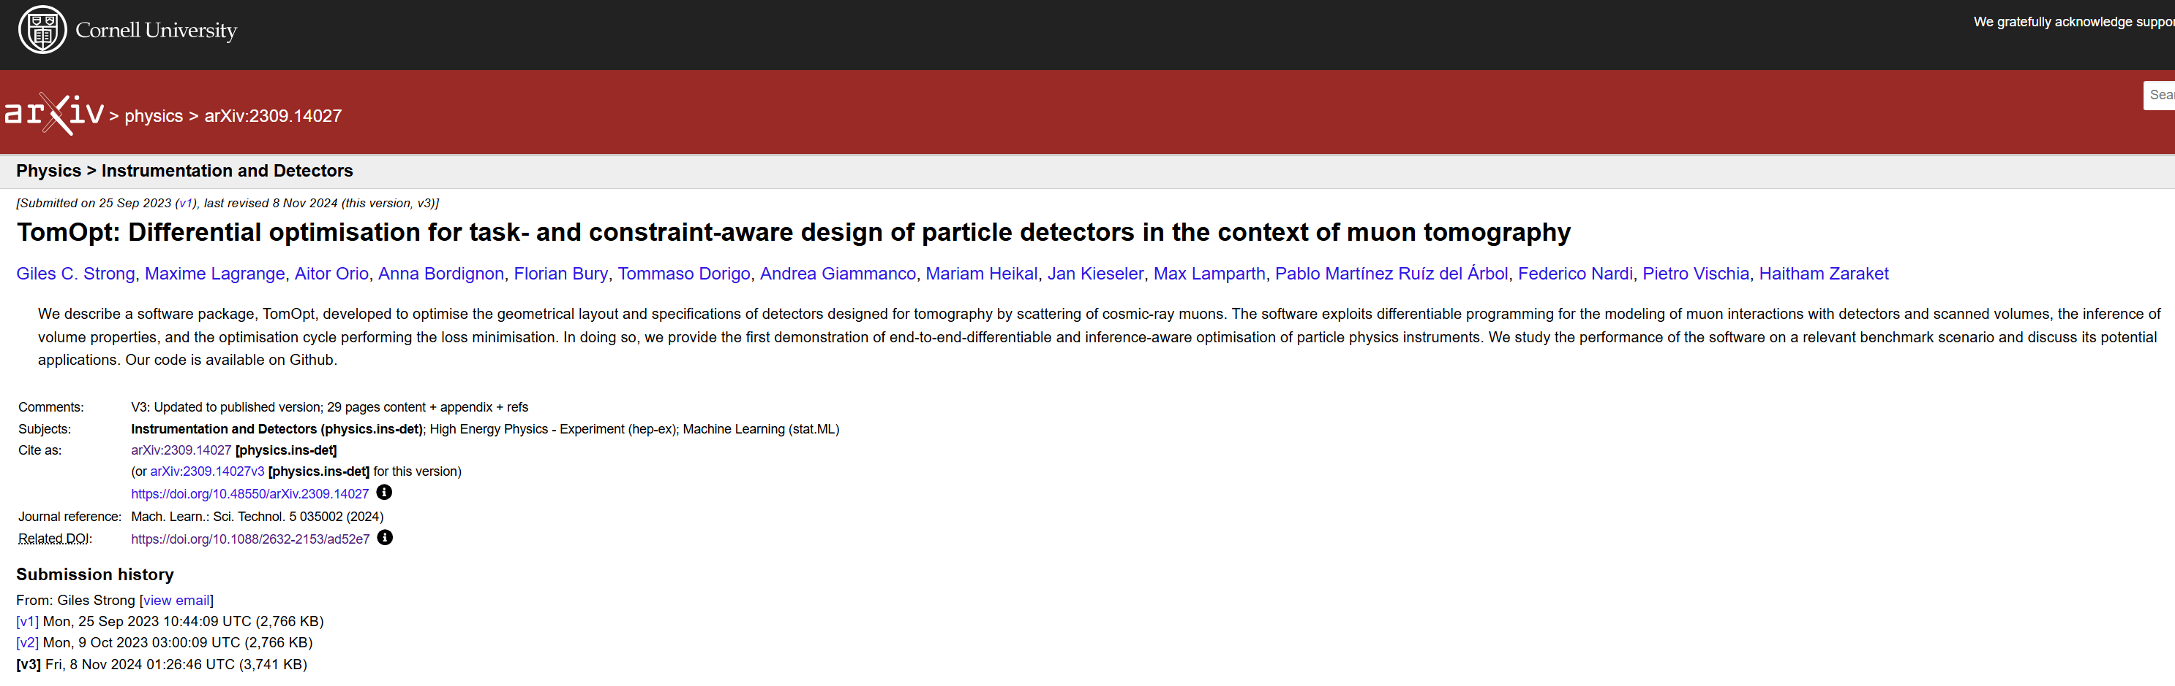
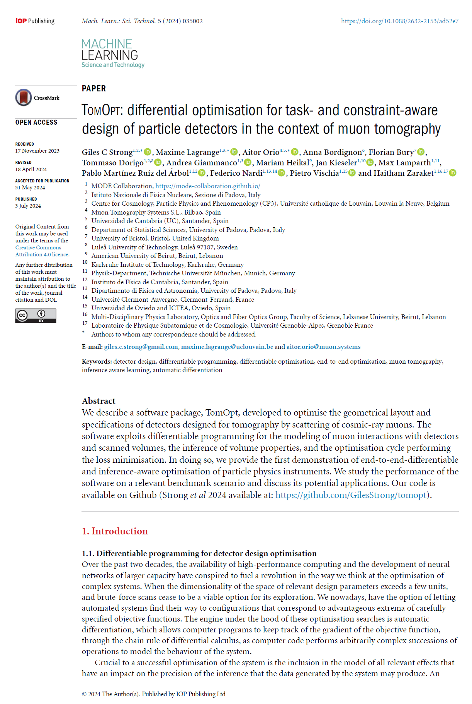
Muon tomography detector optimization: TomOpt
An end-to-end pipeline for optimization of detector geometries and components has been developed by INFN+UCL+UOV (main developer G. Strong)
PyTorch software available at https://github.com/GilesStrong/tomopt
The software performance has been proven, but lots of extensions are useful to make it an appealing product
Handling 3D configurations (so far only handling 2D vertical stacks)
Inserting high-performance graph NN for imaging in pipeline
Current effort: seniors + 2 PhD + others
Happy to accept new contributors

Slide 18
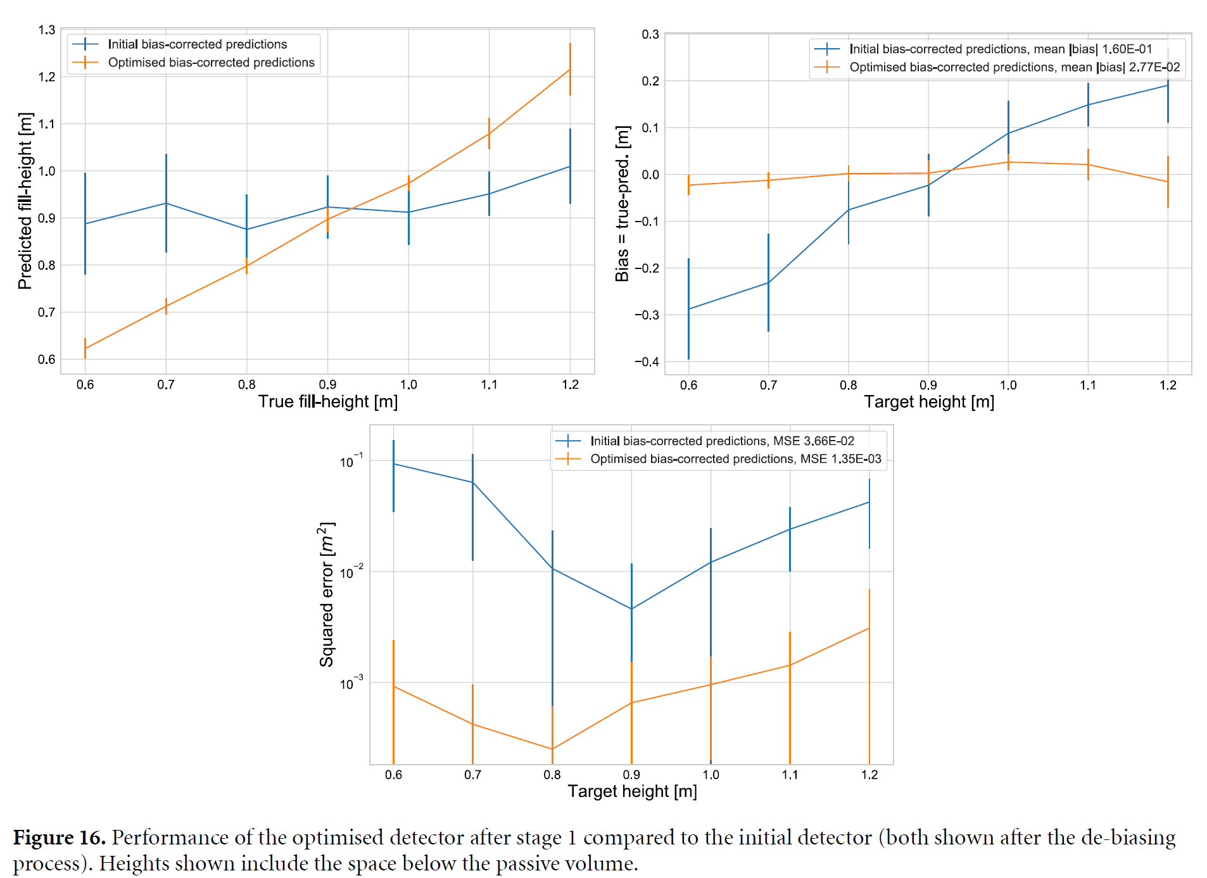
Example from paper (https://iopscience.iop.org/article/10.1088/2632-2153/ad52e7 ):

Slide 19
Other possible crusades to embark on?
A number of planned experiments are toying with co-design ideas.
E.g. in astrophysics (neutrino expts: RNO-G, IceCube-Gen2, TAMBO)
In addition, software for SWGO array optimization produced, proof of principle demonstration of SGD optimization of O(1k) parameter problems, with significant improvements in FoMs (next slide)
Other suggestions?

Slide 20
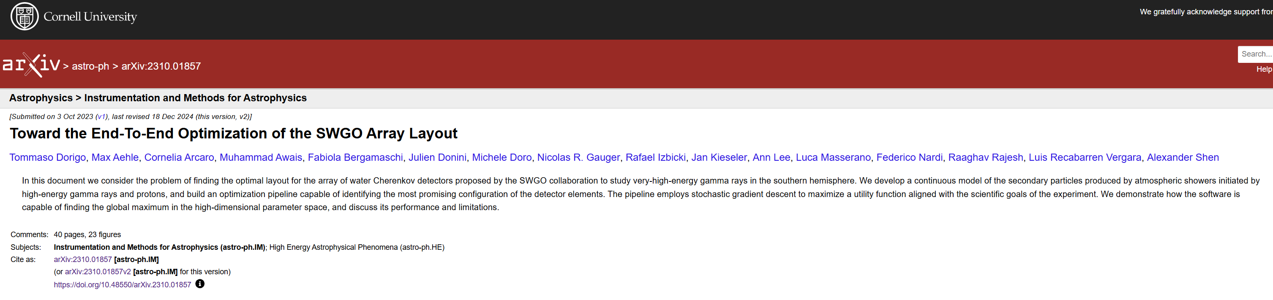
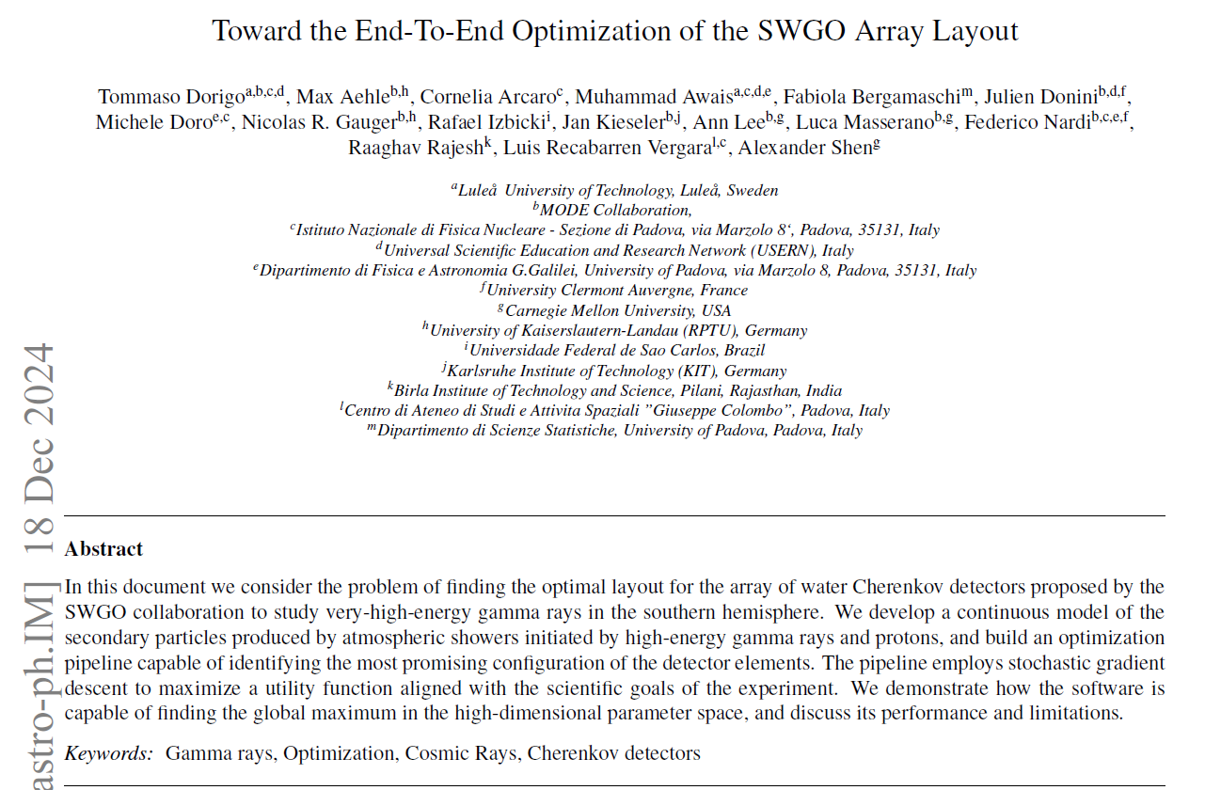
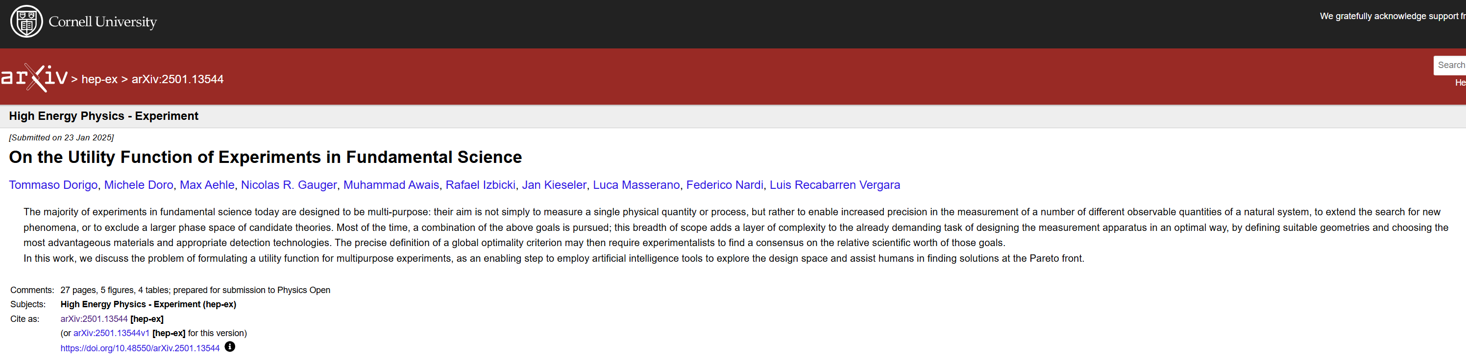
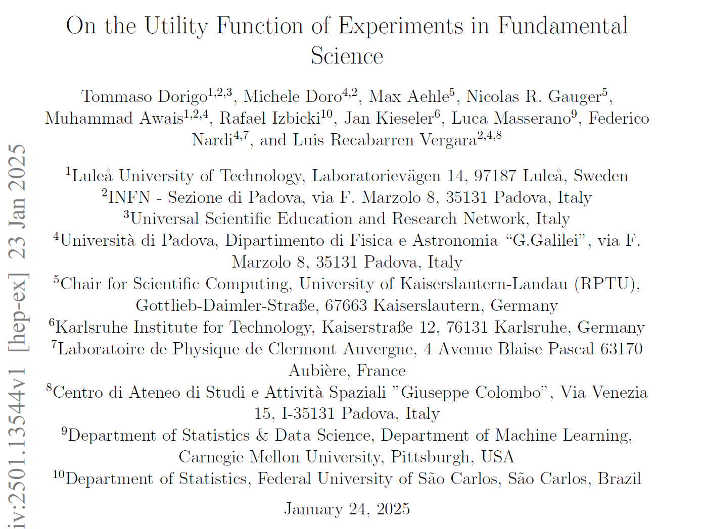
SWGO layout optimization
Two papers in review: software description (https://arxiv.org/abs/2310.05673 ), results discussing Pareto front (https://arxiv.org/abs/2501.13544 ).
Software available on GitHub ()
Current involvement: seniors, 1 PhD
Future developments: extend surrogate model of showers to lower energy, include SWGO-defined performance metrics in loss, compare to full simulation results (one paper expected)
Happy to collaborate with anybody interested!

Slide 21
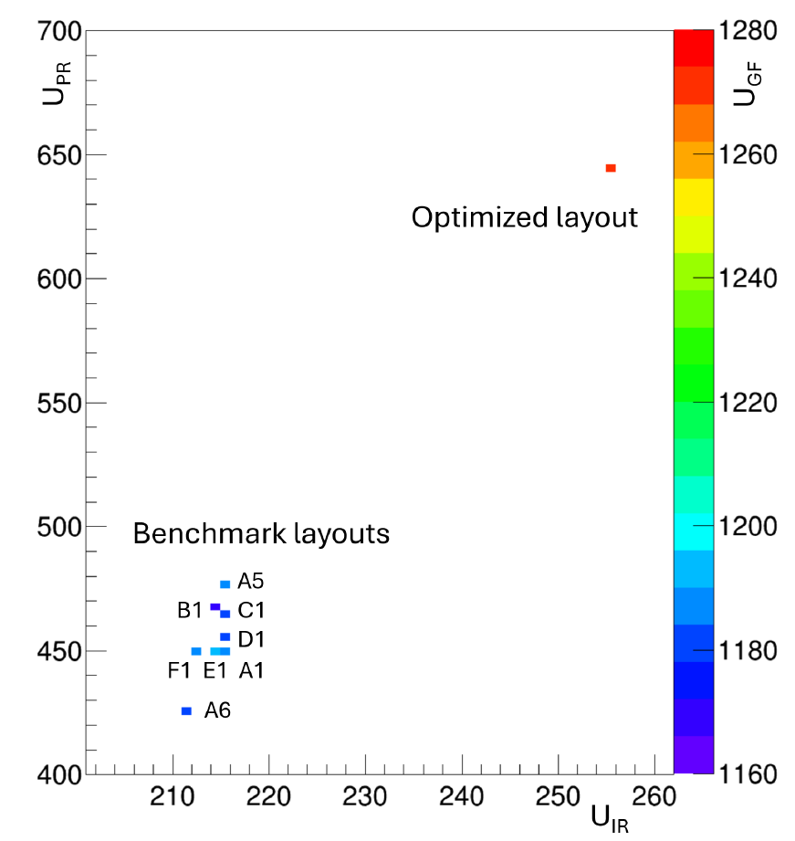
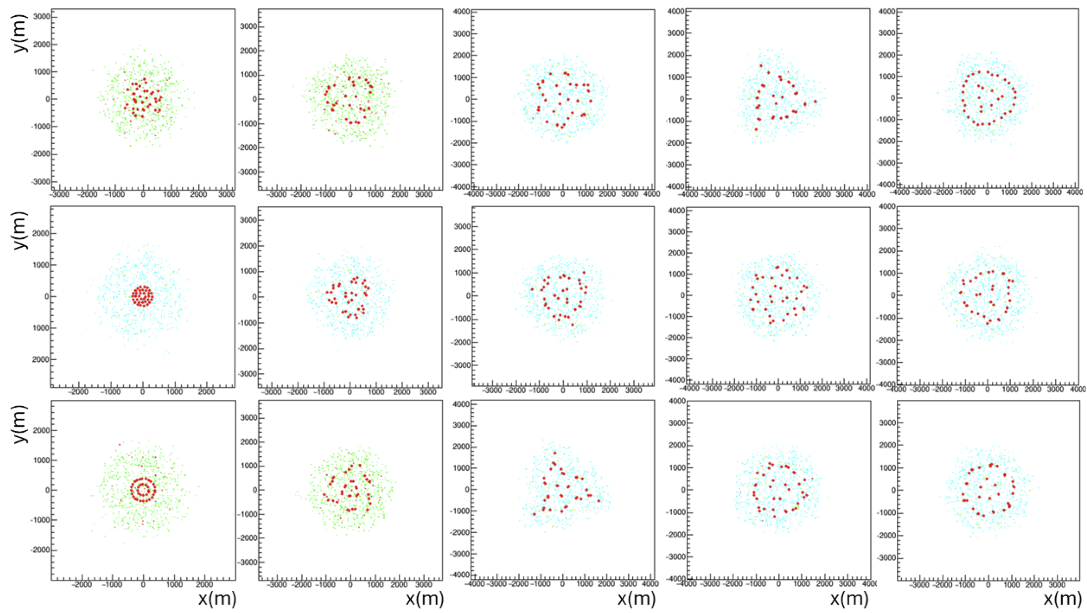
Examples from the papers
Comparison of 3-component
Utility function among 8
benchmarks proposed by SWGO
and optimization result
Epoch 1 epoch 20 epoch 50 epoch 100 epoch 400
Different initial layouts converge to optimality

Slide 22
What objectives could we set to ourselves in 2025?
A common publication where we discuss co-design efforts ongoing and preliminary results?
Progress in collaborative activities?
How do we get organized in practice:
Weekly meetings (already in place for both calorimetry group and tomopt software)
Common repositories (already in place for some of the activities)
Questions? Comments?

Slide 23
Action Items and next meeting
Propose to have next meeting BEFORE the EUCAIF conference
(maybe Christian could update on studies at Uppsala)
Then meet every 2 months to discuss progress
Distribute slides and ask for further diffusion in the community, with indico page and category
Ask for other topics proposed by members
- Other round of questionnaire
Distribute summary of fellows meeting results
Cards from Pietro: 1-slide presentation by participants

Slide 24
AOB

