Slide 1


Knowledge transfer @ CERN
Giovanni Anelli, CERN Knowledge Transfer group leader
Industry, Procurement and Knowledge Transfer (IPT) department
23 June 2025

Slide 2
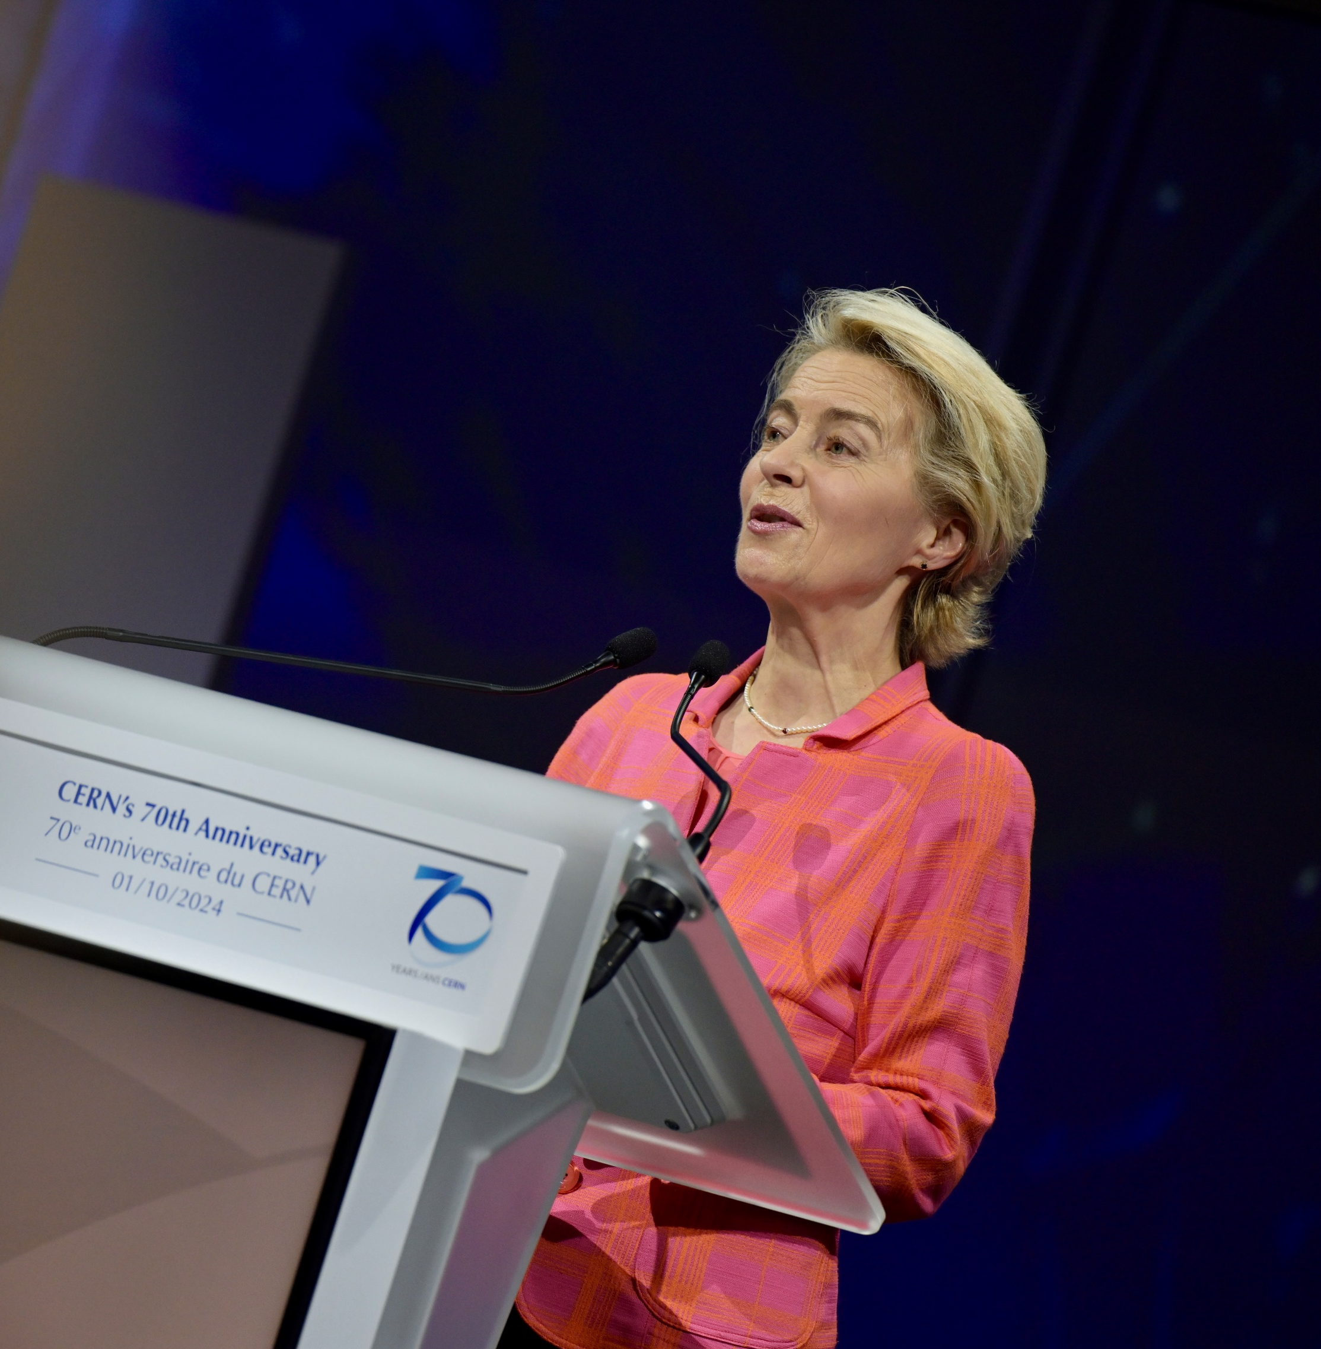
2024 – CERN at 70
“You are constantly working with European industries, to build low-emission airplanes, or to create new solutions to transport liquid hydrogen. CERN is the living proof that science fosters innovation and that innovation fosters competitiveness. We need more of these partnerships between research and business; more ideas that go from the laboratory to the factory.”
Ursula von der Leyen, President of the European Commission

Slide 3

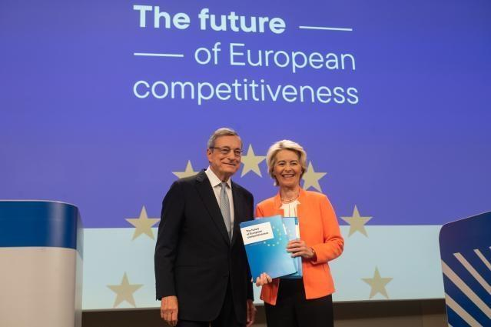
The CERN success story
“CERN’s technologies have generated significant societal benefits, including advancements in cancer therapy, medical imaging, autonomous driving with artificial intelligence, and environmental applications of superconducting cables.”
https://commission.europa.eu/topics/eu-competitiveness/draghi-report_en
Notes:
Report released September 2024

Slide 4
Knowledge Transfer Channels
Dedicated actions to foster the transfer of technologies and know-how to other fields than particle physics
(very often with the involvement of industry)
Technology-intensive procurement contracts
People
(very hard to quantify but extremely impactful for particle physics)

Slide 5
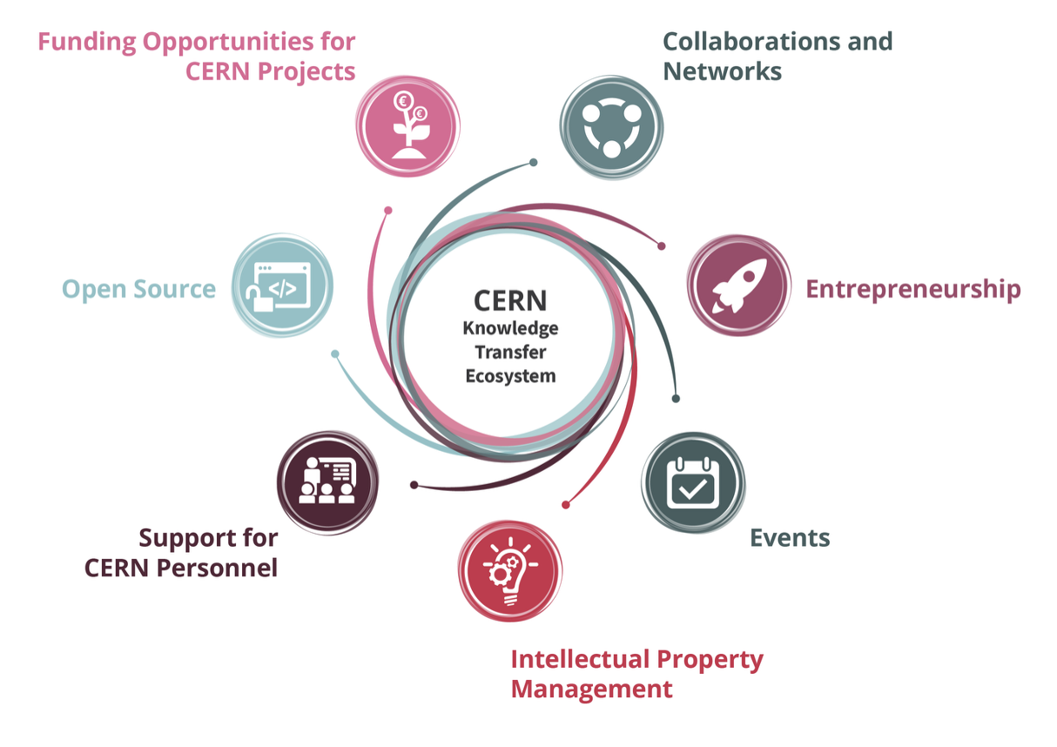

Slide 6
Discover
Discussion with Innovation / R&D management
Discovery day program at CERN
Shape
Define innovation ambitions and technical needs
Discuss expertise contributed by partners
Execute
Formalize partnership:
- Collaborative R&D
- License
- Consultancy
- Contract Research
Find mutual interest
Timeline, resources, IP

Slide 7

Key Areas – Highlights in 2024

Slide 8
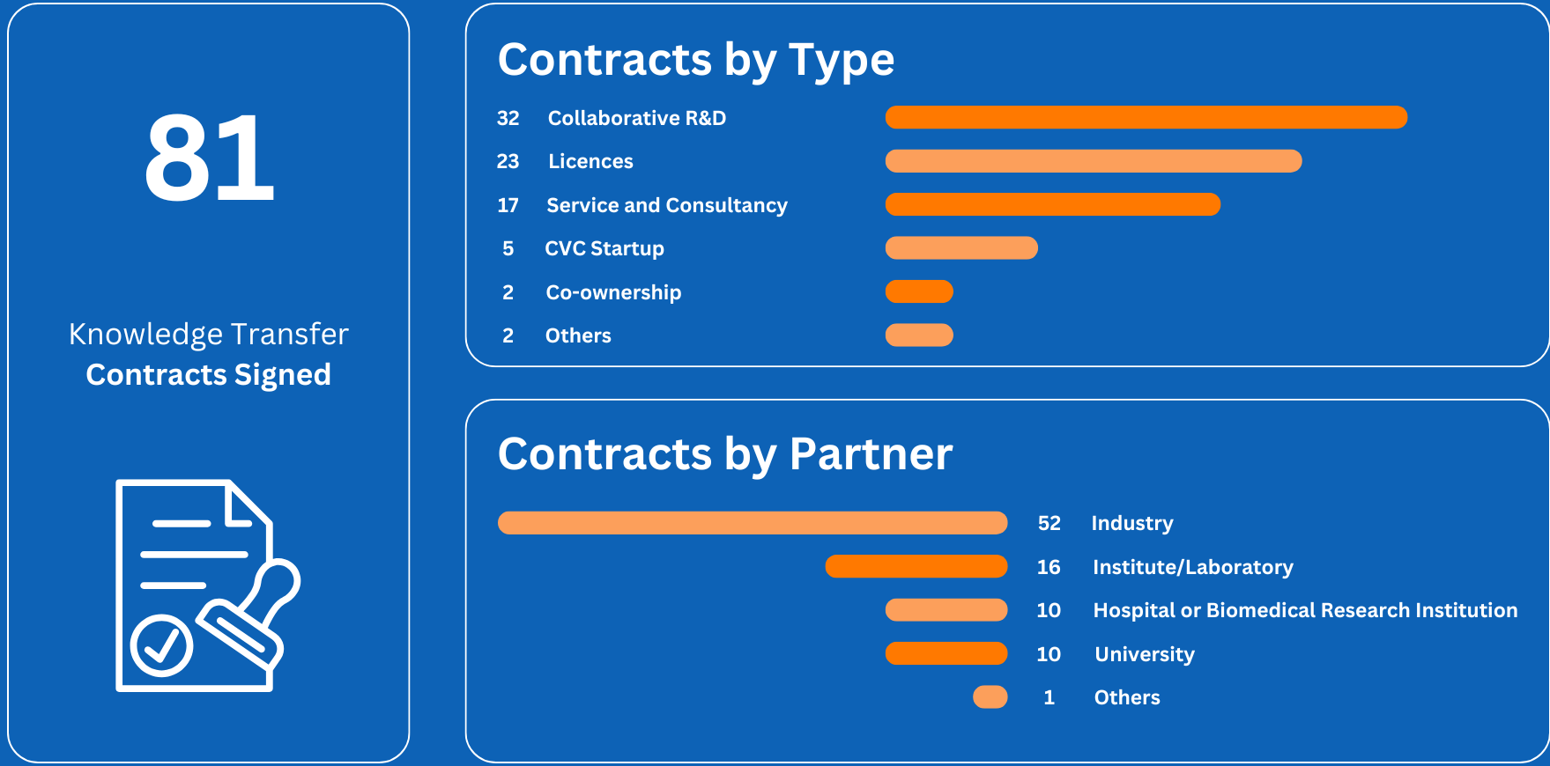
2024 partnerships in numbers
Notes:
2 other: one assignment and one funding agreement

Slide 9

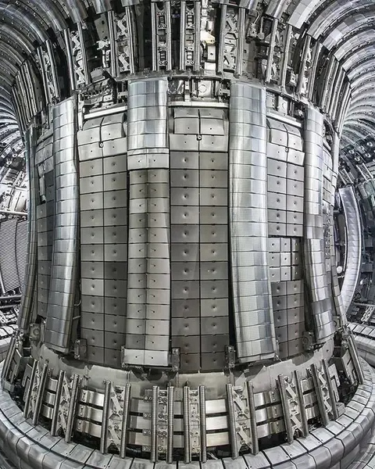
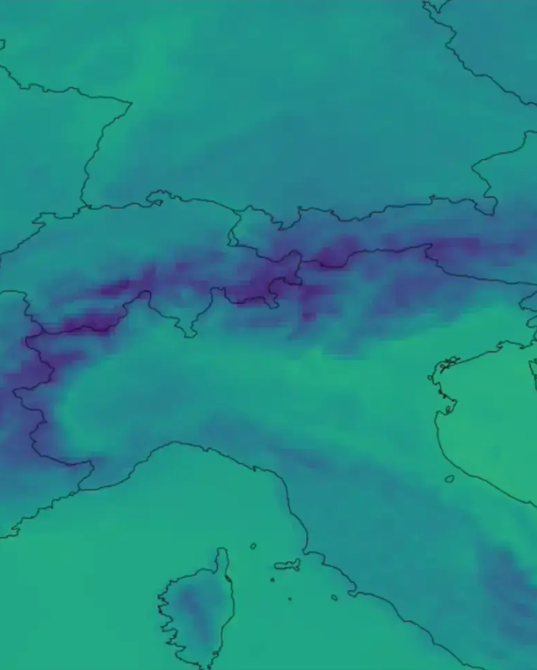

Environmental applications
A partnership with Rolf Kind GmbH to find the right steel for the fusion power plants of tomorrow
Emerging AI models for Improving Weather Predictions and Tackling Global Hunger
Notes:
CERN has partnered with German company Rolf Kind, which specialises in the production of forgings in high-alloy stainless steels, to find the right steel for the requirements of the fusion power plants of tomorrow. Rolf Kind collaborated with CERN’s Materials, Metrology and Non-Destructive Testing section to test their stainless steel at temperatures as low as 4K, or -269°C.
The CERN-Rolf Kind partnership was extended in 2024 with the agreement of a second, two-year phase of collaboration. So far, Rolf Kind has been able to test one potential material at CERN, FXM-19, with results ruling it unsuitable for use inside a fusion reactor.
Thanks to this testing, work has now begun on characterising an alternative material, with initial results showing a great deal of promise.
https://report2024-kt.web.cern.ch/fusion-power-testing-steel-to-harness-the-energy-of-tomorrow/
EMP2 project resulted in the Atmorep model. https://report2024-kt.web.cern.ch/emp2-improving-weather-predictions-with-ai-and-tackling-global-hunger/
EMP2 was one of eight initial projects to be selected for the CERN Innovation Programme on Environmental Applications (CIPEA) back in 2022 and is the first to be concluded. The project was supported by the CERN Knowledge Transfer Fund, and carried out by CERN openlab, in partnership with Magdeburg University, the Jülich Supercomputing Center and the European Centre for Medium-Range Weather Forecasts (ECMWF).
It is part of a pioneering class of a small number of machine-learning based global environmental models trained on terabytes of data, that can be used to, for example, make predictions about the weather or track atmospheric dynamics. These models are known as foundation models.
A unique element of AtmoRep compared to other foundation models being developed is that it is stochastic, meaning that it can factor in random variables or processes in atmospheric conditions. CERN played a key role in the development of the stochastic approach as it has significant in-house expertise in uncertainty quantification of complex physics processes.
The ECMWF will, for example, base the developments of its new WeatherGenerator project largely on AtmoRep ideas. The WeatherGenerator is intended to be a tool that can carry out a broad range of functions, from weather and climate predictions to renewable energy and flood prediction, amongst others.
“EMP2 has been the prototyping phase for the WeatherGenerator, which now will be able to start from a more mature level of understanding and leverage many ideas we used in EMP2 to push the limits of what has been done so far in terms of machine learning approaches for earth system modelling,” said Ilaria Luise, one of the principal investigators for the EMP2 project who now works for the ECMWF on the WeatherGenerator project.
AtmoRep is also being used in the HClimRep project that aims to combine information about the atmosphere, oceans and sea ice into one AI model in order to better predict climate changes. The project is a collaboration between leading climate researchers and AI experts from various institutions of Germany’s Helmholtz Association.
Another example comes from a recent partnership between CERN, the government of Luxembourg, the United Nations World Food Programme (WFP) and the Luxembourg Institute of Science and Technology (LIST).
CERN technologies such as AtmoRep, anomaly detection algorithms, and the CAFEIN federated learning platform will be used together with LIST’s AI for Earth observation and crop modelling to increase the efficiency and effectiveness of WFP’s emergency response and development activities.

Slide 10


Environmental applications
Airbus UpNext collaboration for testing on-board superconducting power distribution options based on CERN technologies for low-emission aviation
New EU-funded project: EdgeSpAIce
Harnessing Edge AI technology for the detection and monitoring of marine plastic pollution from space
Notes:
https://report2024-kt.web.cern.ch/detecting-marine-plastic-pollution-with-edge-ai-data-analysis-techniques/
Around eight to ten million tonnes of plastic end up in the ocean each year. For context, the Great Pyramid of Giza, the largest Egyptian pyramid, weighs approximately six million tonnes.
A global effort is underway to clean-up plastic from the world’s oceans, but finding and tracking it to then remove it is complicated.
The Edge SpAIce project is enhancing on-board satellite data processing by developing more accurate yet compact artificial intelligence models.
When using satellites to monitor marine plastic pollution, an extraordinary amount of data is collected. This data then needs to be sent back to Earth to be processed and analysed. But transferring this quantity of data can be time consuming. That’s where the edge AI system comes in – to help intelligently sort the data into what is useful and what is not, and send only the necessary elements back.
This technology could mean near real-time detection and monitoring of marine plastic litter, helping to find it and then extract it before another pyramid-sized pile builds up.
Edge SpAIce is an EU-funded collaborative endeavour involving CERN’s Experimental Physics Department, Bulgarian aerospace manufacturer EnduroSat and the National Technical University of Athens. The project is coordinated by France-based edge-AI technology specialists AGENIUM Space.

Slide 11
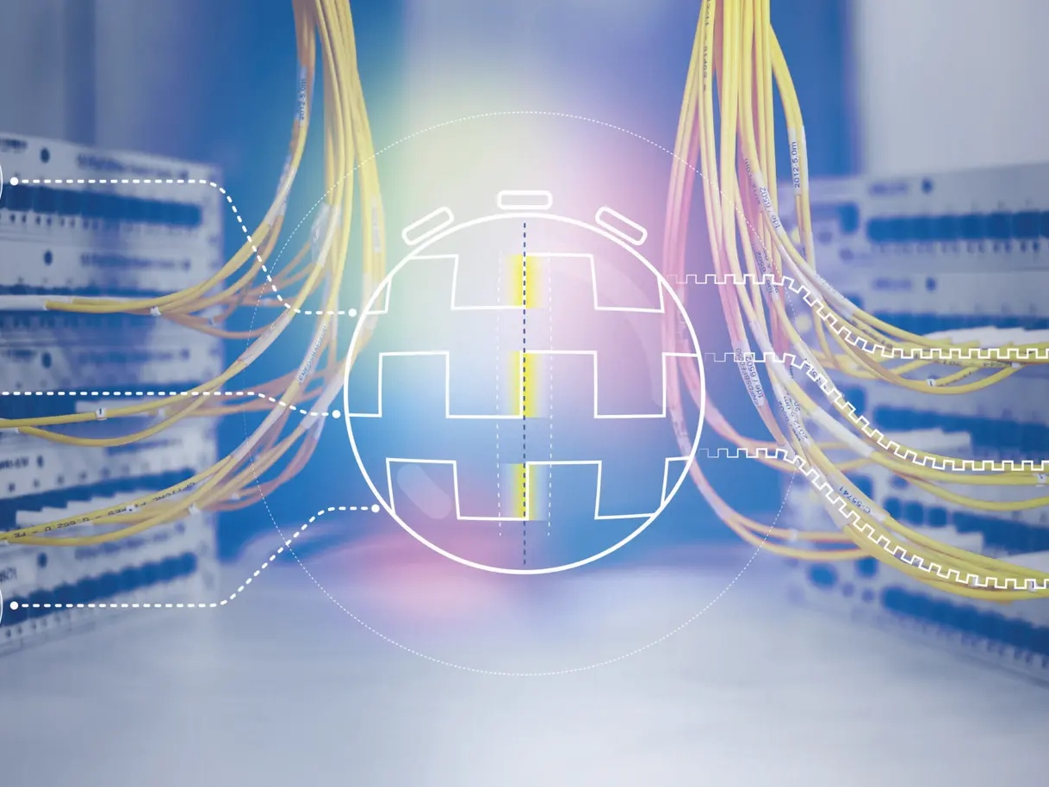


Launch ceremony and workshop in March 2024
From 8 founding partners to 18 members in a year
White Rabbit Collaboration
4 collaboration members are from the finance sector:
Deutsche Börse (DE), Jump Trading (UK),
Liquid-Markets Solutions (CH), Quincy Data (USA)
IQD (UK), GMV (UK) and CERN are working together to realise a new commercially available White Rabbit Switch box
GMV will deliver a fibre-optic time distribution product which could protect the UK’s critical infrastructure from potential GNSS outages
“A key distinctive feature of White Rabbit is that it is open source and based on standards”
Javier Serrano, CERN, Chair of the White Rabbit Collaboration Board and co-inventor of the technology
Notes:
One of the earlier non-scientific adopters of WR lies in the finance sector, where precision timing is essential for high frequency trading, market integrity and regulatory compliance. Currently, four WR Collaboration members come from the finance sector:
Germany’s Deutsche Börse uses White Rabbit for monitoring, verifying that the trading system stays fair, and to provide a high precision timestamp service to its clients.
Quincy Data, USA, is providing a timing service based on WR to the finance sector.
While Jump Trading, UK, is exploring the use of WR for their trading activities.
Liquid-Markets Solutions (LMS), based in Switzerland, has developed a Network Interface Card incorporating WR, which is being tested by selected clients. It was unveiled at a joint event with CERN at the Intel offices in Japan in autumn 2024, showcased at International Timing and Sync Forum ITSF (ITSF) 2024 and the International Conference for High Performance Computing, Networking, Storage, and Analysis in Atlanta, USA. The product has the potential to create a new market, by enabling precision time transfer all the way to the host, with the first clients expected from the finance sector.
Within the framework of the White Rabbit Collaboration, IQD, GMV and CERN are working together to realise a commercially available White Rabbit Switch box built to Version 4 of the design. https://www.iqdfrequencyproducts.com/en/about-iqd/white-rabbit-collaboration
GMV, a UK-based company, will be the first company to commercialise version 4 of the White Rabbit Switch, based on CERN’s open-source design. It will deliver a fiber-optic time distribution product which could protect the UK’s critical infrastructure from potential GNSS outages. This product, expected in the coming years, holds significant export potential, addressing global concerns about over-reliance on vulnerable satellite signals.
Backed by £2 million in funding from Innovate UK, this project aims to establish a time distribution product that will contribute to the creation of a national timing ecosystem and support the domestic supply chain.
In 2024, GMV focused on the final development and prototyping of the switch, working closely with CERN. Thanks to this close collaboration and government funding GMV has created a dedicated team and built its in-house expertise in White Rabbit technology.
Owing to the expansion slot, a new feature of version 4, the switch allows the easy integration of additional capabilities in the form of add-on expansion boards. The first to be available will integrate cutting-edge quantum clock technology to ensure continued operation for certain periods of time in case of failure of the source of time, e.g. in the case of GNSS outrage.
IQD Frequency Products, based in the UK, is engaged in a dedicated R&D project within the White Rabbit Collaboration to develop this first expansion board enables switching to a redundant source of time, the quantum clock, after fault detection. This capability enhances reliability in critical applications.

Slide 12
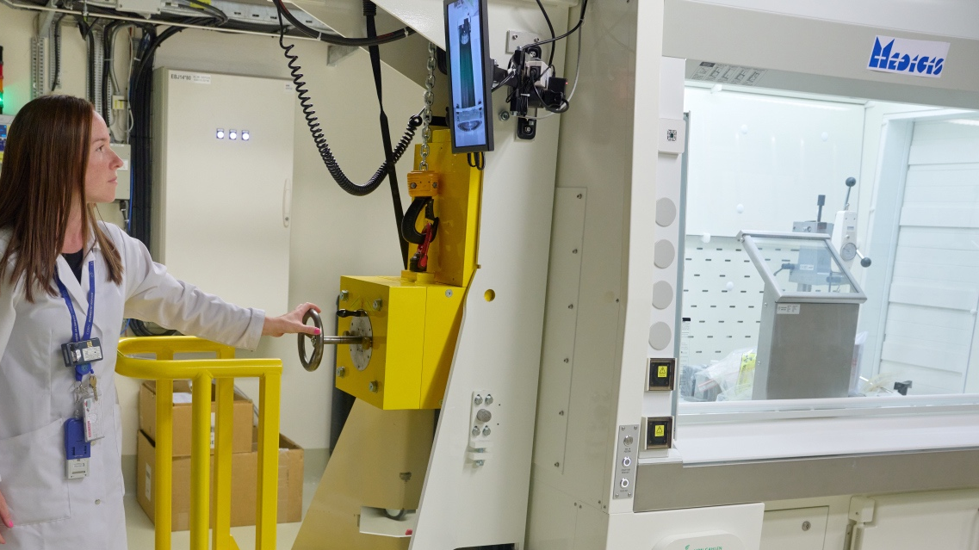

CERN-MEDICIS
Accelerating the progress of European nuclear medicine
Healthcare
7 years of CERN-MEDICIS
Important milestones (again) in terms of output of the facility and record separation efficiency
Provided innovative radionuclides to several hospitals and research institutes such as CHUV (CH), the Klinik und Poliklinik für Nuklearmedizin in Dresden (DE), CEMTHI (FR), the NPL (GB), KU Leuven (BE)
International review panel in December 2023:
“other settings and industrial facilities will never have such a power of innovation and development”
CERN Knowledge Transfer 2023 Highlights
Notes:
https://report2024-kt.web.cern.ch/advancing-the-future-of-european-nuclear-medicine/
In 2024, CERN-MEDICIS has once again achieved important milestones in terms of output of the facility – such as the collection of 1500 MBq Ra-224/Pb-212 and 380 MBq of Ra-225/Ac-225, corresponding to the production of 8 and 38 clinical doses equivalent, respectively.
The facility reached a record separation efficiency higher than 70% for Ra.
The facility has provided batches of innovative radionuclides to several hospitals such as the Centre Hospitalier Universitaire Vaudois (CHUV) in Switzerland and the Klinik und Poliklinik für Nuklearmedizin in Dresden, Germany, as well as to research laboratories such as the Conditions Extrêmes et Matériaux : Haute Température et Irradiation (CEMTHI) in France, the UK’s National Metrology Institute (NPL) in London and KU Leuven in Belgium.
Through these successful productions and deliveries, CERN-MEDICIS has shown its possibility and capability to produce activity levels and purity levels suitable for clinical applications and received twice the requests from medical doctors to translate its radionuclide for clinical trials.
CERN-MEDICIS is also at the heart of the EC-funded project PRISMAP, which federates key European stakeholders for the translation of emerging radionuclides into medical diagnosis and treatment. The technologies and methods being honed at MEDICIS will directly benefit the future facilities aimed at large-scale radionuclide production through mass separation. Among the 47 user projects approved for funding within PRISMAP, two of them are ready for clinical translation including one requesting radionuclides from CERN-MEDICIS.

Slide 13
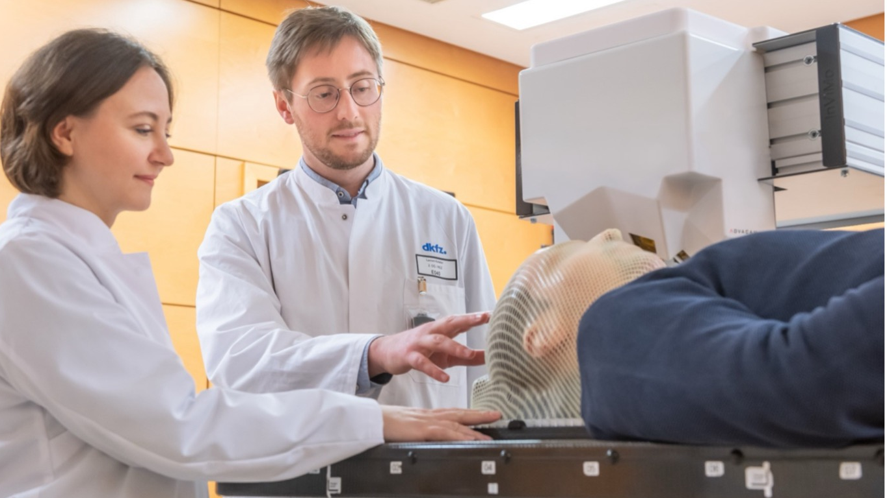
Timepix3
Improving head tumour radiotherapy
Healthcare
First patient trials for a new Timepix3-based imaging device by ADVACAM (CZ) carried out by scientists from the German National Center for Tumor Diseases (NCT), the German Cancer Research Center (DKFZ), and the Heidelberg Ion Beam Therapy Center (HIT).
”The new device will allow us to reduce the overall irradiated volume of tissue, saving healthy tissue and reducing the side effects of radiotherapy. We will also be able to apply higher doses of radiation to the tumour”
Mária Martišíková, head of the DKFZ team
.
Notes:
The Timepix3 detector, developed at CERN as part of the Medipix3 Collaboration, has been customised and embedded in a dedicated device, “Beam TraX”, by the Czech company ADVACAM, and used in first patient trials, InViMo, by scientists from the National Center for Tumor Diseases (NCT) Heidelberg, the German Cancer Research Center (DKFZ) and the Heidelberg Ion Beam Therapy Center (HIT) at University Hospital Heidelberg (UKHD).
These trials are focusing on patients with tumors near the base of the skull, where precise irradiation is extremely important due to the proximity of essential structures such as the brainstem. The ADVACAM device is used to track charged nuclear fragments generated when ions pass through the tissues: this secondary-particle imaging technique could help target cancer cells more accurately in ion radiotherapy of head and neck tumours with the aim of reducing irradiation of surrounding healthy tissue.
The sensitive surface area makes the quad module one of the largest commercially available Timepix3-based plug-and-play particle trackers. Future mini-tracker developments based on Timepix4 promise an even larger sensitive surface area and further improved time resolution.

Slide 14
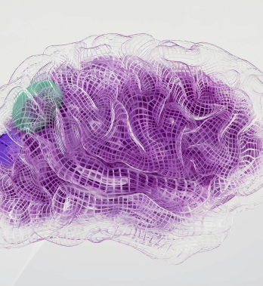
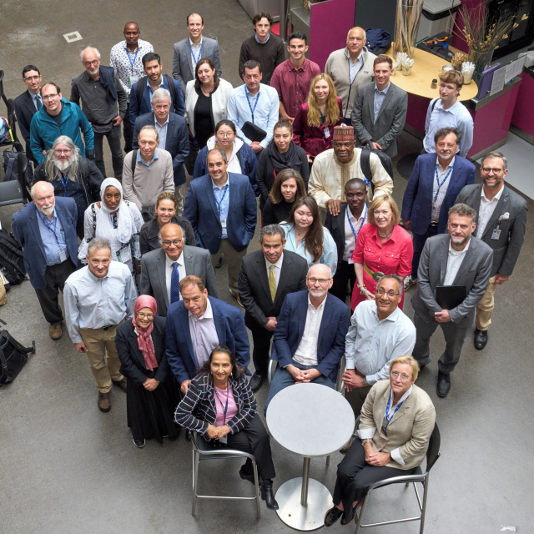
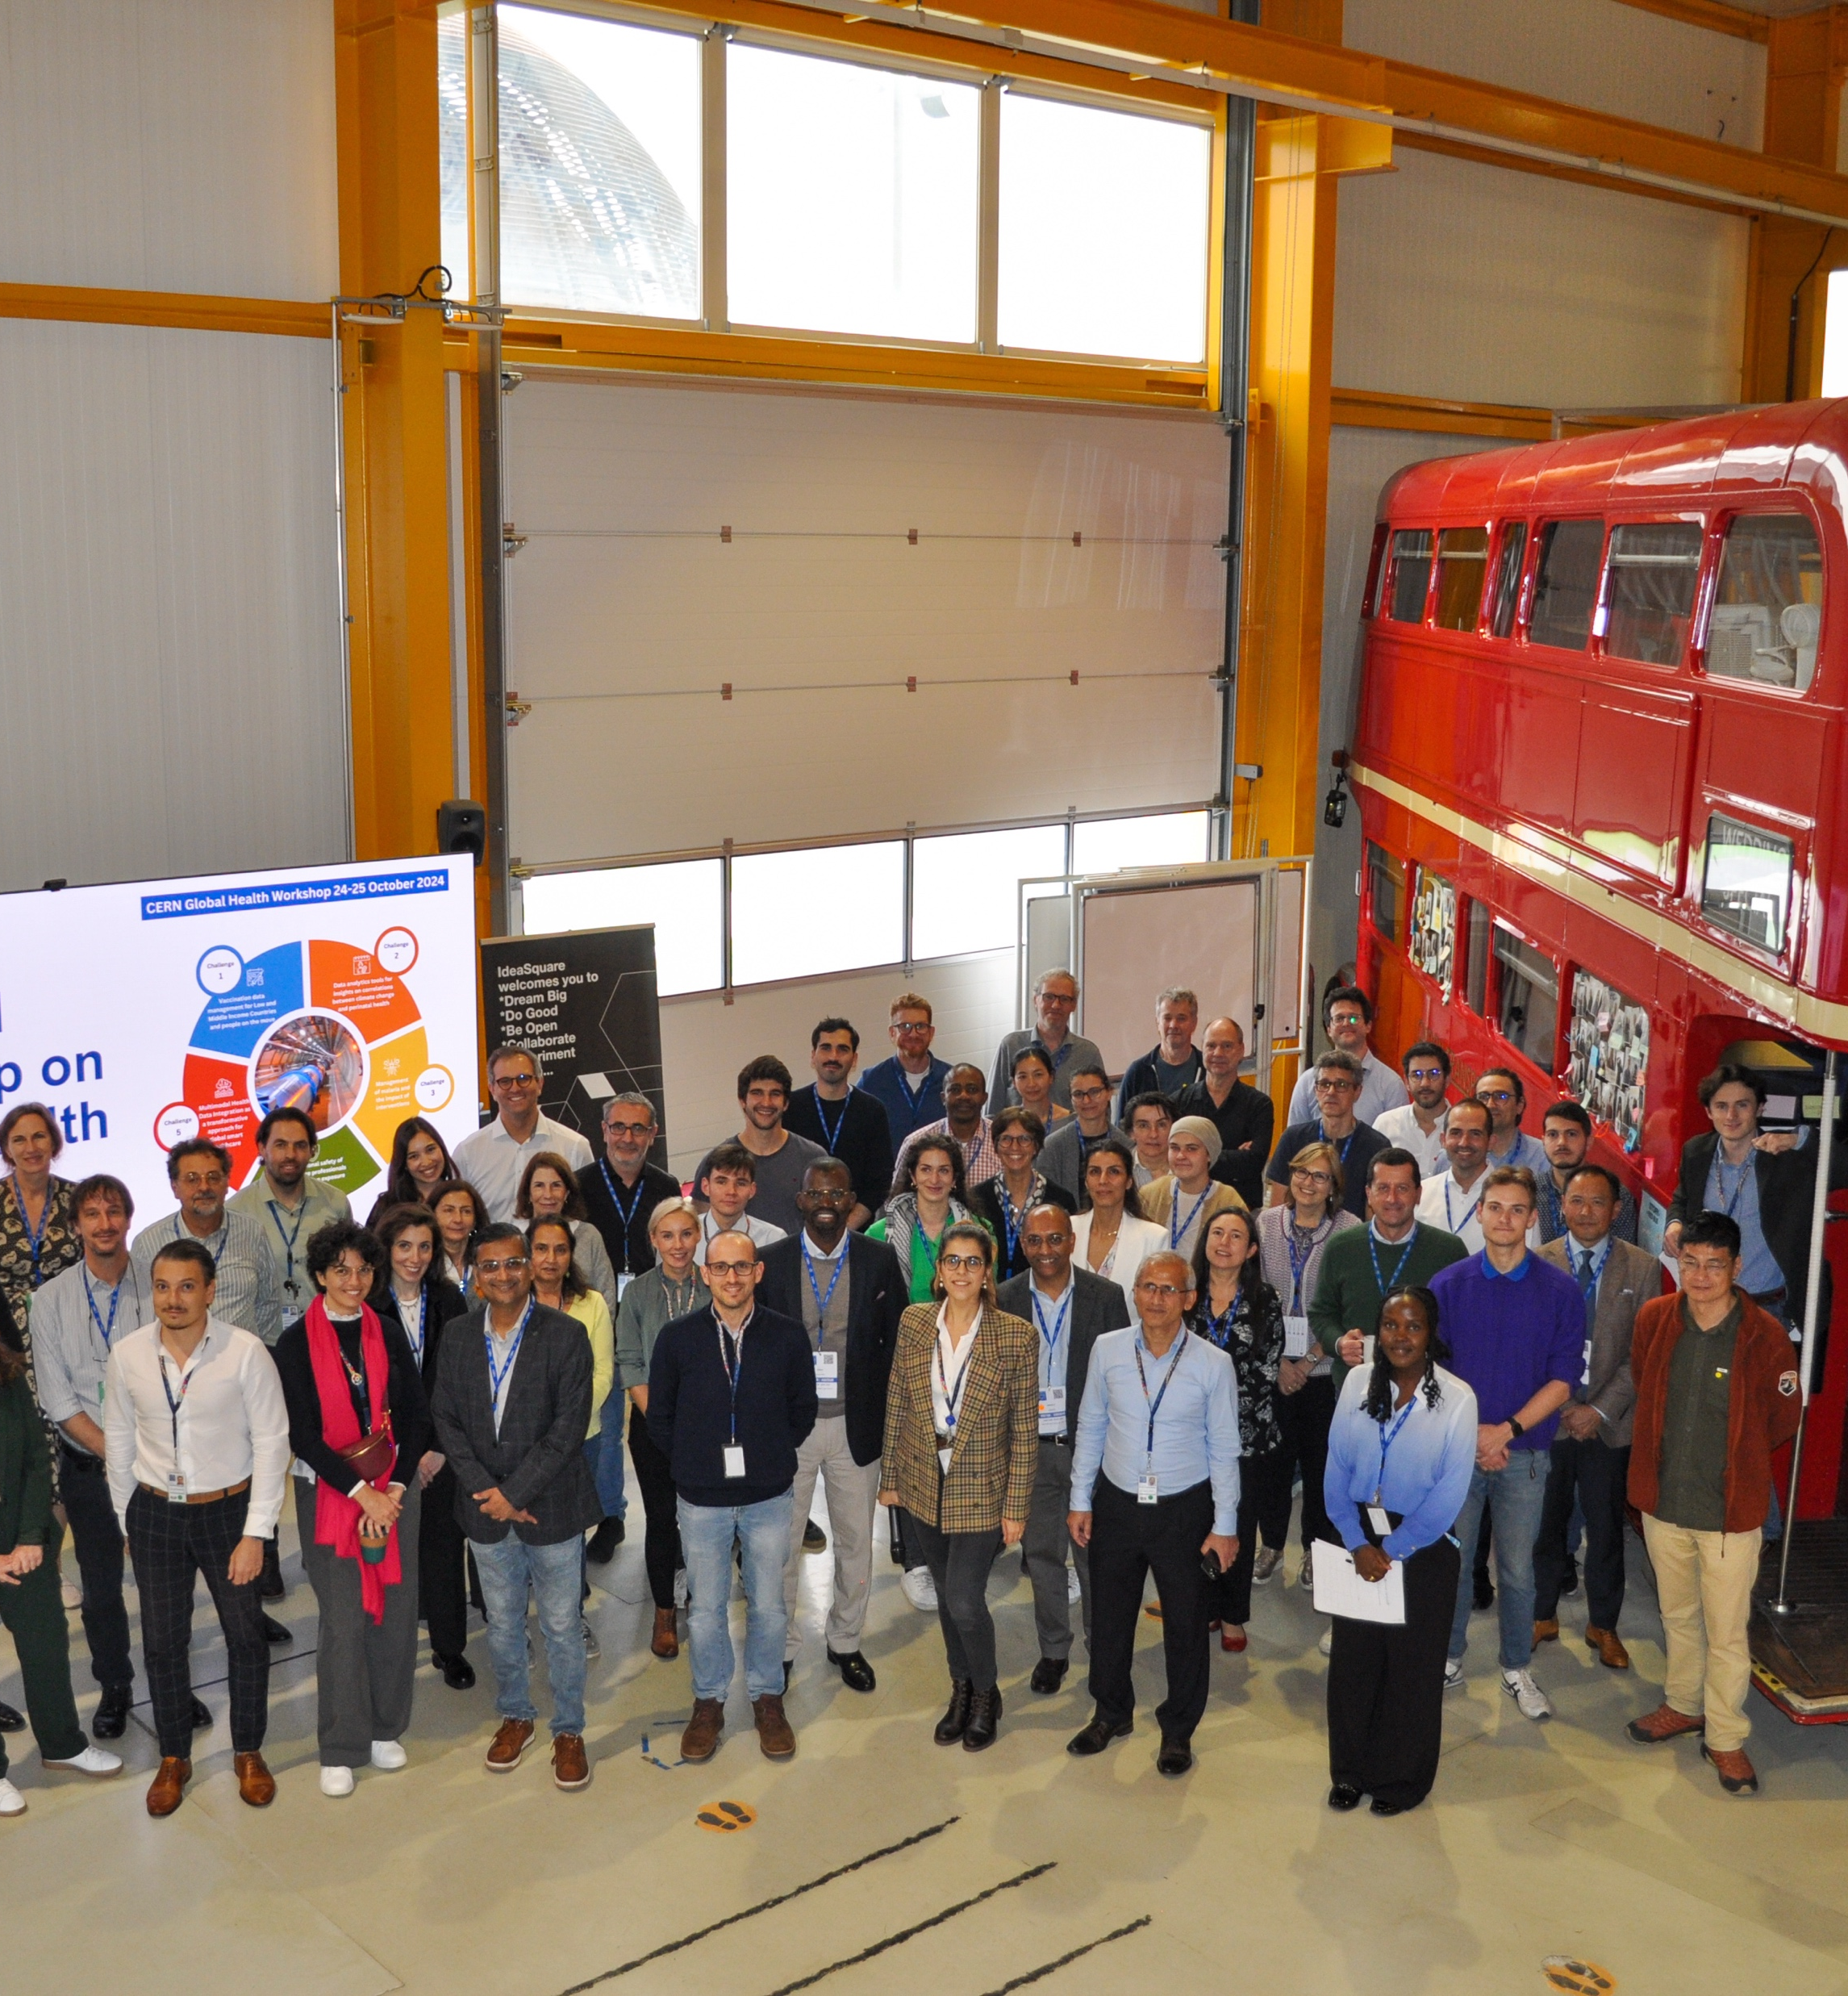
Healthcare
New EU-funded project: UMBRELLA
Smart Technologies to Extend Lives with Linear Accelerators (STELLA)
Global Health Workshop
18-month design study launched by CERN and ICEC. Collaboration with Cambridge, Lancaster and Oxford universities, network of 28 LMICs
Co-creation workshop with healthcare professionals, field experts from NGOs, technology experts, and researchers
CERN’s federated-learning platform CAFEIN set to revolutionise stroke patient care
Notes:
CERN’s federated learning platform, CAFEIN, underpins the data ecosystem at the heart of the EU-funded project UMBRELLA, which aims to transform stroke care across Europe over the next five years. The project is driven by a consortium of over 20 public and private partners co-led by Vall d’Hebron Research Institute (VHIR) and Siemens Healthineers, and kicked off in October 2024.
UMBRELLA will implement a comprehensive approach that addresses gaps along the whole stroke care pathway, from diagnosis and emergency treatment, right through to rehabilitation and the prevention of further strokes. Central to the project is the training and testing of new AI algorithms via a federated learning framework. This approach ensures that the AI models benefit from being trained on multiple datasets, but because the data is not shared or pooled, security and privacy are ensured.
The Innovative Health Initiative (IHI), a partnership between the European Union’s Horizon Europe Research and Innovation programme, industry partners, and industry associations (COCIR, EFPIA, Europa Bío, MedTech Europe, and Vaccines Europe) will fund the project with close to 27 MEUR.
(TrusTstroke focuses on managing stroke patients and assessing disease progression, focusing on:
Clinical worsening leading to unplanned hospital readmissions.
Poor mobility, incomplete recovery and unfavorable clinical long-term outcomes.
Stroke recurrence.
STELLA & Global health workshop: focusing on exploring the potential of CERN tech for global health
STELLA
In 2024, CERN and the International Cancer Expert Corps (ICEC) started a pre-design study for a radiotherapy system. The Smart Technologies to Extend Lives with Linear Accelerators (STELLA) 18-month study is being carried out in collaboration with the UK universities of Cambridge, Lancaster and Oxford, in conjunction with a network of 28 low- and middle-income countries (LMICs). STELLA aims to re-engineer medical linear accelerators (linacs) to function effectively in challenging environments, such as those found in LMICs. This involves developing robust, cost-effective, and user-friendly systems that can withstand infrastructural limitations such as inconsistent power supplies and limited maintenance capabilities. If successful, STELLA will help facilitate radiotherapy delivery in conditions where traditional systems would be less able to function.
Global Health workshop
In October 2024, in collaboration with the Geneva Health Forum, CERN organised a co-creation Workshop on Global Health. The five interdisciplinary working groups gathered healthcare professionals, field experts from NGOs, technology experts, and researchers who explored innovative solutions to pressing global health challenges.
The workshop identified concrete solutions leveraging CERN’s expertise, including: a real-time decision-support tool for health workers administering vaccinations; an AI-powered global framework for malaria predictive modelling; R&D needs in real-time dosimetry, radiation visualisation, and radiation protection materials. The implementation of these solutions is being pursued in different ways, including through multi-partner funding applications.

Slide 15

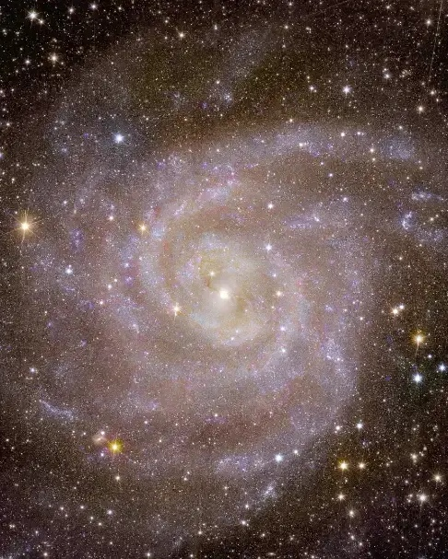
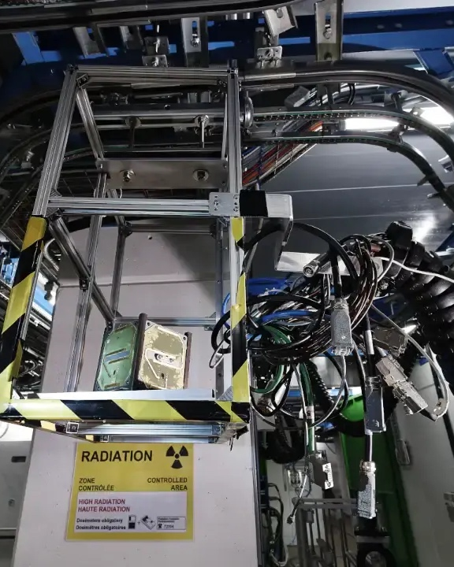
Aerospace
10 years
EU-funded project: HEARTS
Pilot run for external users at CERN’s Proton Synchrotron
CERN-ESA collaboration
https://cerncourier.com/a/cern-and-esa-a-decade-of-innovation/
“The HEARTS set-up provides unique testing capabilities, allowing users to expose components to very-high-energy heavy ions”
Renaud Mangeret, radiation effects expert at Airbus,
and one of the users.
Notes:
https://cerncourier.com/a/cern-and-esa-a-decade-of-innovation/
Euclid first became a CERN-recognised experiment in 2015. CERN also contributes to the development of Euclid’s “science ground segment” (SGS), which processes raw data received from the Euclid spacecraft into usable scientific products such as galaxy catalogues and dark-matter maps. CERN’s virtual-machine file system (CernVM-FS) has been integrated into the SGS to allow continuous software deployment across Euclid’s nine data centres and on developers’ laptops.
Jupiter Icy Moons Explorer (JUICE) mission, which will make detailed observations of the gas giant and its three large ocean-bearing moons Ganymede, Callisto and Europa.
Before JUICE, the direct and indirect impact of high-energy electrons on modern electronic devices, and in particular their ability to cause “single event effects”, had never been studied before. Two test campaigns took place in the VESPER facility, which is part of the CERN Linear Electron Accelerator for Research (CLEAR) project. Components were tested with tuneable beam energies between 60 and 200 MeV, and average fluxes of roughly 10⁸ electrons per square centimetre per second, mirroring expected radiation levels in the Jovian system.
JUICE was successfully launched in April 2023, starting an epic eight-year journey to Jupiter including several flyby manoeuvres that will be used to commission the onboard instruments (see “Flyby” figure). JUICE should reach Jupiter in July 2031. It remains to be seen whether test results obtained at CERN have successfully de-risked the mission.
In 2017 and 2018, ESA teams came to CERN’s North Area with several partner companies to test the performance of radiation monitors, field-programmable gate arrays (FPGAs) and electronics chips in ultra-high-energy ion beams at the Super Proton Synchrotron.
ESA’s φ-lab and CERN’s Quantum Technology Initiative are sponsoring two PhD programmes to study the potential of quantum machine learning, generative models and time-series processing to advance Earth observation.
in August 2021 ESA astronaut Thomas Pesquet activated the LUMINA experiment inside the International Space Station (ISS), as part of the ALPHA mission. Developed under the coordination of the French Space Agency and the Laboratoire Hubert Curien at the Université Jean-Monnet-Saint-Étienne and iXblue, LUMINA uses two several-kilome
LUMINA complements dosimetry measurements performed on the ISS using CERN’s Timepix technology tre-long phosphorous-doped optical fibres as active dosimeters to measure ionising radiation aboard the ISS.
ESA supported studies to develop the CHARM heavy ions for micro-electronics reliability-assurance facility – CHIMERA for short
Initiated in partnership with the University of Montpellier and ESA, and launched in July 2022, CELESTA was CERN’s first in-orbit technology demonstrator.
Advacam collaborated with the Czech Technical University to provide a Timepix-based radiation-monitoring payload called SATRAM to ESA’s Proba-V mission to map land cover and vegetation growth across the entire planet every two days.
HEARTS
In November 2024, 10 companies and institutions spent over 150 hours at CERN testing electronic components and modules for a variety of uses in space, blasting them with very high-energy lead beams from the Proton Synchrotron (PS) at the recently developed HEARTS@CERN facility.
These experiments represented a pilot run for the EU-funded High-Energy Accelerators for Radiation Testing and Shielding (HEARTS) project, which aims to establish two new radiation testing facilities for space applications, one at CERN and the other at the GSI Helmholtz Centre for Heavy Ion Research in Germany.
https://report2024-kt.web.cern.ch/boosting-europes-space-radiation-testing-capabilities/

Slide 16


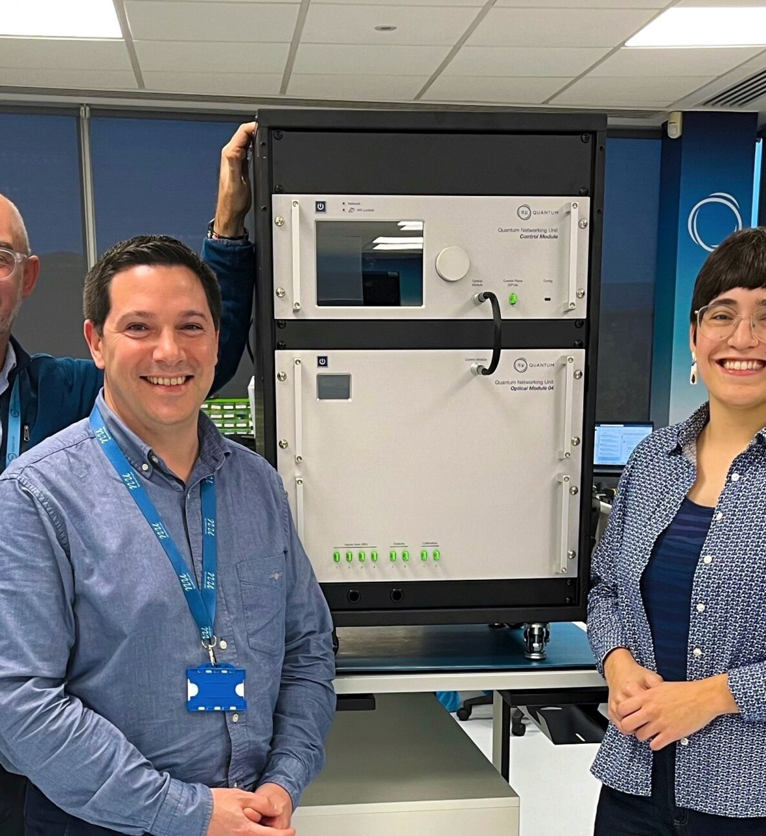
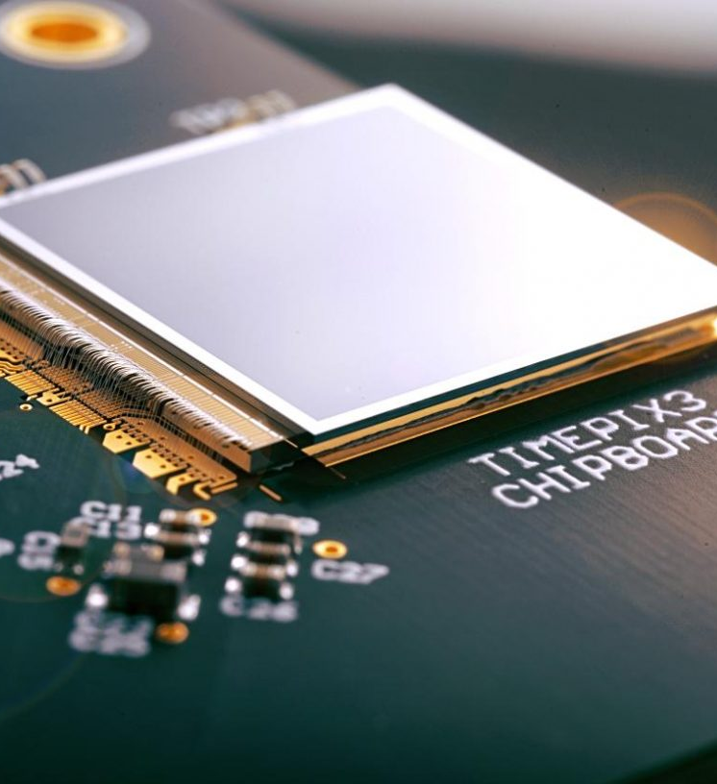
Quantum
CERN QTI
Centre of Competence “Collaboration for Impact”
White Rabbit used to synchronise network components in demonstrations of quantum entanglement
Nu Quantum (UK) is the first industrial partner to use White Rabbit for quantum technology applications
Timepix3-powered chips by Amsterdam Scientific Instruments (NL) increasingly used in quantum applications
Notes:
KT leads the QTI centre of competence “Collaboration for Impact”.
It provides centralised and coordinated support to QTI collaboration activities covering a range of R&D activities across CERN, involving industrial and academic partners.
This mechanism is a good example of the advantages related to having structured initiatives at CERN, such as QTI or, in the future, AI.
Additional note: If somebody asks for an example, cite the unified contract template for all QTI activities with external partners.
In 2024, significant effort was made to reach out to global experts in quantum science and engineering to bring them together for a pivotal conference in early 2025 and shape joint activities within the QTI.
A key area of focus in quantum communications is on exploiting the quantum properties of light to ensure undecipherable, secure communications in a future world with quantum computers. These technologies, which are currently the most mature in this realm, are grouped together in what is usually referred to as quantum key distribution.
Most progress in this area is currently in academia, although there are also start-ups that are, today, aiming at this ambitious goal. To achieve the quantum internet, researchers need to distribute so called ‘entanglement’. That is, create a ‘quantum connection’ between two distant quantum objects. Doing so requires very precise timing to the order of billionths of a second across the network.
The CERN-born technology, White Rabbit, can potentially achieve this connection over hundreds of kilometres.
In 2024, research results were published demonstrating how White Rabbit was used to synchronise components within a network during several important demonstrations where quantum entanglement was distributed over tens of kilometres in a city environment.
For example, in the Netherlands, a quantum metropolitan link between Delft and Den Haag was created using White Rabbit. In this case, researchers successfully linked individual nitrogen atoms which were embedded in small diamond crystals, creating the ability to communicate through a 25-kilometre optical fibre cable.
As another example, researchers used White Rabbit to help deploy a large-scale intercity quantum network connecting laboratories at Stony Brook University and the Brookhaven National Laboratory in the United States of America. Their experiments focused on entanglement-based quantum networking, connecting multiple sites in an urban environment, tens of kilometres apart across Long Island, New York.
Nu Quantum https://report2024-kt.web.cern.ch/nu-quantum/
Nu Quantum develops the networking infrastructure that will enable quantum computers to be interconnected into a larger, scalable system– a future data centre-scale quantum computing centre. Their technology focuses on developing interfaces to extract light efficiently from quantum processors as well as quantum networking hardware that facilitates the light-based links between computing nodes. This ambitious project recently received a significant boost: £2.3 million in UK government funding to build a world-first Quantum Networking Unit in a project that incorporates CERN-born White Rabbit (WR) technology for timing.
Amsterdam Scientific Instruments ASI https://report2024-kt.web.cern.ch/asi/
Amsterdam Scientific Instruments (ASI) has become a recognised innovator in the world of quantum science, neutron research, and mass spectrometry. This was accelerated during 2024 when images obtained using an ASI component were published in a research paper that went viral over social media as 2023 drew to a close. That ASI component uses a CERN Timepix3 chip, designed as part of the Medipix3 collaboration. Timepix3 is at the core of ASI products, making it a vital piece of technology that powers ASI’s product line and is central to the company’s success.
By leveraging CERN technologies, ASI has produced a range of products that can handle the most demanding scientific environments, such as ASI’s Chronos Series that includes the Phoebe hybrid pixel detector being used in quantum applications.
ASI’s innovations are also supporting R&D programmes for innovative particle detectors. One example is the use of ASI’s technology in the innovative 3D optical imaging Liquid Argon Time Projection Chamber (LArTPC) built by the ARIADNE project, funded by the STFC and ERC. The ARIADNE technology has the potential to be an alternative to current charge readout methods for future LArTPC neutrino detectors and is a serious candidate for the DUNE Liquid Argon far detector.
This is just one example of how the work of Medipix collaborations and of their licensees influence one another, benefitting both basic research and commercial uptake.

Slide 17





CERN Venture Connect
Connect with investors
and venture startup economy
Get 0% equity,
express agreements
Access breakthrough
CERN technologies
2% royalty only when
revenues higher than 1MCHF

Slide 18

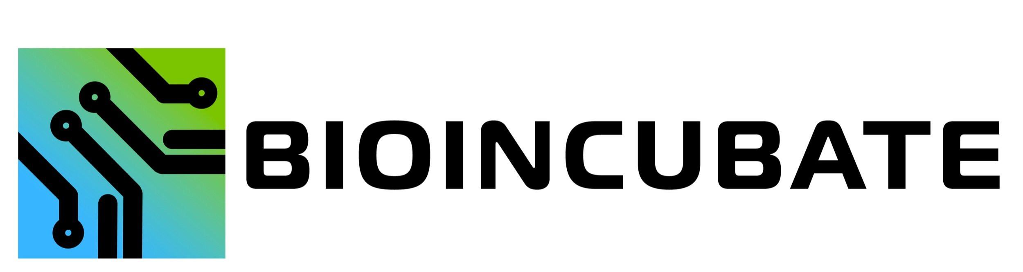


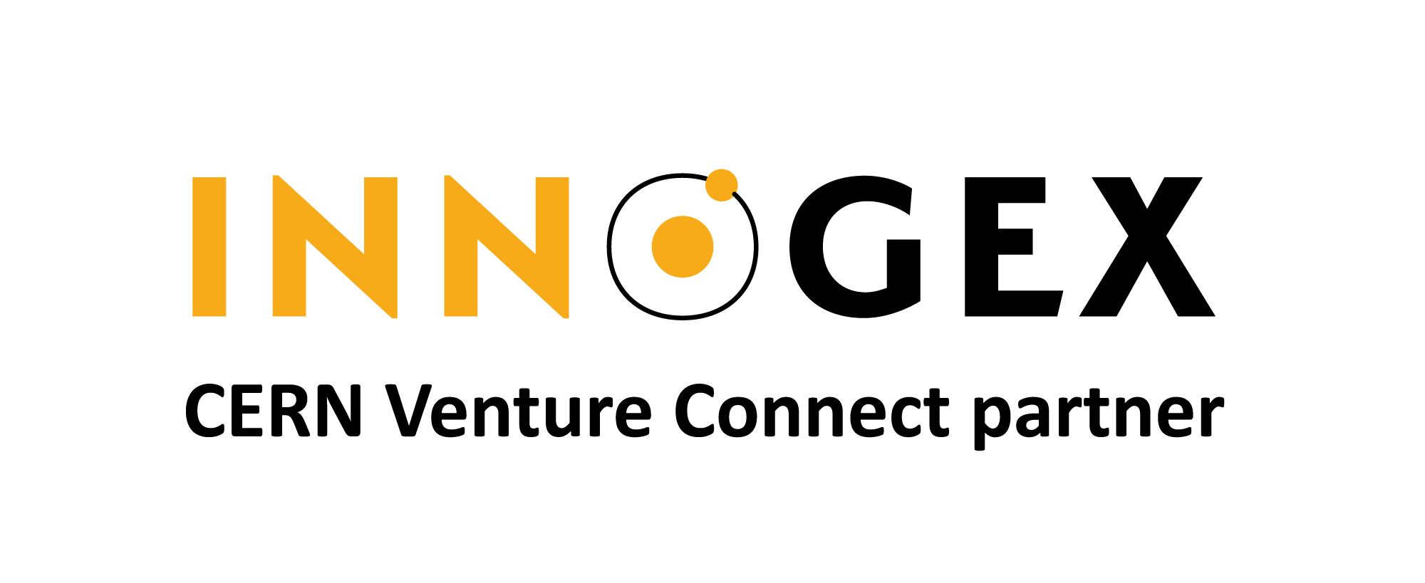
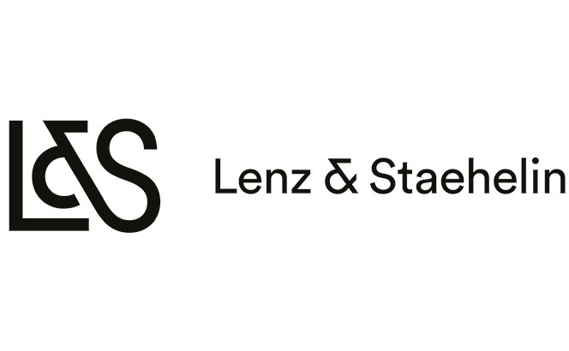



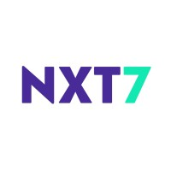
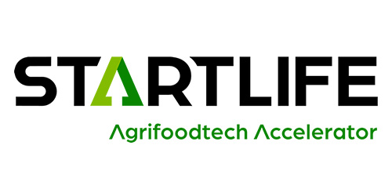









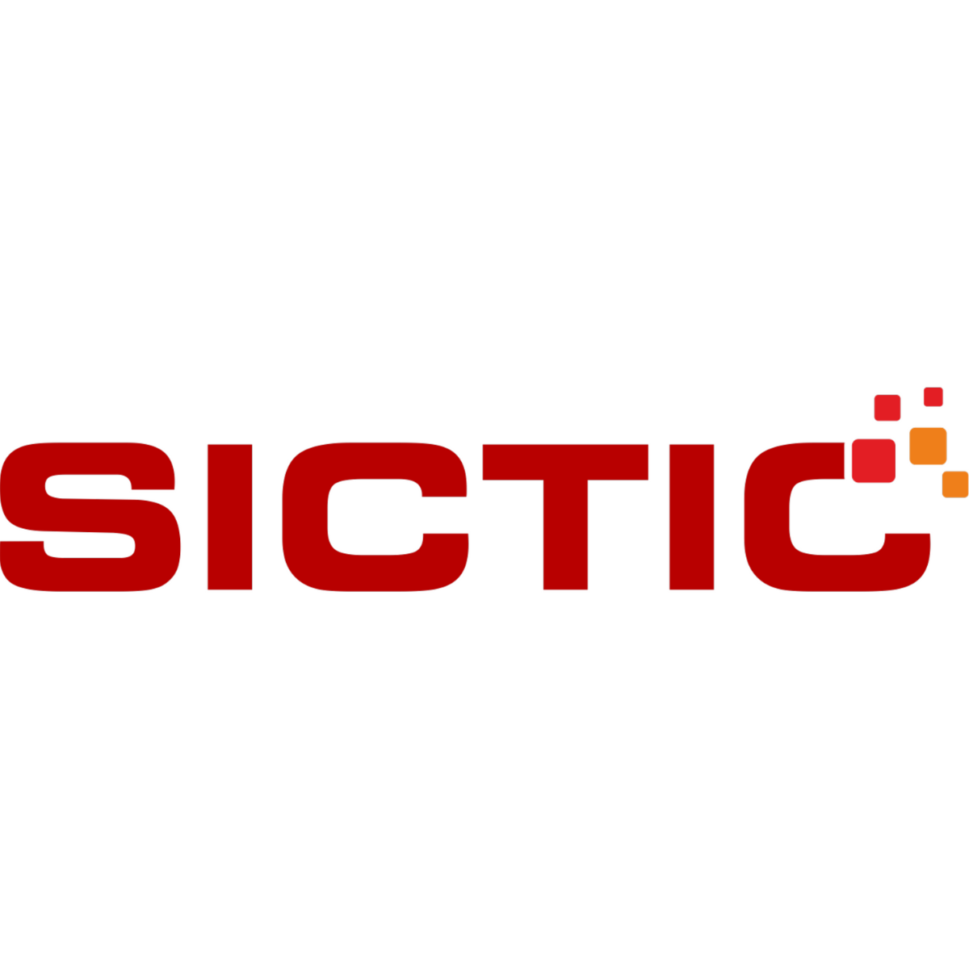

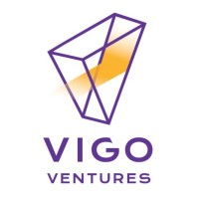

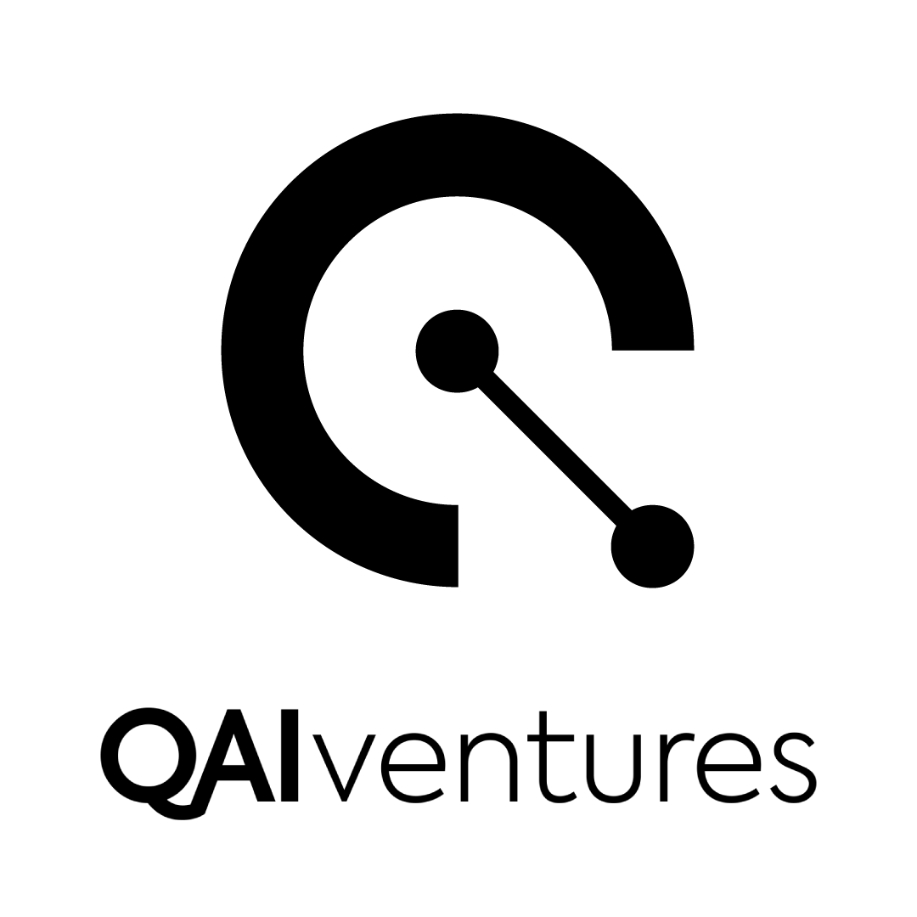

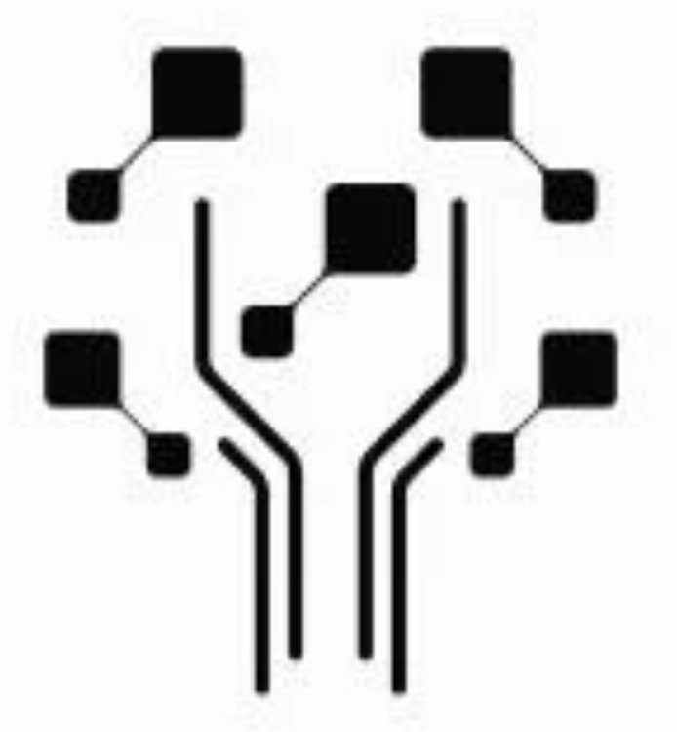
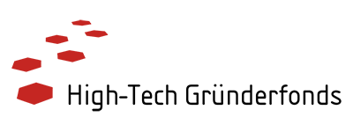
Network of 48 CVC partners - 28 new in 2024
f293305a-a60e-49e1-a9b8-3ec2f13dd3af

Slide 19
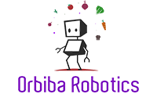


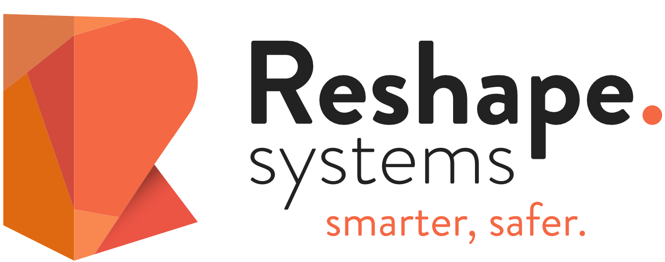

5 startups in 2024

Slide 20
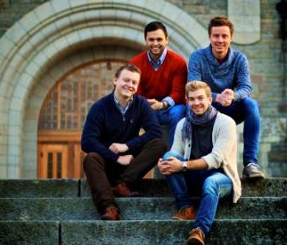

Invenio and Indico for digital libraries
TIND, a library management company building on the CERN open source software Invenio, was established as a result of the CERN-NTNU Screening Week in 2012.
By 2022, they expanded their operations in the United States, opening an office in Palo Alto, California.
TIND delivers the CERN open source software as a professional cloud service. In addition to library management systems, TIND also offers solutions for institutional repositories and research data repositories based on Invenio.
INVENIO is a digital library or repository system that is used to manage the CDS, the CERN Document Server. It is an open source software and CERN has been providing different types of support and service from our technical experts.
TIND founders
Notes:
TIND, a library management company building on the CERN open source software Invenio, was established as a result of the CERN-NTNU Screening Week in 2012.
By 2022, they expanded their operations in the United States, opening an office in Palo Alto, California.
TIND delivers the CERN open source software as a professional cloud service. In addition to library management systems, TIND also offers solutions for institutional repositories and research data repositories based on Invenio.
Received a 1.5 MNOK grant from the NTNU Discovery Fund for developing the company

Slide 21
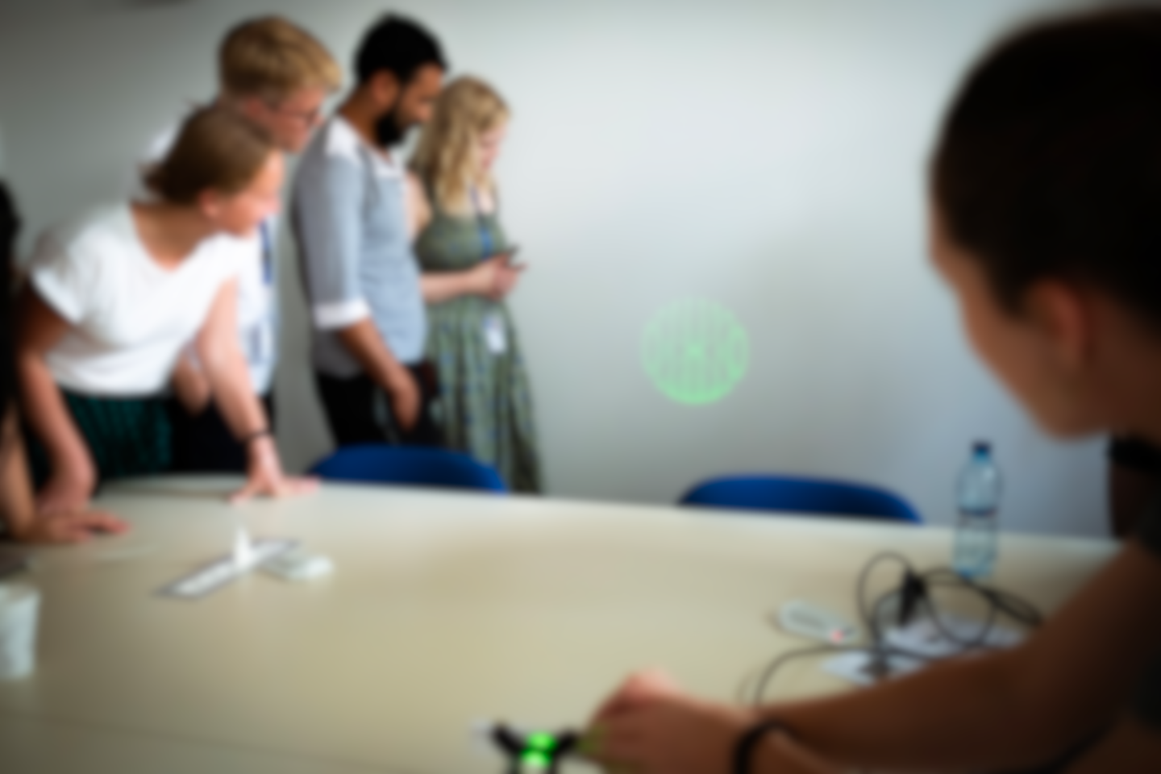
Long-standing CERN-NTNU Collaboration
A Memorandum of Understanding signed CERN and the Norwegian University of Science and Technology (NTNU) defines the scope of cooperation for activities related to feasibility studies at CERN which include:
The NTNU Screening week, wherein around 40 students are able to visit each year
One or two students from NTNU School of Entrepreneurship being able to stay and write their Master thesis in the CERN Knowledge Transfer group
There is also hope to support PhD students from NTNU School of Entrepreneurship, by having them visit CERN for helping them prepare for their PhD at NTNU.
CERN also welcomes faculty from NTNU School of Entrepreneurship who are on sabbatical leave, for non-paid stays.
2019 NTNU students discovering CERN tech (Structured Laser Beam in this case)
Notes:
The Master thesis stay by the NTNU is subject to receipt by CERN of corresponding funding from the Research Council of Norway (RCN).
---
Beyond the CERN-NTNU Screening Week, CERN has a long tradition in training students from NTNU through the CERN doctoral, technical and administrative student programmes. Additionally, CERN and NTNU have recently enhanced their collaboration through the joint PhD programme for engineering students. CERN's Knowledge Transfer group looks forward to continuing this collaboration to keep creating opportunities and make a positive impact while accelerating innovation.
--
A Memorandum of Understanding signed CERN and the Norwegian University of Science and Technology (NTNU) defines the scope of cooperation for activities related to feasibility studies at CERN which include:
The NTNU Screening week, wherein around 40 students are able to visit each year
One or two students from NTNU School of Entrepreneurship being able to stay and write their Master thesis in the CERN Knowledge Transfer group.
There is also hope to support PhD students from NTNU School of Entrepreneurship, by having them visit CERN for helping them prepare for their PhD at NTNU.
CERN also welcomes faculty from NTNU School of Entrepreneurship who are on sabbatical leave, for non-paid stays.

Slide 22
Key lessons learned and key challenges…
  CERN is strong in the ‘extremes’ of the technology scale
  You need passionate experts on both sides to succeed
  Start with a concrete project and clear business need
  Mind the gap – in language, ‘clockspeed’ and culture
  Driving deep tech innovation requires courage
Key challenges
  CERN experts are busy
  Our technologies have low TRL
  What is our Unique Value Proposition?

Slide 23


Explore & Share
Follow us on LinkedIn – CERN Innovation Partnerships
https://report2024-kt.web.cern.ch/

Slide 24
Thank you for your attention

Slide 25
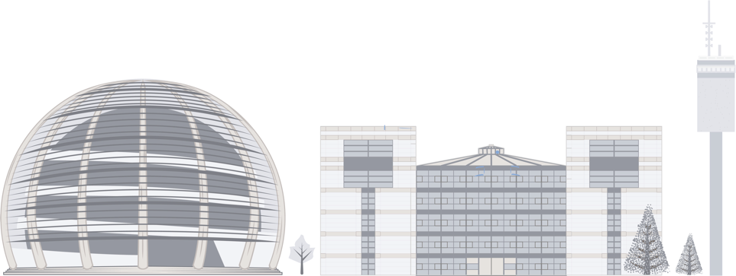
Measuring impact
In 2024 we kicked off a CERN-wide impact study, coordinated for CERN by the KT group, that will cover all aspects of impact
CERN also generates knowledge transfer and impact through technology intensive procurements
→ item 11.c “Report on Procurement Activities in 2024”

Slide 26
Pilot survey on innovation partners
In 2024, a pilot survey was run on 37 CERN innovation partners, delivering evidence of positive impact
Supporting innovation
8 out of 10
Increased their knowledge and enhanced their technological problem solving
Motivating partners
Over 85%
Strengthened research activities
Motivating partners
Over 80%
Strengthened product development
“Our collaboration not only fosters innovation but also enriches ourselves and our collective efforts to advance solutions”
“Our product would not exist if it hadn’t been for the collaboration with CERN”
“Working with CERN made us braver, and more confident in our capabilities”
“The support by CERN was crucial to get the company off the ground”

Slide 27
Pilot survey on innovation partners
In 2024, a pilot survey was run on 37 CERN innovation partners, delivering evidence of positive impact
Boosting recognition and reputation
2 in 5
CERN’s reputation led to an improvement in their financial situation
Increasing competitiveness
Over 70%
Developed new instrumentation, methodologies, or processes used in product development
“CERN’s reputation gives us trust in the market”
“The collaboration with CERN has increased visibility and made our organization more attractive in the recruitment process”
“Customer satisfaction has improved significantly”
“The partnership’s shared knowledge and resources have led to more efficient development and production processes”

Slide 28
Pilot survey on innovation partners
In 2024, a pilot survey was run on 37 CERN innovation partners, delivering evidence of positive impact
Talent pool
Over 75%
Improved the skills of their personnel
Facilitating finance, reducing costs
40%
Reported reduced costs of development and production, and obtained additional funding
“Working with CERN experts is a huge asset that teaches our engineers a lot”
“We appreciate the open technical discussions with the collaboration community which continuously pushes what is technically feasible”
“Working with CERN gives us credibility when talking to investors”
“The collaboration helped us being awarded a £1.25m investment and increasing our workforce from 10 to 40 people”
“If we were to do something like this from the ground up without CERN’s support, we would need investment in the five-to-10-million-euro range”

Slide 29

Digital
Fluka.CERN
8 of 13 licences in 2023-2024 are for commercial purposed
ELI Beamlines (CZ): to provide consultancy services to commercial customers
(already have an institutional licence)
MEVEX (CA): optimise their accelerator system designs in particular for exposure to high neutron
Transmutex (CH): for the design of their subcritical power reactor technology
Marvel Fusion GmbH (DE): for their R&D on laser-driven fusion for energy production
Cerberus Nuclear (GB): to perform radiation shielding and dose uptake assessments for civilian nuclear industry
NorthStar (US): shielding and activation of components in their radiopharma installations
EMPYREAN Medical Systems (US): for radiation oncology technologies
“Fluka really meets the requirements when running radiation safety and impact simulations – it is THE programme to use”
Bryan Verveld, business developer at Demcon Multiphysics

Slide 30
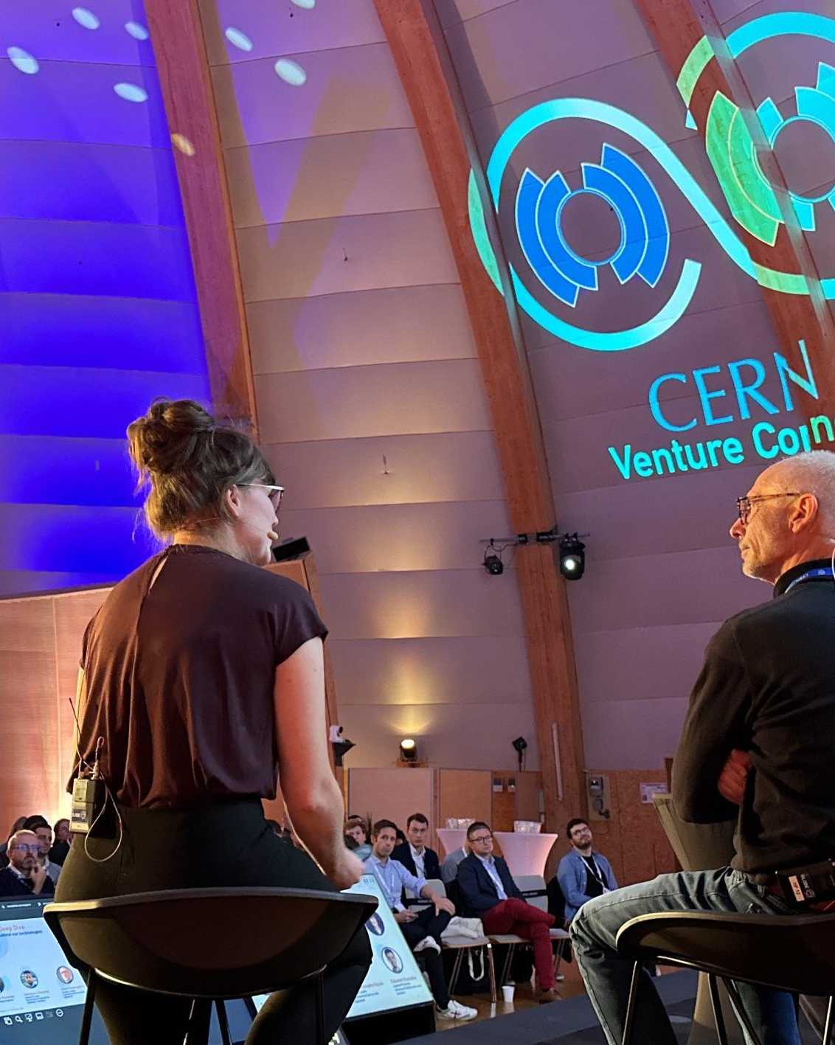
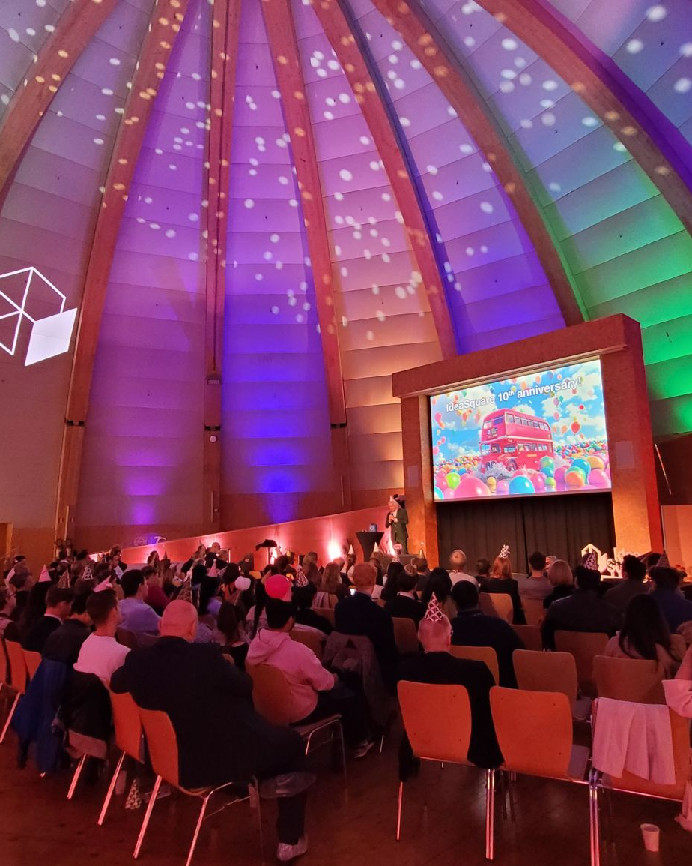
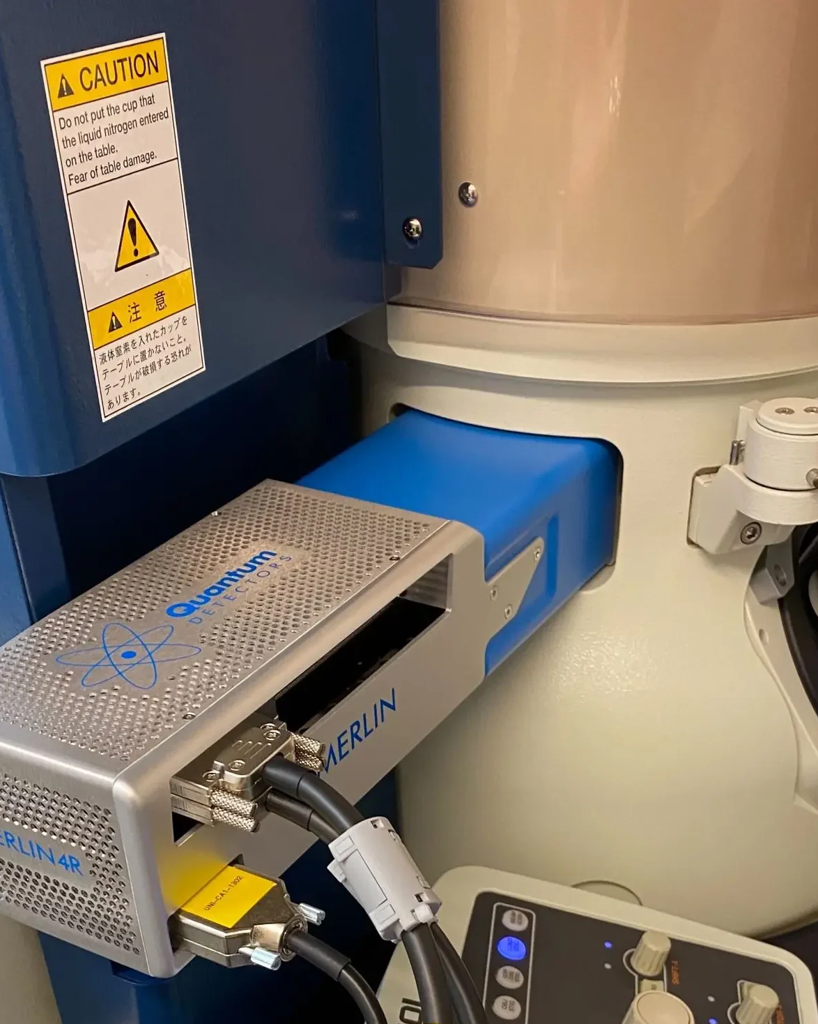
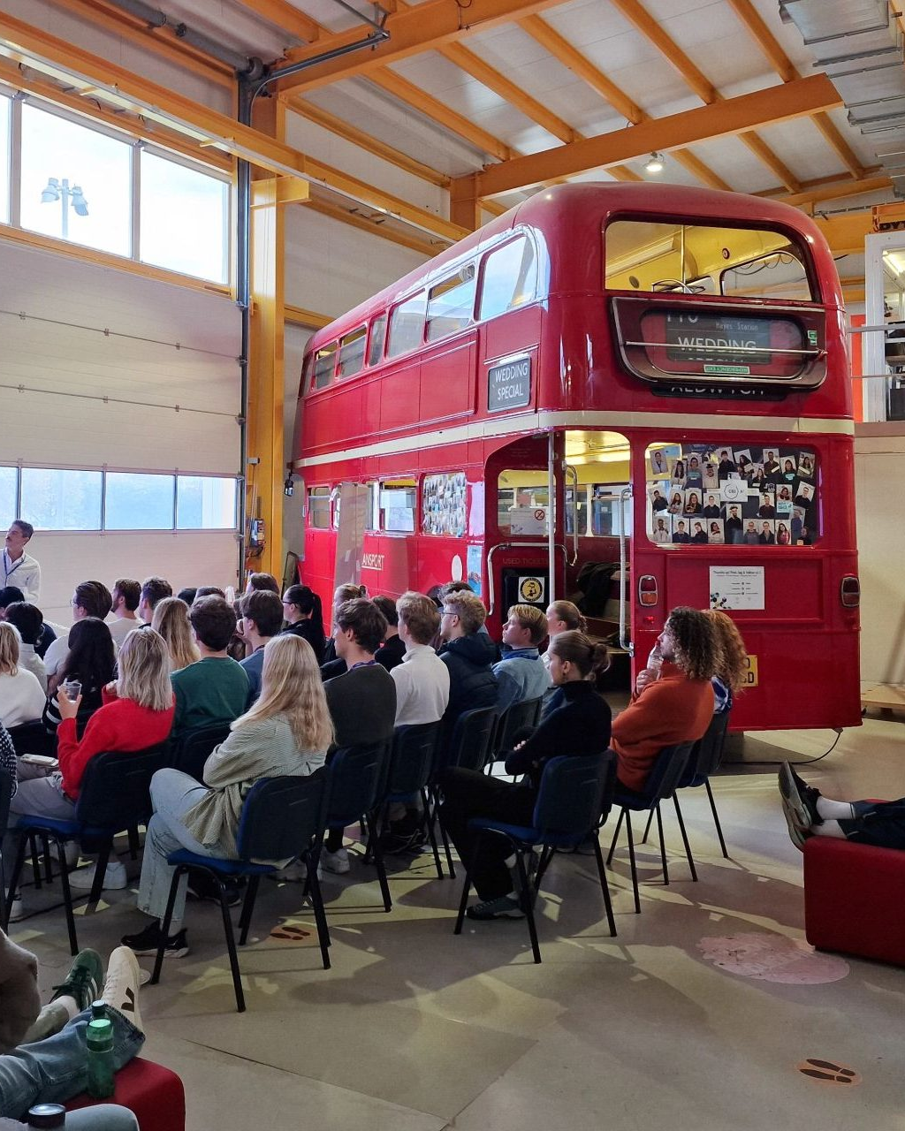
Entrepreneurship events/news
10 years of IdeaSquare
University partnership programme
CVC summit
Quantum Detectors
The CVC community gathered for the first time - fostering deeper connections
Celebrating a decade of innovation at the multipurpose creativity space
Investment, Jobs, Impact: CERN collaboration ‘has been vital’ for UK tech spin-off
CERN continues to foster innovation through academic collaboration, welcoming INSEAD and NTNU in 2024
Notes:
In November 2024, CERN Venture Connect (CVC) marked its first anniversary, expanding its innovation network to 48 deep-tech partners across 15 countries, supporting five pioneering startups, and adding two cutting-edge technologies to its portfolio.
https://report2024-kt.web.cern.ch/cern-venture-connect-summit-boosting-innovation/
The half-day summit brought together more than 100 participants, including technology experts, investors, mentors, and startups, to celebrate achievements, foster new collaborations, and chart the path forward.
IdeaSquare https://report2024-kt.web.cern.ch/partner-spotlight-event-with-microsoft/
As this innovation space at CERN is looking ahead, it also launches new initiatives like IdeaSquare Planet, which challenges students to envision entire societies from scratch using cutting-edge science.
Quantum Detectors uses Medipix3 and Timepix4 chips, developed at CERN in the context of the Medipix collaboration, to make significant improvements to Transmission Electron Microscopy (TEM)
“The collaboration we have with CERN has been instrumental to us over the past five years being awarded a £1.25M investment from shareholders, increasing our workforce from 10 to 40 people and has given us the opportunity to invest millions of pounds into upcoming disruptive new products that will be released imminently”
Roger Goldsbrough, CEO of Quantum DetectorsThe company also received support in 2023 from UK Export Finance to unlock a £300,000 financing package to facilitate expansion into markets outside the UK.
https://report2024-kt.web.cern.ch/investment-jobs-impact-cern-collaboration-has-been-vital-for-uk-tech-spin-off-quantum-detectors/
In 2024, CERN welcomed again executive MBAs from INSEAD, France, and entrepreneurship students from the Norwegian University of Science and Technology (NTNU), School of Entrepreneurship.
33 Executive MBA candidates from INSEAD, accompanied by two facilitators, took part in an intensive deep-tech commercialisation programme, entitled “Deep Tech Key Management Challenges”, at CERN’s IdeaSquare.
“CERN is an amazing partner for our Deep Tech entrepreneurship program at INSEAD. The science innovations they provide are key to our students’ deep dive into the unique challenges facing tough tech venture creation. The team at CERN Venture Connect is motivated and collaborative, the perfect partners to help bring our course alive. And, finishing on CERN’s renowned campus is, of course, an incredible capstone to the months-long programme.”
Professors Adrian Johnson and Bill Magill – INSEAD
a cohort of 47 students from NTNU

Slide 31
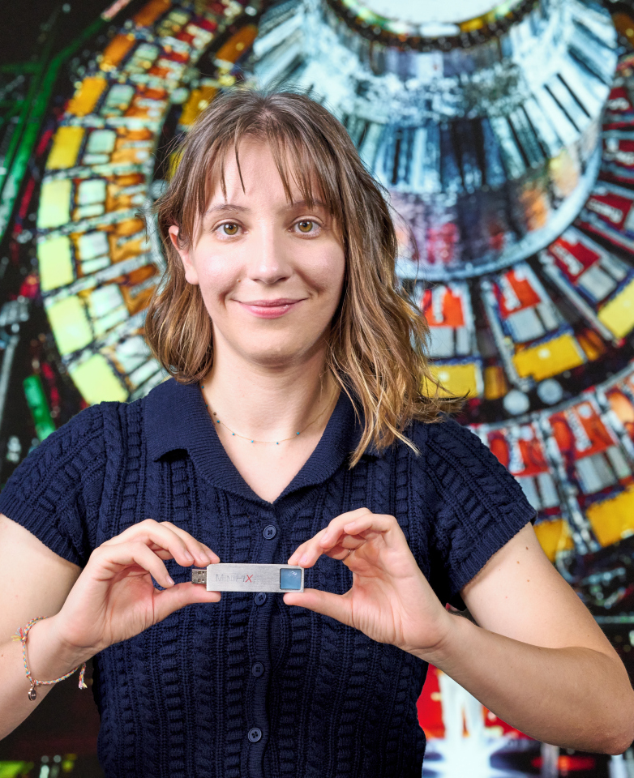
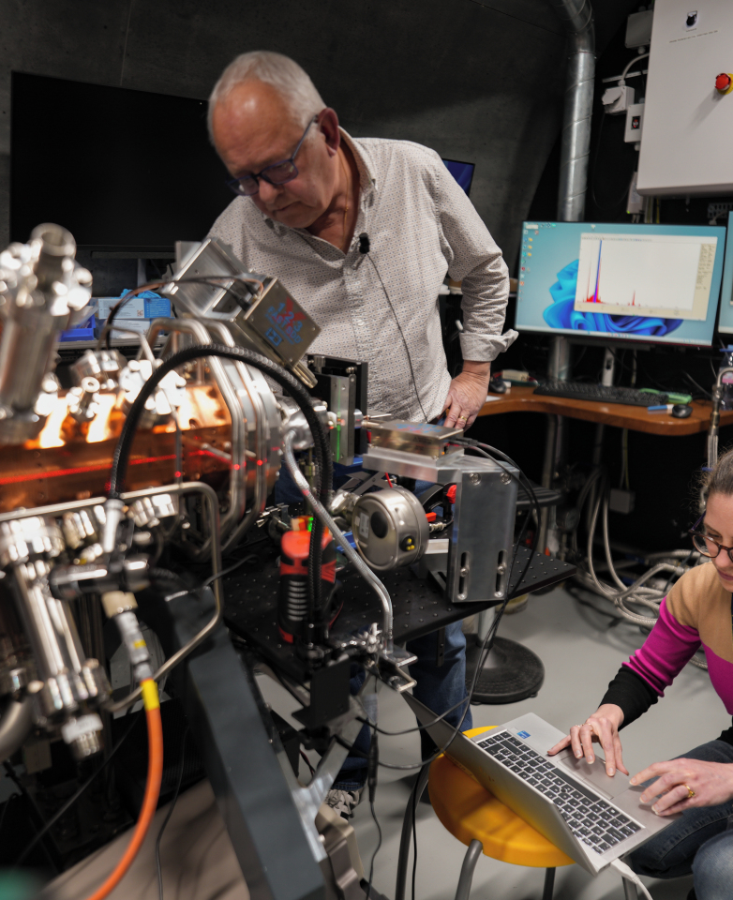
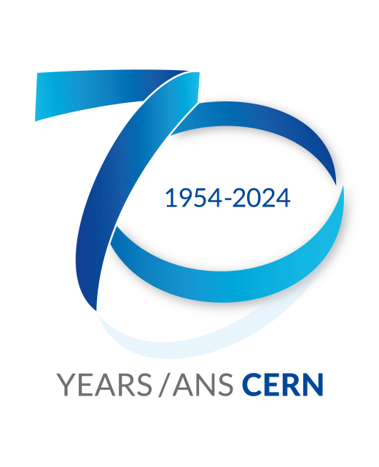
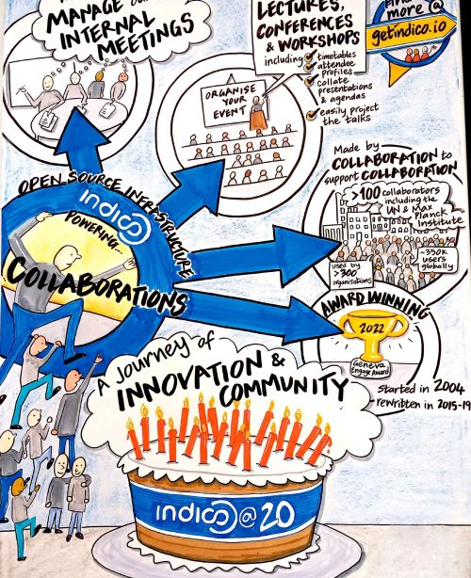
2024 in focus
OSPO & Indico’s 20th anniversary
Timepix@school
ELISA
CERN 70 events
An education project taking CERN technologies into the classroom
CERN Science Gateway now has a working mini proton accelerator
Two knowledge transfer specific events
Indico, the web-based event management tool turned 20
Notes:
After many years of successful pilot schemes, the project, TIMEPIX@school, has been approved as part of the CERN Technology Impact Fund in 2024.
Thank to donations from Rolex and Fondazione Bracco through the CERN and Society Foundation, the philanthropic arm of CERN, the first milestone of the project was completed in 2024. Now more donations are sought to build an international network that will bring the Timepix technology into as many classrooms as possible. The goal being to enable students from all backgrounds to carry out hands-on experiments, with a pocket-sized particle detector and study the radiation all around them.
thanks to CERN’s RFQ (Radio Frequency Quadrupole) technology, smaller transportable accelerators are now possible. One such accelerator, the Experimental Linac for Surface Analysis (ELISA), can now be seen in CERN’s education and outreach centre, the Science Gateway.
ELISA is a one-metre-long version of the first component of Linac 4
, ELISA can analyse objects such as ancient art or archaeological samples. Focusing a proton beam on a sample causes its atoms to emit photons with unique wavelengths specific to its component elements, thus revealing a detailed profile of the sample’s composition. ELISA is similar to another mini accelerator called MACHINA, created in collaboration with INFN, which is soon to be used to study art works with Opificio delle Pietre Dure in Florence.
the most surprising thing about ELISA is that the particle accelerator is conducting this real scientific research whilst being an exhibit at the Science Gateway.
n 29 September 2024, CERN celebrated its 70th anniversary. A rich and varied programme honoured CERN’s contributions to scientific knowledge, technological innovation, and international collaboration. Among the many events, two were specifically devoted to the impact of CERN technologies and know-how:
· From Particle Physics to Medicine
· The Virtuous Circle of Knowledge and Innovation
The exhibition posters on the impact of CERN technologies are available for download in multiple languages. If a language is not showcased, and you’d like to help with the translation, please contact us using the form on the homepage of this website. Further, the CERN@70 videos are available online.
OSPO 1st year
Another example of a successful CERN-developed open source software is Indico, a comprehensive, web-based event management tool which celebrated its 20-year anniversary in 2024. From humble beginnings as an in-house tool for the ATLAS collaboration, it now has 400 000 users and serves a plethora of academic, scientific, and governmental institutions worldwide.

Slide 32

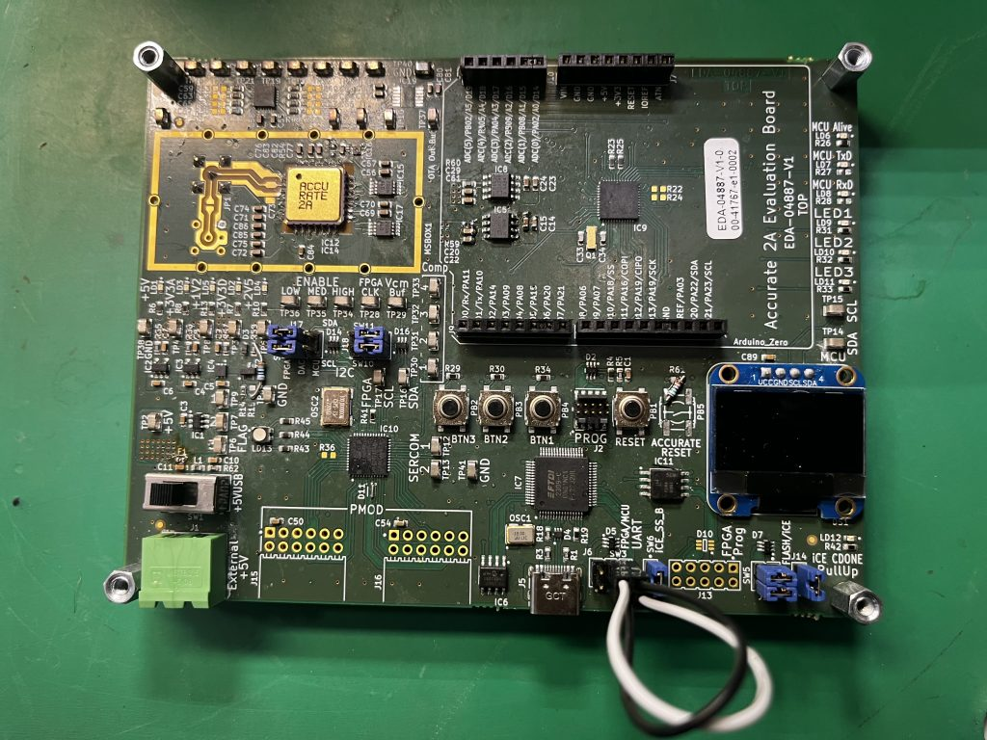

Fast access to 7 CVC Technologies
2 new technologies added in 2024
ACCURATE 2A
Astromesh
Notes:
ACCURATE 2 A
https://ventureconnect.cern/index.php/accurate-chip
High-Precision ASIC for Ultra-Low Current Measurements spanning from -1 fA to -20 μA
Technical precision
Validated in rigorous environments
Integration versatility
Astromesh
Intersatellite Communication and Radiation Monitoring System for CubeSats
Enhanced communication capabilities
Technical precision
Proven performance
Integration versatility

Slide 33
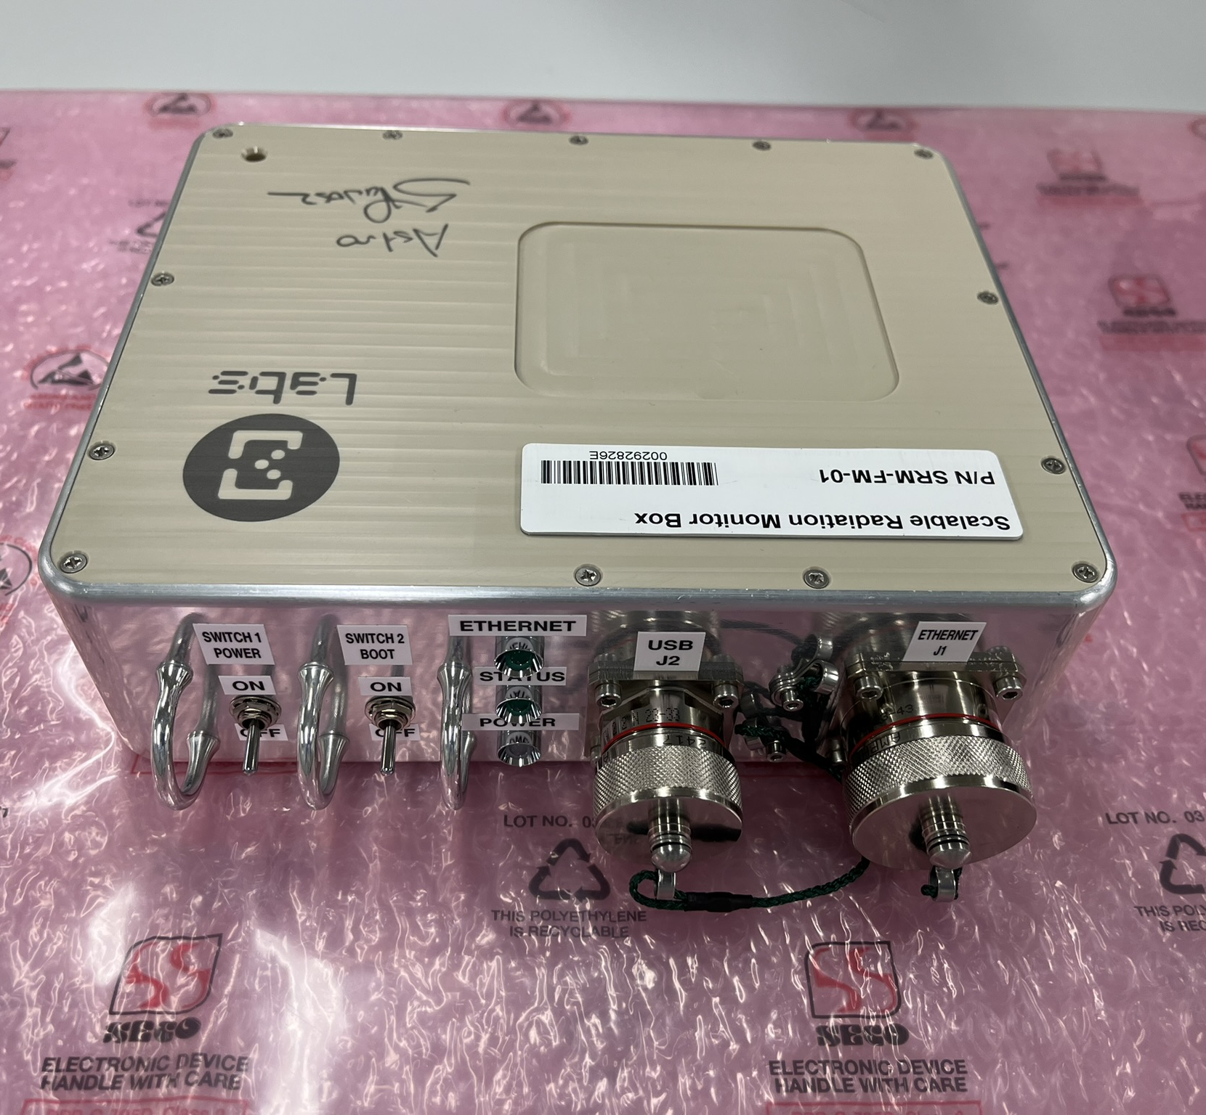
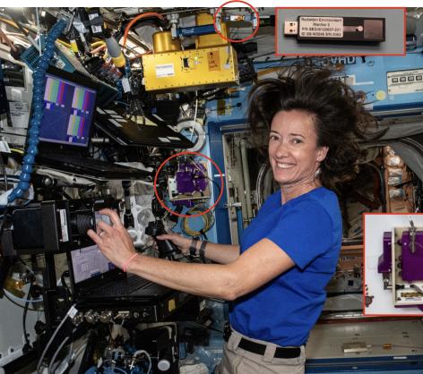
Aerospace
Artemis I mission results published, including Timepix-based NASA Hybrid Electronic Radiation Assessor (HERA)
SigmaLabs (PL) readies CERN’s
space radiation monitor for launch to ISS
Notes:
SigmaLabs – a Polish startup founded by CERN alumni specialising in radiation detectors and predictive-maintenance R&D for space applications. SigmaLabs was recently selected by ESA and the Polish Space Agency to provide one of the experiments expected to fly on Axiom Mission 4 – a private spaceflight to the ISS in 2025 that will include Polish astronaut and CERN engineer Sławosz Uznański (CERN Courier May/June 2024 p55). The experiment will assess the scalability and versatility of the SpaceRadMon radiation-monitoring technology initially developed at CERN for the LHC and flight tested on the CELESTA CubeSat.
https://report2024-kt.web.cern.ch/start-up-readies-cerns-space-radiation-monitor-for-launch-to-international-space-station/
https://report2024-kt.web.cern.ch/timepix-used-for-space-radiation-measurements-during-artemis-i-lunar-mission/
Characterisation of the space radiation environment in the crew cabin was a key objective of Artemis I, an uncrewed Moon-orbiting mission that took place in 2022. The Orion spacecraft for Artemis I carried a variety of detectors for radiation measurements, including the Timepix-based NASA Hybrid Electronic Radiation Assessor (HERA).
The analysis of the data collected from the detectors during the Artemis I mission, including HERA, were published in 2024. These measurements can be extrapolated to model future Mars missions for a similar point in the solar cycle, leading to experimentally derived dose equivalents that are about 30% lower than those reported in the literature.
This is in line with expectations, since Orion is a heavily shielded spacecraft, and therefore shows large improvements in radiation exposure over planetary science missions. However, space programmes have several reasons to prefer long missions using light vehicles to short missions using heavily shielded vehicles. Details of future mission will heavily depend not only on shielding, but also on trajectory, modulation of the galactic cosmic ray environment with the solar cycle and severity of solar particle events. Effective management of radiation risk will remain a key challenge for human space exploration, and HERA will continue to provide essential information onboard many future missions.

