Slide 1
Norwegian industrial activities, technology transfer and recruitment
Ole Petter Nordahl
Norwegian Industry Liaison Officer
CERN – ESS - ESRF
23 June 2025

Slide 2
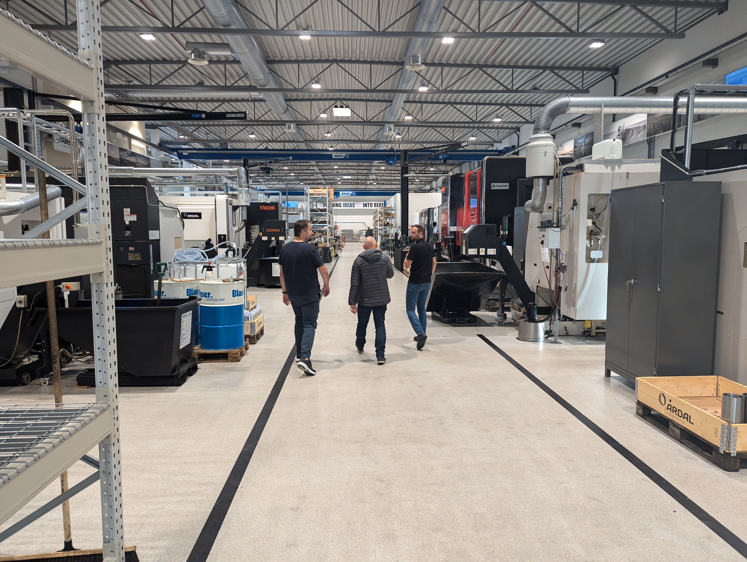
Industrial activities
Norwegian suppliers in the following areas:
Mechanical production and machining
Electronics
Electro mechanics/ Mechatronics
Switchboards
IT equipment
Special products/software
ILO activities:
Help CERN identify potential suppliers in Norway
Organize visits for Norwegian companies at CERN
Organize visits for technical experts and buyers from CERN
Give the companies support and guidance in negotiations

Slide 3
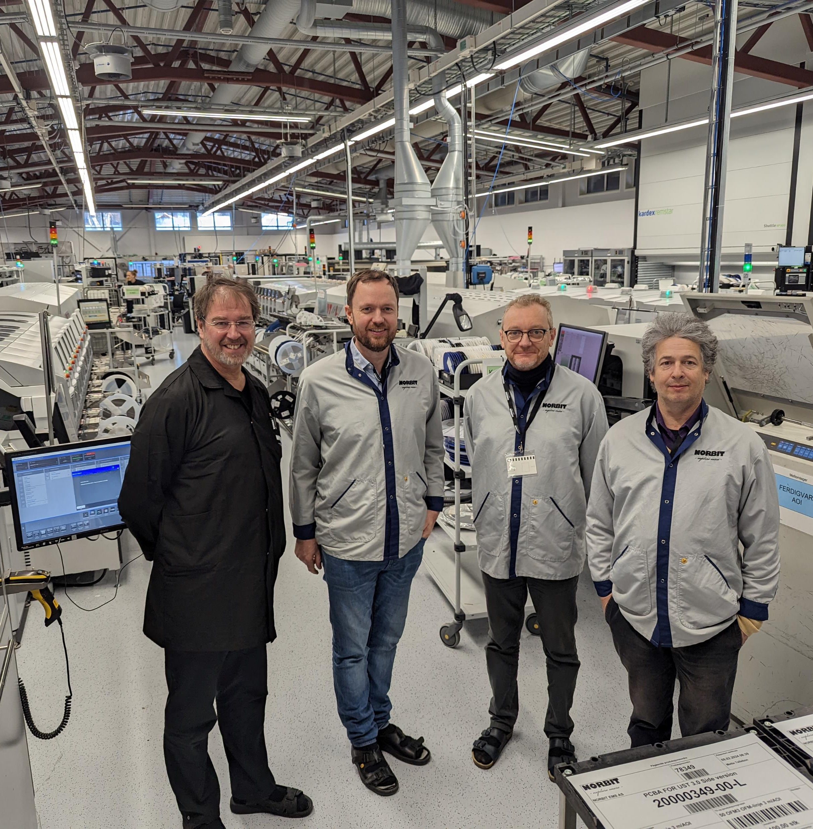
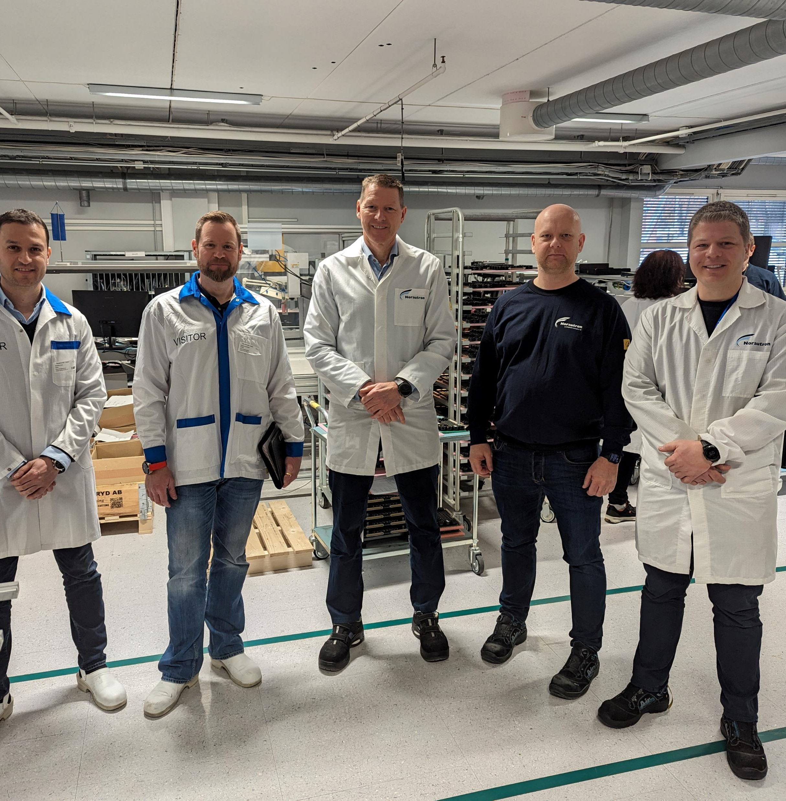
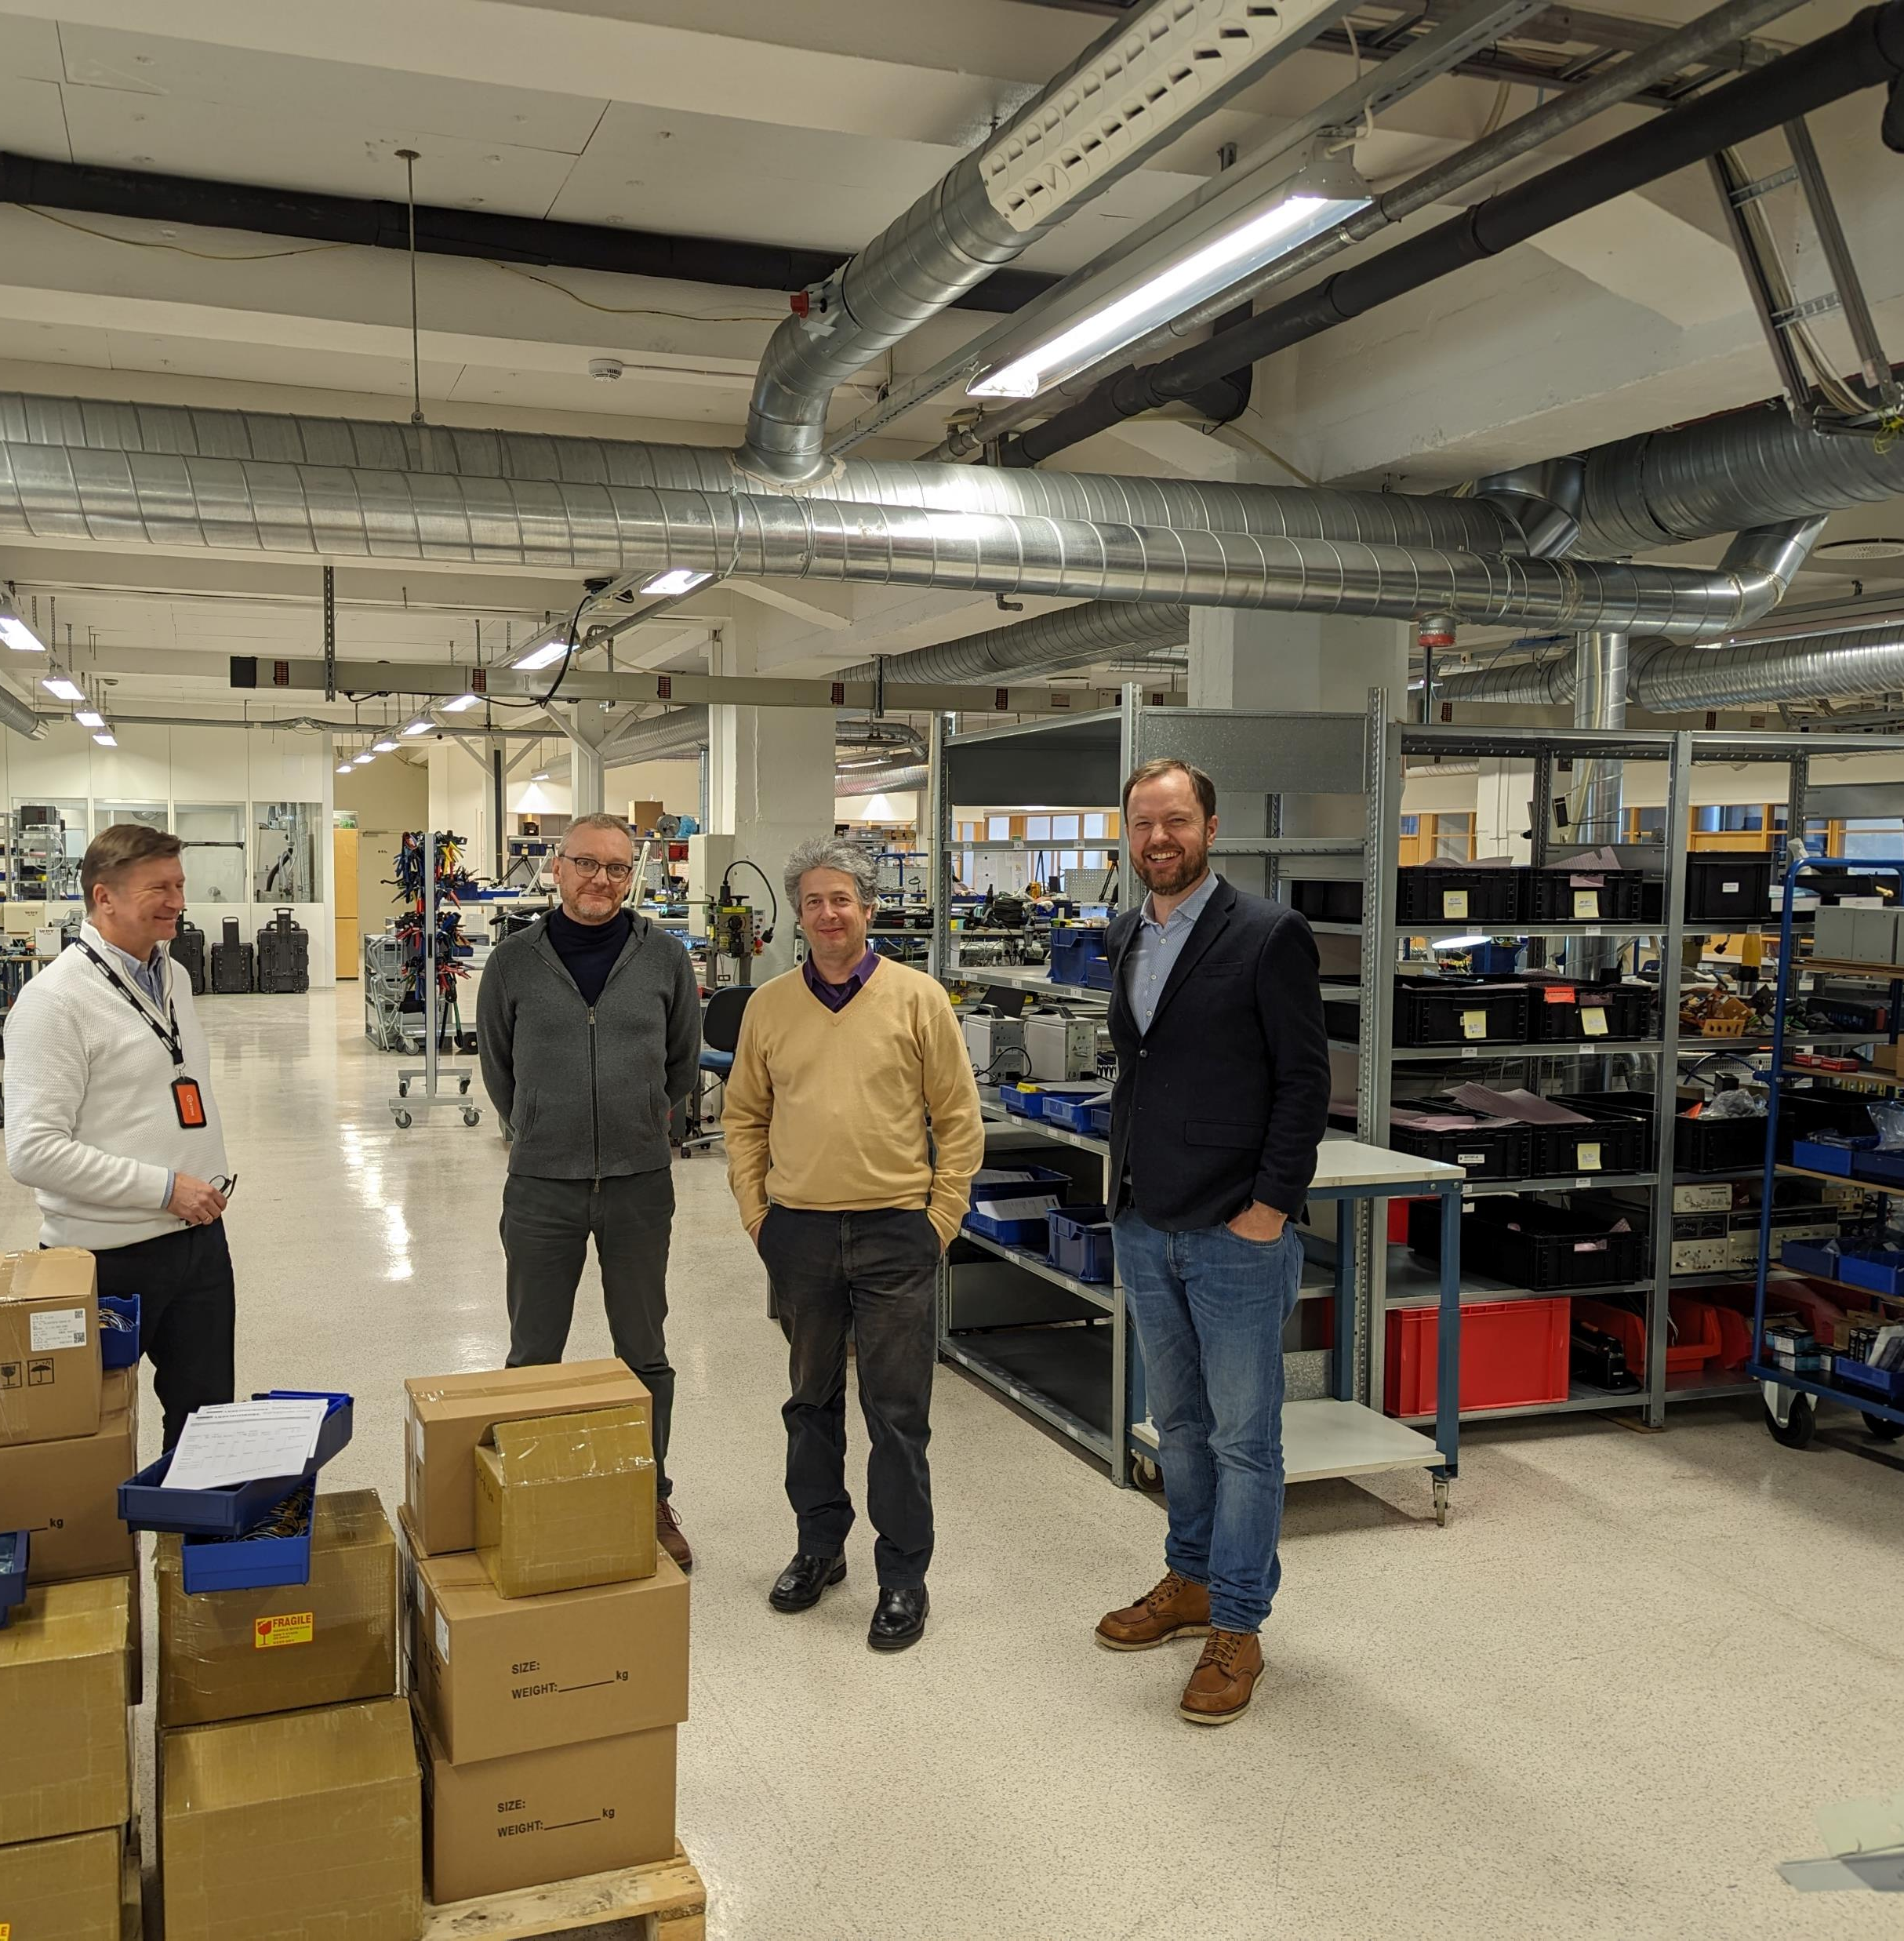
Bedriftsbesøk
Besøk av eksperter fra CERN hos norske elektronikkprodusenter Mars 2024
Norbit (Selbu)
Norbit (Røros)
Norautron (Horten)
Kitron (Arendal)
Westcontron (Tau)

Slide 4
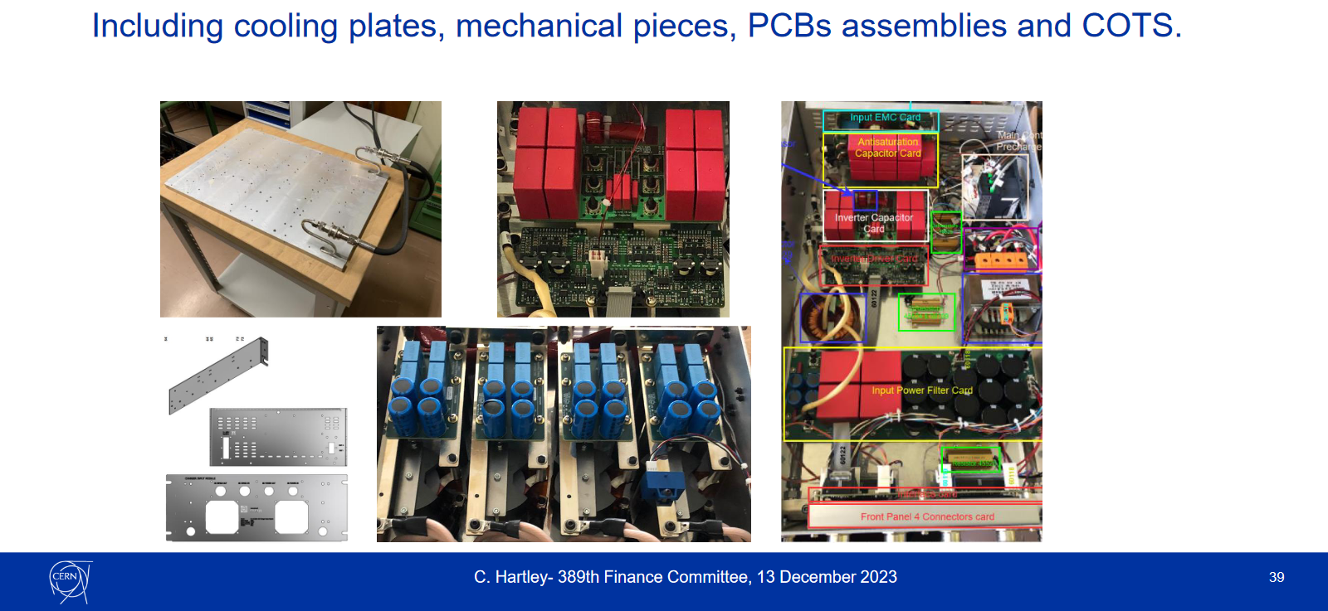
Recent contract:
Power modules for the HL-LHC and PS consolidation projects
Total amount:
19 492 k NOK

Slide 5



















Some examples of Norwegian suppliers

Slide 6


































Industrial return coefficients for supply contracts
Country |  | Supplies
 |  | Well balanced | Poorly balanced
 | Austria |  | 0.76
 | Belgium |  | 0.45
 | Federative Republic of Brazil⁵ | N/A | N/A
 | Bulgaria | 1.19
 | Republic of Croatia² ⁴ | 0.97
 | Republic of Cyprus³ |  | 0.27
 | Czech Republic | 1
 | Denmark |  | 0.62
 | Republic of Estonia | 1.44
 | Finland |  | 0.59
 | France | 1.39
 | Germany |  | 0.85
 | Greece |  | 0.44
 | Hungary |  | 0.69
 | Republic of India² |  | 0.68
 | Israel |  | 0.25
 | Italy | 1.29
Country |  | Supplies
 |  | Well balanced | Poorly balanced
 | Republic of Latvia² |  | 0.68
 | Republic of Lithuania² |  | 0.75
 | Netherlands |  | 0.56
 | Norway |  | 0.43
 | Islamic Republic of Pakistan² ⁴ | 0.43
 | Poland |  | 0.74
 | Portugal |  | 0.72
 | Romania |  | 0.4
 | Serbia |  | 0.51
 | Slovakia |  | 0.62
 | Republic of Slovenia³ |  | 0.7
 | Spain |  | 0.93
 | Sweden |  | 0.42
 | Switzerland | 5.01
 | Republic of Turkiye² ⁴ | 2.28
 | Ukraine² ⁴ | 0.24
 | United Kingdom |  | 0.51

Slide 7
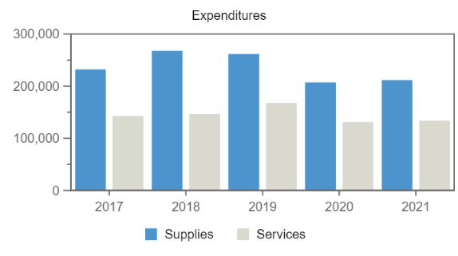
No data available in table
Procurement**
Remaining
Personnel
Expenditures (Norway, kCHF)
Year
*Provisional figure
Norwegian Industrial return
Annual Industrial Return

Slide 8
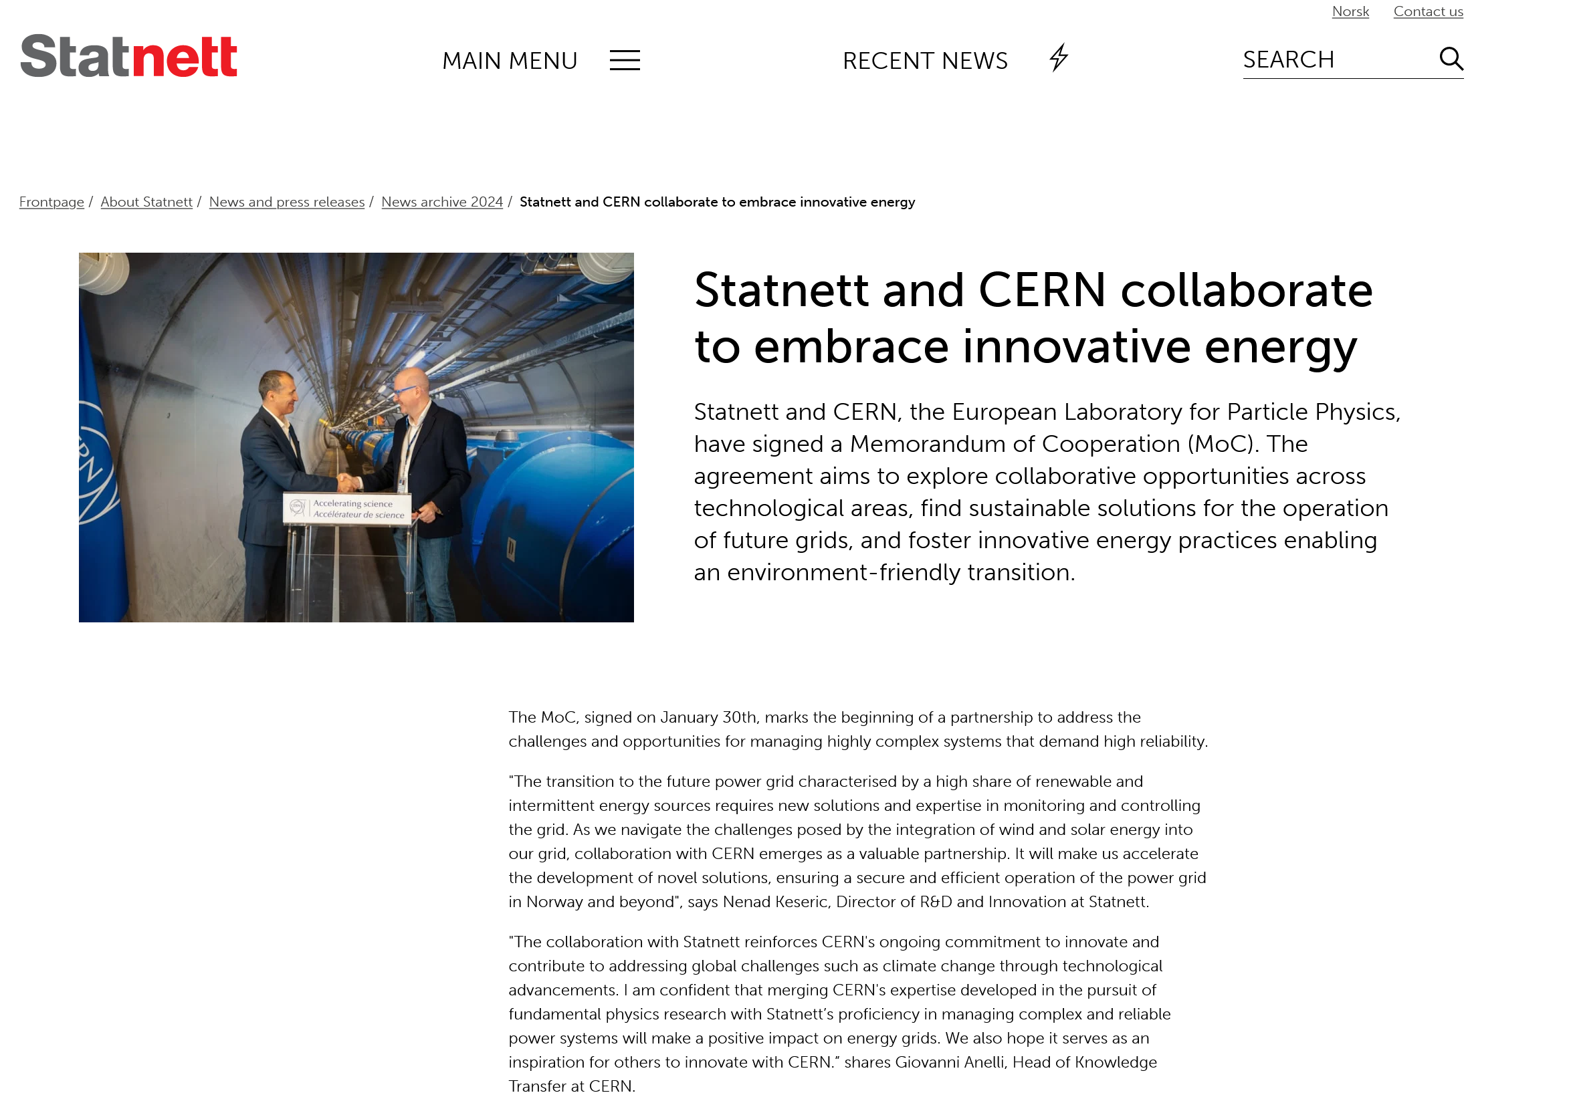

Slide 9

Knowledge transfer projects
R&D collaboration platform high Resolution data in cloud
SCADA -Alarm Handling
PMU / WAMS /WAMPAC Statnett to join CERN PMU-project?
Digital and Automated Substations
Standardization and Time Synchronization (on hold), White Rabbit
CERN quench antenna – for monitoring magnetic field in power transformer. Documentation /Papers sent to SINTEF for possible include this in ongoing project for monitoring of transformers
Solid State Transformer KSP with NTNU, GE and Super Grid institute. Maybe interface to CERN FCC-team. EN EL and SY EPC. Possible online meeting to present this KSP to CERN

Slide 10

Knowledge transfer projects
AI/Machine learning collaboration?
Can algoritms and software used for particle physics be used on seismic data?
Workshops with Eirik Gramstad and Are Strandlie
Could be relevant for AI/Big Data researchers from HVL?

Slide 11

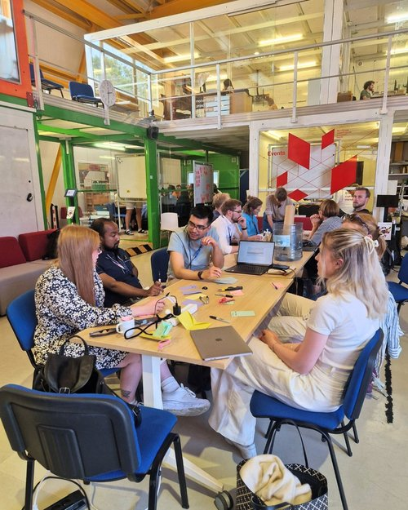
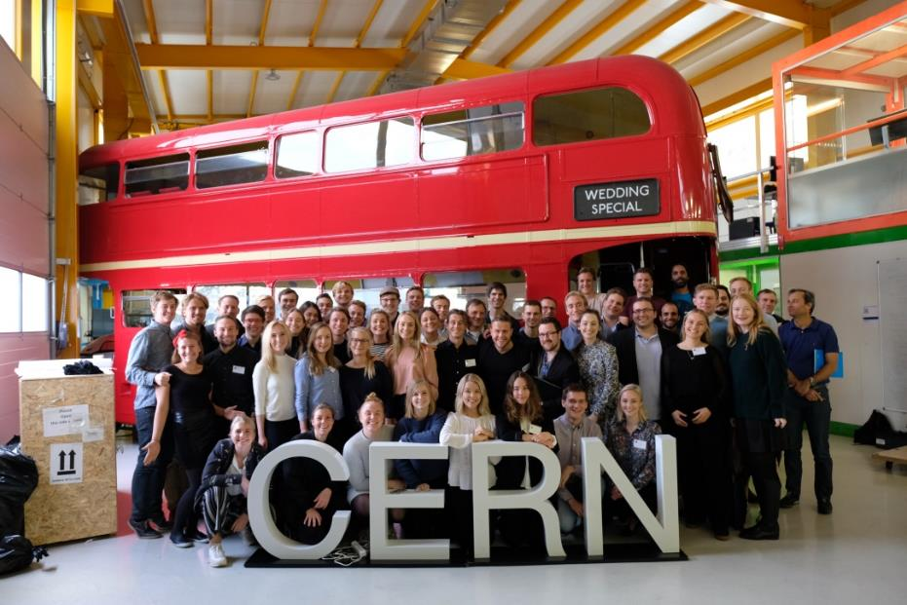
Knowledge Transfer activities:
HVL Skape til CERN IdeaSquare
23 – 30 June, 2024
20 Students
CERN – NTNU Screening Week
17 sessions so far
65 technologies screened in total
More than 400 students have visited CERN and worked with the KT group
Providing a large exposure of CERN technologies to Norwegian industry
Last edition: 13 -18 October 2024
Notes:
12 sessions from 2008 until 2019
In October every year, next edition this October
Students do a great job for KT, helping us in finding application areas for CERN technologies and initiating contact with potential licensees.
The students are happy with their stay and talk warmly about CERN
Start-ups from NTNU Screening Week:
2012: TIND, using Invenio
2013: GEM Radon detectors, using GEM, gave up after some years
2016-2019: 8 projects continued
2016: 1 project continued after (structured laser beam), but they stopped working with it after a couple of months
2017: 2 projects continued. C2MON (company Sensero, reducing loss in transmission lines) still working with their project, might not use CERN technology. Quasar (company Apico, providing sensor data in agriculture) continued for 1 year.
2018: 2 projects continued. Collaboration tool (company WAID, helping aid organisations organize their volunteers) still working, in the process of writing agreements with KT. Collspotting continued for some months.
2019: 3 projects continued: Thermal management material (company name YME Technologies, doing really well and currently discussing license agreement), flame detector, and QF-Lib.

Slide 12
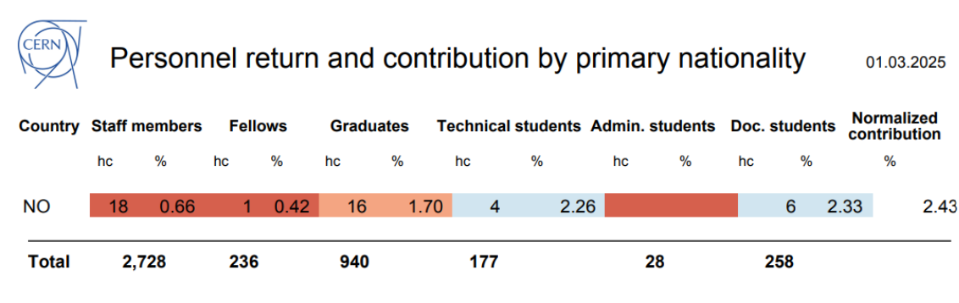
Latest Personnel Return
Graduates distribution:
9 GRAE (Origin – Technician)
5 GRAE (Origin – University Graduates)
1 GRAF (Research Fellow)

Slide 13
Norwegians@CERN – a closer look on today’s representation
Overview of Norwegian
Members of Personnel
by March 2025
Notes:
3 TRNE STAG

Slide 14
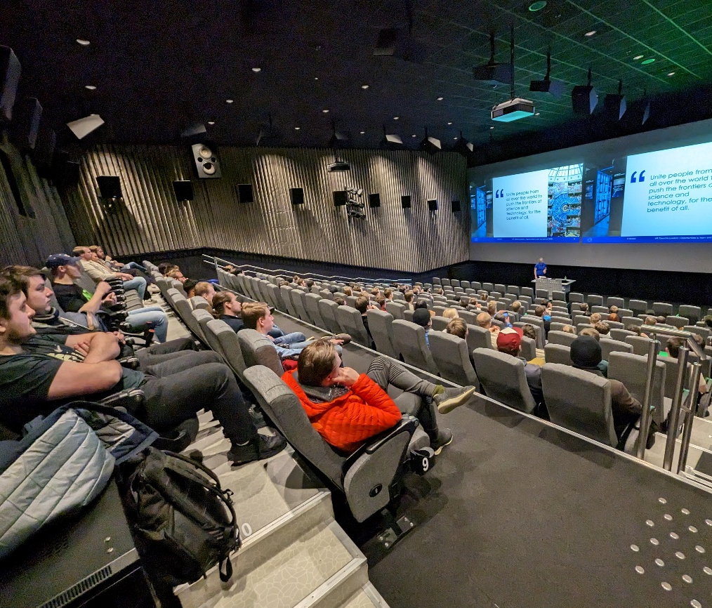
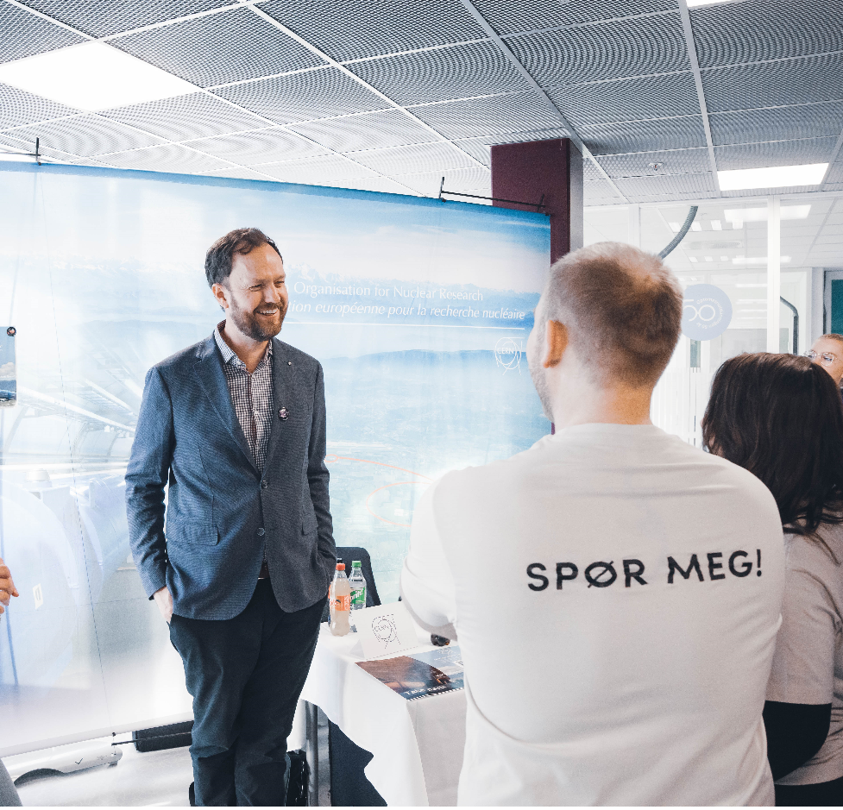
HR Actions
Bi-monthly meetings with CERN HR
  Julie Simic and Priscilla Valavicius
Norwegian recruitment outreach activities
  During last year CERN/NorCC has visited 8 institutions
  NTNU Trondheim, NTNU Gjøvik, UiA, HVL, USN Horten, Grimstad Technical College, Raufoss High- School and Trondheim Technical College
  Many high school students visited CERN per year
Success: Origin Programme for Technichans
    Many end up with LD contracts
Main challenges:
  Retention of staff
    Too few staff continue when they turn 30 years old
    Non extendable LD positions
    Norwegian doctoral students has not been hired for staff positions

Slide 15
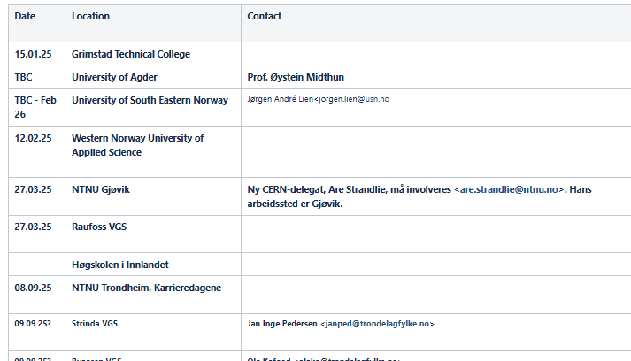
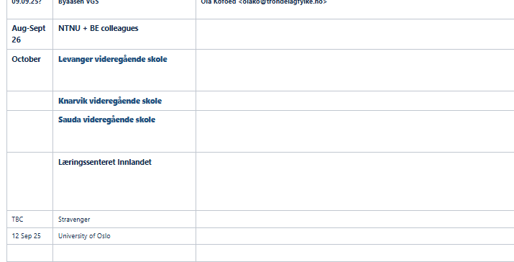
Outreach events

Slide 16
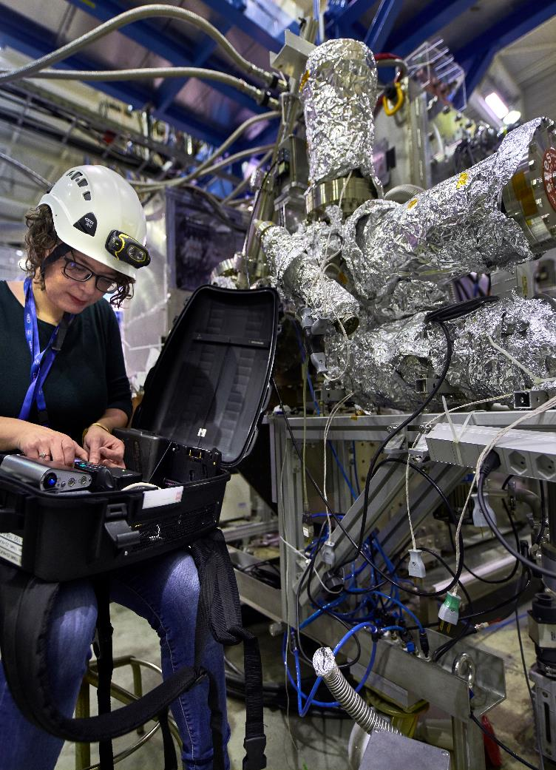
Technical Student Programme
”
~ 250 positions/year
A great place to start a career,
learn new skills, make new friends…, technical student in electronics
Applied physics, electrical or electronics engineering, general or civil engineering, IT, mathematics and robotics, material and surface science, mechanical engineering…
A project with a CERN supervisor
An allowance of 3319 Swiss Francs per month (net of tax)
A travel allowance
A supplement if you have a spouse and/or have children
Comprehensive health insurance
2.5 days of paid leave per month
Eligibility: minimum of 18 months of undergraduate studies
Length: 4 to 12 months

Slide 17

Administrative Student Programme
”
~ 30 positions/year
An enriching experience – I had exposure to more activities than I could have imagined,
Administrative student in legal
Translation, human resources, business administration, law, finance, science communication, public relations…
A project with a CERN supervisor
An allowance of 3319 Swiss Francs per month (net of tax)
A travel allowance
A supplement if you have a spouse/partner and/or have children
Comprehensive health insurance
2.5 days of paid leave per month
Eligibility: minimum of 18 months of undergraduate studies
Length: 2 to 12 months

Slide 18
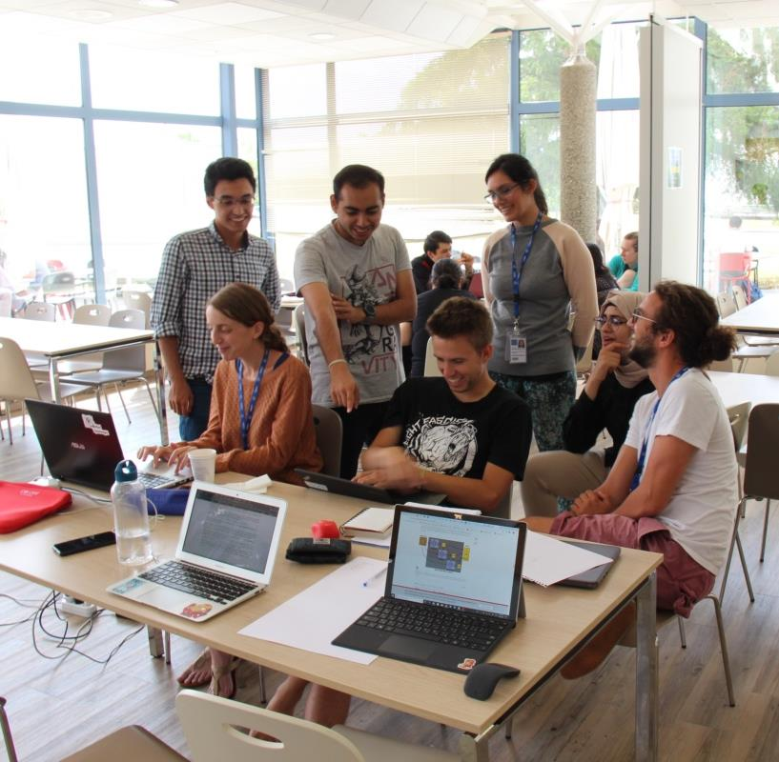
Doctoral Student Programme
”
~ 80 positions/year
An opportunity to meet important people, especially in the research field,
Doctoral student in Physics
Applied physics, electrical or electronics engineering, general or civil engineering, IT, mathematics and robotics, material and surface science, mechanical engineering…
A research topic/project, leading to a PhD thesis co-supervised by the university thesis advisor and a CERN staff member
An allowance of 3719 Swiss Francs per month (net of tax)
A travel allowance
A supplement if you have a spouse/partner and/or have children
Comprehensive health insurance
2.5 days of paid leave per month
Eligibility: Enrolled in a doctoral programme in a university
Length: 36 months and 12 months of unpaid leave

Slide 19
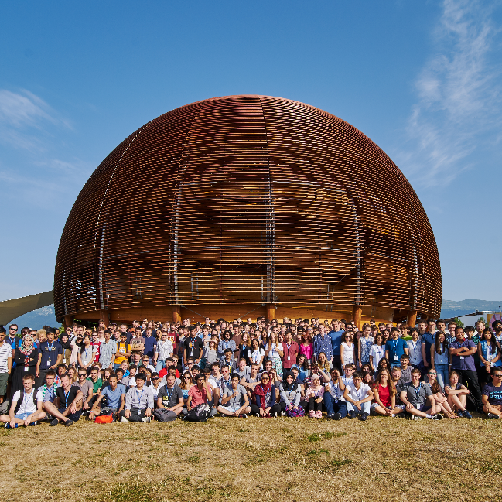
Summer Student Programme
”
~ 300 positions/year
Can’t imagine a better way to spend
my summer,
Summer student in computing
Applied physics, electrical or electronics engineering, general or civil engineering, IT, mathematics and robotics, material and surface science, mechanical engineering…
Series of lectures delivered by world-wide renowned scientists, visits and workshops
A project with a CERN supervisor
Living allowance, incl. health insurance
Accommodation at CERN hostel
Eligibility: 3 years of full-time studies at university level
Length: 8 to 13 weeks over summer

Slide 20

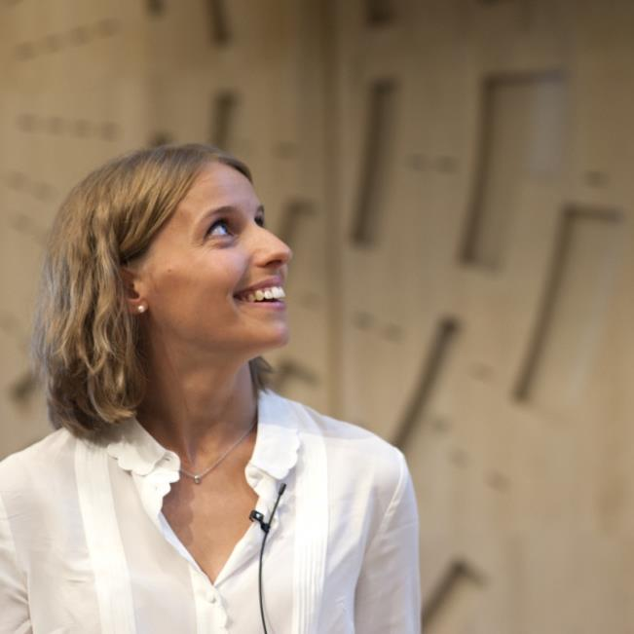
Early Career Professionals
”
~ 300 positions/year
The smartest way to kick-start your
career and give it real momentum.
All disciplines in science, engineering, technical and administrative fields
On-the-job learning by full immersion in a CERN team and their activities
A stipend ranging from 4500 to 5500 Swiss Francs per month (net of tax)
Comprehensive health insurance (for yourself, your spouse/partner, and children)
Membership of the CERN Pension Fund
Other benefits may include: installation grant, family, child and infant allowances; payment of travel expenses at the beginning and end of contract
2.5 days of paid leave per month.
Eligibility: From general secondary education to Master level, with max. 2 years of relevant experience after your highest degree
Length: From 6 to 36 months, in principle duration of 24 months

Slide 21
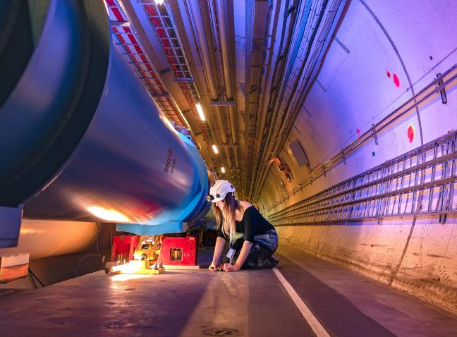

Experienced Project Graduates
”
~ 100 positions/year
Deepen your knowledge and expertise faster than anywhere else on earth.
Applied physics, electrical or electronics engineering, general or civil engineering, IT, mathematics and robotics, material and surface science, mechanical engineering…
Work on well-defined project from A to Z with clear deliverables
Deepen your expertise and expand your professional network by working with the best experts
Opportunity to supervise student
A stipend ranging from 6050 to 6650 Swiss Francs per month (net of tax)
Comprehensive health insurance (for yourself, your spouse/partner, and children)
Membership of the CERN Pension Fund
Other benefits may include: installation grant, family, child and infant allowances; payment of travel expenses at the beginning and end of contract
2.5 days of paid leave per month
Eligibility: Master’s with 2 to 6 years of relevant experience or PhD with up to 3 years of relevant experience
Length: From 6 to 36 months, in principle duration of 24 months

Slide 22
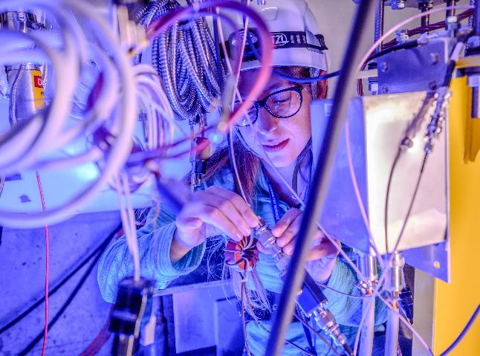

Research Fellows
”
~ 40 positions/year
Make your mark and hone your skills at a place like no other.
Applied physics, theoretical physics, experimental phsysics, electrical or electronics engineering, mathematics and robotics, material and surface science, mechanical engineering…
Define your own research project and benefit from international exposure
A stipend ranging from 6650 to 7050 Swiss Francs per month (net of tax)
Comprehensive health insurance (for yourself, your spouse/partner, and children)
Membership of the CERN Pension Fund
Other benefits may include: installation grant, family, child and infant allowances; payment of travel expenses at the beginning and end of appointment
2.5 days of paid leave per month
Eligibility:
Theoretical and Experimental Physics: PhD with up to 6 years of relevant experience
Applied Sciences and Engineering: PhD with up to 3 years of relevant experience
Length: From 6 to 36 months, in principle duration of 24 months

Slide 23
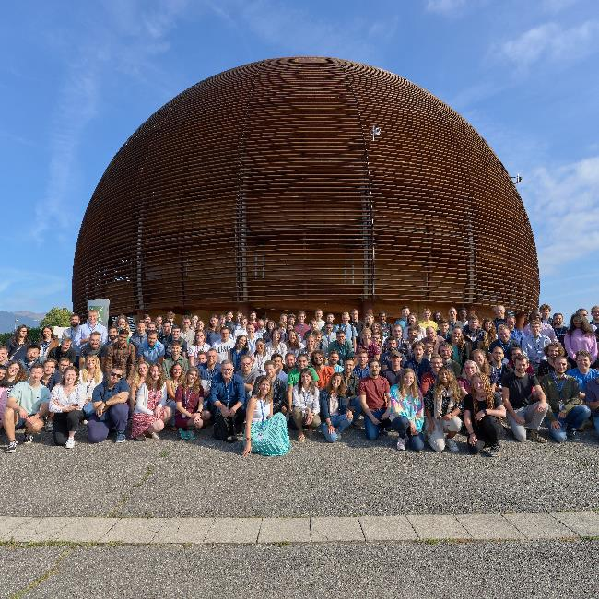
Staff positions
”
~ 150 positions/year
It’s the chance to focus on being the very best at what you do.
All disciplines in science, engineering, technical and administrative fields
Attractive compensation package
Comprehensive health insurance (for yourself, your spouse/partner, and children)
Membership of the CERN Pension Fund;
Other benefits may include: (re)installation grant, family, child and infant allowances; payment of travel
and removal expenses at the beginning and end of contract; unemployment coverage.
2.5 days of paid leave per month.
Eligibility: From general secondary education to PhD
Length: Limited duration contract (5 years). Subject to certain conditions, holders of limited-duration contracts may apply for an indefinite position

Slide 24

Questions?

