Slide 1
Open Hardware at CERN in practice: Electronics
Design Office of the BE-CEM-EPR Electronics Service
R. Berberat

Slide 2
Introduction to the BE-CEM-EPR Electronics Service
BE-CEM-EPR Electronics Service offers a support service to the CERN-wide electronics community in the domains of Layout Design, Printed Circuit Boards (PCB) manufacturing, components procurement and Electronic Module Assembly.
The main activities of the service are:
CERN CAD Libraries: creation and maintenance for Altium, Cadence
Layout design for electronics boards and crates
Manufacturing of bare PCB at CERN or by subcontracting
Mechanical parts production in collaboration with EN-MME
Assembly and integration of electronic modules, internally or by subcontracting

Slide 3
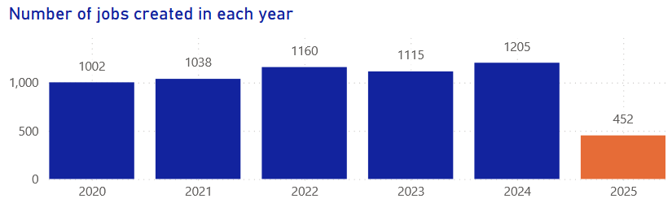
Open Hardware experience in BE-CEM-EPR Electronics Service
BE-CEM-EPR Electronics Service manage several hundreds of projects per year, based on Altium, Cadence and KiCad software
Design Office experience with Open Hardware projects
1st Open Hardware project managed in 2013, see https://edms.cern.ch/nav/EDA-02839-V1-0
Approx. 50 projects (some with multi-execution) managed since 2013

Slide 4

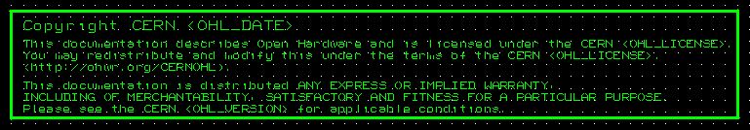


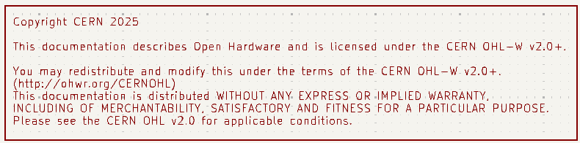

Open Hardware rules in Schematics and Layout (1/3)
Any Open Hardware project shall include the CERN Open Hardware License copyright in the schematic and ideally on each individual sheet of the schematic
https://ohwr.org/CERNOHL/

Slide 5

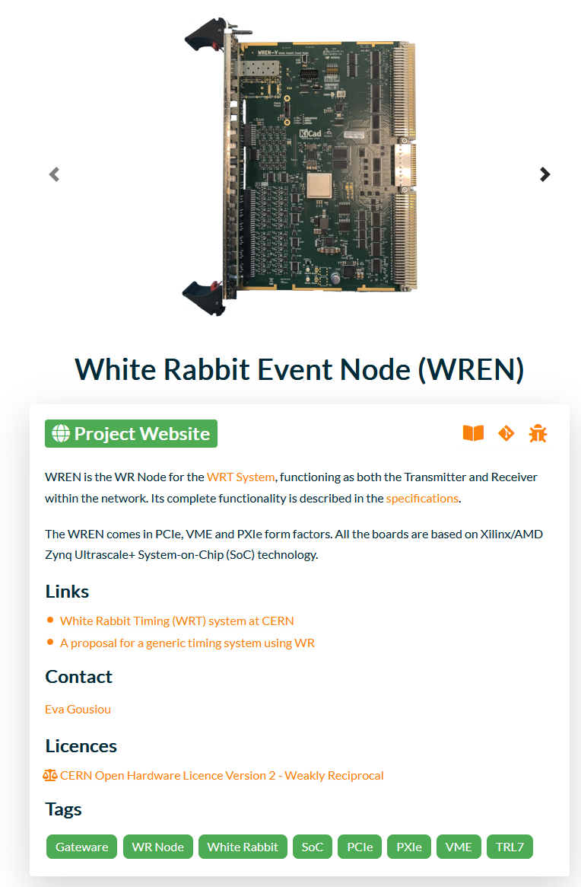
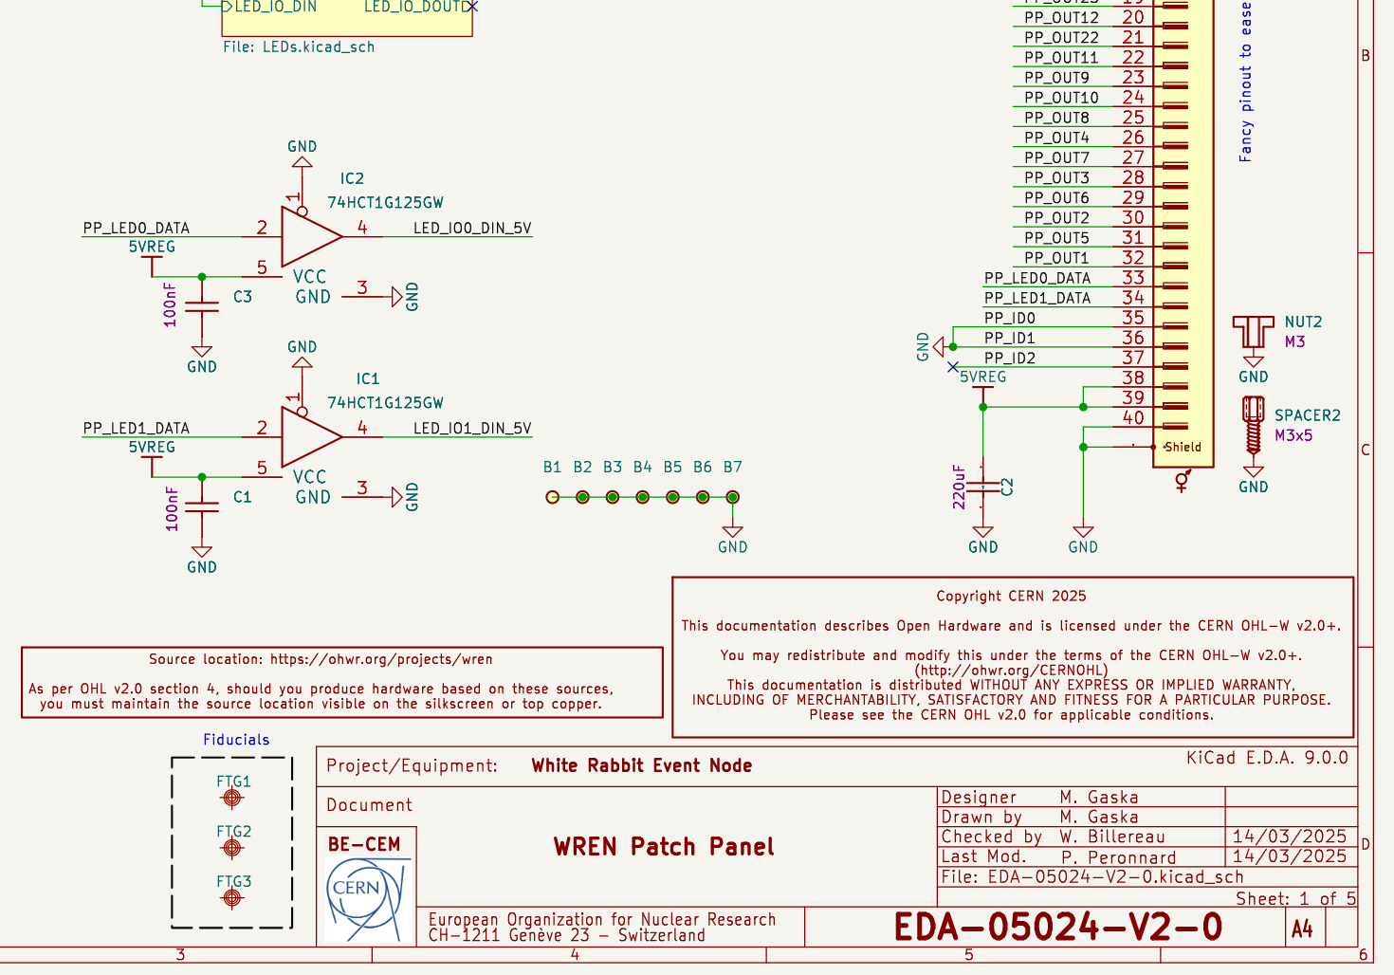
Open Hardware rules in Schematics and Layout (2/3)
Any Open Hardware project shall include also the link to the Open Hardware Repository Project, see https://ohwr.org/

Slide 6
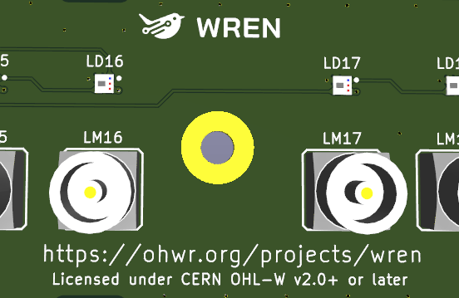
Open Hardware rules in Schematics and Layout (3/3)
What is true on schematics is also recommended on Layout design, using silkscreen for writing on bare PCB the reference on CERN OHL licenses information but also the link to the Open Hardware Repository

Slide 7
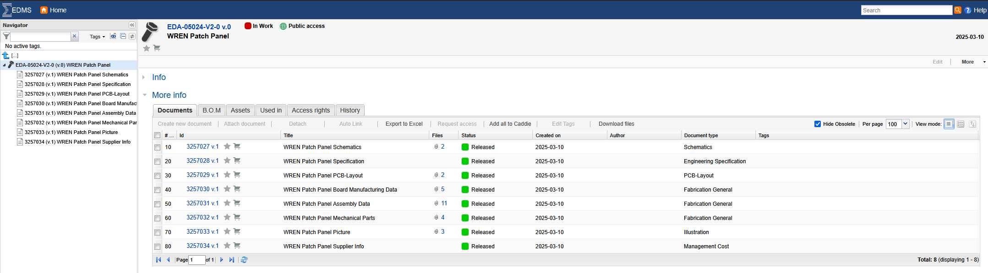
EDMS specifics when up-loading Open Hardware projects
Full project should be Public access on EDMS (CERN's Engineering Data Management Service) and any sub-document folders status should be Released. This give access to anyone to have access on any sub-document files without CERN account/login

Slide 8
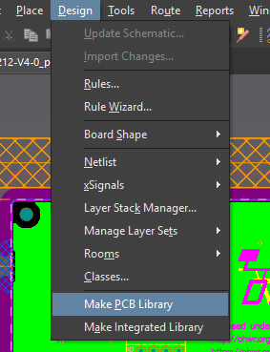
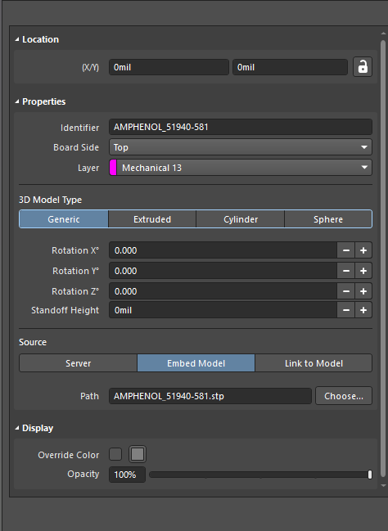
Extraction files on different software tool
Altium and KiCad are working on an identical way:
Using Altium/KiCad tools in dedicated schematics or “PCB file” in ALTIUM or .Kicad_pcb for KiCad, all components library can be extracted.
In PCB layout, using the command Make PCB library creates a local library with all footprints used in the PCB. This is an alternative until a release open-source CERN KiCad library may be available (work in progress with CERN juridic team)

Slide 9
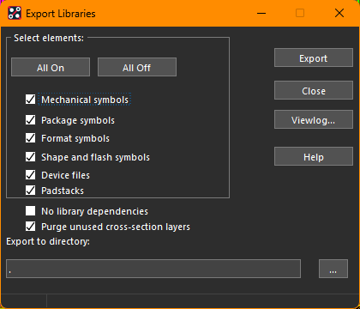
Extraction files on different software tool
Cadence works on a different model:
The BRD file can be used with the “Dump-library” command and everything can be retrieved from that BRD file:

Slide 10
Summary
CERN Open Hardware projects should respect some design rules as for:
Include the CERN Open Hardware License copyright and the link to the Open Hardware Repository Project in Schematic and it is recommended in the Layout
To give full access to CERN Open Hardware projects, it is easy to manage with EDMS, releasing any folder and passing the full project in Public mode
Extraction of CAD library per project is easily possible for Altium, Cadence and KiCad
BE-CEM-EPR Design Office is used to work with Open Hardware projects and can manage the EDMS repository available in case your project is managed to be an EDA project

Slide 11
Thank you for your attention!

