Slide 1

CERN Open Hardware License (OHL)
Dane Tacchini
CERN Knowledge Transfer

Slide 2

Open-Source Hardware
"Open hardware" or "open-source hardware" refers to the design specifications of a physical object which are licensed in such a way that said object can be studied, modified, created, and distributed by anyone

Slide 3
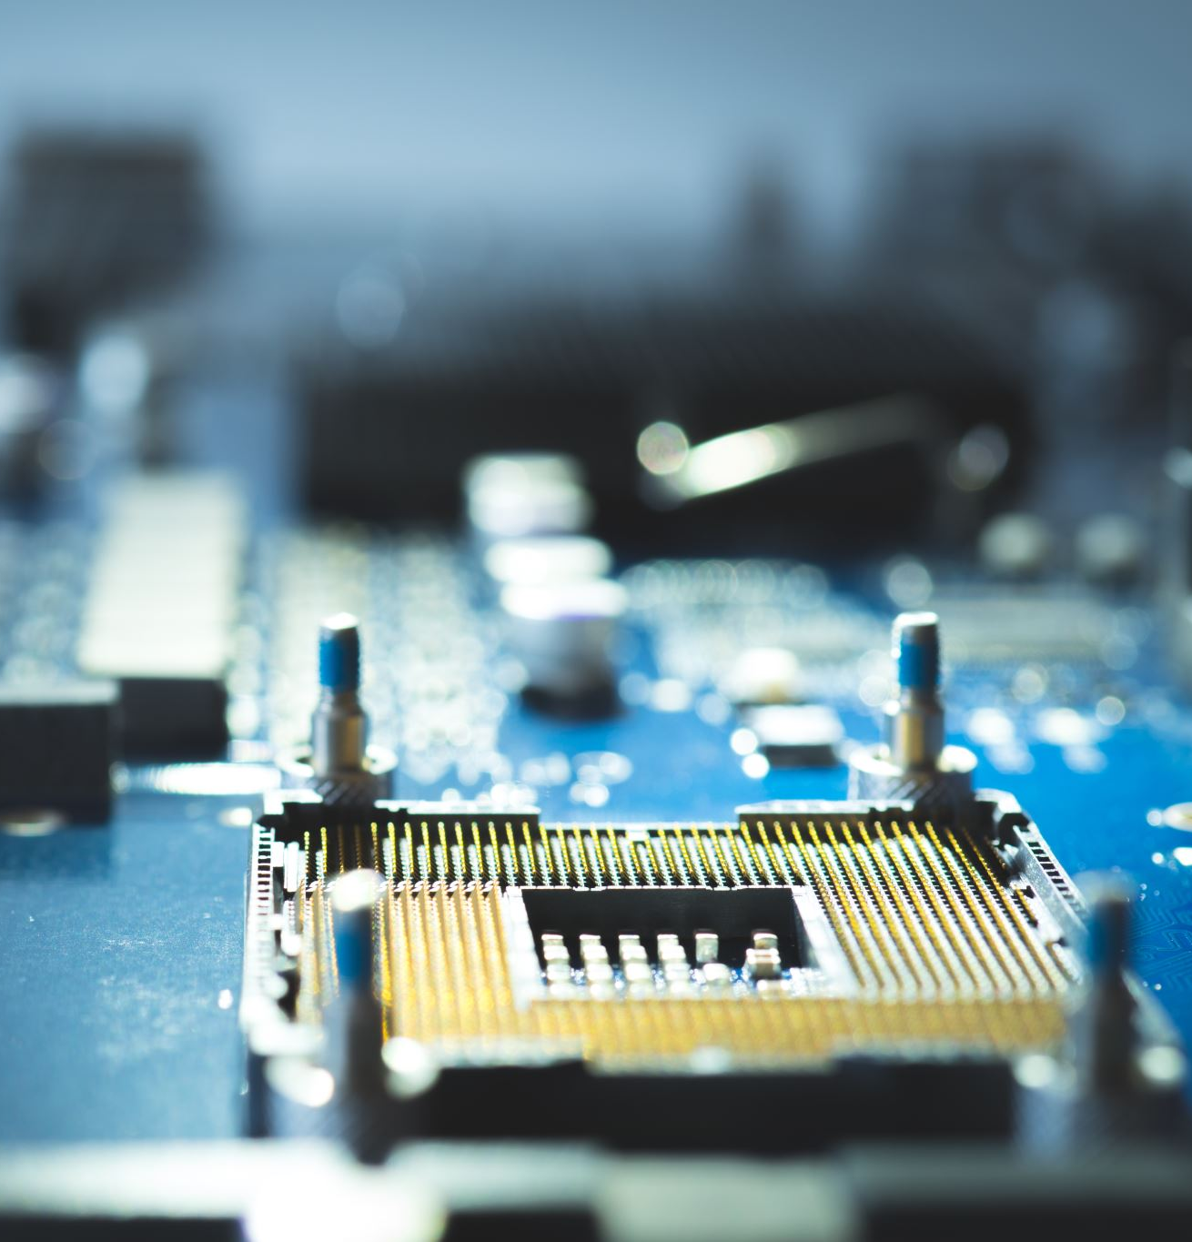
Why a New Open Hardware License

Slide 4
Realities of Software vs Realities of Hardware
SOFTWARE
HARDWARE
Intangible & digital
Homogeneous
IP: Protected by copyright, as a literary work, based on harmonized worldwide standards + patents
Based on documentation, but requires physical manufacturing
Non-Homogeneous, representing a variety of forms, products and shapes
IP: Copyright protection more uncertain due to the functional nature + patents + design rights
Due to the costs often dominated by proprietary tools

Slide 5
CERN OHL WAS CREATED TO
Promote Collaboration and Provide a Clear Legal Framework to
Use
Study
Modify
Share
Distribute
hardware designs and products based on those designs
Notes:
Specifically designed for hardware designs. It covers both the design files (which are protected by copyright) and the act of manufacturing devices from those designs. It ensures that when hardware is built from an open design, the design remains accessible

Slide 6
Evolution of CERN OHL
Mar. 2011
CERN OHL 1.0
July 2011
CERN OHL 1.1
Sep. 2013
CERN OHL 1
2017
CERN OHL 2 (beta 1)
2019
CERN OHL 2 (beta 2)
Mar. 2020
CERN OHL 2.0

Slide 7

Key Concepts
“Source” and “Covered Source” –
information such as design materials or digital code which can be applied to Make or test a Product or to prepare a Product for use, Conveyance or sale, regardless of its medium or how it is expressed.

Slide 8
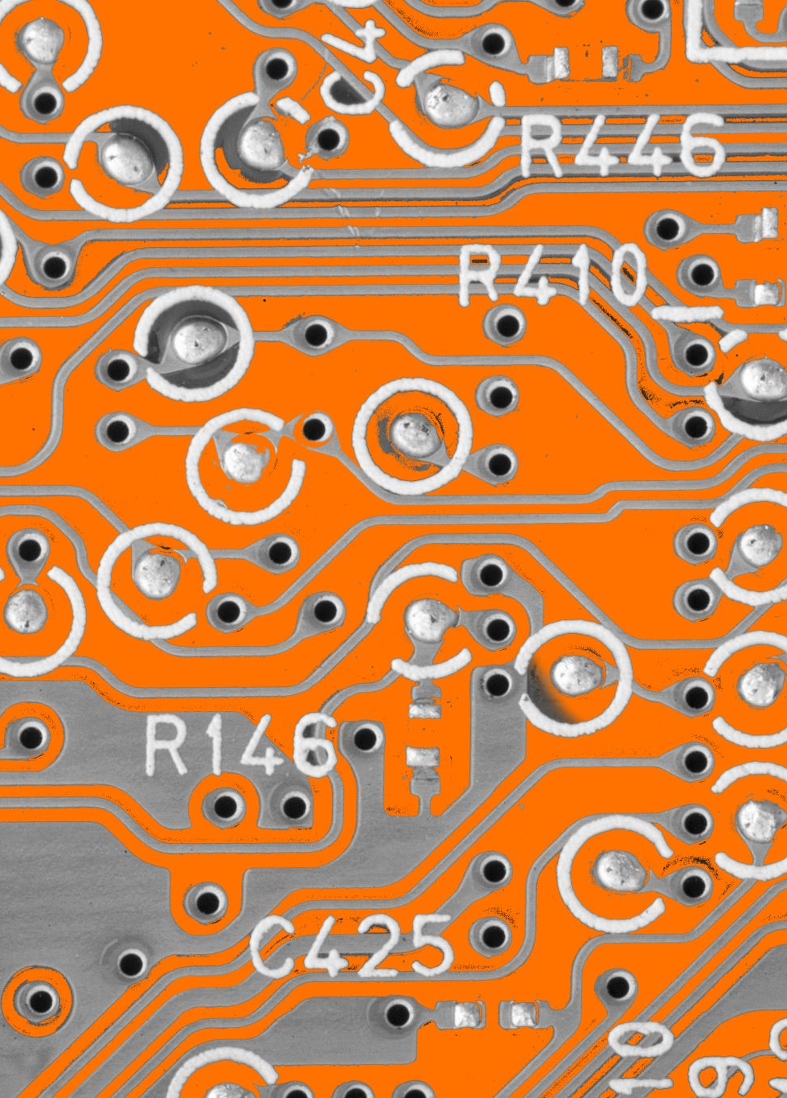
CERN OHL 2.0 Variants
Version 2 of the CERN Open Hardware Licence comes in Three Variants:
CERN-OHL-P : Permissive
CERN-OHL-W : Weakly Reciprocal
CERN-OHL-S : Strongly Reciprocal

Slide 9
Choosing the Most Appropriate Variant for your Project
CERN-OHL-W (Weakly Reciprocal): A weaker copyleft – the design can be used as a component in larger projects without requiring the entire project to be open-sourced, but if you modify the OHL-W component itself, you must share those modifications under the same license
(comparable to LGPL)
CERN-OHL-S (Strongly Reciprocal): A strong copyleft license – any derivative designs or products must be released under the same OHL-S license. Ensures hardware designs remain free and open along with all their derivatives
(comparable to GNU GPL)
CERN-OHL-P (Permissive): A permissive license – you can mix the design freely with proprietary designs, and you are not required to share modifications or derivatives. You must simply acknowledge the original and include the license notice (comparable to MIT or Apache 2.0.)

Slide 10
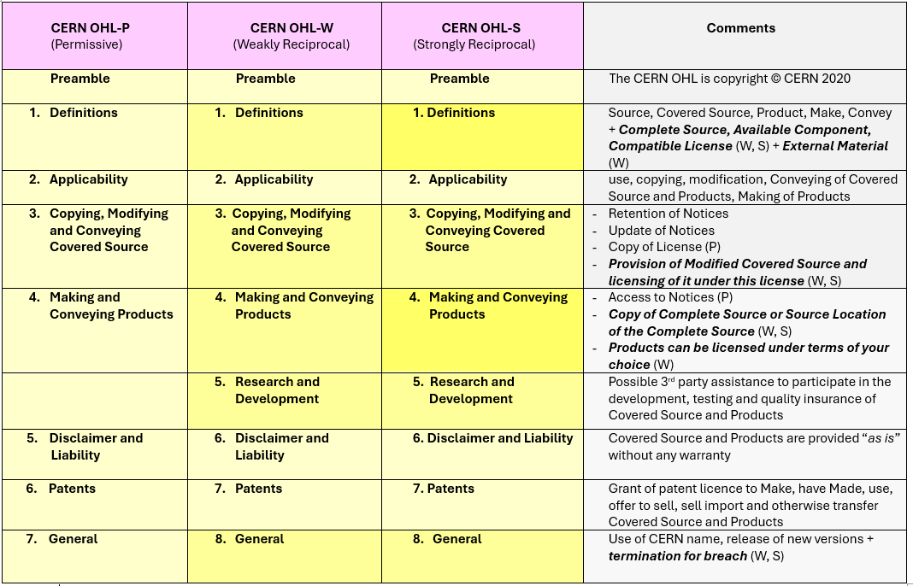

Slide 11

Specific Adaptations of CERN OHL
“Available Components” exception:
OHL addresses hardware-specific issues by excluding certain parts from share-alike requirements. Standard, off-the-shelf components or vendor-provided IP blocks can be treated as “Available Components” – you don’t have to provide source for those, since they are readily available elsewhere.
(e.g. you don’t need to document how to make a resistor or a proprietary FPGA core if it’s a known available part)

Slide 12
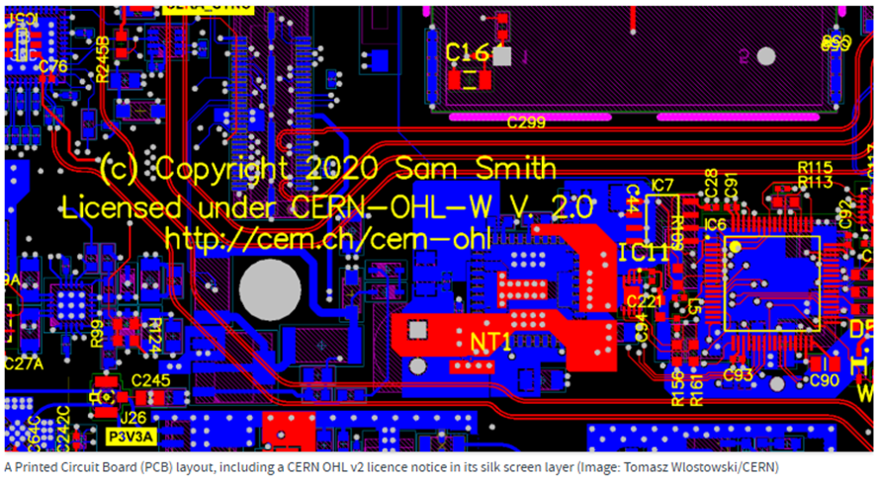
International Recognition
On 15 January 2021, the CERN Open Hardware License 2.0 was approved by the Open Source Initiative (OSI) and is now OSI Certified

Slide 13


Glimpse into the Open Hardware Repository

Slide 14
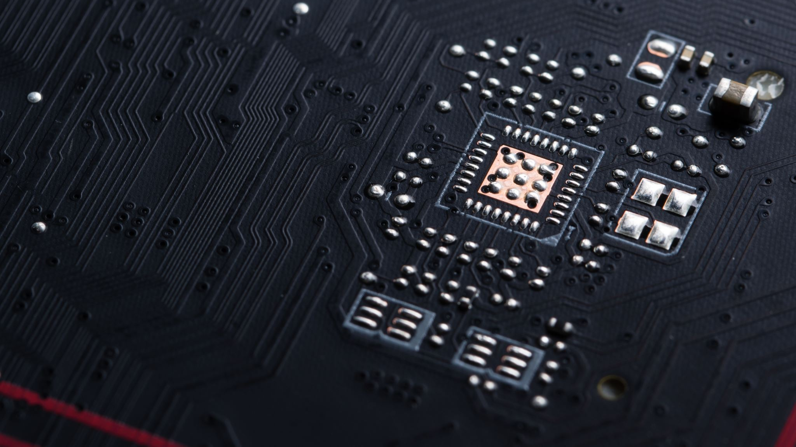
Thank you
Visit: KT.CERN
Contact us at: kt@cern.ch

