Slide 1
Support for Open Hardware in CERN’s Open Source Program Office (OSPO)
Hamza Boukabache, CERN OSPO
May 9th 2025
EDMS reference

Slide 2

Introduction to CERN OSPO
CERN OSPO – Mission:
A central office to support open-source projects (software, firmware/gateware, and hardware) across CERN​.
Established under CERN’s Open Science strategy to maximize the impact of CERN technologies on society​
Role & Scope:
Consults and trains the CERN community on open-source best practices, tools, and licensing​.
Provides guidance for open-sourcing hardware designs and coordinates related efforts.
Facilitative (Not Decisional):
OSPO does not decide whether a design is open-sourced; that decision requires formal approval by the project’s responsible entities​.
Once a project gets a “green light” to go open source, OSPO guides and supports the open-sourcing process.

Slide 3
CERN’s Approach to Open Hardware
What is Open-Source Hardware OSHW?
OSHW refers to releasing hardware designs (electronics, machines, etc.) with all the necessary design files and documentation, so others can study, modify, make, and distribute them. CERN pioneered OSHW in the 2010s by developing the CERN Open Hardware Licence (CERN-OHL)​, providing a legal framework similar to open-source software licenses.
Hardware vs. Software Open Sourcing :
Unlike pure software, open hardware projects involve physical fabrication. This means engaging industrial partners (manufacturers) is almost always necessary​. Hardware development cycles also tend to be longer and costlier, since producing and testing prototypes takes time and money​. These differences require additional planning and support.
Holistic Designs:
An open hardware project typically isn’t just a circuit board; it includes firmware/gateware (HDL code for FPGAs, etc.), software (for control or interfaces), and documentation​. All these components should be treated as part of the open-source project to ensure users can fully utilize the hardware. OSPO encourages designers to open-source all relevant parts of a hardware project (design files, HDL code, software, manuals) under appropriate licenses.

Slide 4
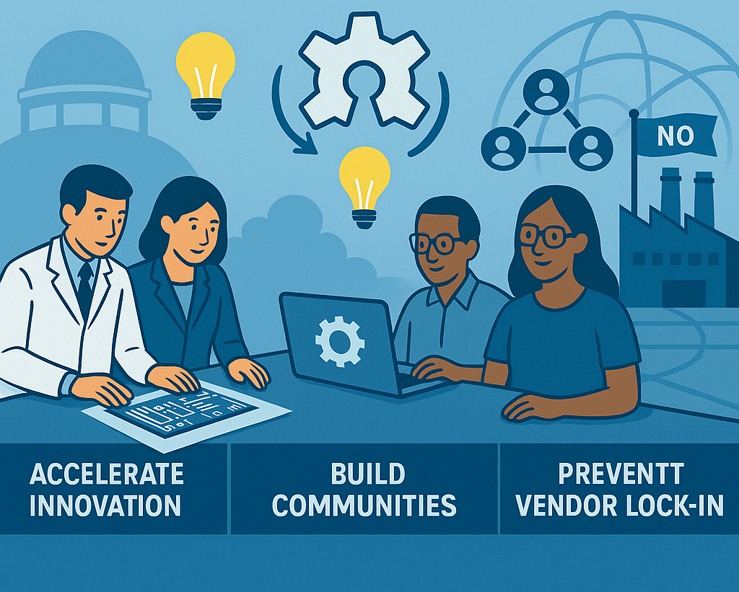
CERN’s Approach to Open Hardware
Why Open-Source Hardware OSHW at CERN ?
Open-sourcing hardware aligns with CERN’s mission to share knowledge.
It can :
accelerate innovation by enabling collaboration beyond CERN
build communities around CERN designs
prevent vendor lock-in by allowing multiple manufacturers to produce CERN-developed hardware​.
Ultimately, OSHW allows CERN and others to benefit from improvements made by any party, much like open-source software.

Slide 5
OSPO Support 1 :
Best Practices for Sharing Designs

Slide 6
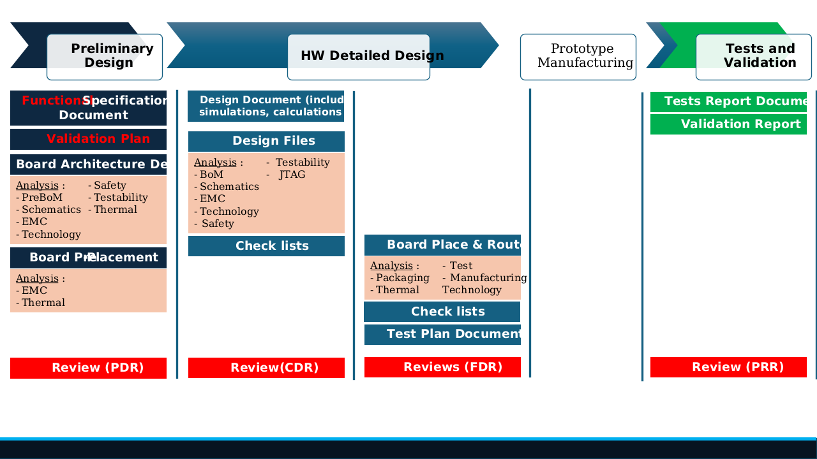
OSPO Support 1 :
Best Practices for Sharing Designs
Guidelines & Checklists:
OSPO maintains detailed best-practice guides for open-source hardware and FPGA/HDL (gateware) projects​.
These guides distill lessons learned and recommend how to structure and run a hardware project for successful open-sourcing.
Topics include :
Project setup,
Documentation,
Issue tracking,
Version control for design files, and more.
1
https://ospo.docs.cern.ch/howtos/pcb-flow/

Slide 7
OSPO Support 1 :
Best Practices for Sharing Designs
Quality Assurance:
Following best practices is crucial when preparing to release hardware designs.
OSPO will :
review a project’s readiness
check for quality indicators
give a recommendation to open-source it​.
If there are gaps (for example, missing documentation or unclear design files), OSPO provides guidance to improve the project to the required quality level. This ensures that once a design is published openly, it’s usable and understandable to others.
2

Slide 8
OSPO Support 1 :
Best Practices for Sharing Designs
Key Best Practices:
Designers are advised to :
create a clear entry point for their project – e.g. a well-organized wiki or README page containing the project description, features, status, team contacts, and links to all design files​
Use an issue tracker for bugs/requests
communicate on public forums or mailing lists
keep an up-to-date list of companies involved (for manufacturing or support).
OSPO’s documentation even covers specifics like embedding license notices directly in PCB schematics/layouts to mark the design as open hardware​.
Adhering to these practices helps build trust and a community around the hardware.
3

Slide 9
OPSO Support 2 :
Licensing and Maximizing Impact

Slide 10
OPSO Support 2 :
Licensing and Maximizing Impact
Open Hardware Licensing:
Choosing the right license for an open hardware project is a critical decision.
OSPO advises teams :
on licensing options
works closely with CERN’s Knowledge Transfer (KT) group (which includes legal experts) to select an appropriate open-source hardware license.
In practice, CERN HW designs are released under the CERN Open Hardware Licence (CERN-OHL) – v2.0 offers three variants :
Permissive (P),
Weakly reciprocal (W),
Strongly reciprocal​ (S).
There’s no one-size-fits-all :
OSPO helps the project team and stakeholders decide which variant (P, W, or S) best matches their goals​.
This consultation ensures that the license chosen maximizes impact while protecting both CERN’s and contributors’ interests.
1

Slide 11
OPSO Support 2 :
Licensing and Maximizing Impact
Publishing & Community Building:
Beyond the legalities, OSPO advises on :
how and where to publish open hardware designs for maximum visibility and community engagement.
A key resource is the Open Hardware Repository (OHWR) – a public website that catalogs open hardware projects​ :
OSPO can help designers get their project listed on ohwr.org, which complements platforms like GitLab/GitHub by making designs easier to discover by functionality or tags.
By publishing on OHWR, along with a well-maintained GitLab/GitHub repository for code and wiki documentation​, CERN projects ensure they reach a broad audience.
OSPO also encourages practices that foster community:
Using public forums for Q&A,
Tagging projects with relevant keywords,
Engaging with external contributors.
The office can guide teams on announcing their project, managing contributions (inbound/outbound via Contributor License Agreements if needed), and generally building an open-source community around the hardware.
2

Slide 12
OSPO Support 3 :
Engaging Industry and External Stakeholders

Slide 13
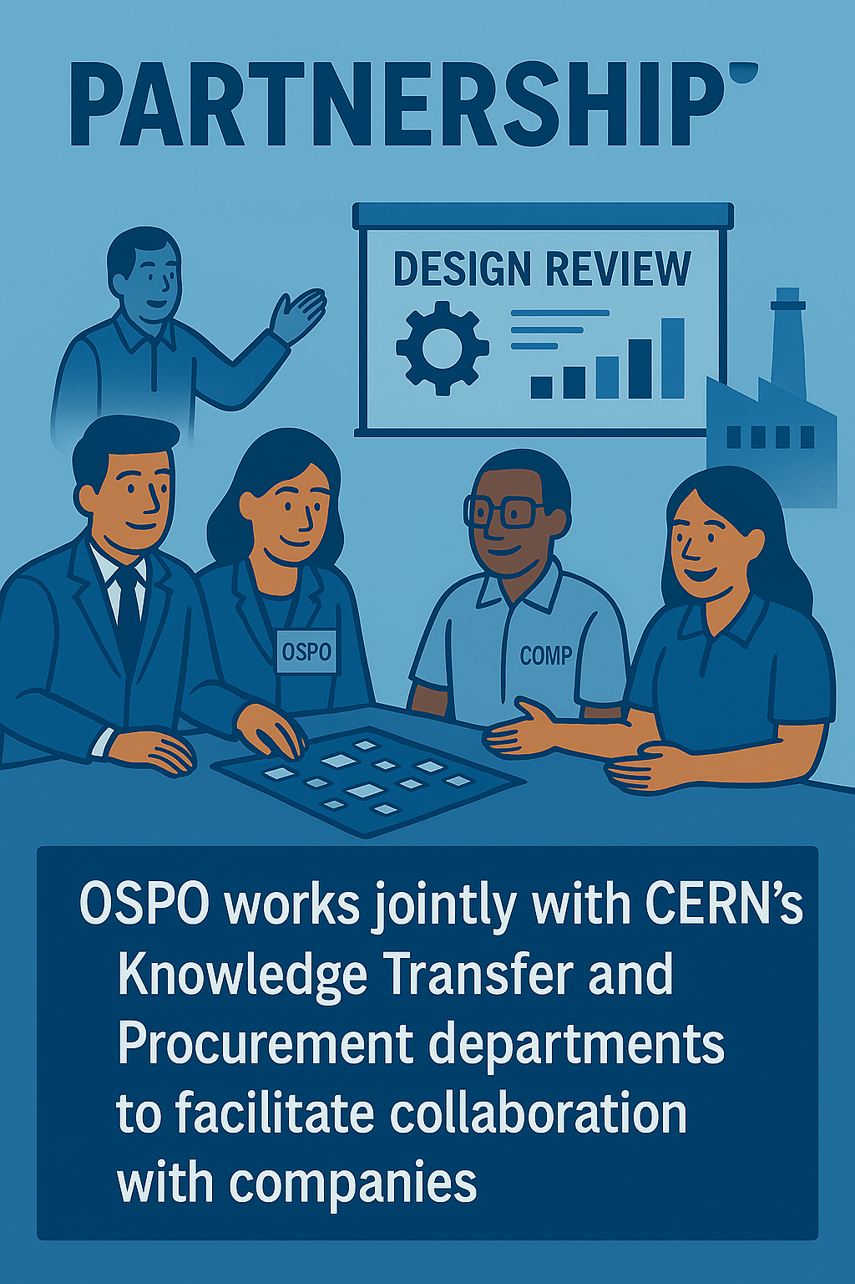
OSPO Support 3 :
Engaging Industry and External Stakeholders
Early Industry Involvement :
OSPO works jointly with CERN’s Knowledge Transfer and Procurement departments to facilitate collaboration with companies on open hardware projects.
Hardware projects at CERN typically require external manufacturing or components, so involving industrial partners from the beginning is encouraged​.
OSPO helps identify relevant companies (often those already experienced in the project’s technical domain) and brings them into the project through workshops or design reviews.
The idea is to build a partnership where companies contribute know-how or services, even before any formal procurement, ensuring the design benefits from industrial expertise early on.
1

Slide 14
OSPO Support 3 :
Engaging Industry and External Stakeholders
Aligning with Business Models:
A key part of OSPO’s outreach to companies is explaining how Open-Source Hardware can fit into commercial strategies.
Many companies initially worry that “open source” means losing business opportunities.
OSPO, together with KT experts, addresses these concerns by highlighting benefits:
  a company can freely take a CERN open hardware design and manufacture products from it, which they can sell worldwide without exclusivity issues.
  They are even invited to participate in development – such as joining design reviews (often paid consultations) – to influence the product early​.
  Once the design is open, any company (including the ones involved) can commercialize the hardware, offering it as a product with their own value-add (assembly quality, support, warranties, etc.).
This can be a win-win:
  CERN gets multiple sources for a device (no vendor lock-in),
  Companies get a new product line without having had to develop it from scratch,
  Companies can provide support services to customers using that open hardware​.
OSPO often showcases such success stories to demonstrate that open hardware can be profitable for industry while still upholding open principles.
2

Slide 15
OSPO Support 3 :
Engaging Industry and External Stakeholders
Mediating Expectations:
Collaboration between a research institute and commercial firms can expose differences in culture and expectations :
differing timelines,
support response times,
definitions of “done.”
OSPO plays a mediating role here​. Together with KT and Procurement, OSPO sets up :
regular meetings with company partners to maintain a feedback loop​.
In these discussions, OSPO ensures that CERN’s open-source approach is clear (for instance, that designs will be published openly) and listens to the companies’ needs (perhaps they need certain documentation to support manufacturing).
By actively managing these relationships, OSPO helps prevent misunderstandings and keeps the collaboration productive.
Additionally, if there are sensitive considerations—like ensuring a project isn’t “dual-use” military technology—OSPO and KT will handle those, since CERN must remain civil-use only​. The outcome is that companies engaged with CERN on open hardware projects understand the process, see the benefits, and are willing to contribute, knowing how it can serve their interests too.
3

Slide 16
OPSO Support 4:
Open Hardware in Procurement

Slide 17


OPSO Support 4:
Open Hardware in Procurement
Open-Source Requirements in Tenders:
When CERN needs to procure hardware (e.g. to have a batch of boards manufactured externally) :
OSPO assists :
the Procurement Service (IPT-PI-SU) in drafting Price Enquiries and Calls for Tender that include open-source hardware deliverables.
writing specifications such that any contractor must deliver not only the physical items but also the complete design documentation (schematics, PCB files, firmware, etc.) under an open license (typically CERN-OHL).
OSPO’s guidance :
helps ensure the tender documents clearly state the openness requirements and that bidders understand CERN will publish the designs.
avoids confusion later and legally binds the supplier to provide the design files openly.
1

Slide 18
OPSO Support 4:
Open Hardware in Procurement
Tender Process Collaboration:
Throughout the procurement process, OSPO remains involved :
along with KT and the Procurement officers to answer bidders’ questions regarding the open-source aspect. It’s not uncommon for a company responding to a CERN tender to ask, “What does it mean that we have to release designs under CERN-OHL?”
to clarify terms and reassure bidders that, for instance, they can still profit by manufacturing and selling the hardware (they just can’t claim proprietary rights over the design).
Additionally, OSPO and KT help craft any necessary contractual language. For instance, ensuring the contract explicitly requires delivery of design files in a format that can be published, and maybe a commitment to support CERN in open-sourcing (like reviewing the documentation).
By being part of these discussions, OSPO ensures that when the contract is executed CERN receives everything needed to share the hardware openly, and the supplier fully understands the process.
This close collaboration has led to smoother procurement of open hardware, with contractors even providing valuable feedback to improve the designs during production​. It’s another way OSPO bridges CERN’s open-source aims with practical procurement workflows.
2

Slide 19
Summary
OSPO’s Open Hardware Support

Slide 20
Summary of OSPO’s Open Hardware Support
1
Best Practices & Quality:
OSPO provides guidelines and hands-on assistance to ensure open hardware projects meet high standards (comprehensive documentation, proper project setup, issue tracking, etc.) before release.
This mentoring and review process helps CERN designs to be released in a professional, reusable state.
Licensing & Publication:
The OSPO guides teams through selecting the right open-source licenses (in collaboration with KT for legal advice) and ensures all parts of the project (hardware, software, documentation) are openly licensed.
It also advises on publishing strategies – for example, using the Open Hardware Repository – to maximize the project’s visibility and community uptake.
Industry Collaboration:
Recognizing that hardware development involves industry, OSPO facilitates early engagement with companies.
It demystifies open-source hardware for businesses, aligning the open approach with their commercial interests.
By mediating collaborations and expectations, OSPO helps build productive partnerships where companies invest in and benefit from CERN’s open hardware projects.
Procurement Integration:
OSPO works with CERN’s procurement team to embed open hardware principles into contracts and tenders. This ensures that when CERN outsources manufacturing, the openness of the design is maintained. The result is a multi-supplier ecosystem around CERN hardware designs, fostering competition, innovation, and long-term availability of the hardware.
2
3
4

Slide 21
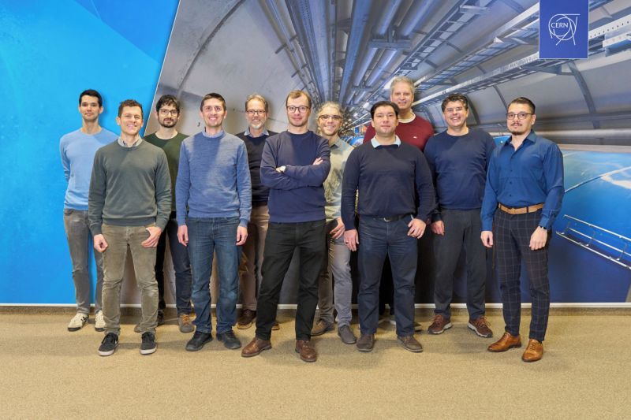
Summary of OSPO’s Open Hardware Support
Big Picture :
“ In essence, CERN’s OSPO is a comprehensive support system that enables hardware designers to confidently open-source their work. From initial preparation and licensing, through community building, to navigating company relationships and procurement, OSPO’s support covers the full journey of open-sourcing a hardware project.
”
https://ospo.docs.cern.ch

