Slide 1
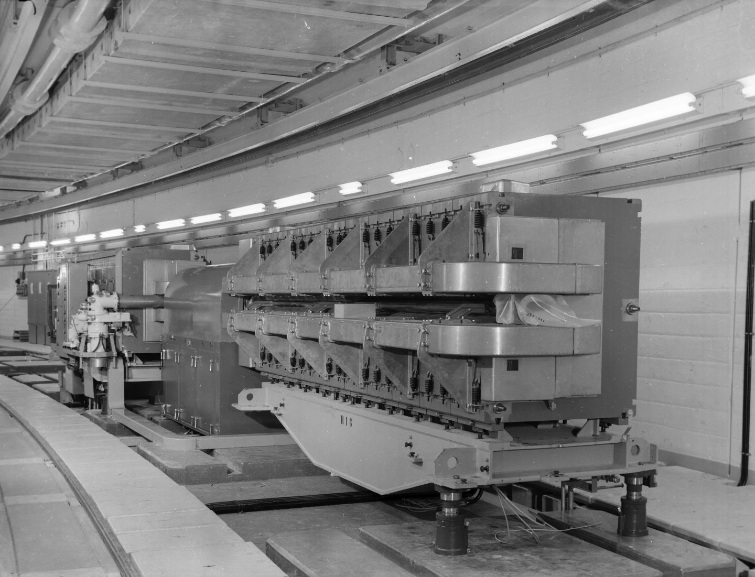
Putting it all together:
Radiation-tolerant lighting in CERN's Proton Synchrotron (PS)
James Devine
09/05/2025

Slide 2
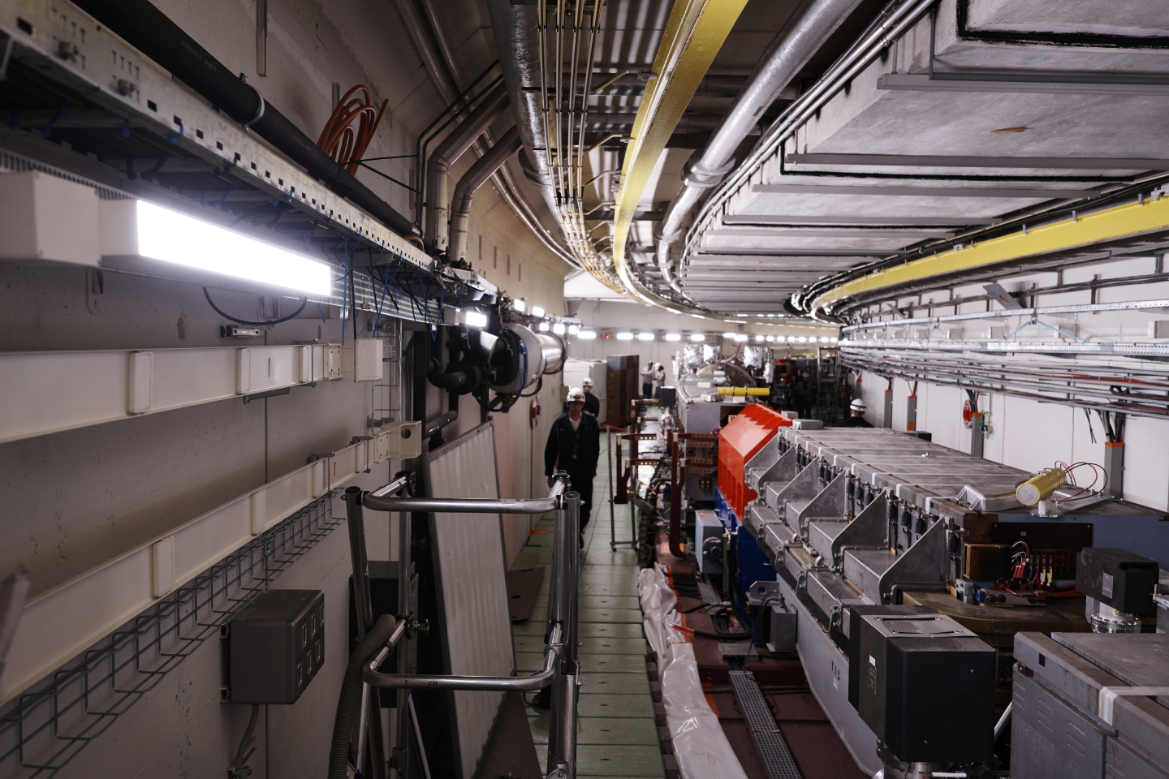







Content
?
Why can’t you buy radiation tolerant LED lights off the shelf?
A very (very) short primer on radiation effects in electronics.
Justifying an open hardware approach to management.
How we designed for radiation without batch & lot qualification.
Getting the design CE certified.
What about patent infringement?
Updating and adapting the design for new applications.

Slide 3
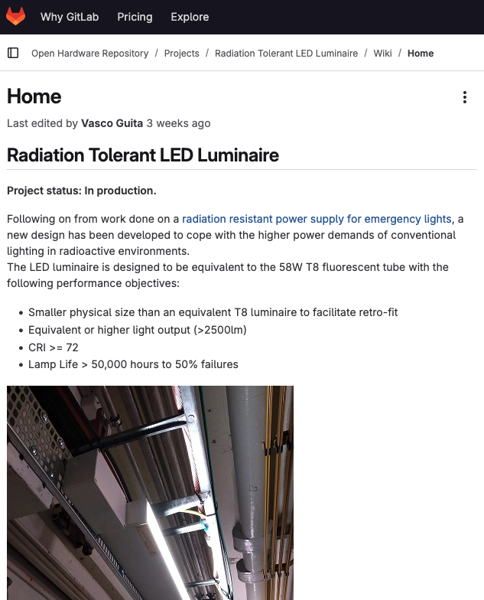
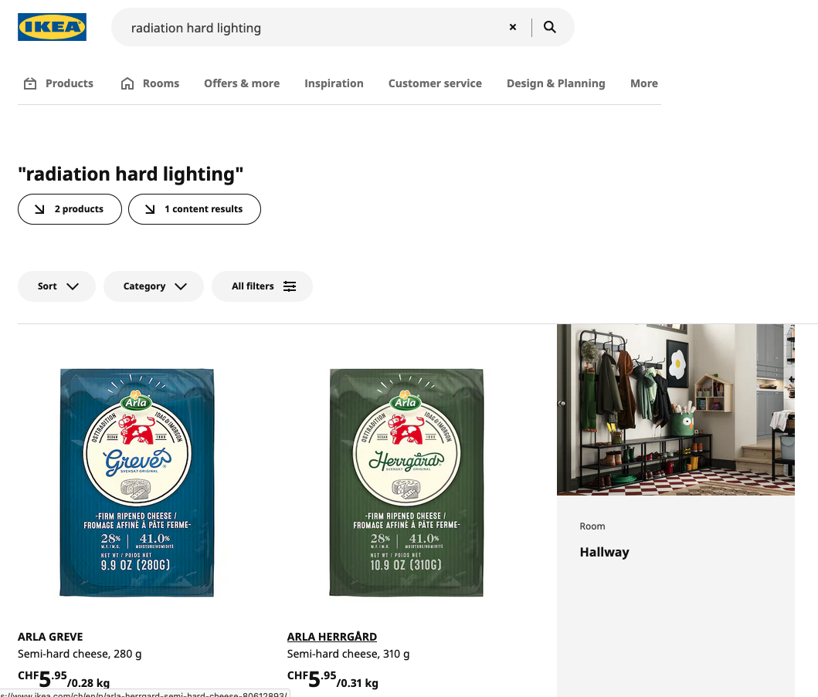
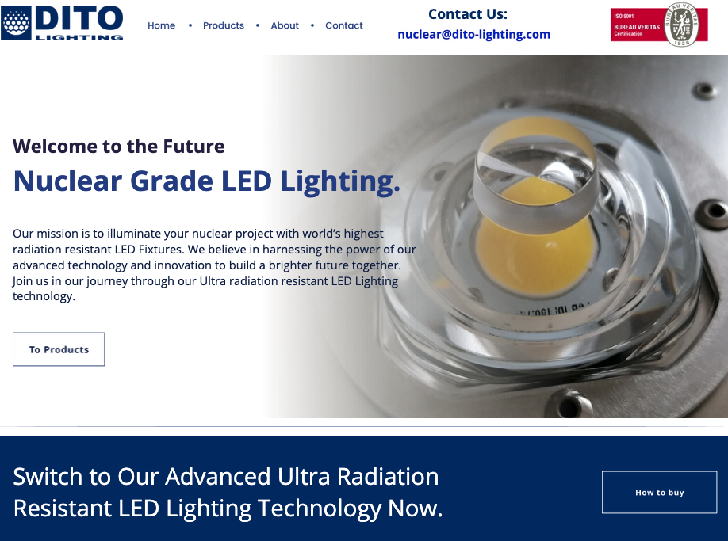
Buying radiation resistant lights?
Specialists…
Off the shelf?
DIY…!
J Devine | Radiation-tolerant lighting in CERN's Proton Synchrotron (PS)
9 May 2025

Slide 4
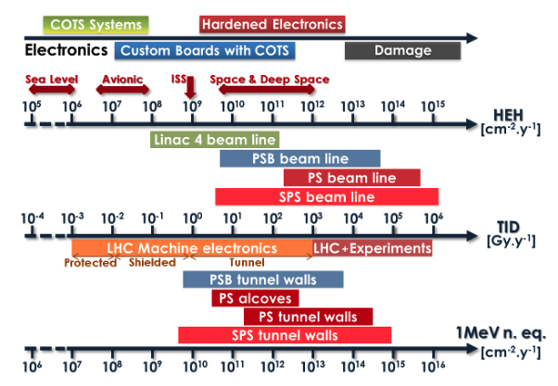
A (very) short primer on radiation and electronics.
First tests for emergency lighting in 2011/2012. Life expectancy of COTS SMPS in LHC-like radiation environment = <5 minutes.
Radiation hard emergency lighting design (2013), good to 1kGy (+/-).
For the PS design 10kGy was our target hardness. The LED chip is the limiting factor, irrespective of technology used (flip chip, substrate etc.). The power supply can go higher.
This predates the Hi-Lumi era…
2013
2019
Source: CERN-ATS-Note-2011-077 TECH (2011).
J Devine | Radiation-tolerant lighting in CERN's Proton Synchrotron (PS)
9 May 2025

Slide 5



Selling open hardware… to management!
We needed approximately 1000 LED luminaires for the PS electrical refurbishment in LS2.
The total budget for the project was CHF 4M, including all electrical infrastructure for the PS and associated surface buildings. The project had been budgeted based on installing fluorescent lights, which cost circa 300€ each (in 2018).
In this case we had three choices:
Business As Usual – install reconditioned fluorescent lights from surface buildings. Could be done, but not sustainable in the long term; might work for PS & Booster, but not for SPS & LHC.
Specialist route – A manufacturer of radiation resistant lights quoted us 4k€/luminaire in 2017.
Total cost: 4M€ !
DIY option – Our IP, give it away to manufacturers to drive price competition. Multiple manufacturers make normal profits, minimal risk. Can re-tender at any point. Design is very close to conventional LED luminaires.
The price should be similar.
J Devine | Radiation-tolerant lighting in CERN's Proton Synchrotron (PS)
9 May 2025

Slide 6
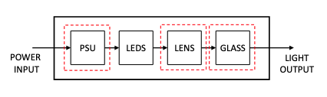
Radiation hardness at the lowest cost.
Systems approach…
One component at a time.
Find the optimal answer,
write the specification.
Component tests show that all LEDs behave more or less the same in mixed field radiation, so we set a 10kGy limit.
Lenses are typically polysiloxane, not something we can change.
The macro-optical elements are more challenging. The ideal material is quartz glass, but that is too expensive. PMMA is the best cost/radiation/performance compromise, followed by polycarbonate.
This is the tricky part. Commercial SMPS are not suitable.
We designed a linear regulator based on SiC & GaN semiconductors.
This is intrinsically radiation resistant, as long as you stick to the BOM.
No time for Batch & Lot qualification.
No budget for Batch & Lot qualification.
No supply chain experience with Batch & Lot qualification.
J Devine | Radiation-tolerant lighting in CERN's Proton Synchrotron (PS)
9 May 2025

Slide 7
How to get a CE certificate for your design?
De-facto requirement from CERN HSE, especially on such a large quantity! Cannot be avoided.
Our solution was to provide an outline design only, essentially a functional prototype.
Manufacturers adopted this design, improved it (within our BOM constraints) and added RF filters.
We listed relevant test standards required in the specification, with testing & certification by manufacturer with external lab.
CE Certificates are now in the PS safety file.
You could do it all yourself and provide the manufacturer a file.
They would still need to adopt the design and take responsibility for it. We’re not experts in this, so we left it to them…
J Devine | Radiation-tolerant lighting in CERN's Proton Synchrotron (PS)
9 May 2025

Slide 8
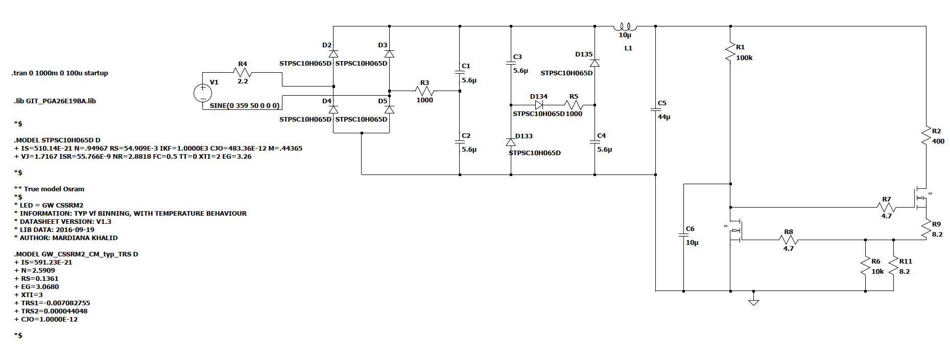
What about patent infringement?
?
We tried to add a third manufacturer in 2020.
They were concerned about patent infringement from our design.
KT helped us to do a patent search.
It didn’t find anything problematic.
Bridge Rectifier
Valley Fill Circuit
Linear regulator
🥳
This wasn’t a surprise.
We based our design on expired patents.
The ‘special’ part of the design is component choice, not a fancy circuit.
J Devine | Radiation-tolerant lighting in CERN's Proton Synchrotron (PS)
9 May 2025

Slide 9
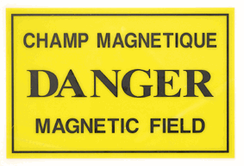
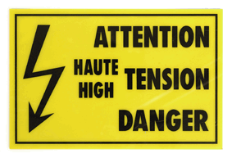
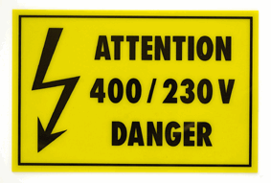

Adapting and updating the design
Since the initial design in 2018, we have made several updates driven by component obsolecense.
Gallium Nitride transistors are still a fast developing area, we have qualified our third manufacturer/part number in 7 years.
This takes effort and requires competence in electronic design and radiation testing, but not as much as the initial design.
The design has also been adapted by EN/AA for the next generation of flashing ODH warning beacons that will go into the LHC during LS3, and I’m currently adapting that for new flashing warning signs for general hazards (high voltage, magnetic fields etc).
J Devine | Radiation-tolerant lighting in CERN's Proton Synchrotron (PS)
9 May 2025

Slide 10
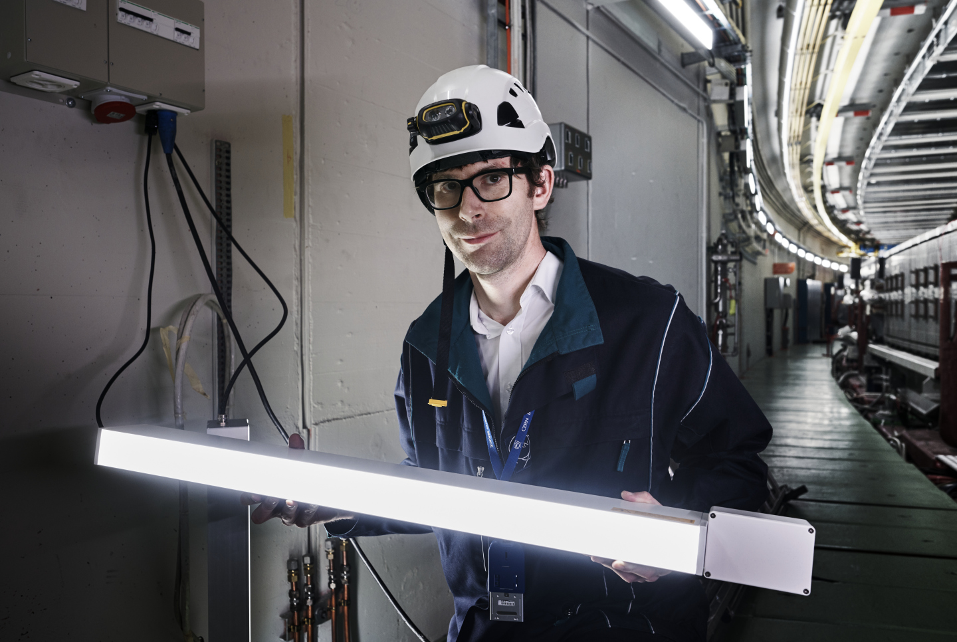
Conclusion
Very challenging and rewarding project.
Average cost for our first batch of lights was only 415€ each. This saved us approx 3.3M€, compared to buying from the specialists, almost the entire project budget.
Manufacturing took longer than expected, but we got the lights installed before the end of LS2.
All the lights are still working…
Design since adapted for use in accelerators in Austrlia and the USA (The Australian Synchrotron, SLAC and Jefferson Lab)
J Devine | Radiation-tolerant lighting in CERN's Proton Synchrotron (PS)
9 May 2025

Slide 11
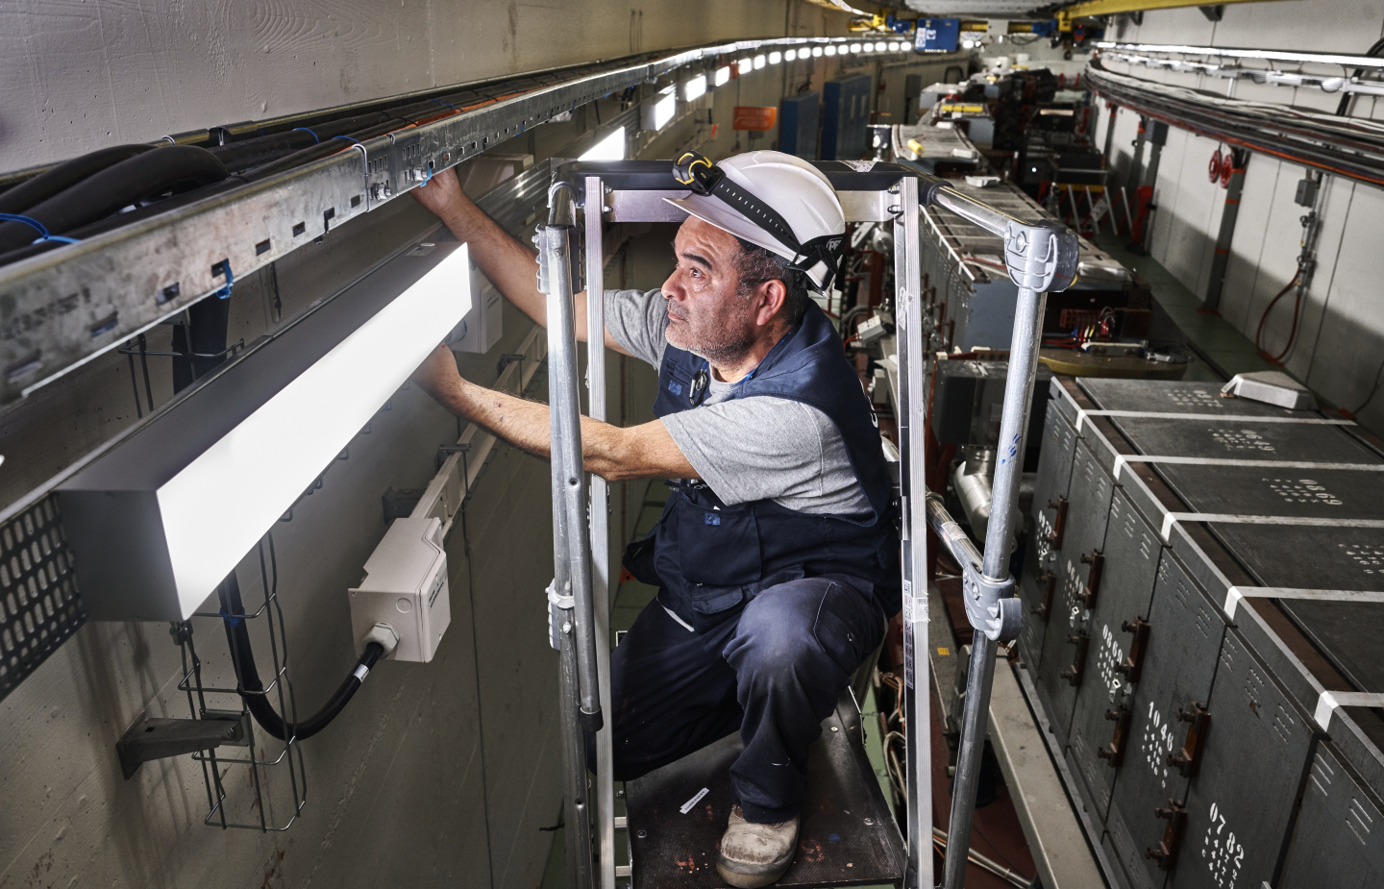
Credits
Thanks to everyone who’s worked on, or helped with this project journey, in particular:
Jean-Marie Foray,
Alessandro Floriduz
Eva Cano Gonzalez
Bart Hommels
Images:
This presentation has been designed using resources from Flaticon.com, with content from Freepik, Srip, Iconjam, Justicon, Rutmer Zijlstra and Andrean Prabowo.
CERN photos from CDS.
Link to the project on OHWR:
https://gitlab.com/ohwr/project/radtol-led-luminaire/-/wikis/home

Slide 12
Backup slides

Slide 13
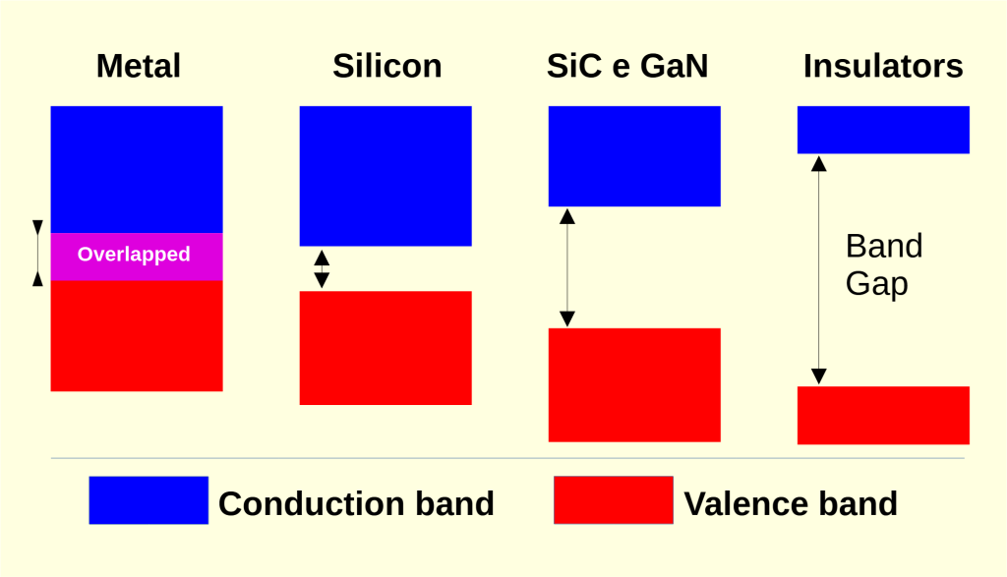
Wide Bandgap Semiconductors

Slide 14
Linear regulator in GaN with SiC diodes.

