Slide 1
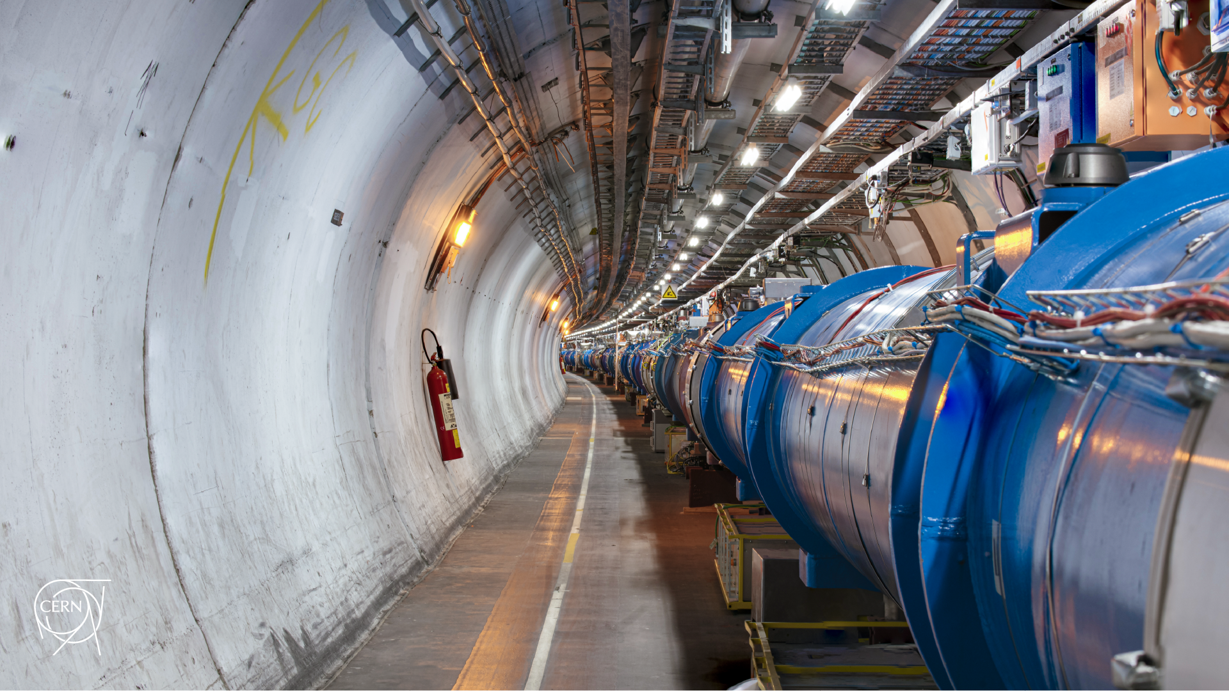
Status of MP checks for the
LHC collimation system + TWOCRYST + BSRTMB
D. Mirarchi on behalf of the LHC Collimation Team, BE-OP-LHC, BE-CEM-MRO, BE-CEM-MTA, SY-BI-PM
259th Machine Protection Panel Meeting

Slide 2
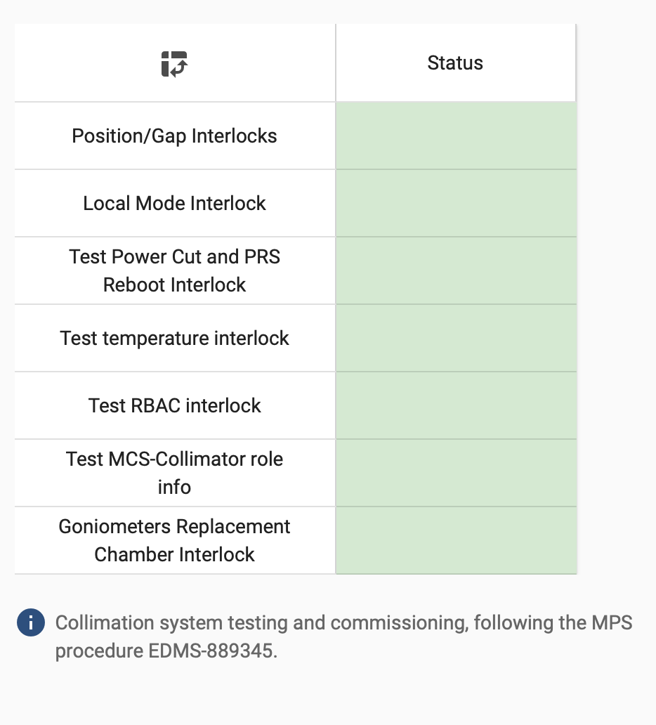
Overview - Collimation
Position, energy, β* limits of all ring collimators
tested and validated
Local mode interlock carried out for one ring collimator per BIC
PRS reboot carried out for one ring collimator per BIC
plus each PXIs replaced during YETS
Temperature completed for all ring collimators
Both probes not working on TCSG.A6L7.B1 – left
and TCLIA.4L8 – right (redundancy from other jaw)
No devices in the inconsistency list found with
Parameter Configuration Application
Both interlock on replacement pipe and on limits tested
Both SIS and BIS testes
Links to the elog and collimation web page with detailed information in the checklist

Slide 3
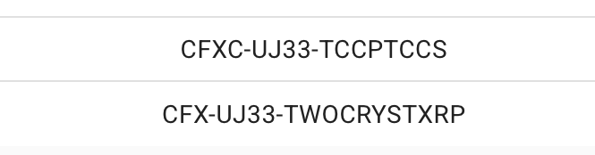
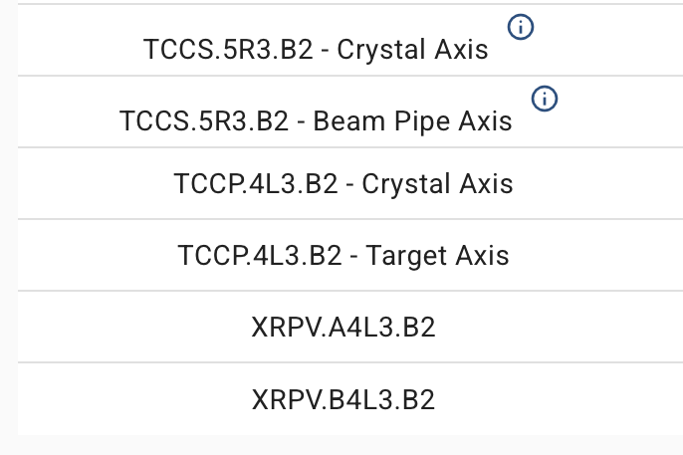
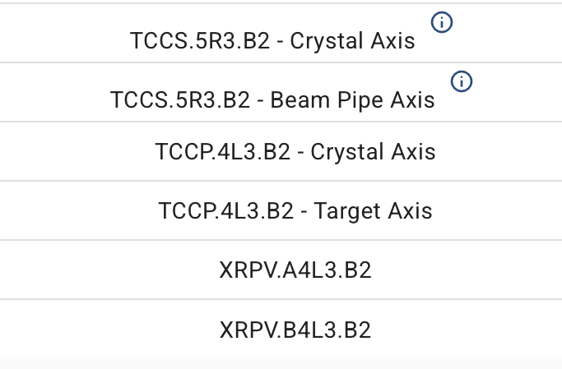
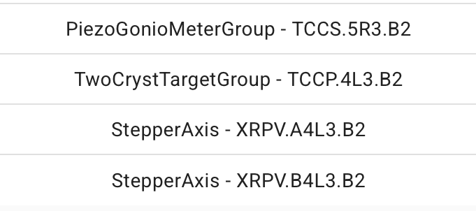

Overview - TWOCRYST
PRS reboot
Position interlock SIS
Position interlock BIS
Access map and RBAC
High level architecture (LSA, sequencer, controls) and middle layer controls (FESA) for all devices were prepared, tested and deployed.
All MP validation tests successfully completed for both SIS and BIS
Links to the elog and collimation web page with detailed information in the checklist

Slide 4
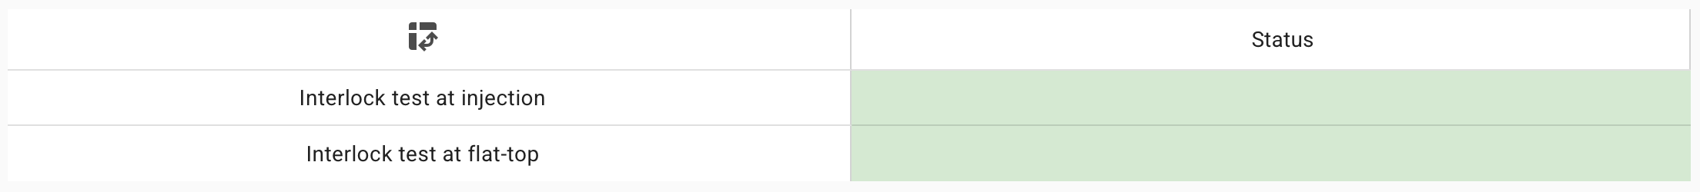
Overview - BSRTMB
Position interlocks as a function of energy successfully tested and validated
Sequences updated and settings generated, accordingly to 2022 run
Links to the elog and collimation web page with detailed information in the checklist

Slide 5
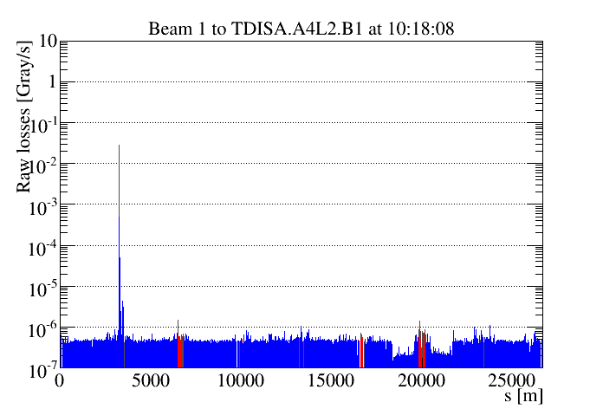
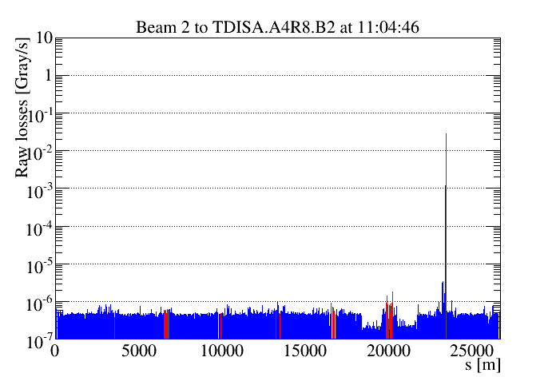
Status waiting for first beams – Threading
Beam left “circulating” step-by-step: collimators used to stop the beam in each IR (except IR4…)
a.k.a. Threading
Beam 1 | Beam 2
TDIS[A|B].A4L2.B1 | TDIS[A|B].A4R8.B2
TCP.6L3.B1 | TCP.B6R7.B2
TCTPV.4L5.B1 | TCSP.A4L6.B2
TCSP.A4R6.B1 | TCTPV.4R5.B2
TCP.B6L7.B1 | TCP.6R3.B2
TCTPH.4L8.B1 | TCTPH.4R2.B2
TCTPH.4L1.B1 | TCTPH.4R1.B2
Beam 1
Beam 2
Ring coll. at: LD = 0.5mm, LU = -1mm, RD = -1mm, RU = -2.5mm
TDIS[A|B] at: L = [4.0|-2.5], D = [2.5|-4.0]
BP and sequences tested and ready for first beam

Slide 6
Commissioning/setup – settings
Reduced set of collimators at COARSE settings
Collimator | IR | Setting
 |  | Inj. | FT (first ramp) | FT (if squeezing OR with INDIVs)
TCP (H&V) | 7 | 8 σ | 20 σ | 8 σ
TCSP | 6 | 9 σ | 25 σ | 9 σ
TCP | 3 | 12 σ | 30 σ | 30 σ
TCTP | 1/2/5/8 | ±15 mm | ±15 mm | 10 σ/±15 mm/10 σ/15 σ (@30cm)
TCDQ | 6 | 20 mm | 20 mm | 20 mm
Two set of FT settings defined whether or not beams get squeezed: collimators kept fixed after reaching FT

Slide 7
Conclusions
Ring collimators + new TWOCRYST devices + BSRTMB fully commissioned and validated:
ready for first beam in 2025!

