Slide 2
SIS status for first beam
J. Wenninger, A. Calia

Slide 3
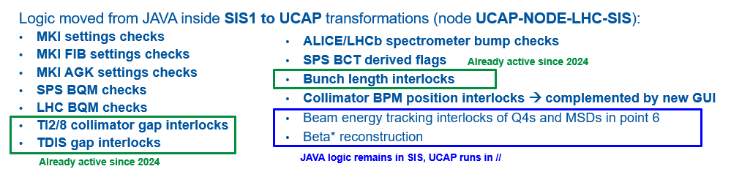
Configuration
> 99% of SIS configuration identical to 2024
Changes mentioned in previous MPP are in place:
Removal of the orbit interlock that covers the entire cycle.
Removal of the tree to open the switches of the RB and RQ dump resistors.
TWOCRYST injection interlocks (crystals, RPs).
Delay for the 60A CODs (FGClite comm. Failure). To be deployed.
Logic migration to UCAP for some interlocks.

Slide 4
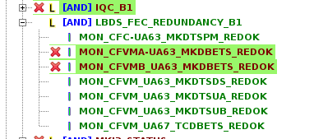
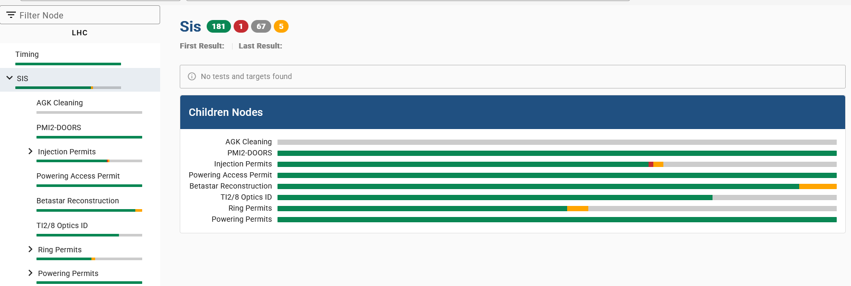
Test status
Testing well advanced a lot of tests come for free just during machine switch on, remaining tests mainly related to beam related logic.
“Non-conformity”: on 4 LBDS FECs, the PS redundancy monitoring does not work. To be checked with CSS.
+ same issue on B2

Slide 5
Beta* reconstruction
SIS beta* reconstruction working for the nominal pp cycle.
MTG/SMP beta* will always be the lower beta* for flat optics.
For IR5 the new UCAP beta* publication (information only !) does not agree with the SIS beta* at the start of the ramp. The final explanation is not yet confirmed, but the cause seems to be due to a combination of factors:
The UCAP node relies on a another UCAP concentrator for the LHC quadrupole and for S12 (RB12 is used to normalize). Converters introduced small delays.
At the start of the ramp, quad currents are low (200-300 A), ramp rates of ~few A/s combined with second level delays introduce ~% level systematic shifts of results.
The table relating the PC currents to beta* is particularly ‘compressed’ in IR5 with RP optics (not much choice of quad pairs) → enhanced sensitivity to small current systematics.
The UCAP test node will be used to improve the reconstruction (eg remove RB normalization…).

Slide 6
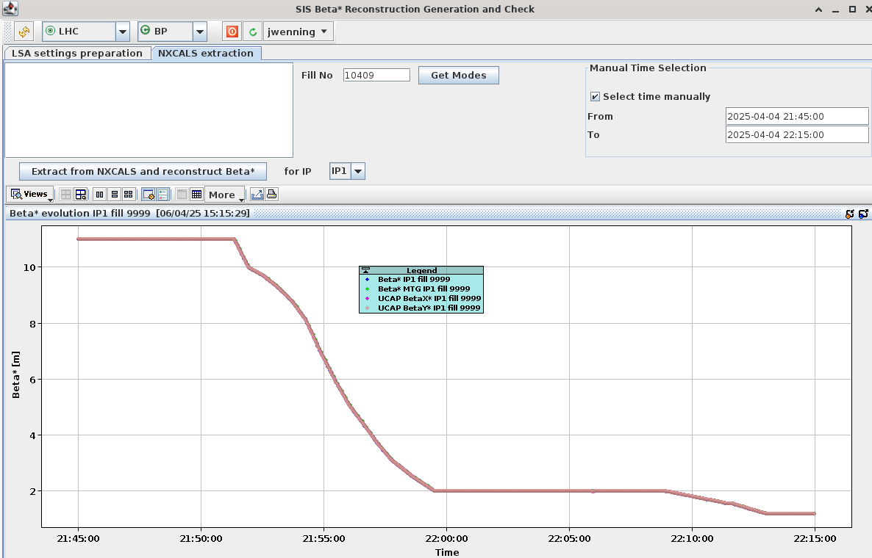
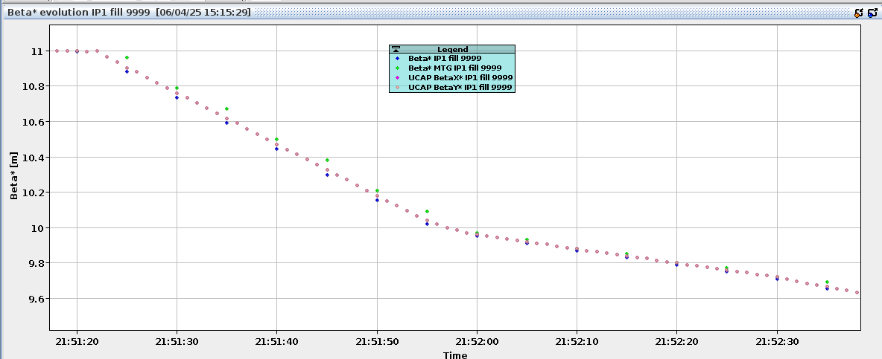
Example - Beta* IP1
All beta* reconstructions (SIS, GUI, UCAP) are consistent within the uncertainty due to data collection and data evaluation periods. SIS values are ~1-2 seconds behind, UCAP ~1 second behind.
Published by SIS/SMP/MTG
Reconstruction inside GUI from nxcals logging of PC data
UCAP reconstruction

Slide 7
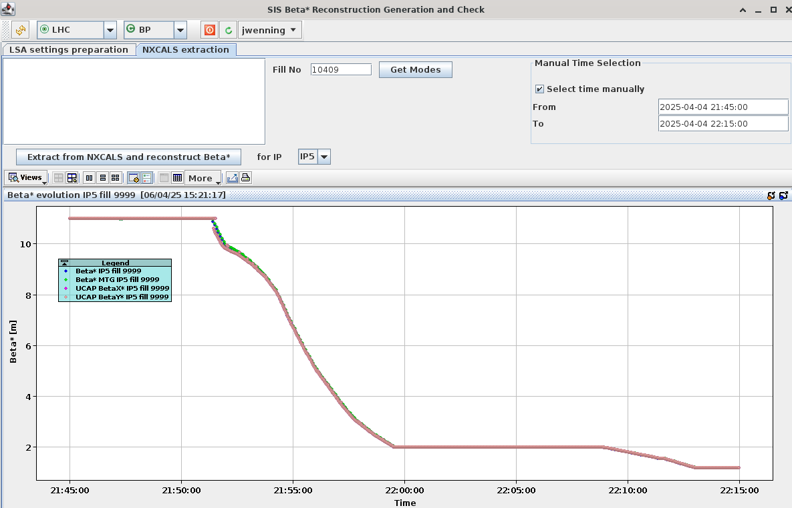
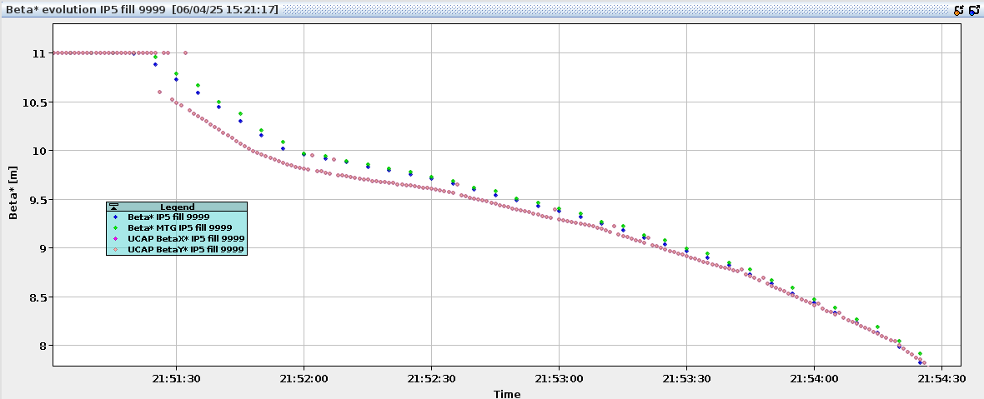
Example Beta* IP5 – start of CRS issue
In IP5 there is disagreement between SIS/GUI and UCAP at the start of the squeeze in the ramp.
  Only the UCAP publication is not correct.
  Does not affect other parts of the nominal pp cycle.
Published by SIS/SMP/MTG
Reconstruction inside GUI from nxcals logging of PC data
UCAP reconstruction

