Slide 1


FTBF Data Analysis Update
Biweekly DAMSA Update - 4/15/2025
Brad Brown
Head Lab Manager - Intensity Frontier Neutrino Group

Slide 2
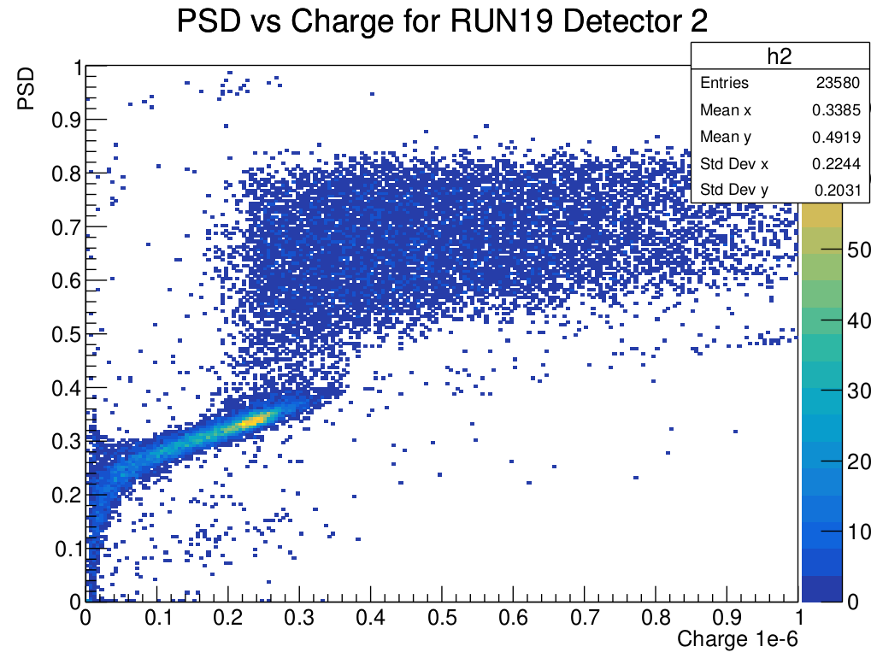
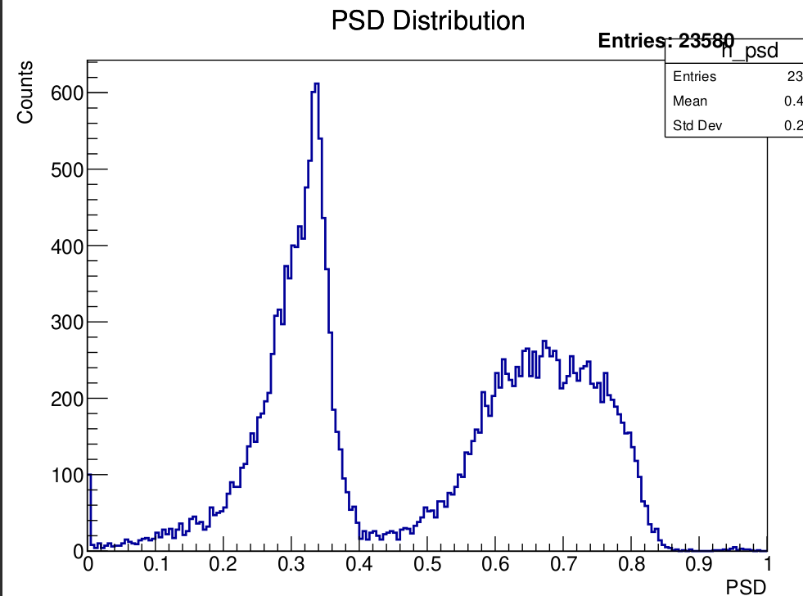
Results From Last Meeting

Slide 3
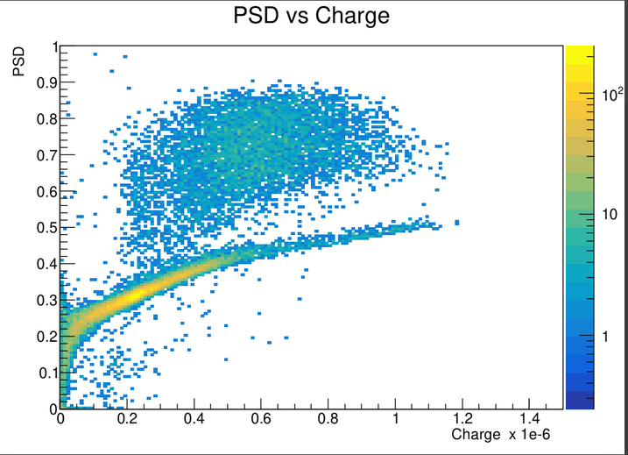
Results from Last Meeting Cont.
Previous code used the following:
  Start bin determined by ADC threshold
  Tail bin determined by a constant offset of 270 bin
  End bin set at 1024 (integrate the full
The piecewise-like behavior was caused by truncation of the integral

Slide 4
New Plan
Check if our start, end, tail bins are being placed properly by looking at individual waveforms from plotter code
Adjust these values based on observations from plotter code
Redo plots after modifying the integration bounds

Slide 5
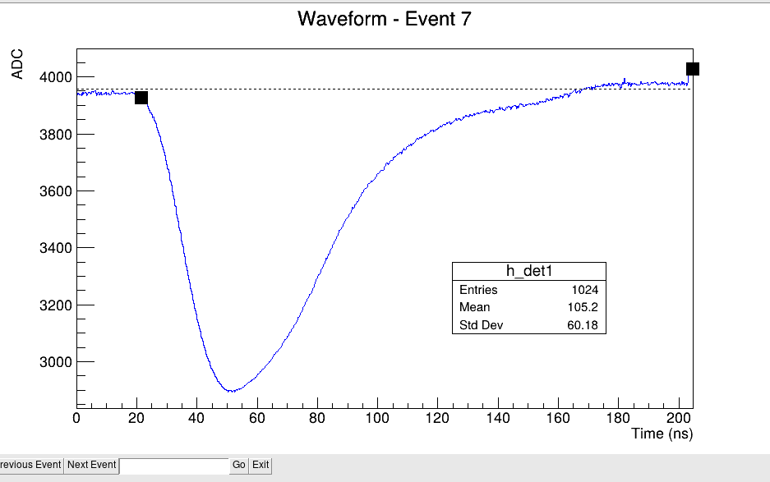
Some Individual Waveforms
Bad!
Instead of end bin hardcoded at 1024 implement a similar ADC threshold as done in start bin
Good!

Slide 6
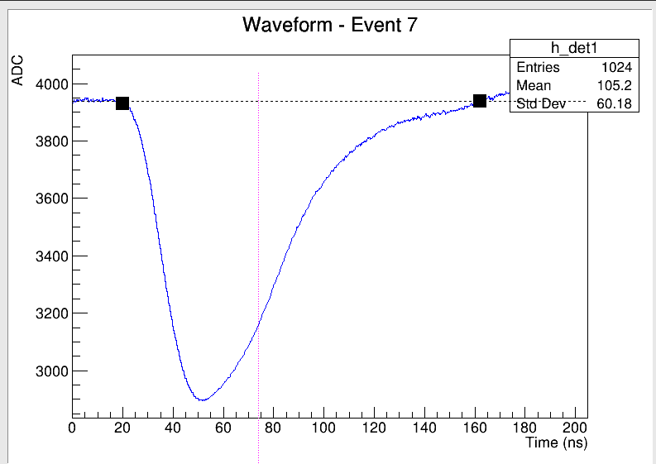
New Results
Start/end bin is better!
New pink line marks the tail start
Good!
Good!

Slide 7
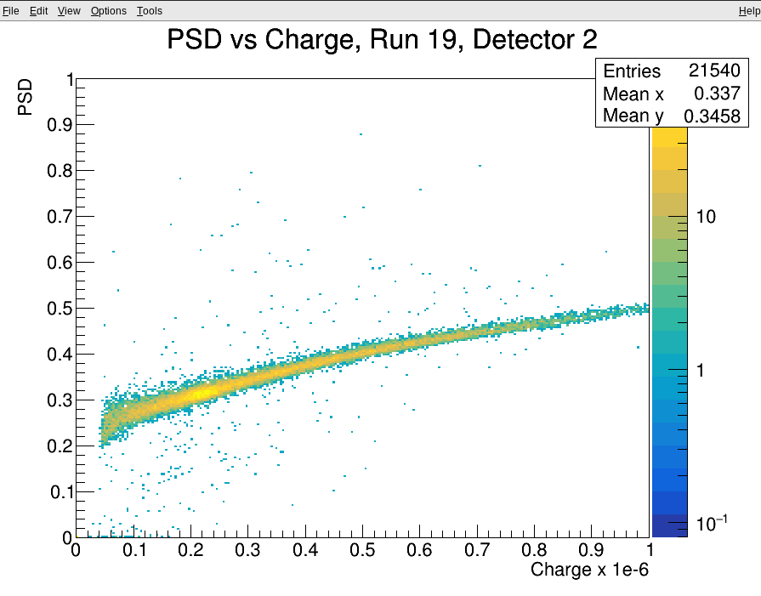
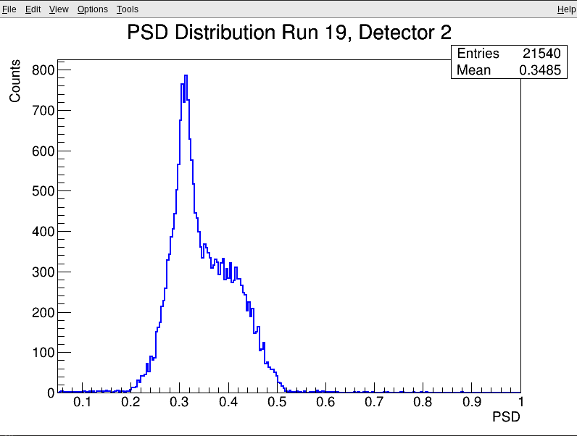
New Results

Slide 8
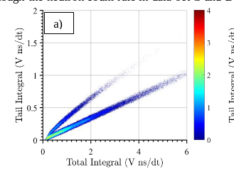
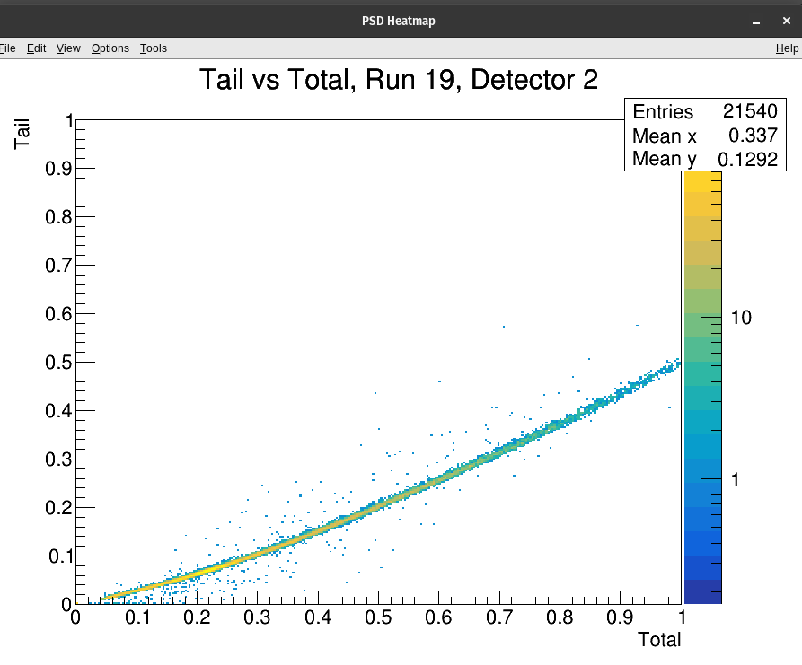
New Results
From a paper using Cf-252

Slide 9
Questions?

